Slide 1
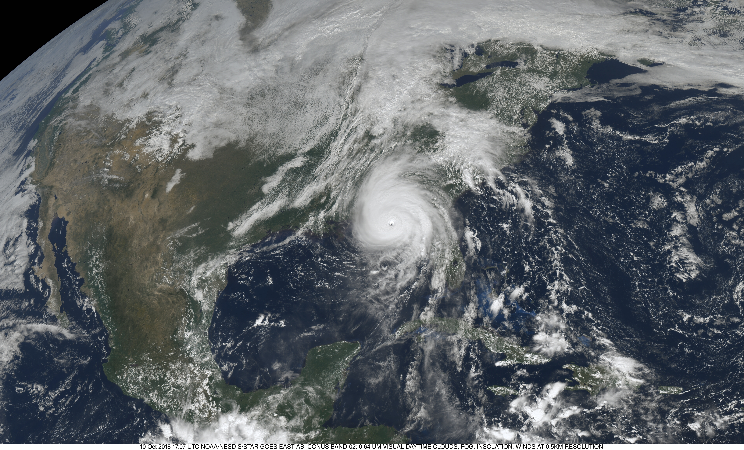

Leveraging AI for Tropical Cyclone Prediction
Stephanie Stevenson^{1,2}, Mark DeMaria²,
John Kaplan³, Matthew Onderlinde²,
Kate Musgrave¹, Andrew Penny^{4,2}
1 Cooperative Institute for Research in the Atmosphere at Colorado State University, Fort Collins, CO
2 NOAA/NWS/NCEP National Hurricane Center, Miami, FL
3 NOAA/AOML Hurricane Research Division, Miami, FL
4 University Corporation for Atmospheric Research, Boulder, CO
NESDIS AI Workshop
April 2019, College Park, MD

Slide 2
Outline
National Hurricane Center forecast history
Physical vs. Empirical modeling
NHC forecast model evolution
Track
Intensity
AI for tropical cyclone analysis
Future improvements

Slide 3
National Hurricane Center Forecast History
1954: First quantitative forecasts of 24 hr lat/lon began at the Miami Hurricane Forecast Center
The Hurricane Forecast Center officially became NHC in 1956
1961 – Forecasts extended to 48 hr
1964 – Forecasts extended to 72 hr
2003 – Forecasts extended to 120 hr
2018 – Experimental forecasts to 7 days
Primary forecast parameters
Track: Lat, Lon of storm center
Intensity: Maximum sustained surface winds
Size: Radii of 34-, 50- and 64-kt winds (only to 72 hr)

Slide 4
Physical and Empirical Models
Physical (dynamical) models
Use basic principles from physics to create mathematical model
Solve mathematical model with numerical method
Hybrid statistical-dynamical models
Use output from physical models as input to statistical models
Empirical (statistical) models
Gather observations related to parameter being forecast
Train an algorithm on large dataset
Linear regression, neural networks, classification methods, advanced machine learning, etc.
Apply algorithm in real time to provide forecast
Notes:
In this talks all statistical and hybrid statistical-dynamical models will be referred to as “AI models”.

Slide 5
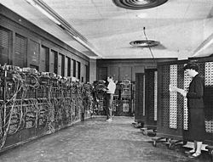
Evolution of Physically-Based Weather Models (Numerical Weather Prediction)
THEN
NOW
First model (1949) – ENIAC computer
1 vertical layer
700 km resolution
N. America domain
24 hr forecast
Lynch (2008) developed cell phone version
Modern day weather models
~100 vertical layers
~10 km grid spacing
Global domains
Multi-week forecasts
Regional hurricane models with ~1 km grid spacing
ENIAC:
100 ft long, 27 tons
Notes:
Main point is that NWP models have gotten a lot better since 1949

Slide 6
Physical Model Limitations
Large range of scales
40,000 km earth’s circumference
10,000 km jet streams
1000 km winter storms
100 km hurricane inner core
10 km thunderstorms
1 km cumulus clouds
1-100 m thermals, turbulence
10⁻³ m cloud particles
Inadequate resolution on computational grid
Requires parameterization of some processes
Cloud microphysics, turbulence, air-sea interaction, etc.
Lack of observations of initial state
Data assimilation
Predictability
Large sensitivity to small initial errors (Chaos)
Statistical (AI) methods are used to provide objective TC forecast guidance not directly available from physical models
Notes:
Models are still not perfect and statistical (AI) methods fill the void when models don’t directly provide parameters needed by forecasters.

Slide 7
NHC’s First Generation “AI” Application: The Miller-Moore Model
24-hr track forecast model (Miller and Moore 1960, BAMS)
Input from 700-hPa geopotential height maps and previous storm motion
Trained on 1951–1956 Atlantic data
Independent tests 1957, operational 1959
Δx = [0.42u₇ + 0.54P_{x} – 2.4] Δt
Δy = [0.23v₇ + 0.65P_{y} + 2.3] Δt
(u₇,v₇) = 700-hPa geostrophic wind components
(P_{x},P_{y}) = Components of previous 12h storm motion vector
Notes:
Starting point for NHC track guidance models

Slide 8
Evolution of AI Hurricane Track Forecast Models
1959–1972
Increasingly sophisticated models using observations and analyses
Multiple regression and analog techniques
1973–2006
Statistical-dynamical track forecast models
Input from global model forecast fields and t=0 hr information
2006 – Last AI track model retired (NHC-98)
Dynamical models were much more accurate
CLIPER model still used for skill baseline
2015–Present
Revival of AI for track forecasting to optimally combine input from single- and multi-model ensembles
HFIP Corrected Consensus Approach (HCCA)

Slide 9
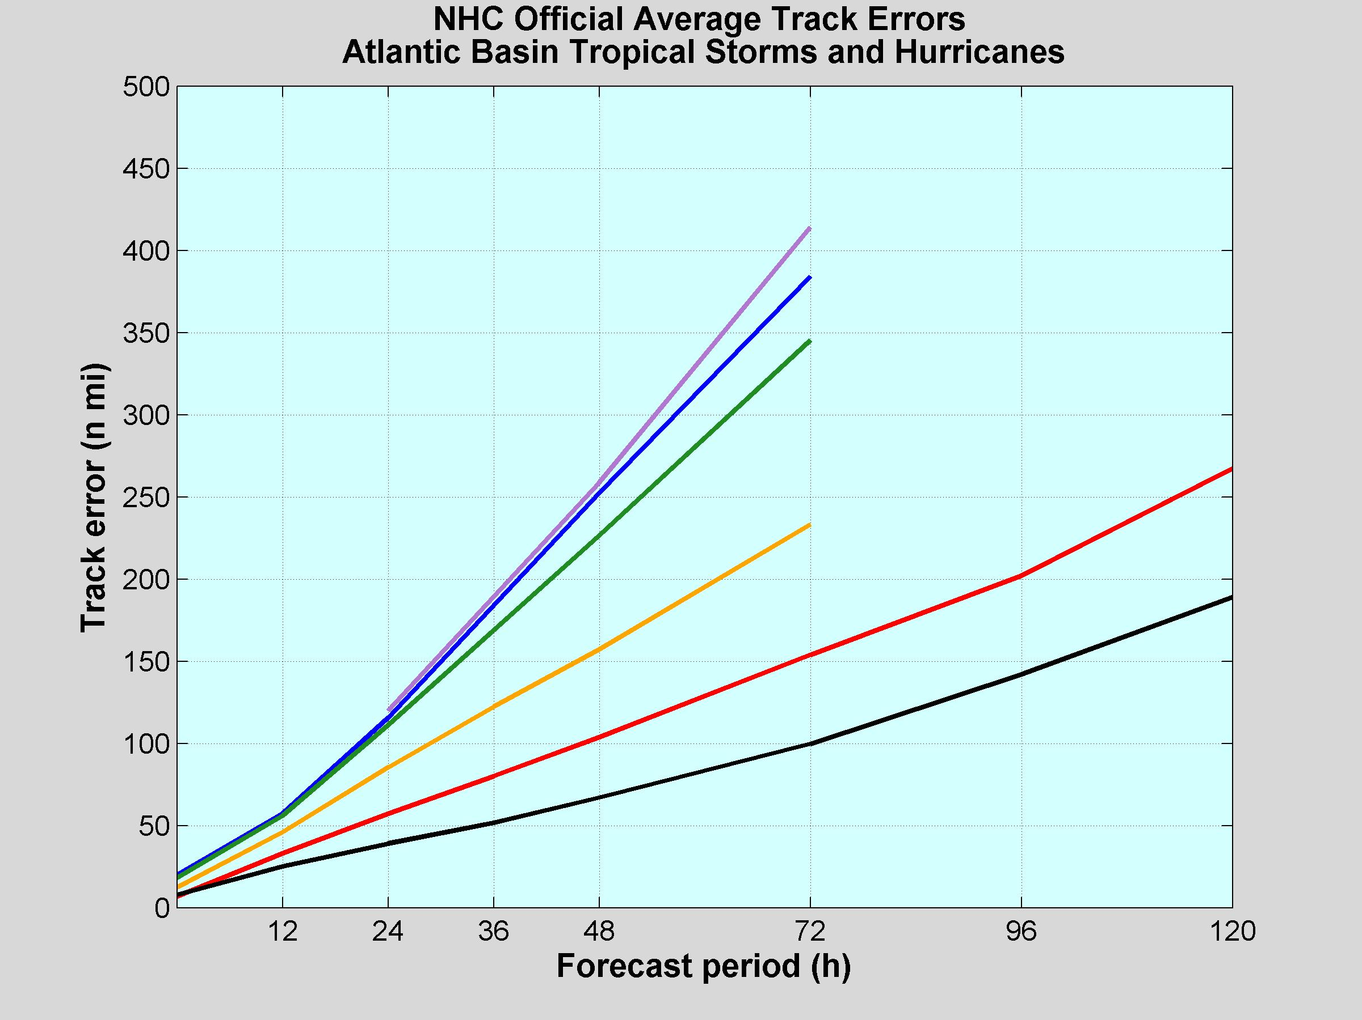
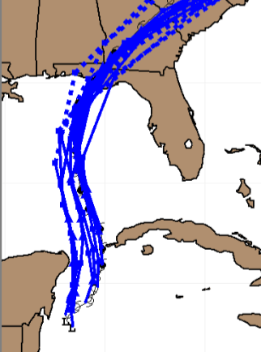
Atlantic Track Error Trends
1960-69
1970-79
1980-89
2000-09
1990-99
2010-18
Hurricane Michael (2018) NHC track forecasts
Notes:
AI methods using dynamical model input mostly responsible for improvements from 1960’s to 1990’s. Dynamical models (ECMWF, GFS etc) lead to improvements after that. AI methods to extract maximum info from multi-model ensembles will help further reduce track errors and provide uncertainty information.

Slide 10
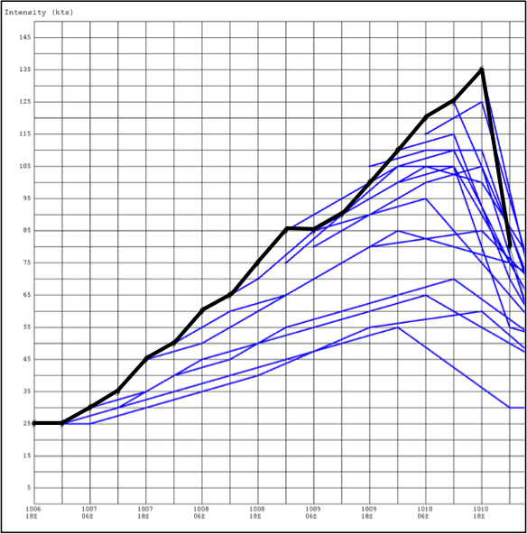
Tropical Cyclone Intensity Forecasting
More difficult than track forecasts
Latent heat release, surface energy exchanges with the ocean are 1st order processes
Wide range of scales need to be modeled
~10,000 to ~1 km
Ocean response needs to be included
Observations limited near hurricanes
Hurricane hunter aircraft and satellite observations
AI techniques still used operationally
Hurricane Michael (2018)
NHC intensity forecasts

Slide 11
NHC Intensity Guidance Models
1990
1995
2000
2005
2010
2015
2018
SHIFOR
SHIPS w\ GFS Analysis
SHIPS w\ GFS Forecast Fields
LGEM
GFDL
HWRF
Other:
Global models: GFS, ECMWF, UKMet, Canadian
Consensus models: IVCN, ICON, FSSE, HCCA
Probabilistic Rapid Intensification Indices (RII)
On the near Horizon: FV3-GFS
COAMPS-TC
HMON
Notes:
Blue bars are AI methods. SHIPS based on multiple regression with input from GFS, SST and ocean analyses and satellite data. LGEM uses same input but with a more sophisticated fitting technique (Logistic Growth Equation).

Slide 12
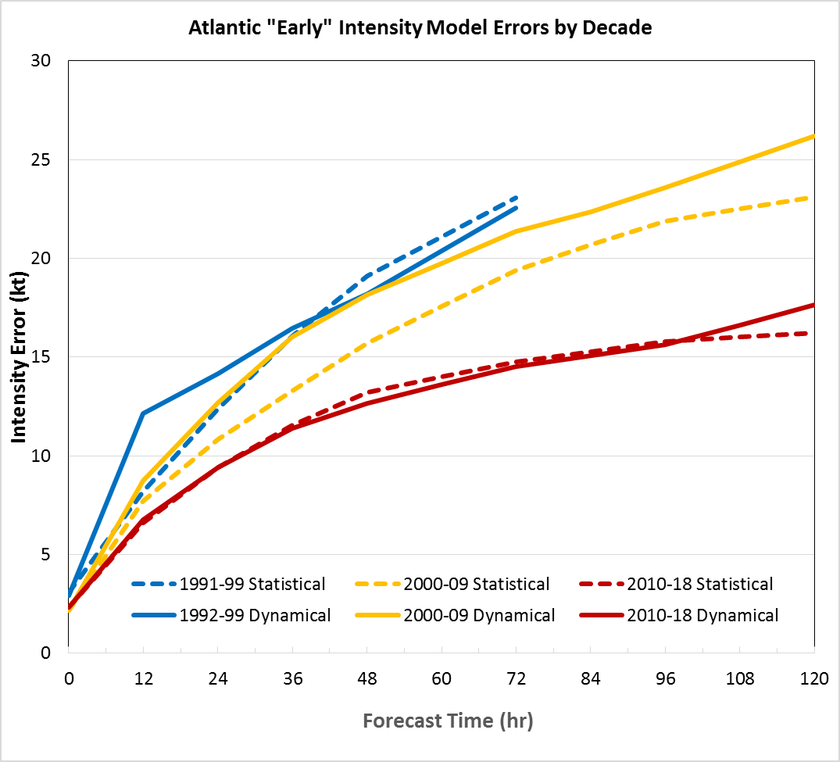
Atlantic Intensity Error Trends
2000-09
1991-99
2010-18
Notes:
1990’s statistical and dynamical intensity models were similar, 2000’s statistical models were better, 2010’s dynamical models caught up

Slide 13
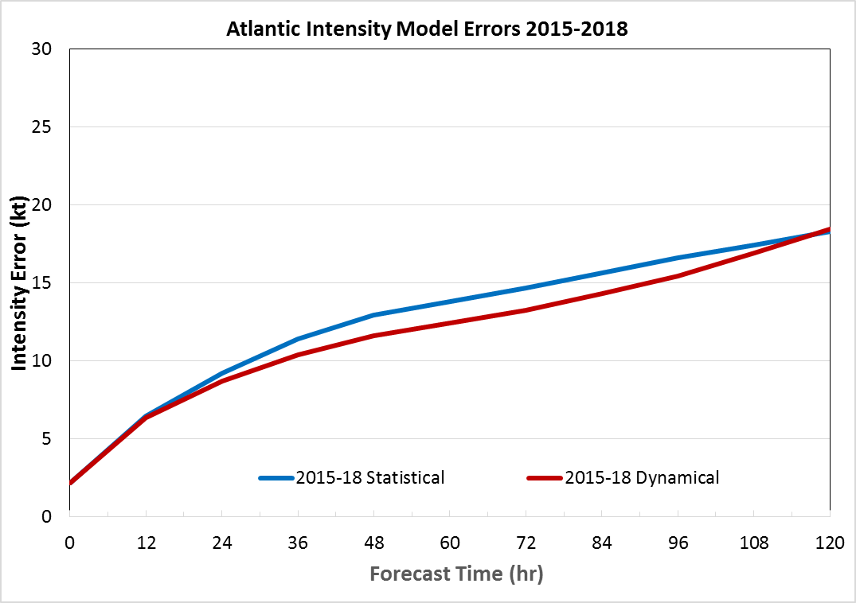
Best Intensity Model 1991-2018
SHIPS | GFDL | SHIPS | SHIPS | SHIPS | GFDL | GFDL | GFDL | GFDL | SHIPS | SHIPS | SHIPS | SHIPS | SHIPS
1991 | 1992 | 1993 | 1994 | 1995 | 1996 | 1997 | 1998 | 1999 | 2000 | 2001 | 2002 | 2003 | 2004
SHIPS | GFDL | SHIPS | LGEM | LGEM | SHIPS | SHIPS | SHIPS | HWRF | SHIPS | HWRF | HWRF | HWRF | HWRF
2005 | 2006 | 2007 | 2008 | 2009 | 2010 | 2011 | 2012 | 2013 | 2014 | 2015 | 2016 | 2017 | 2018
Dynamical models
Statistical (AI) models
Notes:
Since 2015, dynamical intensity models outperformed AI methods

Slide 14
Future for AI Intensity Models
SHIPS/LGEM focused on improving input variables
2018 models include GFS forecasts, SST analyses, NCODA sub-surface ocean profiles, GOES IR data
Experimental versions show improvement with microwave imagery
Can more sophisticated AI techniques improve SHIPS/LGEM forecasts?
JHT projects to use Advanced IT methods
Evolutionary programming, Support Vector Machines, Random Forests, Neural Networks
Future focus on AI for:
Multi-model intensity ensembles
Rapid intensification
Forecast uncertainty
Notes:
Still more can be done with single model AI methods by using more input data and more sophisticated statistical methods. In the longer term the emphasis will be on post-processing ensembles and RI to provide info forecasters can use.

Slide 15
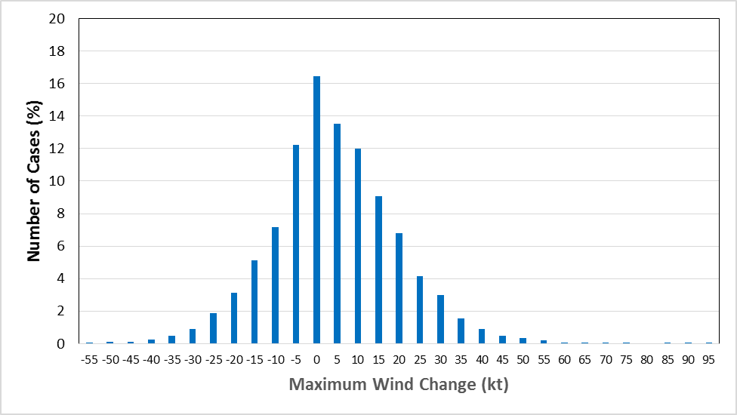
24 hr Intensity Change PDF 1982-2018 Atlantic Over-Water Cases
No Yes
Rapid intensification
Mean: 4.3 kt Std Dev: 15 kt Range -55 kt to +95 kt
4th percentile: -25 kt 96th percentile: +30 kt
Notes:
Beginning in 2003, instead of trying to forecast intensity changes, a new tool was developed to help discriminant between RI and non-RI cases. The 30 kt or more increase in 24 hr was the original definition of RI (Kaplan and DeMaria). It roughly represents the 95th percentile of 24 hr intensity changes in the Atlanitc.

Slide 16
Operational Statistical RI Classification Models
Use subset of SHIPS model predictors to estimate RI probability
Kaplan SHIPS-RI
Discriminant analysis
Rozoff RI
Logistic regression and Bayesian versions
Use intensity forecasts as input to logistic regression
Deterministic To Probabilistic Statistical (DTOPS) model
DTOPS input: HWRF, GFS, ECMWF, SHIPS, LGEM

Slide 17
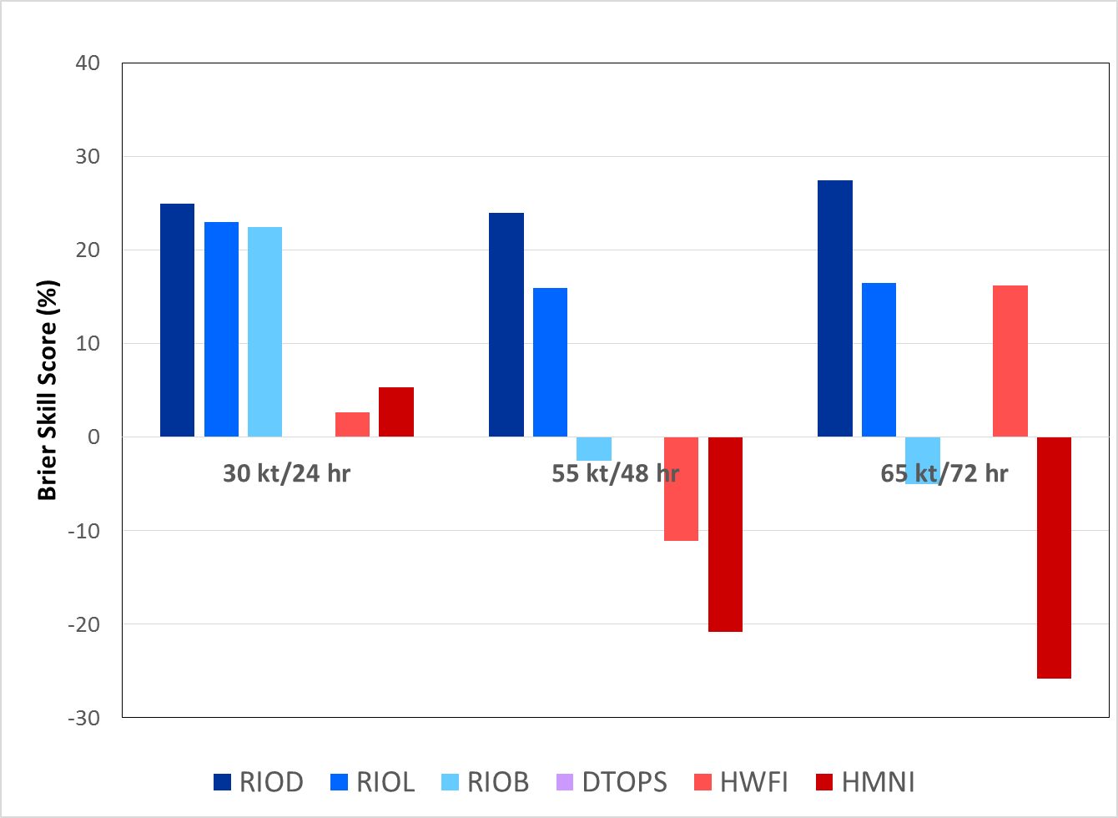
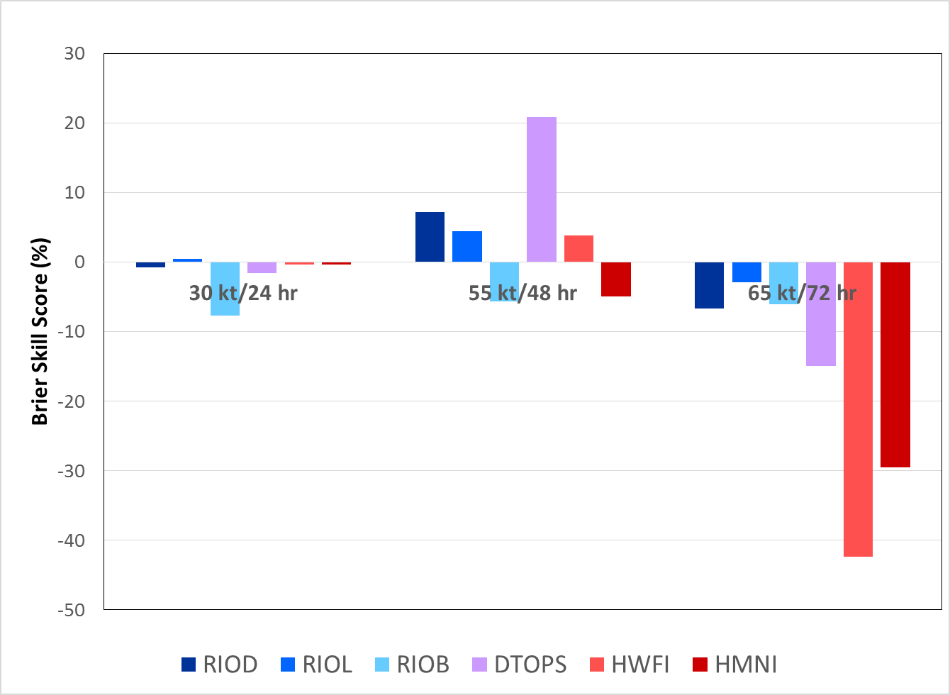
Brier Skill Scores for RI Forecasts
2017
2018
Notes:
For the Atlantic, the AI methods for RI work better than the dynamical HWRF and HMON regional models even though HWRF and HMON have errors than SHIPS and LGEM that use the same input as the RII techniques.

Slide 18
Using GLM to Improve the RII
Experimental tests using lightning in RII show improved skill
Plan to run real-time experimental version this season
RII predictors
POT: SST Potential
SHDC: Shear
D200: Divergence
PER: Persistence
PC30: % IR pixels < -30°C
TBSTDo: GOES IR brightness temp
standard deviation
OHC: Ocean heat content
RHLO: Relative humidity
LM02: Inner-core lightning
LM24: Outer-rainband lightning
Stevenson et al. (2014, MWR)
Notes:
Example of a method to further improve the RII using GOES data.

Slide 19
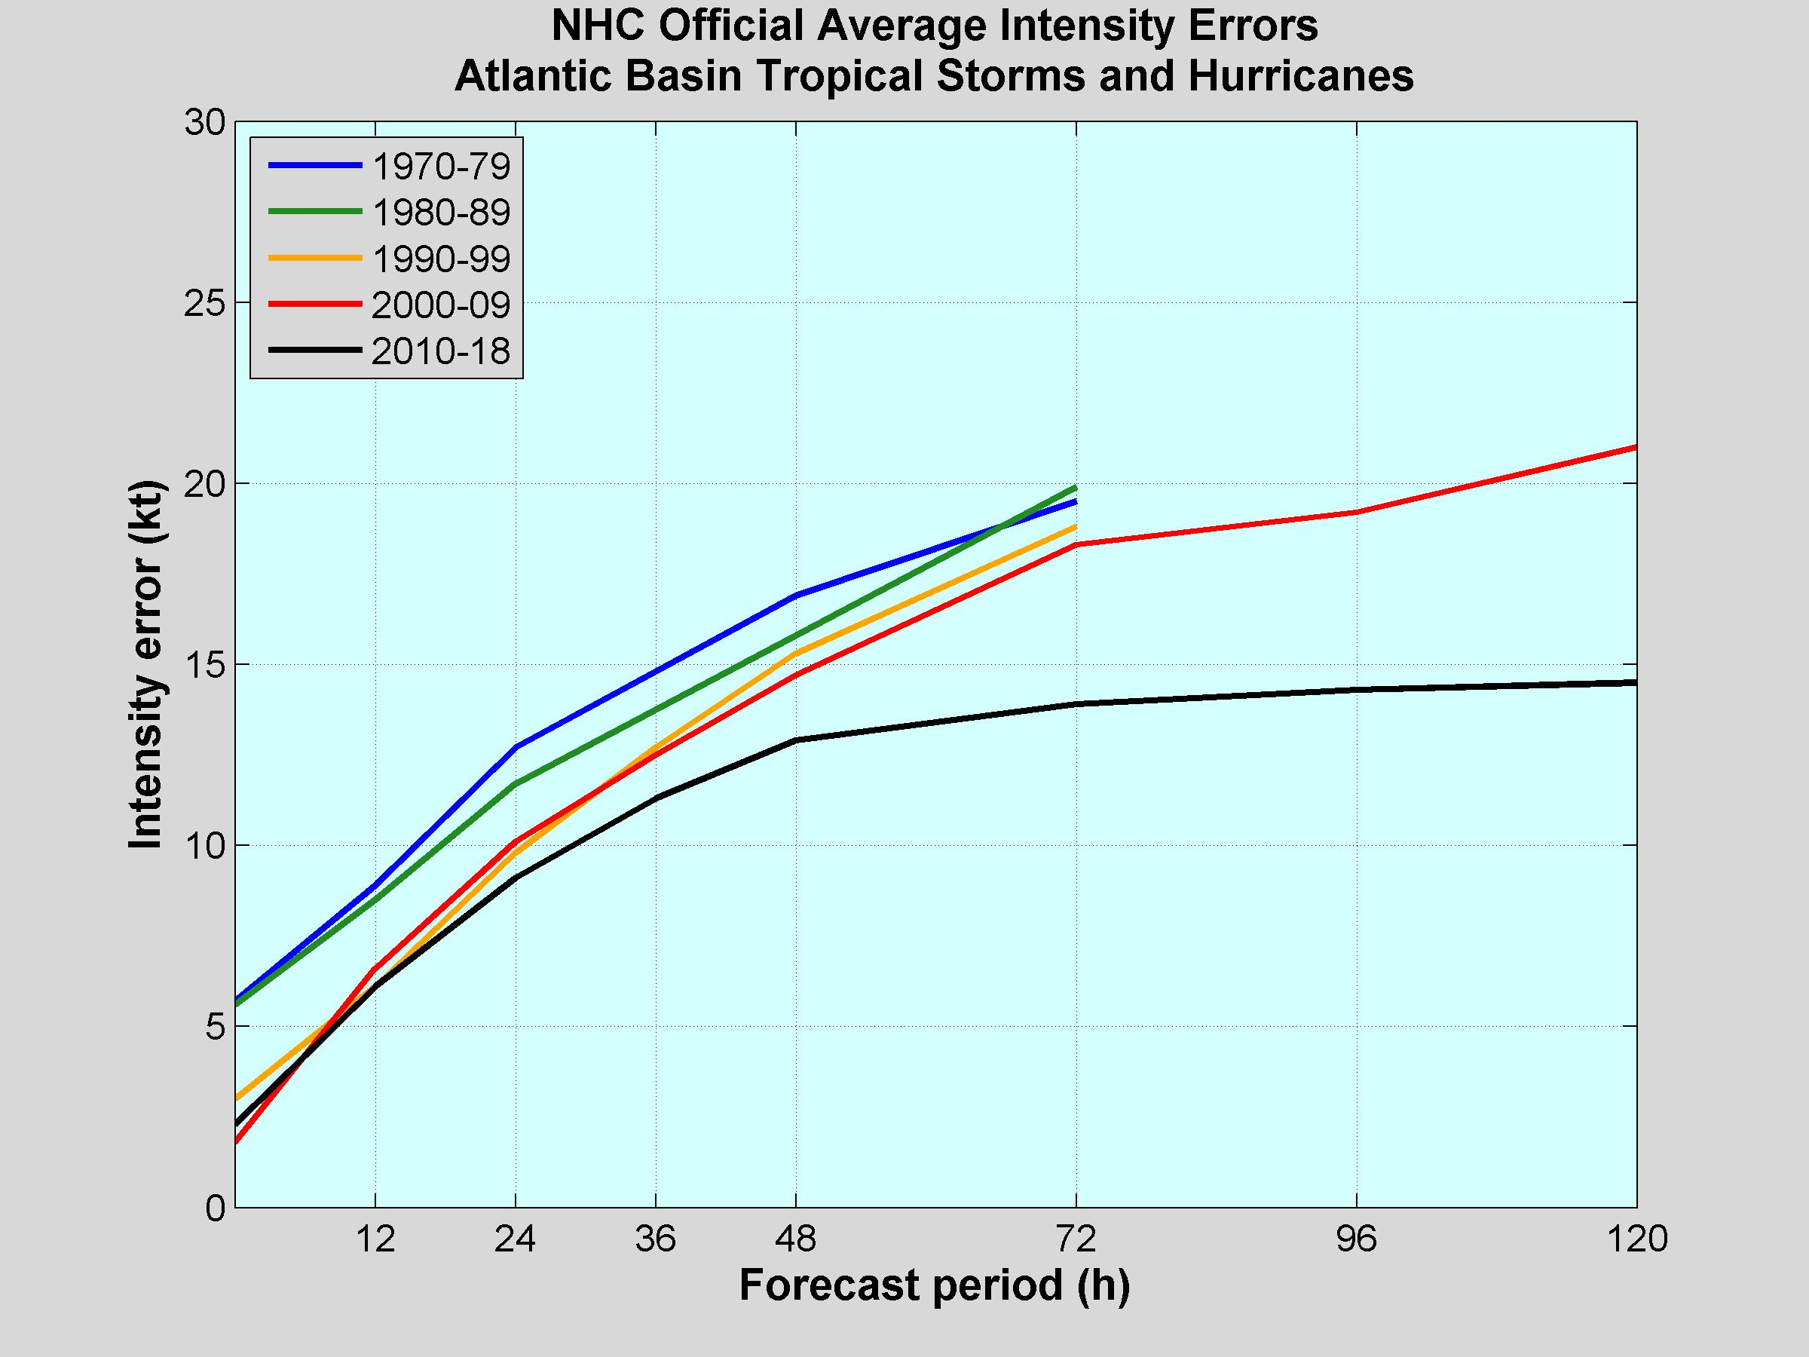
Atlantic Intensity Error Trends
Only small improvements between 1970-2009, but errors have decreased more sharply this decade.
Notes:
Recent improvements due to (1) HWRF model improvements, (2) RII algorithms, (3) Consensus Intensity models, (4) SHIPS/LGEM improvements

Slide 20
Additional AI Techniques for TC Analysis and Forecasting
JPSS PG-RR Tropical Cyclone project
ARCHER method for automated center location using microwave, IR and vis satellite data
Radius of maximum wind estimation algorithm using AI with microwave and IR imagery
NESDIS/CIRA Wind Radii Estimation model
FSU Probabilistic Tropical Cyclone Genesis model
AI techniques to post-processing several global model forecasts to estimate genesis probabilities

Slide 21
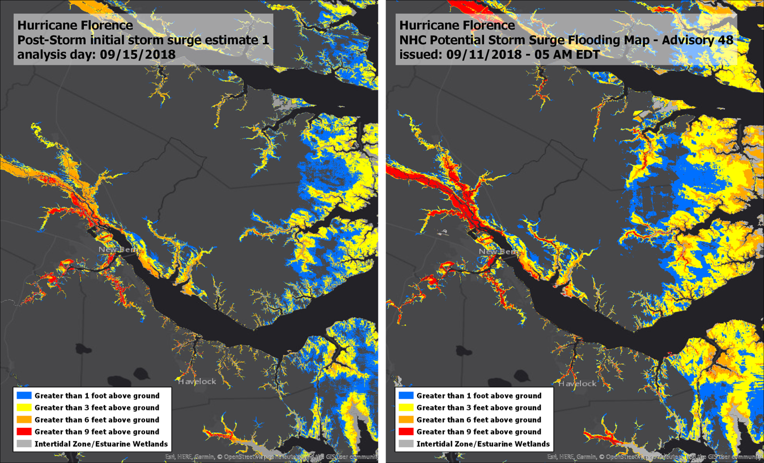
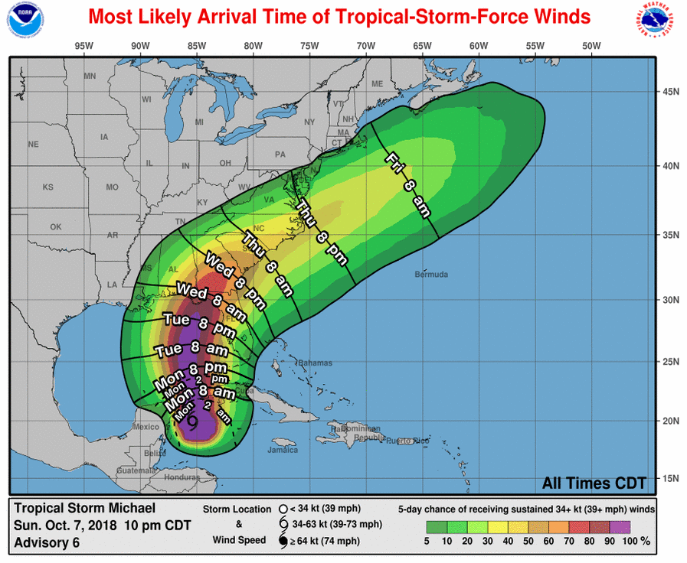
NHC Probabilistic Products
Operational Wind Speed Probability
Product and Time of Arrival
of 34 kt winds for Hurricane Michael
Potential Storm Surge Flooding
Graphic based on Probabilistic Storm Surge Model – Hurricane Florence
Notes:
Next generation of AI will focus on using ensemble modeling system output in combination with remote sensing products to produce probabilistic hazard products.

Slide 22
Summary
AI techniques used by NHC for TC forecasting since the 1950s
Initial emphasis on track forecasts
Simplified statistical methods
Multiple regression, analog techniques
AI track models phased out in early 2000’s due to better dynamical models
AI intensity models used since 1988
Dynamical models overtaking AI models in past few years
AI methods still superior for rapid intensification
More sophisticated machine learning methods under development
AI methods useful for TC analysis with multi-spectral satellite imagery
Future AI methods will focus on using ensemble model output and remote sensing data for probabilistic hazard products

