Slide 1
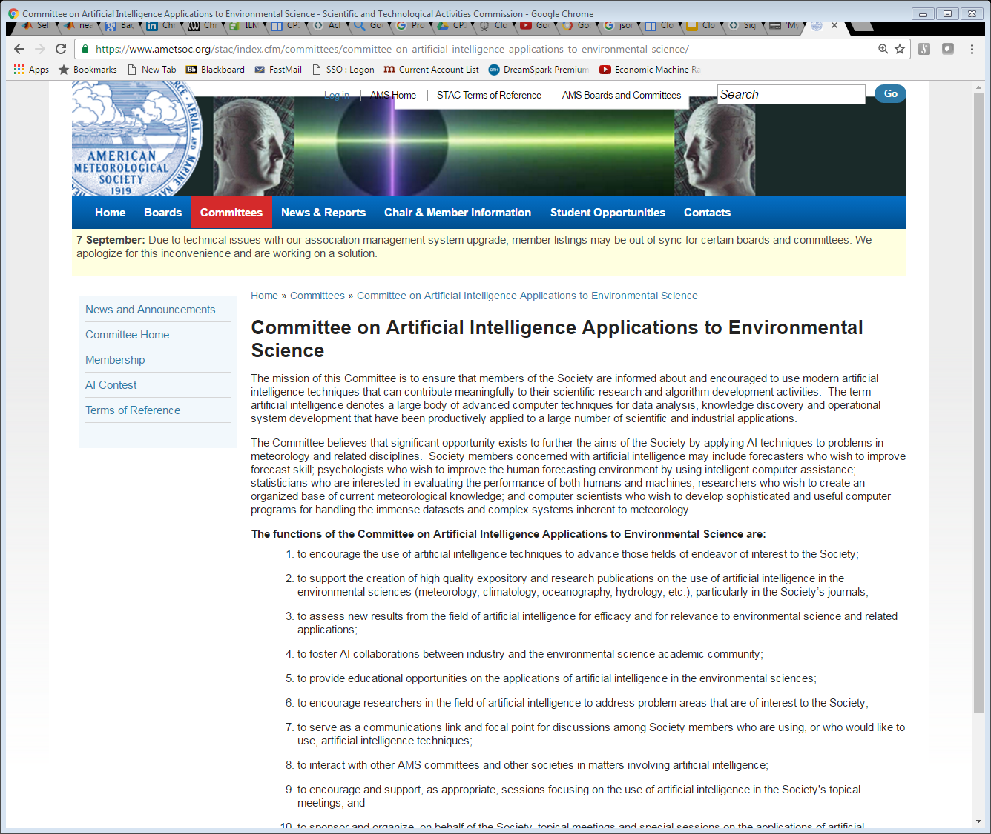
The AMS AI Committee on Artificial Intelligence Applications to Environmental Science: 30+ Years and Counting Supporting the Community
Philippe Tissot
Chair, AMS AI Committee 2016-20 Interim Director
Conrad Blucher Institute
Texas A&M University-Corpus Christi

Slide 2
*Past Chairs
Committee Members
Philippe Tissot, Chair (TAMUCC)
Amy McGovern, Vice-Chair (Oklahoma U.)
David John Gagne, II Conference Chair (NCAR)
Carlos Gaitan (ClimateAI)
Christiane Jablonowski (U. of Michigan)
Lucas Joppa (Microsoft)
Evan Anton Kodra (RisQ)
Vipin Kumar (U. of Minnesota)
Valliappa Lakshmanan (Google)
Karthik Mukkavilli (Mila/McGill)
Beth Ann Reid (Google)
Timothy Sliwinski (Texas Tech U.)
Ryan A. Lagerquist (Oklahoma U.)
Thomas Vandal (NASA Ames/BEARI)
William Moninger (NCAR/ret.)
Carr McLeod (Env. Canada/ret?)
Rosemary (NRL/dec.)
Vladimir Krasnopolsky (NOAA)
Caren Marzban (UWA)
Sue Haupt (NCAR)
John Williams (IBM)
Amy McGovern (OU)
Valliappa Lakshmanan (Google)
Philippe Tissot (TAMUCC)
* Work in progress for first chairs

Slide 3
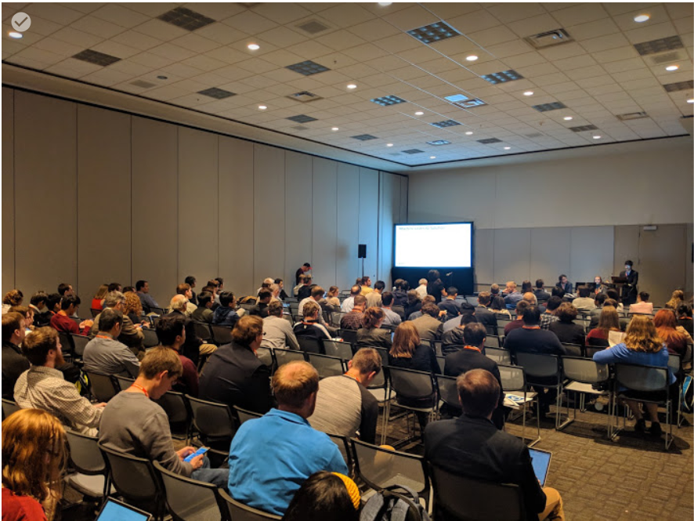
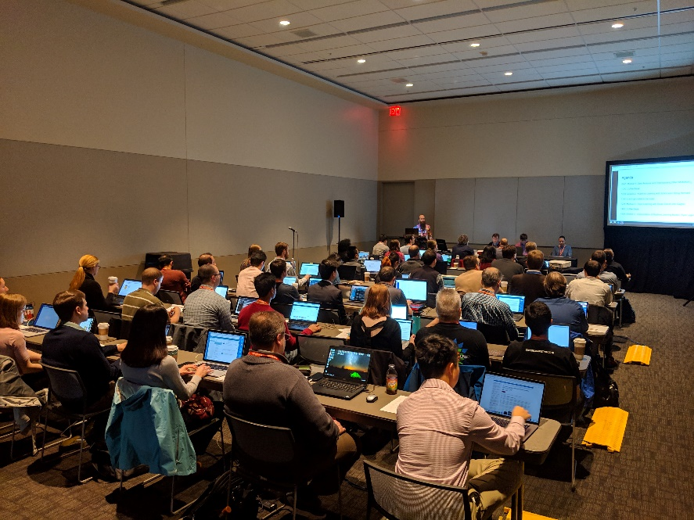
About the AMS AI Committee: Main Events
AI Conference at AMS Annual meeting
Yearly
Talks, posters, panels, science keynotes, …
Great for interdisciplinary nature of work
Joint sessions and events with other committees
Short Courses
Many are starting in the field/foundations
Boston 2020: hacking session?
AI Contests
Comparisons between techniques/approaches, what is most important
AMS AI Conference 2019
AMS AI Short Course 2019

Slide 4
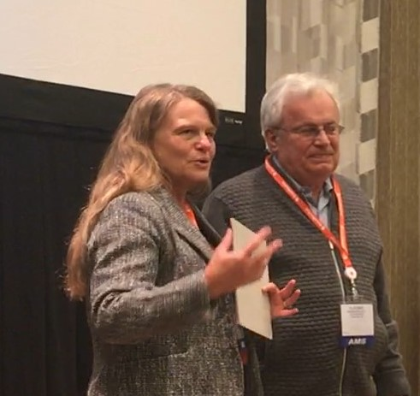
About the AMS AI Committee: Practices, Award, …
AMS AI STAC Awards:
Recognition of meritorious scientists in our young field
AMS AI Practices:
Committee members overlapping with other AMS committees (STAT, HPC, PYTHON, WAF/NWP, …)
Wide open committee: meetings/luncheons/dinners
Goal of serving a community
Take on new challenges:
EnviRoNet, IAC, leverage the AMS AI committee to provide feedback and guidance
Diversity: the good and the challenge
Academia (5), private sector (6), national lab (1), students (2)
Early career (4), mid career (4), senior (5)
Men (11), women (3)
Presentation to Vladimir Krasnopolsky of a Distinguished Scientific Committee award (…emulations of complex multidimensional mappings) by Sue Haupt, former AI Committee Chair and 2019 AMS Fellow
Notes:
Presentation to Vladimir Krasnopolsky of a Distinguished Scientific Committee award for “Contributions to advancing the application of artificial neural networks to earth science problems and in particular emulations of complex multidimensional mappings” by Sue Haupt, former AI Committee Chair

Slide 5
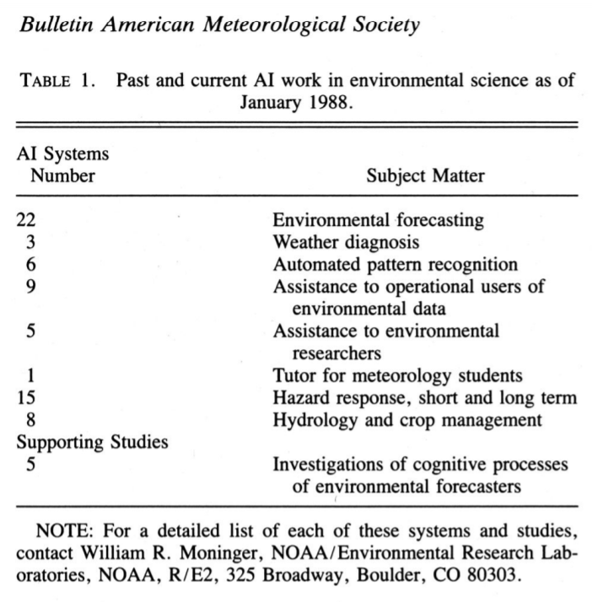
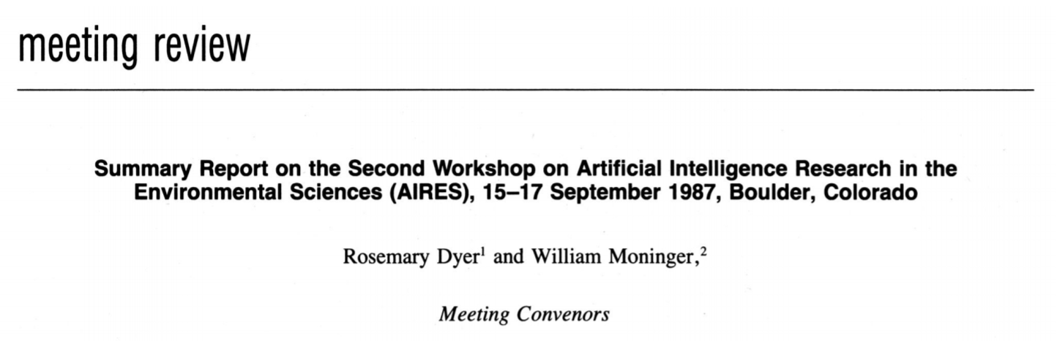
AMS AI Workshop and Short Courses: 1985 – Boston 2020 …..
Boulder 1987: AIRES II
Goals:
Forum for ongoing AI work in environmental sciences & promising directions
Give newcomers survey of state of the art
Other info:
80 participants
Meteorology, hydrology, environmental protection, and uses of intelligent data base
Emphasis on expert systems & their inference engines
One mention of neural nets (K. Young, univ. Arizona)
https://journals.ametsoc.org/doi/pdf/10.1175/1520-0477-69.5.508
Notes:
AIRES: Artificial Intelligence Research in the Environmental Sciences

Slide 6
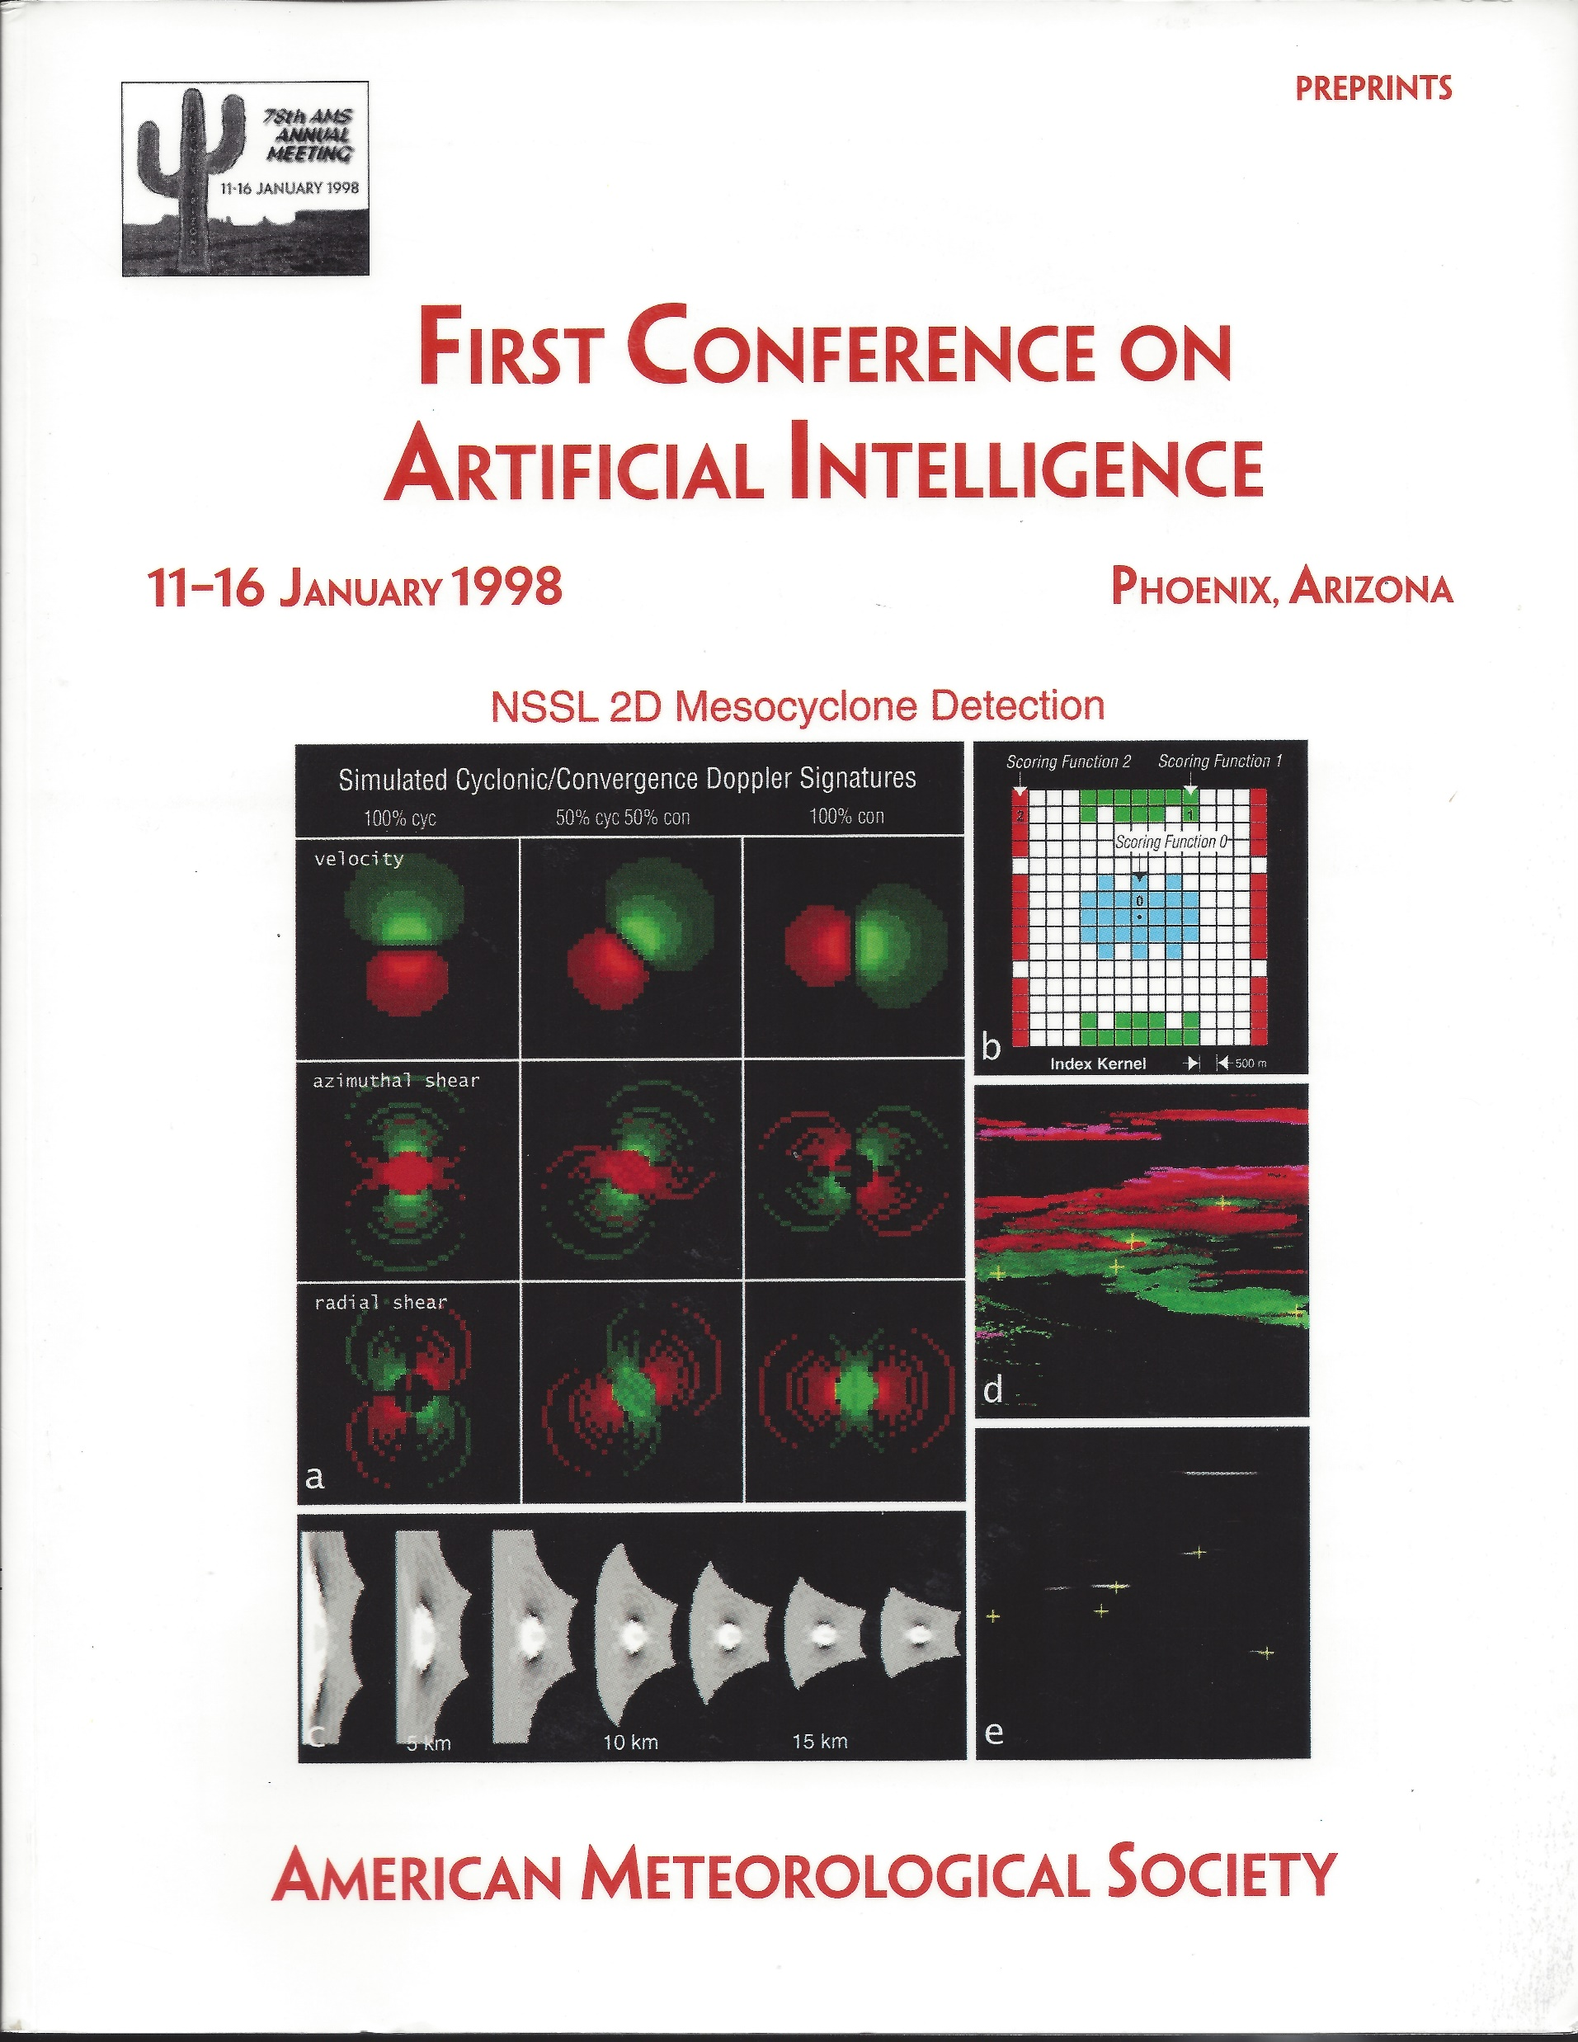
AMS AI Conferences
1998 – Boston 2020 …..
1998: 8 Sessions – 47 Presentations
Artificial Neural Nets for Precipitation Forecasts
Artificial Neural Nets for Satellite Retrieval and Pattern Recognition
Climate Classification and Prediction
Decision Aids and Natural Language Systems
Image Processing
Poster
The Human Element in Forecasting
Intelligent Statistics (joint with PROB/STAT)
Including:
“Neural Networks as a Generic Tool for Satellite Retrieval Algorithm Development and for Direct Assimilation of Satellite Data into Numerical Models”, V.M. Krasnopolsky

Slide 7
AMS AI Conference through Time
?
# Presentations at AMS AI Conferences
Notes:
Averaged about 40 presentations per year up until after 2016. Than sharp rise. How far, how long?

Slide 8
Use of AI Methods in Time
Methods: Expert Systems, Fuzzy Logic, Neural Nets, Tree based methods, SVMs, Genetic Algorithms, Genetic Programming, Deep Learning, …
1987: Workshop, mostly expert systems, 1 mention of Neural Nets
1998 (47 presentations)
Neural Nets (49%) – Expert Systems (17%) – Fuzzy Logic (9%) – Tree Based (6%) – Other (19%)
2008 (32 presentations)
Neural Nets (27%) – Tree Based Methods (14%) – SVMs (13%) – Genetic Algorithms (9%) – Fuzzy Logic (5%) – Expert Systems (3%) - Other (34%)
2019 (101 presentations)
Deep Learning (36%) - Neural Nets (10%) – Tree Based Methods (10%) – K-Means (3%) - SVMs (2%) –Other (38%)

Slide 9
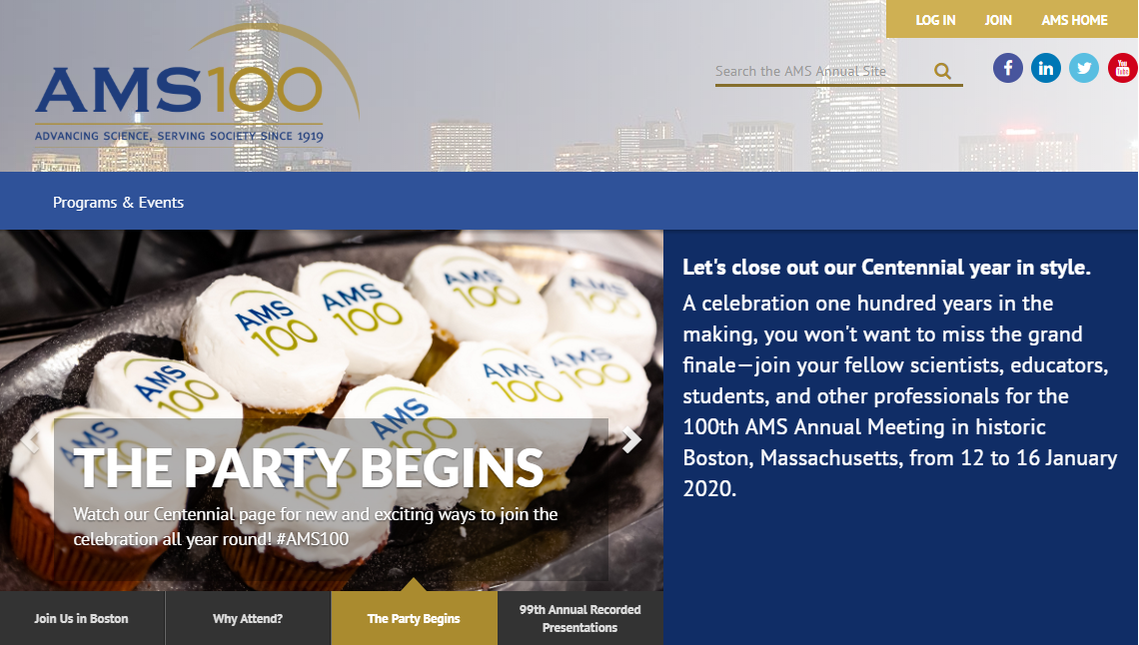
AMS AI 19th Conference: Boston Jan 11-16, 2020
Saturday-Sunday AI Short Course
4 day conference:
Presidential Talk
Science Keynotes
Oral sessions
Joint Sessions
Panels
Poster Session
Conference Organizing Committee: David John Gagne, Amy McGovern, Carlos Gaitan
Short Course Organizing Committee: Gregory Herman et al.

Slide 10

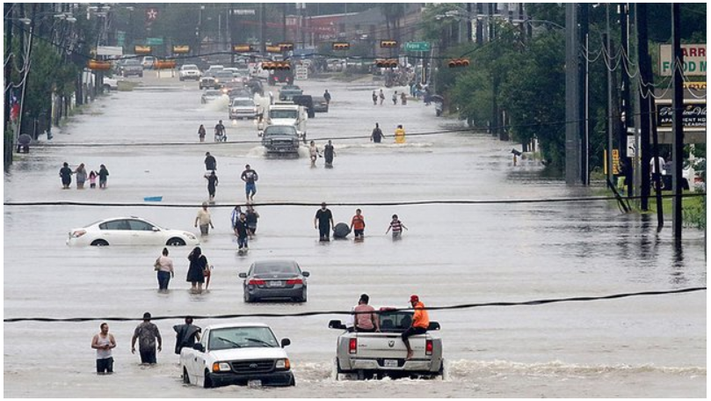


Role/Potential of AI?
AI contributions for climate science
e.g. earth-systems science and modeling
Early successes suggest tremendous potential
"Accelerate the use of artificial intelligence to support climate resilience building”
Assess actual usage in decision contexts
Need assessment, test bed, scalability ….
Where will AI reach its potential for climate? academia, private sector, govt labs, collaborations?
“AI to help bridge the last mile”?
AI for Climate Mitigation
e.g. Wind/Solar Energy forecasting
AI for climate adaptation
Report: “Evaluating Knowledge to Support Climate Action: A Framework for Sustained Assessment” Weather Climate and Society (2019) Moss, R.H. et al.
Report of an Independent Advisory Committee on Applied Climate Assessment
https://journals.ametsoc.org/doi/10.1175/WCAS-D-18-0134.1

Slide 11
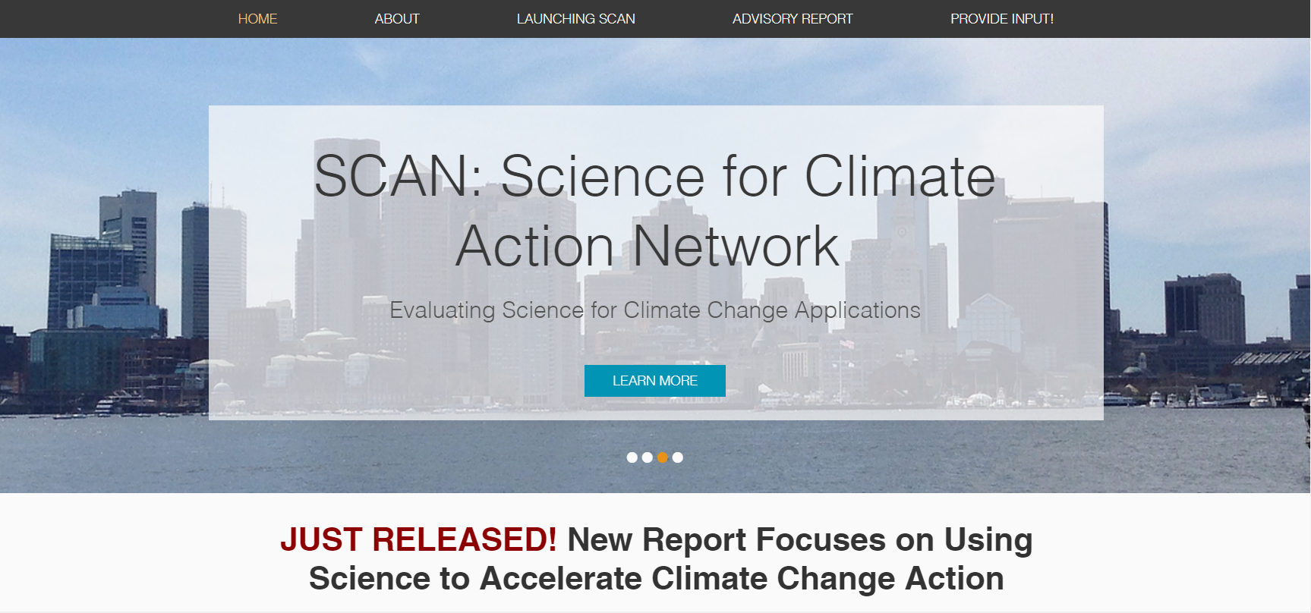
Science for Climate Action Network (SCAN)
Launched 4/4/2019
"Local governments and communities need help to use climate science to evaluate how mitigation and adaptation opportunities interact with their broader goals” Richard Moss
Work collaboratively with individuals and organizations across the country who are taking actions to limit and adapt to changing climate conditions.
AMS AI: "Artificial intelligence and machine learning are used daily across the country to improve our understanding and prediction of daily and high-impact weather forecasting. AI and machine learning can improve climate resilience and improve understanding and communication of probabilities of risk, but to realize its potential we want to work closely with decision makers and stakeholders through efforts such as the Science for Climate Action Network."
https://www.climateassessment.org/
#Science4Action
For more information: Richard Moss, Anne Waple, and the SCAN committee. Email: info@climateassessment.org.
For AI: Auroop Ganguly (a.ganguly@northeastern.edu) and the AMS AI committee.

Slide 12
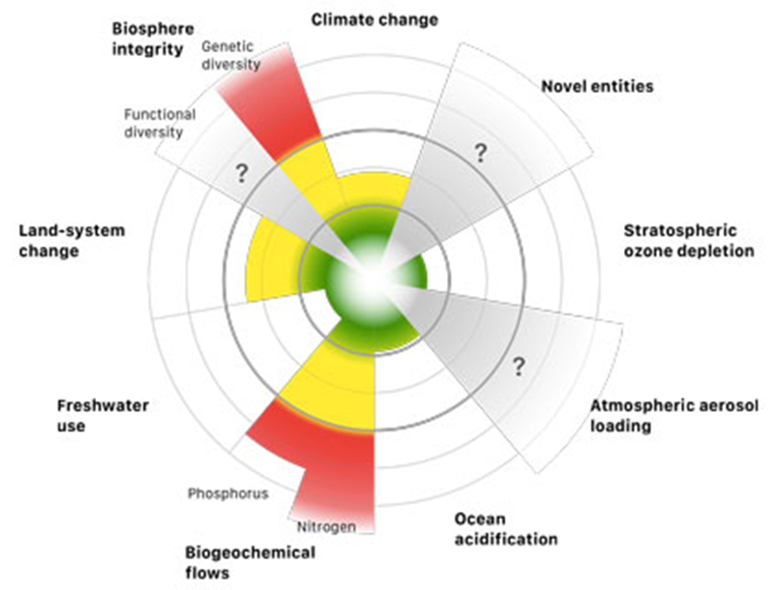
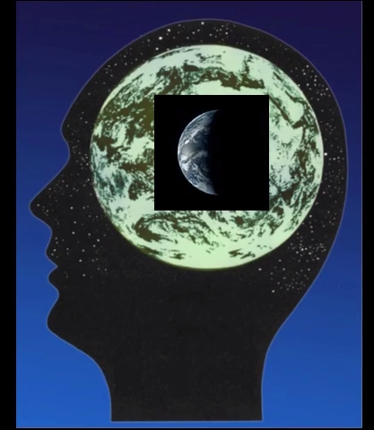
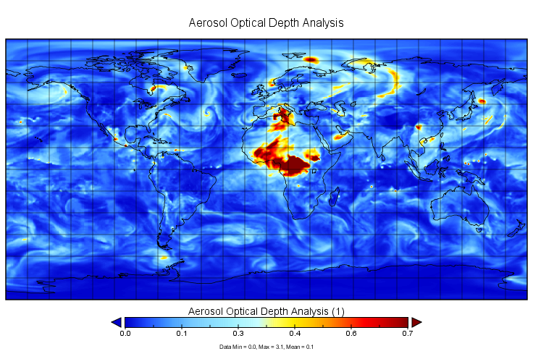
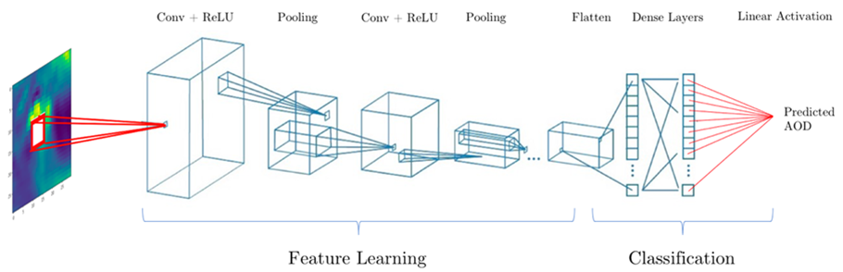
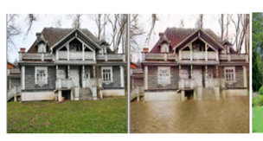
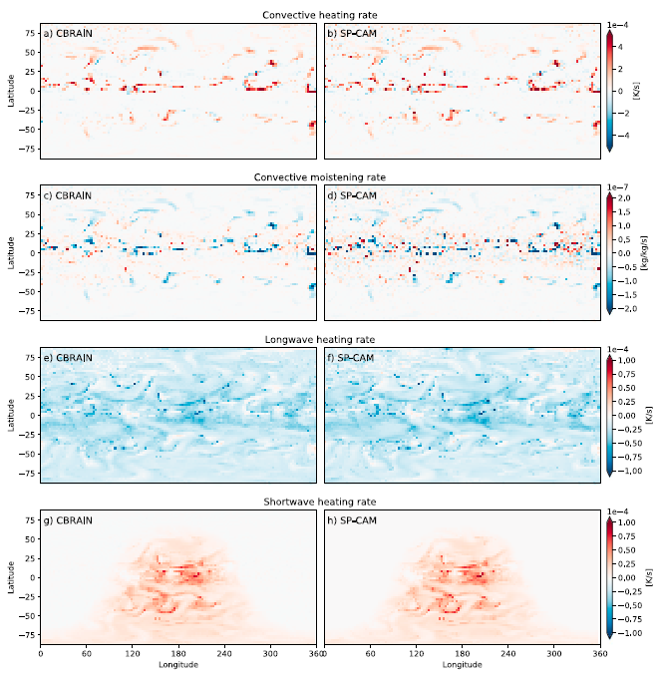
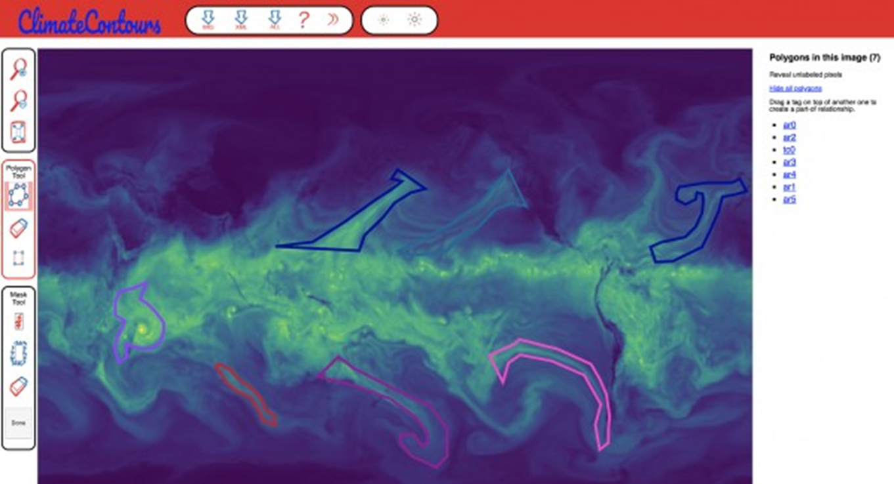
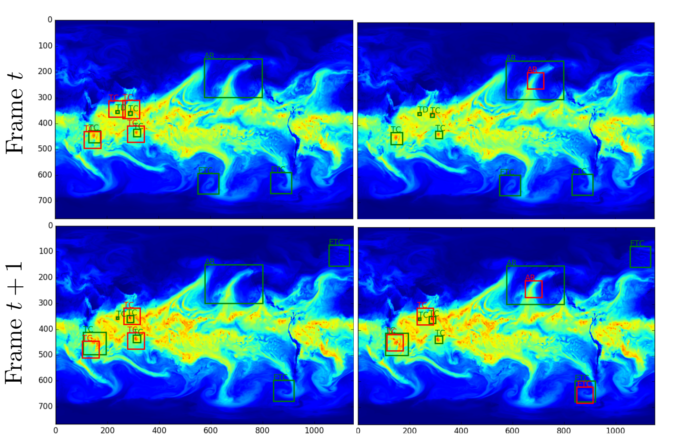

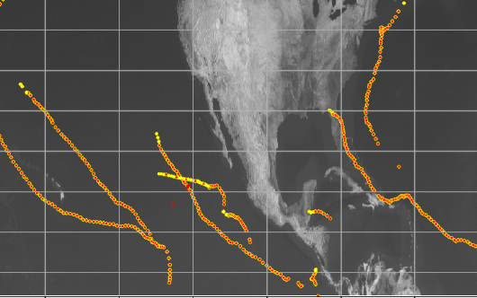

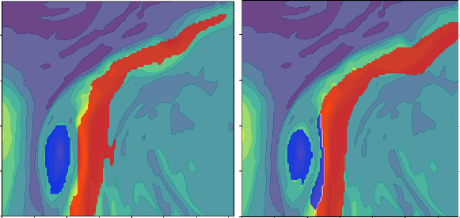
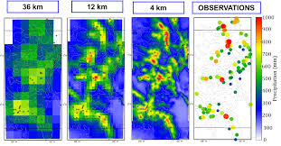



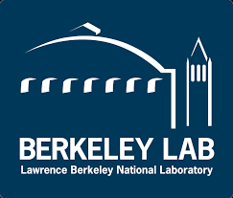





EnviroNet: repository & challenge with Environmental ImageNet analogs
Planetary Challenges
Planetary
Intelligence
Physics guided
EnviroNet
AI challenges
Crowdsourcing
Generate Viceralizations
EnviroNet Cloud Data
Climate Science
Emulate
& Forecast
‘Terra’ Sapiens
ClimateNet
Detect
& Localise
FluxNet, AeroNet, AquaNet, IceNet, CoralNet
Tracking
Segmentation
Super-resolution or downscaling
Mukkavilli et al.
EnviroNet review (in prep.) with collaborators
Planet
Data
Notes:
EnviRoNet (imagenet for atmosphere and climate)

Slide 13
ClimateNet: bringing the power of Deep Learning to the weather and climate community via open datasets and architectures
Pattern recognition using DL works best (so far) in the supervised mode
Reliable labeled data is sparse in climate science
Heuristics for pattern detection in climate science fraught with discrepancies and uncertainties
Ultimately we want to minimize heuristics (“feature engineering”)
ClimateNet is the first step towards a community-sourced labeled dataset for supervised DL for climate science
https://www.nersc.gov/research-and-development/data-analytics/big-data-center/climatenet
Notes:
NERSC: https://www.nersc.gov/
National Energy Research Scientific Computing Cetner

Slide 14
How to get Involved?
Participation to AMS AI conference and activities
Environet, ClimateNet, SCAN, …
Help organize events
What Can AMS AI Do for the Community?

