Slide 1
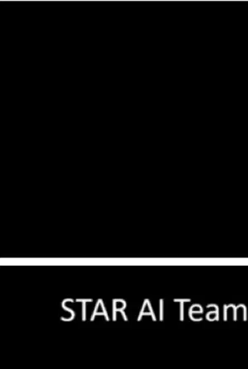
Overview of NOAA AI Activities in Satellite Observations and NWP*:
-Status and Perspectives
S. Boukabara^{(NESDIS)}, V. Krasnopolsky^{(NWS)}, J. Stewart^{(OAR)}
With contributions from many Contractors and CI scientists including:
E. Maddy^{(RTI)}, N. Shahroudi ^{(RTI)}, J. Conran ^{(RTI)}, R. Hoffman^{(UMD)}, T. Connor ^{(AER)}, S. Upton^{(AER)}
*This overview is not meant to be exhaustive but rather to give a few highlights
1st Workshop on Leveraging AI in the Exploitation of Satellite Earth Observations and Numerical Weather Prediction

Slide 2
Content
1
Background Information and Why AI ?
2
Exploring Using AI for the NOAA Mission
3
Conclusions

Slide 3
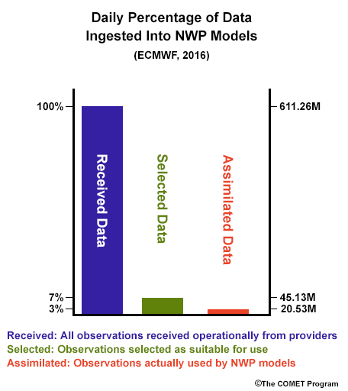
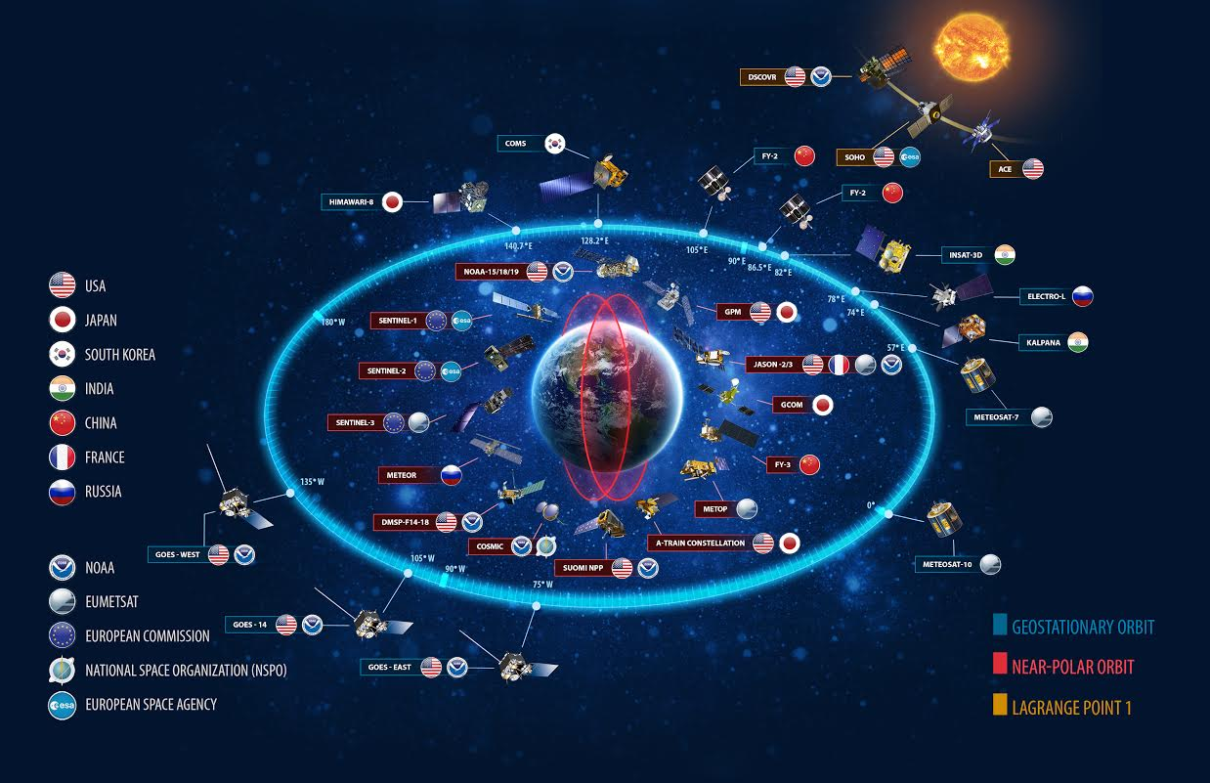
Trends in Global Earth Observation Systems
GOS Trends:
  New Sensors (higher resolutions, etc)
  New technologies (small sats, etc)
  Emergence of New GOS (IoT, etc)
  New Players in GOS (international, commercial, etc)
  Significant Increase in volume and diversity of data
Parallel Trends
  Budget, HPC Constraints
  Higher societal impact
  Higher users expectations of enhanced model resolutions, accuracy

Slide 4
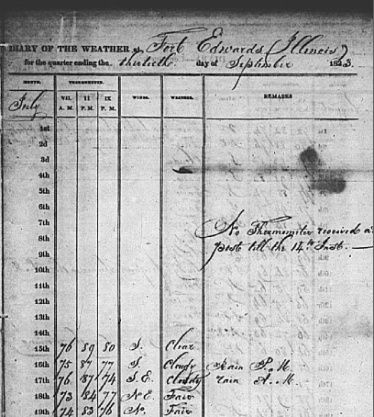
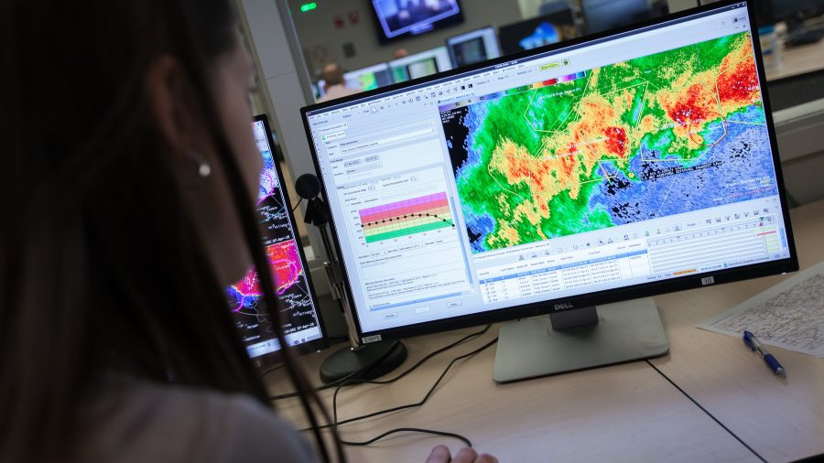
Evolution of Environmental Data Exploitation
This evolution applies to all areas of computing.
It has led several major companies to adapt their business models to take advantage of AI
Credit: Materials adapted for Environmental Observations specifically, inspired from an IBM presentation by Dr John Kelly, senior vice president, cognitive solutions, to the NOAA Science Advisory Board (SAB) on November 2016
Tabulating Systems Era
(1800-1940s)
Manual Measurement and analysis
Programmable Intelligence Era
(1950-Now)
Transformational efficiency in
Applying Human Intelligence
Cognitive Computing –AI Era
(2011- Foreseeable Future)
Enhancement/Augmentation of Human Intelligence (physics/data-science)

Slide 5
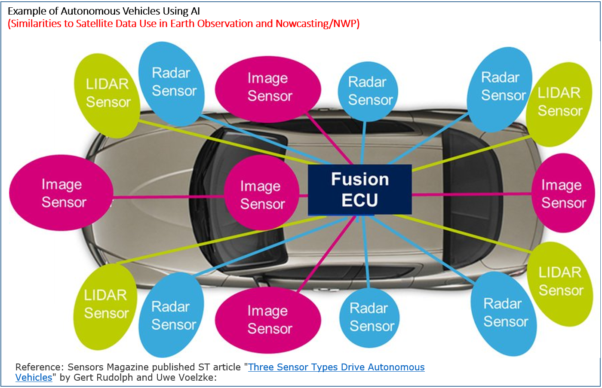
Why Consider AI to address these Challenges?
AI applied successfully in fields with similar traits as Environmental data & NWP/SA: (1) # obs. systems to analyze/assimilate/fuse and (2) predict behavior and with a (3) Big data challenge, (4) Multi-variate problem, (5) Large variability space, (6) Forecasting component
  Medical field (Watson Project): Scan Image Analysis, Pattern/Cancer detection, heart Sound analysis
  Self-Driving Transportation Devices: Fusion of Multiple Observing Systems for situational awareness
  And other fields (finance forecasting, gaming industry, music composition, etc…..)
Environmental data exploitation (remote sensing, data assimilation and forecasting), presents a viable candidate for AI application.
Note FF NNs have been around for decades in our field. Modern AI tools are a powerful enhancement to these (RNN, LSTM, etc): Keras, Tensorflow, etc
This presentation is meant to present a few examples to convey that the AI benefit is significant in terms of savings without loss of accuracy, sometimes as a complement and sometimes as an alternate to heritage approaches.

Slide 6
Content
1
Background Information and Why AI ?
2
Exploring Using AI for the NOAA Mission
Satellite Data Calibration
Radiative Transfer & radiation emulation
Remote Sensing and DA Pre-processing
Gap Filling and Morphing
Data Fusion & Assimilation
Post-Forecast Correction and Extreme Weather Events
3
Conclusions

Slide 7
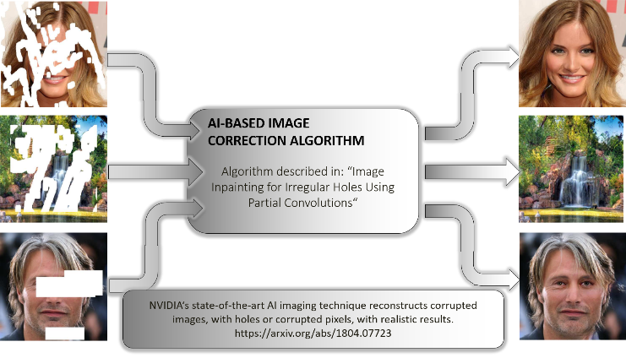
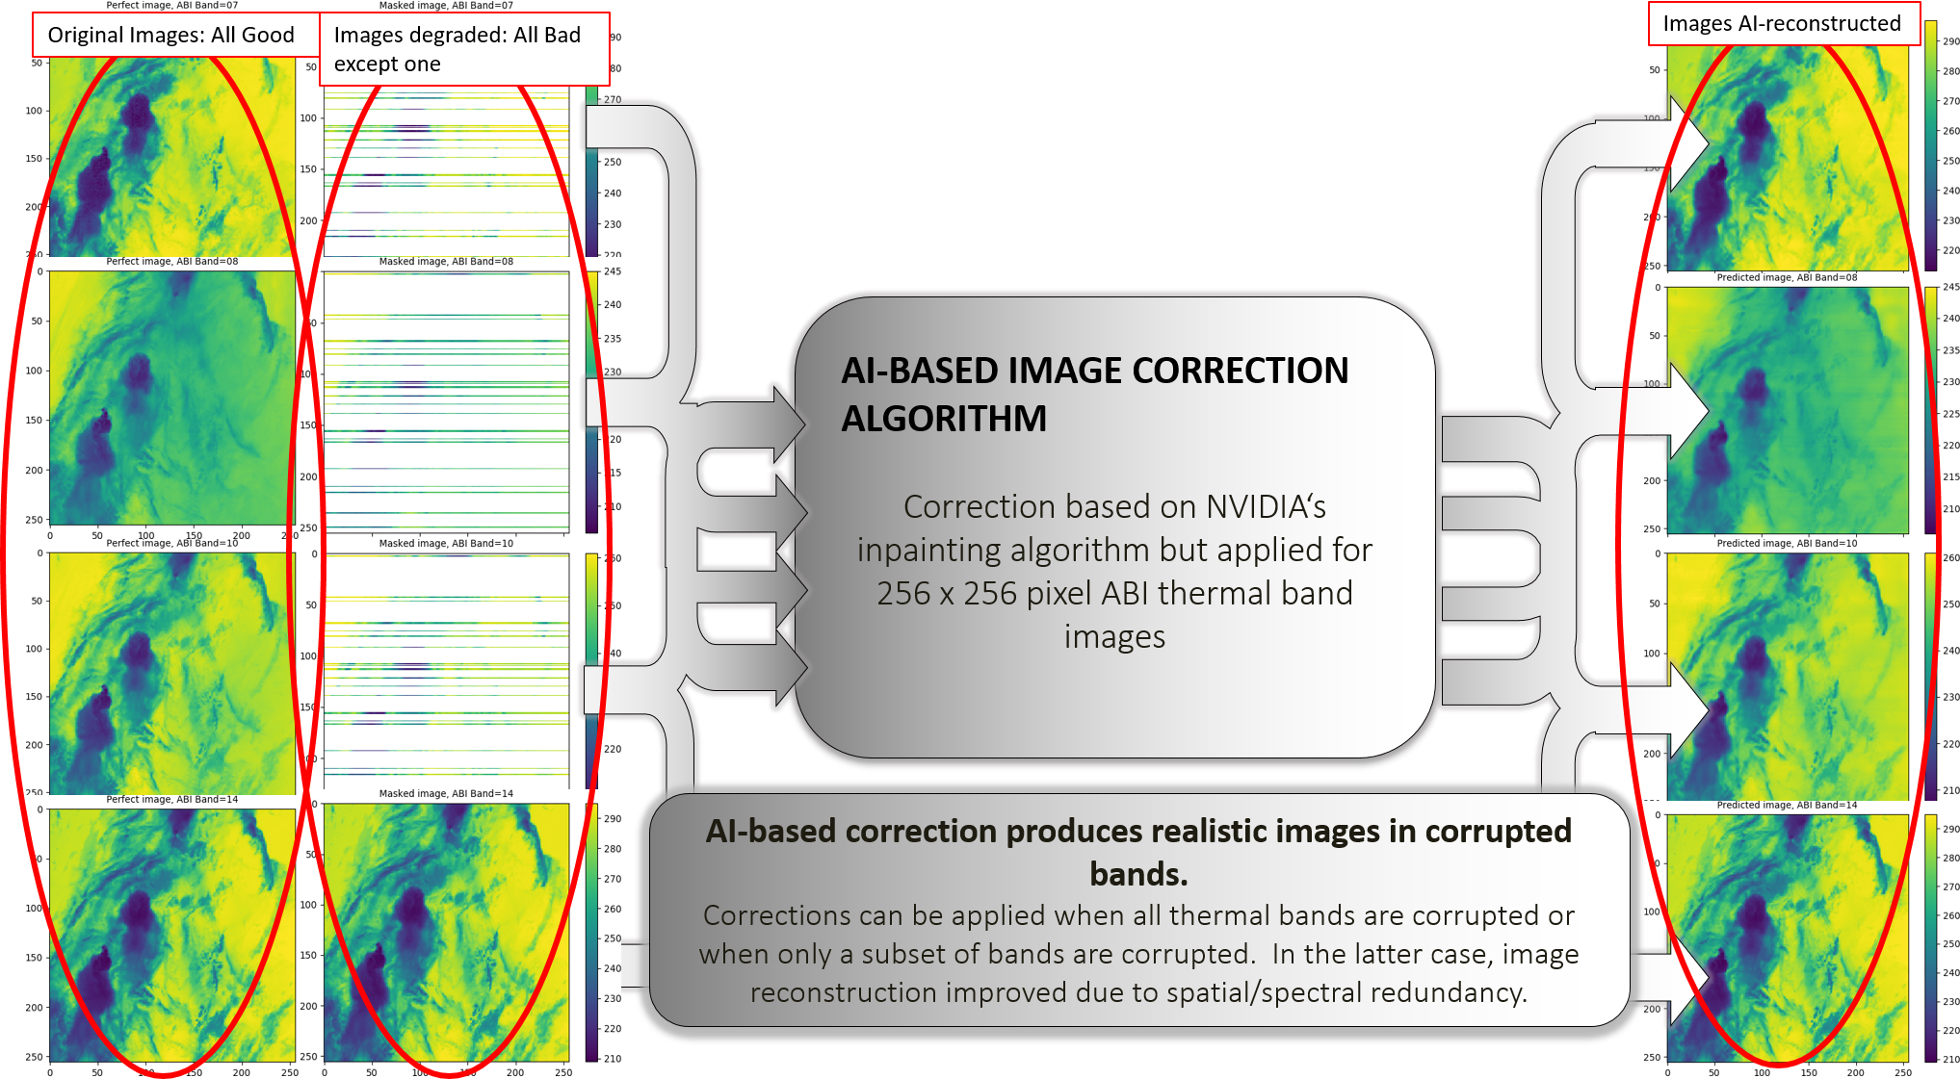
GOES-17 ABI Thermal Band Calibration Correction
Using NVIDIA’s Image Inpainting Algorithm (U-Net Algorithm) –Gap Filling/Reconstruction

Slide 8
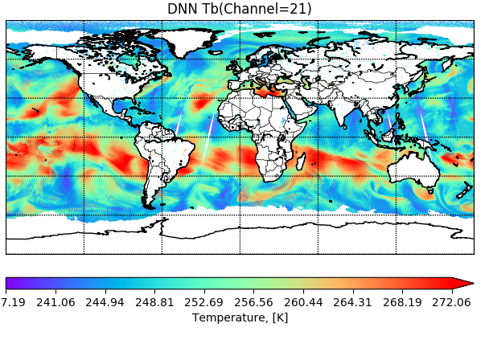

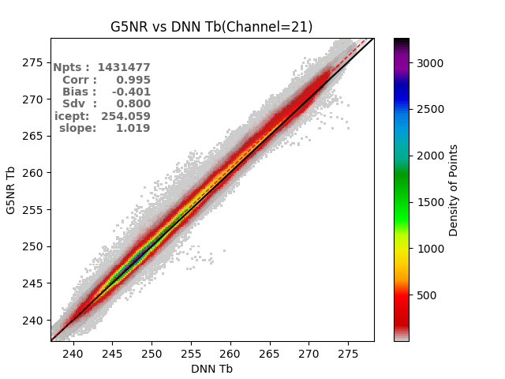
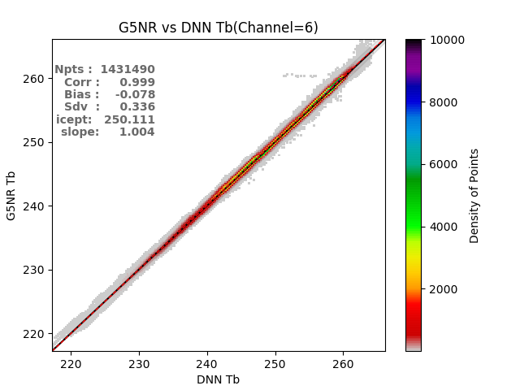
Can AI Be Used as Forward Operator?
Use of Deep Neural Network (DNN) for Radiative Transfer Modeling Purposes (CRTM)
CRTM/AI-Chan21
CRTM- Chan21
N-dVAR Assimilation/Retrieval
Measured Radiances
Comparison: Fit
Within Noise Level ?
Yes
Solution
Reached
Simulated Radiances
No
~1000 faster
Update
State Vector
Initial State Vector
AI-Based
ForWard
Operator
AI vs CRTM
New State Vector
Chan21
Chan6
 | CRTM-AI | CRTM
Processing Time for a full day data. A single sensor channel(ATMS). Excluding I/O | <1 second | ~ 1.3 hours

Slide 9
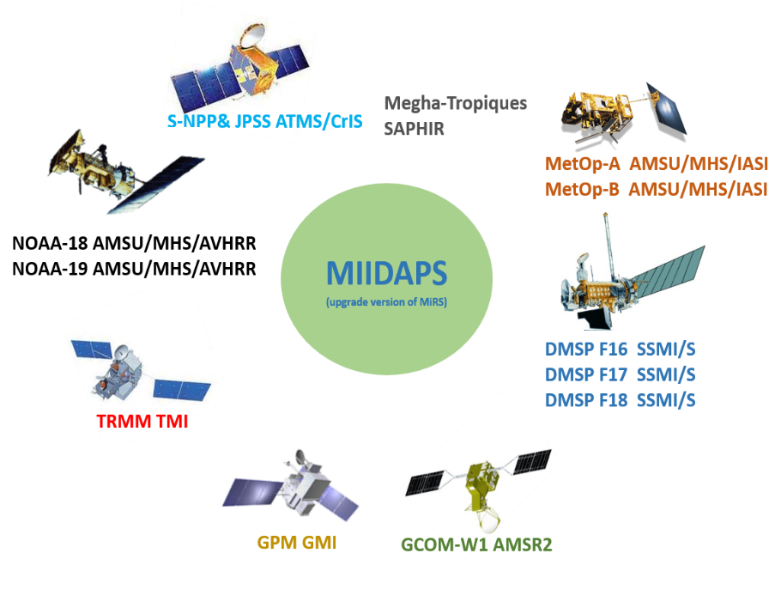
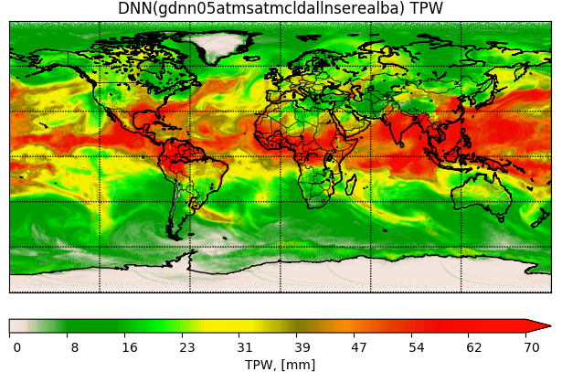
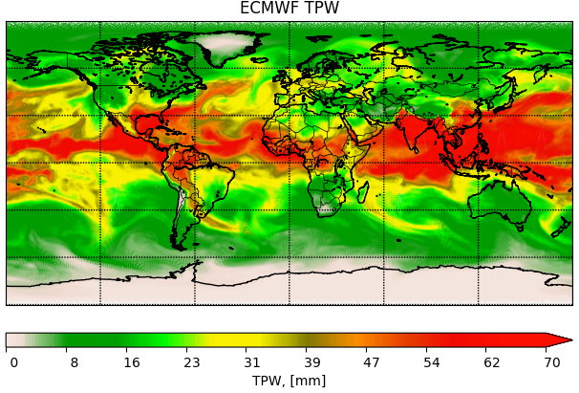
Pilot Project: MIIDAPS-AI:
Multi-Instrument Inversion and Data Assimilation Preprocessing System
Use of Deep Neural Network (DNN) for Geophysical Retrieval and Quality Control Purposes
Google TensorFlow/KERAS Tools used for MIIDAPS-AI
MIIDAPS-AI outputs (TPW) Using SNPP/ATMS Real Data
Reference source of TPW: ECMWF Analysis
How to assess that AI-based output (Satellite Analysis) is valid?
Assessing quality by comparing against independent analyses
Assessing Radiometric Fitting of Analysis
Assessing analysis spatial coherence
Assessing inter-parameters correlations
MIIDAPS-AI
ECMWF
 | MIIDAPS-AI | MiRS
Processing Time for a full day data. A single sensor (ATMS). Excluding I/O | ~5 seconds | ~ 2 hours
9

Slide 10
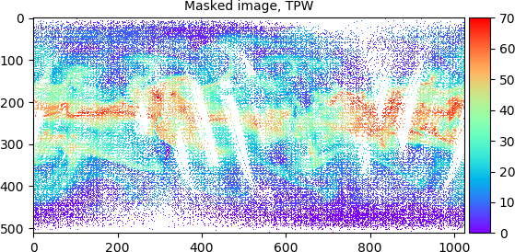
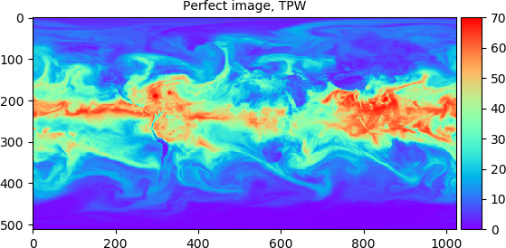

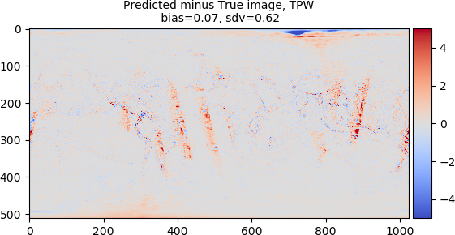

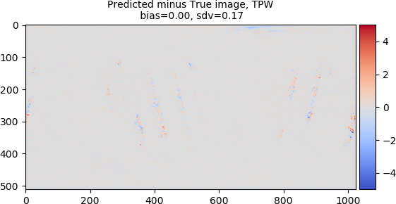
Estimation of TPW at 0.35ºx0.35º without background Info (Data Fusion mode)
Assessing AI-based Data Assimilation and Fusion:
(U-Net Algorithm) –Gap Filling/Reconstruction
Estimation of TPW at 0.35ºx0.35º with background Info (Data Assimilation mode)
Timing to estimate T(500hPa) and TPW at 0.35ºx0.35º on a single Tesla P100 (Pascal): 1.8 sec for 18 cycles or 0.1 sec/cycle

Slide 11
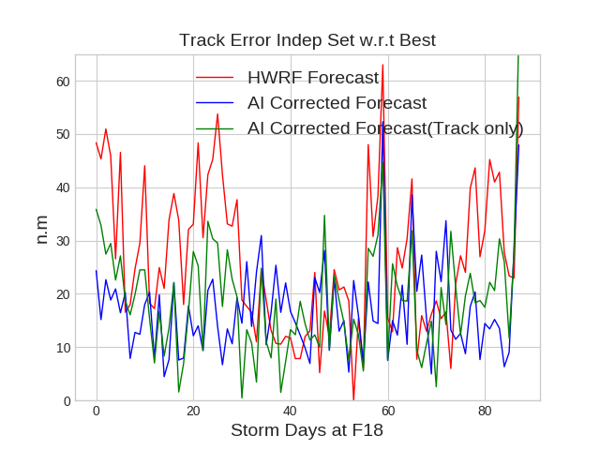
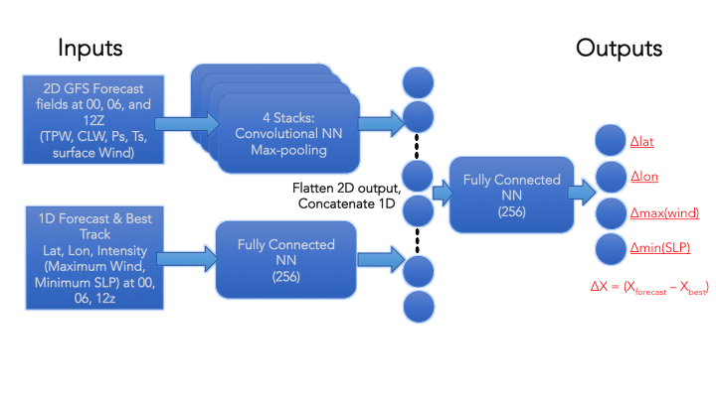
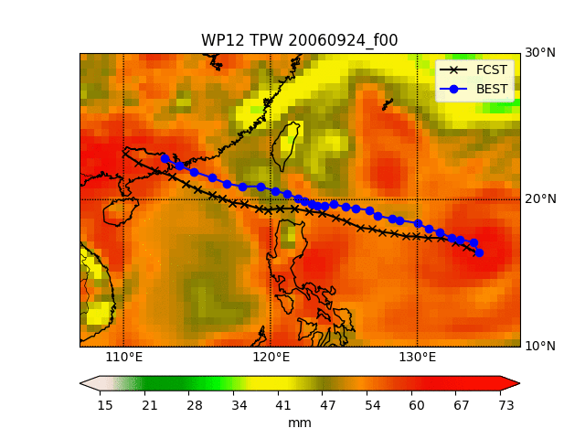
AI-based Hurricane Track/Intensity Forecast Correction (combined Use of AI and Physics)
Combination of 2D and 1D fields from GFS and best track at 00z, and F06, F12 are used to predict corrections to the 00z forecasted track and intensity valid at 18z (18hr forecast length).
Using surrounding environment (measured by satellites) further improves both intensity and track AI-based correction
Network trained on 25 storms in the Atlantic basins (530 occurrences). Using real data and HWRF predictions.
Results on independent storms shown at right.
 | HWRF Forecast |  | AI corrected w/Env |  | AI corrected Track Only
 | Bias | Stdv | Bias | Stdv | Bias | Stdv
Track err | 26.41 | 13.78 | 16.96 | 8.57 | 18.99 | 10.54
Wind error | 0.91 | 10.59 | 0.60 | 8.49 | -1.72 | 8.03
Sfc error | 5.75 | 8.56 | 0.43 | 5.14 | 2.24 | 4.87
AI corrected forecast shows reduced track and maximum wind (intensity) errors

Slide 12
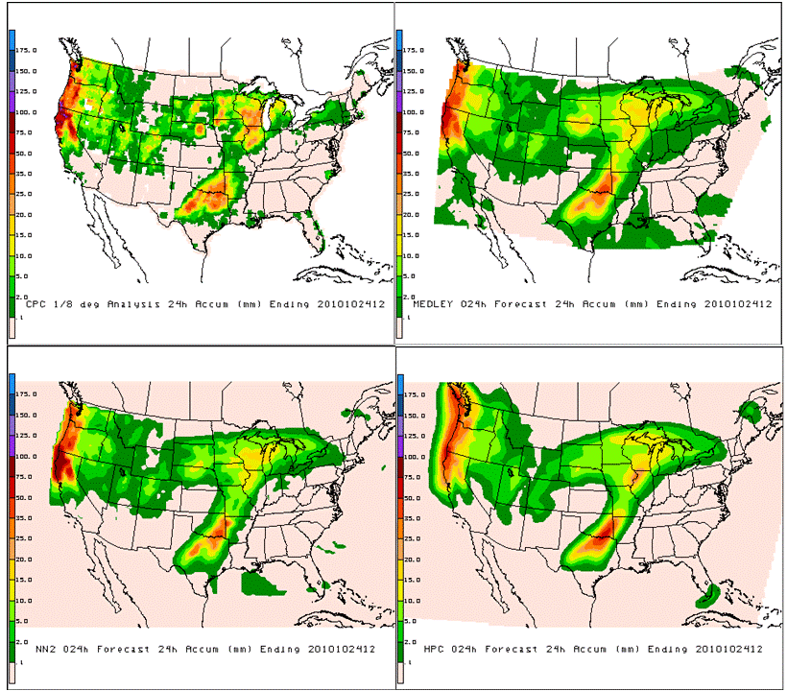
Example of AI (NN)-based Ensemble:
Nonlinear Multimodel Ensemble Mean
Precipitations over ConUS
Ensemble mean members: NCEP (global and regional), UKMO, ECMWF, JMA, Canada.
Reduced maximum and diffused sharpness and reduced fronts.
Due to slightly shifted maps from ensemble members.
CPC analysis (ground truth)
EM (arithmetic ensemble mean)
AI-based Ensemble composite.
Closer to CPC with maintained sharpness and minimal false alarm.
NNE (NN ensemble)
Human analyst prediction

Slide 13
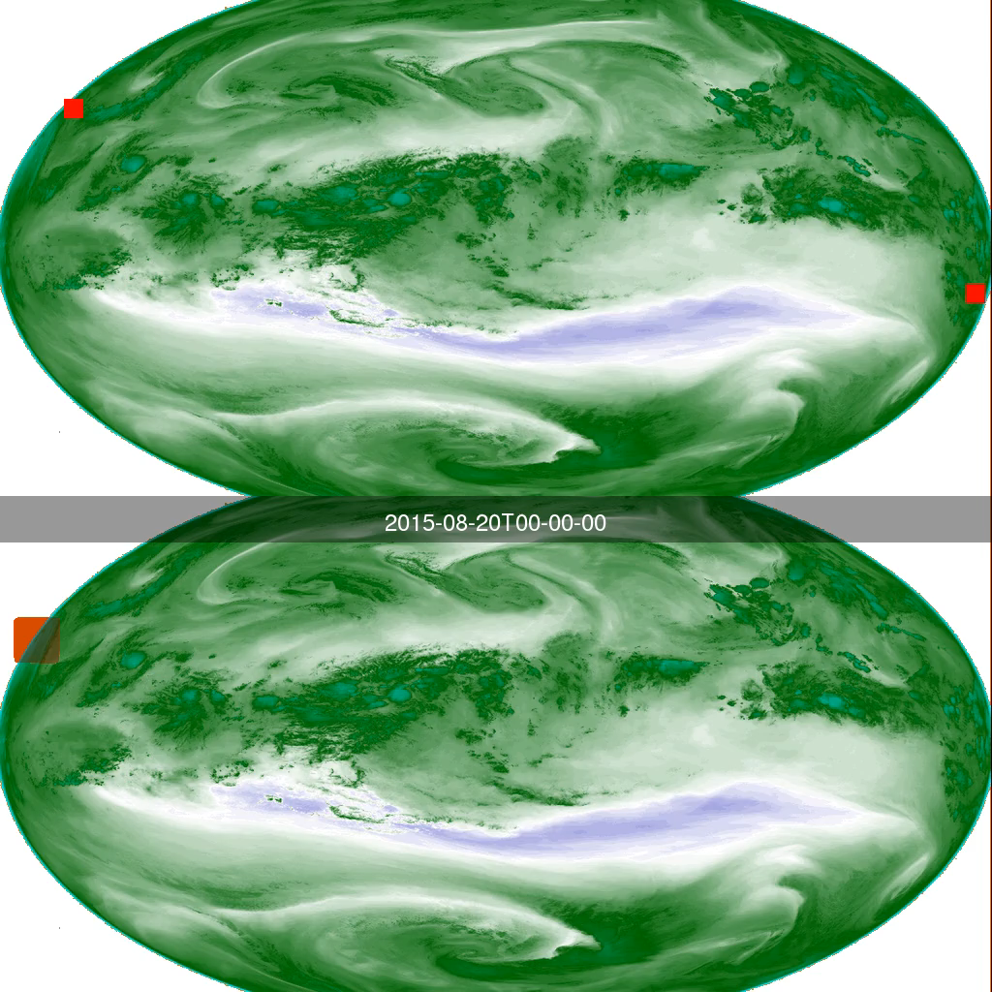
Use of AI for automatic TC storm detection -from satellite data-, to detect any atmospheric instability (convective, baroclinic, convective initiation), which helps forecasters
Manual Labels
Automatic Labels from Trained Neural Network

Slide 14
Conclusions
Big Data Challenge already here. AI allows to address this & turns it into an Opportunity (to enhance the NOAA systems performances).
AI/ML approach is an evolution of how to exploit data (Fortran -> Python -> TensorFlow->..)
For optimal results, in some cases, AI is to complement or enhance, not necessarily fully replace (case of combining Physics-modeling and AI-based correction)
Two major drivers will continue to make AI attractive in our field: (1) Significantly increased efficiency (therefore driving down cost) and enhancement of skills (accounting for unknown or difficult to model phenomena, etc present in the data)
AI is potentially a transformative technology for Environmental data processing & exploitation AND in NWP. In particular for Satellite and other high-volume data

Slide 15
BACKUP

Slide 16
Exploring AI for Remote Sensing, NWP & Nowcasting/Situational Awareness (SA). Status
Secure Data Ingest
Calibration
Bias Correction
Intelligent Thinning
Pre-processing & Inversion
Quality Control (QC) and Cloud-Clearing
Radiative Transfer
Data Assimilation
Long-Term Data Quality Monitoring
NowCasting
Data Fusion
Multiple types of AI models are being tested depending on problem :
DNN, RNN, CNN, GPR, Morphing Tool, LSTM, etc
Software Tools used: TensorFlow and KERAS
Value Chain of Observing Systems Data Exploitation
Post-Forecast Correction
Short-term Forecasting
Post-Forecast Correction
NWP Forecasting
Not Tested. Unknown level of confidence | Not tested. Reasonable level of confidence | Tested or not: Moderate level of confidence | Tested. High level of confidence

Slide 17
NOAA/OAR Artificial Intelligence/Machine Learning Efforts
Earth System Research Laboratory
Regions of Interest Detection and Extraction for Targeted Data Assimilation
  Detection of Active Weather from Satellite Imagery (Cyclones, Atmospheric Rivers, Convection Initiation)
Soil State from GOES ABI for Model Assimilation
Cloud Classification for Process Oriented Classification
  Evaluating how model performs for different atmospheric conditions like shallow cumulus
Improved Fire Radiative Power behaviour for Smoke and Particulate Modeling
  Fire behavior models from satellite detections of Fire Radiative Power correlated to specific atmospheric conditions
Model Parameterizations
  Improve performance over existing methods
Improving Speed of Radiative Transform for Aerosols
National Severe Storm Laboratory
Hail Size from Polarimetric Radar Data
Hail Climatology from remote sensed data
Storm Detection and Tracking
Low Level Storm Scale Rotation

Slide 18
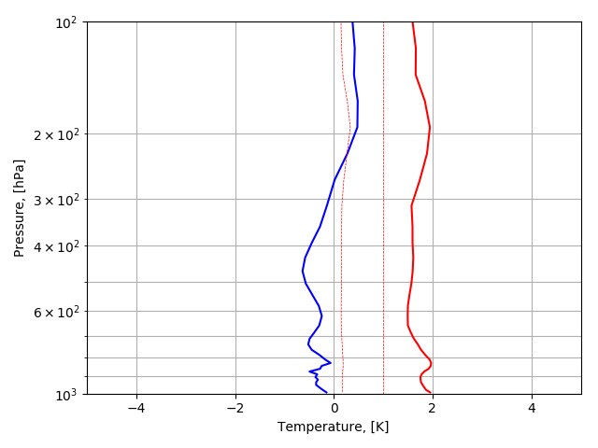
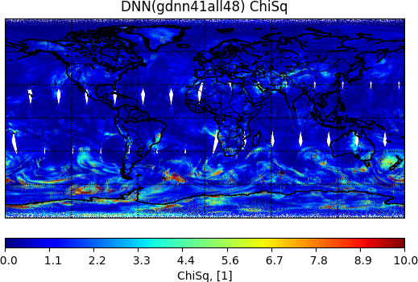
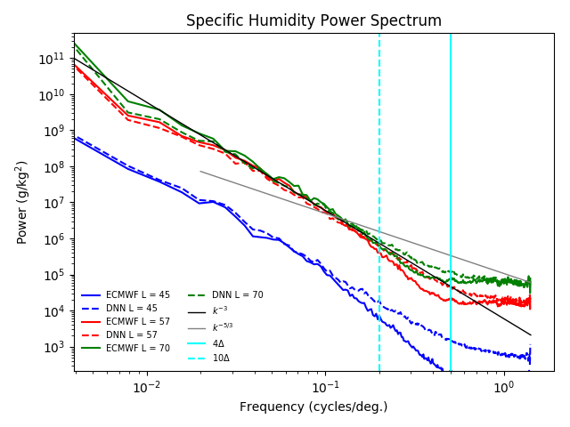
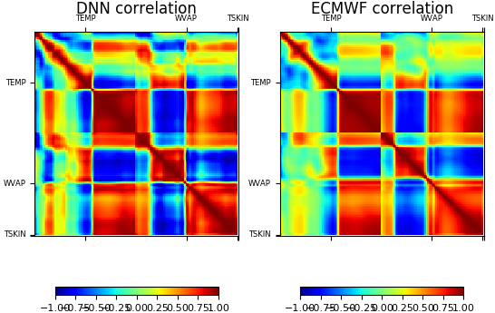
How do we know if this AI-based satellite-analysis is scientifically valid?
Statistical Performance
(against ECMWF analysis)
(2) Radiometric Convergence
(Fitting ATMS Observations)
(3) Spatial Coherence Assessment
(against ECMWF)
(4) Inter-Parameters Correlation (Comparison to ECMWF)

Slide 19
Cost/Time Saving: Case of MIIDAPS-AI Production System
 | JPSS/ATMS |  | JPSS/CrIS
 | MIIDAPS-AI | MiRS | MIIDAPS-AI | NUCAPS
Algorithm (days/day) | 720 (Factor 200 saving) | 3.6 | 400 (Factor 100 saving) | 3.9
Significant Savings in CPU time when using AI numerical approach and Google Tensorflow/Keras language (used for AI applications)
Comparison of number of days that can be processed per day using the same computing resources and using either the next generation (MIIDAPS-AI) algorithm or traditional variational approaches (MiRS, or NUCAPS). Saving in CPU time (excluding I/O)

Slide 20
Example of Accurate and Fast Emulations of Model Radiation Parameterizations
Note: Work in progress to extend radiation emulation for FV3
 |  | NCEP CFS/GFS (L = 64)
 |  | RRTMG LWR | RRTMG SWR
Error Statistics in Kelvin/day | Bias | 2.·10⁻³ | 5. · 10⁻³
 | RMSE | 0.49 | 0.2
Speedup factor, η | Times | Averaged speedup factor: 16 Speedup factor in cloudy conditions: 20 | Averaged speedup factor: 60 Speedup factor in cloudy conditions: 88
17 year parallel runs did not show any significant differences between runs with NN and RRTM radiations

Slide 21
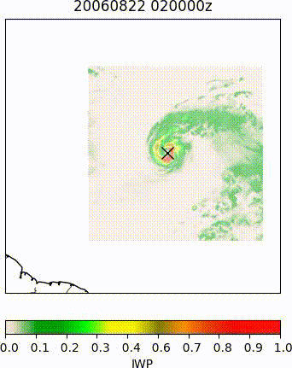
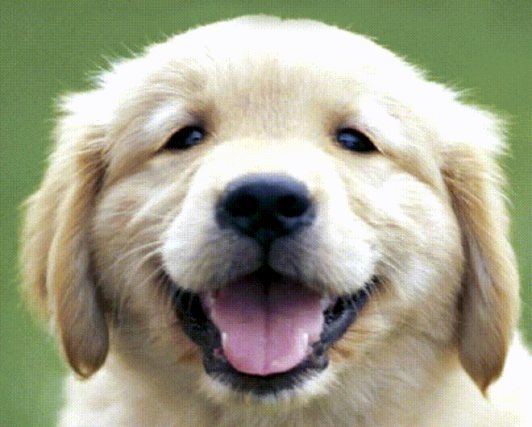
Use of “morphing” AI Tool for Cloud/Precip morphing
Note the potential for morphing both the shape and color (i.e. equivalent of track and intensity)
Used total integrated cloud ice from NASA GEOS-5 Nature Run (G5NR) “AL01” tropical cyclone at two time-steps (0200z and 0600z).
Morphing software applied as a black box with some hand tuning of transformations between the two images.
  Image at right sampled using 20 transformations between images
Credit: Example output and software from:
http://andrew.gibiansky.com/blog/image-processing/image-morphing/
Notes:
Used hourly IWP from NASA GEOS-5 Nature Run (G5NR) “AL01” tropical cyclone.
Morphing software used as a black box without any tuning of image subdivision mesh.
15 frames per image to morph between each time step.

Slide 22
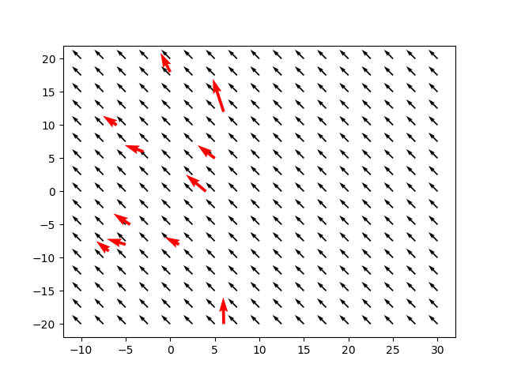
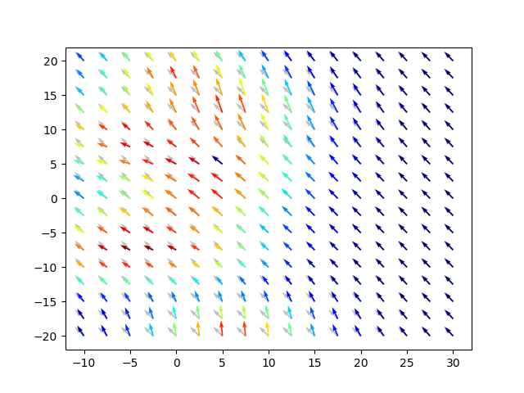
Can AI Tools Be Used for Data Fusion & Data Assimilation?
Use of GPR (Gaussian Process Regression) AI Model for Data Fusion/Assimilation (Case of AMV or conventional data)
Color confidence/error estimates
Background and Measurements
GPR-Based Analysis
Wind background (black) and observations (red)
GPR estimated winds
Synthetic wind observations (red) are injected onto background (black) fields and GPR used to “fuse” the two.
Color code corresponds GPR confidence – warmer colors reflect high confidence, while colder colors reflect low confidence estimates – and are consistent with observation locations.

Slide 23
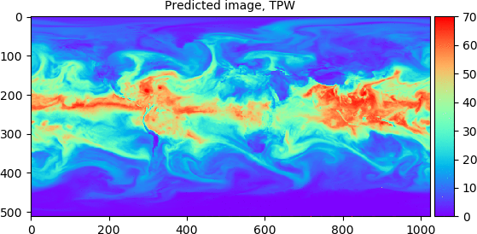
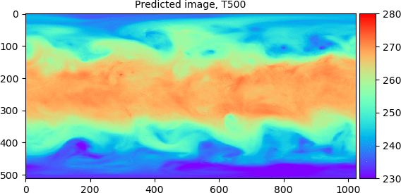
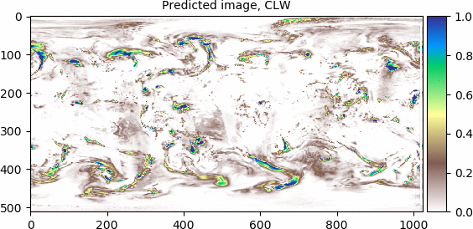
AI for Data Assimilation of TPW, CLW, and 500hPa Temperature
Total Precipitable Water
500 hPa Temperature
Cloud Liquid Water
Hourly analysis fields estimated at 0.35x0.35 resolution using satellite “observations” and 1hour forecast as “background”
AI outputs for TPW (top left), CLW (bottom left) and 500hPa Temperature (top right) are shown for 2016/10/06 00z through 18z
Timing to estimate T(500hPa) and TPW at 0.35ºx0.35º on a single Tesla P100 (Pascal): 1.8 sec for 18 cycles or 0.1 sec/cycle

