Slide 1
Opportunities for using AI methods in weather forecasting at ECMWF
Alan Geer
Earth System Assimilation Section, Research Department
Thanks to: Patricia de Rosnay, Peter Dueben, Peter Bauer, Leonhard Scheck (DWD/LMU), Elias Holm, Peter Lean, Massimo Bonavita, Marcin Chrust, Robin Hogan, Mohamed Dahoui, Lars Isaksen, Stephen English, Andy Brown

Slide 2
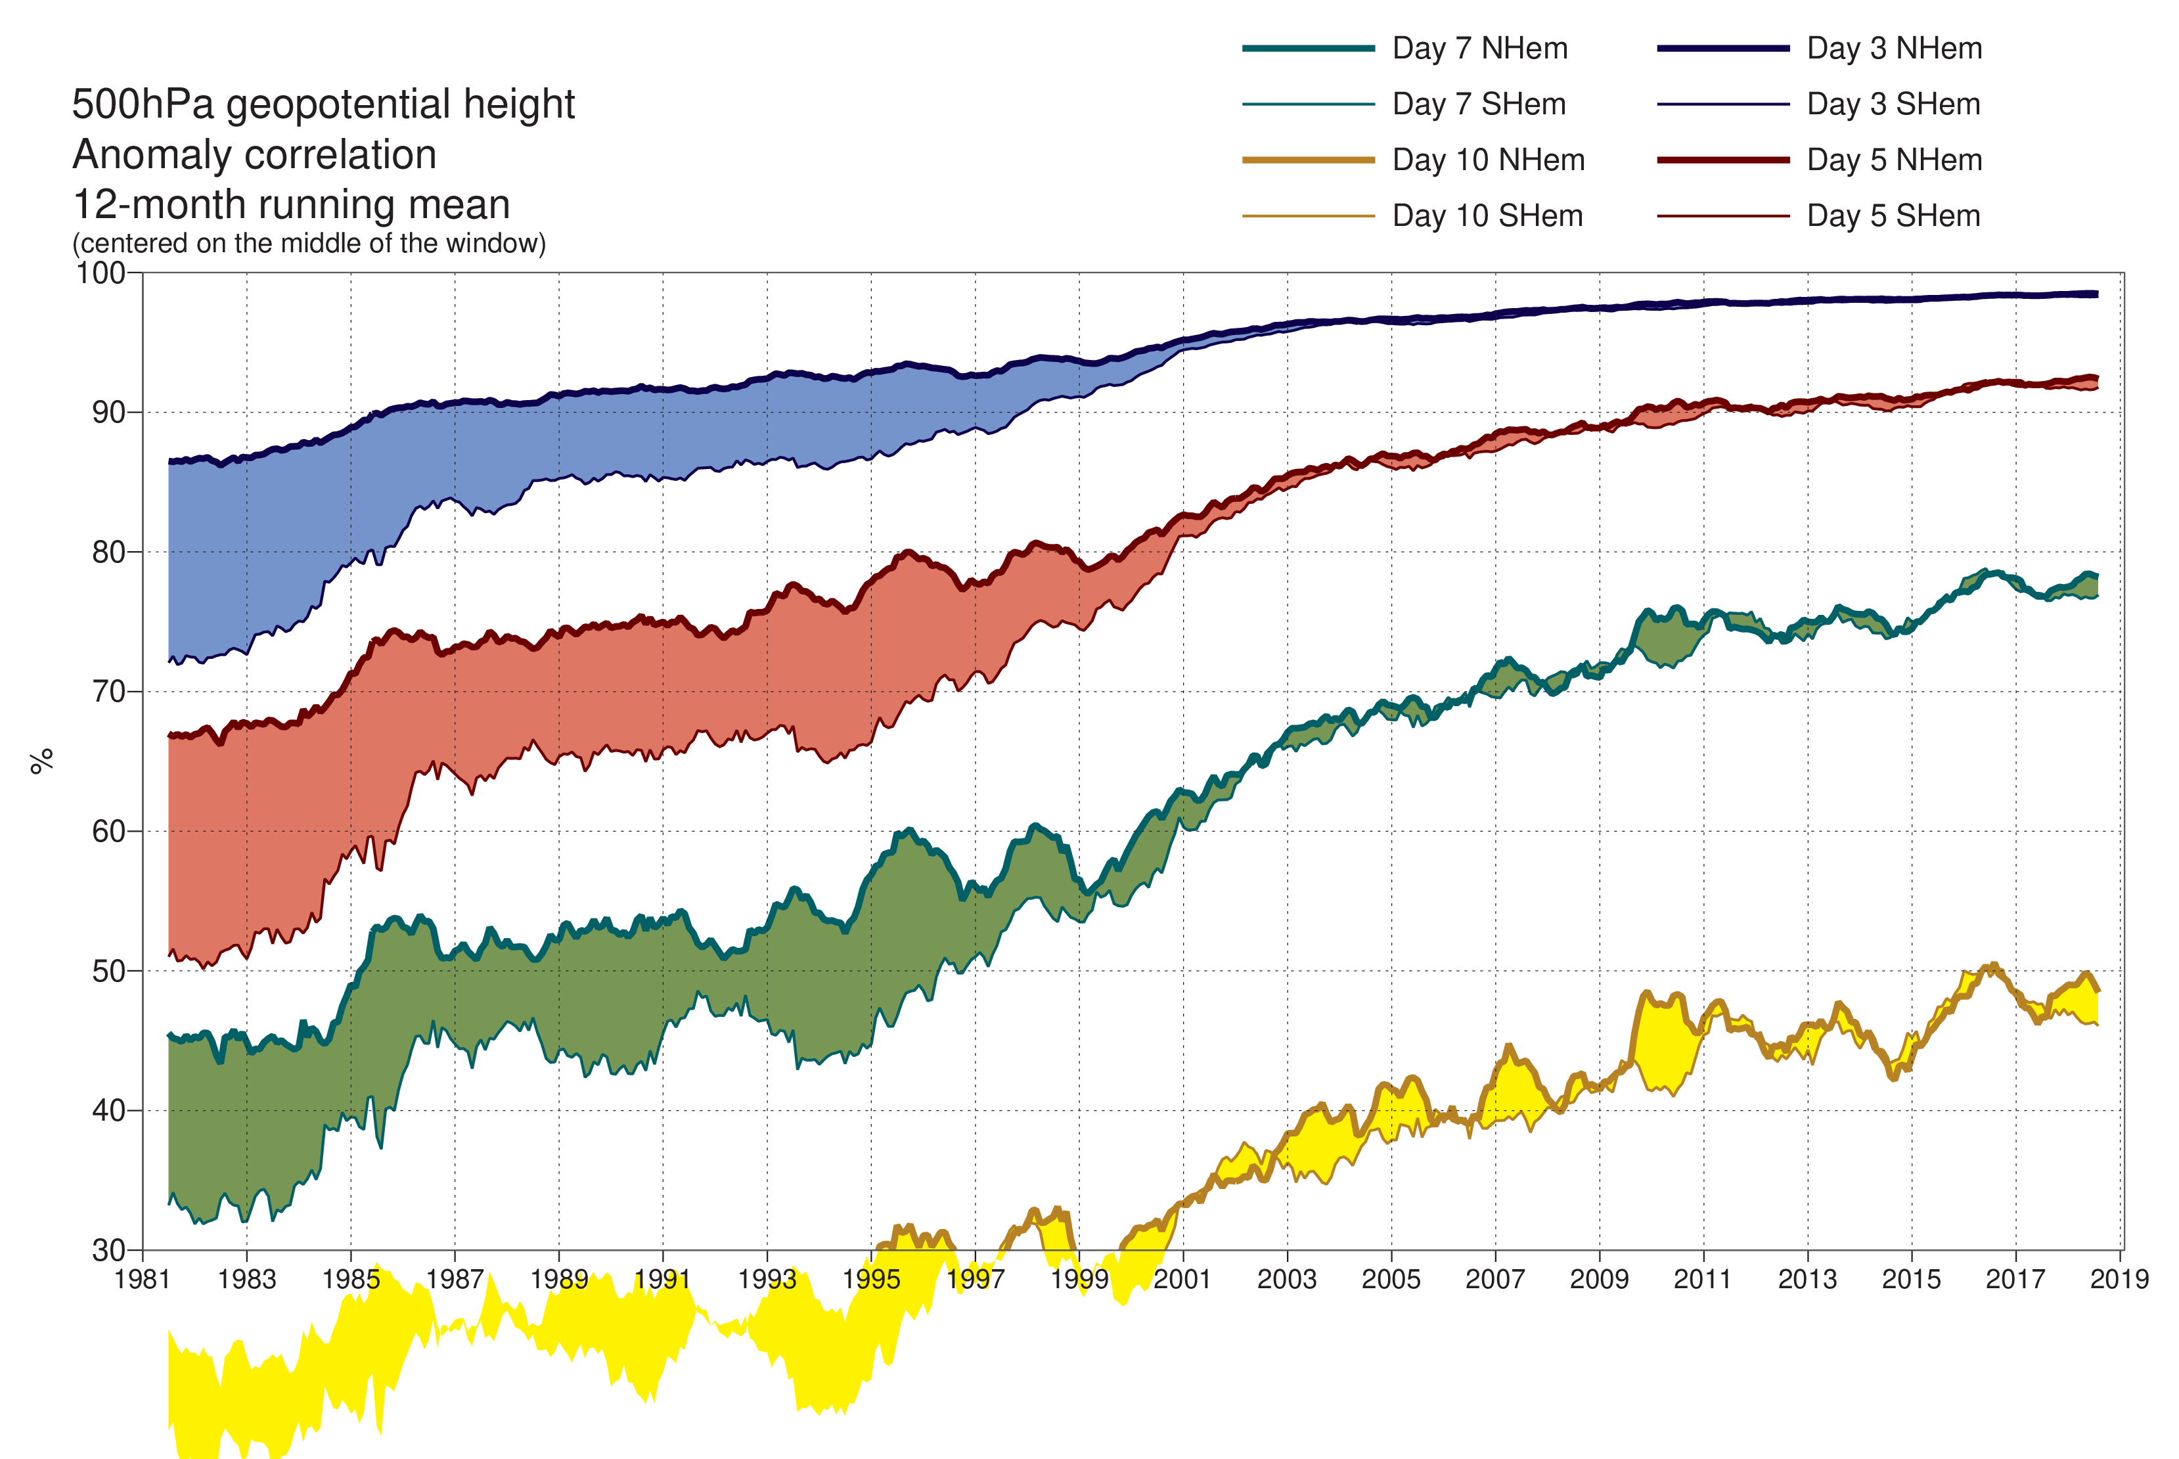
ECMWF’s core goal: maximising an objective function
Better
Day 3
Day 5
Quality of weather forecast
Day 7
Day 10
1981
2019
Time

Slide 3
Data assimilation for weather forecasting Variational minimisation of a cost function to blend short forecast and new observational data
Long forecasts
Physical model of the atmosphere (fluid dynamics, thermodynamics, …)
4D-Variational data assimilation: Bayes theorem with Gaussian error assumption
Data assimilation
Data assimilation
Data assimilation
Short forecast
Short forecast
Observations, physical forward models (radiative transfer theory)
Observations
Observations
Observations
Time
09 UTC
21 UTC
09 UTC
21 UTC

Slide 4
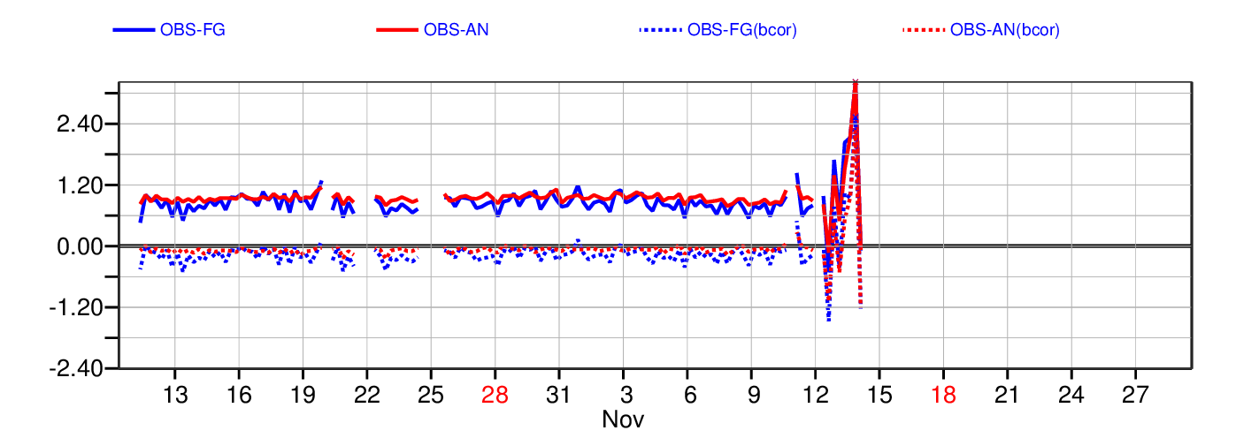
What can AI techniques bring?
1. Computational efficiency savings
Replace physically-based models with more-efficient neural networks (NN)?
2. Do new things
Satellite monitoring and quality control
Data assimilation, observation operators, bias correction
Learn model components
Model physics – clouds, precipitation, turbulence, gravity wave drag, radiation
Model error estimation
Downstream postprocessing of the forecast
3. Replace traditional numerical weather prediction entirely?
How soon can we detect SAPHIR going wrong and apply quality control?
Bias [K]
Oct 2018
Nov 2018

Slide 5
What can AI techniques bring?
1. Computational efficiency savings
Replace physically-based models with more-efficient neural networks (NN)
2. Do new things
Satellite monitoring and quality control
Data assimilation, observation operators, bias correction
Learn model components
Model physics – clouds, precipitation, turbulence, gravity wave drag, radiation
Model error estimation
Downstream postprocessing of the forecast
3. Replace traditional numerical weather prediction entirely?

Slide 6


Ambitious science goals, e.g. Move ensemble forecasts from the current 18 km resolution, to 5km
New science goals leading to increased cost
$$×$$
Computational efficiency savings or cheaper methods
$$≤$$
Increasing supercomputer capacity

Slide 7
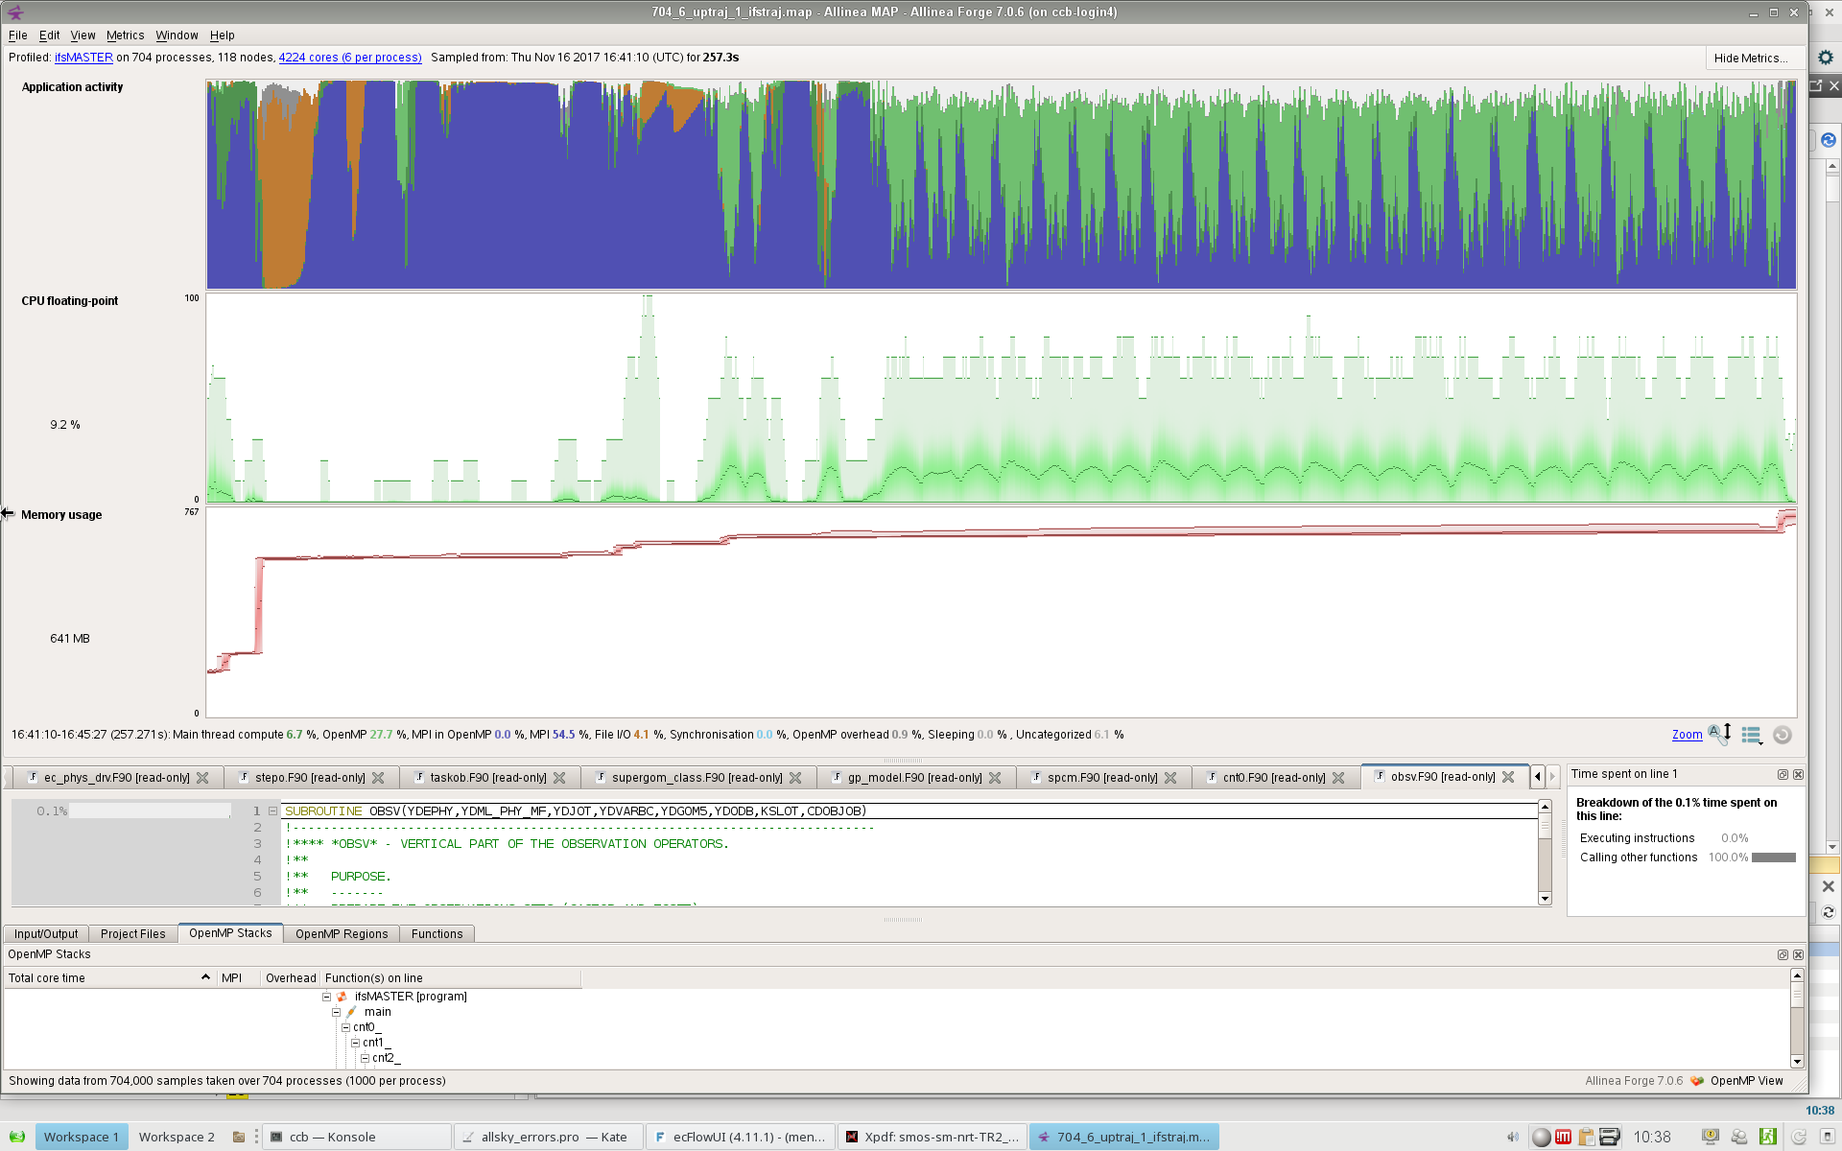
9km forecast model in data assimilation “outer loop” Operational cycle 43r3 configuration: 704 parallel processes with 6 CPUs each
Nonlinear forecast and compute observation equivalent
Setup
100%
0%
Time: 0
Time: 4 mins 30 secs
File I/O
Communication
Compute
Idle CPUs

Slide 8
9km forecast model in data assimilation “outer loop” Operational cycle 43r3 configuration: 704 parallel processes with 6 CPUs each
Nonlinear forecast and compute observation equivalent
Cost breakdown by activity
Model physics | 26%
Store trajectory | 17%
Model dynamics | 12%
Coupled wave model | 12%
Others | (30%)
Observation equivalents | 1.8%
Single column “embarrassingly parallel” compute
Communication-dominated
Of which:
1.6% communication: moving data to observation locations
0.2% compute: observation forward models are already fast

Slide 9
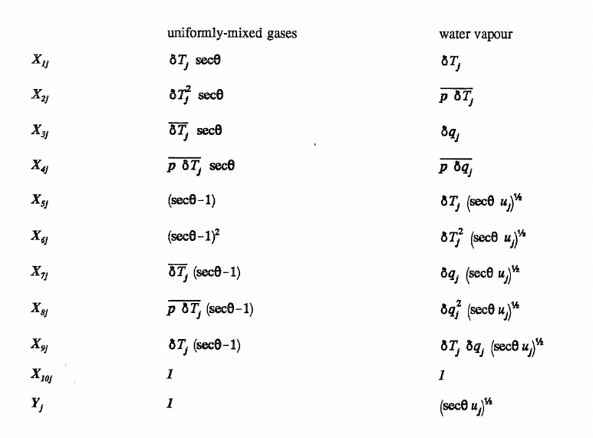
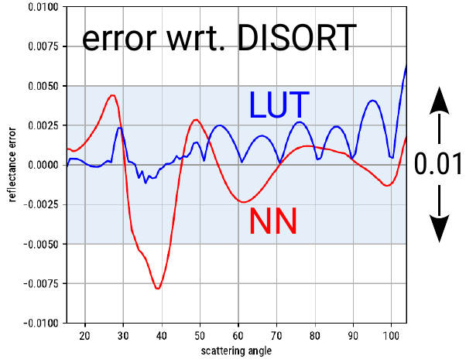
Fast radiative transfer for observation operators – RTTOV Developed by the EUMETSAT NWP-SAF combining UK Met Office, Météo France, ECMWF and DWD
Fast approximations fitted to reference physical models, using a training dataset:
Linear regression of optical depths
- against carefully chosen predictors
Principal components (optional)
+ improved extrapolation using Gaussian kernels
Neural networks (research)
All-sky solar scattering radiative transfer currently uses an 8 dimensional lookup table (MFASIS, Scheck et al., 2016, JQSRT)
Try replacing LUT with 5 layer NN, 26 nodes each
Eyre, 1991, ECMWF TM 176
Havemann et al. (2018, JQSRT)
Current work of Leonhard Scheck at DWD
10 GB
30 kB

Slide 10
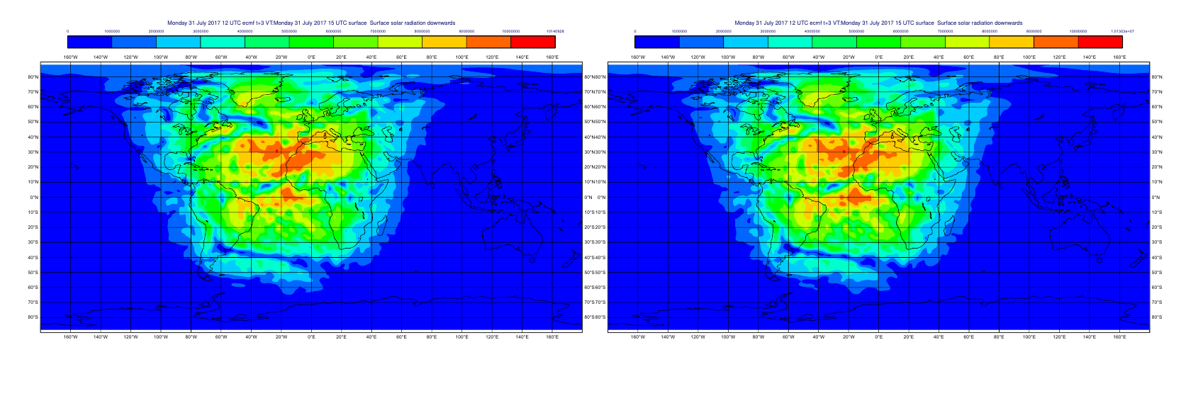
Replacing physics parametrisations in the forecast model Current work of Jakob Progsch, Christoph Angerer from NVIDIA and Peter Dueben, Robin Hogan, Peter Bauer from ECMWF
Downward shortwave (solar) radiation at the surface
Physically-based model NN trained on model
Vertically resolved heating/cooling rate profiles are also critical
But there is not always such good emulation of radiative flux profile, particularly in vicinity of clouds

Slide 11
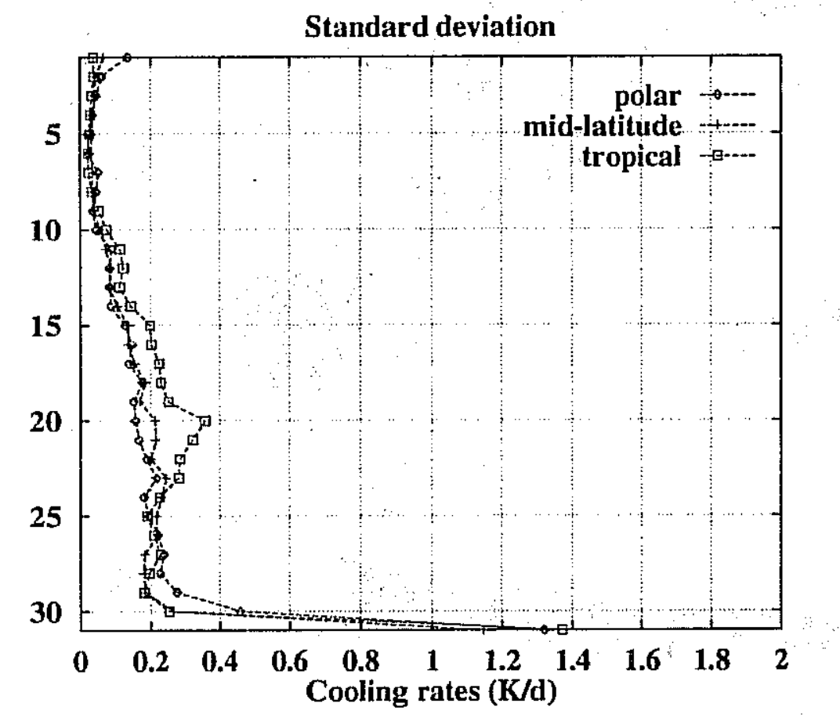
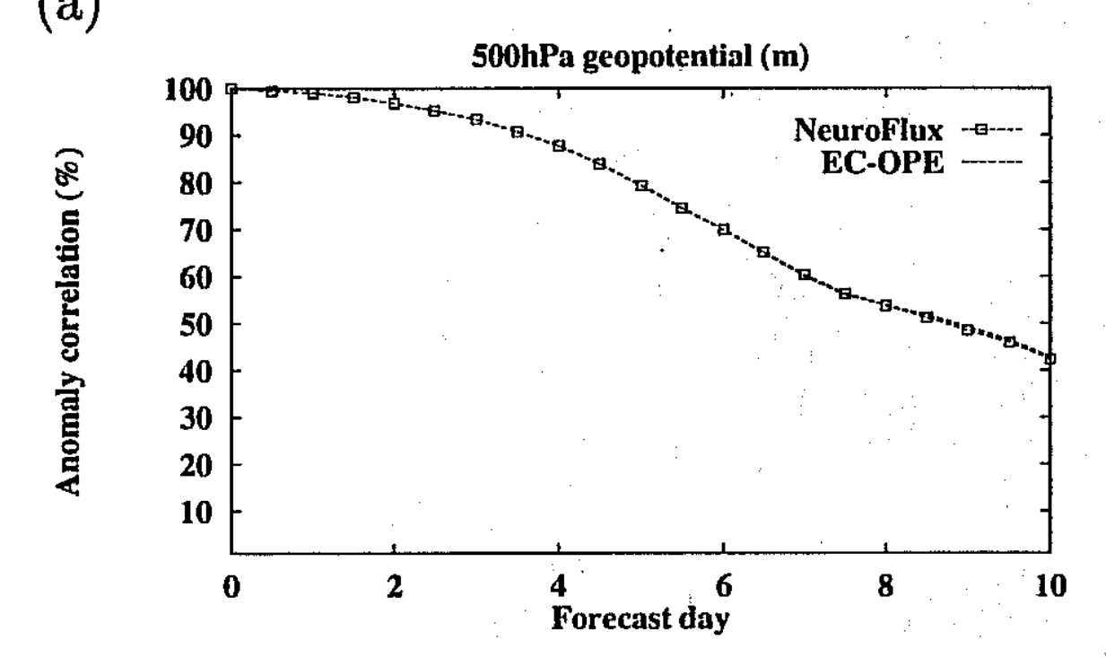
Replacing physics parametrisations in the forecast model
Chevallier et al. (1999 ECMWF TM 276 ) “Use of a neural network-based longwave radiative transfer scheme at ECMWF”
6000 profile training dataset
7 times speedup
Physics-aware NN designed to fit within the physical problem (inside the cloud overlap):
2 NNs, 1 each for up and down clear-sky fluxes
2 x N(layers) NNs for up and down cloudy fluxes
Cooling rate errors:
Stddev (NN – physical model)
Forecast errors: nearly identical with NN or physical scheme
Model level

Slide 12
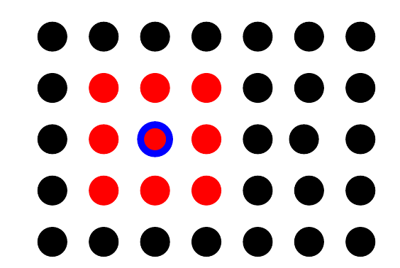
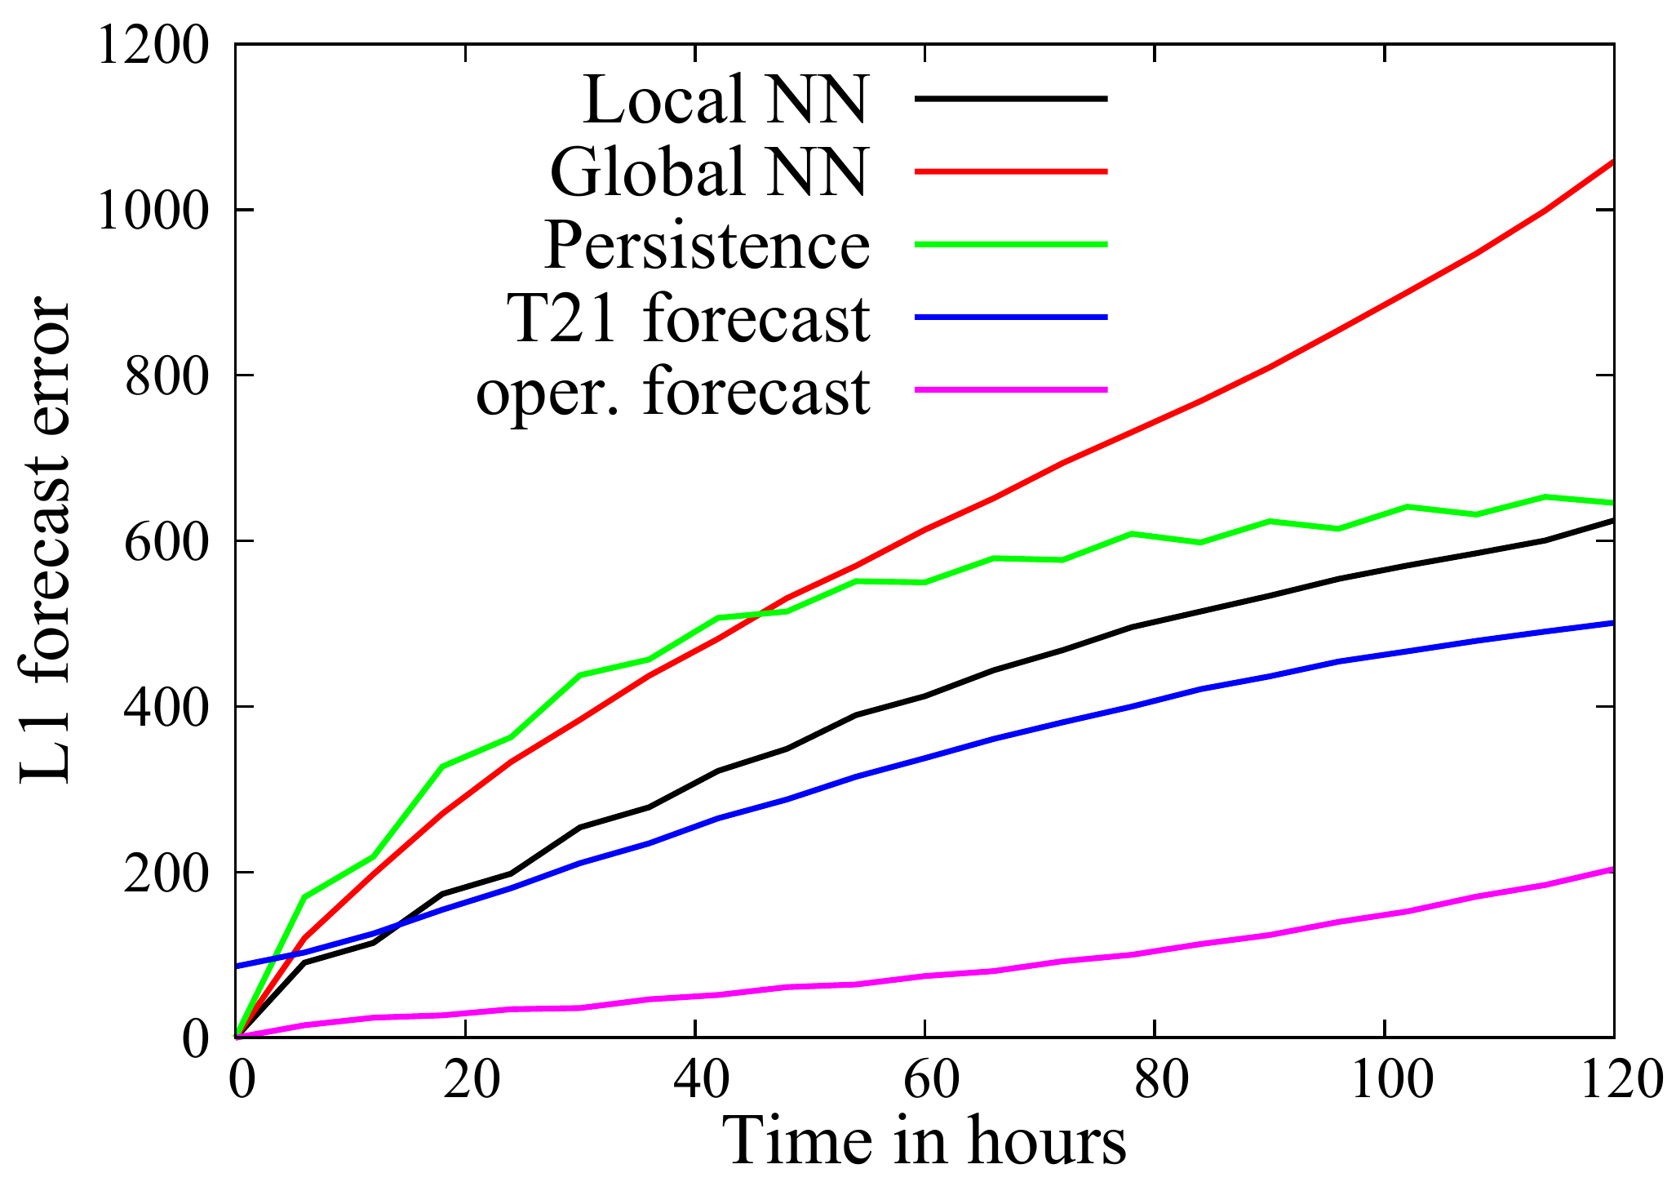
Replace the atmospheric dynamics
Dueben and Bauer (2018, GMD, https://doi.org/10.5194/gmd-11-3999-2018)
Can NN replace the physically-based 500hPa geopotential height forecast?
6 degree resolution single-level training
Best results with local stencil (not global) approach
Local NN only slightly worse than a T21 (1000km resolution) forecast model
But this is the real target: TCo1279 (9km) forecast model with around 10¹⁰ state vector size

Slide 13
What can AI techniques bring in improving efficiency?
Fast modelling:
Traditional: linear regression, LUT and principal components
New opportunities with ML, NN
How to do fast modelling?
Replace the whole model
E.g. Atmospheric profiles in → TBs / heating rates out
Replace key components within a physically-based model
E.g. RTTOV gas optical depths, solar reflectivity lookup table
Currently more success with “physically aware” use of traditional and ML data reduction techniques, within physical framework models
Challenge for ML: can it more directly replace physical models (e.g. fluid dynamics, radiative transfer)?

Slide 14
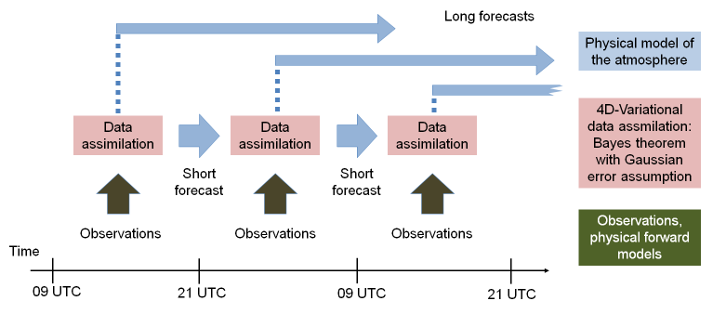
What new things can we do with AI techniques?
Replace traditional weather forecasting (NWP) entirely?
Just hang on a moment – how different are data assimilation and machine learning anyway?
AI techniques and the overlap with data assimilation have been exciting interest for years – e.g. Hsieh and Tang (1998, BAMS)
Also see Peter Jan van Leeuwen’s talk on Wednesday: “Machine learning meets data assimilation”

Slide 15
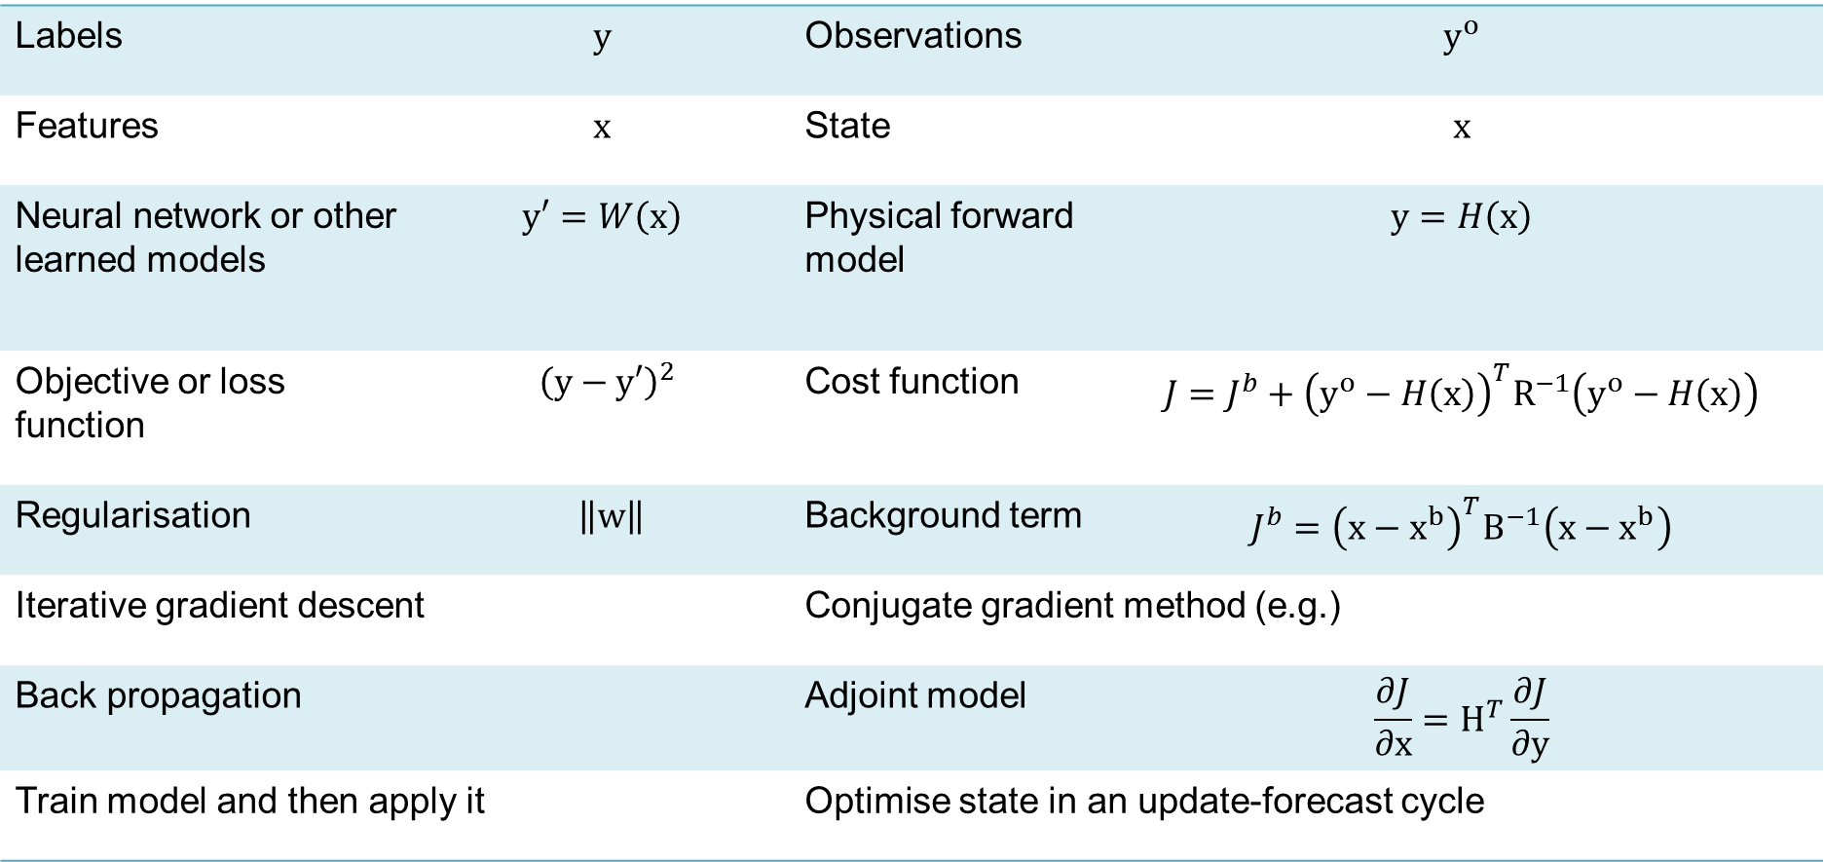
Machine learning (e.g. NN) Variational data assimilation
Labels | $$y$$ | Observations | $$y^{o}$$
Features | $$x$$ | State | $$x$$
Neural network or other learned models | $$y′=W\left(x\right)$$ | Physical forward model | $$y=H\left(x\right)$$
Objective or loss function | $${\left(y−y′\right)}^{2}$$ | Cost function | $$J={J^{b}+{\left(y^{o}−H\left(x\right)\right)}^{T}R}^{−1}\left(y^{o}−H\left(x\right)\right)$$
Regularisation | $\left\|w\right\|$ | Background term | $$J^{b}={{\left(x−x^{b}\right)}^{T}B}^{−1}\left(x−x^{b}\right)$$
Iterative gradient descent |  | Conjugate gradient method (e.g.)
Back propagation |  | Adjoint model | $$\frac{∂J}{∂x}=H^{T}\frac{∂J}{∂y}$$
Train model and then apply it |  | Optimise state in an update-forecast cycle

Slide 16
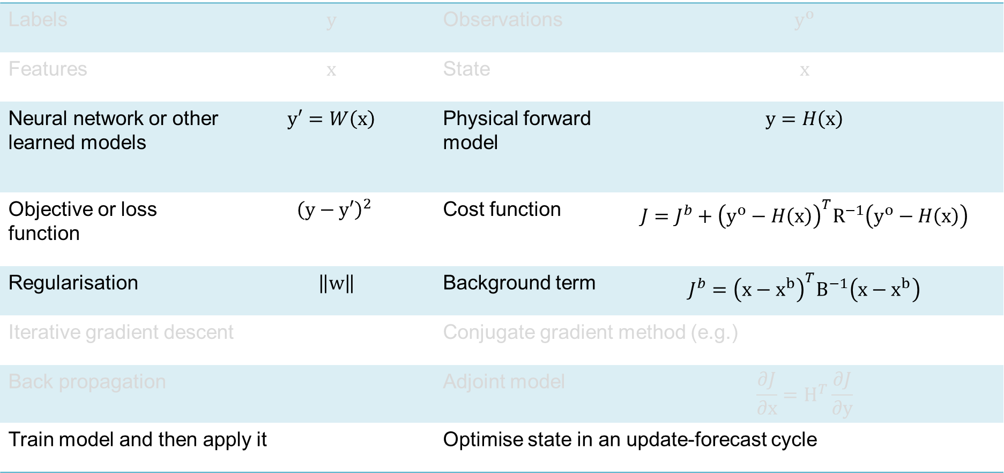
Machine learning (e.g. NN) Variational data assimilation
Labels | $$y$$ | Observations | $$y^{o}$$
Features | $$x$$ | State | $$x$$
Neural network or other learned models | $$y′=W\left(x\right)$$ | Physical forward model | $$y=H\left(x\right)$$
Objective or loss function | $${\left(y−y′\right)}^{2}$$ | Cost function | $$J={J^{b}+{\left(y^{o}−H\left(x\right)\right)}^{T}R}^{−1}\left(y^{o}−H\left(x\right)\right)$$
Regularisation | $\left\|w\right\|$ | Background term | $$J^{b}={{\left(x−x^{b}\right)}^{T}B}^{−1}\left(x−x^{b}\right)$$
Iterative gradient descent |  | Conjugate gradient method (e.g.)
Back propagation |  | Adjoint model | $$\frac{∂J}{∂x}=H^{T}\frac{∂J}{∂y}$$
Train model and then apply it |  | Optimise state in an update-forecast cycle
1: Model
2: Statistical basis
3: Application

Slide 17
Convergence
Machine learning
Data assimilation
1. Model | Train or incorporate a physical (differential equation) model |  | Include NN components in physical models
2. Statistical basis | Are there more rigorously formulated Bayesian versions of machine learning? (Yes – e.g. RM Neal, “Bayesian learning for neural networks”, PhD thesis, 1995) But does Bayes approach mean the same thing in ML and DA? |  | Bayes theorem underlies data assimilation. As applied in NWP: Incorporates uncertain prior knowledge (from earlier observations and model) Constrains solutions according to physical knowledge from models Considers observation error
3. Application | Can machine learning be operated in a “continuous learning” (Bayesian update) mode? |  | Forecast model “training” is already a concept in data assimilation: “parameter estimation” Fully train a physical model (e.g. Bocquet et al., 2019, https://doi.org/10.5194/npg-2019-7: “Data assimilation as a deep learning tool to infer ODE representations of dynamical models”)

Slide 18
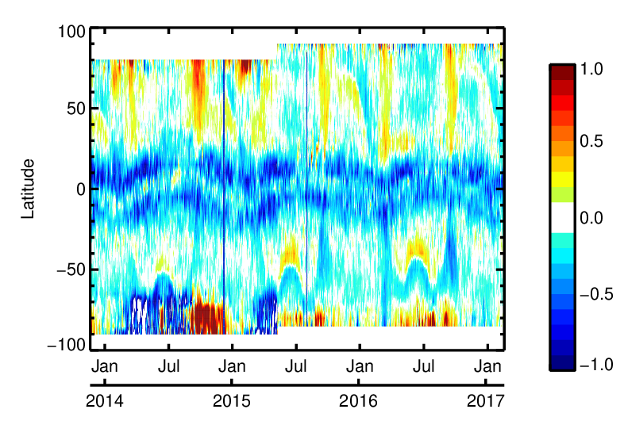
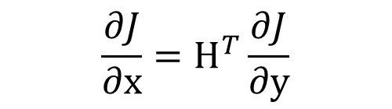
Initial goals for AI implementation within operational forecasting
Incorporate NN as an additional bias model (targeting either satellite bias or model errors) within variational data assimilation
Even if NN representations of forecast model components are not yet accurate enough to replace the physical nonlinear models, they and their back-propagation/adjoint models could replace hand-coded simplified TL and adjoint models
As a quick and efficient tool when developing new observation operators….
SSMIS channel 11 bias [K]
$$\frac{∂J}{∂x}=H^{T}\frac{∂J}{∂y}$$

Slide 19
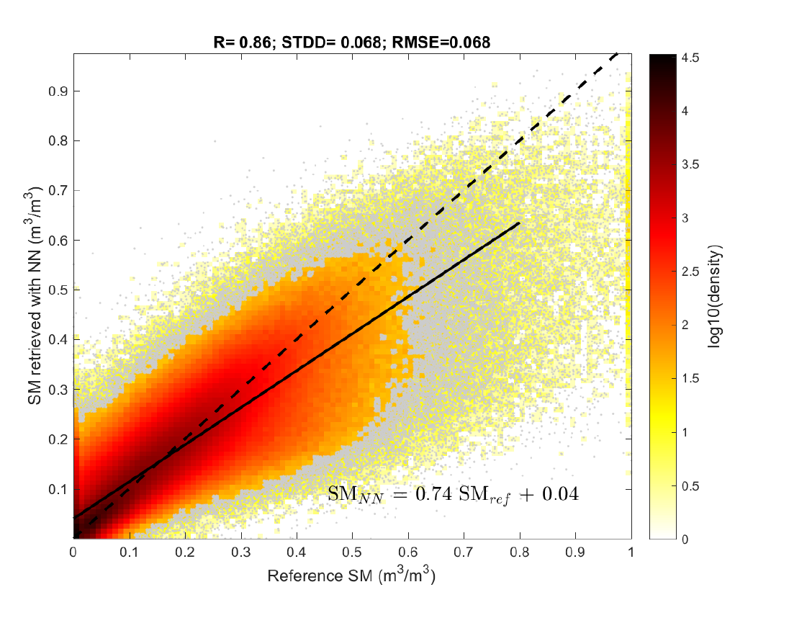
A NN-learned observation operator: SMOS soil moisture retrievals Work for ESA by N.J. Rodrı́guez-Fernández, P. de Rosnay, J. Muñoz-Sabater, …
SMOS: Soil Moisture and Ocean Salinity satellite
Original solution: train a NN on the L2 retrievals (so ultimately trained on a physical-based reference model)
Single hidden layer, 5 neurons, 13 inputs
Even better:
Train the same network using ECMWF soil moisture forecast against observed SMOS brightness temperatures
Unbiased with respect to ECMWF forecast model
To become operational at ECMWF with cycle 46r1, June 2019
No physically-based reference model needed!
Next step: learn inside the DA system, and so keep NN continually updated with knowledge from new observations

Slide 20
Conclusion: What can AI techniques bring to NWP?
Replace current numerical weather prediction?
Will fundamental computational issues in NWP also affect its AI challengers?
Hardest inefficiencies in NWP come from communication, not compute
Very high dimension (10¹⁰) chaotic systems
There exists a well-understood Bayesian framework for incorporating uncertain observations, prior knowledge and physical models: data assimilation
Very successful physical models (fluid dynamics, thermodynamics, radiative transfer)
Improve computational efficiency
ML adds to the toolbox of fast modelling (following lookup tables, regressions, PCs ...)
So far, judicious “physically aware” inclusion of ML seems to work better than throwing away the whole physical framework
Areas where reduced accuracy could be outweighed by speed and convenience:
Replace tangent-linear and adjoint models in variational data assimilation using ML models
Ensemble forecasting
Do new things: Learn what we do not already know
Learn model error, bias correction, sub-grid parametrisations, new observation operators
Apply ML within the existing Bayesian NWP observe-update-forecast cycle based on data assimilation
The most important question –
How to combine DA and ML?

Slide 21
Computational costs of operational forecasting Fractional, averaged over 2019. Taking on average 10% of the ECMWF Cray XC40 supercomputers (total 2 x 3600 nodes with 36 cores each)
4D-Var data assimilation | 12%
Ensemble 4D-Var data assimilation | 16%
Deterministic forecast to 10 days | 9%
Ensemble forecast to 15 days | 32%
Monthly forecast to 45 days, including calibration reforecasts | 26%
Others (FSOI, seasonal, …) | 5%

