Slide 1
AI FOR SCIENCE
DEEP LEARNING oN NVIDIA GPUS
FOR weather, climate, and space
David Hall Senior Solutions Architect, NVIDIA April 2019 dhall@nvidia.com
Notes:
My name is David Hall, and I am a solution architect for NVIDIA.
My job is to keep up with the latest advances in artificial intelligence, and to figure out how they may be adapted for scientific goals.
In this presentation, I will demonstrate that GPUs are becoming critical to high performance computing and explain why deep learning is emerging as an increasingly important tool for research.

Slide 2
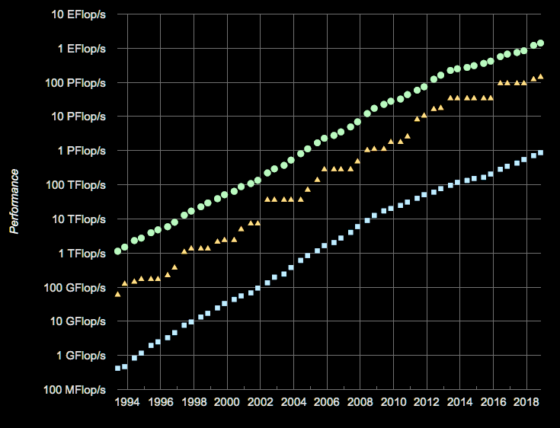
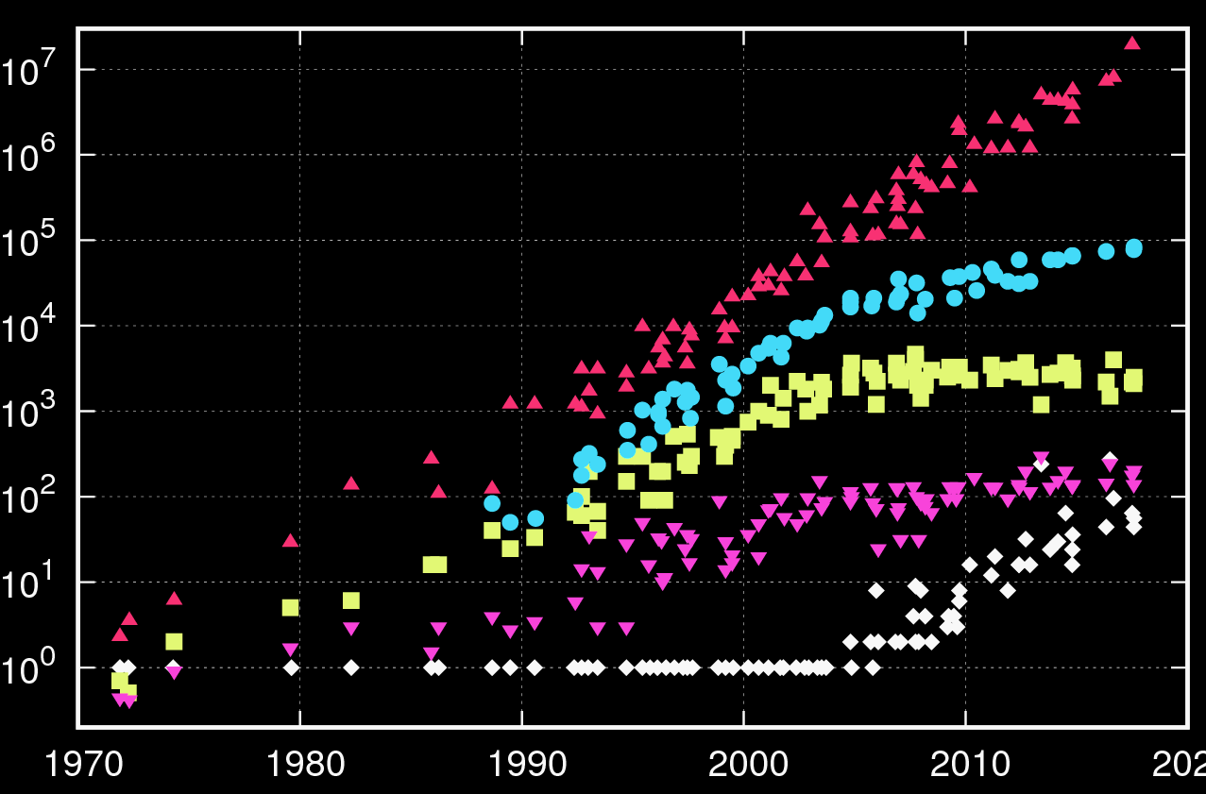

MOORE’S LAW IS DEAD. LONG LIVE MOORE’S LAW.
Exponential growth continues, via massive thread parallelism
Sum
#1
#500
CPU clock rates have plateaued
Single thread growth at 10% per year
Top supercomputers are bucking this trend
How? Through massive parallelism
Much of this is enabled by NVIDIA GPUs
ref: https://www.karlrupp.net/2018/02/42-years-of-microprocessor-trend-data/performance
Notes:
References
https://www.karlrupp.net/2018/02/42-years-of-microprocessor-trend-data/performance
https://www.top500.org/statistics/perfdevel/
As researchers, we come to expect exponential grow of computer performance.
Since 2005 cpu clock rates have plateaued and single thread performance growth has declined from 50%/yr to 10% per year.
Despite this, the top 500 list shows exponential growth continues unabated for the top supercomputers.
How is this possible? Through massive thread parallelism. In particular NVIDIA GPUs are providing much of this performance gain.

Slide 3
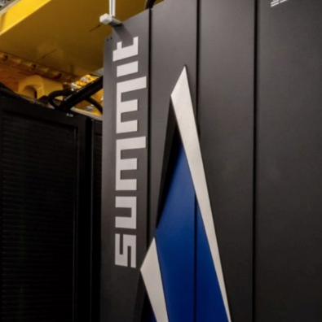
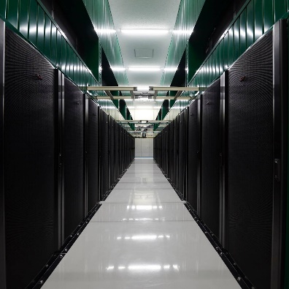
WORLD’S FASTEST SUPERCOMPUTERS
ARE POWERED BY NVIDIA GPUS
ORNL Summit
World’s Fastest
27,648 GPUs| 144 PF
LLNL Sierra
World’s 2nd Fastest
17,280 GPUs| 95 PF
Piz Daint
Europe’s Fastest
5,704 GPUs| 21 PF
ABCI
Japan’s Fastest
4,352 GPUs| 20 PF
ENI HPC4
Fastest Industrial
3,200 GPUs| 12 PF
Top supercomputers are loaded with GPUs
This trend is likely to continue
We need to learn to utilize them
Finding ways to exploit massive parallelism
Notes:
He were see the fastest machines in the US: summit sierra, and piz daint are loaded with 1000s of GPU accelerators, and this trend is likely to continue for the foreseeable future.
Therefore, it makes a lot of sense for researchers to learn to use these resources effectively. This means making use of algorithms that can take advantage of massive thread parallelism.

Slide 4
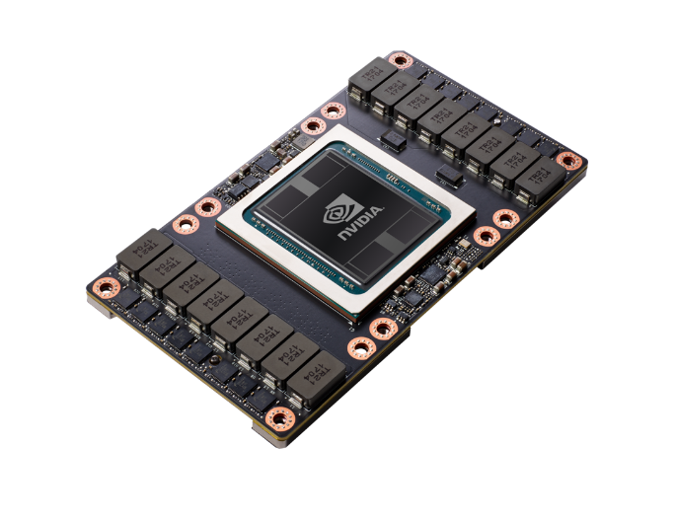
Five ROADS to GPU COMPUTING
GPU Libraries
______________
Drop-in replacement for existing libraries
cuBLAS, CUDA Math, cuSPARSE, cuRAND, cuSOLVER, nvGRAPH, cuDNN, cuFFT, Thrust
OPEN-ACC
______________
Comment-based
directives in
C / C++ / Fortran
Single source code parallelization for multiple architectures
CUDA
______________
Parallel Programming Model for GPUs in C, C++, Fortran, Python, MATLAB
Specialized Kernels for general purpose GPU
RAPIDS
______________
GPU Acceleration of
Traditional Machine Learning
Accelerate Scikit-Learn style ML algorithms
DEEP LEARNING
______________
GPU accelerated deep learning frameworks
TensorFlow, Pytorch
Build GPU-accelerated functions directly
from data
Notes:
https://www.nextplatform.com/2019/01/16/burying-the-openmp-versus-openacc-hatchet/
There are at least 5 roads to making effective use of GPUs. The first is to use GPU accelerated libraries as a drop in replacement for linear algebra and Fourier transform libraries.
The second is to add open acc directives to your c/c++/fortran code to actomatically parallelize loops. The third is to write custom CUDA kernels, which enable you to take full control of the GPU resources.
Additionally, you can use NVIDIA RAPIDS to accelerate traditional machine learning algorithms.
In the rest of this talk, however, I fill focus on the 5th approach which is the use of deep learning.

Slide 5
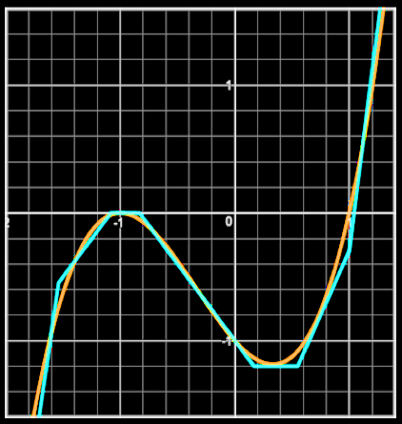
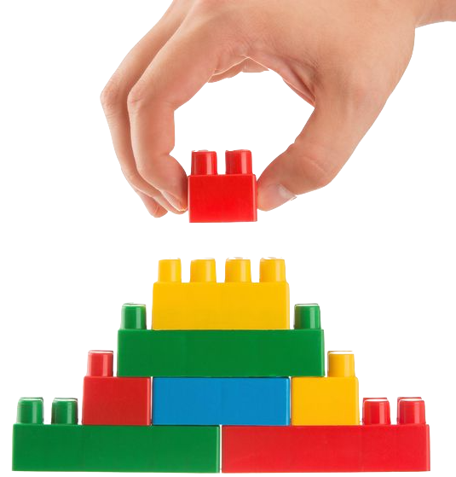
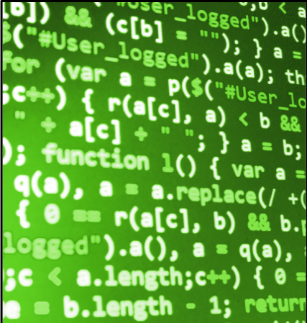



Deep learning = SOFTWARE, BY EXAMPLE
Supervised deep Learning builds functions from input/output pairs
Hurricane
Neural
network
$P_{h}=f$(obs)
HURRICANE
DETECTOR
Optimizer
Not Hurricane
Functions are the building blocks of software. DL can approximate any function.
DL builds complex functions from a set of examples.
Mix freely with conventional software and algorithms
Notes:
Supervised deep learning is a method for constructing functions by providing examples of its desired behavior, rather than coding up the solution by hand.
For example you can provide a neural network with thousands of images with or without a hurricane, and use this information to automatically construct a function that gives the probability that a new image is a hurricane.
As functions are the building blocks of software, deep learning can be viewed as a new general purpose tool for constructing software.
It has been shown that DL is a universal function approximator, which means that it can learn to do just about anything, given enough resources.
An advantage of this approach is it enables us to find functions that have proven too subtle or too complex for people to code by hand, and can save a lot of software development time.
We should not expect this approach to replace traditional software approaches. Rather, the two should be freely mixed, using both approaches to their best advantage.

Slide 6
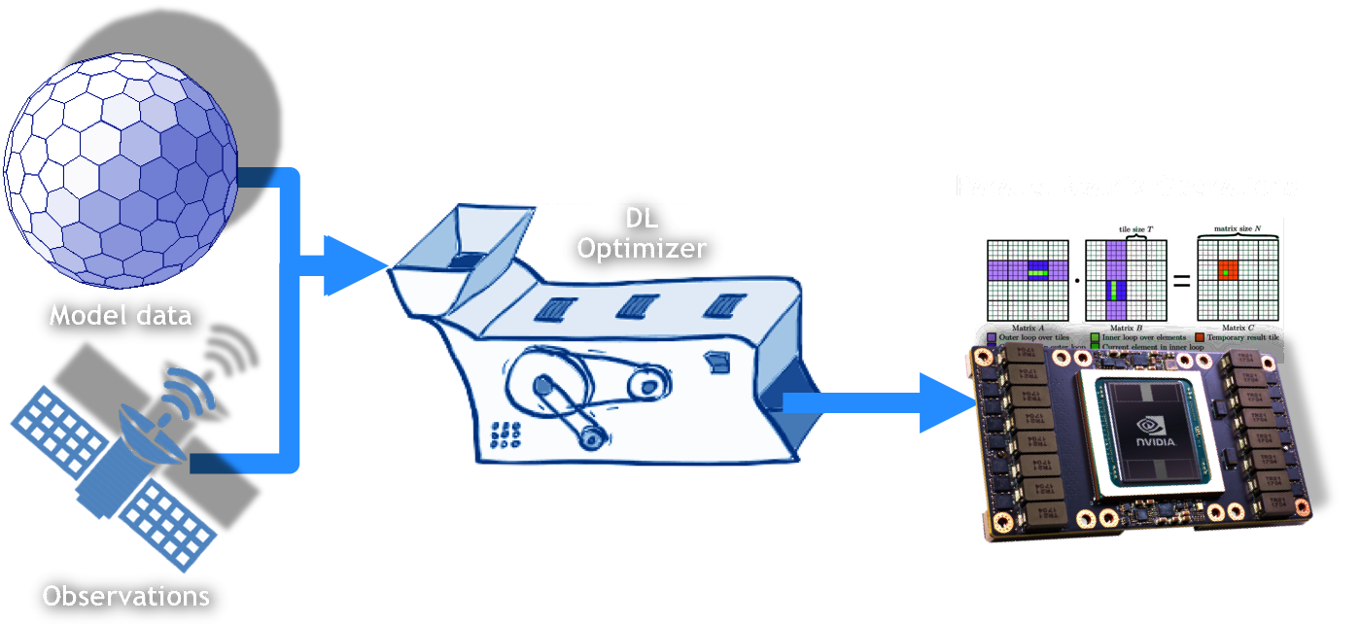
DEEP LEARNING is PERFECTLY SUITED to GPUS
Like a magic machine that converts your data into GPU-ready functions
If you can train a deep neural net to solve your problem,
you can take advantage of the GPU’s strengths
Notes:
The reason this technique is so promising, is that a deep neural network can emulate, or approximate pretty much any function, and in doing so it converts it to a series of dense matrix-matrix computations and simple nonlinear functions that can all be performed in parallel. Therefore, this is a technique for mapping a wide variety of functions onto the GPU without explicit coding. So, If you can train a neural net to solve your problem you can take advantage of the GPU’s strengths.

Slide 7
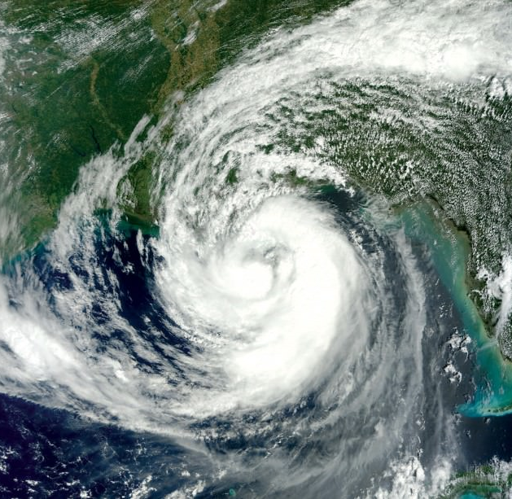
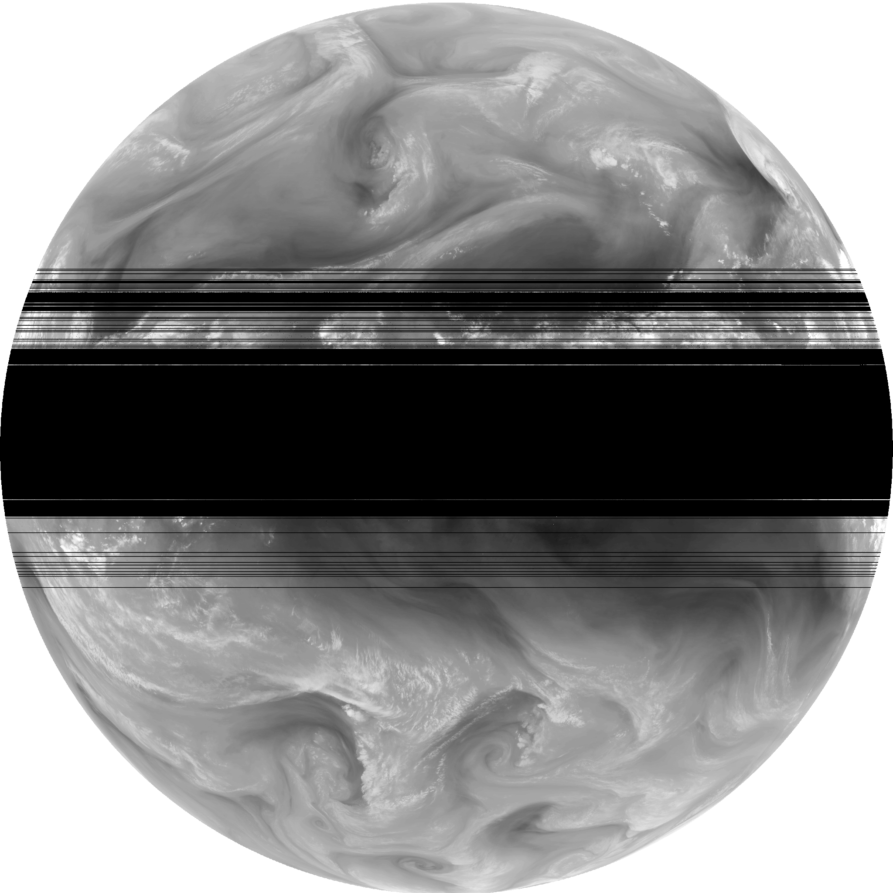
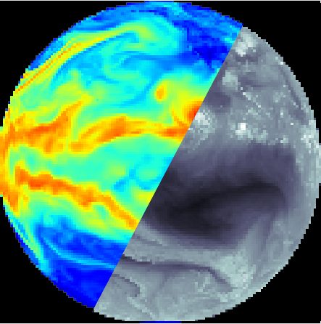
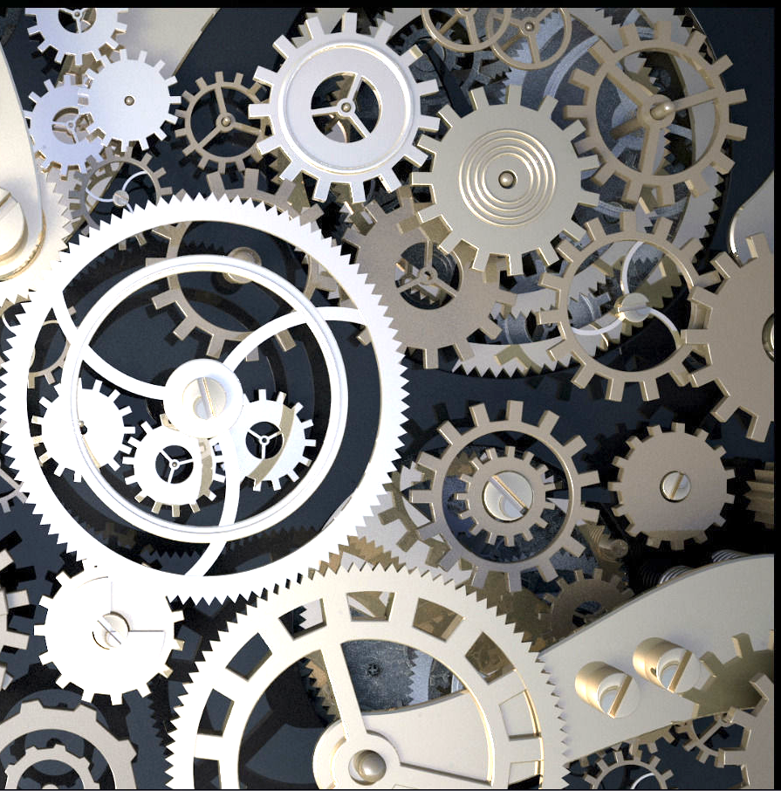
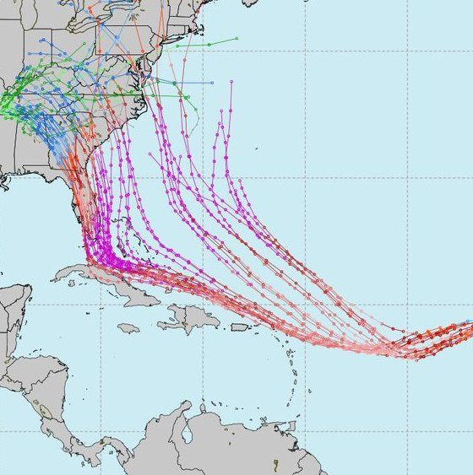
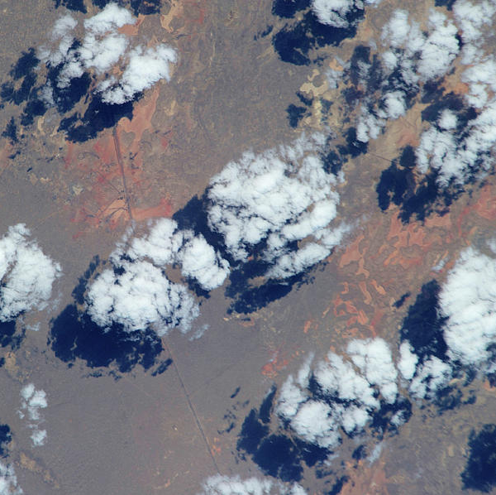
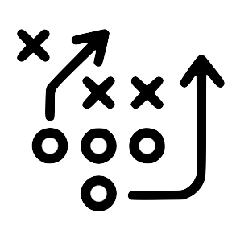
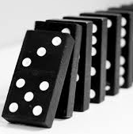

detection
ENHANCEMENT
Tropical storms, extreme weather
Forest fires
Impact craters
Exoplanet light curves
Coronal holes, sunspots, CMEs
Storm damage
Frame repair
Sequence repair
Slow motion
Super-resolution
Cloud removal
Data augmentation
translation
EMULATION
Data Assimilation
Forecast verification
Model intercomparison
Common data formatting
Colorization
Digital Elevation from Imagery
Physics Acceleration
Turbulence
Radiation
Convection
Microphysics
Dynamics Acceleration
prediction
PARAMETRIZATION
Uncertainty prediction
Storm track
Storm intensity
Fluid motion
Now casting
Satellite frame prediction
New parametrizations
From higher resolution model
From observational data
STRATEGY
DISCOVERY
Sensor placement
Instrument control
Adaptation and mitigation
Evacuation planning
Search & rescue
Performance tuning
Geoengineering
Correlation discovery
Hypothesis testing
Causality identification
Equations from data
ASSISTANCE
Natural language interfaces
Augmented reality
Guided analysis
Literature recommendations
Error detection
Notes:
What sorts of things can we do with deep neural networks? Many many things.
When brainstorming about ways to apply deep learning to NWP, I came up with a large list of ideas, which is growing all the time.
Potential applications include: detection of extreme weather events, enhancement and repair of satellite data, satellite to model variable conversion for data assimilation, automated acceleration of expensive routines using neural-net emulation, time series prediction for now-casting or storm tracking, and the development of improved physical parameterizations from data.

Slide 8
detection
ENHANCEMENT
Tropical storms, extreme weather
Forest fires
Impact craters
Exoplanet light curves
Coronal holes, sunspots, CMEs
Storm damage
Frame repair
Sequence repair
Slow motion
Super-resolution
Cloud removal
Data augmentation
translation
EMULATION
Data Assimilation
Forecast verification
Model intercomparison
Common data formatting
Colorization
Digital Elevation from Imagery
Physics Acceleration
Turbulence
Radiation
Convection
Microphysics
Dynamics Acceleration
prediction
PARAMETRIZATION
Uncertainty prediction
Storm track
Storm intensity
Fluid motion
Now casting
Satellite frame prediction
New parametrizations
From higher resolution model
From observational data
STRATEGY
DISCOVERY
Sensor placement
Instrument control
Adaptation and mitigation
Evacuation planning
Search & rescue
Performance tuning
Geoengineering
Correlation discovery
Hypothesis testing
Causality identification
Equations from data
ASSISTANCE
Natural language interfaces
Augmented reality
Guided analysis
Literature recommendations
Error detection
Notes:
Other applications include automated strategy for control of scientific instruments or evacuation planning, AI assisted discovery for automated hypothesis testing, and AI assistance using spoken word interfaces our augmented reality.
I can’t discuss all of these here, but in the remainder of this presentation I will give and overview of some of the projects in which I am actively involved.

Slide 9
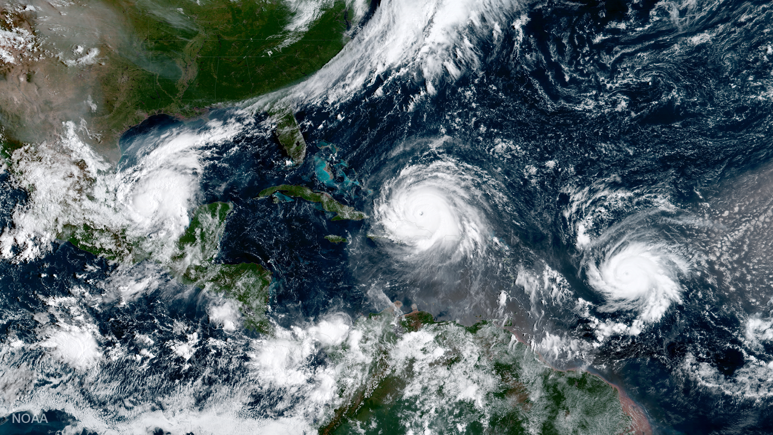
TROPICAL STORM
DETECTION
NOAA ESRL, NVIDIA
The quantity of data produced by models, satellites and other sensors has become impractical to analyze manually. AI can help by detecting important features, tends, and anomalies. Applications include storm tracking, data thinning, advanced warning systems, search and rescue, route planning, and more.
HURRICANE: CAT 2
HURRICANE: CAT 1
IMAGE CREDIT: NOAA NESDIS
Notes:
We are working with the ESRL group at NOAA to automated the detection of tropical storms and other high impact weather events in model and satellite data.

Slide 10
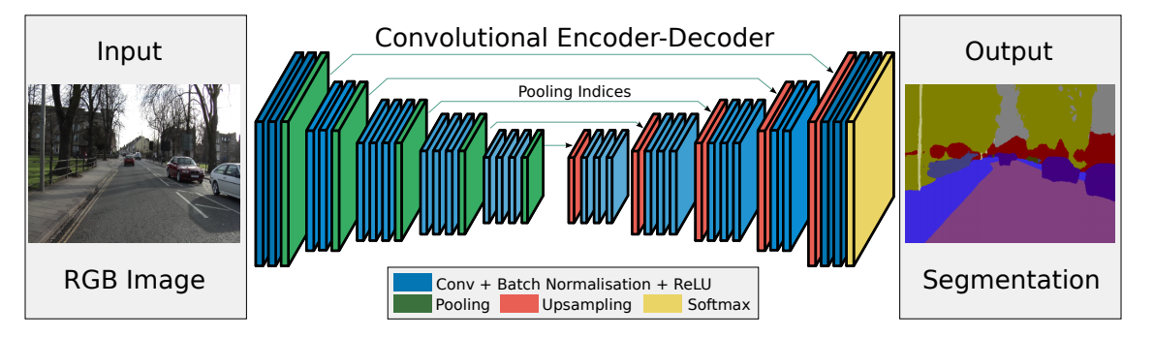
SEGMENTATION
segmentation at multiple scales using CNNs
GFS Model Data
Or GOES Satellite Observations
Storm Labels
Based on IBTracs
Storm detection is a segmentation task
Each pixel classified as 1 or 0
Accomplished with CNNs
Use UNET for multi-scale segmentation
Notes:
Training a NN to detect a given feature in spatial data can be viewed as a segmentation task where each pixel is classified as a 1 if it belongs to a storm or a 0 if it does not.
This type of segmentation can be accomplished with convolutional neural networks. In particular, we use a unet-style architect which is able to detect features at multiple spatial scales.

Slide 11
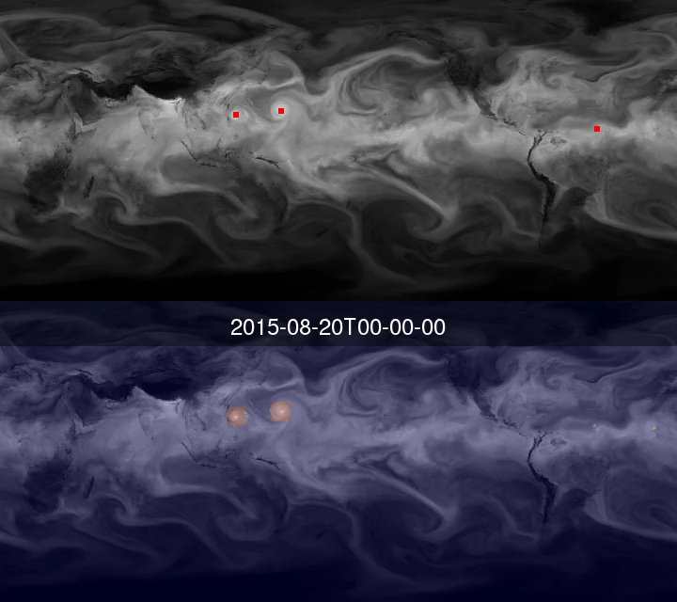
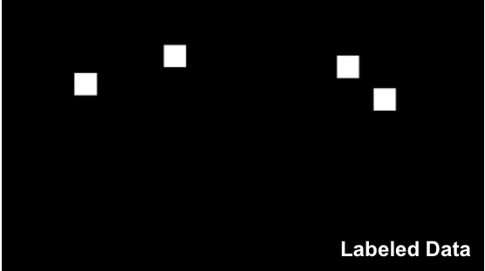
TROPICAL STORMS IN GFS MODEL DATA
Ground Truth
Jebb Stewart, Christina Kumler, Mark Govett NOAA
David Hall NVIDIA
INPUT | GFS PWAT + IBTRACKS
OUTPUT | DETECTION CONFIDENCE
TRAINING SET | 2010-2015
TEST SET | 2016
NETWORK | U-NET
TRAINING TIME | 500 hr CPU, 1.5 hr 8 GPUs
Prediction
Automatically detect future storms.
Storms defined implicitly by example.
See Christina Kumler’s Talk for More
Notes:
Here we see the results of applying DL to find tropical storms in GFS model data. We used the international best tracks database to label the GFS precipitable water vapor field. Then we trained a u-shaped convolutional neural network (U-Net) to identify tropical storms. Using 5 years of images, consisting of a few thousand storm examples, we were able to achieve accurate results.
Why would we train a neural network to do this? By training a neural network from examples, we avoid having to hard code some arbitrary heurist for a given storm type. Then it can automatically flag such storms without the need for human intervention.

Slide 12
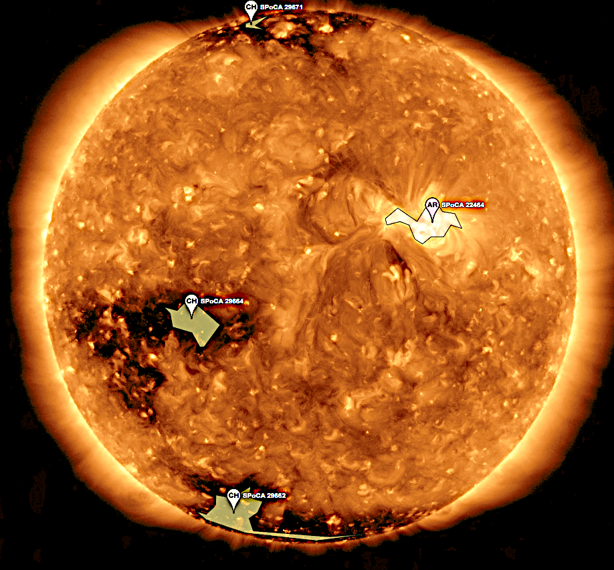
Solar activity
DETECTION
NASA Goddard, Altemere, NVIDIA
Parametric codes for classifying solar features are computationally expensive. So, only a very small fraction of solar data has been labelled. By using these labelled examples, were able to construct deep neural network capable of rapidly labelling the remaining images.
Notes:
A single neural net can be trained to perform many related tasks. The same unet network may be applied to identify features in solar observations.

Slide 13
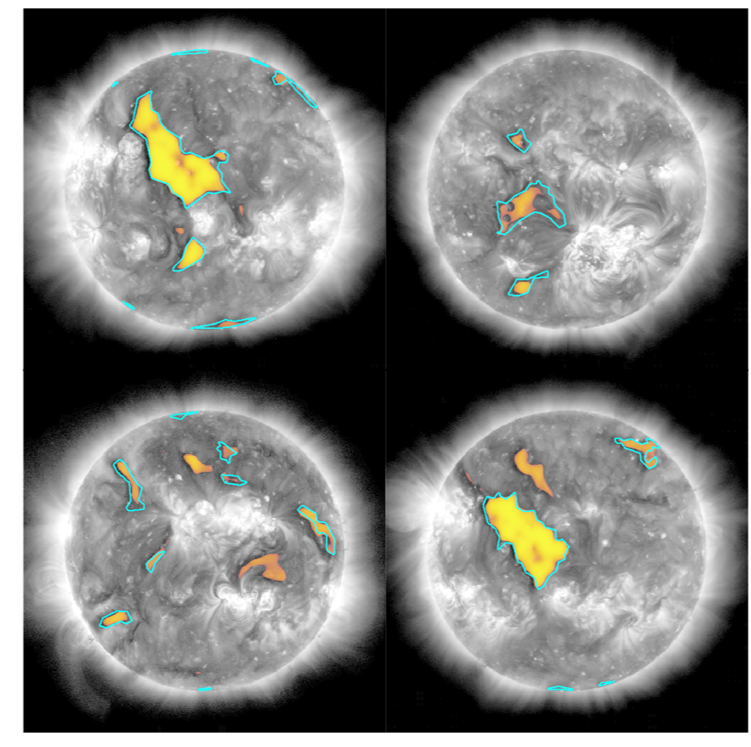
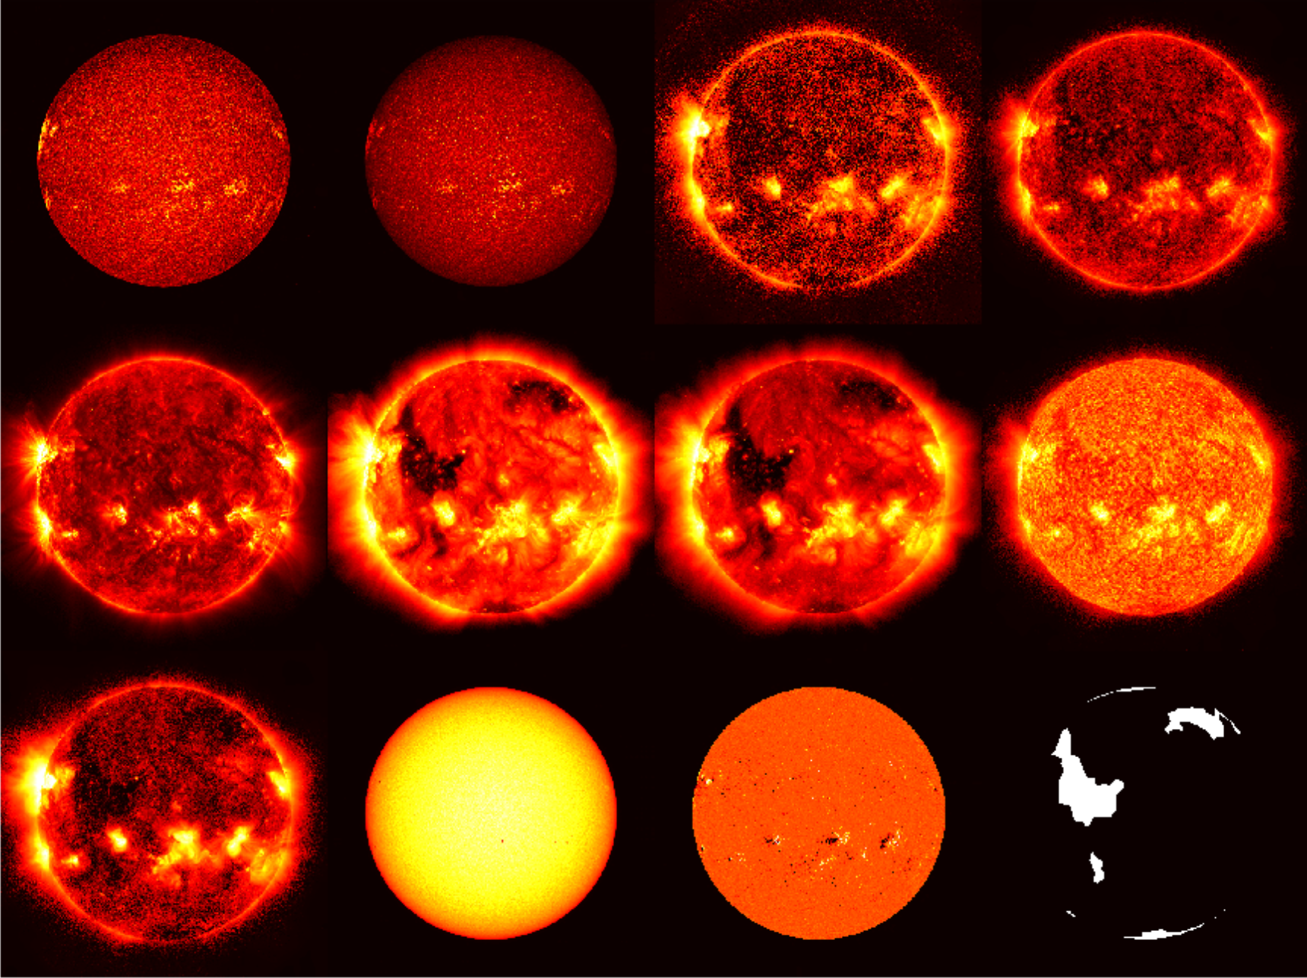
RESULTS:
CORONAL HOLES
Michael Kirk, Raphael Attie, Barbara, Thompson (NASA)
David, Hall (NVIDIA)
James Stockton, Matt Penn (Altamira)
INPUT | SDO AIA Image, HEK labels
OUTPUT | DETECTION CONFIDENCE
TRAINING SET | 2012 June,July: 232 images
TEST SET | 2012 June, July: 58 images
NETWORK | U-NET
TRAINING TIME | 15 minutes, 1 V100 GPU
Input
Preliminary results based on a few hundred images
Notes:
With only about 250 images per feature we can see that the NN is already doing a pretty solid job of detecting coronal holes. Blue line is ground truth. Color represents pixel-level confidence values.

Slide 14
RESULTS:
ACTIVE REGIONS
Michael Kirk, Raphael Attie, Barbara, Thompson (NASA)
David, Hall (NVIDIA)
James Stockton, Matt Penn (Altamira)
INPUT | SDO AIA Image, HEK labels
OUTPUT | DETECTION CONFIDENCE
TRAINING SET | 2012 June,July: 232 images
TEST SET | 2012 June, July: 58 images
NETWORK | U-NET
TRAINING TIME | 15 minutes, 1 V100 GPU
Input
Preliminary results based on a few hundred images
Notes:
It seems to do even better at detecting active regions.

Slide 15

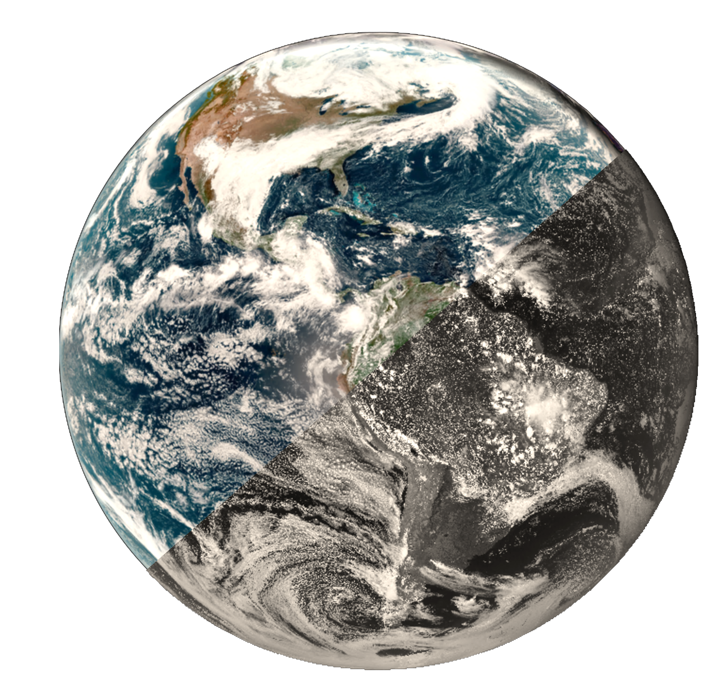
IMPROVED DATA
ASSIMILATION VIA
INVERSE MODELING
JCSDA, NVIDIA
Deep learning can automatically construct maps between any two related coordinate systems. This can be used to convert satellite observations into model variables, with applications to data assimilation. It also has the potential to enable us to combine information from multiple models or satellites into a single dataset of greater accuracy and completeness.
GOES-16 CIRA GEO COLOR / GOES-15 RED BAND
Notes:
We are working with the JCSDA to

Slide 16
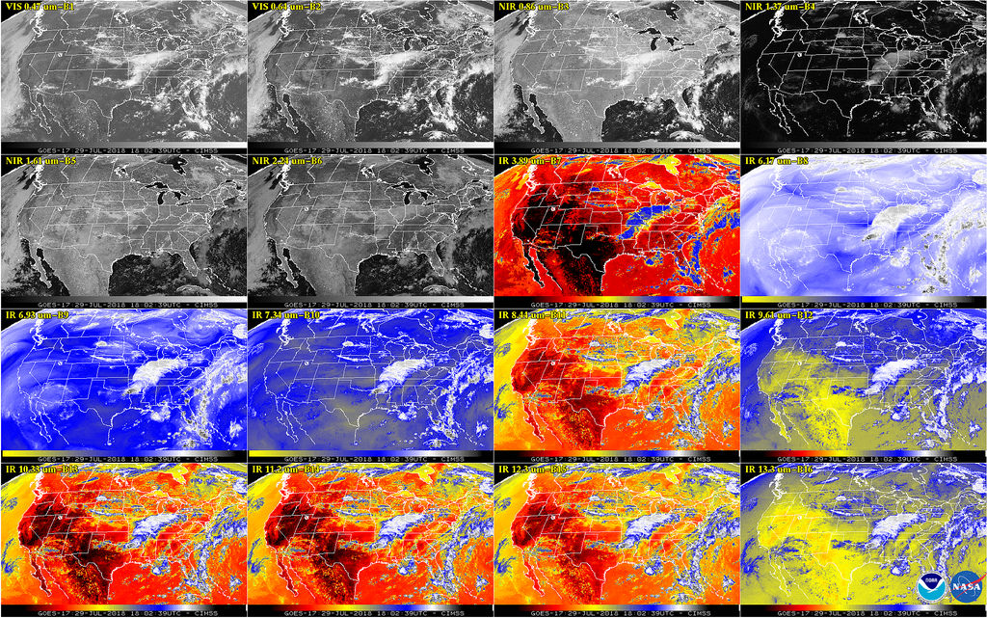
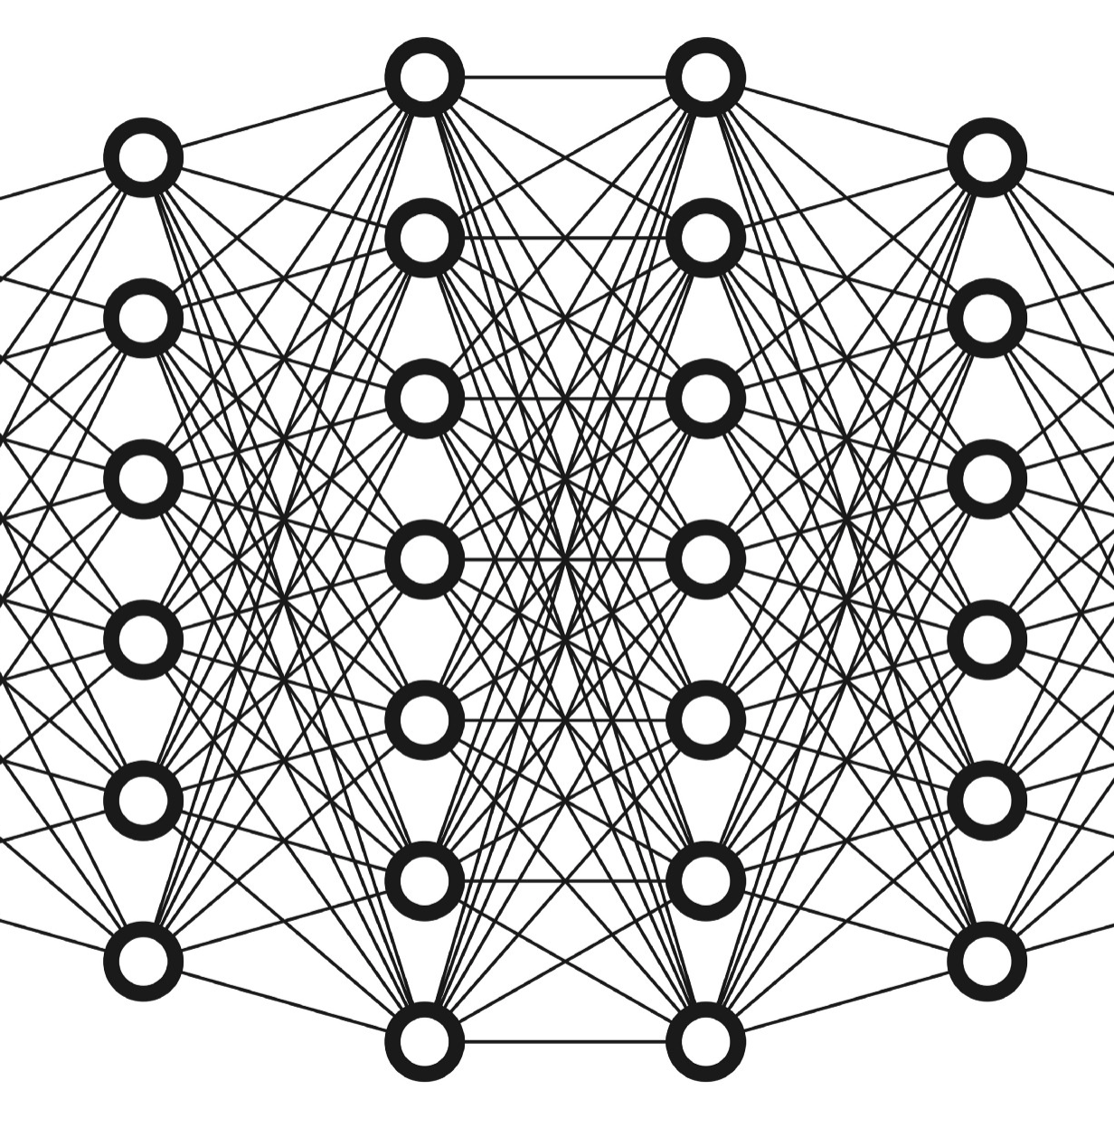
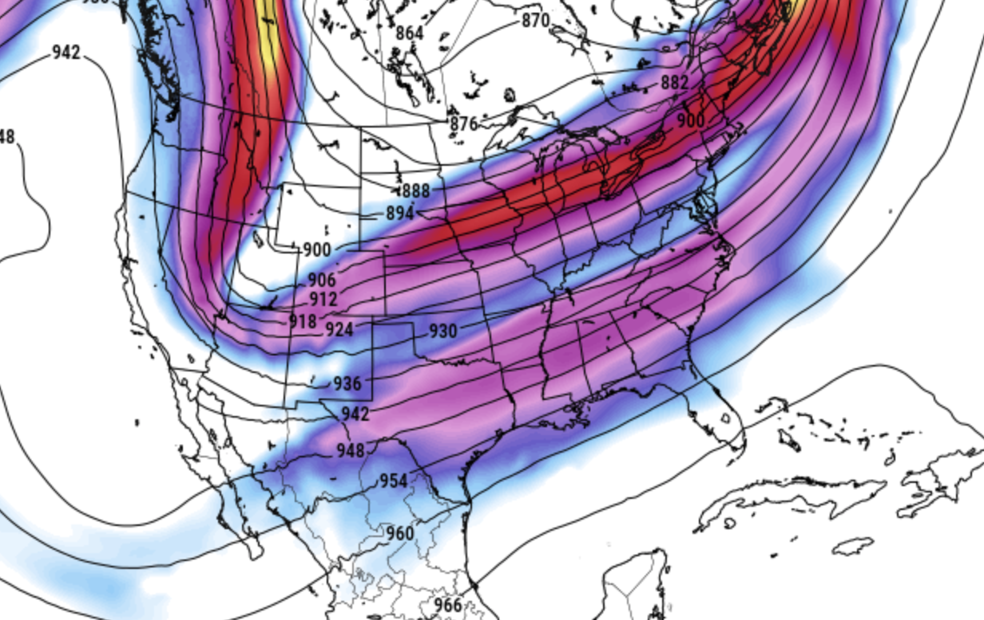
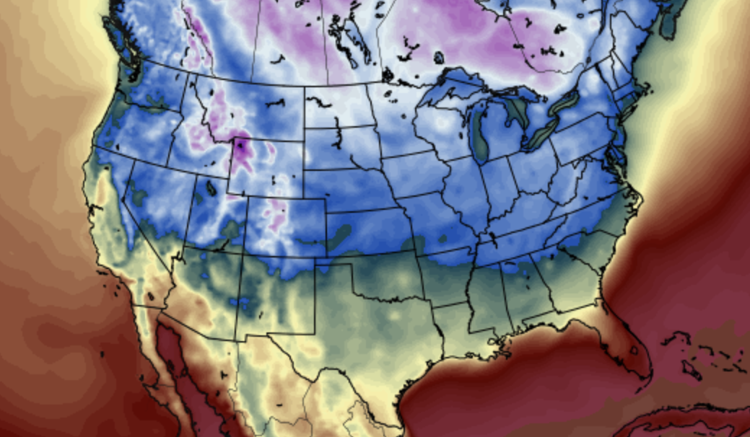
MAP: SATELLITE TO MODEL (INVERSE OPERATOR)
Satellite observations to model analyses
SATELLITE RADIANCES
Convolutional Neural Network
MODEL VARIABLES
Hard to construct an inverse model by hand, but no more difficult for a neural network than the forward model.
Notes:
A neural network can be used to perform the inverse operation as well. An inverse map is difficult to build by hand, but it is no more challenging than the forward operator, for a deep neural net.
Of course the original training data had to be generated using standard techniques, but once trained, the neural network can approximate this process at very high speed.

Slide 17
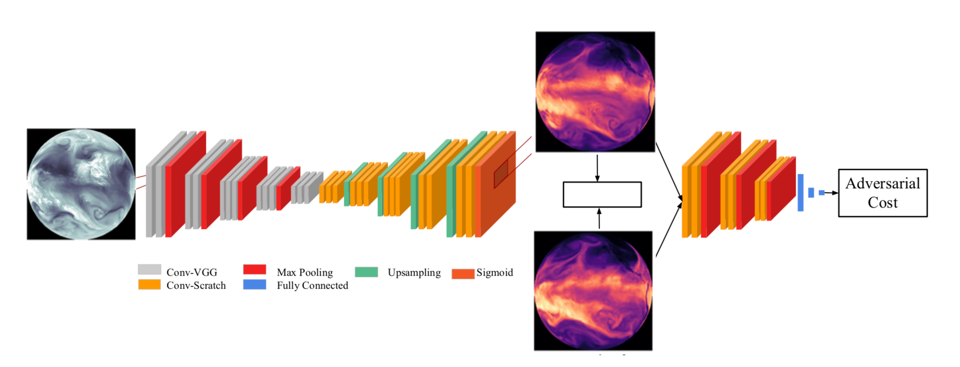
CONDITIONAL GANS
Generates output consistent with the training set
Generated
Generator
(Regressor)
Discriminator
(Classifier)
Loss fcn
Target
If the output is under-constrained your output will look fuzzy.
It won’t capture the true peaks and valleys
We can overcome this problem using a conditional GAN
Generates output matching the training set

Slide 18
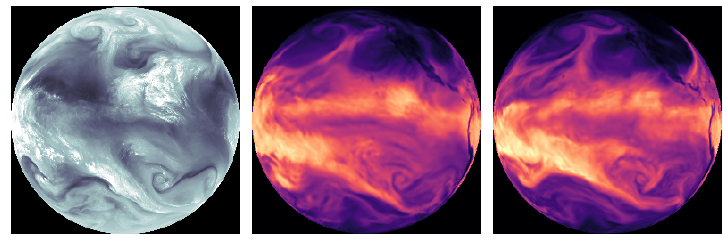
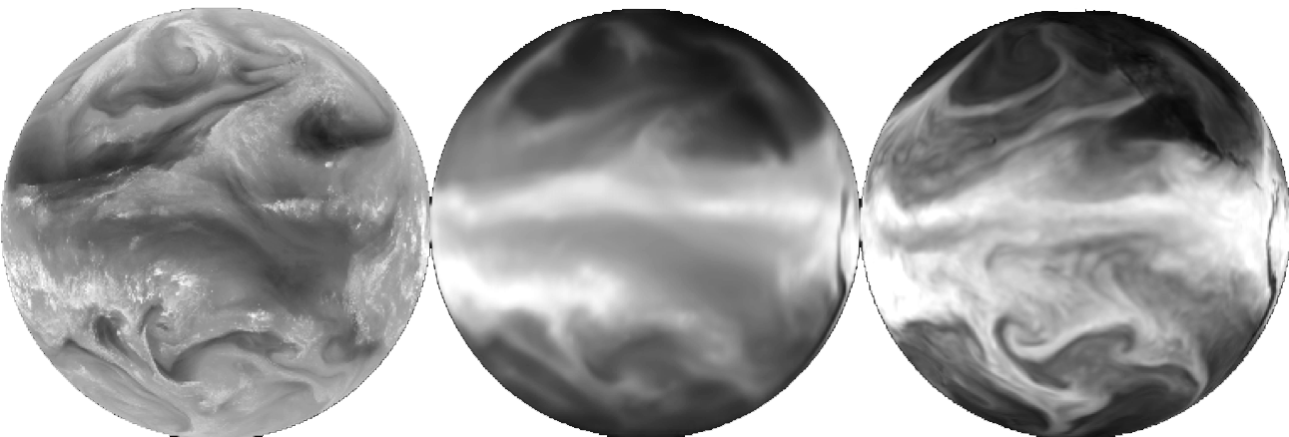
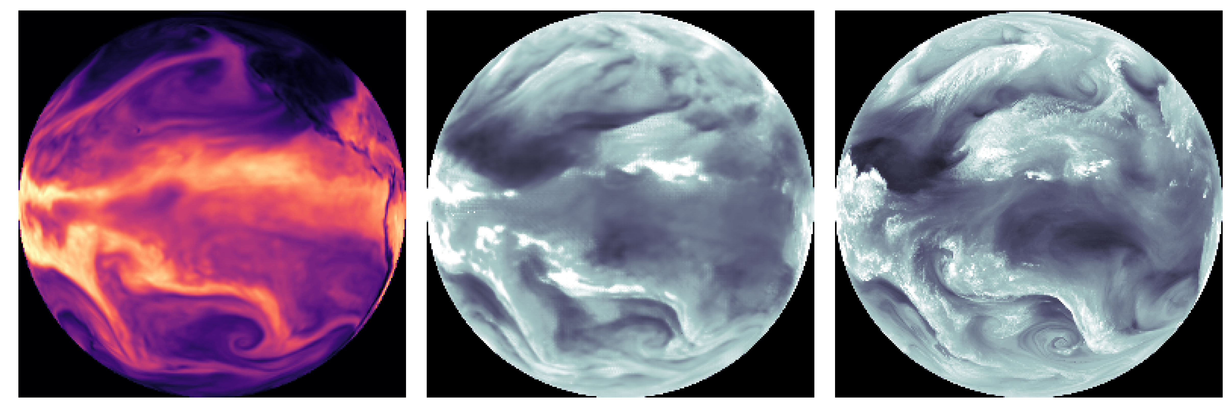
RESULTS:
GOES TO GFS
(SINGLE CHANNEL)
INPUT: GOES-15
CGAN-GENERATED
TARGET: GFS
David Hall NVIDIA
OBSERVATION | GOES-15 band 3
MODEL VAR | GFS Precipitable water
Training | 2014-2016
Test | 2013
INPUT: GFS
REGRESSION ONLY
TARGET: GOES-15
Adversarial model outputs a physically plausible state
Like an ensemble member from uncertain initial conditions
Both forward and inverse maps
For data assimilation and forecast verification
Notes:
Using a conditional generative adversarial network, we are able to fill in the missing details using a single randomly selected physically plausible state.
This is analogous to generating a single ensemble member from uncertain initial conditions.
On the top row you can see the results of satellite to model translation. The generated model variable field looks convincingly like the training examples.
This technique has the potential to accelerate or replace both for the forward model and its inverse, for data assimilation purposes.

Slide 19
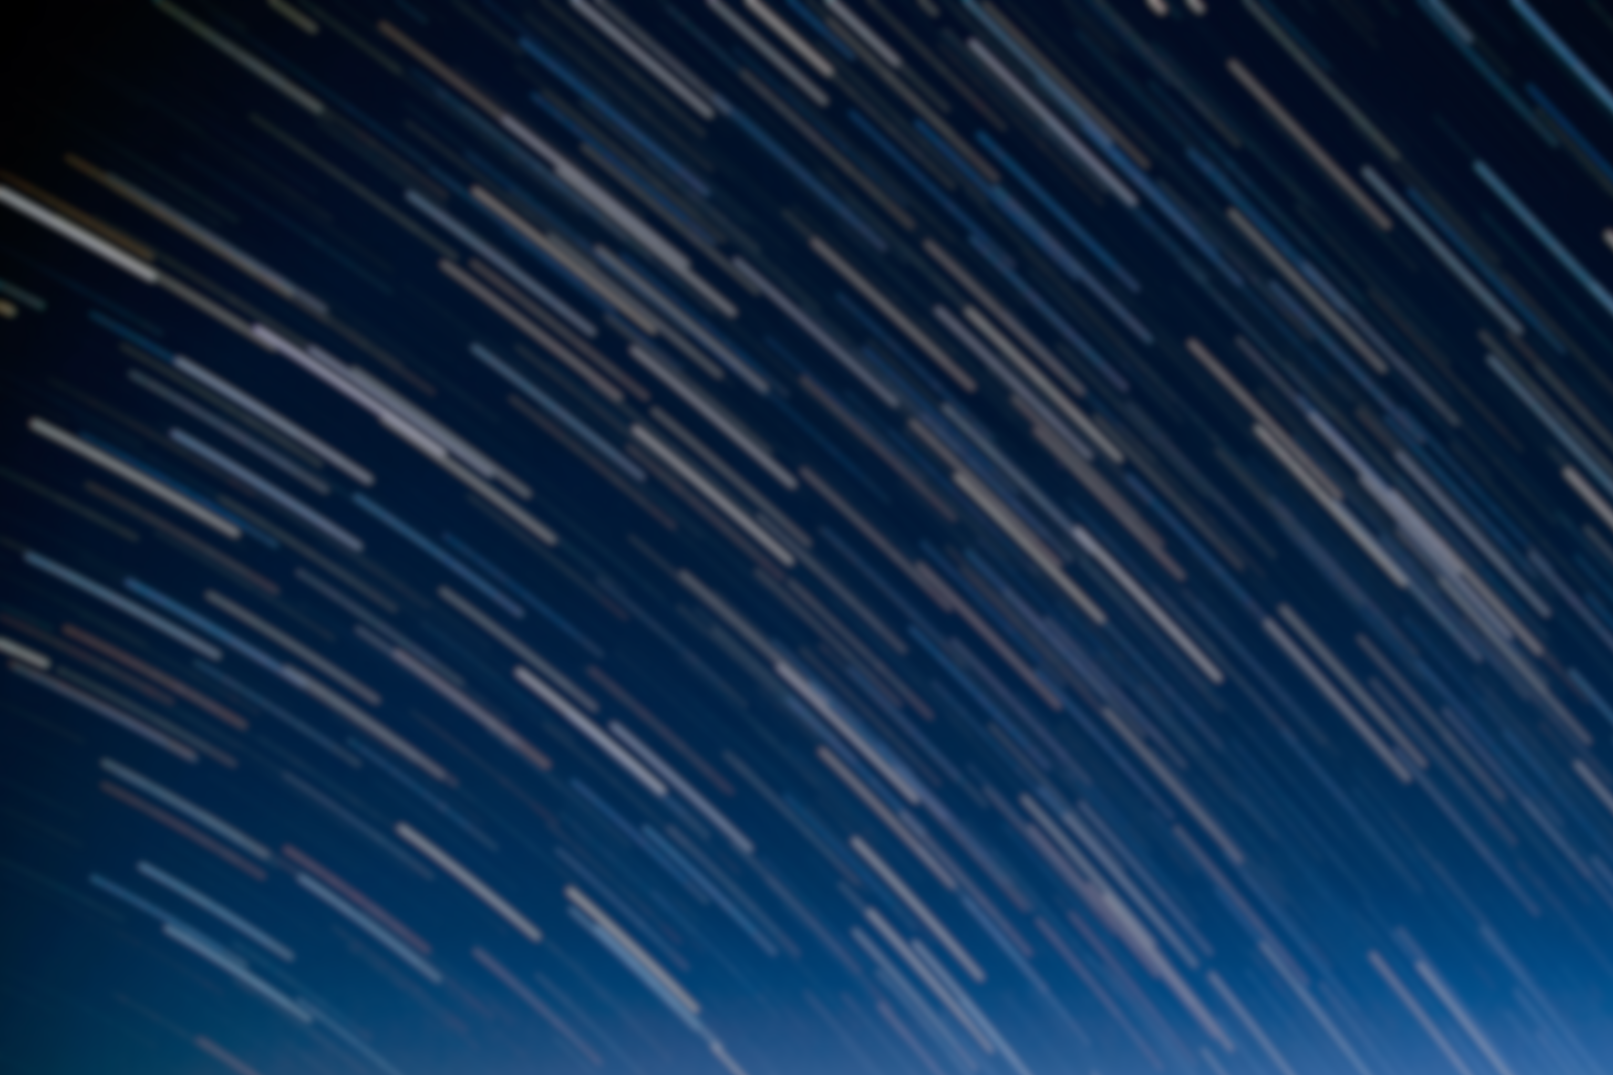
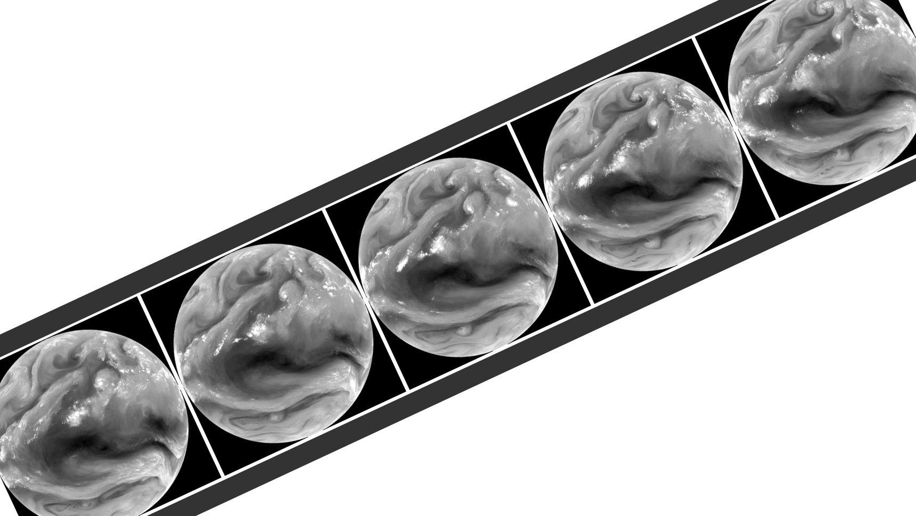
ERROR CORRECTION
AND INTERPOLATION
NOAA SOS,NVIDIA
Science on the Sphere
Deep learning may be used to enhance satellite data by learning to intelligently interpolate it in time. We can also repair damage data by imputing missing pixels, missing channels, or even dropped frames. More ambitiously, deep learning has the potential to learn the underlying dynamics directly from observations,
Which may then be used to estimate future satellite observations directly.
Notes:
Our third project involves using slow motion to increase the frame rate of satellite image loops

Slide 20
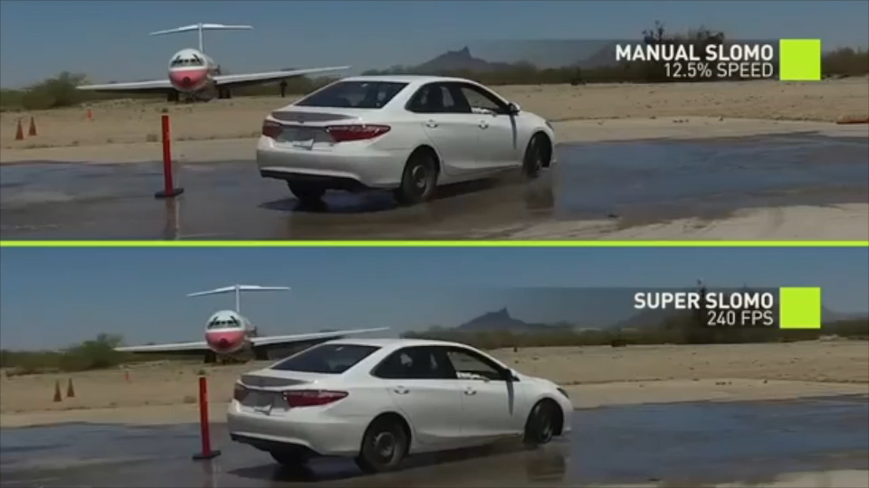
NVIDIA SUPER SLOW-MOTION
Deep learning for temporal interpolation
Notes:
NVIDIA has developed an AI technique for intelligently interpolating between video frames to make a smooth, physically consistent video.
I wondered if this technique might be adapted to enhance satellite loops from GOES-15, for example.
Unfortunately, a model trained on 3d rotating objects does not handle geophysical fluid dynamics very well.
Clouds behave quite differently from cars, and it had trouble generating an accurate optical flow.

Slide 21
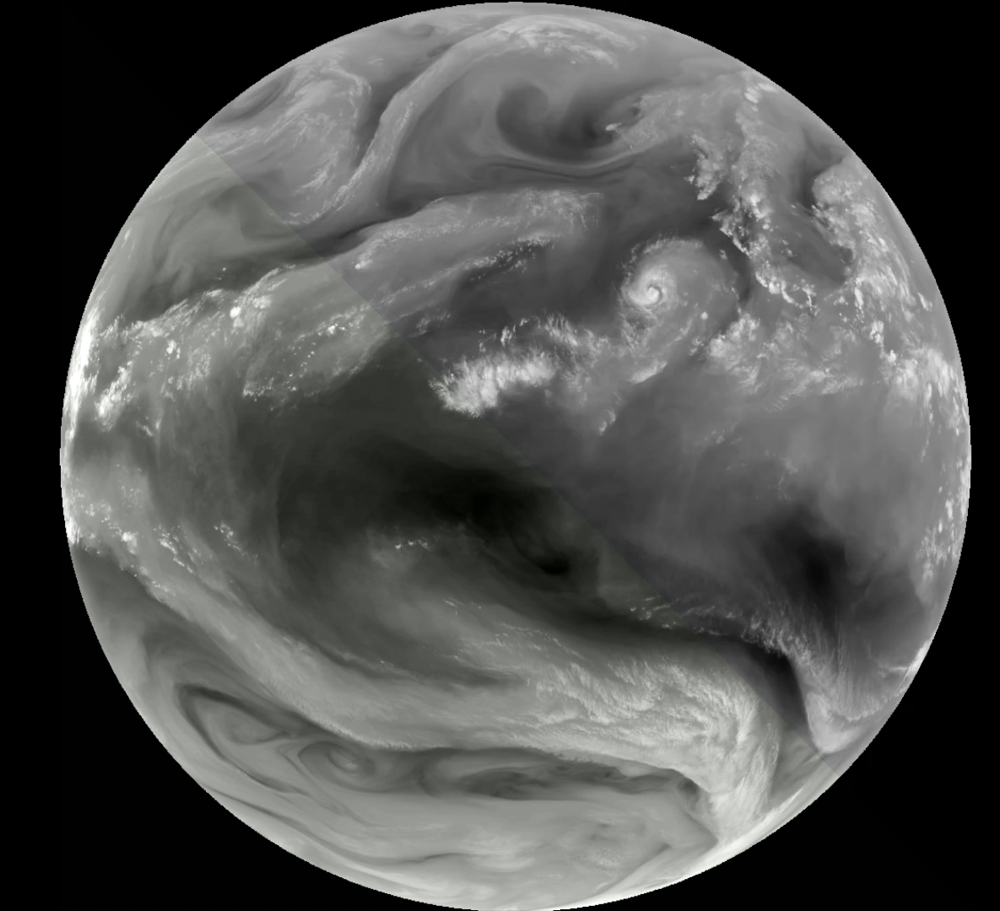
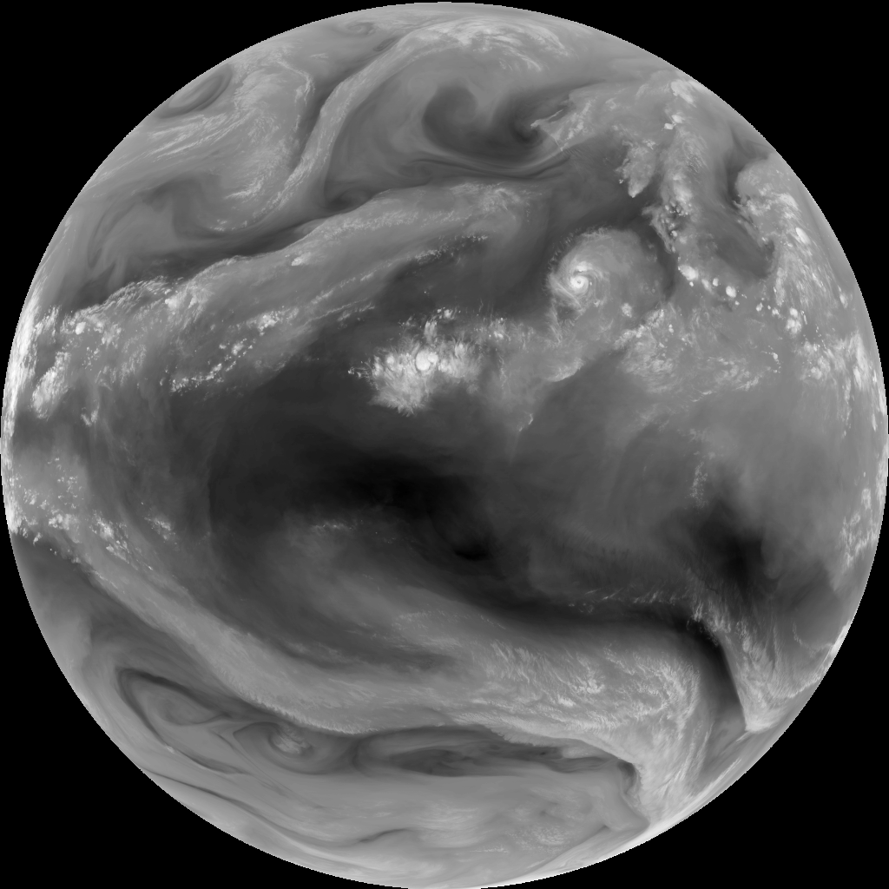
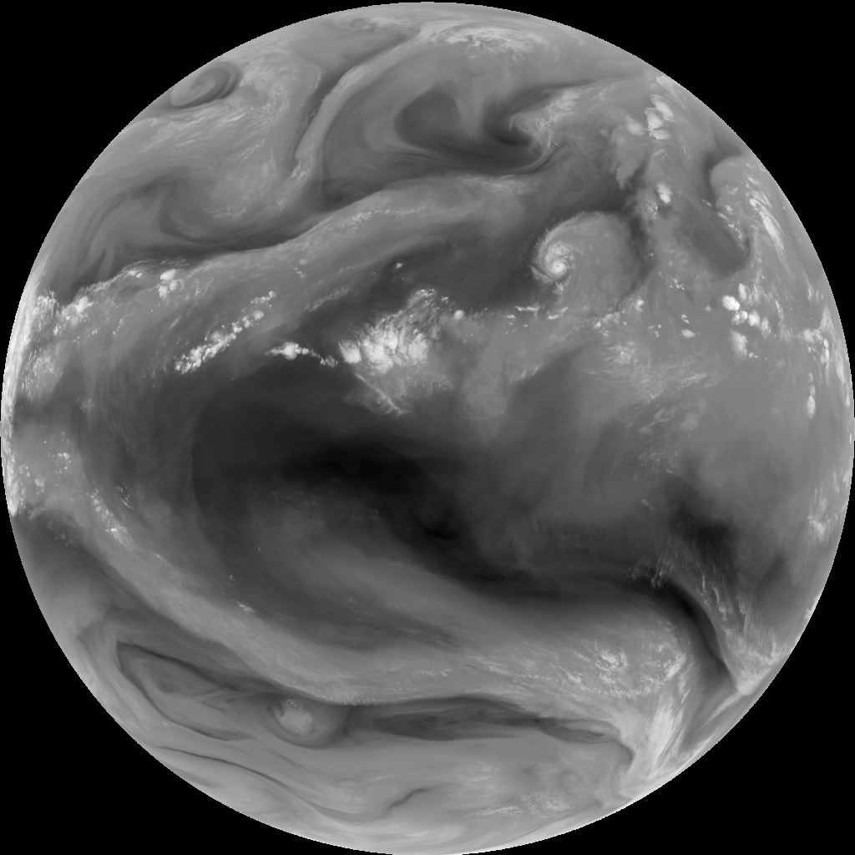
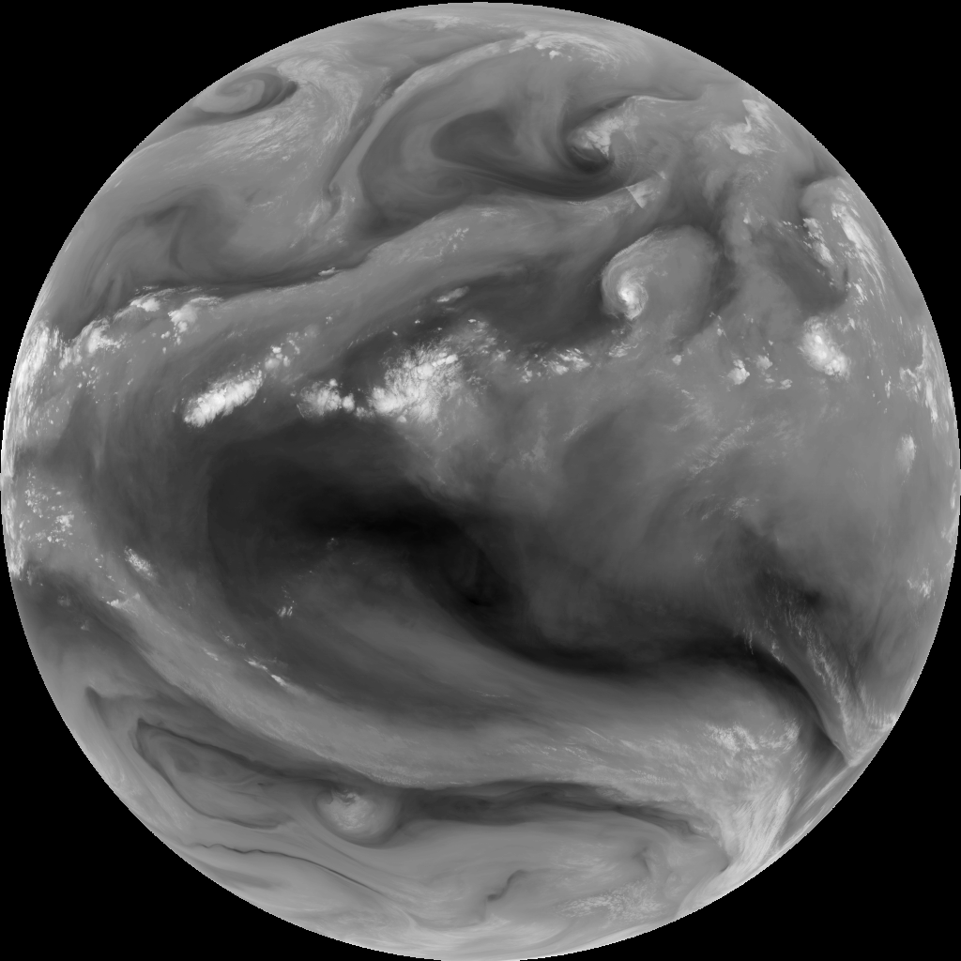
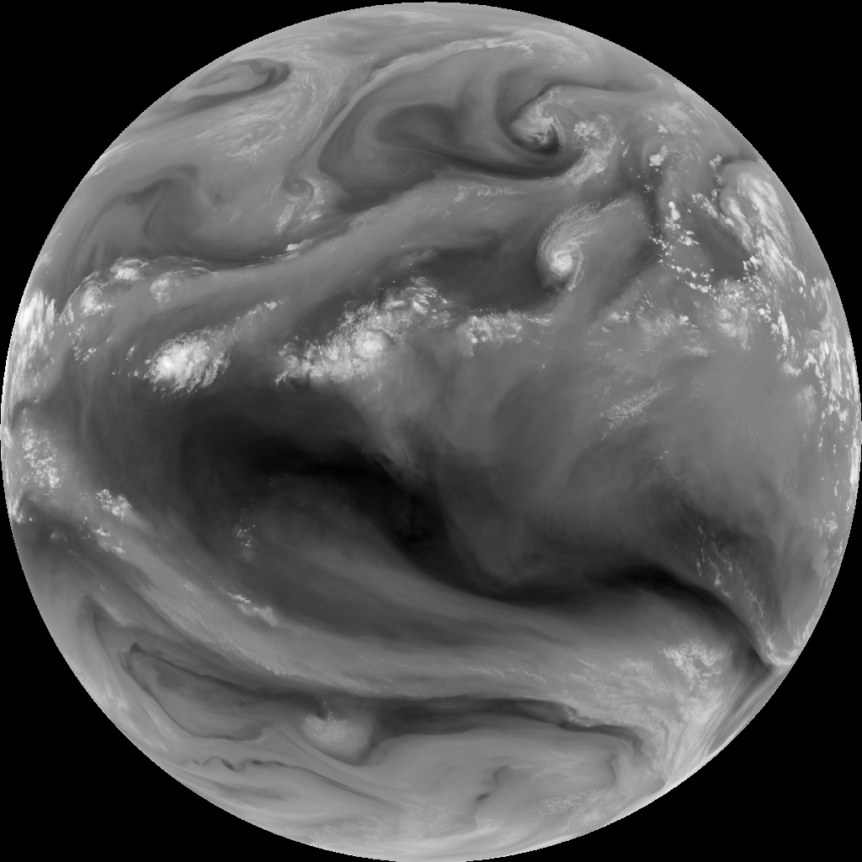

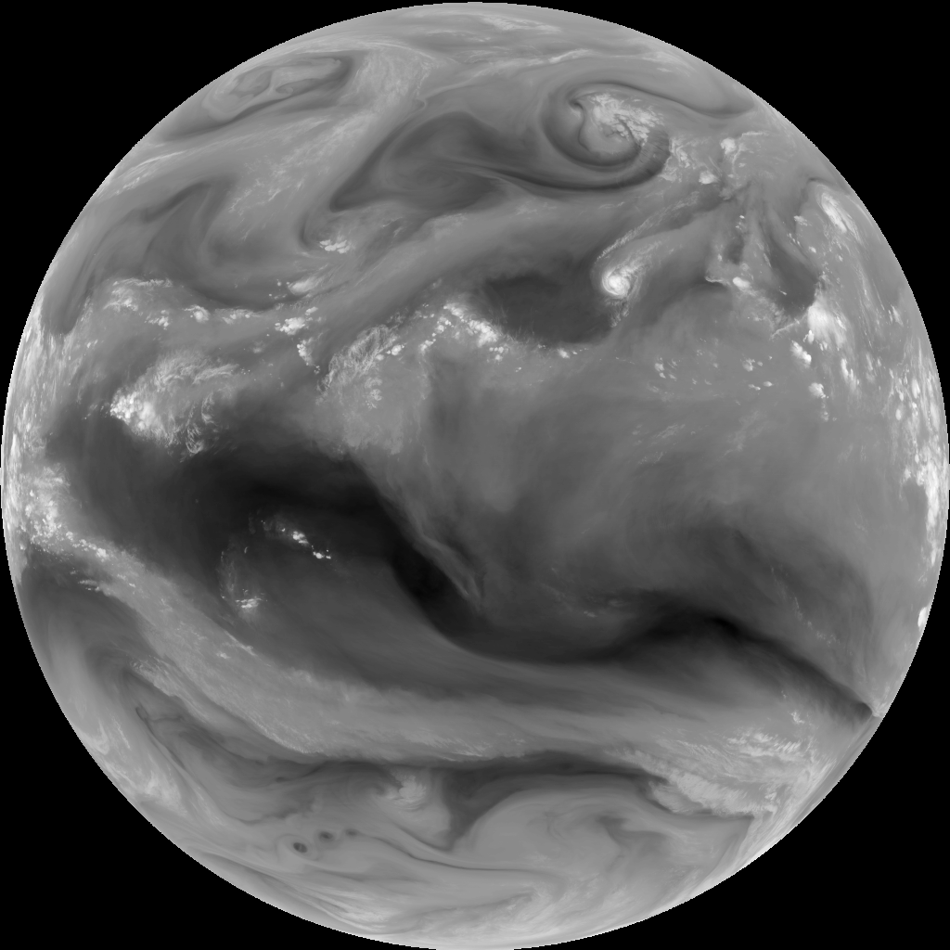
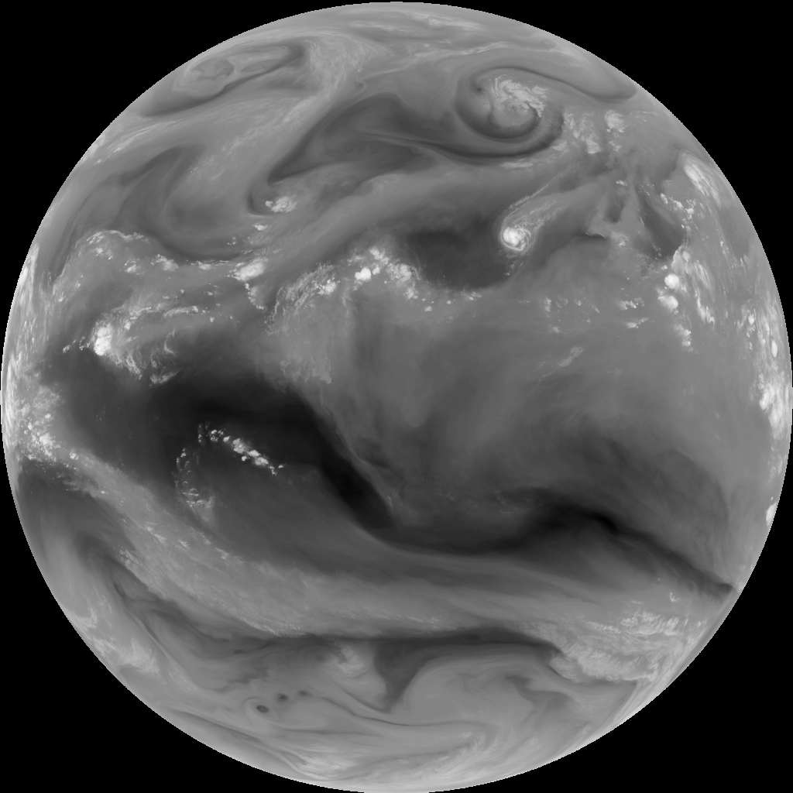
GOES-15
SLOW-MOTION SATELLITE Loop
110 output frames
Ground Truth
Keith Searight, NOAA ESRL SOS
David Hall NVIDIA
INPUT | GOES-15 band 3, GFS winds
OUTPUT | Interpolated GOES-15
INPUT FREQ | 1 every 3 hours
OUTPUT FREQ | 1 every 18 minutes
Prediction
Applications:
Visualization
Data Augmentation
Replace dropped frames
Reduce storage requirements
11 input images
Notes:
Here we show the results of inputting 11 images and outputting 110 interpolated frames.
This type of slow motion movie can be used for visualization, for data augmentation, replacing dropped frames, or for reducing data storage requirements.
For a first attempt, it works pretty well. However, the wind fields are only an initial guess, and simple advection fails to capture cloud formation, evaporating, and the three dimensional nature of the flow.

Slide 22
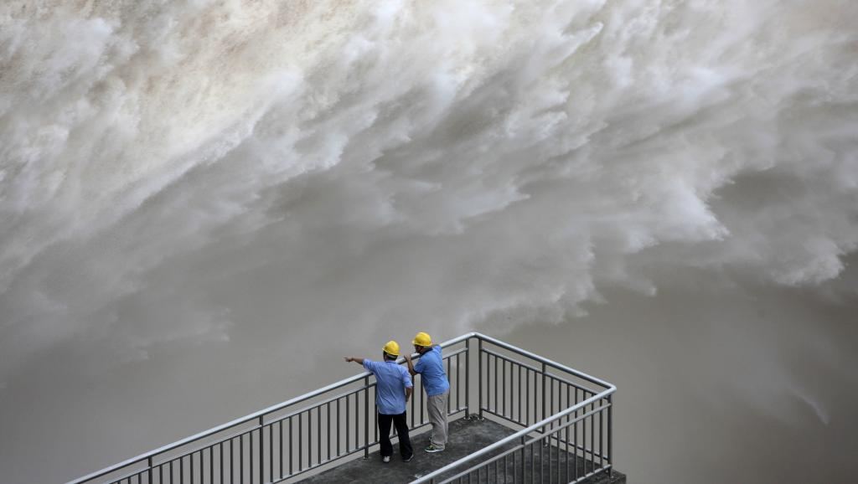
PReDICTING STREAMFLOW
UNDER CLIMATE CHANGE
UC Davis, NVIDIA
Climate models are able to predict changes in precipitation, but how will this effect streamflow rates? To answer this question one can built a detailed physical model, or train a neural network to predict time series data. In this case, we find a simple network performs just as well.
GOES-16 CIRA GEO COLOR / GOES-15 RED BAND
Notes:
Our second project involves image-to-image style translation with applications to data assimilation.

Slide 23
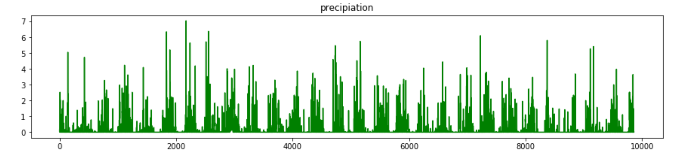
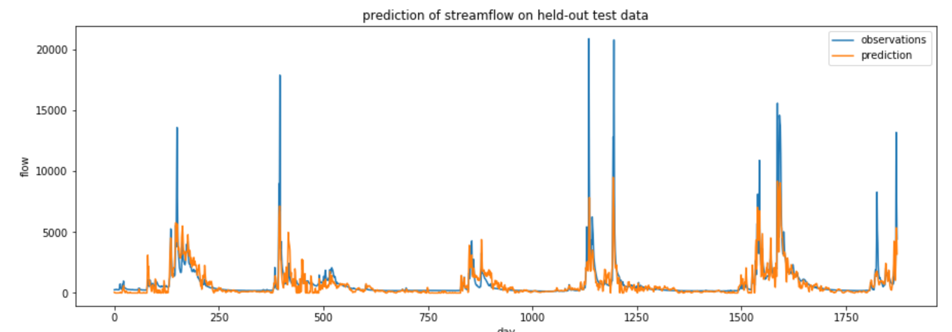
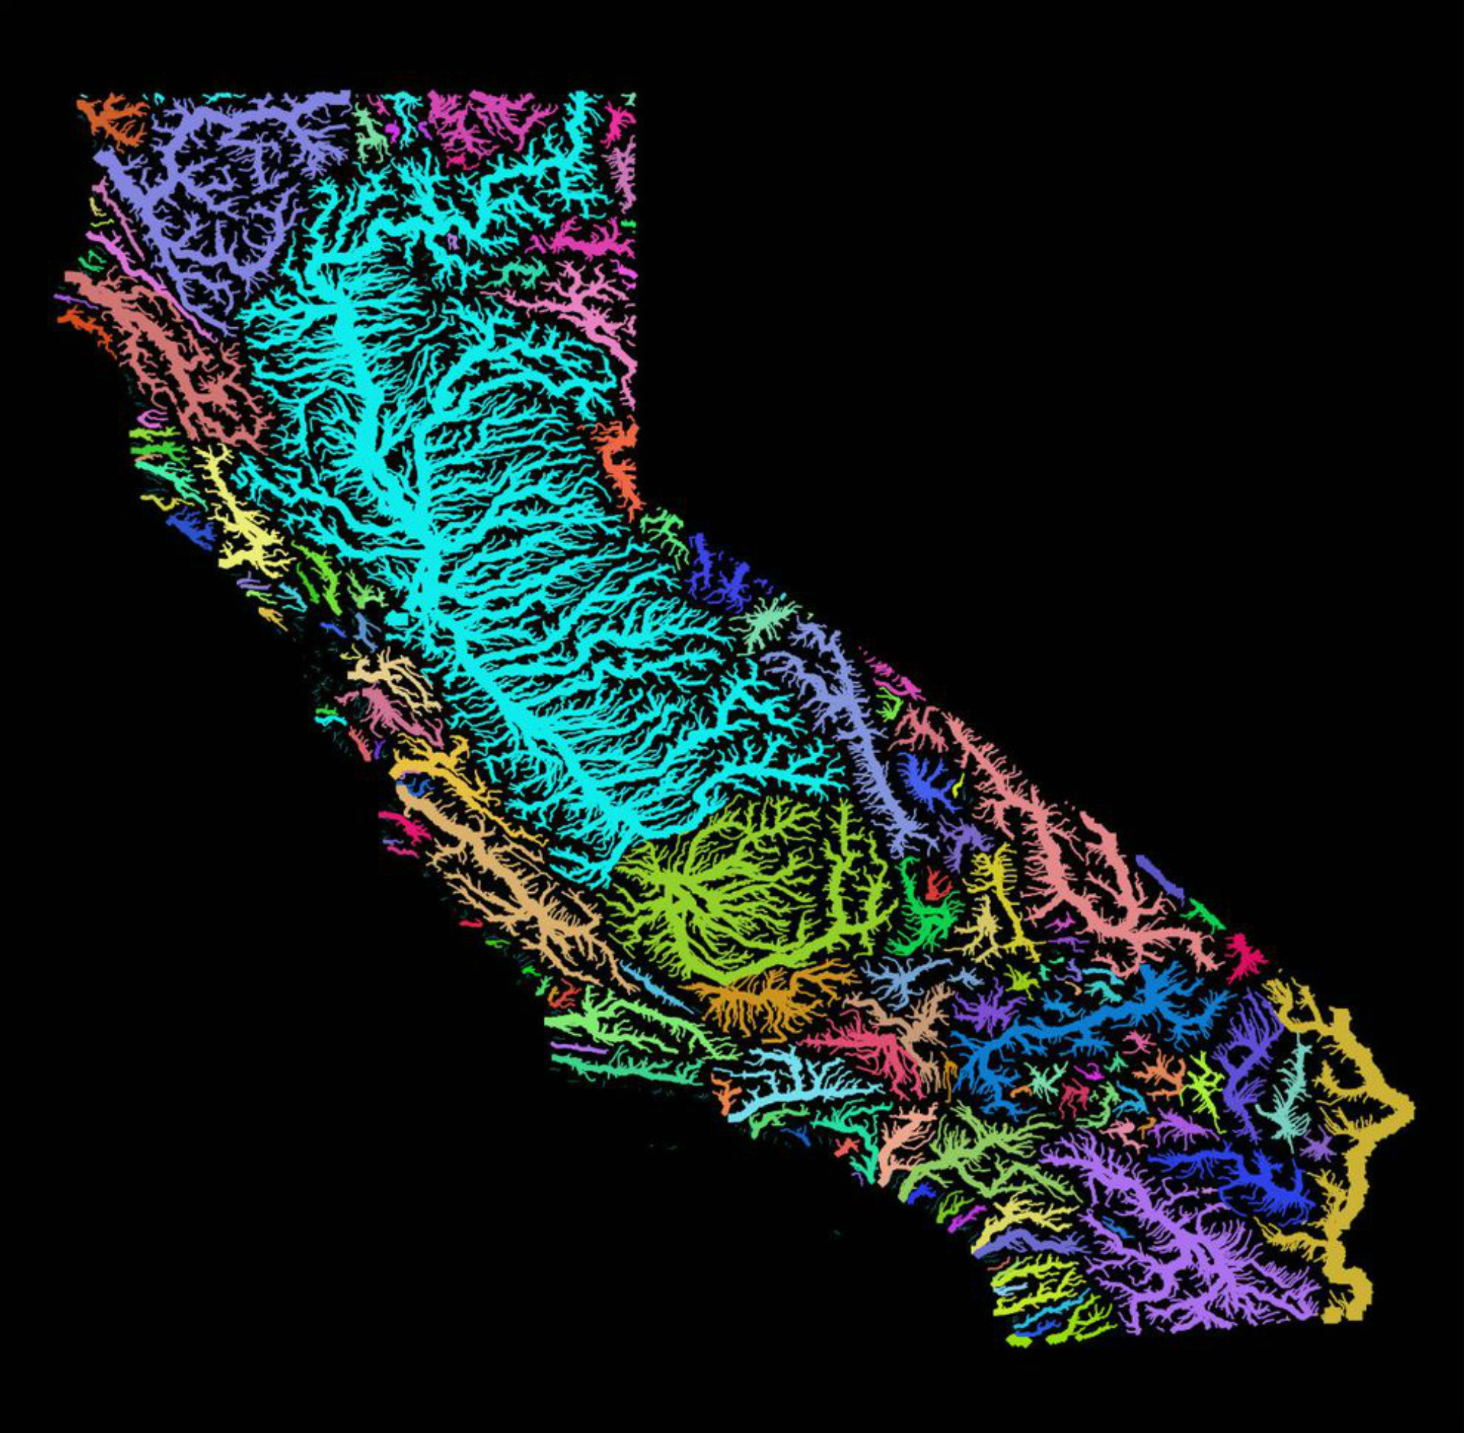
STREAMFLOW FROM PRECIPITATION
Fully-connected net matches performance of best physical models
Paul Ullrich, Lele Shu,
Shiheng Duan (UC Davis)
David Hall (NVIDIA)
INPUT: PRECIPITATION
OBSERVATIONS | PRISM Data
MODEL VAR | Streamflow Gague
Training | 1990-2011 (8k daily)
Test | 2012-2016 (2k daily)
R2 = 0.85, NSE=0.70
OUTPUT: STREAMFLOW
Notes:
Now lets look at some details of task 3: slow motion for satellite lops

Slide 24
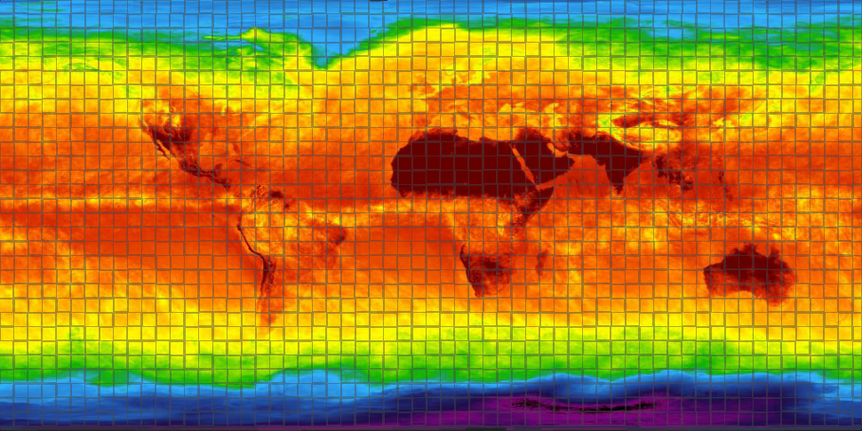
NOISE ELIMINATION IN
GLOBAL CLIMATE
OBSERVATIONS
Freie Universität Berlin & NVIDIA
HadCRUT4 data is one of the most widely used long term data sets for climate. But it is filled with missing values. By using a noise2noise algorithm, we can filling in the missing values, making a complete, gridded product, far more accurately than the usual approach of linear interpolation.
Notes:
Our second project involves image-to-image style translation with applications to data assimilation.

Slide 25
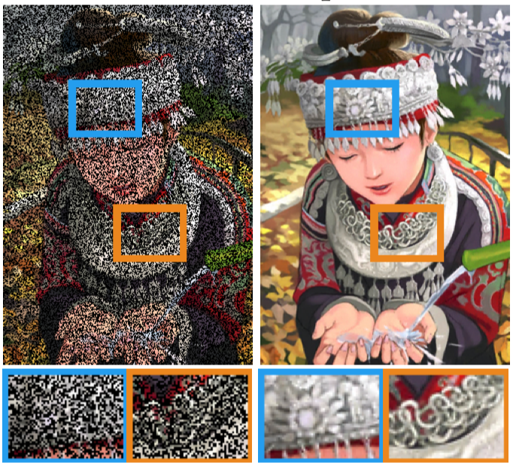
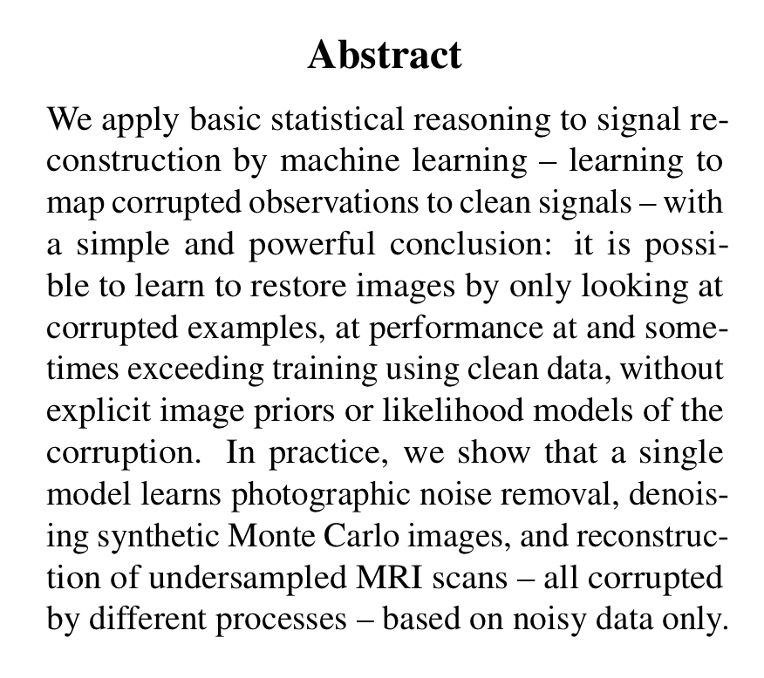
NOISE2NOISE DENOISING
Removing noise from images, in the absence of clean training targets
Noisy Input
Denoised Output
https://arxiv.org/pdf/1803.04189.pdf

Slide 26

Filling in the blanks
Use noise2noist to fill in missing values in the HadCRUT4 Climate Dataset
No results yet.

Slide 27

Improved SOIL-MOISTURE
PARAMETRIZATION IN
HRRR
NOAA ESRL
Mark Govett
Isadora Jankov
Lidia Trailovic
CIRA
Kyle Hilburn
Steve Miller
NASA LIS
SOIL MOISTURE IMAGE

Slide 28



SOIL MOISTURE FROM MESONET DATA
More accurate soil moisture parametrization via deep learning
Use DL to create a better parametrization from observations
Use surface observations to infer sub-surface state
Use mesonet weather station observations as ground truth
See Jebb Stewart’s Talk for preliminary results
No results yet.
Notes:
Now lets look at some details of task 3: slow motion for satellite lops

Slide 29





SUMMARY
NVIDIA GPUs are powering current performance gains
Deep learning provides a new general purpose set of tools which are well suited for GPUs.
Use DL to construct functions by example, and freely mixed with traditional code.
AI
DL can be applied to a wide variety of tasks on weather and climate
These examples are just the tip of the iceberg
dhall@nvidia.com
Notes:
I covered a lot of material, so please allow me a moment to summarize the key points…
If you would like to know more, or are interested in collaborating, please feel free to email me at dhall@nvidia.com
Thank you for your attention.

Slide 30


SOLAR DYNAMICS OBSERVATORY
AIA
SDO
Atmospheric Imaging Assembly
NASA Goddard
SDO: 1.5 Tera-bytes per day
AIA has 10 wavelength channels
150 million images to be labelled
30 thousand labelled so far (0.02%)
Use these labels to train DL model
Apply model remaining images millions of images
Notes:
We have just begun a project with nasa goddard to label solar features on data from the SDO observatory.
They have code for labelling features, but it is time consuming.

