Slide 1
Combining the Power of Experts and Deep Learning to Explore NASA and NOAA Data
Tianle Yuan
NASA GSFC Climate and Radiation Lab
/UMBC JCET

Slide 2
Co-workers: H. Song, C. Wang, S. Platnick, K. Meyer, R. Wood, J. Morhmann, L. Oreopoulos Funding: NASA MEaSUREs program (Lucia Tsaoussi) NASA Terra/Aqua program (Paula Bontempi) IT support: NCCS (Dan Duffy and his Discover and ADAPT teams); AWS Research Credits (Adam Ginsburg and his team); GPUs!
Acknowledgement

Slide 3
Outline
The expert-machine hybrid approach
Supervised
Ship-tracks in MODIS and GOES-16
Search for object of interest
Unsupervised
Track Sc cloud evolution
Classify global low-clouds with a GAN
Understand cloud behavior with a GAN
Notes:
Brief introduction of general idea of the hybrid approach
Four examples, two using supervised learning approaches, two unsupervised
The cloud behavior piece will be skipped in this talk due to time constraint

Slide 4
The Expert-Machine Hybrid
Deep learning offers powerful tools
They have limitations
Generalization issue
Explainability
Costly to train a good model
Domain expertise is valuable
Notes:
Take advantage of the strength of both worlds
No AGI yet.
3) Active participation of experts is very beneficial
Past experience

Slide 5
The Expert-Machine Hybrid Approach
Reduce the cost of building up a training set
Optimize input data and model design
Incremental improvements
“Gradatim Ferociter”
Notes:
Both domain experts and deep learning experts actively participate
This approach can have these three advantages.
It’s an iterative process.

Slide 6
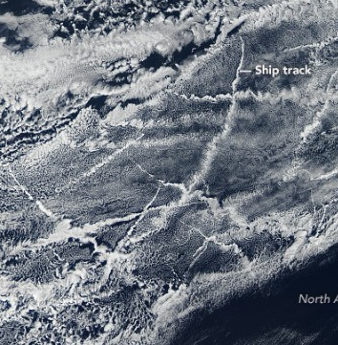
Ship-tracks
Notes:
Prof. Bretherton’s 2000 editorial on ship-tracks as ideal aerosol-cloud interaction experiments

Slide 7
Model performance
Input
M 1
M 2
M 3
Human
Yuan et al., 2019a, sub
Notes:
Picks out human label well
Picking out missed labels from humans

Slide 8
Full granule: an example
Brightness temperature difference
Mask

Slide 9
Global Statistics
>100X faster on NVIDIA V100 GPUs
Three orders of increase in samples
Yuan et al., 2019b, In prep
Notes:
Fractions of low clouds that are affected by ship-tracks

Slide 10
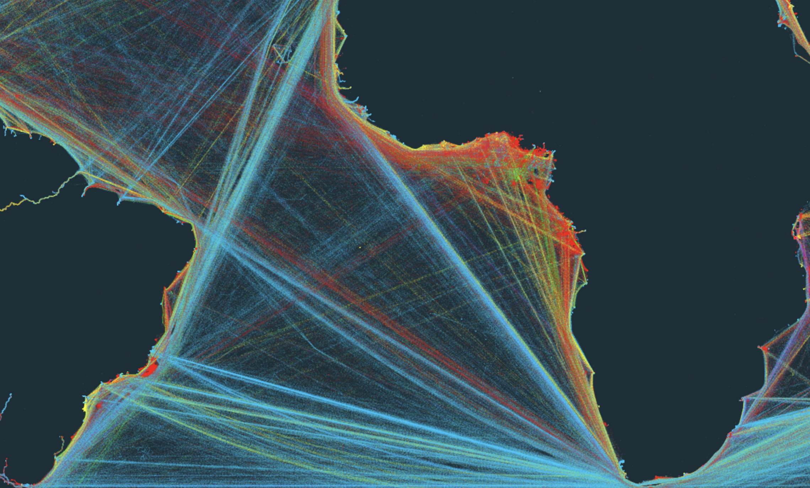
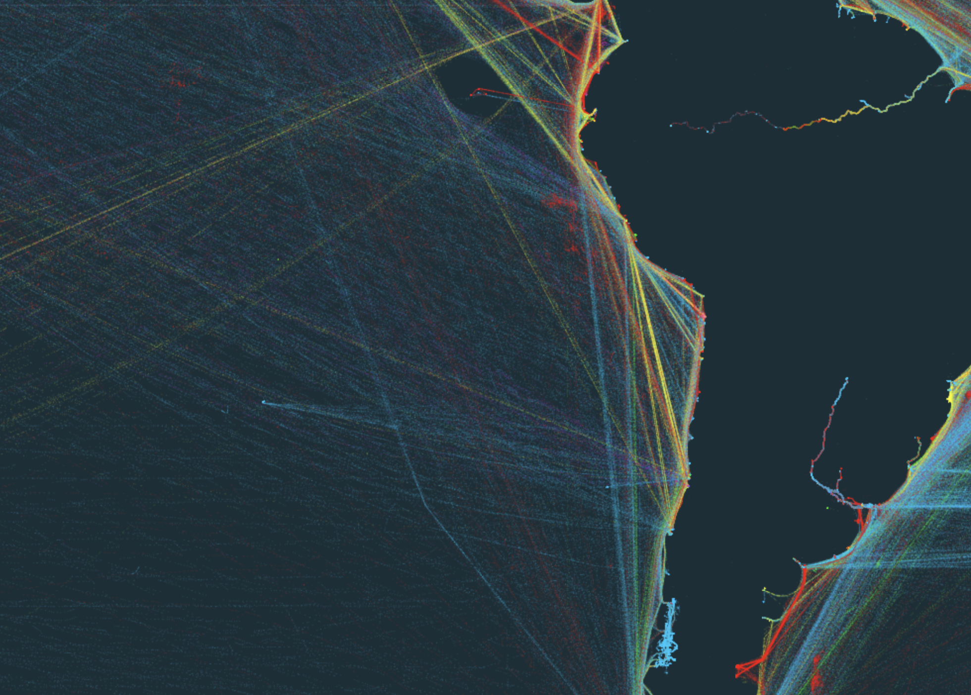
Global Statistics
>100X faster on NVIDIA V100 GPUs
Three orders of increase in samples
From KILN

Slide 11
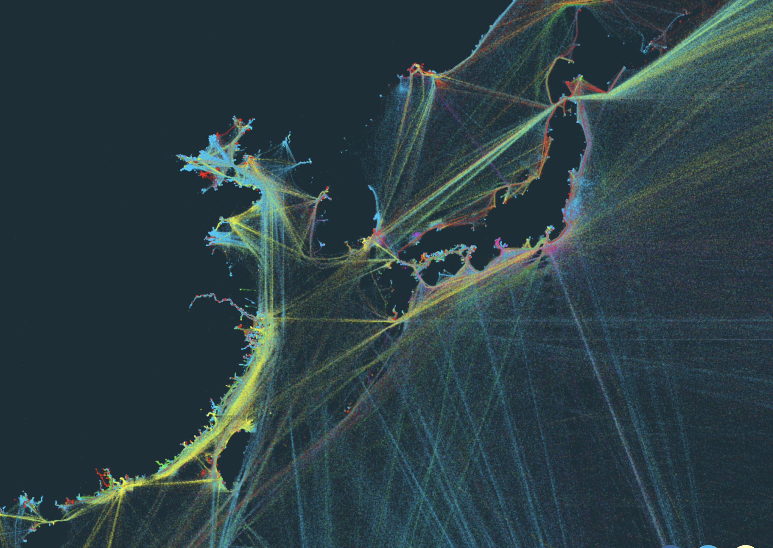
Regional: Asia
Missing record for the route between N Korea and Russia
Ship traffic in the Taiwan Strait
MODIS Ship-tracks
2012 Commercial Data
From KILN
Notes:
Surprise in the North Korea.
Expected but interesting feature in the Taiwan Strait.

Slide 12
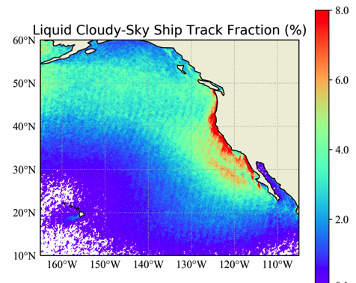
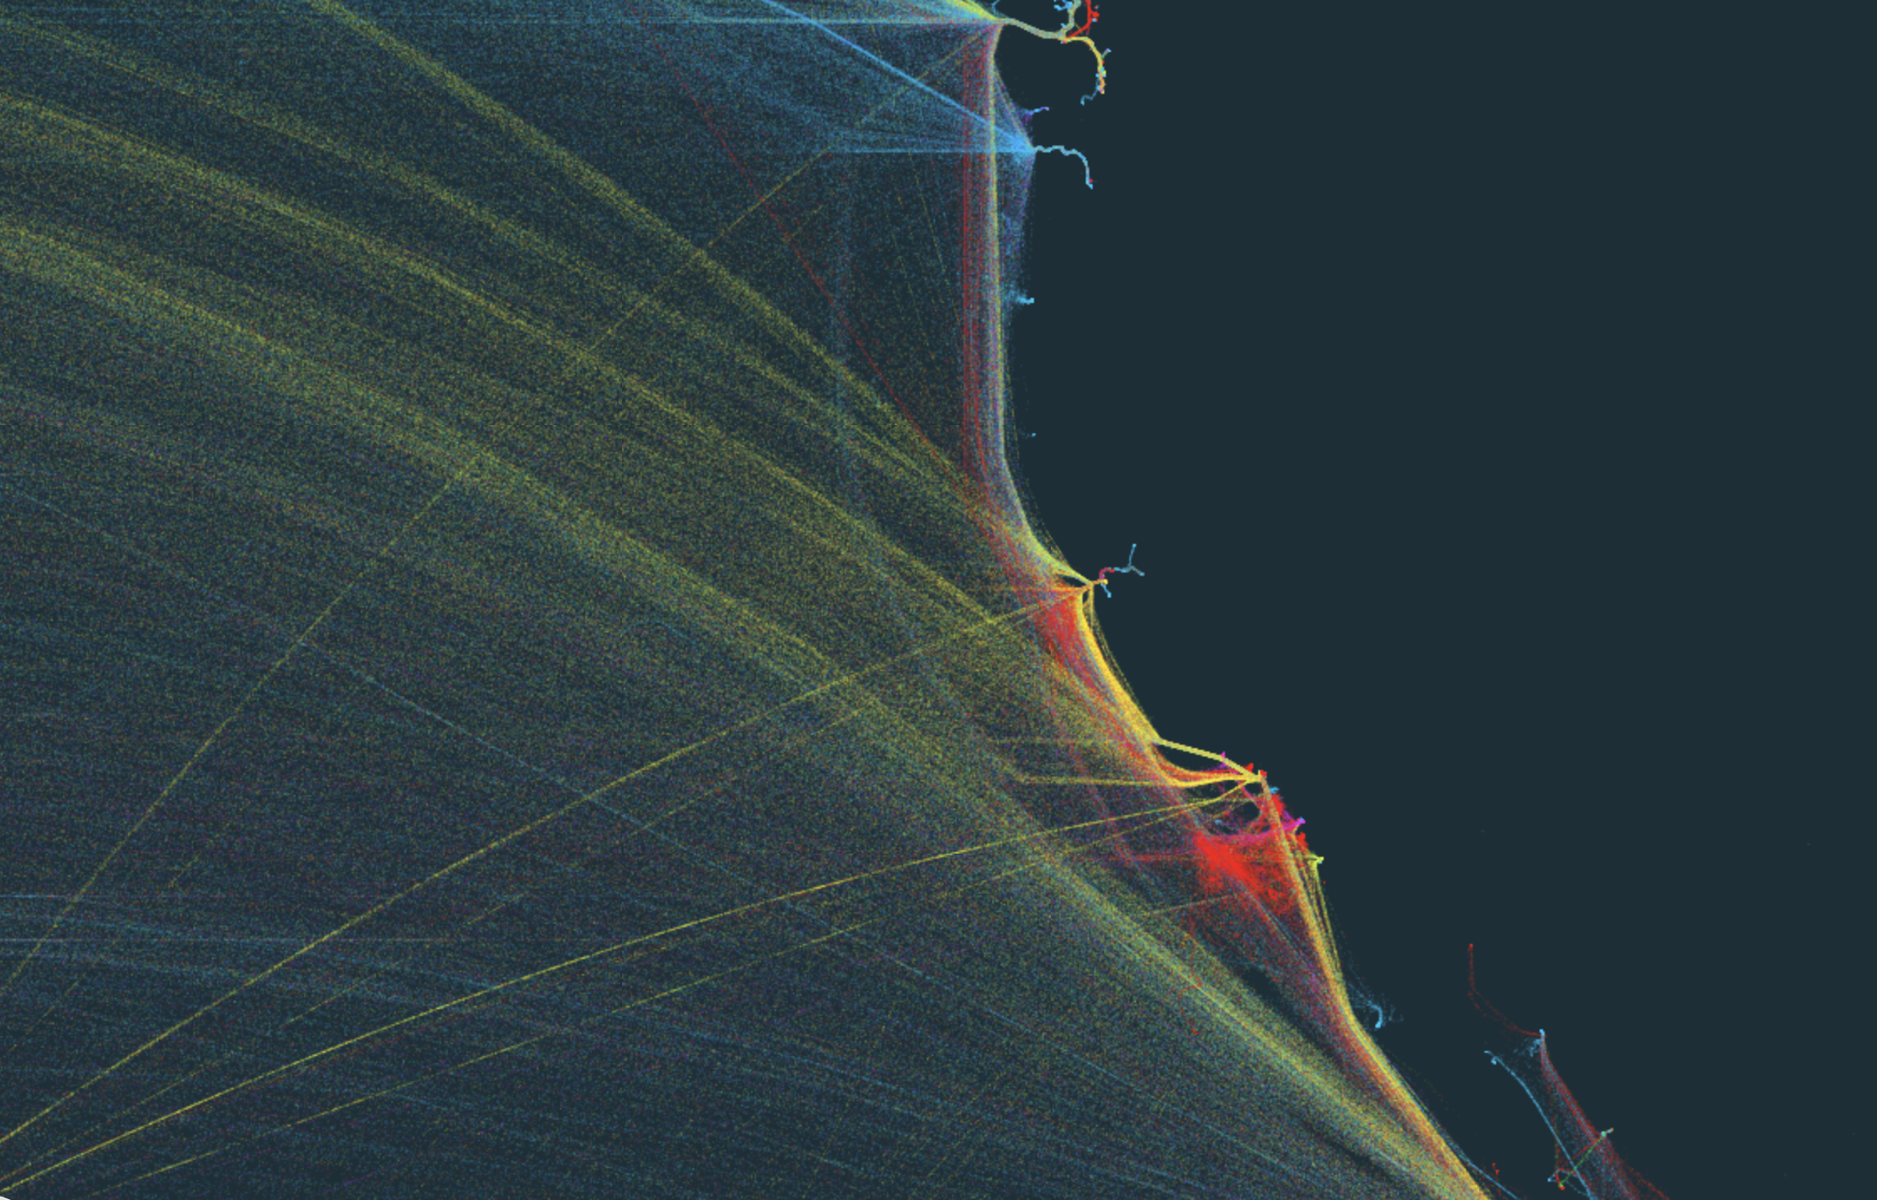
Regional: NE Pacific
Notes:
Separation of 1) Local west coast traffic 2) International route between Asia and the Americas.

Slide 13
Ship-tracks in GOES-16

Slide 14
Ship-track evolution in GOES-16
Ship-tracks found by the algorithm are generally a bit too ‘chubby’.
AWS+ NOAA
Notes:
This region is on the edge of GOES-16.
It doesn’t have the chubby issue for Southeast Pacific.
Probably a combo of resolution and viewing angle.

Slide 15
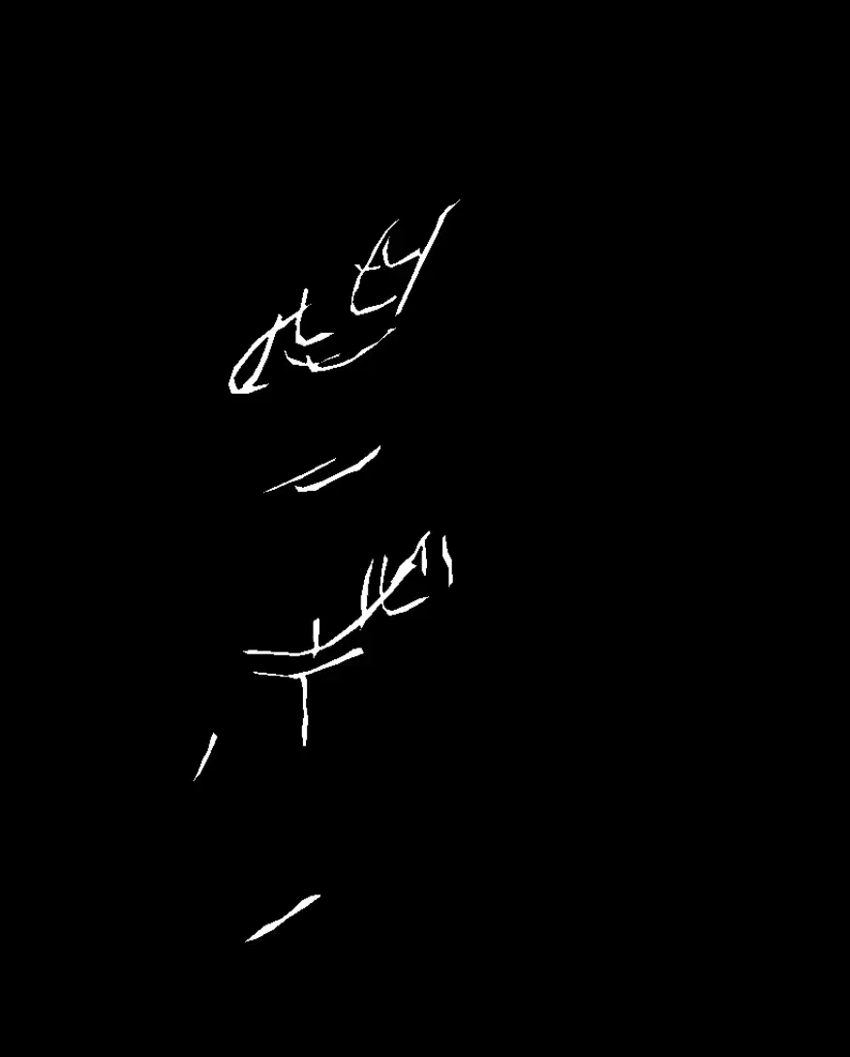
Ship-track evolution in GOES-16
AWS+ NOAA
We have time evolution!

Slide 16
Search for Object of Interest

Slide 17
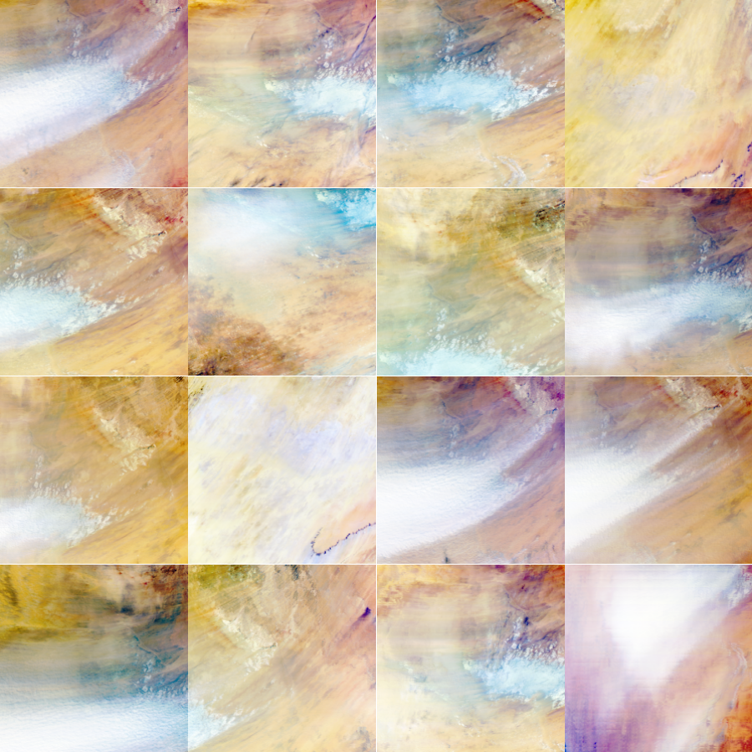
Search for Object of interest
Query image: a MODIS three-channel reflectance image of a dust plume from the Bodele Depression (top-left corner).
The algorithm return 200 (adjustable) images within 10 seconds from 1 TB of MODIS data. 15 are shown.
Notes:
Helps the expedite exploration of data.

Slide 18
Sc Cloud Evolution

Slide 19
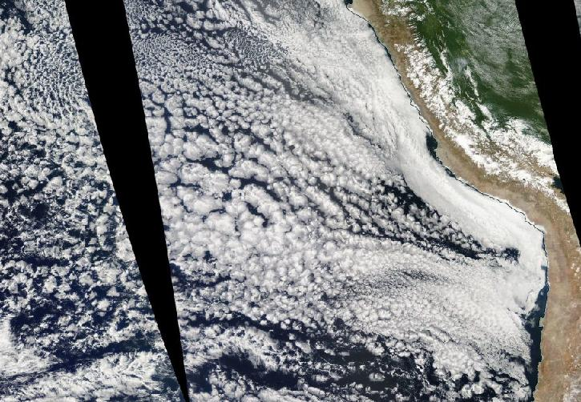
Notes:
This region is on the edge of GOES-16.

Slide 20
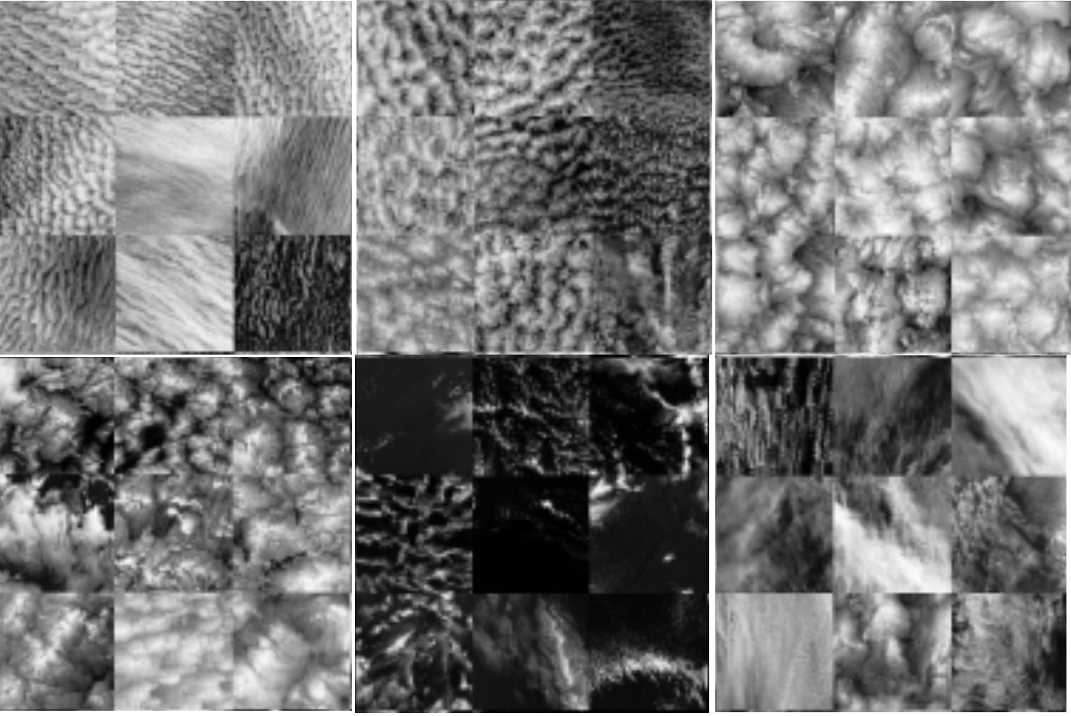
Unsupervised study of Sc evolution
Increase in cell size
Cat 1
Cat 2
Cat 3
Typical evolution of a stratocumulus cloud is captured.
Cat 4
Cat 5
Cat 6
Notes:
This region is on the edge of GOES-16.

Slide 21
Classify Global Low-clouds with a GAN

Slide 22
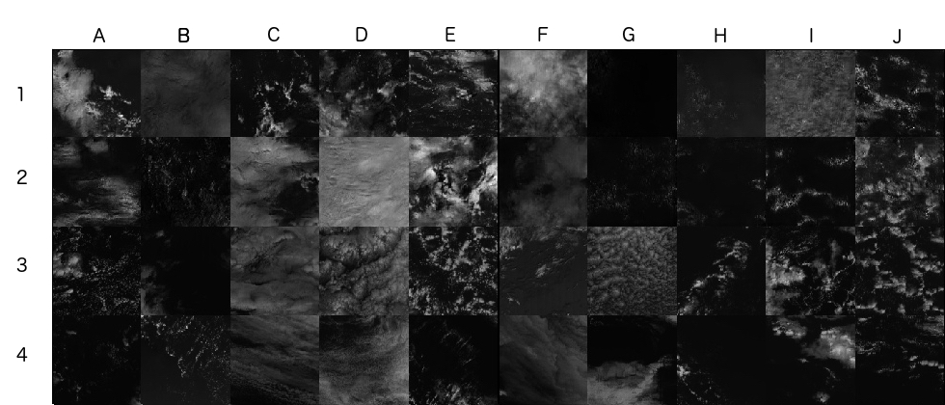
Classify Low-Clouds with a GAN
Notes:
It is trained on all low cloud types including but not limited to Sc.
In fact, most training samples are from trade cu regions.

Slide 23
Classify Low-Clouds with a GAN
Generated
MODIS
Notes:
Realistic samples
Diverse

Slide 24
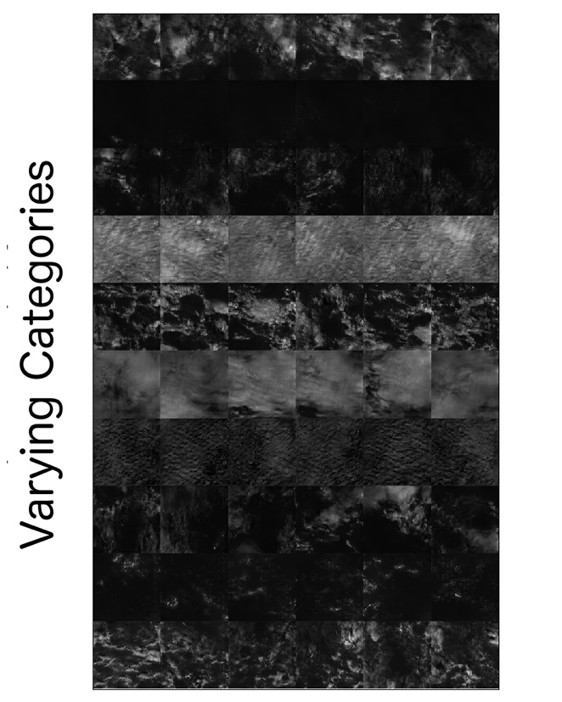
Classify Low-Clouds with a GAN
Varying categories
Captures major mesoscale cloud
structures in the
Sc to trade cumulus range.
Perturbation
Yuan, 2019
Notes:
This region is on the edge of GOES-16.

Slide 25
Conclusion
Deep learning
+ Experts
+ Iterations
=
Realize the value of NASA and NOAA data

