Slide 1
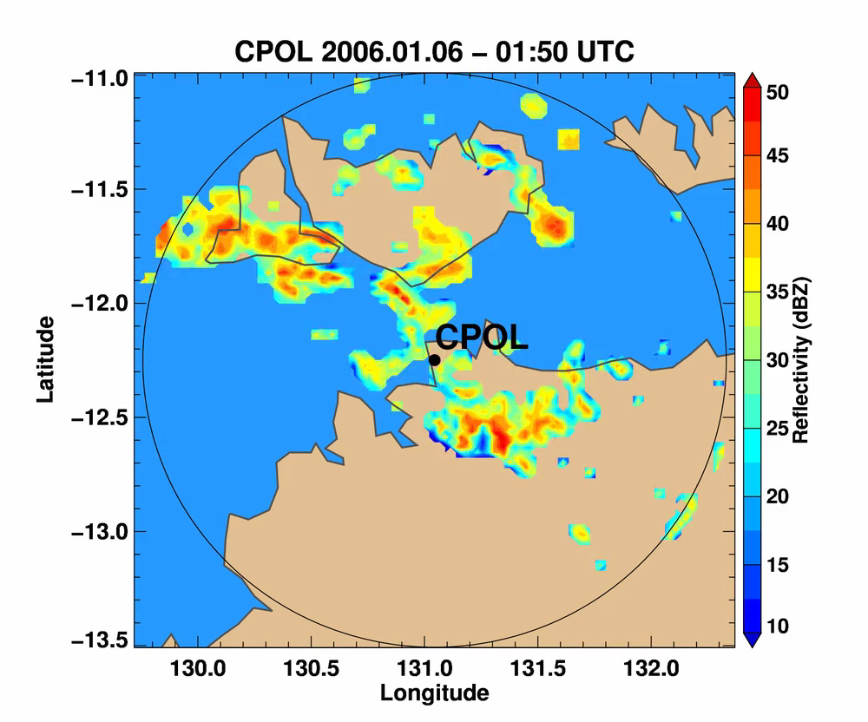

Recent Application of Machine Learning Techniques to Environmental Science at PNNL
Philip Rasch, Karthik Balaguru, Zhe Feng, Andrew Geiss,
Samson Hagos, Joseph Hardin, Wenwei Xu
A Machine Learning Assisted Cloud Parameterization.
Predicting Hurricane Intensification using Deep Neural Networks
Analyze and Reconstruct Radar Data
Notes:
My abstract
Recent Application of Machine Learning Techniques to Environmental Science at PNNL
Philip Rasch, Karthik Balaguru, Jennifer Comstock, Zhe Feng, Andrew Geiss, Samson Hagos, Joseph Hardin, Laura Riihimaki, Wenwei Xu
Machine Learning Techniques (MLT) are providing a fascinating and promising opportunity in our lab’s research over a wide range of activities. I will provide a brief introduction to our activities making use of MLT in: 1) forecasting hurricane intensity; 2) in radar data quality control, reconstruction of degraded data to produce higher resolution products, and cloud condensate phase identification; and 3) the characterization of cloud populations within convective parameterizations.

Slide 2
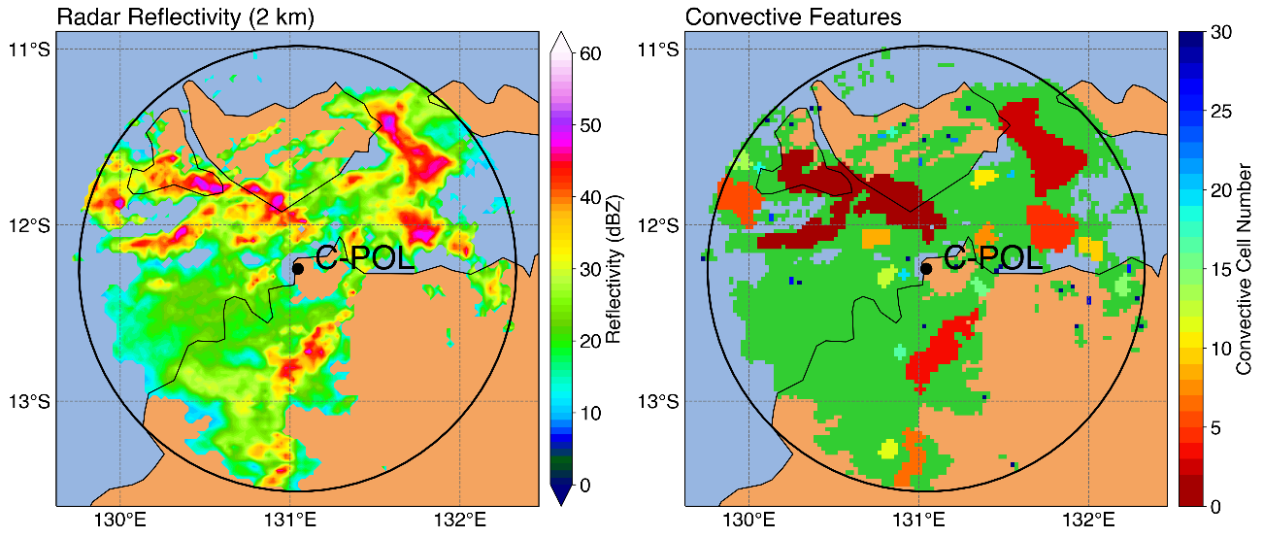




A Machine Learning Assisted Development of a Model for the Population Dynamics of Clouds
Samson Hagos¹ , Zhe Feng¹, Robert Houze Jr.¹, Bob Plant², Alain Protat³
Characterize the processes that govern the evolution of the population of convective and stratiform clouds?
Radar reflectivity (2km)
Convective features
Convective cells
Total convective area
Stratiform area
C-Pol observation at Darwin
12 winters of C-Pol Radar reflectivity data at Darwin
Stainer et al. (2005) algorithm is used to identify convective cells and stratiform areas.
Notes:
[JMC] Removed repeated word in first bullet (scales repeated twice)

Slide 3
The model
  After Arakawa and Schubert (1974)
  The next state is some function of the current state and the change in convective area fraction.
  Convective mass flux per cell depends on cell size.
  The growth rate of stratiform area is some function of convective cells and decays exponentially in the absence of active convection.
Notes:
[JMC] Removed repeated word in first bullet (scales repeated twice)

Slide 4
1. Machine learning
The algorithms for determining f_{c} and f_{s}
Convective
Stratiform
  The machine learning code is written in TensorFlowTM
  The algorithm is trained by half of the 150,000 cases of observed transitions.
TensorFlow, the TensorFlow logo and any related marks are trademarks of Google Inc.
Notes:
[JMC] Removed repeated word in first bullet (scales repeated twice)

Slide 5
Validation of f_{c}: Convective clouds
  The model → “machine Learning Assisted Model for Population of clouds (LAMP)”.
Observation
LAMP
  The algorithm predicts the convective cell size distribution and its diurnal cycle reasonably well.
Cell size distribution
Diurnal Cycle
Notes:
[JMC] Removed repeated word in first bullet (scales repeated twice)

Slide 6
Estimating Hurricane Intensity using Deep Neural Networks
Karthik Balaguru, Wenwei Xu
Challenge:
  Hurricanes are a destructive and recurrent natural hazard
    Eg: Economic damages inflicted by Harvey (2017) = 10% of Texas GDP.
  Forecasts of hurricane tracks are quite good, but intensity remains challenging.
  Current Standard Methodologies often use a Statistical Approach
  (merge deterministic products + statistical correction based on SST, julian day, persistence, etc),
  e.g. SHIPS → NOAA Statistical Hurricane Intensity Prediction System
Approach
  Data Sources:
    Inputs = SHIPS model predictors computed from reanalysis: 1982-2017, (35 years of data = ~9k events)
  Multilayer Perceptron (MLP) Algorithm:
    Architecture: inputs→48→32→16→output.
  Train/test split: (training → validation → testing
    80% training, 20% validating, a reserved full year of data for testing
    One model for each testing year using consistent model setting
Notes:
Challenge:
hurricanes remains the most destructive natural disaster in the U.S.. Harvey example.
One of the biggest challenge is the forecast of hurricane intensity. NHC uses a combination of approaches, including dynamic numerical modeling, statistical models, and statistical-dynamical models. There is still room for improvement, for example, the mean absolute variance of 24 hour intensity change in the Atlantic is 13 knots (AME calculated when assuming a model always predict the mean intensity change), and current state of the art forecast skill is 8.6 knots.
(2) Our approach:
In collaboration with NOAA’s John Kaplan and Greg Foltz, and with NHC’s Mark DeMaria, we acquired the various predictors, computed from reanalysis, used in the statistical-dynamical model SHIPS (Statistical Hurricane Intensity Prediction System) for the North Atlantic.
We built one model for each year using consistent model setting to evaluate the model skill. For example, to test on year 1990, we would use 1991-2017 data as training/validation, and test the model on year 1990. And for year 1991, we would use 1990, 1992-2017 data as training/validation, and test the model on year 1991. All plots shown are testing results.
The MLP model we are using is a generic MLP in Keras with architecture of inputs>48>32>16>output, with a few customizations including (1)learning rate decay; and (2) early stopping with patience=5 & restore_best_weights=True; (3) split 20% of training data for validation and early stopping purpose, and test on a new year of data.
Hurrican dynamics
SSTs
For 24-72 hours ahead
Deterministic models, Stat-Dyn models
SHIPS = flagship = statistical hurricane intensity prediction system = obs (satellites, winds, also analyses. OHC)
Consensus models are used for final intensity from many models.
Predictor = e.g., climatological (lat, lon distributions of SST, julian day, persistence) + dynamical predictors (upper ocean Heat contents, etc).
Always a situation where hurricanes were present
For each event there are about 50 predictors, fed to a lyer with 48 nodes, then to 32, then to 16, then to output (which is intensity change)

Slide 7
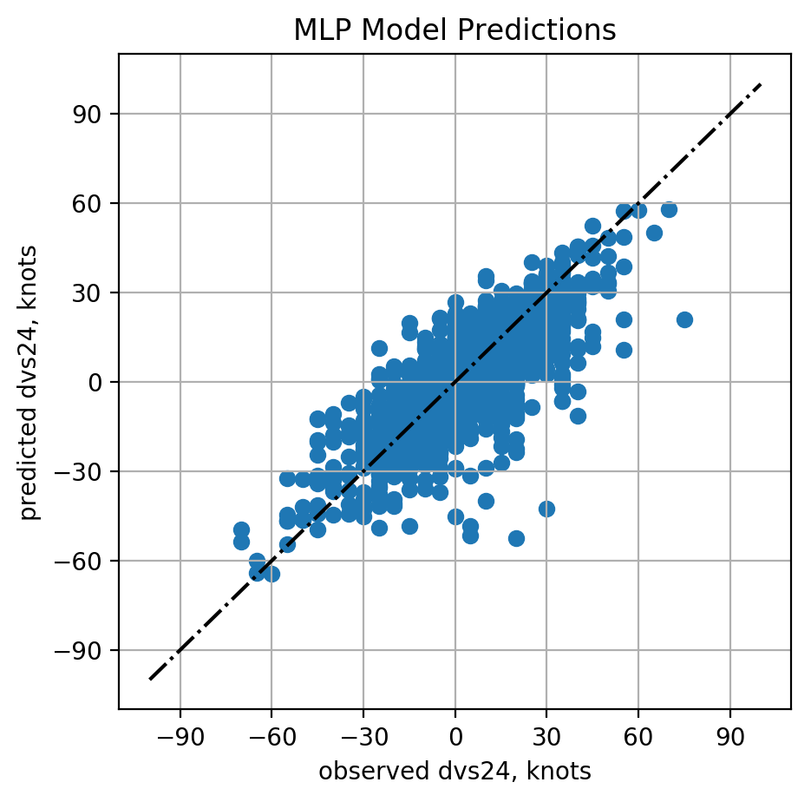
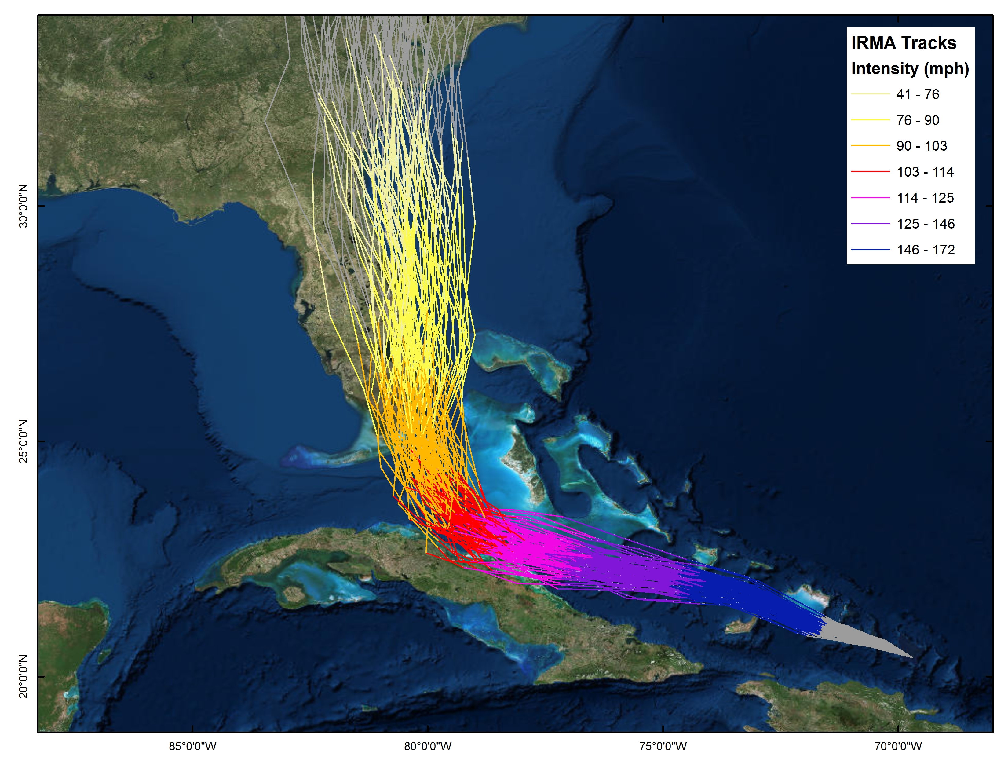
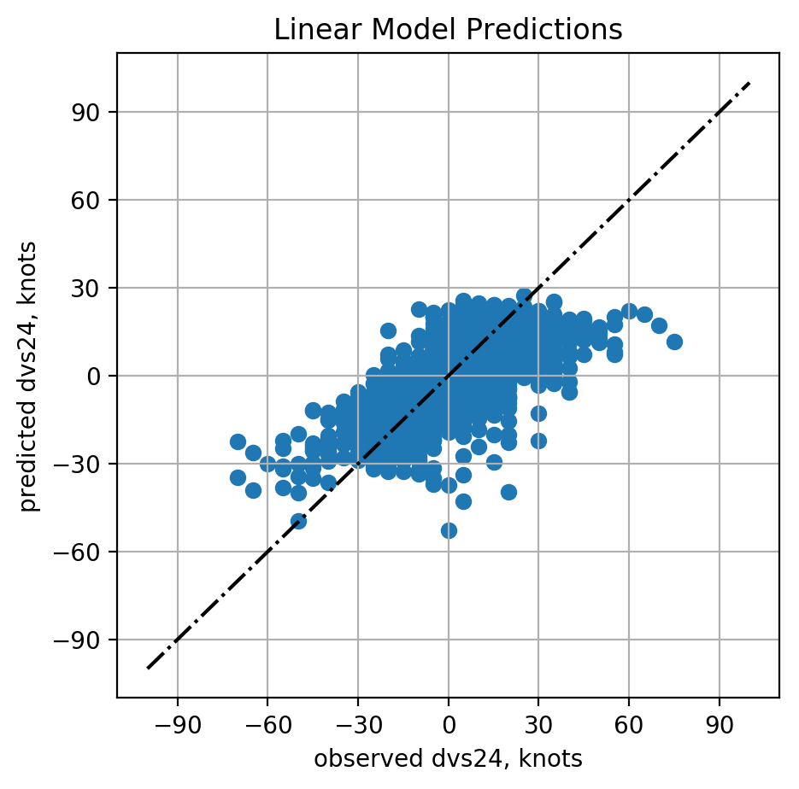
Testing Results on Year 2010-2017
Using the same training data, the MLP outperforms the Linear Regression (LR) model.
MLP predicted 50 Rapid Intensification events correctly (precision=82%,recall=34%).
RI
events
Potential application in real time intensity forecasting (IRMA,2017)
(AME=7.51 , R²=0.61)
(AME=9.07, R²=0.43 )
Notes:
Using the same predictors and labels, the MLP outperforms Linear Regression (LR) model.
Scatter plots on the left: One of the biggest challenge in hurricane intensity prediction is correctly forecasting rapid intensification event (24 hour intensity change >= 30 knots). MLP predicted 50 Rapid Intensification events correctly (precision=82%,recall=34%), while linear regression model does not return any RI events.
The figure on the right shows how the model can be utilized in a real time forecast setting. We did some experiments back in 2017 using an earlier version of the MLP model to predict intensities along forecasted tracks for Hurricane Irma in near real time.

Slide 8
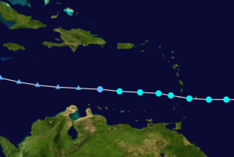
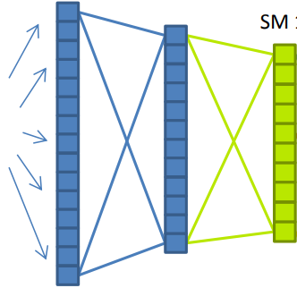
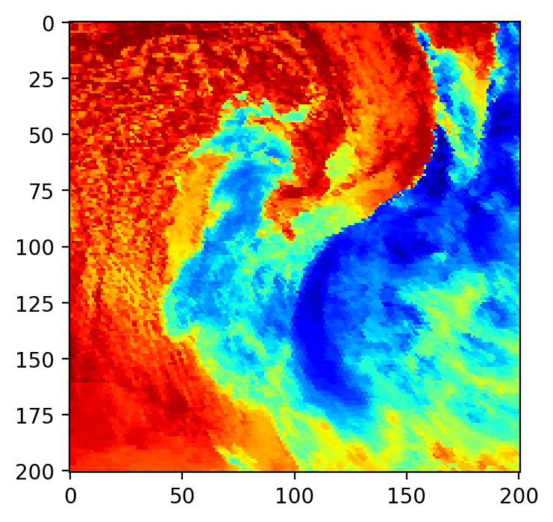
Next Steps: Add 3D (ocean) + Satellite
Ocean vertical T,S profiles along forecasted track
Existing MLP Model
Dense Layers
Dense Layers
+
Intensity change
prediction
Satellite Images
+
Convolutional Layers
Deep Neural Networks offers flexible ways to combine raw and engineered features.
Project goals:
  (1) Improving operational forecasts;
  (2) a lightweight DL model for intensity estimation in low-resolution climate models.
Notes:
Deep Neural Networks offers flexible ways to combine raw and engineered features, which is another advantage over traditional models. We plan to add convolutional layers to extract additional useful information from satellite images. Using neural network, we can also easily add on Argo floats’ ocean temperate/salinity profiles at forecasted future track locations, which we believe will further improve the model performance.
Project goal: (1) the potential of improving the operational forecast; (2) producing a lightweight DL model for intensity estimation in climate research.

Slide 9
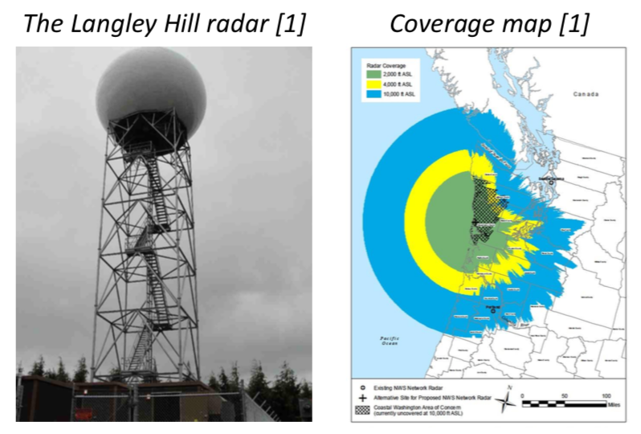
Improving Radar Products with Machine Learning
ARM produces a large amount of data (>1PB).
  More than can be looked at by hand
ARM data quality is a key priority
Machine learning is a promising approach to tackle the problem
Supervised machine learning has challenges with training data for detecting instrument malfunctions.
Unsupervised learning potentially sidesteps this problem.
  Exploit statistical relations between parameters in the data.

Slide 10




Using Unsupervised Machine Learning Models to Predict Anomalous Data Quality Periods
Joseph C hardin¹, Nitin Bharadwaj¹, Mahantesh HalapPanavar¹, Adam Theisen
Utilize a variation on unsupervised clustering.
Break data up into N statistically different groups
  Not predefined, but data driven
Clusters represent statistical modes of operational returns.
Use out of cluster distances to detect anomalies.
One of the largest challenges in unsupervised clustering:
  You can’t force certain clusters.
  You can always find N clusters. Doesn’t mean they are statistically independent.

Slide 11
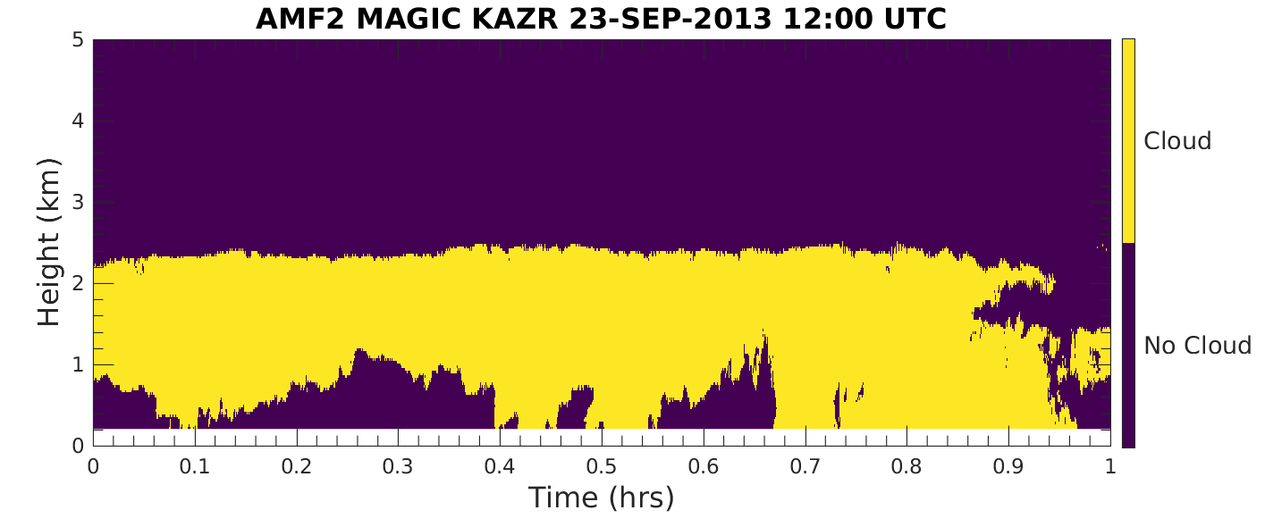
Toy Example using AMF2-MAGIC KAZR Radar Reflectivities
1 Input (Reflectivity),
2 Clusters
Radar Reflectivities
Ask for 2 Clusters
→ Rough Definition of
Cloud & Cloud Free

Slide 12
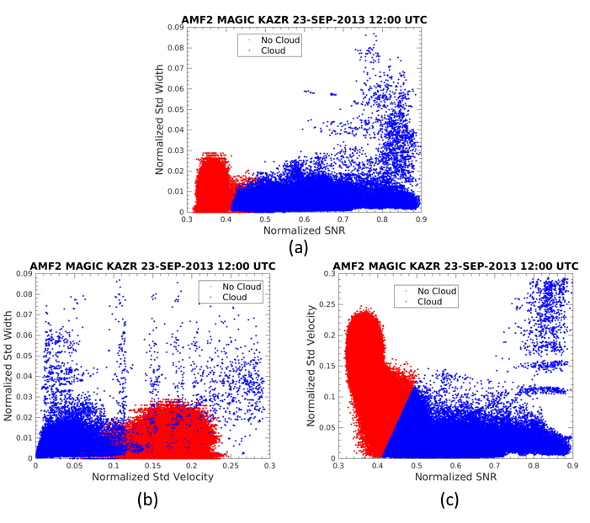
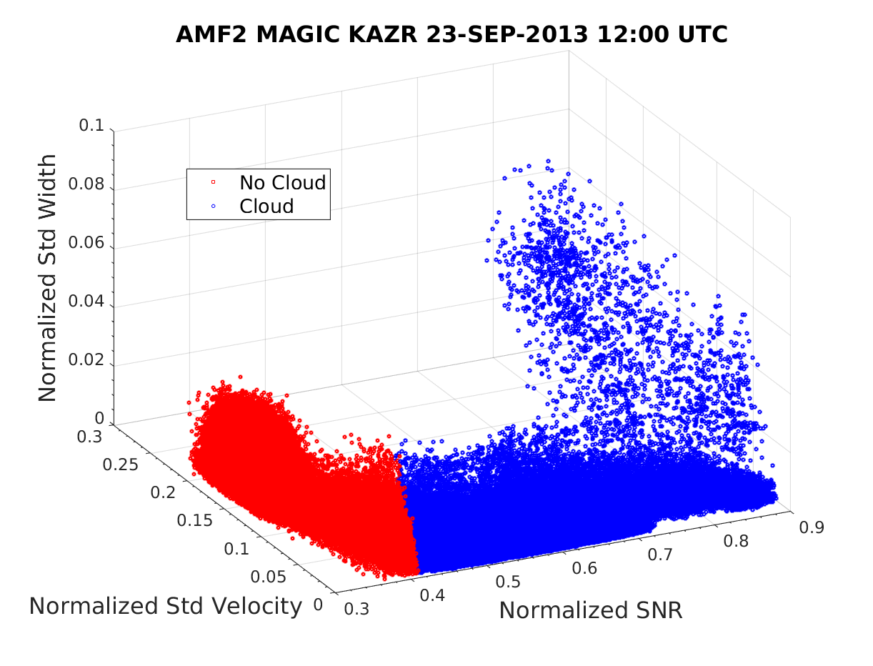
AMF2-MAGIC KAZR Toy Example
3 Inputs ← Distribution Width, Velocity, Signal Noise Ratio (SNR)
2 Clusters
Figure 5: Classification Surface as a function of three input variables.
Notes:
Utilizing dimensionality.

Slide 13
Radar Super-Resolution Using a Convolutional Neural Network
Andrew Geiss (UW), Joseph Hardin (PNNL)
Low resolution is sometimes chosen to reduce quantity, or sample more rapidly
→ (e.g. spin radar antenna faster).
Perhaps we can synthetically increase resolution of data beyond native resolution.
Typical strategies use interpolation to estimate from neighboring data regardless of context.
Neural network can learn relations in context of large scale image features
Deep convolutional neural network used to enhance the resolution of NEXRAD PPI scans.
Model trained on 6-months of high res, high quality data [reflectivity observations from the Langley Hill WA (KLGX) radar]

Slide 14
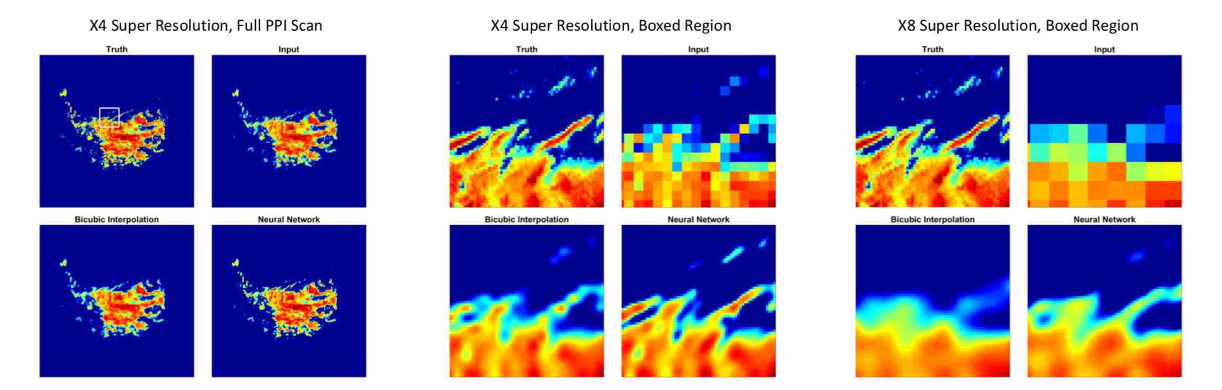
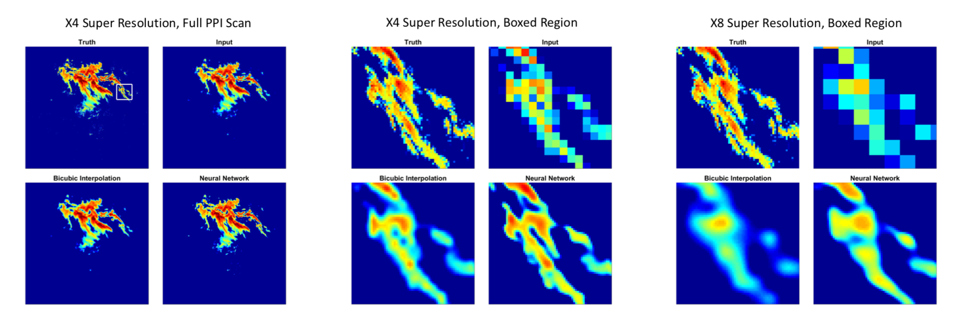
Validation Images

Slide 15
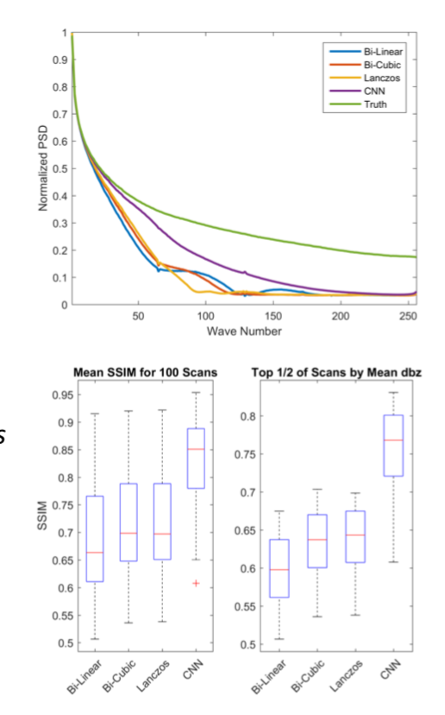
Validation Statistics
The CNN approach has a lower MSE pixel error.
It also has a higher SSIM score
  Perceptual quality metric that approximates how much structure an image maintains.
Mean power spectral density shows retention of a larger amount of fidelity in the frequency domain.
  Retains small scale features better.
Substantially outperforms common interpolation schemes

Slide 16
Extras

Slide 17
Validation of f_{s} (Stratiform area)
  Given convective cell sizes the algorithm represents stratiform area distribution and it diurnal cycle well.
Notes:
[JMC] Removed repeated word in first bullet (scales repeated twice)

Slide 18
Summary
Stratiform clouds damp the variability in size and number of convective cells.
For the same convective area fraction, a larger number of smaller cells favors larger stratiform area than small number of large cells.
This interaction leads to large stratiform area (i.e., MCS like features).
Future work: A parameterization based on this framework will be tested in an atmospheric model.

Slide 19
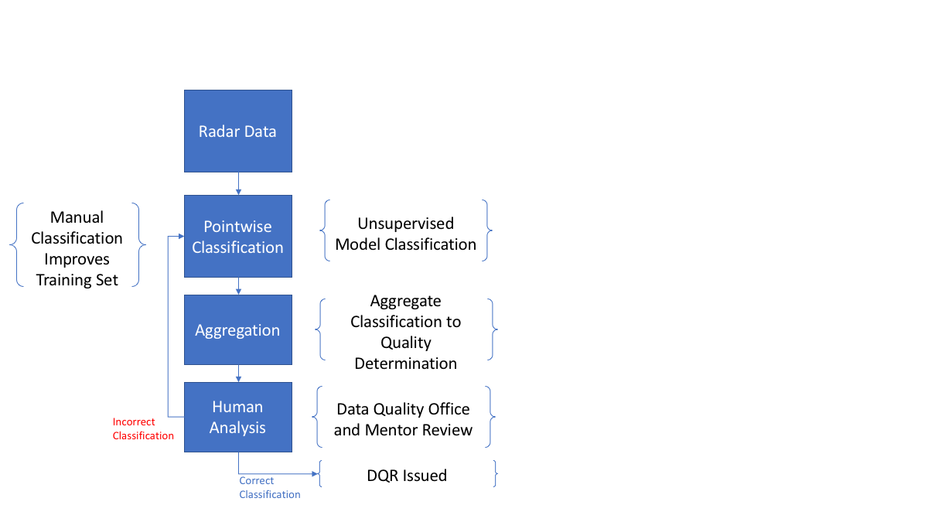
Methodology
Unsupervised clustering to detect statistically independent clusters.
  “typical operating regimes”
Data Clustering for initial pointwise classification
  Clustering on a graph/b-matching
Region based aggregation
  Convert point estimates into time periods.
Human-in-loop review to tweak hyper-parameters and verify.
Envisioned as a way to make data quality review more effective – focus on likely problematic times.
  Directed attention

Slide 20
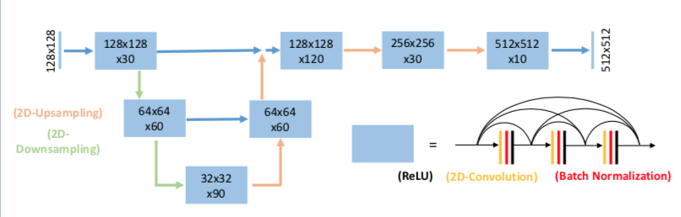
Model Architecture
“U-Net” CNN architecture.
Trained on 7500 radar images.
Additional 25% for validation.
Images were artificially
reduced to 1/4th and 1/8th
resolution
  Effective 1/16th and 1/64th size.
CNN was trained to reconstruct the original image.
Tested additional architectures including Res-net and Dense-Net
U-net ultimately gave best performance.
[1] https://atmos.uw.edu/cliff/Langleyradar.html

Slide 21
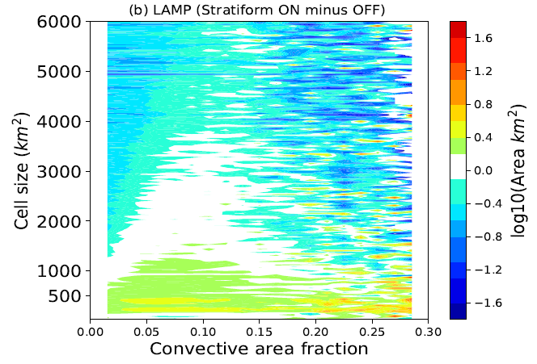
The interaction between convective and stratiform clouds
Consider convective cells vs convective area fraction with stratiform feedback off
LAMP (Stratiform feedback ON minus OFF)
  Stratiform feedback favors increase of the number of smaller cells as opposed to growth of existing cells.
Notes:
[JMC] Removed repeated word in first bullet (scales repeated twice)

Slide 22
The interaction between convective and stratiform clouds
The comparative effect of large cells vs large number of small cells on the growth of stratiform area.
Growth rate of stratiform area
  For a given cell size, the growth rate of stratiform area is approximately linearly related to convective area.
  But it is more sensitive to the number of cells than to the sizes.
Larger cells
Large number of cells

Slide 23
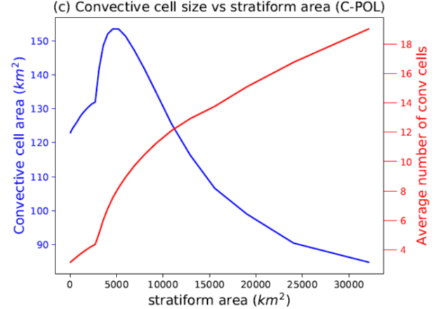
The interaction between convective and stratiform clouds
Direct verification
Convective cell size vs stratiform area (Observation)
  As stratiform area increases, the median size of convective cells decreases but the average number of cells increase.

Slide 24
2. Mass Flux
Relationship with Convective Cell Sizes
Why do we care about cell size distribution anyway?
m_{b} (kg m⁻² s⁻¹)
Because larger cells carry more than their share of mass flux.
From Hagos et al. 2018 (JAMES)
Notes:
[JMC] Removed repeated word in first bullet (scales repeated twice)

Slide 25
3. The Model
(a) Response to stationary stochastic forcing
F constant mean exponential distribution
Stratiform Feedback OFF
Stratiform Feedback ON
  Stratiform feedback damps the oscillation by favoring smaller convective cells.

Slide 26
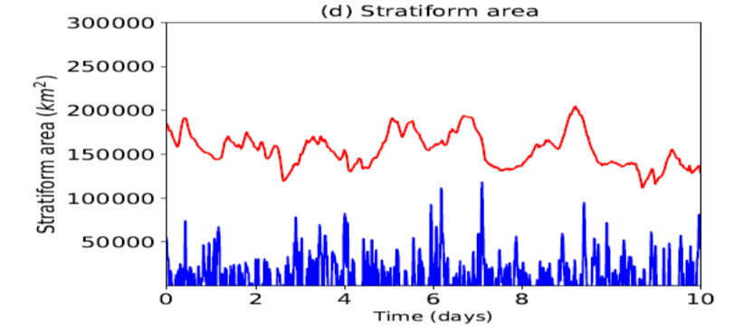
(b) Response to stationary stochastic forcing
Mass flux and stratiform area
Mass flux
Stratiform Area
  Stratiform feedback damps the oscillation by favoring smaller convective cells.

Slide 27
(b) Response to diurnally varying forcing
F is exponential distribution random variable with diurnally varying mean amplitude with peak at noon and is zero at night
Mass flux
Convective area
Stratiform area
  Without stratiform feedback the diurnal cycle of mass flux is delayed.
  There is larger swing in mass flux, convective cloud area as well as stratiform area.

