Slide 1
Democratizing Machine Learning AI for Earth’s API Framework
Patrick Flickinger
Engineer, AI for Earth
NOAA Artificial Intelligence Workshop
April 24th, 2019

Slide 2
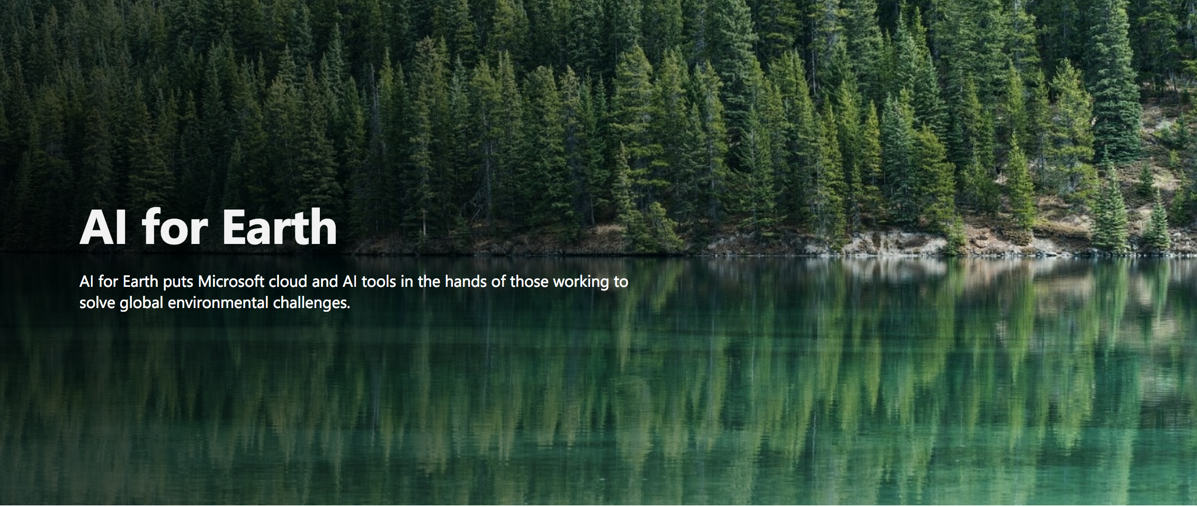
Notes:
- a five-year, US$50 million Microsoft initiative

Slide 3
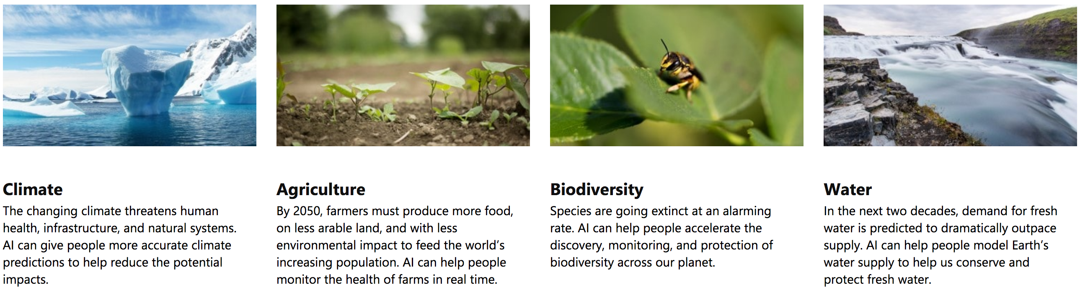
AI for Earth
Areas of Focus

Slide 4
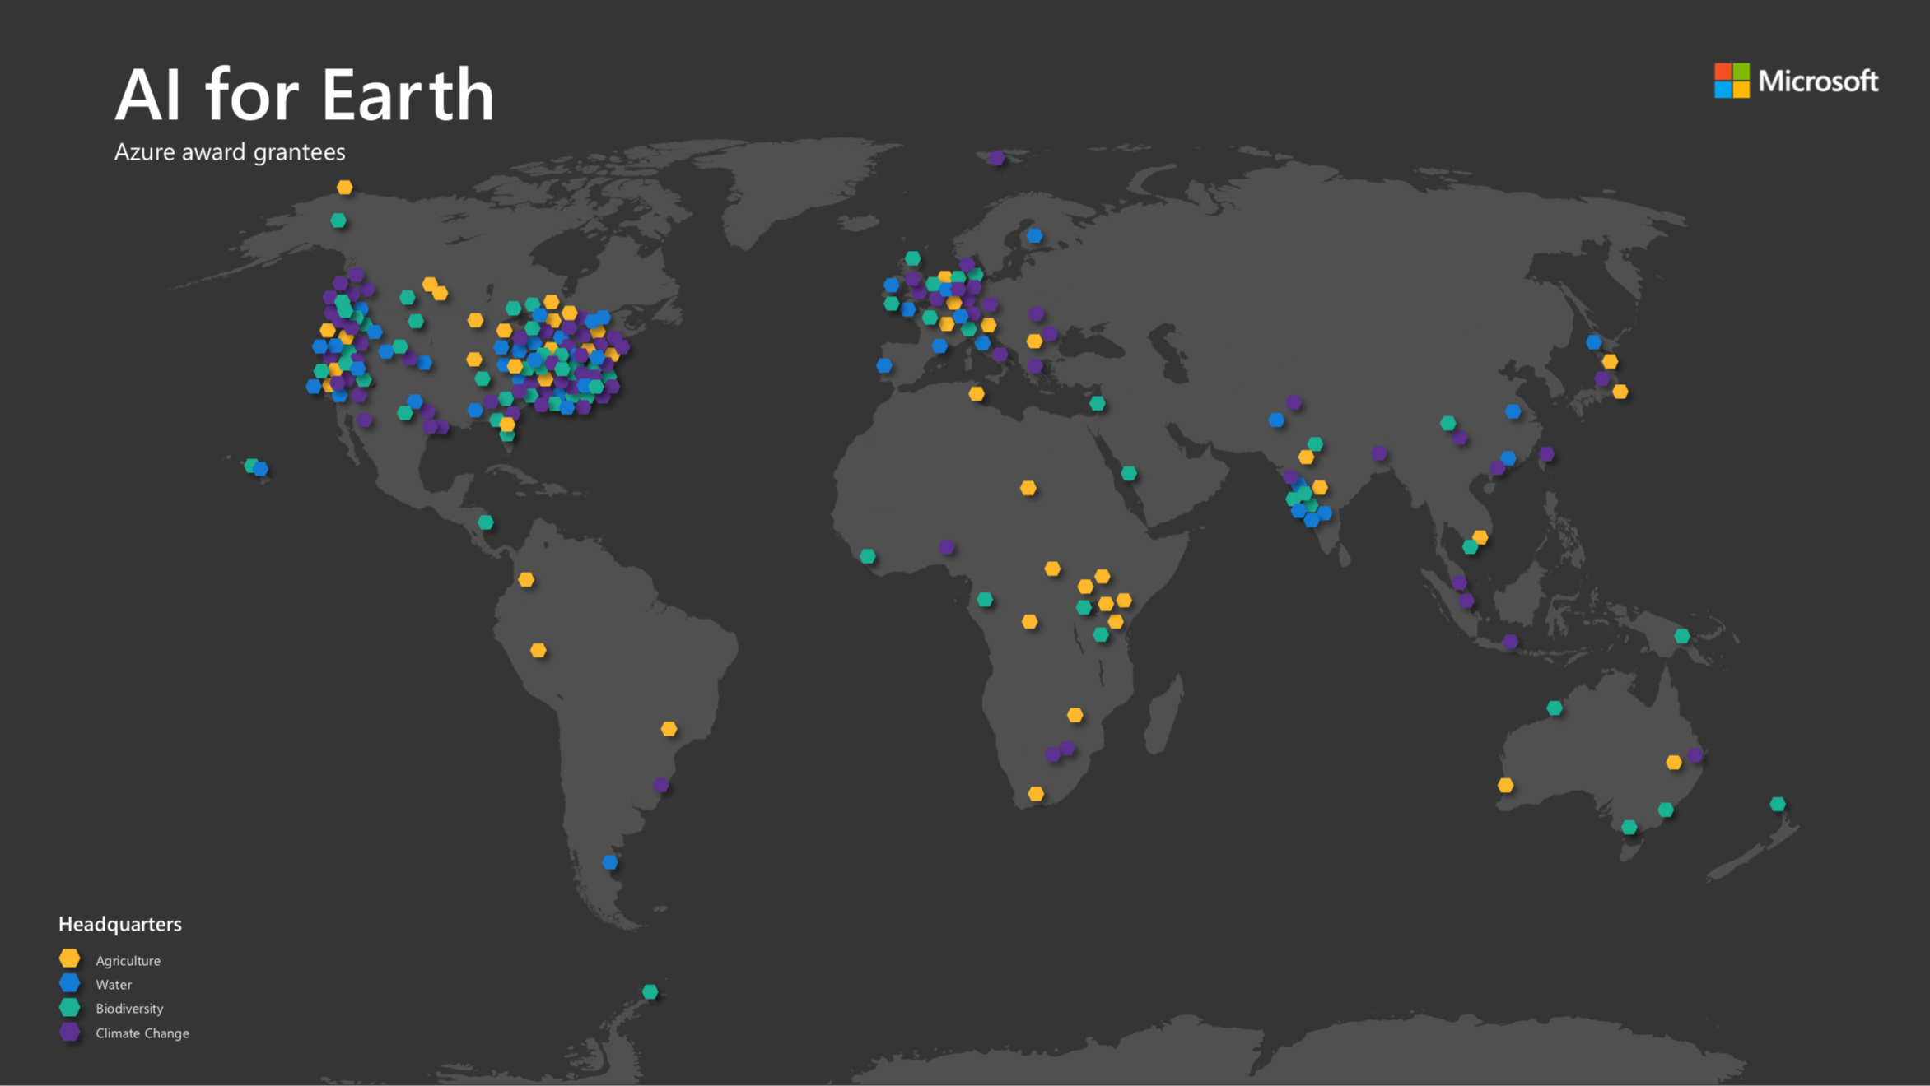
Notes:
Around 250 grants issued
AI for Earth awards grants to support projects that change the way people and organizations monitor, model, and ultimately manage Earth’s natural systems.
Depending on project need, our grants can award Microsoft Azure cloud computing resources (including AI tools) and/or data labeling services.

Slide 5
The problem with machine learning
Notes:
the vast majority of this work exists confined to the researcher's private device, thus detrimentally limiting the model's application

Slide 6
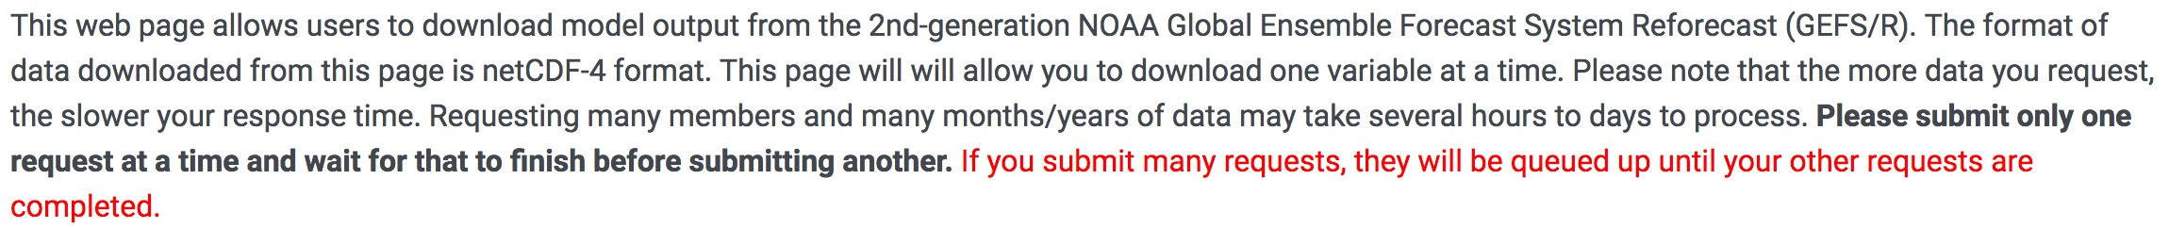
Model Isolation – Today’s Reality
Private Labs
Researcher’s PC
Private labs
Data sets that are restricted or difficult to access
Models are private, restricted, or a black-box
Notes:
Private labs, where models and data is gated behind layers of process.
Inaccessible data + black-box software tends to result in mistrust among external parties
Siloed data dictates model creation constraints, which can limit available tools and technologies.
AI for Earth is working to ingest large data sets from NOAA, NASA, and others to put the data adjacent to the latest tech

Slide 7
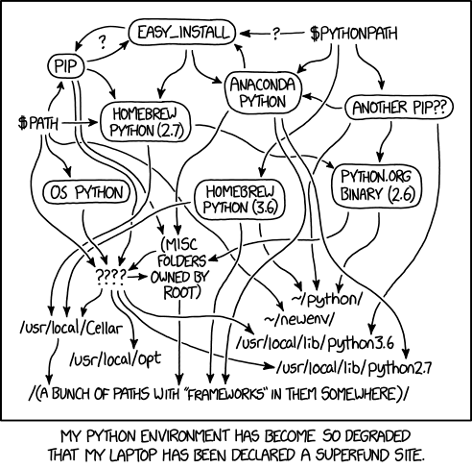
Researcher’s personal computer
Localized Monolithic Model
One-off Scripts
Researcher’s Environment
Local Data Sources
* https://www.xkcd.com/1987/
Notes:
- unique set of tools, libraries, and frameworks, all have specific versions
- result is one-off scripts and glue code tailored to overcome very specific environment problems
data scientists spend around 80 percent of their time on repetitive and tedious tasks (data preparation, feature engineering)
Many of these tasks are repeated among data scientists

Slide 8
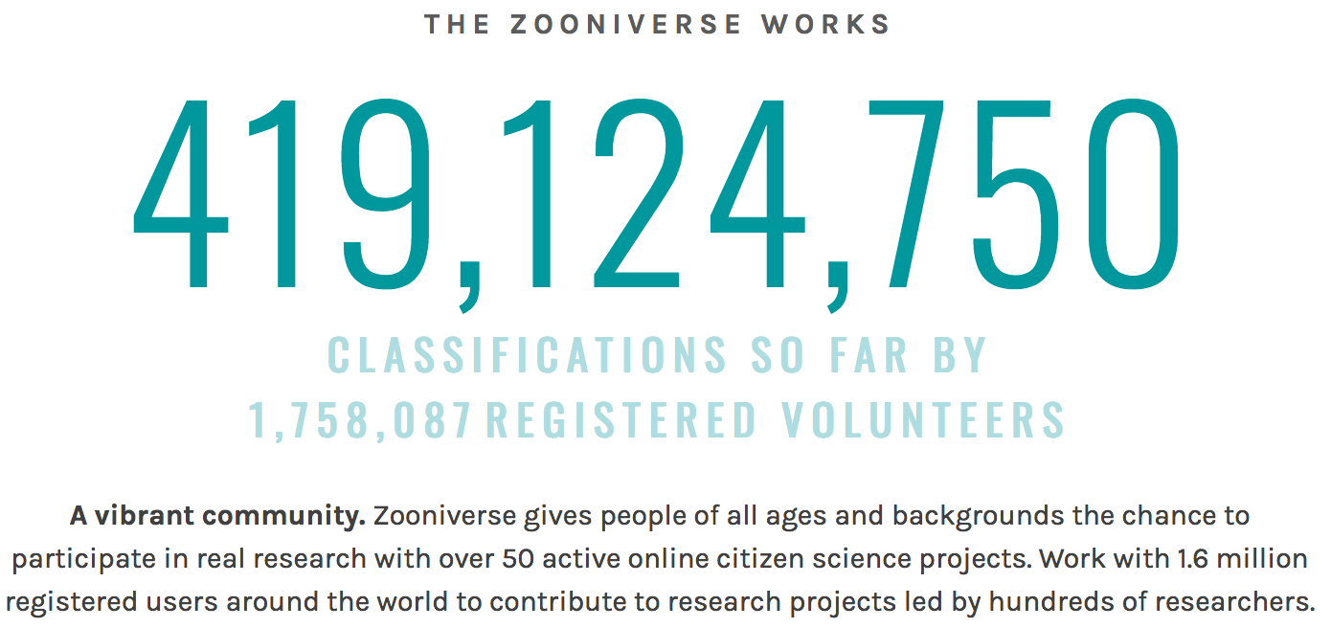
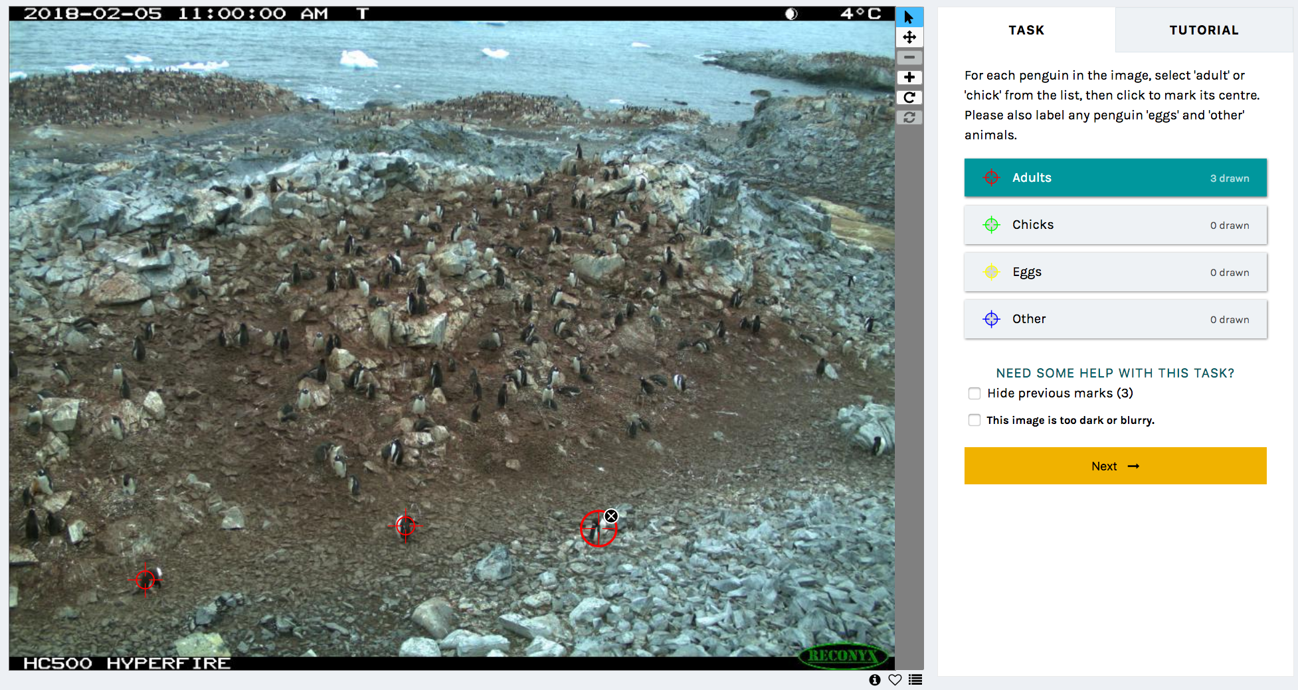

Why is this important?
Notes:
for the first time in human history, we have the opportunity to harness the power of citizen science at a massive scale
last week, my 8 and 11 year-old daughters took part in an alzheimer's labeling megathon, where people world-wide came together to help advance alzheimer's research – in 2 hours, the megathon accomplished 2.5 months of lab-equivalent research
Oct 2018: A 16-year-old high school student built a website around public data from the NIH ClinVar archive, helping clinicians advance genomic treatments, and says similar innovations depend on more freely-available data.

Slide 9
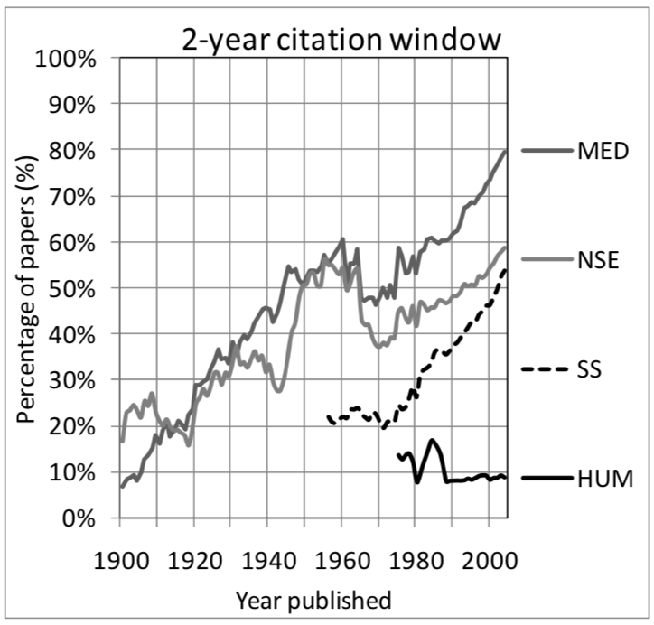
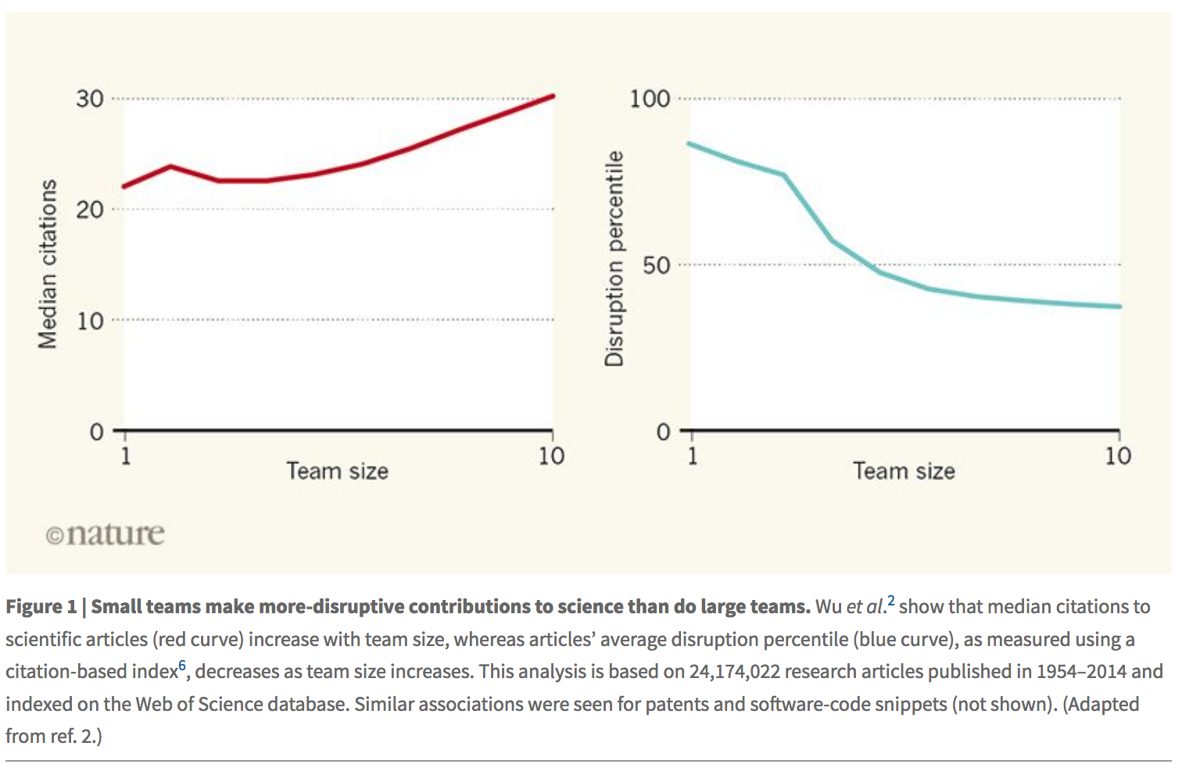
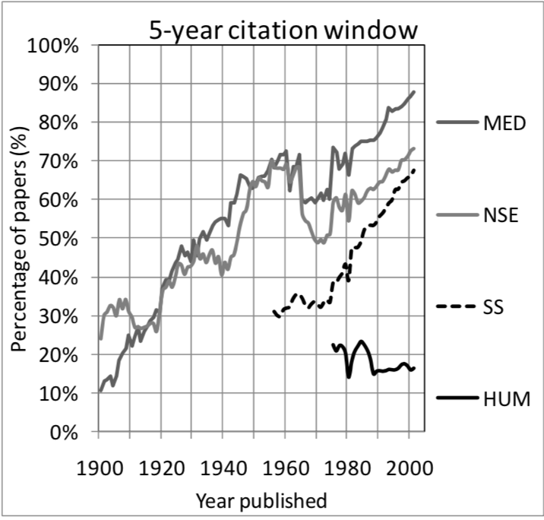
Why is this important?
* The decline in the concentration of citations, 1900–2007
Vincent Larivière, Yves Gingras
* Small research teams ‘disrupt’ science more radically than large ones Pierre Azoulay, Nature, 13 February 2019 https://www.nature.com/articles/d41586-019-00350-3
Notes:
Real world impact vs impact factor (citation analysis), 40% not cited in first 2 years, 1/3 after 5 years
Research has shown that small teams disrupt science more than lager ones
While our tools can be utilized across teams, we also focused on the individual researcher to give them the tools needed to drive real impact.
Broad applicability

Slide 10
Democratizing machine learning
Notes:
Microsoft's AI for Earth Team has built tools to democratize a researcher's product through the use of containerized APIs that allow scientists to "drop-in" their models and deploy to the Cloud for world-wide consumption.

Slide 11
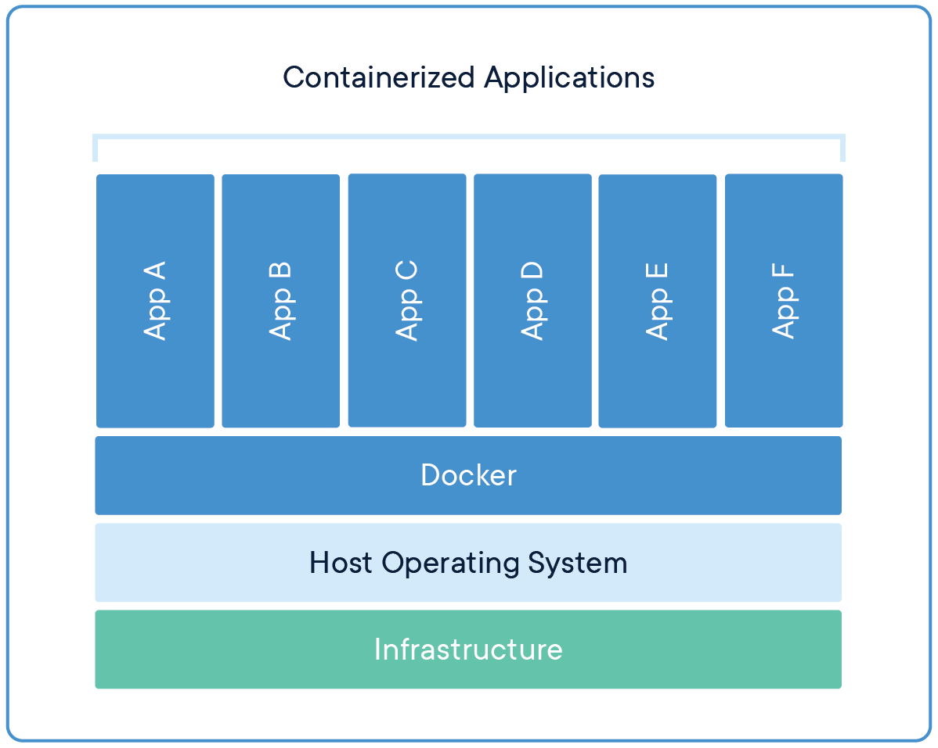
A Containerized Approach
Containers are an abstraction at the app layer that packages code and dependencies together.
Containers share the OS, which alleviate the need for heavy, mostly duplicate, VMs.
Containers let us deploy quickly – and are portable.
We provide base images that provide an API framework, advanced logging capabilities, and Azure blob tools so that you can quickly get your model hosted in an API.

Slide 12
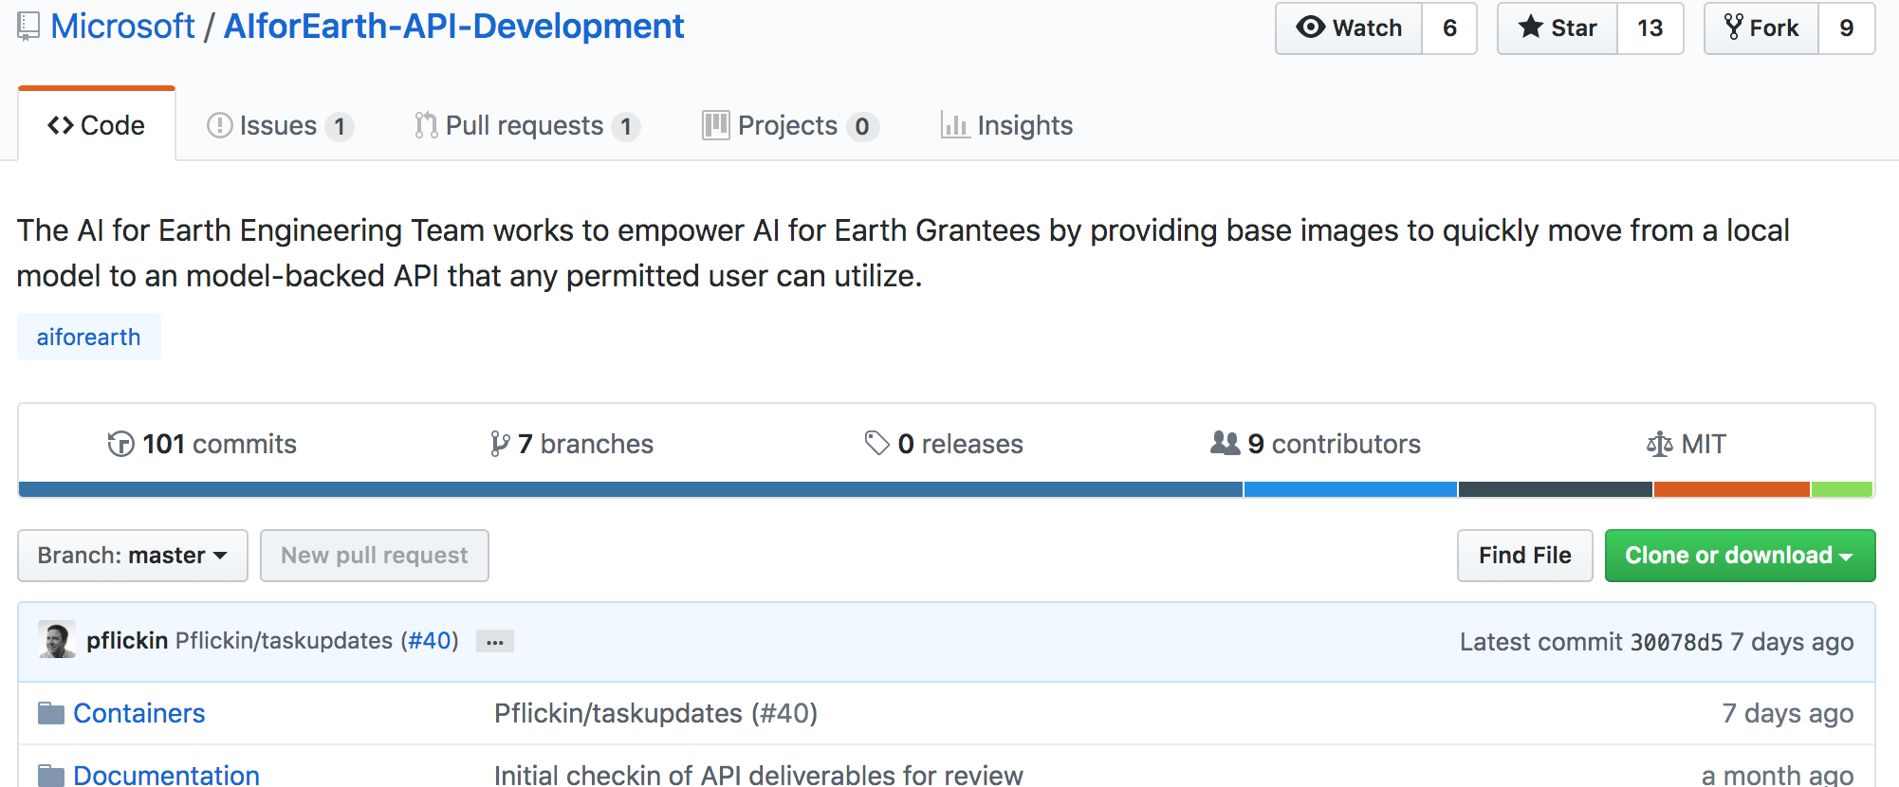
AI for Earth API Framework
API Service Library (decorators, task mgmt, etc.)
Storage and Logging Libraries
API Hosting (Flask, uwsgi, supervisor, etc.)
nvidia/cuda ubuntu
Notes:
Goal is to give researchers all the tools they need to “drop in” models so they can immediately expose as an API, with little engineering knowledge required.

Slide 13
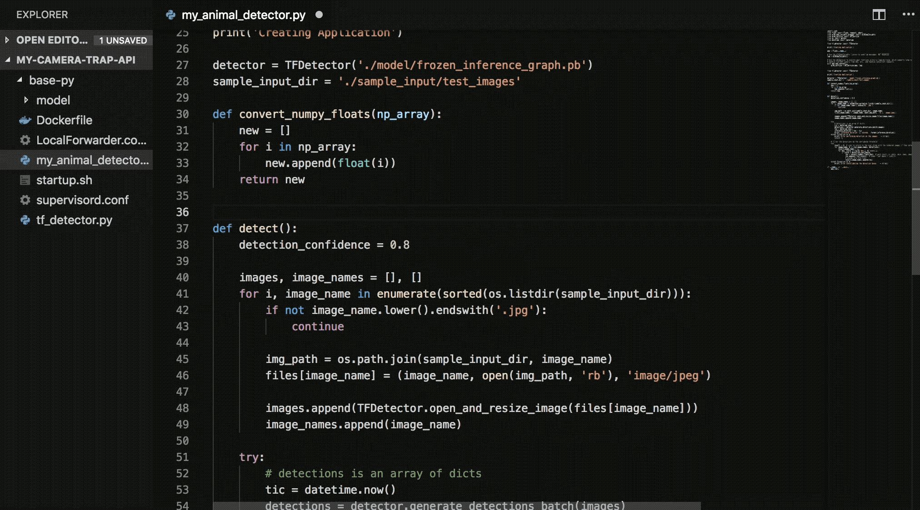
AI for Earth API Framework
Model and Algorithm Production Assembly
Base Container Images | Packaged OS and versioned libraries for consistent execution environments
API Framework | Decorator supported API development patterns with integrated request input checking, container disposal checking, and auto-tasking for asynchronous endpoints
Task Library | Support for long-running inference though a service-based task database
Storage Libraries | Provide options for interacting with Azure storage
Logging Libraries | Secure logging, telemetry, and tracing with a dual-sink for diagnosing hosted partner solutions
Notes:
We have created a GitHub repo that contains all the source to our base images, many examples, and extensive documentation on how to go from model to API. We also detail how to surface your API for world-wide consumption via Azure Container Instances.
Base images, a decorator takes care of surfacing your function as an API through an endpoint you specify, and handles long-running, or async requests through an integrated tasking system. Storage libraries and logging libraries round out tools that we provide to help keep tabs on running operations.
Azure Container Instances, when combined with Azure API Management, provides a cheap, feature-rich, secure solution for deploying a model that is available world-wide, accessible with granted tokens, and enriched with extensive OpenAPI documentation.

Slide 14
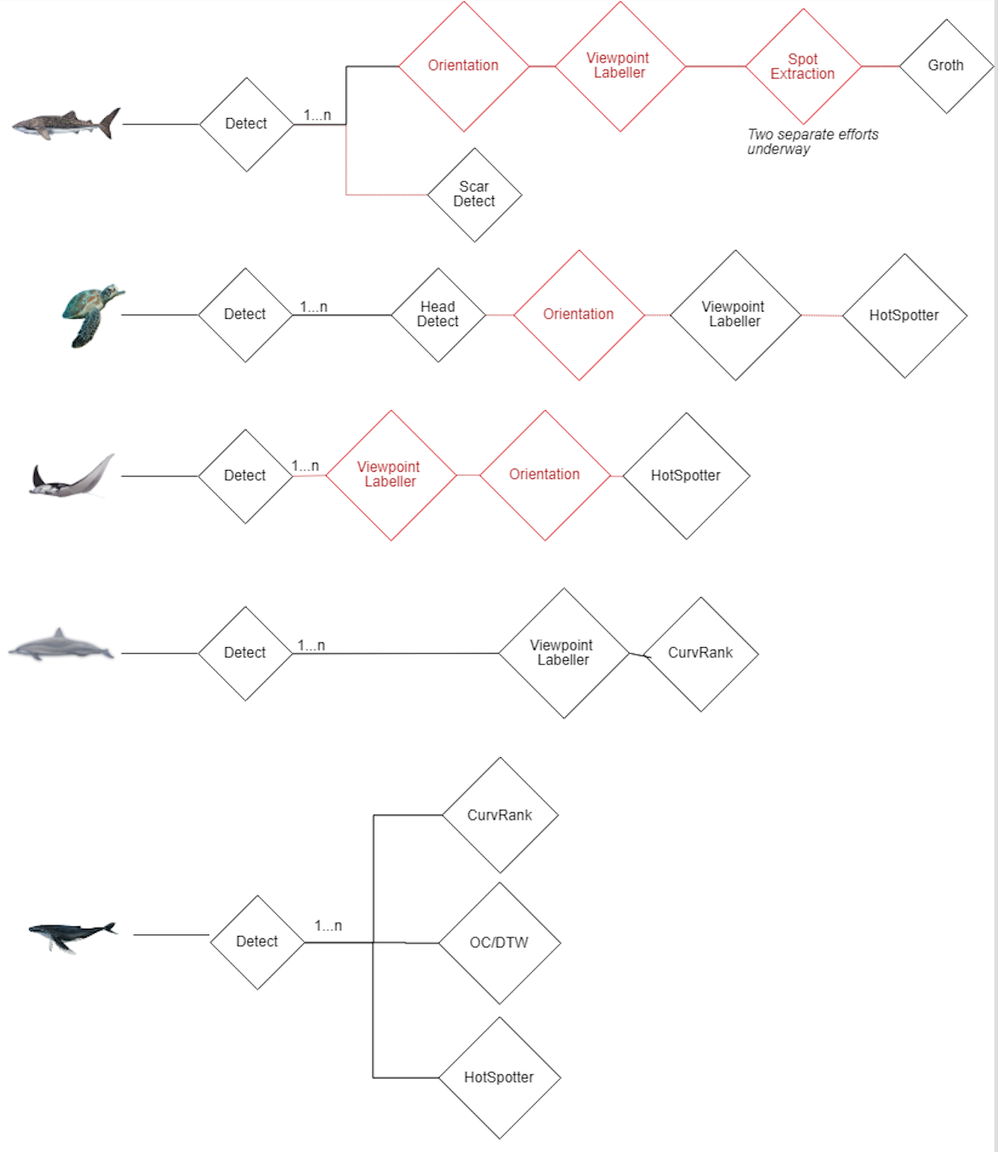
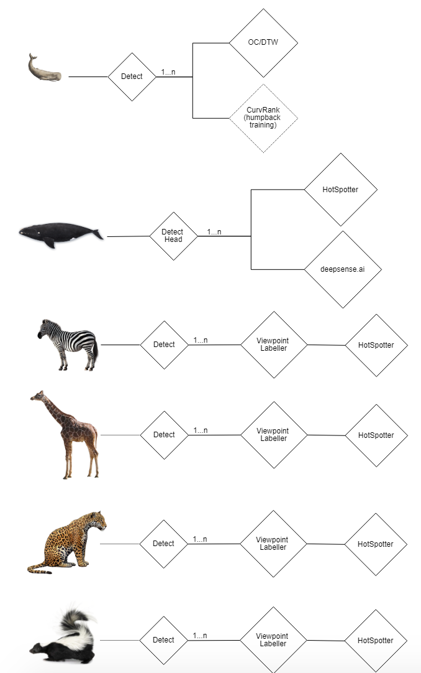

A Multiple Pipeline Problem
11 pipelines
40 running service VMs (before scaling)
Manually scaled
Requests are queued
Massive idle VM costs
Additional species require building new pipelines

Slide 15
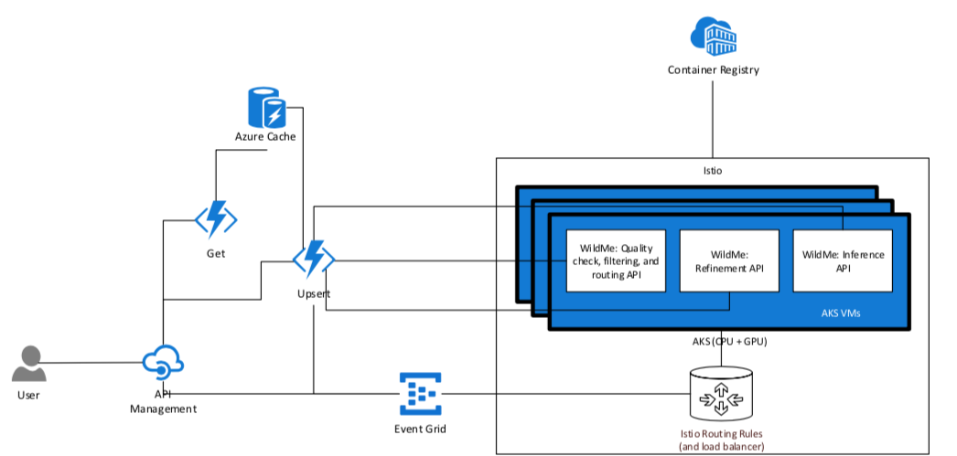
API Platform
Core Service Hosting
Load-balanced Service Hosting | Traffic to redundant service instances is automatically managed (AKS)
Custom-defined Routing | Service mesh routing provides customizable routing to services, versioned routing, percentage dispersal, and duplicated routing
Long-running Inferences | Task database and functions provide asynchronous capabilities with on-demand task updates
Key-based Service Access | Keys can be distributed to groups for individuals (Azure API Management)
Service Documentation | Services are individually documented adhering to the OpenAPI standard
Backed by the Latest Technologies | Multiple clusters can be run in parallel, each of which may be hosted on any Azure CPU or GPU SKU
Extensible | Ingestion from Azure IoT, etc.
Service Pipelining
Reduces Redundancy | In parallel pipelines, identical services instances are scaled by demand and do not need to be duplicated
Promotes Reusability | Existing services are inserted into new pipelines
Create new APIs (Model Ensembles) | APIs can be created by combining existing services into a new product
Monitoring
Logging and Telemetry | Search, monitor, and alert on telemetry from all infrastructure elements
Distributed Tracing | Deep-dive into individual function timings and call stacks
Tasks | Query awaiting, running, completed, and failed tasks
Scaling
Container Resources | Scale based on CPU and memory of individual containers
Tasks | Enhanced ability to scale based on the number of awaiting tasks, per service
Generic Application Insights Metrics | Customize scaling based on any metric logged to Application Insights
Notes:
Off the shelf Azure services, which all provide, at least 99.9% SLA
Highly extensible – anything that plugs into Azure Event Grid, Azure’s eventing service, can interface with this system – IoT, real-time streaming, etc.
Created a segmented jobs service we are using for processing large data sets.

Slide 16
Kubernetes-backed Scaling
11 pipelines
40 12 running service VMs containers
Each container is independently auto-scaled
New pipelines built via composable APIs

Slide 17
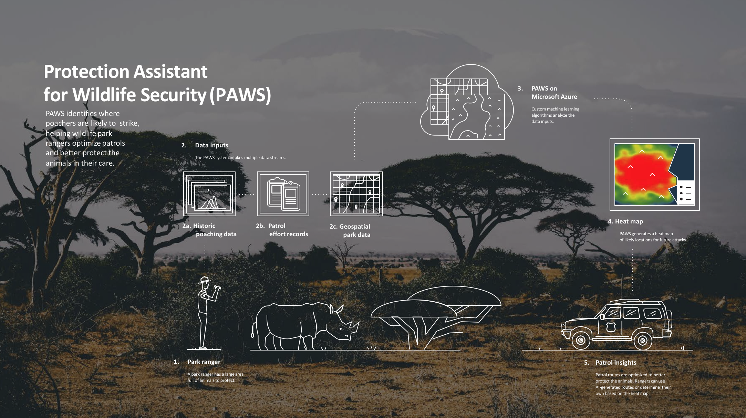
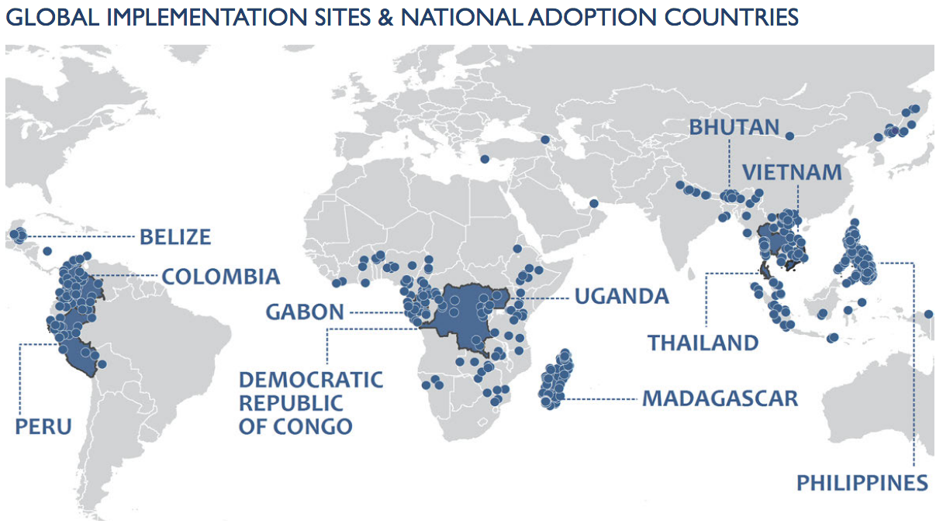
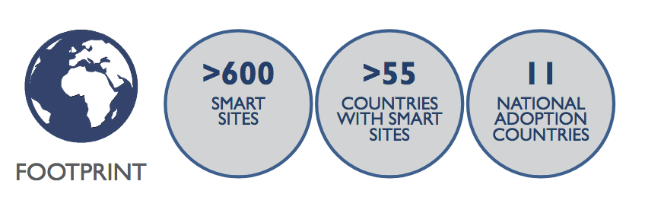
Scale
Notes:
With > 600 SMART sites, deployment to every park is a non-starter.
Working with USC, we developed a container platform that allows researchers to drop in their model to immediately surface an api.
Explain api containers OSS
Drop this api in our distributed, kubernetes service mesh, and we’re now able to scale for this increased usege, world-wide
Inference api platform handles long-running apis, seen from running large ML models, and can pipeline multiple models/apis to generate new apis.
Integrate directly with SMART – explain usage

Slide 18
https://github.com/Microsoft/AIforEarth-API-Development
Patrick Flickinger
pflickin@microsoft.com
@NeuronicCoder

