Slide 1
Improvement to Hurricane Track and Intensity Forecast by Exploiting Satellite Data and Machine Learning
Narges Shahroudi^{1,2}, Eric Maddy^{1,2},
Sid Boukabara¹, Vladimir Krasnopolsky³
¹NOAA/NESDIS Center for Satellite Applications and Research (STAR)
²Riverside Technology Inc. (RTI) @ NOAA/STAR
³NOAA/National Weather Service

Slide 2
OUTLINE
Motivation and Objectives
Proposed Methodology and Network Architecture
Results (OSSE)
HWRF Dataset
Preliminary Results (HWRF)
Summary and Future Works

Slide 3
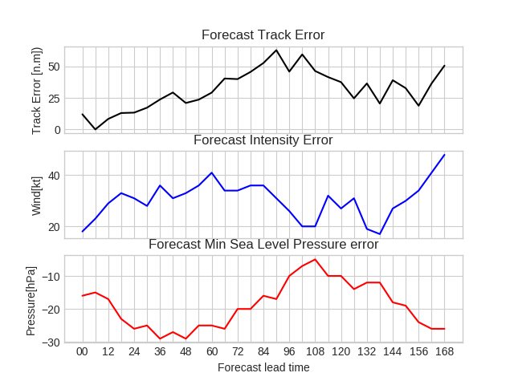
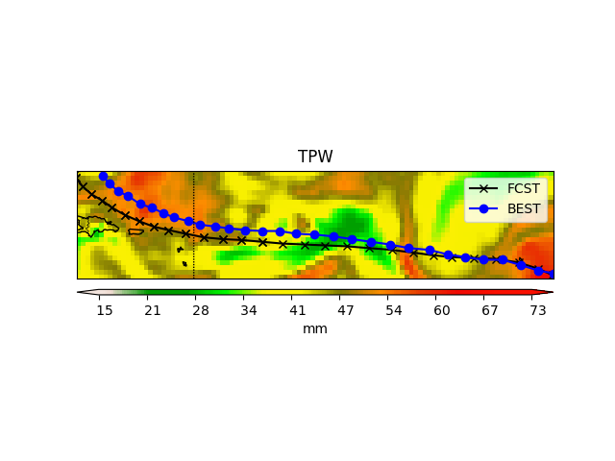
Motivation and Objectives
Can we correct the hurricane track and intensity forecast error using Machine Learning?

Slide 4
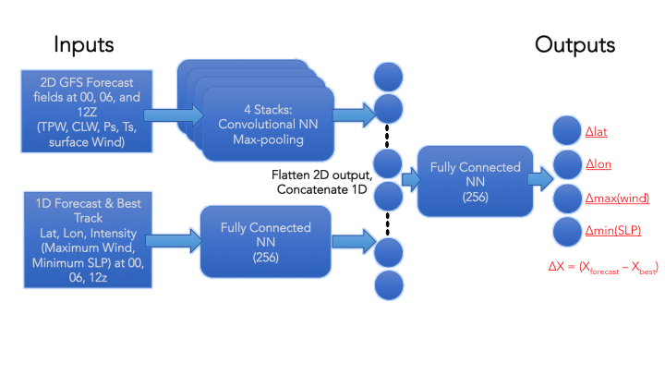
Proposed Methodology
CNN trained for the 2D Environment (hurricane area)
FFN trained for the 1D track and intensity information (1 hidden layer of 256).
Combined into 1 fully connected network (1 hidden layer of 256).
Predict a 4 layers output

Slide 5
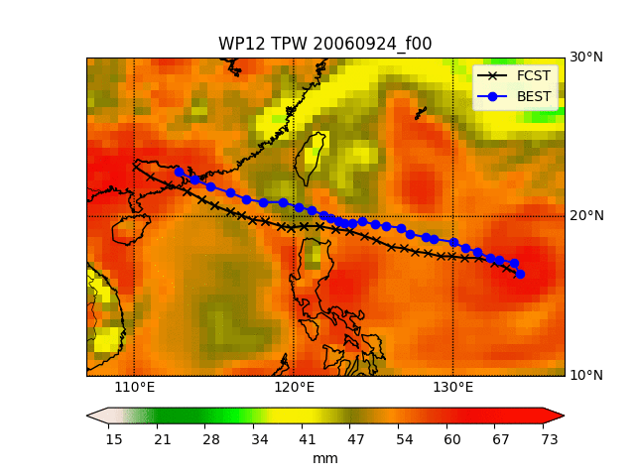
Data: (OSSE/GFS)
As a quick start an OSSE forecast results were used
Simulated observations (based on NASA G5NR)
NOAA’s operational GDAS/GFS model to do the assimilation and forecast
Provides a database of GFS forecasts of TCs over a period of 30 days.
TC forecast information (best track forecasts) were extracted
Network trained on 16 storms in the Atlantic and Pacific basins and using 00z GFS fields:
Inputs:
  TPW, Surface Temperature, Surface Wind, surface Pressure
  ATCFUNIX: Track (lat,lon), Max Wind, and MSLP
  Best track: Track (lat,lon), Max Wind, and MSLP

Slide 6
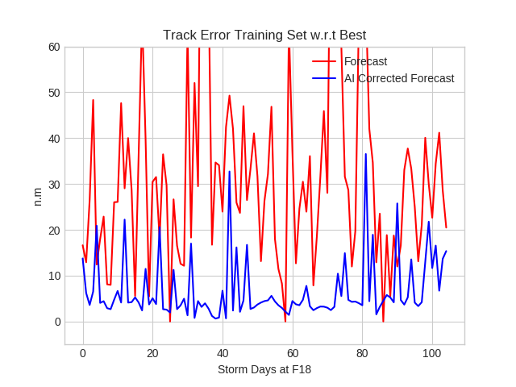
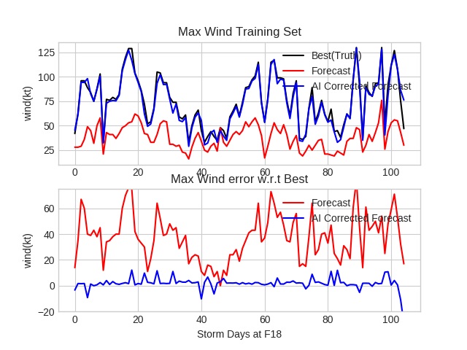
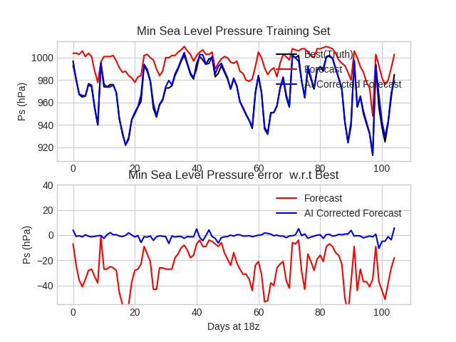
Results: (OSSE-GFS)
 | GFS Forecast |  | AI corrected
 | Bias | Stdv | Bias | Stdv
Track err | 32.44 | 22.81 | 6.73 | 6.65
Wnd err | 37.33 | 17.77 | 1.82 | 4.83
SLP err | -25.89 | 14.39 | -0.77 | 2.22
-Training was done on 80% of the data
-Test on the whole data set to validate the training process

Slide 7
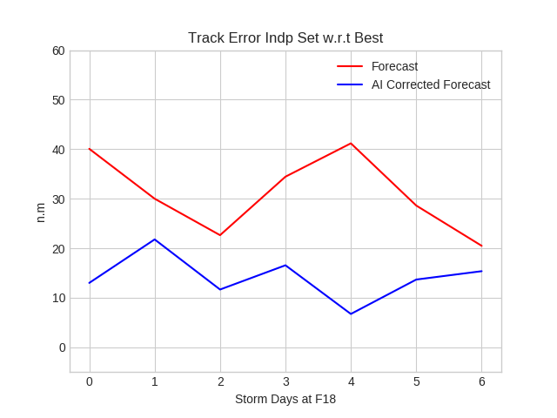
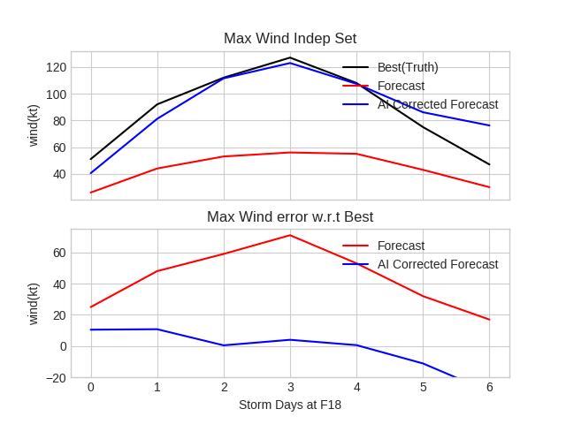
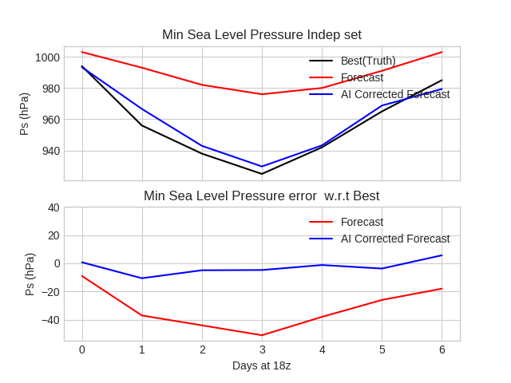
Results: (OSSE-GFS)
 | GFS Forecast |  | AI corrected
 | Bias | Stdv | Bias | Stdv
Track err | 31.06 | 7.42 | 14.11 | 4.28
Wnd err | 43.57 | 18.06 | -1.97 | 13.06
SLP err | -31.86 | 13.77 | -2.71 | 4.72
-The model was applied on an independent storm (not included in the training set)
-AI corrected forecast shows reduced track and maximum wind (intensity) errors

Slide 8
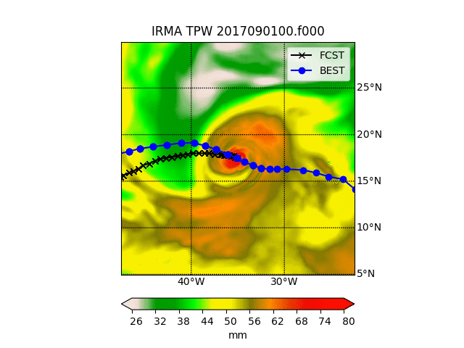
Data: (HWRF)
Testing on another model HWRF and real observation
Hurricane Weather and Research Forecasting (HWRF)
Serve both operational forecasting and atmospheric research needs.
Same information as the pervious data set were extracted from the output of the HWRF model
TPW, Surface Temperature, Surface Wind, surface Pressure, LAT,LON
ATCFUNIX: Track (lat,lon), Max Wind, and MSLP
Best track: Track (lat,lon), Max Wind, and MSLP
2017-2018 Hurricane Season

Slide 9
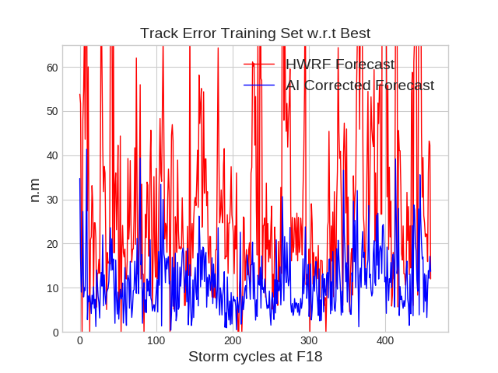
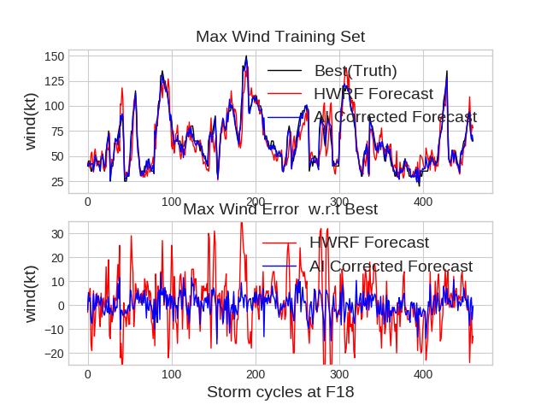
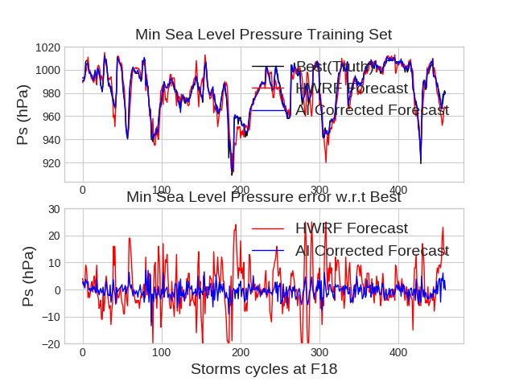
Results: (HWRF)
Training Set
 | HWRF Forecast |  | AI corrected
 | Bias | RMS | Bias | RMS
Track err | 30.95 | 39.12 | 11.52 | 13.46
Wnd err | 0.96 | 11.47 | 0.30 | 4.41
SLP err | 0.87 | 7.96 | -0.50 | 2.54
Training was done on 80% of the data
-Test on the whole data set to validate the training process

Slide 10
Network Architecture
CNN trained for the 2D Environment (hurricane area)
FF trained for the 1D track and intensity information (1 hidden layer of 256).
Combined into 1 fully connected network (1 hidden layer of 256).
Predict a 4 layers output

Slide 11
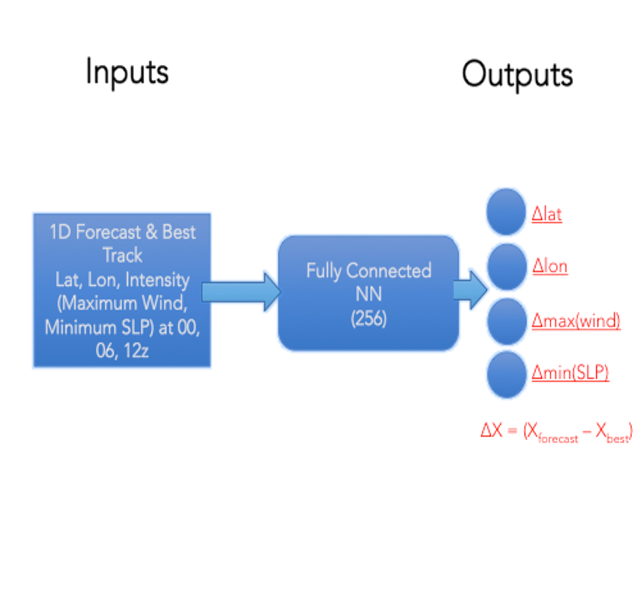
Network Architecture
Trained a new network to see the impact of using the surrounding environment information
FF trained for the 1D track and intensity information (1 hidden layer of 256).
Predict a 4 layers output
Track ONLY without the surrounding Environment

Slide 12
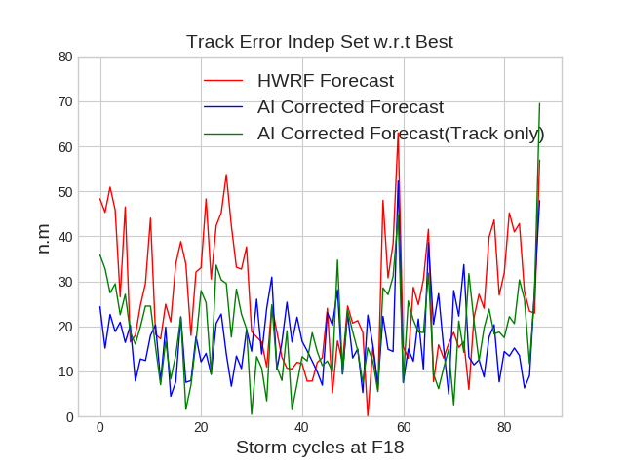
Results: (HWRF)
Track Error
Atlantic Ocean Basin Independent storm
 | HWRF Forecast |  | AI corrected w/Env |  | AI corrected Track Only
 | Bias | RMS | Bias | RMS | Bias | RMS
Track err | 26.41 | 29.79 | 16.96 | 19.00 | 18.99 | 21.72
-The model was applied on two independent storm (not included in the training set)
-AI corrected forecast shows reduced track error for both with surrounding environment and without for correction
IRMA 2017
Leslie 2018

Slide 13
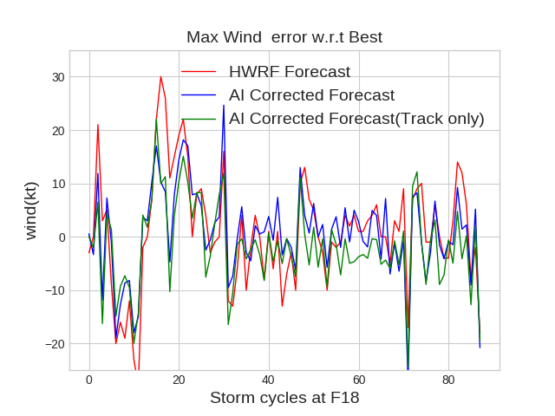
Results: (HWRF)
Intensity Error
Atlantic Ocean Basin Independent storm
 | HWRF Forecast |  | AI corrected w/Env |  | AI corrected Track Only
 | Bias | RMS | Bias | RMS | Bias | RMS
Wind err | 0.91 | 10.63 | 0.60 | 8.51 | -1.72 | 8.21
-The model was applied on two independent storm (not included in the training set)
-AI corrected forecast shows reduced intensity error for with surrounding environment and but not when trained without.
IRMA 2017
Leslie 2018

Slide 14
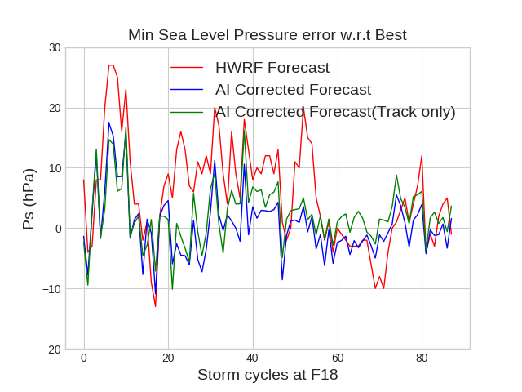
Results: (HWRF)
Min Sea Level Pressure Error
Atlantic Ocean Basin Independent storm
 | HWRF Forecast |  | AI corrected w/Env |  | AI corrected Track Only
 | Bias | RMS | Bias | RMS | Bias | RMS
MSLP err | 5.75 | 10.31 | 0.43 | 5.16 | 2.24 | 5.36
-The model was applied on two independent storm (not included in the training set)
-AI corrected forecast shows reduced MSLP error for both with surrounding environment and without for correction
IRMA 2017
Leslie 2018

Slide 15
Summary & Future works
Summary:
A combination of CNN and DNN was used the predict the hurricane forecast error (Track and Intensity)
Adding the surrounding environment improves the results especially the intensity error
Challenges and Future Work:
Right now we are dividing the training between Atlantic Basin and Pacific Basin storms
  -Can we optimize the network by adding more information to have one model for all the basins?
OSSE corrections are much larger than HWRF. Because the actual Forecast error is larger than HWRF errors
  -Can we optimize the network to capture the smaller errors?
Adding more information or modifying the network architecture
More Data! More storms!
Correct longer Forecast lead time

