Slide 1
Improving Processing and Extracting Value from Satellite Observations through Deep Learning
Jebb Stewart*, Christina Bonfanti**, Isidora Jankov*, Lidia Trailovic**, Stevan Maksimovic*, Mark Govett
April 24th, 2019
NOAA Earth System Research Laboratory (ESRL), Boulder, CO
*Cooperative Institute for Research in the Atmosphere (CIRA)
**Cooperative Institute for Research in Environmental Sciences (CIRES)
NOAA - Earth System Research Laboratory

Slide 2
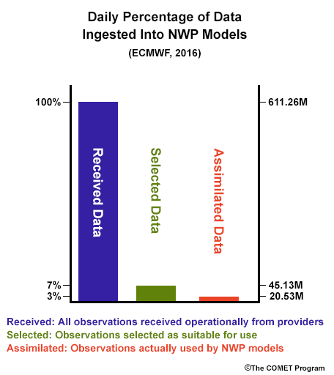
Challenge – Data Assimilation
There are far more satellite data than can be assimilated into the models
At present, we use only ~3% of the available satellite data
Next generation Geostationary Satellites (GOES-16, GOES-17)
  Order of magnitude increase in data volume!!
Goal - Improve quality of selected data
Notes:
From Every 3 hours, 10 bits data, 4 bands
to Every 15 minutes, 14 bits data, 16 bands
Remove the numbers just talk about the magnitude
There are many forms of satellite data
Radiances from infrared and microwave sounders on polar orbiters
Cloud and water vapor motion vectors from geostationary platforms
Surface winds from space-based scatterometers

Slide 3
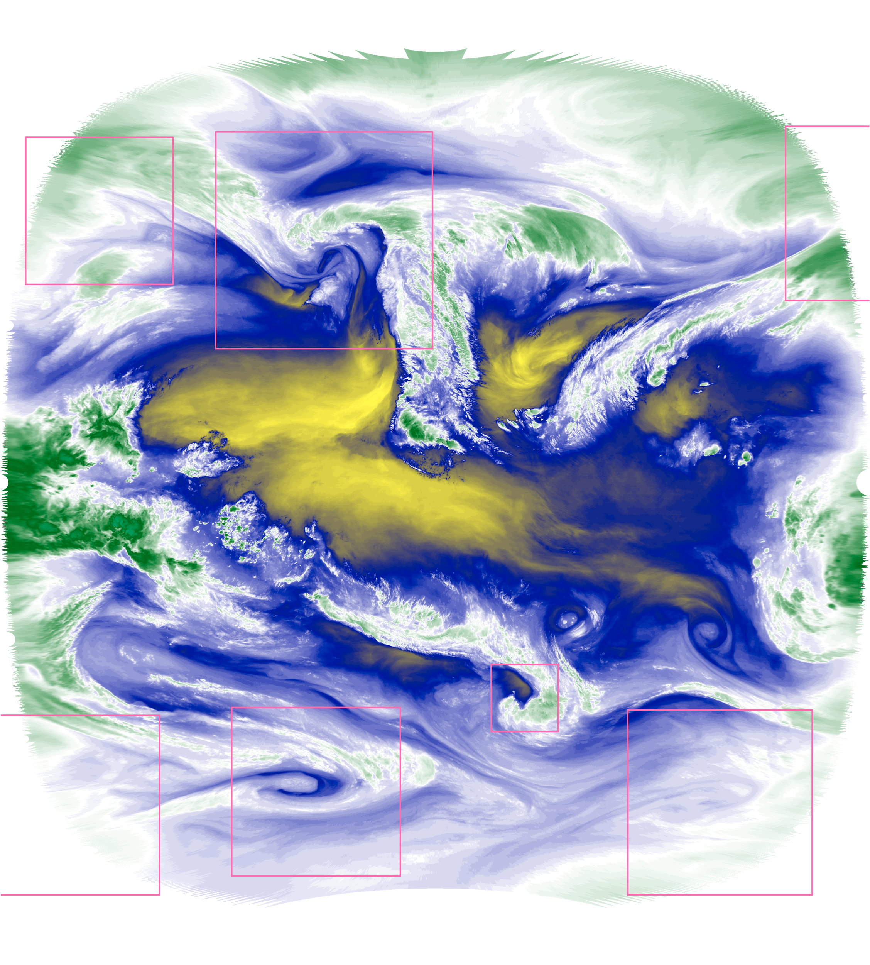
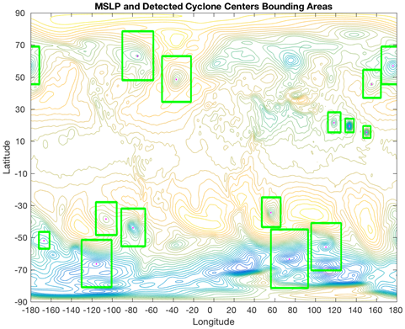
Regions of Interest (ROI’s)
Use deep learning object detection to identify areas of atmospheric instability from satellite observation data.
Focus the extraction of observations on these regions of interest.
Identify other important phenomena for forecasting from satellite data:
  convective instability
  baroclinic instability
  convective initiation
NOAA - Earth System Research Laboratory
Notes:
spherical convolution --

Slide 4
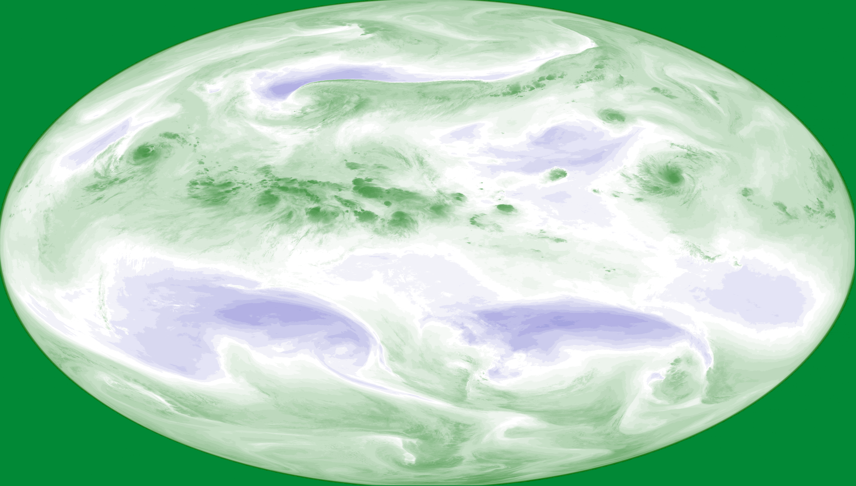

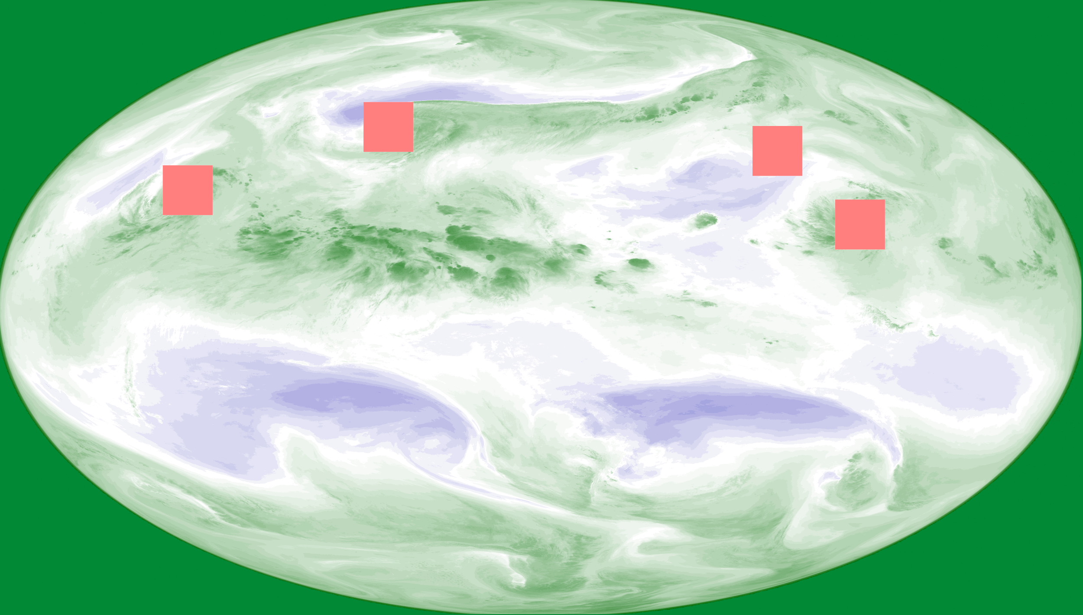
Using Satellite Data for Training
Water Vapor Channel from GOES 10 through 15
Storm centers from IBTracks Dataset
Trained 2010-2013, validated 2014, test 2015
Images resized and cropped to 1024x512
Image segmentation 25x25 pixel box segmentation centered on storm
Only use storms classified as Tropical Storm or greater on Saffir Simpson Scale
  34 knots and above
Input
Labeled Data

Slide 5
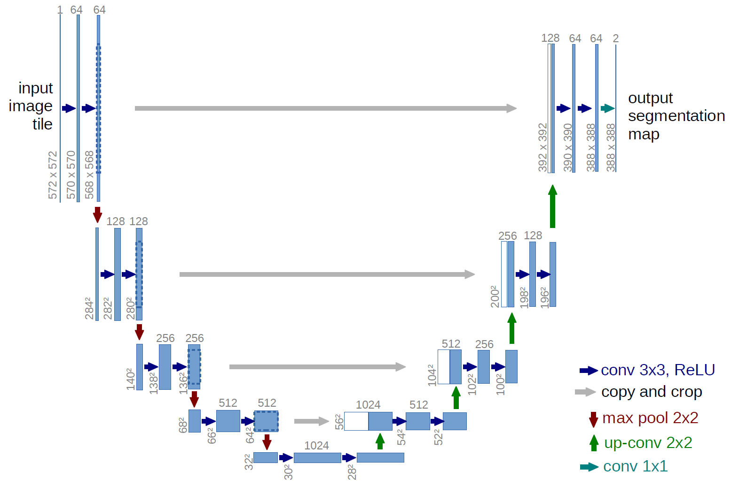
Deep Learning Development for Image Segmentation
Keras
https://keras.io
High Level Deep Learning Library using Google Tensorflow under the hood
Unet - Deep Neural Network
Links larger features before compression with smaller features after compression
Commonly seen in image segmentation challenges on Kaggle.com

Slide 6
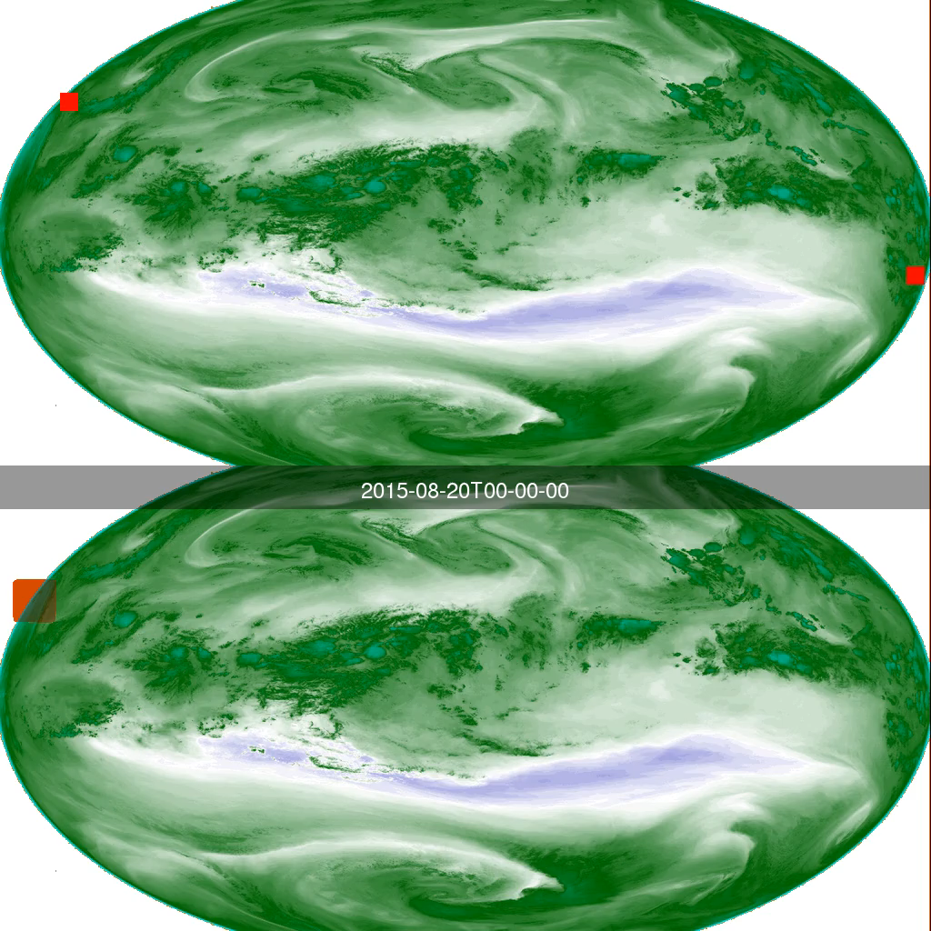
Manual Labels
Automatic Labels from Trained Neural Network

Slide 7
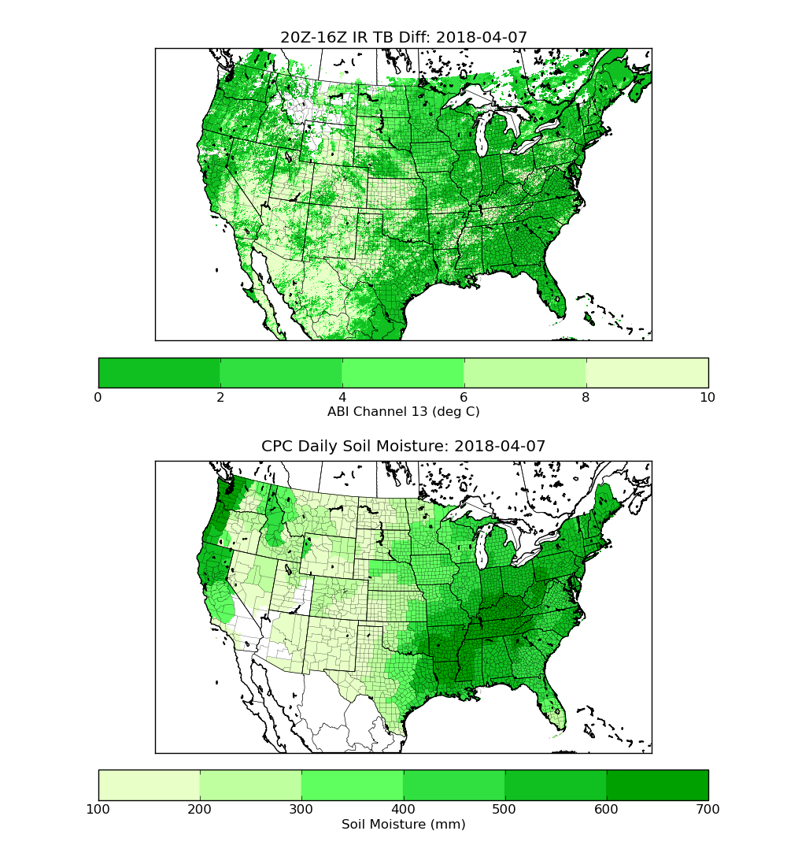
Other Deep Learning Applications
Soil Moisture from Satellite Radiances
Use machine learning to correlate radiances from GOES-16 ABI to generate soil moisture product for model assimilation
Working with CIRA, Kyle Hilburn and Steve Miller
NOAA - Earth System Research Laboratory

Slide 8
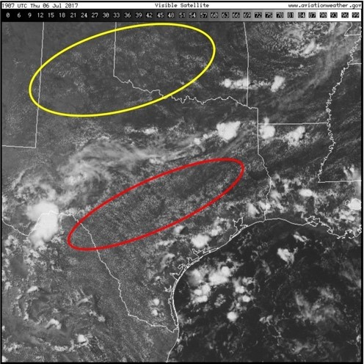
Classification for Process Oriented Verification
Grouping similar homogeneous and high purity areas of atmospheric conditions for future evaluation of model performance
Notes:
Fig 1: GOES visible image showing two distinct fields of ShCu on either side of a boundary marked by the cirrus. The red and yellow ellipses are idealized examples of what we desire the ML device to do automatically. Note the markedly different visual charact-eristics of the ShCu in the two ellipses.

Slide 9
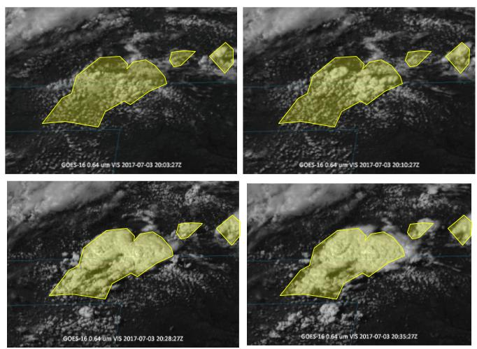
Convection Initiation from Satellite Observations
Partnership with Taiwan Central Weather Bureau (CWB)
Goal - Neural Network for Automatic Detection and Labeling of Convection Initiation Areas

Slide 10
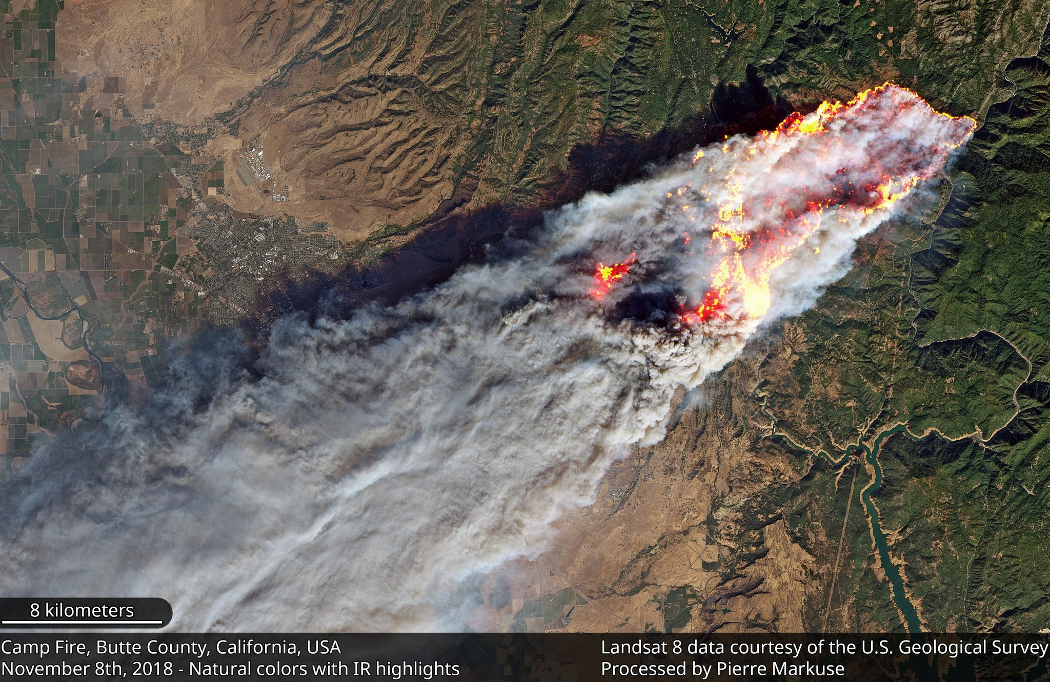
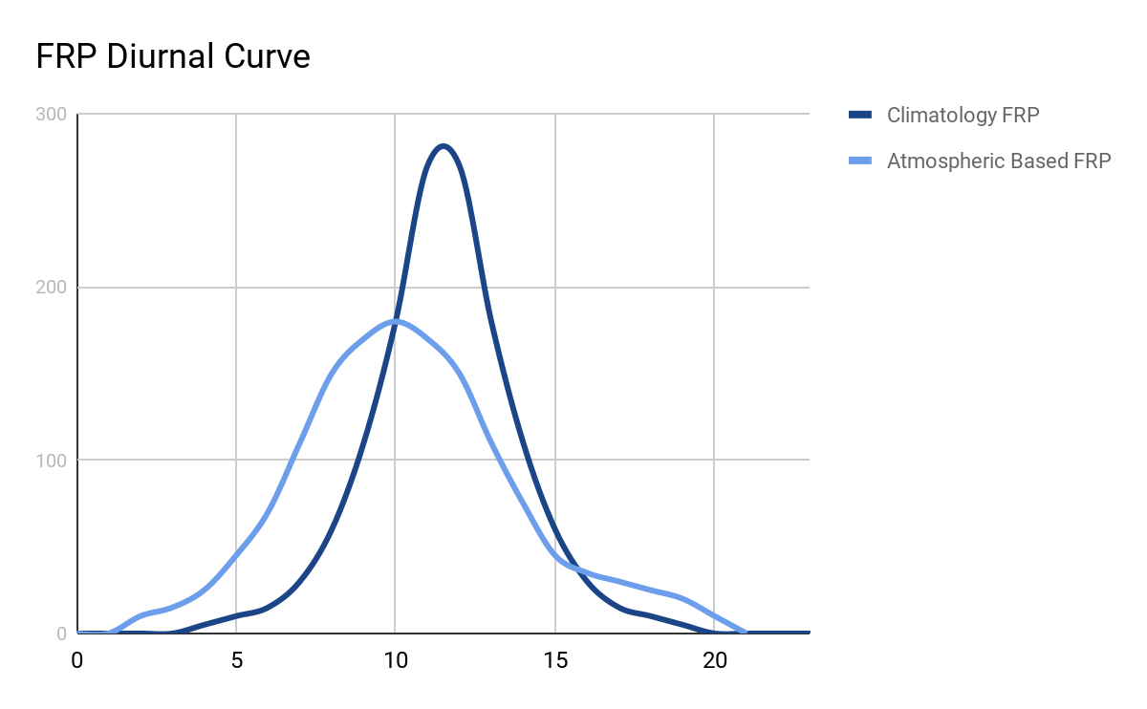
Improved Smoke and Particulate Forecasting
Better than climatology, develop Fire Radiative Power algorithm based on atmospheric conditions
Filling Gaps when smoke or cloud obscure satellite detection of fires

Slide 11
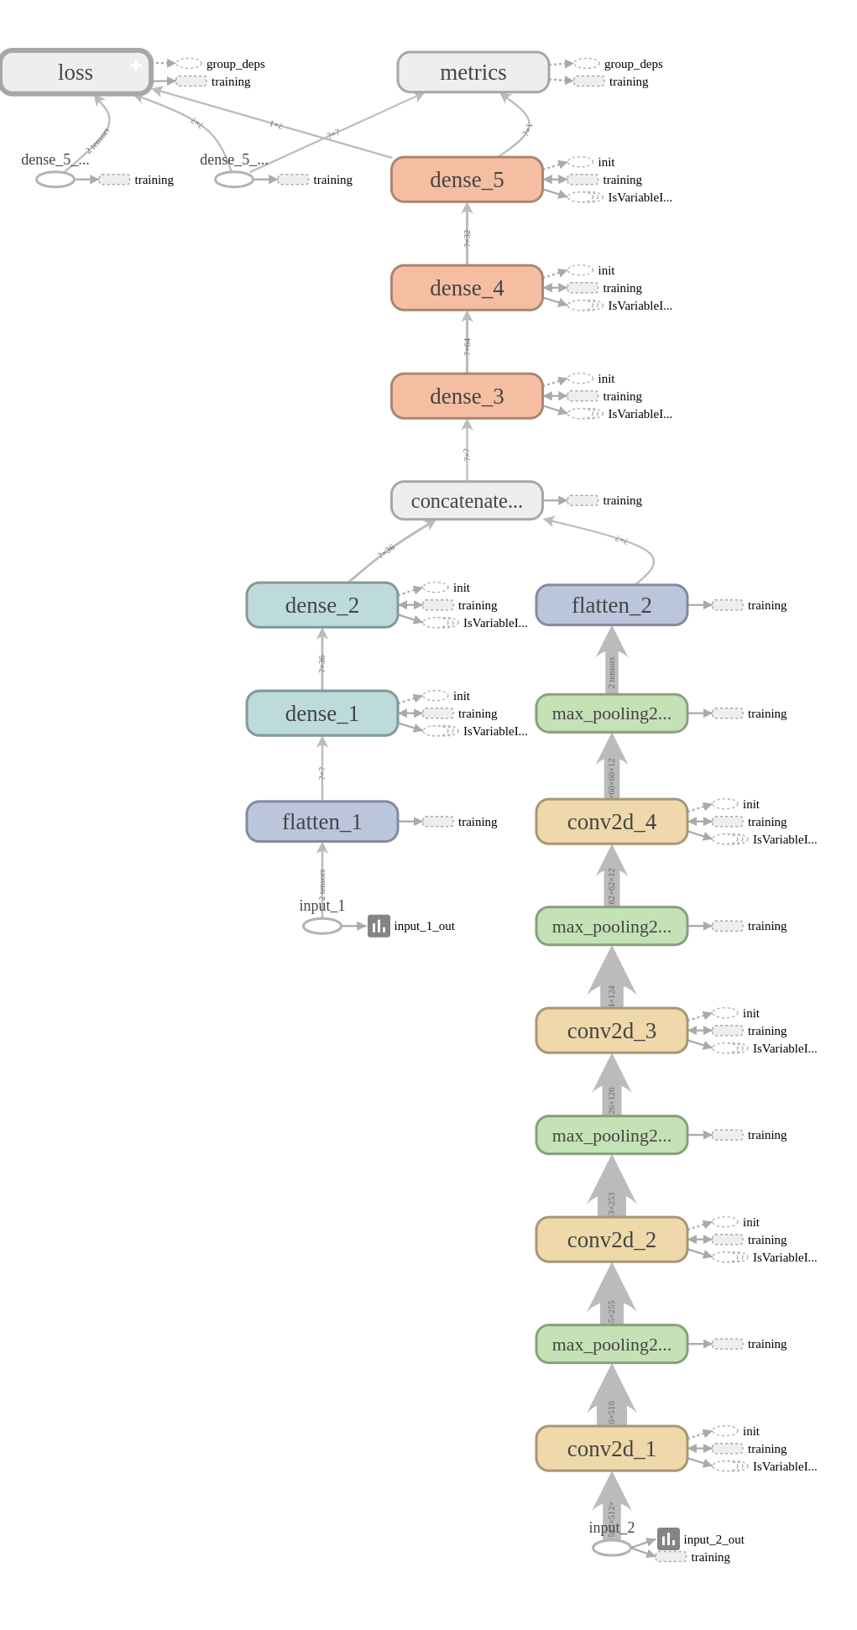
Complex Networks
Convolutional layers good for data where neighboring points have some relation
Fully connected layers good for disjoint, distinct data
Combine both into single network

Slide 12
Information on Training Compute Capability
NOAA High Performance Computing System
Theia
100 nodes
Each node has two 10 core Haswell processors
Each node has 256 GB of memory
Each node has 8 Tesla P100 (Pascal) GPUs.
  16 GB Memory Each
** Effort funded by NOAA CIO Software Engineering for Novel Architectures (SENA)
NOAA - Earth System Research Laboratory
Notes:
Remember inference is fast and can be run on CPU

Slide 13
Training with Satellite Data
1024x512x3 (RGB Data)
UNET neural network 24 convolutional layers (6 down, 6 up) developed with Keras
2.6 GB memory per image
 | CPU | GPU
Hardware | Two 10 core Haswell Intel | 8 Tesla (P100)
Training (per epoch) | 11.5 hours | 3 minutes
Complete training (~ 70 epochs) | ~ 5 weeks | ~ 3 hours
Inference for single input | 1 second | 40 milliseconds

Slide 14
What Impacts Training
Size of input
  Data dimensions (ie width and height)
  Channels or different data combinations
  Training/validation dataset size
Neural Network Layers
  Type: Dense vs Convolutional vs Recurrent
  Hyperparameter selection
  Number of layers
* Not a complete list

Slide 15
Why Performance Matters
Tweaking Neural Network
  Adding/Removing Layers
  Changing Layer Types (Convolutional, Fully Connected, etc…)
  Changing Hyperparameters (Kernel Size, etc..)
Reprocessing Data
  Adding new observations
  Adding new type of data
Waiting a weeks or more is not efficient use of time
Hyperparameter Search (many different permutations)

Slide 16
Questions?
Jebb.Q.Stewart@noaa.gov

Slide 17
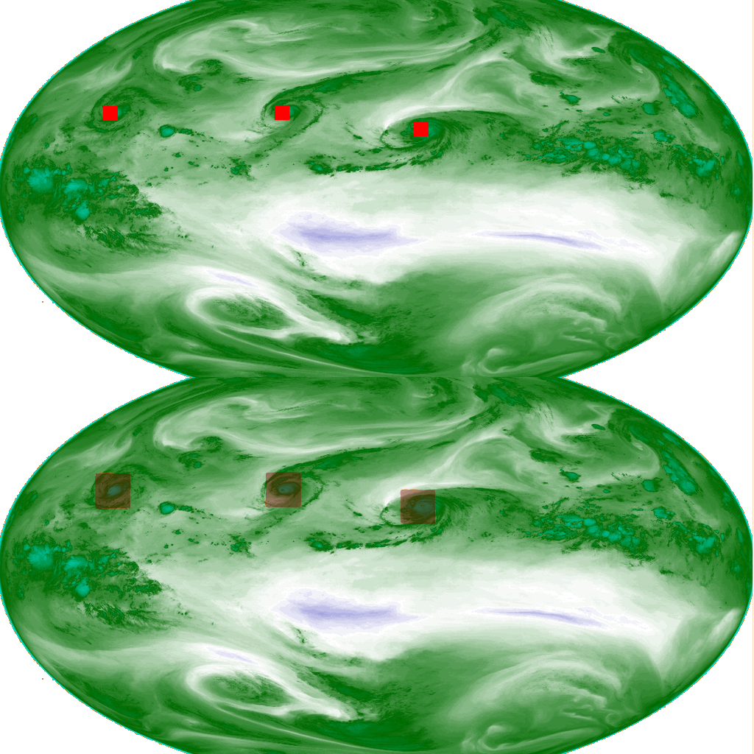
Segmentation with Fully Connected Network
Truth
Water Vapor GOES-15
Prediction

