Slide 1
MACHINE LEARNING TECHNIQUES FOR ANALYSIS OF HIGH-DIMENSIONAL CHAOTIC SPATIOTEMPORAL DYNAMICAL SYSTEMS
1st Workshop on Leveraging AI in the Exploitation of Satellite Earth Observations and Numerical Weather Prediction,
NOAA Center for Weather and Climate Prediction, April 23-25, 2019
Edward Ott
University of Maryland, College Park
Other team members: Brian Hunt, Istvan Szunyogh, Michelle Girvan, Andrew Pomerance, Jaideep Pathak, Alex Wikner, Troy Arcomano

Slide 2
OUR GOAL
Use machine learning to substantially improve weather
forecasting by mitigating inaccuracies in the
dynamical prediction model
(e.g., inaccuracies due to unresolved processes
and features at small scales).
CHARACTERISTICS OF GEOPHYSICAL PREDICTION PROBLEMS:
Spatial
Very large regions
Multiscale time and space dependences
Chaotic time evolution
Complex geography
Large data handling requirements

Slide 3
STATUS OF OUR WORK AND FUTURE PLANS
Accomplished so far:
(1) Formulation of basic methodology and performance
of testing on very simplified toy models.
Almost done:
(2) Implementation on the 3D SPEEDY atmospheric model.
Near Future:
(3)Testing on SPEEDY.
Within the next year:
(4) Incorporation of cyclic data assimilation and further testing.
THIS TALK: Topic (1)

Slide 4
OUTLINE
Pure machine learning prediction: Given a limited time series of past measurements, can we predict the future state of a spatiotemporally chaotic system ?
Enabling Scalability
*Parallelization of the pure machine learning prediction system
for application to large systems.
*Hybrid ML/knowledge-based prediction.
*Combination of the parallel and hybrid schemes.
Main point: We believe that the parallel-hybrid
combination is essential for achieving our goal.

Slide 5
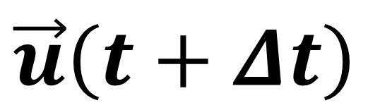
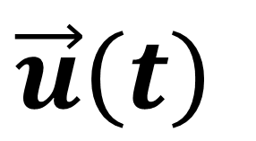
A SIMLPLE SCHEME FOR PREDICTING DYNAMICAL STATE EVOLUTION PURELY FROM PAST TIME SERIES DATA
Ideal result of training:
Prediction:
ML device with memory
ML device with memory
$$\vec{u}\left(t\right)$$
$$\vec{u}\left(t+Δt\right)$$
“open-loop configuration”
“closed-loop configuration”
Jaeger and Haas, Science (2004)

Slide 6
MACHINE LEARNING TECHNIQUE
In our numerical experiments, we use reservoir computing*, but our approaches could equally well be used with other machine learning techniques.
*Jaeger (2001), and Maass et al. (2002).

Slide 7
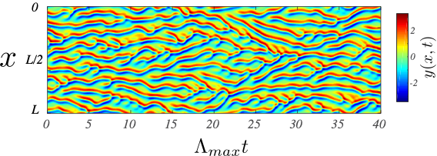
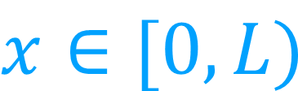
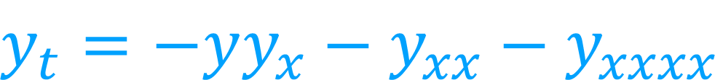

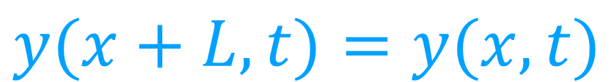
THE KURAMOTO-SIVASHINSKY (KS) SYSTEM
A nonlinear, spatiotemporal chaotic PDE
$$y_{t}=−yy_{x}−y_{xx}−y_{xxxx}$$
$$x∈[0,L)$$
$$y(x+L, t)=y(x, t)$$
$$L=100$$

Slide 8
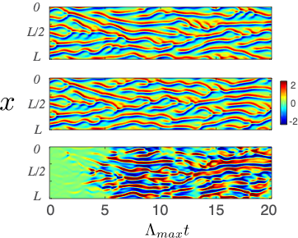


FORECASTING OF CHAOS:
KURAMOTO-SIVASHINSKY EQUATION
TRUE STATE
$$L=60$$
RESERVOIR PREDICTION
$$y(x,t)$$
DIFFERENCE

Slide 9
VERY LARGE SYSTEMS
As the size and complexity of the predicted system increase, the demands on the machine learning system can become overwhelming.
How can this issue be dealt with?

Slide 10
SHORT TIME SPATIAL LOCALITY OF CAUSAL INTERACTIONS
We assume our system has short time spatial locality of causal interactions, and we use this property to enable a parallelized approach* for application to large systems.
* Pathak, Hunt, Girvan, Lu, Ott, "Model-free prediction of large spatiotemporally chaotic systems from data: a reservoir computing approach." Physical Review Letters 120.2 (2018): 024102.

Slide 11
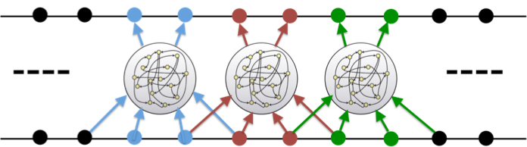
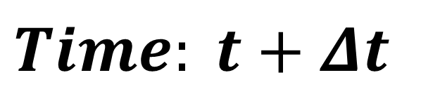
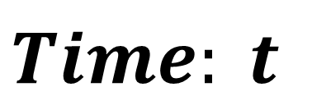
VERY LARGE DYNAMICAL SYSTEMS
Training
$$Time: t+Δt$$
$$Time: t$$
Each machine learning device is assigned to a local neighborhood on the spatial grid and is trained to predict a subset of its inputs.
The local neighborhood consists of the grid points to be predicted plus buffer zones on each side.
Each of the relatively small parallel machine learning devices is independently trained.

Slide 12
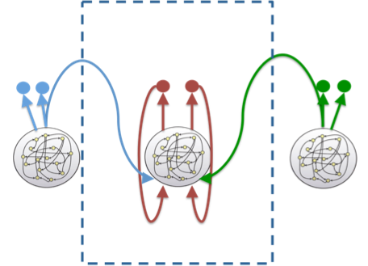
VERY LARGE DYNAMICAL SYSTEMS
Training
Prediction
During the prediction phase, a given machine learning device has feedbacks from its own outputs and from the outputs of neighboring machine learning devices on each side.

Slide 13
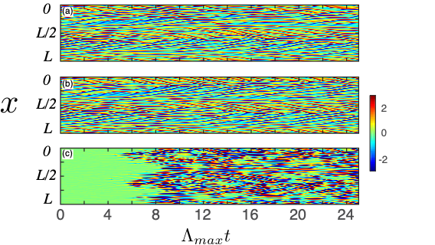



VERY LARGE DYNAMICAL SYSTEMS: KURAMOTO-SIVASHINSKY
TRUE STATE
Model Parameters:
$$L=200$$
$$D_{KY}=43$$
RESERVOIR PREDICTION
Reservoir:
DIFFERENCE
$$(D_{r}=5000)×64$$

Slide 14
DATA-ASSISTED MODELS: USING BOTH KNOWLEDGE AND DATA
Even with parallelization, if the system is very complex, a purely data-driven approach may require a prohibitive amount of training data or computational resources.
This motivates the question: Can we build a hybrid data-assisted model that combines machine learning with an imperfect knowledge-based model?

Slide 15
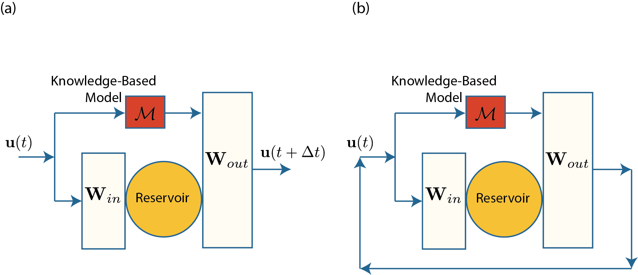
HYBRID APPROACH
Open-loop Configuration
(Training)
Closed-loop Configuration
(Prediction)
Comments:
It should be advantageous to utilize all potentially valid information whether it is in the
form of data or physical laws.
(2) It is expected that the minimization of error in the training phase will lead to combining
of disparate prediction components in such a way that, if one component is superior for
some aspect, then it will be more determinative for that aspect of the combined prediction.
skip
Reference:
J. Pathak, A. Wikner, R. Fussell, S. Chandra, B. R. Hunt, M. Girvan, E. Ott, Chaos 28, 041101 (2018).

Slide 16
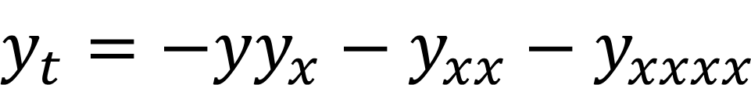
DATA-ASSISTED MODEL
Ground Truth:
$$y_{t}=−yy_{x}−y_{xx}−y_{xxxx}$$
Imperfect Model:
$$y_{t}=−yy_{x}−(1+ε)y_{xx}−y_{xxxx}$$

Slide 17
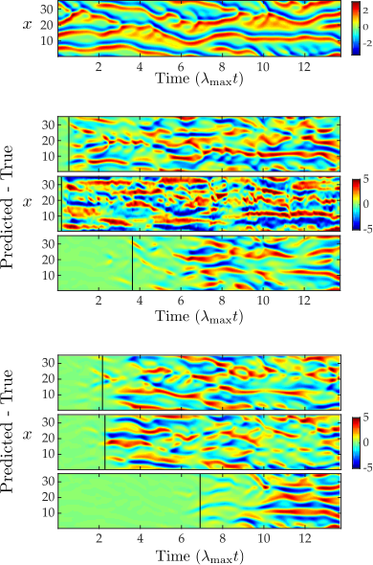




DATA-ASSISTED MODEL
Ground Truth:
(a) True State
$$y_{t}=−yy_{x}−y_{xx}−y_{xxxx}$$
Imperfect Model:
(b) High Model Error
$$(ε=0.1)$$
(c) Small Reservoir
$$y_{t}=−yy_{x}−(1+ε)y_{xx}−y_{xxxx}$$
$$(D_{r}=500)$$
(d) Hybrid (b) + (c)
(e) Low Model Error
$$(ε=0.01)$$
skip
(f) Large Reservoir
$$(D_{r}=8000)$$
(g) Hybrid (e) + (f)

Slide 18
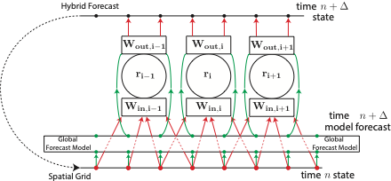
COMBINING THE PARALLEL AND HYBRID SCHEMES

Slide 19
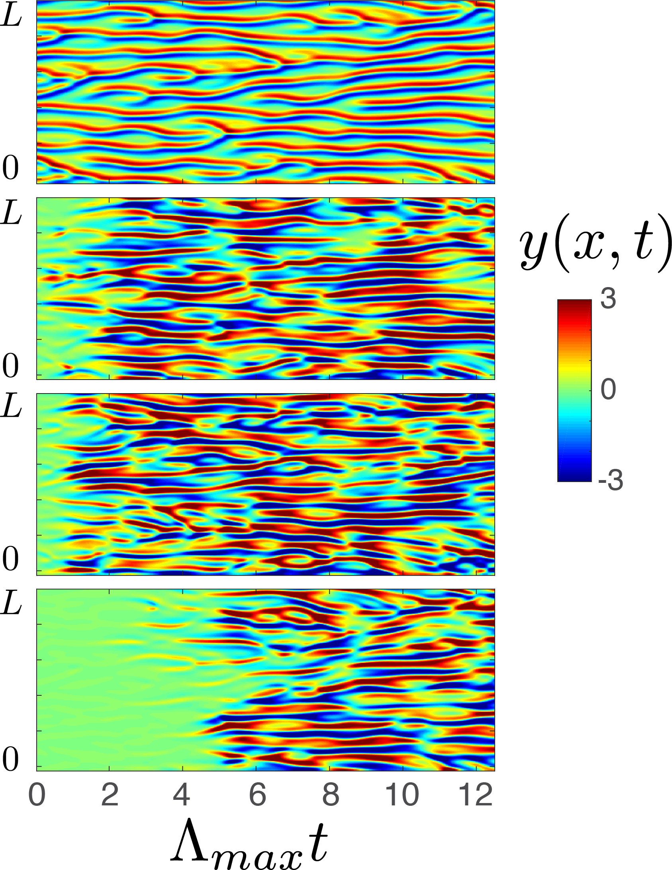
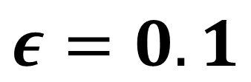
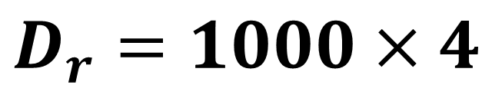
DATA-ASSISTED MODEL: SCALABILITY
Ground Truth:
$$y_{t}=−yy_{x}−y_{xx}−y_{xxxx}$$
Truth
Imperfect Model:
Pure ML
$$y_{t}=−yy_{x}−(1+ε)y_{xx}−y_{xxxx}$$
$$D_{r}=1000×4$$
Imperfect Model
Predicted - Truth
$$ε=0.1$$
skip
Hybrid
We get similar good results, e.g., using Lorenz’s 1996 two-scale “model 3” as truth vrs. Lorenz’s 1996 one scale “model 2” as the imperfect model.

Slide 20
CONCLUSIONS
By using a combination of both the parallel and hybrid schemes, we believe that we will be able to employ machine learning for enabling substantial data-assisted improvements of weather forecasting.
But we have a lot of remaining work to do.

Slide 21
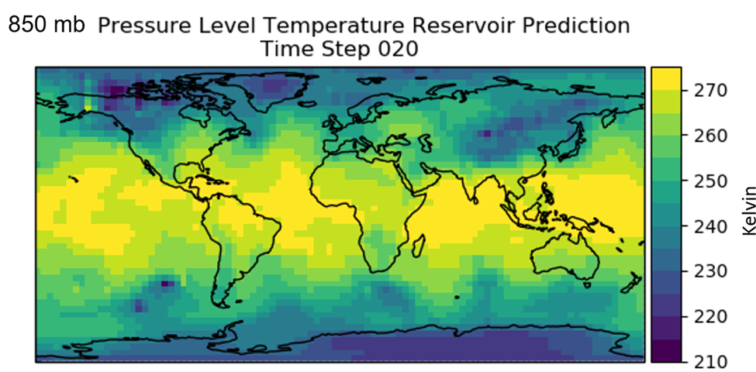
A VERY PRELIMINARY TEST USING THE SPEEDY SIMPLIFIED WEATHER CODE (gotten yesterday)
= 10 hours

Slide 22
REFERENCES
J. Pathak, B. Hunt, M. Girvan, Z. Lu, and E. Ott, "Model-free prediction of large spatiotemporally chaotic systems from data: a reservoir computing approach." Physical Review Letters, vol 120, issue 2 (2018): 024102.
J. Pathak, A. Wikner, R. Fussell, S. Chandra, B. Hunt, M. Girvan, and E. Ott, "Hybrid forecasting of chaotic processes: using machine learning in conjunction with a knowledge-based model." Chaos, vol. 28, issue 4 (2018): 041101.
s

Slide 23
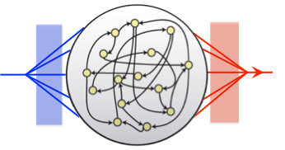



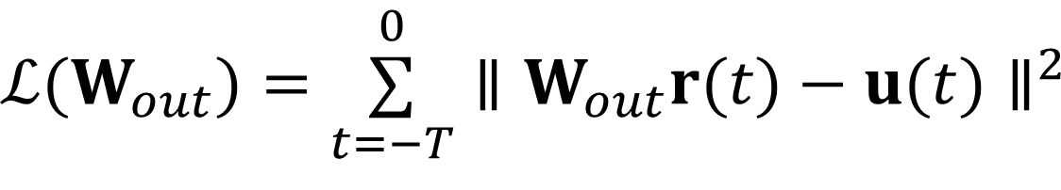





RESERVOIR NEURAL NETWORK IMPLEMENTATION
FEED DATA
An input is coupled to the reservoir network through a fixed, randomly generated input matrix.
An input is coupled to the reservoir network through a fixed, randomly generated input matrix.
$$W_{in}$$
$$r(t+Δt)$$
$$W_{out}$$
$$u(t)$$
$$v(t+Δt)$$
$$r(t+Δt)=tanh\left(Ar(t)+W_{in}u(t)\right)$$
$$−T≤t≤0$$
LINEAR FIT
Find the output weight matrix that minimizes the following loss function
$$ℒ(W_{out})=\overset{0}{\underset{t=−T}{∑}}∥W_{out}r(t)−u(t)∥^{2}$$
$$v(t)=W_{out}r(t)$$
$$v(t)≃u(t)$$

Slide 24
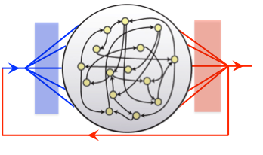




RESERVOIR NEURAL NETWORK IMPLEMENTATION
FEED DATA
An input is coupled to the reservoir network through a fixed, randomly generated input matrix.
An input is coupled to the reservoir network through a fixed, randomly generated input matrix.
$$W_{in}$$
$$r(t+Δt)$$
$$W_{out}$$
$$u(t)$$
$$v(t+Δt)≃u(t+Δt)$$
$$r(t+Δt)=tanh\left(Ar(t)+W_{in}u(t)\right)$$
$$−T≤t≤0$$
LINEAR FIT
Find the output weight matrix that minimizes the following loss function
PREDICTION
$$t>0$$
$$ℒ(W_{out})=\overset{0}{\underset{t=−T}{∑}}∥W_{out}r(t)−u(t)∥^{2}$$
$$v(t)=W_{out}r(t)$$
$$r(t+Δt)=tanh\left(Ar(t)+W_{in}v(t)\right)$$
$$v(t)=W_{out}r(t)$$
$$v(t)≃u(t)$$
24￼

Slide 25
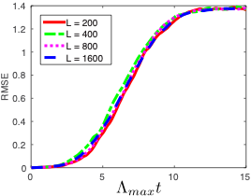


VERY LARGE DYNAMICAL SYSTEMS: KURAMOTO-SIVASHINSKY
In this plot we show the RMS error as a function of time in the prediction phase (averaged over many trials).
$$(D_{R}=5000)×64$$
$$(D_{R}=5000)×512$$

