Slide 1
What are the U.S. NWS Weather Research and Forecast (WRF) / North American Mesoscale (NAM) and Global Forecast System (GFS) models’ forecast needs for IR hyperspectral soundings (i.e. model forecast accuracy improvements, horizontal spatial resolution, temperature and moisture profile requirements (over land, over water)?
High-resolution Hurricane Data Assimilation,
Modeling and Prediction
Tomislava Vukicevic¹
S. Aberson¹, A. Aksoy^{1,2}, L. Bucci^{1,3}, Gopal¹, S. Lorsolo, F. Marks¹, K. Sellwood^{1,2} , T. Quirino¹, X . Zhang^{1,2} and K. Yeh^{1,2}
Collaborations with EMC, ESRL, CIMSS (NOAA) and JPL/NASA
¹NOAA/AOML Hurricane Research Division
²U. Miami/RSMAS Cooperative Institute for Marine & Atmospheric Studies
³Science Applications International Corporation

Slide 2
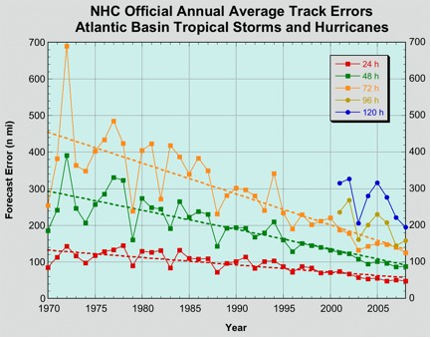
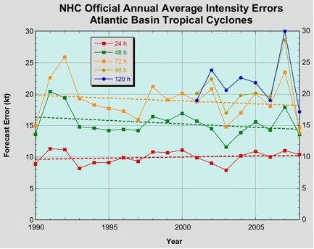
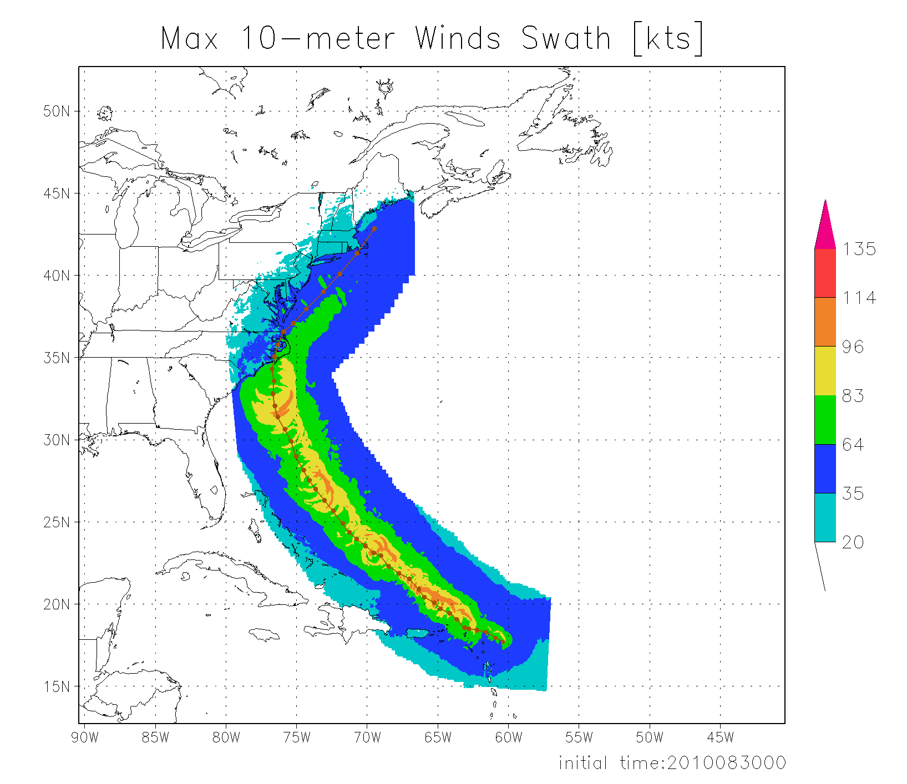
Motivation and Objective
In HRD/AOML research is conducted on assimilation of airborne and other observations into high-resolution Hurricane NWP model to reduce track and intensity forecast errors by
Better representing NWP initial conditions on storm scales and in the environment
Demonstrating the potential for value added to the data analysis from new observations using OSSEs
Improving the model by diagnostic verification using the observations and data assimilation results
Improving the modeling by estimating model parameters using the observations
  Models used in HRD are HWRF research and operational versions
*Figure from www.nhc.noaa.gov

Slide 3
Data Assimilation technique: Ensemble Kalman Filter (EnKF)
EnKF data assimilation combines model background with observations to obtain
a best estimate of atmospheric conditions to initialize a model run
An ensemble of short-range forecasts provides the flow-dependent background covariance information
For the assimilation of obs, use covariances
sampled from the ensemble of forecasts
Subsequent forecast cycle is
initialized from the previous
analysis ensemble
Instead of a single state that represents the initial state of the atmosphere …
Analysis uncertainty becomes the initial
condition uncertainty for the new forecast cycle
… Start with an ensemble of states (ensemble members)
that better represent the
initial uncertainty about the
“mean” state
EnKF
Observations
t = t₀
t = t₀+Δt
t = t₀+2Δt

Slide 4
HRD’s experimental Hurricane Ensemble Data Assimilation System (HEDAS)
Forecast model:
  HRD’s Experimental HWRF (HWRF-X)
  2 nested domains (9/3 km horizontal resolution, 42 vert. levels)
  Static inner nest to accommodate covariance computations
    ➔ Inner nest size: ~10x10 degrees
  Explicit microphysics on inner nest
Data assimilation:
  Square-root ensemble Kalman filter, EnKF (Whitaker and Hamill 2002) with covariance localization (Gaspari and Cohn 1999)
  Assimilates inner-core aircraft data on the inner nest
    ➔ NOAA P-3, NOAA G-IV, USAF, PREDICT G-V
Ensemble system:
  Initialized from semi-operational GFS-EnKF (NOAA/ESRL) ensemble
  30 ensemble members

Slide 5


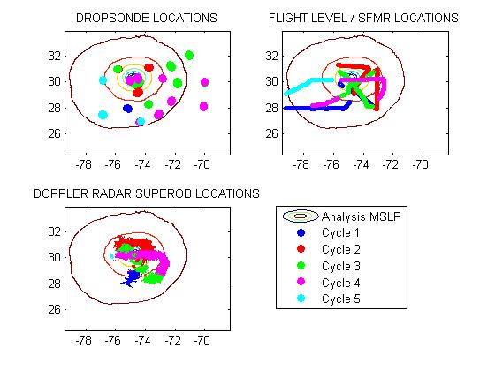
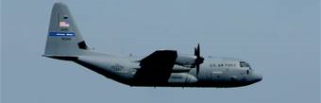
Airborne observations in HEDAS
2 NOAA Orion P-3
Dropsonde + Flight level
+ Tail Doppler Radar
1 NOAA Gulfstream G-IV
Dropsonde
Data types
flight level: wind temperature and humidity + SFMR surface wind
GPS dropwindsonde: wind, temperature, humidity and pressure
Tail Doppler Radar: radial winds.
Approximate vertical location
Orion P3: ~ 3 km
G-IV : 13 - 14 km and
U.S. A.F. C-130’s: 10km maximum with a minimum 2000ft. vertical separation from the P3’s
Observation distribution
(9/02/2010 02Z analysis)
U.S.A.F WC-130J
Flight level + Dropsonde

Slide 6
Implementation of HEDAS in 2010 hurricane season : Summary of Cases
A total of 19 cases were run (when NOAA P-3’s collected Doppler radar data)
Number of Observations Assimilated per Cycle
Number of Observations
Number of Cycles

Slide 7
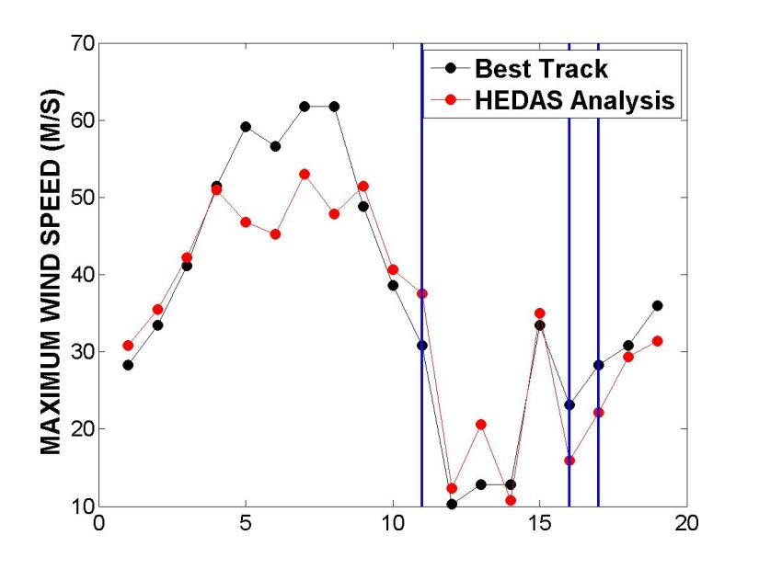
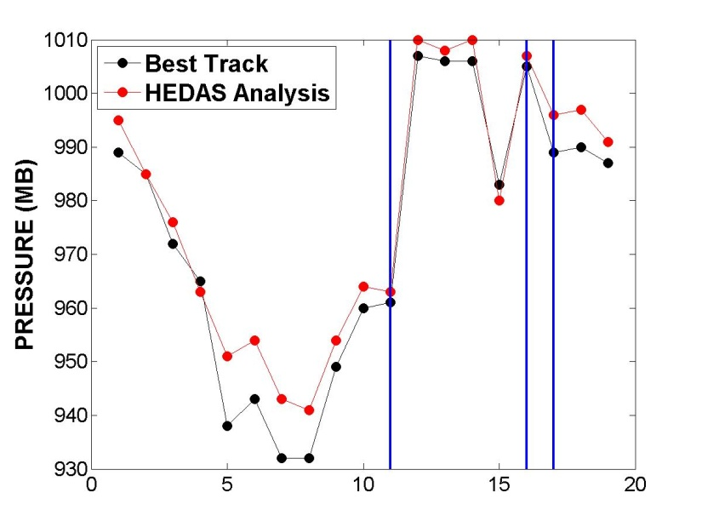
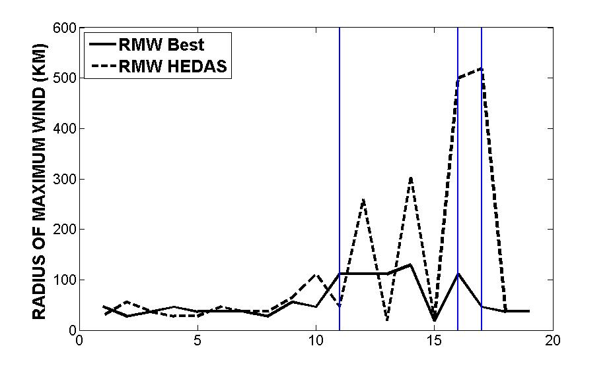
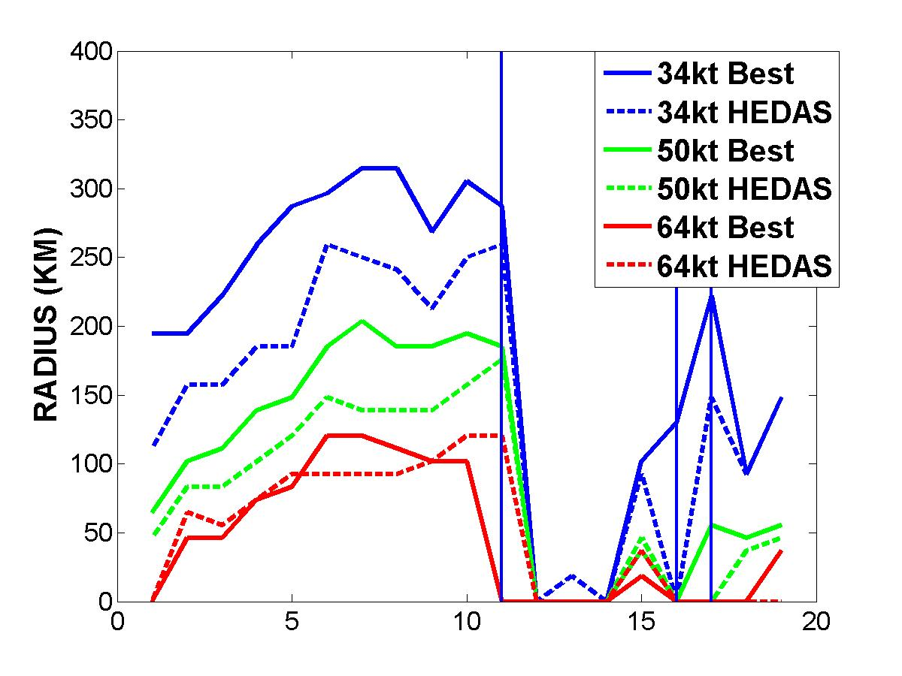
Summary of results : Storm intensity and size
Earl
Karl
Richard
Tomas
Weak System

Slide 8
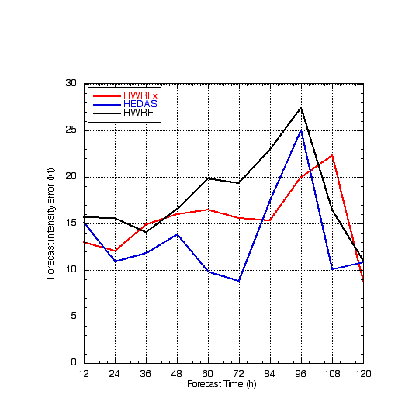
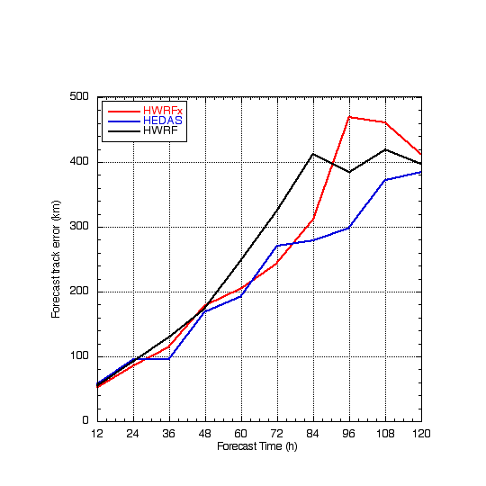
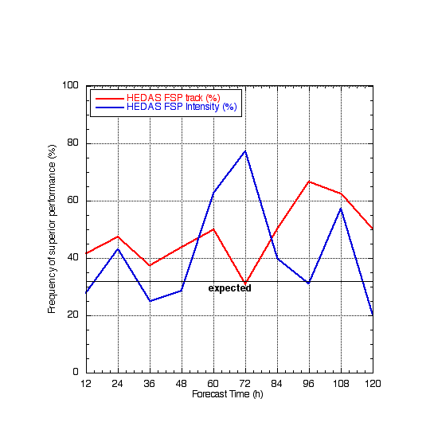
2010 HEDAS
Summary of Forecast Performance
Frequency of
Superior Performance (%)
Intensity Error
(kt)
Track Error (km)
operational
HEDAS
HWRFx
18
19
16
16
14
13
12
9
8
6
Forecast Time (hour)
Number of Homogeneous Cases
Assimilation of airborne observations on the storm-scales into the high resolution forecast model shows strong potential for improving the TC forecasts

Slide 9
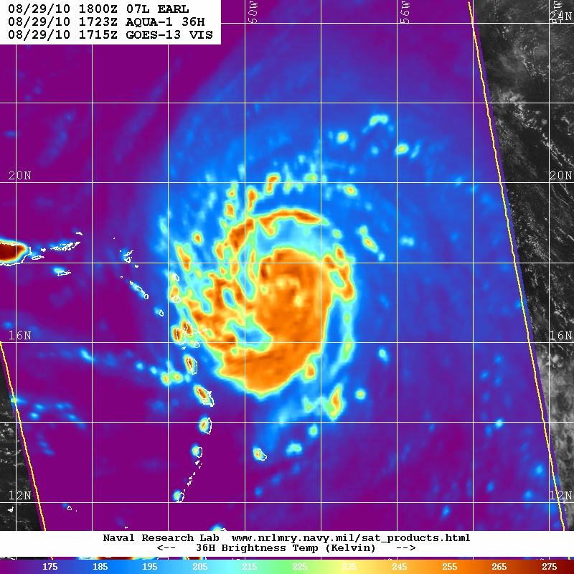
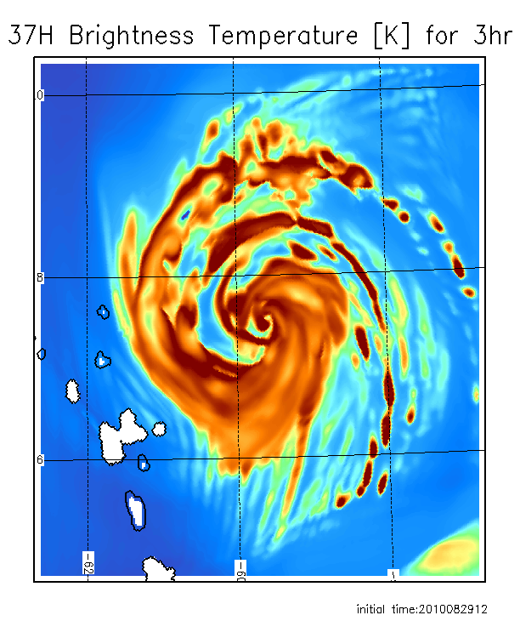
Comparison to satellite observations: observed and forecast images for hurricane Earl
36 GHz observed AQUA closest time within 1 h
3h 37 GHz forecast from HEDAS IC
Forecast initial time 12:00Z, 08/29/2010

Slide 10
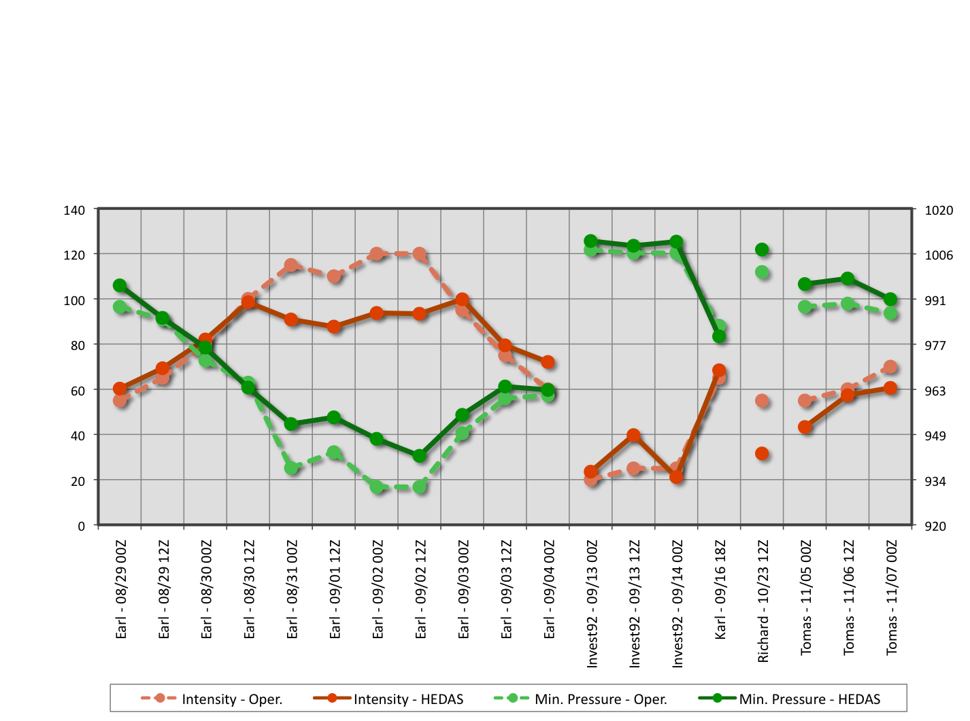
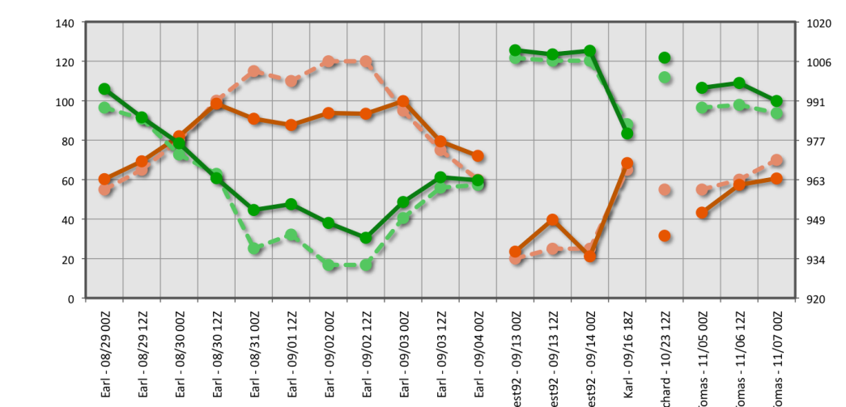
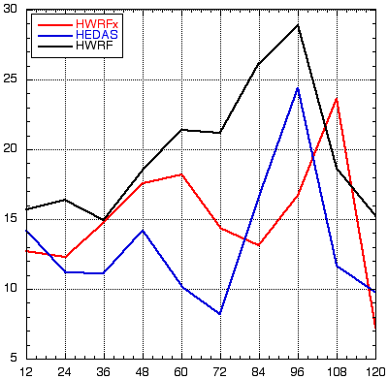
Data assimilation results opened up questions about skill of the model and observations, leading to new diagnostic analysis
Analysis intensity error
The analyzed maximum surface wind was significantly underestimated in HEDAS analysis during periods with strong and intensifying hurricane (the cases of hurricane Earl while category 3 and 4)
Forecast intensity error HEDAS in blue
Despite demonstrated improvements, new results are similar to the prior results with our or other regional hurricane forecast systems, in that the short-term intensity forecast errors are large in average
Forecast Time (hour)
Notes:
These results indicate presence of a systematic dynamical adjustment to the initial condition in the short-term forecasts ; In this study we focus on the analysis of systematic intensity errors in the analysis

Slide 11
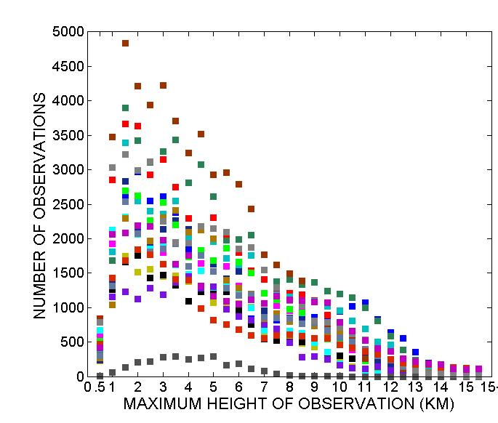
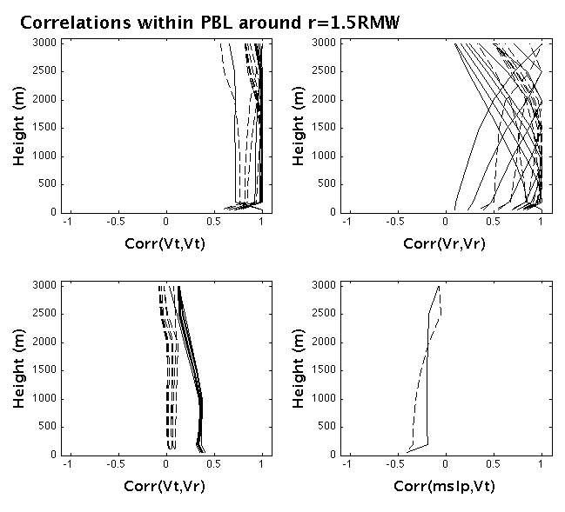
Diagnosing the model errors and deficiencies in observations by the analysis of error correlations from the ensemble data assimilation
Background error correlations within model PBL
Number of Doppler radial wind observations
Vertical coupling of the background forecast errors is too strong due to erroneously too deep PBL
Current observations do not constrain well the PBL, thus do not provide proper wind correction

Slide 12
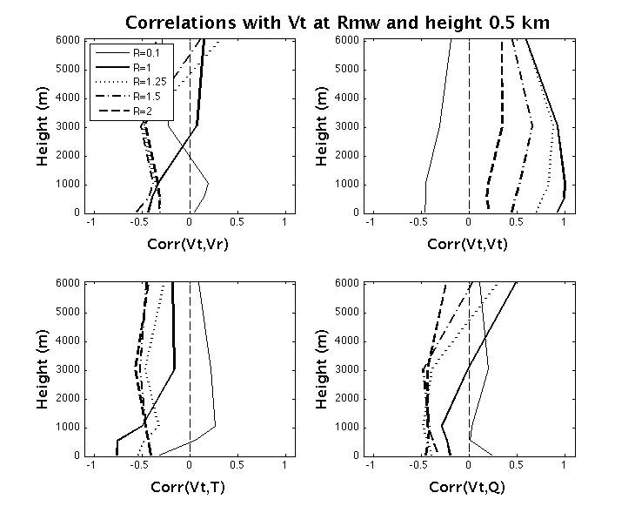
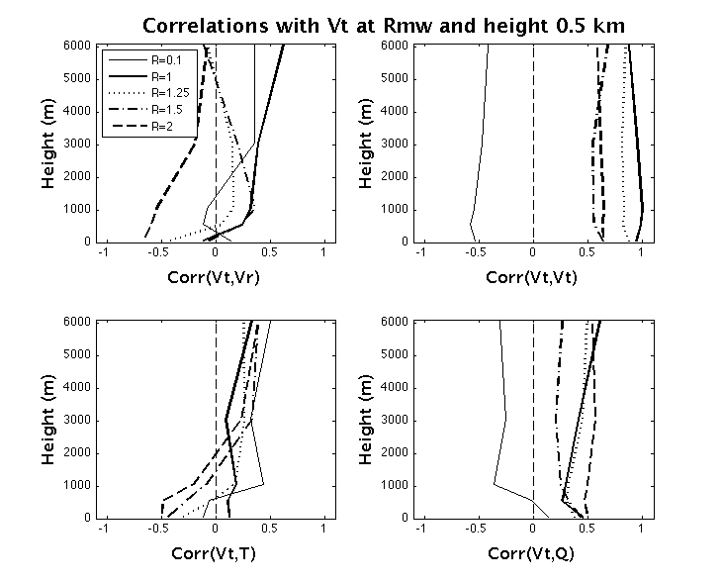
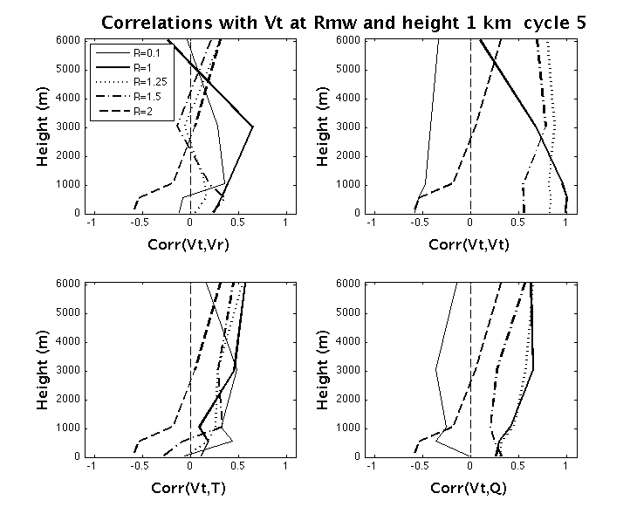
Diagnosing the model the errors and deficiencies in observations by error correlations
Spin-down dynamical mode
Spin-up dynamical mode
Vr
Vt
Vr
Vt
Earl Aug 31
Earl Aug 29
T
Q
T
Q
The background error correlations differ between dynamical regimes in the background forecast
Thermal and humidity observations are needed
Notes:
Do not try to interpret the correlations; Just say that they are different for different dynamical regimes which suggests hat the analysis increments project onto model error

Slide 13
Summary
The experience with HEDAS in 2010 shows that the assimilation observations on the vortex scale with HWRF model produces skilled 3D atmospheric mesoscle state analysis and has potential for making significant improvements to the deterministic forecast of intensity
Diagnostic evidence of the model error interaction with the analysis suggests what improvements are needed to the model and observations
The improvements are especially needed in thermal and hydrological observations and the analysis on all scales

Slide 14
Ongoing and future research
  Satellite data assimilation on synoptic scales: Developing the capability for continuous cycling of HWRF Ensemble DA using the satellite observations from the current operational systems (collaboration with ESRL/PSD, UofU, CIMSS and NCEP/HWRF)
  Forecast and model verification using the satellite observations on vortex scale : Forecast diagnostics of thermal and hydrological states with satellite observations (collaboration with JPL)
  OSSEs with regional DA system: focusing on the high resolution ; horizontal, vertical and temporal
Notes:
The analyzed maximum surface wind was significantly underestimated in HEDAS analysis during periods with strong and intensifying hurricane (the cases of hurricane Earl while category 3 and 4)

Slide 16
How much has been done?
Short answer is NOT MUCH
Use of satellite observations in -cloud and -precipitation conditions within operational systems
  Precipitation affected microwave (MW) radiances over ocean and infra red (IR) above clouds at ECMWF
  MW un-contaminated by precipitation, over oceans, at EMC, NAVDAS, JMA, UKMO and MSC
Cloud properties are not explicitly analyzed in the operational systems
Limited number of research case studies on assimilation of satellite cloud and precipitation observations with high-resolution regional models

Slide 17
What hinders progress?
Issues summarized in the review article
Observations
  IR observations are limited to information about cloud tops and above
  Passive MW observations are sparse in space and time, and highly sensitive to surface emissivity which is difficult to evaluate well over land
  Visible observations are highly sensitive to cloud top micro-properties
  Active sensors such as TRMM, CloudSat and CALIPSO have limited temporal and horizontal coverage
NWP Models
  Inaccurate representation of clouds and precipitation due to resolution and parameterizations
  Uncertainties in parameterizations which link cloud and precipitation to thermal, humidity and other variables
  Highly nonlinear relationship between variables
Radiative transfer (RT) models
  Uncertainties or poor knowledge of particle properties which affects evaluation of emission and scattering by precipitation and clouds
  Uncertainties due to 3D effects which are typically not modeled (too expensive)
Assimilation methodology
  Limited to near-linear relationships between observed and analyzed quantities
  Poor background information from NWP

Slide 18
Example of research on assimilation GOES imager visible and IR observations in cloudy conditions
4DVAR assimilation of GOES imager observations with cloud resolving model (Polkinghorne et al, 2009 and Polkinghorne and Vukicevic, 2010, Vukicevic et al, 2005, 2006)
  NWP model : RAMS (Regional Atmospheric Modeling System, Cotton et al, SCU)
  GOES imager observations from visible, near-IR and IR wavelengths at frequency of 15 or 30 minutes and resolution of 1-4 km
  Cases of mixed clear and multi-layer cloudy atmosphere without convection in South-Central US , centered at ARM site in Oklahoma
  4DVAR includes cloud microphysics through adjoint of full physics of the cloud resolving model
Major issues
  Model background data had large biases in surface temperature, cloud cover and spatial distribution of clouds
  Strongest nonlinearities in the assimilation occurred when cloud types in the model and observations were different, including cloud- no-cloud conditions

Slide 19
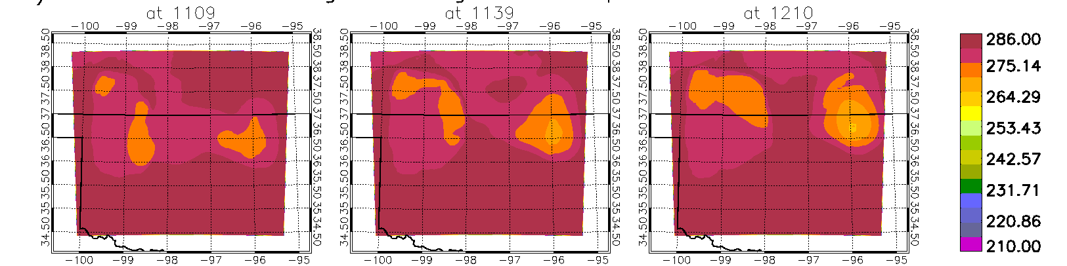
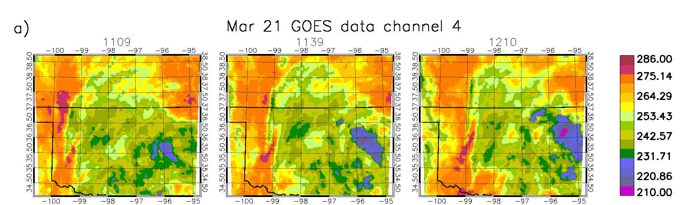
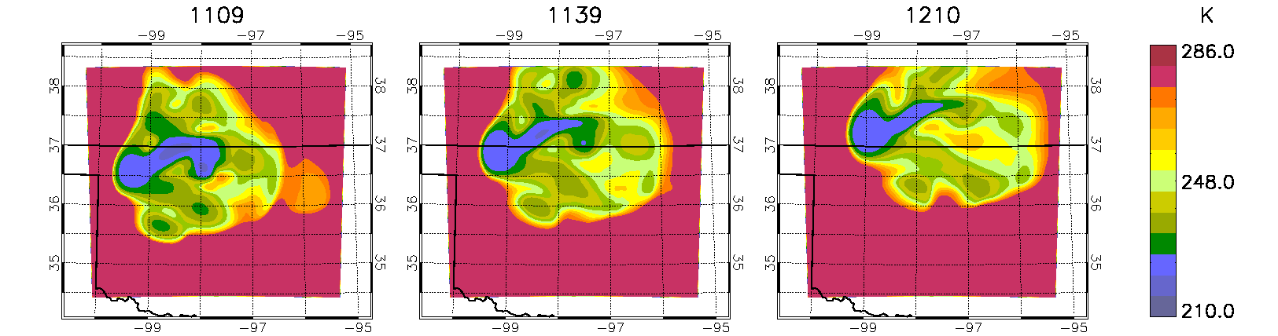
background
Example of optimal analysis
observed
analysis

Slide 20
Summary of what has been learned
Large background bias in cloud distribution strongly limits success of assimilation
More frequent observations improve the assimilation results
Coupling of time and space dimensions improves the assimilation
  Achievable by 4D assimilation approaches: 4VAR or ensemble filters with frequent cycling
Impact of nonlinearities is reduced by more accurate background and inclusion of dynamic coupling with frequent observations
IR observations in cloudy conditions are valuable when the above conditions are favorable

Slide 21
Assimilation of satellite cloud and precipitation observations in TC and hurricane conditions
Prior studies indicate that progress could be made by ensuring the following
  Good quality of background forecast with respect to the satellite cloud and precipitation observations
  Time and space coupling in the assimilation
  Frequent observations at spatial scales that are adequate for improving the conditions that govern a desired prediction skill

Slide 22
HRD’s Hurricane Ensemble Data Assimilation System (HEDAS)
Forecast model:
  HRD’s Experimental HWRF (HWRF-X)
  2 nested domains (9/3 km horizontal resolution, 42 vert. levels)
  Static inner nest to accommodate covariance computations
    ➔ Inner nest size: ~10x10 degrees
  Ferrier microphysics, explicit convection on inner nest
Ensemble system:
  Initialized from semi-operational GFS-EnKF (NOAA/ESRL) ensemble
  Initial ensemble is spun up for 3-4 hours before assimilation begins
  30 ensemble members
Data assimilation:
  Square-root ensemble Kalman filter, EnKF (Whitaker and Hamill 2002)
  Assimilates inner-core aircraft data on the inner nest
    ➔ NOAA P-3, NOAA G-IV, USAF, PREDICT G-V
  Covariance localization (Gaspari and Cohn 1999)

Slide 23
2010 HEDAS Semi-Real-Time Runs for HFIP:
Summary of Final Mean Analysis Intensity
Max. 10-m Wind Speed (knots)
Min. Pressure (mbar)

Slide 24
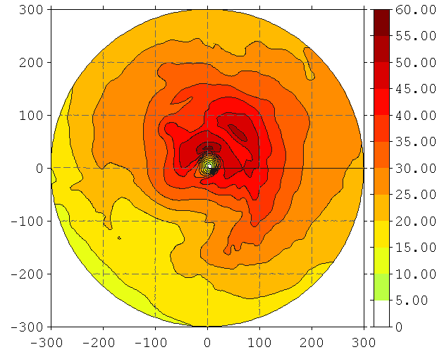
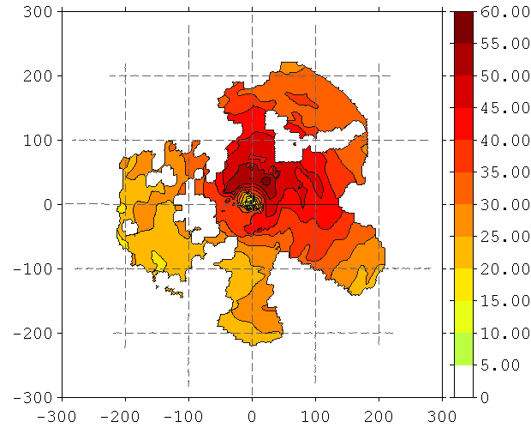
2010 HEDAS Semi-Real-Time Runs for HFIP:
Comparison of Structures (Earl 08/30 12Z)
Wind Speed at 1 km (m/s)
Analysis
Radar
Distance from Center (km)
Distance from Center (km)

Slide 25
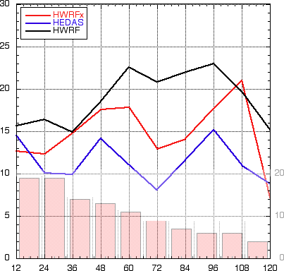
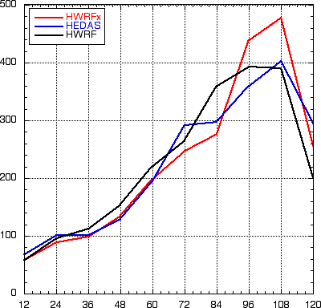
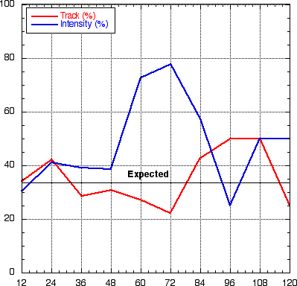
2010 HEDAS Semi-Real-Time Runs for HFIP:
Summary of Forecast Performance
Intensity Error (kt) &
Number of Cases
Track Error (km)
Frequency of
Superior Performance (%)
Forecast Time (hour)
HEDAS (in blue) performs better in intensity and comparably in track (to HWRF and HWRFx)

Slide 26
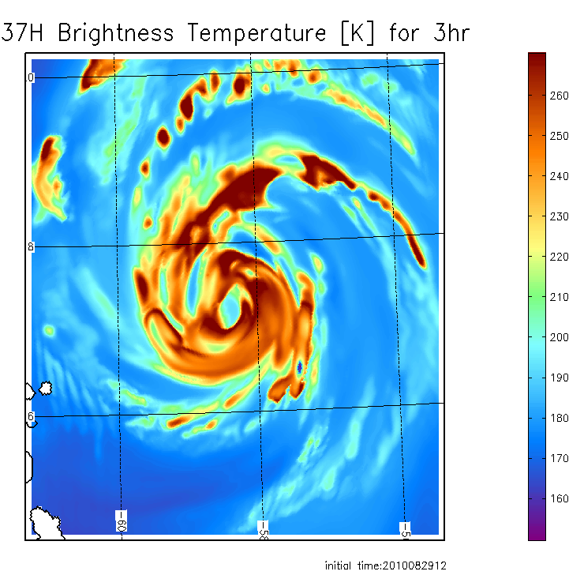
Relevance to assimilation of satellite cloud and precipitation observations
36 GHz observed AQUA closest time within 1 h
3h 37 GHz forecast from HEDAS IC
3h 37 GHz forecast from HWRF IC
Forecast initial time 12:00Z, 08/29/2010

Slide 27
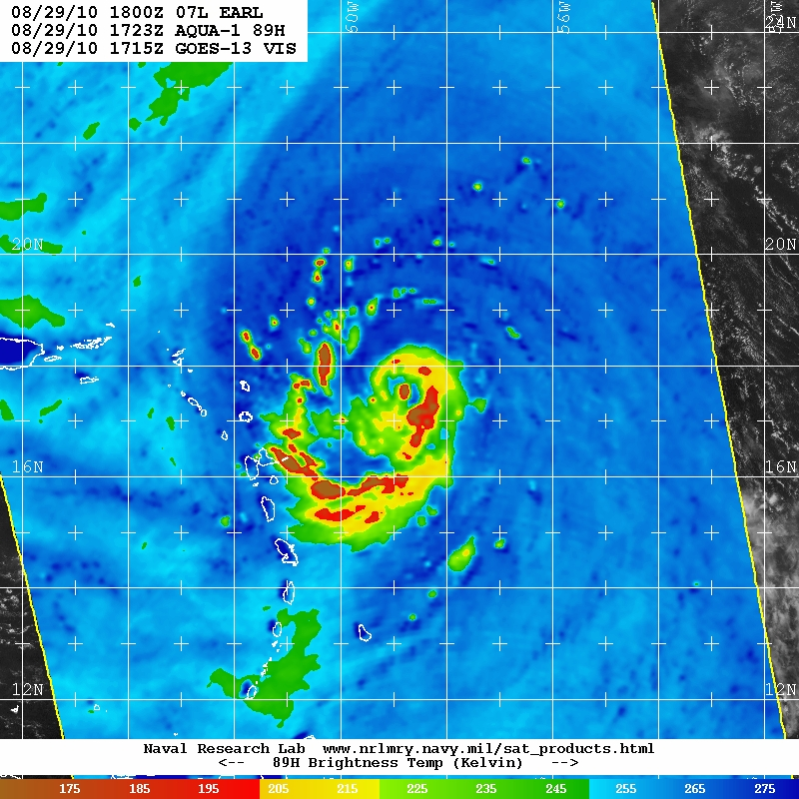
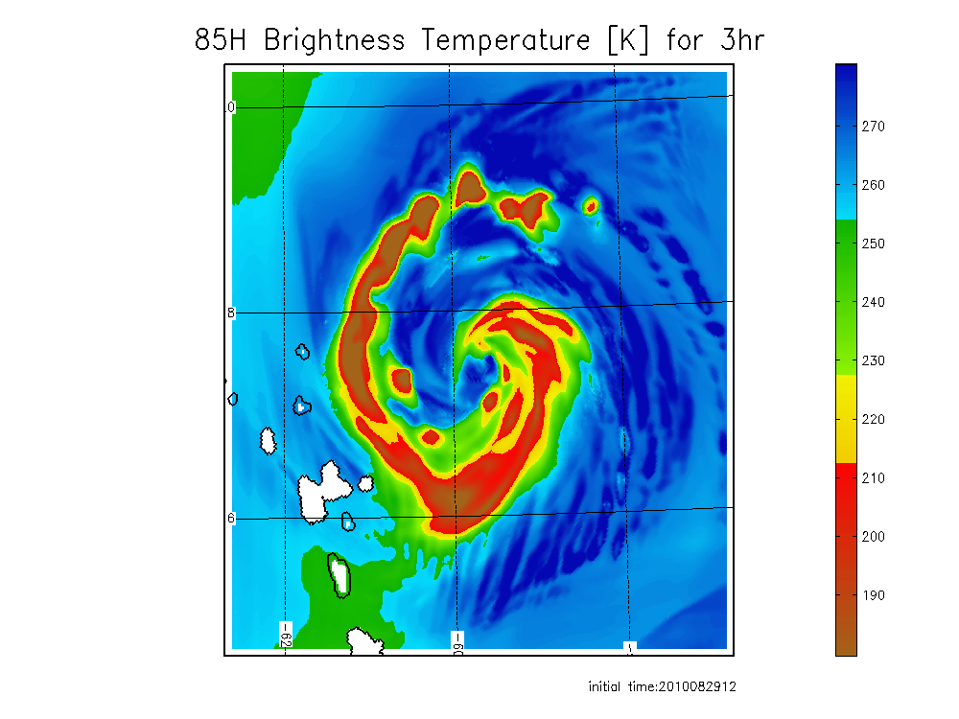
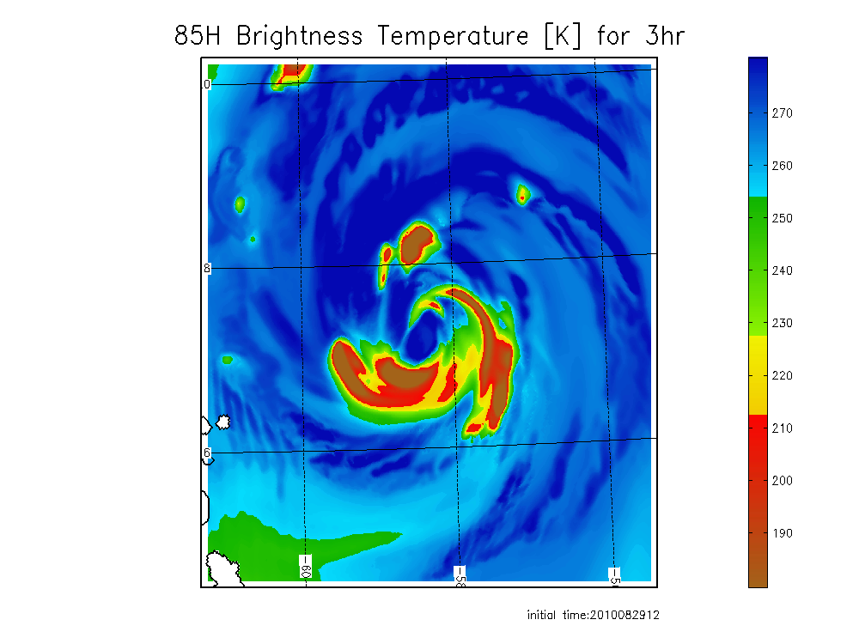
Comparison of observed and forecast images for hurricane Earl from HEDAS and HWRF ICs
89 GHz observed AQUA closest time within 1 h
3h 85GHz forecast from HEDAS IC
3 h 85 GHz forecast from HWRF IC
Forecast initial time 12:00Z, 08/29/2010

Slide 28
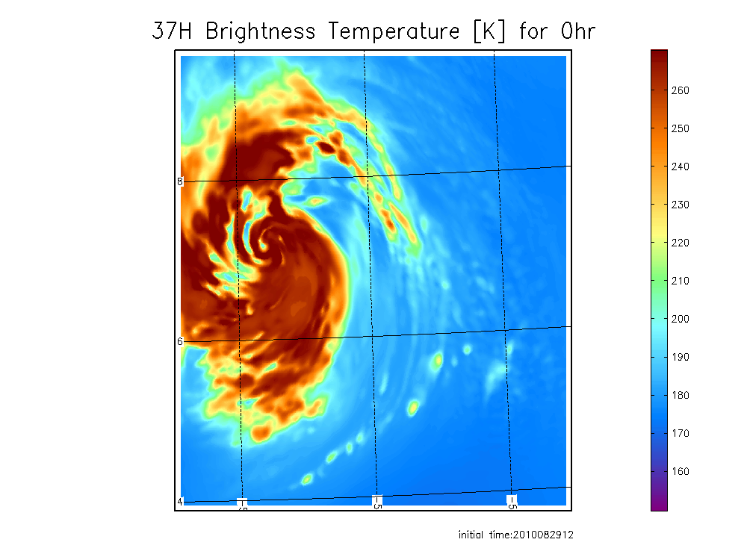
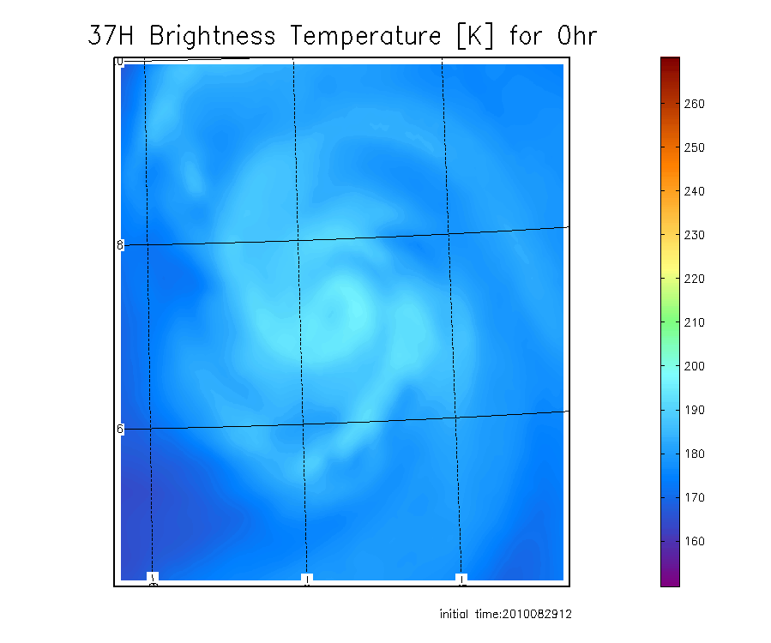
Coupling of cloud and dynamic state variables in HEDAS
37 GHz from HEDAS IC
37 GHz from HWRF IC

Slide 29
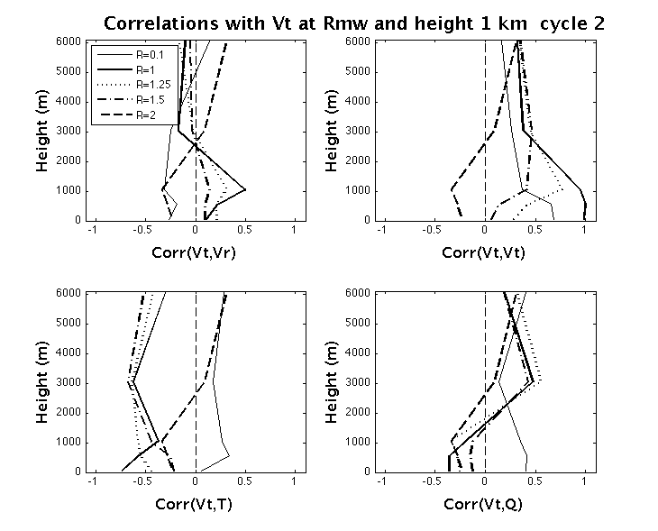
Ensemble based correlations on vortex scale

Slide 30
Summary
Hurricane background forecasts in high resolution may be skilled enough to enable successful assimilation of satellite cloud and precipitation observations
Joint assimilation of high resolution 3D wind and satellite observations is likely necessary for success, together with using 4DDA techniques with dynamic coupling in space and time dimensions
Planned updates in HEDAS, before the 2011 season:
  Satellite data assimilation in the core (Vukicevic)
  Representation of model error in surface and PBL physics (Aksoy and J. Zhang)
  Improved parallelization
All of HEDAS forecast case results can be found at the following link:
https://storm.aoml.noaa.gov/realtime

