Slide 1

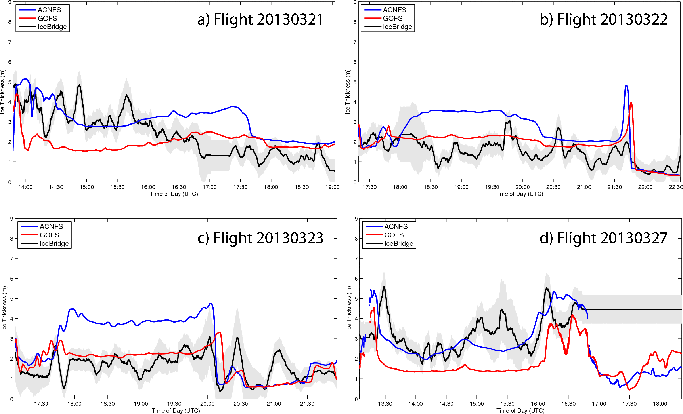
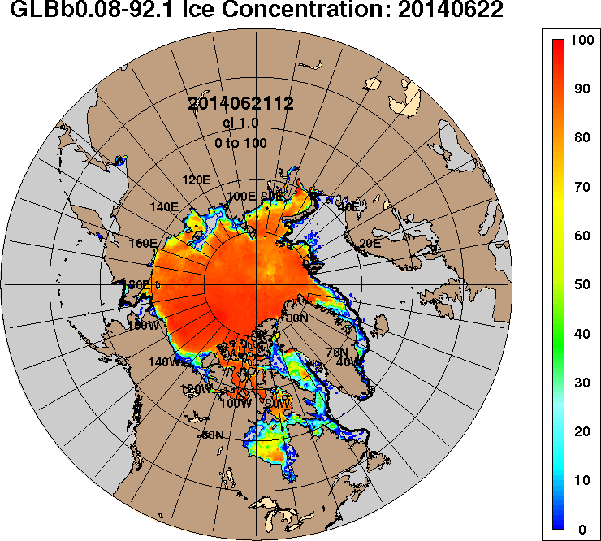
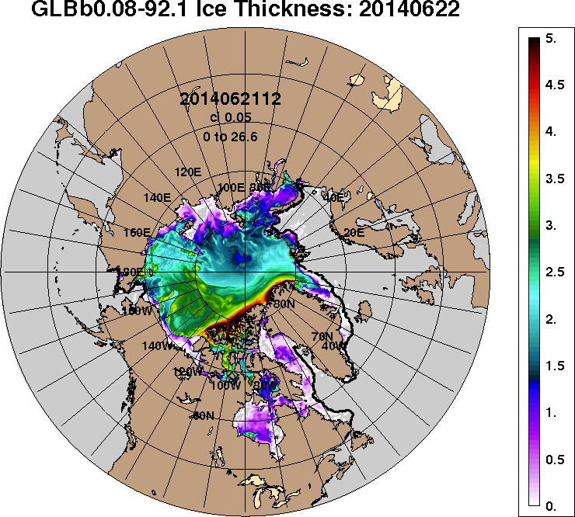
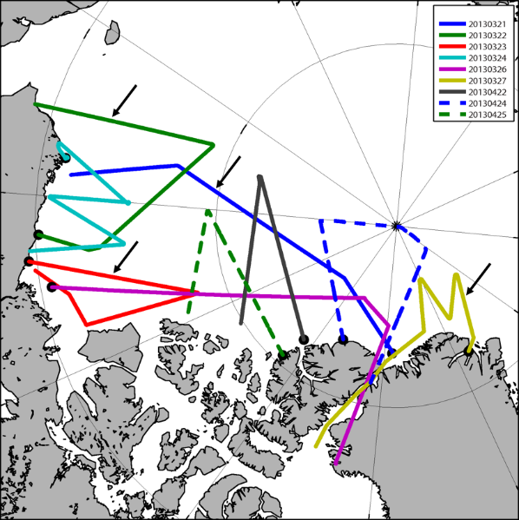
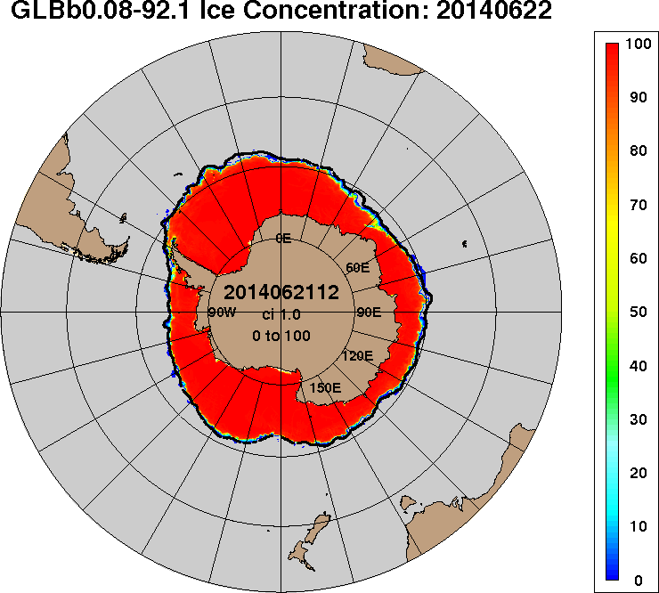
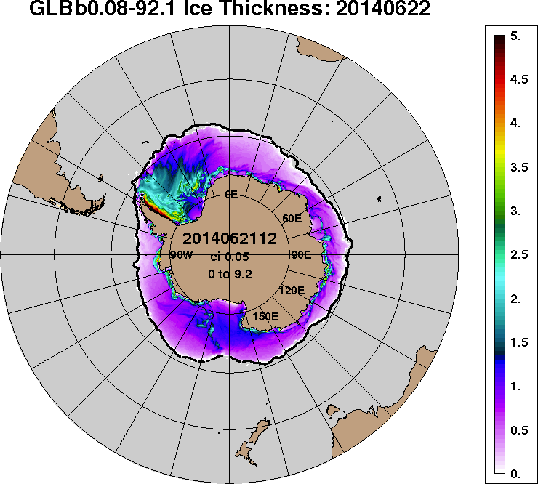
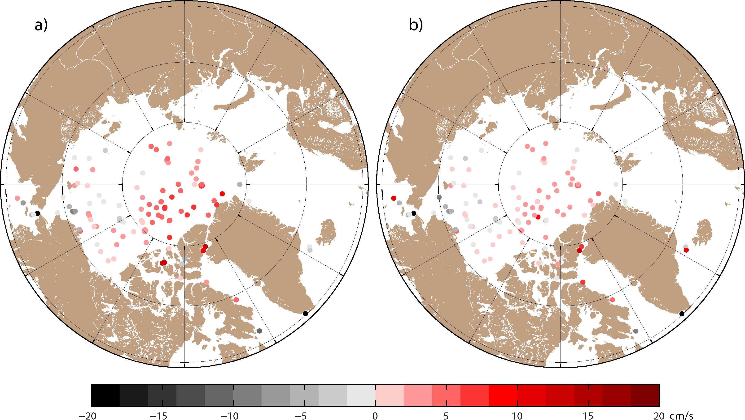
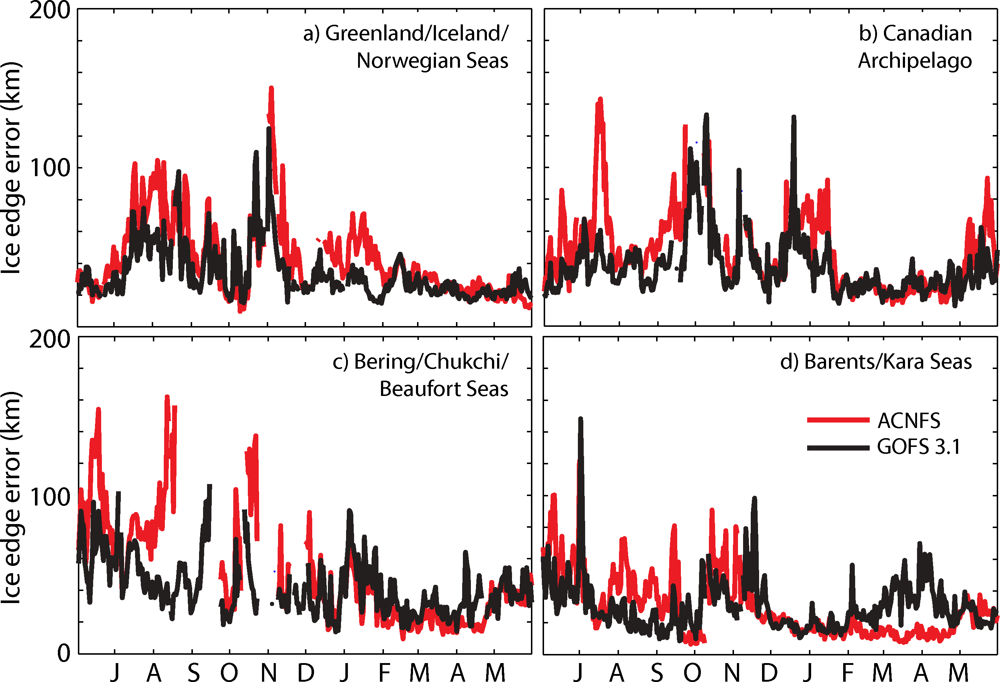
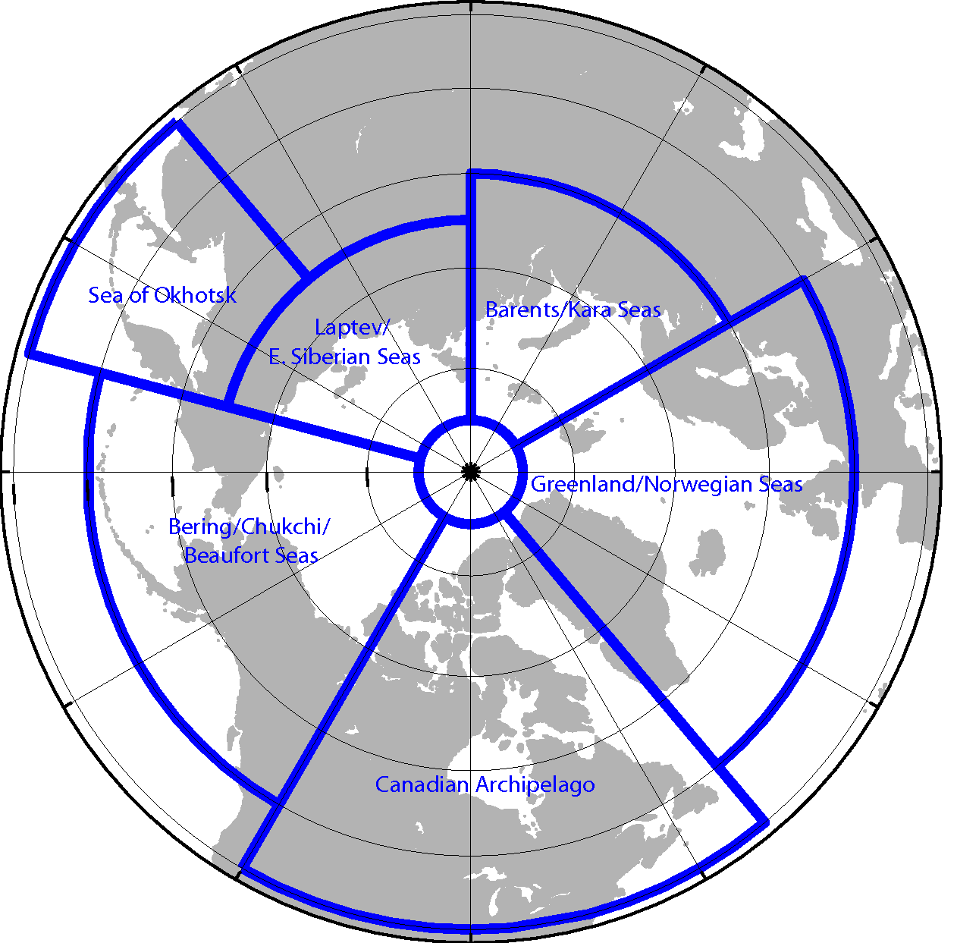
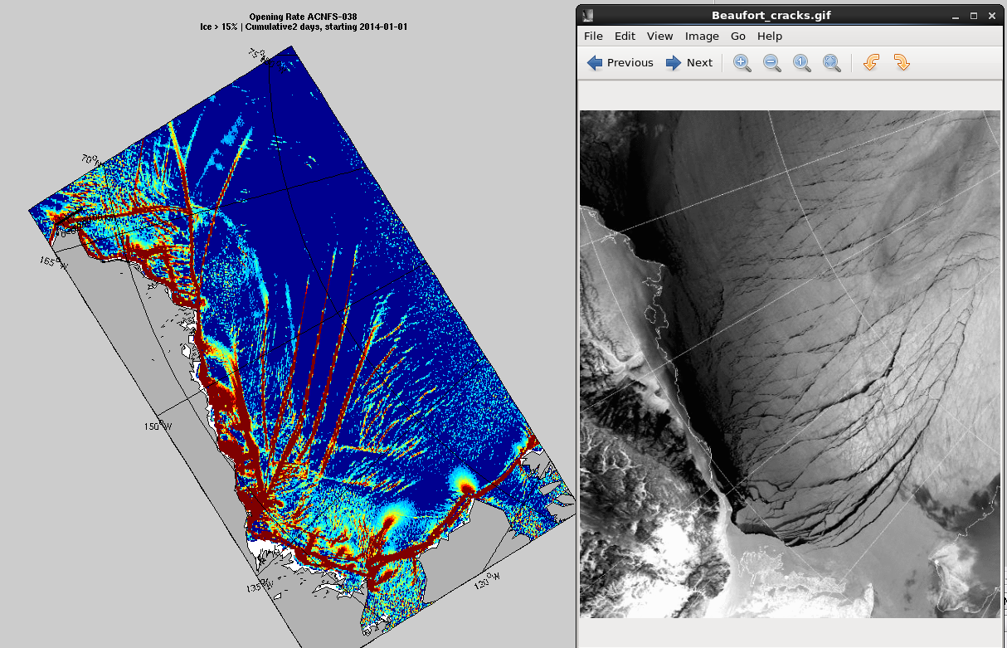
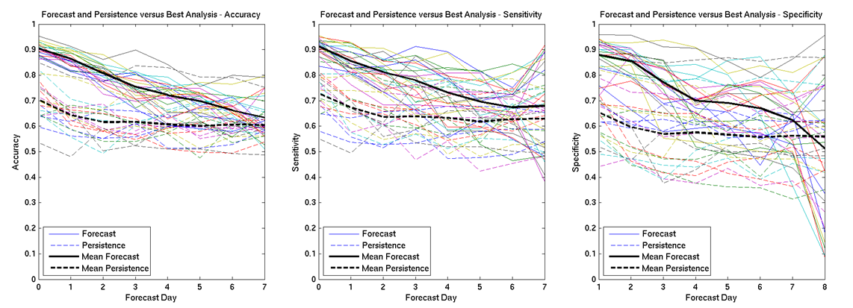
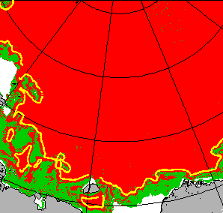
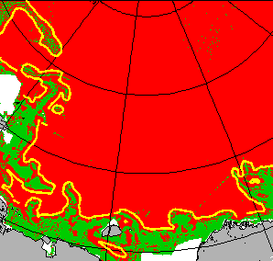
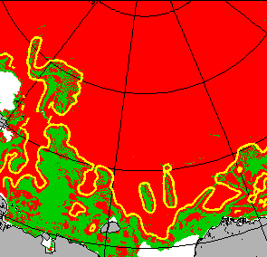
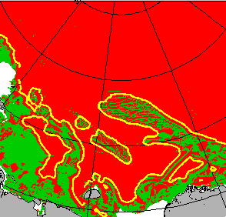
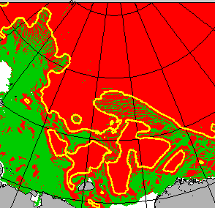
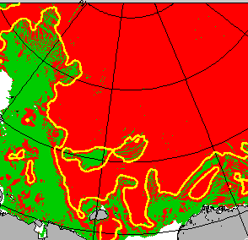
Ice Validation and Verification of the Global Ocean Forecast System 3.1
Ruth H. Preller¹, E. Joseph Metzger¹, Pamela G. Posey¹, Alan J. Wallcraft¹, Ole M. Smedstad² and Michael W. Phelps³
¹Naval Research Laboratory, ²Vencore Services and Solutions, Inc., ³Jacobs Technology
Abstract: The Global Ocean Forecast System (GOFS) 3.1 is comprised of the 1/12° HYbrid Coordinate Ocean Model that is two–way coupled with the Community Ice CodE and employs the Navy Coupled Ocean Data Assimilation. It additionally uses Improved Synthetic Ocean Profiles to project surface information downward into the water column. GOFS 3.1 nowcasts/forecasts the ocean’s “weather,” which includes the three-dimensional ocean temperature, salinity and current structure, the surface mixed layer, the location of mesoscale features, and ice concentration, thickness and drift in both hemispheres. It is scheduled to replace GOFS 3.0 for the ocean and the Arctic Cap Nowcast/Forecast System (ACNFS) for ice, both of which are the existing operational prediction systems running daily at the Naval Oceanographic Office. This poster describes the ice validation and verification against unassimilated observations. Overall, GOFS 3.1 is performing equal to or better than ACNFS.
GOFS 3.1 Ice Prediction
for the Northern Hemisphere
Ice concentration (%) – left
Ice thickness (meters) – right
Comparison Against IceBridge Ice Thickness Flight Data
Flight | Bias (m) |  | Absolute Bias (m) |  | RMS Difference (m)
 | GOFS 3.1 | ACNFS | GOFS 3.1 | ACNFS | GOFS 3.1 | ACNFS
20130321 | -0.43 | 0.60 | 0.98 | 0.90 | 1.22 | 1.09
20130322 | 0.39 | 0.98 | 0.54 | 1.08 | 0.67 | 1.33
20130323 | 0.23 | 1.04 | 0.55 | 1.33 | 0.77 | 1.59
20130324 | 0.59 | 0.82 | 0.82 | 1.01 | 1.05 | 1.32
20130326 | -0.76 | 0.76 | 0.96 | 1.09 | 1.23 | 1.32
20130327 | -1.89 | -1.11 | 1.91 | 1.45 | 2.14 | 1.93
20130422 | -0.57 | 0.80 | 0.83 | 0.85 | 1.00 | 0.99
20130424 | -1.33 | -0.11 | 1.40 | 0.62 | 1.87 | 0.94
20130425 | -0.28 | 1.46 | 0.63 | 1.47 | 0.79 | 1.55
World’s First Ice Prediction System
for the Southern Hemisphere
IceBridge flight paths
NASA Operation IceBridge collects airborne remote sensing measurements of ice thickness
Serendipitous that flights are in a region where GOFS 3.1 and ACNFS have large thickness differences
Flight paths marked by arrows (left) are the time series shown (above left)
Black circle denotes the beginning of the flight path
GOFS 3.1 generally has lower error in the regions of the Beaufort Sea and Canadian Archipelago
ACNFS generally has lower error in the region north of Greenland
System components:
41 layer 1/12° global HYbrid Coordinate Ocean Model (HYCOM)
Navy Coupled Ocean Data Assimilation (NCODA) – 3DVAR
Los Alamos developed Community Ice CodE (CICE)
Improved Synthetic Ocean Profiles (ISOP)
Major ocean model changes:
Newer HYCOM source code (v2.2.86 vs. v2.2.19)
Improved base bathymetry (30” GEBCO vs. ETOP05)
Improved vertical structure (additional 9 near surface layers)
Improved Equation of State (17-term vs. 9-term)
In-line surface momentum calculation that accounts for ocean currents
Improved ocean turbidity (chlorophyll-based)
Major NCODA-3DVAR changes:
NCODA analysis at 12Z rather than 18Z
Data selection for assimilation at receipt time
(vs. obs. time)
Use First Guess at Appropriate Time (FGAT)
for late arriving data
Downward projection of surface information:
Uses ISOP (vs. MODAS) to better represent the vertical structure of the ocean by also constraining vertical gradients of temperature and salinity
Ice assimilation changes (vs. ACNFS):
Both systems assimilate SSMIS ice concentration
ACNFS only assimilates near the ice edge
GOFS assimilates near the edge and into the interior using the NCODA analysis ±10%
GOFS 3.1 has received approval from the Validation Test Panel and is beginning OPerational TESTing (OPTEST) at the Naval Oceanographic Office (for the ocean) and the National Ice Center (NIC) (for the ice).
For more information: pamela.posey@nrlssc.navy.mil
Approved for public release; distribution is unlimited
Mean 24-hr ice drift speed error (cm/s)
GOFS 3.1 ACNFS
Comparison Against Ice-Bound Drifting Buoy Data
Average ice speed and component velocity (cm/s)
Black line is the independent NIC ice edge
Variable | Observed | GOFS 3.1 | ACNFS | GOFS - Observed | ACNFS -Observed
Statistics over the period January-August 2014
Speed | 8.78 | 9.97 | 9.59 | 1.19 (14%) | 0.81 (9%)
U-velocity | 6.09 | 6.85 | 6.41 | 0.77 (13%) | 0.32 (5%)
V-velocity | 5.07 | 5.89 | 5.85 | 0.83 (16%) | 0.79 (16%)
Statistics over the period January-March 2014
Speed | 7.90 | 9.43 | 9.96 | 1.53 (19%) | 2.06 (26%)
U-velocity | 5.23 | 5.79 | 6.06 | 0.56 (11%) | 0.83 (16%)
V-velocity | 4.74 | 6.12 | 6.57 | 1.38 (29%) | 1.83 (39%)
Statistics over the period June-August 2014
Speed | 10.41 | 11.20 | 9.87 | 0.79 (8%) | -0.54 (-5%)
U-velocity | 7.28 | 7.85 | 6.75 | 0.57 (8%) | -0.53 (-7%)
V-velocity | 5.95 | 6.49 | 5.91 | 0.54 (9%) | -0.04 (-1%)
24-hour Ice Edge Location Error – Northern Hemisphere
Northern Hemisphere Ice validation regions
116 fast vs. 78 slow 99 fast vs. 95 slow
Buoy data from the International Arctic Buoy Program
Use daily average ice velocity from GOFS 3.1 and ACNFS to advect model buoys and compare against the actual buoy displacement
Can also translate 24-hour buoy displacements into ice velocity and compare against model ice velocities
Analysis is only performed for ice-bound buoys
ACNFS opening
rate product
MODIS
24-hour Ice Edge Location Error (km)
Region | GOFS 3.1 | ACNFS | % Change
Greenland/Iceland/Norwegian Seas | 28.4 | 36.4 | 22.0
Barents/Kara Seas | 28.8 | 25.6 | -12.5
Laptev/East Siberian Seas | 26.8 | 56.0 | 52.1
Sea of Okhotsk | 34.4 | 32.0 | -7.5
Bering/Chukchi/Beaufort Seas | 38.9 | 44.9 | 13.4
Canadian Archipelago | 38.4 | 43.6 | 11.9
New Products Requested from Ice Forecasting System
Validated ACNFS/GOFS 3.1 ability to nowcast/forecast a Fractures, Leads
And Polynyas (FLAP)-like product
Compared ACNFS/GOFS 3.1 output vs MODIS imagery
Compared ACNFS/GOFS 3.1 opening rate to the NIC’s FLAP messages.
In both ACNFS and GOFS between 80-90% of fractures (Match + Possible Matches) were identified and 90% of polynyas were identified in ACNFS
Operational testing completed June 2015
by NIC.
1 Jan 2014
Accuracy of
Forecast vs Persistence
Fractures | MATCH | Possible Matches |  |  |  | MISS
 |  | Off-set | Part cov | Sub-set | Weak Fract
ACNFS | 31% | 5% | 21% | 22% | 9% | 12%
 |  | 57%
GOFS | 26% | 4% | 21% | 18% | 10% | 21%
 |  | 53%
Polynyas
ACNFS | 68% | 24% |  |  |  | 8%
Forecasting FLAPS products -green indicates FLAP areas
- Ice edge error in the Southern Hemisphere is comparable to this
Northern Hemisphere error
Day 1 - - - - - - > Day 7

