Slide 1

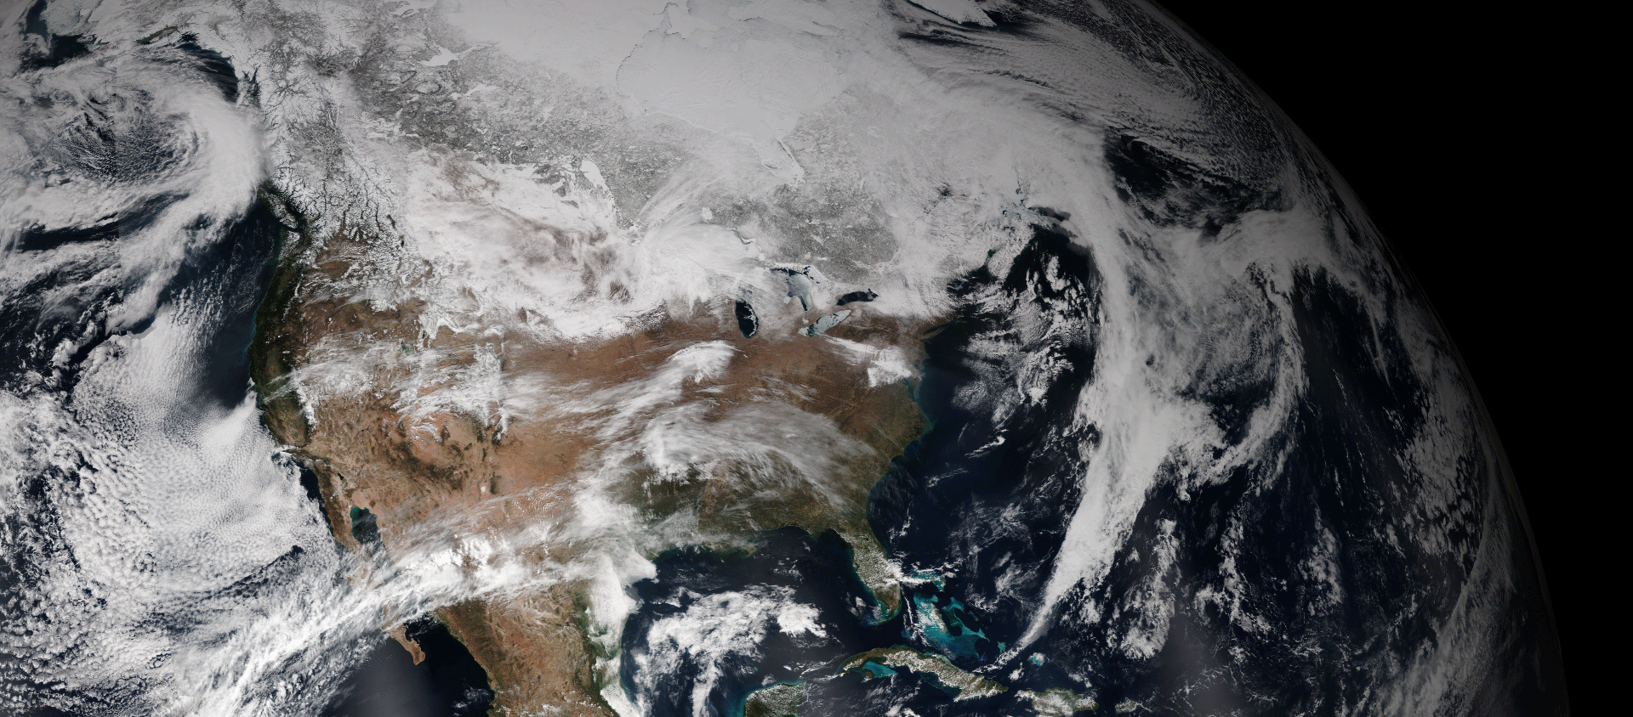
Science, Service, and You
Dr. Stephen Volz
Assistant Administrator for NOAA Satellites and Information Service
NOAA CREST Technical Meeting – May 7, 2015

Slide 2
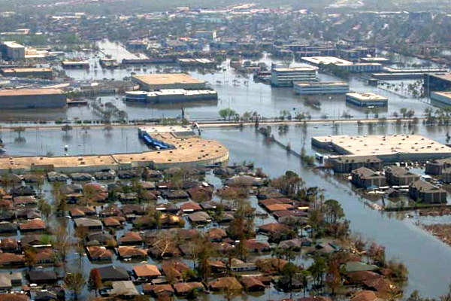
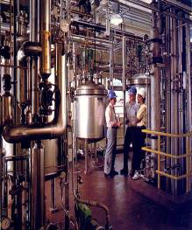
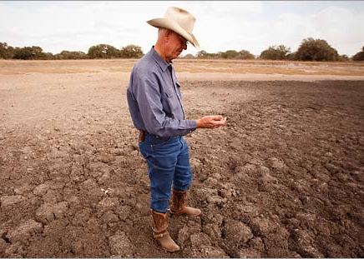
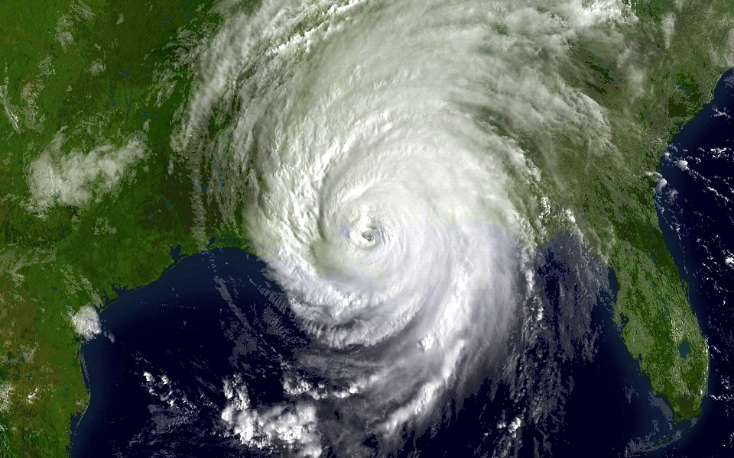

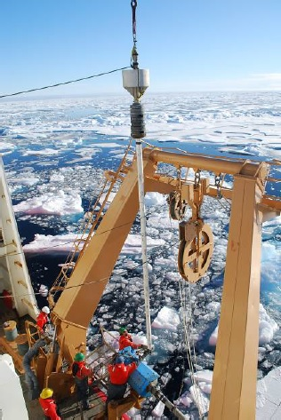
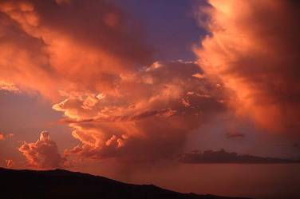

NOAA: Where Science Earns Value
Notes:
NOAA is where science earns value.
NOAA satellites are foundational to protecting life and property from severe weather, to understanding Earth’s vast ocean system, to supporting shipping, transportation, fisheries, health, communication, and agricultural industries
NESDIS also contributes to the national economy by providing environmental data that support resource management in areas such as energy, water, global food supplies, and other economic and environmental resources.

Slide 3
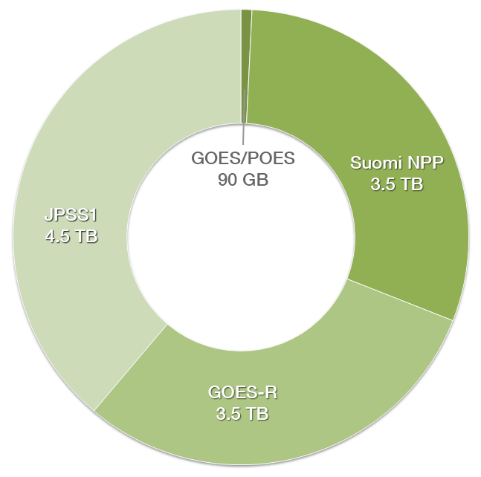

Big Data
NOAA produces more than 20 terabytes of data daily from many different sources, and just 10 percent of it is made accessible to the public on a timely basis.
Next-generation satellites like GOES-R and JPSS will produce even more data, so skilled computer scientists are crucial to getting that data into the hands of users.
Over the last 10 years, the climate data storage alone at the National Centers for Environmental Information has increased from 2 to 14 petabytes.
We need to utilize this data!
Notes:
We will need very smart data processing and data analysis people as we incorporate signals and data from many sources.
What is Volz (your) vision and engaging CREST with Giant Cooperate Sectors?

Slide 4
DOC Big Data Project
Cooperative Research and Development Agreement:
Collaboration with Amazon Web Services, Google Cloud Platform, IBM, Microsoft Corp, and the Open Cloud Consortium to explore ways of bringing the Department closer to its goal of unleashing its vast resources of environmental data and delivering on one of the Department’s key priorities – transforming Department data capabilities and supporting a data-driven economy.
Notes:
These collaborations, established through Cooperative Research and Development Agreements, or CRADAs, will provide the framework for a set of data alliances led by each of the anchor companies.
Data alliances, which consist of participating organizations across the private and public sectors, will work to research and test solutions for bringing the NOAA vast information to the cloud, where both the public and industry can easily and equally access, explore, and create new products from it, fostering new ideas and spurring economic growth.

Slide 5

Opportunities for Collaboration
More capabilities are coming online
More countries are joining the remote-sensing community
Big Data / Cooperative Research And Development Agreement (CRADA)
DOC’s big data project with Amazon Web Services, Google Cloud Platform, IBM, Microsoft Corp and the Open Cloud Consortium will explore ways of bringing the DOC closer to its goal of unleashing its vast resources of environmental data– transforming DOC data capabilities and supporting a data-driven economy..

Slide 6
BDP Architectural Concept
end users
end user 1
end user 2
end user 3
maximum diversity
application &
product providers
Custom
Product/
App #1
Custom
Product/
App #2
Custom
Product/
App #3
integration functions
analysis functions
maximum standardization
cloud provider(s)
working copy of data
agency security boundary
Agency Service Tier
agency-provided
services
Catalog
Access Services
Metadata
Formatting
master
copy of data
Earth
Observations
Earth
Observations
Model
Outputs

Slide 7
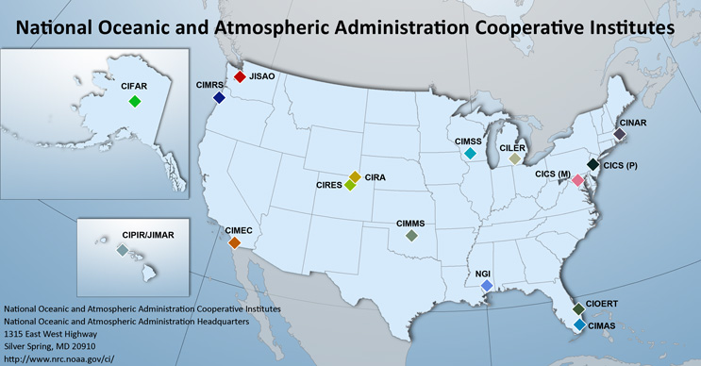
NOAA Cooperative Institutes
NOAA supports 16 Cooperative Institutes consisting of 42 universities and research institutions across 23 states and the District of Columbia.
Notes:
These are academic and non-profit research institutions conduct research that supports NOAA's Mission Goals and Strategic Plan
Many Cis are collocated with NOAA research laboratories, creating a strong, long-term collaboration between scientists in the laboratories and in the university. Cooperative Institutes not collocated with a NOAA laboratory often serve diverse research communities and research programs throughout NOAA.
Many of the cooperative agreements between NOAA and our academic partners provide for formal NOAA sponsorship of students through fellowships.
A. They help educate and train the next generation of NOAA's and the nation's scientific workforce.
B. Cooperative Institutes are located at parent institutions whose geographic expanse extends from Hawaii to Maine and from Alaska to Florida.
What is Volz (your) vision and how to engage CREST with Giant Cooperate Sectors?

Slide 8
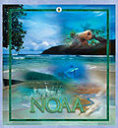
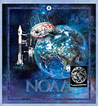
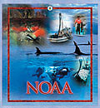
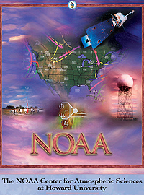
NOAA Cooperative Science Centers
Environmental Cooperative Science Center at Florida A&M University
Cooperative Remote Sensing Science & Technology Center at City College of the City University of NY
Living Marine Resources Cooperative Science Center at the University of Maryland Eastern Shore
Center for Atmospheric Science at Howard University
Notes:
NOAA provides funding to eligible MSIs, on a competitive basis, to educate, train and graduate students in NOAA mission, particularly atmospheric, oceanic, environmental, marine science and remote sensing technology.
The CSC goals are to:
1. Educate, train and graduate students, particularly from underrepresented communities, in NOAA mission;
2. Increase graduation rates of students from underrepresented minority communities in NOAA mission sciences;
Impact NOAA and national STEM workforce statistics by increasing the number of graduates from underrepresented communities in NOAA mission sciences;
3. Contribute to NOAA’s mission by strengthening and building capacity in NOAA scientific and management areas at MSIs and building research experience in NOAA scientific areas; and,
4. Leverage NOAA funds to build the education, training and research capacity at MSIs.

Slide 9
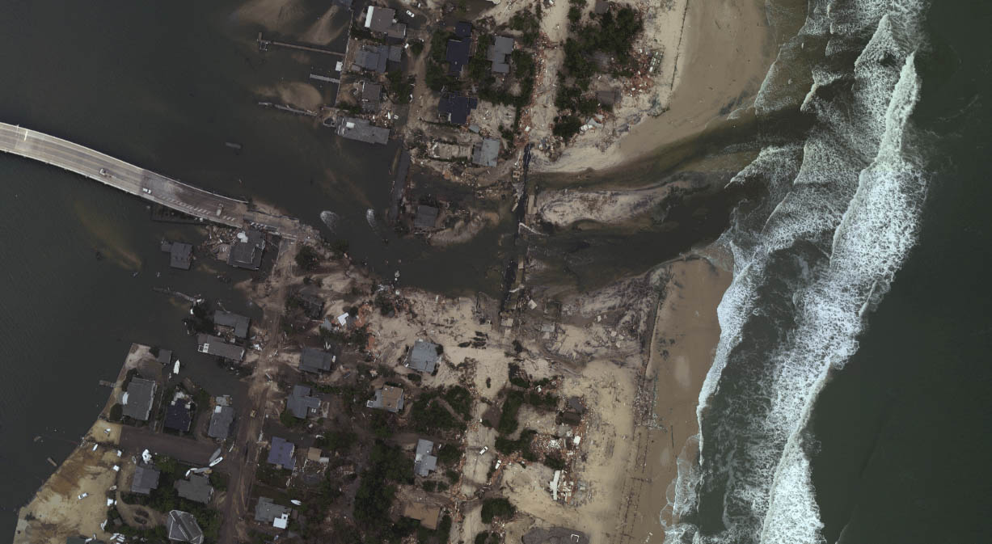
Science, Technology, Engineering & Mathematics (STEM)
We need skilled hands and inspired minds to help society prepare for and respond to weather-related events, to sustain healthy and productive ecosystems and to ensure resilient coastal communities and economies.
Our future success and technological advantage depends on a highly trained and highly technical workforce.
A 2011 report from Commerce’s Economics and Statistics Administration found that in the past 10 years:
Growth in STEM jobs was three times greater than that of non-STEM jobs;
STEM workers earn 26 percent more than their non-STEM counterparts; and
Job growth in these fields will continue to grow at a faster rate than other jobs.
Notes:
Good investment in the advancement of science and grooming the next generation of NOAA scientists.
NOAA is able to hire and retain a talented workforce due to our partners at CUNY, Hampton University, University of Puerto Rico, California State University, and the University of Maryland, Baltimore County. This partnership influences the use of science and technology in our classrooms; engages students in STEM education; attracts new and qualified STEM teachers; AND encourages a system that retains and rewards effective STEM teachers.
To-date over 700 students have been trained, mentored and later graduated in NOAA mission-related sciences through CREST, and many of those same students are now employed within the federal agencies, private sectors, federal contractors, local and state agencies, and academia.
As NOAA prepares to launch new satellite and remote sensing technology, improve our understanding of the changing climate system, and advance the way we manage and share environmental data, the NOAA-CREST partnership is needed like never before. Tomorrow’s STEM workforce is prepared through innovative technology experiences for students - experiences created through our partnership. To fully capture the economic benefits of existing and undiscovered technologies, NOAA requires a consistent stream of professionals equipped with STEM knowledge and abilities.
We look forward to a continued partnership with CREST and supporting the STEM leaders of tomorrow, and I look forward to future collaborations.

Slide 10
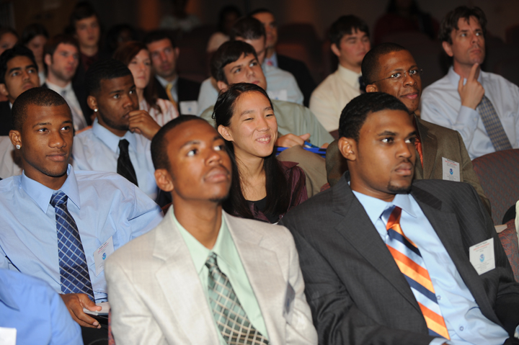
Information and Contacts
Acting Director, STAR &Technical Monitor of CREST:
Michael Kalb
Mike.Kalb@noaa.gov
Acting Cooperative Research Program Director:
Christopher W. Brown
Christopher.W.Brown@noaa.gov
NESDIS Education:
Nina Jackson
Nina.Jackson@noaa.gov
NESDIS Career & Student Opportunities:
Eli Salahuddun
Eli.Salahuddin@noaa.gov
NOAA Office of Education:
http://www.oesd.noaa.gov/
NOAA Educational Partnership Program:
http://epp.noaa.gov/
Notes:
Another Option: Under President Obama’s leadership, the Federal Government has taken steps to help students and recent graduates join the Federal service. www.usajobs.gov/StudentsAndGrads
The Pathways Programs offer clear paths to Federal internships for students from high school through post-graduate school and to careers for recent graduates, and provide meaningful training and career development opportunities for individuals who are at the beginning of their Federal service. As a student or recent graduate, you can begin your career in the Federal government by choosing the path that best describes you and where you are in your academics:
Internship Program
Recent Graduate Program
Presidential Management Fellows Program

Slide 11
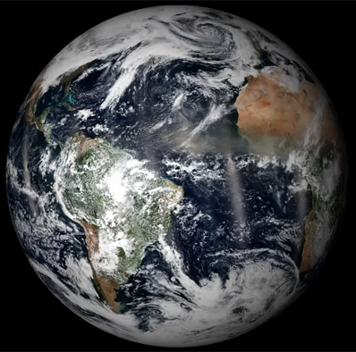
Thank You
Notes:
Satellites are very complicated and difficult machines to build. But, their capabilities are critical to NOAA’s mission to predict the Earth’s environment.
Mentors, Coaches, Advisors, and Sponsors
1. Are professional activities, a trusted relationships, a meaningful commitments to provide career advice and personal enrichment.
2. Builds and retains a healthy workforce that can react quickly to change and can develop, adapt, and regenerate itself over time.
Are informal or have formal agreements between expert and the mentee.
To those who serve as a mentor, coach, advisor or sponsor, I commend you for dedicating your time and resources. Those who are not, I encourage/empower you if time permits to do so.
Students need a strong foundation. Serving as a mentor, coach, advisor or sponsor is very important for social, spiritual, and personal values.
I would be happy to answer any questions you may have.

