Slide 1
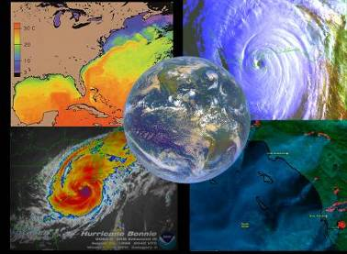
Geostationary Operational Environmental Satellite R- Series GOES-R Proving Ground
High Latitude and Arctic Test Bed
Dr. Frank P Kelly
Director Alaska Region
NWS

Slide 2
Proving Ground Mission Statement
The GOES-R Proving Ground engages NWS in pre-operational demonstrations of selected capabilities of next generation GOES
Objective is to bridge the gap between research and operations by:
Utilizing current systems (satellite, terrestrial, or model/synthetic) to emulate future GOES-R capabilities
Infusing GOES-R products and techniques into NWS operations with emphasis on AWIPS and transitioning to AWIPS-II.
Engaging in a dialogue to provide feedback to developers from users
The Proving Ground accomplishes its mission through:
Sustained interaction between developers and end users for training, product evaluation, and solicitation of user feedback.
Close coordination with GOES-R Algorithm Working Group (AWG) and Risk Reduction programs as sources of demonstration products, promoting a smooth transition to operations
Intended outcomes are Day-1 readiness and maximum utilization for both the developers and users of GOES-R products, and an effective transition to operations
Notes:
The Alaska Experiment activity at National Oceanic and Atmospheric Administration’s (NOAA’s) National Weather Service (NWS) Alaska Region and University of Alaska Fairbanks (UAF) High Latitude Testbed (HLT) provides the GOES-R Proving Ground (PG) with a pre-operational environment in which to deploy and demonstrate algorithms associated with its next generation GOES-R geostationary satellite system. These products are to include both GOES-R baseline products and operational readiness trials of products transitioning from Risk Reduction, but with the main focus on demonstrating the official GOES-R Baseline and Option-2 products. The availability of GOES-R products will demonstrate, pre-launch, a portion of the full observing capability of the GOES-R system, subject to the constraints of existing high latitude data sources to emulate the satellite sensors.

Slide 3
Products to be Demonstrated
Demonstrated Product | Category
Volcanic Ash: Detection and Height | Baseline
Cloud Phase | Baseline
Cloud/Snow Discrimination (Cloud Mask) | Baseline
Low Cloud and Fog | Option 2
SO₂ Detection | Option 2
Category Definitions: Baseline Products - GOES-R products that are funded for operational implementation as part of the ground segment base contract. Option 2 Products - New capability made possible by ABI as option in the ground segment contract.
Notes:
The Alaska Experiment activity at National Oceanic and Atmospheric Administration’s (NOAA’s) National Weather Service (NWS) Alaska Region and University of Alaska Fairbanks (UAF) High Latitude Testbed (HLT) provides the GOES-R Proving Ground (PG) with a pre-operational environment in which to deploy and demonstrate algorithms associated with its next generation GOES-R geostationary satellite system. These products are to include both GOES-R baseline products and operational readiness trials of products transitioning from Risk Reduction, but with the main focus on demonstrating the official GOES-R Baseline and Option-2 products. The availability of GOES-R products will demonstrate, pre-launch, a portion of the full observing capability of the GOES-R system, subject to the constraints of existing high latitude data sources to emulate the satellite sensors.

Slide 4
Key Components of Proving Ground
Ability to fully test
Individual components
Integrated components
Testing concepts
Simulate
Low-end events
High-end non-routine events
Archived events
Live events
Test team
Independence
Test experts, trainers, and operational users
Ability to make recommendations based on impacts

Slide 5
Proving Ground Participants
Proving Ground participants are broken into two categories
Providers
Providers are those organizations that develop and deliver the demonstration product(s) and training materials to the consuming organization.
Cooperative Institute for Meteorological Satellite Studies (CIMSS)
Consumers
Consumers are those who work with the providers to integrate the product(s) for demonstration into an operational setting for forecaster interaction.
Weather Forecast Office, River Forecast Center, Alaska Aviation Weather Unit (includes VAAC)
Partner agencies
National Park Service
Federal Aviation Administration
United States Geological Survey
Notes:
The Alaska Experiment activity at National Oceanic and Atmospheric Administration’s (NOAA’s) National Weather Service (NWS) Alaska Region and University of Alaska Fairbanks (UAF) High Latitude Testbed (HLT) provides the GOES-R Proving Ground (PG) with a pre-operational environment in which to deploy and demonstrate algorithms associated with its next generation GOES-R geostationary satellite system. These products are to include both GOES-R baseline products and operational readiness trials of products transitioning from Risk Reduction, but with the main focus on demonstrating the official GOES-R Baseline and Option-2 products. The availability of GOES-R products will demonstrate, pre-launch, a portion of the full observing capability of the GOES-R system, subject to the constraints of existing high latitude data sources to emulate the satellite sensors.

Slide 6
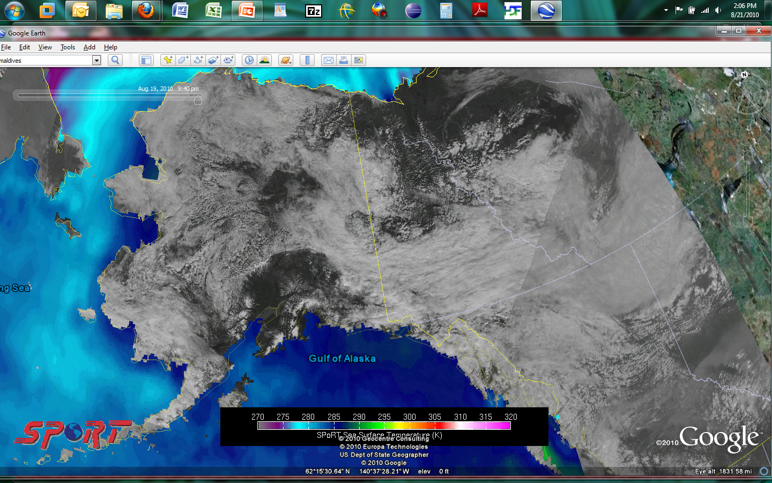
Google Earth example
Hybrid: MODIS (Terra) 250m Vis (1940Z)over GOES-West 1km Vis (1930Z)
SPoRT Sea Surface Temperature

Slide 7
Background

Slide 8


Potential GOES-R PG Products / Issues –
Alaska – Canada
(Partnering with NASA SPoRT)
Issues to address in Proving Ground activities
to what extent will high latitude viewing of Alaska with GOES-R instrumentation affect utility of GOES-R ABI products?
how can combined GOES-R / POES products alleviate these shortcomings?
Relevant products to address forecast problems?
work with GOES-R algorithm working group (AWG) teams to acquire proxy ABI products (based on current GOES or MODIS data streams) and disseminate
Decision support system of choice – AWIPS, AWIPS II, Google Earth, other collaboration tools
Aviation
Volcanic ash detection and height
Visibility – smoke, low cloud, fog
Land
Snow cover, LST
Vegetation products
Fire hot spots / intensity
Ocean
SSTs
Atmospheric
TPW
Precipitation estimates
transitioning unique NASA data and research technologies to operations

Slide 9
GOES-R Products
SPoRT Alaska interests
BASELINE Products
OPTION 2 Products
Clouds and Moisture Imagery (KPP)
Clear Sky Mask
Cloud Top Pressure and Height
Cloud Top Phase
Cloud Top Temperature
Cloud Particle Size Distribution
Cloud Optical Path
Temperature and Moisture Profiles
Total Precipitable Water
Stability Parameters (Lifted Index)
Aerosol Detection
Aerosols Optical Depth
Derived Motion Winds
Hurricane Intensity
Fire/Hot Spot Characterization
Land and Sea Surface Temperature
Volcanic Ash
Rainfall Rate
Snow Cover
Downward Solar Insolation: Surface
Reflected Solar Insolation: TOA
Lightning Detection
Cloud Layer/Heights
Cloud Ice Water Path
Cloud Liquid Water
Cloud Type
Convective Initiation
Turbulence
Low Cloud and Fog
Enhanced “V”/Overshooting Top
Aircraft Icing Threat
SO2 Detections (Volcanoes)
Visibility
Upward Longwave Radiation (TOA)
Downward Longwave Radiation (SFC)
Upward Longwave Radiation (SFC)
Total Ozone
Aerosol Particle Size
Surface Emissivity
Surface Albedo
Vegetation Index
Vegetation Fraction
Flood Standing Water
Rainfall probability and potential
Snow Depth
Ice Cover
Sea & Lake Ice Concentration, Age, Extent, Motion
Ocean Currents, Currents: Offshore
Advanced Baseline Imager (ABI)
Advanced Baseline Imager (ABI)
GLM
transitioning unique NASA data and research technologies to operations
Notes:
9
AWG is developing algorithms for both the baseline products and the option-2 products.
Baseline products tend to reflect operational GOES heritage level-2 products generated by NESDIS operations today.
Some of the option-2 products are truly new and have not been generated before in operations (ie., convective initiation, turbulence, enhanced-“V”/overshooting top

Slide 10
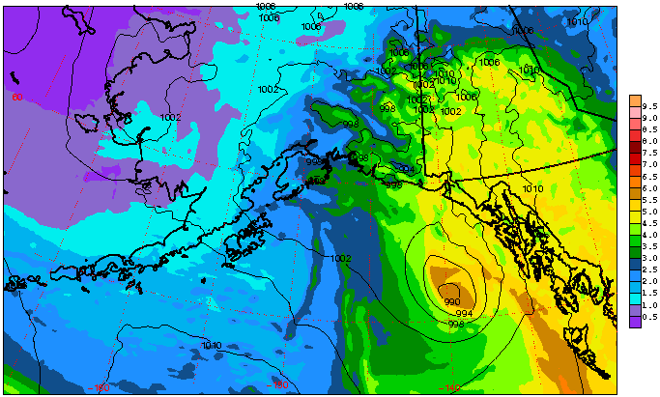
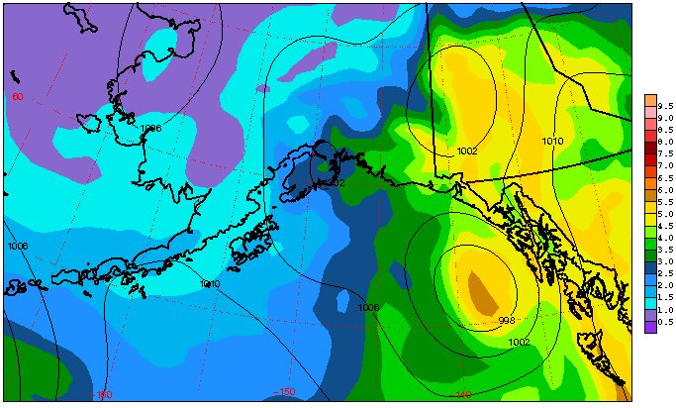
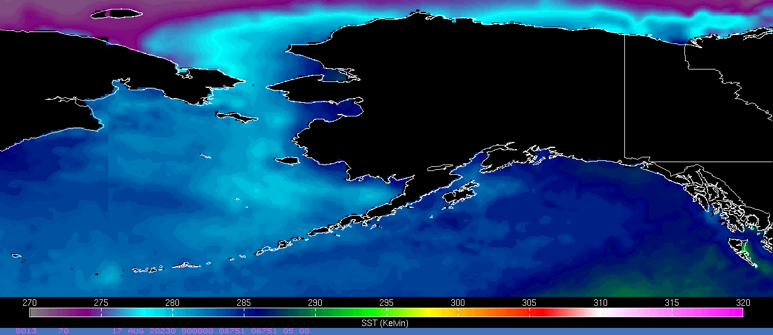
A Few Pertinent Examples
SPoRT produces a high resolution (1km) SST product derived from MODIS and AMSR-E SST data
provides valuable input to weather models
combined with ice analysis, can be useful diagnostic tool throughout the year.
AIRS Real-time 3D Analysis / Forecasts
AIRS
GFS-ANALYSIS
12-hr forecast valid 0000 UTC 8 February 2010
Contour intervals for 1000 hPa mixing ratio (filled) are 0.5 g/kg;
Interval for PMSL (black) is 4 hPa
WRF forecast with AIRS profile information over North Pacific Ocean
AIRS forecast provides a more detailed thermodynamic structure than GFS
Mixing ratio in AIRS run closer to GFS analysis than in control run (no AIRS data) in both magnitude and pattern
Analysis alone provides improved thermodynamic structure for improved diagnostic analysis
High resolution SST product
transitioning unique NASA data and research technologies to operations

Slide 11
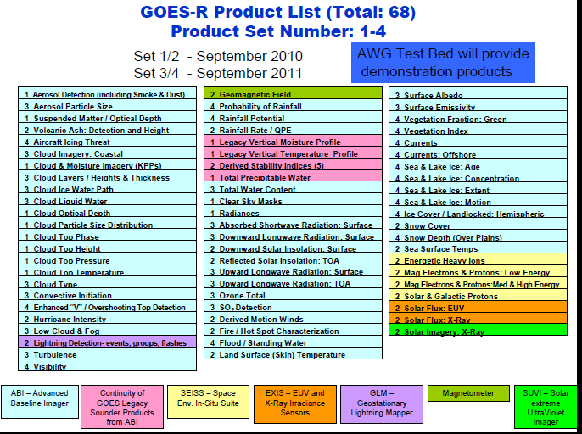

Slide 12
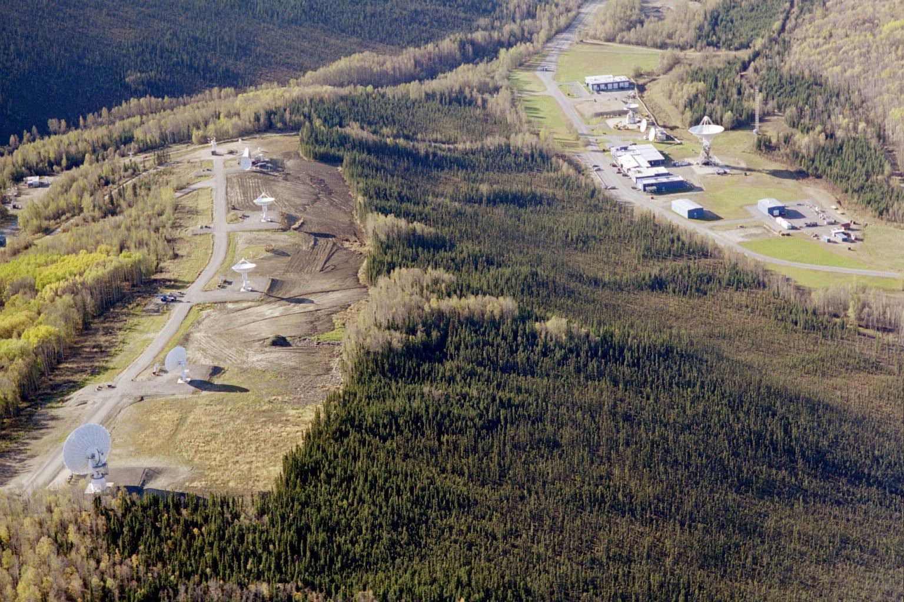
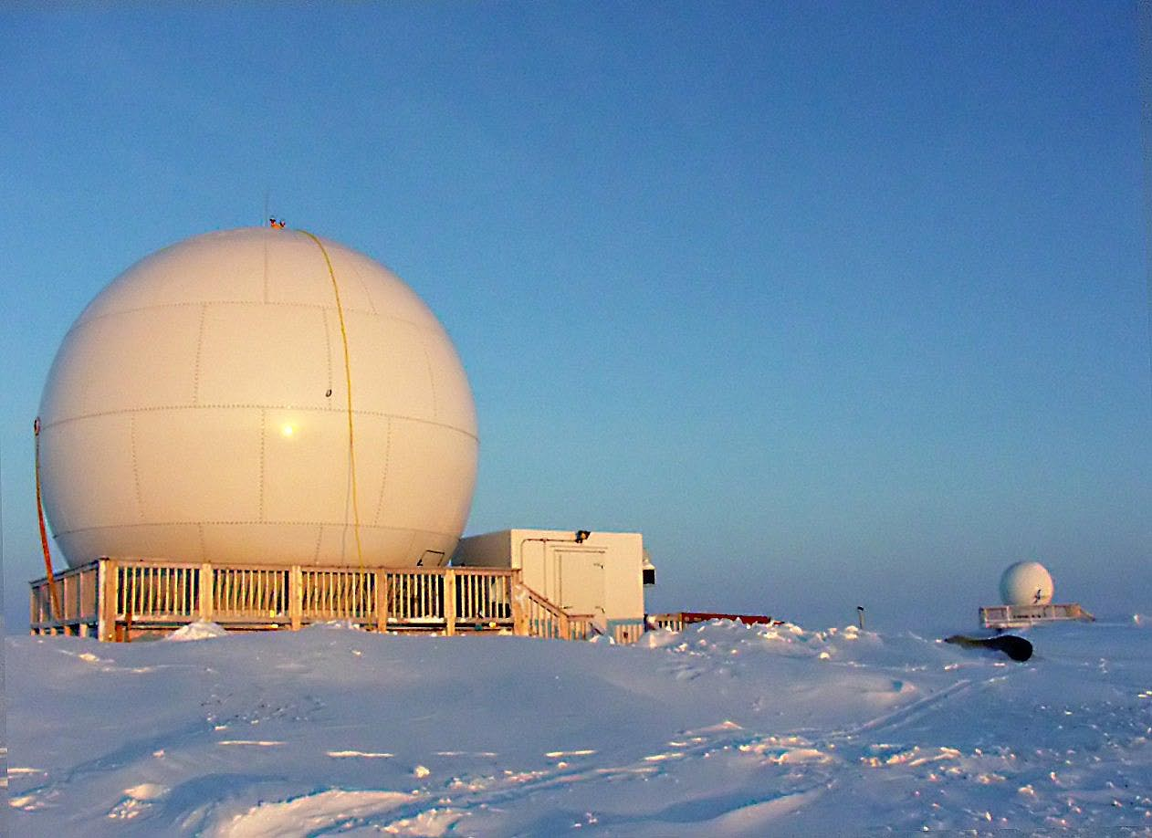
Barrow Downlink Site
Fairbanks Command and Data Acquisition Site

Slide 13
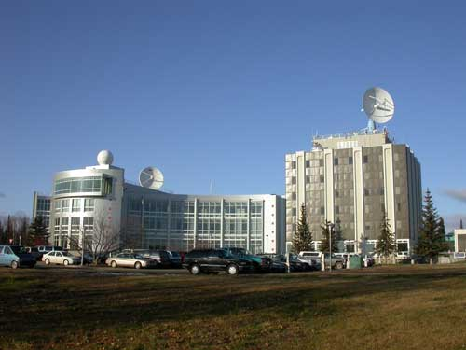
attachment
GINA/CIFAR UAF

Slide 14
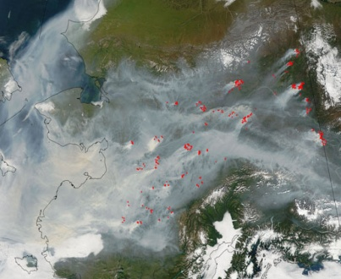
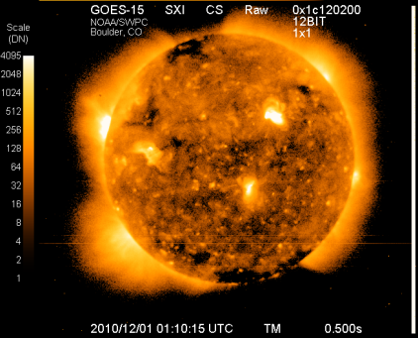
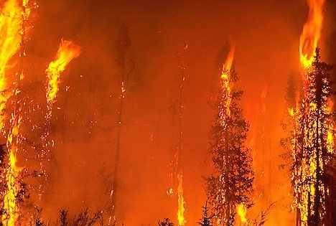
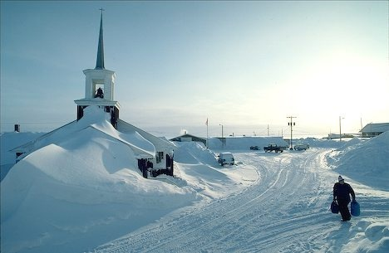
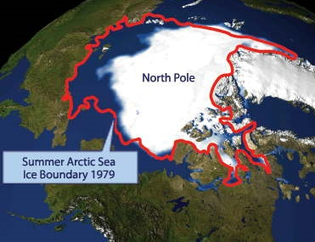
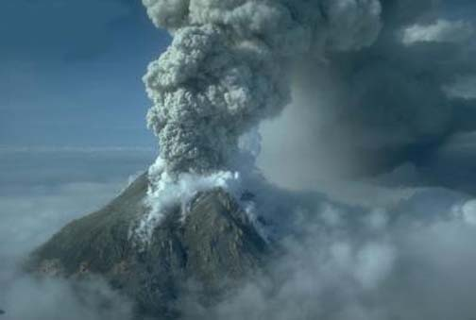
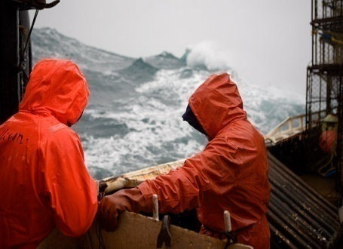
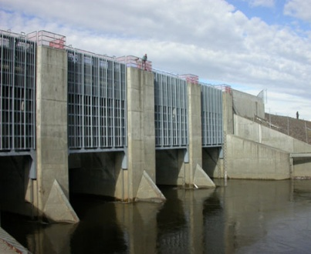
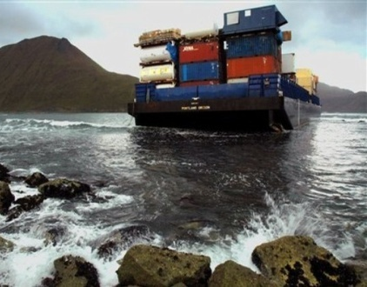
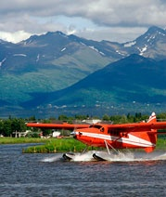
NOAA’s National Weather Service Alaska Region
Polar Communications and Weather Satellite Workshop
Dr. Frank Kelly
Director, Alaska Region

