Slide 1
NESDIS Snowfall Rate Product and Assessment in NWS Forecast Offices
July 18, 2018
Presented by:
Huan Meng¹, Kristopher White^{2,3}
Team: Jun Dong⁴, Cezar Kongoli⁴, Ralph Ferraro¹
¹NOAA/NESDIS/Center for Satellite Applications and Research
²NWS/Huntsville, AL Weather Forecast Office
³NASA/MSFC/Short-term Prediction Research and Transition Center
⁴University of Maryland/ESSIC/Cooperative Institute for Climate and Satellites

Slide 2
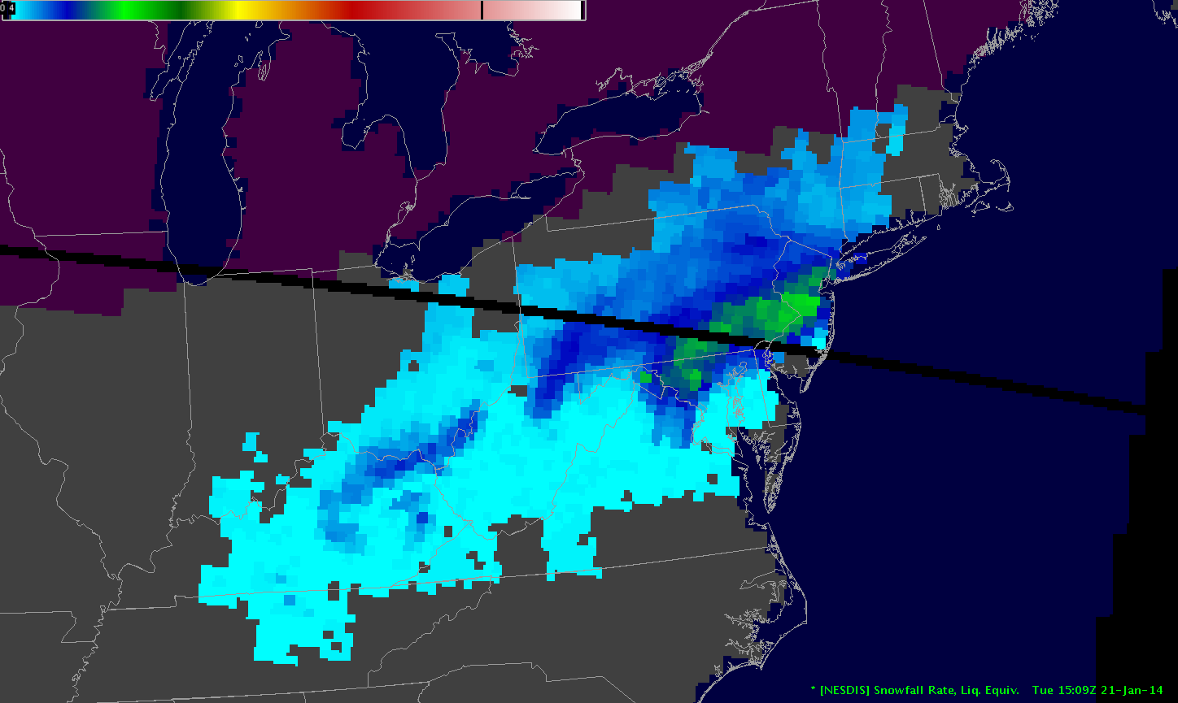
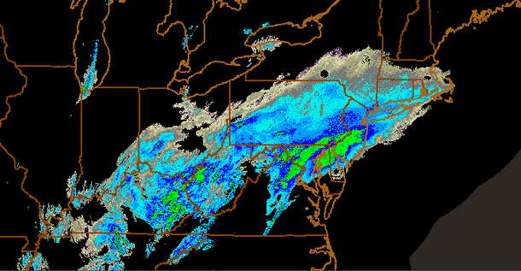
Product Overview
Water equivalent snowfall rate (SFR) estimate over global land
SFR is generated from passive microwave sensors (ATMS, AMSU/MHS, SSMIS, GMI)
Conical or cross-track scanning radiometers
Frequencies used: 23 GHz – 183 GHz
Nine satellites: S-NPP, NOAA-20, NOAA POES, EUMETSAT Metop, DMSP, NASA GPM
SFR in operation since 2012
S-NPP, POES and Metop SFR are operational
NOAA-20, DMSP and GPM will be transitioned to operation
Eighteen snowfall rate estimates per day on average at mid-latitudes and more at high latitudes
Retrieved Snowfall Rate
NEXRAD Reflectivity
2

Slide 3
Algorithm Overview
SFR algorithm includes two main components
Snowfall detection (SD)
Snowfall rate estimation
Snowfall Detection: Statistical algorithm (Kongoli et al., 2015, 2017)
Snowfall Rate: Physically-based algorithm (Meng et al., 2017; Ferraro et al., 2018)
3

Slide 4
SD Algorithm
Satellite-based module
NWP model-based module
Optimal combination of the two modules
NWP model-based screening
4

Slide 5

SD – Satellite Module
Coupled principal components and logistic regression model (Kongoli et al., 2015)
Input data: High frequency channels above 88/89 GHz
Three principal components for ATMS/MHS
Model output is the probability of snowfall; preset thresholds for snowfall
Training data sets are composed of matching satellite and ground snowfall observation data, Quality Controlled Local Climatology Data (QCLCD)
5

Slide 6
SD – Satellite Module
Two temperature regimes: warm and cold
Defined with limb-corrected T_{B}53.6 GHz data
Satellite measurements exhibit different characteristics depending on atmospheric conditions: scattering signal dominates in relatively warm and moist atmosphere, emission signal dominates in cold and dry atmosphere or atmosphere with abundant supercooled cloud liquid droplets
No retrieval if limb corrected T_{B}53.6 GHz < 240 K; not enough water vapor to mask surface
Two cloud thickness (CT) regimes
CT derived from NWP model data
Shallow (low and thin cloud layer) snowfall is much more challenging to detect than snowfall from thick clouds
6

Slide 7
Combined SD Algorithm
Numerical Weather Prediction (NWP) model-based weather SD module
Logistic regression model
Input data: RH, T, V-Vel, CT
The SD algorithm is an optimal combination of the satellite module and weather module (Kongoli et al., 2018)
Screening
Relative humidity
Temperatures
CT
7

Slide 8
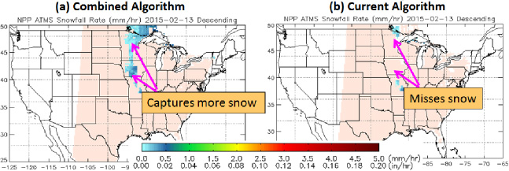
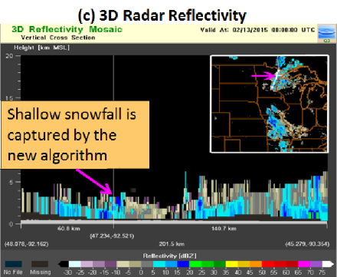
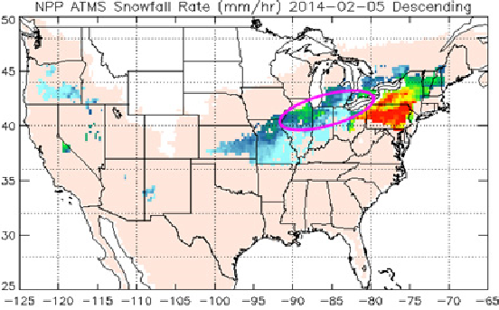
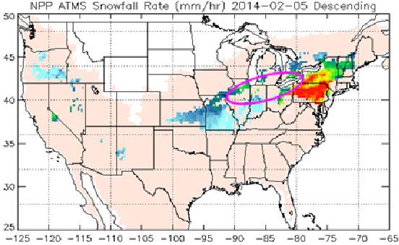
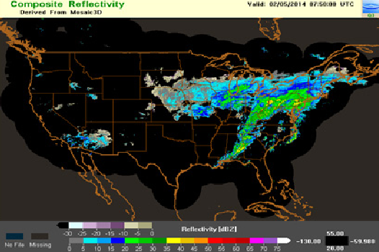
Combined SD Algorithm
The combined SD algorithm improves detection of both shallow- and deep-cloud snowfalls
Combined SD
Satellite only SD
Radar Reflectivity
Shallow-Cloud Snowfall Case
Deep-Cloud Snowfall Case
8

Slide 9
Snowfall Rate Algorithm
Retrieve cloud properties with 1DVAR
Derive ice water content (IWC)
Compute ice particle fall velocity
Derive SFR
9

Slide 10
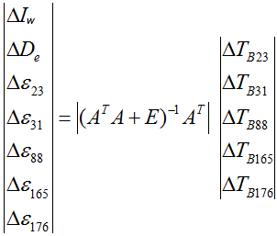
SFR Algorithm
1D variational method
Forward simulation of T_{B}’s with a radiative transfer model (RTM) (Yan et al., 2008)
Iteration scheme with ΔT_{Bi} thresholds
Iw and De are retrieved when iteration stops
Iw: ice water path
D_{e}: ice particle effective diameter
ε_{i}: emissivity at 23, 31, 88/89, 165/157, and 183±7/190 GHz
T_{Bi}: brightness temperature at 23, 31, 88/89, 165/190, and 183±7 GHz
A: Jacobian matrix, derivatives of T_{Bi} over Iw, D_{e}, and ε_{i}
E: error matrix
10

Slide 11




SFR Algorithm
Terminal velocity is a function of atmospheric conditions and ice particle properties, Heymsfield and Westbrook (2010):
Uncalibrated SFR (Meng et al., 2017):
Equation solved numerically
11

Slide 12
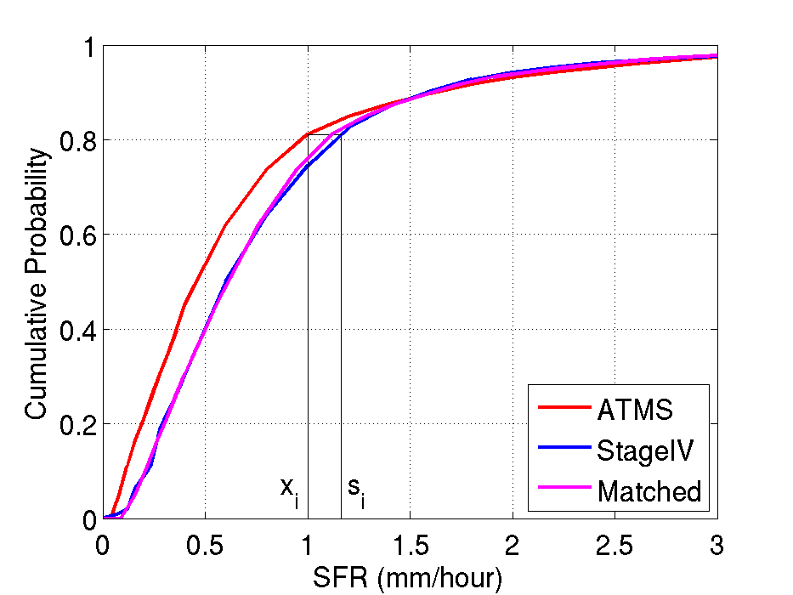
SFR Calibration
Calibration data is Stage IV precipitation analyses
Best snowfall rate data available: uses Multi-Radar Multi-Sensor (MRMS) precipitation data as input, incorporates gauge/model/satellite data, and applies human quality controls
Snowstorm data from two winter seasons (2015-2016)
CONUS coverage
Histogram matching (Kidder and Jones, 2007):
CDF adjustment
Lease square method to achieve optimal overall agreement between SFR and StageIV CDFs
SFR:
SFR = 1.5813 SFR_{u} – 0.2236 SFR_{u}² + 0.0216 SFR_{u}³
12

Slide 13
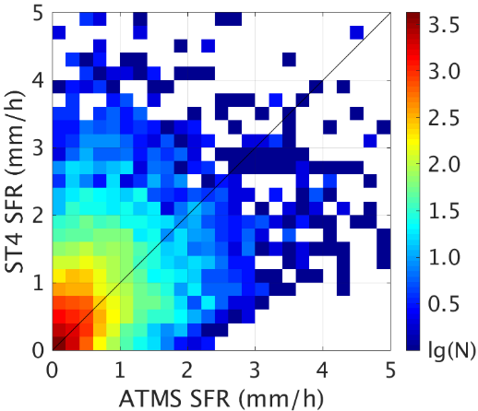
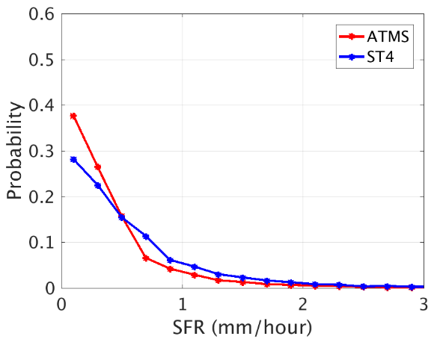
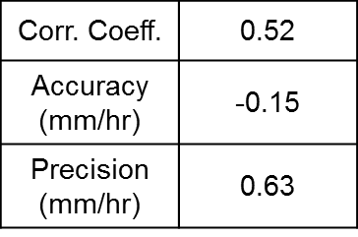
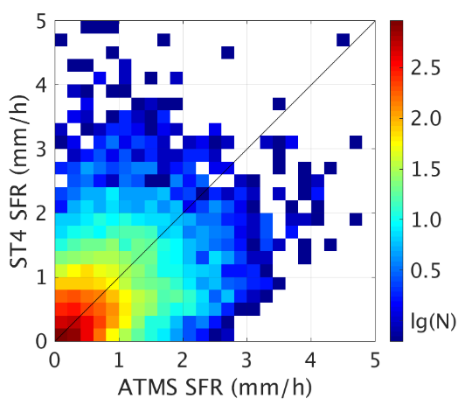
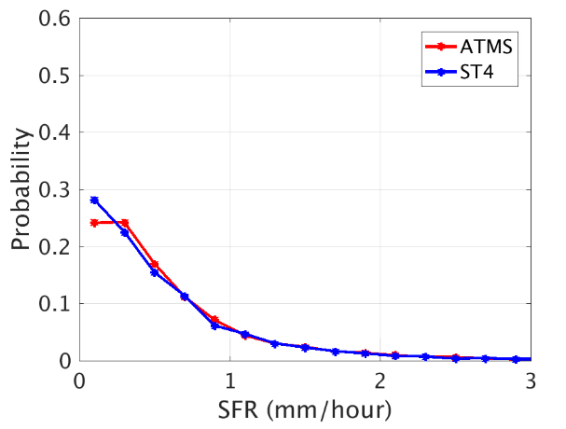
SFR Calibration
Before calibration
After calibration
Corr. Coeff. | 0.51
Accuracy (mm/hr) | -0.02
Precision (mm/hr) | 0.64
13

Slide 14
SD Validation: Methodology
Three-year validation dataset (2015-2017)
Multi-Radar Multi-Sensor (MRMS) – ATMS Match-up
In-situ – ATMS Match-up
Over Continental US (MRMS and in-situ)
Over Alaska (in-situ only)
Validation Metrics
14

Slide 15
SD Validation Metrics
Probability of Detection (POD) is the fraction of true snowfall retrieved
False Alarm Rate (FAR) is the fraction of false snowfall retrieved
Accuracy Rate is the fraction of correct snowfall and no-snowfall retrieved
Heidke Skill Score (HSS) is the correct forecast relative to the chance forecast. A zero score indicates no skill. A negative score indicates forecast does worse than a chance forecast
15

Slide 16
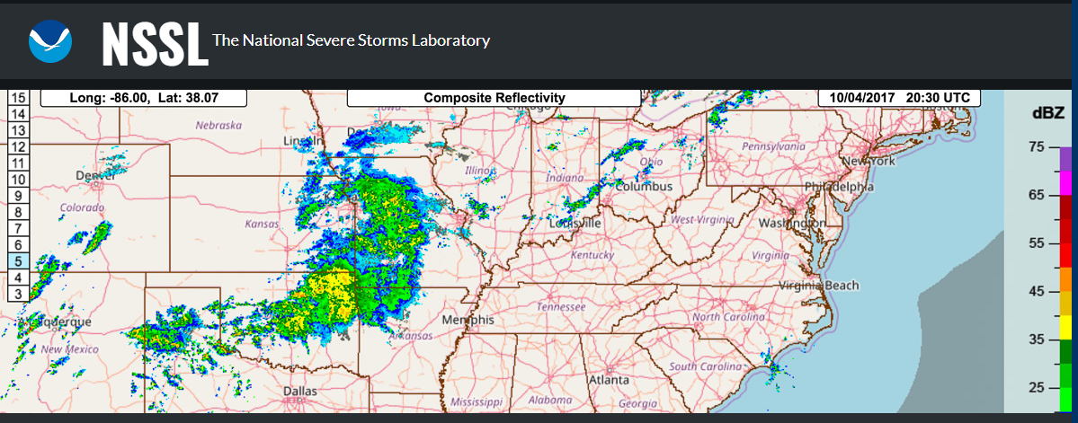
MRMS – ATMS Match-up
MRMS is a system with automated algorithms that quickly and intelligently integrate data streams from multiple radars, surface and upper air observations, lightning detection systems, and satellite and forecast models.
MRMS pixels were collocated with ATMS FOVs. Calculated were fraction of precipitating ATMS FOV, fraction of snowing and raining FOV and an effective FOV snowfall rate (SFR). An ATMS FOV was classified as “snowing” for positive values of effective SFR and no-snowing for zero SFR values.
16

Slide 17
In-Situ – ATMS Match-up
In-situ data: Quality Controlled Local Climatological Data (QCLCD)
Measurements include surface temperature, humidity, surface liquid precipitation and present weather
Present weather flag indicates if it is snowing, raining or no-precipitation
Hourly weather observations were collocated with ATMS SFR/SD product
Nearest in-situ observation within 15 km to the ATMS FOV center and 30 minutes time off-set
An ATMS FOV was classified as snowing if the present weather was flagged as “snowfall” and not-snowing if the present weather was flagged as other than snowfall and accumulated gauge precipitation was equal to zero.
17

Slide 18
Results: vs MSMR (CONUS)
Year | Accuracy | POD (%) | FAR (%) | HSS
2015 | 0.92 | 53 | 4 | 0.47
2016 | 0.90 | 55 | 7 | 0.43
2017 | 0.88 | 51 | 8 | 0.40
Combined | 0.90 | 53 | 6 | 0.43
18

Slide 19
Results: vs in-situ (CONUS)
Year | Accuracy | POD (%) | FAR (%) | HSS
2015 | 0.90 | 50 | 7 | 0.42
2016 | 0.89 | 53 | 8 | 0.42
2017 | 0.88 | 50 | 8 | 0.40
Combined | 0.88 | 51 | 8 | 0.40
19

Slide 20
Results: vs in-situ (Alaska)
Year | Accuracy | POD (%) | FAR (%) | HSS
2015 | 0.85 | 45 | 9 | 0.39
2016 | 0.87 | 47 | 10 | 0.38
2017 | 0.85 | 47 | 11 | 0.35
Combined | 0.86 | 46 | 10 | 0.37
20

Slide 21
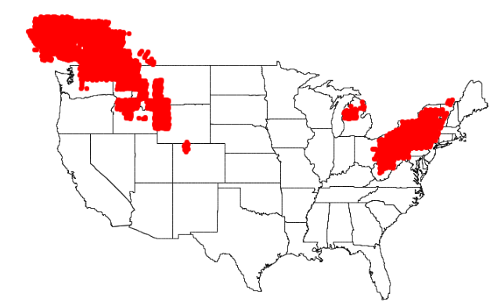
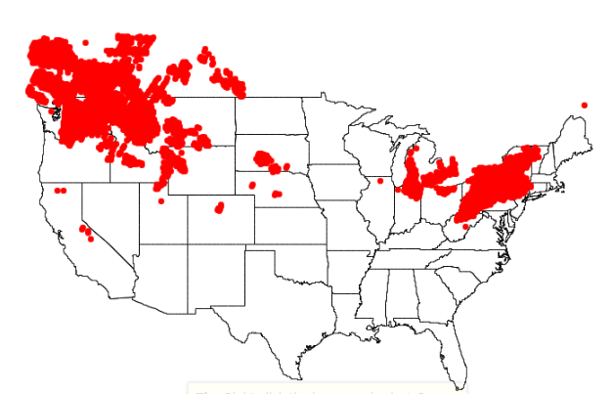
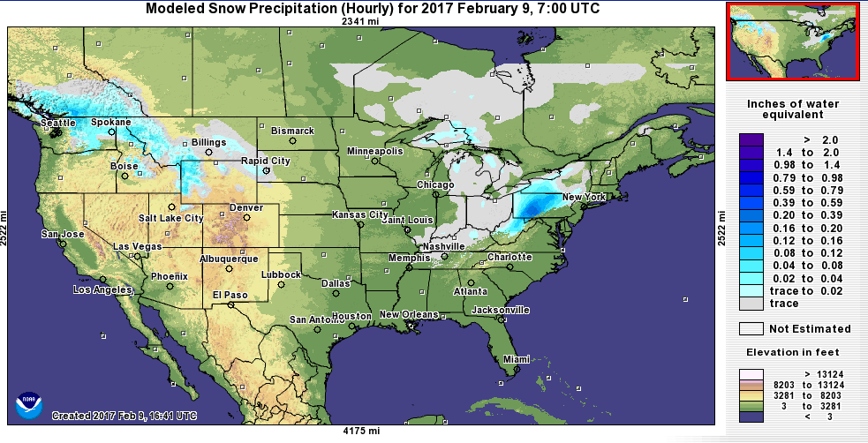
Comparisons with MRMS and NOHRSC
ATMS – 20170209: Descending
MRMS – 20170209: Descending
National Operational Hydrologic Remote Sensing Center (NOHRSC) Snowfall Analysis is a unified snowfall analysis from several high-resolution operational forecast model precipitation data sets
NOAA’s NOHRSC Snow Analysis
21

Slide 22
SFR Validation: Methodology
Validation data
Stage IV (hourly, 4 km) data from winter 2016-2017, over 92K points, CONUS
MRMS (instantaneous, 0.01 degree) data from winter 2016-2017, over 160K points, CONUS
Validation method
Statistics from collocated instantaneous SFR and validation data
Statistics from collocated seasonal-average SFR and validation data
Validation metrics
Correlation coefficient
Bias
RMS
Histogram comparison
Scatter plot
22

Slide 23
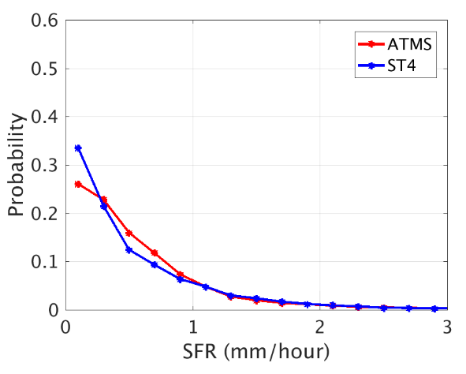
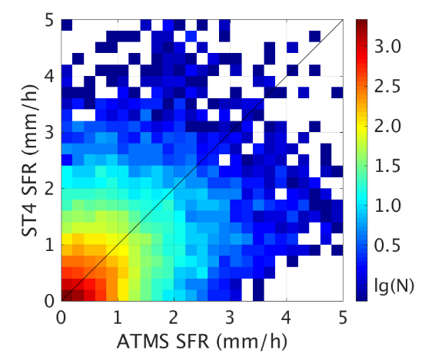
SFR Validation: vs. Stage IV
Collocate Stage IV with S-NPP ATMS SFR through convolution to ATMS footprint
Corr. Coeff. | Bias (mm/hr) | RMS (mm/hr)
0.50 | 0.06 | 0.74
23

Slide 24
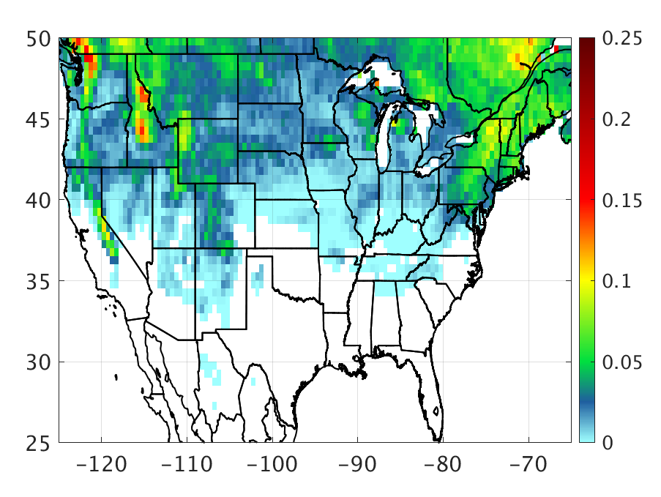
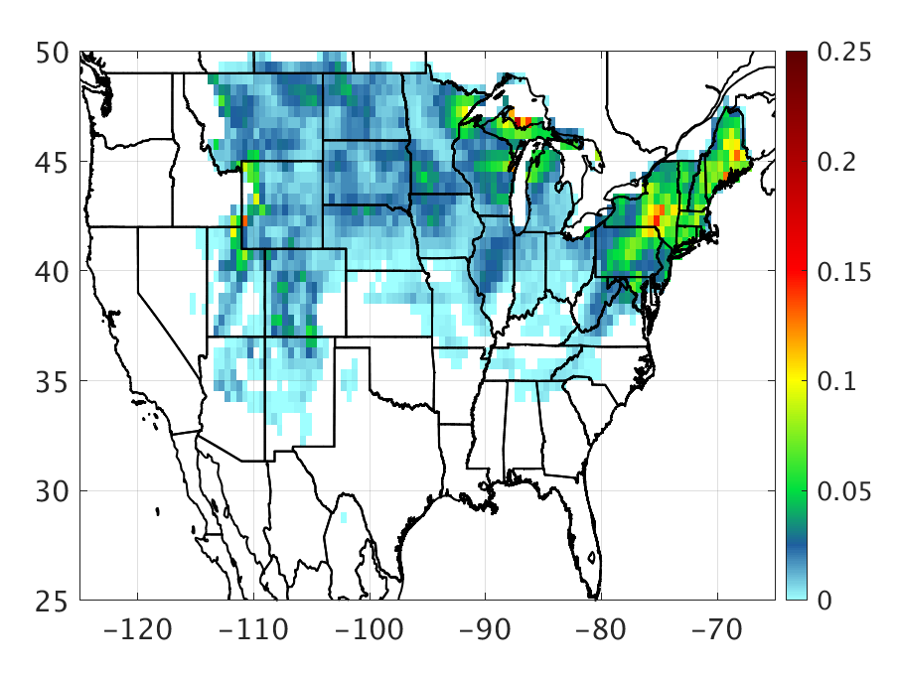
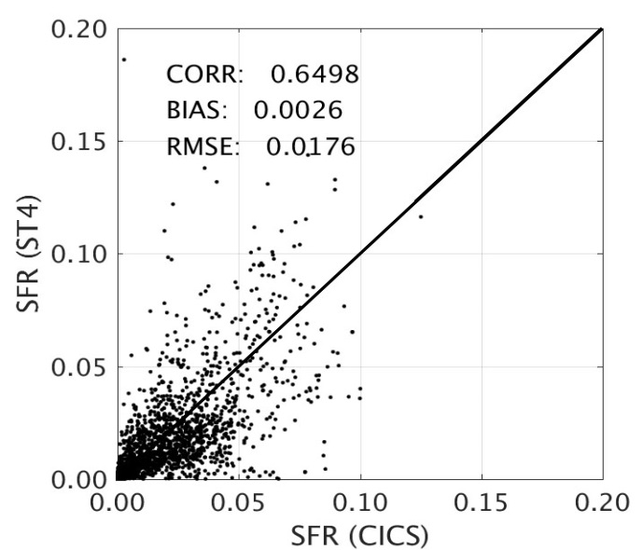
Seasonal Average (Jan – Mar, 2017)
No
Co-ver
age
S-NPP SFR
Stage IV
mm/hr
mm/hr
Corr. Coeff. | Bias (mm/hr) | RMS (mm/hr)
0.65 | 0.00 | 0.02
24

Slide 25
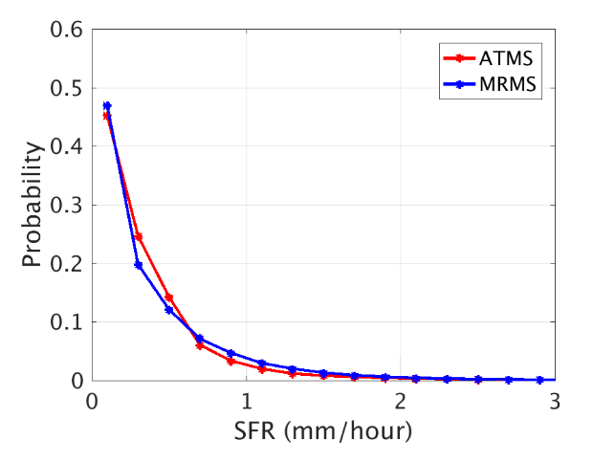
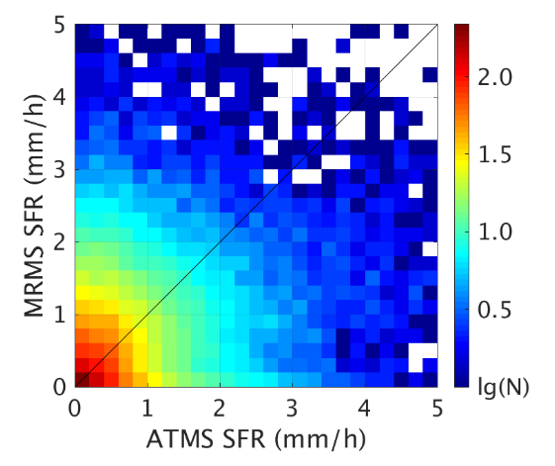
SFR Validation: vs. MRMS
Collocate MRMS with S-NPP ATMS SFR through convolution to ATMS footprint
Corr. Coeff. | Bias (mm/hr) | RMS (mm/hr)
0.43 | -0.01 | 0.55
25

Slide 26
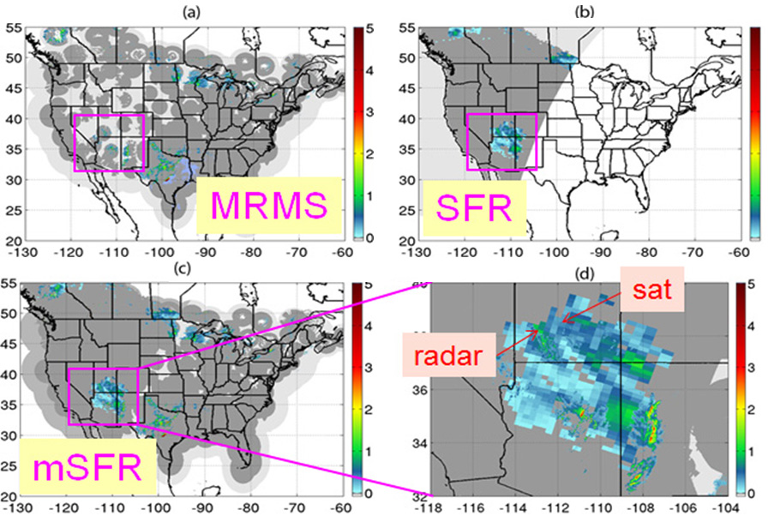
Radar and Satellite Merged SFR (mSFR)
Merging MRMS instantaneous snowfall product and SFR from 8 satellites provides better spatial and temporal (10-min) coverage and ability to loop the data (mSFR); fills radar gaps especially in western U.S.
26

Slide 27
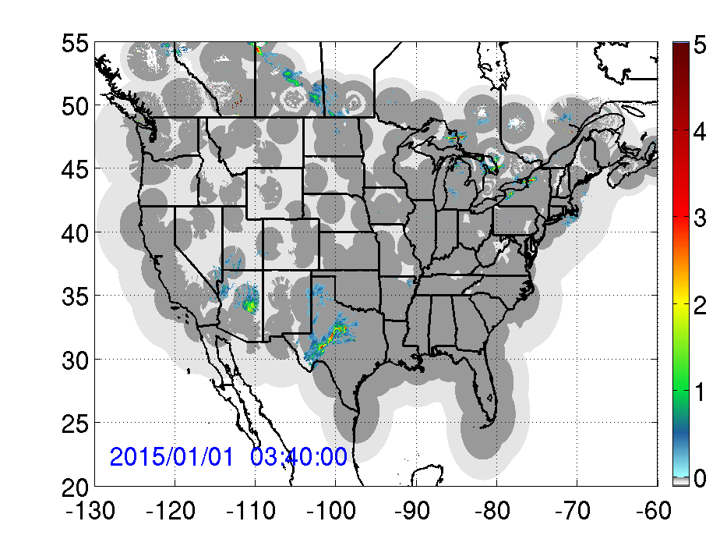
Radar and Satellite Merged SFR (mSFR)
mm/hr (liquid equivalent)
27

Slide 28
Future Plans
SFR algorithms enhancement
NOAA-20 SFR development, calibration and validation
Transition NOAA-20 SFR to operation
Transition GPM and DMSP SFR to operation
Develop Metop-C SFR algorithm
28

Slide 29
NESDIS SFR 2018 Assessment
JPSS PGRR Project Milestone
Leads: NASA SPoRT (POC: Kris White), NESDIS/STAR (POC: Huan Meng)
Support team: Algorithm developers from NESDIS/STAR and CICS-MD (J. Dong, C. Kongoli, and R. Ferraro)
Assessment period: January 2, 2018 – March 31, 2018
Product
Existing sensors: ATMS and AMSU/MHS snowfall rate (SFR)
New sensors: SSMIS (DMSP: F16, F17) and GMI (NASA GPM)
Available for CONUS (NWS ABQ) throughout, AK after March 12th
SFR and merged SFR (utilizes MRMS derived precipitation)
Improved snowfall detection and snowfall rate algorithms
Goals: Determine operational utility in the forecaster environment as it relates to:
Temporal and spatial resolution of data/imagery
Sufficient accuracy of snowfall detection and rates for operational purposes, especially with new measurements from SSMIS and GMI
Filling radar gaps
Tracking snowfall rate maxima
Determine areas where cloud seeding may be occurring ahead of falling precipitation
Active Participating NWS Offices:
Albuquerque, NM
Juneau, AK
Anchorage, AK

Slide 30
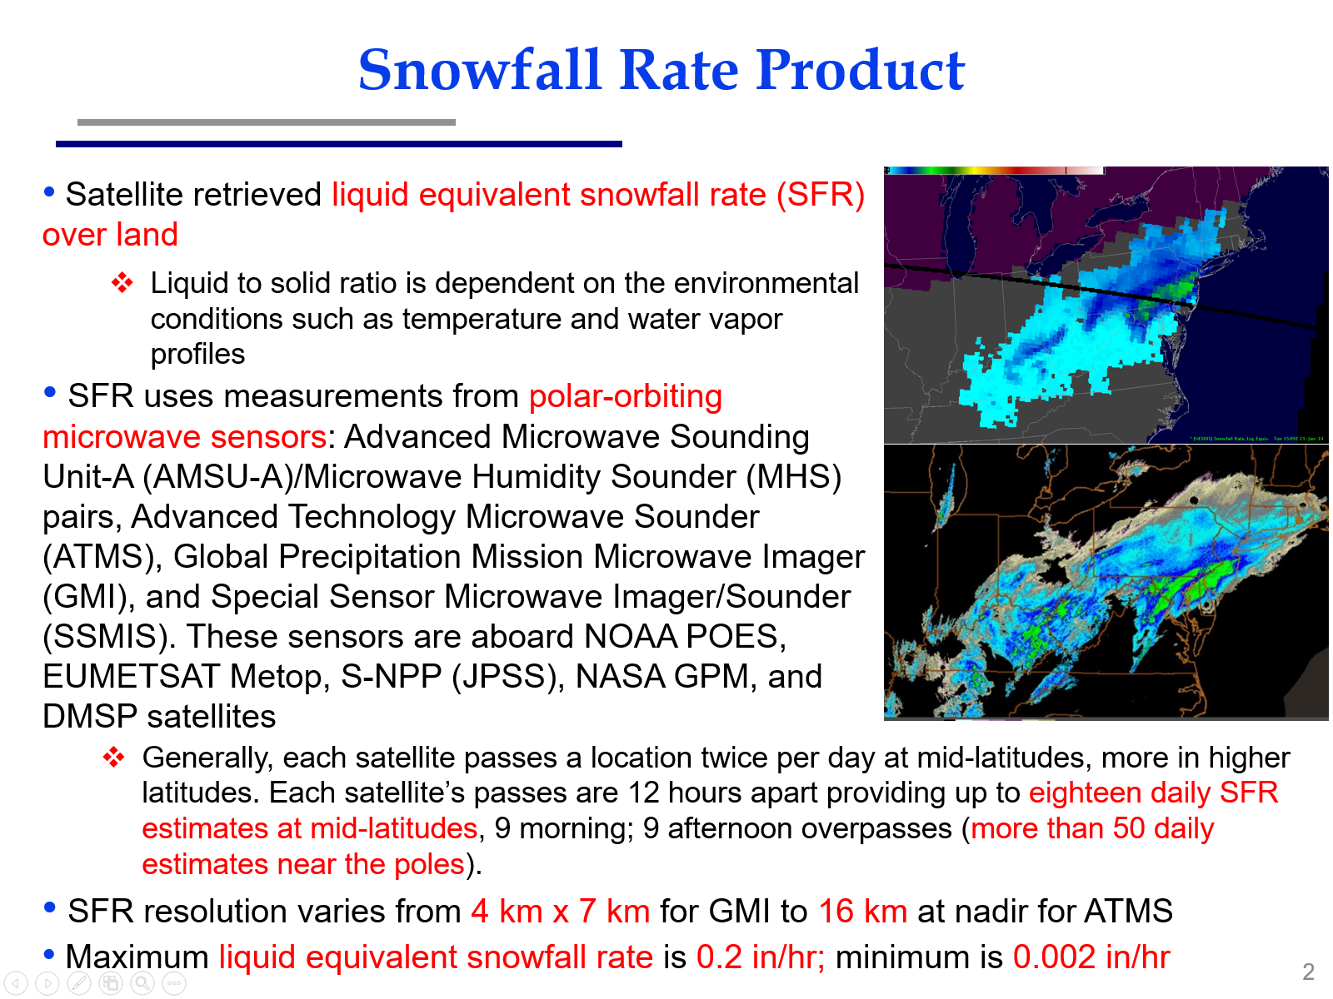
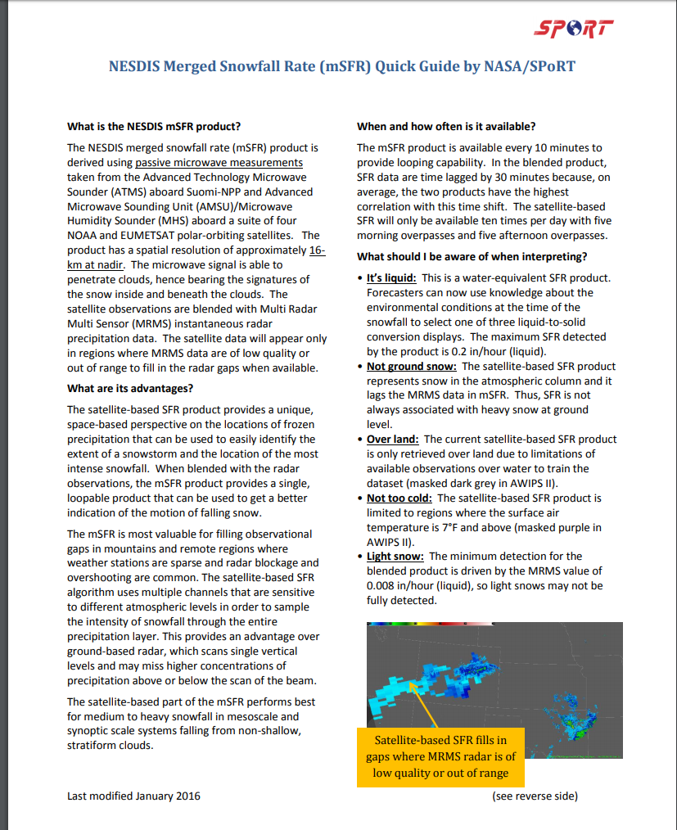
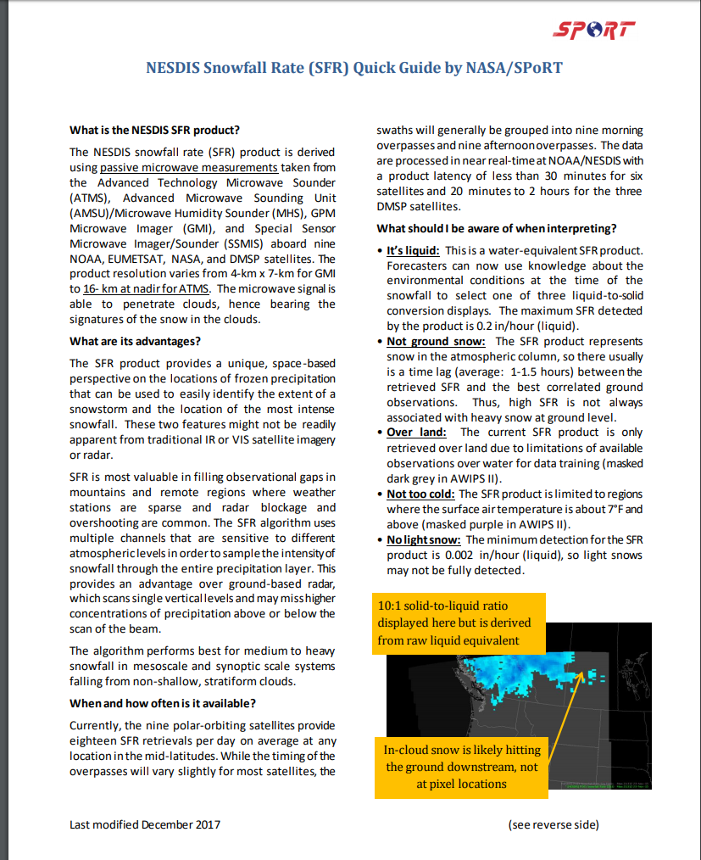
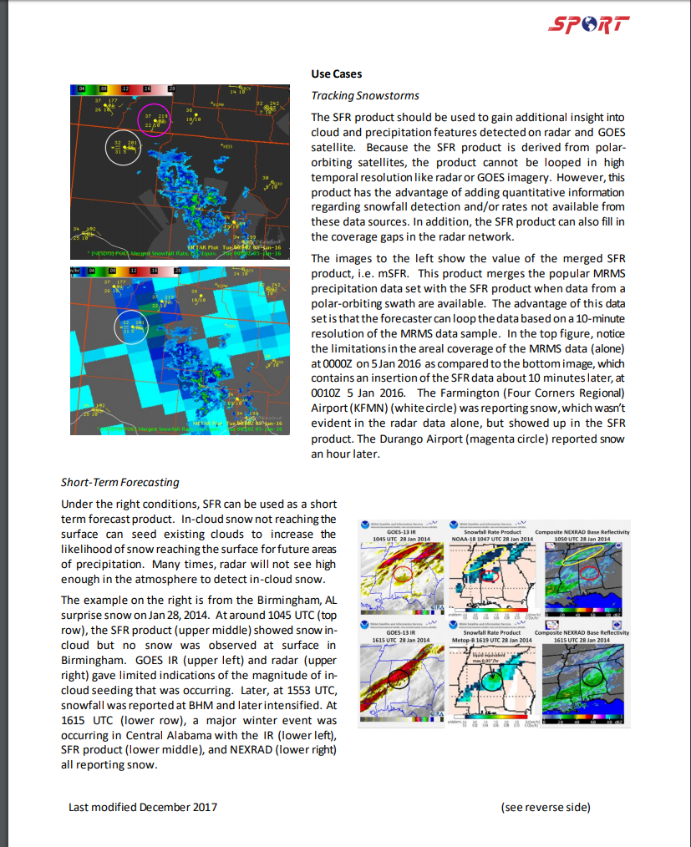
Training
Quick Guides
Available for both CONUS and Alaska
Separate QG to address the merged SFR product
PowerPoint training file

Slide 31
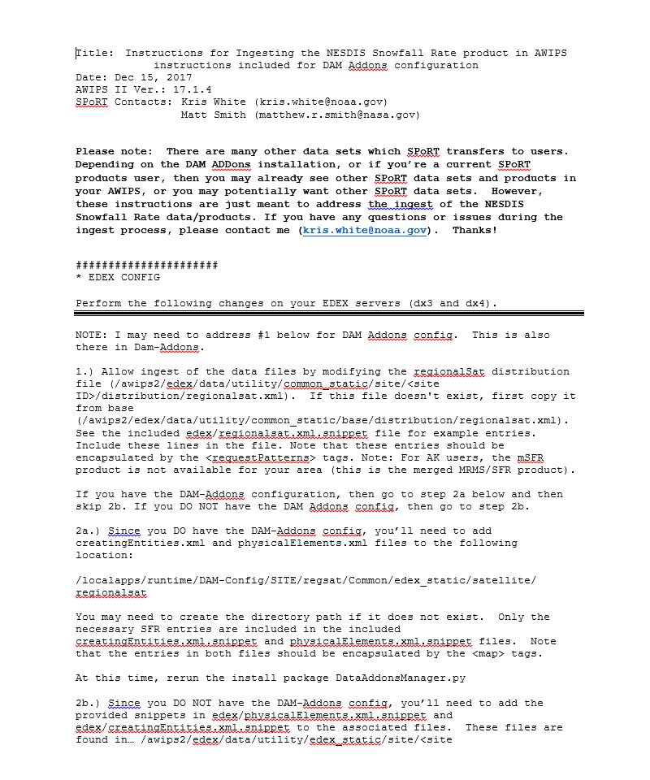
Getting Data into AWIPS
Data need to be accessible via standard platforms (i.e., AWIPS)
Ingest instructions for SFR data were created and provided to WFOs
Data ingest via Local Data Manager

Slide 32
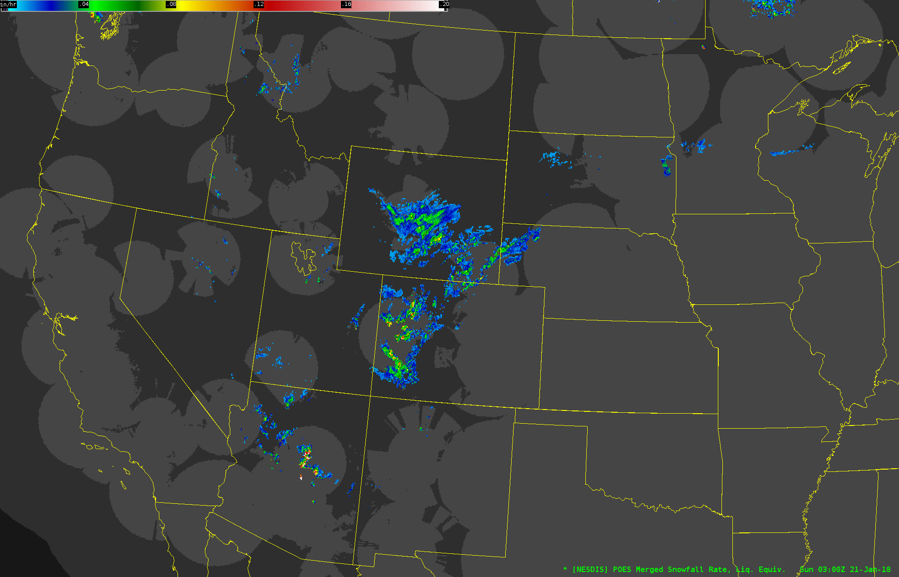
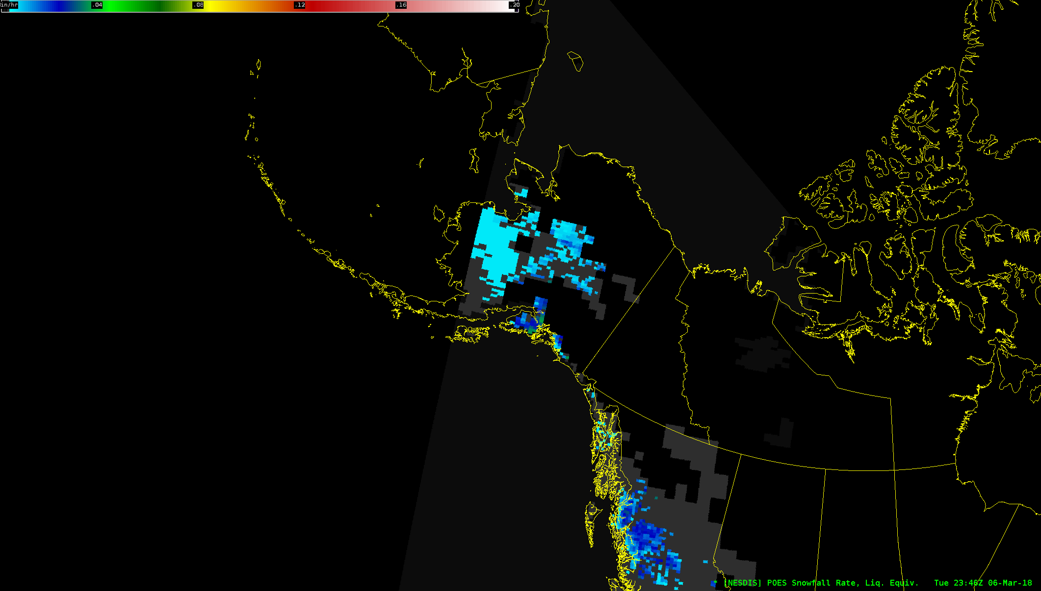
SFR Data in AWIPS
Example: SFR data in AK
Example: merged SFR data in CONUS

Slide 33
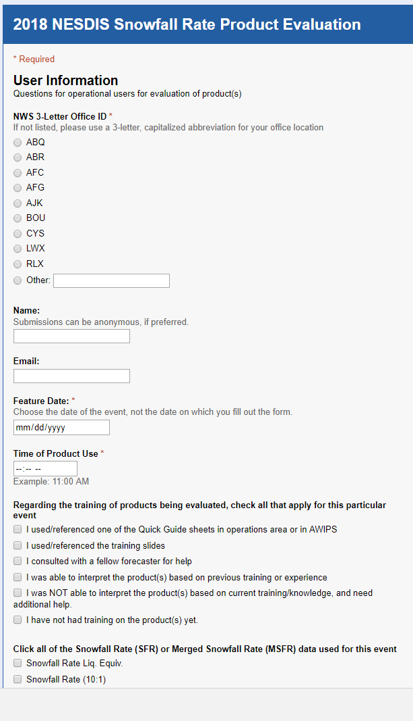
Feedback Methodology
Feedback primarily obtained via survey
Office, name and contact, date/time of product use, training, product(s) used
Product impact and forecaster confidence
Overall product utility
Used for which operational challenges?
Product issues/problems
Comments
Email
Webinar

Slide 34
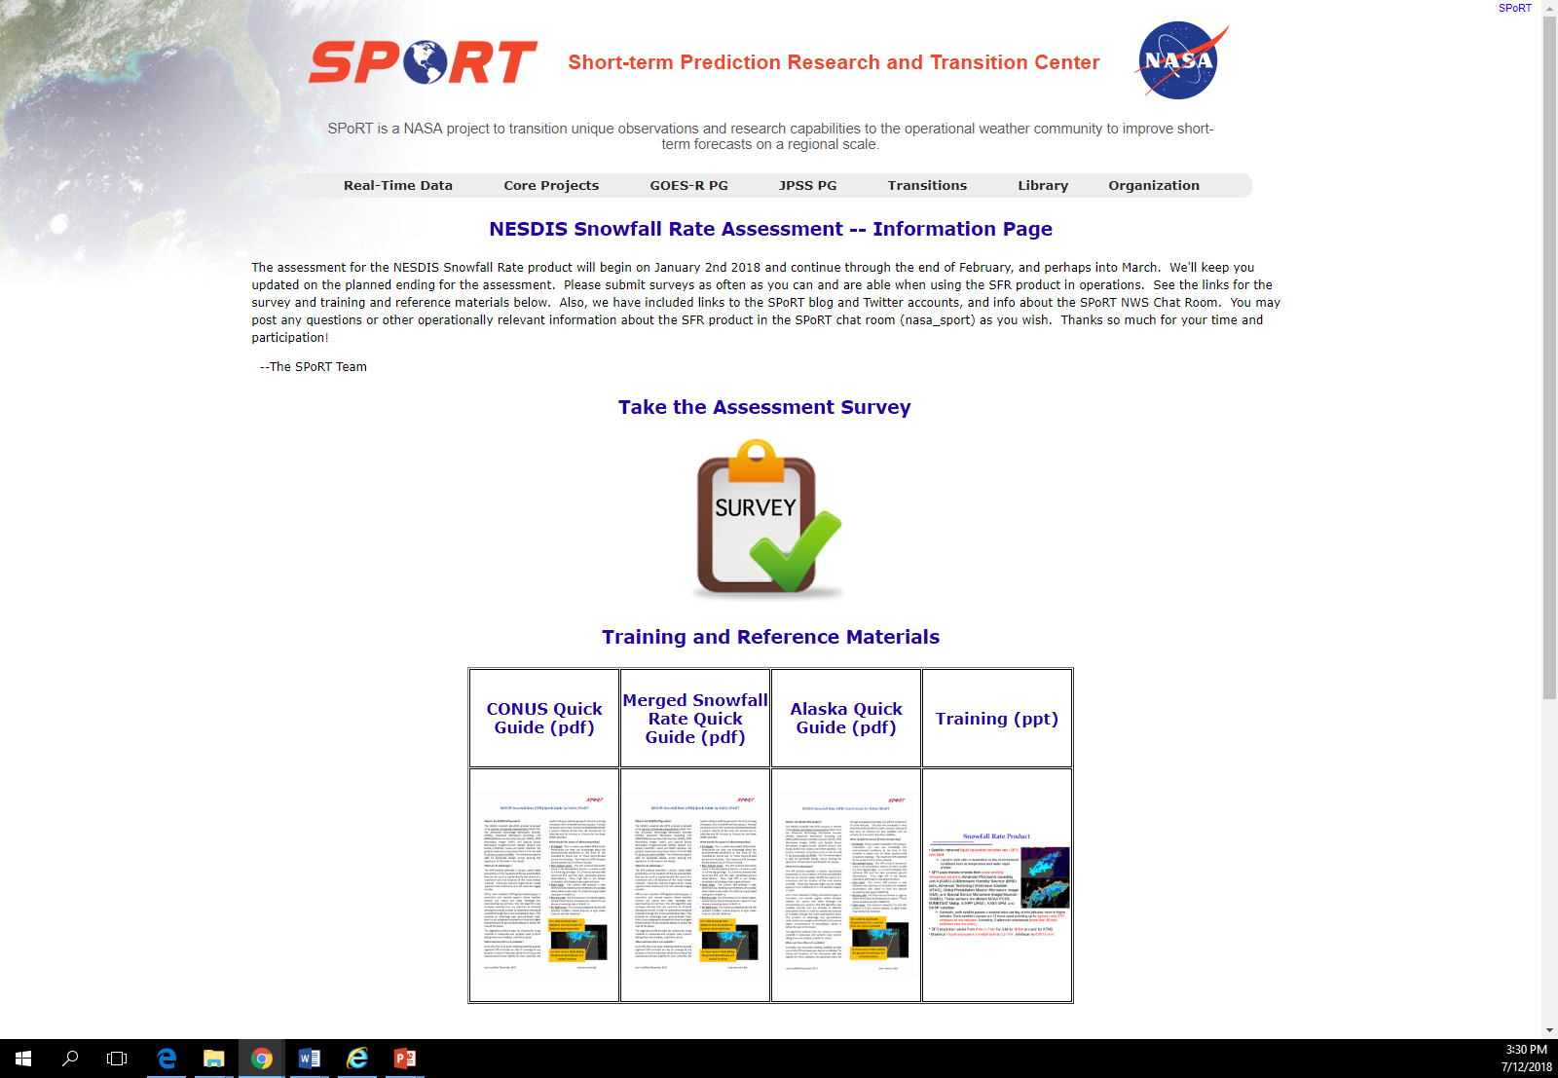
SFR Assessment Web Portal
Web portal
Survey access
Training
SPoRT social media
SPoRT NWS Chat Room

Slide 35
Assessment Results
15 survey responses received from the three different offices during the Jan-Mar period
8 email discussions
1 webinar
Hosted by NWS Albuquerque

Slide 36
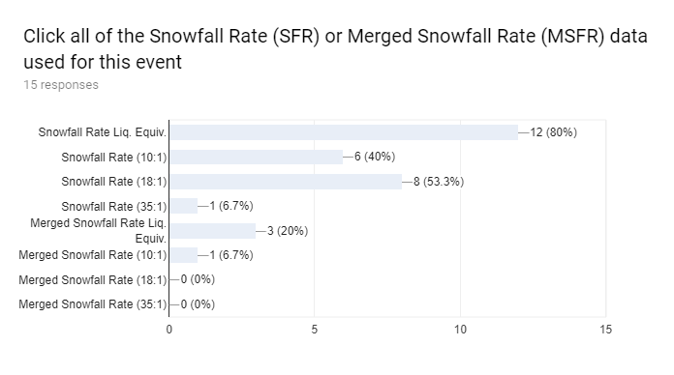
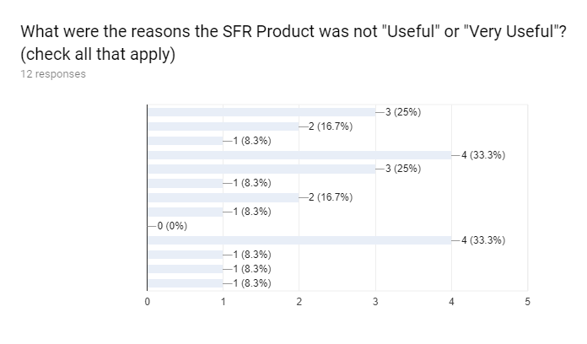
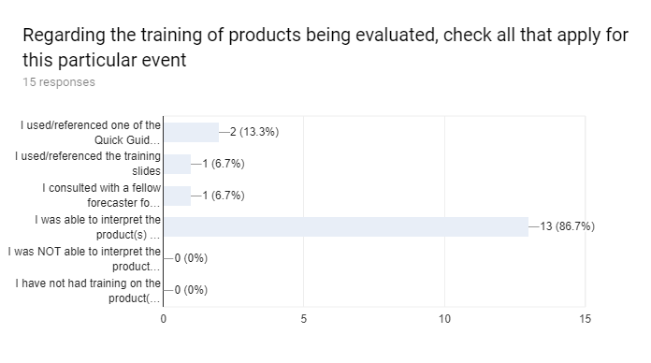
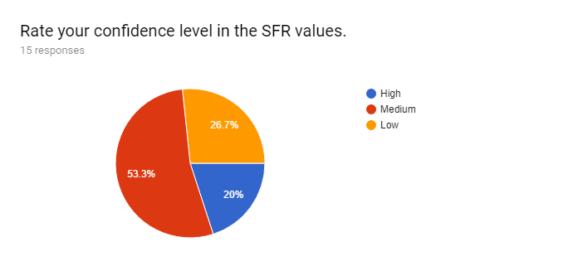
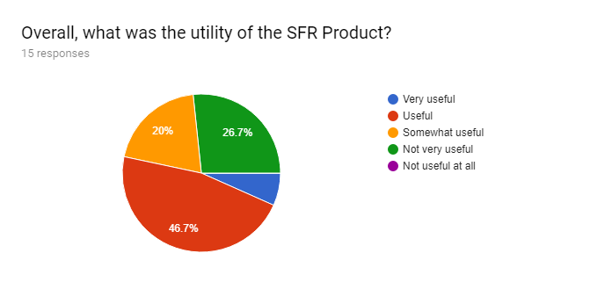
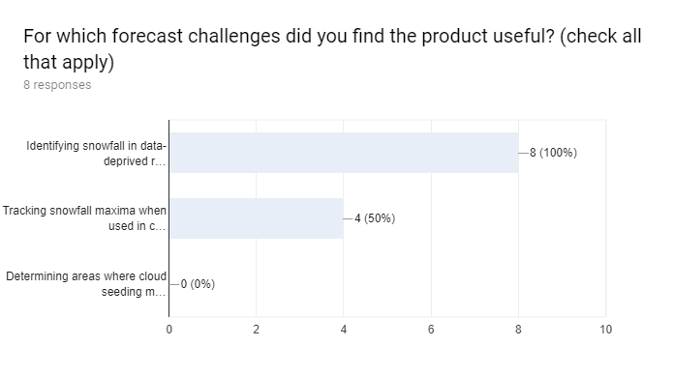
Assessment Results
Training
Product usage
Goals
Data resolution
Data accuracy
Assessing utility
Data quality poor or not sufficient resolution
Was not available over water or coastline
Underestimated snowfall amount

Slide 37
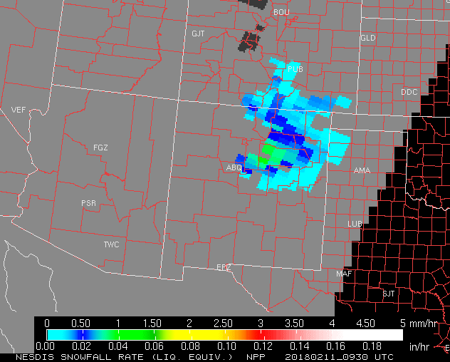
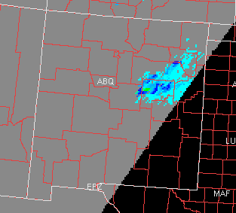
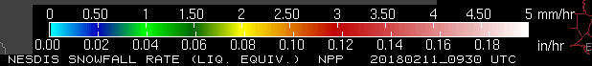
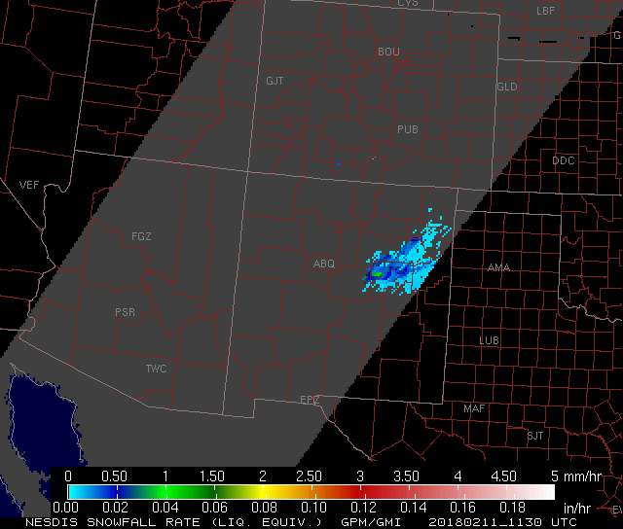
Resolution of Data/Imagery
Albuquerque, NM WFO: “… The snowfall rate maximums in the higher resolution satellite passes were more accurate in location and intensity than the lower resolution imagery when compared to composite reflectivity values on radar. The additional number of satellite passes also made the product more useful and improved gaps in coverage compared to the assessment last year.”
This information received from the Albuquerque, NM NWS office is the type of feedback that helps to address specific questions for product developers.
SFR Liquid Equivalent from Suomi-NPP,
0930 UTC 11 Feb 2018
SFR Liquid Equivalent from GMI,
1130 UTC 11 Feb 2018
This band of snowfall had moved eastward and dissipated some during the 0930 to 1130 UTC period. During the assessment, the higher-resolution SFR data from GMI consistently indicated less snowfall coverage, but further testing and algorithm development is necessary. Nevertheless, the SFR data from GMI showed snowfall in Guadalupe County where radar indicated no snowfall (yellow circle).

Slide 38
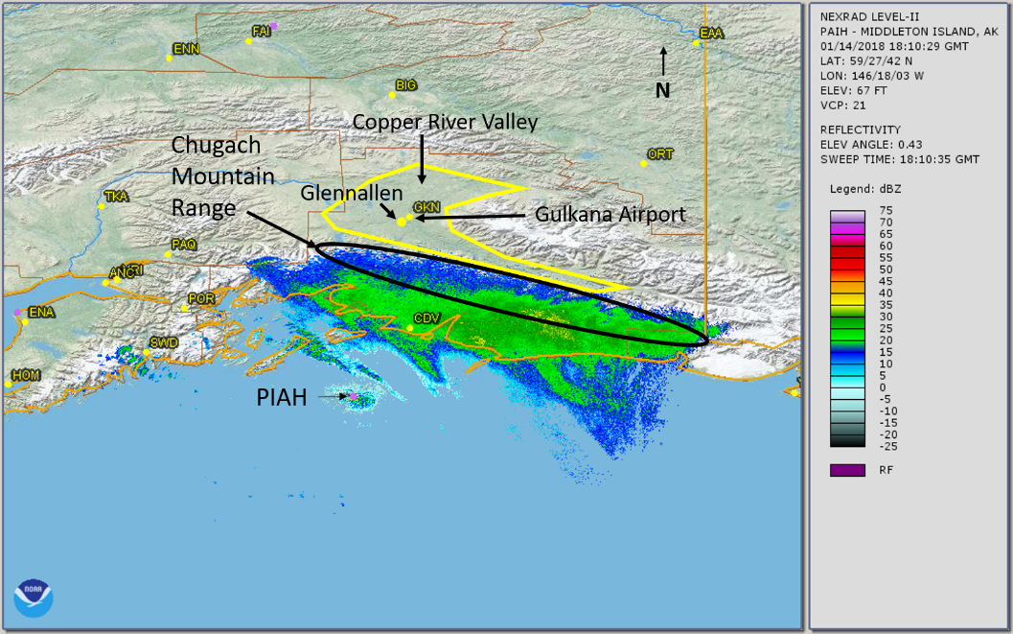
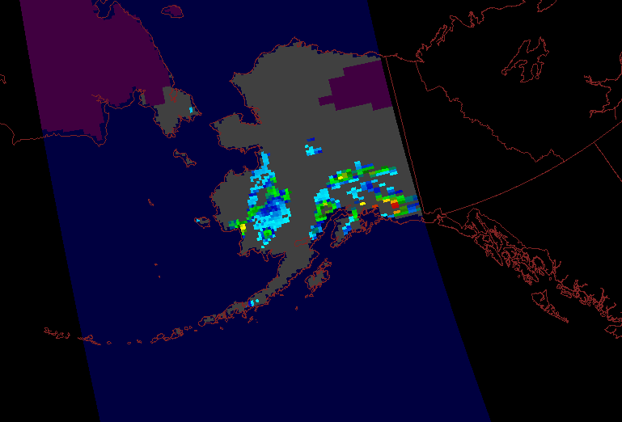
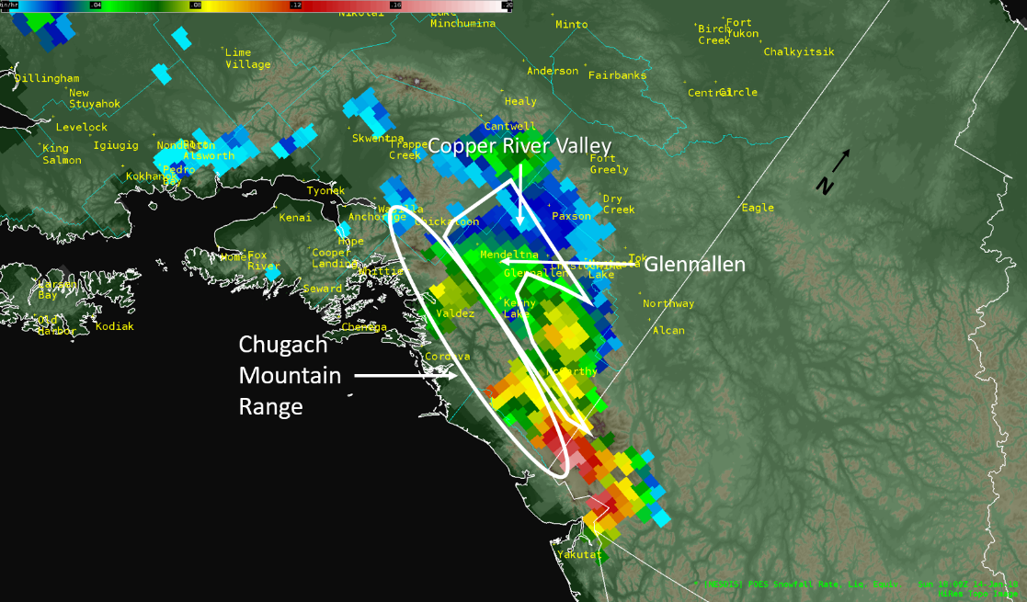
Filling Radar Gaps
Anchorage, AK WFO: “This product has been especially useful in the Copper River Basin, an area where we have no radar imagery and very few surface observations (ASOS/Mesonet/Snotel). Not only does it give us an idea of where it is precipitating, but helps verify model performance in a location where they really struggle with qpf [quantitative precipitation forecasts] and where there can be wildly different model forecasts for precipitation. In this case, I was able to use the SFR product to help figure out which guidance was verifying the best and lean toward that solution for the new forecast.”
Copper River Basin
Notes:
A lot of the precipitation detected by radar (PIAH) along/near the coast was rain, per observations. So, SFR also helps to differentiate between liquid precip and snow in this case too.

Slide 39
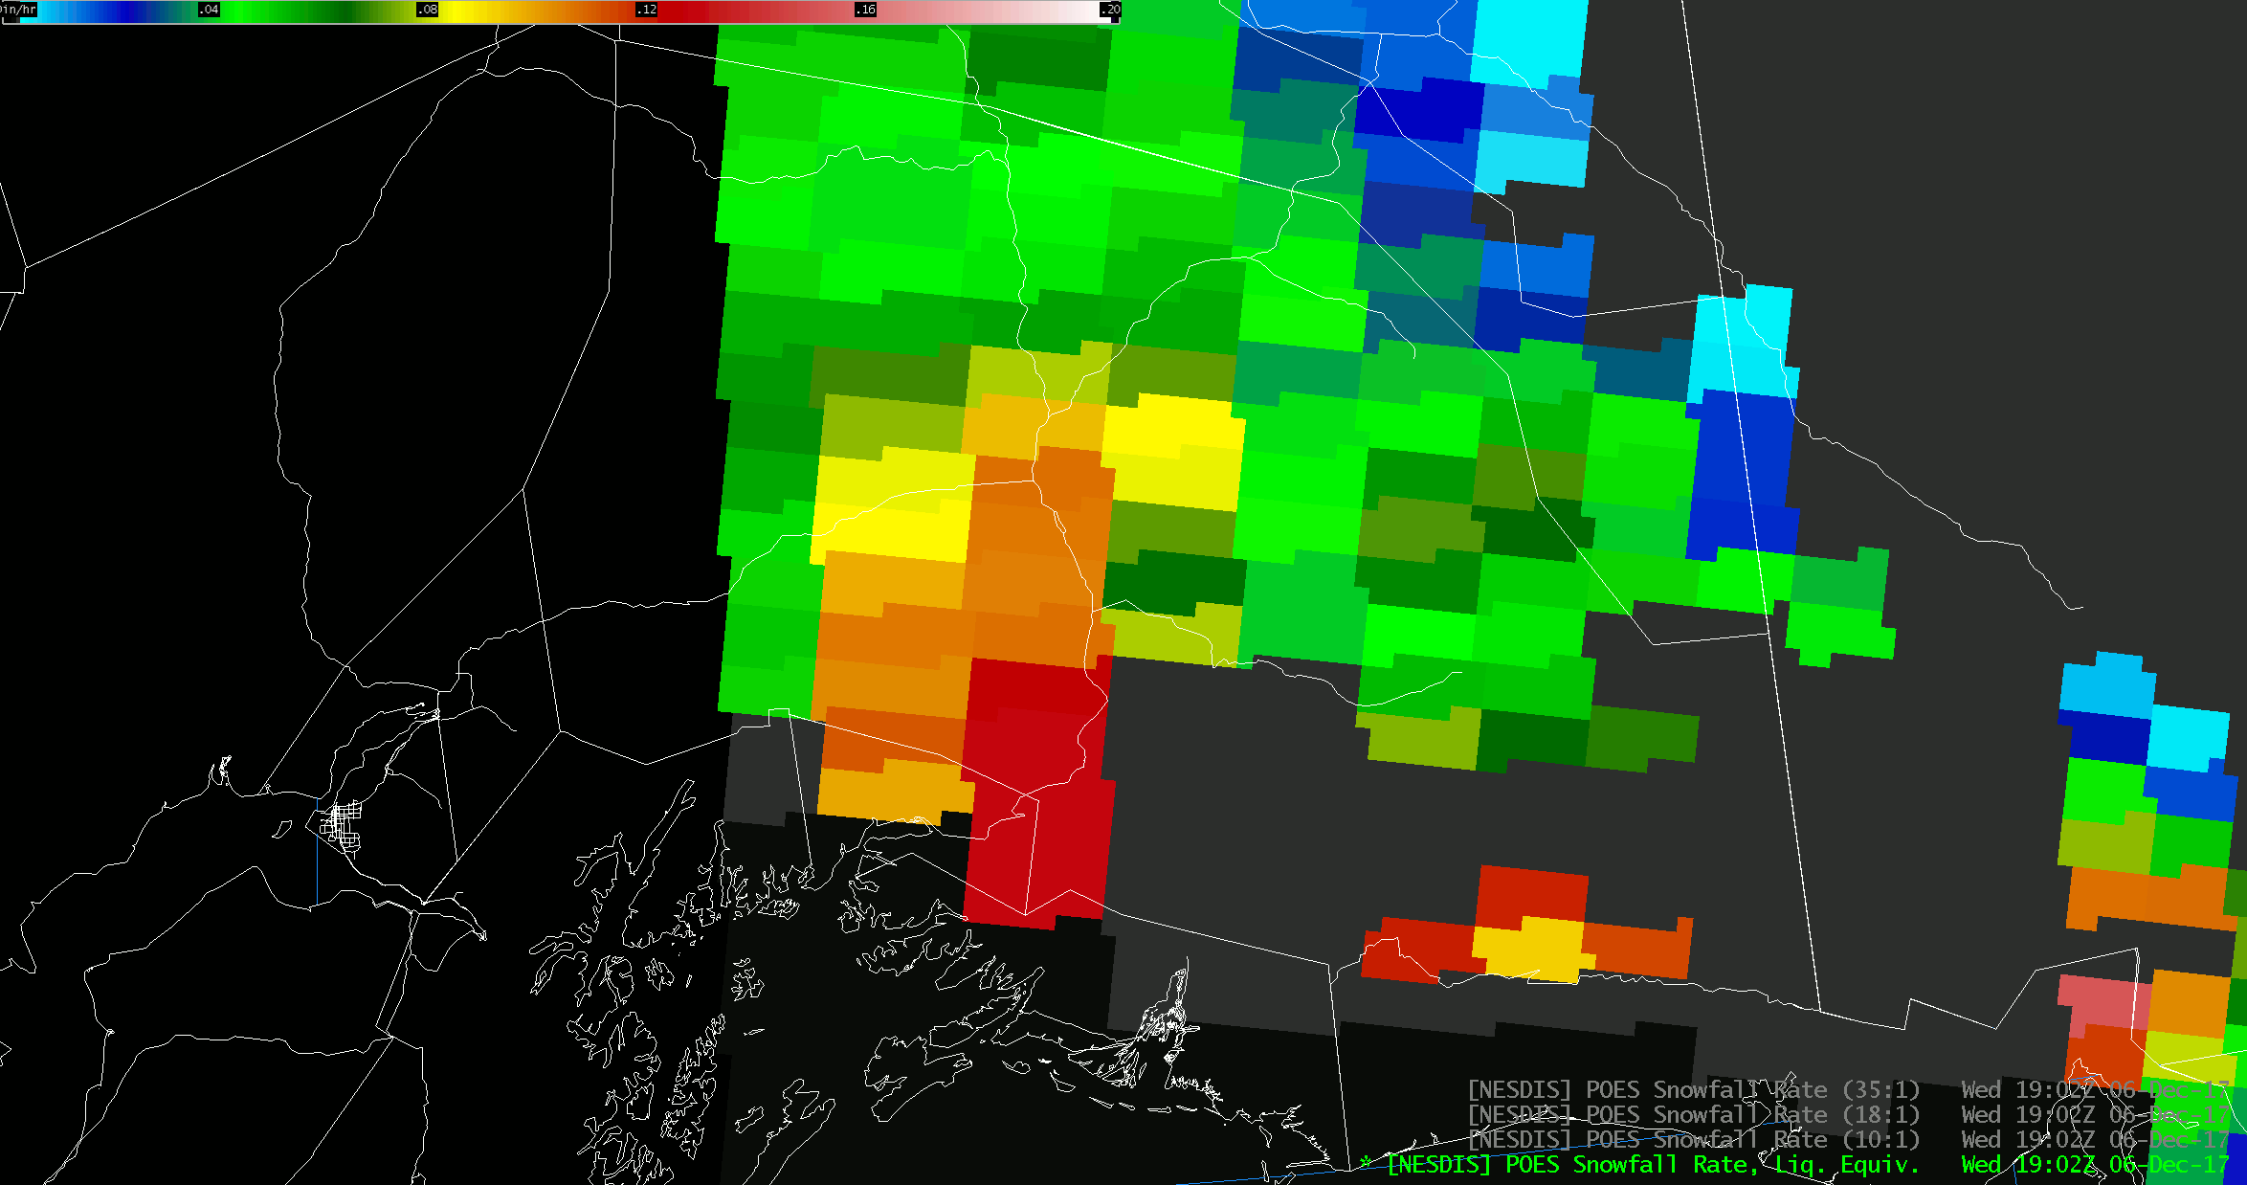
Accuracy of Snowfall Detection/Rates
Anchorage, AK WFO: “The SFR product did a great job of accurately depicting where the heaviest snow was falling in northeast Prince William Sound (Valdez/Thompson Pass) and across the Copper River Basin. Thompson Pass observed 15" of snow in a 90 minute period and 40" of snow in 12 hours. These products helped define the area over which the heaviest snow was falling. It was underdone on the snow rates, but did show a large area of 0.15"/hr liquid equiv.”
Thompson Pass
Images provided by Shaun Baines, NWS Anchorage
39

Slide 40

Accuracy of Snowfall Detection/Rates
Juneau, AK WFO: “We experienced another heavy snow event over local portions of Southeast Alaska from late Saturday afternoon through early Sunday afternoon. We still do not have a final total, but it appears that the "Pleasant Camp" area along the Haines Highway near the Canadian border received 16 plus inches of snow… Overall, I think the SFR could help us validate a winter storm warning we had in effect that was not supported by guidance. We suspect that the 0.3 - 0.7 inches per hour may have undercounted some of the snow rates. But we were pleased that it was indicated in the area. But it may be the more accurate rates were slightly displaced to the south.”
Graphic provided by Wes Adkins, NWS Juneau
40

Slide 41


Advantages of Assessments…
New to the SFR product suite for this assessment was the inclusion of observations and data from the SSMIS and GMI instruments, which were not available until March in Alaska. Rather large discrepancies were noted in SFR values and coverage between these new data sets and the original, lower resolution ATMS and AMSU/MHS data, particularly over Alaska rather than the CONUS. This was communicated to the research/development team.
SFR from ATMS, 1143 UTC 13 Mar 2018
SFR from GMI, 1201 UTC 13 Mar 2018
41

Slide 42


Accuracy of Snowfall Detection/Rates
Albuquerque, NM WFO scheduled a webinar for the Snowfall Rate Assessment team following discrepancies observed between the SFR (polar-orbiting only data) and mSFR products. An example shown during the webinar is provided below. Snowfall rate values in the mSFR product were about half those in the standard SFR polar-orbiting swaths. This issue was tracked and subsequently fixed.
So, in this example, forecaster participants helped to identify and effectively communicate a problem, which lead to its quick resolution. Thus, these types of intensive assessment activities foster an environment of closer communication and collaboration between end-users and product developers, which can be advantageous for product development and refinement.
42

Slide 43
Conclusions…
Consider future additional testing and evaluation at national testbeds or proving grounds, such as the WPC Hydrometeorology Testbed
Need further evaluation and investigation of large discrepancies between ATMS and AMSU/MHS and SSMIS and GMI data sets, particularly over Alaska
Continue research to extend product to include coastline areas
Continue research to refine the algorithm for improvement with snowfall rates, especially with regard to the underestimation of rates that is typical in the Alaska region
Add more direct broadcast data from the Alaska region if it is available.

Slide 44
Thanks for your time!
Questions or suggestions?
Huan Meng: huan.meng@noaa.gov
Kris White: kris.white@noaa.gov
Special thanks to our NWS participants!
Wes Adkins, WFO Juneau
Shaun Baines, WFO Anchorage
Brian Guyer, WFO Albuquerque
Aaron Jacobs, WFO Juneau
Michael Lawson, WFO Anchorage
Edward Liske, WFO Juneau
Samuel Shea, WFO Anchorage
Also, Thanks to Kevin McGrath and Frank LaFontaine of NASA SPoRT for their support

