Slide 1
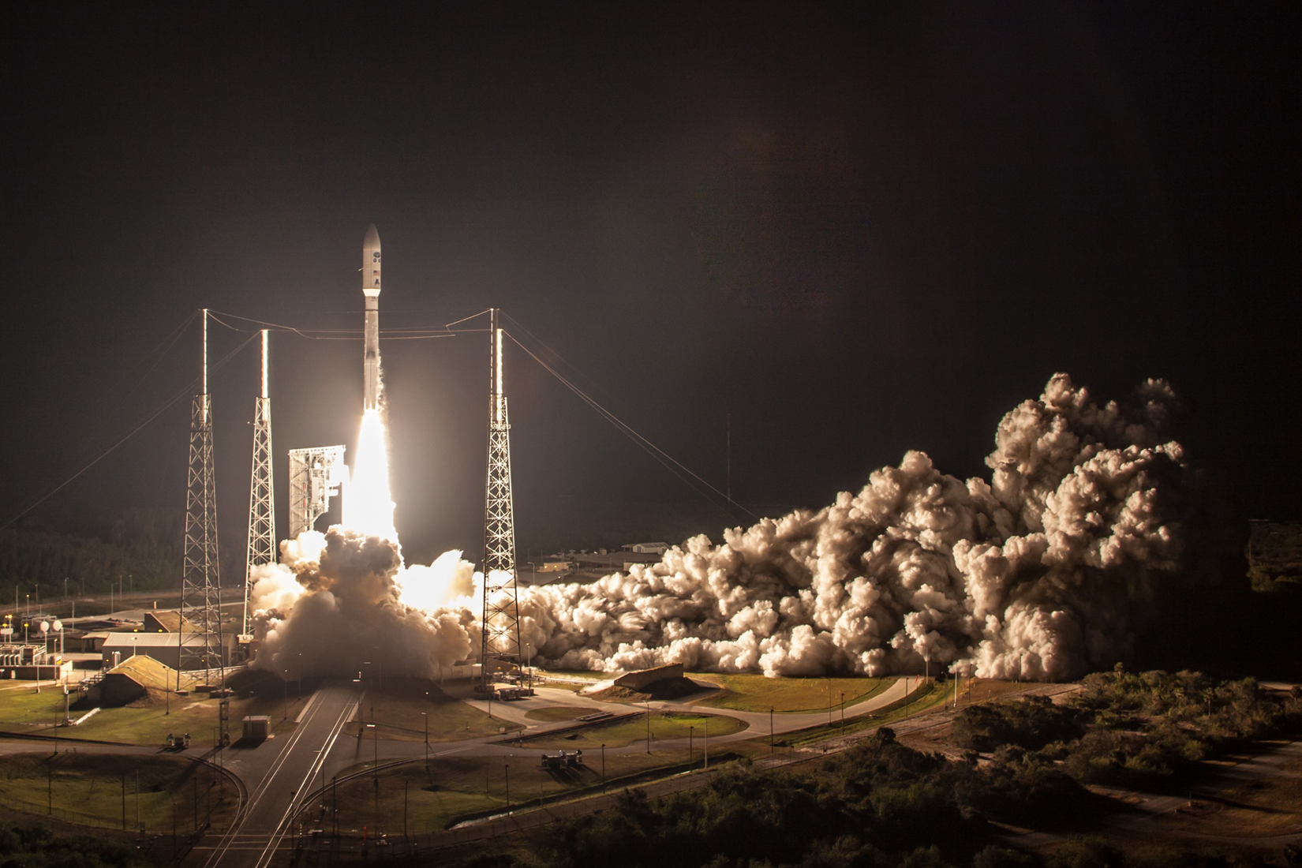
Instrument Calibration and Radiance Validation of
GOES-R ABI
Fred Wu, October 18, 2018

Slide 2
Acknowledgements
Current CWG members: F. Yu, V. Kondratovich, H. Yoo, H. Qian, Z. Wang, and S. Guo.
Former CWG members: C. Cao, F. Padula, A. Pearlman, D. Pogorzara, R. Datla, X. Shao, M. Grotenhuis, M. Chu, B. Efremova, R. Iacovazzi, L. Zhu, J. Choi, and R. Mirza-Saliq.
External members: T. Schmit, M. Gunshor, D. Lindsey, M. Coakley, K. Mitchell.
Colleagues at Harris: J. Van Naarden, D. Gall, L. Roop, W. Harting, M. Wilson.
Colleagues with GOES-R Program: C. Rollins, A. Reth, J. Fulbright, E. Kline, W. Labair, J. Kronewetter, M. Seybold, E. Grigsby, S. Goodman, C. Keeler, A. Krimchansky.
Colleagues in STAR: J. Daniels, AWG leads, L. Brown, S. Kalluri, Front office.
And many more.

Slide 3
Calibration, Verification, and Validation
Calibration
  Instrument Calibration: Characterization of instrument responses to known signals.
  Measurement Calibration: Conversion of instrument response to physical quantity.
  Product Calibration: Homogenization of multiple products, e.g., inter-calibration of radiance; empirical correction of higher level products.
Verification: System did what it is supposed to.
Validation: System achieved what it is intended to.
“Instrument Calibration and Radiance Validation …”

Slide 4
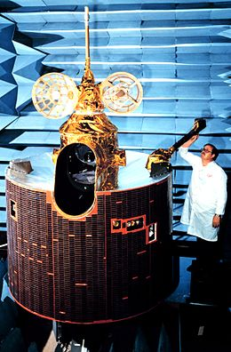
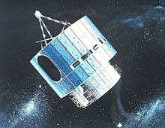
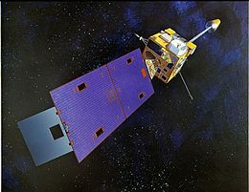
History of GOES Imaging
Space weather, solar observation, sounding not covered
1st Generation:
  GOES-1/2/3. October 16, 1975.
  Visible Infrared Spin Scan Radiometer (VISSR)
1.5 (or 2nd) Generation
  GOES-4/5/6/G/7
  VISSR Atmospheric Sounder (VAS)
2nd (or 3rd) Generation:
  GOES-8/9/10/11/12, April 1994
  Imager (and Sounder)
  3-axis stabilized platform
2.5 (or 4th) Generation:
  GOES-13/14/15/Q
  Improved battery and navigation.
3rd (or 5th) Generation:
  GOES-16/17/T/U, 19 Nov 2016
  Advanced Baseline Imager (ABI)
  ~500 times more detectors.
Notes:
Started as Synchronous Meteorological Satellites (SMS) in 1974. SMS-C was transitioned to GOES-1.

Slide 5
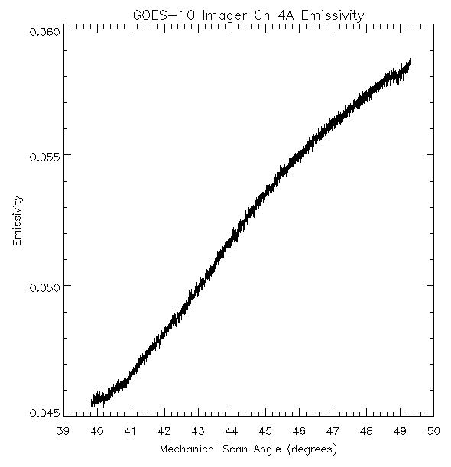
Past Generation Transition
3-axis stabilization – AOL Variation
M. Weinreb

Slide 6
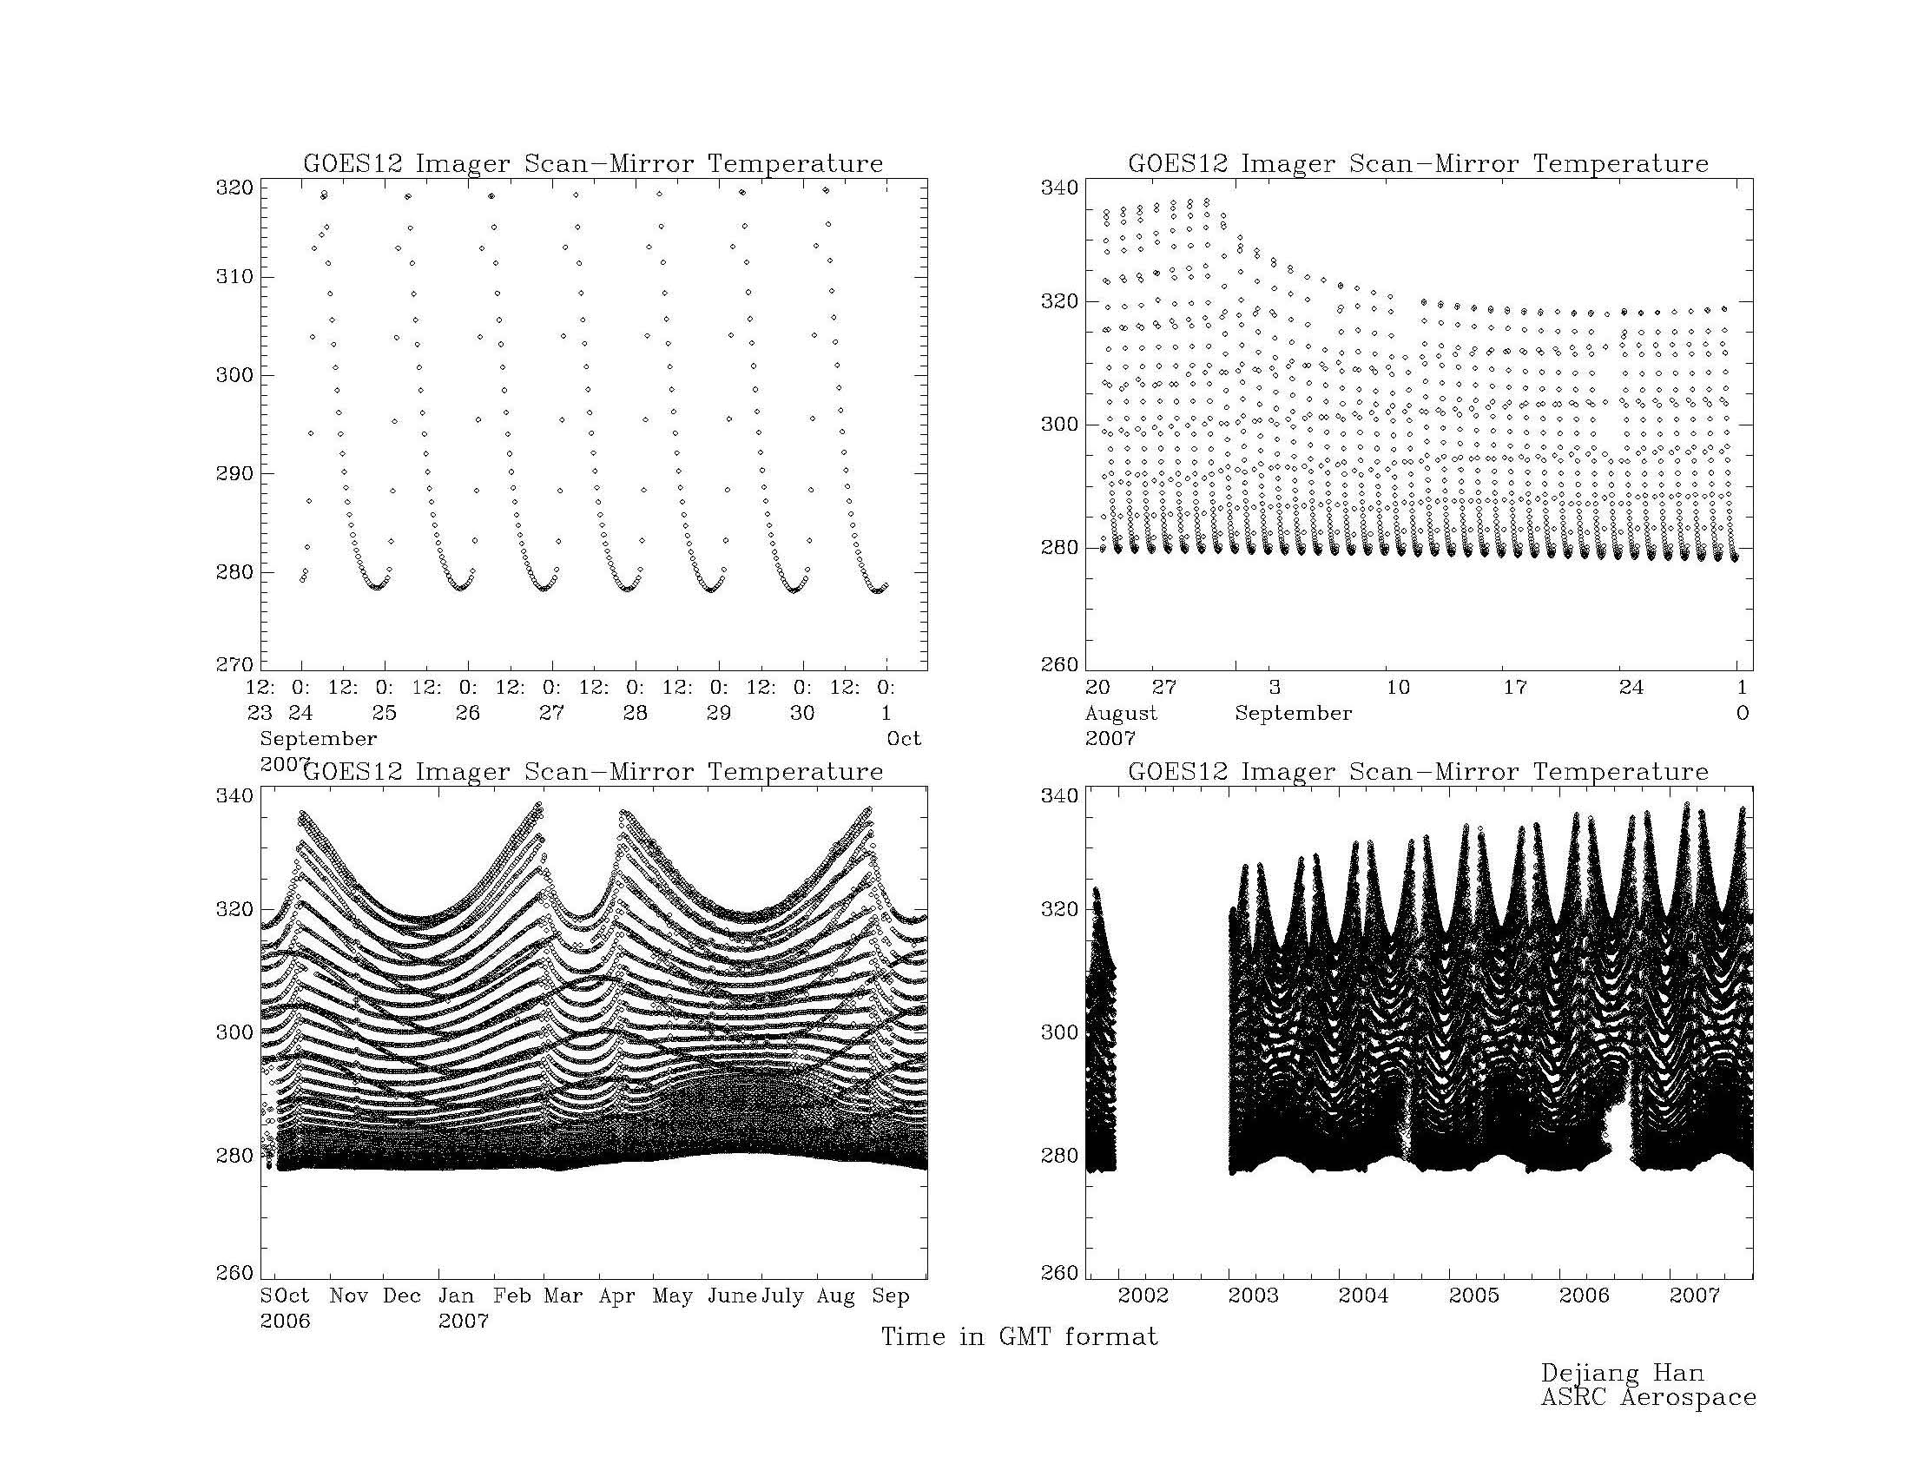
Past Generation Transition
3-axis stabilization – Temperature Variation
One Week
One Month
~60ºK some other days
~40ºK “now”
Complicated seasonal variations of diurnal heating
Long term trend
D. Han
One Year
One Satellite
Goes-12 Scan Mirror Temperature

Slide 7
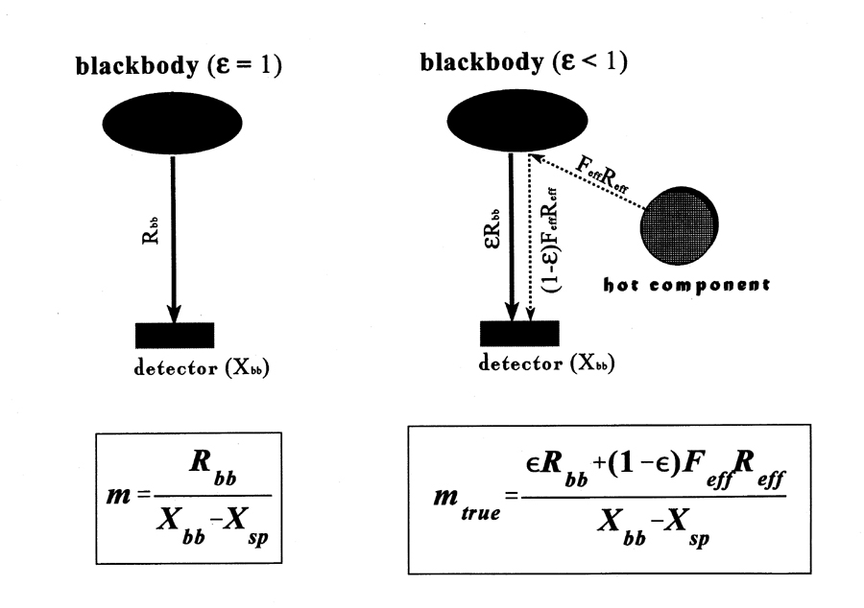
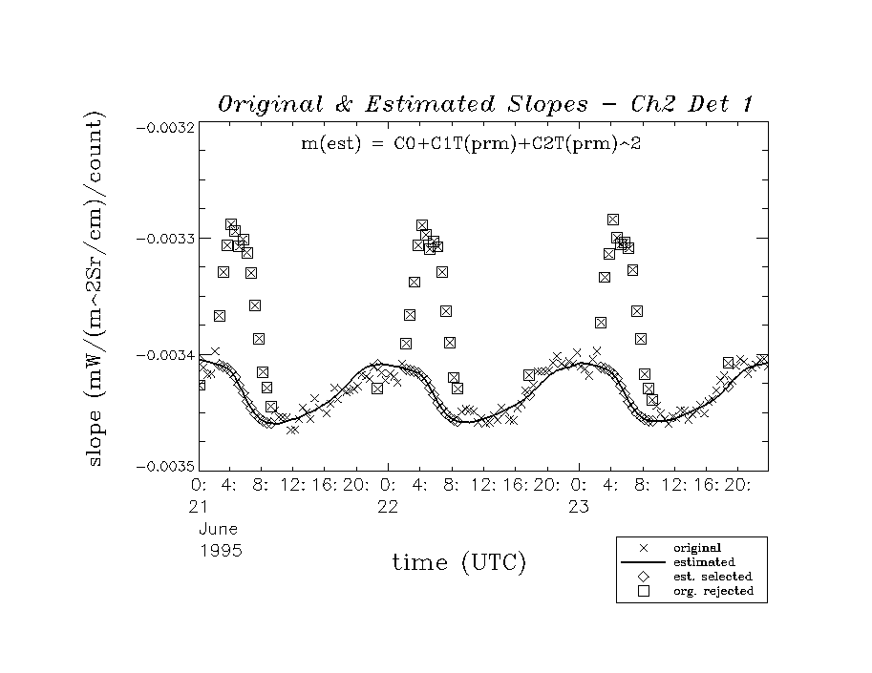
Past Generation Transition
3-axis stabilization – Temperature Variation
T_{BB}
T_{BB}
OK if ε=1 or T_{env}=T_{BB}
Less true for GOES
T_{env}
M. Weinreb (Modified)

Slide 8
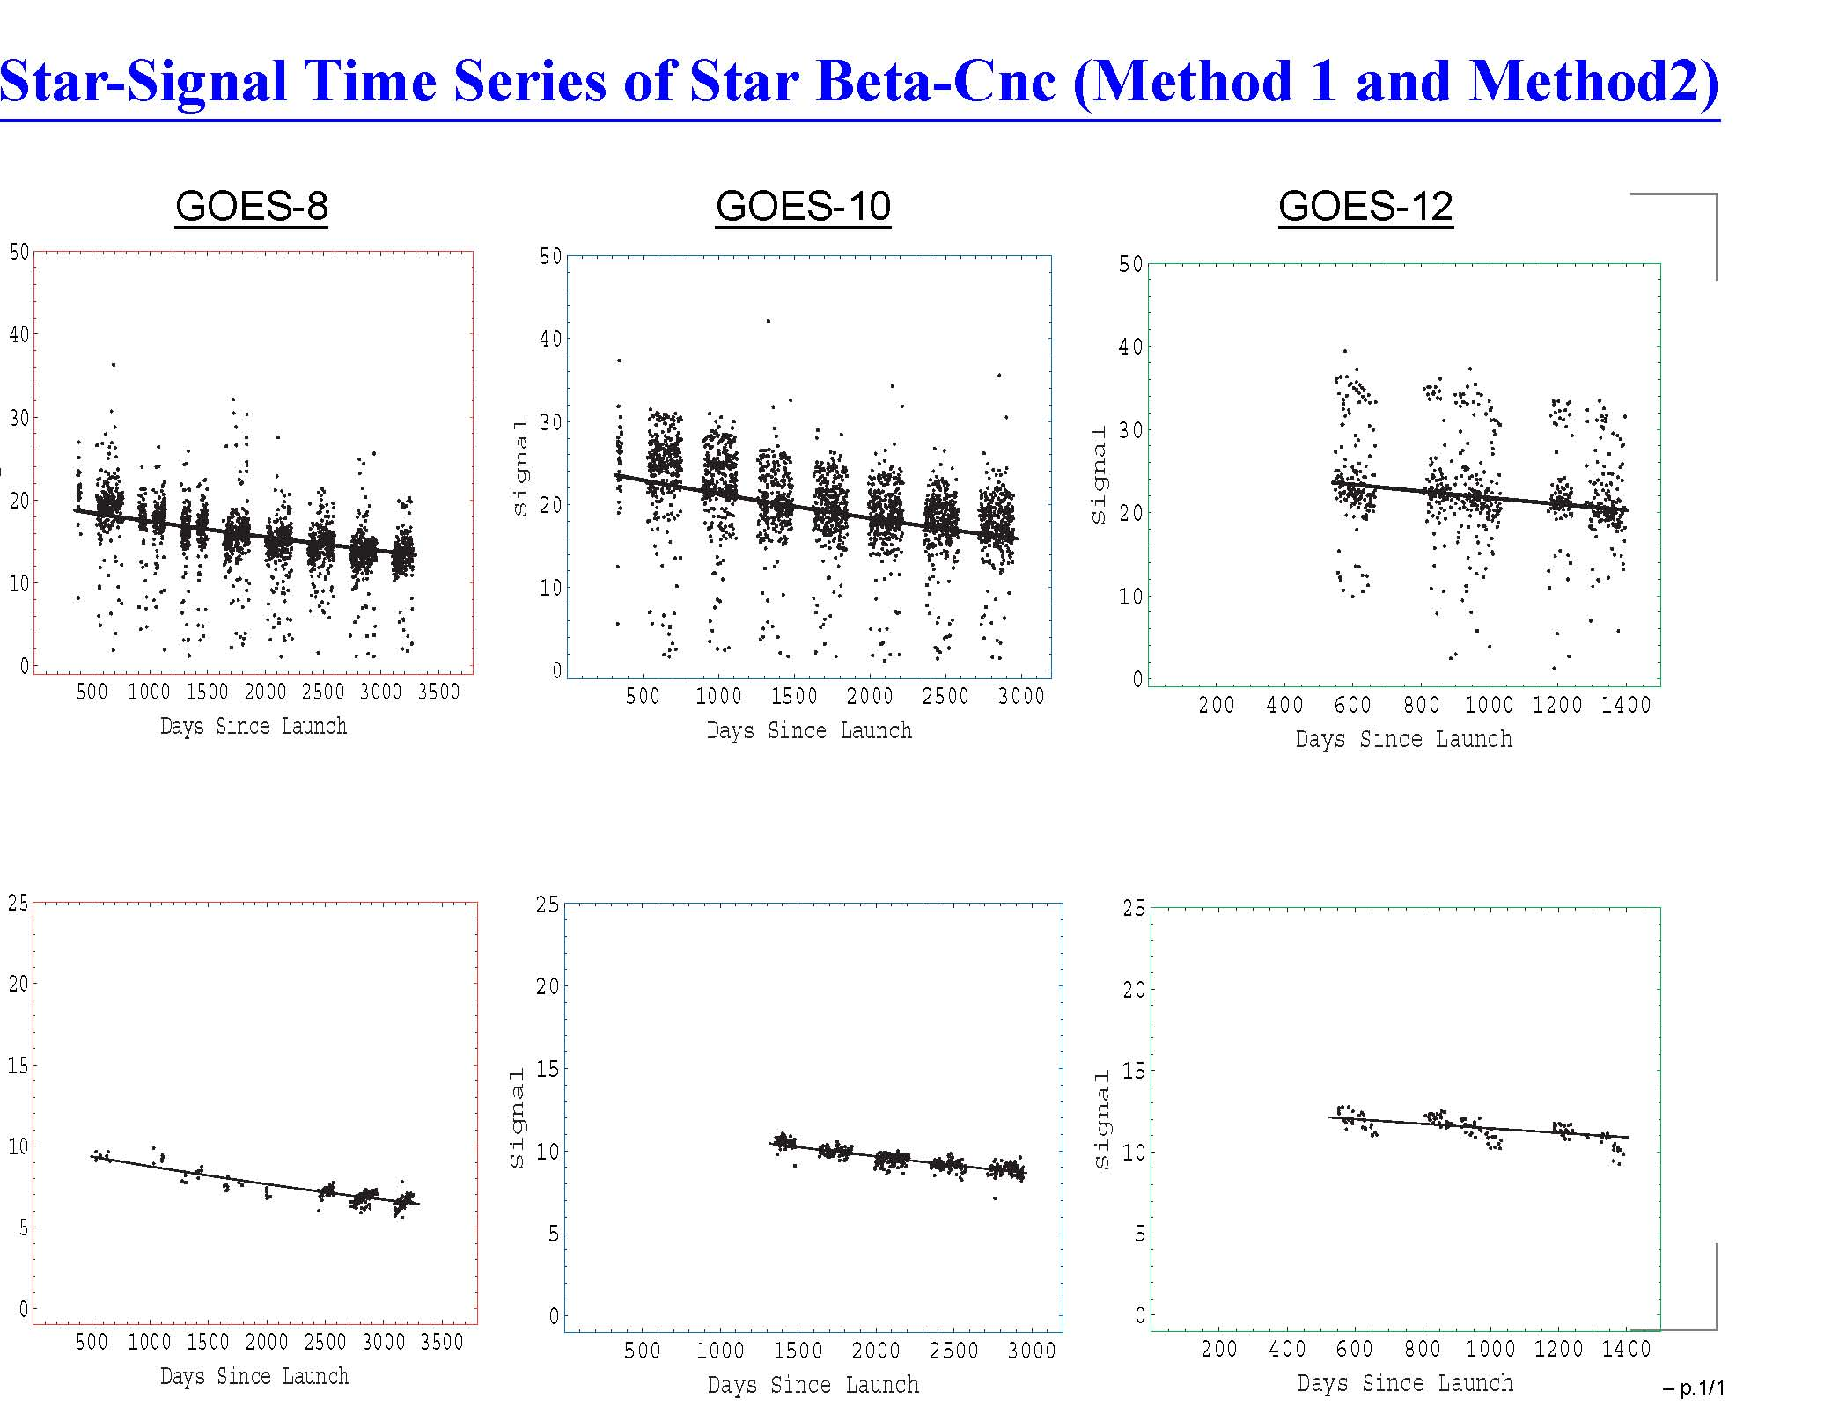
Past Generation Transition
I. Chang

Slide 9
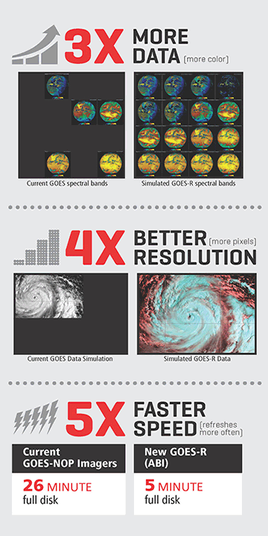
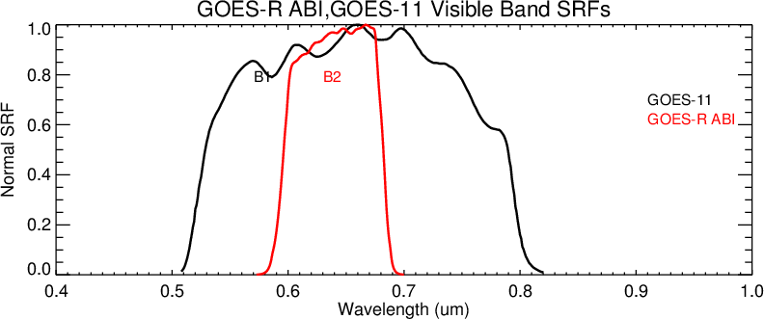
Expected GOES-R Benefits …
Compared to Imager, ABI must provide …
  3 times more channels (5 –> 16)
  4 times finer spatially (4/1 km –> 2/0.5 km)
  5 times faster temporally (26 min –> 5 min)
… and the data must be better.
  Optimized (narrower) SRF
  Lower noise
  Calibrated solar bands
More detectors – 16 –> 7,856 (24 –> 77,400).
Harris Corp & T. Schmit
Notes:
In-band radiance for the red band is 132.21 for ABI, 348.87 for GOES-11(worst), and 252.92 for GOES-13 (best).
Inter-cal experience: spectral difference is the most difficult to reconcile. Requested to align ABI SRF with those of VIIRS. Did not approve for 0.47 band (between 0.445um and0.488um) and 0.64 band (can’t be narrower).

Slide 10
… Come With New Challenges …
Large arrays of detectors – Spectral Uniformity.
Multiple focal planes – Geometric calibration based on Kalman filter
  From “aim then collect” to “collect then tell”
  Radiometric and geometric calibrations become more closely intertwined.
Cooling – Loop Heat Pipe
Onboard calibration for the solar bands.
New telescope design – Spatial Uniformity.
Notes:
Polar orbiting sensor covers nearly globally, whereas the “full disk” from geostationary orbit is only 20% – 25% of the globe.
But to a sensor on geostationary orbit, the “geo” appears stationary.
Survey more than twice a day from one satellite.
Capture transient phenomena (clouds, smoke, temperature)
Observe dynamical interactions of the developing systems.
Faster – everything else being equal (or better).
60° local zenith – 60° from nadir.

Slide 11
… Also New Tools …
Global Space-based Inter-Calibration System (GSICS) – rapid validation.
Lunar Calibration – thanks to GSICS partners.
Rayleigh Scattering – new channel.
North-South Scan – new capability.
CRTM
Notes:
Polar orbiting sensor covers nearly globally, whereas the “full disk” from geostationary orbit is only 20% – 25% of the globe.
But to a sensor on geostationary orbit, the “geo” appears stationary.
Survey more than twice a day from one satellite.
Capture transient phenomena (clouds, smoke, temperature)
Observe dynamical interactions of the developing systems.
Faster – everything else being equal (or better).
60° local zenith – 60° from nadir.

Slide 12
… Drive PLPT Plan …
Test ID | Short Title
ABI-L1b-PLPT-001 | IR Validation IASI CrIS
ABI-L1b-PLPT-002 | IR Validation CRTM
ABI-L1b-PLPT-003 | ZRDQ Performance
ABI-L1b-PLPT-004 | VNIR Validation VIIRS
ABI-L1b-PLPT-005 | VNIR Validation Sonora
ABI-L1b-PLPT-006 | VNIR Validation RVS
ABI-L1b-PLPT-007 | Monitoring
ABI-L1b-PLPT-008 | AD Converter
ABI-L1b-PLPT-009 | Low Light SNR
ABI-L1b-PLPT-010 | Image Navigation
ABI-L1b-PLPT-011 | Image Registration
ABI-L1b-PLPT-012 | Image Stitching
ABI-L1b-PLPT-013 | VNIR Validation DCC
ABI-L1b-PLPT-014 | Detector Uniformity Stability NSS
ABI-L1b-PLPT-015 | Validation SNO NSS
ABI-L1b-PLPT-016 | L2 Validation Support NSS
ABI-L1b-PLPT-017 | Lunar NSS
ABI-L1b-PLPT-018 | Detector Uniformity Investigation
ABI-L1b-PLPT-019 | Initial Solar Calibration
ABI-L1b-PLPT-020 | IR Spatial Uniformity
Test ID | Short Title
ABI-L1b-PLPT-021 | SRF Verification
ABI-L1b-PLPT-022 | OOB Response
ABI-L1b-PLPT-023 | Polarization
ABI-L1b-PLPT-024 | Cal-to-Cal Repeatability
ABI-L1b-PLPT-025 | Linearity
ABI-L1b-PLPT-026 | Ghosting
ABI-L1b-PLPT-027 | Field Campaign – Aircraft
ABI-L1b-PLPT-028 | Field Campaign – Surface
ABI-L1b-PLPT-029 | VNIR Verification – Rayleigh
ABI-L1b-PLPT-030 | VNIR Verification – Uyuni
ABI-L1b-PLPT-031 | BDS
ABI-L1b-PLPT-032 | VNIR SNR & Dynamic Range
ABI-L1b-PLPT-033 | IR Cal Stability
ABI-L1b-PLPT-034 | MTF
ABI-L1b-PLPT-035 | Coherent Noise
ABI-L1b-PLPT-036 | IR SNR & Dynamic Range
Critical tests are in bold.
Experimental tests are in italic.

Slide 13
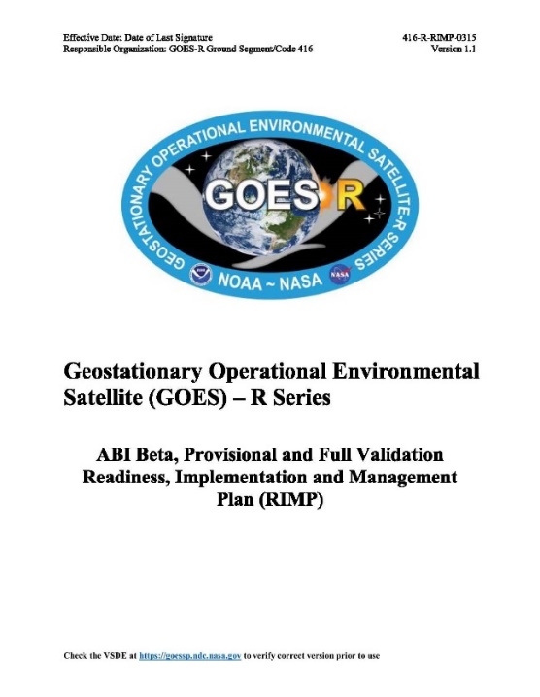
… Captured in RIMP
Planning
  Readiness, Implementation, and Management Plan
Execution
  Post-Launch Tests (PLT) – Beta
    Verification of instrument for required functionalities
    Planned adjustments
    Flight-Ground Integration
  Post-Launch Product Tests (PLPT) – Provisional
    Validation of products for intended applications
    Program-User Integration
  Extended Validation (XV) – Full Validation
    Comprehensive evaluation of operation in intended environment
    Phase into normal operation

Slide 14
VNIR Noise
Meet the requirement with large margin.
Mean has been stable.
064 Band is challenging.

Slide 15
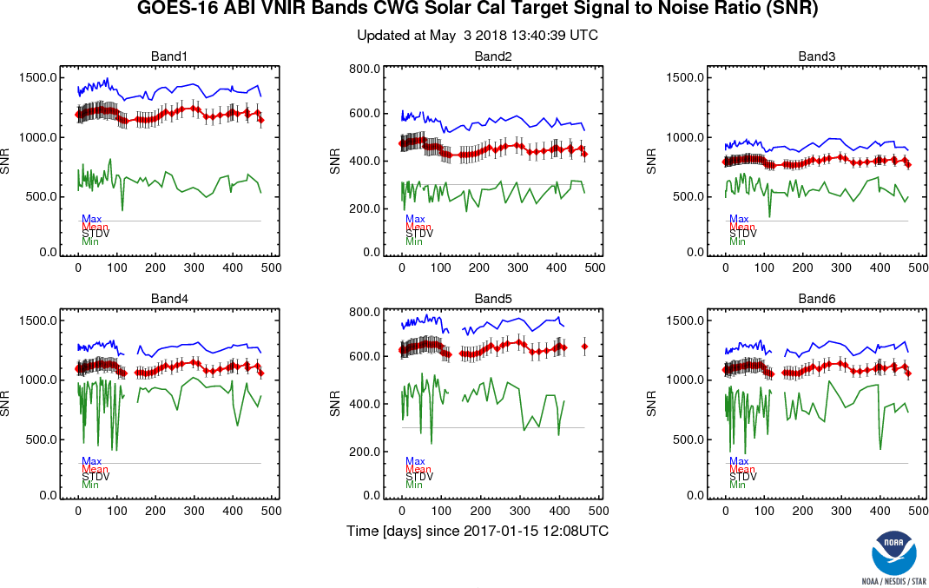
VNIR Noise Stability

Slide 16
IR Noise

Slide 17
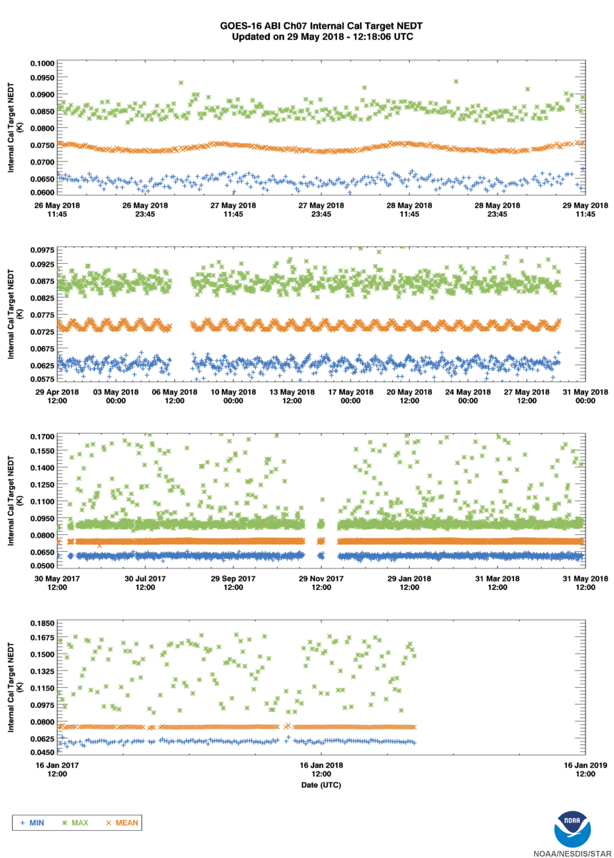
IR Noise Stability

Slide 18
VNIR Accuracy

Slide 19
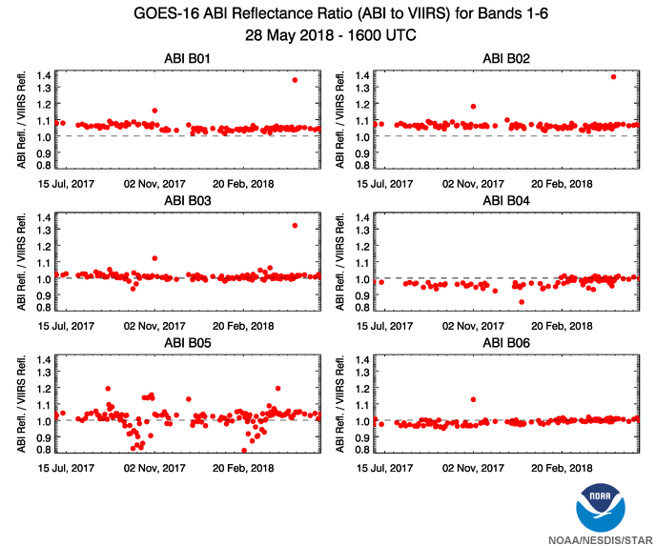
VNIR Accuracy Stability
Outliers are due to GS, e.g. the 1.61μm before Feb. 2018.

Slide 20
IR Accuracy

Slide 21
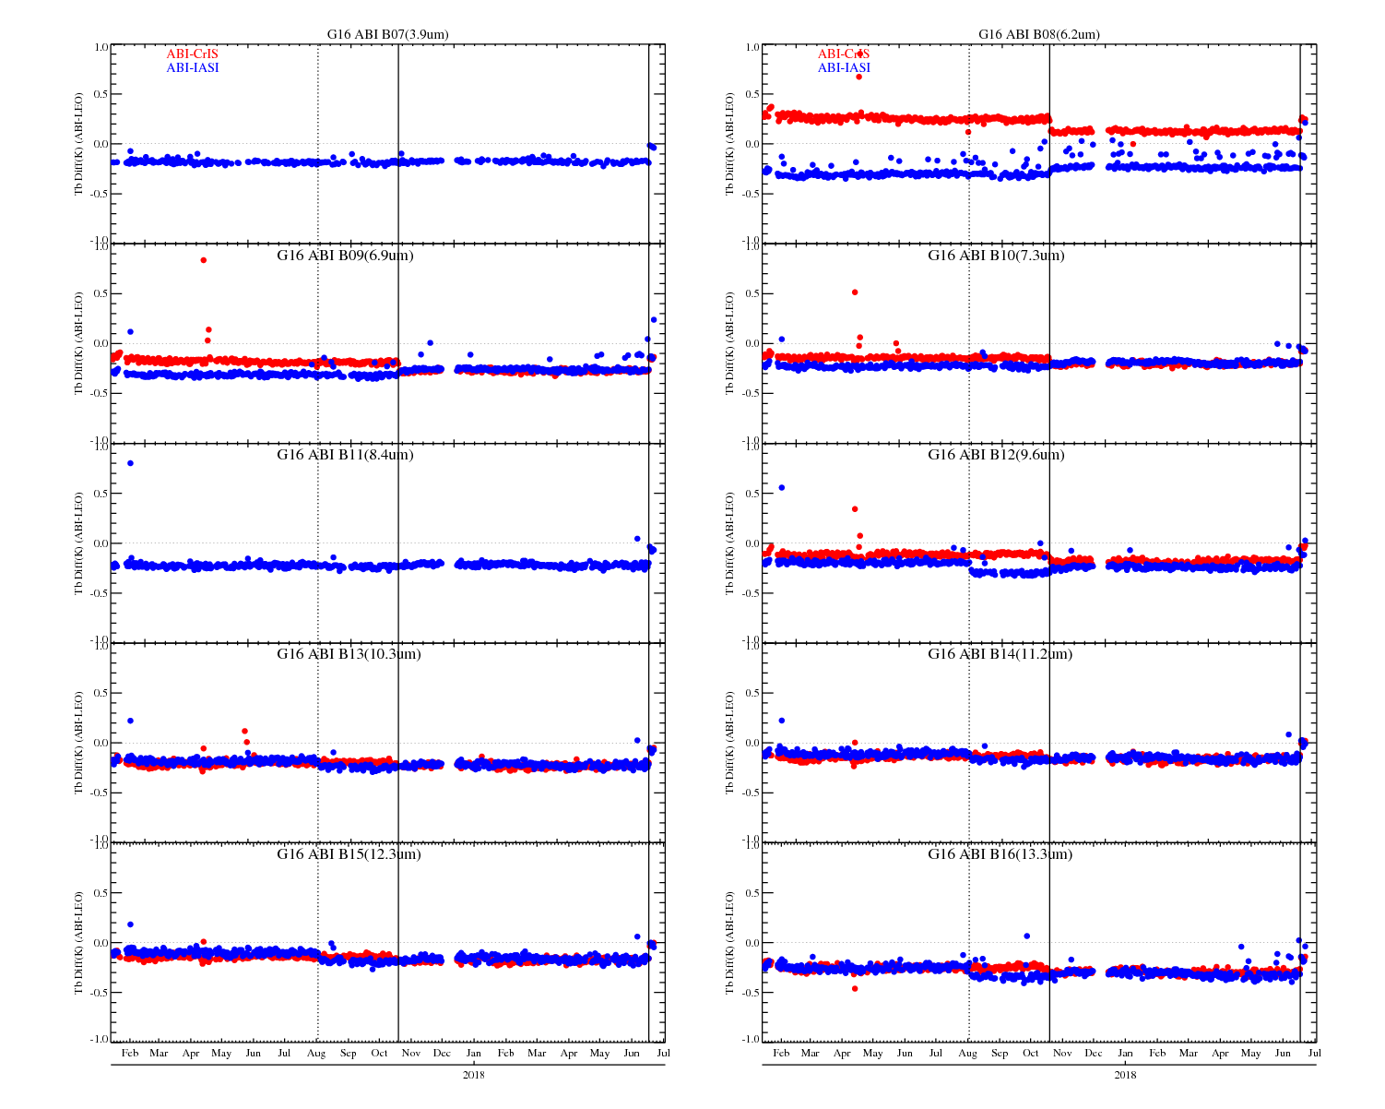
IR Accuracy Stability

Slide 22
Navigation Error (I)
Many did not meet the requirement at Provisional
  By a lot for some bands.
All met the requirement at Full Validation
  With large margin.

Slide 23
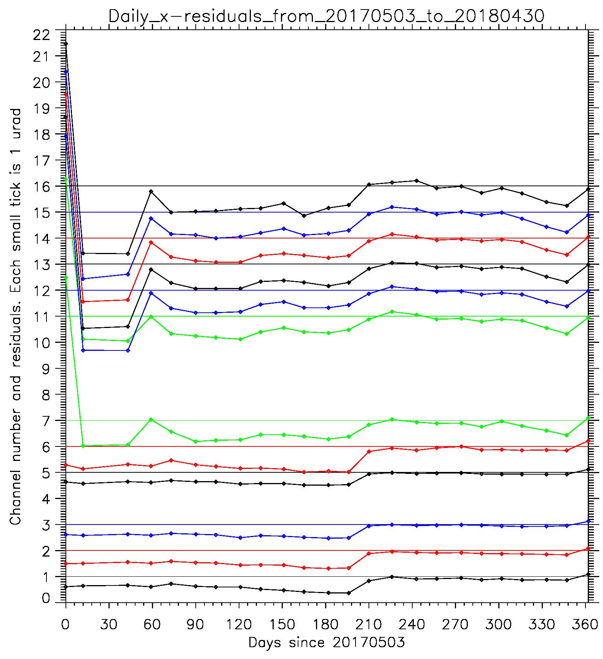
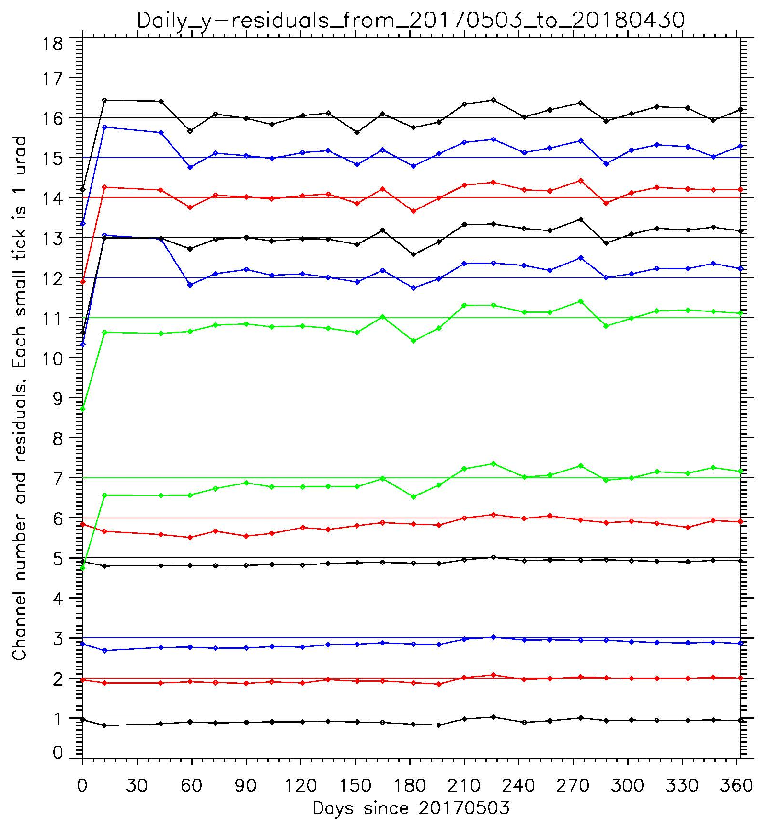
Nav Improvement – Residual
Errors were reduced by an order of magnitude in a year, after halved before then.
Notes:
Legend: ABI daily-average residuals, 2017-05-03 – 2018-04-30. Uninterrupted data stream is joined by lines. Empty spaces are data gaps.
Discussion: EW (x) and NS (y) navigation errors are reduced by the order of magnitude during that year (after they were halved before that period).

Slide 24
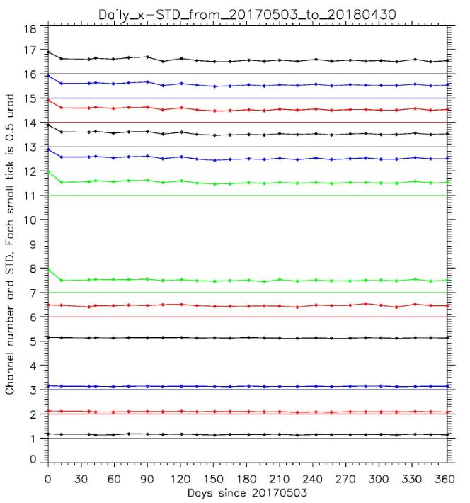
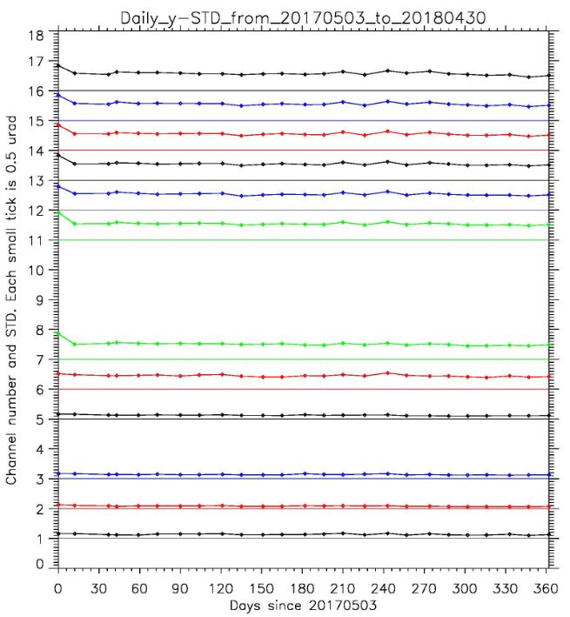
Nav Improvement – STD
STD were reduced to 1/3. Total Error = Residual + 3*STD
Notes:
Legend: ABI daily STDs are plotted. Uninterrupted data stream is joined by lines. Empty spaces are data gaps.
Discussion: EW (x) and NS (y) standard deviations (STD) have decreased 3 times during the period. This is as important as reduction in residuals because its contribution to the total error (3*STD) was also reduced by the order of magnitude.

Slide 25
Navigation Error (CCR)
… and better than required, but some not as good as expected.

Slide 26
Navigation Error (FFR)
For the window channels only.
Sounding channels should show FFR similar to the window channels on the same FPA.
Better than requirements and baseline since provisional.
  Still, notable improvement in last year.

Slide 27
Navigation Error (WIFR I)
CWG uses different methodology for WIFR error – we look at 24-hour averaged STD of the FD image. We do not compare pixel location in FD, CONUS, and MESO image.
Our measurement is in the family with requirements.
Provisional measurements used a single image, so they are not directly comparable with the full maturity data.
IPATS has found ½-pixel disagreement between position of MESO pixels and corresponding pixels in the FD and CONUS images. ADR 540 was formulated and scheduled for implementation in DO07.

Slide 28
Navigation Error (WIFR II)
We have estimated the image-averaged Swath-to-Swath Registration error (SSR).
Our measurements are in the family with requirements, though some image quality issues seem to be still present. It looks like the navigation process needs more star observations and better tuning of the Kalman filter.

Slide 29
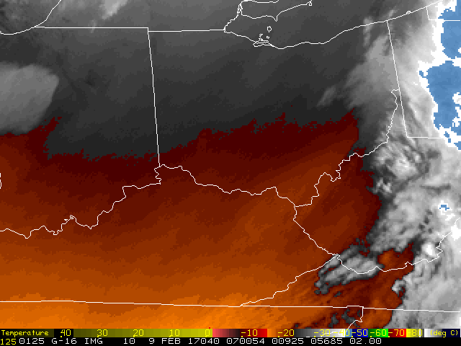
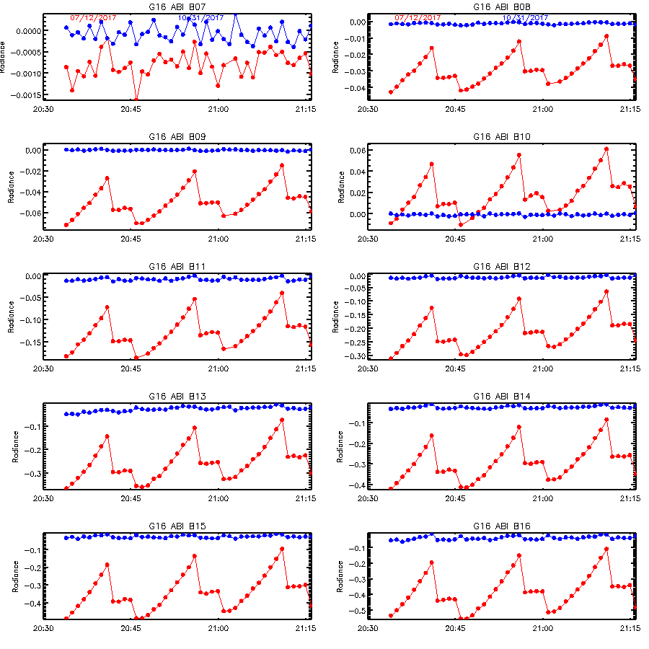
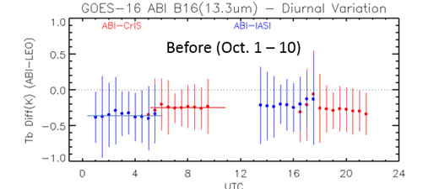
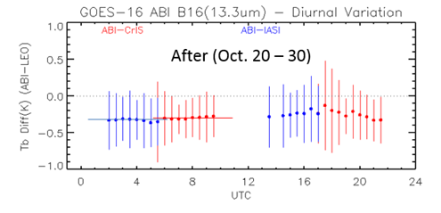
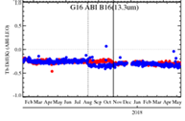
PICA – Periodic Infrared Calibration Anomaly
PICA is the anomaly with 15-minute of periodicity observed at GOES-16 ABI Mode-3 MESO and CONUS images.
Investigation of the space MESO images from the lunar chasing events revealed root cause was due to the residuals of incident-angular scan-mirror emissivity corrections
Update the scan-mirror emissivity look-up-tables (LUTs) on 10/19/2017 greatly reduced the PICA impact, improved the IR spatial uniformity, reduced the diurnal calibration variations, and ensured more consistent GEO-LEO inter-calibration results to CrIS and IASI.
PICA impact. Courtesy of C. Gravelle via D. Lindsey
Reduced PICA impact after GS update
Improved spatial uniformity
More consistent GEO-LEO Tb biases
Reduced diurnal variation

Slide 30
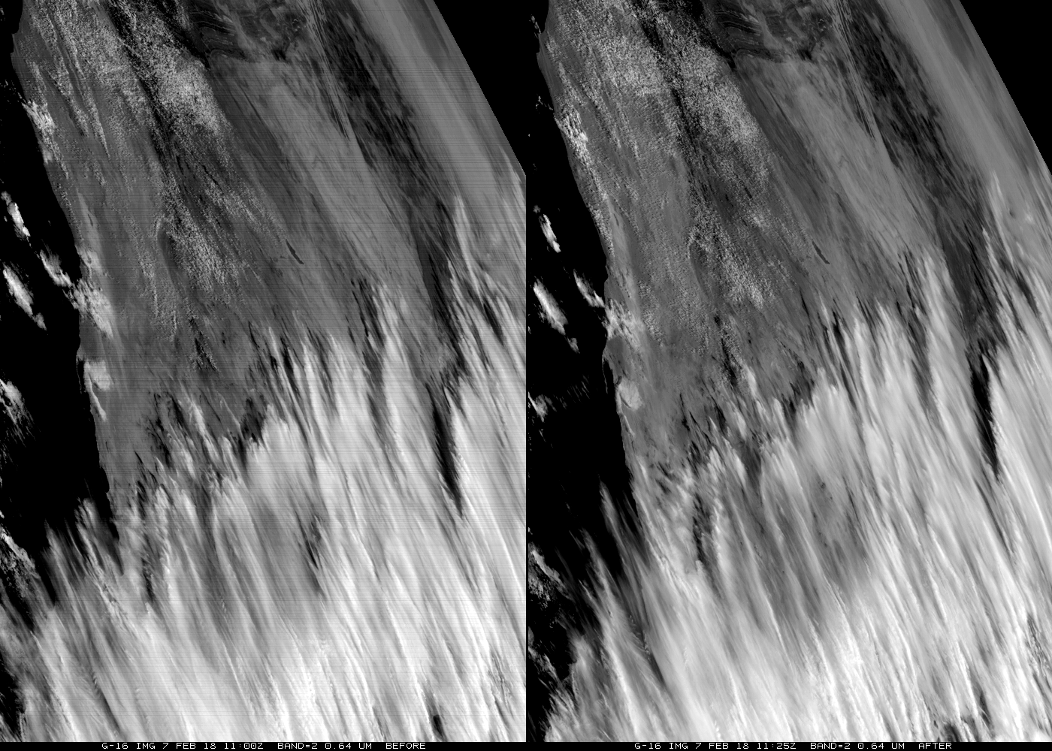

B01-03 Striping
Striping was observed at GOES-16 ABI VNIR bands, especially at B01/02/03 since PLT period
  CWG reported discrepancy of Q-scaling scheme between the operational calibration algorithm and the Equation described in radiometric calibration ATBD in Sept. 2017
  Vendor believed silicon detector response may also get changed in-orbit (e.g. ~4% jump of B02 in mid-March 2017)
    New Q values derived iteratively with in-orbit Earth data for B01-B03 using Q-scaling algorithm
The new Q values for B01/02/03 and “Q-scaling” scheme for all the six VNIR bands were implemented completely on 02/07/2018.
  VNIR B01/02/03 striping significantly reduced
  B04 experienced ~3% reduce in the radiance while change in the other channels was less than 1.5%
GOES-16 ABI B02 images obtained at 11:00Z (left) and 11:25Z (right) on 7 February 2018. (image provided by T. Schmit) showing the reduction in image striping after the complete implementations of the striping reduction parameters and algorithms at 11:16Z
Mean radiance difference estimated for the Earth scenes before and after the operational algorithm update

Slide 31
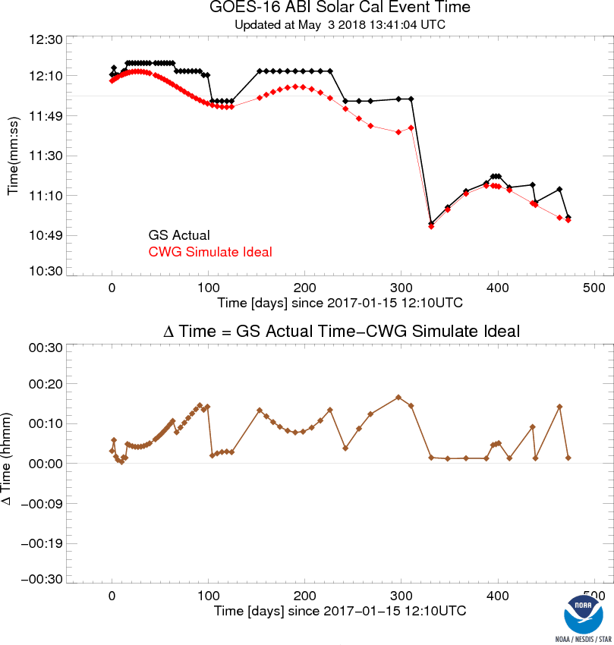
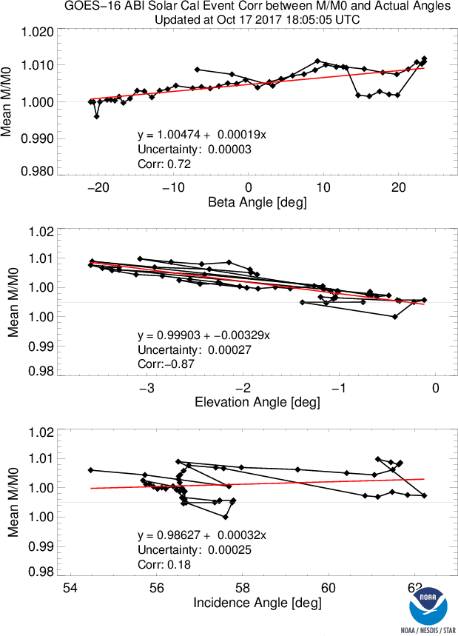
Solar Calibration Timing
SD reflectance varies bi-directionally.
Pre-launch, it was known for one elevation angle (0°) and variety of beta angle (-±23.5°).
Solar calibration should occur when elevation angle is zero.
In 2017, solar cal often occurred at the fixed clock time with varying elevation angle.
Negative impact on solar calibration
Fixed since Dec 2017.

Slide 32
Comments
Anomalies resolved before Provisional were often due to operational errors
  Reversed order of LUT;
  Incorrect Integration Time Multiplier;
  Outdated files after CBU switch; etc.
Anomalies resolved after Provisional require comprehensive understanding of ABI instrument calibration, ingenuous analysis, and deep dive into the data.
  Will continue into future.

Slide 33
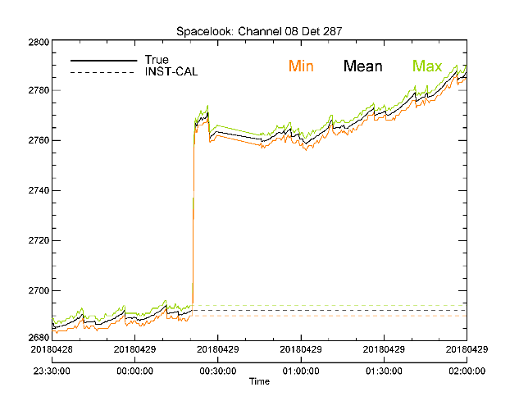
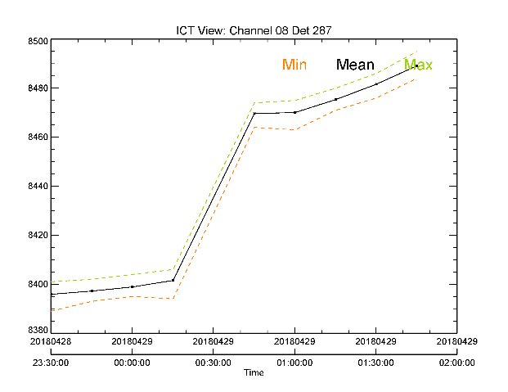
Latched Detector Response
ABI IR detectors may experience sudden change in response – detector level shift
The level shift, if greater than lunar rejection threshold, can set the space look of this detector “latched”. Striping thus occurs
  Erroneous calibration coefficient
Striping is removed or reduced:
  If response (space look and ICT counts) is not saturated, striping is removed by resetting the space look statistics object.
  If response is saturated, space look reset can trigger “band-aid” algorithm to reduce apparent striping till the BDS is updated.
    Ongoing effort for the current operational algorithm to protect from the saturated ICT
Actual detector responses
Detector level shift
“Latched” space look used for operational calibration

Slide 34
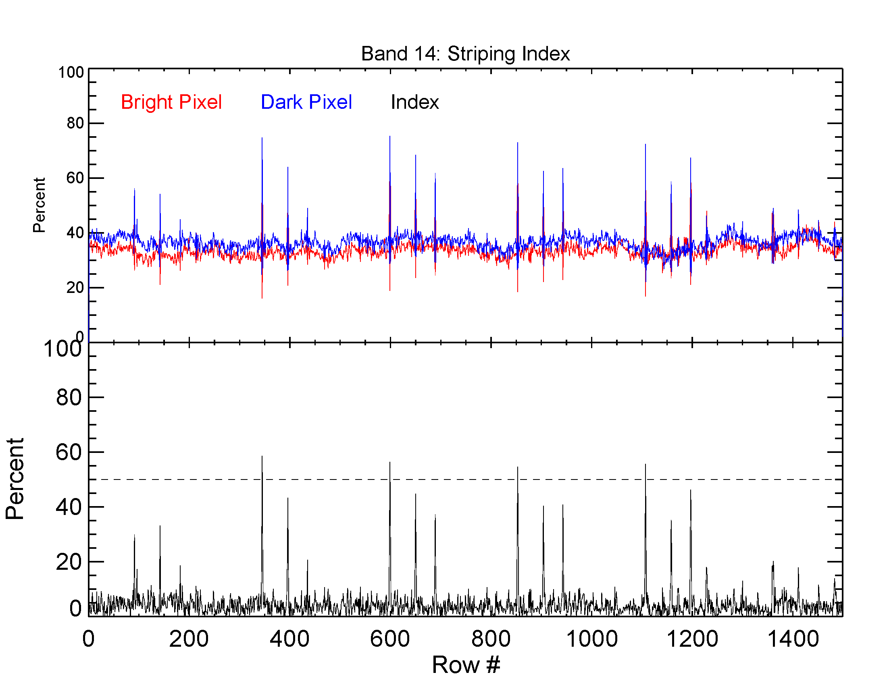
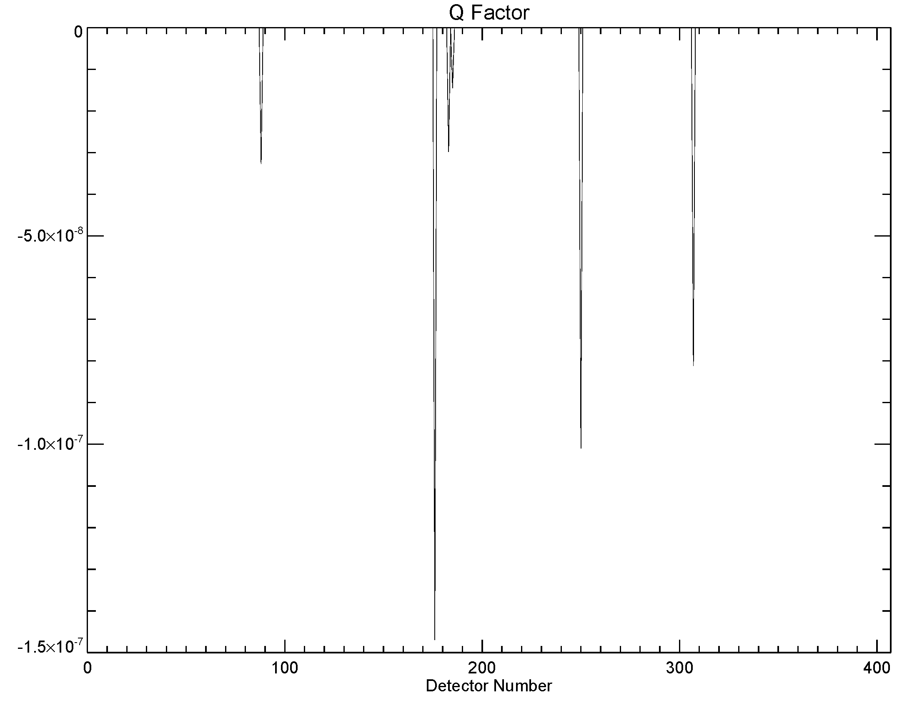
11.2μm Striping
Horizontal striping has been detected for the 11.2μm band and, less frequently, for some other IR bands.
For the 11.2μm band, the most obvious striping is linked to 3 detectors with non-zero Q. The same correlation is discovered for bands 15 & 16.
The striping patterns also suggest that the Q LUT of these detectors are probably problematic.
There is an on-going effort by CWG to determine the root cause.
repeat each swath
D307
D250
D176

Slide 35
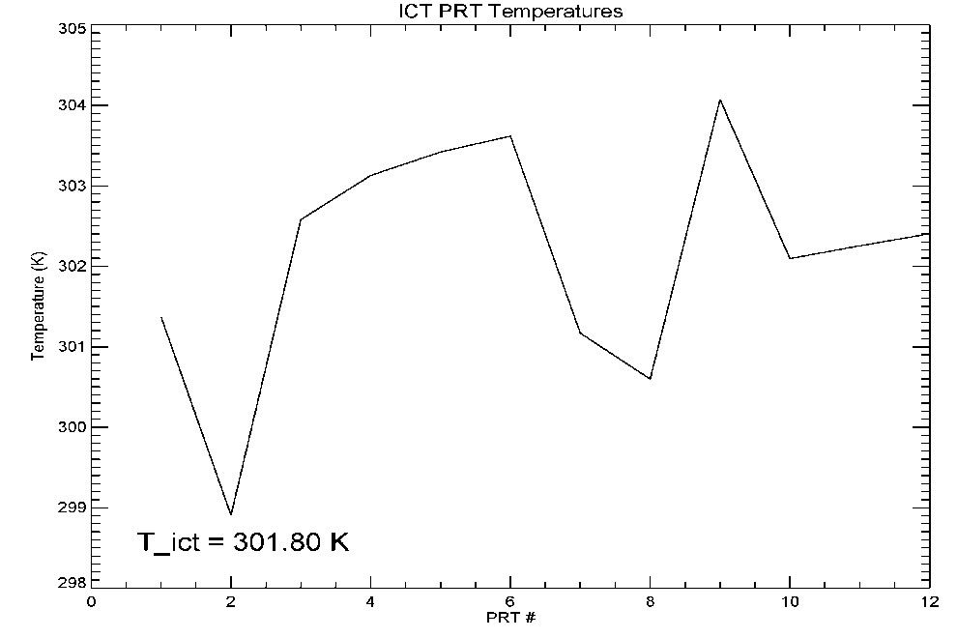
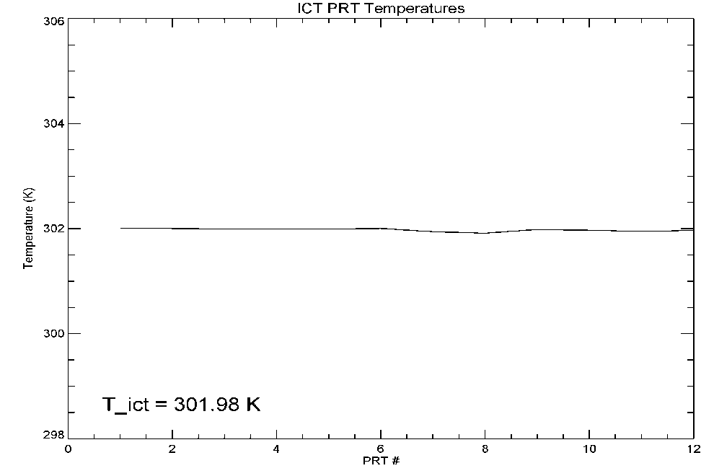
ICT PRT Coefficients
In April 2018, a possible discrepancy between the ICT PRT coefficients saved in Flight CDRL-42 and GS LUT was discovered and later confirmed.
The implementation of the correct CDRL 42 coefficients shall shrink the spread of the 12 ICT PRT temperatures from ~ 6 K to < 0.1 K. The reported average ICT temperature for gain calculation shall increase by 0.2 K.
The update of GS LUT is expected to remove at least the majority of ~ -0.2 K bias observed for all IR bands.
PRT Coeff. from GS LUT

PRT Coeff. from CDRL 42

Slide 36
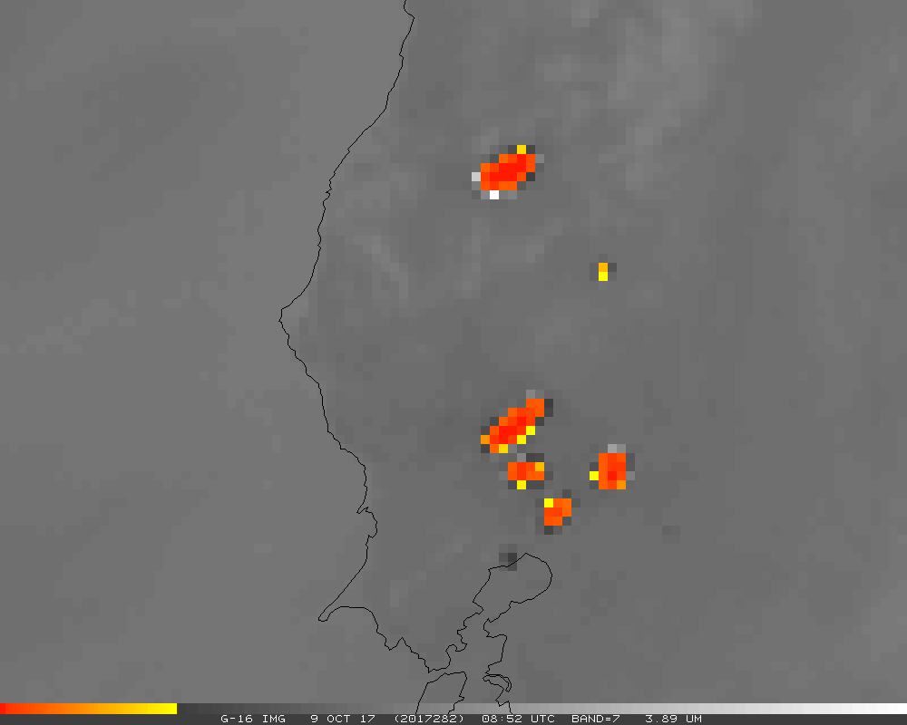
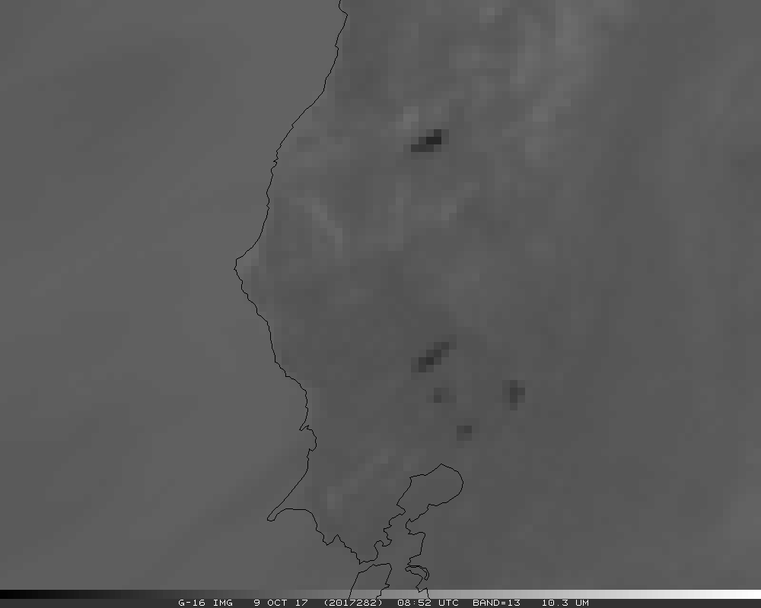
Cold Pixels Around Fire (CPAF)
Compare 390um channel with a longwave IR channel such as 112um for a fire scene, the fire can be much hotter in 390 band than 112 band (412K or saturated vs. 302K).
Nearby pixels can be much colder in 390 band than 112 band (0K or saturated vs. 287K).
Both phenomena are well understood.
Flag has been implemented in operation, and works well, to avoid confusion.
User requested enhancement, which seems within reach.
Several options have been considered. One was chosen. Work is underway.

Slide 37
064 Band Bias
064 Channel is more than 5% brighter than pre-launch, VIIRS, and AVIRIS-NG (Field Campaign).
It is likely caused by uncertainty in the K factor, the detector- and angle-dependent reflectance of solar diffuser that was determined pre-launch.
There is no consensus whether K is wrong and, if it is, what is the right value for K.
There is consensus that the calibrated radiance is wrong and users demand quick change.
It is recommended to adjust K to bring 064 radiance to be in family.

Slide 38
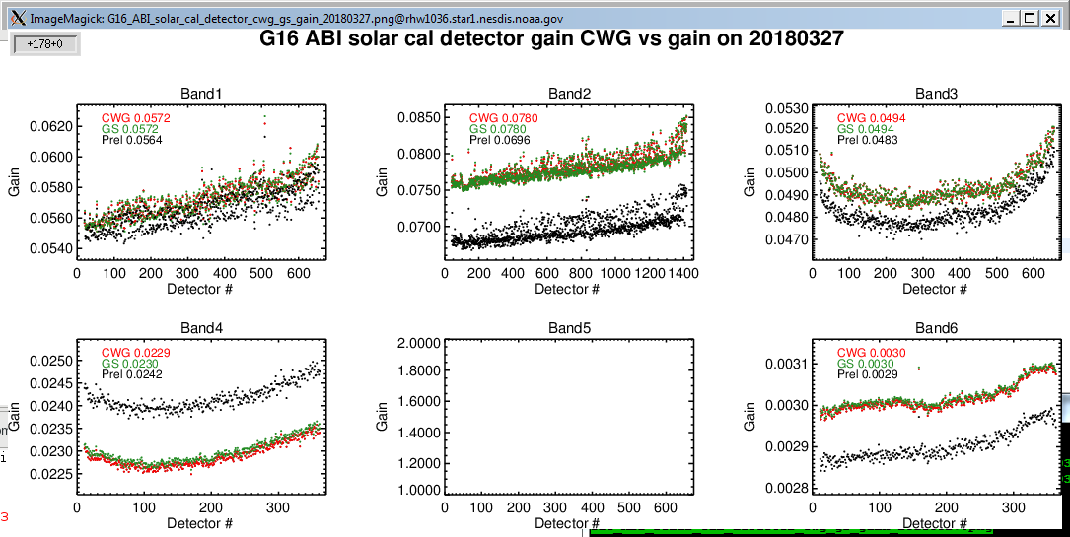
ABI CH02 Bias and Mitigation
ABI CH02 showed 6-8% large radiometric biases immediately after first solar calibration which violated the MRD radiometric requirement
ABI CH02 bias has been confirmed with the long term GEO-LEO (VIIRS) bias monitoring and field campaign comparison with AVIRIS-NG
One important fact
  ABI CH02 prelaunch gain is lower than post-launch Solar Cal gain by 6.5%
Pre-launch Sphere and FEL tests are two separate calibration tests
  Sphere test is used to derive prelaunch gain and Q for detectors of each ABI VNIR bands (SI-traceable)
  FEL test is to derive the K factor (proportional to SD BRDF) which is used in post-launch calibration
Post-launch gain factor from Solar Cal can only be traced to the prelaunch FEL test
This leads to the investigation of uncertainty in the prelaunch FEL test
Post-launch Solar Cal Gain
Prelaunch gain

Slide 39
Evidence of Uncertainty in ABI PRE-LAUNCH FEL TEST for ABI CH02
FEL test signal is significantly weak
  Large space look signal (~ 3460 counts) with uncertainty of 11 counts (ABI CH02 has the largest uncertainty)
  FEL lamp signal for ABI CH02 is ~130 counts (~21 W/m²-sr-um). (much weaker than space look and can be affected by the large uncertainty in space look)
Sphere Test for prelaunch gain and Q for ABI CH02
  Signal level varies from 15 to 1929 W/m²-sr-um over 24 levels (much higher than FEL lamp)
Post-launch Solar Cal signal is around 4100 counts after subtracting space look.
Other uncertainties
  FEL test has ~ 7 counts stray light (ABI CH02 is the highest)
  Solar diffuser K factor can be affected by the stray light correction model
  FEL lamp non-uniformity characterization
Further evidence
  ABI CH02 solar diffuser K factor is higher than all other bands (inconsistent with the reflectance property of solar diffuser material )

Slide 40
Mitigation Plan for ABI CH02 BIAS
Multiple independent evaluation confirmed the bias for ABI CH02.
Root cause for radiometric bias of ABI CH02 needs further investigation
Immediate Mitigation Plan
  Use pre-launch and post-launch gain ratio to normalize K factor and peg the shape of K factor w.r.t. detector from FEL test (~6.5% reduction)
Detector uniformity improvement and accounting for solar diffuser degradation
  The detector K factor will be optimized with the lunar and earth surface NSS data to minimize the striping/banding effects due to the change in algorithm.

Slide 41
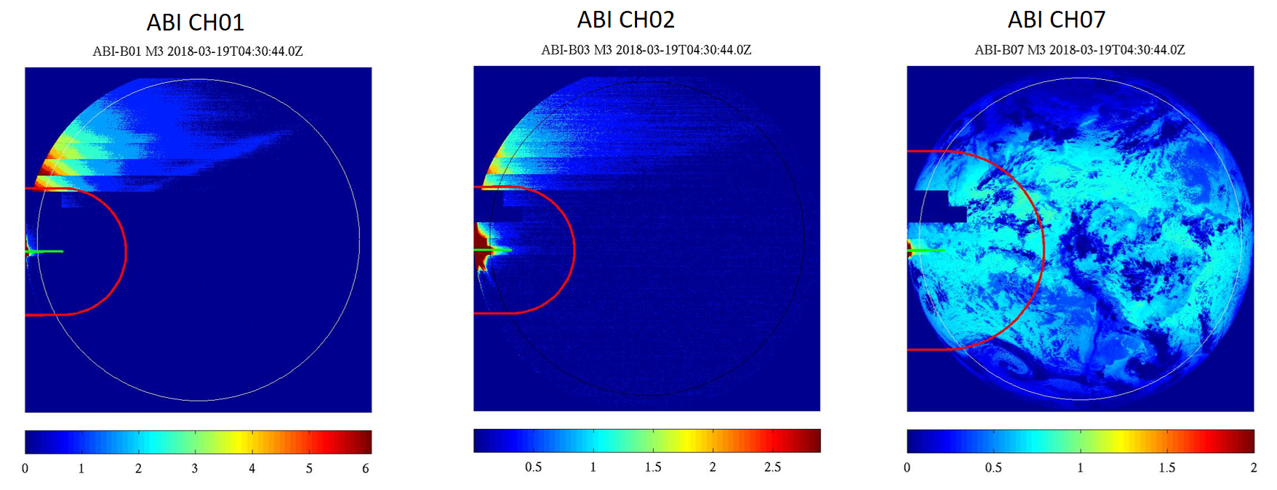
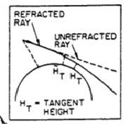
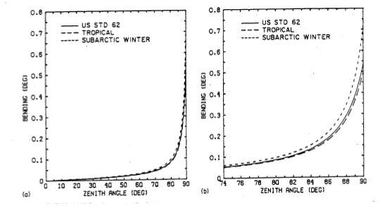
Strong Refracted Solar Light Leaking onto ABI Detector in March, 2018
At night side, strong solar light leaked onto ABI detectors when Sun is behind Earth due to refraction of solar light propagating through the atmosphere
Occurred frequently when the sun is near the limb margin in March, 2018
Caused the ABI VNIR detectors to saturate. Harmful for ABI detectors.
ABI solar avoidance truncation was confirmed to perform correctly with the limb margin set at 8.1 degree
It was concluded that the swath truncation is not adequate with the current limb margin at 8.1 degree
Proposed adjustment of limb margin radius to 7.9 degree or lower to avoid the strong leaking light.
The MODTRAN 2/3 Report and LOWTRAN 7 MODEL

Slide 42
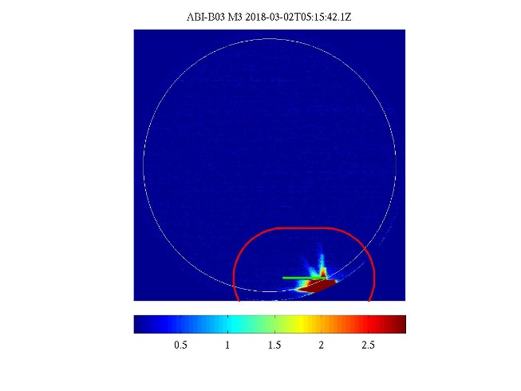
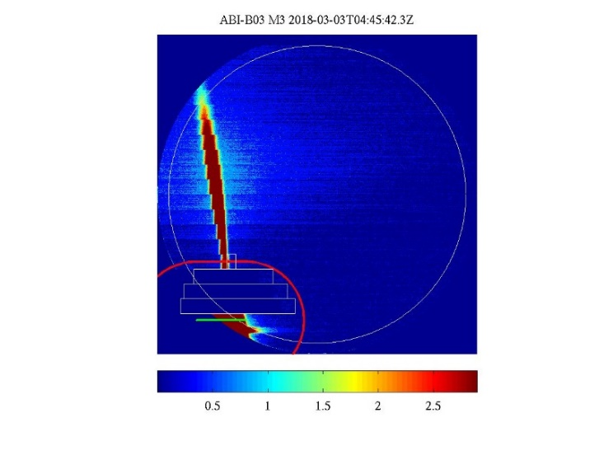
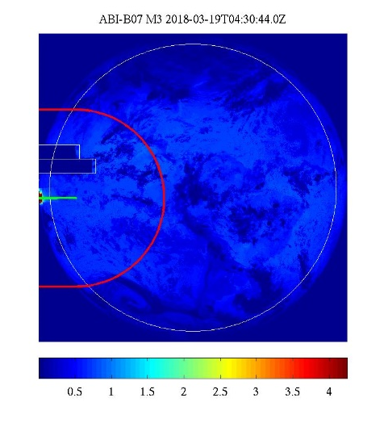
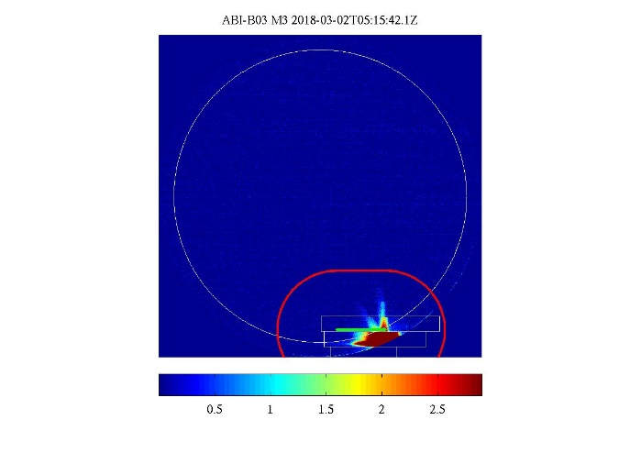
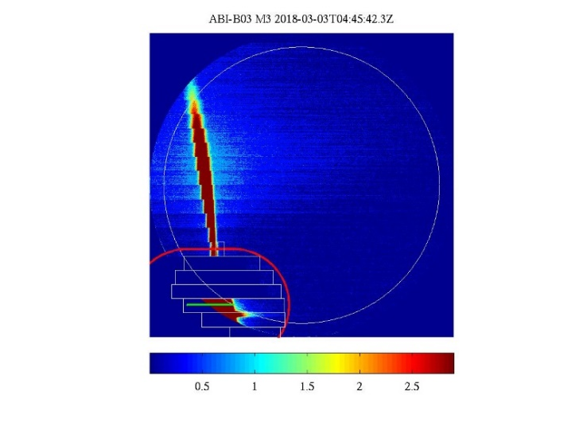

Proposed Solar Avoidance Parameter to Avoid Strong Refracted Solar Light Leaking onto ABI Detector
Mar. 2, 2018, ABI CH03
Mar. 3, 2018, ABI CH03
Mar. 19, 2018, ABI CH07
Current Swath Truncation with Limb Margin at 8.1 Degree
Missed
Missed
Missed
Proposed Swath Truncation with Limb Margin at 7.9 Degree
The proposed change of the limb margin radius to 7.9 degree for solar avoidance truncation can effectively avoid the strong leaking solar light onto the ABI detectors

Slide 43
Summary
Definition of cal/val.
Cal/val lessons from past generation transition.
Planning of ABI cal/val
Execution of ABI cal/val
Key results of ABI cal/val

