Slide 1
Explainable Artificial Intelligence Application to Tropical Cyclone CNN
Eric Wendoloski
Connor Sprague
Ingrid Guch
Kurt Roettiger
Phil Slingerland
Sue Vogel
17 DEC 18
Approved For Public Release. OTR2019-00184.

Slide 2
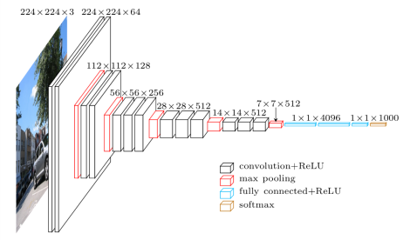
Overview
Difficulty explaining origins of AI-based prediction a key barrier to adoption
Machine-learning (ML) models (basis for AI) often perceived as black boxes
  Notion prevalent in deep-learning (DL; e.g., Convolutional Neural Networks – CNNs)
  CNNs composed of interconnected layers; O(10M-100M+) trainable parameters
  Filters within layers trained to distill relevant features that map to some output
VGG16 CNN bottleneck architecture - 138M trainable parameters
Figure adapted from Cord et al. 2016
Notes:
Benefits in legal/policy domains, Viewed as opaque, difficult to understand

Slide 3
Overview
Operational users require explainable decision processes / knowledge of model vulnerabilities
  Predictions informing life and death decisions must be traceable
  Predictions of physical processes should depend on physically relevant features
  Vulnerabilities may be exploited to alter predictions
Explainable AI techniques capable of conveying DL model behavior/vulnerabilities
  Analysis rooted in the visual information distillation process
  Demonstrate physical features/concepts that the model relates to its predictions
  Provide understanding of a vulnerability to adversarial inputs
All topics presented represent areas of open research in the community.

Slide 4
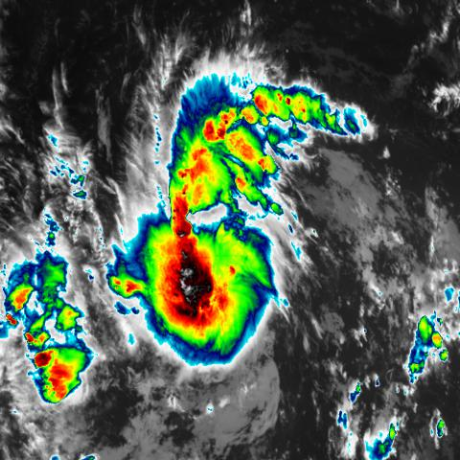
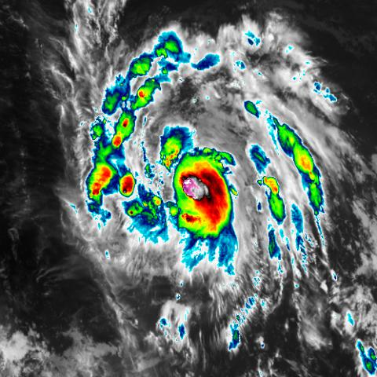
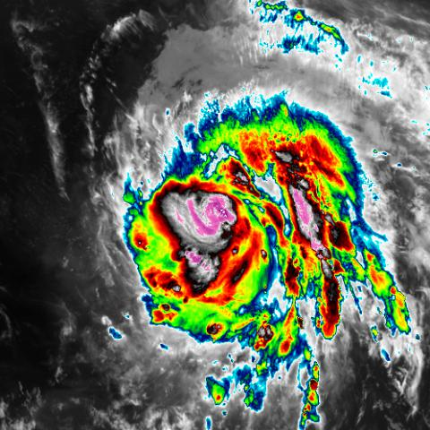
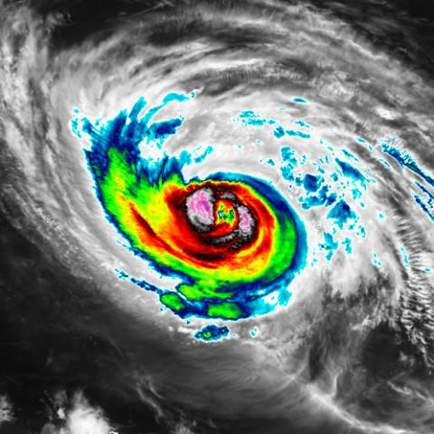
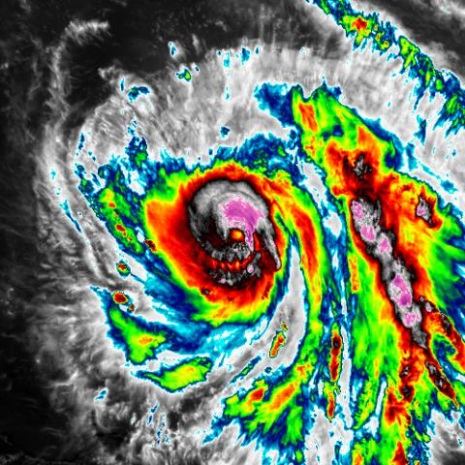
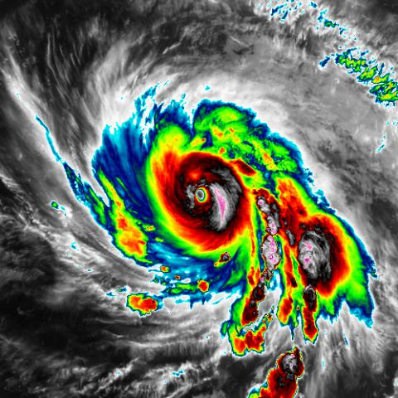
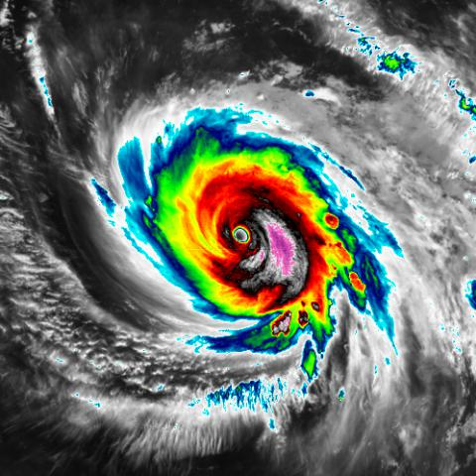
Tropical Cyclone (TC) Classification CNN
Model trained to categorize TCs
  Tropical depression (TD), Tropical Storm (TS), Cat 1 – Cat 5 Hurricanes
  Null class included of randomly pulled regions away from TCs
Model only intended to highlight application of methods
  Methods extensible to numerous environmental problems
TC Data:
  2017/2018 Atlantic & Eastern Pacific TCs – interpolated to hourly
  2017 – NOAA Best Track Data
  2018 – CIRA RAMMB Archive
CNN Input
  GOES-East satellite images - 11.2 um band
  Image chips centered on TC center of circulation
  ~14000 images from 71 TCs
Maria TD-HU5 examples
TD
TS
HU1
HU2
HU3
HU4
HU5
Notes:
No need to replace automated dvorak technique, but this is a problem domain that is relatable for the sake of these methods.
RAMMB – regional and mesoscale meteorology branch
600x600 was minimum – wanted to maintain storm structure while minimizing outside weather phenomena

Slide 5
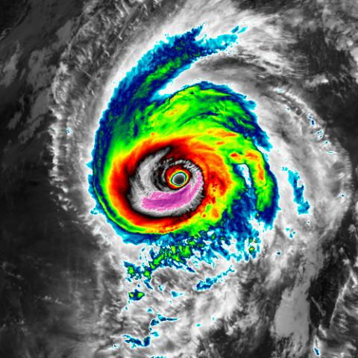
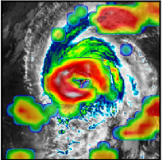
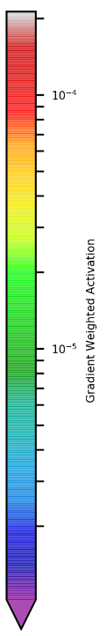
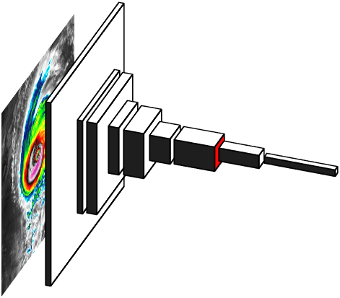
Gradient Weighted Class Activation Mapping (Grad-CAM)
Objective
  Determine if the model focusing on the most important features for prediction
Visual explanation for CNN decisions
  Indicates input image pixels most important to prediction of a class
    These pixels positively influence prediction of a given class
Method (Selvaraju et al. 2017)
  Run image through CNN
  Gather activations – output of a CNN layer
  Compute gradient of the predicted score for class of interest
  Global average pool the gradients – one avg. gradient for each filter in the layer
  Multiply activations by respective gradients, apply RelU
    Weights activations by how important they are to predicting the class of interest
  Results may be aggregated as layer mean or individual filter results can be examined
  Results viewed as heatmap of pixel importance on the input image
Michael as Cat. 4 (left), Grad-CAM heatmap (right; final conv. layer, 3rd strongest)
Notes:
Activations result of applying image filters learned by the CNN to image information) from a given layer

Slide 6
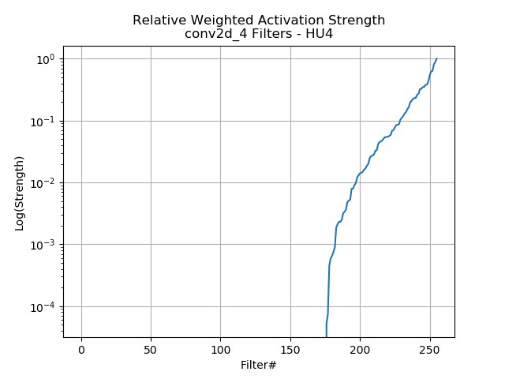
Grad-CAM-based filter influence in TC CNN Final Conv Layer
Gathered weighted activation for all 256 filters in last layer of TC CNN
  Summed weighted activations for each filter
  Allows sorting of filters that produced most influential output to Cat. 4 prediction
Input: Michael as HU4
Only 80/256 filters in final layer produced output with meaningful positive influence on the HU4 prediction
The top filters may be 1+ orders of magnitude more influential to class prediction than remaining filters
Behavior of active filters has implications for model-capacity
  Are some of the filters inactive or non-influential over all classes? Model may be deeper than necessary
  Are most filters active over all classes? Model may be too shallow

Slide 7
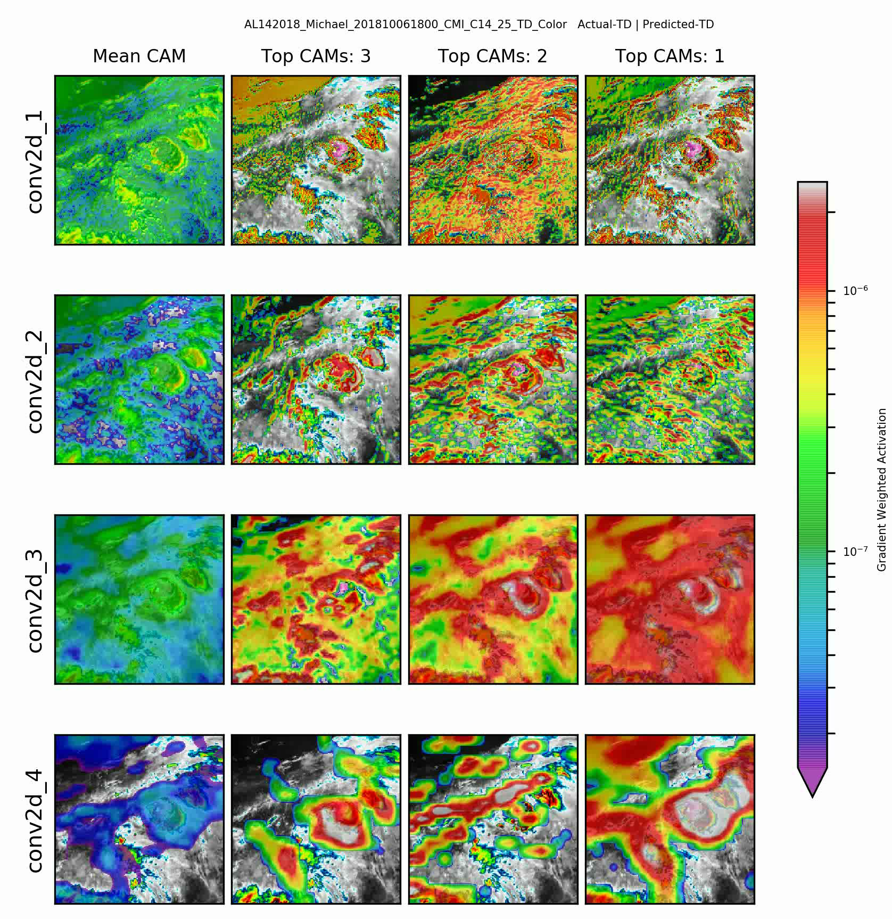
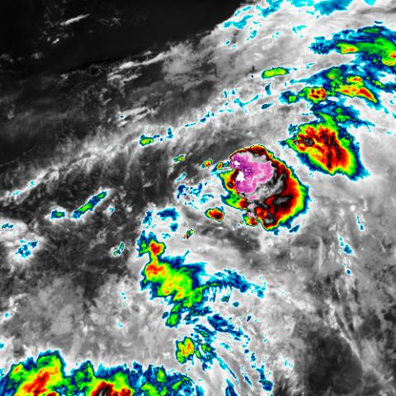
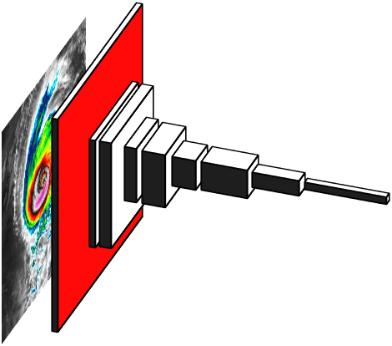
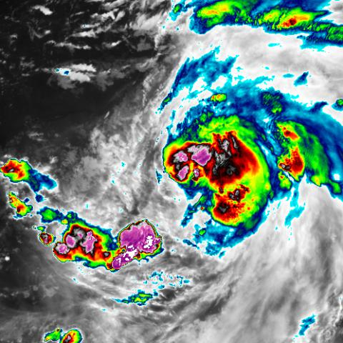
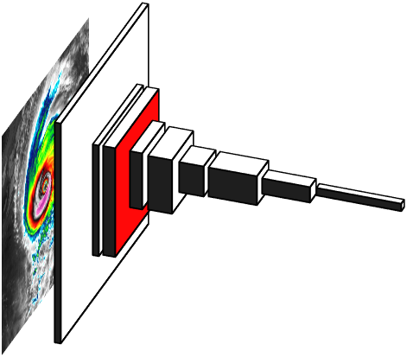
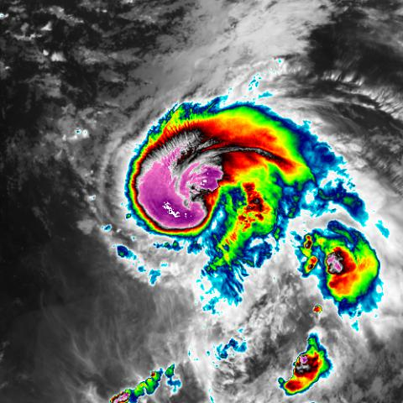
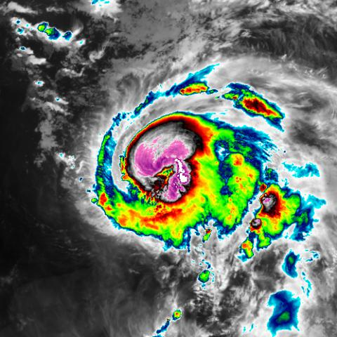
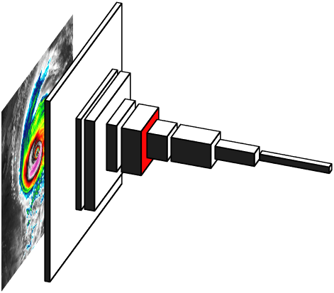
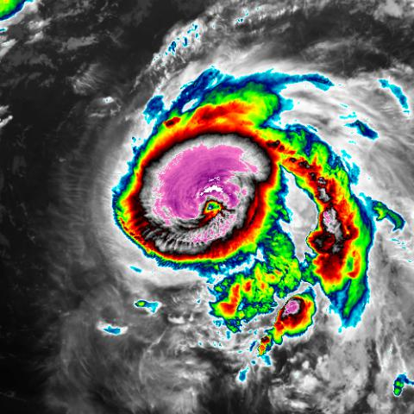

CAM Heatmaps – Michael as TD – Cat. 4 by Conv. Layer
Inputs
1st Layer
2nd Layer
3rd Layer
Final Layer
Notes:
In general, by the last layer, the central core is important to the prediction, outflow regions are important. Interfaces around strongest convection. Banding interfaces. Things that are bad – maybe too much activation on outer cloud free areas. You’d hope main focus is on the storm features, but sometimes it is not by the last layer.
Results local to the input image. Other methods are required to examine if a specific physical concept deemed important by the user is being utilized by the CNN.
Strongest activations in last column indicate that by the final conv later (conv2d_8), the model keys in on the core convective structure of the storm surrounding the eyewall.
Especially on the expanded convective region on the east side of the eyewall.
Earlier layers were keying on much broader regions. Edge detectors also apparent in earlier activations.
As one would hope, the central core structure of the storm was important to the HU4 prediction.
Note 50th %ile CAM sometimes indicates no positive contribution – see slide 7

Slide 8
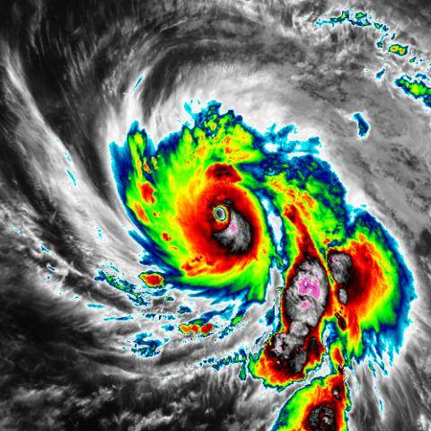
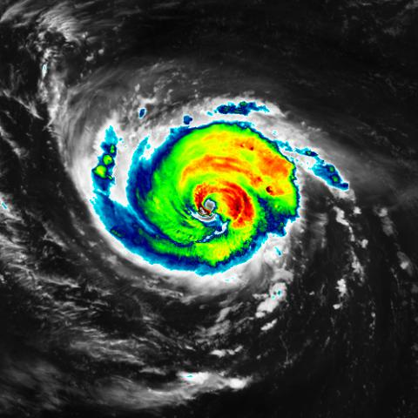
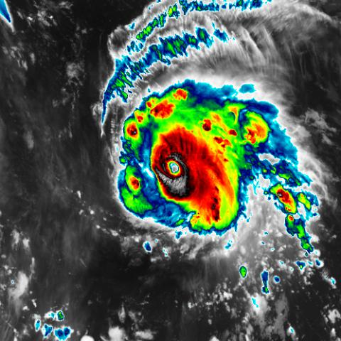
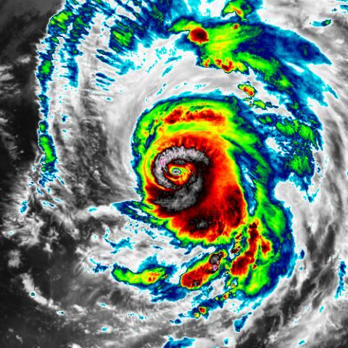
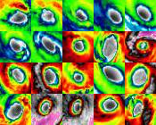
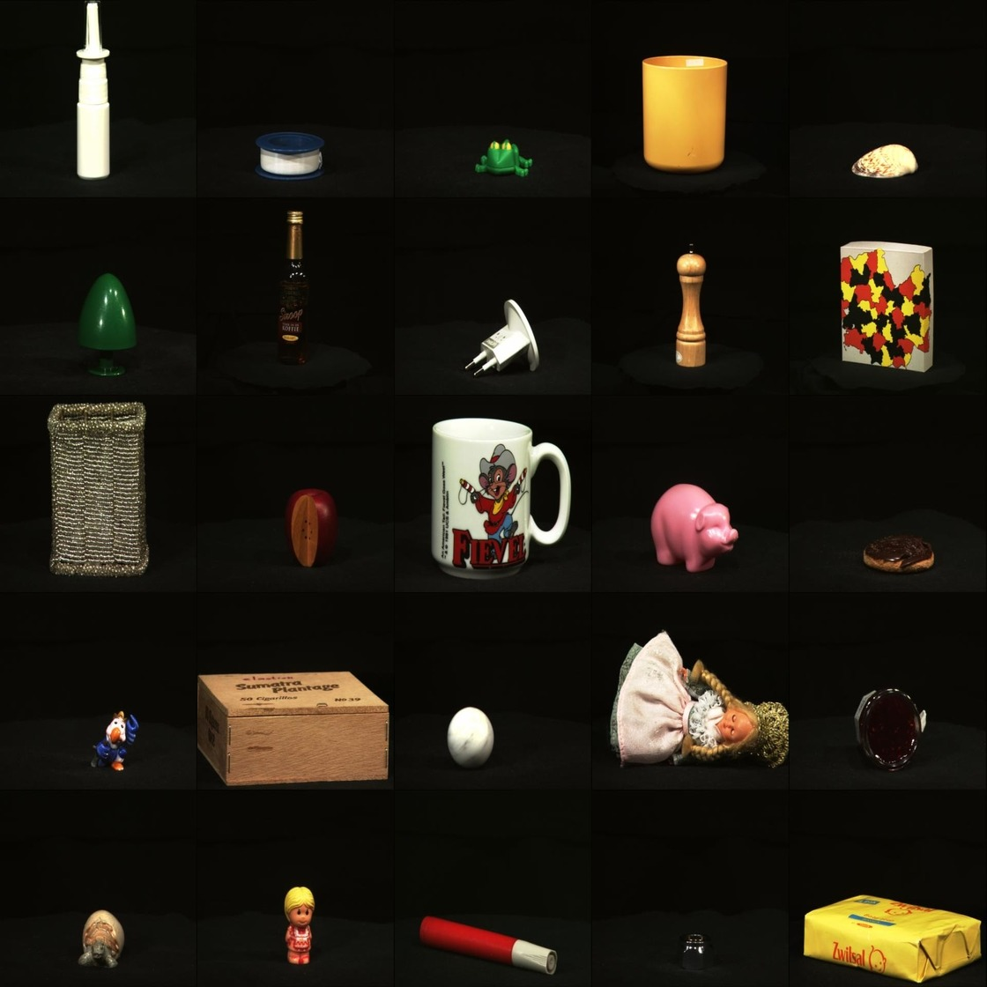
Testing with Concept Activation Vectors (TCAV; Kim et al. 2018)
- Importance of Eye structure to HU4 predictions
Calculate gradient of model loss function for HU4 class w.r.t. activations from final layer
Gradient vectors point in direction of decreasing probability of correct class identification
Gather known HU4 class images.
A few hundred here.
Taken from training set.
Gradient vectors
Concept images
Negative images
Determine Concept Activation Vector
Gather concept images (eye; N>50)
Gather negative images
Gather layer activations for 1,2
Train linear classifier on activations to obtain CAV
Separating hyperplane
CAV (points towards “Eye” activations)
Negative images from ALOI
(Geusebroek et al. 2005)
Does CAV tend to point in opposite direction of gradient vectors?
If so, CAV points in direction of increasing probability of correct class identification
Negative Activations

Slide 9
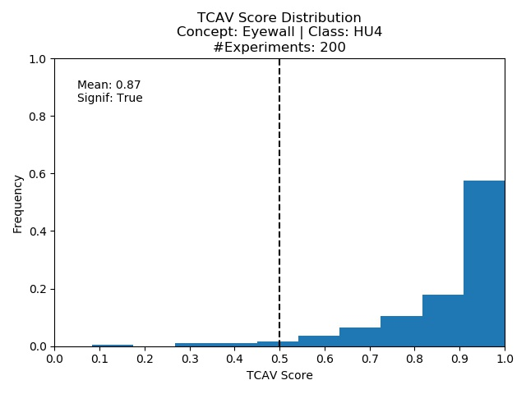
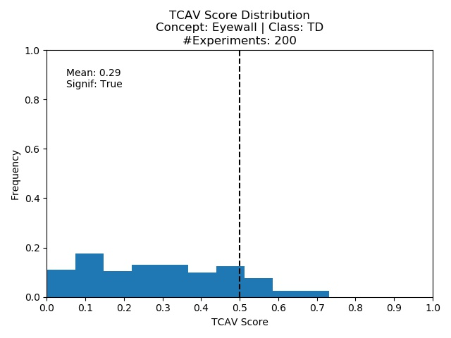
“Eye” Concept Activation Vectors
Kim et al. 2018 suggests a concept is important if CAVs point opposite of >50% of gradient vectors
87% of HU4 gradient vectors point in opposite direction of “Eye” CAV
  Eye important to prediction of Category 4 TCs
29% of TD gradient vectors point in opposite direction of “Eye” CAV
  Eye not important to prediction of TD class
Results obvious for this test case, but:
  Such methods extensible to physical features deemed most important by the user for a given model and class.

Slide 10
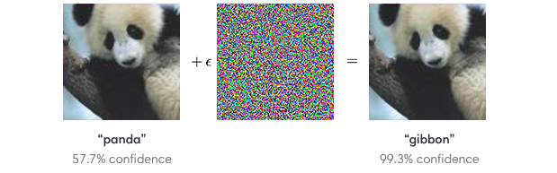
Adversarial Attacks
Purpose of most adversarial attacks to cause erroneous model inference
  Occurs at testing or deployment stage
  Targeted – misguide to specific class
  Untargeted – misguide to arbitrary class
Adversarial generation noise to images causing misclassification
  Noise often imperceptible to humans
  Adversarial examples expose and exploit flaws in decision function of model
  Model-to-model transferability possible (Papernot et al. 2016)
  Implies model security risk even when attacker has no access to victim model
Operational use of CNNs requires knowledge of vulnerabilities/robustness
May require ability to detect, screen, and remediate adversarial inputs
Fast Gradient Sign Method (FGSM) -Goodfellow et al. 2015
Notes:
Cross-model generalization – victim model has different architecture than model generating attacks
Cross-dataset generalization – victim model trained on different training set than model generating attacks
It is the direction of the perturbations that matters – latching perturbations on to input such that the you align with the gradient vector points in a direction of increasing loss.

Slide 11



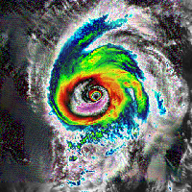
Adversarial Examples
Pick the original image. Four images are adversarial.
Notes:
CarliniWagner was a targeted attack – tried to push prediction to “NULL”. When it worked, it worked well, but it was effective at raising the probability of NULL.
If you allow the strength

Slide 12
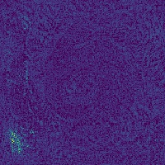
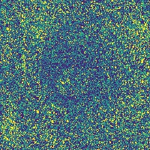
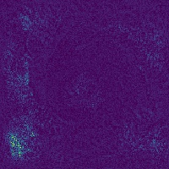
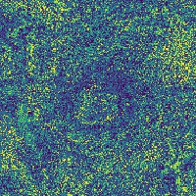
Adversarial Examples
Original
DeepFool
FGSM
NewtonFool
BIM
HU4
HU3
HU3
HU3
NULL
Adversarial Noise
Adversarial methods used here
  Fast Gradient Sign Method (FGSM) – Goodfellow et al. (2015)
  NewtonFool – Jang et al. (2017)
  DeepFool – Moosavi-Dezfooli et al. (2016)
  Basic Iterative Method (BIM) - Kurakin et al. (2016)
Notes:
BIM was a targeted attack – tried to push prediction to “NULL”. When it worked, it worked well, but it was effective at raising the probability of NULL.
If you allow the strength
Adversarial examples are quite interested in perturbing input along the direction of increasing loss. It looks like the all perturbations (but most visible for Deep/Newton Fool) are perturbing cloud free regions of the storm. Although the end predicting is HU3, perturbing the cloud free areas is forcing the model to attend signals aligning with the direction of increasing loss.

Slide 13
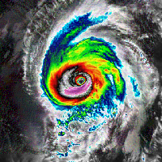
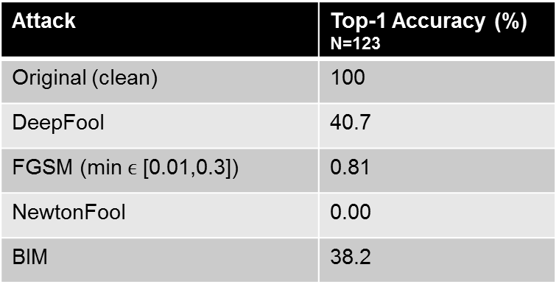
Adversarial Examples
Original
DeepFool
FGSM
NewtonFool
BIM
HU4
HU3
HU3
HU3
NULL
Varying levels of success in altering Michael Top-1 accuracies
Attack | Top-1 Accuracy (%) N=123
Original (clean) | 100
DeepFool | 40.7
FGSM (min $ϵ$ [0.01,0.3]) | 0.81
NewtonFool | 0.00
BIM | 38.2
Notes:
BIM here was a targeted attack – tried to push prediction to “NULL”. It took a lot to get the model to falsely predict NULL, because as will be seen soon, the model was more robust to adversarial attacks for NULL than the other classes
Model did a better job generalizing Null

Slide 14
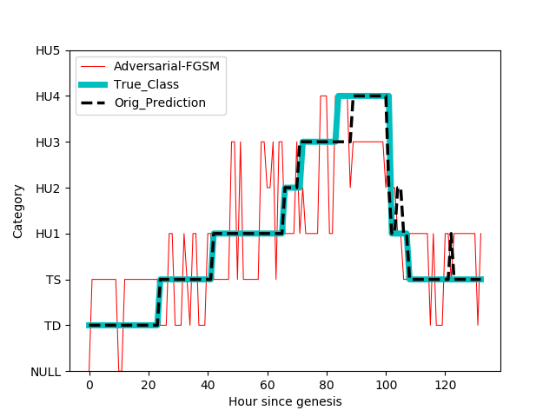
Hurricane Michael Predictions

Slide 15
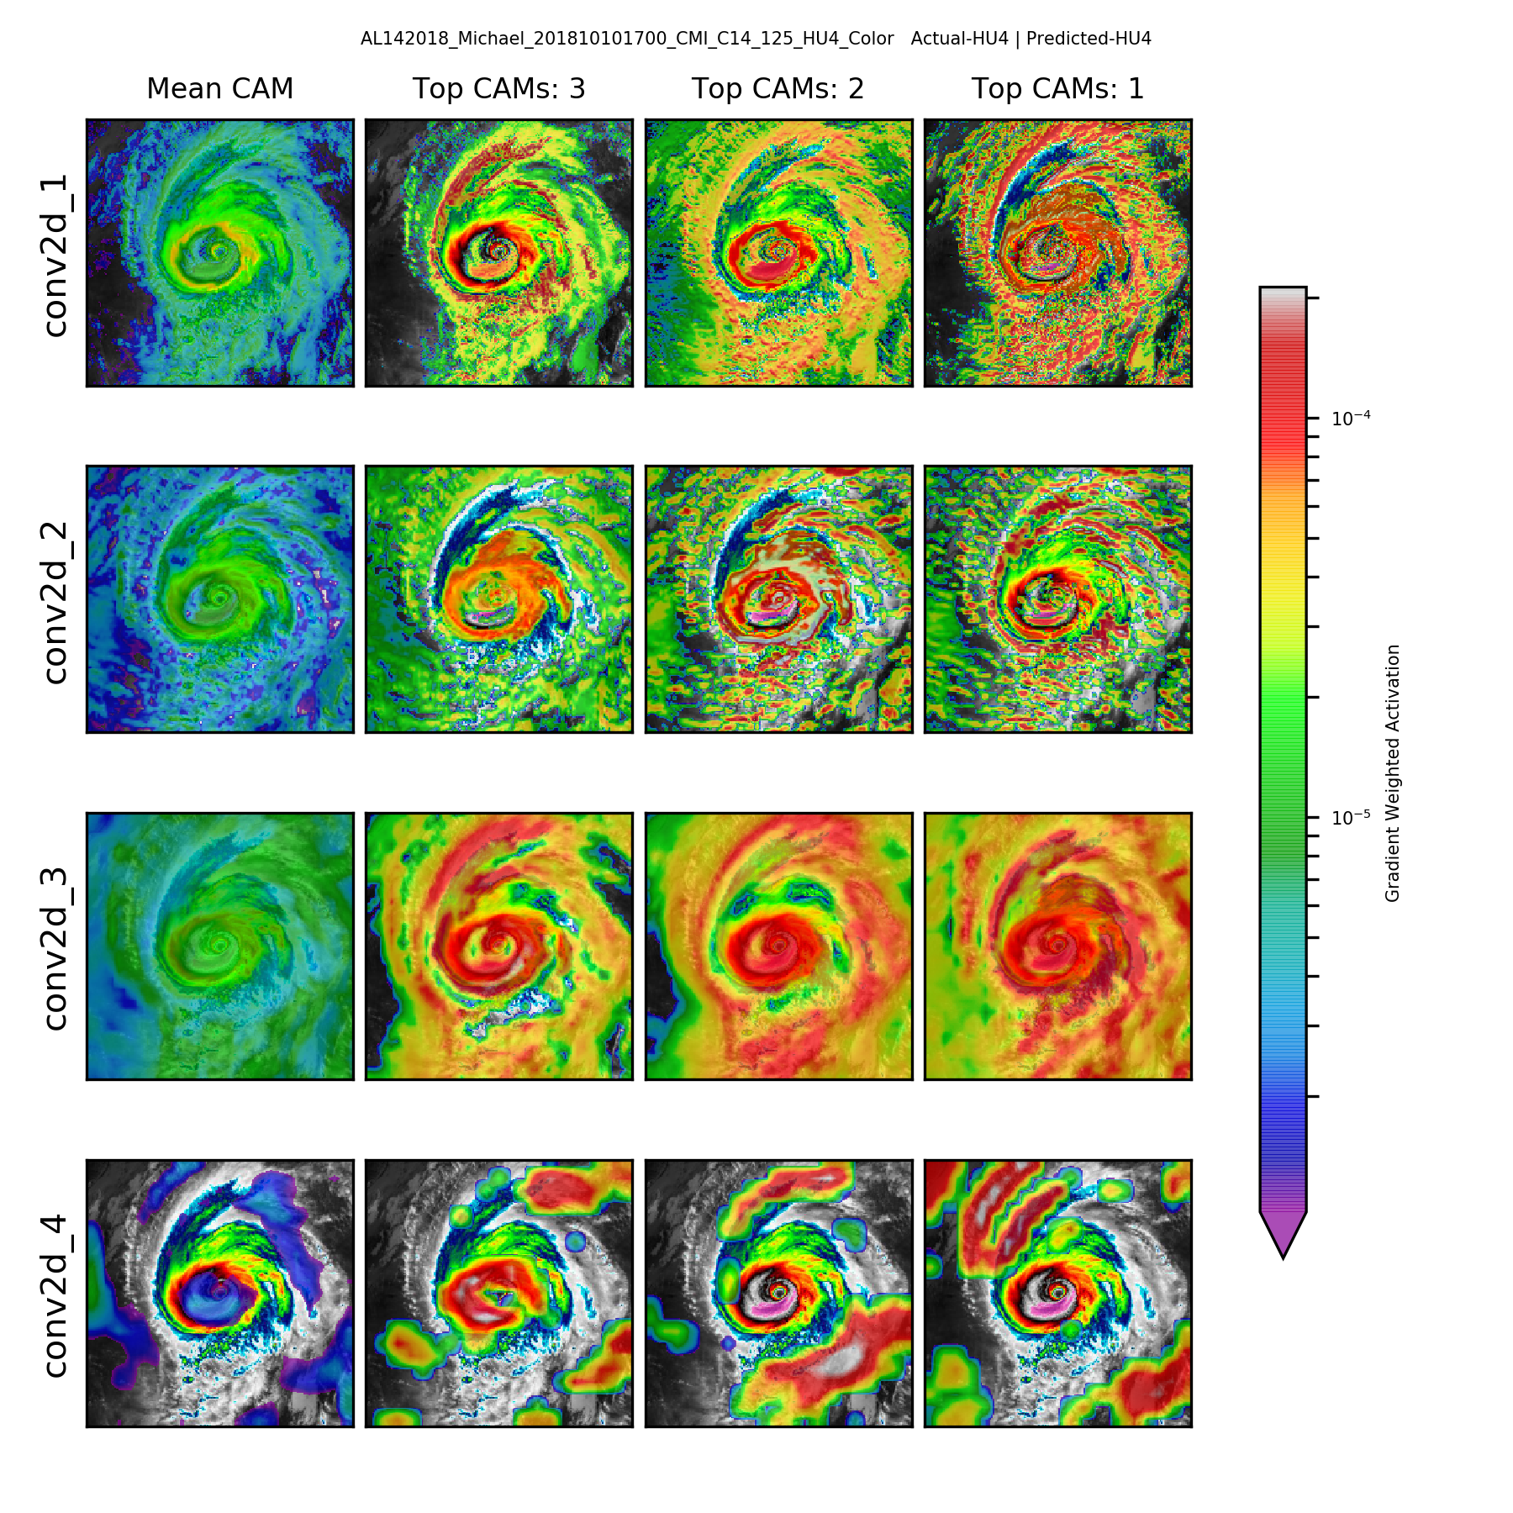
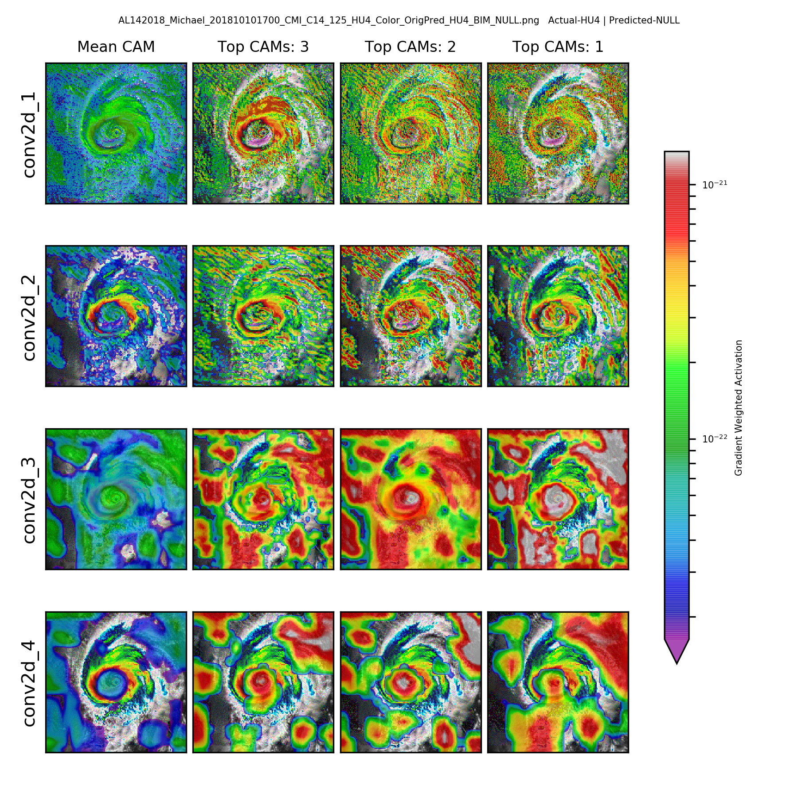
Grad-CAM Heatmaps – Michael – Cat. 4 + Adversarial Noise
Original Input Image CAMs
Adversarial Input Image CAMs
1st Layer
2nd Layer
3rd Layer
Final Layer
Original prediction: HU4
Adversarial prediction: NULL – note less focused, activations 17 orders of magnitude weaker

Slide 16
Quantifying Model Robustness
Metrics for quantifying model robustness
  Minimal perturbation required for misclassification (most common)
  Sensitivity of loss function to input changes
  Sensitivity of logits w.r.t. input changes
Empirical robustness (ER – minimal input perturbation required for success of given attack)
  Euclidean distance between successful adversarial & original input (Moosavi-Dezfooli et al. 2016)
  Larger ER → for a given attack type, larger perturbations required
Class | ER
TD | 0.013
TS | 0.016
HU1 | 0.011
HU2 | 0.012
HU3 | 0.013
HU4 | 0.011
HU5 | 0.011
NULL | 0.133
NULL class order of magnitude more robust to FGSM
  Random cloud fields and cloud free regions
  Model built more robust decision boundary for NULL
  Leaves less opportunity for adversaries to exploit deficiencies
TC classes built on finite number of storms
  Limited data causes deficiencies in space of storm structures
  Similarities from class to class problematic
  Easier to exploit deficient decision boundaries
Model hardening possible through fine-tuning on adv. examples
  Hardening HU4 class for FGSM attack
  ER: 0.011 → 0.127
Notes:
Logits are values coming out of the model before final activation function is applied to get a prediction. Softmax is applied to logits to get class probabilities
Caution – large transformations of the original samples has a counter productive effect on model generalization, so make sure FGSM strength isn’t too crazy
Hardening helps regularize model
Correct classification only occurs on a thin manifold close to where x occurs in data
Models fail when input is in a space with low probability in the data distribution
Hardening allows a model to represent a function resistant to adversarial perturbation (like the movie Inception when people are trained to defend against adversarial ideas being implanted in brain while dreaming)
Adversarial inputs are unnatural, but they expose flaws in models decision function

Slide 17
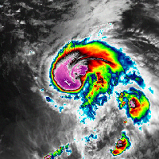
Adversarial Defense Methods
Increase robustness with model hardening
  Training on adversarial imagery (fine-tuning or from start)
    Shown to offer regularization
  Noise data augmentation during training
Reduce adversarial noise through data preprocessing at test/deployment
  E.g., filter noise by reducing bit depth, spatial smoothing, data compression
Runtime detection
  Additional classifier fit on adversarial and clean data (activations or inputs)
Original
Adversarial
 | HU1 | HU2 | HU3 | HU4 | HU5 | NULL | TD | TS
Original | 0.994 | 0.002 | 0.002 | 0.000 | 0.000 | 0.000 | 0.000 | 0.002
FGSM | 0.261 | 0.080 | 0.601 | 0.000 | 0.000 | 0.000 | 0.000 | 0.058
PNG | 0.261 | 0.080 | 0.601 | 0.000 | 0.000 | 0.000 | 0.000 | 0.058
JPEG-Q100 | 0.545 | 0.058 | 0.333 | 0.000 | 0.000 | 0.000 | 0.000 | 0.063
JPEG-Q1 | 0.712 | 0.055 | 0.108 | 0.000 | 0.000 | 0.001 | 0.006 | 0.117
See Nicolae et al. 2018 for details on common defense methods.
Notes:
Add REFS

Slide 18
Summary
Grad-CAM
  Capable of highlighting input pixels most important to class prediction
  Helpful in diagnosing filter contributions to class prediction
  Results local to input images
  May be used to flag certain potential adversarial attacks
TCAV
  Offers general method to test if a concept deemed important by the user is significantly important to the prediction of a given class
Adversarial
  ML models can be highly vulnerable to adversarial attack
    Extends to shallow and deep architectures
  Attacks expose weaknesses in generalization of decision boundaries
  Fine-tuning allows model to generalize such that decision-boundary flaws are remediated
Future efforts
  Extension of explainable AI approaches to regression rather than classification
  Visualization of decision-boundary improvements
  General methodology to increase attack-agnostic robustness
Notes:
Hardening helps regularize model
Correct classification only occurs on a thin manifold close to where x occurs in data
Models fail when input is in a space with low probability in the data distribution
Hardening allows a model to represent a function resistant to adversarial perturbation (like the movie Inception when people are trained to defend against adversarial ideas being implanted in brain while dreaming)
Adversarial inputs are unnatural, but they expose flaws in models decision function

Slide 19
References
Carlini, N. and D. Wagner, 2017: Towards evaluating the robustness of neural networks. https://arxiv.org/abs/1608.04644v2
Cord, M., T. Durand, N. Thome, and P. Gallinari, 2016: Deep learning and weak supervision for image classification. Accessed 12 November 2018, http://webia.lip6.fr/~cord/pdfs/news/TalkDeepCordI3S.pdf
Geusebroek, J, G. Burghouts, and A. Smeulders, 2005: The Amsterdam library of object images, International Journal of Computer Vision, 61, 103-112.
Goodfellow, I, J. Shlens, and C. Szegedy, 2015: Explaining and harnessing adversarial examples. https://arxiv.org/abs/1412.6572v3
Jang, U., X. Wu, and S. Jha, 2017: Objective metrics and gradient descent algorithms for adversarial examples in machine learning. https://doi.org/10.1145/3134600.3134635
Kim, B., M. Wattenberg, J. Gilmer, C. Cai, J. Wexler, F. Viegas, and R. Sayres, 2018:Interpretability beyond feature attribution: quantitative testing with concept activation vectors (TCAV). https://arxiv.org/abs/1611.11279v5
Kurakin, A., I. Goodfellow, and S. Bengio, 2016: Adversarial machine learning at scale. https://arxiv.org/abs/1807.012396
Landsea, C. W. and J. L. Franklin, 2013: Atlantic Hurricane Database Uncertainty and Presentation of a New Database Format. Mon. Wea. Rev., 141, 3576-3592.
Moosavi-Dezfooli, S., A. Fawzi, and P. Frossard, 2016: DeepFool: a simple and accurate method to fool deep neural networks. https://arxiv.org/abs/1511.04599
Nicolae M.I., and Coauthors, 2018: Adversarial robustness toolbox v0.3.0. https://arxiv.org/abs/1807.01069
Papernot, N., P.D. McDaniel, and I.J. Goodfellow, 2016: Transferability in machine learning: from phenomena to black-box attacks using adversarial samples. arXiv:1605.07277
RAMMB, 2018: Real-time tropical cyclone products – 2018 Season. Accessed 12 November 2018, http://rammb.cira.colostate.edu/products/tc_realtime/season.asp?storm_season=2018
Selvaraju, R.R., M. Cogswell, A. Das, R. Vedantam, D. Parikh, D. Batra, 2017: Grad-CAM: Visual Explanations from Deep Networks via Gradient-based Localization. https://arxiv.org/abs/1610.02391v3
Useful Toolboxes
IBM Adversarial Robustness Toolbox - https://github.com/IBM/adversarial-robustness-toolbox
FoolBox - https://github.com/bethgelab/foolbox
CleverHans - https://github.com/tensorflow/cleverhans

Slide 20
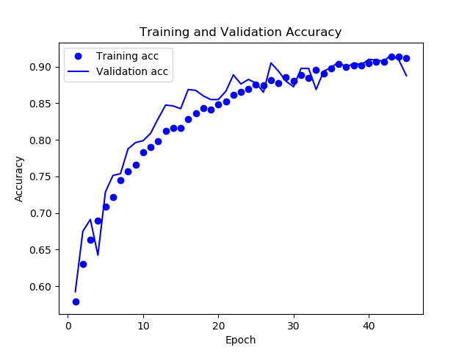
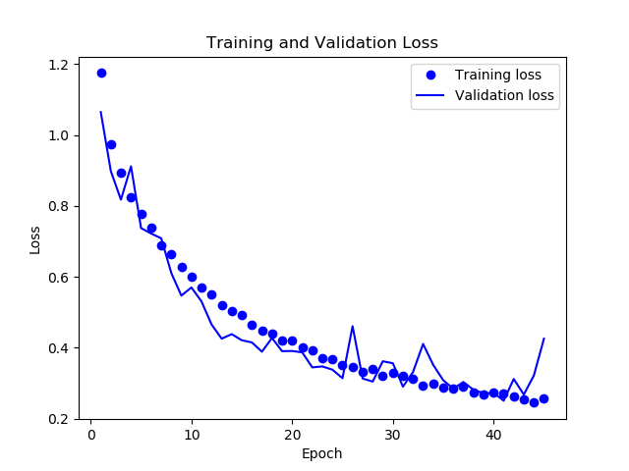
EO Tropical Cyclone CNN
Model Architecture
  4 convolutional layers
  1 dense layer mapped to TC classifications
  52M trainable parameters
  Regularized via dropout and data augmentation
    Prevents overfitting to training data
  Test accuracy: ~90%
  Weights saved at epoch 40
Notes:
25% dropout, augmentation with height and width shifts, zooms, and shears. Model shows a reasonable balance between overfitting and underfitting.

Slide 21
EO Tropical Cyclone CNN
Layer (type) Output Shape Param #
=================================================================
conv2d_1 (Conv2D) (None, 198, 198, 32) 896
_________________________________________________________________
max_pooling2d_1 (MaxPooling2 (None, 99, 99, 32) 0
_________________________________________________________________
conv2d_2 (Conv2D) (None, 97, 97, 64) 18496
_________________________________________________________________
max_pooling2d_2 (MaxPooling2 (None, 48, 48, 64) 0
_________________________________________________________________
conv2d_3 (Conv2D) (None, 46, 46, 128) 73856
_________________________________________________________________
max_pooling2d_3 (MaxPooling2 (None, 23, 23, 128) 0
_________________________________________________________________
conv2d_4 (Conv2D) (None, 21, 21, 256) 295168
_________________________________________________________________
max_pooling2d_4 (MaxPooling2 (None, 10, 10, 256) 0
_________________________________________________________________
flatten_1 (Flatten) (None, 25600) 0
_________________________________________________________________
dropout_1 (Dropout) (None, 25600) 0
_________________________________________________________________
dense_1 (Dense) (None, 2048) 52430848
_________________________________________________________________
dense_2 (Dense) (None, 8) 16392
=================================================================
Total params: 52,835,656
Trainable params: 52,835,656
Non-trainable params: 0
_________________________________________________________________
Notes:
25% dropout, augmentation with height and width shifts, zooms, and shears. Model shows a reasonable balance between overfitting and underfitting.

