Slide 1


Observations of Atmospheric Dynamics in 3D with LEO-GEO and GEO-GEO Stereo Imaging
James L. Carr¹
28 February 2019
¹Carr Astronautics, 6404 Ivy Lane, Suite 333, Greenbelt, MD 20770, USA, jcarr@carrastro.com
NOAA sponsorship NA14NES4320003 (CICS, UMD)
NASA sponsorship NNG17HP01C, TO#28 (SAMDA, SSAI)
6404 IVY LANE SUITE 333 GREENBELT, MD 20770
Notes:
Version 10/23/2013

Slide 2
Collaborations
NOAA Collaboration
  Jaime Daniels, Houria Madani (Carr Astro), Wayne Bresky, Jeff Key
  Focuses on GEO-GEO combinations
  In progress with preliminary results
NASA Collaboration
  Dong Wu, Michael Kelly (APL), Jie Gong
  Focuses on LEO-GEO combination
  First-year finished, second year starts March 1st
  Starting to work with JPL

Slide 3
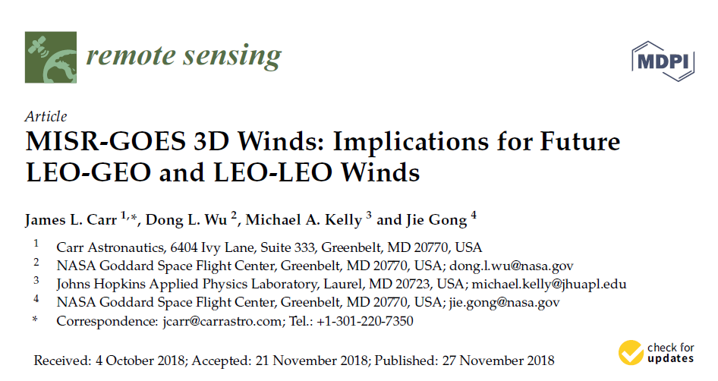
MISR & GOES-R
Motivation
Method
Results
Validation
MISR Special Issue of Remote Sensing:
Carr, J.L.; Wu, D.L.; Kelly, M.A.; and Gong, J., “MISR-GOES 3D Winds: Implications for Future LEO-GEO and LEO-LEO Winds”, Remote Sens. 2018, 10(12),1885; https://doi.org/10.3390/rs10121885
3D = Velocity with 3D location of Wind in the atmosphere

Slide 4
Motivation
MISR & GOES each have different strengths and weaknesses for Wind observations
  MISR measures cross-track velocity well and altitude (parallax), but in-track velocity couples to altitude
  GOES-R measures two wind components well, but operational wind products must infer altitude from IR temperature
MISR & GOES should be better together than each working alone and therefore solve both problems.
Advanced “Image Navigation and Registration (INR)” with the new GOES-R series makes using GOES-R with MISR attractive (geo-registration better than ~200 m @ nadir).

Slide 5
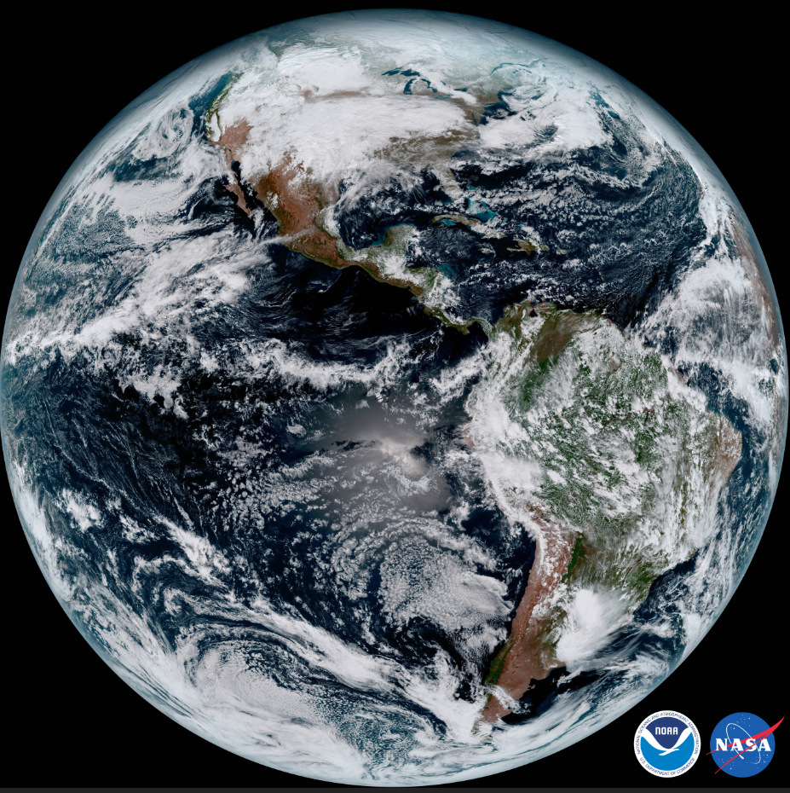
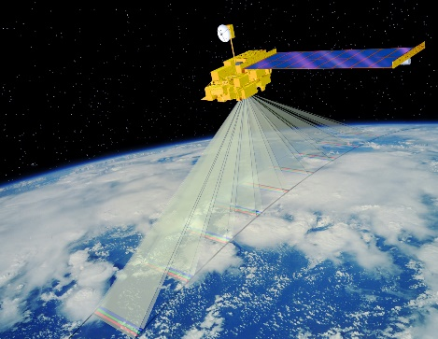
MISR & GOES-R
GOES-R
Terra
MISR
Multi-Angle
Multi-Temporal
LEO on NASA Terra S/C
Fore & Aft-looking Cameras
  An: nadir looking
  Af, Aa: ±26.1°
  B, C, D: oblique viewing
Red Band
  275 m resolution
  360 km swaths
Winds: Zong, Davies, Muller & Diner, 2002
GOES-16 stationed at -75.2°
GOES-17 stationed at -137.2°
Advanced Baseline Imager
  Full-Disk (5, 10, 15-min. refresh)
  CONUS (5-minute refresh)
  MESO (30, 60-sec. refresh)
Red Band
  500 m resolution
NOAA Operational Winds
JPL

Slide 6

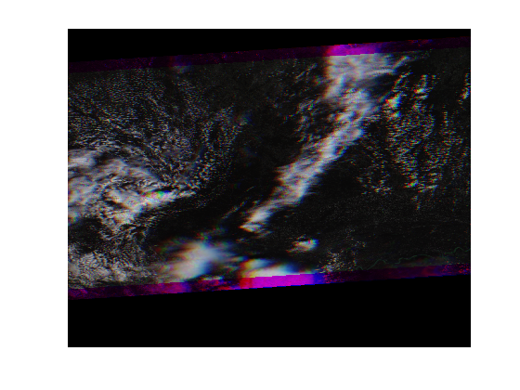
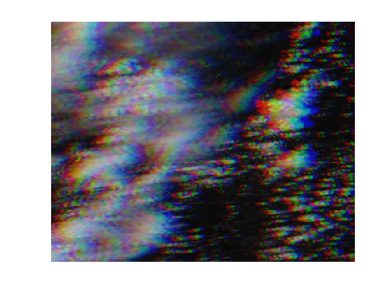

MISR Multi-Angle Imagery
Color Separation shows Disparities between Cameras
  In-track is Parallax + (mostly) V-wind
  Cross-track is (mostly) U-Wind
MISR Wind Challenge is the separation of Parallax from V-Wind
(R,G,B) = (Aa, An, Af)
Δt = (45s, 0, -45s)
MISR Red Band
(672 nm)
Track
275 m
U (East)
SOM Projection over WGS84 Ellipsoid
(Blocks 60, 61, 62 on P024 O098797)
V (North)

Slide 7
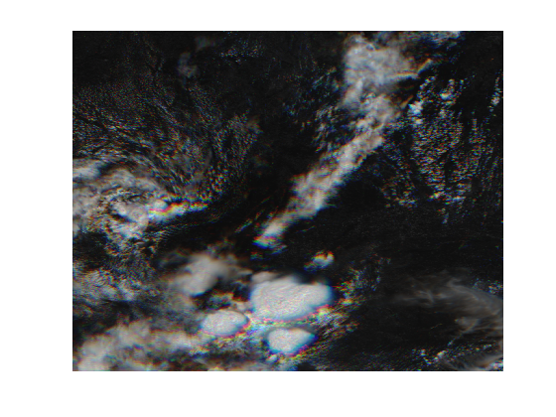
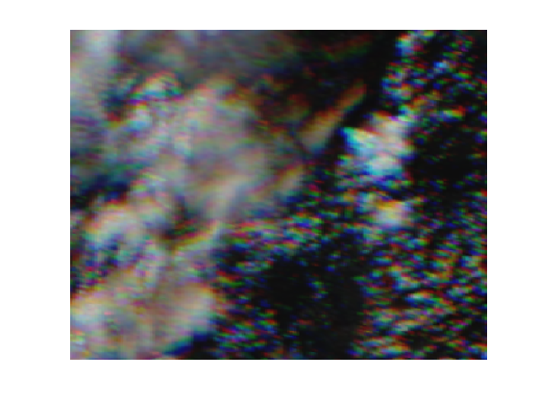
GOES Multi-Temporal Imagery
Color Separation shows Disparities between Frames
  Pure Atmospheric Motion
  No Parallax
T₀ picked close to MISR An Time
CONUS scene used here
Advanced Baseline Imager (ABI)
(R,G,B) = (T₀-5min, T₀, T₀+5min)
ABI Band 2 (B02)
(640 nm)
275m
(Native 500 m)
Remapped into MISR SOM Projection

Slide 8
Disparity Measurements
40x40 MISR pixel templates
8 x 8 MISR pixel sampling (2.2 km)
Normalized Cross Correlation
Subpixel resolution by Interpolation
Self
GOES
Time
MISR
An
MISR Track

Slide 9
Disparities

Slide 10
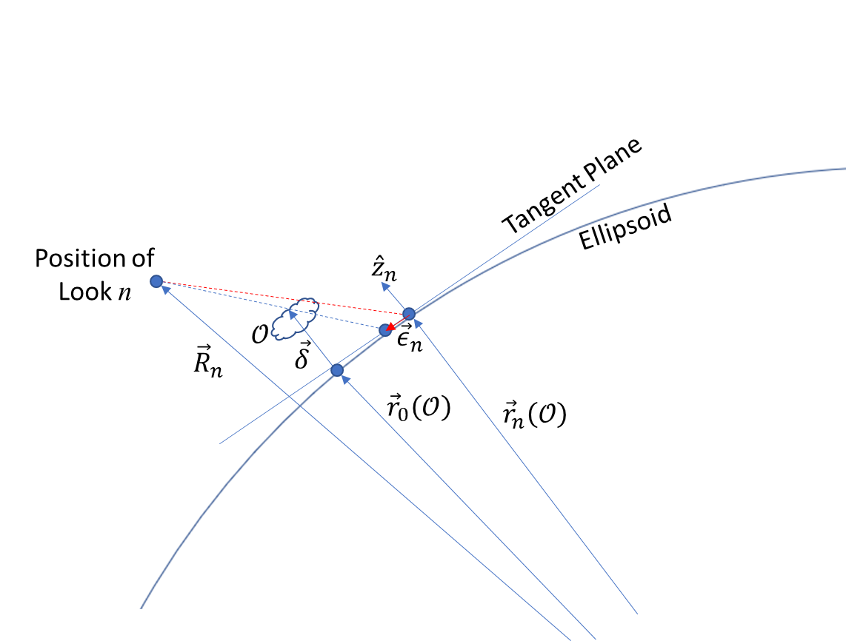
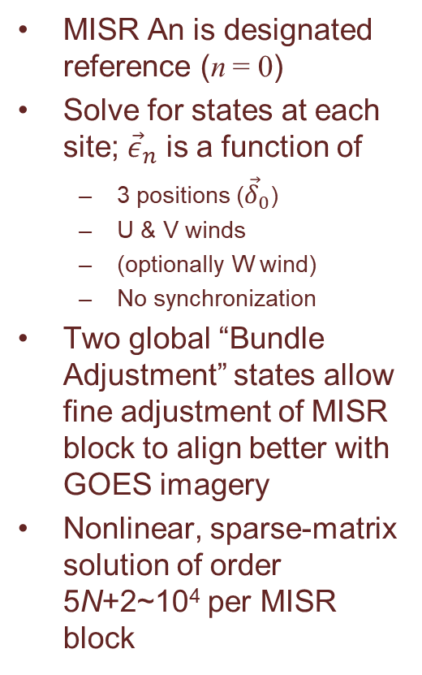



Wind Retrieval Model
MISR An is designated reference (n = 0)
Solve for states at each site; ${\vec{ε}}_{n}$ is a function of
  3 positions (${\vec{δ}}_{0}$)
  U & V winds
  (optionally W wind)
  No synchronization
Two global “Bundle Adjustment” states allow fine adjustment of MISR block to align better with GOES imagery
Nonlinear, sparse-matrix solution of order 5N+2~10⁴ per MISR block
$$χ^{2}=\sum_{n=1}^{N}{{{\vec{ε}}_{n}}^{T}W_{n}{\vec{ε}}_{n}}$$
Minimize:
$$\vec{δ}\left(t_{n}\right)={\vec{δ}}_{0}+\vec{v}∙\left(t_{n}−t_{0}\right)$$
States
$$\text{Times} \text{assigned}$$
to looks at$𝒪$

Slide 11
Residual Disparities
Residuals after Solution
A Cameras + GOES-16
Disparities ~15 km
Residuals < 275m
Block 61 on P024 O098797

Slide 12
MISR+GOES over CONUS 2018
A Cameras
Jointly
Retrieved
3D-Winds
with 2.2 km
sampling
MISR
Path 024
One Frame of 5-minute
GOES CONUS Imagery
PBL

Slide 13
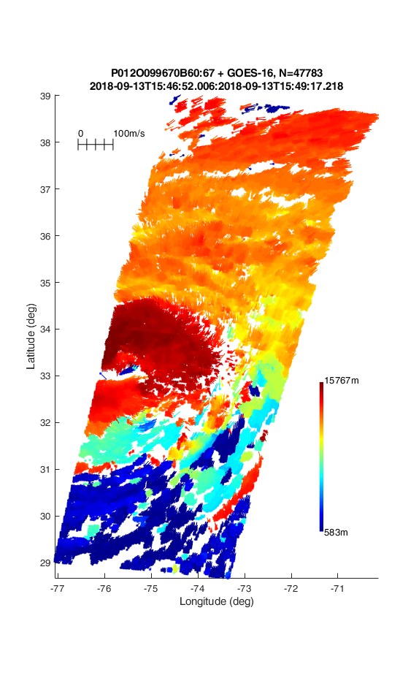
Florence MESO 2018
A Cameras
One Frame of
30-Second
GOES MESO
Imagery
PBL
Low-altitude winds
feeding in warm, moist air

Slide 14
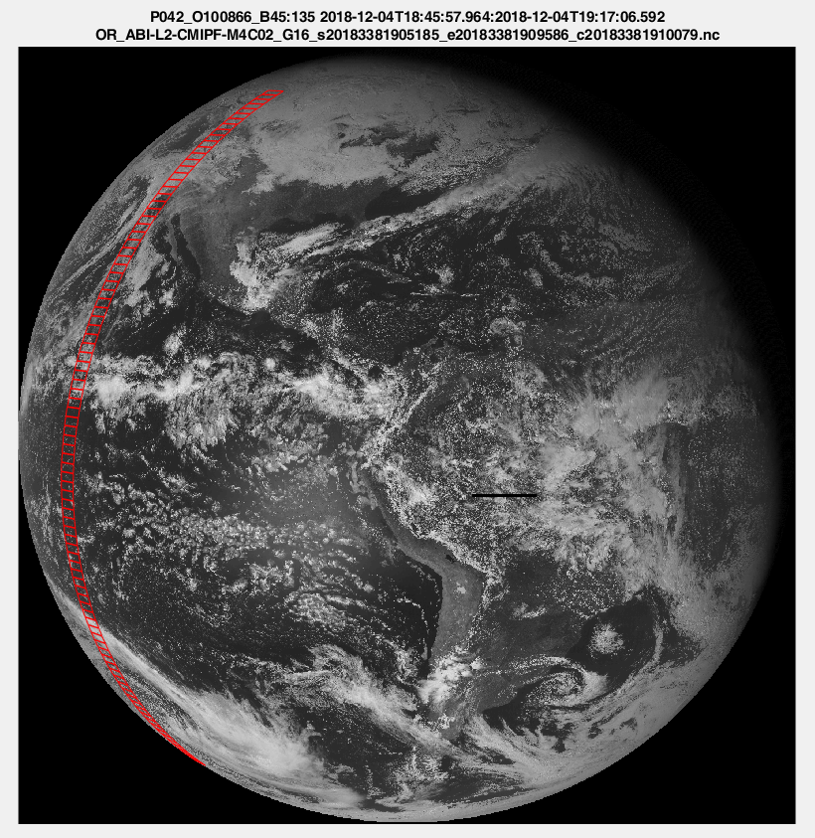
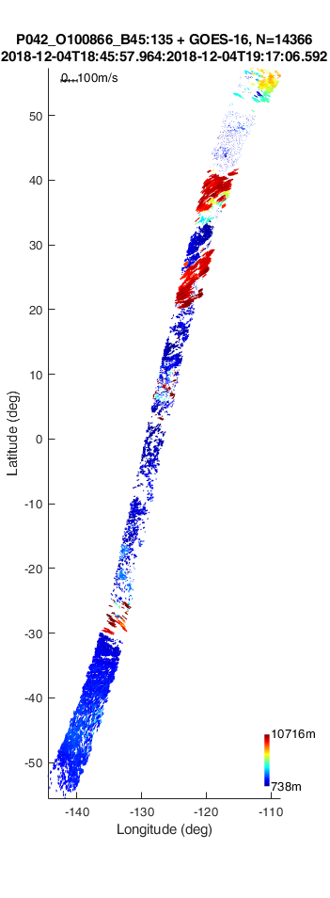
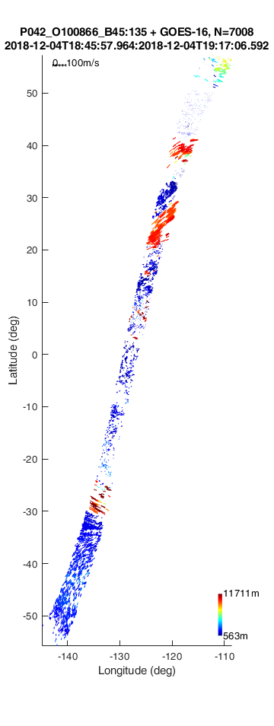
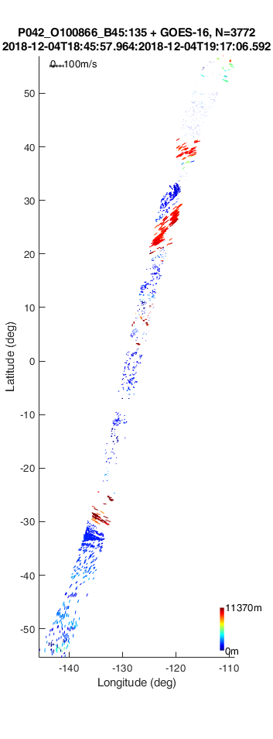
MISR+GOES
Full Disk 2018
N=14,366
N=7,008
N=3,772
One Frame of
M4 5-minute
GOES FD
Imagery
Emulated
M6 (FD every
10 minutes)
Emulated
M3 (FD every
15 minutes)
M4 (FD every
5 minutes)
A Cameras

Slide 15
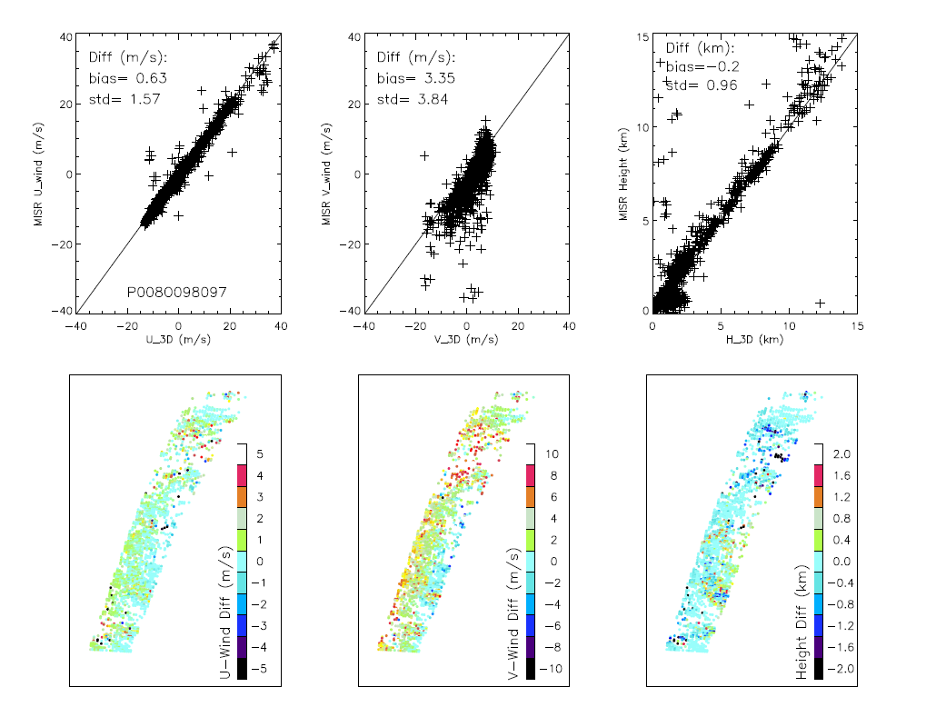
Comparison to MISR Winds

Slide 16
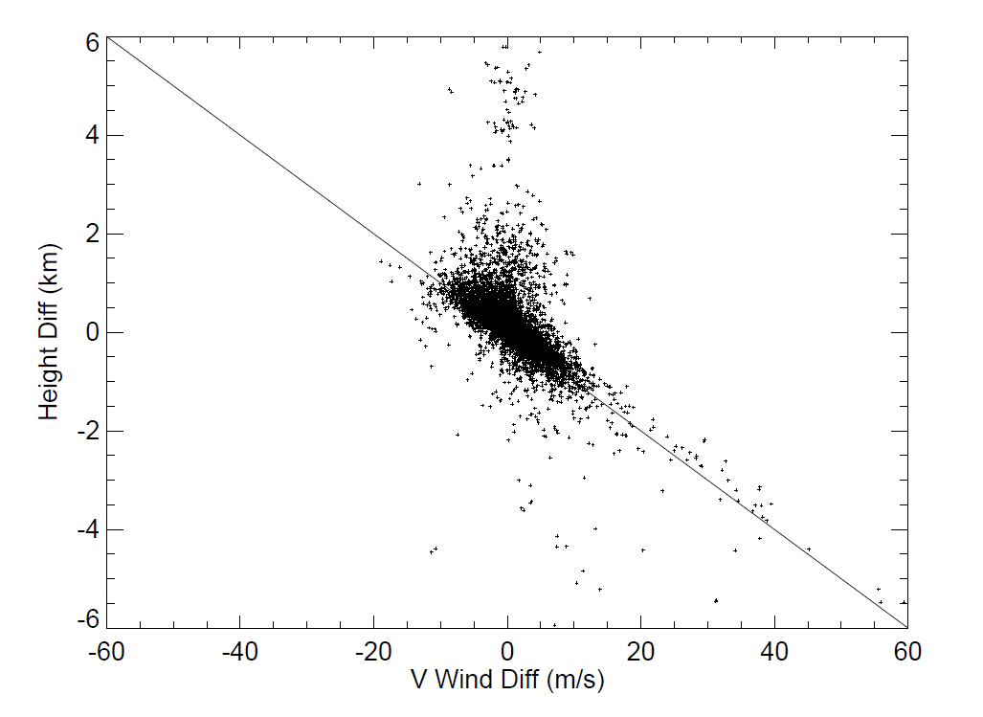
MISR Wind-Height Correlation
*Slope = -100 s
*Davies, Horváth, Moroney, Zhang & Zhu, 2007
Mueller, Wu, Horváth, Jovanovic, Muller, Girolamo, Garay, Diner, Moroney & Wanzong, 2017

Slide 17
Comparison to GOES Winds

Slide 18
Comparison with GOES IR Height Assignments
PBL
Multilayer?
Multilayer?
>> Estimated
LEO-GEO
3D-Winds
Retrieval
Uncertainty
PBL

Slide 19
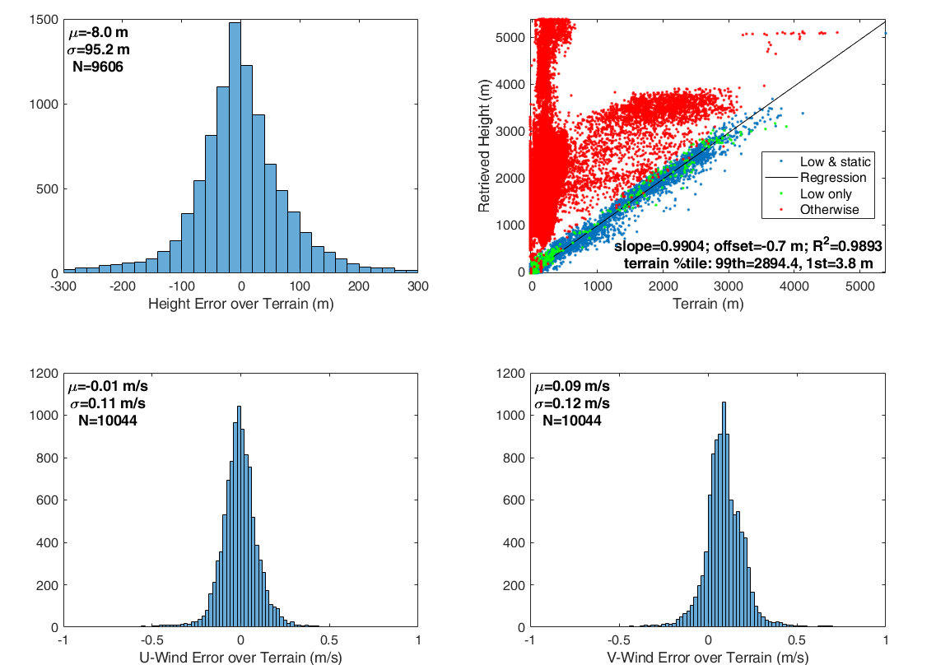
Validation: Clear-Sky Terrain
< 200 m
< 0.5 m/s
< 0.5 m/s

Slide 20
W Winds
W-Component is observable according to the math model
Usually W-wind in small, so we generally constrain it to zero
Interpretation as a true “wind” requires confirmation, may be
  Cloud-top growth/collapse
  Artifact of side-looks at cloud
Apparent quality improves with number of poses
2 Velocity Components
Observable from each Pose
Pose 1
Pose 2
W
U
V
Disparity
2 x (3 + 2) = 10 > 6

Slide 21
W-Component Retrievals
W-Component
UV vs. UVW Retrievals
Comparison with MISR A + 1 GOES
MISR
ABCD
+ 1 GOES

Slide 22
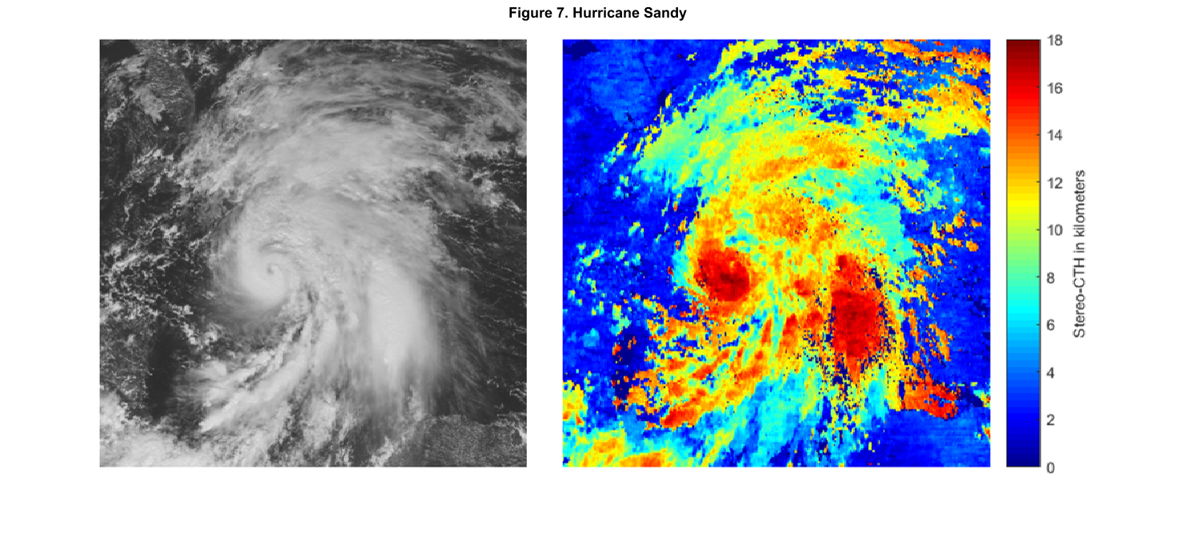
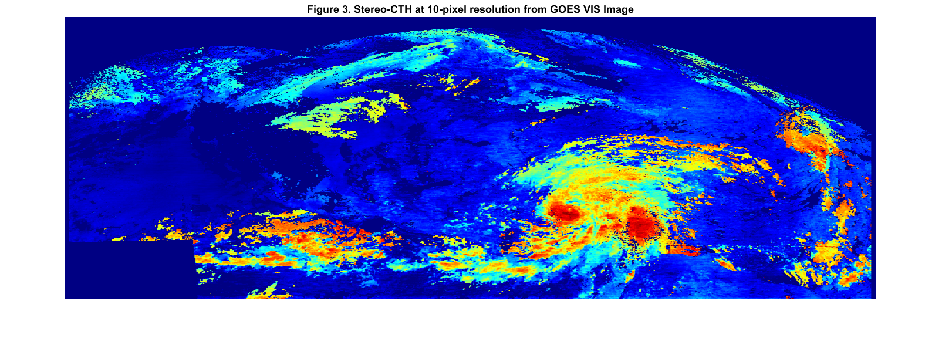
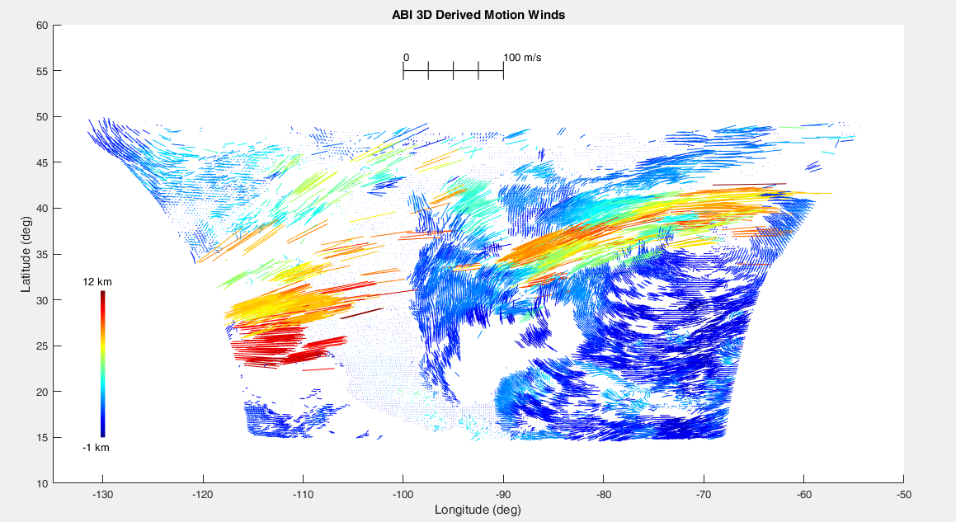
IR&D GEO-GEO Stereo Imaging
GOES-13, -14, -15
Sandy
Madani, H. and J. Carr, “Stereo Cloud Top Height Products for the GOES-R Era”, NOAA Satellite Conference, April 2015.
Madani, H., J. Carr, Andrew Heidinger, and Steve Wanzong, “Inter-Comparisons between Radiometric and Geometric Cloud Top Height Products”, American Geophysical Union, December 2015.
2017 Emerging Technologies Workshop
GOES-13, -15, -16

Slide 23
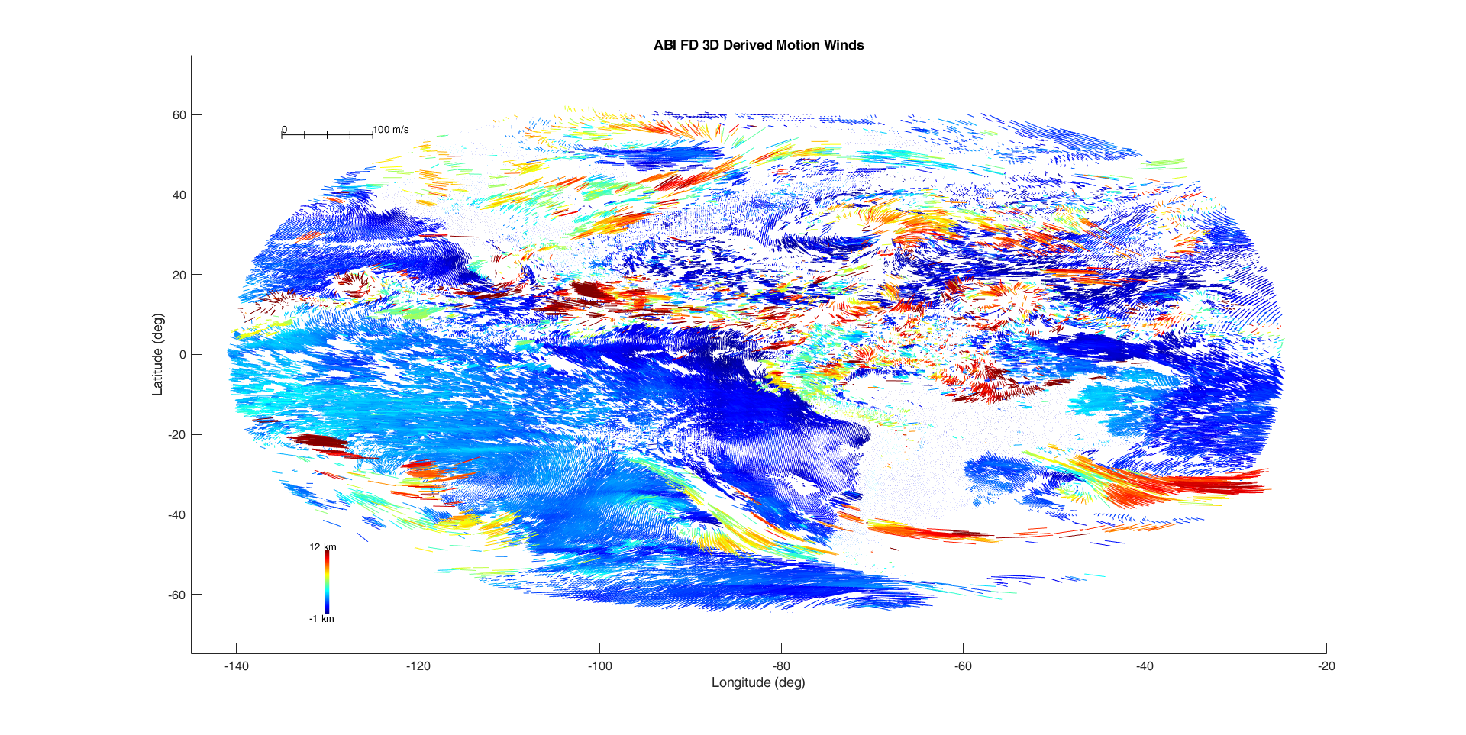

IR&D Full Disk G-13, -16 (Test Slot)
17 September 2017 18:00Z
No Synchronization
0
100 m/s
60
Wind Speed
40
20
0
Latitude (degrees)
-20
12 km
-40
Wind
Height
-60
-1 km
-140
-120
-100
-80
-60
-40
-20
Longitude (degrees)

Slide 24
STAR Study
NOAA can do parallax 3D-Winds NOW
Objective of our present work is to prove this in a way that has a path into operations to provide alternative height assignments for DMWs
Validations/comparisons will quantify the quality of parallax heights
  Comparison with IR height assignments
  MISR-GOES winds
  Rawinsondes and aircraft wind in situ measurement
No synchronization
Trade-off between vertical resolution and coverage
Operational Configuration
Configuration from our IR&D Study

Slide 25
STAR Study Methodology
G-17 Remapped
into G-16
Fixed Grid
G-16
in the G-16
Fixed Grid
Remap G-17 into G-16 fixed grid
Match each triplet using operational winds matching & clustering algorithm
Ingest matches into MISR/GOES-heritage retrieval model
Use MISR/GOES-heritage matching for ground-point validation
Time
Can Mix CONUS/MESO/FD

Slide 26
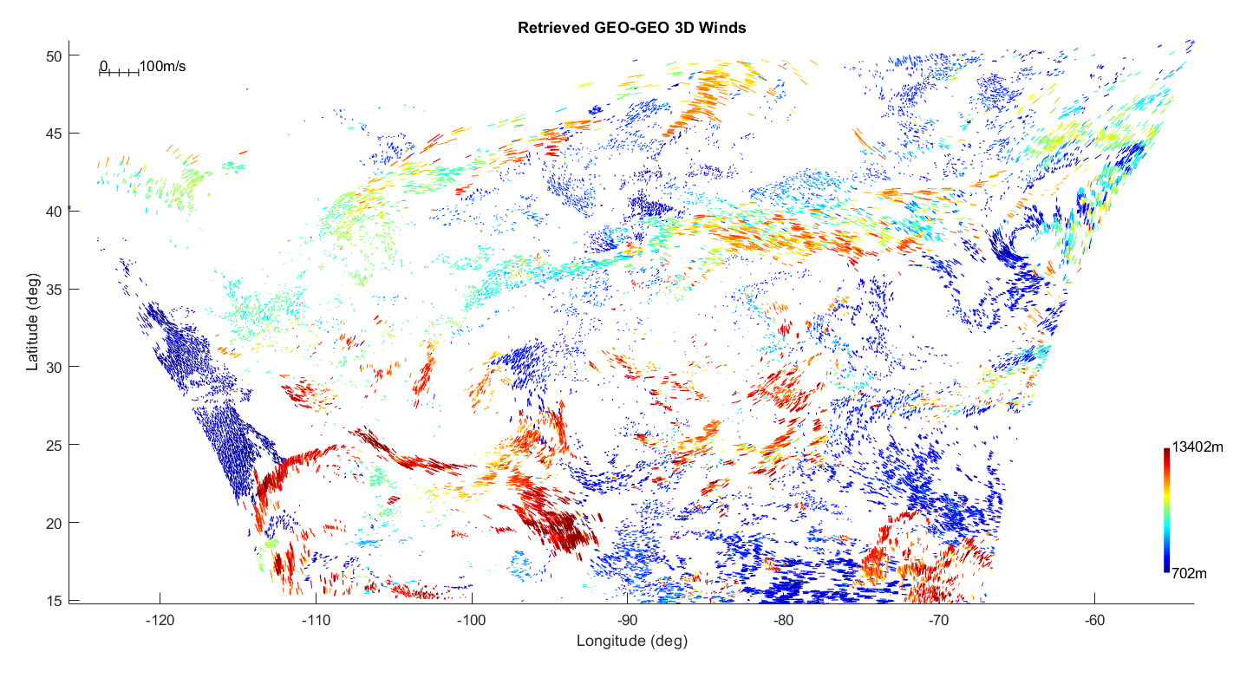
CONUS Retrievals with GOES-16, -17 (Test Slot)
B02
Matches from NOAA code
CONUS-CONUS
PRELIMINARY

Slide 27
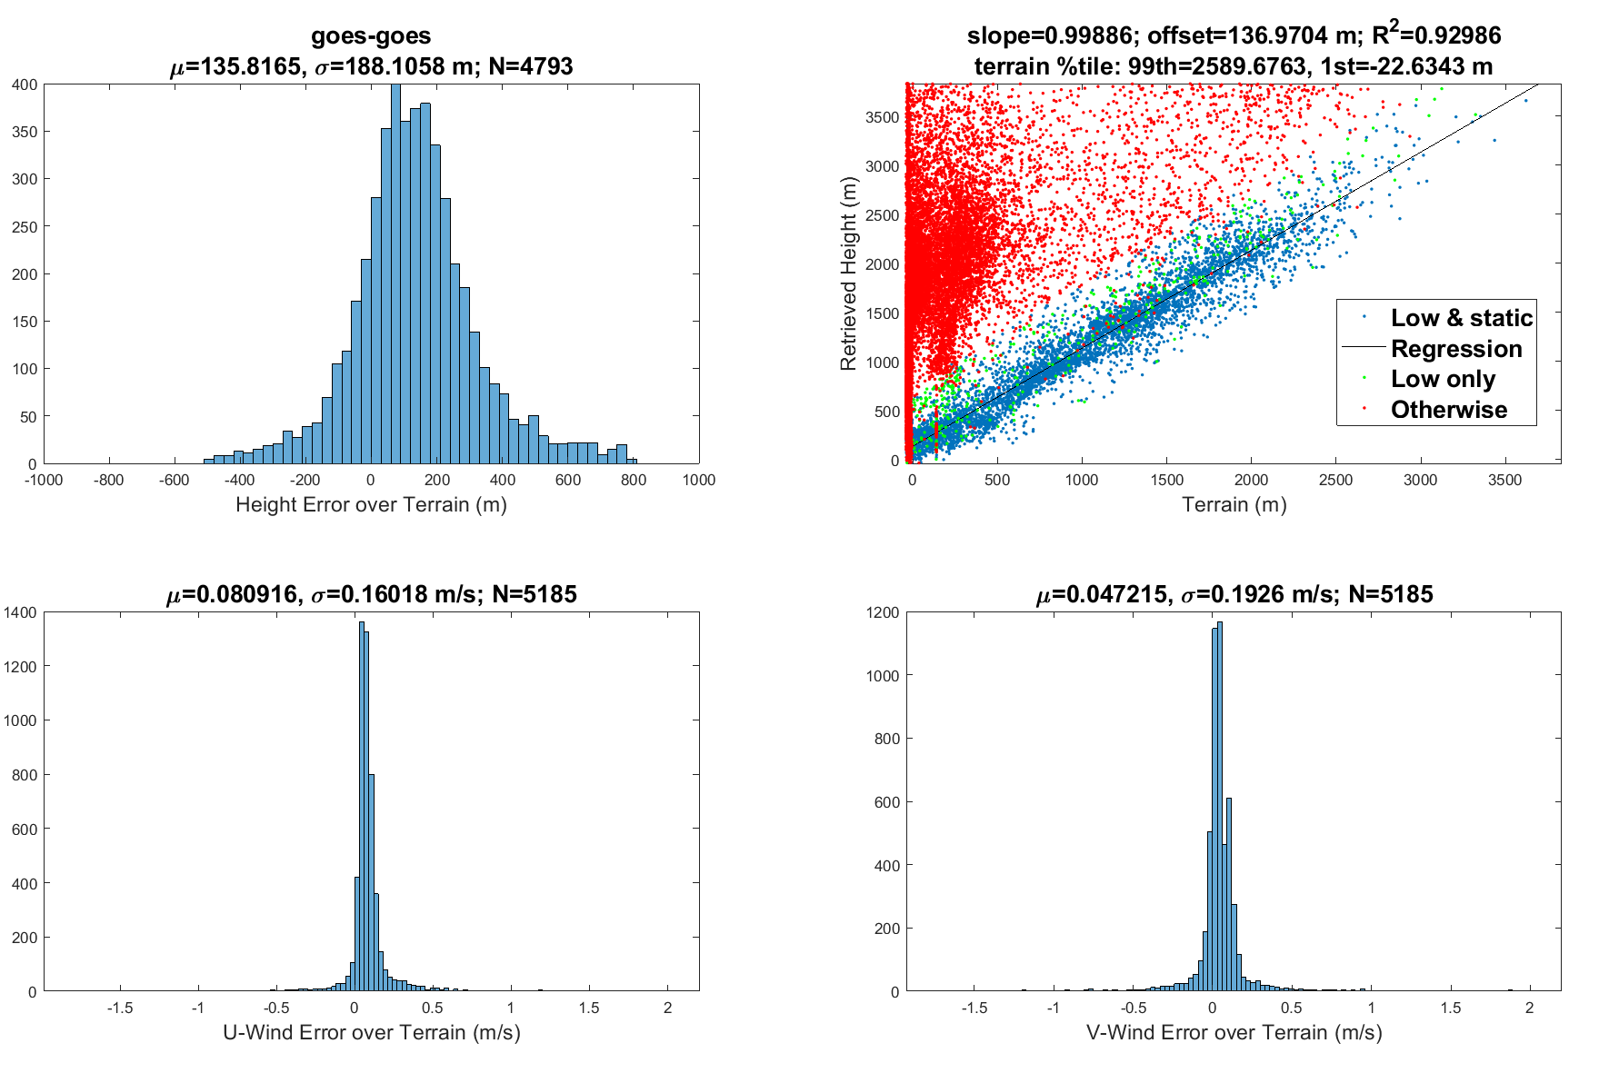
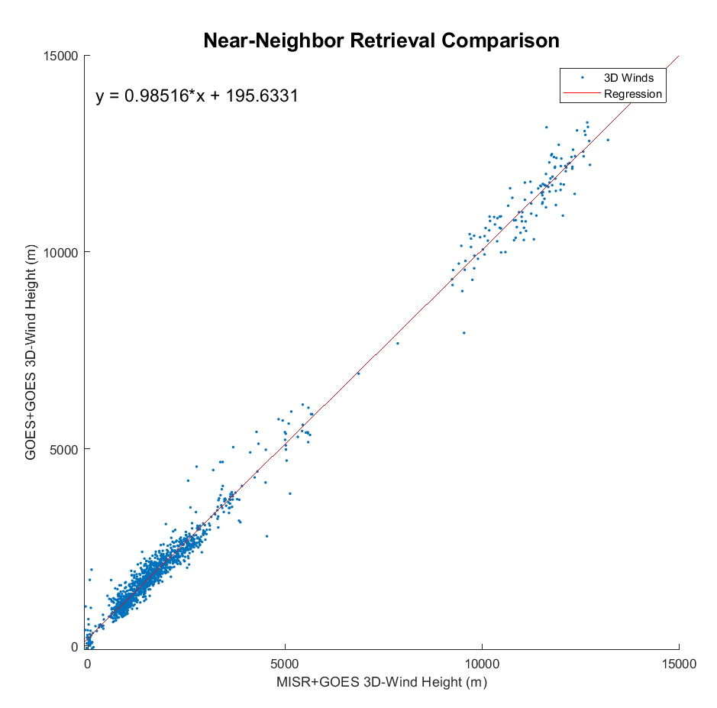
B02 CONUS Validations
MISR + GOES
Ground Retrievals
PRELIMINARY

Slide 28
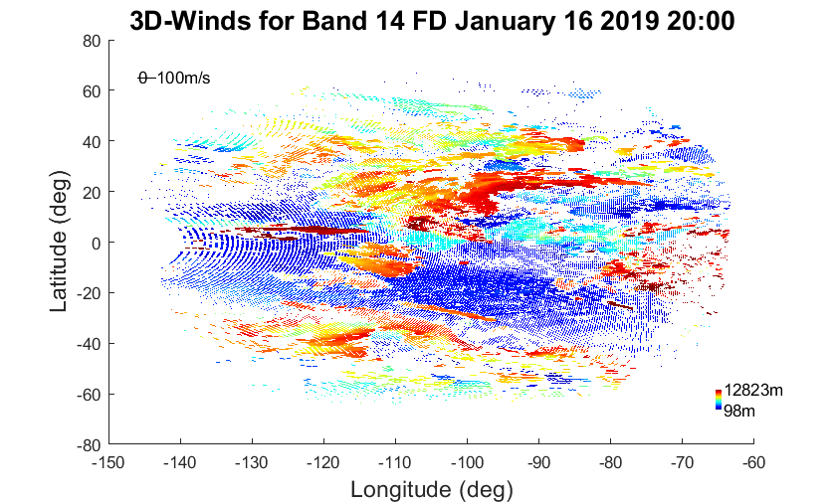
IR Full Disk G-16, -17 (W Slot)
FD-FD
PRELIMINARY

Slide 29
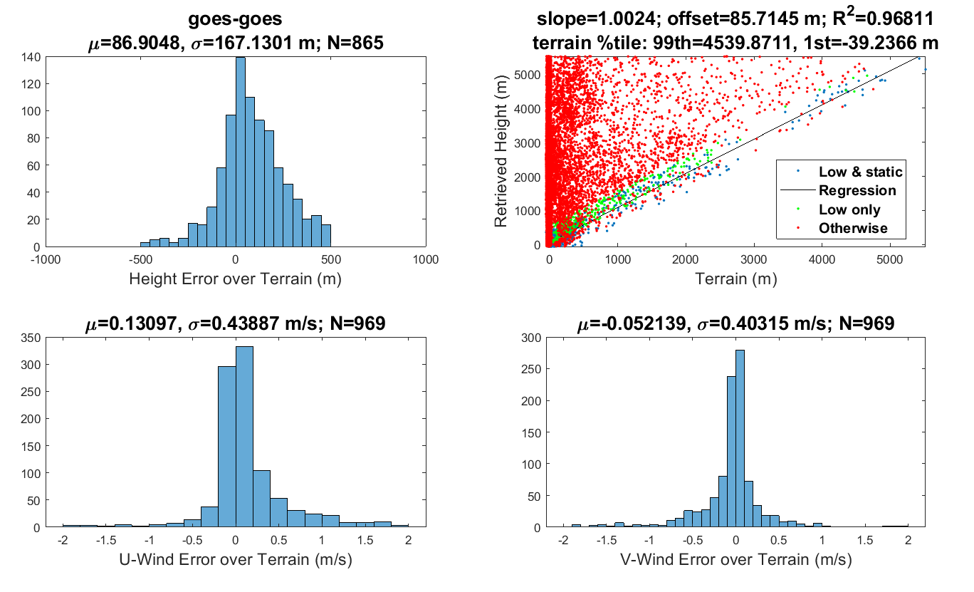
IR Ground Retrievals
We see less ground with this band than with Band 2
2.55 % of good retrievals are ground for Band 14
11.25% of good retrievals are ground for Band 2
PRELIMINARY

Slide 30
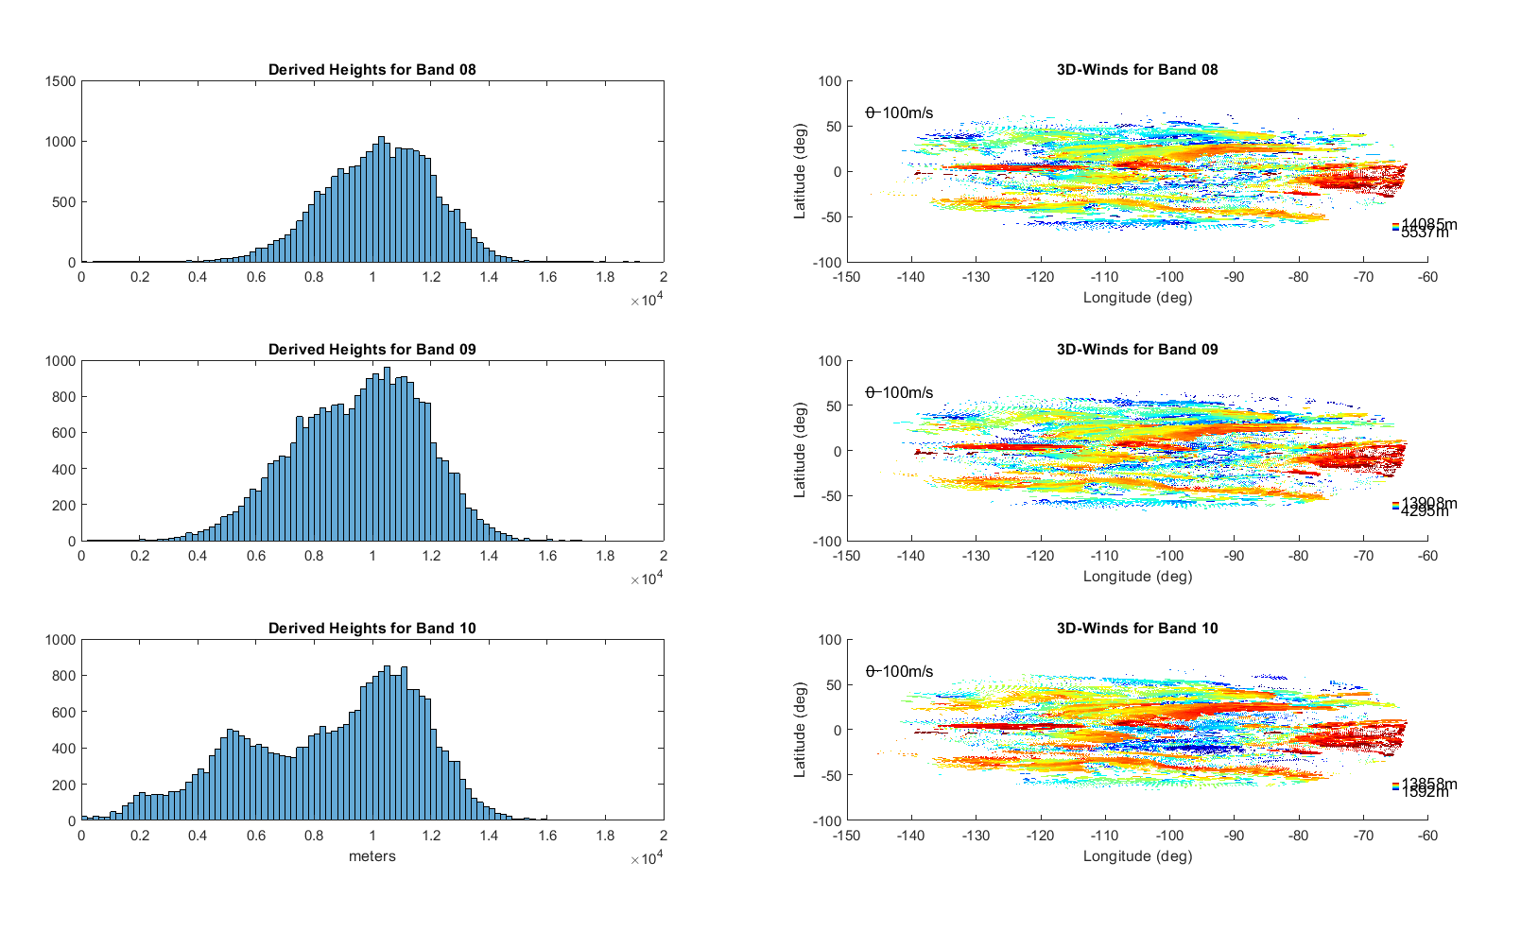
Full Disk WV 3D-Winds
Just for Fun!
Mean=10212 m
Mean=9540 m
Mean=859 m
FD-FD
Did we retrieve the height? TBD
PRELIMINARY

Slide 31
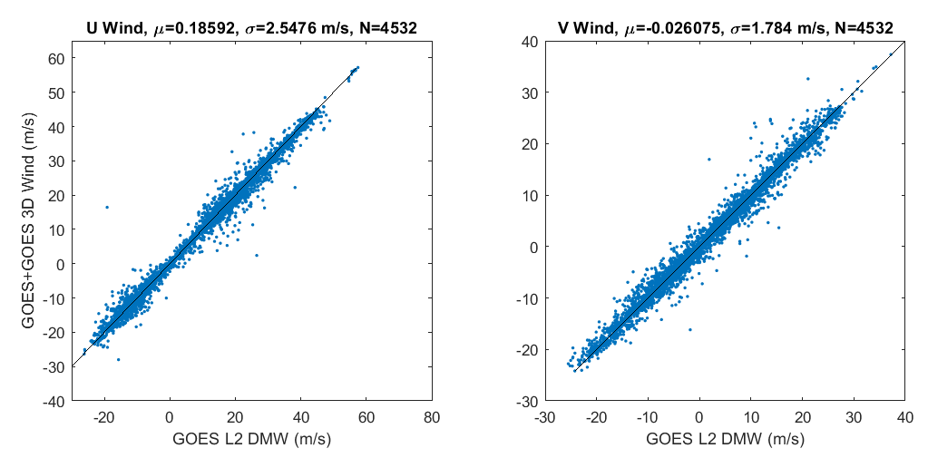
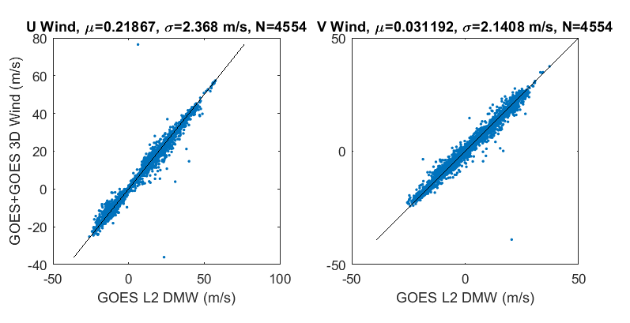
WV 3D-Wind Comparisons with DMW Products
B08
B09
PRELIMINARY

Slide 32
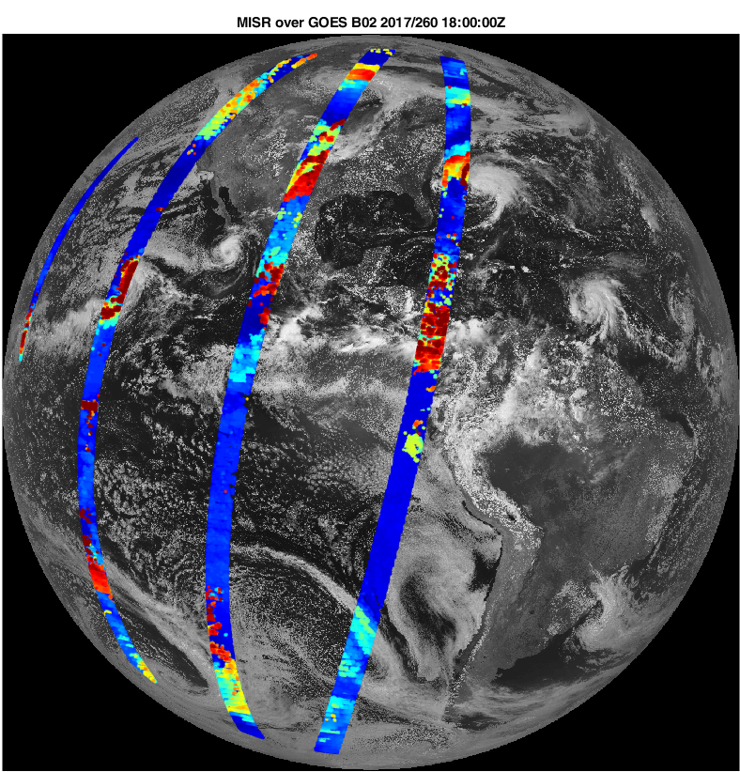
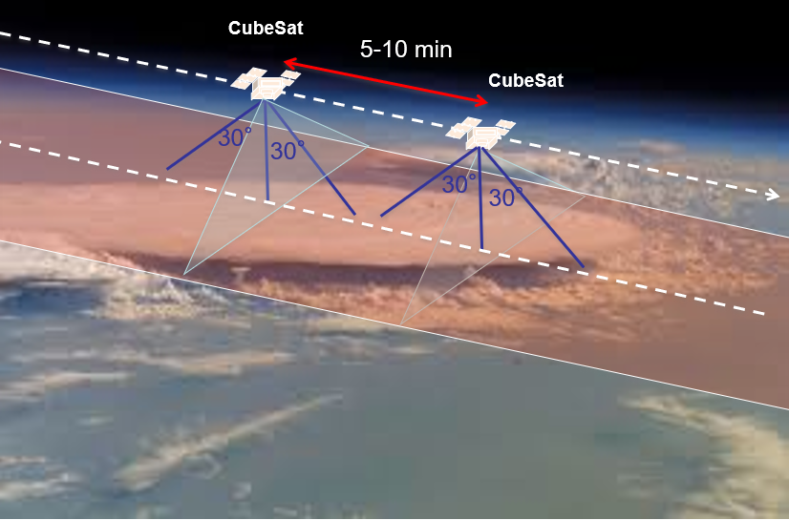
The Future
LEO-GEO Constellations
LEO-LEO Leader-Follower
Cubesat Deployments
International Partners
Hosted Payloads

