Slide 1

Machine Learning Specific to Climate and Weather Applications
Part 1: Christina Kumler
CIRES University of Colorado Boulder & NOAA/OAR/ESRL/Global Systems Division
Part 2: Imme Ebert-Uphoff
CIRA & Dept. of Electrical and Computer Engineering, Colorado State University
NOAA-STAR seminar - July 18, 2019

Slide 2
PART 1 GSD’s Machine Learning Cyclone Region of Interest (ROI) Project
Christina Kumler^{1,3}, Jebb Stewart^{2,3}, Lidia Trailovic^{1,3}, Isidora Jankov^{2,3}, and Mark Govett³
Christina.E.Kumler@noaa.gov
¹CIRES University of Colorado Boulder, ²CIRA Colorado State University, ³NOAA/OAR/ESRL/Global Systems Division

Slide 3

Very Beginning - Acronyms
AI
AI = Artificial intelligence:
Goal: machines that “work and react in intelligent ways”.
Fairly abstract.
ML = Machine learning:
Algorithms that enable a computer to automatically learn from experience – primarily from data samples - without being explicitly programmed.
Subset of AI. That’s what we typically want for weather/climate applications. (But “AI” sounds more impressive, and is technically correct, too.)
ANN = Artificial Neural Network
Very versatile and powerful ML method, especially for image/video processing.
DL = Deep Learning
ANN with many layers, i.e. of high complexity.
ML
ANN

Slide 4
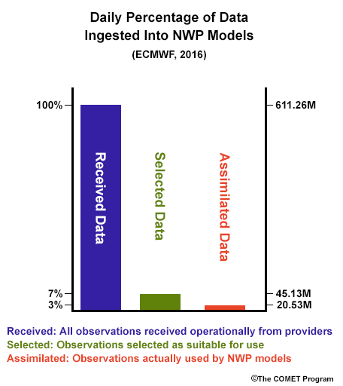
So, Why Machine Learning?
Machine learning is not new
Making a comeback because of amounts of data as well as high performance computing (HPC) abilities
Machine learning is a broad term:
Neural networks
Deep learning
Random Forest
Regression Methods
Clustering

Slide 5
So, Why Machine Learning?
Deep Learning has shown to be a very good tool when used on the following:
Speed up old methods (ex: heuristics)
Identify similar clusters without “supervision”
Identify patterns with “supervision”
We need labels!
We need balanced Datasets!
We have tons of satellite data!
We have an understanding of what we expect!
Pinterest.com
xkcd.com

Slide 6
So, Why Machine Learning?
Remember HPC? It helps us build models quickly
GSD’s theia resource of tremendous value
Bottom line: Could not do what we do without it
Theia
100 nodes
Each node has two 10 core Haswell processors
Each node has 256 GB of memory
Each node has 8 Tesla P100 (Pascal) GPUs
16 GB Memory Each
 | CPU | GPU
Hardware | Two 10 core Haswell Intel | 8 Tesla (P100)
Training (per epoch) | 11.5 hours | 3 minutes
Complete training (~ 70 epochs) | ~ 5 weeks | ~ 3 hours
Inference for single input | 1 second | 40 milliseconds
Table to left shows computational comparisons between CPU and GPU for our ROI project training and inference stages

Slide 7
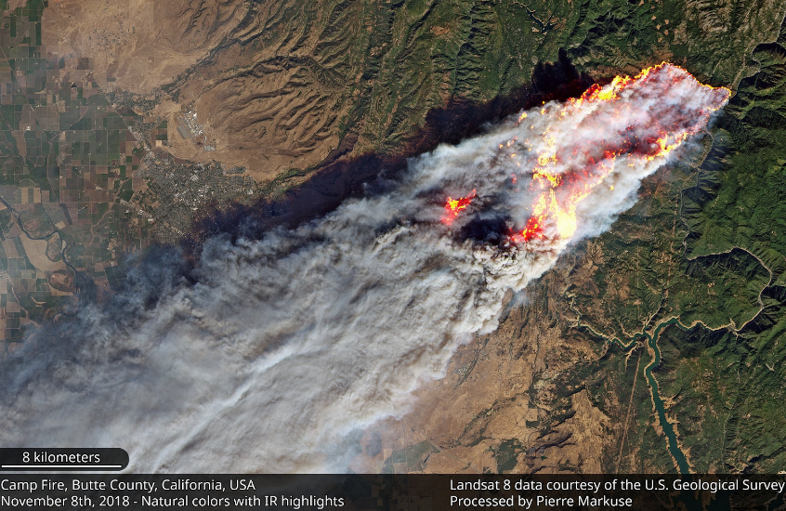
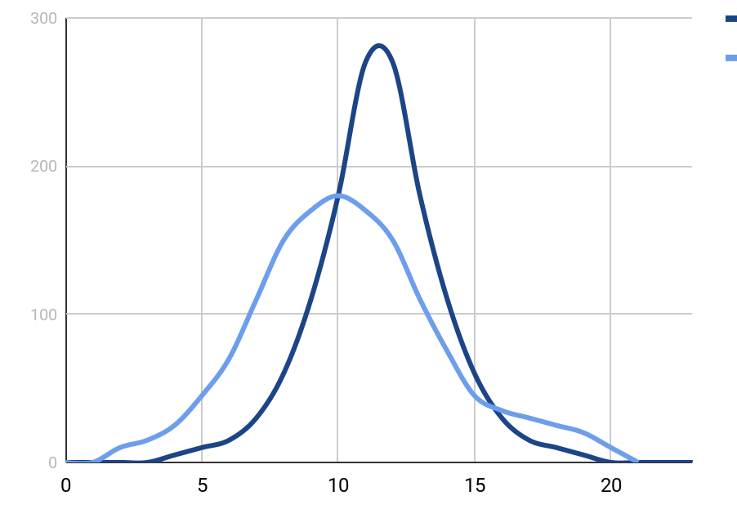
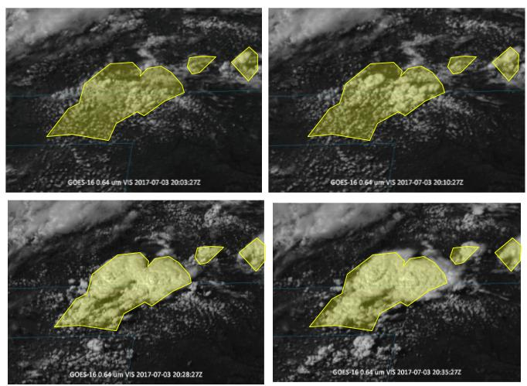
ROI and Deep Learning is Just ONE Area
Soil Moisture – Random Forest
Machine Learning in GSD
Convection Initiation – Deep Learning
Fire Radiative Power – Random Forest

Slide 8
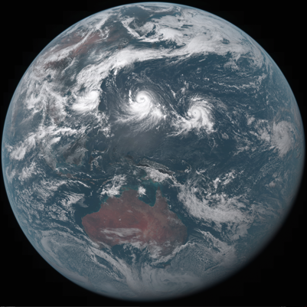
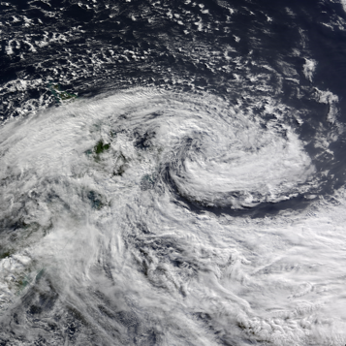
Background into Regions of Interest (ROI)
A ROI can be anything: convection, tornado, hurricane, cirrus clouds, etc.
Select ROI that meteorologist can identify from within satellite data
Cyclones: tropical and extratropical
Note: Storms have similar characteristics but still look different
Winter Cyclone over New Zealand from MODIS Terra satellite in 2008
Himawari-8 true-color Red/Green/Blue (RGB) full-disk image
Spring snow over the Dakotas from MODIS Terra satellite in 2006

Slide 9
Background into Regions of Interest (ROI)
Many post-processing studies in environmental science already have identified datasets/ROI
What about those that don’t?
Image Processing Struggles
How do we validate our models?
Is there a dataset containing images of ocean blooms that’s up-to-date?
Real-time ROI processing even bigger challenging
Especially with large image files such as satellite

Slide 10
Finding Labeled Data For Cyclone ROI
International Best Track Archive for Climate Stewardship (IBTrACS) dataset for tropical cyclones
Most complete worldwide database
Already created
Engineered a unique automatic heuristic labeler for extratropical cyclones
Several heuristic models for extratropical cyclones already, but each have different rules and therefore identify different amounts of cyclones
IMILAST paper lists most trackers in existence
Why not just use this and call it a day? → It’s slow!
Bonfanti, Christina, et al. “Machine Learning: Defining Worldwide Cyclone Labels for Training.” 2018 21st International Conference on Information Fusion (FUSION), 2018, doi:10.23919/icif.2018.8455276.
Neu, Urs, et al. IMILAST: A Community Effort to Intercompare Extratropical Cyclone Detection and Tracking Algorithms. Bulletin of the American Meteorological Society, vol. 94, no. 4, 2013, pp. 529547., doi:10.1175/bams-d-11-00154.1.
https://www.ncdc.noaa.gov/ibtracs/index.php

Slide 11
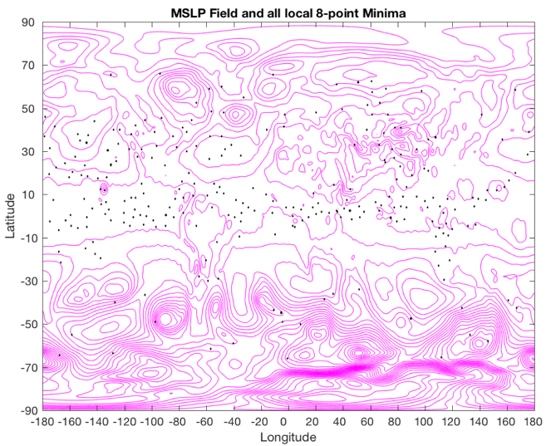
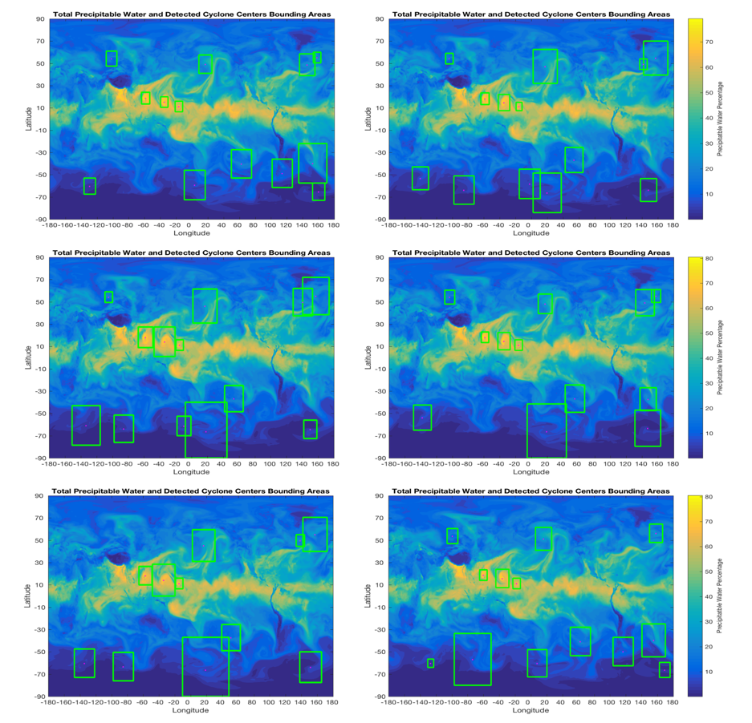
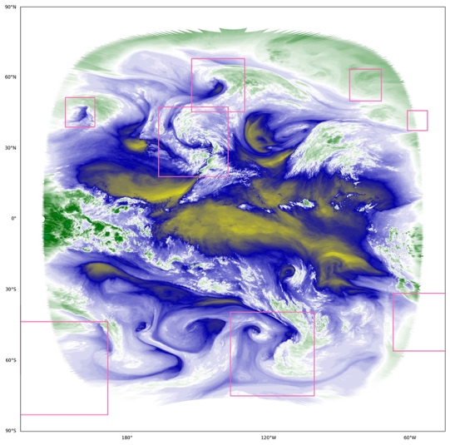
Making the Labels

Slide 12
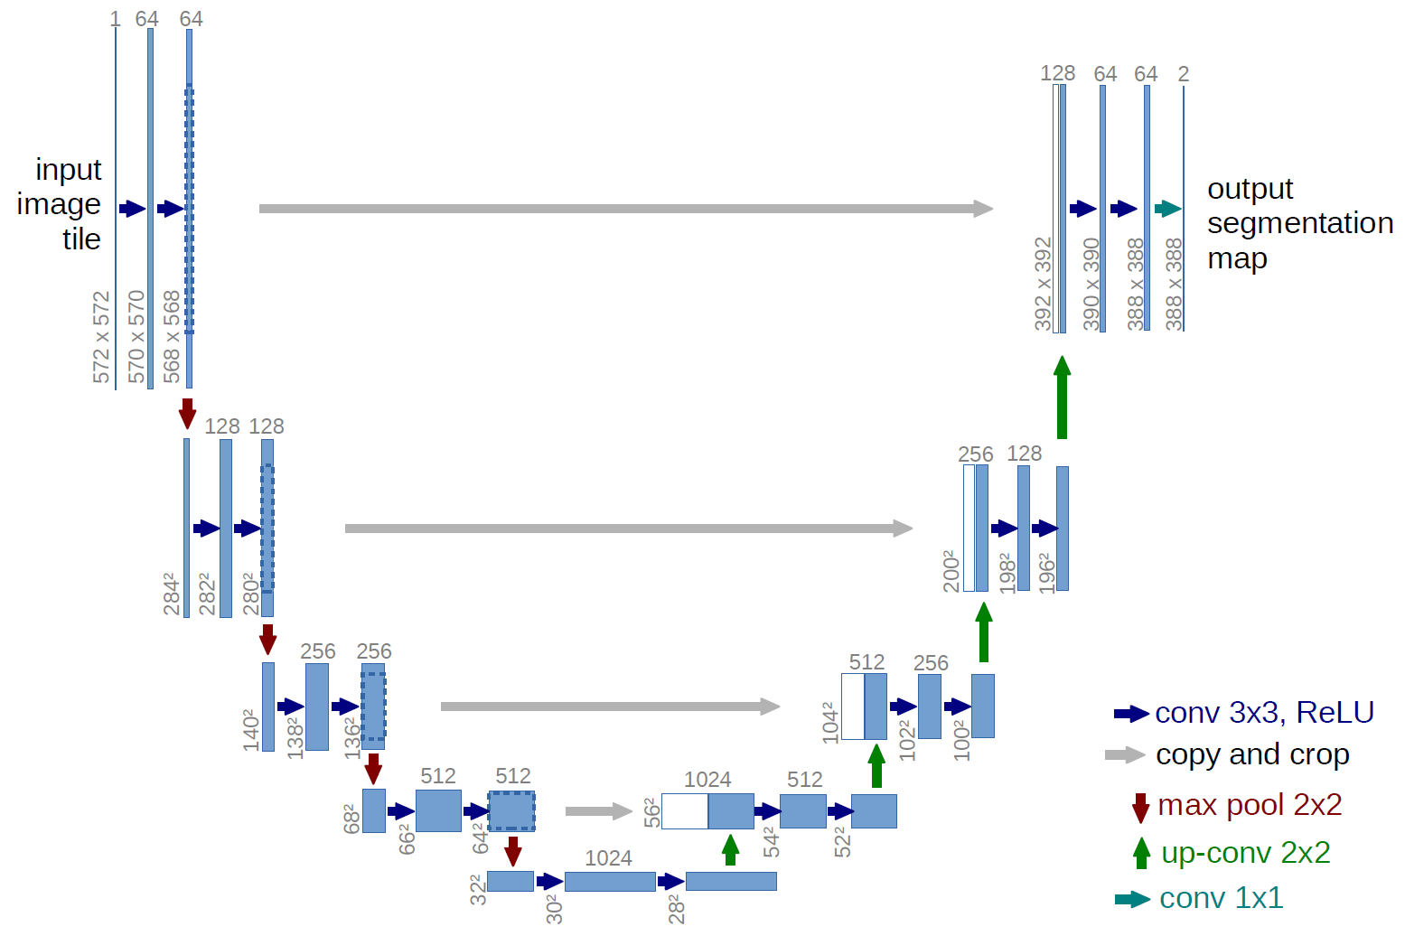
Tropical and Extratropical Cyclone ROI
The UNET: The structure has a contracting path and then an expansion path hence the “U” in the name
Connects larger features before compression with smaller ones after compression
Image Segmentation Problem
Heuristic-derived labels
Keras up top
Google’s tensorflow underneath
GOES water vapor channel
2010-2016
Notes:
Say how NOAA GSD AI group official

Slide 13
Tropical and Extratropical Cyclone ROI
Our UNET:
Loss function: DICE
Activation: RELU
After each convolution, it does a batch normalization
22,232 Training Samples
4,707 Test Samples
40 epochs
Batch size of 16
Images resized and cropped to 1024x512
Notes:
Say how NOAA GSD AI group official

Slide 14
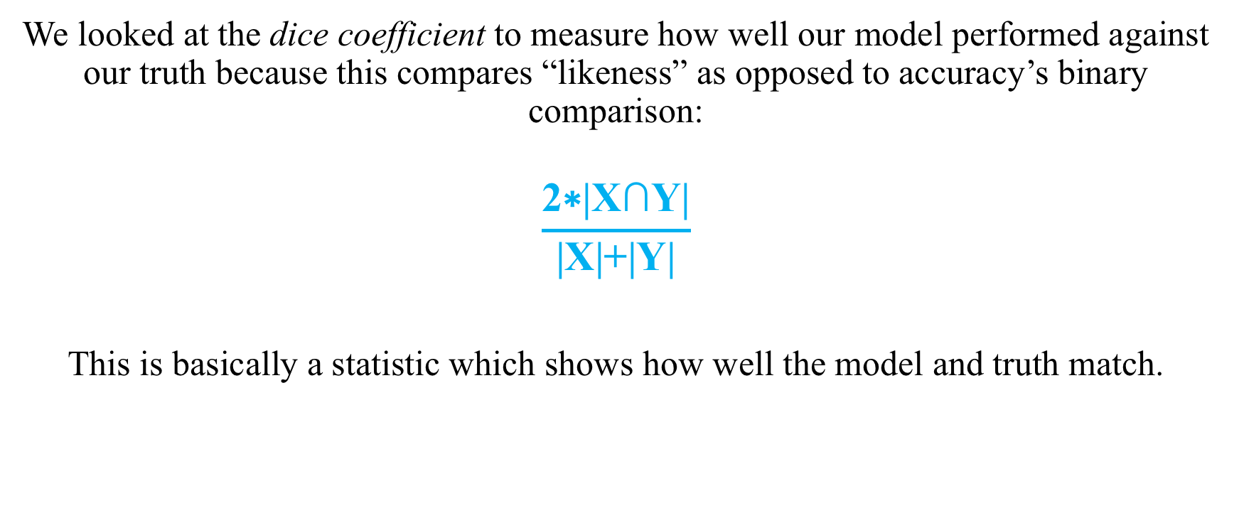
Answering: How well did it work?
We looked at the dice coefficient to measure how well our model performed against our truth because this compares “likeness” as opposed to accuracy’s binary comparison:
$$\frac{\text{2∗|}\text{X}\text{∩}\text{Y}\text{|}}{\text{|}\text{X}\text{|+|}\text{Y}\text{|}}$$
This is basically a statistic which shows how well the model and truth match.

Slide 15
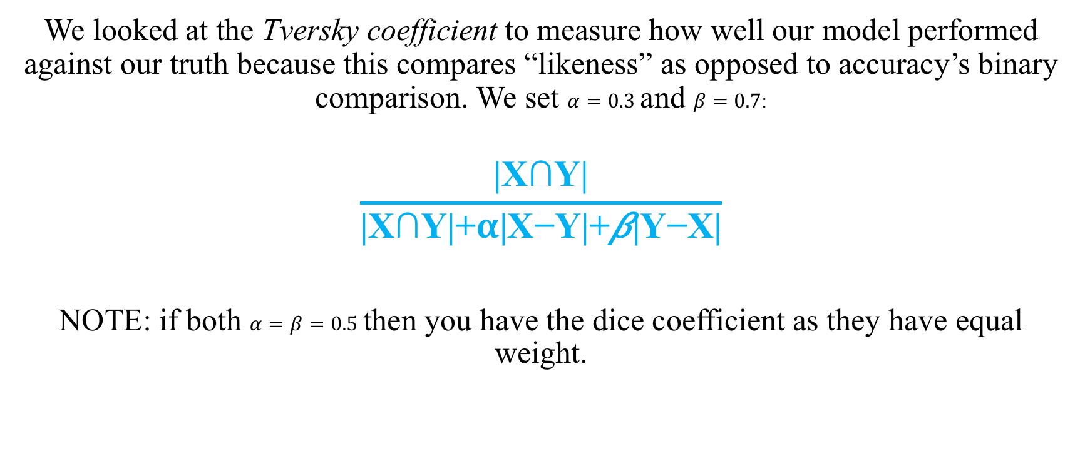
Answering: How well did it work?
We looked at the Tversky coefficient to measure how well our model performed against our truth because this compares “likeness” as opposed to accuracy’s binary comparison. We set $α=0.3$ and $β=0.7$:
$$\frac{\text{|}\text{X}\text{∩}\text{Y}\text{|}}{\text{|}\text{X}\text{∩}\text{Y}\text{|+}α\text{|}\text{X}\text{−}\text{Y}\text{|+}\text{β}\text{|}\text{Y}\text{−}\text{X}\text{|}}$$
NOTE: if both $α=β=0.5$ then you have the dice coefficient as they have equal weight.

Slide 16
Results: Labels on GFS Output
IBTrACS Labels versus DL model
Loss | Dice Coefficient | Accuracy
0.1896 | 0.8243 | 0.9979
Heuristic Labels versus DL model
Loss | Dice Coefficient | Accuracy
----- | 0.7282 | 0.9783

Slide 17
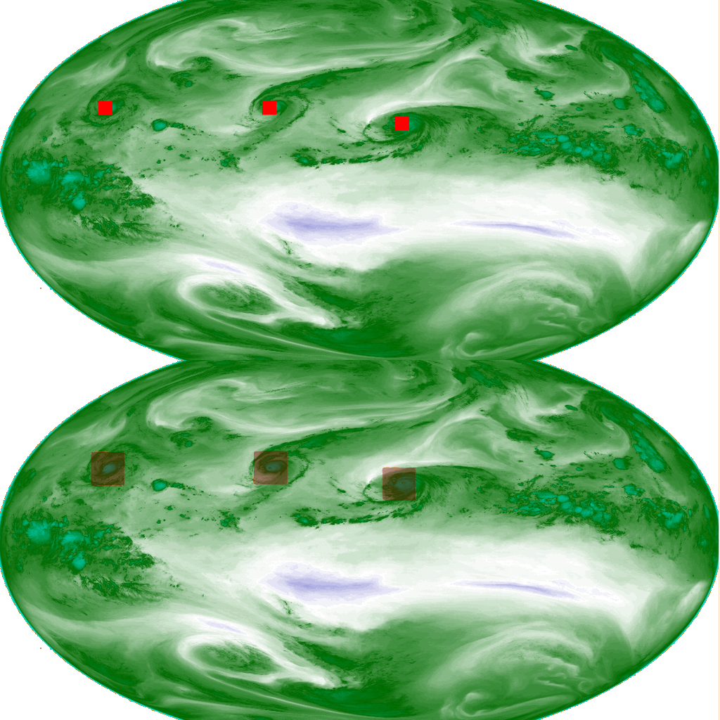
Tropical and Extratropical Cyclone ROI
IBTRaCS label
IBTrACS training only
Model Identified Hurricanes
Notes:
Say how NOAA GSD AI group official

Slide 18
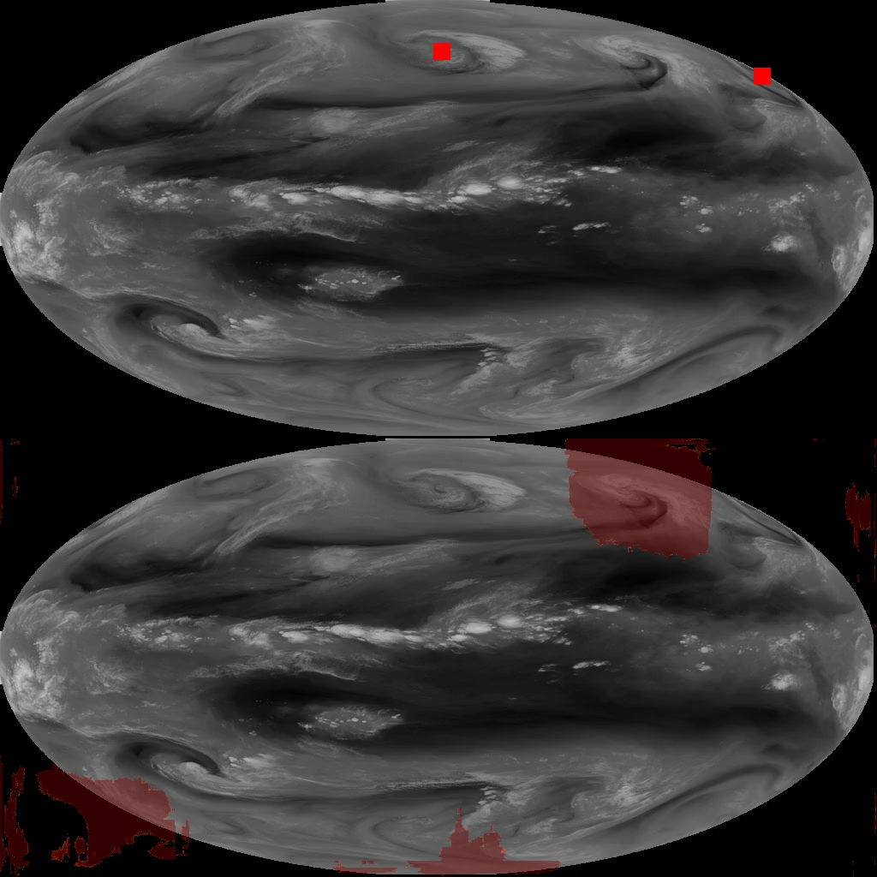
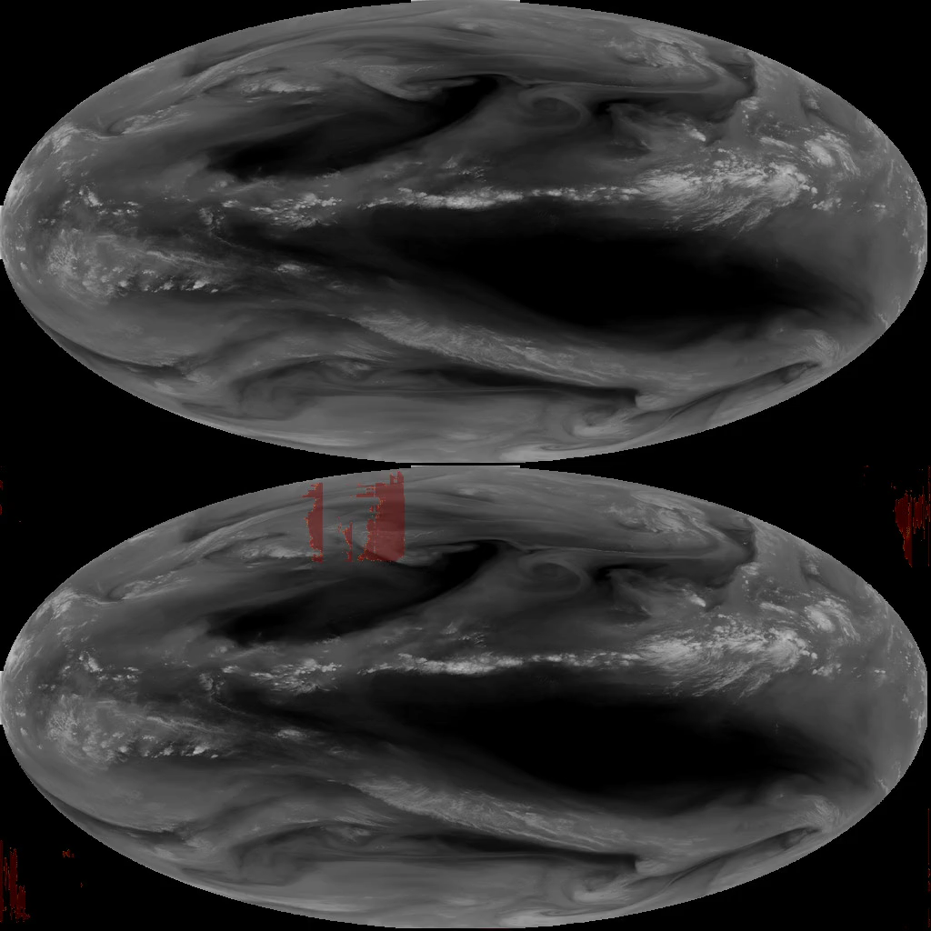
Tropical and Extratropical Cyclone ROI
All cyclones from ROI labeler with 80x80 pixel ROI pixel box at 75% threshold using a dice loss function and relu activation
Heuristic ROI label
Heuristic ROI label
March 2014
August 2014
Model Identified ROI
Model Identified ROI
Notes:
Say how NOAA GSD AI group official

Slide 19
Results: Heuristic labels on Satellite Data
Heuristic Labels versus DL model
Accuracy | Dice Coefficient | Tversky Coefficient
0.8924 | 0.4006 | 0.3626

Slide 20
What needs to be considered in a DL model?
When and how data is processed matters
How is it normalized/scaled? With or without NaN’s?
More success with a batch normalization
Memory is an issue
Picking the right loss and activation function
Up-and-coming methods:
Curvature of the edges- SphereNet

Slide 21
Thoughts/Conclusions
Tropical versus Extratropical cyclones
Tropical Cyclones are more uniform and deviate less in appearance than extratropical
Occur along the equator where projection is less an issue
Edges are an issue for both but more so when projection is also a factor
Impressed by the visual results of extratropical cyclone detection
Numerical measurements of performance don’t speak to the results of ROI detection
How do we compare success to another heuristic-based method?

Slide 22

PART 2 Machine Learning for Climate and Weather – Challenges and Strategies
Imme Ebert-Uphoff
CIRA / Electrical & Computer Engineering
Colorado State University
NOAA-STAR seminar
July 18, 2019

Slide 23
Challenges for Using ML in Weather/Climate
Earth science applications differ from typical machine learning (ML) applications.
→ Not straight forward to apply standard ML algorithms.
Two Key Challenges (these will be discussed in more detail):
Transparency: Scientists usually want to understand how ML methods get their results. Even if not, transparency is important for debugging, etc.
Generalization: ML models must be able to handle new regimes, i.e. scenarios they have not seen during model construction/training.
Other challenges (not further discussed here):
Often large data set, but small sample size. In particular, lack of labeled data, i.e. often not many samples available along with “correct answer”.
Spatio-temporal structure;
Objects may have fuzzy boundaries (e.g., clouds, atmospheric rivers);
Heterogeneity in space and time;
Multi-source, multi-resolution data.

Slide 24
Sample Pitfall
Application: ML applied to Skin cancer detection
Task: Given image of skin lesion, classify whether benign or malignant
On first try: Method had amazing success rate - whenever the doctors thought it was benign/malignant, the ML method came to the same conclusion!
Almost too good to be true.
→ Scientists wanted to know: How did the algorithm figure it out?
Applied visualization tool to learn about method’s reasoning.
Scientists found that …

Slide 25
Skin cancer example
Scientists found that …
… doctors had placed a ruler into the image whenever they thought it was malignant.
The algorithm detected the ruler, then concluded that the growth was malignant. That’s not what folks had intended for the algorithm to do!
Found problem early thanks to transparency tools.

Slide 26
That’s why transparency is important
Conclusion: The algorithm detected the ruler, didn’t look at the skin lesion at all.
Why did the ML algorithm behave this way?
An ML algorithm does not “understand” its task.
It is just looking for any information/patterns that help it solve its task.
ML algorithm did its job perfectly – the ruler was the perfect indicator.
Lack of generalization:
The algorithm worked perfectly for the training samples, but would not have worked when deployed (no rulers).
Including the rulers was an obvious mistake, but there can always be (less obvious) clues that lead to non-generalizable detection algorithms.
How to avoid such pitfalls: Understand reasoning of ML algorithm as much as possible
Obviously: Get to know your data well before applying any ML method.
Visualization/attribution tools can be very helpful.
Scientists found the problem quickly once they applied visualization tools.

Slide 27
Selected Strategies to overcome these challenges
Physics-guided Machine Learning (PGML)
Use of Interpretation/visualization tools of ML methods (especially ANNs).
Insights from Team Science / Interdisciplinary Studies to built innovative + synergistic collaborations between atmospheric and ML researchers. (no time to discuss today)
[1] Newell and Luckie, Pedagogy for Interdisciplinary Habits of the Mind, Conference on Interdisciplinary Teaching and Learning, 2012.
[2] Flinterman et al., Transdisciplinarity: The New Challenge for Biomedical Research, Bulletin of Science, Technology & Society, Vol. 21, No. 4, 2001.
[3] Ebert-Uphoff, I., and Y. Deng (2017), Three steps to successful collaboration with data scientists, Eos, 98, https://doi.org/10.1029/2017EO079977.

Slide 28
Strategy 1: Physics-guided Machine Learning (PGML)
We have a huge advantage in earth sciences:
hundreds of years of knowledge about underlying processes available!
PGML Approach: Integrate as much science knowledge as possible into ML algorithms.
Advantage:
PGML can greatly improve transparency and generalization capabilities.
Disadvantage:
Requires complex, customized solution for each project.
Takes a lot of time!
How? Next slide.

Slide 29
Strategy 1: Physics-guided Machine Learning (PGML)
Sample techniques:
Utilize physics whenever you can
Break task into sub-tasks and solve as many sub-tasks as possible with physics, etc. If possible, only go the last mile with ML.
Examples: Preprocessing, feature engineering. Can I use physics to create information-rich ”features”?
Algorithm & Architecture selection
Example: If using neural networks, can I customize the architecture?
Adding physical constraints
Can we add physical constraints in optimization functions?
In parameter space of optimization?

Slide 30
PGML – Adding physical constraints – Basic Idea
Idea: Many ML algorithms are based on minimizing a cost function (aka loss function).
→ Can use that cost function to add physical constraints.
Typical cost function (no physics):
loss = (prediction error on test data) + (regularization term)
Adding physics:
loss = (prediction error on test data) + (regularization term) + (physics penalty)
Physics penalty =
term that measures how much the results for test data violate a given physical constraint.
Physics penalty guides algorithm toward solutions that obey physical constraint.
Physics term can greatly improve generalization and accuracy.

Slide 31
PGML – Adding physical constraints - Example
Sample Application: Cloud parametrization
Approach: Using Artificial Neural Networks (ANNs) to emulate cloud processes.
Problem: ANNs do not intrinsically conserve energy and mass, etc.
→ emulation results do not conserve those either.
Source: Beucler, Tom, Stephan Rasp, Michael Pritchard, and Pierre Gentine. "Achieving Conservation of Energy in Neural Network Emulators for Climate Modeling." ICML conference, arXiv:1906.06622 (2019).
Solution 1: Constraints can be defined in terms of a linear function of inputs, x, and outputs, y:
[C] [ x^{T} y^{T}]^{T} = 0
Cost function with physics:
loss = (prediction error on test data) + (regularization term) + || [C] [ x^{T} y^{T}]^{T} ||
Enforce constraints in loss function

Slide 32
PGML – Customize architecture – Ex. 1
Source: Beucler, Tom, Stephan Rasp, Michael Pritchard, and Pierre Gentine. "Achieving Conservation of Energy in Neural Network Emulators for Climate Modeling." ICML conference, arXiv:1906.06622 (2019).
Sample Application: Cloud parametrization
Solution 2: Same constraints can be enforced through architecture of ANN.
[C] [ x^{T} y^{T}]^{T} = 0
Enforce constraints in architecture

Slide 33
PGML – Customize architecture – Ex. 2
Second example: Complex network
Principle: Decouple interaction of features in architecture based on which context is needed to extract information from them.
Different types of variables get “different treatment”.
Special features extracted separately from each type.
Resulting features merged later. Simpler model.
Source: Jebb Stewart, Christina Kumler, Isidora Jankov, Lidia Trailovic, Stevan Maksimovic, Mark Govett, Improving Processing and Extracting Value from Satellite Observations through Deep Learning, NOAA Workshop on AI, College Park, MD, 4-24-2019.

Slide 34
Strategy 2: Utilize Newest Interpretation tools for ML
Key idea:
Many new tools exist for interpretation/visualization of ML approaches.
New field: explainable AI.
Use these tools as much as possible to increase transparency of ML methods.
Shine a light inside the black box.

Slide 35
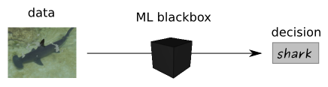
Example - Visualization of ANNs
Source:
www.heatmapping.org
ML tools are often described as a “black box” – with no way to look inside.
But more and more tools are becoming available to get a glimpse inside.
Sample method: Visualization to explain classification of a specific image
Question 1: Is this a shark?
Answer: Yes!
Question 2:
But WHY does the method think this is a shark?

Slide 36
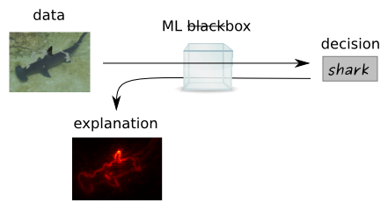
Example - Visualization of ANNs
Source:
www.heatmapping.org
ML tools are often described as a “black box” – with no way to look inside.
But more and more tools are becoming available to get a glimpse inside.
Sample method: Visualization to explain classification of a specific image
Question 1: Is this a shark?
Answer: Yes!
Question 2:
Why does the method think this is a shark?
More specific:
Which pixels of the input image are most important to decide that this is a shark?
Answer: Heatmap.
Note: This is just one of
many explanation techniques.

Slide 37
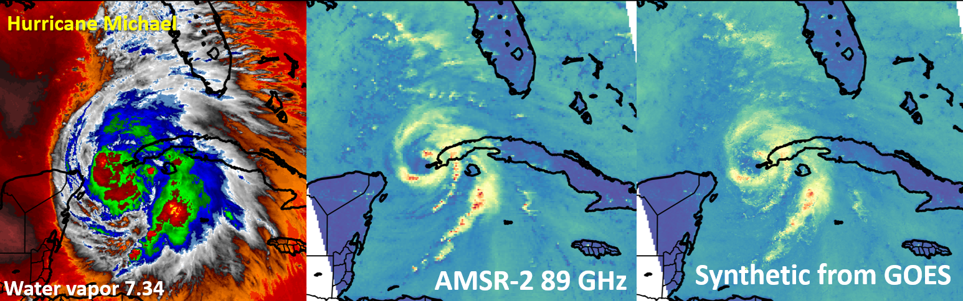
Other On-Going ML Projects
Chris Slocum and John Knaff:
Creating synthetic microwave imagery using GOES-R baseline products for improved hurricane monitoring and rainfall estimation
Current Method: ANNs

Slide 38
Other On-Going ML Projects
Kyle Hilburn and Steve Miller:
Machine Learning Techniques Applied to GOES-R ABI for Cloud Morphology- and Evolutionary-Based Airmass Characterization Toward Cloud-Permitting Model Analyses
Current Method: ANNs
Yoo-Jeong Noh, Steve Miller, John Haynes, John Forsythe, Curtis Seaman:
Improving the VIIRS Nighttime Cloud Base Height and Cloud Cover Layers Products for High Latitude Weather and Aviation Forecast Applications
Current Method: Random Forest

Slide 39
Concluding Comments
Selected strategies discussed:
Physics-guided Machine Learning (PGML) → Atmospheric scientist is very important. → See Item #3 below.
Use of interpretation/visualization tools of ML methods (especially ANNs).
Building innovative + synergistic collaborations between atmospheric and ML researchers (team science, interdisciplinary studies).
These strategies do not provide a magic wand, but they can be quite effective to
Increase transparency,
Improve generalization capabilities,
Deal with small sample size.

Slide 40
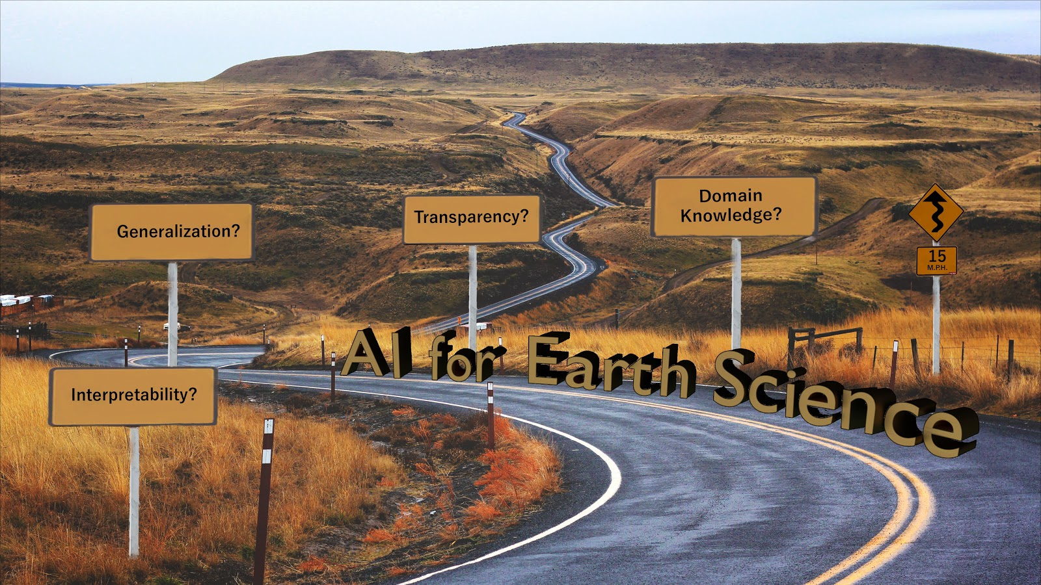
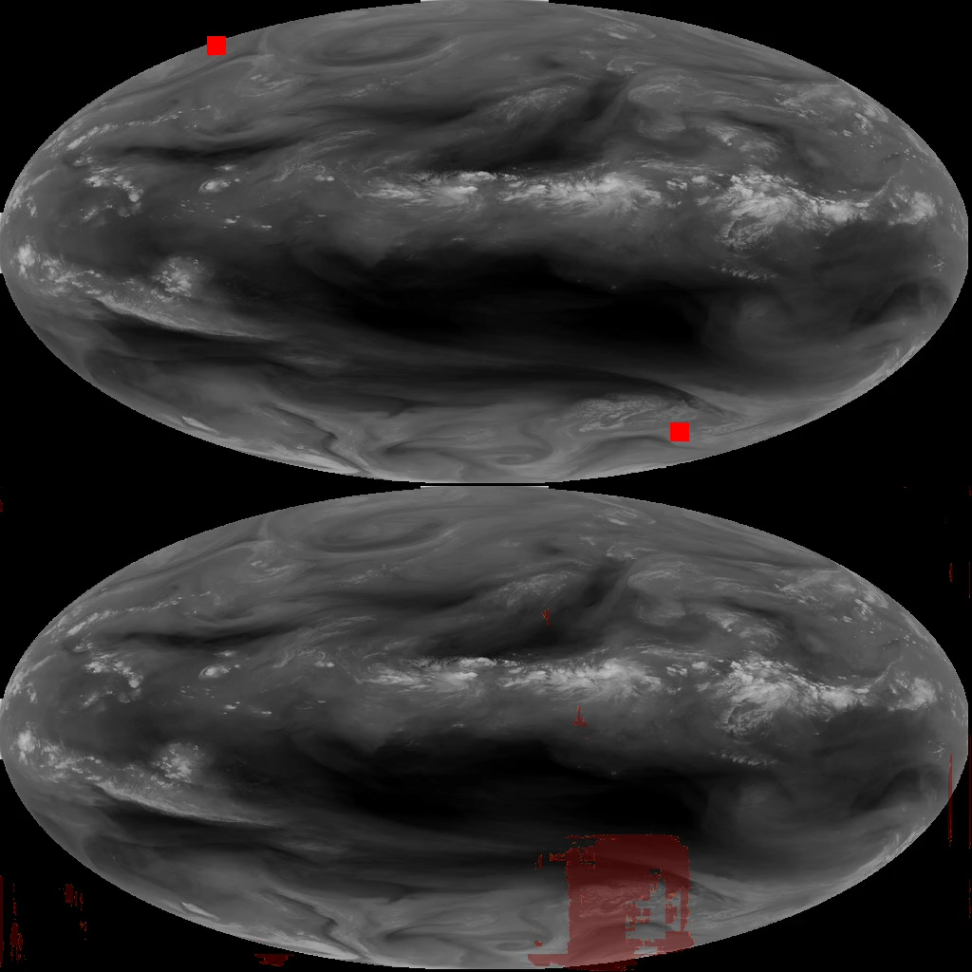
Questions or Suggestions?
Imme Ebert-Uphoff (iebert@colostate.edu)
Christina Kumler (christina.e.kumler@noaa.gov)

