Slide 1
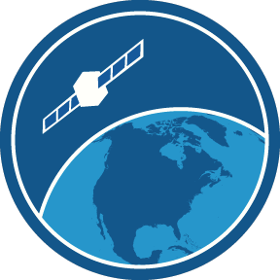
Webinar: NOAA PolarWatch STAR Seminar Series, August 29, 2019
NOAA PolarWatch is the newest satellite data distribution portal of NOAA's CoastWatch program. The portal offers a single location for federal agencies, research groups, and private industry to obtain the most recent and historical satellite observations of Arctic and Antarctic waters, including measurements of sea ice cover, ocean temperature, and winds.
We will provide an overview of the data and services provided by PolarWatch with examples that demonstrate supporting safety at sea, navigation, fishing, transportation, tourism, and recreation. We will also highlight user training materials and training courses that are designed to encourage the use of polar satellite data by broad audiences.
www.polarwatch.noaa.gov

Slide 2
NOAA PolarWatch Seminar Agenda
Thursday, August 29, 2019 - 11:30am - 12:30pm EDT
Facilitators:
Stacy Bunin, NESDIS STAR, College Park, MD
Cara Wilson, NOAA PolarWatch Principal Investigator, Monterey, CA
Presenters:
Jennifer Sevadjian, NOAA PolarWatch Operations Manager, La Jolla, CA
Webinar Introduction, by Stacy
Webinar Agenda/Introduction by Cara
Introduction to the PolarWatch Program (5 minutes)
PolarWatch Users and Applications (5 minutes)
Demonstration of PolarWatch Catalog, data discovery, preview, download (10 minutes)
Demonstration of PolarWatch ERDDAP data server access (10 minutes)
Tools, training and resources (10 minutes)
Q & A (10 minutes)

Slide 3
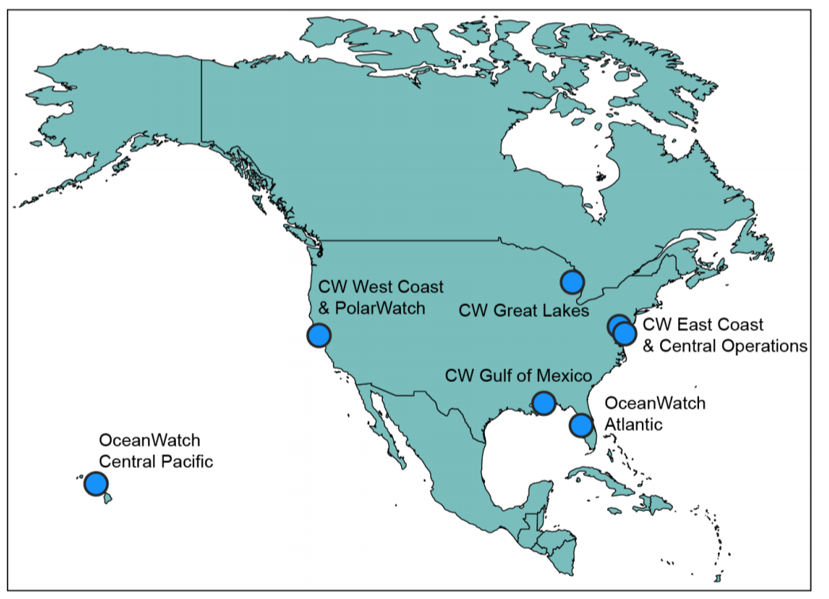
PolarWatch Program
NOAA CoastWatch
PolarWatch is the newest regional satellite data distribution portal of NOAA's CoastWatch program
CoastWatch provides global and regional satellite data products
Regional nodes provide focused support to regional users
PolarWatch offers a single location to obtain the most recent and historical satellite observations of Arctic and Antarctic waters, including measurements of sea ice cover, ocean temperature, and winds

Slide 4
PolarWatch and our Collaborators
PolarWatch at NOAA Fisheries
Jennifer Sevadjian, La Jolla
Cara Wilson, Monterey
Dale Robinson, Santa Cruz
NESDIS | STAR | SOCD
Sinead Farrell
Sheekela Baker-Yeboah
Eric Leuliette
Laurence Connor
Sean Helfrich
CoastWatch/OceanWatch
Paul DiGiacomo
Veronica Lance
Michael Soracco
Heng Gu
Phillip Keegstra
National Ice Center
Kevin Berberich
Bryan Brasher
Walter Clark
National Snow and Ice Data Center
Florence Fetterer

Slide 5
Over 100 satellite datasets available through the PolarWatch ERDDAP
DATA DISCOVERY – DISTRIBUTION – DELIVERY
Sea Ice
Sea Surface Temperature
Winds
Salinity
Sea Surface Height
Ocean Color

Slide 6
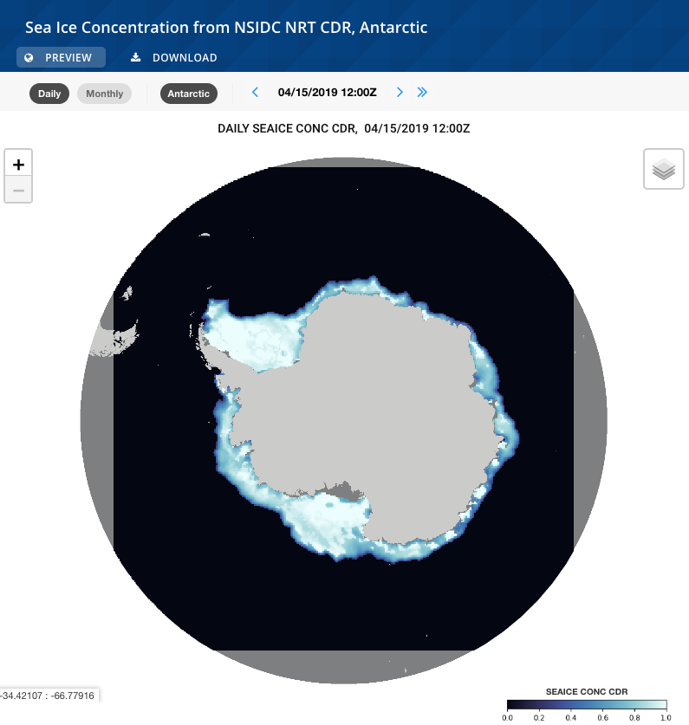
NSIDC Sea Ice Concentration Climate Data Record
Unique datasets and Novel Applications
New data access through the PolarWatch ERDDAP data server
New visualization/previews through the PolarWatch catalog
Eight datasets that comprise the NOAA/NSIDC Climate Data Record of Passive Microwave Sea Ice Concentration, Version 3 and the near real-time version of the Climate Data Record
Long term science quality sea ice concentration records for the Arctic and Antarctic dating back to 1978
Provides demonstration integration of a dataset with projected coordinates
Notes:
.

Slide 7
SOCCOM BioGeoChemical ARGO Float Data
BEYOND SATELLITE DATA
Southern Ocean Carbon and Climate Observations and Modeling (SOCCOM) BGC-Argo
float data is now available on the PolarWatch ERDDAP
    Augments conventional Argo floats with biogeochemical sensors to measure carbon (pH), nutrients (nitrate), and oxygen
    ~ 200 autonomous floats provide coverage over the Southern Ocean
    Vertical coverage deep into the water column
    Allows for easy inter-comparison with satellite data

Slide 8
USERS AND APPLICATIONS
NOAA
  Alaska Fisheries Science Center
  Antarctic Ecosystem Research Division
  Alaska Ocean Observing System (AOOS)
  NESDIS Center for Satellite Applications and Research
  National Weather Service
  PMEL
Other Government Agencies
National Park Service
Interagency
  CCAMLR
  National Ice Center (NIC)
  Commercial/Industry
  SailDrone
Potential Stakeholders
U. S. Arctic Observing Network (AON)
Naval Research Laboratory
  OAR Earth System Research Laboratory (ESRL)
  NOAA Climate Program Office (CPO)
  Southern Ocean Observing System
  NCEP Environmental Modeling Center (EMC)
EUMETSAT
Environment & Climate Change Canada
Finnish Ice Center
Universities, Academic Partners
Notes:
PolarWatch supports polar satellite data users across NOAA line offices, government agencies, industries and academia. We are working to spread the word about our new program and get input on the diverse user needs to inform the development of our services. Our goal is to help anyone with a need to access and use ocean related polar satellite data.

Slide 9
Users and Applications
FISHERIES RESEARCH AND MANAGEMENT
Antarctic Ecosystem Research Division
NOAA Fisheries – SouthWest Fisheries Science Center
Satellite data provides a long time-series of environmental context for fisheries research.
Satellite products commonly used:
Sea ice, water temperature, salinity, chlorophyll
PolarWatch has developed a prototype map-based tool to allow AERD to quickly see what satellite data is available in a region of interest like a CCAMLR region or the new Ross Sea MPA, and preview, subset and download that data.

Slide 10
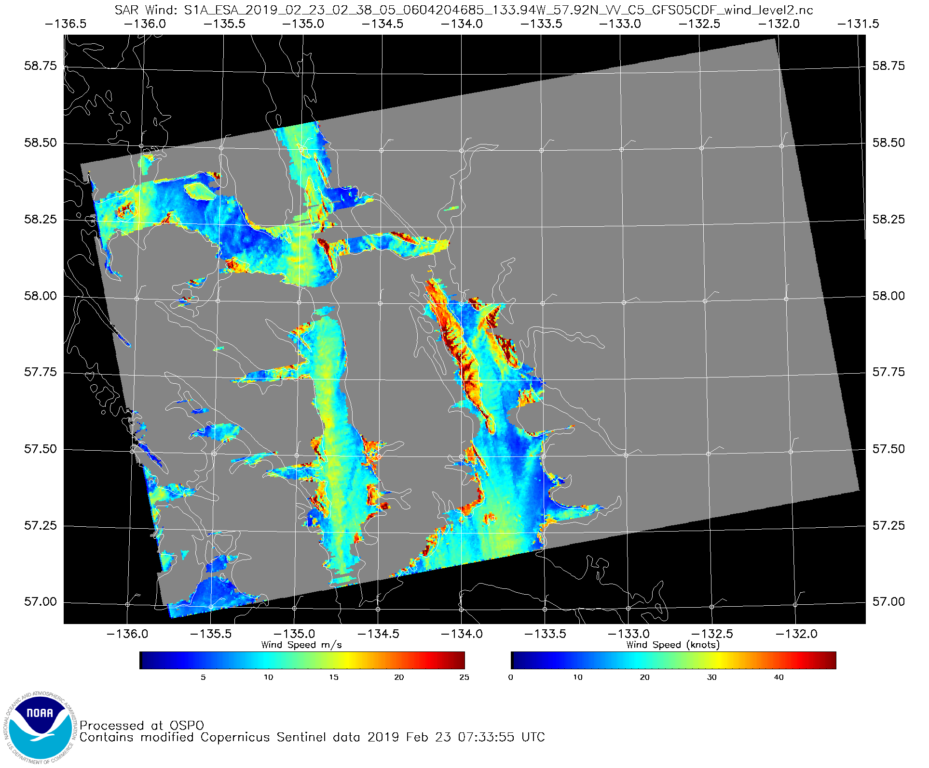
Users and Applications
SAFETY-AT-SEA, NAVIGATION
Brian Bezenek
National Weather Service
“As an operational forecaster with the National Weather Service, I will be looking mainly for forecast verification from near real time products of Surface winds and Sea Heights.
Also will be looking at the research on coastal surge from strong lows as they move inland from the coasts, to develop forecasting tips.”

Slide 11
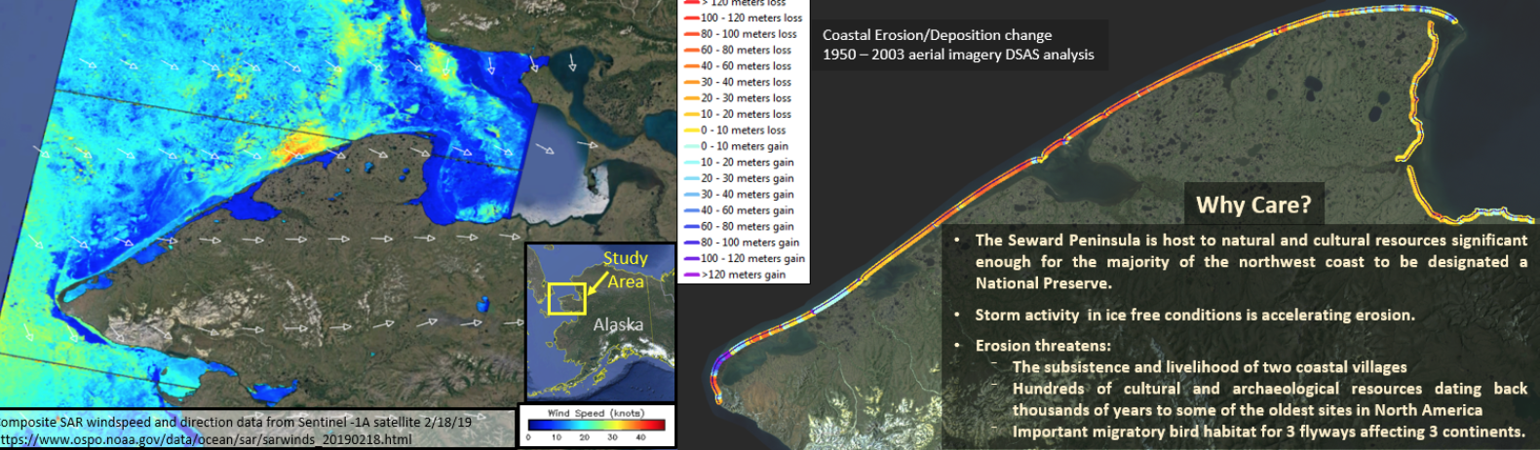
Tahzay Jones
National Park Service
Notes:
Another user at our recent annual satellite course was interested in using SAR winds to look at impact to archaeological resources in the coastal zone.

Slide 12
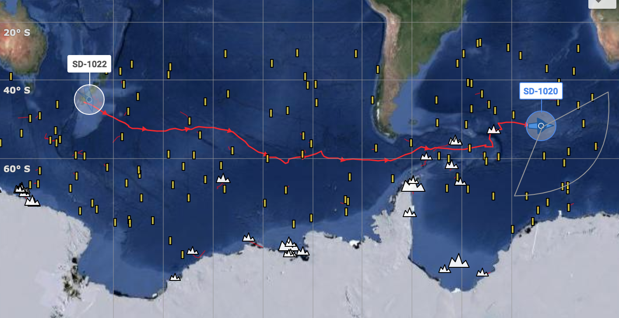
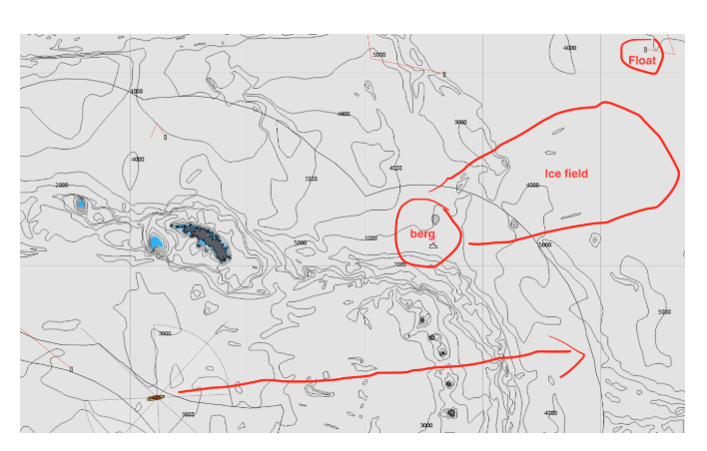
Key Users and Applications
SailDrone Antarctic Circumnavigations 2019
NOAA partnership with industry in support of science education and outreach missions in the Antarctic
Missions require environmental satellite data both for science and for operational support of the autonomous vehicle navigation
“Are there icebergs near my vehicle path today?”
“Where will the Argo floats be and where can I access their near real-time data?”
SAFETY AT SEA, NAVIGATION

Slide 13
Scenarios for Data Discovery, Visualization and Access
visualize data over area/time of interest prior to download
customized access (subset/reformat) data
programmatically access data repeatedly with the same workflow (R, Python, Matlab)

Slide 14
Live Demos

Slide 15
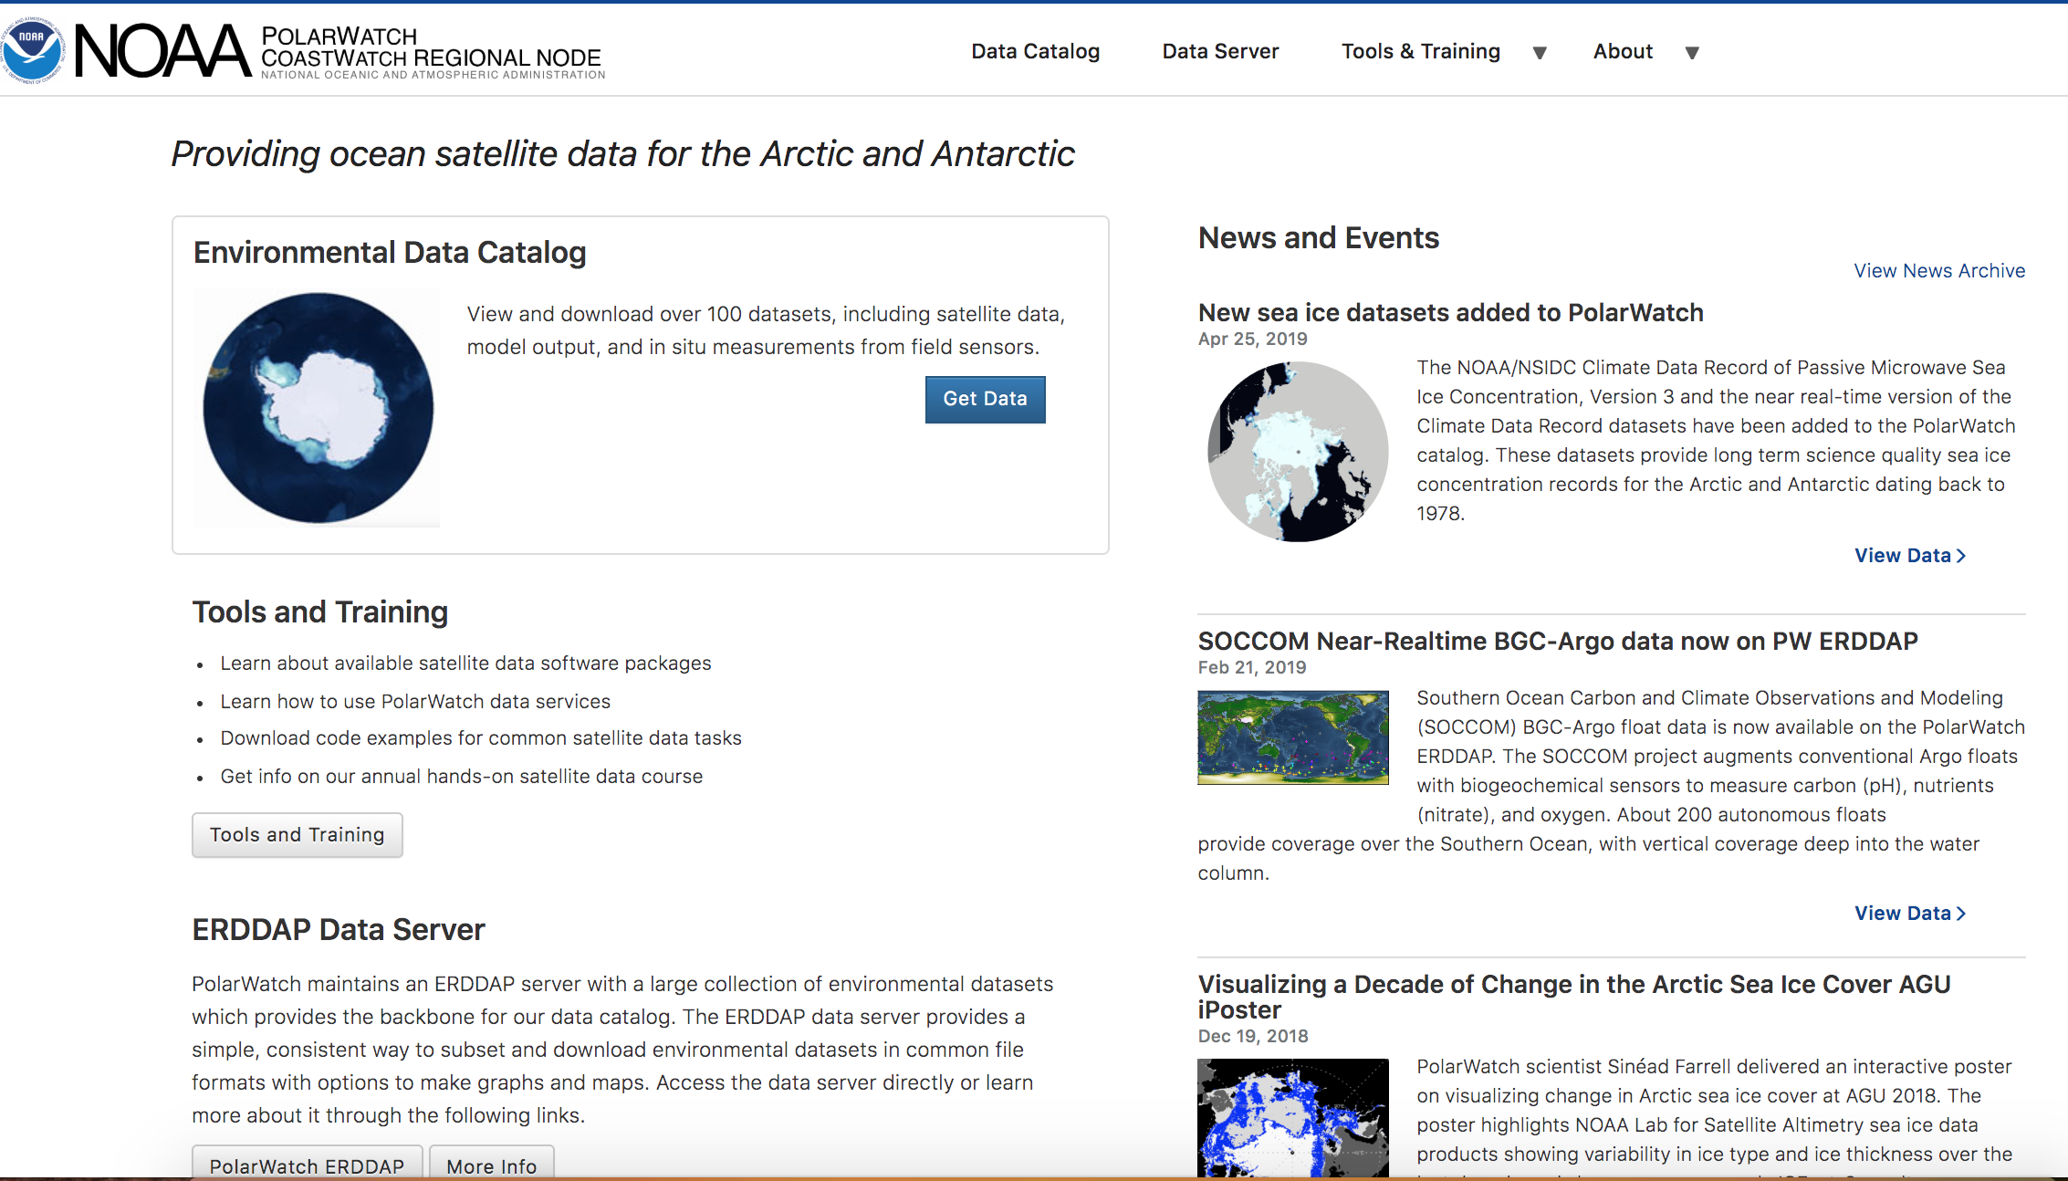
PolarWatch Website overview: polarwatch.noaa.gov

Slide 16
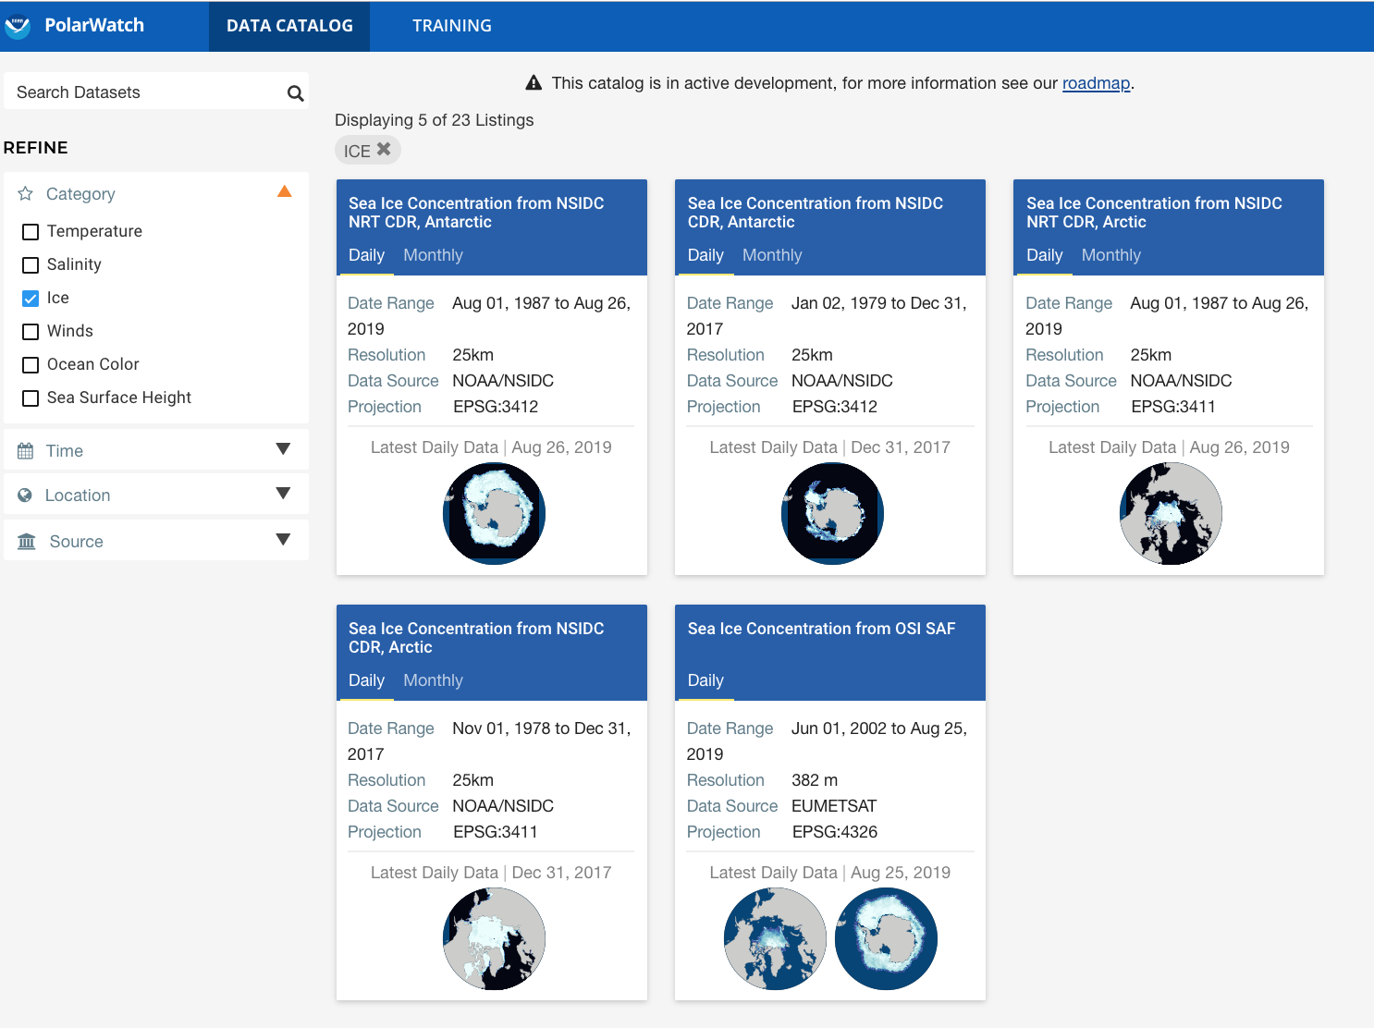
Data Catalog: Find and Filter

Slide 17
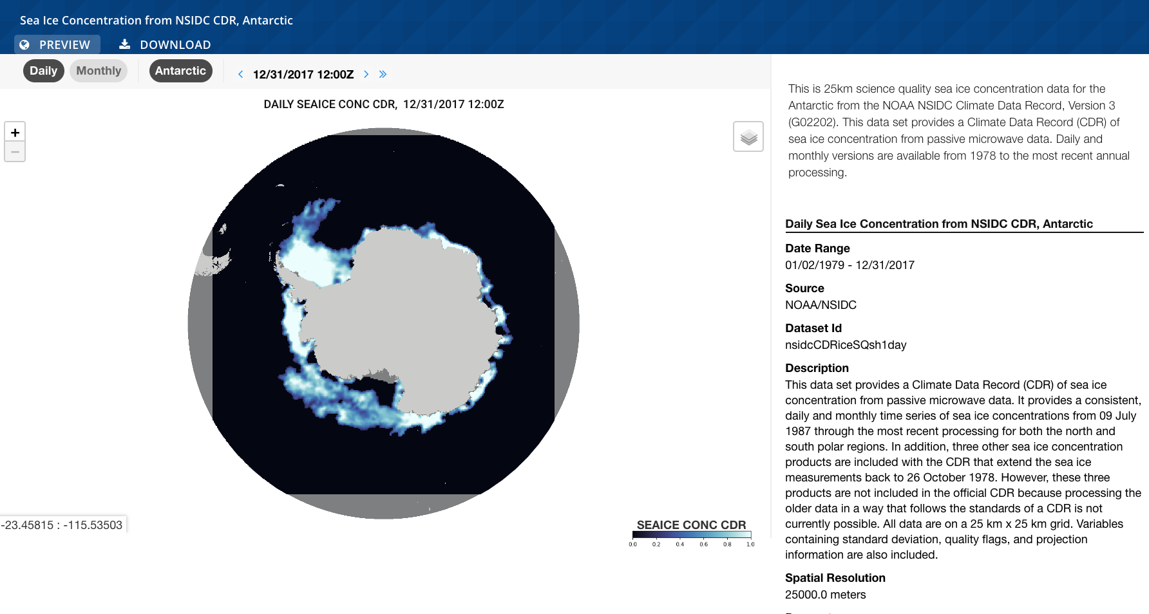
Data Catalog: Preview/Visualization
PolarWatch data catalog

Slide 18
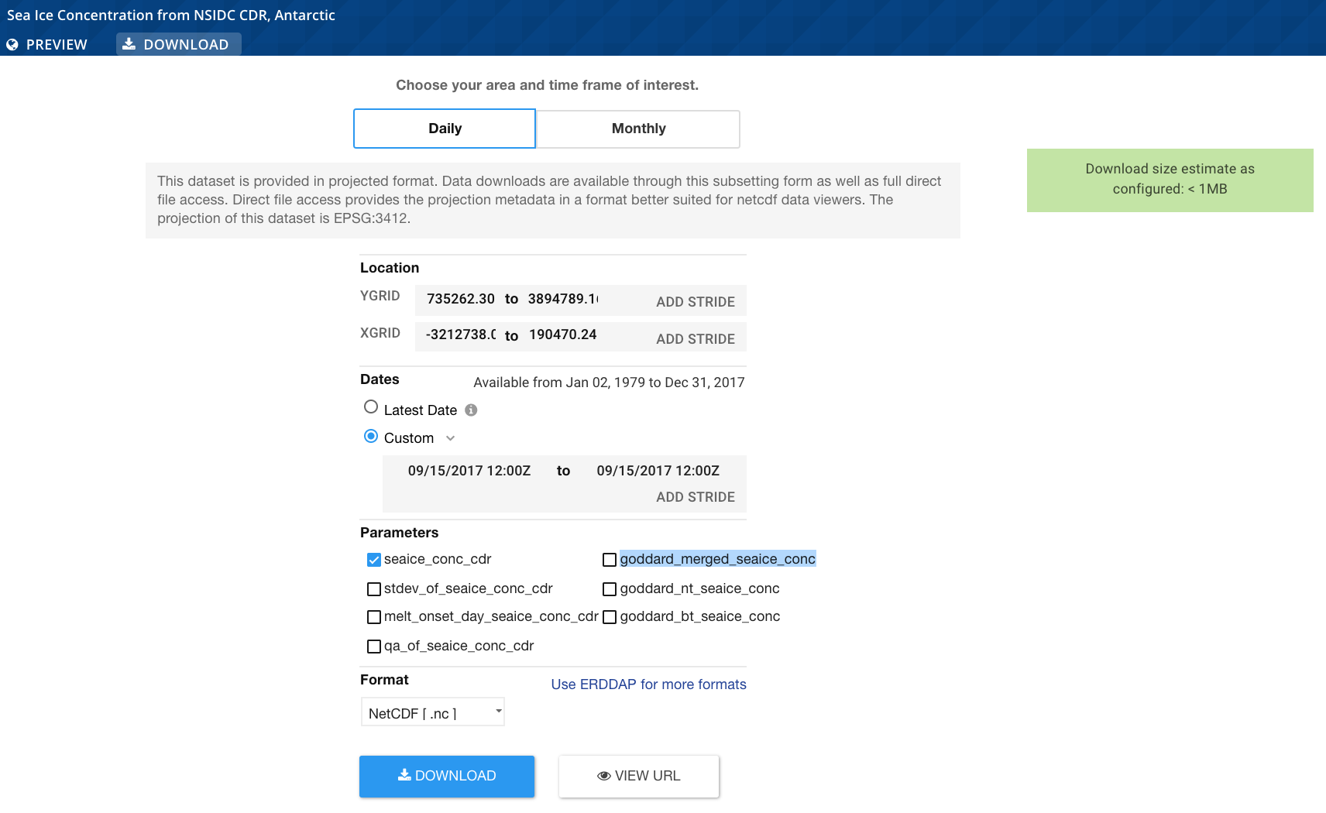
PolarWatch data catalog: Download

Slide 19
PolarWatch Data Services
data discovery, distribution, delivery
ERDDAP
Underlying services, advanced users
CATALOG
Search and Filter
Interactive Preview
Access and Download
PolarWatch Catalog
polarwatch.noaa.gov/catalog
  Enhances ERDDAP capabilities
  More user-friendly data discovery interface
  Subset and download projected datasets
  Preview data on polar projected maps
ERDDAP
polarwatch.noaa.gov/erddap
  Seamlessly integrate data from ERDDAP or aggregated THREDDS services
  Data served in many formats
  Subset data temporally and spatially
  RESTful

Slide 20
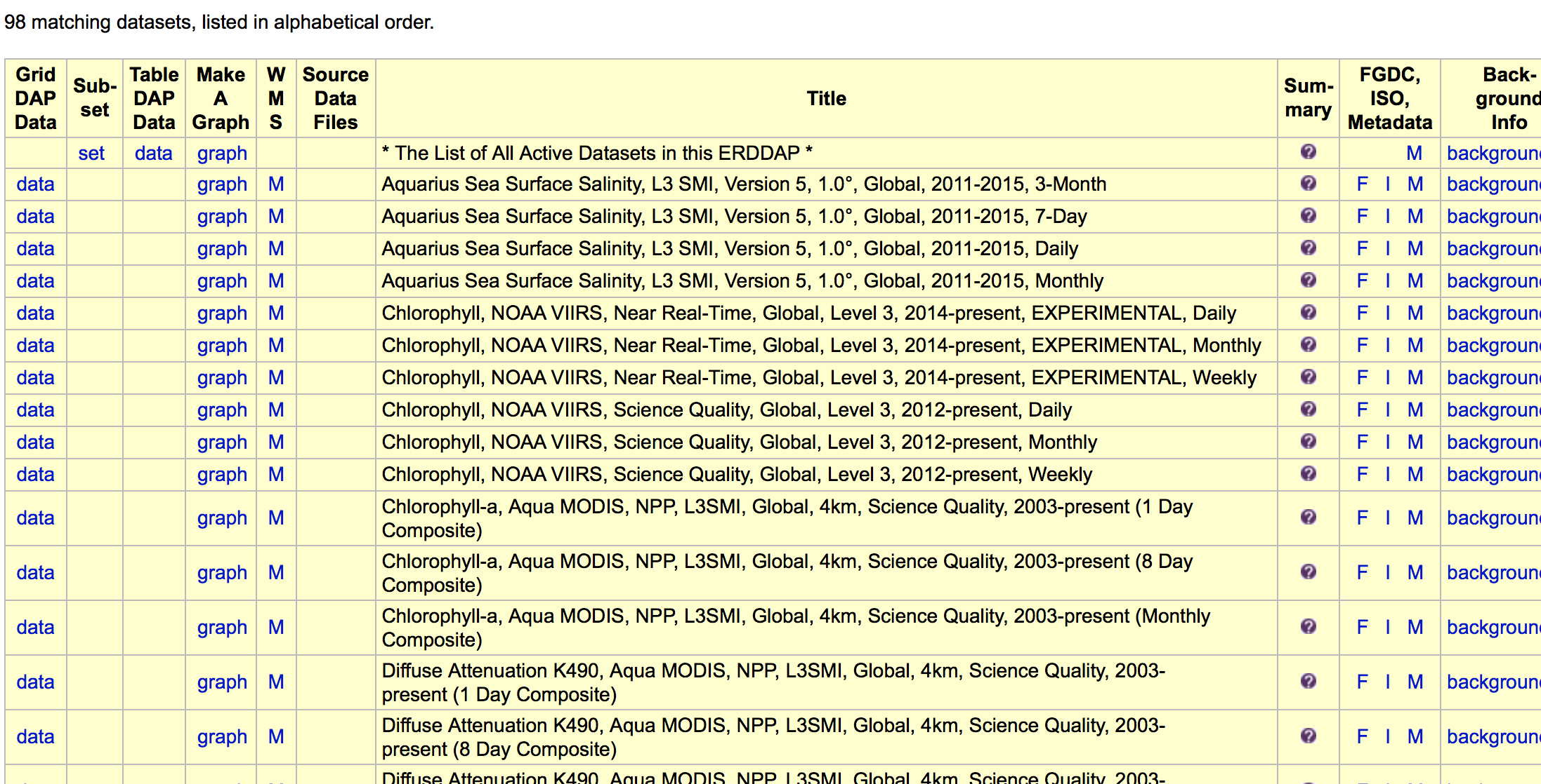
PolarWatch Data Server - ERDDAP
data discovery, distribution, delivery

Slide 21
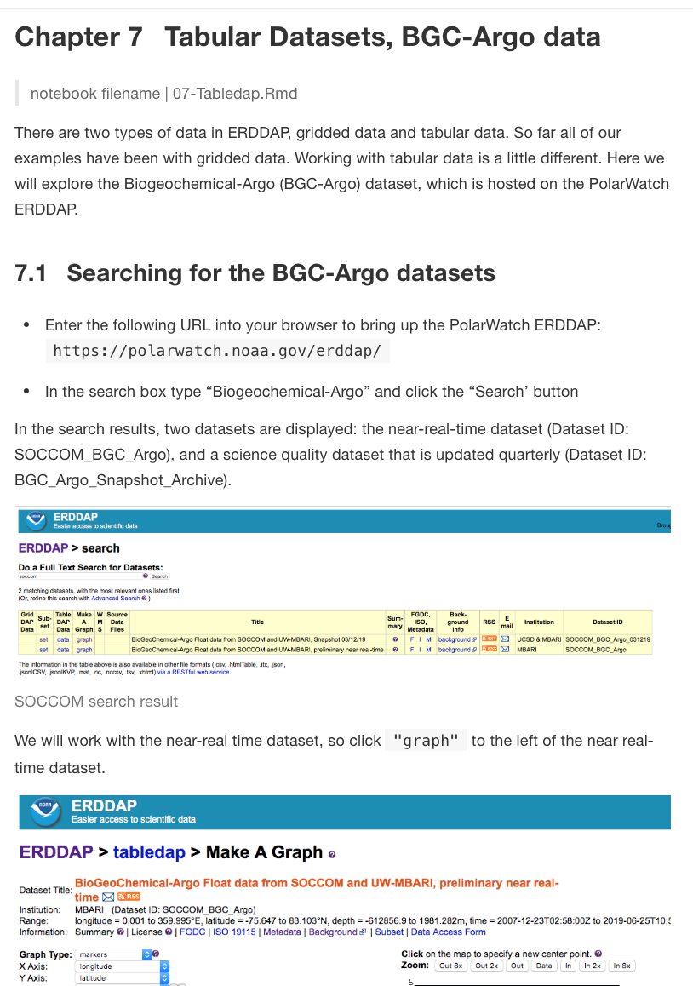
Using ERDDAP to visualize tabular data https://coastwatch.pfeg.noaa.gov/projects/erddap/tabledap.html#visualize-the-buoy-track
data discovery, distribution, delivery

Slide 22
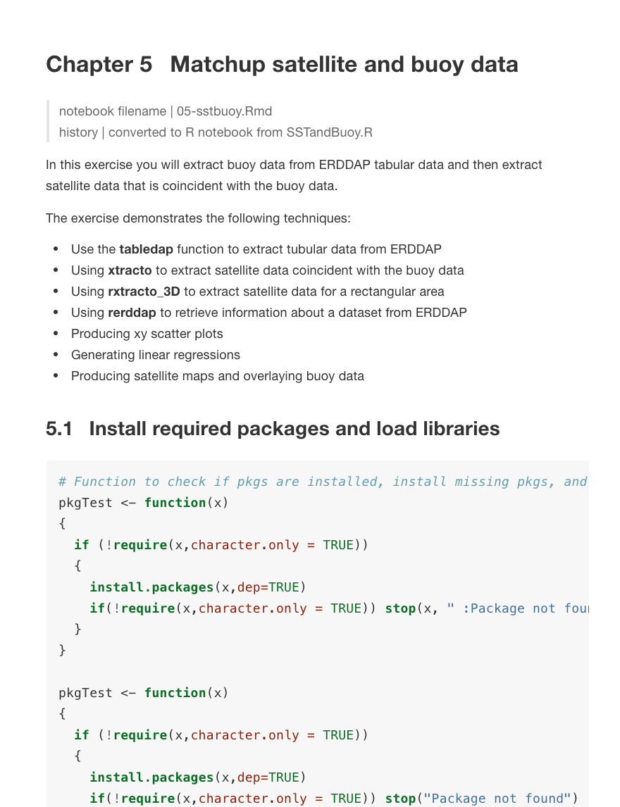
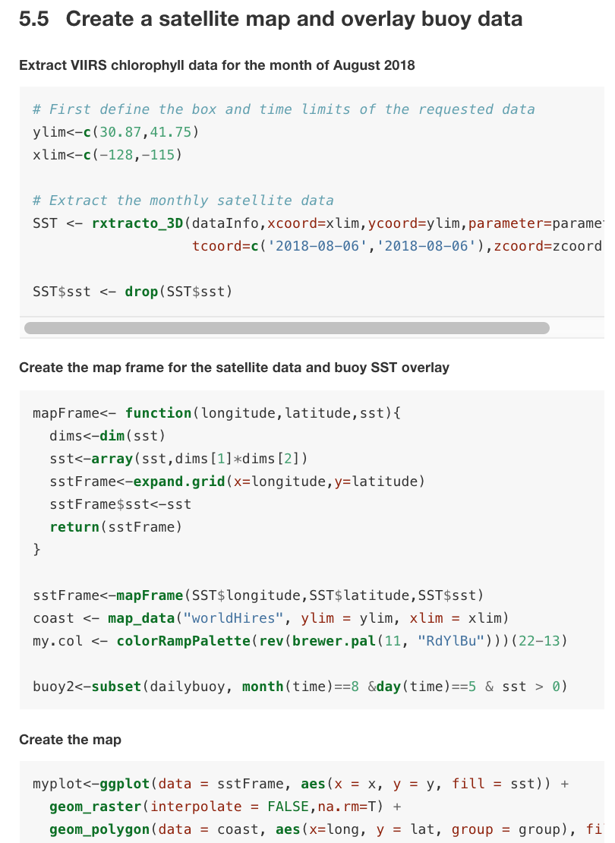
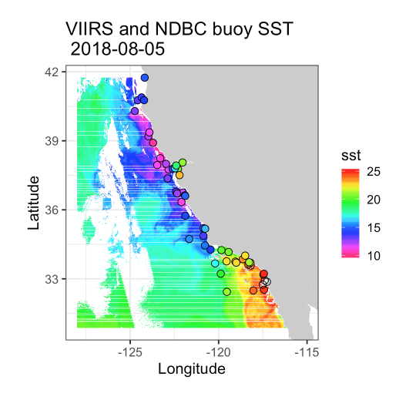
Matchup Satellite and Buoy Data - R Script Demonstration https://coastwatch.pfeg.noaa.gov/projects/r/
data discovery, distribution, delivery

Slide 23
Satellite Data Training Courses
Attend a hands-on training course
Find data
Downloading and accessing data
Beginners and advanced users welcome
Learn to use tools for R, Python, ArcGIS and Matlab
Multiple courses are offered by regional nodes throughout the year
PolarWatch and the West Coast node plan to co-host our next class in Alaska Spring 2020.
https://coastwatch.pfeg.noaa.gov/courses/satellite_course.html

Slide 24
CONNECT WITH US!
Cara Wilson (Monterey)
Jenn Sevadjian (La Jolla)
Dale Robinson (Santa Cruz)
Sinead Farrell (College Park)
cara.wilson@noaa.gov
jennifer.sevadjian@noaa.gov
dale.robinson@noaa.gov
sinead.farrell@noaa.gov
Acknowledgements
ERD DATA GROUP
  Roy Mendelssohn, Lynn Dewitt, Bob Simons
COASTWATCH CENTRAL
  Veronica Lance, Michael Soracco, Heng Gu, Phil Keegstra

