Slide 1
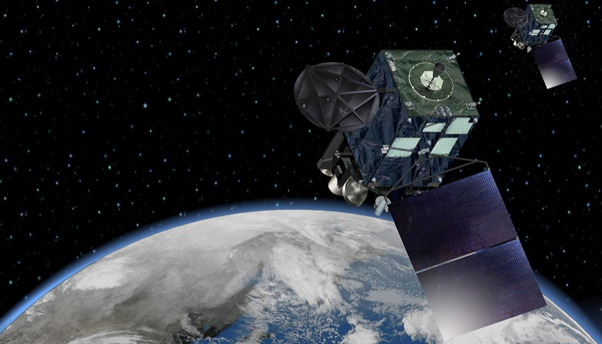
GLM Product Evaluation and
Highlights of My Research at CICS
Ryo Yoshida
Satellite Program Division, Observation Department
Japan Meteorological Agency (JMA)
STAR Seminar, October 24, 2019

Slide 2
Overview of my research visit
“Japanese Government Short-Term Overseas Fellowship Program” sponsored by the National Personnel Authority of Japan
  Period: Nov. 5, 2018 - Nov. 3, 2019
NESDIS accepted me at CICS, based on the framework of the NESDIS-JMA high-level letter exchange on information exchange regarding GOES-R Series & Himawari-8/9
Research topics: GLM & NOAA’s advanced efforts on satellites
I deeply appreciate NESDIS’s giving me this great opportunity

Slide 3
Contents
Overview of JMA and Himawari satellites
Highlights of my research at CICS
GLM product evaluation

Slide 4
1. Overview of JMA and Himawari satellites

Slide 5
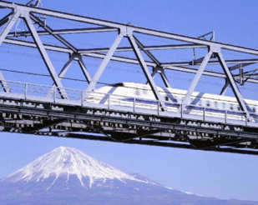

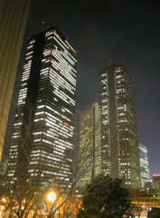
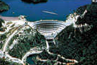

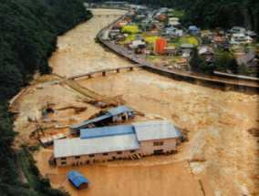

What JMA is
Japan’s national meteorological service, whose ultimate goals are
Safety of transportation
Prevention and mitigation of natural disasters
Development and prosperity of industry
International cooperation
prescribed by the Meteorological Service Act.

Slide 6
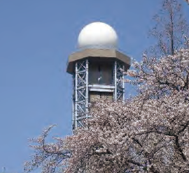
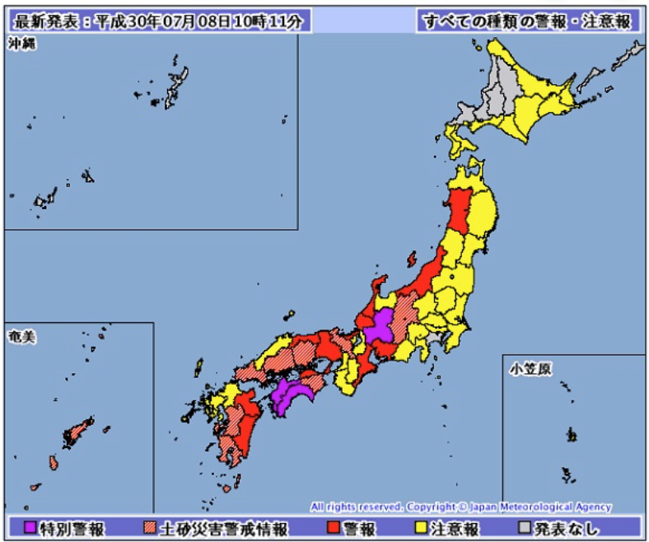
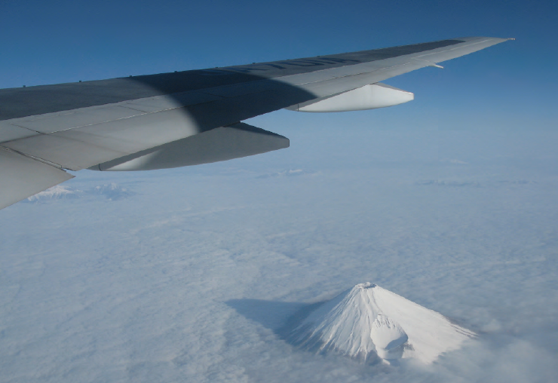
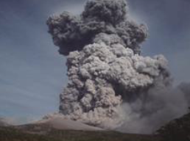
What JMA does
Weather observations
Weather forecasts and warnings
Aviation & marine weather services
Climate & global environment services
Monitoring seismic & volcanic activity & tsunamis

Slide 7
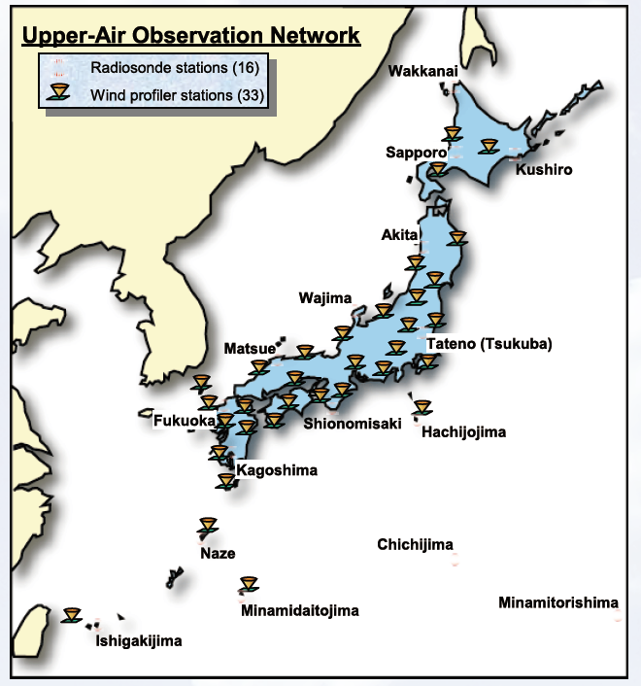
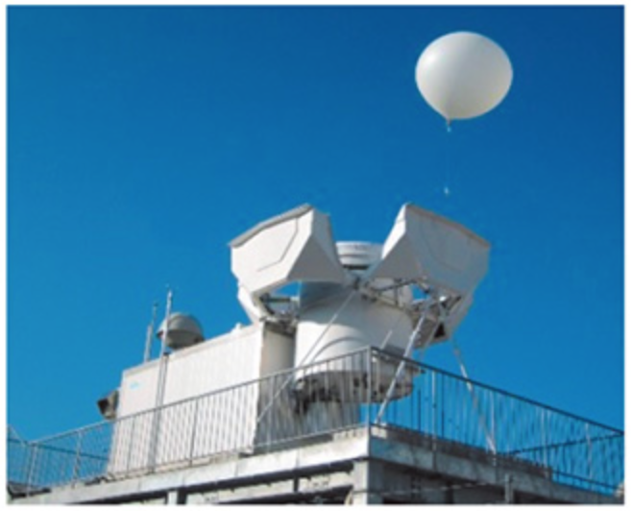
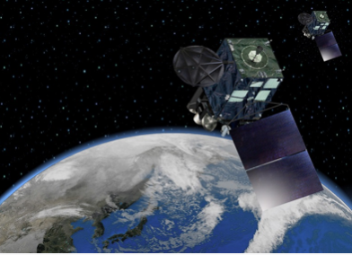
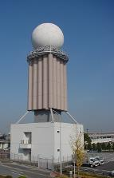
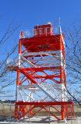

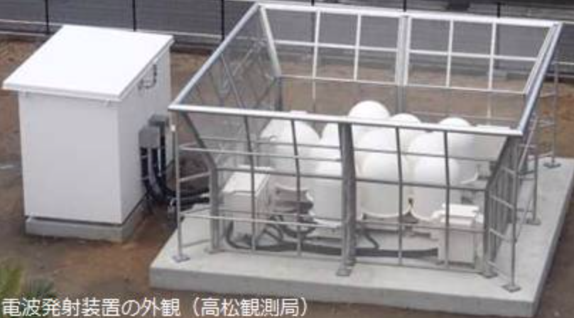
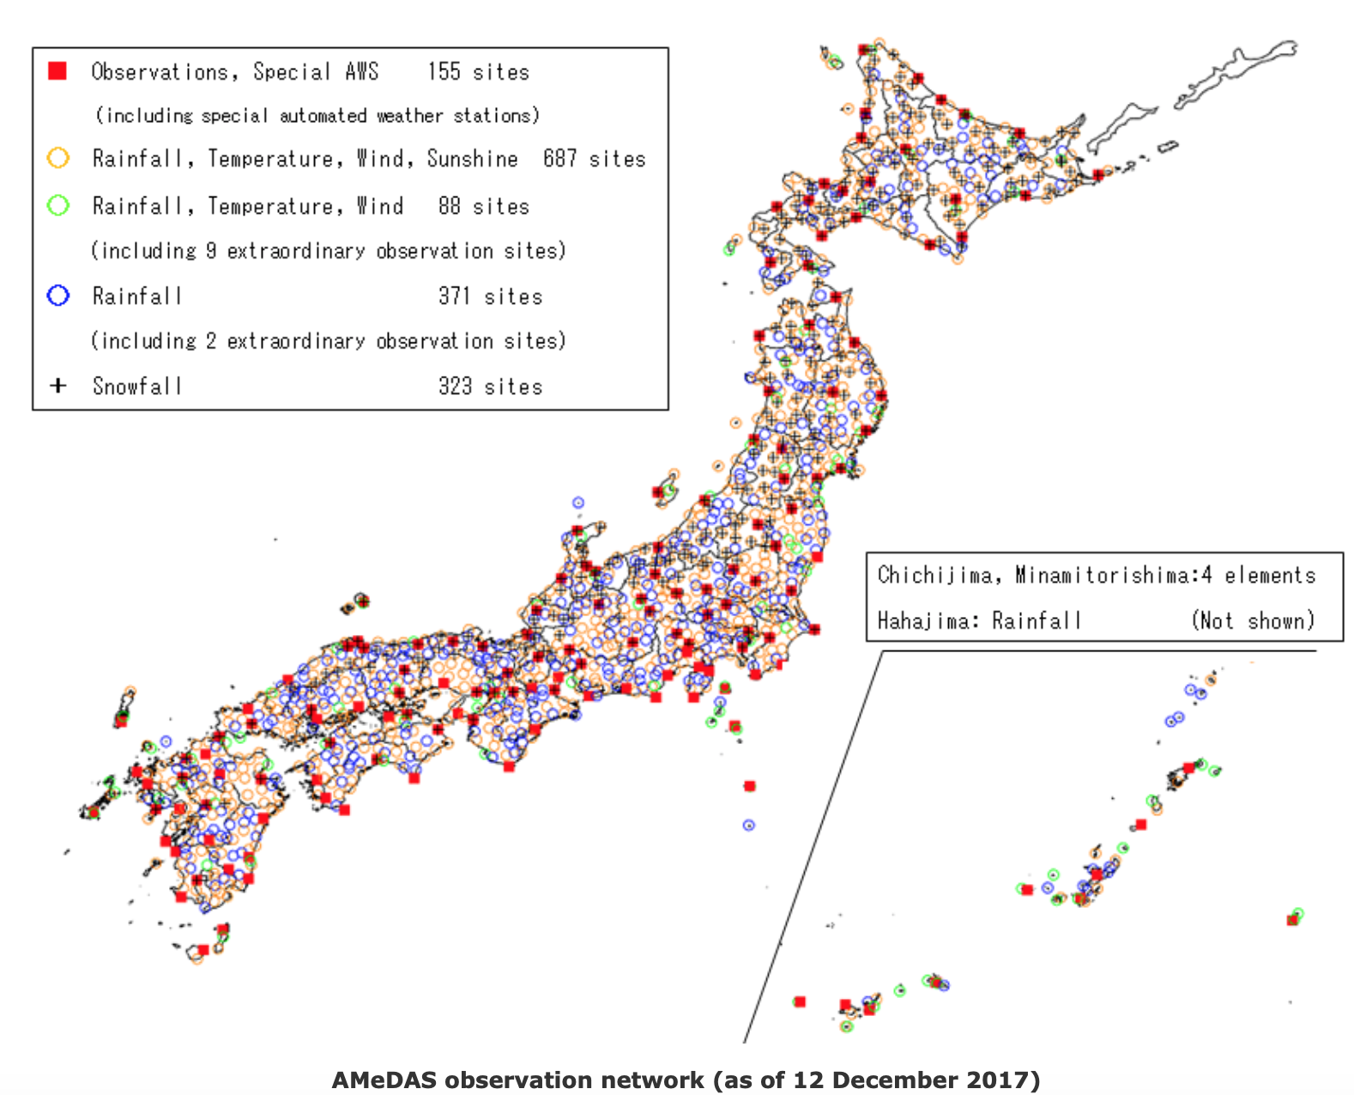
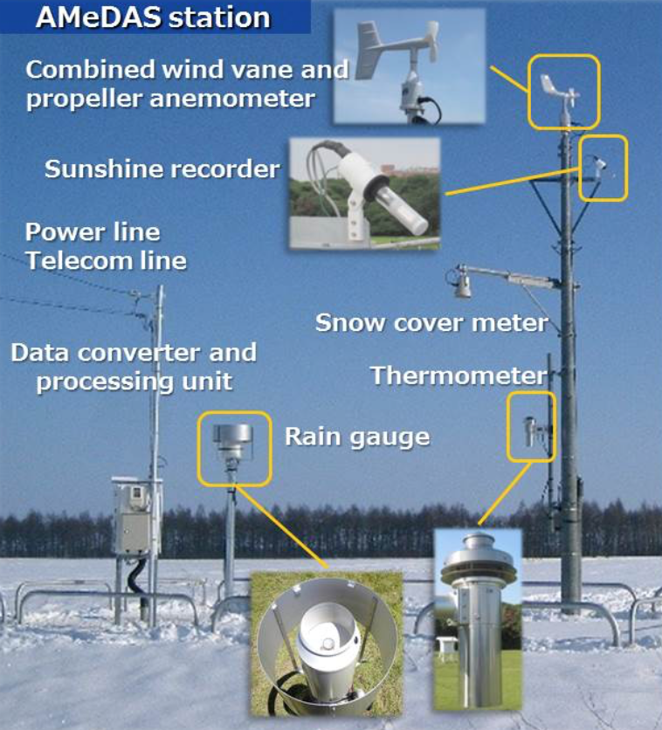
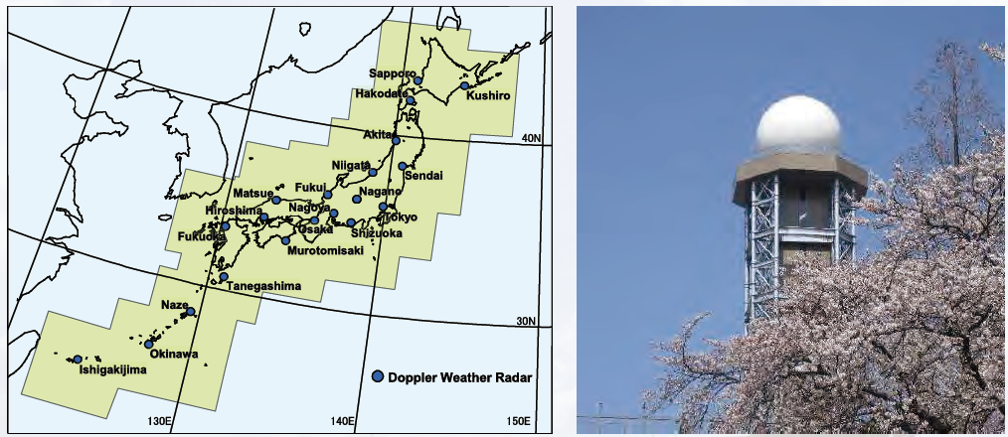
JMA’s weather observation systems
Surface Observations
16 radiosonde stations
33 wind profilers
Upper air observations
Geostationary satellites
Observations for Aviation
20 doppler radars
>1300 stations
Surface observations
Doppler radars

Slide 8

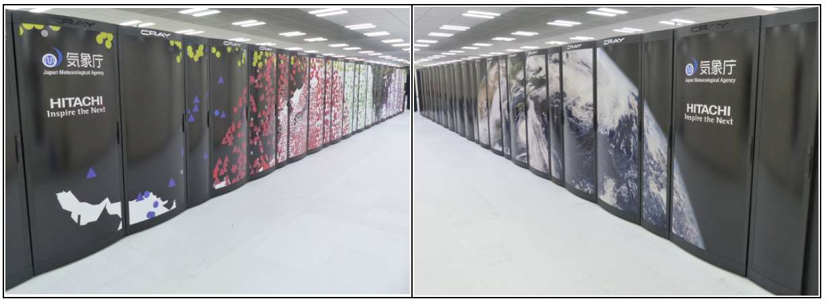

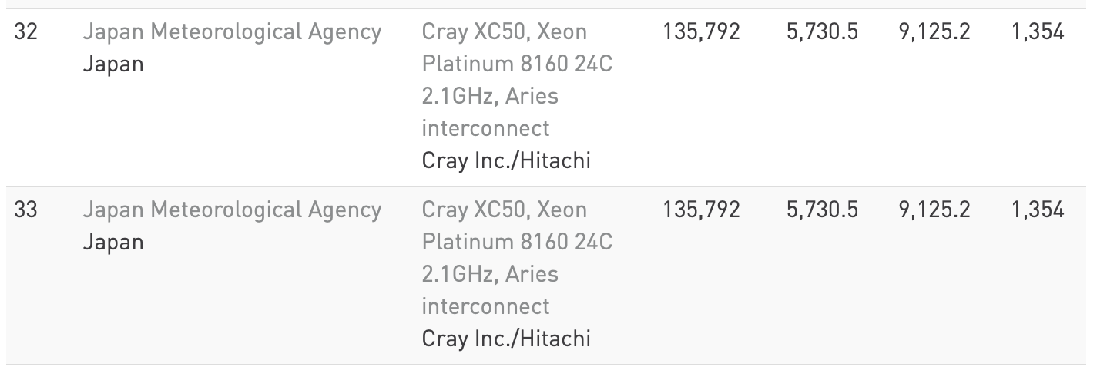
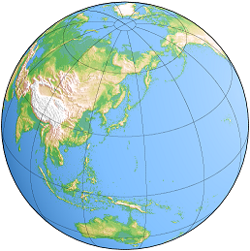
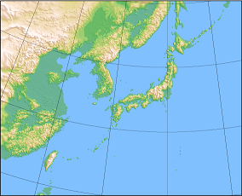
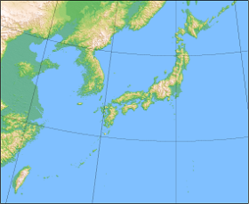
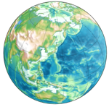
JMA’s weather prediction system
https://www.top500.org/lists/2019/06/
JMA’s world-class operational supercomputer system runs global & regional models.
 | Global Spectral Model (GSM) | Meso-Scale Model (MSM) | Local Forecast Model (LFM) | Global Ensemble (GEPS) | Meso-scale Ensemble (MEPS) | Seasonal Ensemble (CPS2)
Forecast domain | Global | Regional | Regional | Global | Regional | Global (Coupled)
Horizontal resolution | TL959 (0.1875 deg) | 5km | 2km | TL479 / TL319 (0.375 / 0.5625 deg) | 5km | Atmos: 1.125 deg Ocean: 0.3-0.5x1 deg

Slide 9
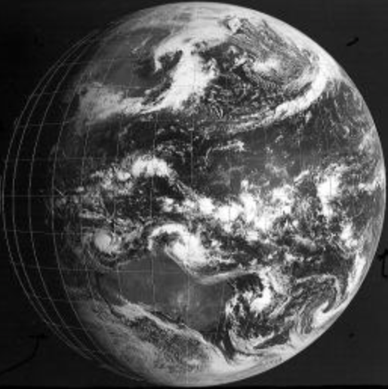
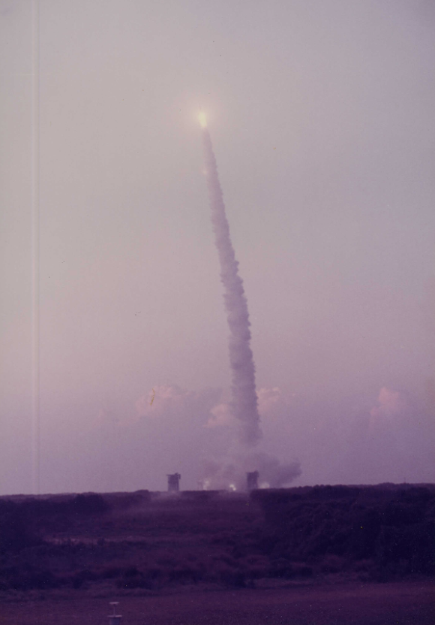
Himawari series satellites
Satellite | Obs period
GMS (Himawari) | 1978 – 1981
GMS-2 (Himawari-2) | 1981 – 1984
GMS-3 (Himawari-3) | 1984 – 1989
GMS-4 (Himawari-4) | 1989 – 1995
GMS-5 (Himawari-5) | 1995 – 2003
GOES-9 | 2003 – 2005
MTSAT-1R (Himawari-6) | 2005 – 2010
MTSAT-2 (Himawari-7) | 2010 – 2015
Himawari-8 | 2015 – (2022)
Himawari-9 | (2022) – (2029)
April 6, 1978
July 14, 1977
Covering the Asia-Pacific region for over 40 years

Slide 10
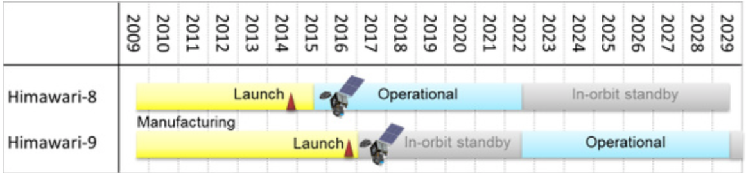
Himawari-8 and -9
The latest generation of Himawari series satellites.
  Himawari-8 in operation since 2015.
  Himawari-9 on standby in orbit, and scheduled to be operational in 2022.
  Compose a twin satellite system until 2029.

Slide 11
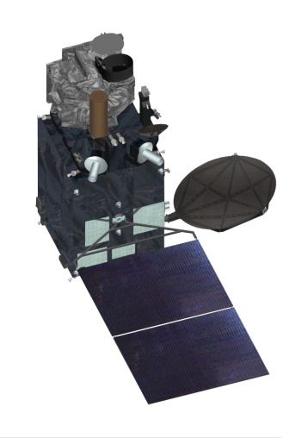
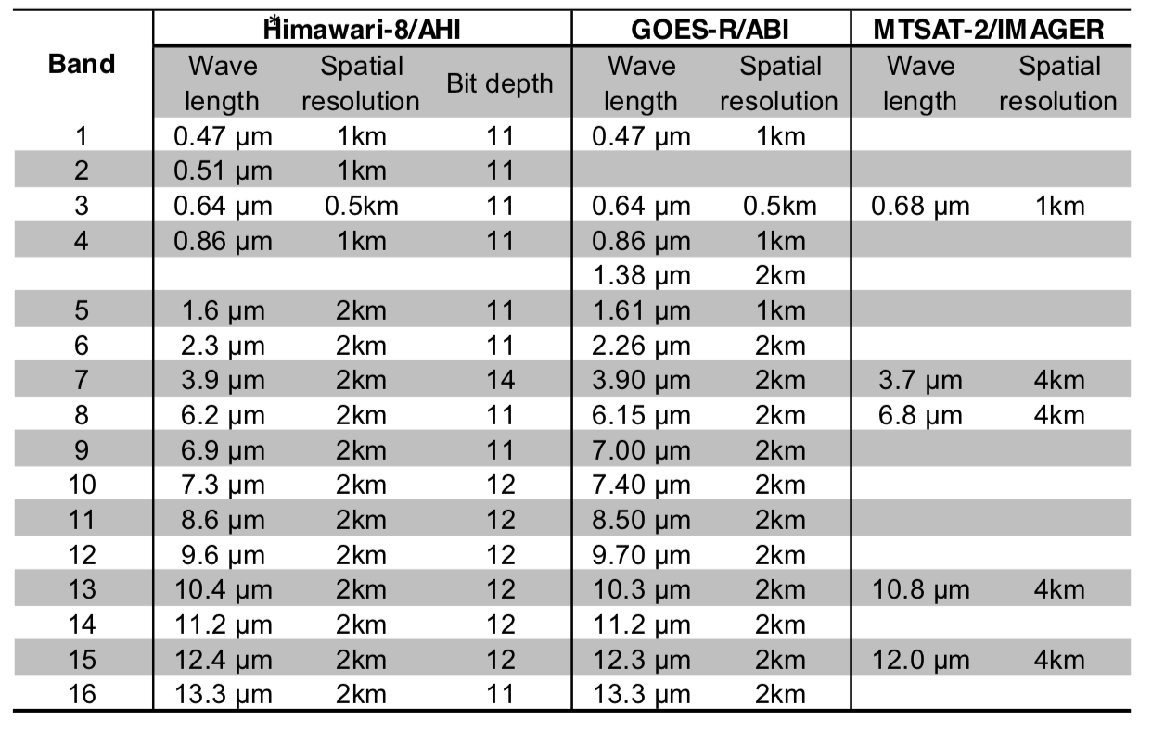
AHI aboard Himawari-8/9
Himawari-8/9 each carry the Advanced Himawari Imager (AHI), an ABI-class 16-spectral-band imaging instrument.

Slide 12
AHI frequent observations
AHI generates a full disk image every 10 minutes, while providing regional observations with 2.5 min and 30 sec intervals.
1000 km x 2000 km
1000 km x 1000 km
500 km x 1000 km

Slide 13



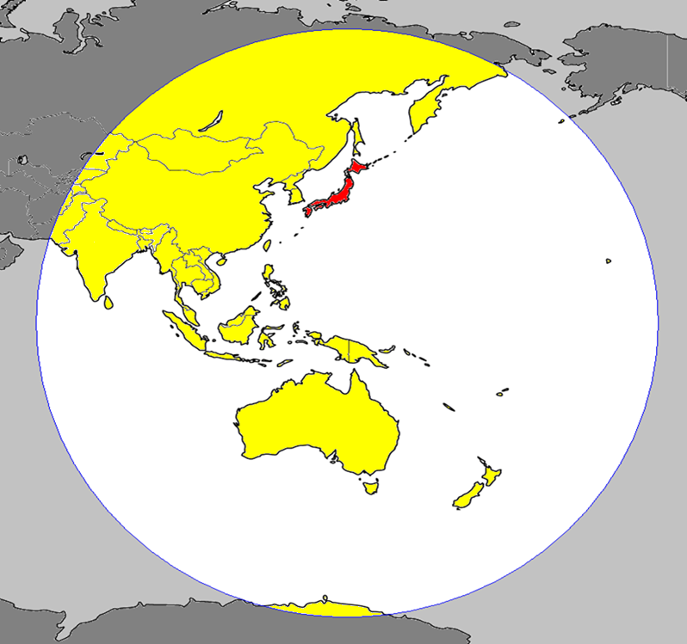

































National weather services using Himawari-8
HimawariCast
32 users
HimawariCloud
21 users and
NESDIS & EUMETSAT
Web service
42 areas including
Timor-Leste & Cook Islands
Russia
Mongolia
Korea
China
Hong Kong, China
Macau
Nepal
Bhutan
Bangladesh
Myanmar
Laos
Sri Lanka
Thailand
Vietnam
Cambodia
Malaysia
Singapore
Indonesia
Observation Area of Himawari-8/9
Philippines
Brunei
Palau
Timor-Leste
Micronesia
Papua New Guinea
Hawaii (USA)
Solomon Islands
Kiribati
Tuvalu
Fiji
Samoa
Cook Islands
Tonga
Vanuatu
New Caledonia (Fr.)
Australia
New Zealand
(As of May 2018)
13

Slide 14
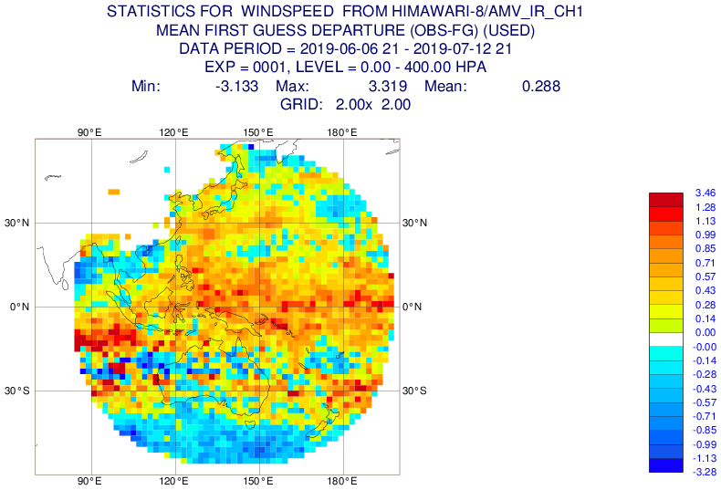
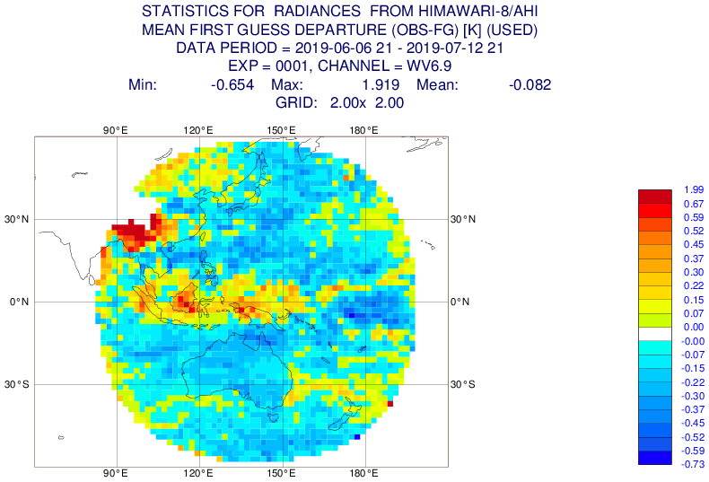
Himawari-8 products for NWP centers
The Himawari-8 AMV & CSR products are provided to NWP centers via the WMO Global Telecommunication System (GTS).
AMV and CSR data used in ECMWF’s assimilation system
ECMWF Website: https://www.ecmwf.int/en/forecasts/quality-our-forecasts/monitoring-observing-system#Satellite

Slide 15
Next Himawari planning
Himawari-8/9 will complete the observation operation in 2029.
JMA has undertaken feasibility studies of their follow-on satellites.
Missions (to be) implemented by satellite operators
Vision for WIGOS 2040
(Geostationary core instruments)
 | USA | Europe | China | Korea
Multi-spectral VIS/IR imagery with rapid repeat cycles | GOES-R series/ ABI | MTG I series [2021²]/ FCI | FY-4 series/ AGRI | GK-2A/AMI
IR hyperspectral sounders |  | MTG S series [2023²]/ IRS | FY-4 series/ GIIRS
Lightning mappers | GOES-R series/ GLM | MTG I series [2021²]/ LI | FY-4 series/ LMI
UV/VIS/NIR sounders | TEMPO [2022¹] | MTG S series [2023²]/ UVN (Sentinel-4) |  | GK-2B [2020³]/ GEMS
[ ] indicate planned launch year based on:
¹ NASA’s press release (July 22, 2019)
² EUMETSAT’s website (as of July 2019)
³ CGMS-47 KMA-WP-01 (May 2019)

Slide 16
2. Highlights of my research at CICS

Slide 17
Highlights of my research at CICS
Study on GLM
  Space system & data processing (with GOES-R Data Book)
  Product evaluation
  Data use in NOAA
Study on cost benefit analysis (CBA) of weather satellites
  Existing Metop-SG CBA & JPSS CBA
  Trial CBA for a hypothetical IR sounder on Himawari
Study on NOAA’s approach for commercial satellites
  Commercial Weather Data Pilot (with NOAA’s report to the Congress)
  Weather Research and Forecasting Innovation Act of 2017
Study on NOAA’s Cooperative Institutes
  General framework (with CI Handbook)
  Research activities (with CICS annual report)

Slide 18
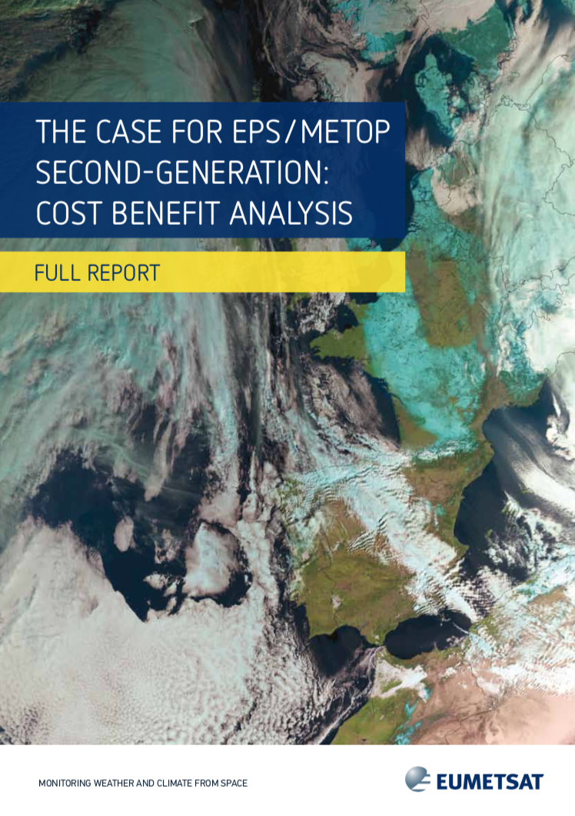
Metop-SG CBA
Socio-economic benefits of weather information in Europe was assessed for three benefit areas:
  Protection of Property and Infrastructure
  Added Value to the European Economy
  Private Use by European citizens
Socio-economic benefits of Metop-SG was estimated by prorating the weather information benefits based on Metop contribution to forecast skill
Value of
weather info.
Contribution to forecast
Value of
Metop-SG
X
=
EUMETSAT (2014)

Slide 19
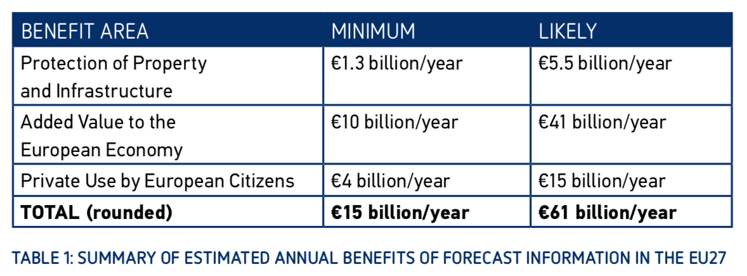
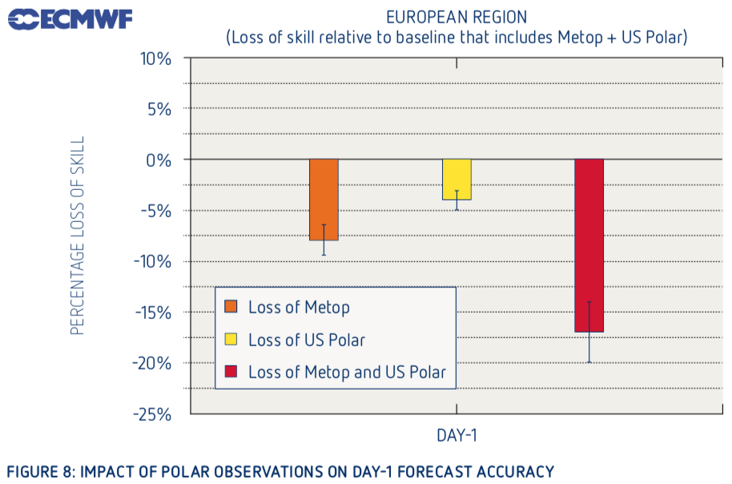
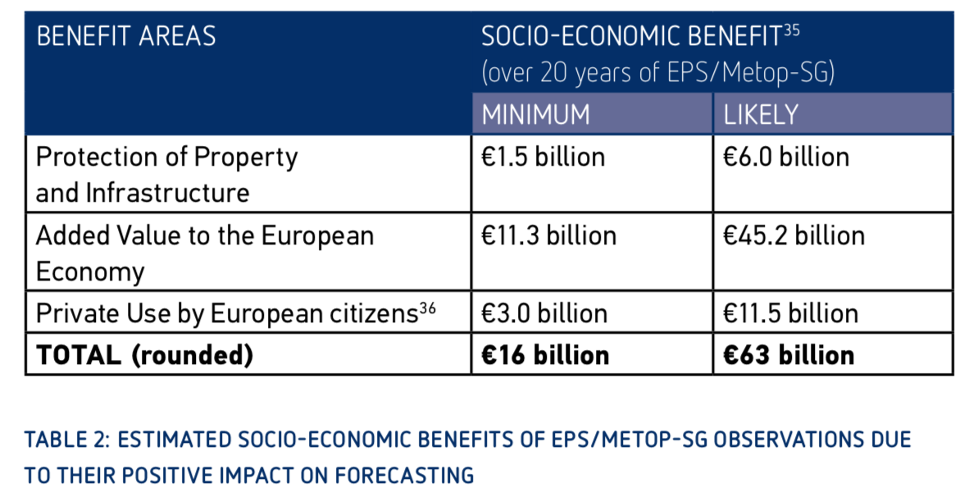
Metop-SG benefit assessment
Annual socio-economic benefits of weather information
mainly based on Hallegatte, S. (2012) etc
Metop contribution to forecast skill 8 %
based on ECMWF’s data denial experiments
Metop-SG benefits for 20 years
B/C = 5 ~ 20
where C = ~€3 billion

Slide 20
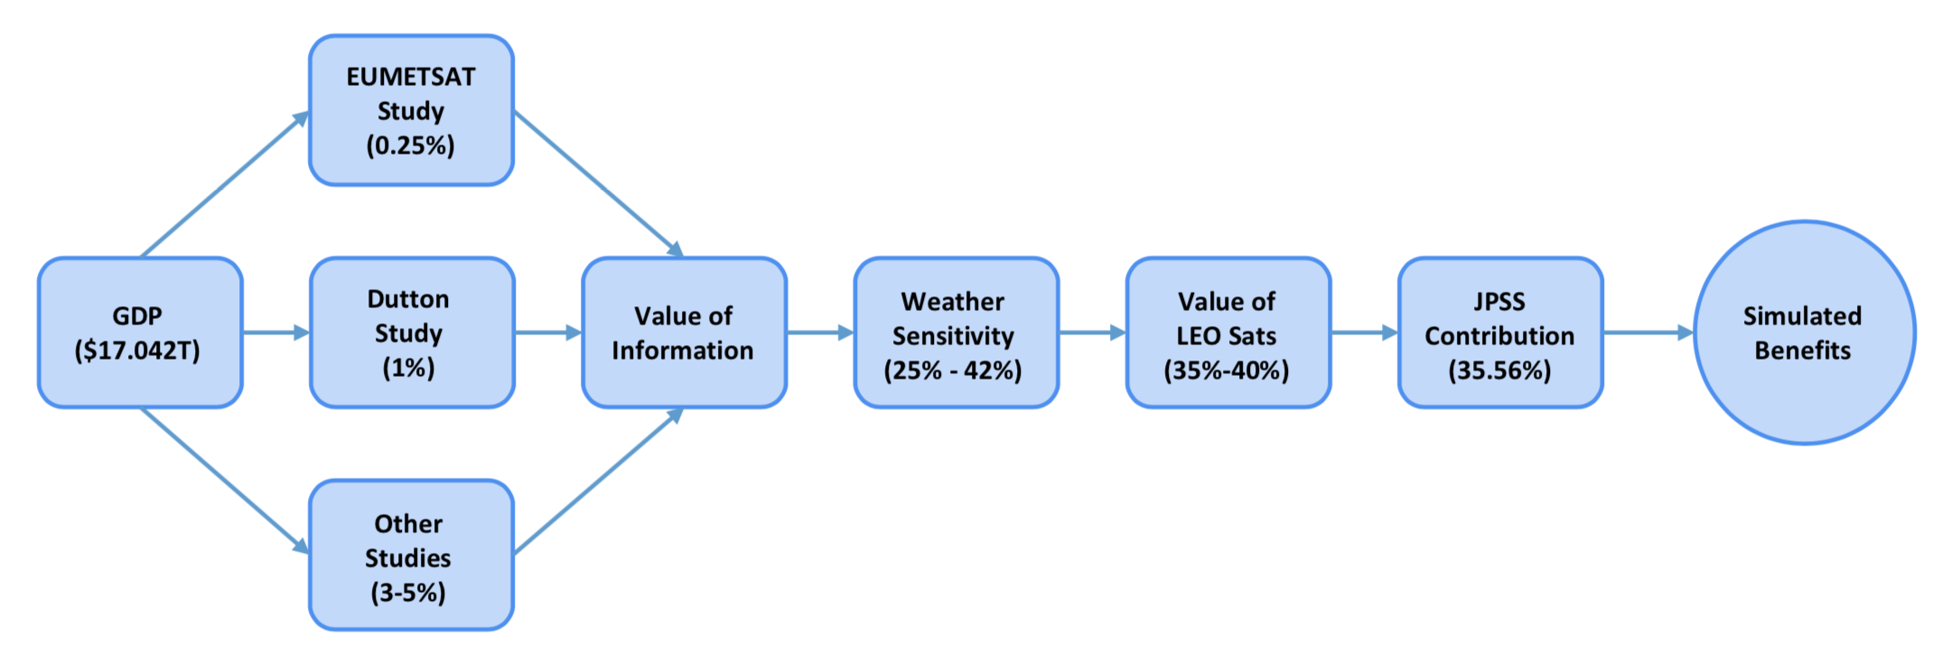
JPSS benefit assessment
Benefit of weather information was assessed by top down analysis using GDP and assumed parameters
JPSS contribution to weather forecasts assessed by the WMO OSCAR database
Mehta, A., 2015 AMS Annual Meeting

Slide 21
CBA for a “hypothetical” IR sounder on Himawari
Socio-economic benefits of weather information in Japan was estimated by scaling those of Europe:
  Protection of Property and Infrastructure -> proportional to GDP
  Added Value to the European Economy -> proportional to GDP
  Private Use by European citizens -> proportional to # of households
B/C is derived as a function of a hypothetical IR sounder contribution to forecast skill.
  Life time and life cycle cost of the hypothetical IR sounder were assumed to be the same with the Himawari-8/9 system

Slide 22




Benefit analysis in Japan
Annual benefit of weather information
Benefit of the hypothetical sounder for a 15-year mission life cycle
Benefit area | Minimum | Likely | Derivation
Protection of Property and Infrastructure | 58.2 | 246.4 | =[Value in EU27]x[GDP ratio JP/EU27]
Added Value to the European Economy | 448.0 | 1836.7 | =[Value in EU27]x[GDP ratio JP/EU27]
Private Use by European citizens | 133.6 | 501.1 | =[Value in EU27]x[# household ratio JP/EU27]x[exchange ratio ¥/€]
Total | 639 | 2584
$$B_{a }$$
$$B_{b }$$
$$B_{c }$$
Unit: billion JPY/Year
$$=f\sum_{t=1}^{15}{\frac{\left\{B_{a }{\left(1+g\right)}^{t−1}+B_{b}{\left(1+g\right)}^{t−1}+B_{c}\right\}}{{\left(1+r\right)}^{t−1}}}$$
f: contribution to forecast skill
g: Annual GDP increase rate (1%)
r: Annual discount rate (4%)

Slide 23
CBA result of the hypothetical IR sounder
18.5
4.6
5%
Contribution to forecast skill [%]
B/C = 4.6~18.5, for a contribution of 5%
A reasonable contribution can be determined by OSSE

Slide 24
For refining this CBA
More realistic benefit assessment
  Benefits of weather information must be dependent on countries
  Benefits in Japan would not be derived correctly by scaling European result.
    (e.g. Typhoons need to be considered for Japan)
  Bottom-up approach is required
  Contribution to forecast skill is determined by numerical experiments
  (e.g. OSSE)
More realistic cost assessment

Slide 25
3. GLM product evaluation
This work was conducted in coordination with
the GLM science team at CICS led by Dr. Scott Rudlosky

Slide 26
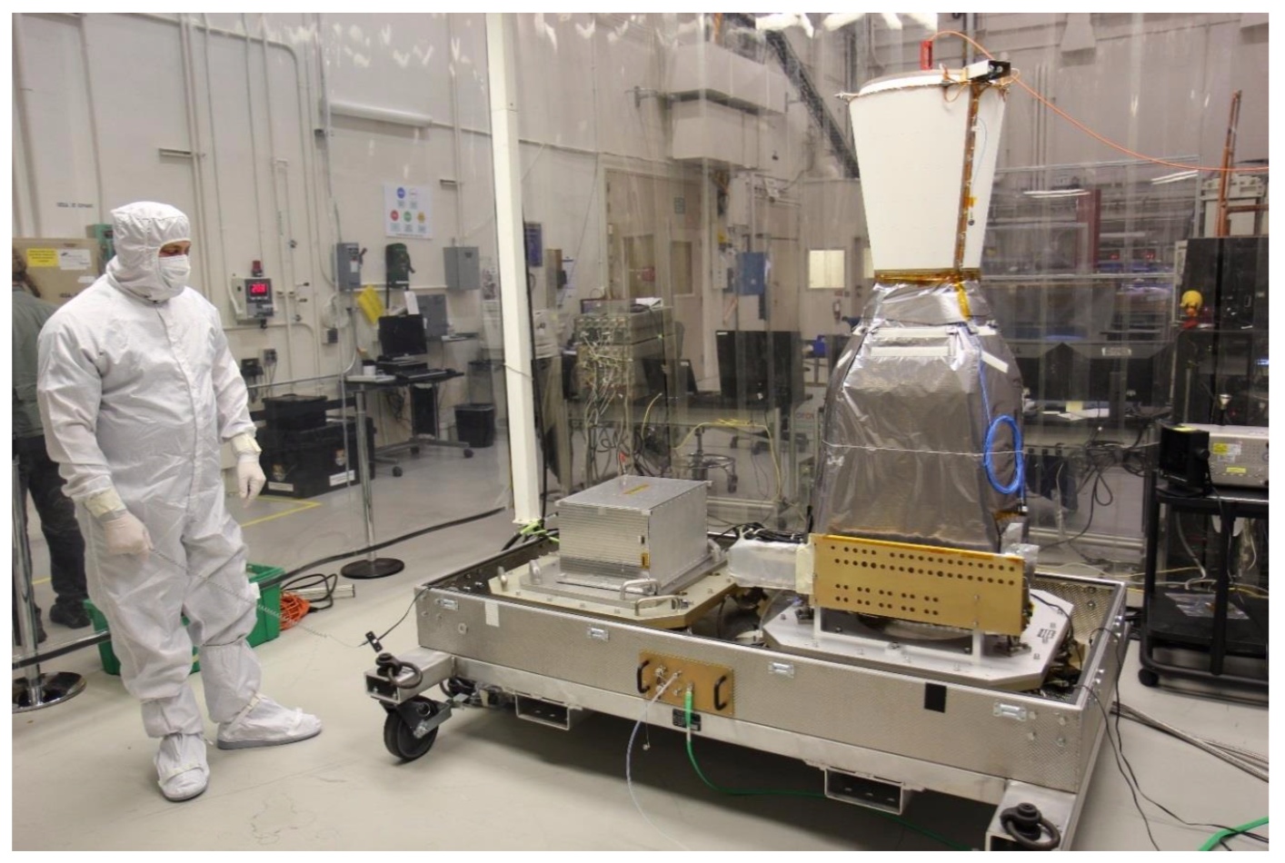
Geostationary Lightning Mapper (GLM)
Optical lightning sensor aboard GOES-R Serie satellites
Continuous & hemispherical coverage (up to 54 deg N/S)
Detection of both intra-cloud (IC) and cloud-to-ground (CG) lightning
  No discrimination between IC & CG
GLM sensor design parameters
# of CCD pixels | 1372 x 1300
Frame rate | 2 ms
Ground sample distance | 8 km (Nadir) 14 km (FOV edge)
Wavelength | 777.4 nm
Image: GOES-R Series Data Book

Slide 27
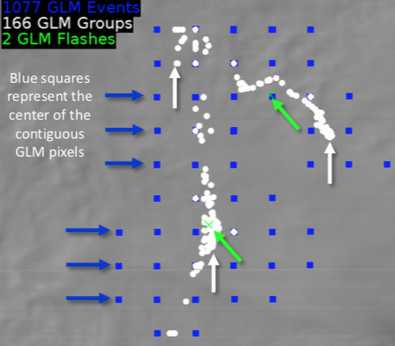
GLM Level 2 product
Event: Pixel-level detection exceeding the threshold in one frame
Group: 1 or more events in adjacent pixels in one frame
Flash: 1 or more groups separated by less than 330 ms and 16.5 km
GLM Level 2 product maturity
Status | GOES-16 | GOES-17
Launch | Nov 19, 2016 | Mar 1, 2018
Beta | June 9, 2017 | Oct 3, 2018
Provisional | Jan 19, 2018 | Dec 20, 2018
Full | Nov 1, 2018
Image: GLM Definitions and Detection Method Quick Guide

Slide 28
GLM L2 product evaluation
A: Flash geographical distribution
B: Flash detection efficiency
  B-1: GLM vs GLD360
  B-2: GLM vs ENTLN
C: Group timing & location

Slide 29
A: Flash geographical distribution

Slide 30
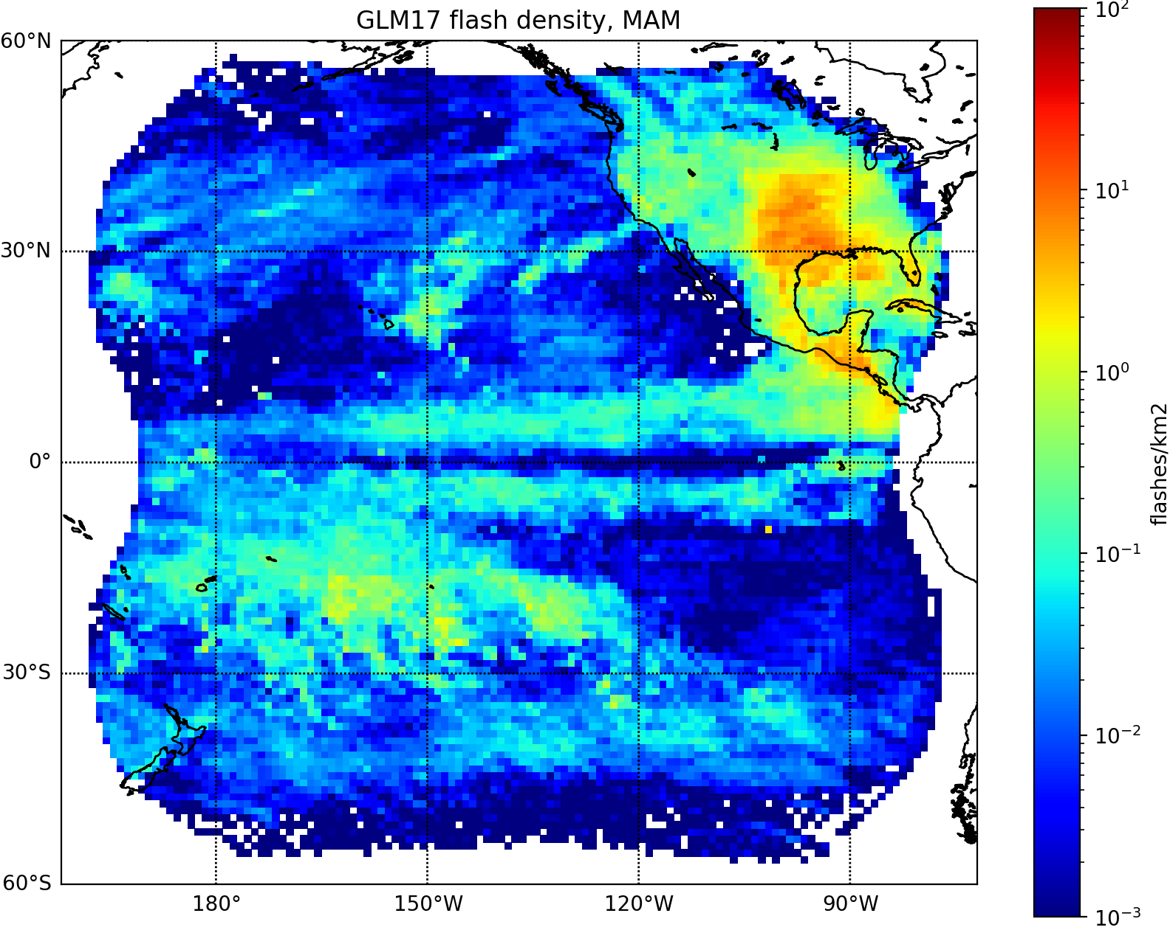
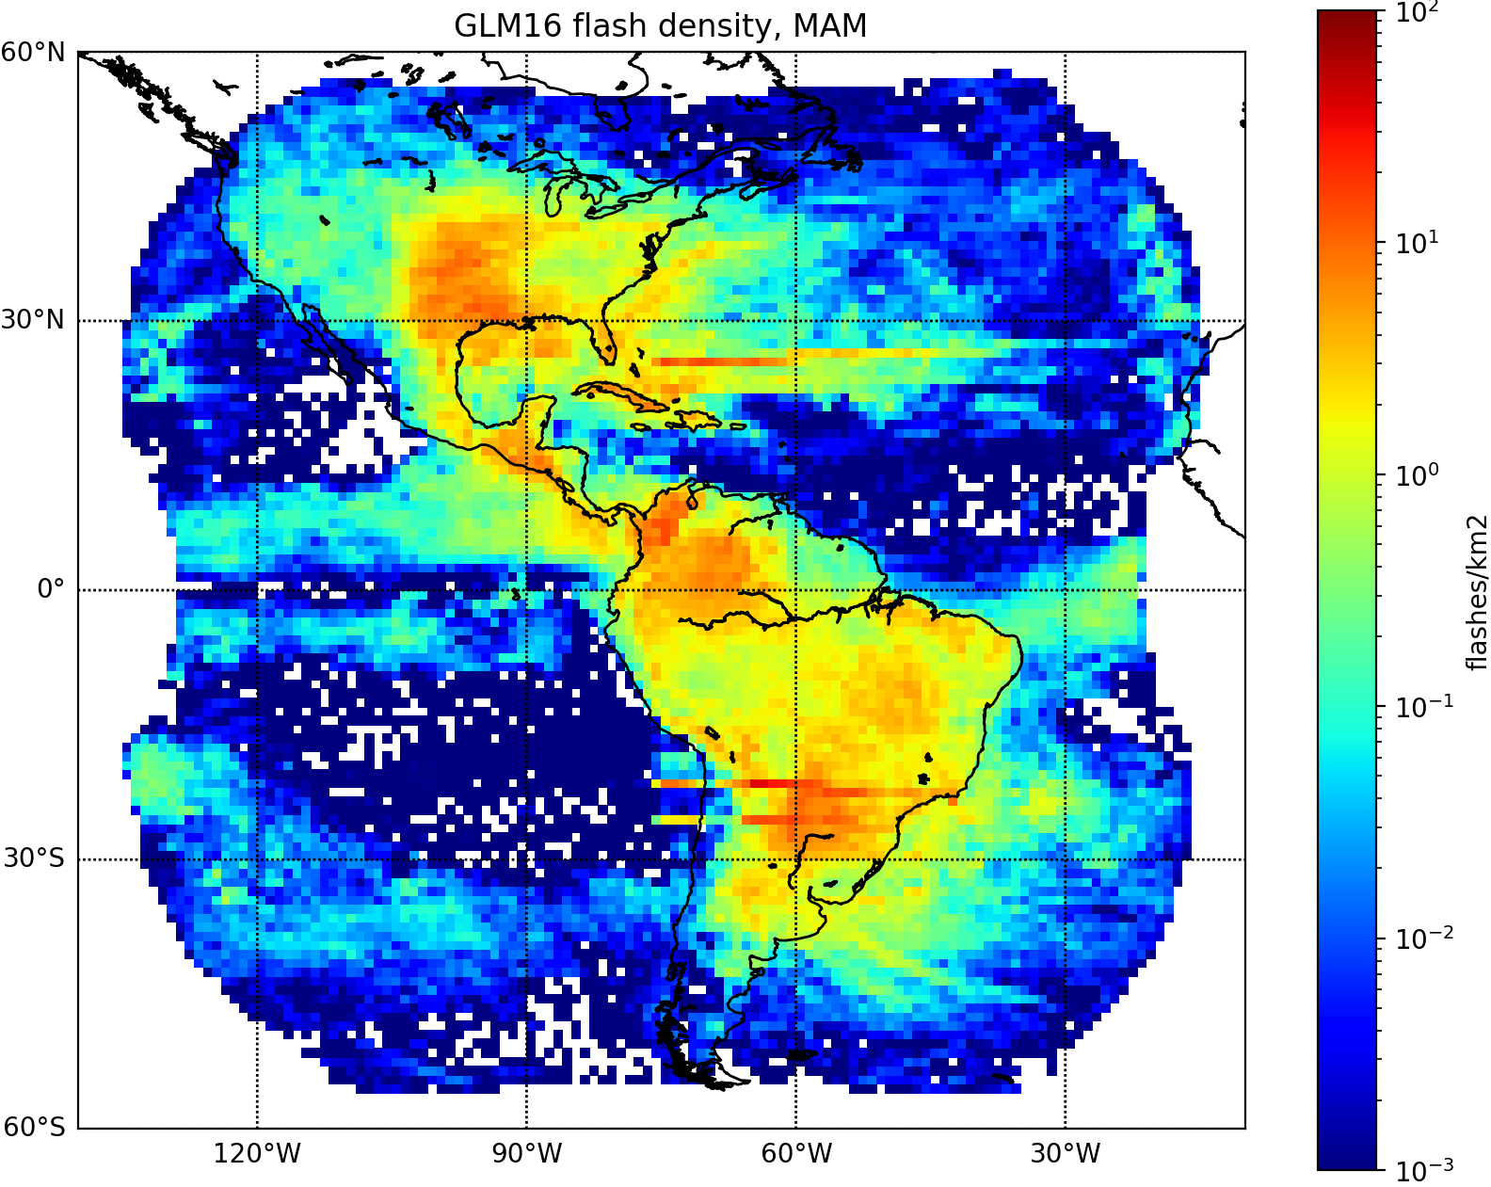
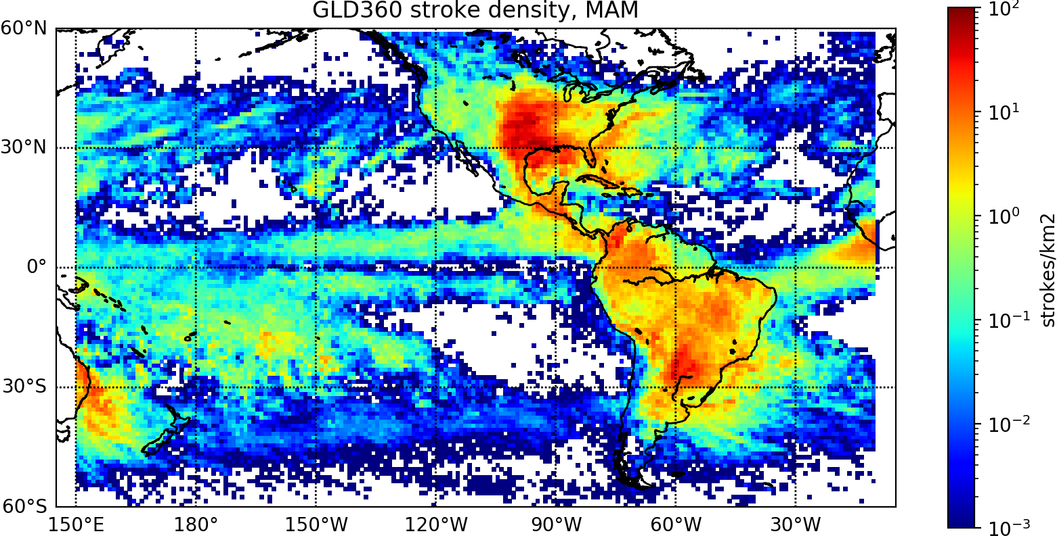
Flash density maps (MAM 2019)
GLM17 flashes
GLM16 flashes
GLD360 strokes
Generally consistent with each other
GLM false detections (e.g. GLM16’s Bahama bars)

Slide 31
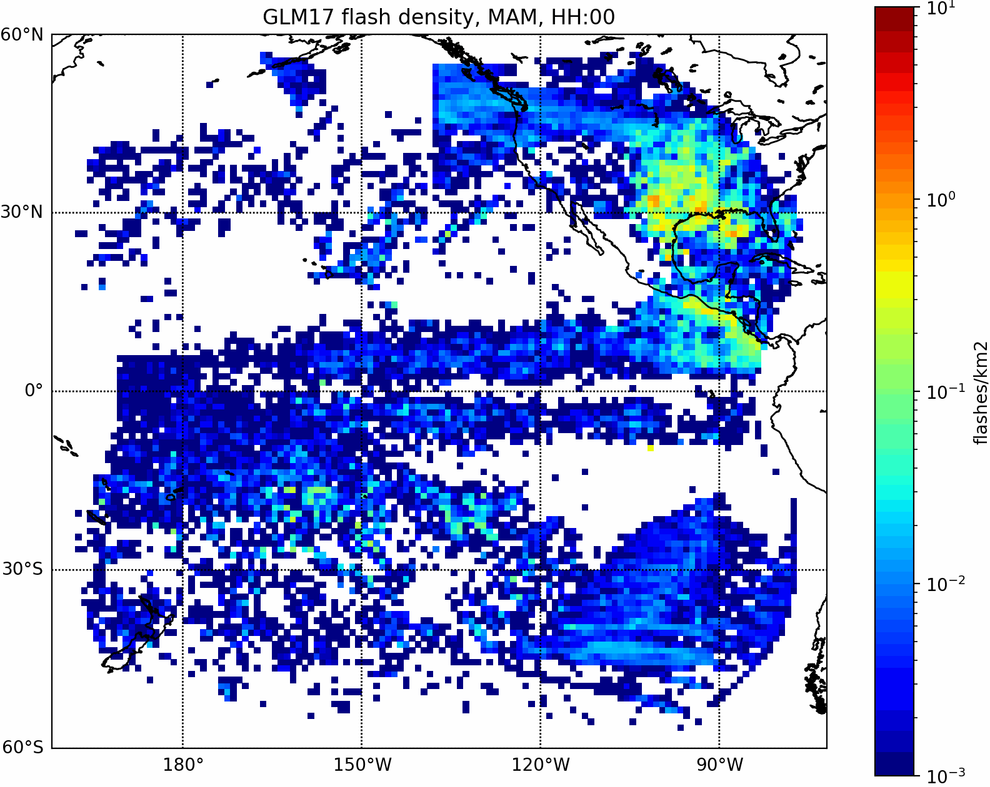
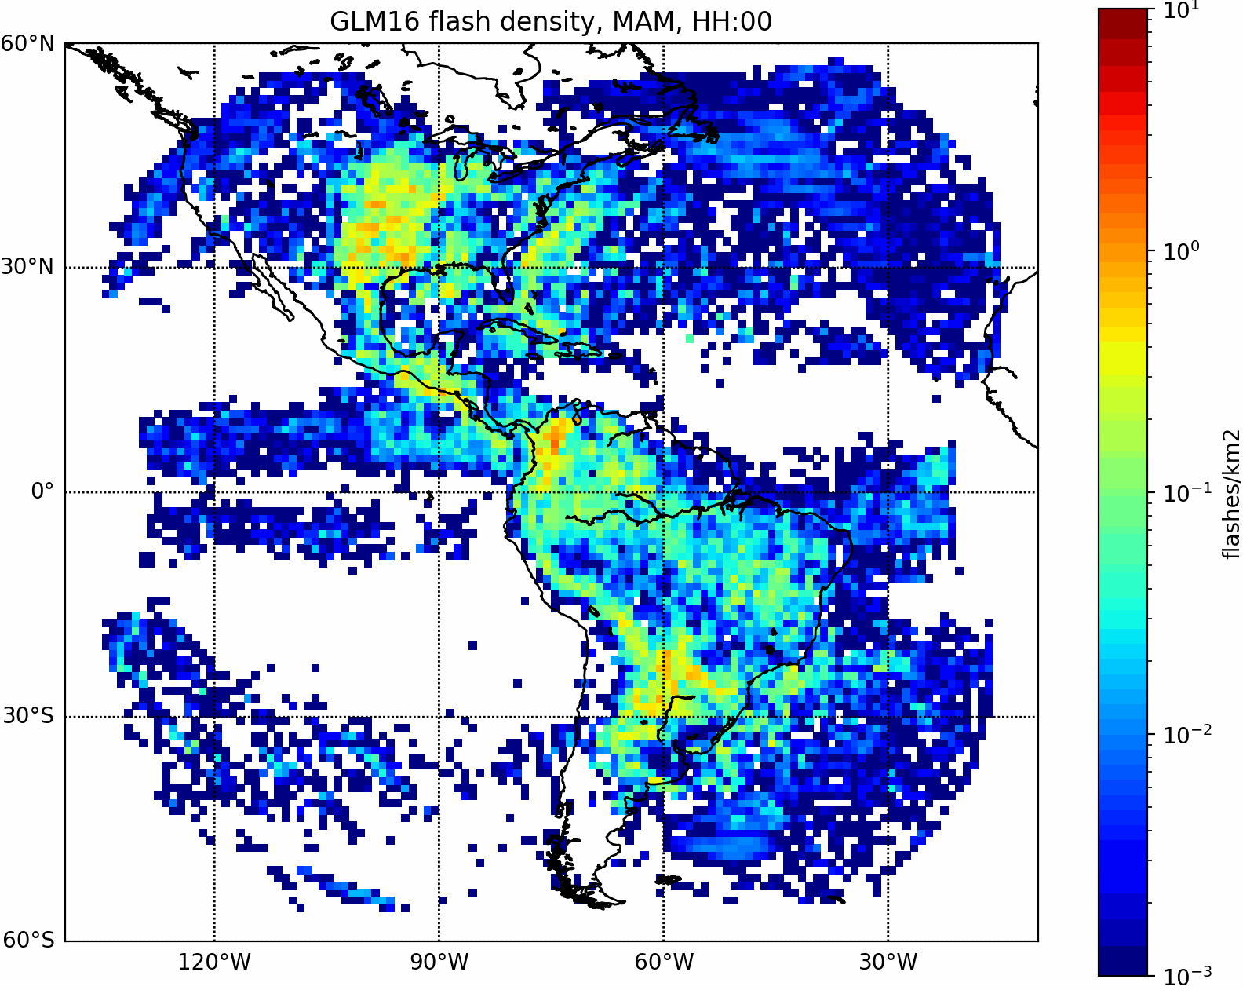
GLM false flashes (MAM 2019)
Flash density hourly variation in nadir local time
GLM17
GLM16
Bahama bars (daytime), Solar intrusions (midnight), Solar glints (morning/evening)
Westward moving daytime artifacts (GLM17 > GLM16)

Slide 32
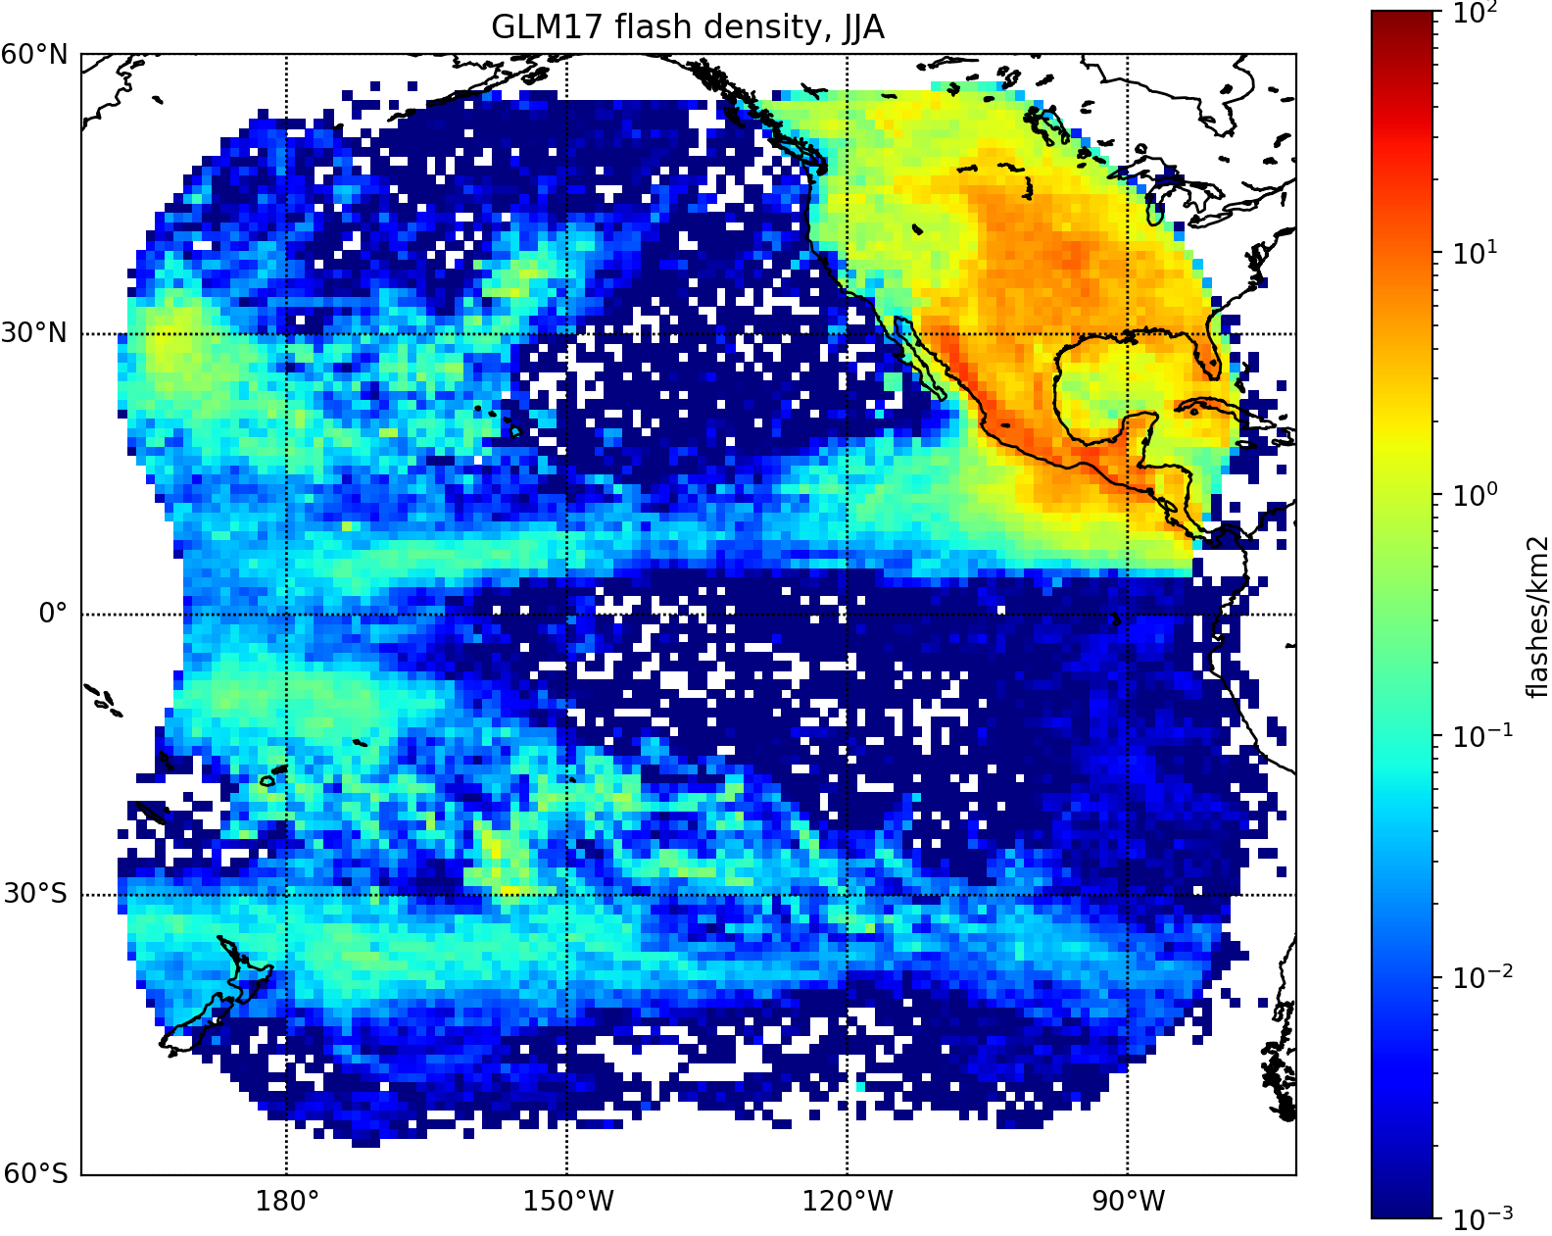
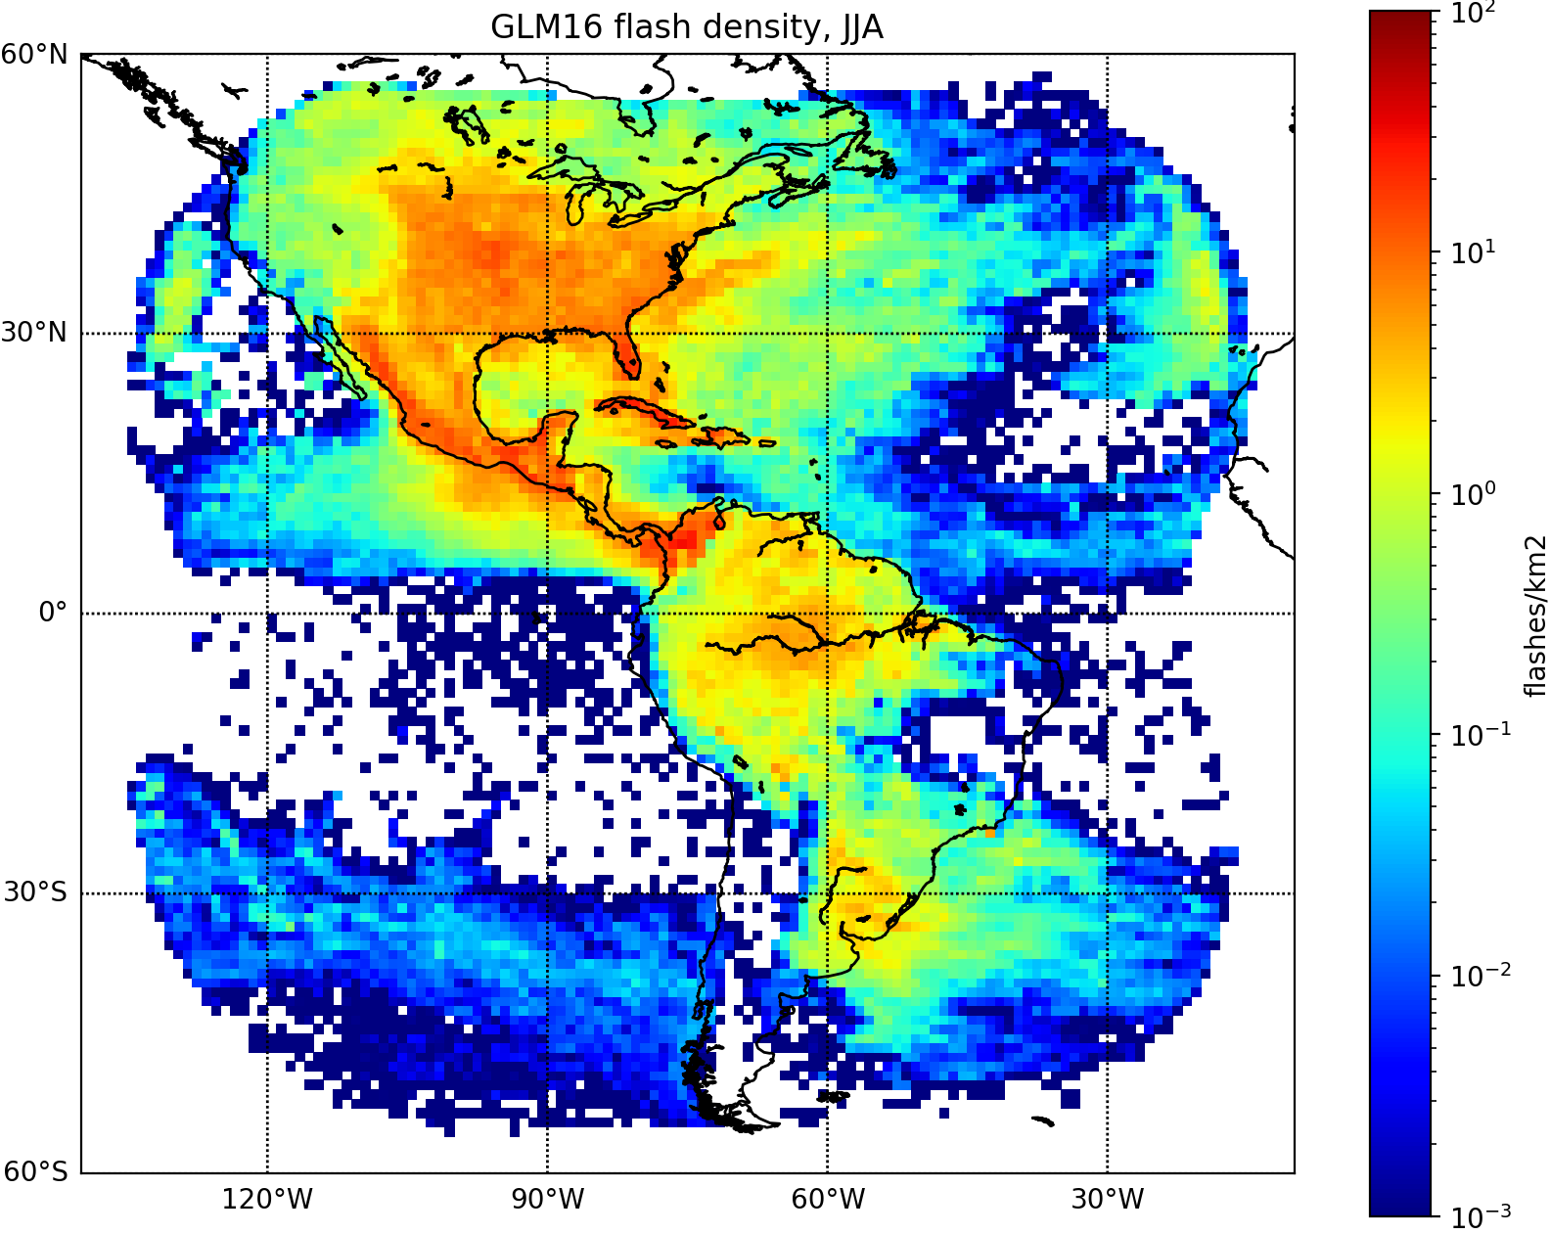
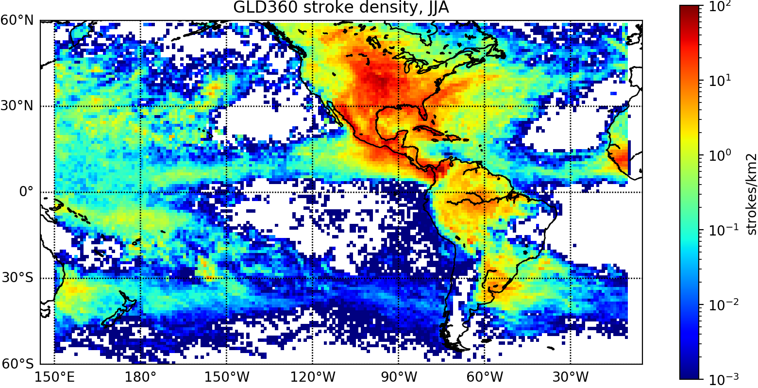
Flash density maps (JJA 2019)
GLM17 flashes
GLM16 flashes
GLD360 strokes
False detections reduced by updating ground processing for G16 & G17
  Contrast Leakage Algorithm activated (Apr. 30) to reduce jitter noise
  2nd-level Threshold Algorithm updated (Apr. 30) to reduce Bahama bars
  Blooming Filter activated (Jul 25) to reduce solar glints and intrusions

Slide 33
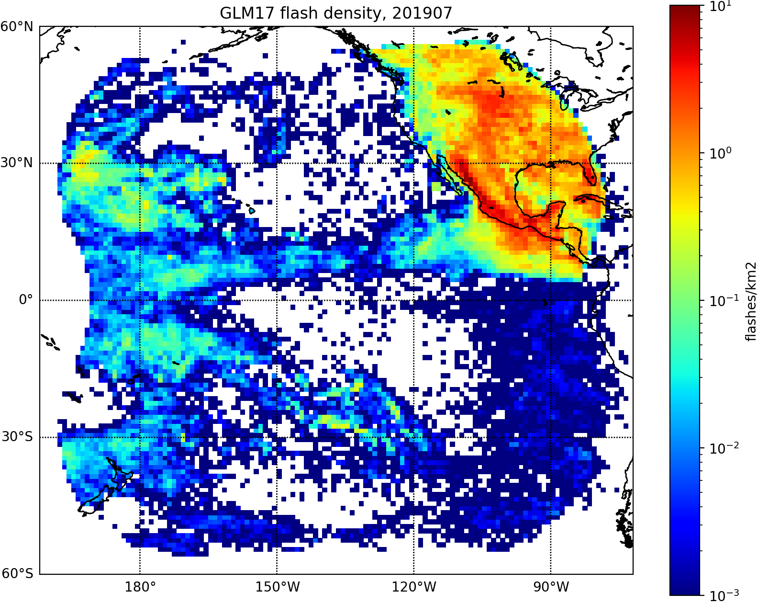
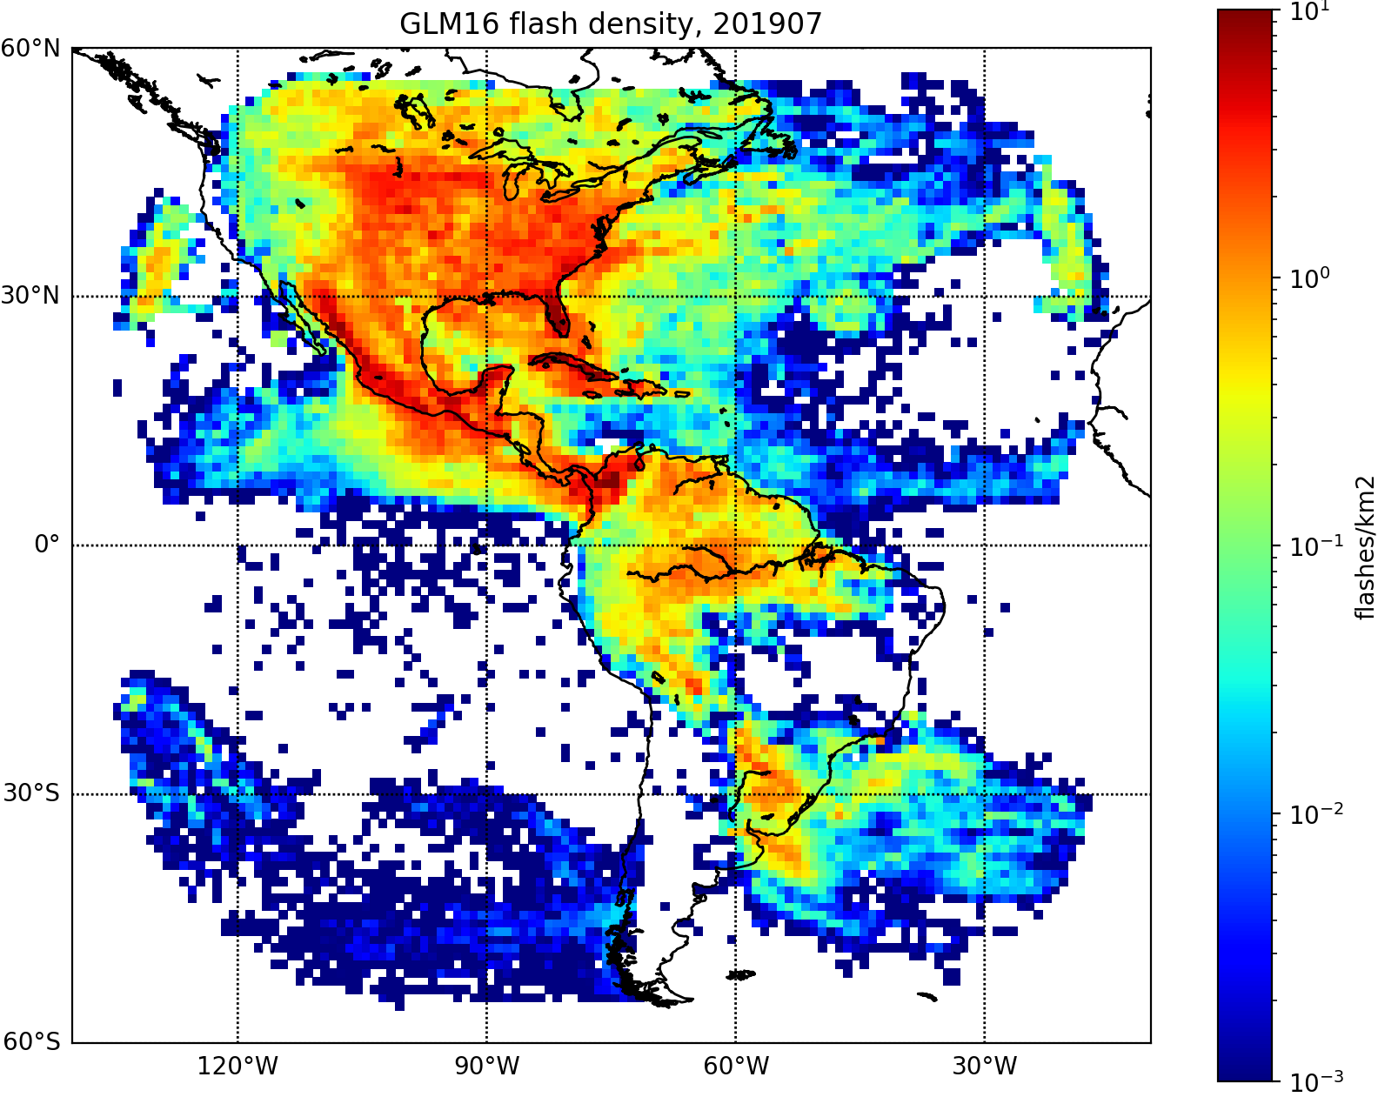
Before Blooming Filter activated (Jul. 2019)
GLM17
GLM16
Solar glints are apparent

Slide 34


After Blooming Filter activated (Aug. 2019)
GLM17
GLM16
Solar glints are mitigated by Blooming Filter

Slide 35
B: Flash detection efficiency

Slide 36

Flash detection efficiency
Flash detection efficiency (DE) indicates the ability to detect flashes
GLM DE relative to a ground-based network (GN)
Detection criteria: flash separation less than 25 km and 0.1 s.
$$GLM DE= \frac{\# GN flashes detected by GLM}{Total \# GN flashes}$$
Spatial separation
Temporal separation
GN flash
AND
GLM flash
GLM flash
GN flash
< 25 km
Time
< 0.1 s

Slide 37

B-1: GLM DE relative to GLD360
GLM16 & GLM17 DE for overall FOV were examined using GLD360
GLD360 is designed to globally detect >80 % CG with VLF sensors
Acknowledgement:
GLD360 used in this study were provided by Vaisala.
GLD360 stroke density for May 2011 to May 2015 (Vaisala, 2015)

Slide 38



GLM DE relative to GLD360 (Mar-Aug, 2019)
GLM17 DE
GLM16 DE
GLD360 DE
GLM DEs are maximized over the oceans and the South America
GLM DE depression over high-boresight-angle CONUS (GLM16: NW, GLM17: NE)
GLD360 pixels with DE < ~30% generally coincide with GLM false detections

Slide 39
DE Monthly variation
GLM16/17 DE decreases in spring & summer, when lightning activity increases over CONUS.
Note: DE is dependent on matching criteria (larger criteria, larger DE)
  Need to focus on variance/difference rather than absolute values

Slide 40

B-2: GLM DE relative to ENTLN
GLM16 DE variance was examined using ENTLN flashes.
  IC/CG difference & diurnal variation
ENTLN is
  Earth Networks Total Lightning Network
  Designed to detect both IC & CG
  with wideband (1Hz to 12MHz) sensors
  High IC detection efficiency over CONUS.
Acknowledgement:
ENTLN data used in this study were provided by Earth Networks, Inc.
Estimated ENTLN IC DE (Liu and Heckman, 2012)

Slide 41



GLM16 DE for ENTLN IC & CG (Dec-Aug, 2019)
GLM DE for IC (DE_{IC})
GLM DE for CG (DE_{CG})
DE_{IC} - DE_{CG}
  DE depression over NW CONUS is more clear for IC
  DE_{IC} < DE_{CG} over CONUS

Slide 42


Diurnal variation over CONUS
0.13
0.18
GLM and ENTLN flashes are maximized in the late afternoon (17-18 local time), associated with day-time thermal convections.
GLM DE decreases during the daytime
  Peak-to-peak diurnal variation of GLM DE is larger for IC (0.18) than CG (0.13)

Slide 43

Cloud light blockage effect
GLM’s flash underestimation due to cloud light blockage was reported in evaluation efforts.
GLM DE dependence on cloud development was examined using the ABI cloud top temperature product (CTT_{ABI}).
Dr. Stano’s report at the 2019 AMS annual meeting:
https://ams.confex.com/ams/2019Annual/meetingapp.cgi/Person/88040

Slide 44








Dependence on cloud top temperature
-10 < CTT_{ABI} < -30
-30 < CTT_{ABI} < -50
-50 < CTT_{ABI} < -70
-70 < CTT_{ABI} < -90
DE_{IC}
DE decreases as CTT_{ABI} decreases
DE_{CG}

Slide 45


Local analysis over CONUS
a)
b)
DE_{IC}
A
B
A
B
GLM DE decreases as CTT_{ABI} decreases to ~0.2 (A) & ~0.1 (B)
DE difference between IC and CG becomes small as CTT_{ABI} decreases

Slide 46
C: Group timing & geolocation

Slide 47


Group timing and geolocation accuracy
ENTLN - GLM timing difference [ms]
Geolocation difference [km]
Peak timing difference (-0.7 ms) is less than the GLM flame rate (2.0 ms).
Peak distance (3.25 km) is less than the GLM ground sample distance (8~14 km).

Slide 48
New parallax correction
Parallax in the GLM L2 product is corrected by ground processing using a static height model (lightning ellipsoid).
A new correction method using the ABI cloud top height product (CTH_{ABI}) was developed.
Earth axis
h=6km
Lightning ellipsoid
Observed
Actual
h=14km

Slide 49

Parallax correction by ABI cloud top height
Geolocation error [km]
Peak error: CTH_{ABI} (2.75 km) < Lightning Ellipsoid (3.25 km)
Lightning Ellipsoid is a reasonable way for parallax correction

Slide 50


Parallax correction by ABI cloud top height
(a) Lightning ellipsoid
(b) ABI could top height
CTH_{ABI} reduces parallax location errors near the edge of FOV

Slide 51
Summary of GLM L2 product evaluation
A: Flash distribution analysis
  GLM flash distributions were consistent with GLD360
  Mitigation efforts significantly reduced GLM false detections
B: Flash detection efficiency (DE) analysis
  GLM’s high & broad detection capability
  DE depression over high-boresight-angle CONUS
  DE_{IC} < DE_{GC} & DE_{Day} < DE_{Night} over CONUS
  DE decreases as CTT_{ABI} decreases
C: Group timing & location validation
  Peak errors not exceeding GLM’s sampling rate & distance
  Further improvement of parallax correction provided by CTH_{ABI}

Slide 52



Thank you for your attention!
Himawari-8
GOES-17
GOES-16
Images created by RAMMB/CIRA SLIDER

