Slide 1
GLM Lightning Val Plans
Monte Bateman, Doug Mach, Rich Blakeslee, Bill Koshak & Steve Goodman

Slide 2
I. Product Generation & Assessment
Proxy products: GLM events, groups, and flashes
Pseudo-GLM (pGLM)
Validate Lightning Data (Valid) tool
User engagement activities – NWS comments
Proving Ground – 2013 Spring program used pGLM
National Lightning Jump Demonstration uses pGLM data

Slide 3
User Comments compiled by Geoffrey Stano
2013 Spring Program
“I can see value in this product during the summer in helping with decision support during big outdoor events where lightning is a concern.”
“Strengths to me were trends in the flash density products.”
“The strength of the lightning data was being able to visualize the lightning jumps related to updraft intensification. The most notable weakness was the data dropouts, which made it difficult to find consistency with respect to time.”
“The strengths were a good correlation with "lightning jumps", ie rapid increases in lightning density and increases in storm severity in terms of large hail.”
“There were very few weaknesses in the products today as we had storms in good coverage areas. The lightning data was very beneficial in linear modes to decipher which storms were the most severe within the line.”

Slide 4
User Comments compiled by Geoffrey Stano, 2
2013 Spring Program
“The lightning data did well picking up on jumps in intensity. This helped signify areas were storms were likely to intensify or already doing so.”
“It definitely helped in detecting where storms were strengthening or weakening quickly.”
“I found the flash extent density to be extremely useful, especially with the sub-severe convection it offered a glimpse in the storms’ intensity between volume scans and offered a way to monitor their growing intensity.”
“The flash extent density was the best one because it’s the simplest to use and process in a rapidly developing warning situation.”

Slide 5
Val Tools
VALID – overall framework; ingests lightning data from all available sources (other satellites & ground-based networks)
Overview: Data Match tool (shown later) Evaluates performance of GLM relative to one or more sources (automatic or user selected)
Data Match “product” is a “stoplight chart” map
UI will allow user to click on a problem area, invoking the deep-dive tool, displaying histograms and time-series behind the warning

Slide 6
Field Programs
CHUVA 2012 Multi-sensor field campaign, centered in Sao Paulo See plot next
IPHEX 2014 Multi-aircraft field campaign, based in SW Georgia
Working on an airborne GLM simulator

Slide 7
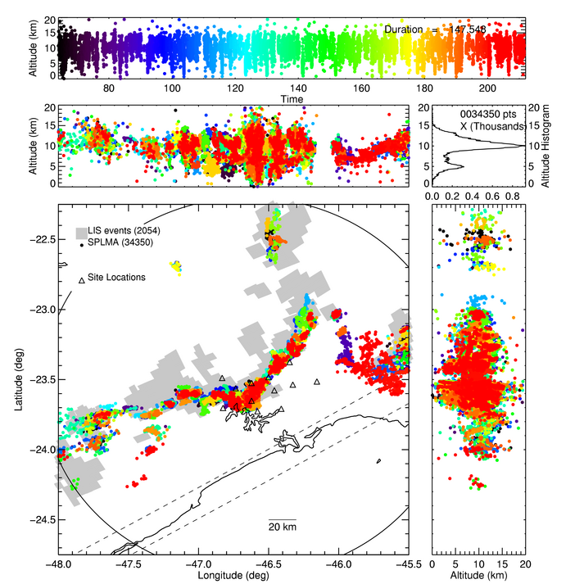
Field Programs
CHUVA 2012
Sample lightning data from CHUVA
LIS (grey squares)
simulate GLM

Slide 8
II. Algorithm Enhancements Beyond Baseline
No enhancements to date
Prepared to implement L2 filters if needed e.g., an artifact passing through the L1b filters
Any modifications or enhancements will be transitioned to operations as needed

Slide 9
III. Post-Launch Test (PLT) & Post-Launch Validation
From “Sample PLT Requests for GLM” 10 Jun 2013
Detection Efficiency Validation Tests comparison with other sources
Threshold Change Tests − Decrease & Increase
Laser Beacon Test (if available) INR, geolocation, energy cals (events & background)

Slide 10
Post-Launch Test (PLT) & Post-Launch Validation, 2
From “Sample PLT Requests for GLM” 10 Jun 2013
Background Signal Validation Test LIS, Vicarious targets: DCC, Deserts, glint, etc.
Lightning Signal Validation Tests − LIS, TARANIS
Continuing Current Detection Tests

Slide 11
Spatial & Spectral Calibration
Underflights: Use data from airborne radiometers/spectrometers and other instruments
Comparison with LIS & TARANIS
Laser beacon cals

Slide 12
QA Tools
Check for errors, artifacts: ghosting, cross-talk, glint L1b filter assessment
Statistical analysis of events Assess the uniformity of the CCD & degradation over time

Slide 13
Instrument Health
Monitor housekeeping data; alarm for low/high
Background radiance trending & analysis
Glint prediction and monitoring
Log: threshold values, instrument commands & responses, spacecraft attitude changes

Slide 14
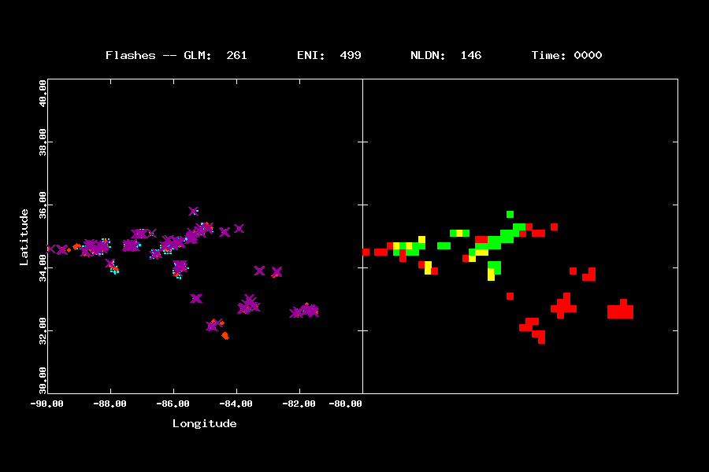
Example of Data Match Tool
Data:
GLM proxy: blue boxes
ENI flashes: red dots
NLDN flashes: purple Xs
Match product:
Green: all saw
Yellow: GLM + 1 other saw
red: ground saw; GLM missed
This GLM proxy is generated
from LMA data, so it is range-limited.
Past that range, it’s all red. This is
a good test for this tool.
Notes:
Left panel: data – GLM proxy is blue boxes, ENI flashes are red dots, NLDN flashes are purple Xs.
Right panel: match product – Green if all 3 saw; yellow if GLM + 1 saw; red if GLM missed.
These are proxy gen from LMA, so they are range limited. So > 200km from HSV, it’s all red. Good test for the tool.

