Slide 1
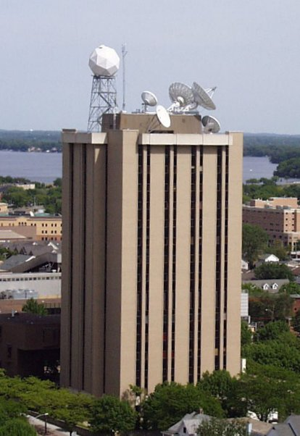
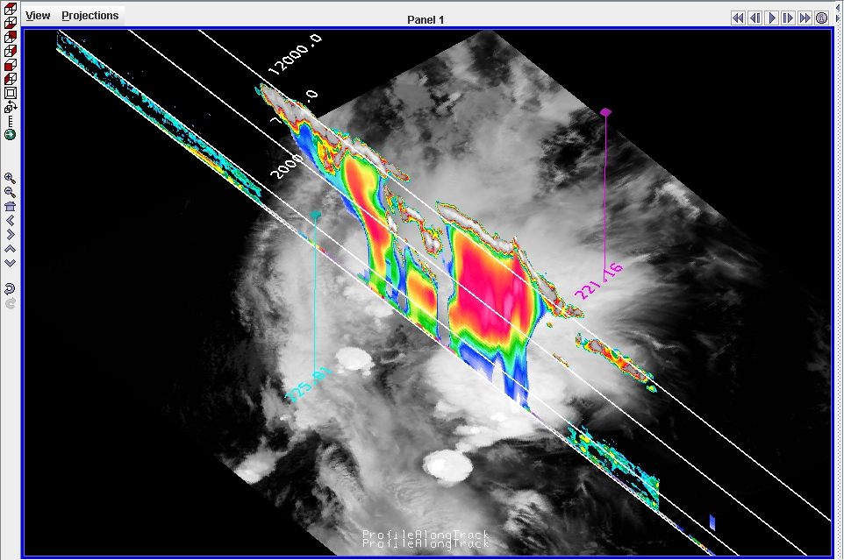
McIDAS-V Analysis and Visualization for AWG
Presenting: Tom Rink
Dave Santek, Tim Schmit, Kaba Bah, Joleen Feltz, Mike Hiley, Mat Gunshor

Slide 2
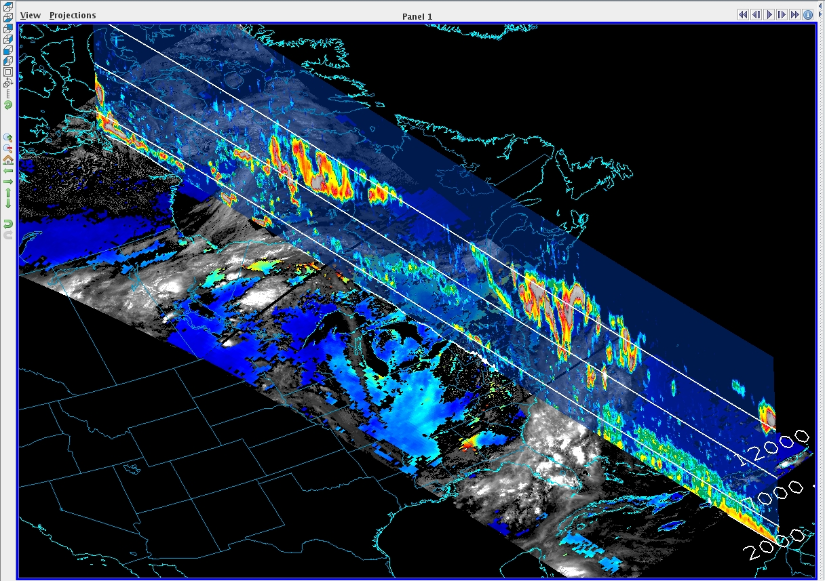
McIDAS-V
Very Interactive Displays (3D+ Animation with Direct Manipulation.
Integration of wide array of Geophysical Data.
User Defined Computation (Scripting).
Built-in, Interactive Analysis Tools.
Easy Point-and-Click installation.

Slide 3
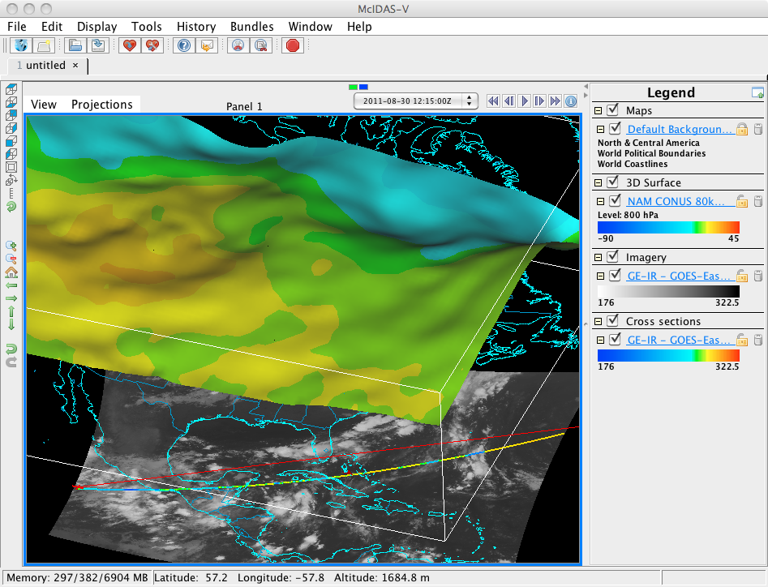
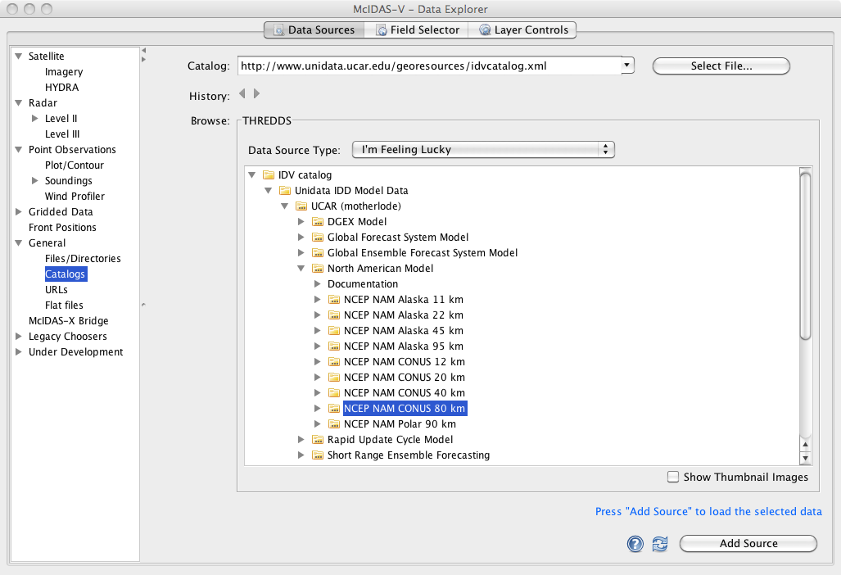
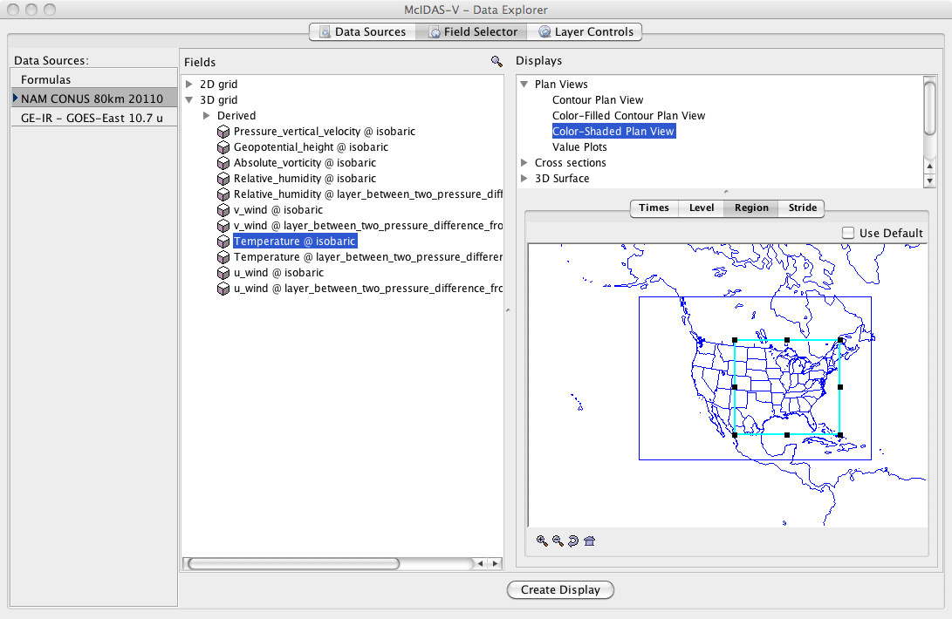
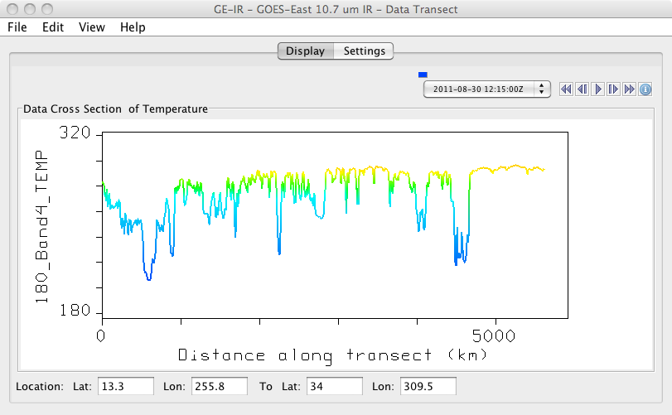
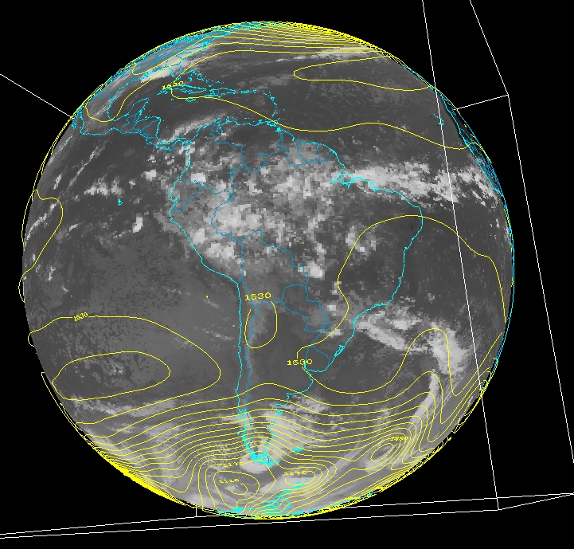
What is McIDAS-V
Data Sources: Local or Remote
Select and Display (image, slice, probe)
IDV
VisAD
Wide array of Geophysical data.
UI components for selecting data and controlling appearance.
User defined computation, Jython
Interaction(rotate,zoom,pan,manipulate)
Animation
Abstract Data Model
Rendering 3D/2D
Control
Java based: portable easy to install
Freely available, open source software.

Slide 4
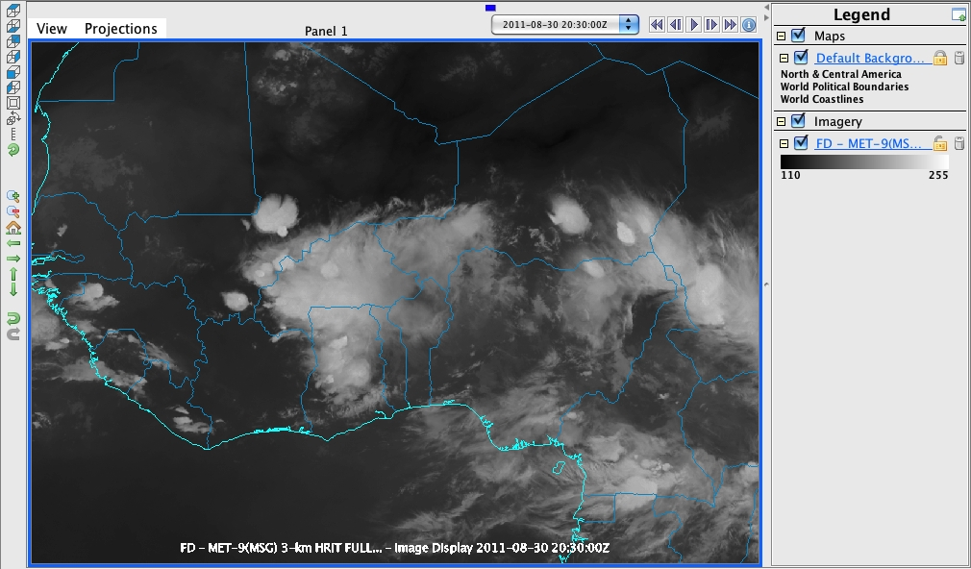
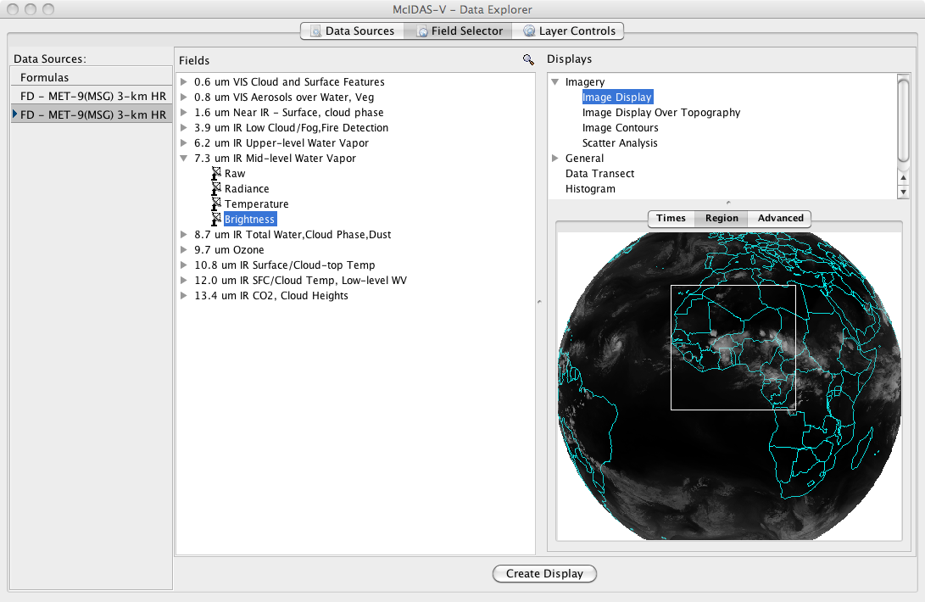
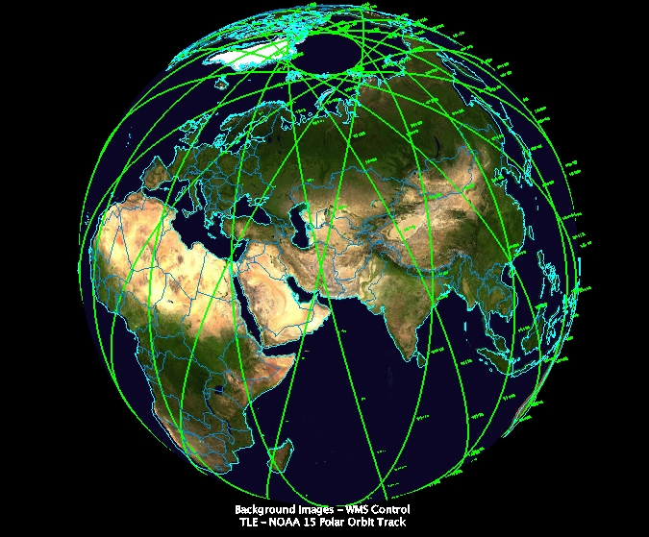
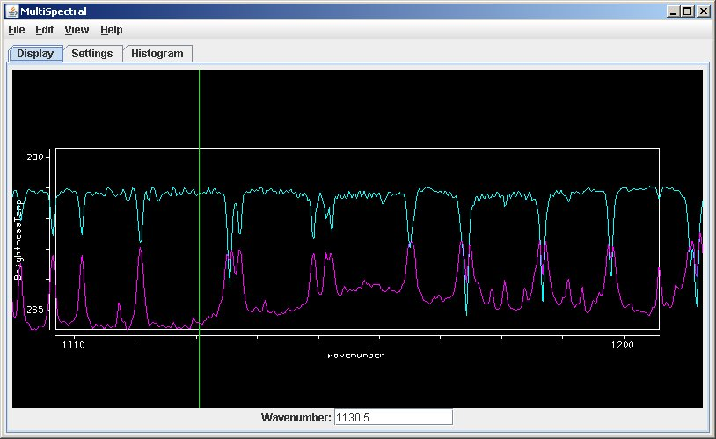
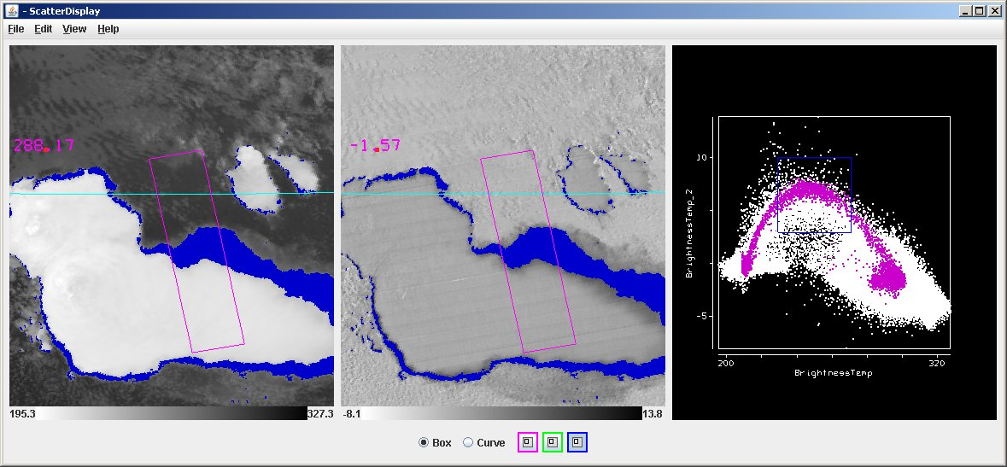
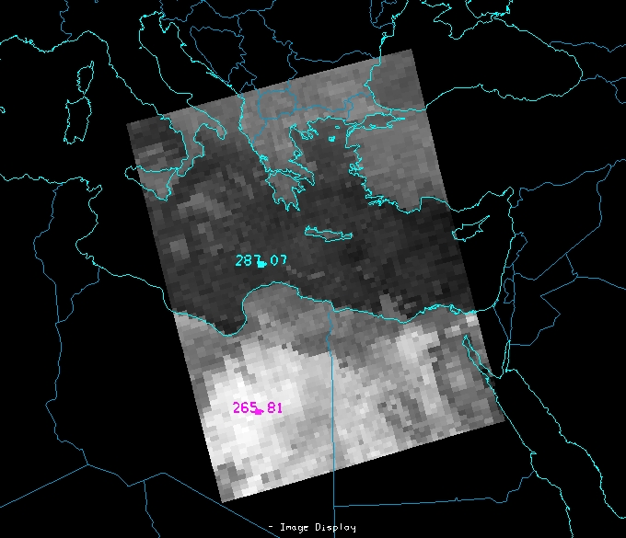
McIDAS-V
Satellite Imagery Enhancements
GEO + LEO
MODIS + CALIPSO
SGP4 Orbit Calc
Specialized DataSource and Display Extensions
Graphical Region sub-setting
Improved Rendering performance (long sequences or very large images)
IASI L1C
Simplified Programming Environment
All Python scripting, not XML based
High-Level functions for configuring displays.
Multi-Spectral Analysis

Slide 5
Local
Remote
Extendable framework for adapting new sources of data, user interface components and creating novel displays.
NetCDF, HDF, GRIB, BUFR, GIS
OpenDAP, ADDE
Adapters
Displays
Tuple (Temp, RH, Lon, Lat)
Grid 2D/3D
Time
Metadata
Coordinate System: (x,y) -> (lon,lat), (Altitude->Pressure)
Units: hPa, Kelvin, degrees, etc.

Slide 6
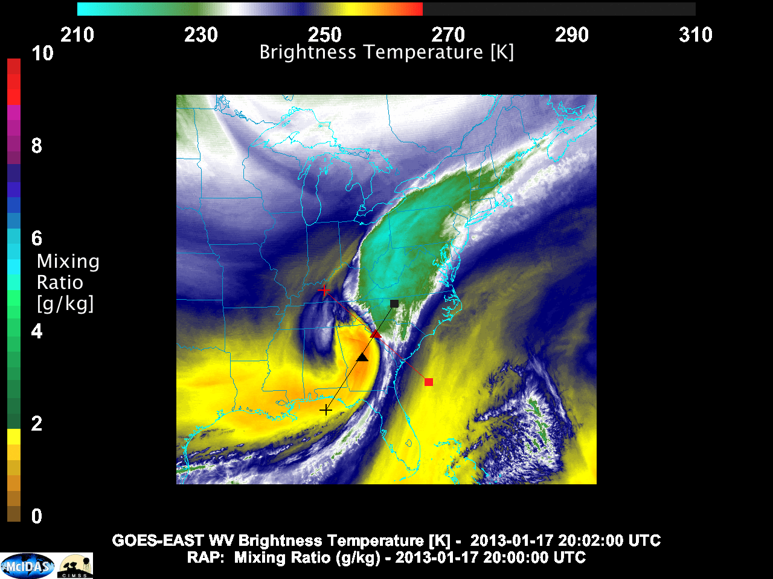

Slide 7
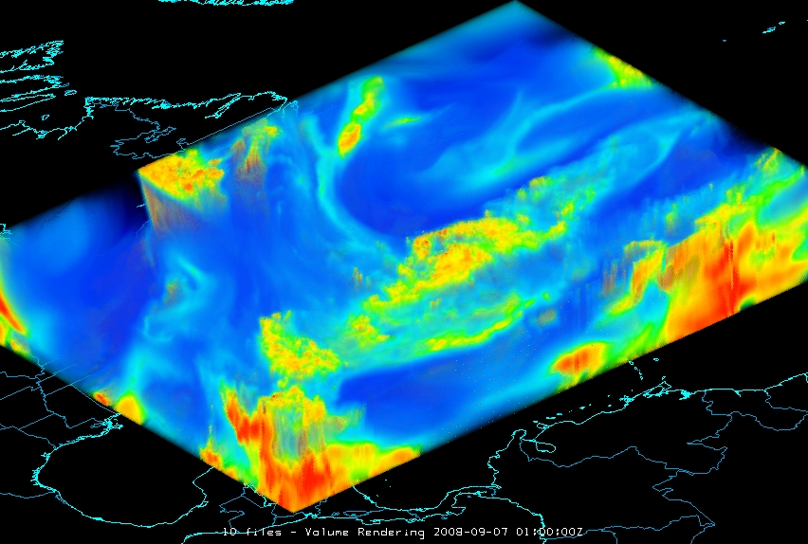
Advanced 4D Visualization
WARF Simulation: 3D RH from a Geo-Hyperspectral Sounder
Hurricane Ike

Slide 8
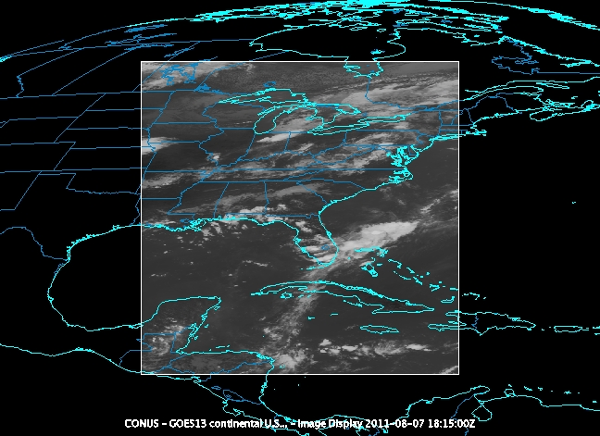
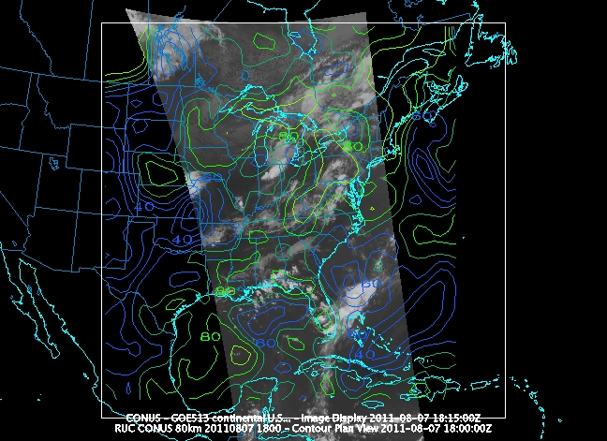
Automatic Re-projection
(line, elem) −> (lon, lat) −> (grid_x, grid_y)

Slide 9
Specific Application to AWG Cal/Val
Development emphasis on scripting to support both routine and ‘deep-dive’ validation activities…
Transition from an arcane XML based programming to Python.
New API is designed from ground up to ease automation of common workflows in McIDAS-V via a user friendly and well documented API
Enhancements: control color enhancements, color ranges, annotations, font sizes, font colors, add logos, place colorbars, change map colors, set frame sizes, and save the images

Slide 10
McIDAS-V scripting overview
Users write scripts in the Python programming language
Python scripts are interpreted in the Java-based McIDAS-V system via Jython, an implementation of the Python programming language in Java
In addition to our new API, advanced users can call any piece of Java code in the McV/IDV/VisAD library. (Without having to actually write Java code).
Notes:
McV/IDV/VisAD includes a huge number of utilities for grid interpolation, quantitative analysis, etc.
Lack of Java.. Scientists don’t want to learn multiple programming languages

Slide 11
Simple example script
Use the “getADDEImage” function* to get some satellite imagery.
Put the data in a display.
Change the map projection.
Write out the image as a PNG.
Notes:
Think of ADDE like HTTP for meteorological data, especially satellite imagery

Slide 12
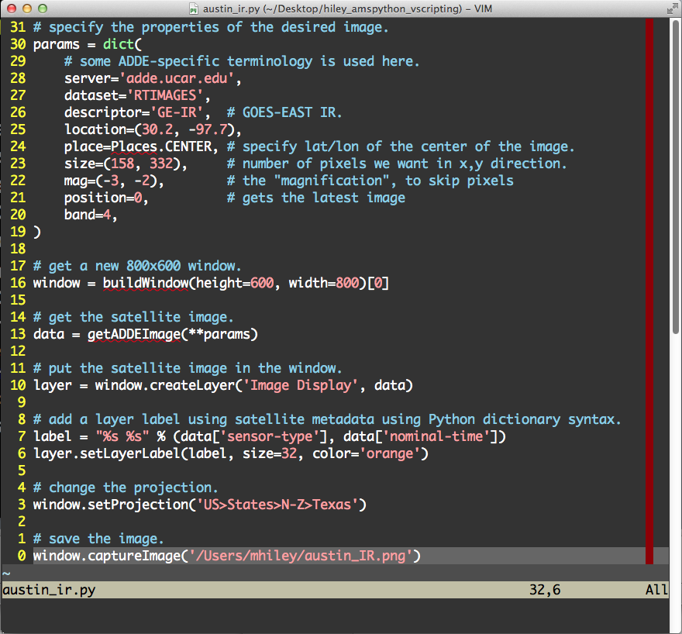
Example
script.
Notes:
Paste a vim screenshot here. Note that arbitrary strings are derived from existing GUI labels. Come back and note where the data, layer, display classes come into play. PNG automatically recognized.

Slide 13
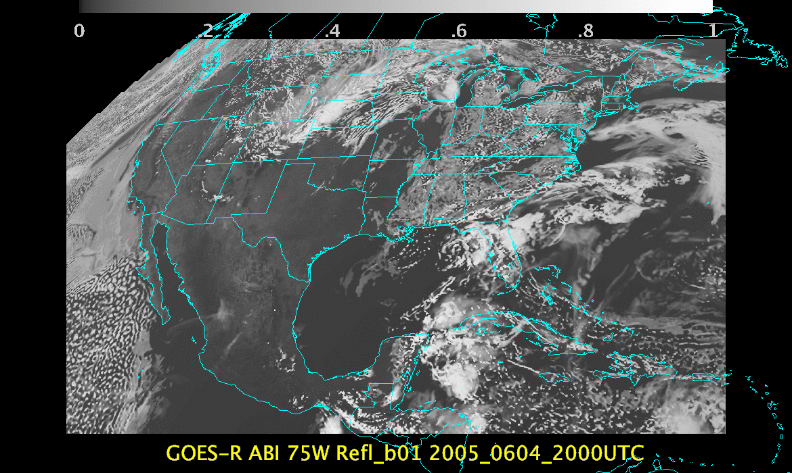
Routine Validation: automatic imagery generator
From script ‘conus.py’ written by Kaba Bah

Slide 14
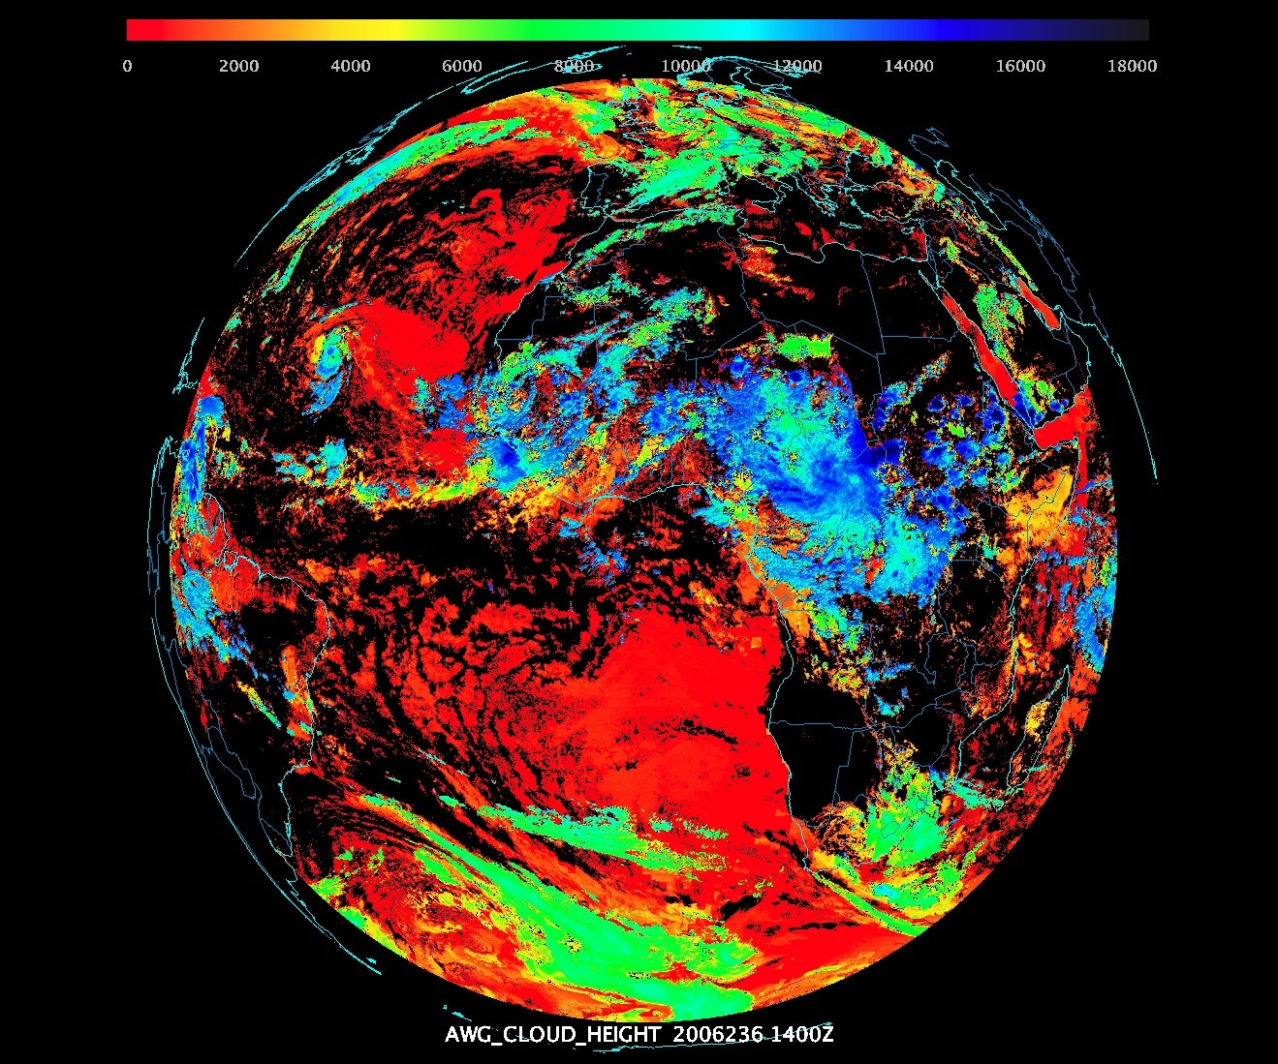

Slide 15
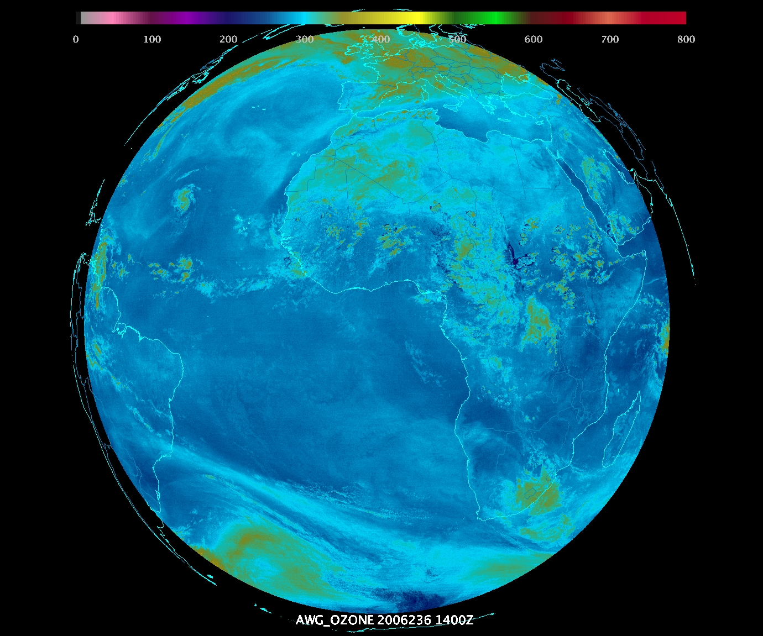

Slide 16
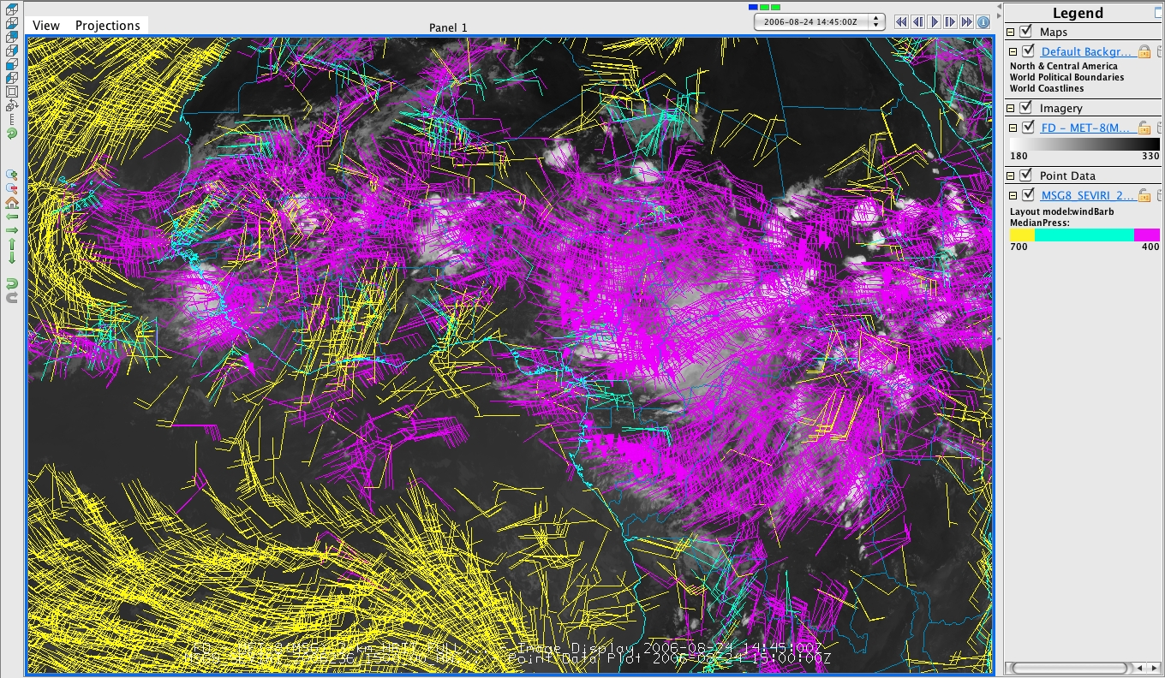
AMV Winds
Multi-level (color-coded), all points displayed…

Slide 17
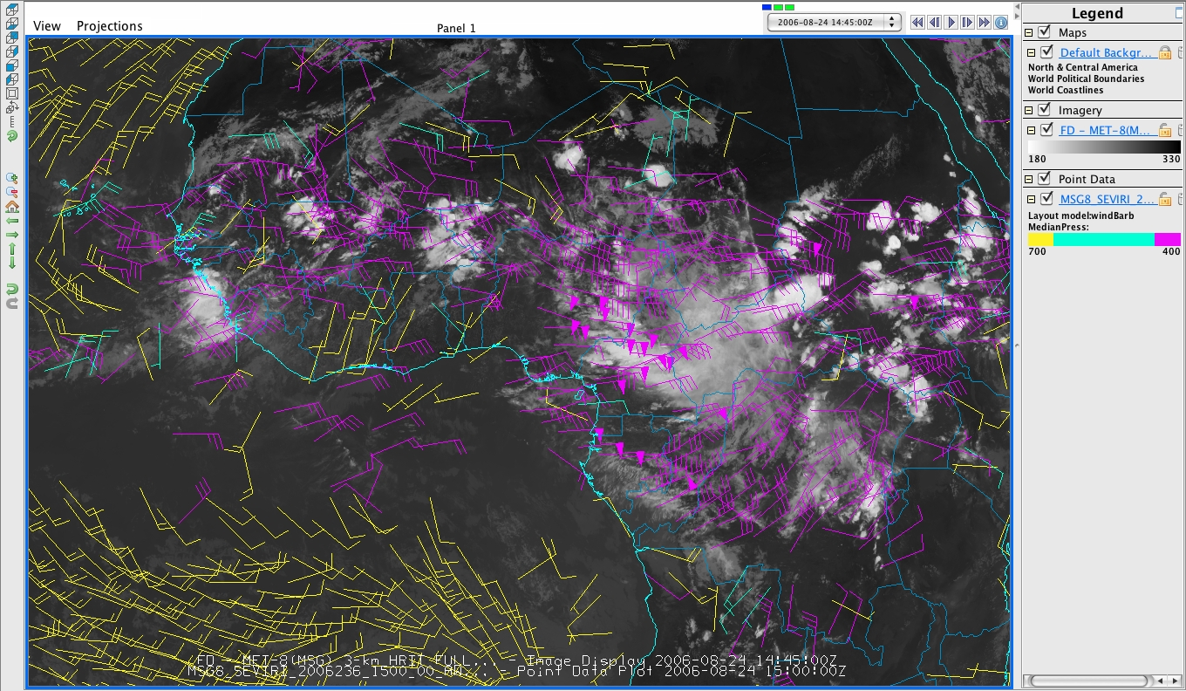
…can be de-cluttered with density interactively controlled.

Slide 18
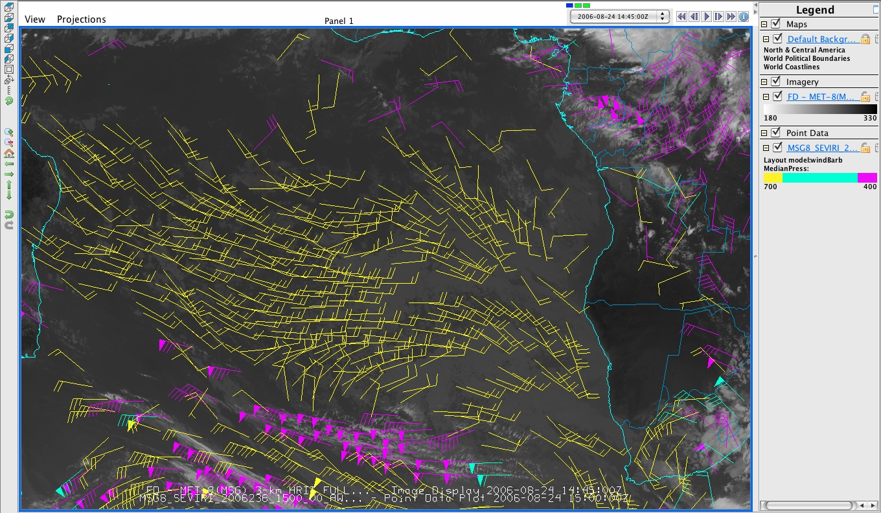
Only data points in view are rendered…

Slide 19
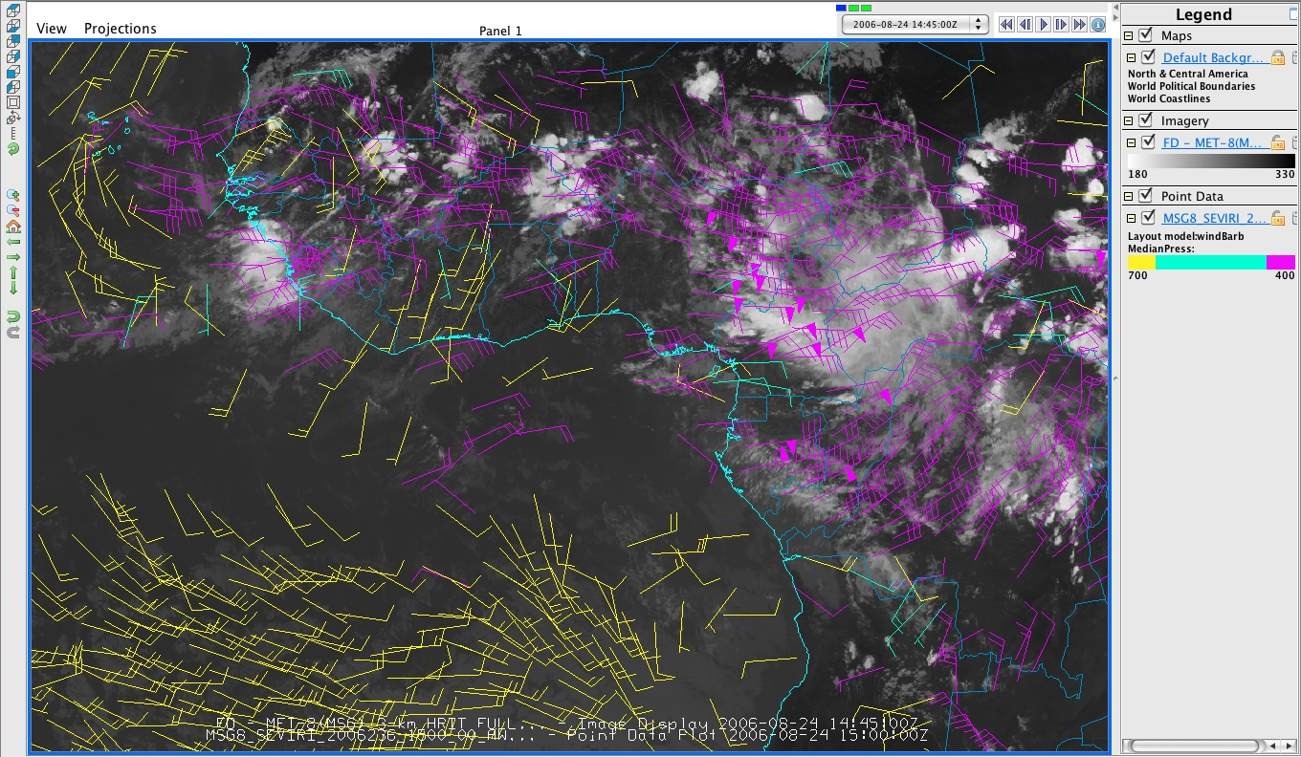
Panning/zooming reveals new points to render (progressive disclosure)

Slide 20
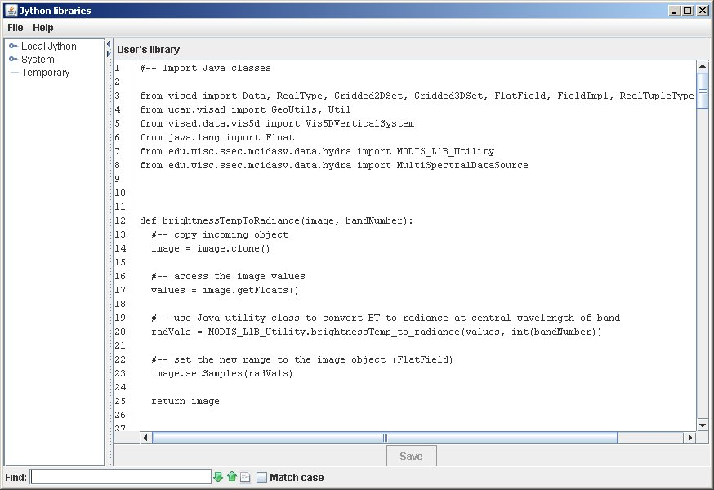
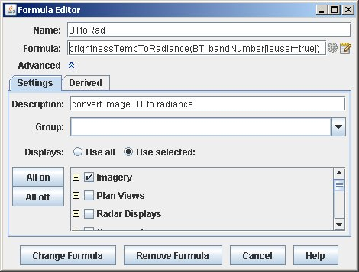
User Defined Computation
Seamless integration between Jython and Java.
Work with Data in abstract terms, irrespective of original data source.
Data Model: can internalize any numerical information.
Built-in meta-data for units, coordinate systems and sampling topology (grid/point)
Hook output into Framework via a Formula
Compute and Display

Slide 21
Additionally, McIDAS-V can facilitate a continuous progression from routine to deep-dive validation…
Interactive Analysis Tools
Click and Drag Data Probes
Data Transects or 3D Cross Sections
Scatter Analysis
User Code

Slide 22
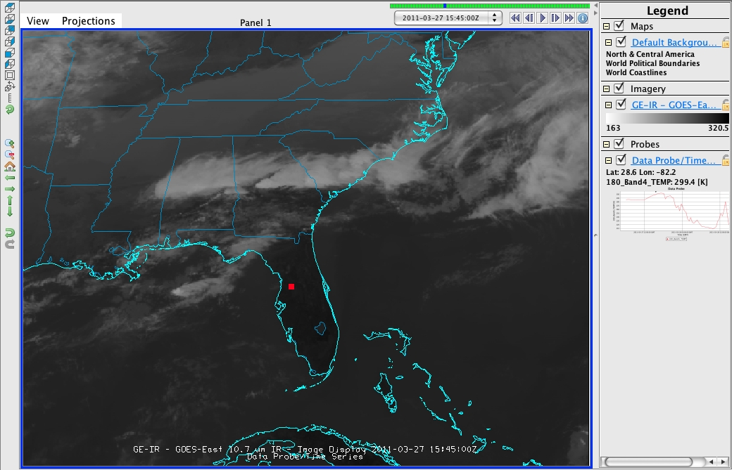
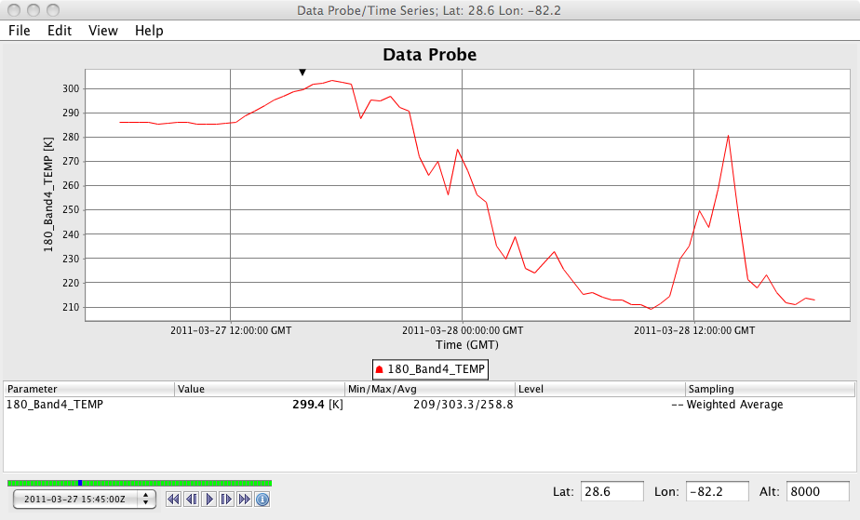
Interactive Time Series
GOES 11 um
Drag Probe – updates time-series

Slide 23
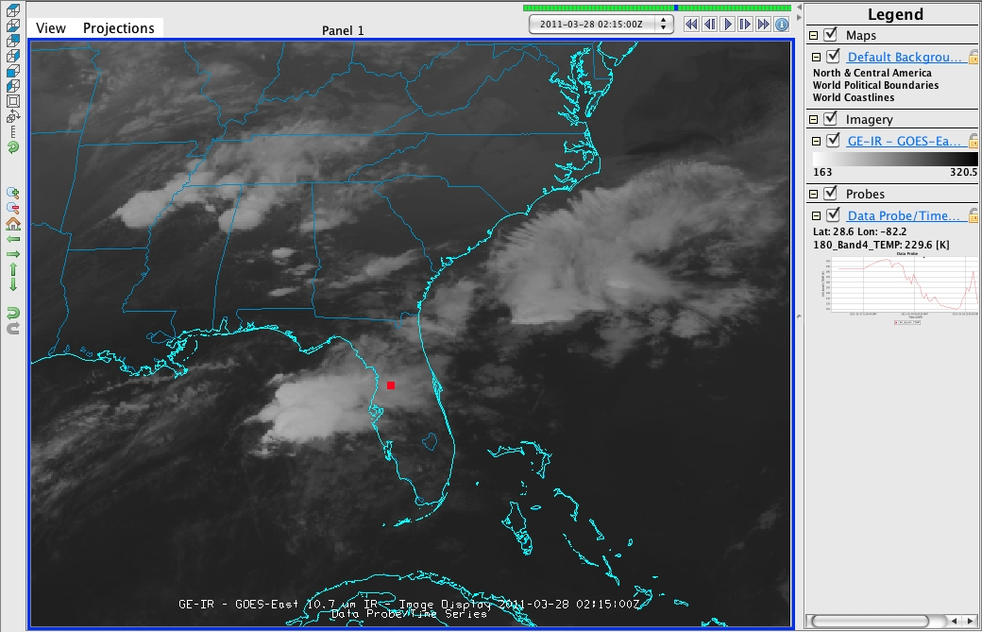
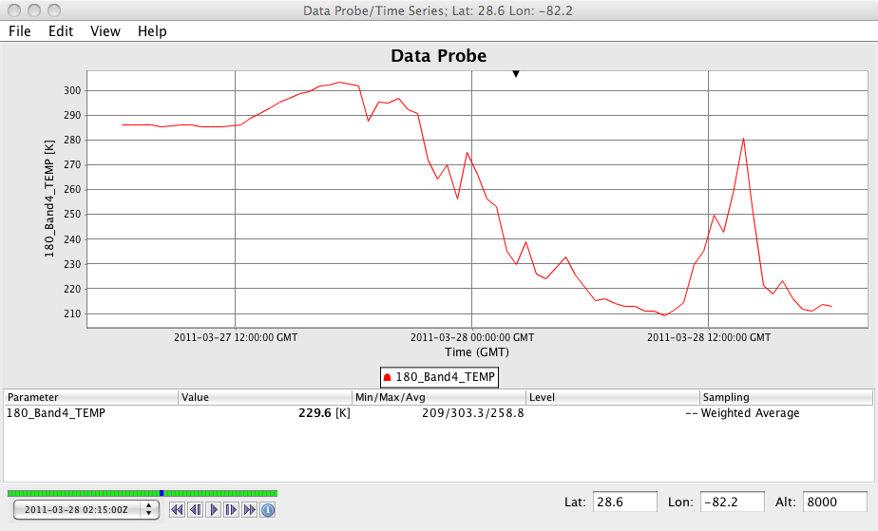
Animation Control
Updates time mark

Slide 24
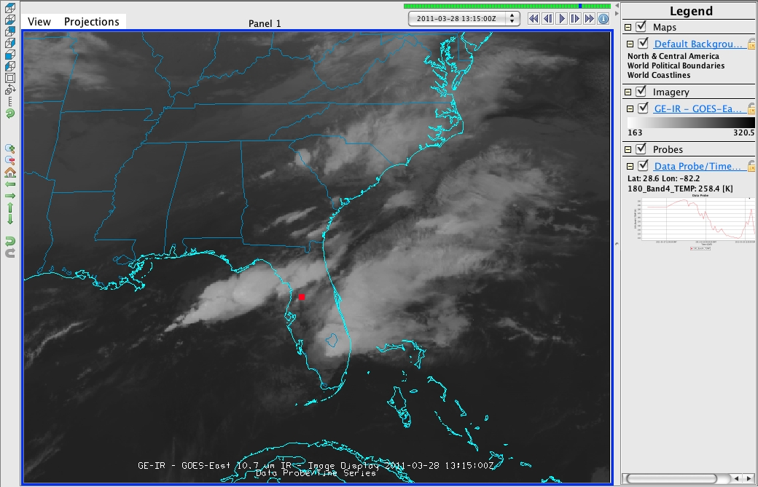

Slide 25
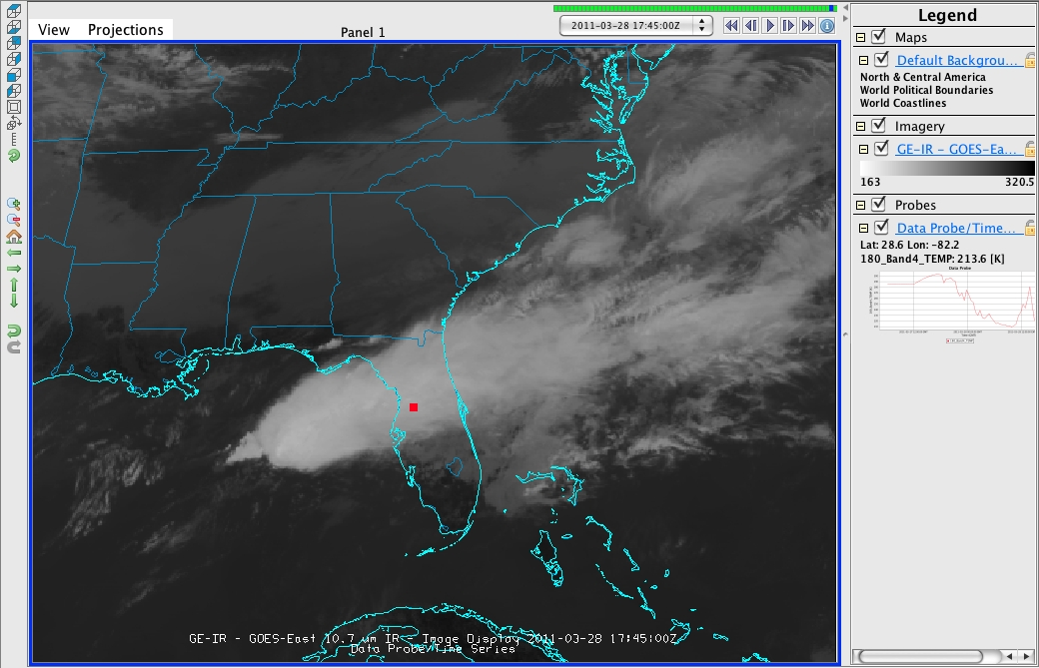

Slide 26
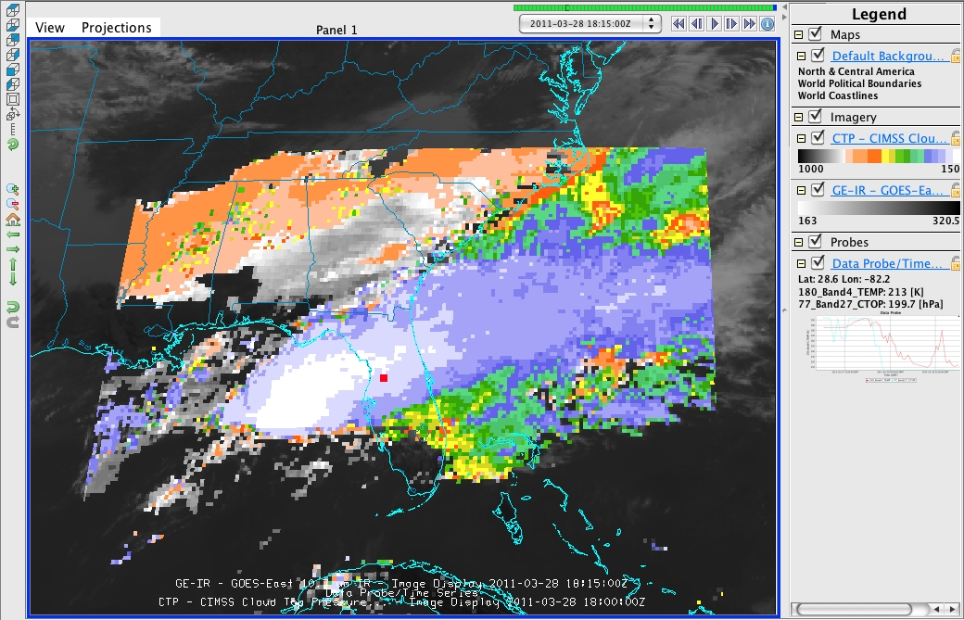
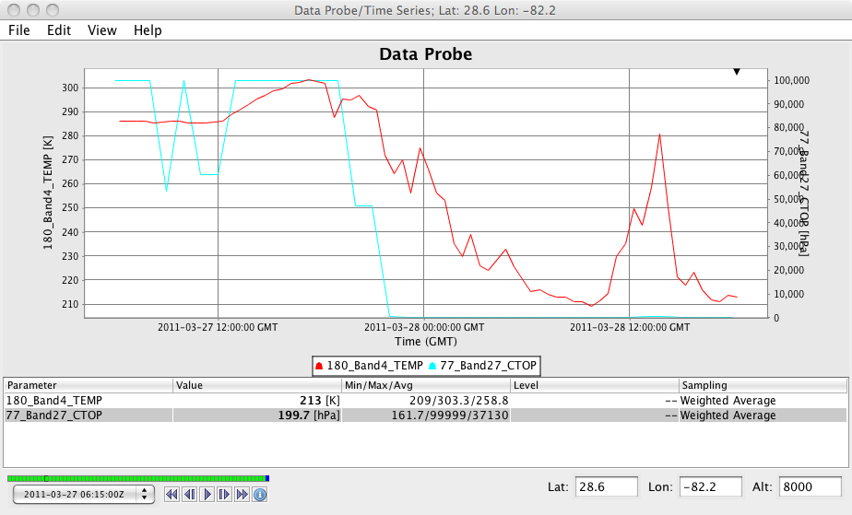
CIMSS Cloud Top Pressure

Slide 27
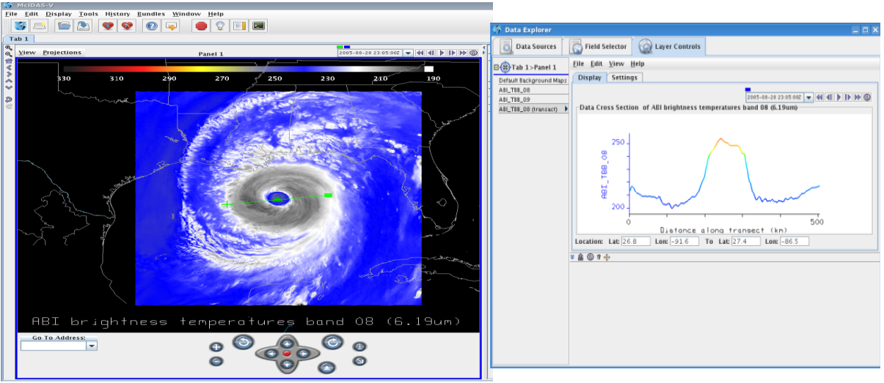
Data Transect

Slide 28
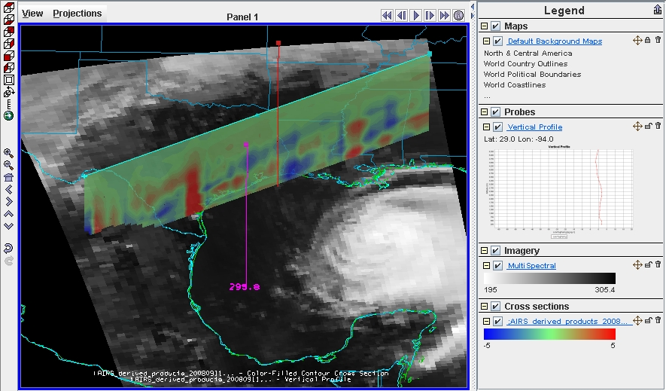
Advanced Display Capability
AIRS Level 1B window channel image (grey-scale) and moveable 2-D slice of ECMWF-AIRS Single FOV water-vapor retrieval (color-scale). Slice values are re-sampled on the fly from the 3-D difference field and auto-updated as the slice is dragged in space - demonstrating interactive direct manipulation, data integration and python driven data computation.

Slide 29
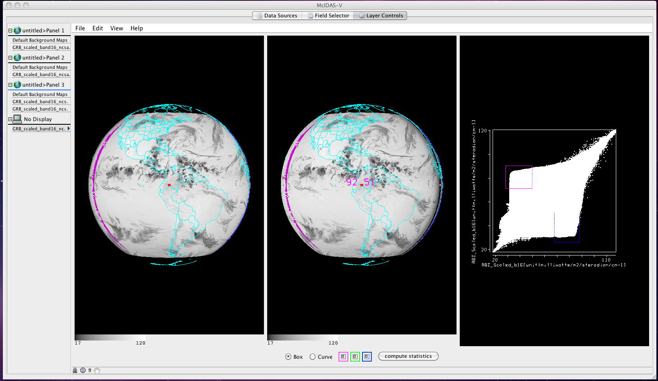
Interactive Scatter Analysis

Slide 30
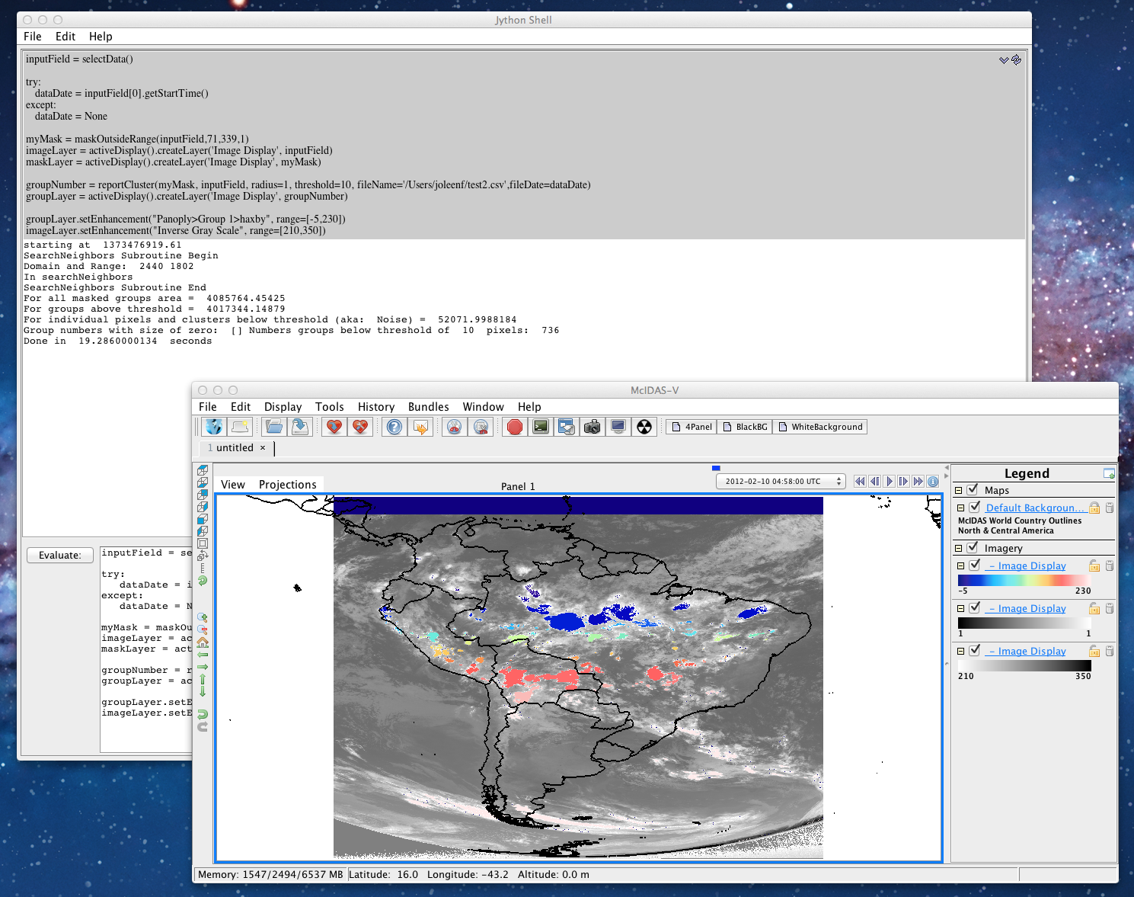
Display clusters of pixel values within value range, search radius, and closeness threshold. Analysis by Joleen Feltz

Slide 31
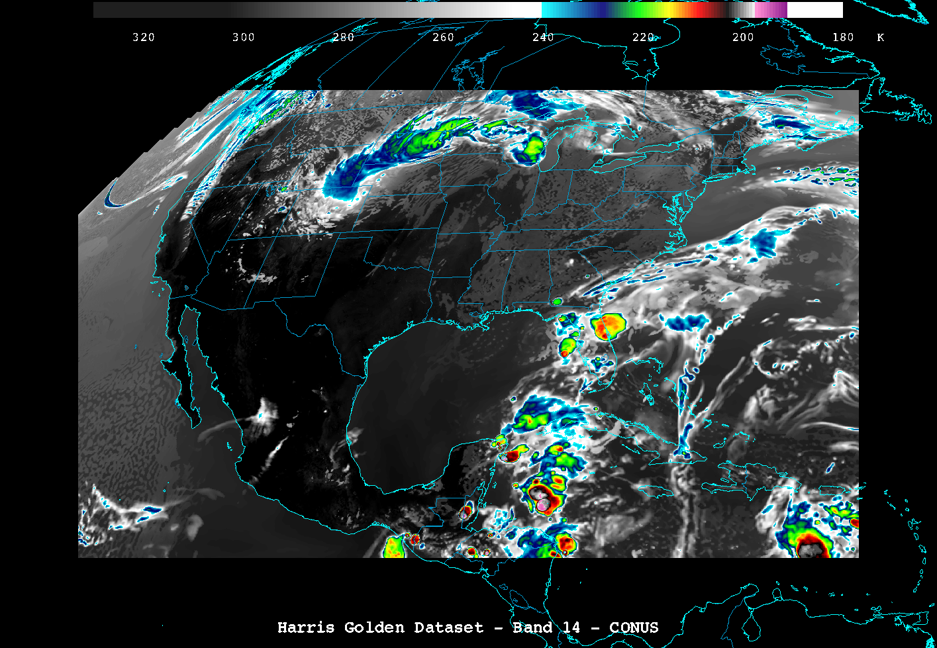
Ready For the Future (GOES-R) Now!
Image produced by W. Straka (CIMSS)

Slide 32
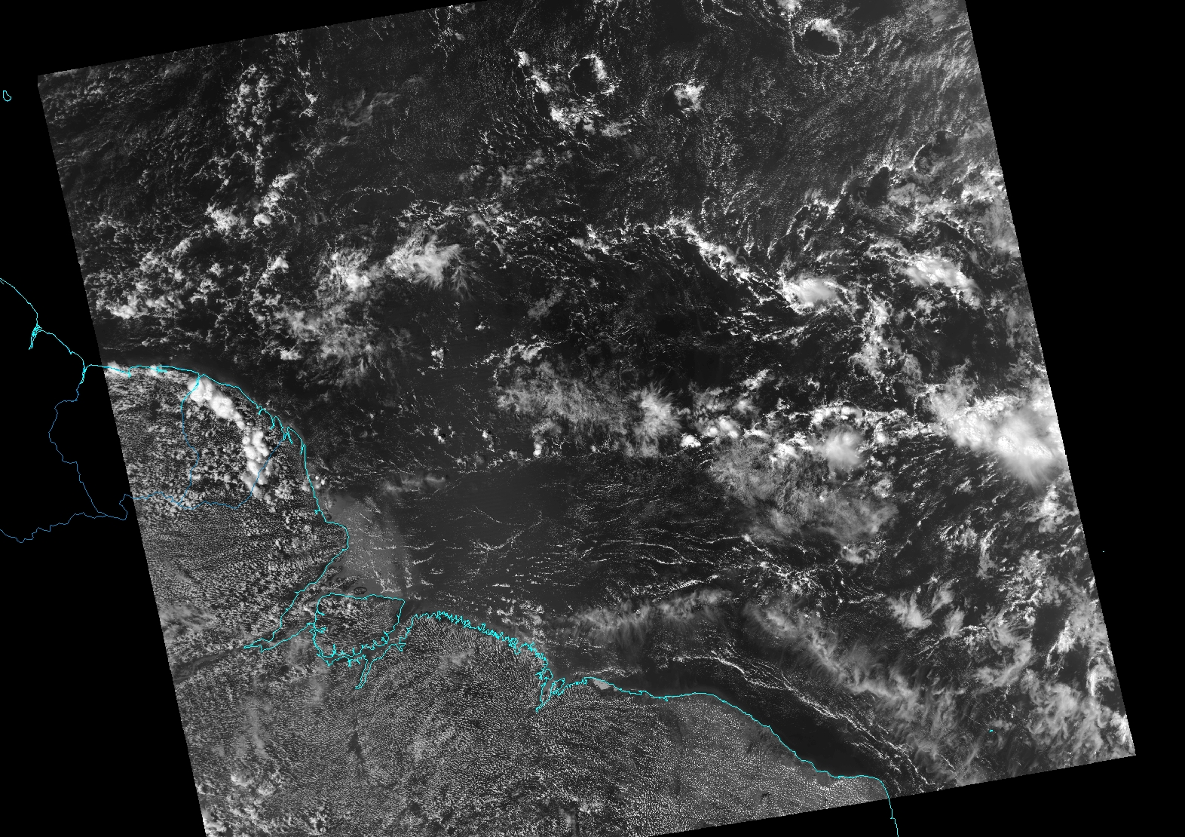
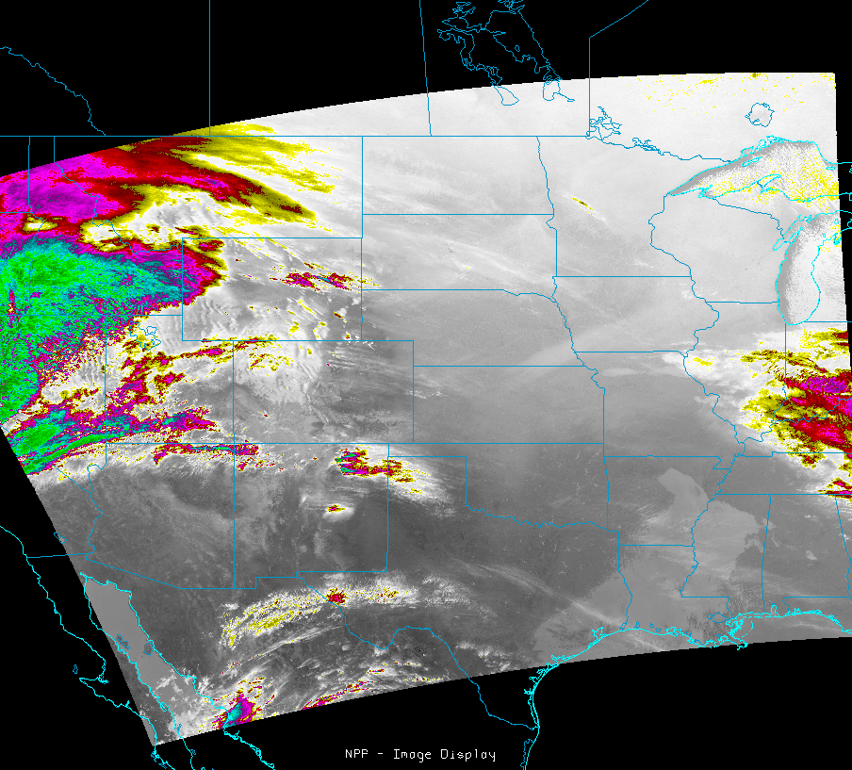
McIDAS-V Sees VIIRS First Light!
Infared/thermal Cooler Doors Open!
Courtesy: Dan Lindsey, CIRA

Slide 33
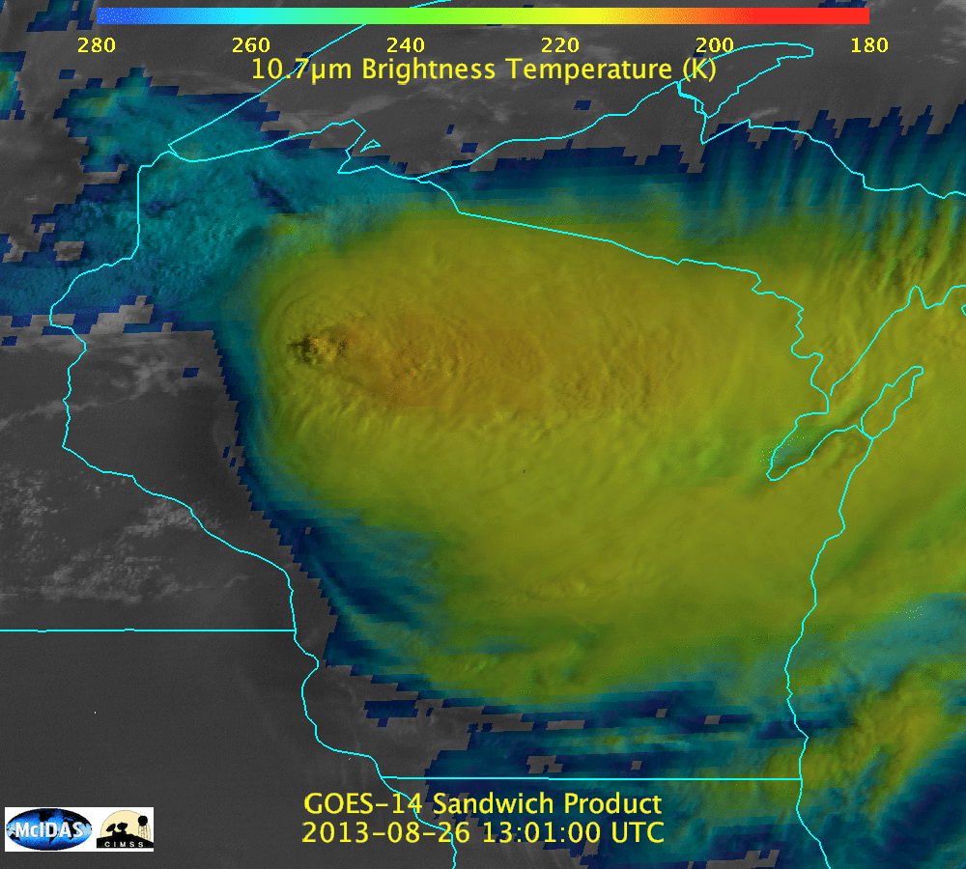

Slide 34
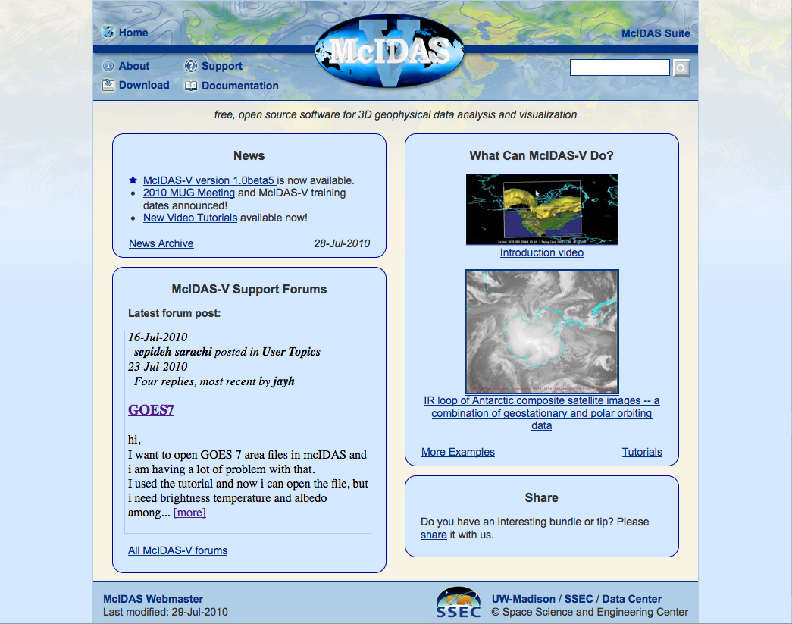
Informing Users of McIDAS-V
Oral /Poster presentations
Web page
User forum
Training data sets with
step by step assist
Training workshops and
demonstrations

Slide 35
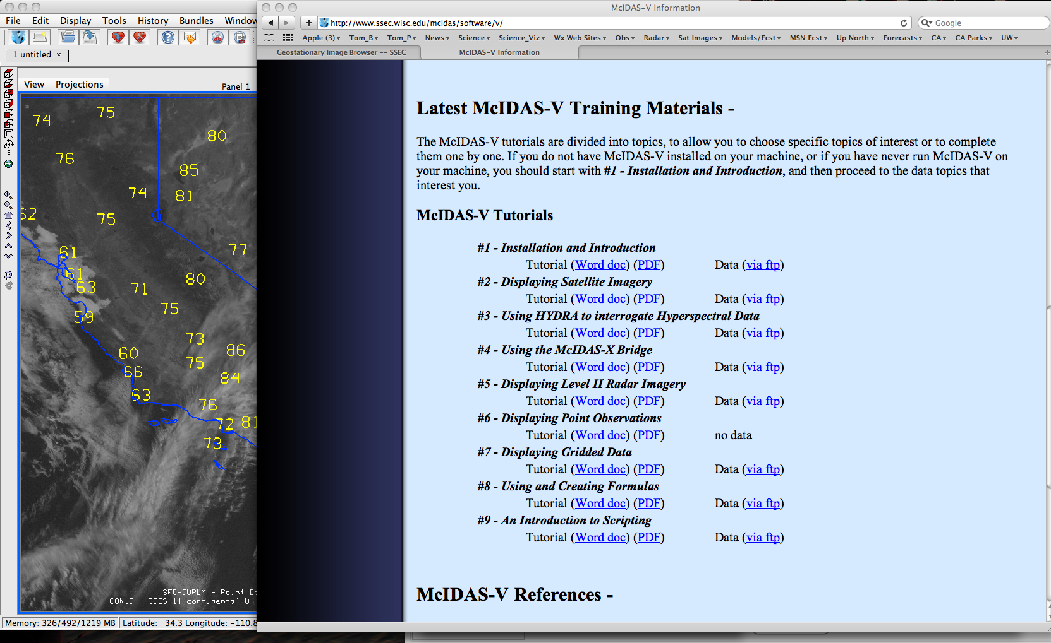
McIDAS-V Tutorials

Slide 36
McIDAS-V software
Is freely available, open source software
Easy to install on most operating systems
Great learning tools available
Excellent user support from MUG
Operates on numerous data types
Powerful analysis tools

Slide 37
McIDAS-V software
McIDAS-V is free, open source software
available at
http://www.ssec.wisc.edu/mcidas
or
google – mcidas

