Slide 1
Status of Activities and Plans for the GOES-R Core Ground System
Satya Kalluri Ph.D.
GOES-R Program Office
Code 416, Building 6, Room C200
NASA Goddard Space Flight Center
Greenbelt, MD 20771
Satya.Kalluri@noaa.gov
http://www.goes-r.gov/

Slide 2
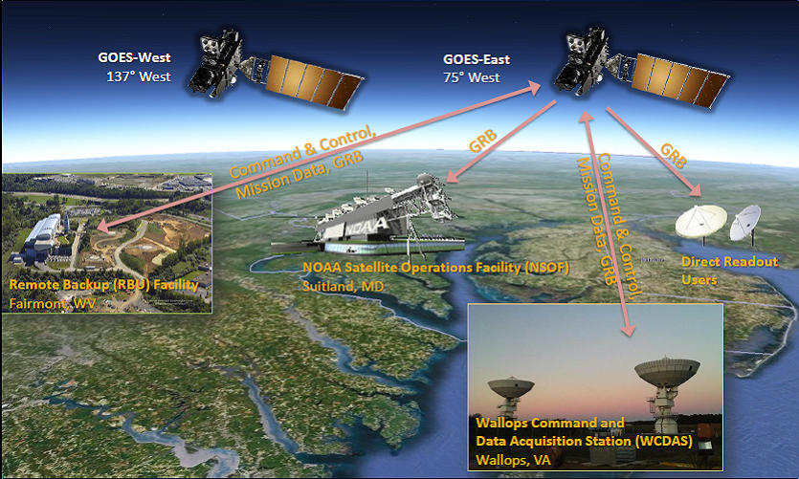
GOES-R Operational System Configuration

Slide 3
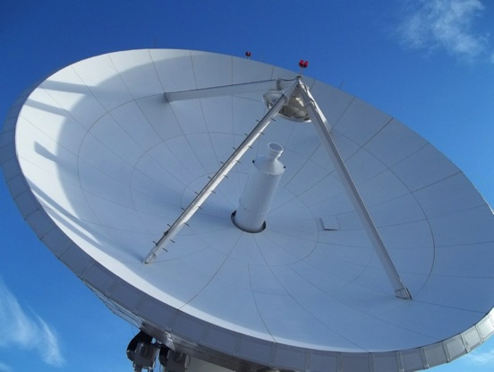
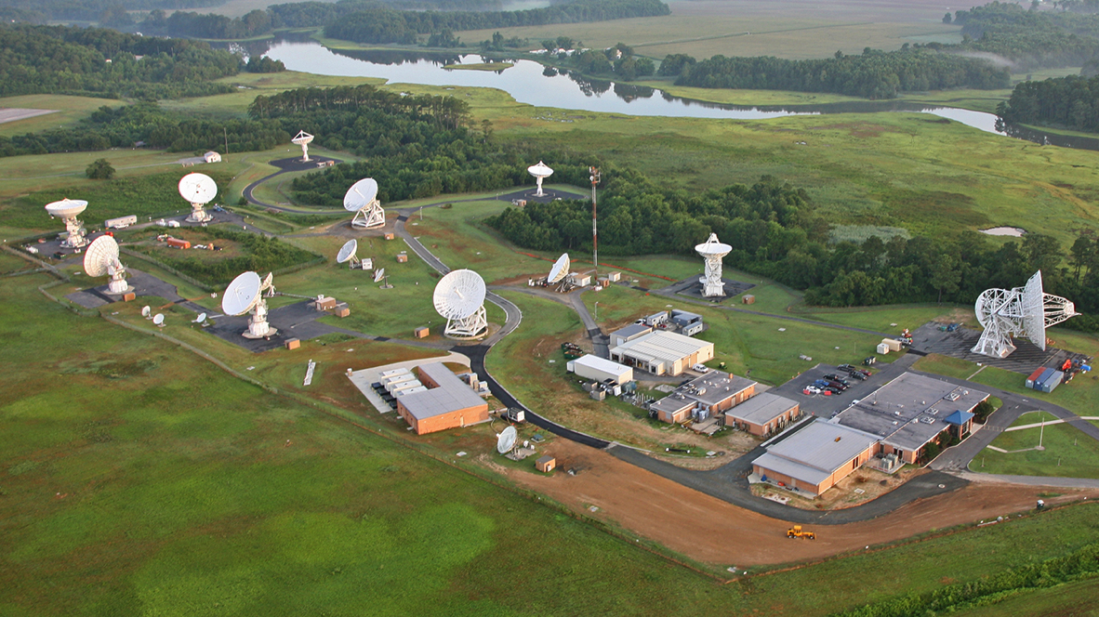
New Antennas Are Being Built to Receive Increased Volume of Data From GOES-R
WCDAS Facility Upgrades and new 16.4m Antennas

Slide 4
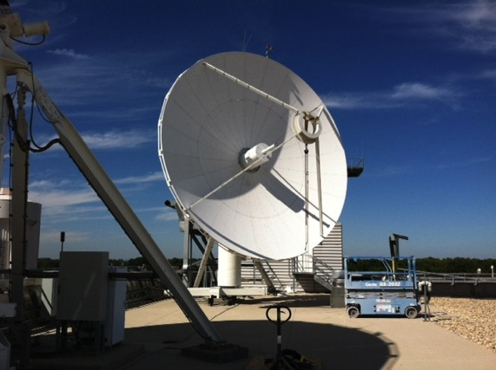
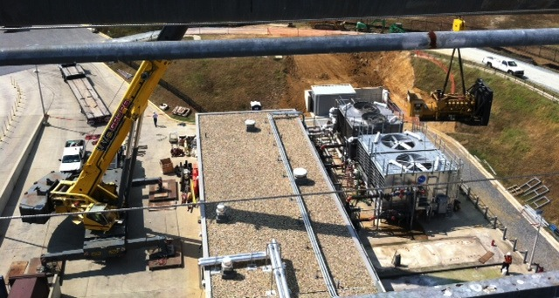
NSOF Facility and Antenna Upgrades
NSOF Antenna Upgrade

Slide 5
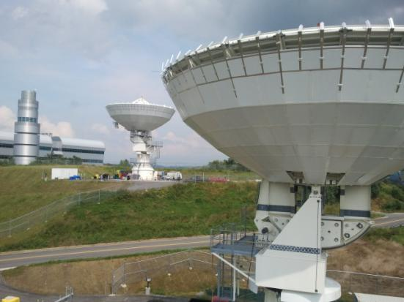
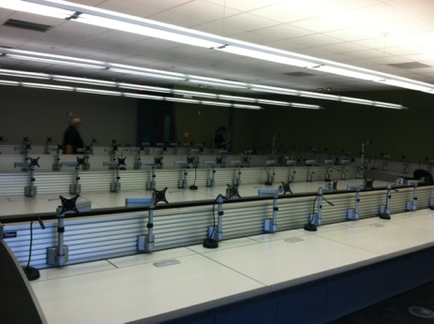
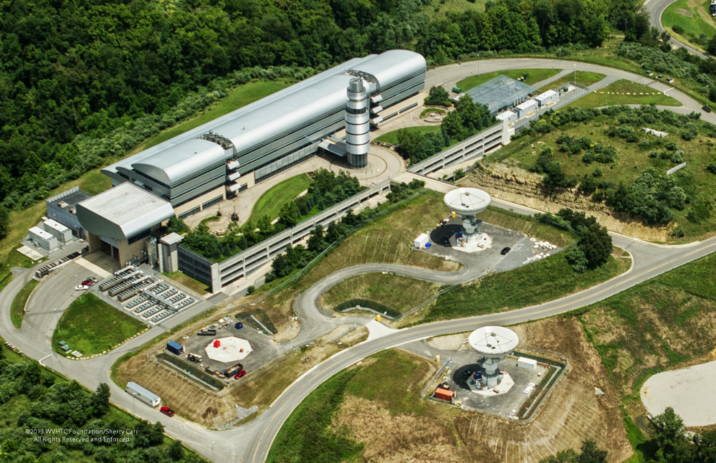
RBU Facility Upgrades and new 16.4m Antennas

Slide 6
GSP Top-Level Schedule
Critical Path

Slide 7
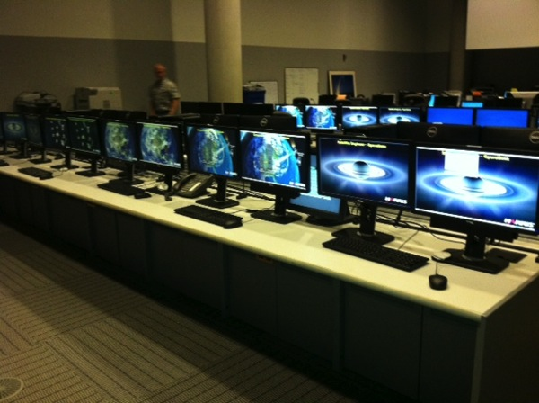
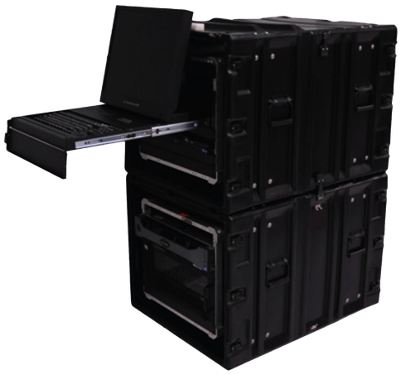
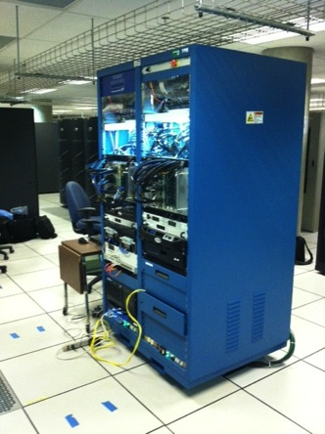
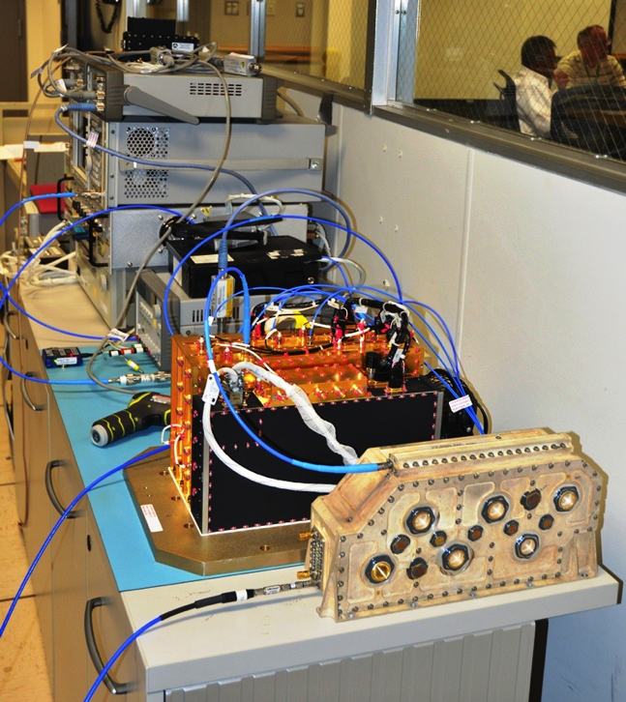
Core GS Accomplishments
Release Mission Management at NSOF
GRB simulators
SatSim at NSOF
SARSAT RF Compat Testing

Slide 8
ABI L2+ Algorithm Implementation Overview
Increment Integration: Each L2+ algorithm is implemented separately following descriptions provided in the ATBDs
  Software Item Qualification Test (SIQT) is the test event where individual algorithm requirements are verified
Build Integration: L2+ algorithms that pass SIQT are integrated in precedence
  Software Build tests (ABIL2, R2ALG) verify that the data can be processed in precedence
    Products are created in NetCDF consistent with product definitions that are documented in the Product Definition and Users’ Guide (PUG)
    Metadata consistent with GOES-R Metadata Model
Release Integration: Multiple Ground System elements (Mission Management, Product Generation, Product Distribution and Enterprise Management) are integrated during different Releases.
  Releases are deployed at site (NSOF, WCDAS, RBU), verified and handed over to NOAA
  Initial Product Set Release includes Cloud & Moisture Imagery product generation and distribution to AWIPS
  Final Product Set Release includes remaining L2+ products (Clouds, Aerosols, Winds, Radiation, Land, etc.) and distribution to PDA

Slide 9
ABI Algorithm Implementation Status
ABI Product Generation Algorithms are implemented in a phased manner
  Develop L0→L1b →GRB (completed)
  Develop L0→L1b →GRB →CMI (In work)
  Develop L2+ Science software (completed for all algorithms)
  Operationalize L2+ algorithms – Process in precedence to meet latency and refresh; create end products to send to externals (PDA, AWIPS)
    Completed CMI, Air Quality, Soundings, Clouds
    Hydrology, Aviation, Winds, Land, Ocean and Radiation Products to be completed in 3/2014
  End to End Capabilities to ingest L0 data from Mission Management to process higher L2+ products (In work)

Slide 10
ABI Product Generation Schedule
ABI L2+ Products will be in 3 releases:
  Initial Product Set Release (9/2014)
    L0→L1b →GRB →CMI (KPP)
      Sectorized KPPs to AWIPS
      Product Performance and Product Monitoring
      End-to-End MM Hardware integration
      EM Ground Control
  Final Product Set (3/2015)
    All L2+ Products Available at PDA
    GRB for all non-ABI instruments
  Post Launch Update (7/2016)
    Alternate Scenes and Timelines

Slide 11
Product Capability Progression
IPS Interim Release
L0 ABI
L1b ABI
PLU Interim Release
L2+ CMI
L1b SEISS/MAG & ALTST
Product Performance ABI
Product Performance ALST
Product Monitoring ABI
Product Monitoring ALTST
Product Distribution ABI
COSI 1.5 (RHEL 6.5)
COSI 1.5 (RHEL 6.4)
SSMP
ALTST
PRDIN
CNMFR
CNMNU
OPMGS
ABIEE
ABIL2
Software Baseline (Clear Case)
ABIL2
R2ALG
SEISS
SUVI
EXEUV
MAG
GLM
ABIEEU
NABID
FPS Interim Release
Product Capability CIs
L0 – Level 0 Processing
L1b – Level 1b Processing
L2+ - Level 2+ Processing
PP – Product Performance
PM – Product Monitoring
PD – Product Distribution
SM – Service Management
PGIM – PG Infrastructure Mgmt
L0 non-ABI
L1b non-ABI & Qbst / CDRL 80 RevC
L2+ Product Set #1 & #2
Product Performance non-ABI
Product Monitoring non-ABI
Product Distribution non-ABI
COSI 1.5 (RHEL 6.4)

Slide 12
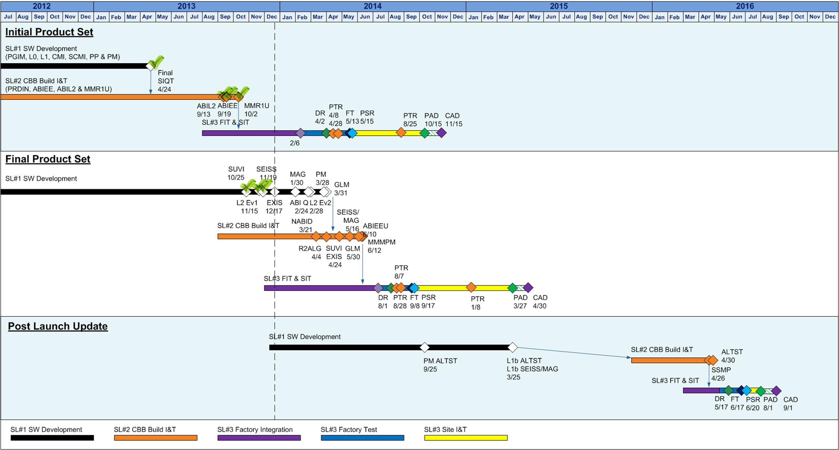
Product Capabilities Schedule
IPS Interim Release
L0 / L1b ABI
L2+ CMI
Prod Perf & Prod Mon for ABI & L2
FPS Interim Release
L0 / L1b non-ABI
L1b ABI Q Boost & CDRL 80 Rev C
L2+ Product Set #1 & #2
Prod Perf & Prod Mon
PLU Interim Release
SEISS/MAG Proc in Storage
Alt Scenes & Timelines

Slide 13
Technical Challenges
Science data provided by AWG with 100% ATBDs was meant to test correct implementation of science
  Only CMI data is realistic representation of ABI
  Test data for all other products came from SEVIRI/MODIS/GOES-12
    Adequate for science testing one algorithm at a time.
      Very good results achieved during science software development (see following slides for examples)
    Not representative of ABI
  Harris has been using WRF simulated data (Triplet) provided by AWG for testing product precedence
    AWG has been helping validate the products
    Initial results look promising
    There are some known artifacts/issues with metadata, data quality – Harris has opened Problem Tracking Reports (PTRs) to fix them; ongoing process

Slide 14
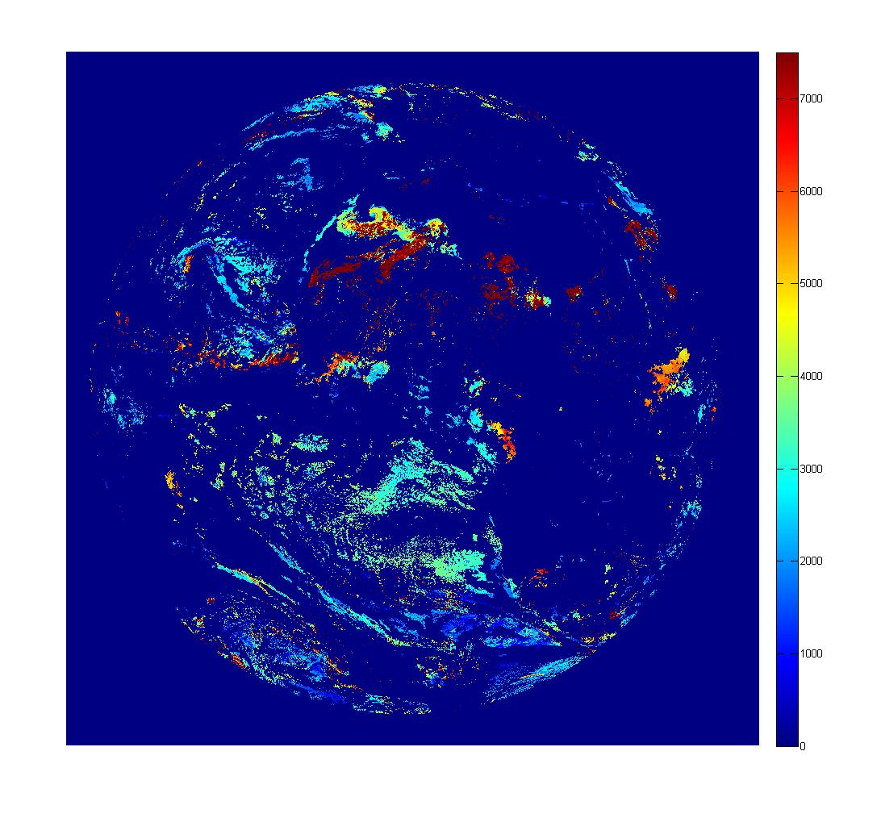
Test Output from Integrated System (1 of 2)
CMI Band 2
Aerosol Optical Depth
Volcanic Ash (height)

Slide 15
Test Output from Integrated System (2 of 2)
Cloud Top Pressure
Cloud Top Temperature
Total Precipitable Water

Slide 16
Summary
Significant progress has been made in implementing ABI product generation capabilities in the ground segment
All the science software development is completed for ABI L2+ products
Integration of full product generation capabilities is on track

