Slide 1



GOES-R AWG Algorithm Development and Product Validation – Current Status and Future Activities (January 2014)
Sounding Application Team
Tim Schmit (STAR/NESDIS)
Jun Li, Yong-Keun Lee, Zhenglong Li, Jinlong Li, William Straka, Ralph Petersen, Graeme Martin, etc. (CIMSS/UW-Madison)
Hua Xie and Shanna Sampson (STAR/NESDIS)
Brad Pierce, Marek Rogal, Bill Smith, Stanislav Kireev, etc.

Slide 2
Topics
Product Generation and Assessment Using Available Proxy Data
  Highlight proxy products being generated
  Highlight validation tools/methods and recent validation results
  Highlight any user engagement activities
  Highlight interactions with or support provided to any GOES-R Proving Ground Demonstrations
Identifying and Planning for Algorithm Enhancements Beyond Baseline
  Description of algorithm enhancements that have been tested
  Highlight test results and benefits of enhancements
  List algorithm enhancements you envision needing to be transitioned to operations after launch
Road to GOES-R Post-Launch Test (PLT) and Post-Launch Product Validation
  AWG team plans and approach to validate your team’s product(s) post-launch
  User engagement plans
  Concerns/comments/questions related to the GOES-R PLT and/or post-launch validation
Notes:
Topic areas to cover. Plan on a 15-20 min presentation.

Slide 3
Products
Legacy atmospheric temperature profile
Legacy atmospheric moisture profile
Total precipitable water
Lifted index
Convective available potential energy
Total totals index
Showalter index
K-index
Coverage and refresh rate:
Full disk: hourly
CONUS: 30 min
Mesoscale: 5 min
Spatial resolution: 10 km
Notes:
Provide a list of products and their specifications (spatial and temporal resolution, coverage). Include an example display(s) of your products.

Slide 4
Products
Legacy atmospheric temperature profile (10 km, hourly, disk)
Legacy atmospheric moisture profile (10 km, hourly, disk)
Total precipitable water (10 km, hourly, disk)
  Layered PW only an intermediate product
Lifted index (10 km, hourly, disk)
Convective available potential energy (10 km, hourly, disk)
Total totals index (10 km, hourly, disk)
Showalter index (10 km, hourly, disk)
K-index (10 km, hourly, disk)
Notes:
Provide a list of products and their specifications (spatial and temporal resolution, coverage). Include an example display(s) of your products.

Slide 5
Requirements
Product | Accuracy | Precision | Latency (mesoscale) | horizontal resolution
Temperature profile (K) | 1K below 400 hPa and above boundary | 2K below 400 hPa and above boundary | 4.4 min | 10 km
Moisture profile (RH) | Sfc-500 mb: 18% relative humidity; 500-300 mb: 18% relative humidity; 300-100 mb: 20% relative humidity | Sfc-500 mb: 18% relative humidity 500-300 mb: 18% relative humidity 300-100 mb: 20% relative humidity | 4.4 min | 10 km
Derived stability indices | LI: 2 K CAPE: 1000 J/ kg SI: 2 K TT: 1 KI: 2 | Lifted Index: 6.5 K CAPE: 2500 J/ kg Showalter index:6.5 K Total totals Index:4 K index: 5 | 2.7 min | 10 km
TPW | 1 mm | 3 mm | 4.4 min | 10 km
5
Notes:
5
To a quick review of most stringent requirements.

Slide 6
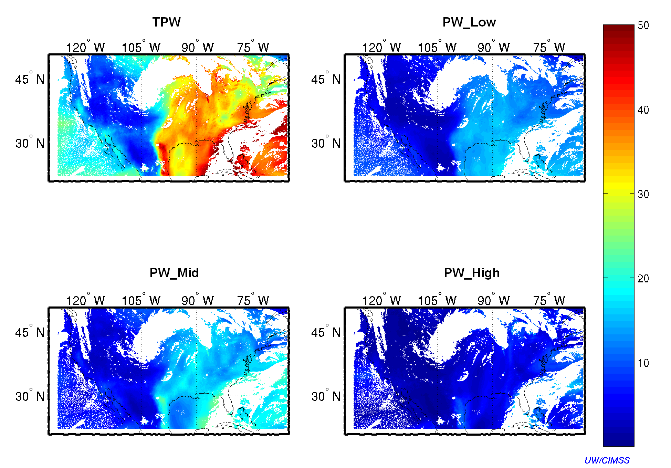
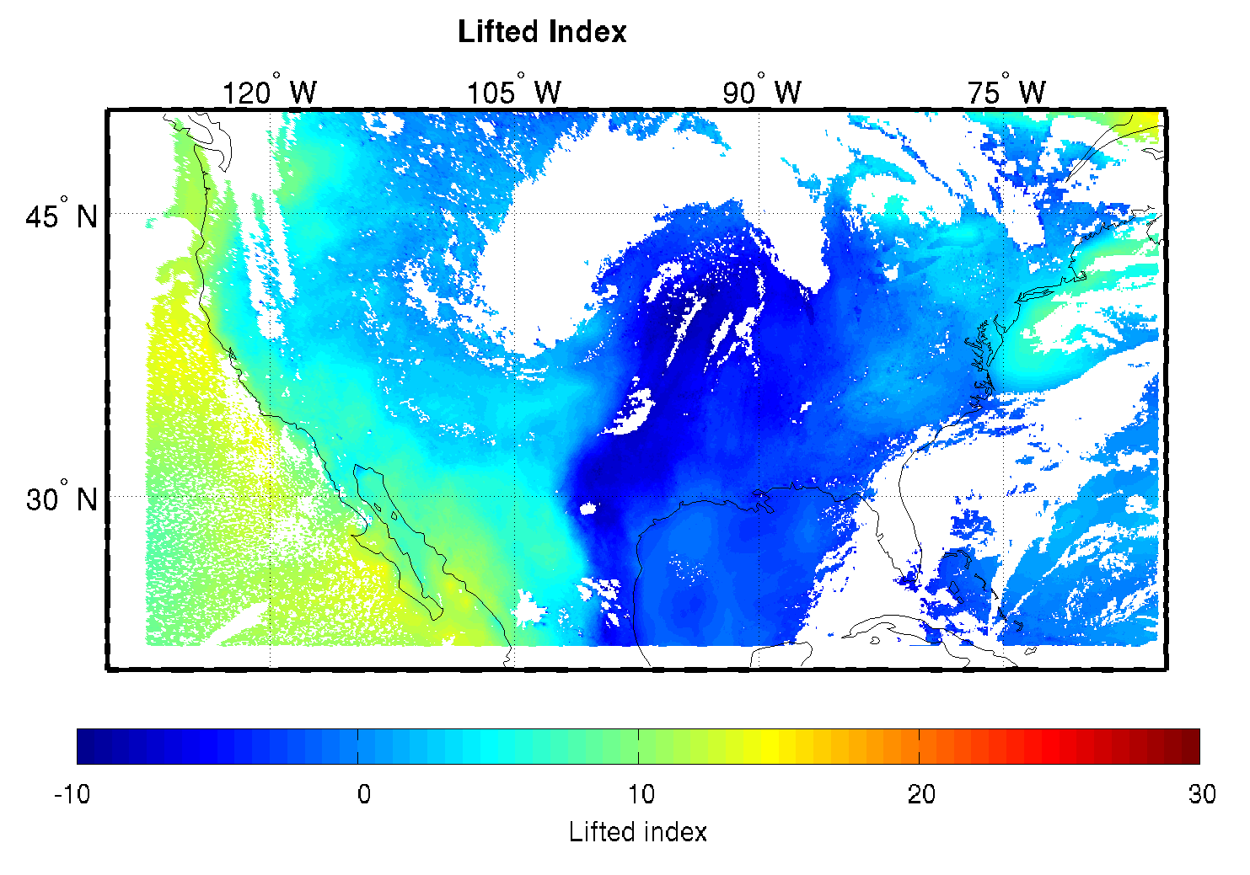
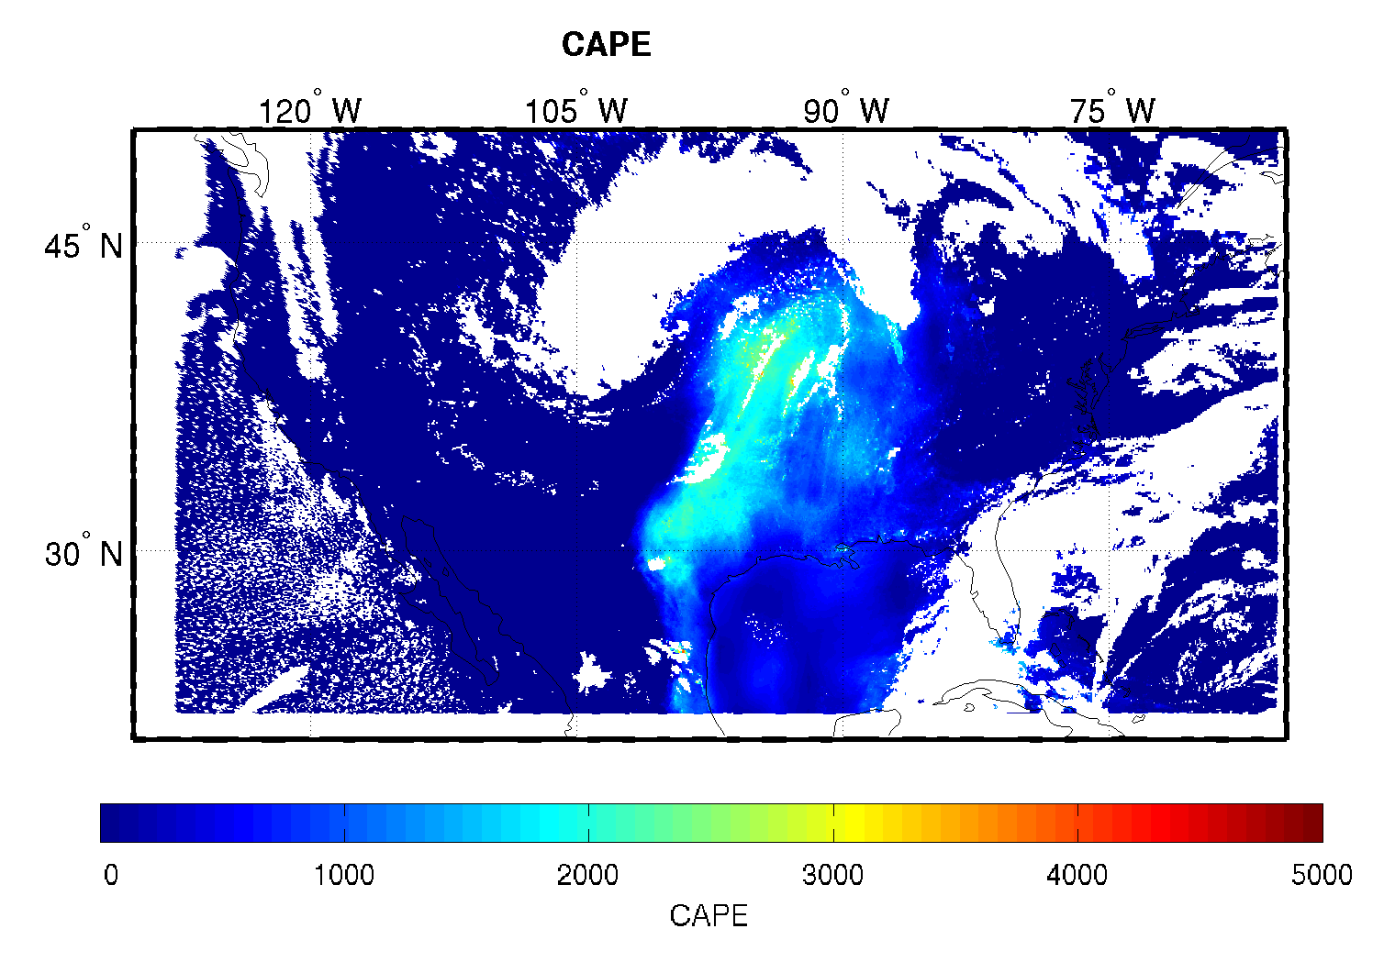
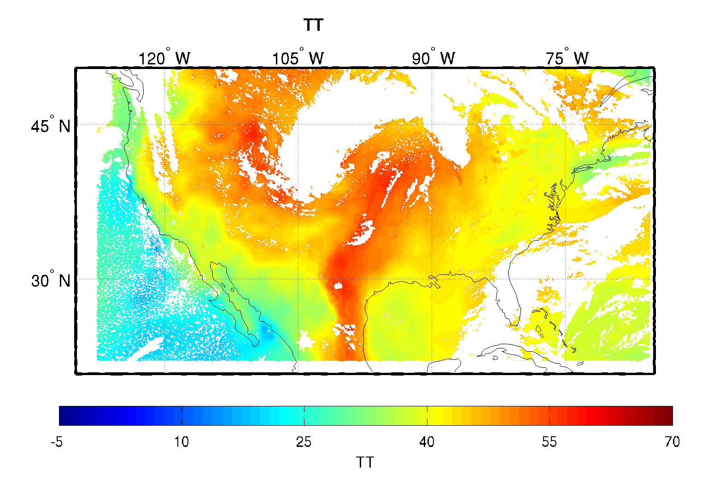
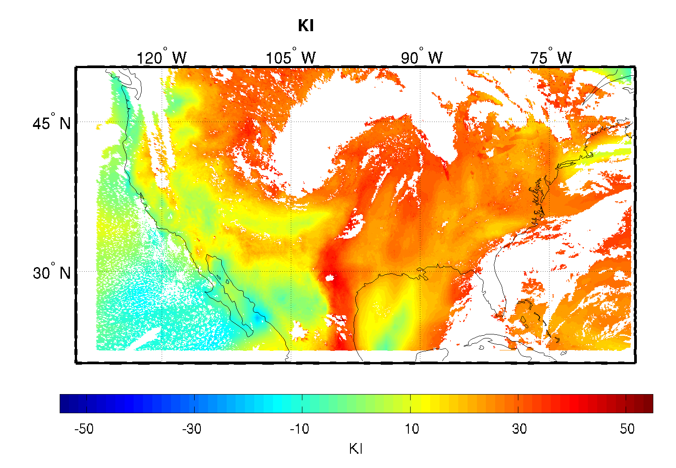
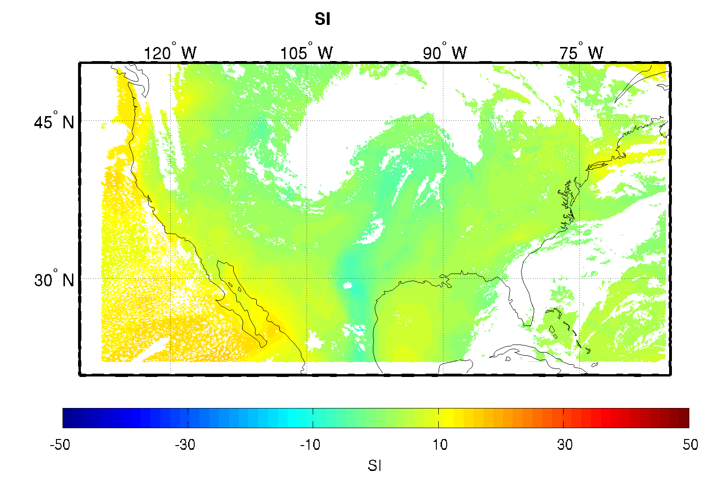
Example LAP Output Using Simulated ABI Data (e.g., CONUS)
TPW and layered PW
Lifted Index
Convective Available Potential Energy
Total Totals
K Index
Showalter Index
Notes:
First algorithm summary slide

Slide 7
Pre-launch Validation Strategies
Proxy data
  Simulated ABI
  GOES Sounder for CONUS and adjacent region
  MODIS for whole GOES-R domain
  SEVIRI/MSG for algorithm validation
Reference data (true)
  WRF nature run (for validating simulated retrievals)
  ECMWF 6-hr analysis for full disk evaluation
  Conventional RAOB for validation over land
  ARM MWR TPW and RAOB (4 times a day) for validating profiles and derived products validation
  GPS-Met TPW for validation over land
  AMSR-E TPW product for validation over ocean
The datasets (MWR TPW, GPS TPW, RAOB TPW at ARM CART and conventional RAOB sites, AMSR-E TPW) make it possible to validate, analyze and monitor the GOES-R LAP algorithm’s seasonal, diurnal performance.
Notes:
Highlight/summarize validation strategy for each product.
Identify reference/”ground truth” datasets that are needed and where/how these are obtained
Identify validation tools (routine & deep-dive) that are needed and being developed

Slide 8
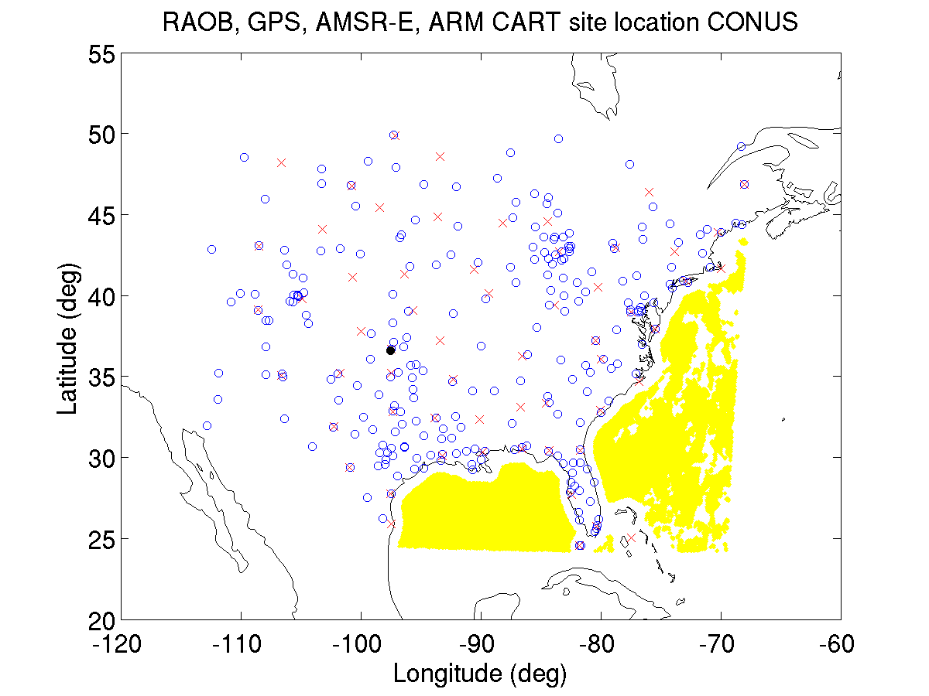
Validation locations over CONUS and adjacent region
x : RAOB
o : GPS
: ARM CART
: AMSR-E
Data collected over the period between
Feb. 11, 2011- Aug. 30, 2012.
For AMSR-E,
Feb. 11, 2011- Oct. 4, 2011
Almost full coverage of CONUS and year round!

Slide 9
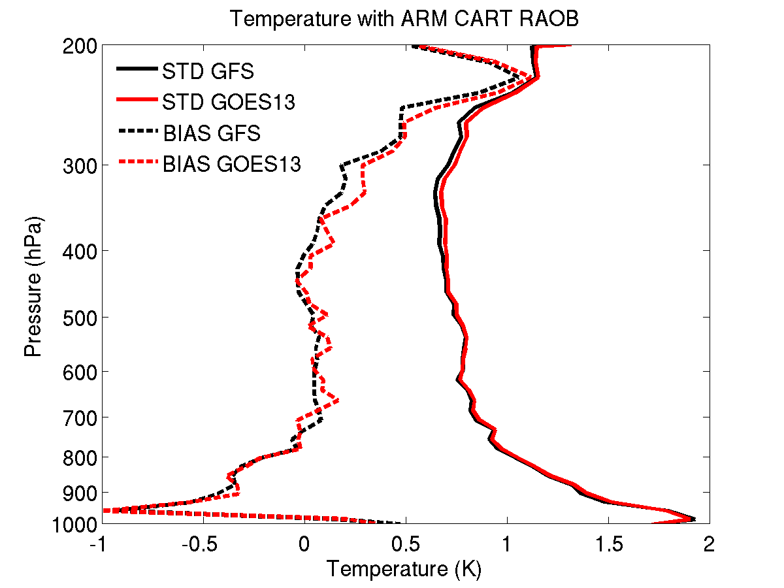
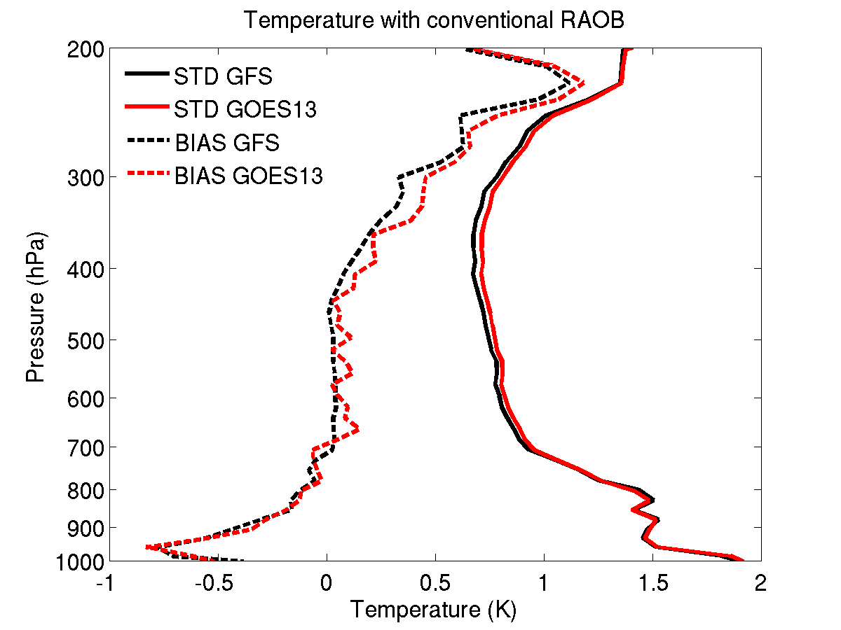
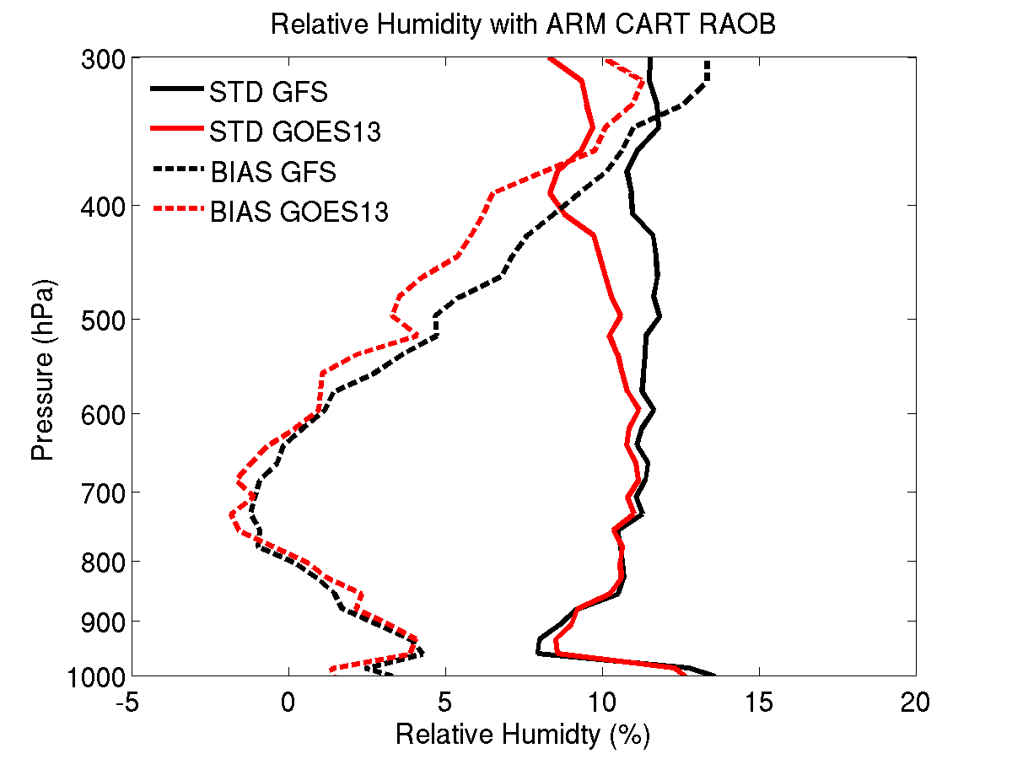
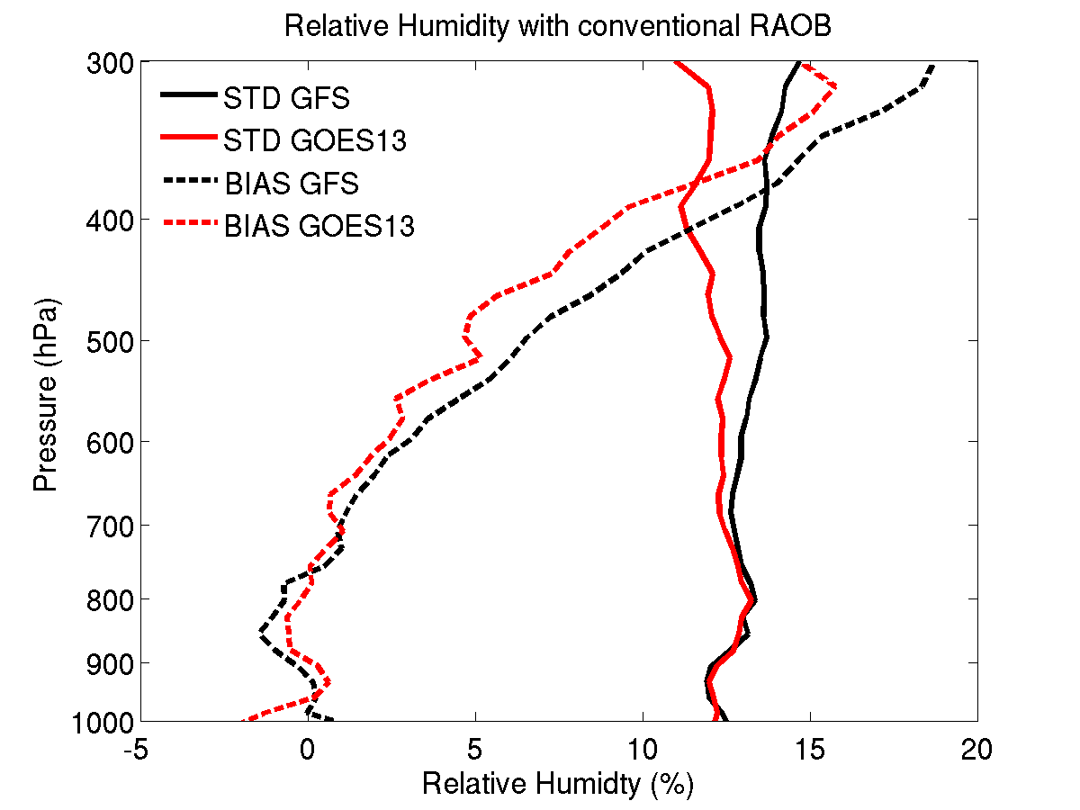
ARM CART
Conventional RAOB
T
ARM CART
Conventional RAOB
RH
Both accuracy (BIAS) and precision (STD) of RH are improved above 700 hPa.
GOES-R ABI LAP algorithm is applied to GOES-13 Sounder radiance measurements.
Notes:
Note: ABI has the similar profile capability of GOES Sounder when combining forecasts and radiances in the retrieval processing (Schmit et al. 2008). In this slides, GOES-R algorithm is applied to process GOES Sounder.

Slide 10
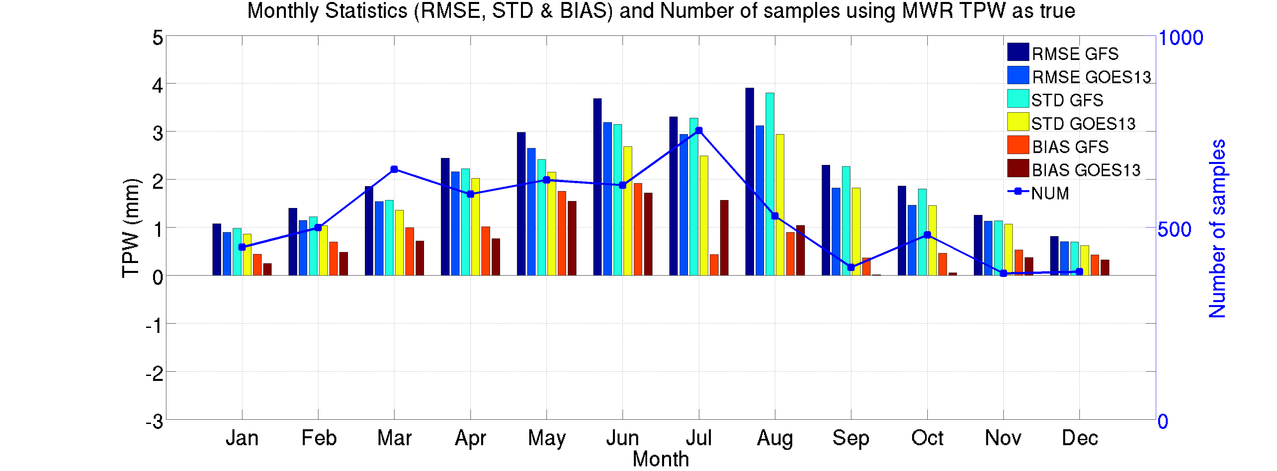
Validation with ARM CART site MWR TPW
GOES-R ABI LAP algorithm is applied to GOES-13 Sounder radiance measurements for validation.

Slide 11
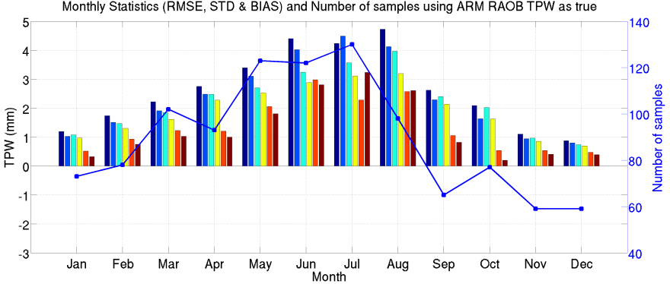
Validation with ARM CART site RAOB TPW
GOES-R ABI LAP algorithm is applied to GOES-13 Sounder radiance measurements for validation.

Slide 12
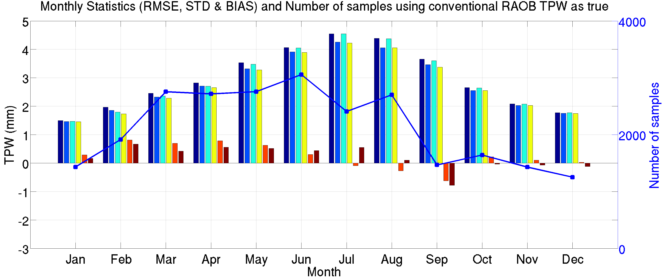
Validation with conventional RAOB TPW
GOES-R ABI LAP algorithm is applied to GOES-13 Sounder radiance measurements for validation.

Slide 13
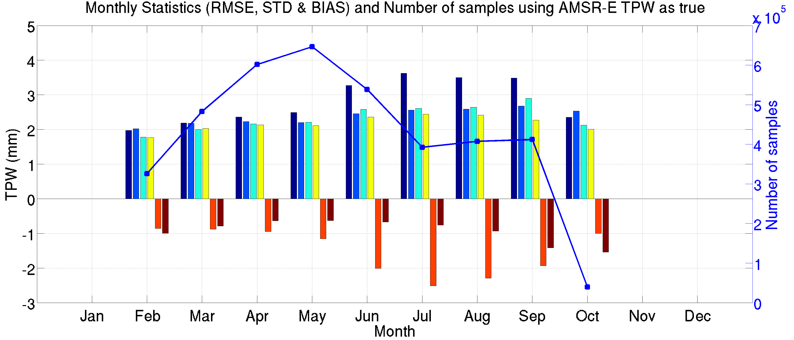
Validation with AMSR-E TPW (over ocean only)
GOES-R ABI LAP algorithm is applied to GOES-13 Sounder radiance measurements for validation.

Slide 14
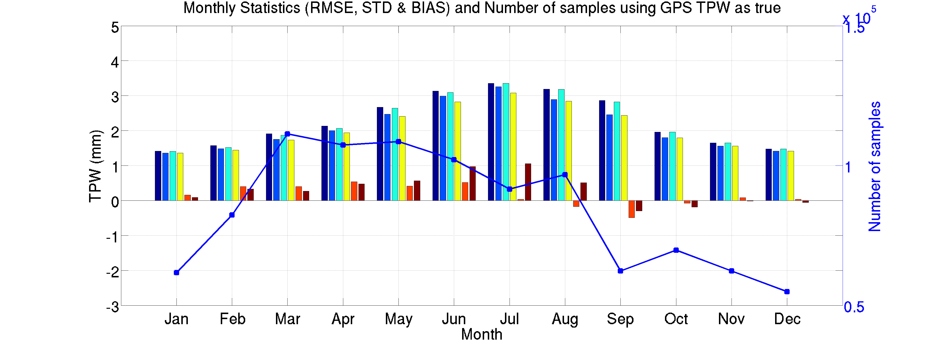
Validation with GPS Met TPW
GOES-R ABI LAP algorithm is applied to GOES-13 Sounder radiance measurements for validation.

Slide 15
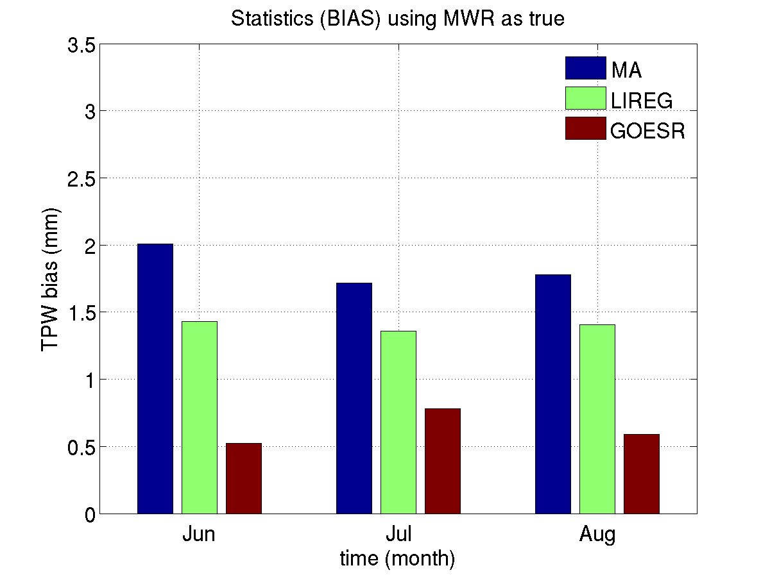
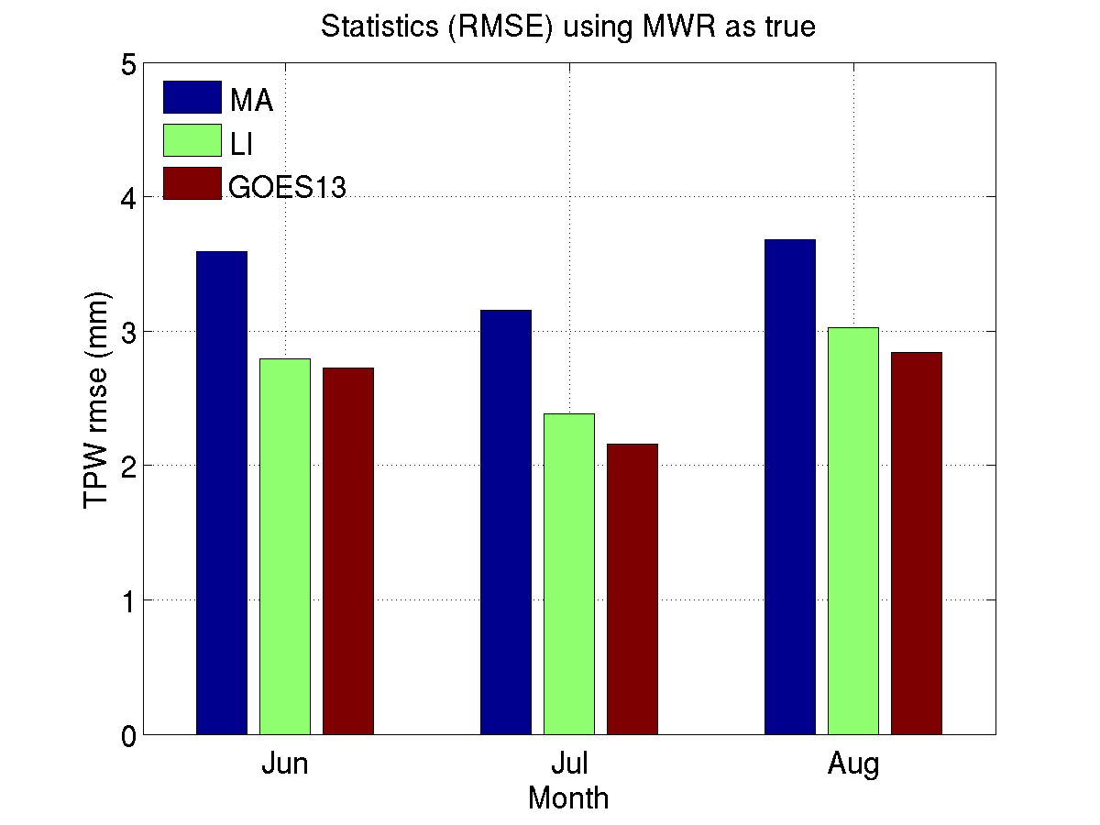
Comparison to the operational GOES sounding algorithm
GOES-R LAP algorithm (GOES13) betters both current (Li) and previous (Ma) operational GOES sounding algorithms in terms of TPW bias and RMSE. Note that Li-algorithm has been operational since February 2013.
Li et al. (2008): current operational GOES sounding algorithm
Ma et al. (1999): previous operational GOES sounding algorithm
GOES-R ABI LAP algorithm is applied to GOES-13 Sounder radiance measurements.

Slide 16
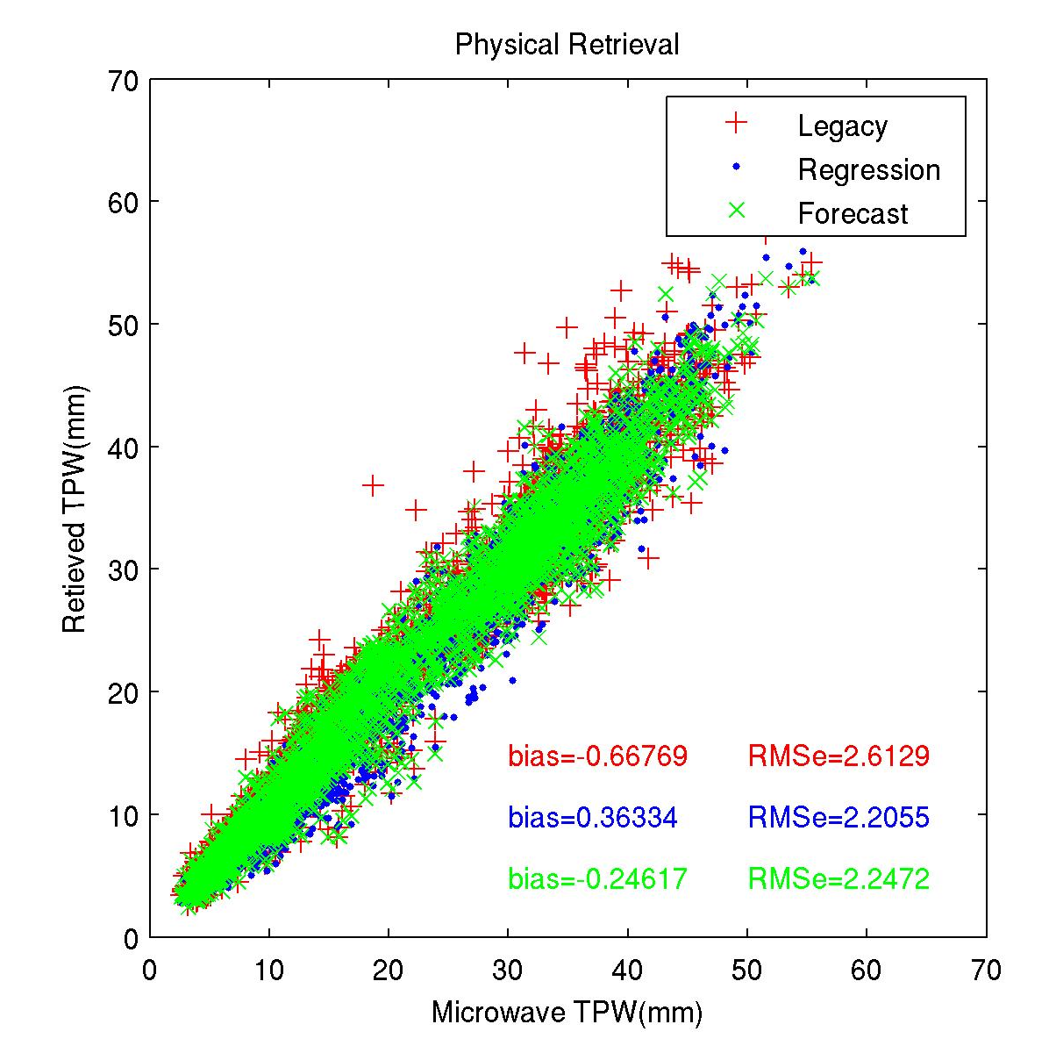
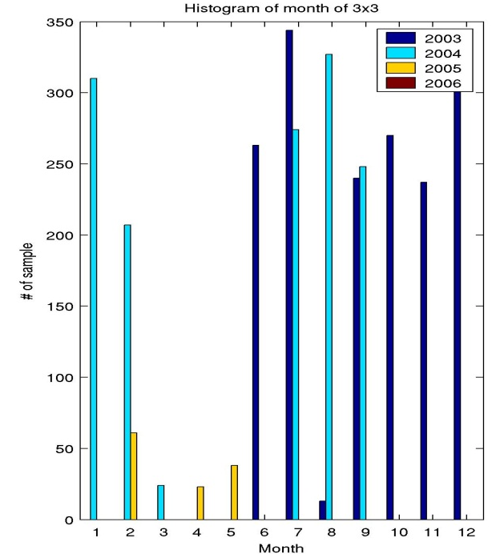
GOES-12 Sounder TPW versus MWR at ARM site
Legacy
Phy1:Regression
Phy2:Forecast
Compared with microwave measured TPW at SGP ARM site from June 2003 to May 2005
Phy2 is similar to GOES-R LAP algorithm

Slide 17
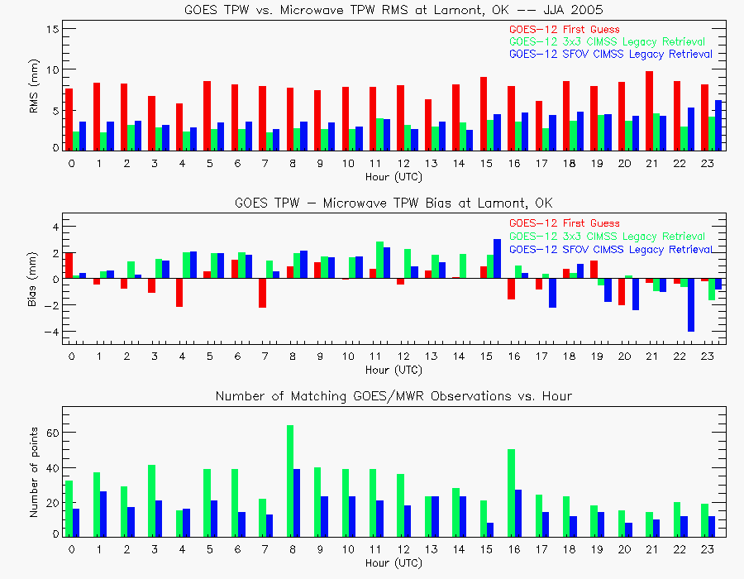
GOES-12 Sounder TPW at ARM CART site - statistics

Slide 18
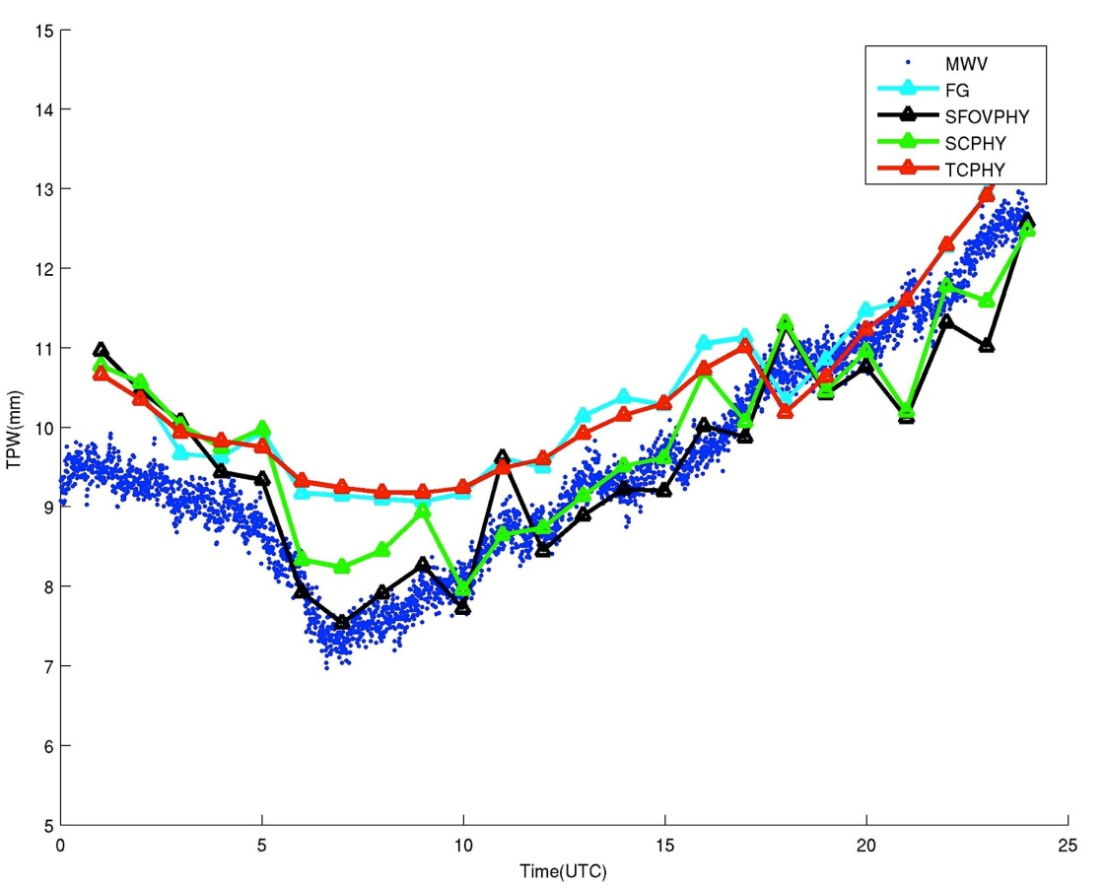
Time series of TPW
(GOES–12 Sounder, MWR)
MWR
FCST
GOES Sounder
GOES Sounder
GOES Sounder
Physically retrieved TPWs from single FOV, spatial continuity and time continuity. The blue dots are microwave measured TPWs at Cart Site (36.61º, -97.49º). The cyan line is the first guess for physical retrievals. The green line is the physical retrieval with spatial continuity. And the red line is the physical retrieval with time continuity. Case study of 00 UTC on Dec 25 2005.

Slide 19
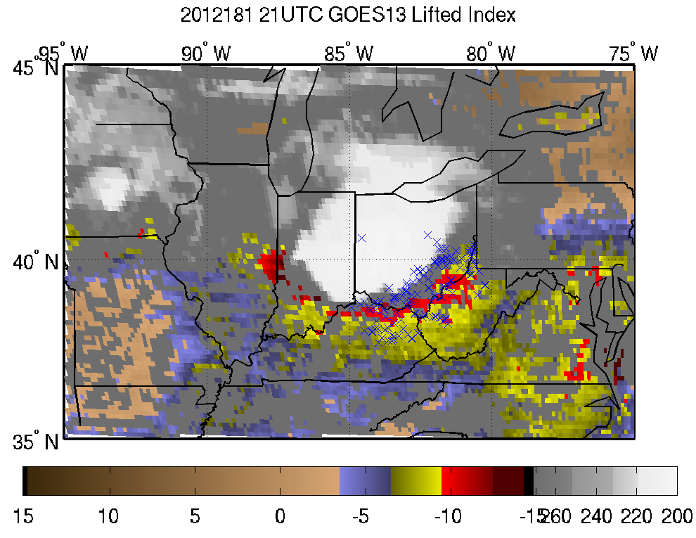
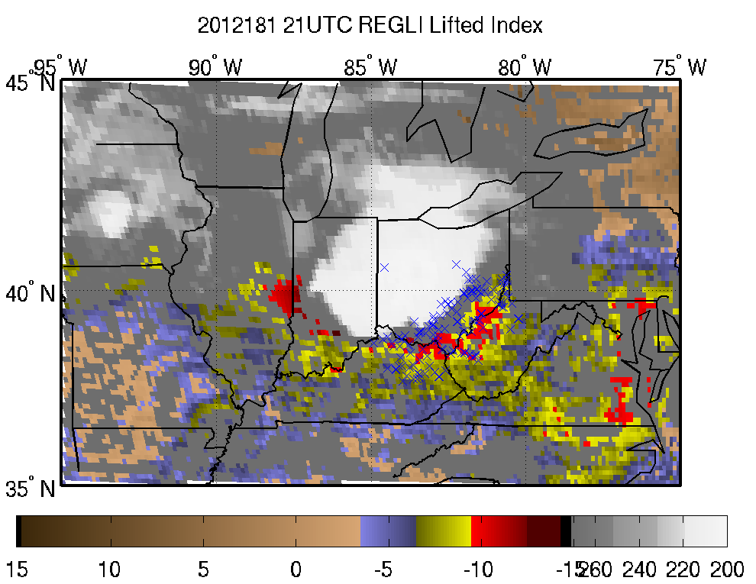
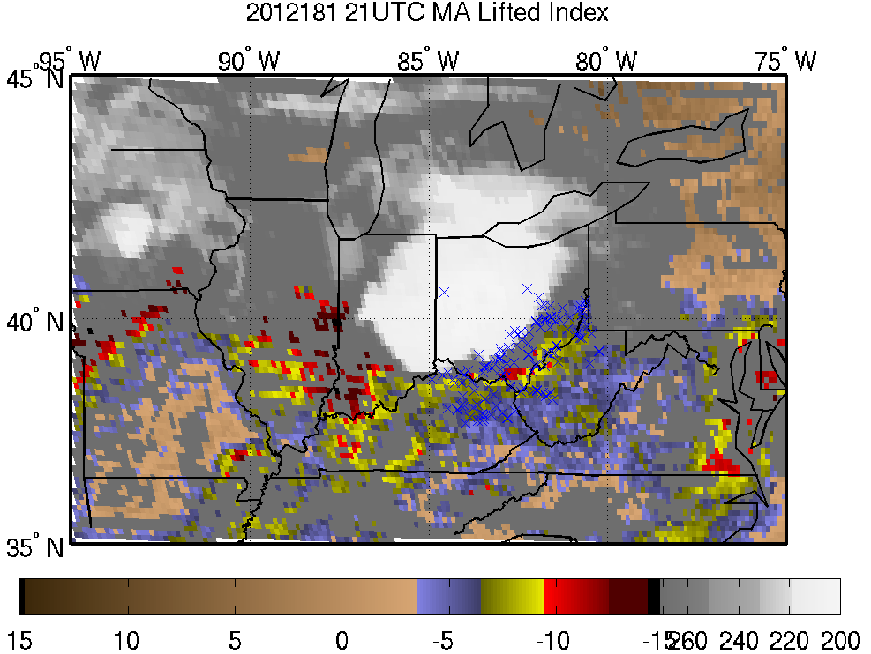
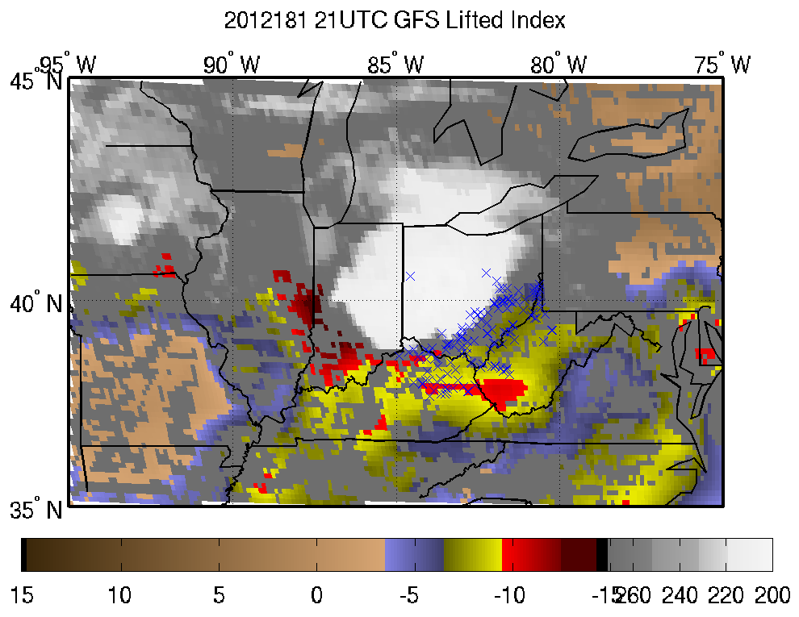
Application of GOES sounding products to severe storm nowcasting
GOES-R
Li - Algorithm
June 29, 2012 derecho
x : locations of wind and hail reports between 2130 - 2330 UTC
Ma - Algorithm
GFS
GOES-R ABI LAP algorithm is applied to GOES-13 Sounder radiance measurements.
Lifted index (K)
BT (K)
Lifted index (K)
BT (K)
Lifted index depicts the unstable region associated with wind/hail reports (x):
GOES-R >~ Li Algorithm >> Ma Algorithm >> GFS

Slide 20
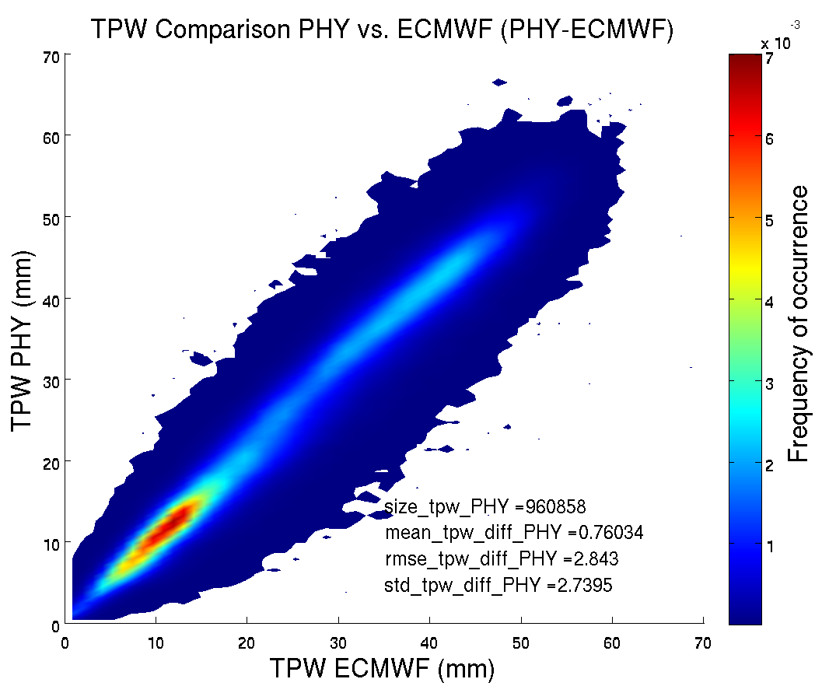
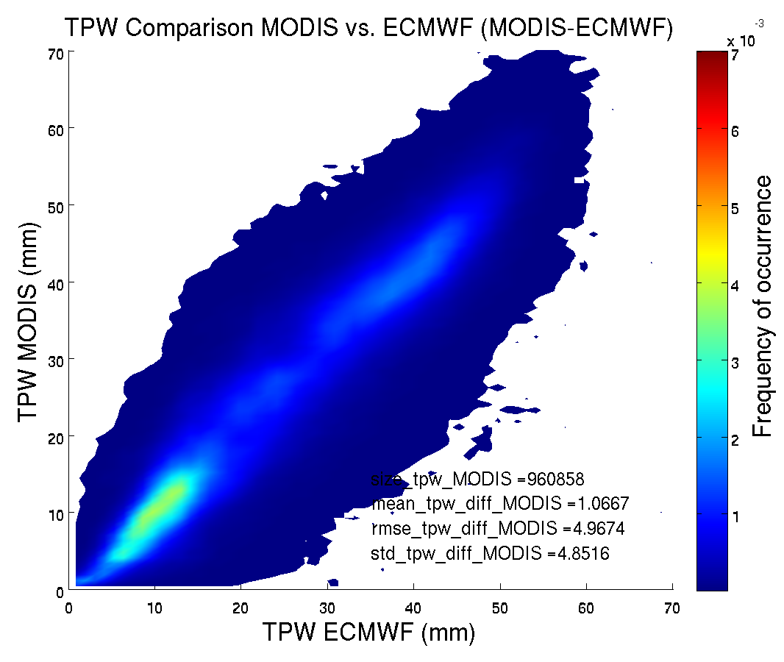
Validation of GOES-R LAP algorithm using MODIS
MODIS (GOES-R)
MOD/MYD07
GOES-R LAP algorithm significantly improves the operational MODIS TPW (MOD/MYD07)
Accuracy (bias): 1.07 mm => 0.76 mm
Precision (standard deviation): 4.85 mm => 2.74 mm
GOES-R ABI LAP algorithm is applied to MODIS/Aqua radiance measurements (hurricane Ike 2008 case).

Slide 21
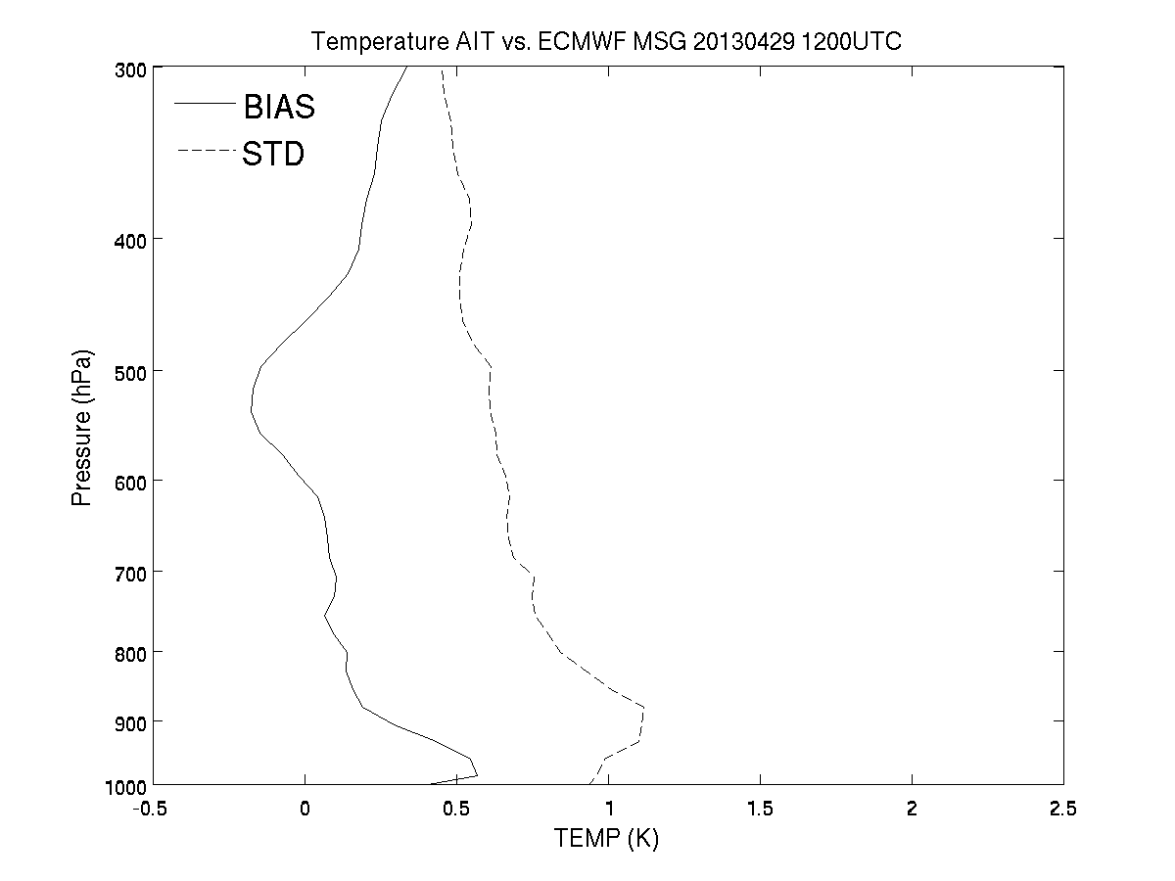
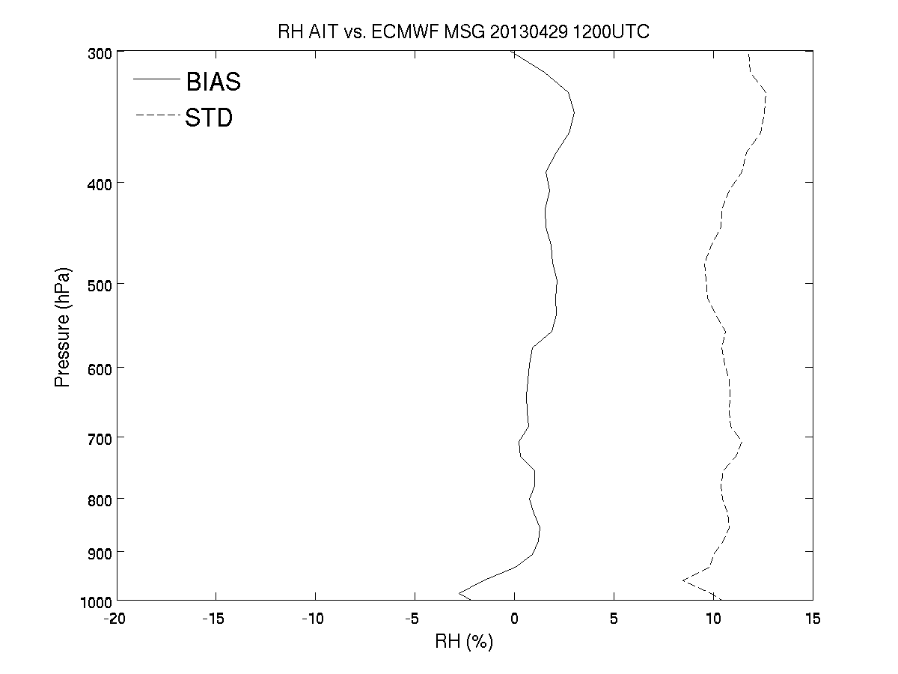
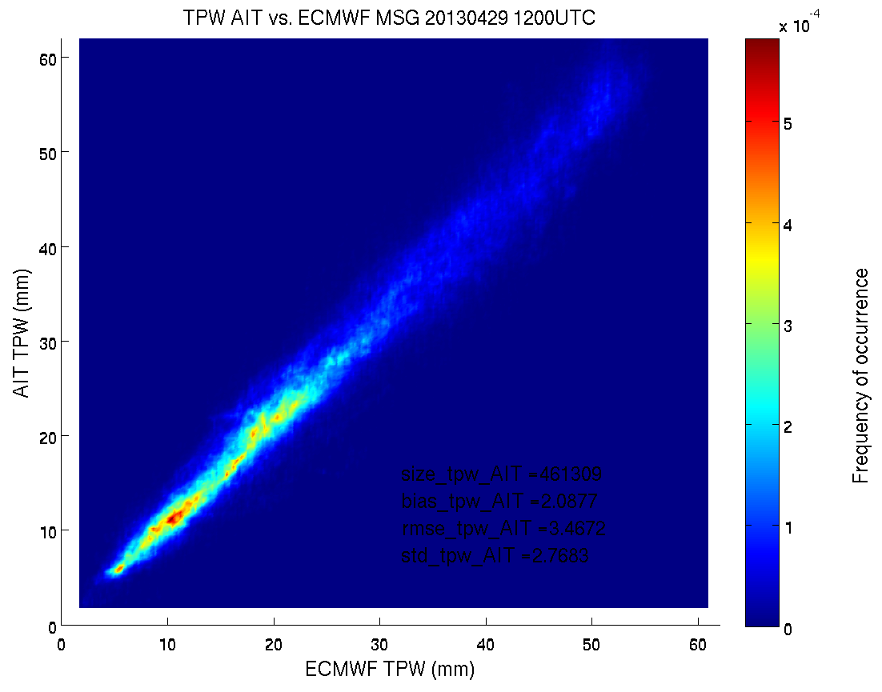
Validation of GOES-R LAP algorithm using SEVIRI measurements
The following images illustrate the AIT temperature/moisture/TPW retrieval using SEVIRI for Apr. 29, 2013 12 UTC against ECMWF analysis
TPW
Temperature
Relative
Humidity
TPW Precision (standard deviation) = 2.77 mm
Requirements met !!
21

Slide 22
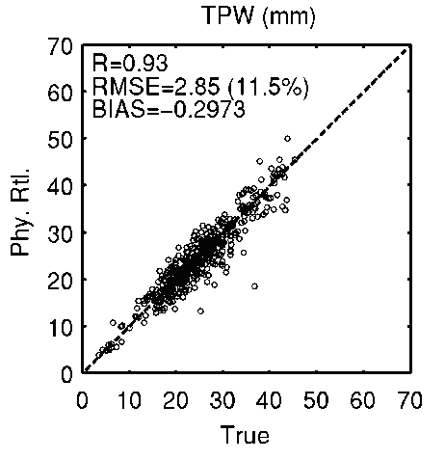
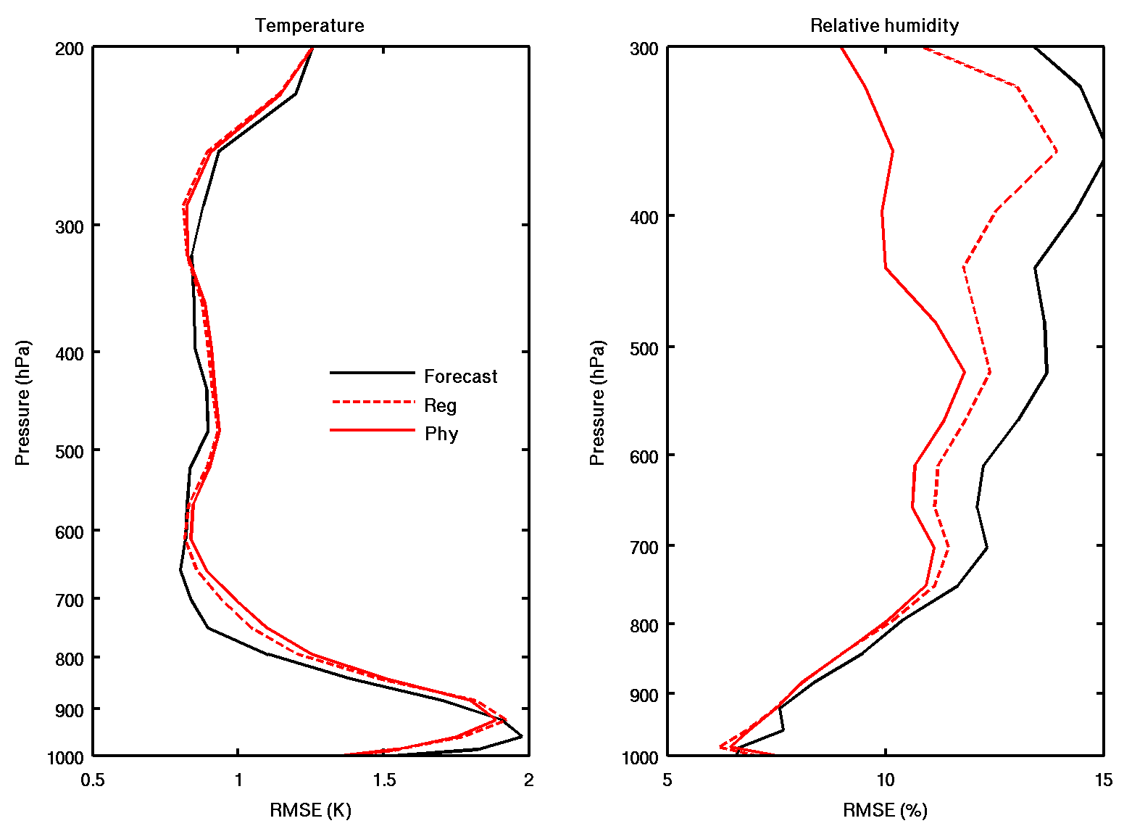
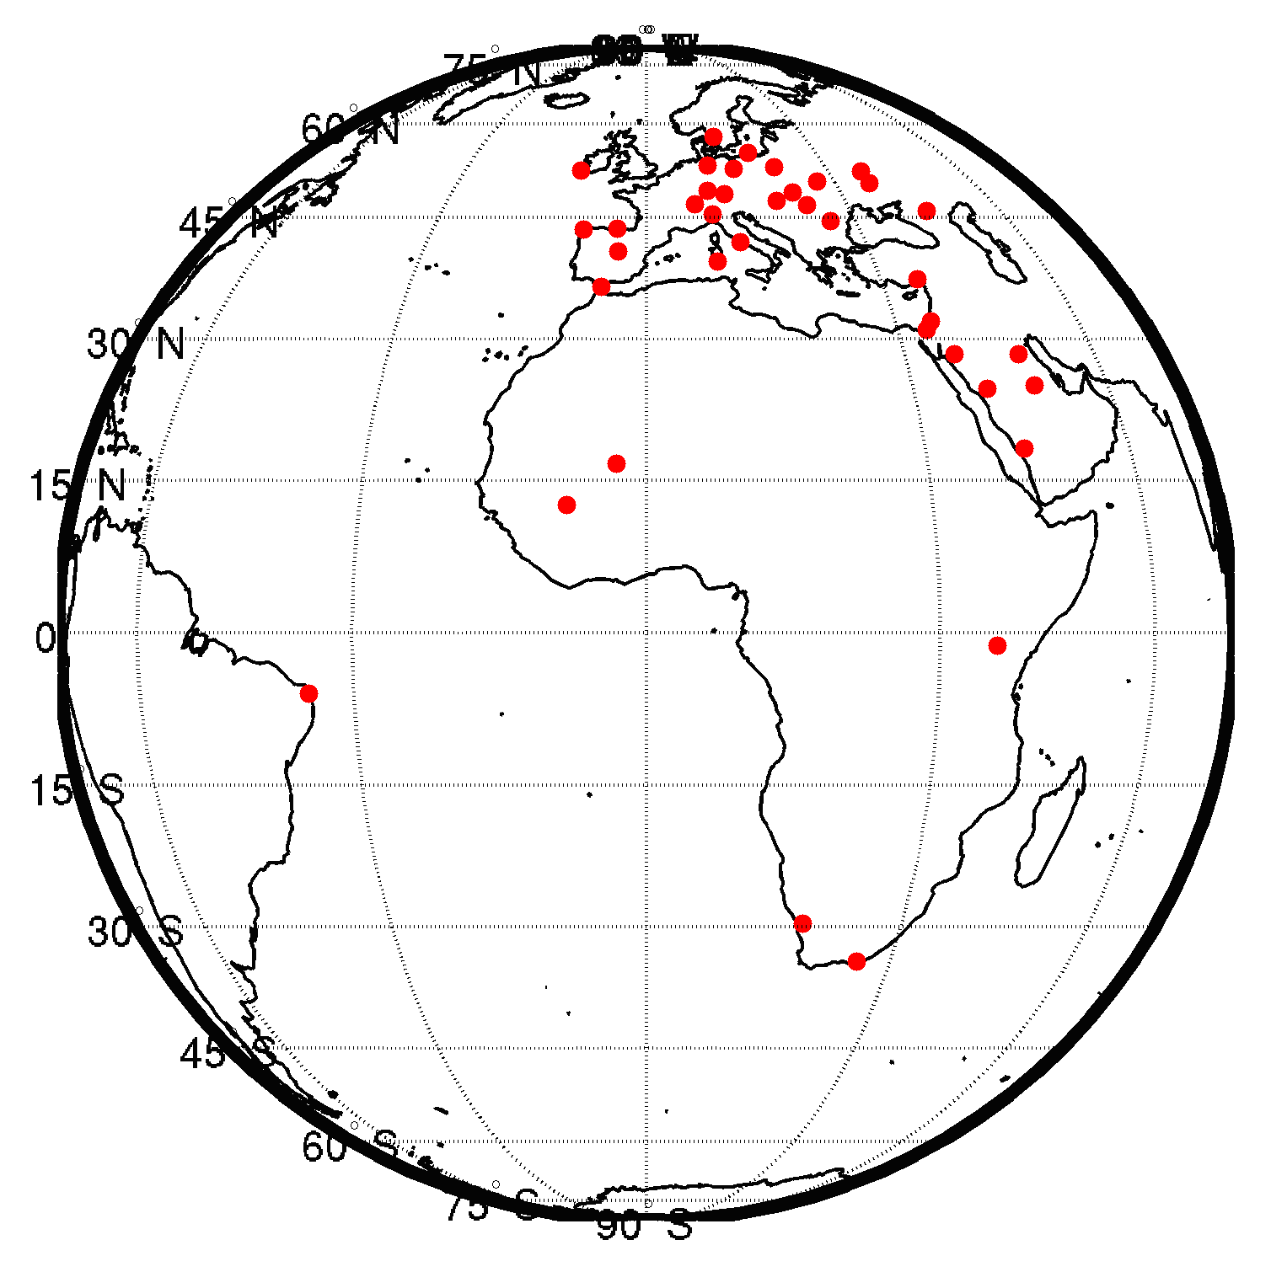
Temperature/Moisture Profile and TPW Validation over Land (with SEVIRI)
The following images illustrate the temperature/moisture/TPW retrieval by SEVIRI against 475 radiosonde measurements over land for August 2006
Accuracy = -0.3 mm and Precision = 2.83 for TPW, requirements met !!
22
Sample sites

Slide 23
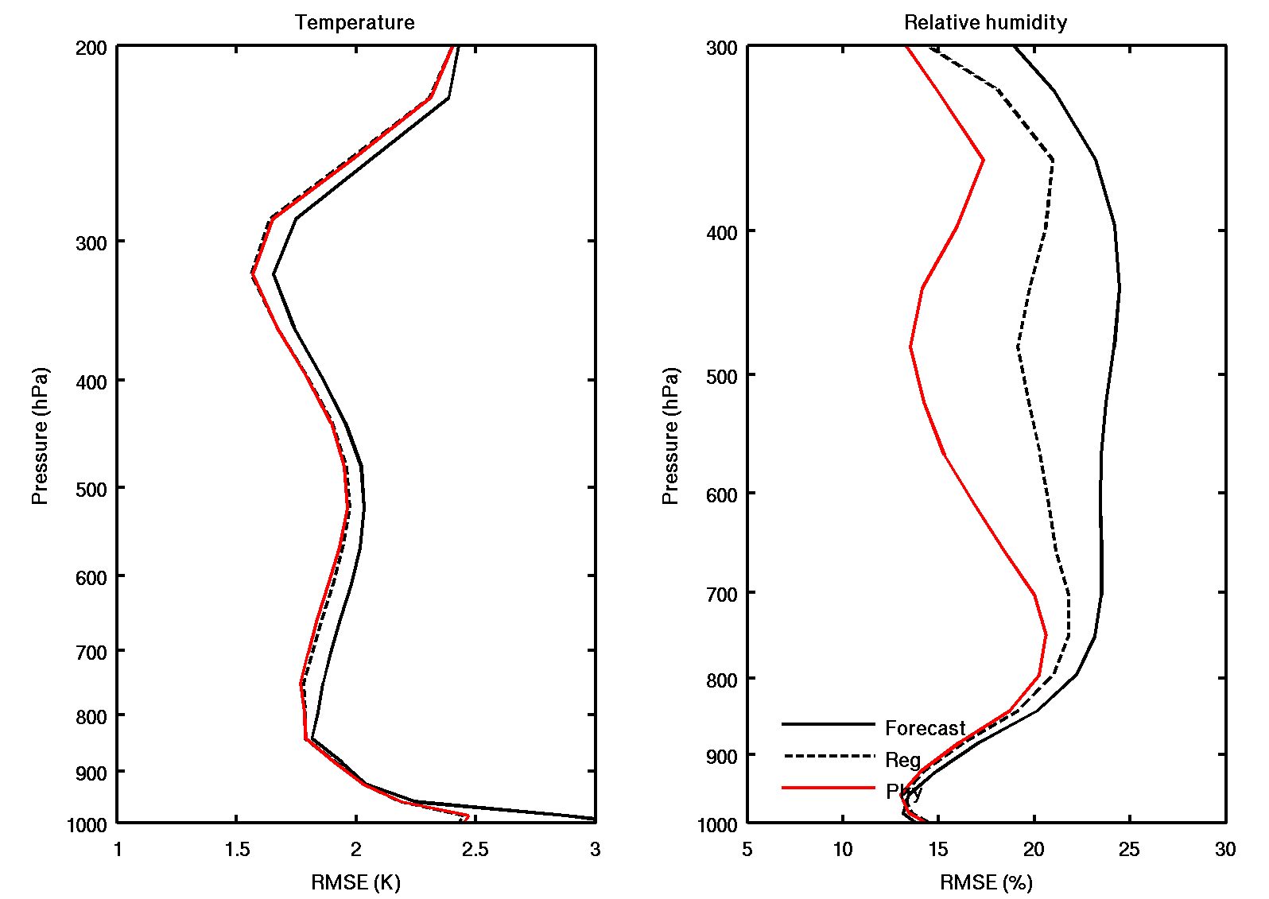
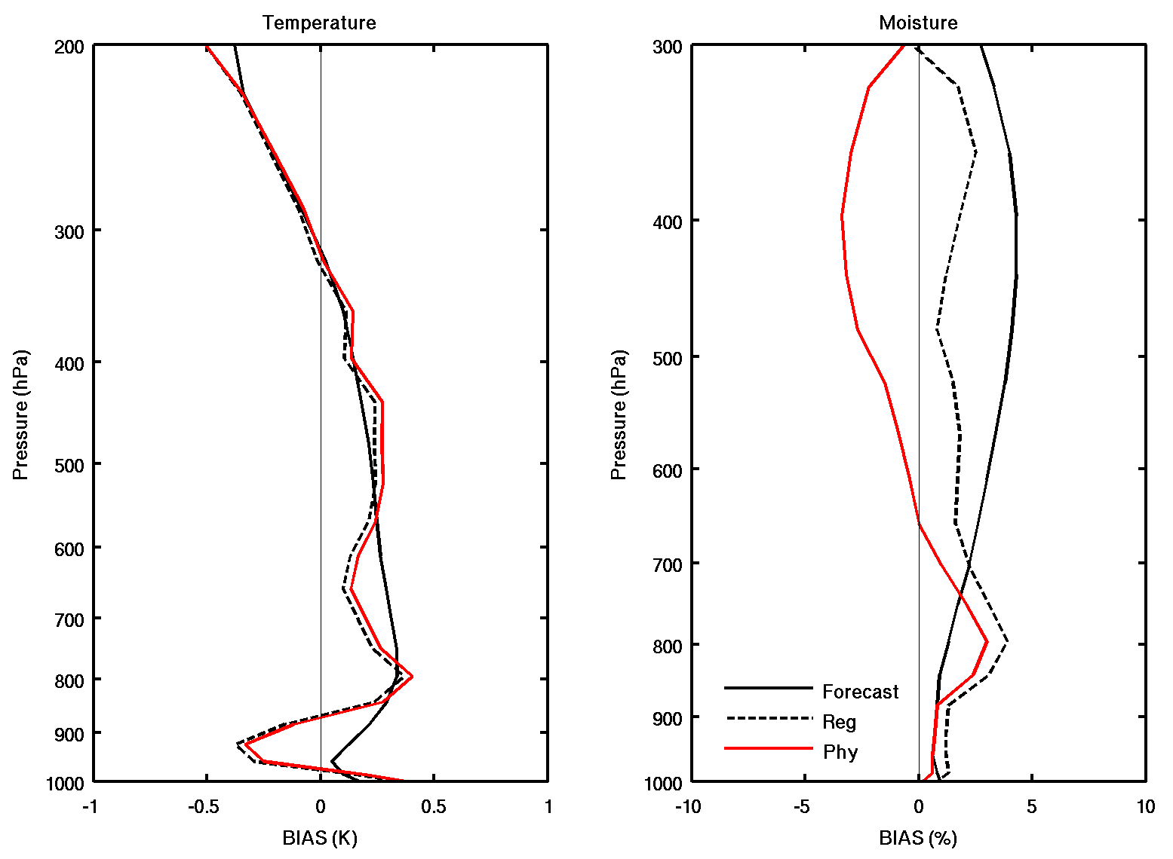
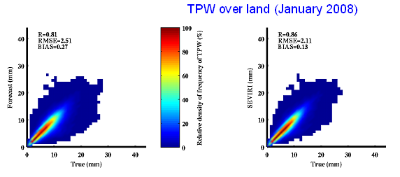
Temperature/Moisture Profile and TPW
Validation over Land (con’d) (SEVIRI)
The following images illustrate the temperature/moisture/TPW retrieval by SEVIRI against ECMWF analysis profiles over land for January 2008
Accuracy = 0.13 mm and
Precision = 2.83 for TPW
Requirements met !!

Slide 24
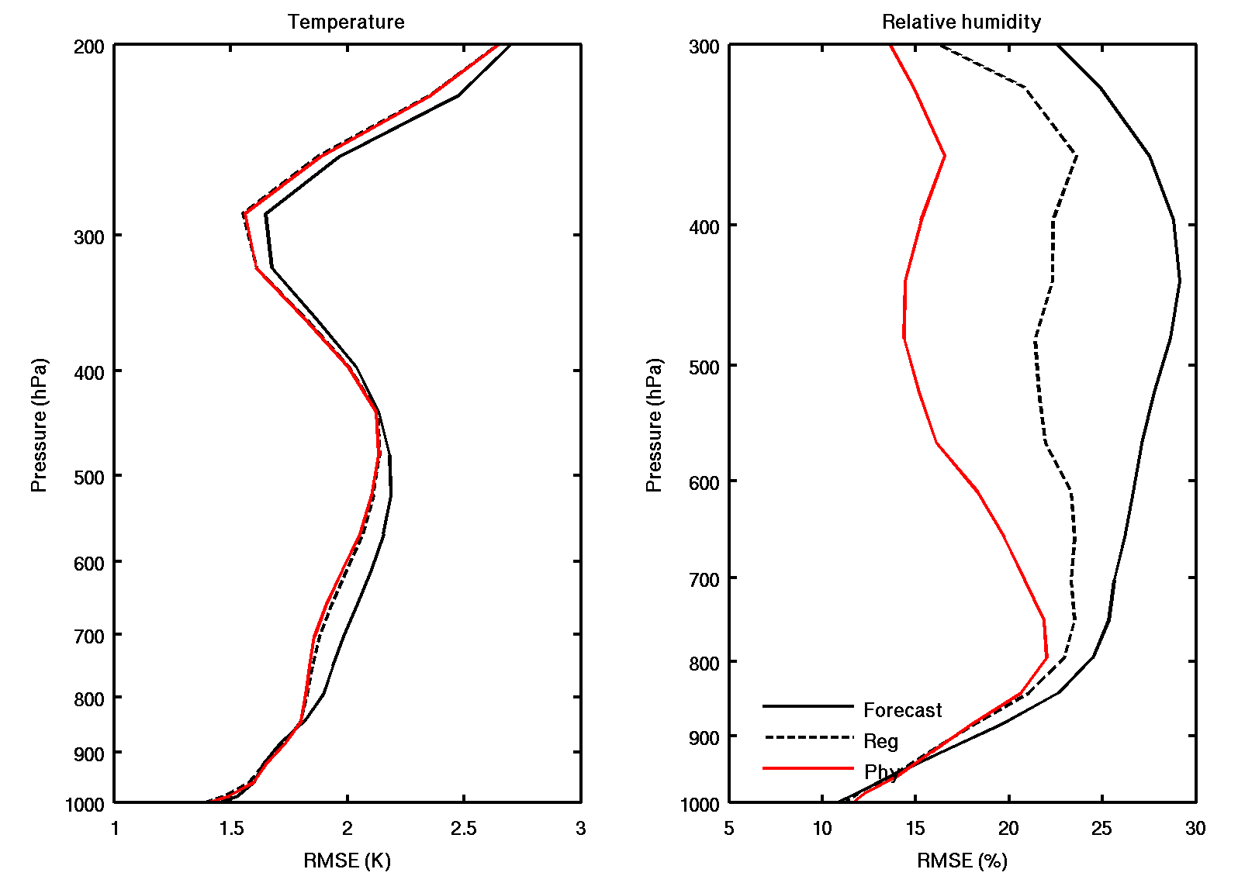
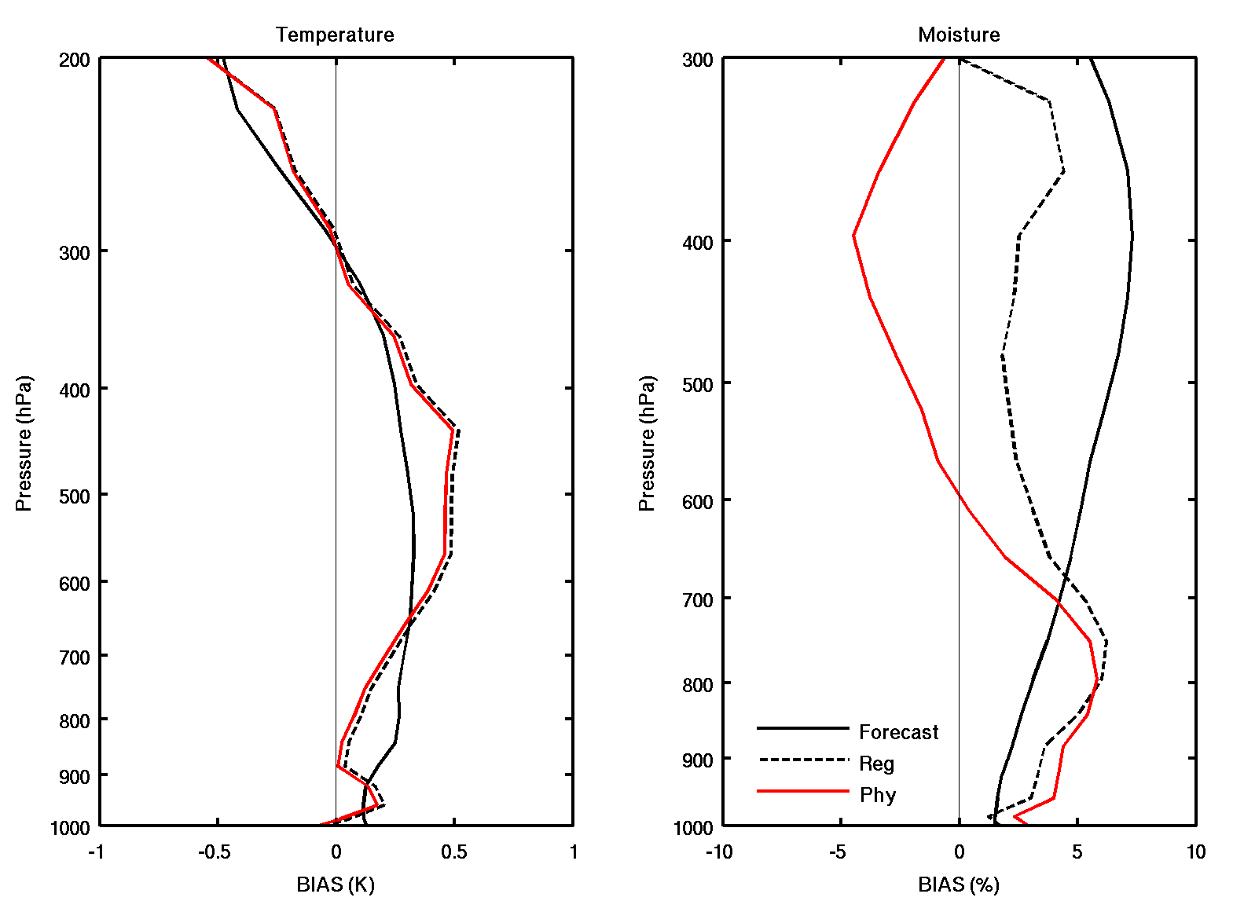
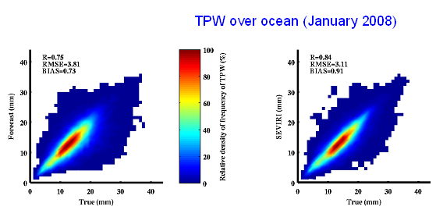
Temperature/Moisture Profile and TPW Validation over Ocean (SEVIRI)
The following images illustrate the temperature/moisture/TPW retrieval by SEVIRI against ECMWF analysis profiles over ocean for January 2008
Accuracy = 0.91 mm and
Precision = 2.97 for TPW
Requirements met !!
24

Slide 25
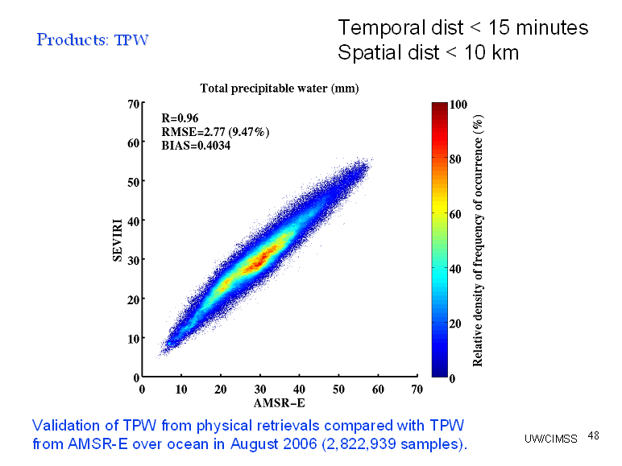
TPW Validation over Ocean (SEVIRI) with AMSR-E
AMSR-E level-2 provides TPW over ocean.
Accuracy = 0.4 mm
Precision = 2.74 mm
Requirements met !!
Jin et al. (2008), JGR

Slide 26
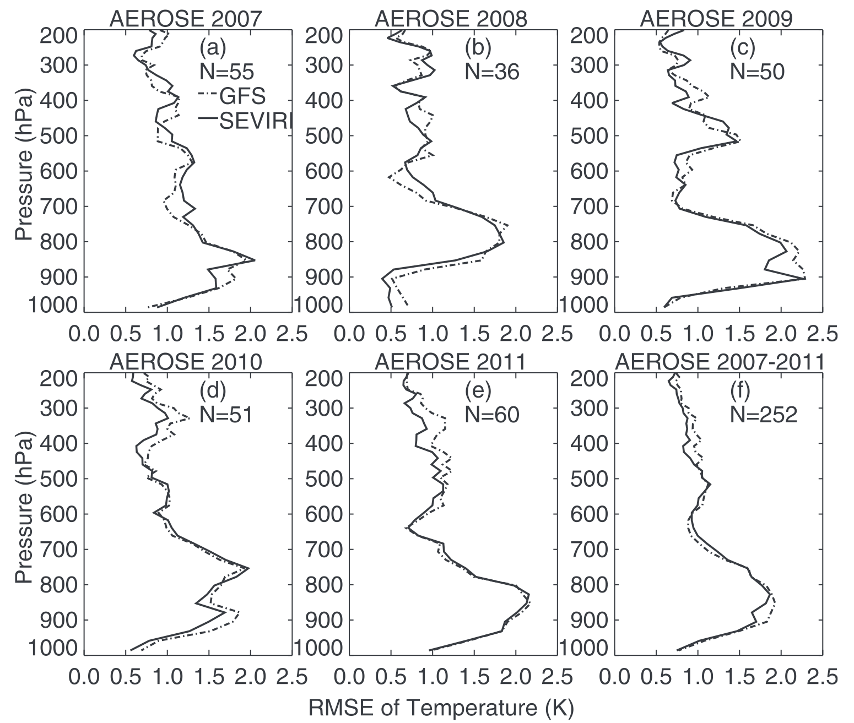
Temperature Validation over Ocean (SEVIRI)
Dedicated RAOB from NOAA Aerosols and Ocean Science Expedition (AEROSE)
2007-2011
Atlantic Ocean
RMSE of temperature (K)
Temperature retrieval is slightly better than GFS forecast !
Xie et al. (2013), JTECH

Slide 27
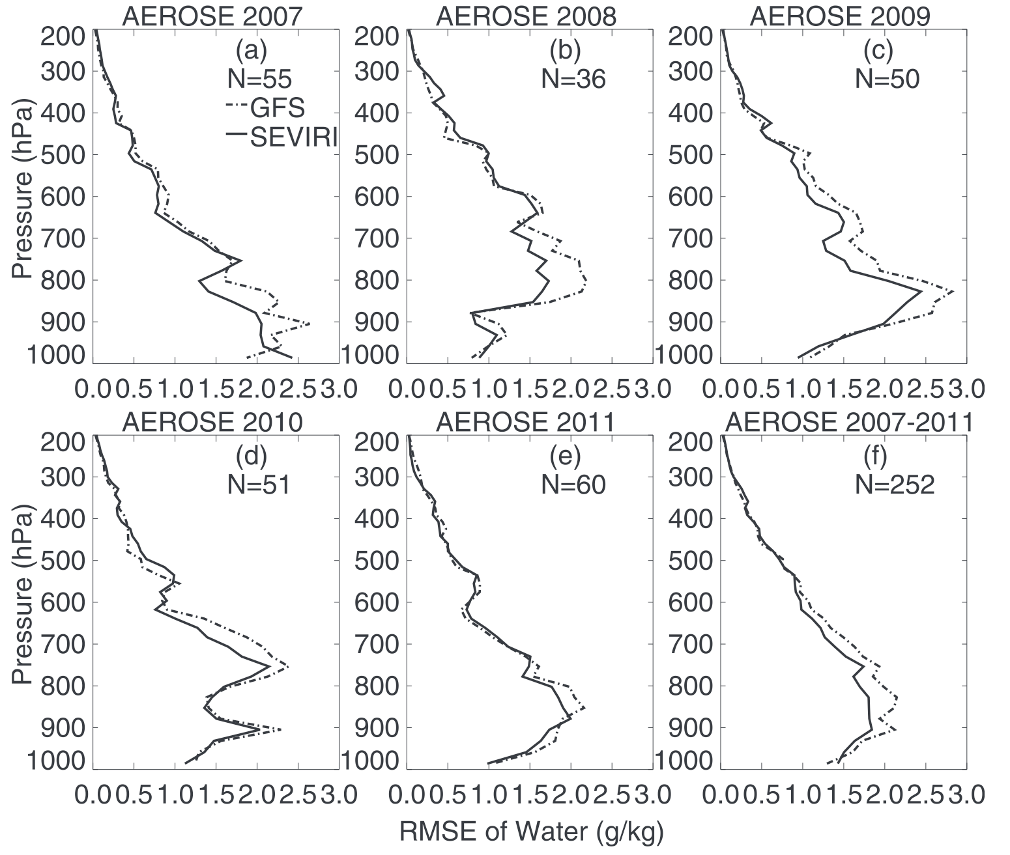
Mixing Ratio Validation over Ocean (SEVIRI)
Dedicated RAOB from NOAA Aerosols and Ocean Science Expedition (AEROSE)
2007-2011
Atlantic Ocean
RMSE of mixing ratio (g/kg)
Mixing ratio retrieval is better than GFS forecast !
Xie et al. (2013), JTECH

Slide 28
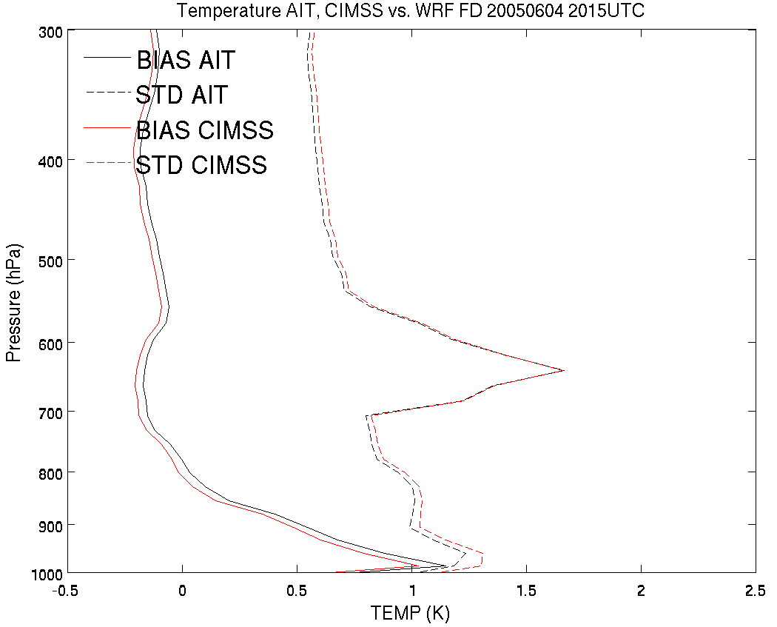
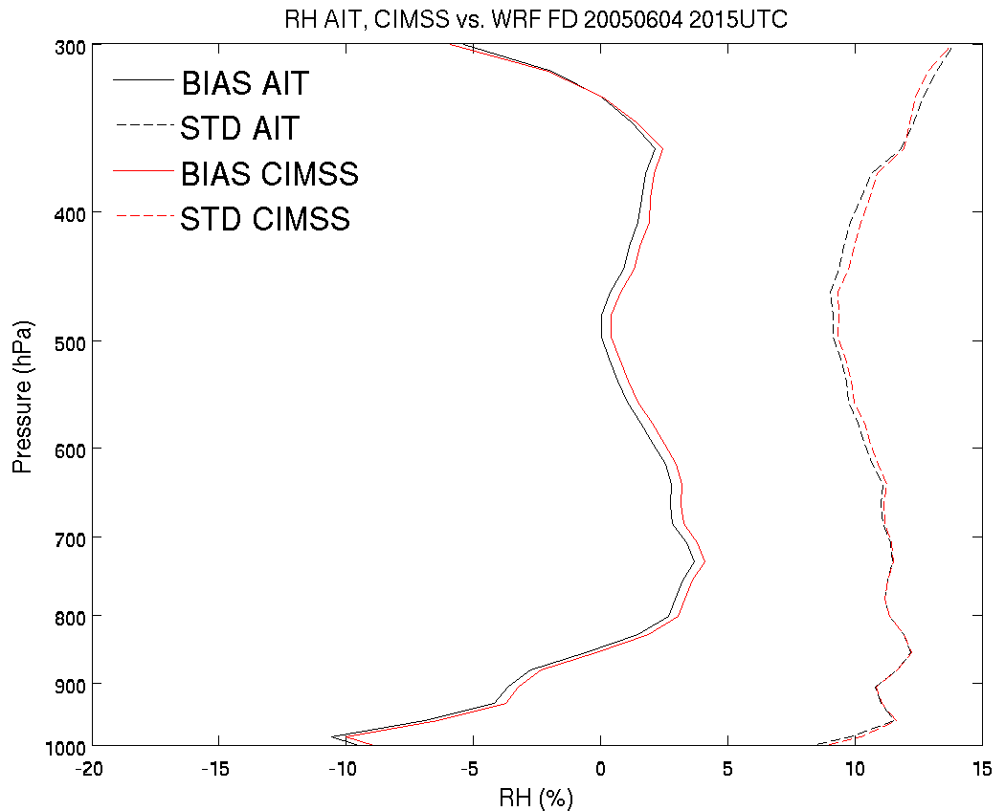
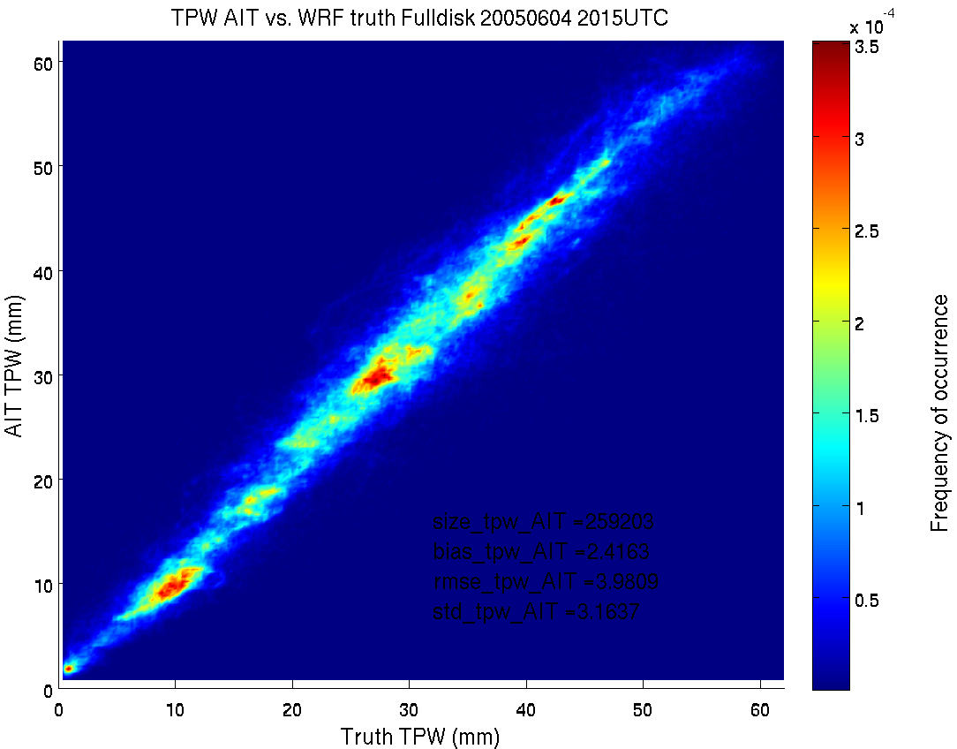

T/RH/TPW validation using simulated ABI full disk 20050604 2015 UTC 75 W
Also consistency check between CIMSS and STAR AIT process
Temperature
Relative
Humidity
AIT vs. WRF
CIMSS vs. WRF
TPW Accuracy (bias) = 2.42 mm for AIT, 2.49 mm for CIMSS
TPW Precision (standard deviation) = 3.16 mm for AIT, 3.19 mm for CIMSS

Slide 29
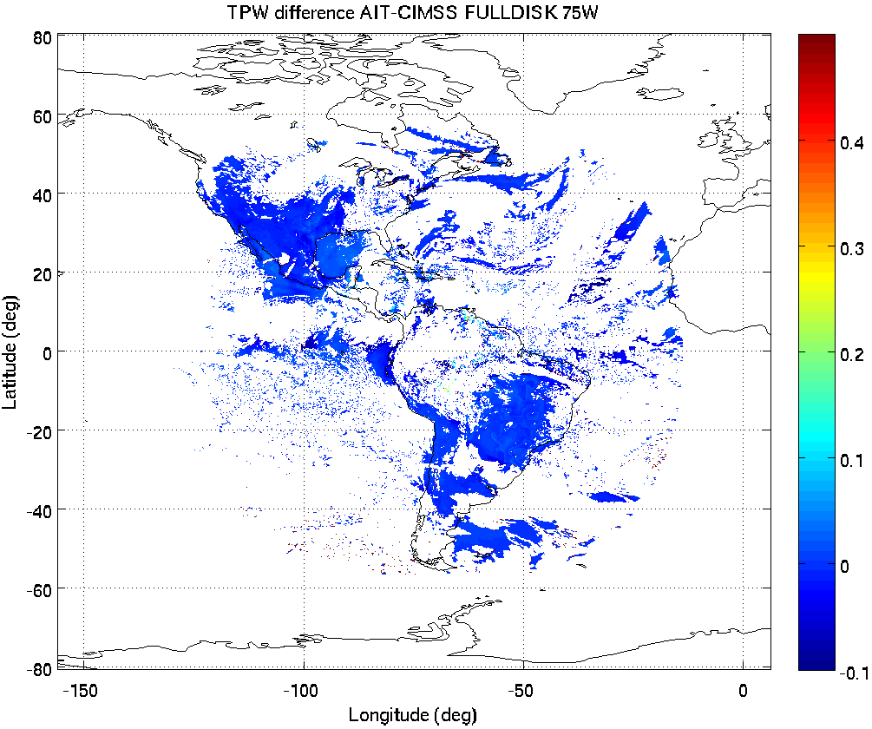
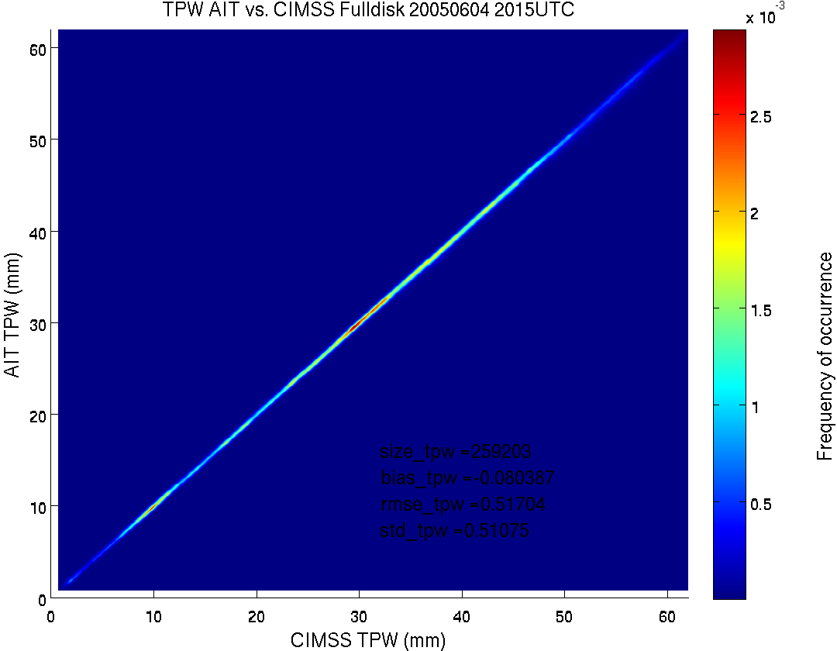
AIT vs. CIMSS Fulldisk 20050604 2015 UTC
2D TPW difference (mm)
75 W
TPW bias (CIMSS – AIT) = -0.08 mm
TPW STD = 0.51 mm

Slide 30
GOES-R LAP Product Validation Tool
Routine Capabilities:
- Monitoring the quality of atmospheric temperature and moisture profiles in near real time
- Monitoring the quality of TPW, LI, TT, CAPE, KI, and SI in near real time
Deep Dive Capabilities:
- Monitor any anomalies of any GOES-R LAP product and identify the cause
- Quantify the error/uncertainty of GOES-R LAP products for better applications
Datasets used:
Radiosonde T/Q profiles (ARM CART and conventional RAOB sites);
microwave radiometer TPW, GPS TPW, RAOB TPW (ARM CART site);
RAOB TPW (conventional RAOB sites);
AMSR-E TPW (which will be replaced by AMSR2 TPW);
Stability indices from RAOB (ARM CART and conventional RAOB sites)
NWP forecast used in the LAP retrieval
ABI IR brightness temperatures
Notes:
For each product, describe and illustrate the routine validation tools that you have or are developing. At a minimum address the following:
- Capabilities (in their final state)
- Datasets used
- Visualization software tools used (IDL, McIDAS, other…) to visualize the products, intermediate products, diagnostic data, product performance measures, reference/”ground-truth” data, etc…
-

Slide 31
GOES-R LAP product Validation Tool (continued)
Visualization and software tools based on Matlab include
- Time series of BT difference (obs – cals (FCST)) images for ABI IR channels
- Time series of difference (RTVL - FCST) images (TWP, LI, CAPE, TT, KI, SI)
- Time series of TPW, LI, CAPE, TT, KI, SI from GOES-R RTVLs, FCSTs and radiosondes at ARM CART
and conventional RAOB sites with atmospheric status (e.g., T/Q profiles) for a selected time.
- Time series of GOES-R TPW, FCST TPW, and MWR TPW at ARM CART site
- Snap shot of atmospheric status at ARM CART site
- Statistics of T/Q, TPW, stability indices retrievals against ARM CART and conventional RAOBs over land
- Statistics of TPW retrievals against MWR, GPS TPW at ARM CART site over land
- Statistics of TPW retrievals against AMSR-E TPW over ocean
- Statistics of retrievals against ECMWF analysis both over land and ocean
- Animations of 2D variable imageries over CONUS
including BTs for ABI IR channels, TPW, atmospheric stability indices,
temperature (100, 200, 300, 400, 500, 700, 850, 1000 hPa),
and water vapor (300, 400, 500, 700, 850, 1000 hPa)
with the difference between RTVLs and FCSTs
- Monitoring product quality
- Comparison with other products (e.g., CrIS, VIIRS, and ATMS soundings)
- Quality flag, cloud mask, and aerosol/dust product images
* Most time series and statistics include bias, std, and rmse compared with the truth dataset.
Notes:
For each product, describe and illustrate the routine validation tools that you have or are developing. At a minimum address the following:
- Capabilities (in their final state)
- Datasets used
- Visualization software tools used (IDL, McIDAS, other…) to visualize the products, intermediate products, diagnostic data, product performance measures, reference/”ground-truth” data, etc…
-

Slide 32
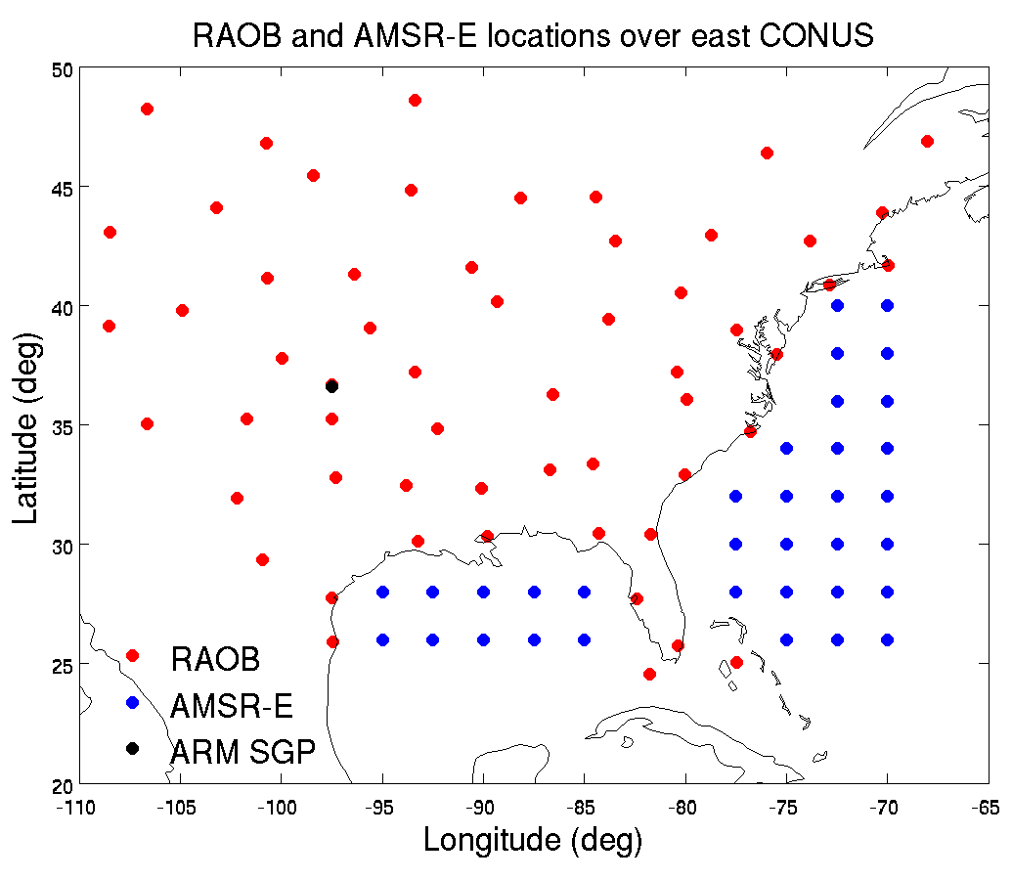
Matchup data locations
ARM CART, conventional RAOB, and AMSR-E sites
ARM CART (36.61°N, 97.47°W), Apr. 7, 2010 – Mar. 26, 2011 (00, 06, 12, and 18 UTC)
RAOB: T/RH, TPW, and atmospheric stability indices
MWR: TPW every 30 seconds
GPS: TPW every 30 min
57 conventional RAOB sites: T/RH, TPW, and atmospheric stability indices, Apr. 23, 2011 – Apr. 30, 2012 (00 & 12 UTC)
34 AMSR-E locations: TPW, Aug. 1, 2011 – Aug. 10, 2011

Slide 33
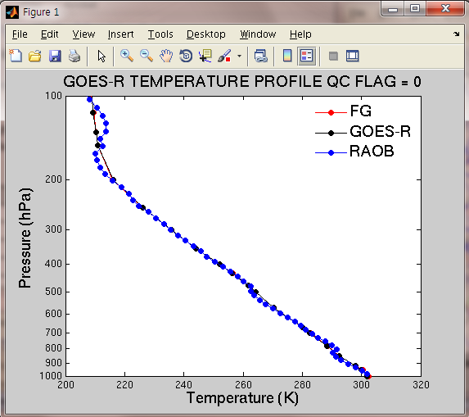


T/Q profile snapshot at ARM CART site in Validation Tool
Regular axis
Skew-T diagram of temperature and dew point temperature at 00UTC Jun 1, 2010 at ARM CART site and
corresponding profiles of temperature and water vapor mixing ratio on a regular axis.

Slide 34






T/Q profile statistics at ARM CART site in Validation Tool
T
RMSE
BIAS
STD
RH
RMSE
BIAS
STD
Statistics of temperature and RH profiles for June 2010 at ARM CART site

Slide 35


Time series of TPW and related statistics at ARM CART site in Validation Tool
Time Series
Selected T/Td profile
Deep Dive
Time series of TPW and the statistics of TPWs from several sources compared with MWR TPW
during the period between Sep. 11, 2010 00UTC and Sep. 14, 2010 23 UTC at ARM CART site.
Selected skew-T profiles of temperature and dew point temperature on Sep. 12, 2010 23UTC.

Slide 36


Imagery of 2D variables in Validation Tool
Deep Dive
TPW
GFS GOES-R Difference
Deep Dive
T 850hPa
GFS GOES-R Difference
Horizontal imagery comparison between GFS and GOES-R ABI LAP for TPW and 850 hPa temperature
with cloud regions filled with GOES-13 sounder 11 um Tb (K) on Aug. 10, 2011 01 UTC.

Slide 37


Scatter plots and time series of TPW at conventional RAOB sites in Validation Tool
Scatter plots
Time Series
Deep Dive
GFS GOES-R
GFS and GOES-R ABI LAP TPW comparison with RAOB TPW
TPW scatter plots for all 57 conventional RAOB locations for the period from Jul. 31, 2011 to Aug. 11, 2011
Time series for the same period at Shreveport Regional Airport with related statistics.

Slide 38


Time series of TPW and related statistics at AMSR-E pixels in Validation Tool
Scatter plots
Time Series
Deep Dive
GFS and GOES-R ABI LAP TPW comparison with AMSR-E TPW
TPW scatter plots for all 34 selected AMSR-E locations for the period Aug. 1-10, 2011
Time series for the same period at 26°N and 72.5°W with related statistics.

Slide 39

Monthly statistics of TPW at conventional RAOB sites in Validation Tool
RMSE
BIAS
STD
Sample
Number
GFS and GOES-R ABI LAP TPW monthly statistical comparison with radiosonde measurement for the period between
Apr. 23, 2011 and Apr. 30, 2012 for all 57 conventional RAOB locations.

Slide 40
Post-Launch validation plan
Use the validation tool
  Monitor product quality
    Time series of T/Q/TPW/LI/CAPE,TT,KI,SI
  Identify anomaly
  Quantify product uncertainties
    Compared with RAOB, MWR, GPS and NWP analysis
  Deep dive to identify causes and fix problems
Inter-comparison with other sounding products:
  - Operational GOES sounding, CrIS/ATMS sounding
Impact on weather forecasting
  Assimilation of GOES-R LAP products (TPW, LPW) into regional forecast system (WRF, HWRF)
GOES-R proving ground demonstration
Nearcast application
Need periods of moisture/instability over CONUS!
Notes:
Please provide your thoughts and ideas for enhancing the capabilities and utililty of the validation tools beyond what you already planned to do. For example:
1) Could your matchup databases support product reprocessing?
2) What new visualization technologies could be used to further enhance the capability/utility of a routine or “deep-dive” validation tool?
3) What web interfaces to your validation tool outcomes could/should be developed (if not already developed)?
4) Other ideas?

Slide 41
GOES-R proving ground demonstration
The GOES-R LAP algorithm for GOES Sounder has been implemented in CIMSS GEOCAT
  Real-time GOES Sounder product generation using GOES-R LAP algorithm
The validation tool will be implemented in GEOCAT to validate
  GOES Sounder sounding products from GOES-R LAP algorithm
  GOES-R LAP products (post-launch validation)
Real-time GOES Sounder sounding products using GOES-R LAP algorithm will be available to local forecasters for applications, and to institutes (e.g., NOAA/ESRL) for research

Slide 42

GOES-15 TPW retrievals from GEOCAT and McIDAS compared with GPS: comparison between GEOCAT online (GOES-R algorithm) and McIDAS online (GOES Li algorithm, also the current operational GOES algorithm)
P058
P315
ABQ5
SA27

Slide 43



GOES-15 TPW retrievals from GEOCAT and McIDAS compared with GPS
11/03/2013
11/04/2013
11/05/2013
11/03/2013
11/04/2013
11/05/2013
offlineM: GEOCAT offline run with same input of McIDAS
offlineG: GEOCAT offline run with same input of GEOCAT online
1. GEOCAT online and offline have the same results if the input is same
2. GEOCAT online (GOES-R algorithm) and McIDAS (GOES Li algorithm) have different results, the main cause is the different forecast input (see right)
3. GEOCAT team will make the GEOCAT online the same input of McIDAS online in January 2014

Slide 44

October 26, 2013 NearCast Analysis Loop in SPC NAWIPS
Convective Instability (theta-e diff) Analysis, IR Overlay
Texas severe hail/wind
Convection developed with observations of greatest convective instability
Forecasters like viewing recent analyses of NearCast moisture and stability fields
STABLE UNSTABLE
Notes:
It is also useful for forecasters to view recent past analyses of the NearCast fields. This allows them to see the most recent observed evolution of moisture and stability in the atmosphere along with satellite/radar imagery.

Slide 45
GOES-R ABI Profile Validation using Synthetic Retrievals
0.5ºx0.5º
GFS
Meteorological Forecast
1ºx1º
RAQMS Aerosol Forecast
1ºx1º
RAQMS Ozone Forecast
Truth
Total Column Ozone (TCO)
Truth
2x2km Fixed Grid
Remap (GOES-R GRB)
8x8km
WRF-Chem
Met/Aerosol Forecast (CONUS)
Total Precip Water (TPW)
Lifted Index (LI)
Validation:
WRF-Chem Truth
vs
ABI synthetic retrieval
CAPE
CRTM
Radiative Transfer
16 ABI bands
Total Column Ozone (TCO)
GEOCAT
GOES-R ABI
Legacy Profile Retrieval
using Synthetic Radiances
Total Precip Water (TPW)
2kmx2km Fixed Grid
Remap (GOES-R GRB)
Lifted Index (LI)
CAPE
Synthetic Retrieval

Slide 46

Moore OK Tornado Case Study
12Z May 20 to 12Z May 21, 2013

Slide 47


Synthetic Retrieval
Total Precip Water (TPW) Validation
Truth
Synthetic Retrieval - Truth

Slide 48


Synthetic Retrieval
CAPE Validation
Truth
Synthetic Retrieval - Truth

Slide 49


Synthetic Retrieval
Lifted Index (LI) Validation
Truth
Synthetic Retrieval - Truth

Slide 50
Topics
Product Generation and Assessment Using Available Proxy Data
  Highlight proxy products being generated
  Highlight validation tools/methods and recent validation results
  Highlight any user engagement activities
  Highlight interactions with or support provided to any GOES-R Proving Ground Demonstrations
Identifying and Planning for Algorithm Enhancements Beyond Baseline
  Description of algorithm enhancements that have been tested
  Highlight test results and benefits of enhancements
  List algorithm enhancements you envision needing to be transitioned to operations after launch
Road to GOES-R Post-Launch Test (PLT) and Post-Launch Product Validation
  AWG team plans and approach to validate your team’s product(s) post-launch
  User engagement plans
  Concerns/comments/questions related to the GOES-R PLT and/or post-launch validation
Notes:
Topic areas to cover. Plan on a 15-20 min presentation.

Slide 51
Future algorithm improvement
Algorithm improvement that could be transitioned to operation
  Use surface observations of air temperature and air moisture to improve boundary layer retrieval; algorithms have been developed.
  Extend the GOES-R sounding retrieval from clear sky only to selected cloudy region, including thin clouds and low opaque
Other possible improvement
  Limitation of current operational GOES-R LAP algorithm include fixed 5x5 field of regard, hourly for full disk, 30 min for CONUS and 5 min for meso scale
  Flexible GOES-R products can be developed (e.g., in GEOCAT) based on users’ requirement, for example,
    Preferred region
    Preferred refresh rate
    Preferred spatial resolution
Blending LEO advanced IR sounder and GOES-R ABI for improved LAP products

Slide 52


Surface Observations improve GOES-R Moisture sounding products
Relative Humidity (%) Mixing Ratio (g/Kg)
GOES-12 Sounder
Conventional RAOBs over CONUS as reference
Time coverage 01/2007 – 11/2008
Sample size of 23308

Slide 53


Surface Observations improve other GOES-R sounding products
TPW (mm) LI (K)
GOES-12 Sounder
Conventional RAOBs over CONUS as reference
Time coverage 01/2007 – 11/2008
Sample size of 23308

Slide 54

Soundings in thin clouds are as useful as in clear sky
GOES-12 Sounder
COT <= 2.0
08/2006 to 05/2007
RAOBs at SGP ARM
RMS of PW3 is reduced by 0.4 mm, and bias by 0.38 mm
FCST RMS
RTVL RMS
Li et al. (2009), JGR

Slide 55

Soundings in low opaque clouds are as useful as in clear sky
GOES-12 Sounder
CTP >= 850 hPa
COT > 2.0
08/2006 to 05/2007
RAOBs at SGP ARM
RMS is reduced by 0.21 mm for PW3, and by 0.38 mm for PW2
Li et al. (2009), JGR

Slide 56

Significant increase in sounding coverage
57 % coverage deduction in non-use area
18 UTC on 13 April 2006
Li et al. (2009), JGR

Slide 57

Validation of GOES-12 moisture soundings using Conventional RAOB
RAOB collected over CONUS from Jan 2007 to Nov 2008

Slide 58
Topics
Product Generation and Assessment Using Available Proxy Data
  Highlight proxy products being generated
  Highlight validation tools/methods and recent validation results
  Highlight any user engagement activities
  Highlight interactions with or support provided to any GOES-R Proving Ground Demonstrations
Identifying and Planning for Algorithm Enhancements Beyond Baseline
  Description of algorithm enhancements that have been tested
  Highlight test results and benefits of enhancements
  List algorithm enhancements you envision needing to be transitioned to operations after launch
Road to GOES-R Post-Launch Test (PLT) and Post-Launch Product Validation
  AWG team plans and approach to validate your team’s product(s) post-launch
  User engagement plans
  Concerns/comments/questions related to the GOES-R PLT and/or post-launch validation
Notes:
Topic areas to cover. Plan on a 15-20 min presentation.

Slide 59


ESRL GSD’s 2013 Contributions
Facilitated near real-time GOES TPW product validation at more than 300 sites over CONUS.
Provided GPS data to NCEP operational models, NESDIS Blended TPW Product, NESDIS/STAR and SSEC/CIMSS and others 24/7/365 @ > 95% reliability.
Produced a DBMS, archive & GUI to compare matched GOES moisture soundings at GPS-Met sites over Eastern & Western CONUS regions.
Input module reads experimental and operational TPW products produced by STAR and CIMSS.
Analyzed and evaluated TPW products derived from the GOES-East and GOES-West Sounders using the legacy Ma algorithm and the newer Li algorithm with GPS IPW, GFS analyses & 6-hour Fcsts used as the first guess in the generation of legacy & new products. Also evaluated a new regression technique developed by CIMSS to estimate the first guess.
Contributed to SPSRB briefing that resulted in the transition of the Li algorithm from research into operations on 25 February 2013.

Slide 60


2014 Plans for GPS-Met validation
Sustain 30-min GPS-Met data, products and services provided by OAR/ESRL until (at least) Q4 FY14.
Continue verification of the GOES-R Sounder Product algorithm as long as possible using both the full range of currently available spectral bands and GOES-R ABI bands.
To facilitate the transition from what we have now for pre-operational GOES-R TPW product validation, ESRL/GSD will replace the current input module with one that converts CIMSS GEOCAT to NetCDF for the DB and web-based analysis system.
Transition to operational GOES-R format should be seamless and transparent to users.
Outstanding issues:
  The cause and reconciliation of systematic differences between GOES E and W TPW products remain.
  Systematic differences between microwave TPW and GPS estimates offshore are forward- model dependent .
  GOES/GOES-R and LEO IR and microwave TPW differences also need to be resolved.
Notes:
Notes:
OAR has notified the Line Office Transition managers (LOTM) that it needs to have a decision on the transition of NOAA GPS-Met from research to operations. Otherwise, ESRL/GSD data acquisition, processing and distribution will cease at the end of FY14. A decision not to transition (the most likely outcome) will in all probability end NOAA/OAR activities with this observation unless someone in the private sector decides to pick it up commercially. If that occurs, GPSPW data from some sites may still be available from UCAR/COSMIC as long as they receive funding from NSF or some other entity to support it.
Slides 41-52 describe applications/areas that we believe can benefit from ongoing GPSPW comparisons. We welcome the opportunity to discuss these with you at your convenience.

Slide 61
GOES-R LAP algorithm improvement and transition strategy
Offline development, test and evaluation (CIMSS)
GOES Sounder sounding (pre-launch) and GOES-R LAP (post-launch) real time validation in GEOCAT (CIMSS)
GOES-R real time LAP (post-launch) demonstration and validation in AIT’s framework (STAR, CIMSS, ESRL, HU?)
Operational implementation and transition (STAR, OSPO)
Need fully funding teams! For example, should test the HU approach: ABI+PHS (Polar Hyper-Spectral).

Slide 62

HU: ABI+PHS
William L. Smith and Stanislav Kireev

Slide 63
Summary
GOES-R LAP algorithm has been implemented for GOES Sounder, MODIS, SEVIRI and simulated ABI process. The GOES-R LAP algorithm can also be implemented for NPP/JPSS CrIS sounding retrieval.
Extensive validations have been performed to GOES-R LAP algorithm using various proxy data to ensure meeting the product requirements.
The GOE-R Validation Tool has been developed for routinely monitoring and validation.
In support of the Proving Ground, the GOES-R LAP algorithm is being implemented in GEOCAT for real-time processing GOES sounder radiances.
Need a full range of product ranges during the PLT!

Slide 64
Selected References
Schmit, T. J., J. Li, J. J. Gurka, M. D. Goldberg, K. Schrab, J. Li, W. Feltz, 2008: The GOES-R ABI (Advanced Baseline Imager) and the continuation of current sounder products. J. of Appl. Meteor., 47, 2696–2711.
Jin, Xin, Jun Li, Timothy J. Schmit, Jinlong Li, Mitchell D. Goldberg, and James J. Gurka, 2008: Retrieving Clear Sky Atmospheric Parameters from SEVIRI and ABI infrared radiances. J. Geophys. Res., 113, D15310.
Schmit, T. J., J. Li, S. A. Ackerman, and J. J. Gurka, 2009: High spectral and temporal resolution infrared measurements from geostationary orbit, Journal of Atmospheric and Oceanic Technology, 26, 2273 - 2292.
Li, Jun; Liu, Chian-Yi; Zhang, Peng and Schmit, Timothy J., 2012: Applications of full spatial resolution space-based advanced infrared soundings in the preconvection environment. Weather and Forecasting, Volume 27, pp.515-524.
Smith, William L. Sr.; Weisz, Elisabeth; Kireev, Stanislav V.; Zhou, Daniel K.; Li, Zhenglong and Borbas, Eva E. Dual-regression retrieval algorithm for real-time processing of satellite ultraspectral radiances. Journal of Applied Meteorology nd Climatology, Volume 51, Issue 8, 2012, 1455–1476.
Xie, Hua; Nalli, Nicholas R.; Sampson, Shanna; Wolf, Walter W.; Li, Jun; Schmit, Timothy J.; Barnet, Christopher D.; Joseph, Everette; Morris, Vernon R. and Yang, Fanglin, 2013: Integration and ocean-based prelaunch validation of GOES-R Advanced Baseline Imager legacy atmospheric products. Journal of Atmospheric and Oceanic Technology, 30, 2013, 1743–1756.
Lee, Yong-Keun, Zhenglong Li, Jun Li, and Timothy J. Schmit, 2013: Evaluation of the GOES-R ABI LAP retrieval algorithm using the current GOES sounder, Journal of Atmospheric and Oceanic Technology (in press).

