Slide 1
QPE / Rainfall Rate January 10, 2014
Presented By: Bob Kuligowski
NOAA/NESDIS/STAR

Slide 2
Outline
QPE Algorithm Review
Product Generation and Assessment Using Available Proxy Data
Identifying and Planning for Algorithm Enhancements beyond Baseline
Road to GOES-R PLT and Post-Launch Product Validation

Slide 3
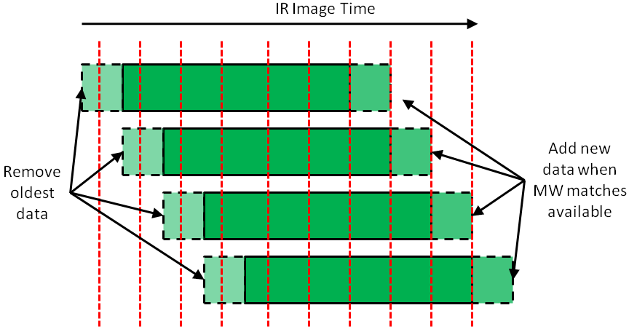
QPE Algorithm Review
An ABI-based algorithm calibrated using MW-derived rain rates:
Combine rapid refresh of IR with accuracy of MW
Update calibration whenever new MW data become available based on a rolling-value matched dataset

Slide 4
QPE Algorithm Review
8 predictors derived from 5 ABI bands
Twelve separate calibrations for 3 cloud types (based on BTD’s) and 4 latitude bands
Rain / no rain separation via discriminant analysis
Rain rate retrieval via regression
Includes nonlinear transformation of all predictors
Final rain rates adjusted via histogram matching against MW rain rates to ensure same distribution

Slide 5
Outline
QPE Algorithm Review
Product Generation and Assessment Using Available Proxy Data
Identifying and Planning for Algorithm Enhancements beyond Baseline
Road to GOES-R PLT and Post-Launch Product Validation

Slide 6
Proxy Data Products
Began running a real-time version of the algorithm on both current GOES in August 2011:
Covers 165ºE – 15ºW, 60ºS to 70ºN
Instantaneous rates for every GOES scan, plus hourly multi-hour totals and daily multi-day totals
Differences from ABI algorithm:
Only 4 predictors from 2 bands instead of 8 from 5
Only 2 cloud classes instead of 3
Improvements incorporated into RT algorithm
Images available at http://www.star.nesdis.noaa.gov/smcd/emb/ff/SCaMPR.php

Slide 7
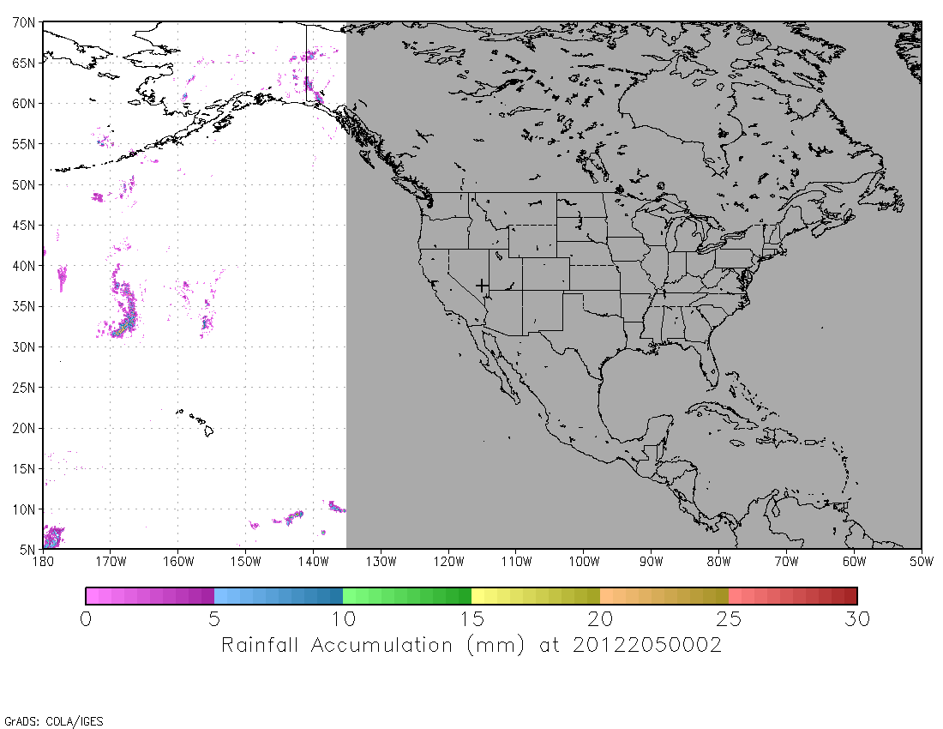
Proxy Data Products
Example from 23 July 2012

Slide 8
Proxy Data Products
Collaboration with NASA SPoRT to distribute in real time via AWIPS2 to NWS FO’s in AR, MFD, SJO for evaluation and feedback
Algorithm improvements being made in response to issues identified by forecasters:
Non-physical time variations in rainfall fields)
Underestimation of warm-top convection
Also performing routine and “deep-dive” validation vs. MPE and gauges over CONUS
Automated routine validation at http://www.star.nesdis.noaa.gov/smcd/emb/ff/aboutProductValidation.php

Slide 9
Outline
QPE Algorithm Review
Product Generation and Assessment Using Available Proxy Data
Identifying and Planning for Algorithm Enhancements beyond Baseline
Road to GOES-R PLT and Post-Launch Product Validation

Slide 10
Enhancements
MW rain rate QC
RH correction
Smaller Regions
Warm-Cloud Rainfall
Orographic Correction

Slide 11
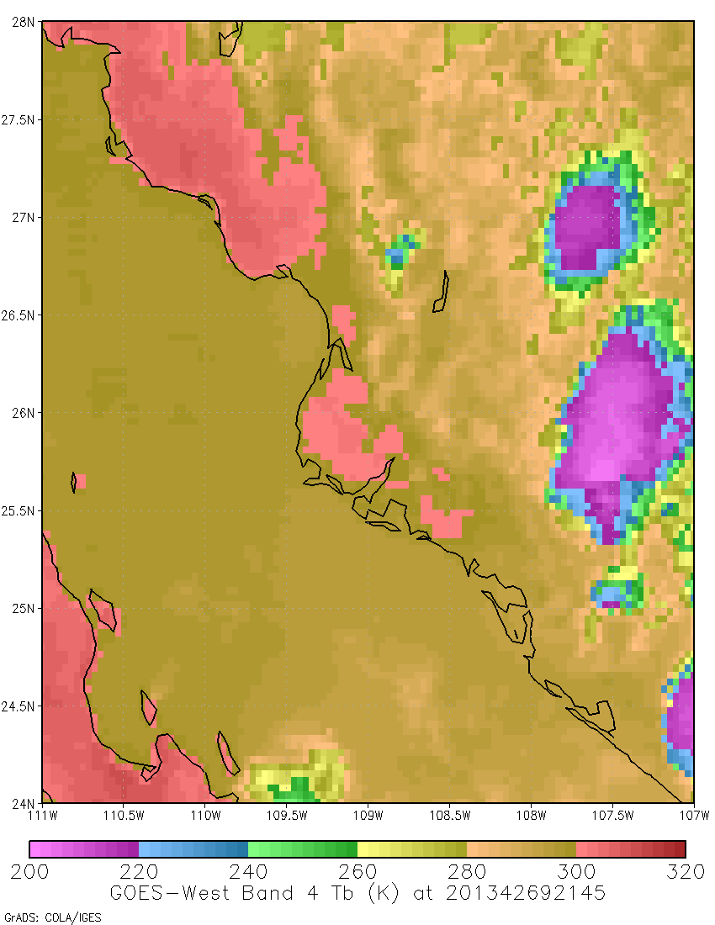
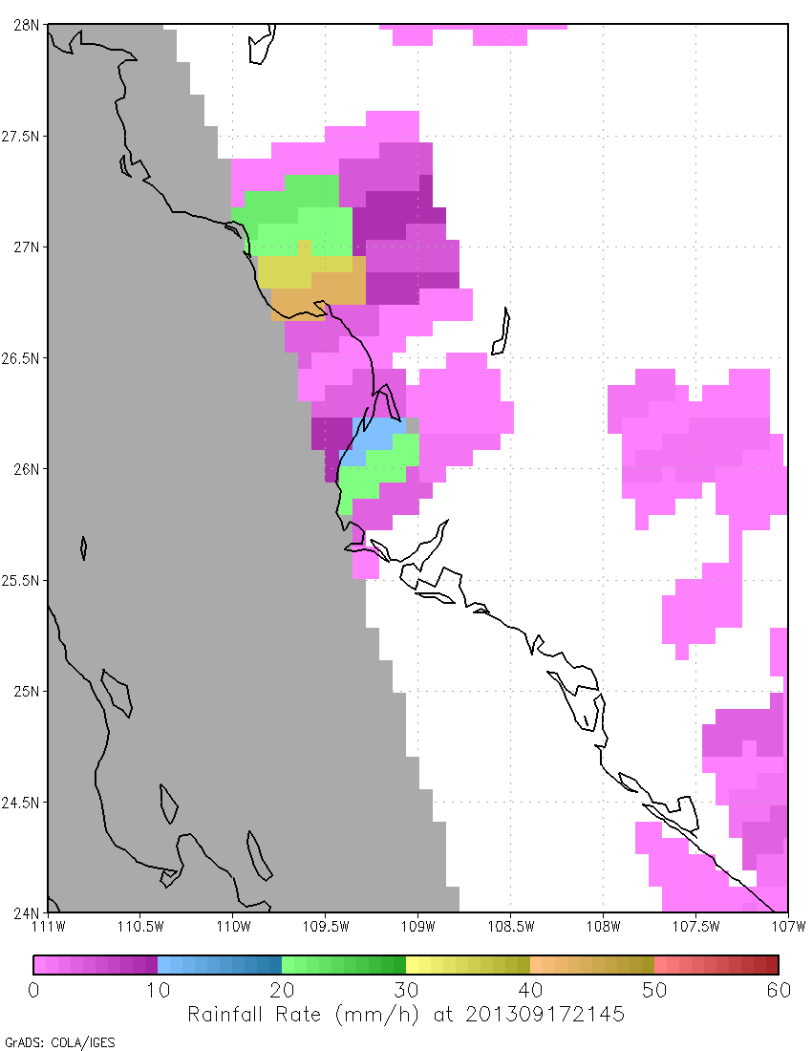
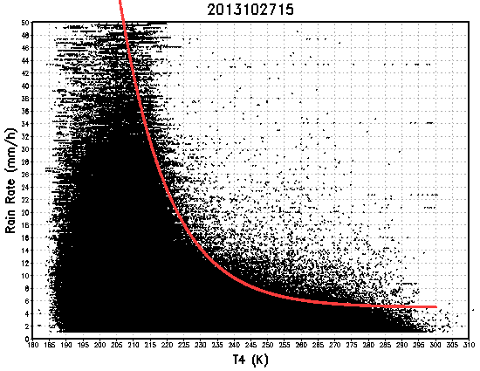
Enhancement: MW RR QC
Motivation: bad MW rain rates degrade the calibration
Methodology: remove pixels with high rain rates if clouds are too warm
Impact: still being evaluated
GOES IR
MW RR

Slide 12
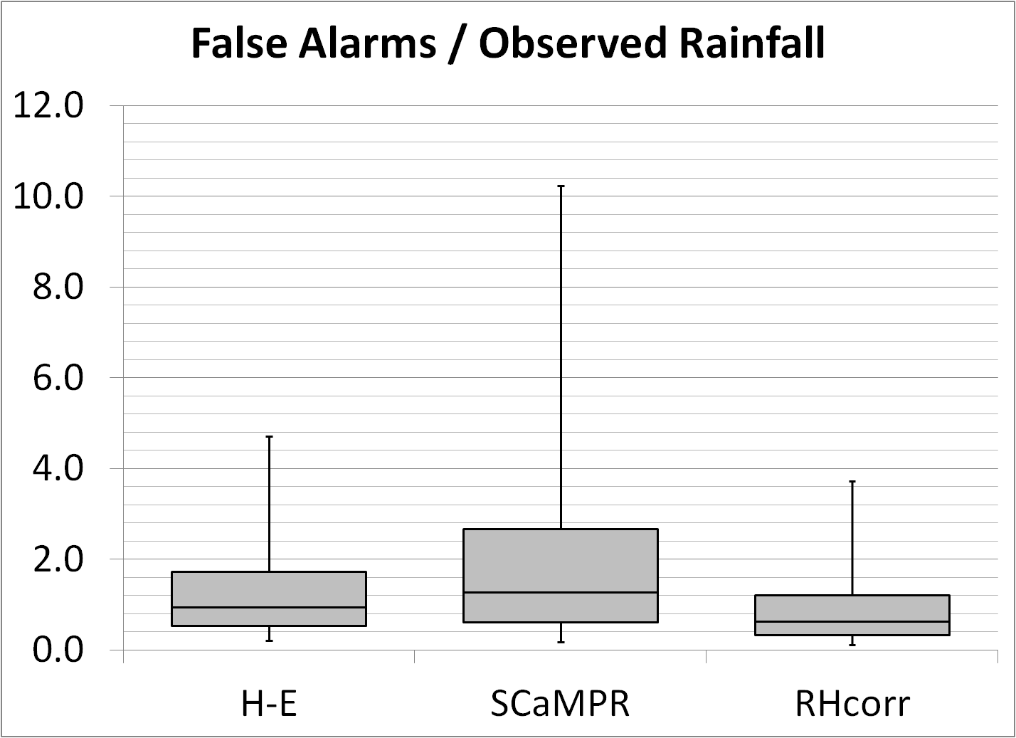
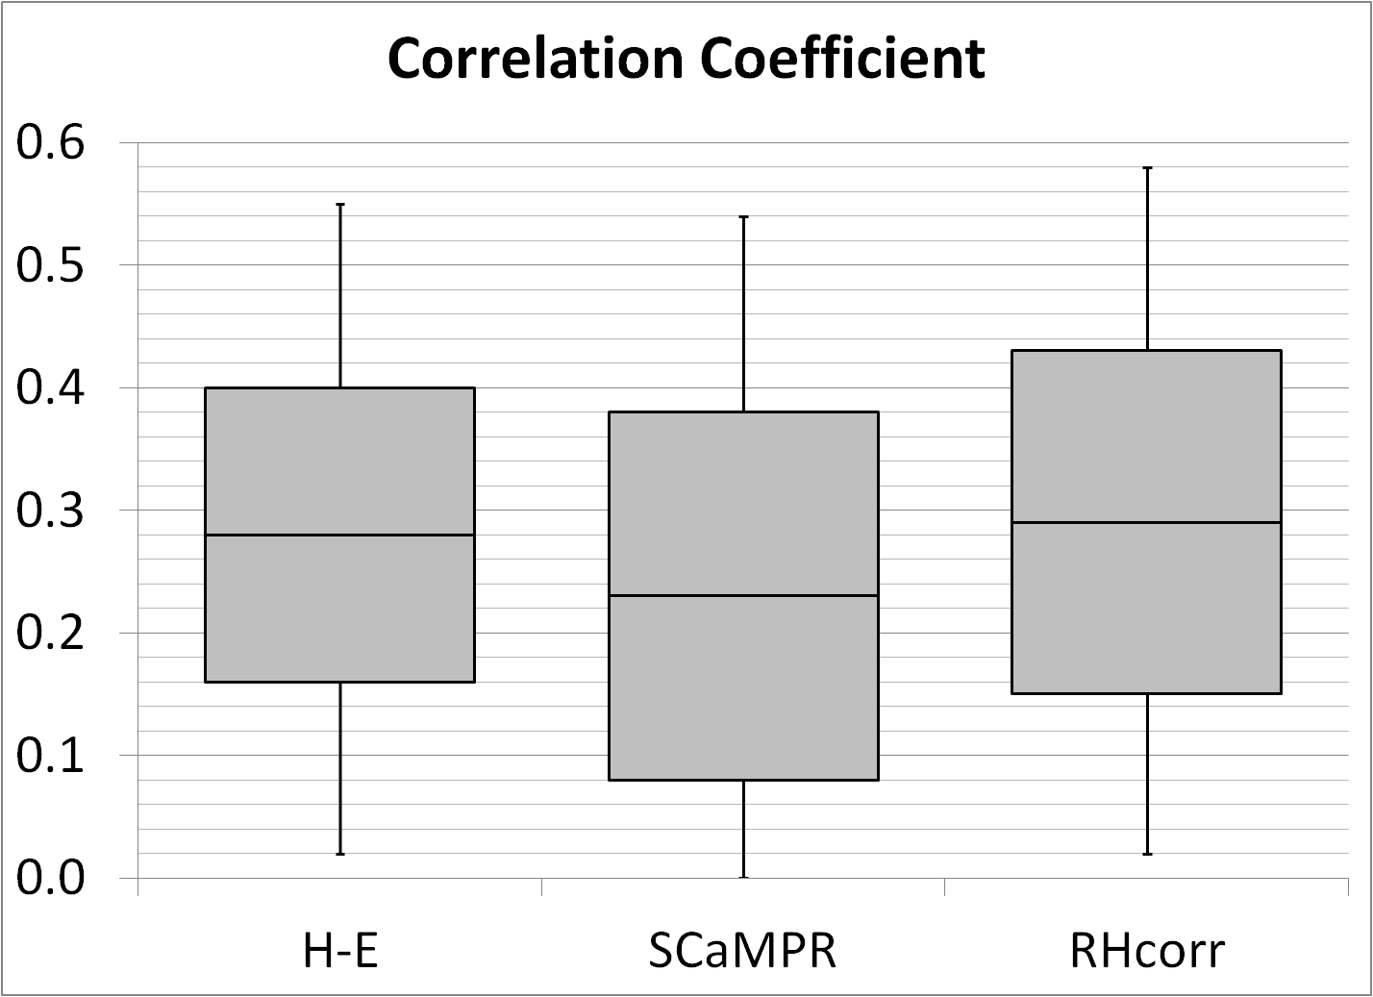
Enhancement: RH Correction
Motivation: significant false alarm rainfall due to evaporation of subcloud hydrometeors
Methodology: correction based on additive and multiplicative errors of MW rain rates vs. MPE
Impact: Fewer false alarms; better correlation

Slide 13
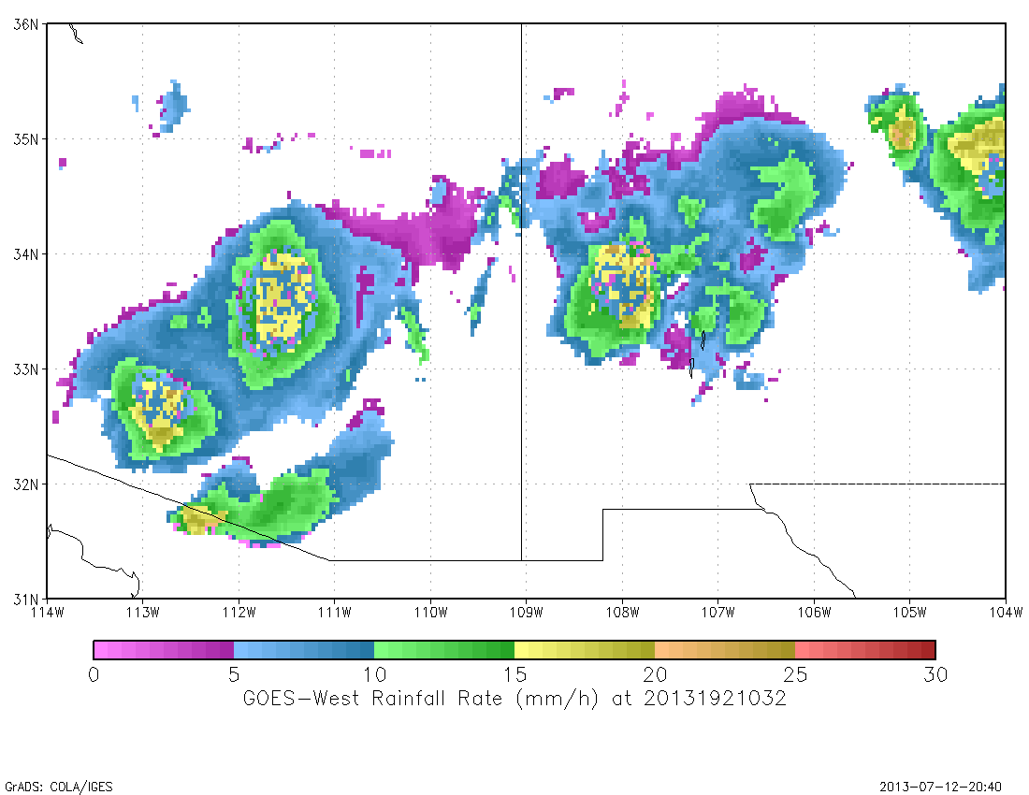
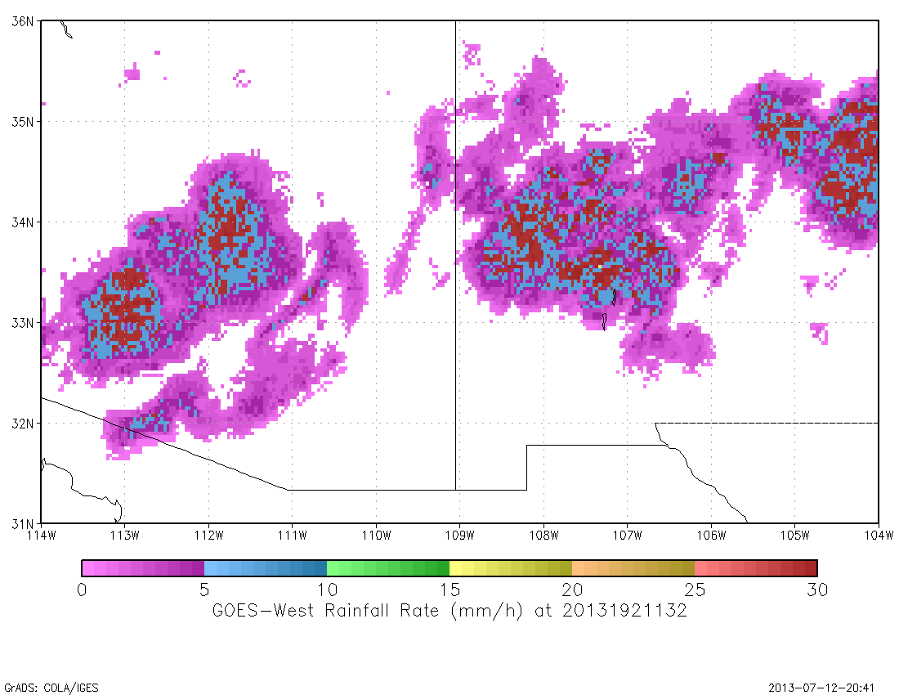
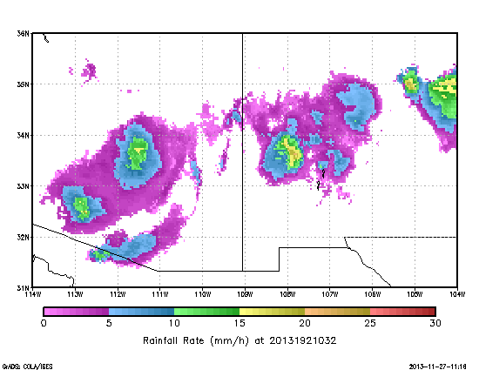
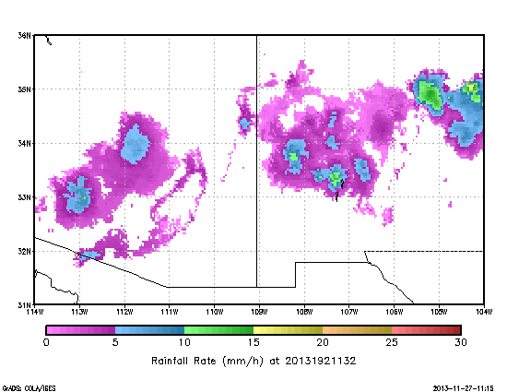
Enhancement: Smaller Regions
Original 30ºx120º regions
Motivation: histogram matching over large regions makes calibration unstable
Methodology: reduce region size from 30ºx120º to 15ºx15º and maybe smaller
Impact: Improved calibration stability
New 15ºx15º regions
1032 UTC 11 Jul 2013
1132 UTC 11 Jul 2013

Slide 14
Enhancement: Warm-Cloud Rainfall
Motivation: MW and IR often fail to capture rain from shallow clouds that can be significant
Methodology: Use validation statistics to determine instances where the warm-rain retrieval of Li et al. (using cloud optical depth, LWP / IWP, and particle size) produces better results than MW and / or SCaMPR and use the warm-rain retrieval in those instances.
Impact: Study is ongoing

Slide 15
Enhancement: Orographic Correction
Motivation: The current algorithm does not capture the effects of orography on rainfall
Methodology: Find relationships between SCaMPR errors vs. gauges in a mountainous region (NW Mexico) and w computed from NAM winds and terrain
Impact: Very weak relationships; unsure if problems are with w or with representativeness of gauges in complex terrain
Have also reached out to ORI developers but their output is subjective

Slide 16
Outline
QPE Algorithm Review
Product Generation and Assessment Using Available Proxy Data
Identifying and Planning for Algorithm Enhancements beyond Baseline
Road to GOES-R PLT and Post-Launch Product Validation

Slide 17
Post-Launch
Real-time validation vs. MPE will continue post-launch
Will continue to solicit feedback from users
SAB analysts
Users with relationships from SPoRT collaboration

Slide 18
Questions?

