Slide 1
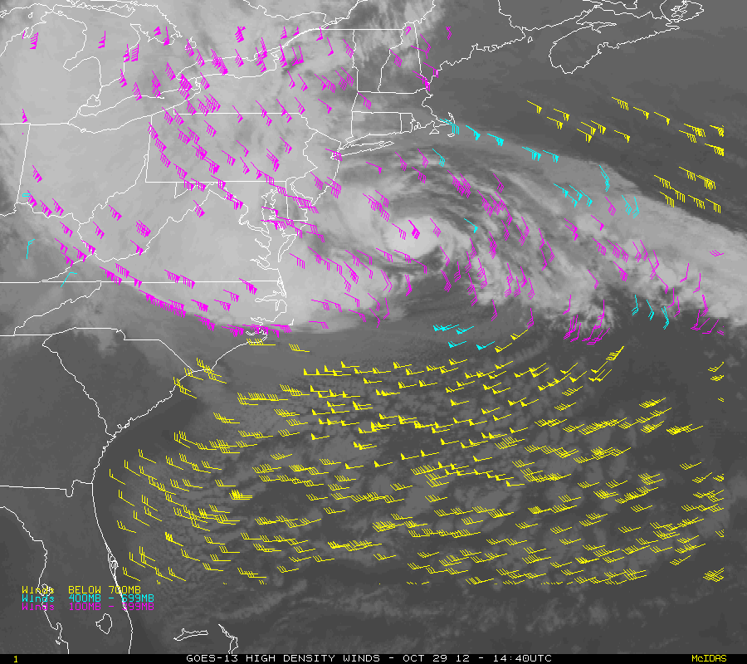

Derived Motion Winds: Pre-Launch Proxy Product Generation and Validation Activities
Jaime Daniels (STAR)
Wayne Bresky (IMSG)
Steve Wanzong (CIMSS)
Andy Bailey (IMSG)
Americo Allegrino (IMSG)
Chris Velden (CIMSS)

Slide 2
OUTLINE
Derived Motion Wind Products Generated from Proxy Data
Validation Strategies
Validation Tools and DMW Product Assessments
DMW Algorithm Enhancements Beyond Baseline Delivery
Road to GOES-R Post-Launch Test (PLT)

Slide 3
OUTLINE
Derived Motion Wind Products Generated from Proxy Data
Validation Strategies
Validation Tools and DMW Product Assessments
DMW Algorithm Enhancements Beyond Baseline Delivery
Road to GOES-R Post-Launch Test (PLT)

Slide 4
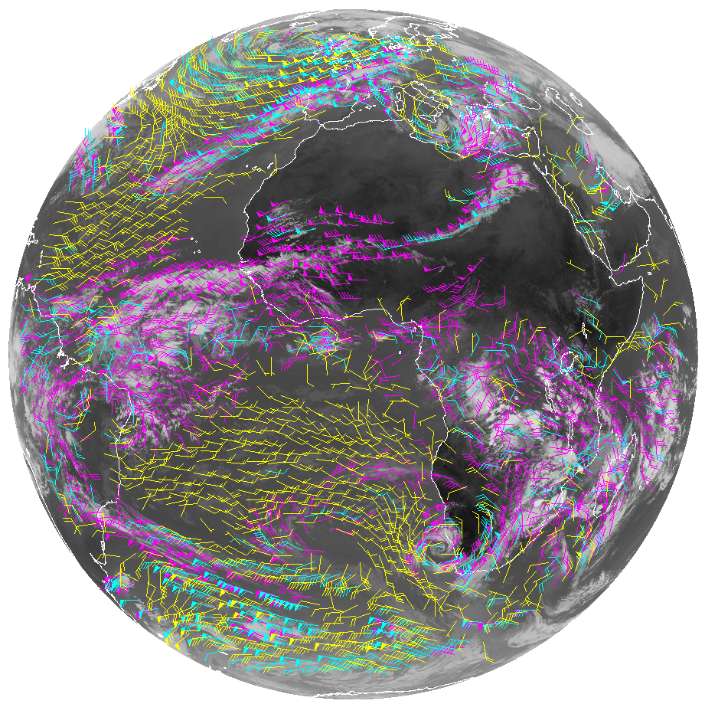
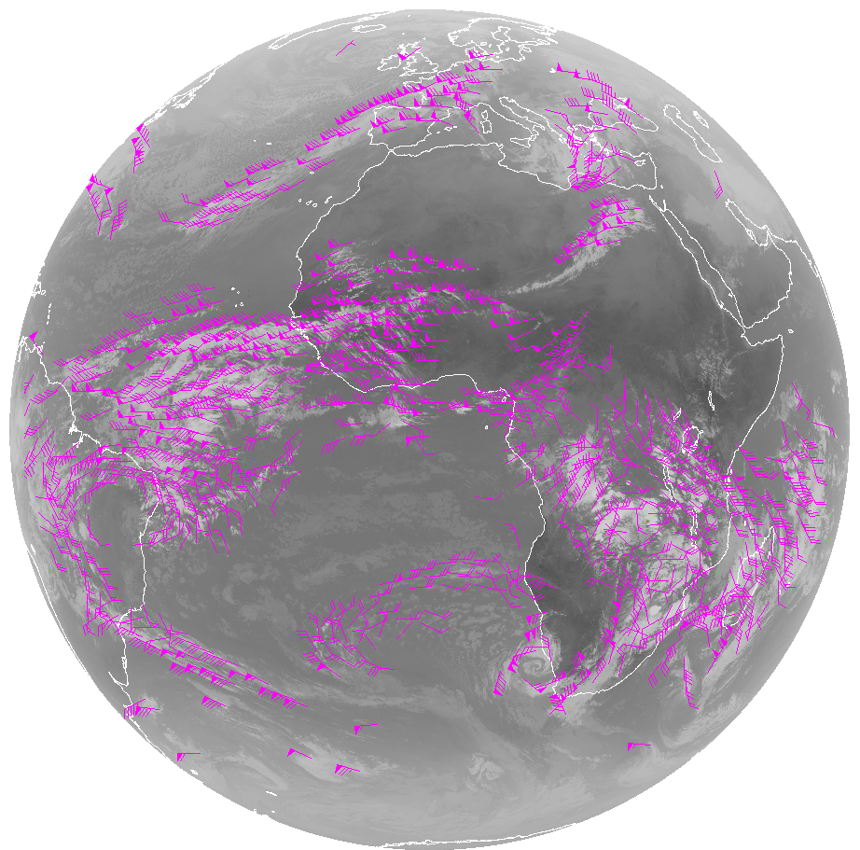
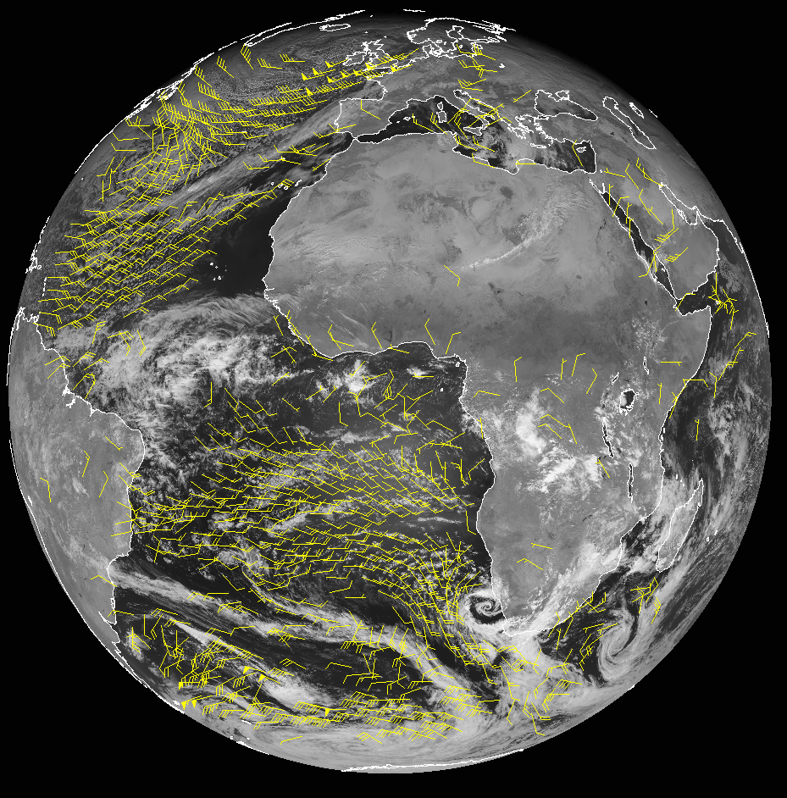
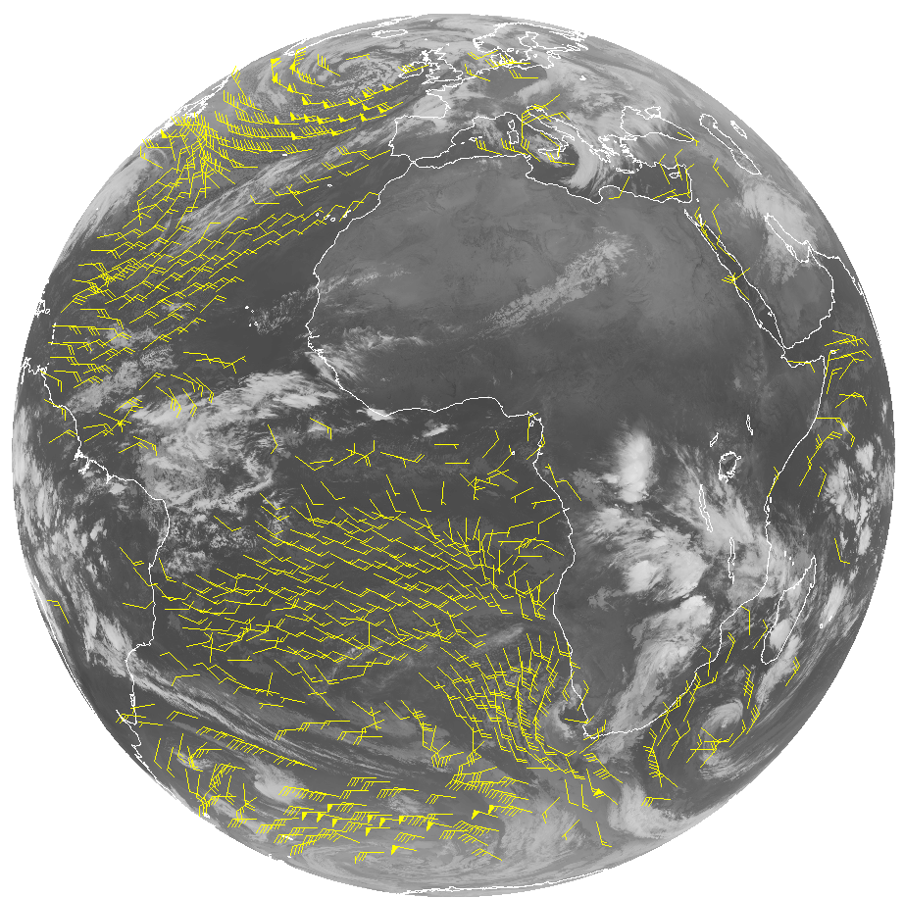
Meteosat-10/SEVIRI FD Winds
LWIR (10.8um)
January 6, 2013)
WVCT (6.2um)
New nested tracking algorithm introduced that makes use of a two-dimensional clustering algorithm to capture the dominant motion in each target scene
Utilizes clear sky mask product
Wind height assignment relies on the utilization of pixel level cloud heights generated upstream
Running in real-time
VIS (0.60um)
High-Level 100-400 mb
Mid-Level 400-700 mb
Low-Level >700 mb
SWIR (3.9um)
Notes:
The Winds Team has been routinely generating experimental winds from GOES-13, GOES-15, Meteosat-9/10/SEVIRI , and NPP/VIIRS using the GOES-R winds algorithm.
Meteosat-10/SEVIRI FD Winds derived rom 0.60um, 3.9um, 6.2um (WVCT & CSWV), 7.3um (CSWV) and 10.8um bands the winds team is routinely generating
4

Slide 5
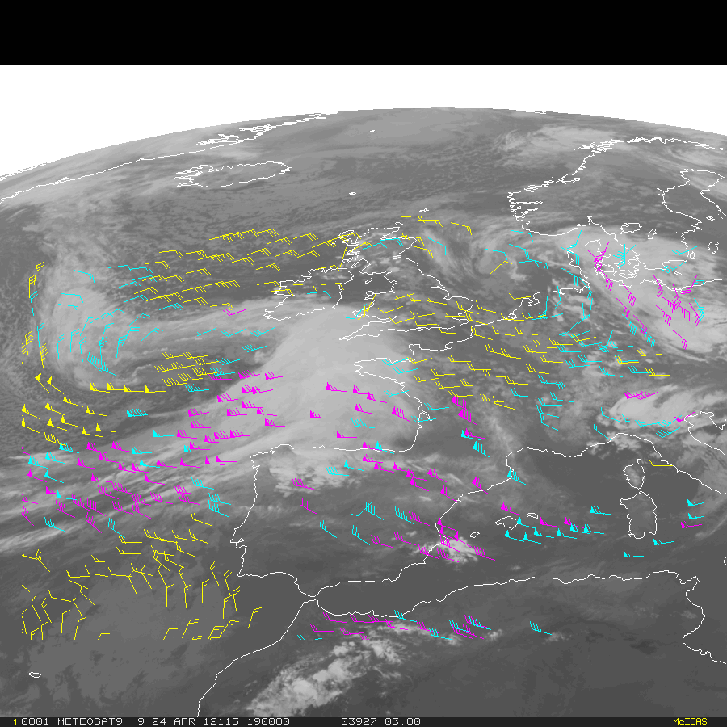
Using SEVIRI as a Proxy for the Future GOES-R ABI
Loop of winds derived from hourly Full Disk Meteosat-9 SEVERI 10.8 µm imagery (22 UTC Apr 24 – 08 UTC Apr 25, 2012
High-Level 100-400 mb
Mid-Level 400-700 mb
Low-Level >700 mb
Experimental winds are being routinely generated from Meteosat-10/SEVIRI , GOES-13, GOES-15, and NPP/VIIRS using the GOES-R winds algorithm.
Notes:
22 UTC April 24 – 08 UTC April 25, 2012

Slide 6
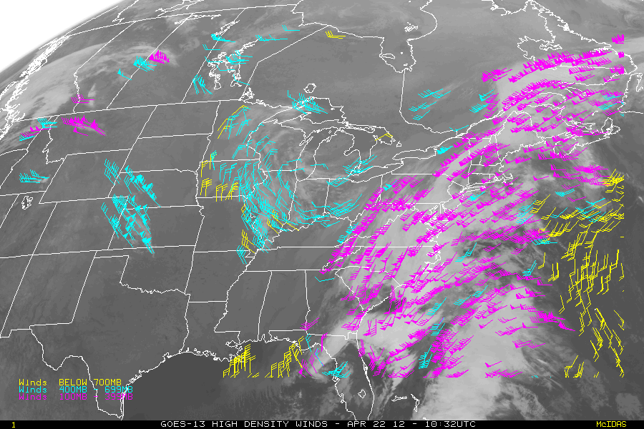
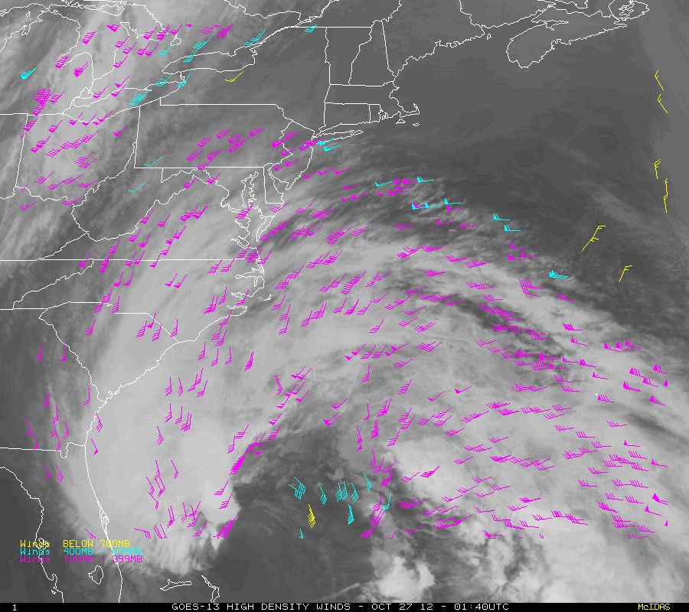
GOES-13 Winds Using GOES-R Clear-Sky Mask, Cloud and Derived Motion Winds (DMW) Algorithms
Nor’Easter
Hurricane Sandy
High-Level 100-400 mb
Mid-Level 400-700 mb
Low-Level >700 mb
Cloud-drift winds derived from 15-min GOES-13 11um imagery 1000 UTC 22 April 2012 – 0800 UTC 23 April 2012
Significance: Early demonstration of GOES-R algorithms using current operational GOES imagers. Plans and work in place to replace existing operational GOES cloud and DMW algorithms with GOES-R algorithms.
High-Level 100-400 mb
Mid-Level 400-700 mb
Low-Level >700 mb
Cloud-drift winds derived from 15-minute GOES-13 LWIR (11um) imagery over Hurricane Sandy (4-day loop)
Notes:
0.64um, 3.90um, 6.15um, 7.0um, 7.4um, and 11.2um bands. These are the so-called heritage channels that are used operationally today to derive atmospheric motion vectors.
Derived motion winds will be generated separately from each of these six ABI bands.
Collectively, the derived motion winds from each of the six runs are the derived motion winds product.
6

Slide 7
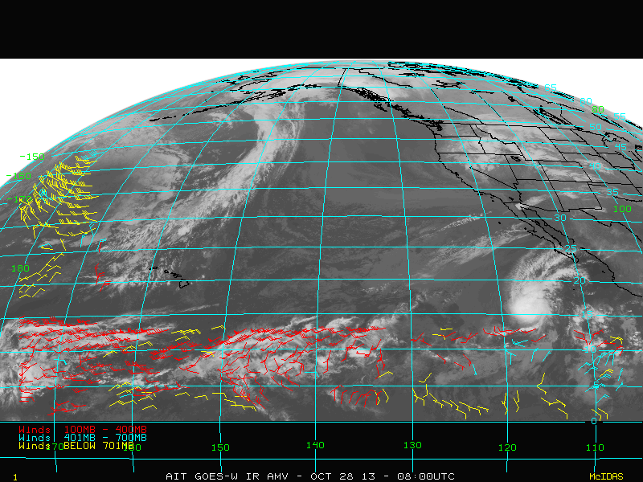
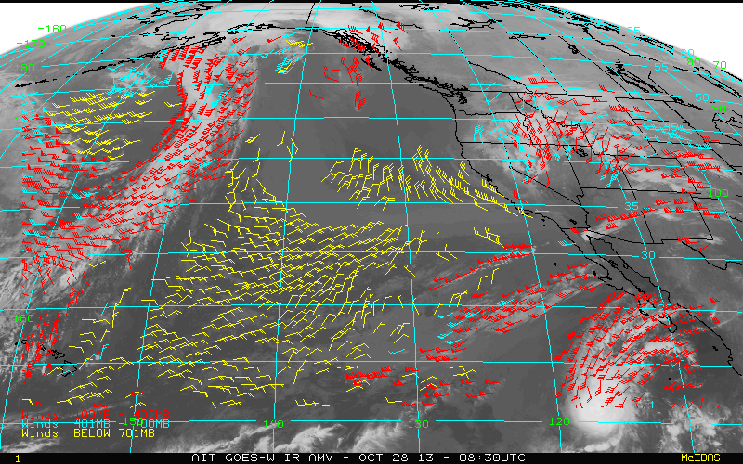
GOES-15 Winds Using GOES-R Clear-Sky Mask, Cloud and Derived Motion Winds (DMW) Algorithms
GOES-15 LWIR Winds derived from 10.7µm image triplets on 28 October 2013
NHEM Sector
PACUS Sector
High-Level 100-400 mb
Mid-Level 400-700 mb
Low-Level >700 mb
Notes:
0.64um, 3.90um, 6.15um, 7.0um, 7.4um, and 11.2um bands. These are the so-called heritage channels that are used operationally today to derive atmospheric motion vectors.
Derived motion winds will be generated separately from each of these six ABI bands.
Collectively, the derived motion winds from each of the six runs are the derived motion winds product.
7

Slide 8
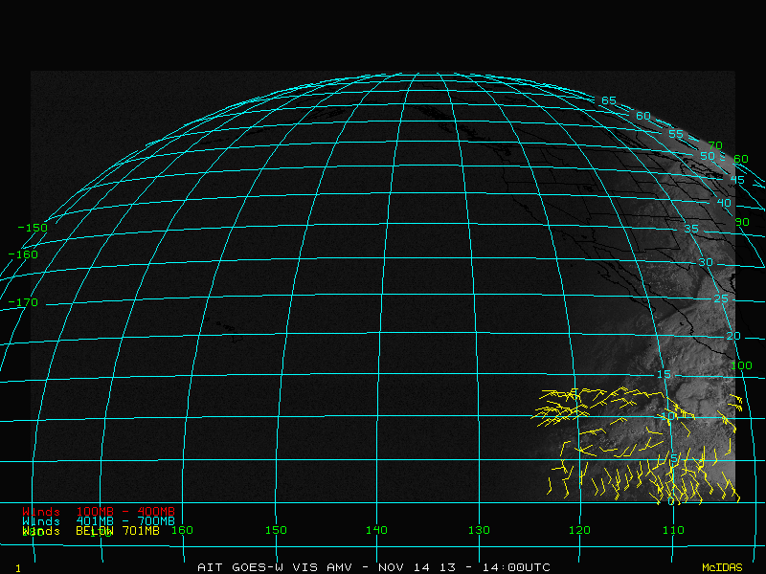
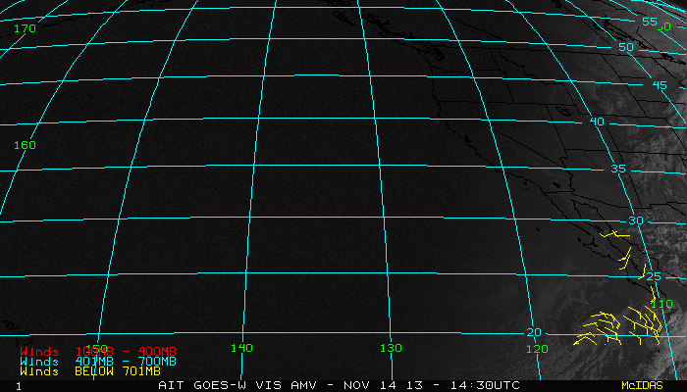
GOES-15 Winds Using GOES-R Clear-Sky Mask, Cloud and Derived Motion Winds (DMW) Algorithms
NHEM Sector
GOES-15 Low-Level Visible Winds derived from 0.64um image triplets on 14 November 2013
PACUS Sector
High-Level 100-400 mb
Mid-Level 400-700 mb
Low-Level >700 mb
Notes:
8

Slide 9
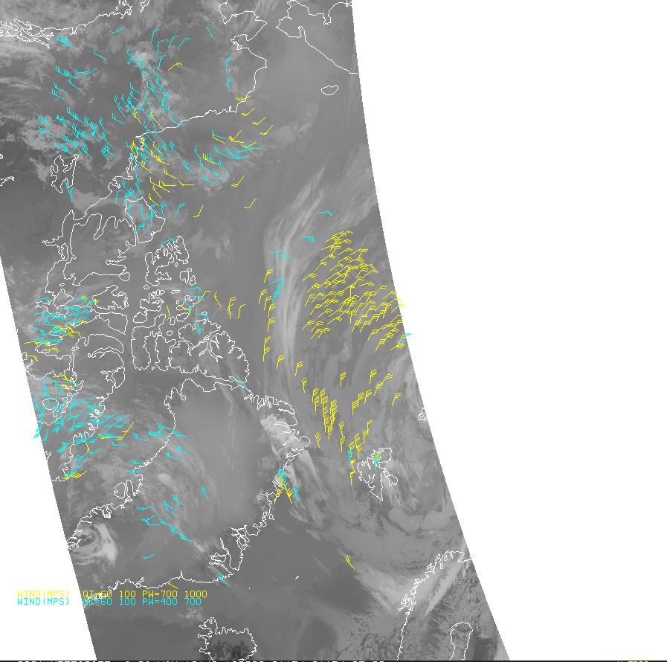
NPP/VIIRS Winds Using GOES-R Cloud and Derived Motion Winds (DMW) Algorithms
Highlight: STAR will deliver a VIIRS Polar Winds product processing capability to NDE in December 2013. This capability leverages the GOES-R AWG system framework and the GOES-R product Derived motion winds and cloud-top property algorithms.
Accomplishments:
The VIIRS polar winds (over both poles) are now being derived routinely at STAR by tracking cloud features observed in the VIIRS M15 (10.7um) band from overlapping NPP orbits
Winds science team has validated the wind products and show they meet accuracy specifications
STAR delivered an initial Delivered Algorithm Package (DAP) to NDE in October 2013.
Significance:
Early demonstration of GOES-R algorithms using current operational VIIRS imager;
Demonstrates an enterprise approach for satellite processing and use of common Level-2 product algorithms.
Notes:
AIT is routinely generating the VIIRS winds for the winds team.
9

Slide 10
OUTLINE
Derived Motion Wind Products Generated from Proxy Data
Validation Strategies and Tools
DMW Product Assessments
DMW Algorithm Enhancements Beyond Baseline Delivery
Road to GOES-R Post-Launch Test (PLT)

Slide 11
Validation Strategies
Routinely generate Derived Motion Wind (DMW) product in real-time using available ABI proxy data
Collocate DMW products to a number of different reference/”ground truth” datasets
Wind data from Radiosondes, Aircraft, GFS analysis,
CALIPSO data/products
Analyze and visualize data (imagery, GFS model, L2 products, intermediate outputs, reference/ground truth) using available and developed (customized) tools
Measure/quantify performance, search for outliers, analyze and understand (case studies),
Develop/test algorithm adjustments, as necessary

Slide 12
Validation Strategies
MET-9/10 SEVIRI, GOES-13/15, NPP/VIIRS Imagery
GFS Analyses
Derived Motion Wind Products
Radiosondes
ACARS
CALIPSO
Routine generation of L2 product chain (ACM, clouds, DMW)
Collocate DMW product with reference/ground truth data
Clear-Sky Mask & Cloud Products
GFS forecast files (GRIB2)
DMW/Radiosondes
Update L2 Product Algorithm(s), as necessary
Analyze/
Visualize
DMW / GFS Analyses
DMW / CALIPSO
DMW/ACARS
Deep Dive Tools
Routine Tools
Re-retrieve single DMW
Perform Case Study Analysis
Search for outliers
Display Product & Ground Truth Data
Compute comparison statistics
Notes:
Highlight/summarize validation strategy for each product.
Identify reference/”ground truth” datasets that are needed and where/how these are obtained
Identify validation tools (routine & deep-dive) that are needed and being developed

Slide 13
OUTLINE
Derived Motion Wind Products Generated from Proxy Data
Validation Strategies
Validation Tools and DMW Product Assessments
Comparisons to Radiosondes, Aircraft, GFS Analysis winds
Case Study Examples
Assessment of DMW impact in NCEP GFS (summary/highlights of GOES-R3 work; engagement with NCEP)
DMW Algorithm Enhancements Beyond Baseline Delivery
Road to GOES-R Post-Launch Test (PLT)

Slide 14
Routine Validation Tools
Visualization Tools
AMV product, upstream products, intermediate output, ancillary data, reference/”ground truth” observations
Customized code that
Co-locates AMV product and reference data in space and time
Enable the generation and visualization of comparison statistics
Tabular form
Time series
GOES-13 CD WIND RAOB MATCH ERROR STATISTICS
PRESSURE RANGE: 100 - 1000 LATITUDE RANGE: -90 - 90
SAT GUESS RAOB
RMS DIFFERENCE (m/s) 6.68 6.11
NORMALIZED RMS 0.34 0.31
AVG DIFFERENCE (m/s) 5.51 5.02
STD DEVIATION (m/s) 3.78 3.48
SPEED BIAS (m/s) -0.97 -1.32
|DIRECTION DIF| (deg) 14.85 15.06
SPEED (m/s) 18.55 18.20 19.52
SAMPLE SIZE 87100

Slide 15
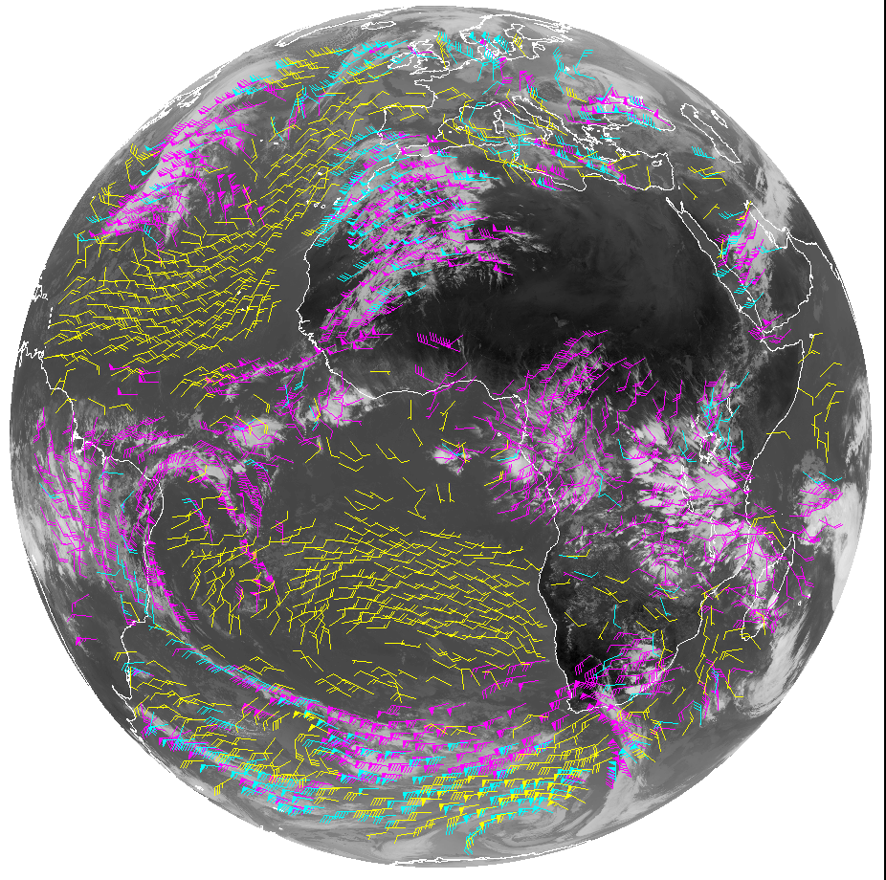
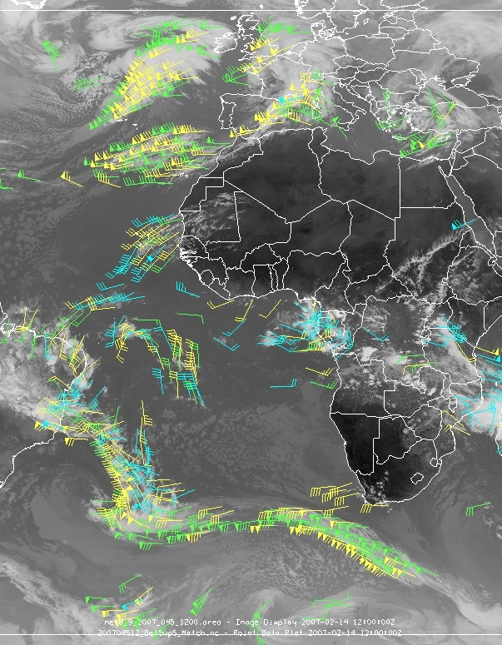
Routine Validation Tools Product Visualization …
McIDAS-X
McIDAS-V
Heavy reliance on McIDAS to visualize DMW products, intermediate outputs, diagnostic data, ancillary datasets, and reference/”ground-truth”
Notes:
15

Slide 16
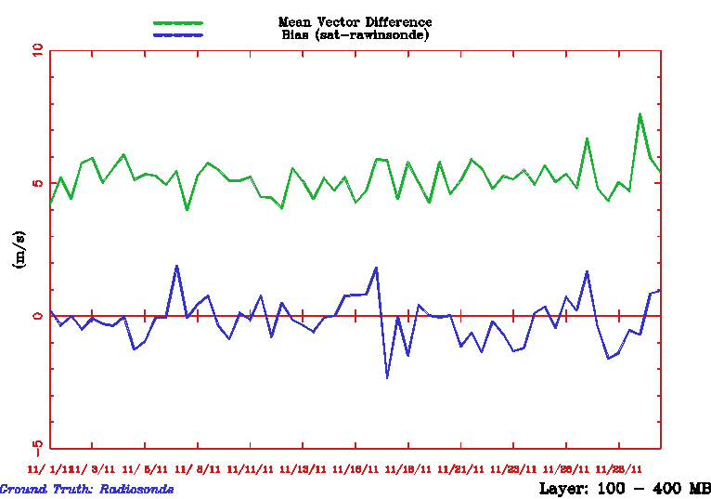
Met-9/SEVIRI Winds (10.8um) vs Radiosondes
100-400 mb QI > 80
GOES-R AMV Algorithm Used
Nov 2011 Stats:
MVD = 5.05 m/s
NRMS = 0.31
Speed Bias = -0.31
N = 7295

Slide 17
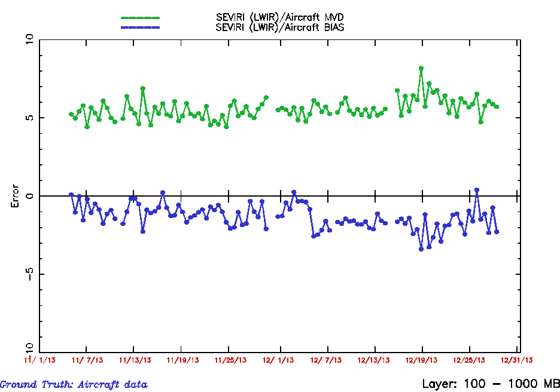
Met-10/SEVIRI Winds (10.8um) vs Aircraft Winds
GOES-R AMV Algorithm Used

Slide 18
Validation Strategies
MET-9/10 SEVIRI, GOES-13/15, NPP/VIIRS Imagery
GFS Analyses
Derived Motion Wind Products
Radiosondes
ACARS
CALIPSO
Routine generation of L2 product chain (ACM, clouds, DMW)
Collocate DMW product with reference/ground truth data
Clear-Sky Mask & Cloud Products
GFS forecast files (GRIB2)
DMW/Radiosondes
Update L2 Product Algorithm(s), as necessary
Analyze/
Visualize
DMW / GFS Analyses
DMW / CALIPSO
DMW/ACARS
Deep Dive Tools
Routine Tools
Re-retrieve single DMW
Perform Case Study Analysis
Search for outliers
Display Product & Ground Truth Data
Compute comparison statistics
Notes:
Highlight/summarize validation strategy for each product.
Identify reference/”ground truth” datasets that are needed and where/how these are obtained
Identify validation tools (routine & deep-dive) that are needed and being developed

Slide 19
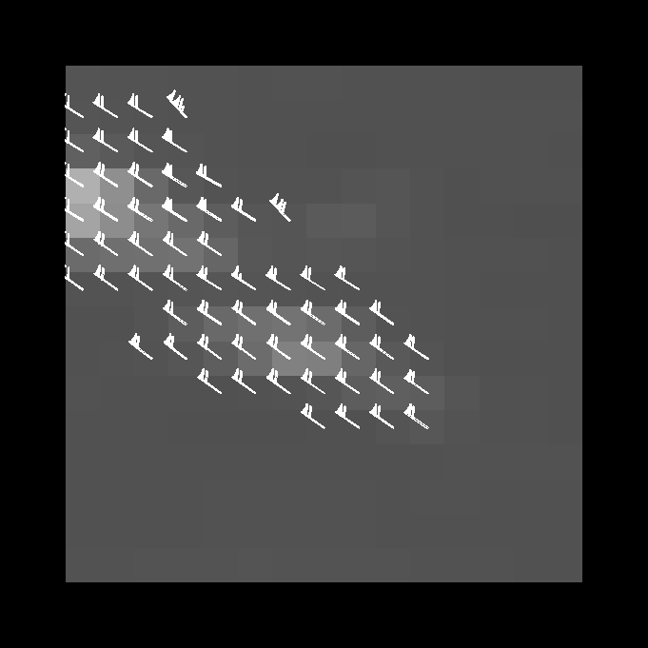
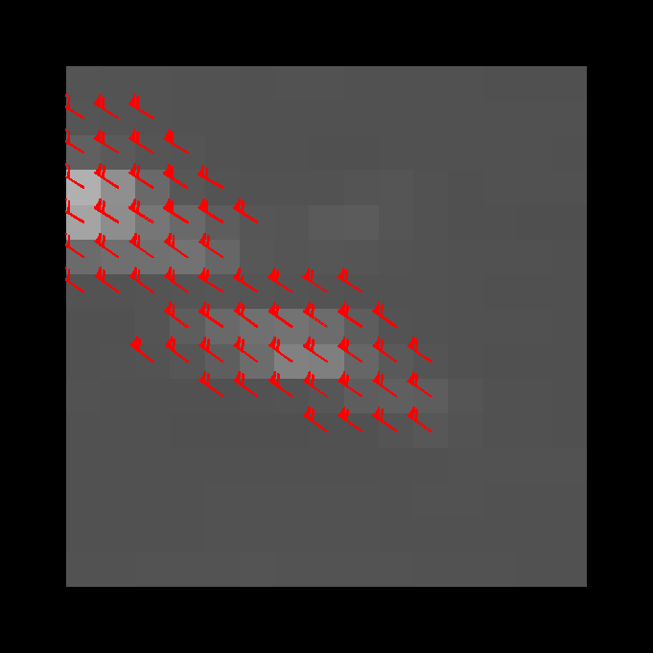
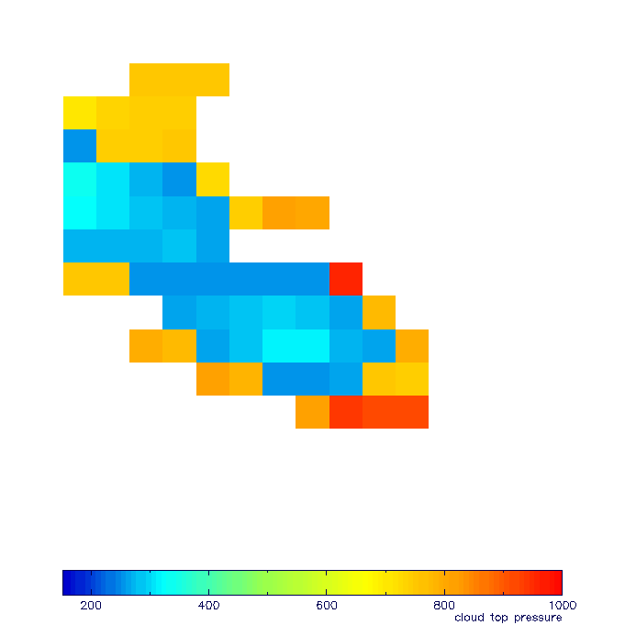
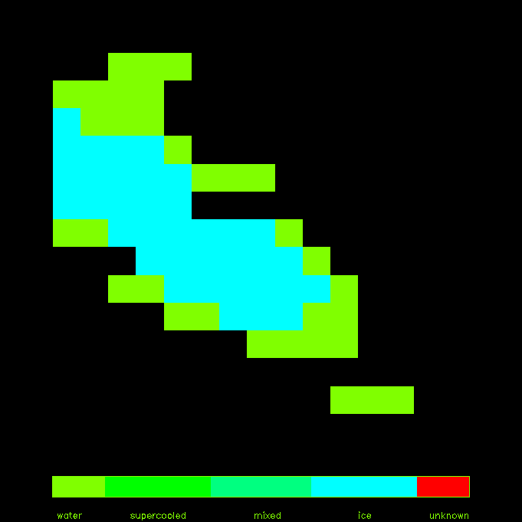
“Deep-Dive” Validation Tools
X-windows based (PGPLOT – freeware)
Allows user to display results from a single target scene
Upper Left: Shows initial sample of
local motion vectors (before cluster
analysis)
Upper Right: Shows final sample of local
motion vectors (associated with largest
cluster)
Lower Left panel shows cloud-top
pressure
Lower Right panel shows cloud phase;
We determined that we could use (one
option) cloud phase to eliminate bad
CTP values in thin cirrus
“Stand-alone DMW re-retrieval & visualization tool “ that enables the generation of a single derived motion wind vector for a single target scene and allows for the visualization of wind solution, tracking diagnostics, target scene characteristics .
Notes:
We developed a “Deep-Dive” tool for the derived motion wind (DMW) product that would allow us to perform a more detailed analysis of the DMW algorithm performance.
In this case, as we typically do, we locate an outlier Atmospheric Motion Vector (AMV) obtained from a AMV/Radiosonde matchup file.
19

Slide 20
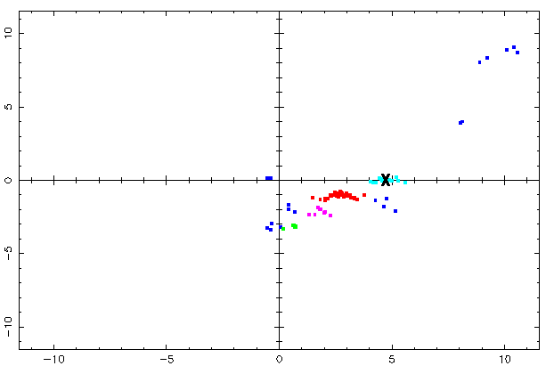
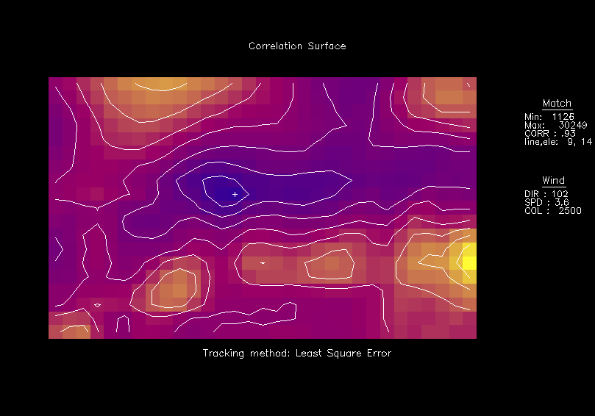
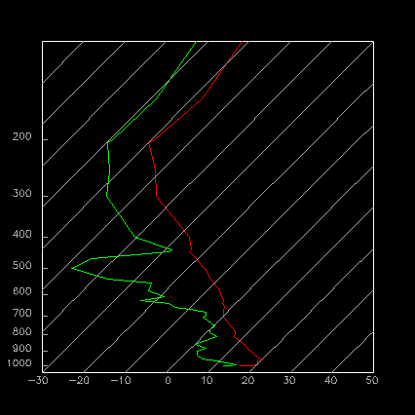
“Deep-Dive” Validation Tools
Outcome of clustering of local motion displacements
Feature Tracking Diagnostics
Line Displacement
Correlation Surface Plots
Element displacement
Nearby Reference/Ground truth data
“Stand-alone re-retrieval & visualization tool “: Other plots that can be generated that enable a more detailed analysis of the DMW algorithm performance.
Notes:
X-windows based (PGPLOT – free)
Allows user to display results from a single target scene
Upper Left panel shows initial sample of local motion vectors (before cluster analysis)
Upper Right panel shows final sample of local motion vectors (associated with largest cluster)
Lower Left panel shows cloud-top pressure
Lower Right panel shows cloud phase; We determined that we could use (one option) cloud phase to eliminate bad CTP values in thin cirrus
20

Slide 21
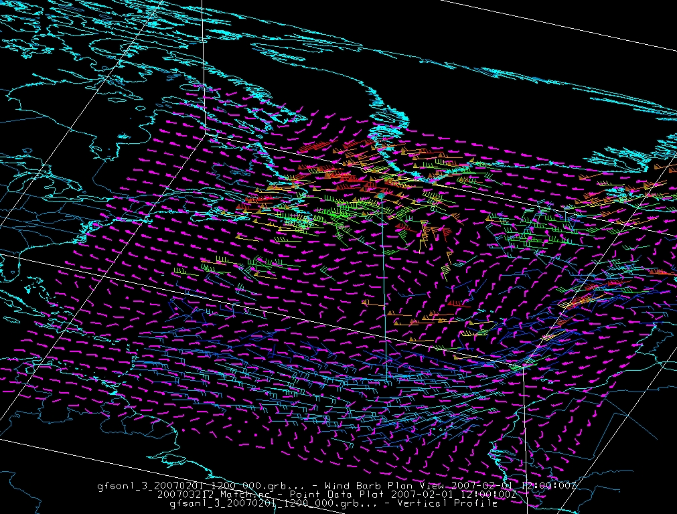
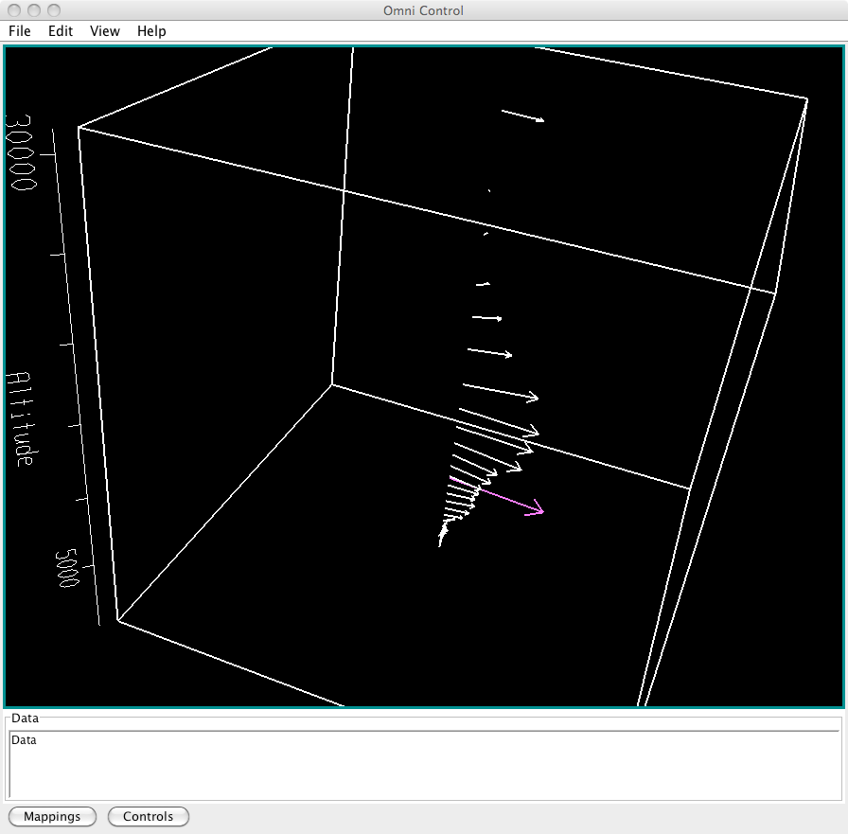


Deep Dive Validation Tool – McIDAS-V Utilities Under Development
Interrogation of vertical structure of surrounding reference winds from model analysis and/or in-situ obs near location of selected AMV allows for easier visualization in error diagnosis.
Slide courtesy of Tom Rink, UW-Madison/SSEC/CIMSS
Profile of GFS winds (white) at
selected AMV (magenta) location
Plot of low-level AMVs color scaled by wind speed,
with nearest-level GFS gridded wind field in magenta.

Slide 22
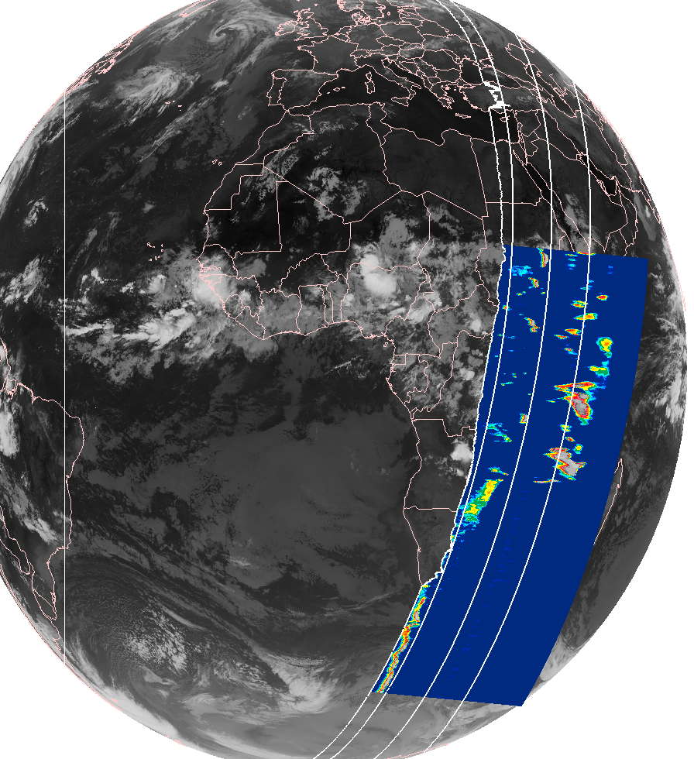


Another Example of Deep Dive Validation – Meteosat-9 AMVs vs CALIPSO
September 15, 2011, 00 UTC
Preliminary use of CALIPSO
to assess AMV height assignments
Piece of CALIPSO transect
showing cross-section of
backscatter signal from clouds

Slide 23
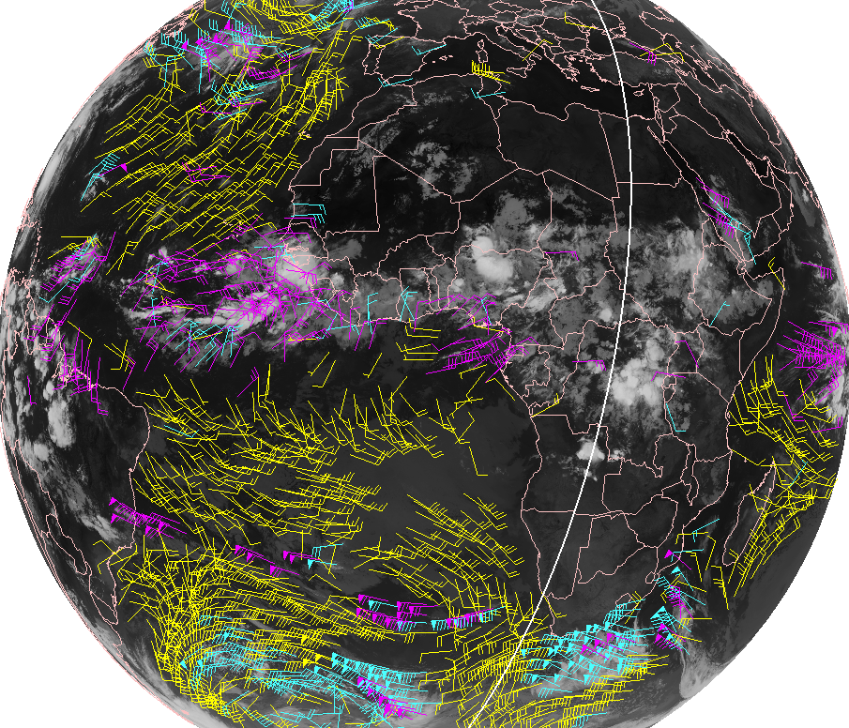
Example Deep Dive Validation – Meteosat-9 AMVs vs CALIPSO
September 15, 2011, 00 UTC
Plot of GOES-R proxy AMVs using Meteosat-9 along with track of CALIPSO pass near the time of the dataset

Slide 24
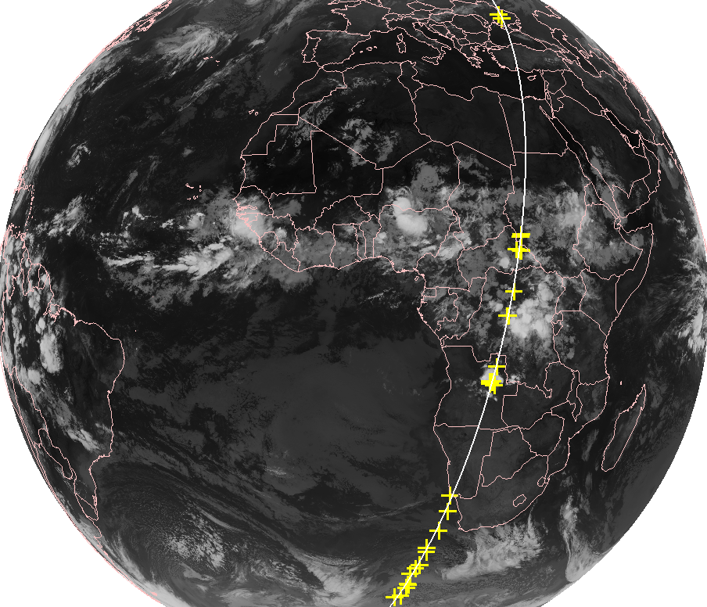
Example Deep Dive Validation – Meteosat-9 AMVs vs CALIPSO
September 15, 2011, 00 UTC
In this case we identify 29 AMVs with CALIPSO collocation criteria of 50 km and 30 minutes (yellow tick marks).
The matches circled in yellow are examined in the next slide.

Slide 25
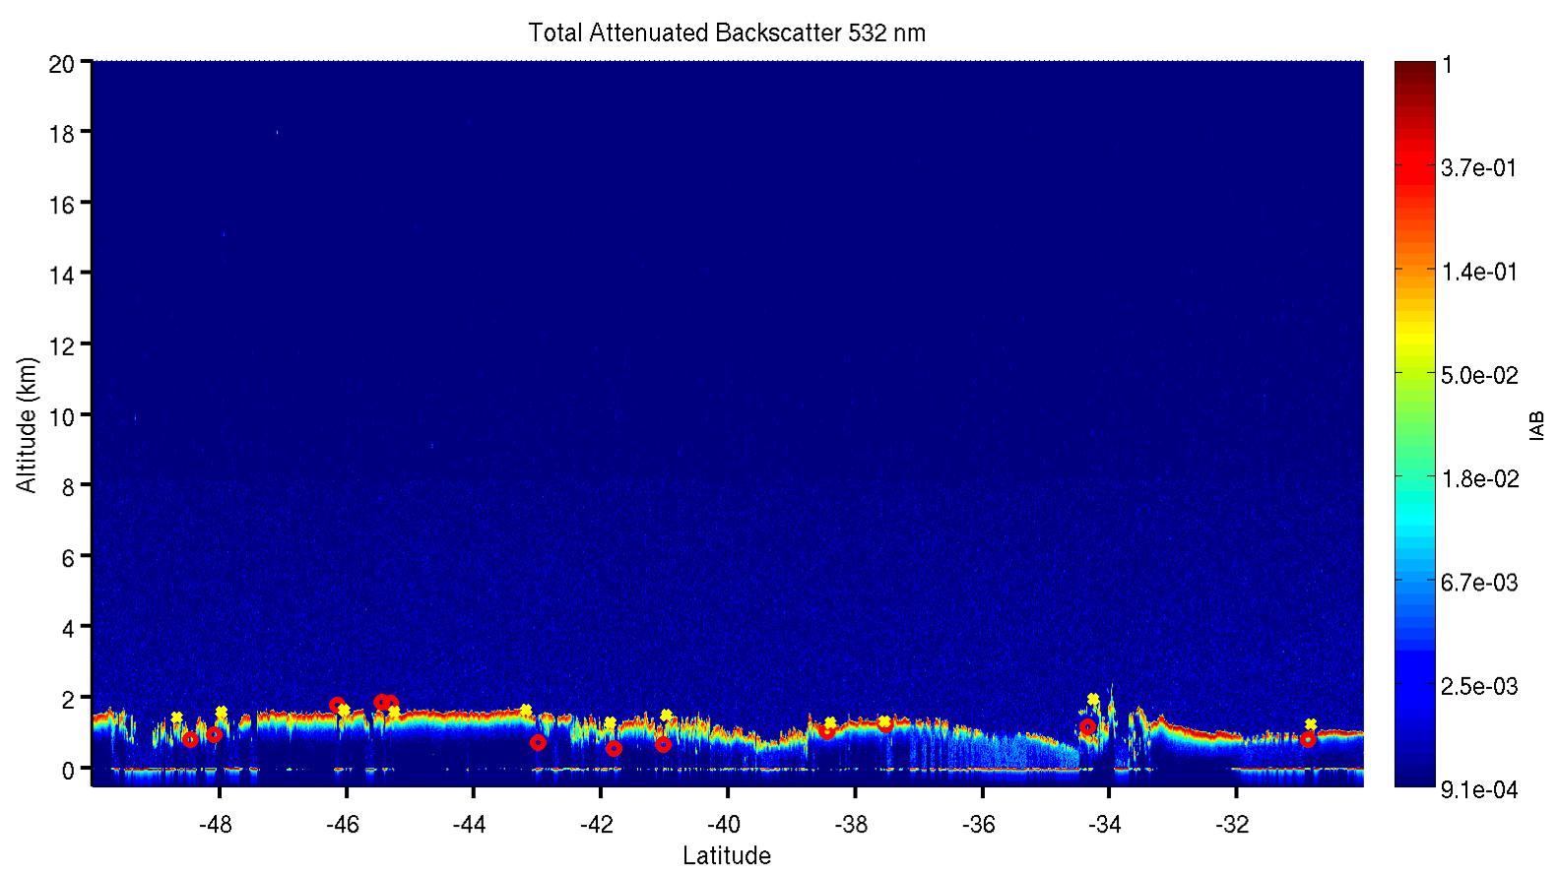
Example Deep Dive Validation: CALIPSO Cloud-Top Heights vs. AMV Height Assignments
AMVs (Meteosat-9)
CALIPSO 5km CTH
AMV height assignments shows good agreement with CALIPSO CTHs for low-level opaque water clouds.

Slide 26
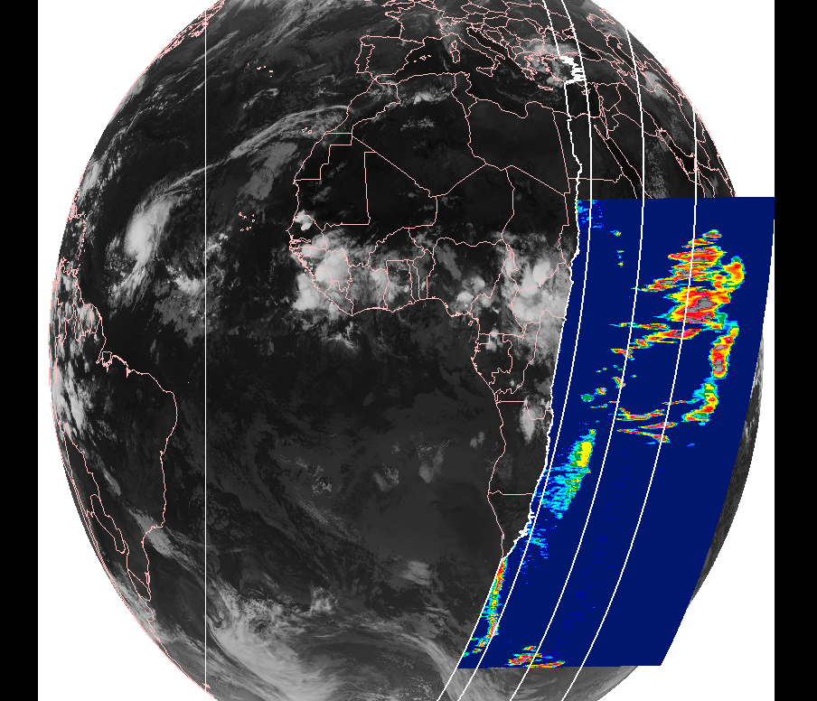
Example Deep Dive Validation – Meteosat-9 AMVs vs CALIPSO
September 22, 2011, 00 UTC
Preliminary use of CALIPSO
to assess AMV height assignments
Piece of CALIPSO transect
showing cross-section of
backscatter signal from clouds

Slide 27
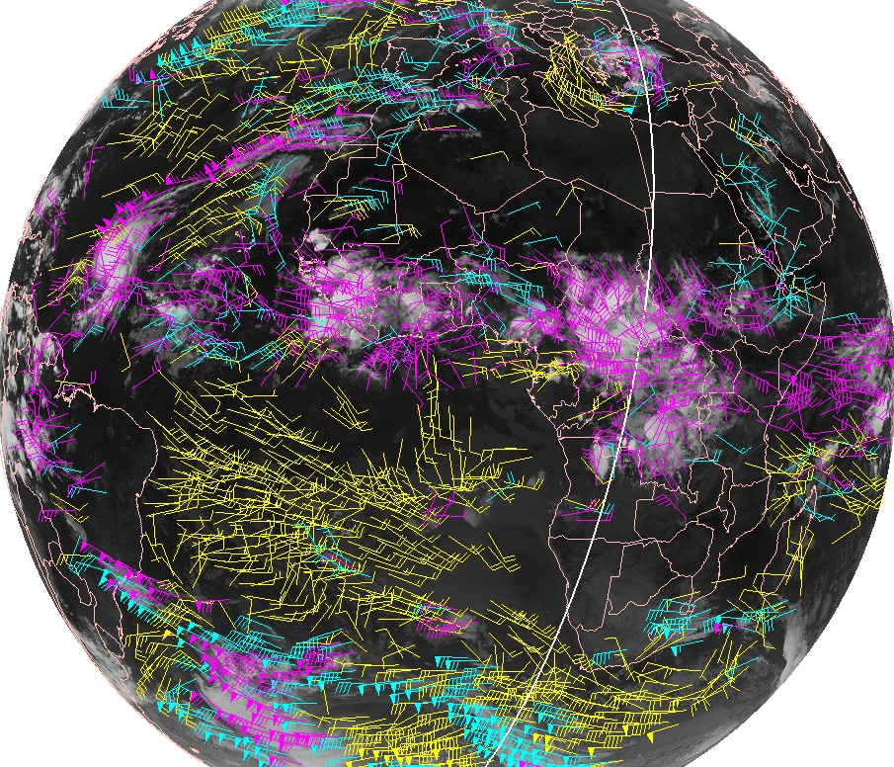
Example Deep Dive Validation – Meteosat-9 AMVs vs CALIPSO
September 22, 2011, 00 UTC
Plot of GOES-R proxy AMVs using Meteosat-9 along with track of CALIPSO pass near the time of the dataset

Slide 28
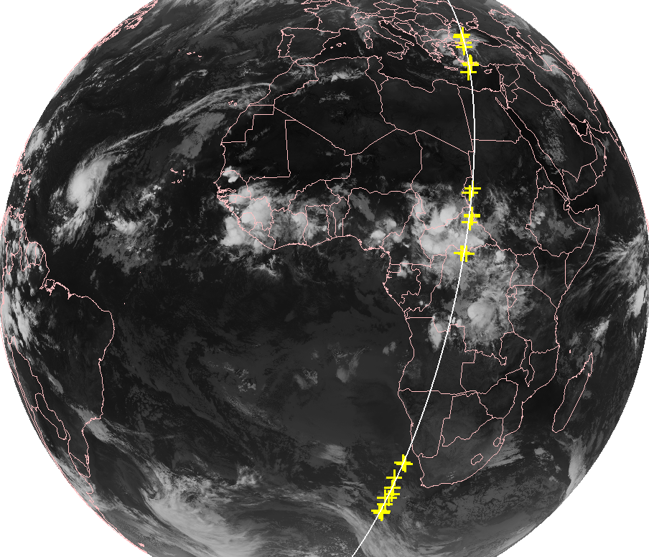
Example Deep Dive Validation – Meteosat-9 AMVs vs CALIPSO
September 22, 2011, 00 UTC
In this case we identify 30 AMVs with CALIPSO collocation criteria of 50 km and 30 minutes (yellow tick marks).
The matches circled in yellow are examined in the next slide.

Slide 29
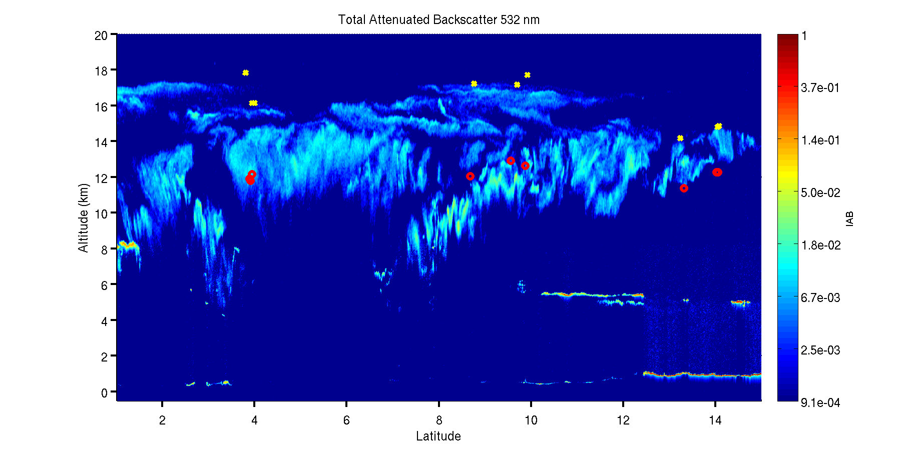
Example Deep Dive Validation: CALIPSO Cloud-Top Heights vs. AMV Height Assignments
AMVs (Meteosat-9)
CALIPSO 5km CTH
Instruments “see” different things, but comparisons are still useful

Slide 30
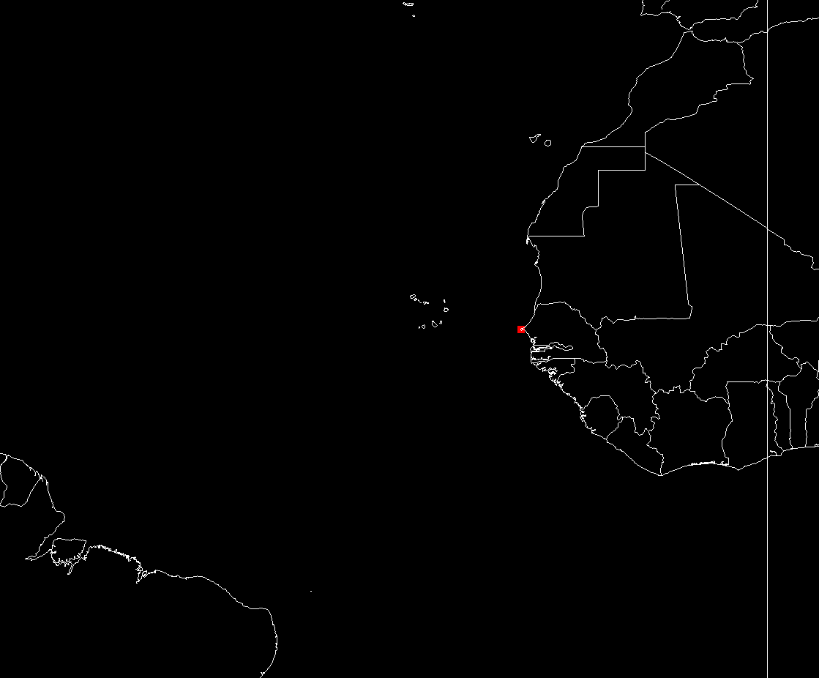
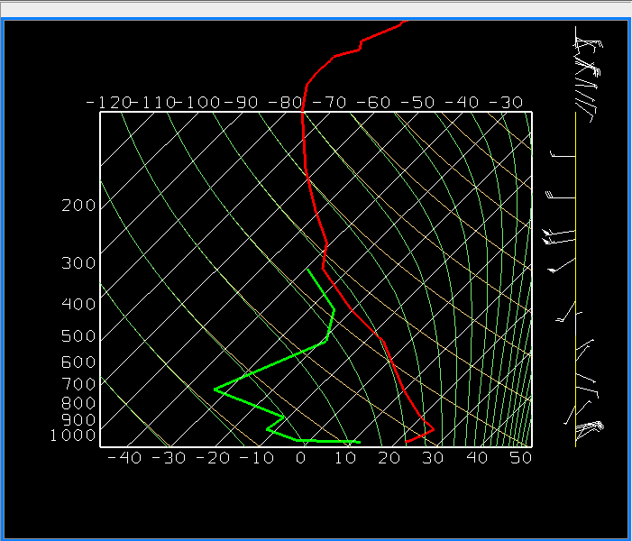
“Deep-Dive” Validation Tools
Visualization of reference/”ground truth” data using McIDAS-V…
Done using McIDAS-V
Notes:
30

Slide 31
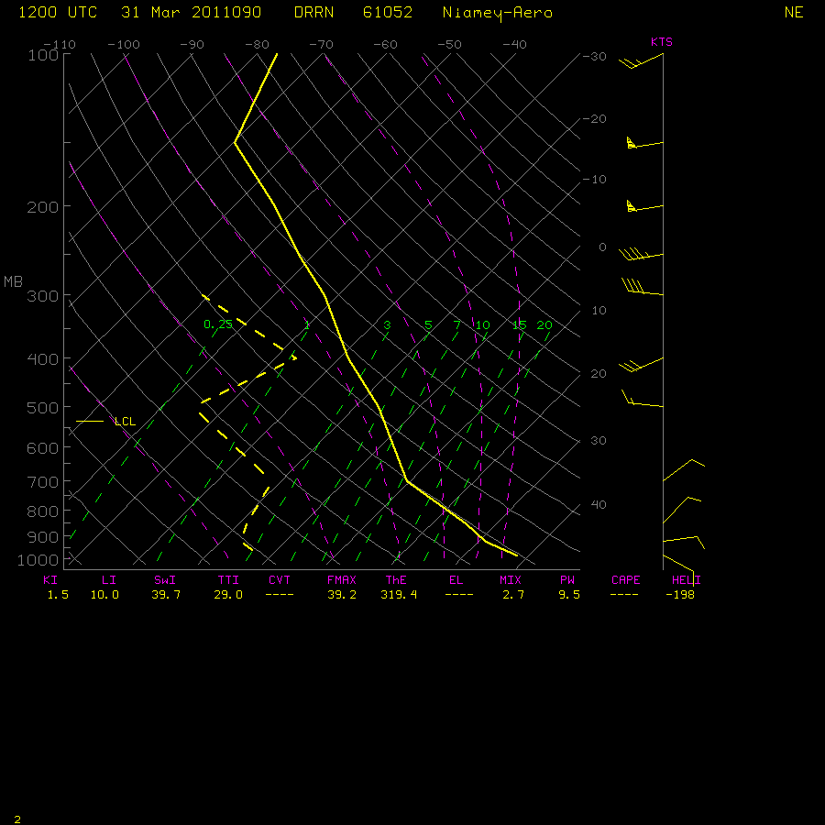
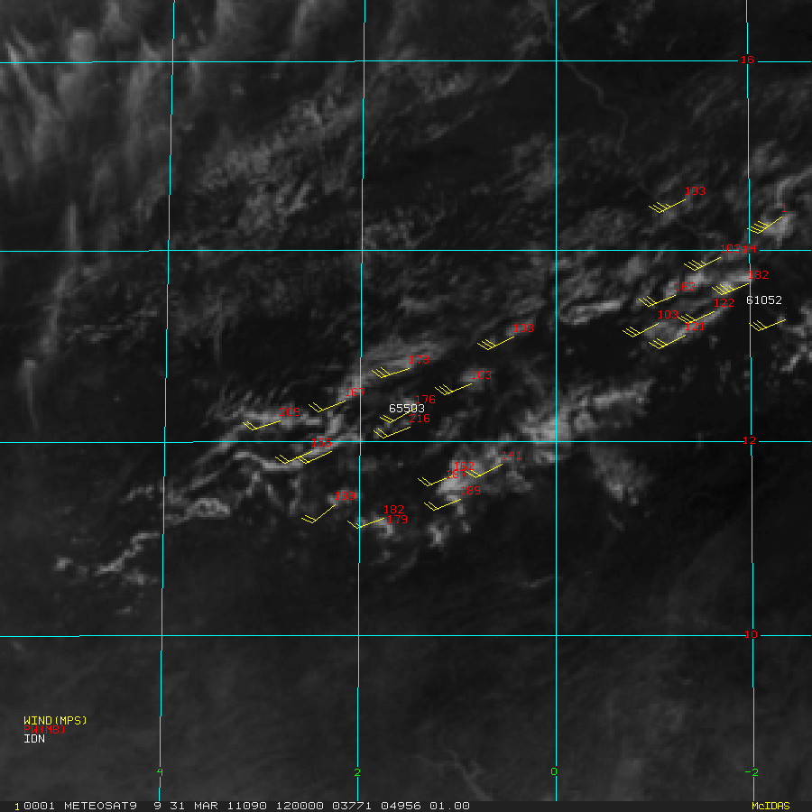
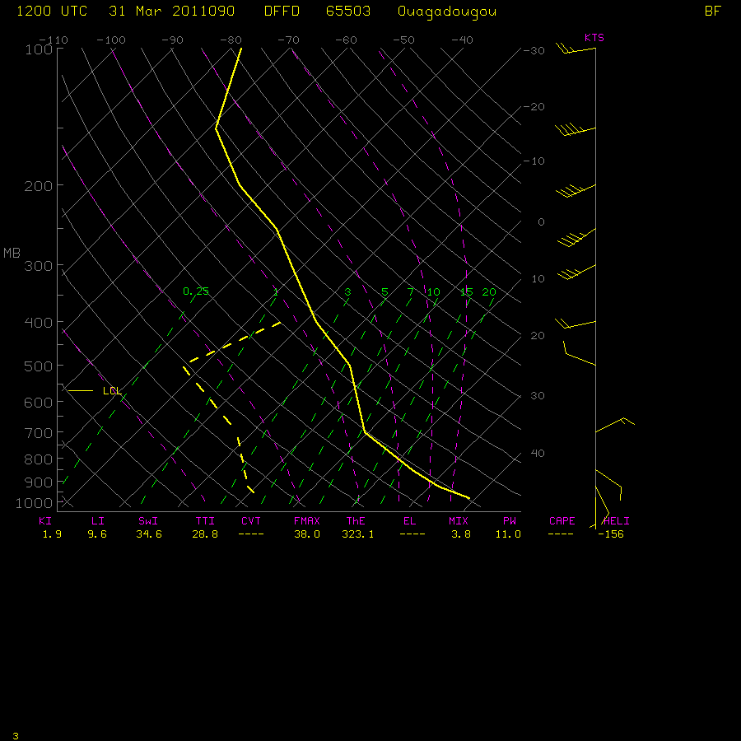
“Deep-Dive” Validation Tools
At what height does satellite wind “best fit”?
Notes:
31

Slide 32
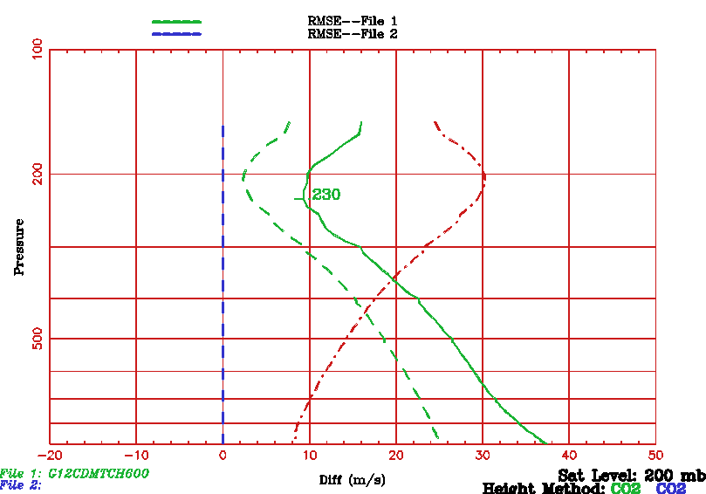
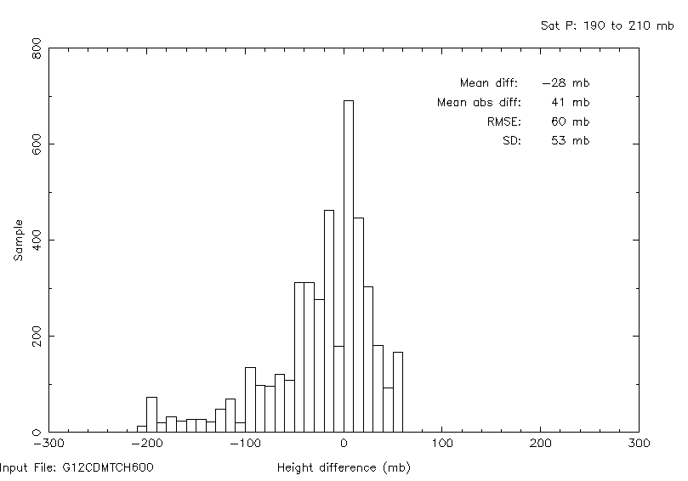
“Deep-Dive” Validation Tools
“Level-of-Best-Fit” Assessment of AMVs
Uses AMVs together with collocated Radiosonde wind profiles over a period of time
Use these data to characterize the quality of the height assignments
Level of Best-Fit is defined to be the level at which vector difference between the satellite wind and the radiosonde wind is a minimum
Notes:
32

Slide 33
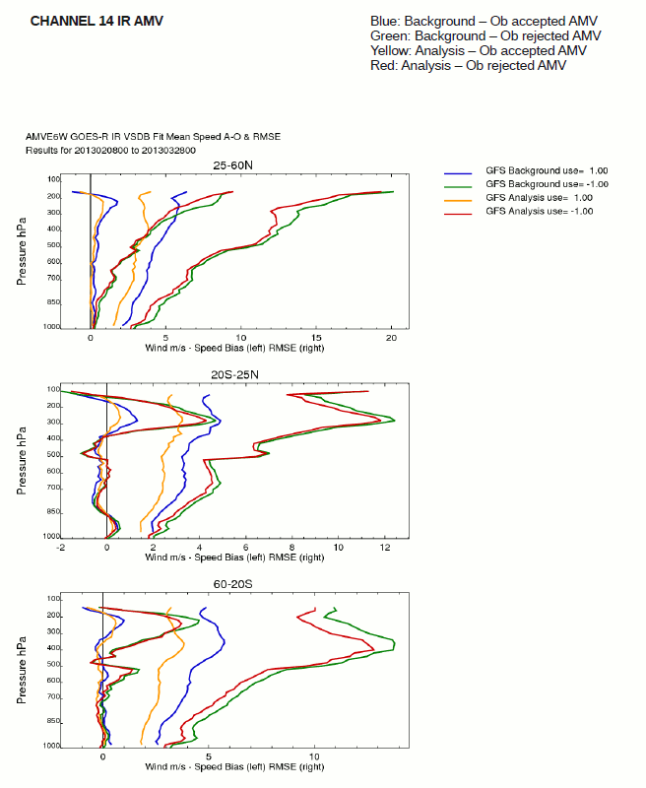
Assessment of Proxy GOES-R DMW Impact in NCEP GFS
Assessing Winds, derived via the GOES-R DMW algorithm, in the NCEP GFS Data Assimilation System (GOES-R Risk Reduction Project)
Using Meteosat/SEVIRI winds
Derived initial data assimilation stats (O-B) and developed assimilation quality control procedures that make use of new information afforded by the GOES-R DMW algorithm (quality indicators, cluster size, cloud phase, cloud type, etc)
Conducting forecast impact studies for two seasons (in progress)
Deliver to NCEP an assimilation capability for GOES-R AMVs (2014)
Developing a new AMV BUFR Winds Sequence in coordination with members of the International Winds Working Group (IWWG)
Meteosat-10/SEVIRI 10.8um AMVs
Notes:
Assessment of DMW impact in NCEP GFS (summary/highlights of GOES-R3 work; engagement with NCEP)

Slide 34
OUTLINE
Derived Motion Wind Products Generated from Proxy Data
Validation Strategies
Validation Tools and DMW Product Assessments
DMW Algorithm Enhancements Beyond Baseline Delivery
Road to GOES-R Post-Launch Test (PLT)

Slide 35
DMW Algorithm Enhancements Beyond Baseline Delivery
1D-VAR cloud heights, instead of brightness temperatures, used to assign heights to the Water Vapor Cloud-Top (WVCT) winds
PMAX cutoff of 350 mb implemented for WVCT winds
Addition of additional cluster analysis variables to the DMW output that were found useful for quality control in the NCEP GFS data assimilation system
Level of Best Fit pressure being computed (from UK Met Office) and added to the DMW output as diagnostic quantity
Cloud Phase used to separate ice and liquid water pixels – improves height assignment at cirrus cloud edges where pixels are misclassified as liquid (most prominent in tropics)
A weighted pressure is computed using the local 5x5 correlation values of largest motion cluster and used as the AMV height assignment – currently being evaluated
Extension of DMW algorithm capability to GOES-N/OP and NPP/VIIRS
Line prefix time used to compute time interval for GOES winds – more accurate than nominal time interval

Slide 36
OUTLINE
Derived Motion Wind Products Generated from Proxy Data
Validation Strategies
Validation Tools and DMW Product Assessments
DMW Algorithm Enhancements Beyond Baseline Delivery
Road to GOES-R Post-Launch Test (PLT)

Slide 37
Road to GOES-R Post-Launch Test (PLT) and Post-Launch Product Validation
Prepared routine validation tool software that we can provide to OSPO
Co-location and comparison statistics
Accommodates NetCDF4 DMW product files
Deep-dive tools are in place which will be needed to analyze DMW products and resolve any issues after launch
Work to understand and become familiar with DMW product software written by Harris/AER
Continue working closely with NCEP to ensure their readiness to assimilate GOES-R AMVs
Coordinate with GOES-R Proving Ground (PG) for a future demonstration activity
Work with the GOES-R Program to ensure ground system facilities (ie., GS Development Environment) are in place and configured in a way for STAR/AWG/CWG to test and execute updated product codes?

Slide 38
Summary
GOES-R DMW algorithm is running routinely for a suite of different sensors (Meteosat/SEVIRI, GOES-N/O/P, VIIRS). In the process of transitioning this algorithm to OSPO for current GOES and VIIRS.
Validation tools continue to be developed and used to analyze the performance of the DMW algorithm
We have a list of DMW algorithm enhancements which will need to find their way in the ground system
Getting familiar with Harris DMW product software is important
Important that the ground system facilities (ie., GS Development Environment) are in place and configured in a way for STAR/AWG/CWG to test and execute updated product codes
Important that a process is established to get updated software into the ground system

