Slide 1
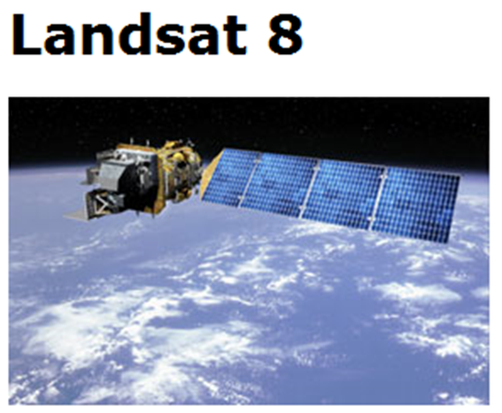
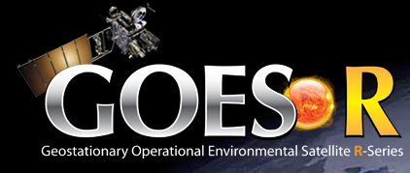
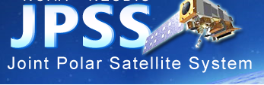
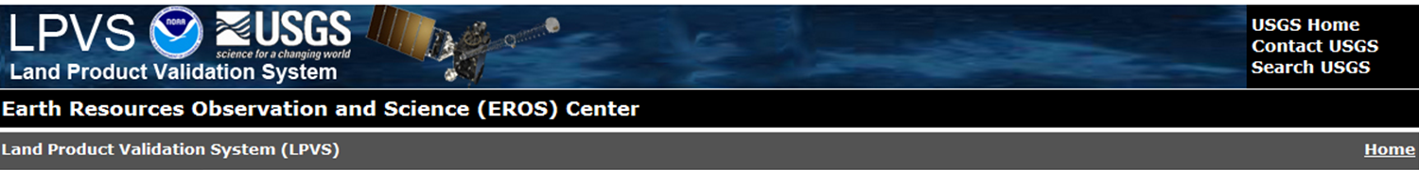
NOAA-USGS Land Product Validation System GOES-R AWG 2nd Validation Workshop 10 January 2014 Kevin Gallo: NESDIS/STAR John Dwyer: USGS/EROS Calli Jenkerson: SGT/EROS Ryan Longhenry: USGS/EROS Greg Stensaas: USGS/EROS

Slide 2
Land Product Validation System (LPVS)
What is LPVS
Why LPVS developed/hosted at EROS
Highlights of LPVS
Inventory & Ordering
Analysis Tools
Path Forward
Summary

Slide 3
Land Product Validation System (LPVS)
What is LPVS
Why LPVS developed/hosted at EROS
Highlights of LPVS
Inventory & Ordering
Analysis Tools
Path Forward
Summary

Slide 4
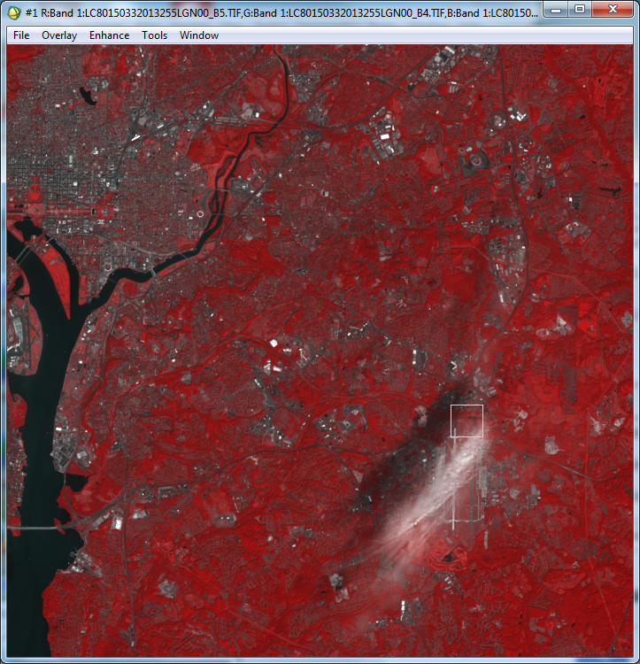
What is LPVS
General characteristics
Desired functionality
A web-based system designed to use moderate to high-resolution satellite data for validation of GOES-R ABI and JPSS VIIRS products.
Landsat 8: 12 Sept 2013
1 x 1 km

Slide 5
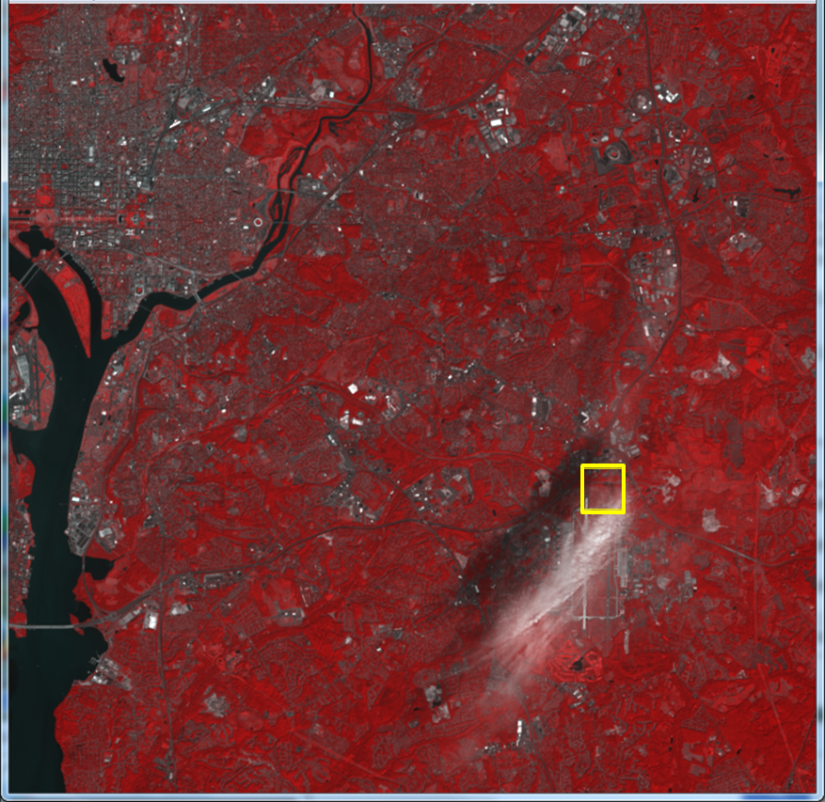
What is LPVS
General characteristics
Desired functionality
A web-based system designed to use moderate to high-resolution satellite data for validation of GOES-R ABI and JPSS VIIRS products.
Ready for GOES-R and JPSS-VIIRS pre- and post-launch testing and validation.
Landsat 8: 12 Sept 2013
1 x 1 km

Slide 6
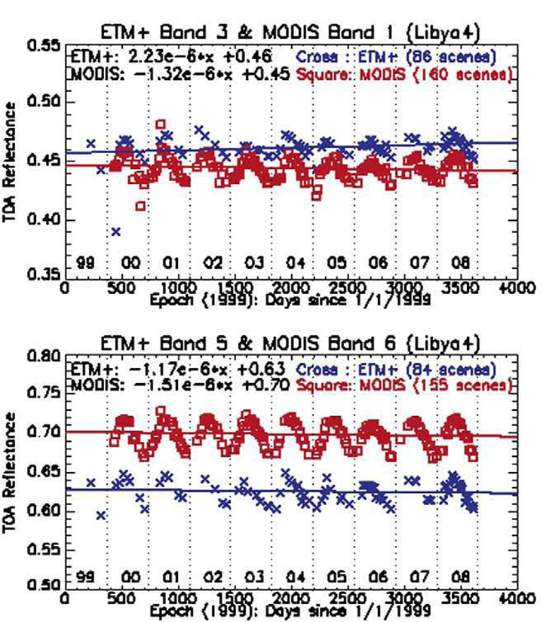
What is LPVS:
Output example
Trending of similar bands of data from multiple sensors.

Slide 7
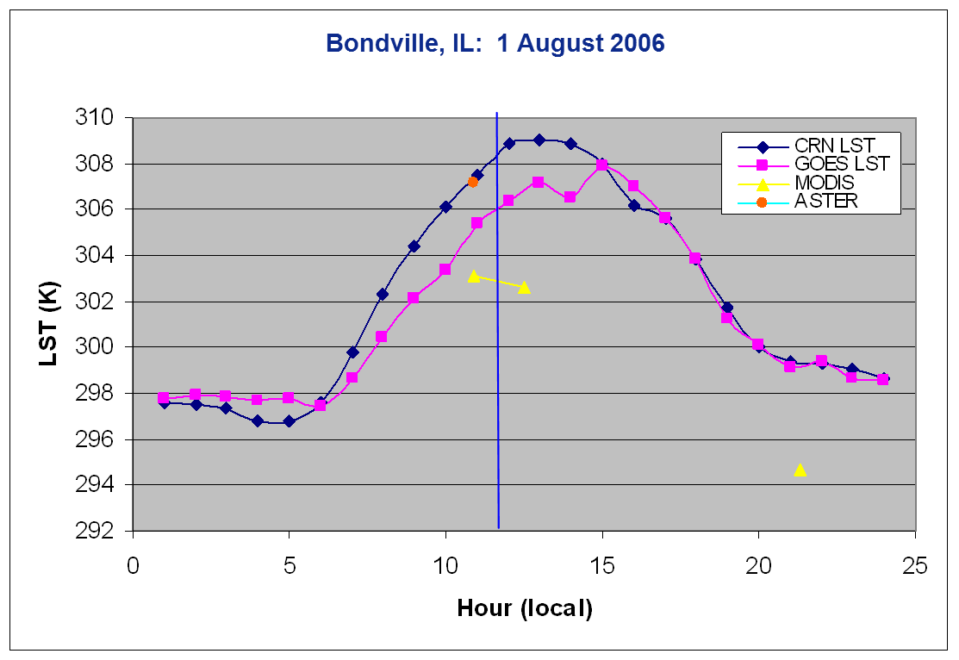
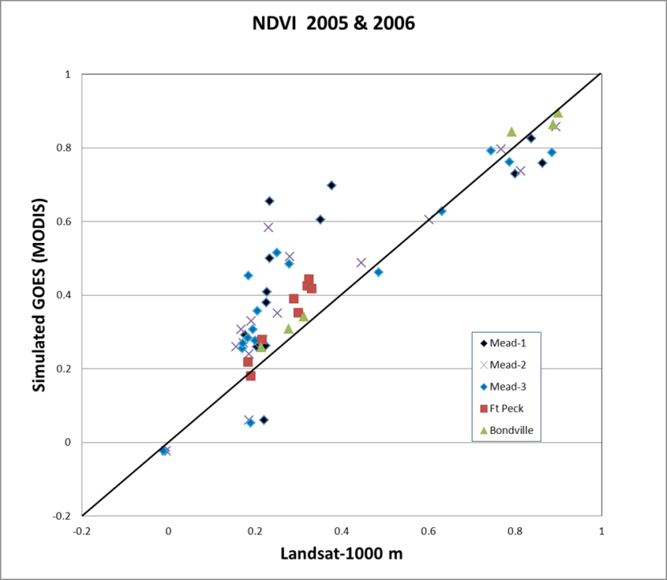
What is LPVS:
Output example
Land
Surface
Temp.
Multiple sensor (satellite and in situ) comparisons for single location and date.
NDVI
Multiple sensor comparison for multiple locations and dates.

Slide 8
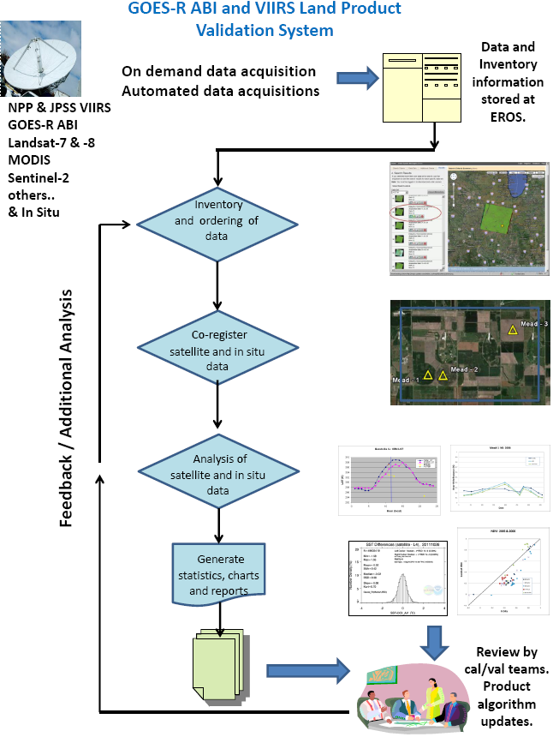
What is LPVS
A web-based system designed to use moderate to high-resolution satellite data for validation of GOES-R ABI and JPSS VIIRS products.
Ready for GOES-R and JPSS-VIIRS pre- and post-launch testing and validation.

Slide 9
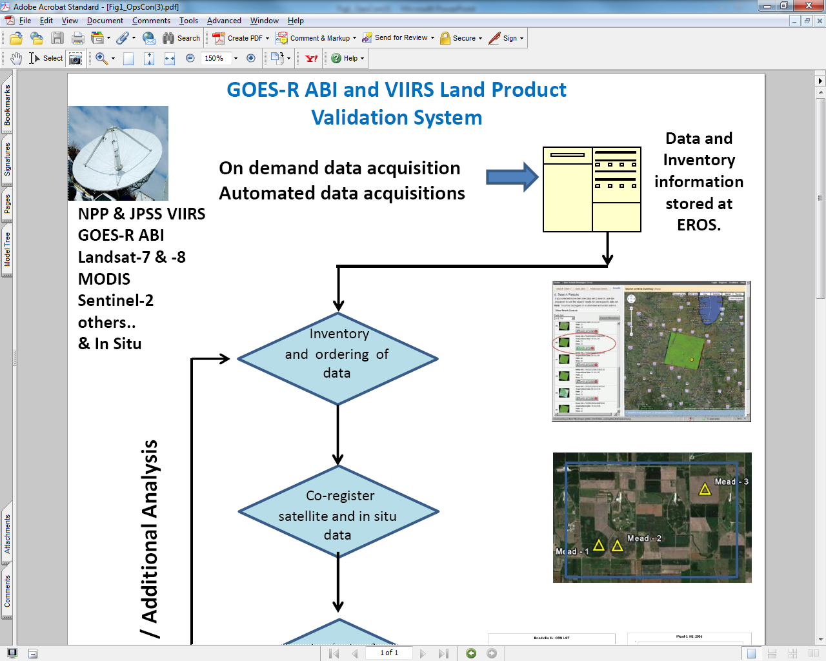
What is LPVS
Characteristics and desired functionality

Slide 10
What is LPVS
Characteristics and desired functionality

Slide 11
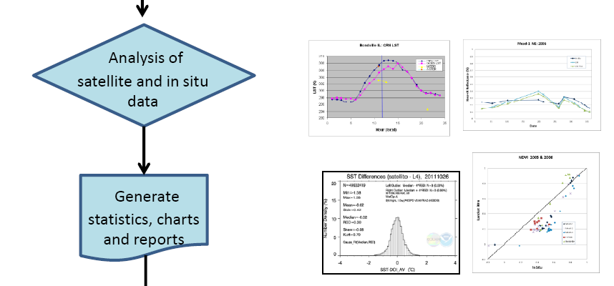
What is LPVS
Characteristics and desired functionality

Slide 12
Land Product Validation System (LPVS)
What is LPVS
Why LPVS developed/hosted at EROS
Highlights of LPVS
Inventory & Ordering
Analysis Tools
Path Forward
Summary

Slide 13
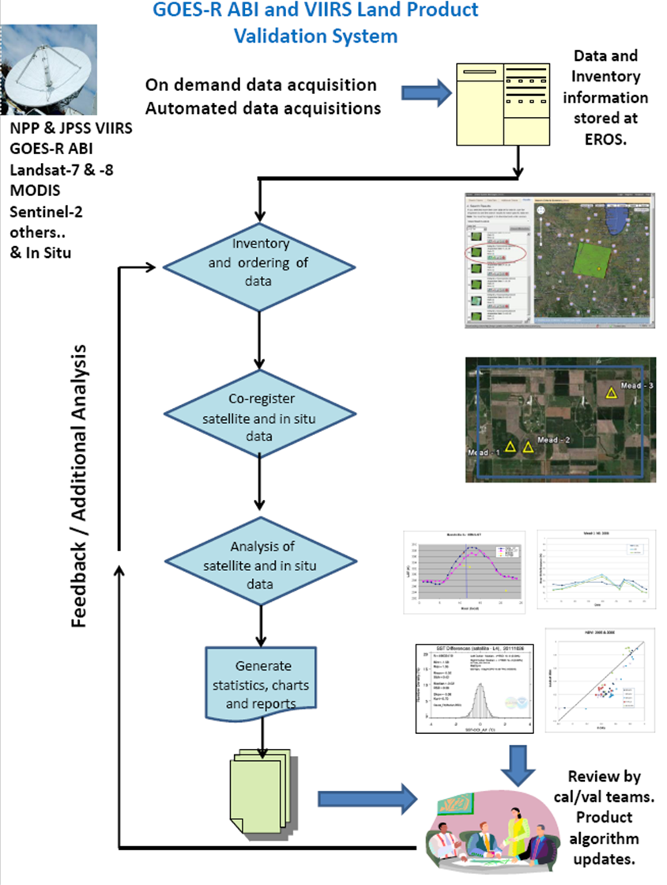
1
Why LPVS developed and hosted at USGS/EROS?
Facility Assets
Landsat
Landsat product development
2
3

Slide 14
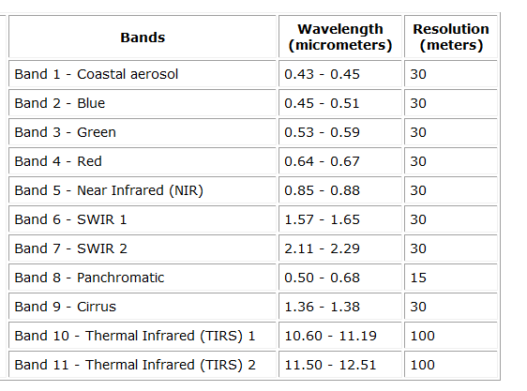
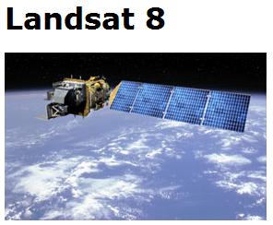
LDCM (Landsat 8)
11 Bands
9 vis to mid-IR; 15-30 m resolution
2 thermal IR; 100 m resolution 30 m
Absolute calibration of OLI and TIRS
Why LPVS developed and hosted at USGS/EROS?
Facility Assets
Landsat characteristics
Landsat product development
Launched 11 Feb. 2013
http://landsat.usgs.gov/band_designations_landsat_satellites.php

Slide 15
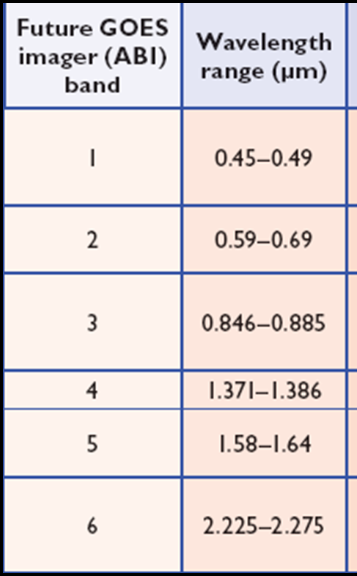
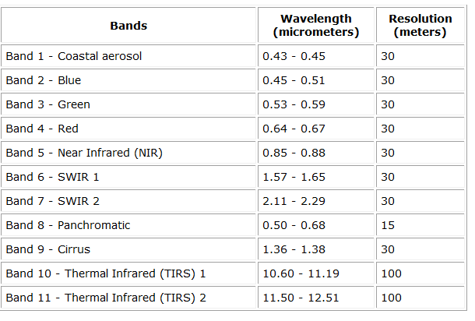
Landsat characteristics
GOES-R ABI
Visible/NIR
Landsat 8

Slide 16
Landsat characteristics
GOES-R ABI
Visible/NIR
Landsat 8

Slide 17
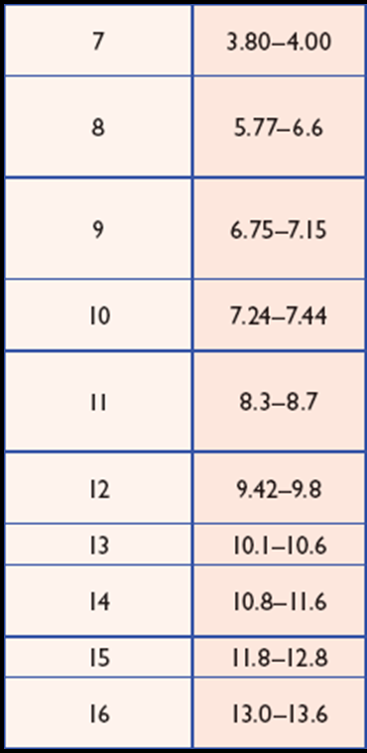
Landsat characteristics
GOES-R ABI
IR Bands
Landsat 8

Slide 18
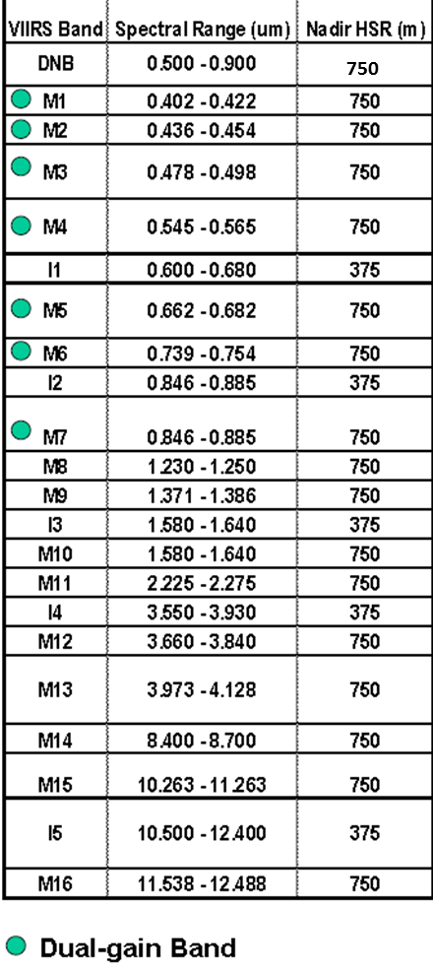
VIIRS
Landsat characteristics
Landsat 8

Slide 19
VIIRS
Landsat characteristics
Landsat 8

Slide 20
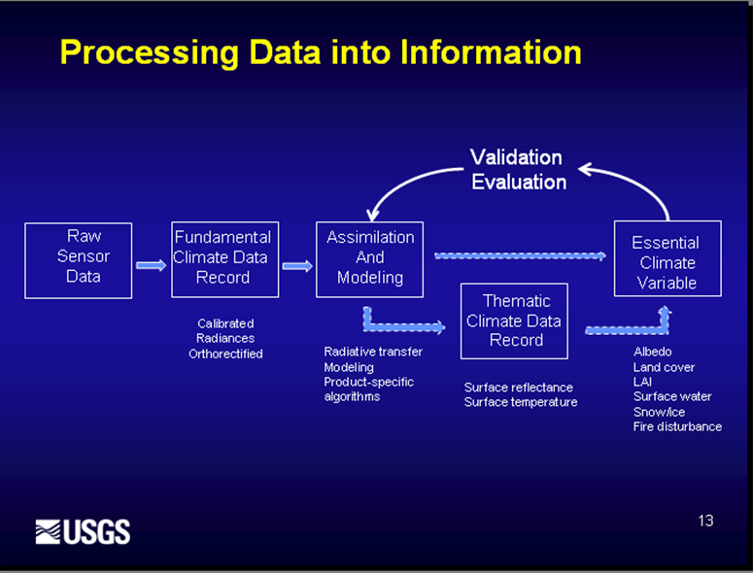
Why LPVS developed and hosted at USGS/EROS?
Facility Assets
Landsat
Landsat product development
Landsat Product Development
CDRs and ECVs (available March 2014)
CDRs
Surface Reflectance (and NDVI),
Land Surface Temperature/Emissivity
ECVs
Surface Water Extent,
Burned Area Extent,
Snow Covered Area

Slide 21
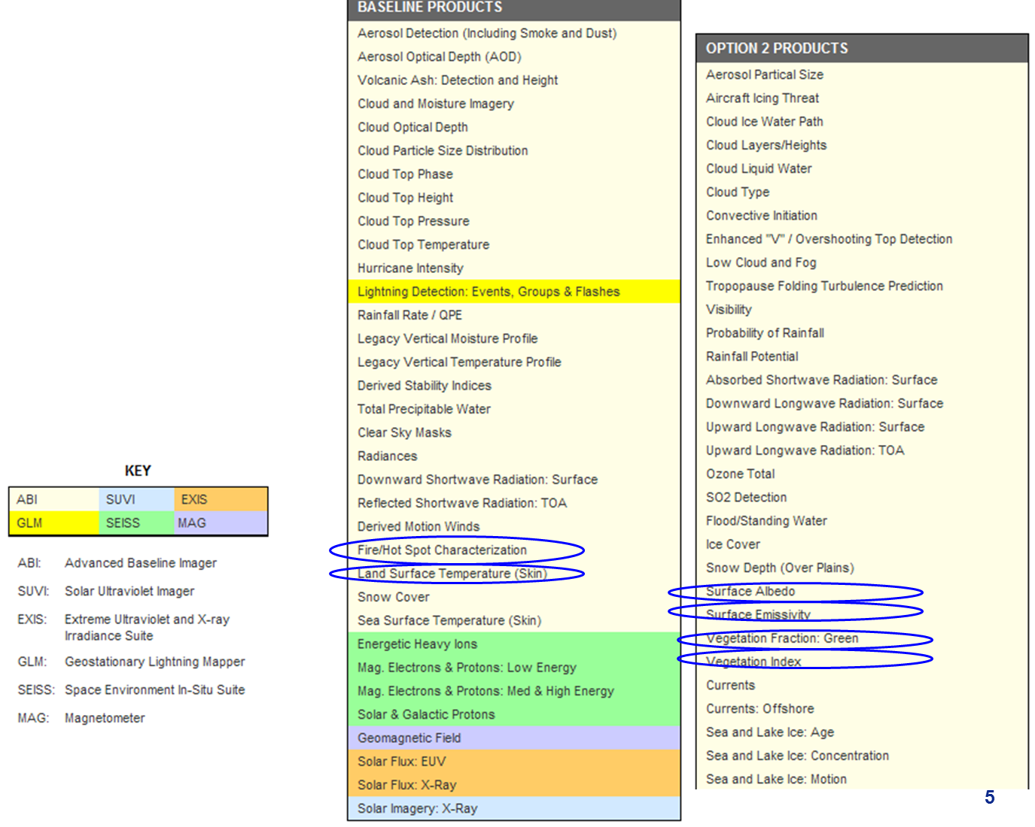
EROS-NOAA validation synergy
Several products of mutual interest (e.g. GOES-R ABI)

Slide 22
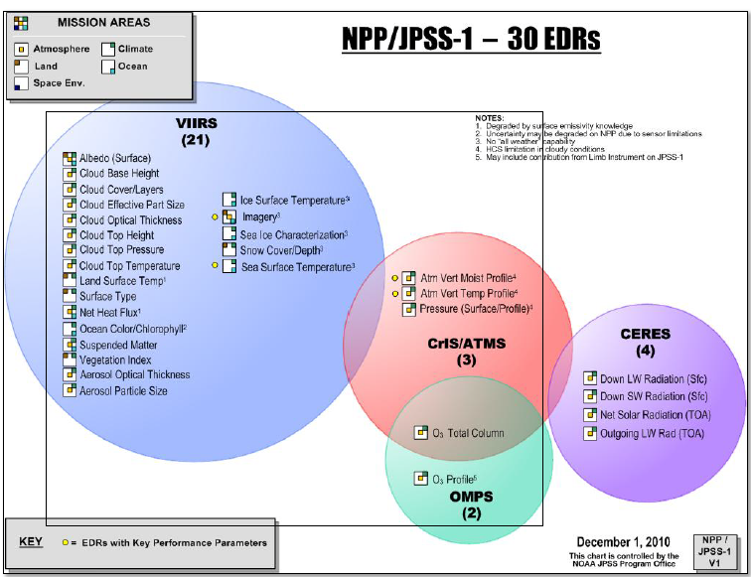
EROS-NOAA validation synergy
Several products of mutual interest (e.g. VIIRS)

Slide 23
Land Product Validation System (LPVS)
What is LPVS
Why LPVS developed/hosted at EROS
Highlights of LPVS
Inventory & Ordering
Analysis Tools
Path Forward
Summary

Slide 24
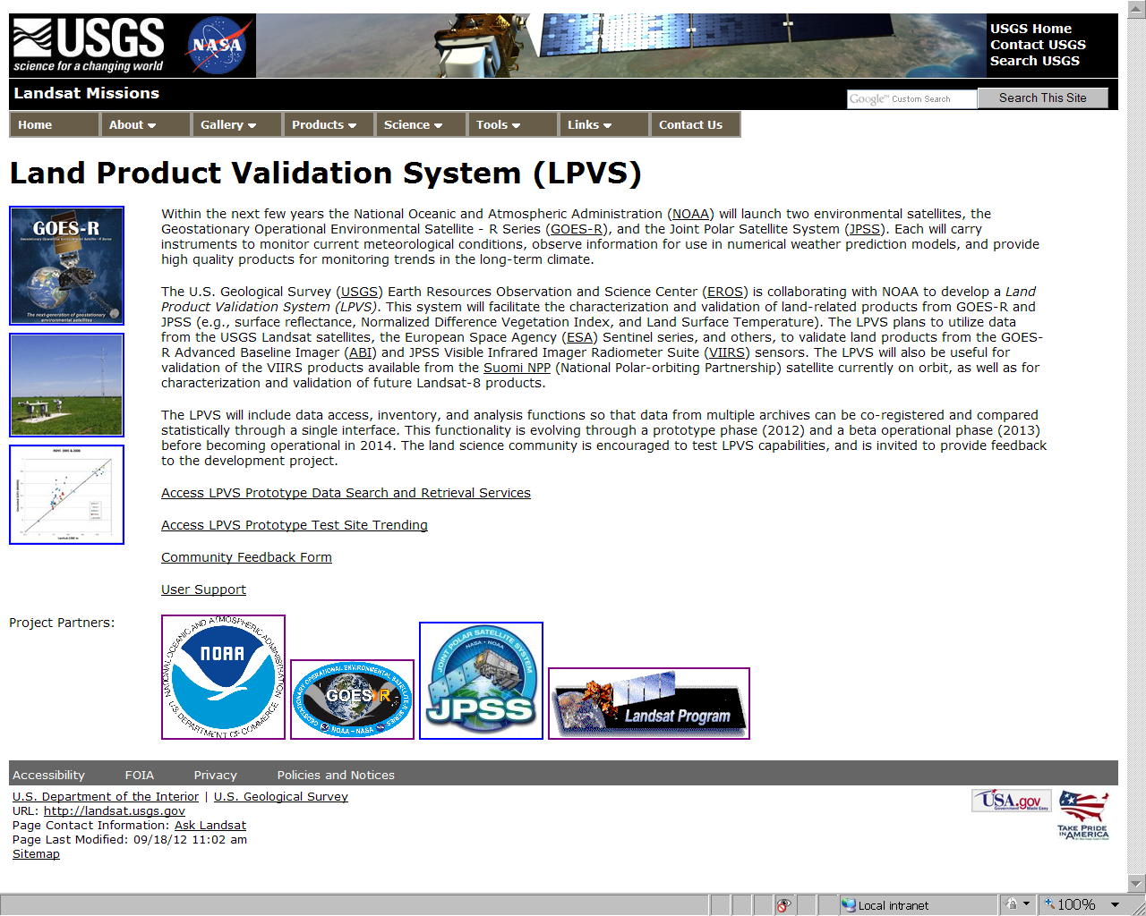
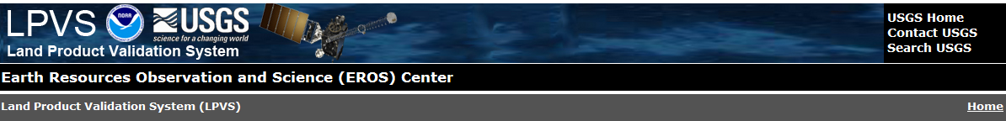

Slide 26
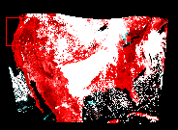
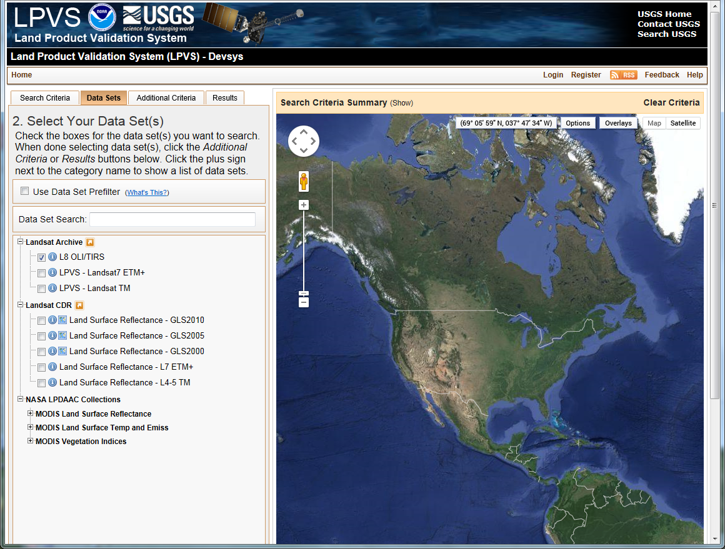
Search for Landsat data on date of simulated GOES-R ABI data : 23 April 2013 (provided by Univ. Wisc./CIMSS).

Slide 27
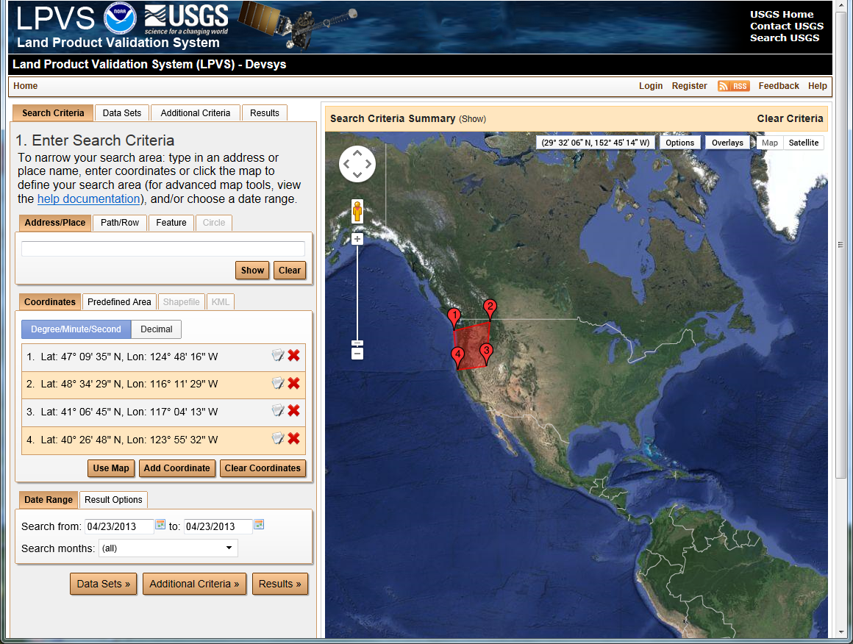
Search for Landsat data on date of simulated GOES-R ABI data (23 April 2013).

Slide 28
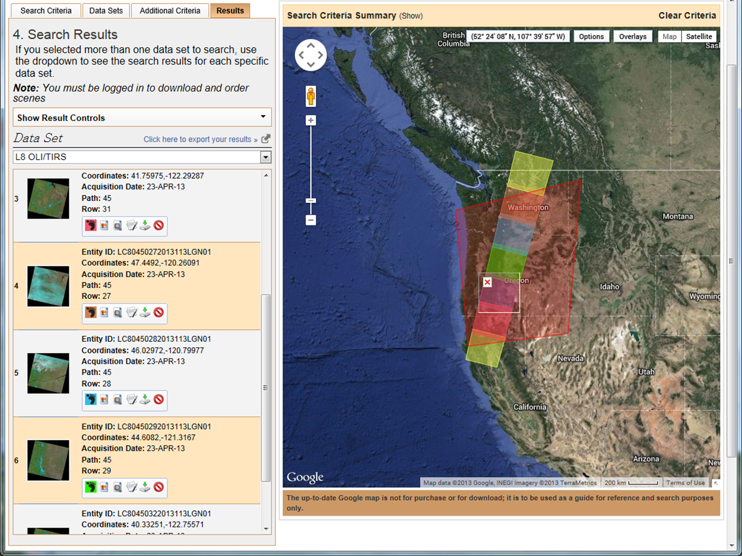
Search for Landsat data on date of simulated GOES-R ABI data (23 April 2013).

Slide 29
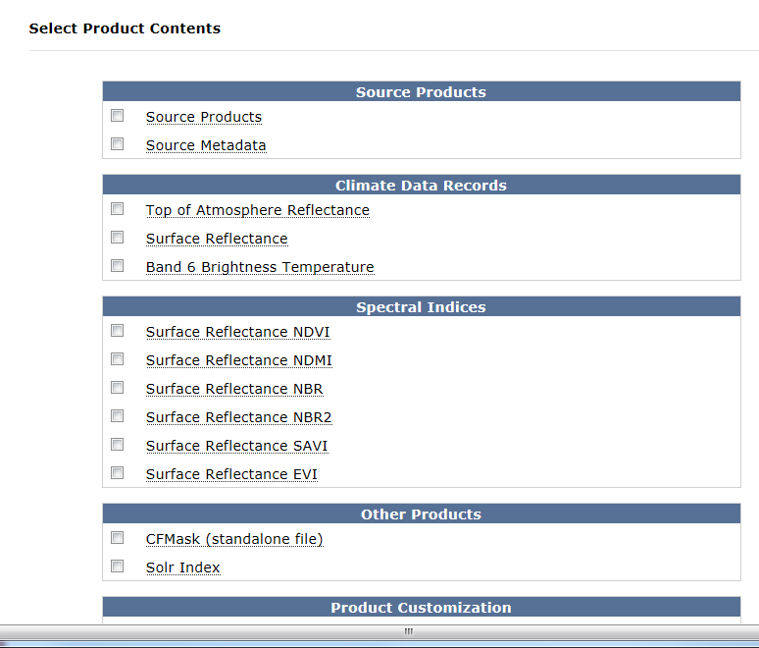
Enhanced Landsat Products
Additional ECVs and CDRs will be added to menu as available.

Slide 30
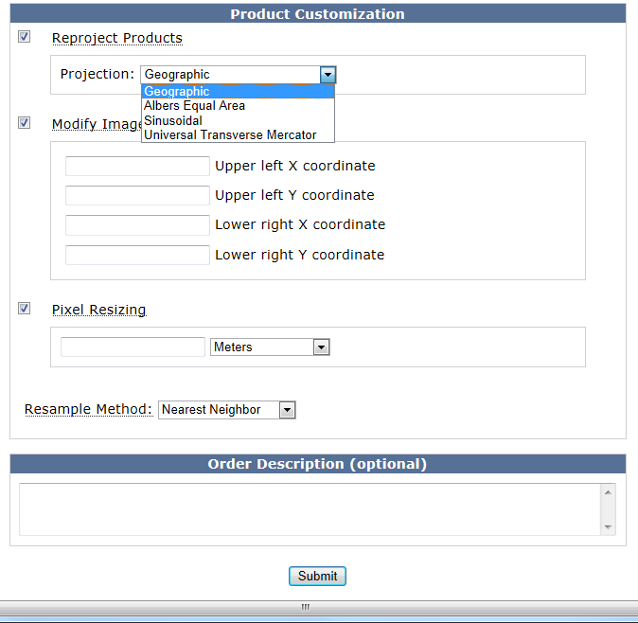
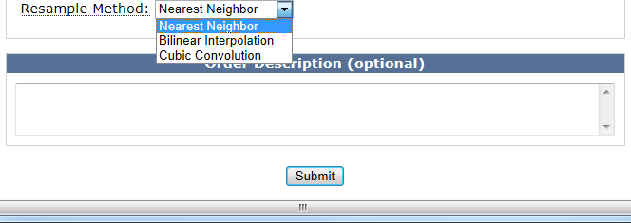
Enhanced Functionality
Auto-registration of data to common map projections for analysis.
User defines area of interest for analysis
Match pixel size for all images
Several resampling options
1
2
3
4

Slide 31
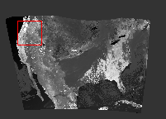
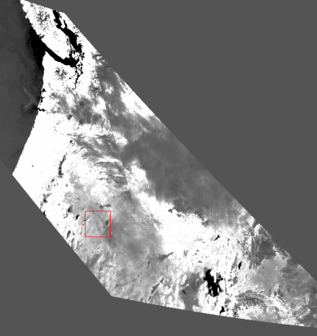
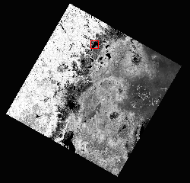
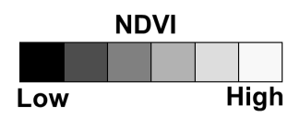
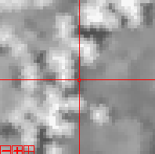
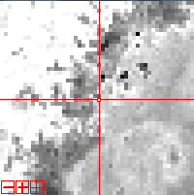
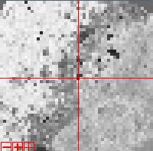
Example of New Functionality
Example of georegistration of ABI, VIIRS and Landsat for 23 April 2013.
Simulated GOES-R ABI
VIIRS
Landsat
Georegistered Data
Same Pixel Size
Same Map Projection

Slide 32
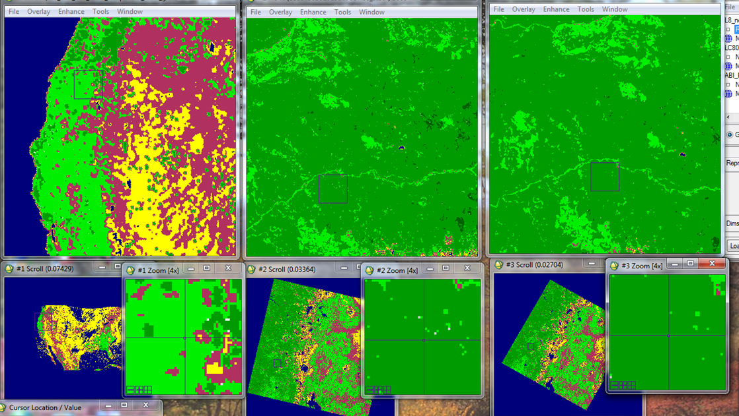
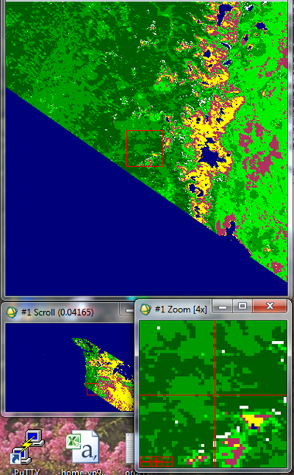
Example of New Functionality
Eight coincident sample locations (100 x 100 km) selected and data extracted.
Simulated GOES-R ABI
VIIRS
Landsat

Slide 33
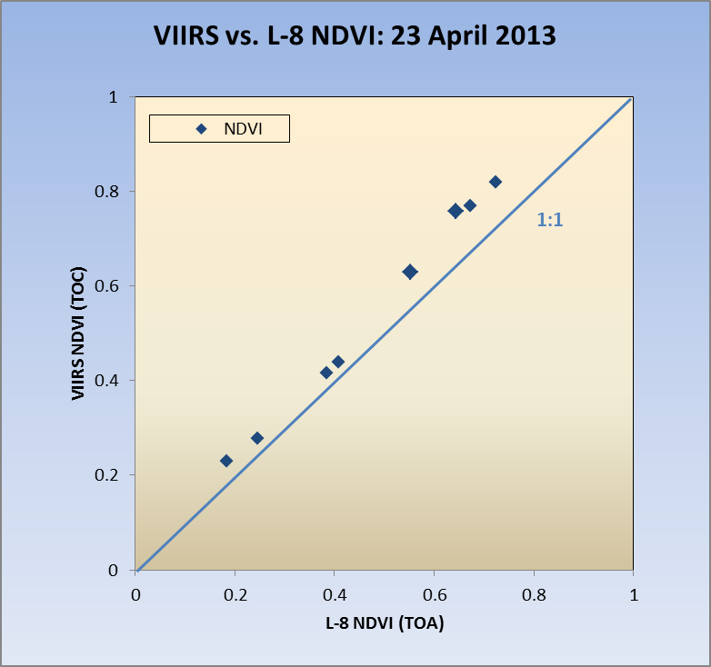
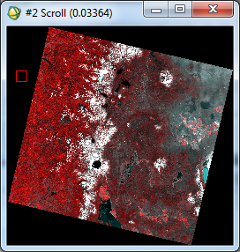
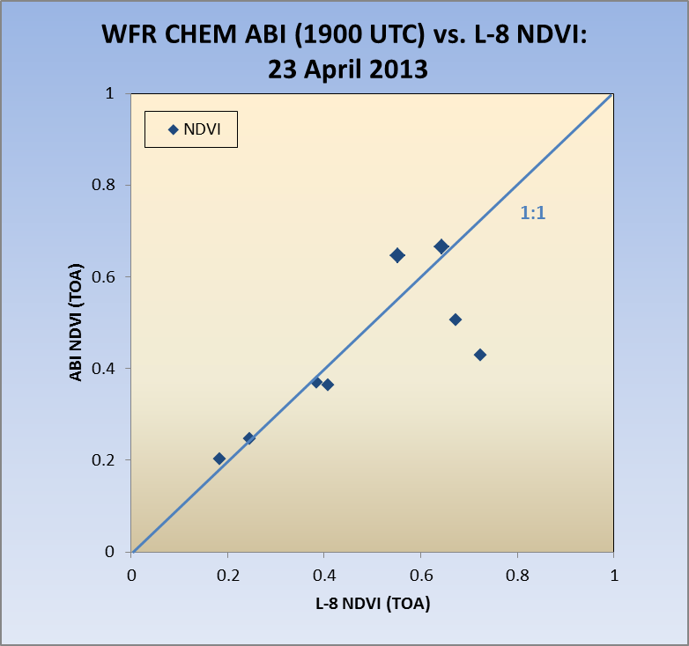
(A)
Example of Potential Analysis
Landsat-8 (TOA) NDVI compared to:
(A) VIIRS (TOC) NDIV and
(B) simulated GOES-R ABI (TOA) NDVI
Each point within figures represents 100 km² sample area.
(B)
Landsat 8: 23 April 2013, NW USA.

Slide 34
Land Product Validation System (LPVS)
What is LPVS
Why LPVS developed/hosted at EROS
Highlights of LPVS
Inventory & Ordering
Analysis Tools
Path Forward
Summary

Slide 36

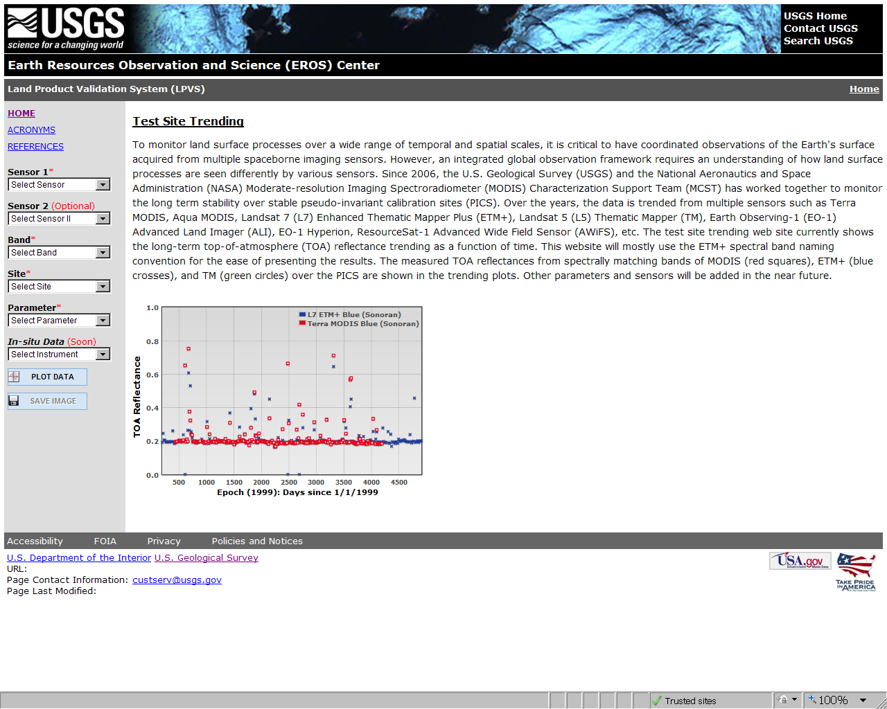
Landsat 7: Blue band comparison, Sonoran test site

Slide 37
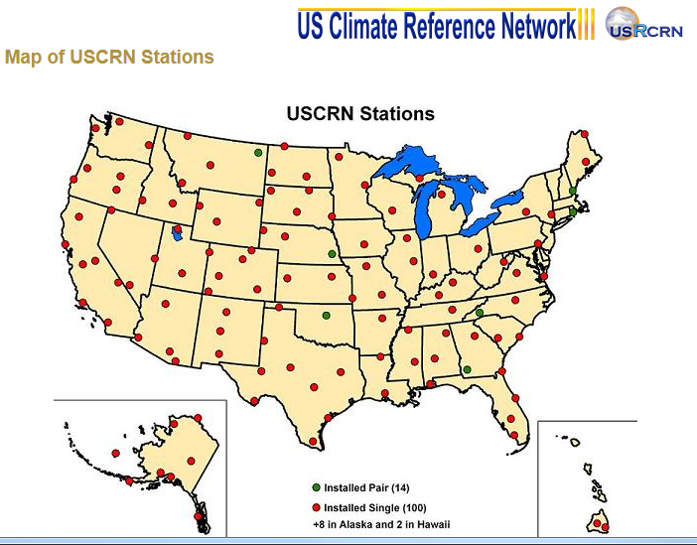
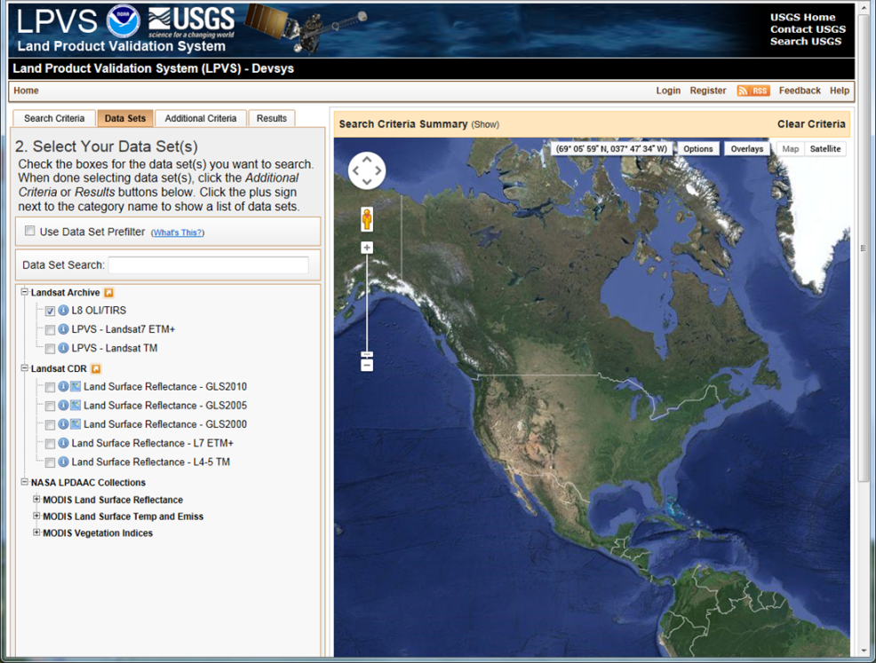
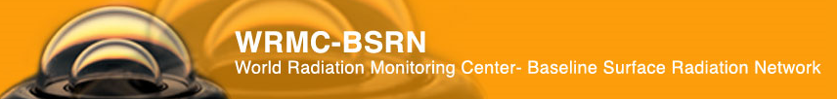
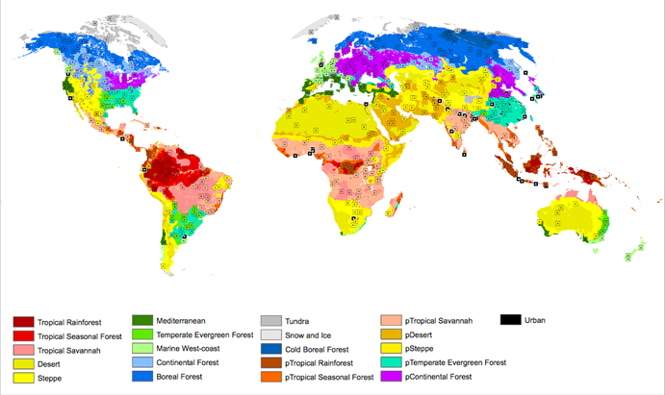
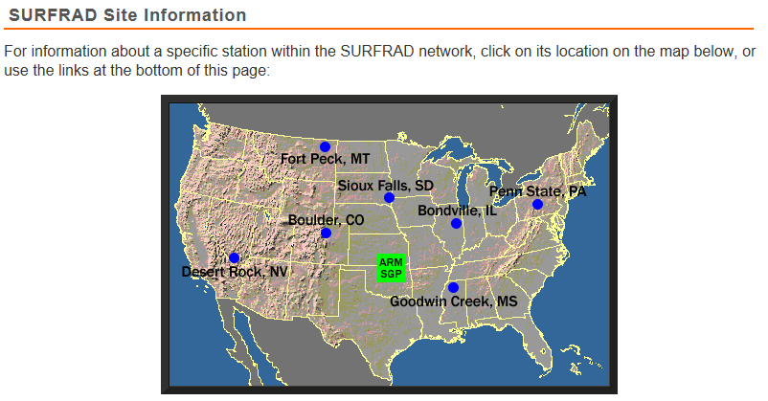
Predefined sample sites: user selectable for satellite (and potential in situ) inter-comparisons
X
X
X
Global Land Cover Validation: Global Stratification and Sample Sites
□ Test Sites
From M. Roman, NASA

Slide 38
Land Product Validation System (LPVS)
What is LPVS
Why LPVS developed/hosted at EROS
Highlights of LPVS
Inventory & Ordering
Analysis Tools
Path Forward
Summary

Slide 39
What is LPVS
A web-based system designed to use moderate to high-resolution satellite data for validation of GOES-R ABI and JPSS VIIRS products.
Ready for GOES-R and JPSS-VIIRS pre- and post-launch testing and validation.

