Slide 1
GOES-R Product Operations Science Support Team: Planning for GOES-R Cal/Val
AWG Second Validation Workshop
Bob Iacovazzi, Jr.
GOES-R POSST Ops Manager (POM)
January 9-10, 2014

Slide 2
Outline
GOES-R Program Cal/Val:
  Scope
  Partners
  Product Operations Science Support Team (POSST) synopsis
  Timeline
  Product validation maturity stages
POSST Planning for GOES-R Cal/Val:
  Post-Launch Support Readiness Preparations
    System Integration Review (SIR) and Mission Operations Review (MOR) support
    GOES-R System-level Cal and Product Measurement Val CONOPS/OPSCON finalization
    Cal/INR/Product Science (CIPS) Monitoring and Analysis Software Tool (MAST) planning, development, implementation, and testing
    Defining CIPS-related external data operations validation objectives (EDOVOs)
    Creating a CIPS post-launch test (PLT) suite
    Ground Segment training coordination
    PLT validation field campaign planning and coordination

Slide 3
Outline
GOES-R Program Cal/Val:
  Scope
  Partners
  Product Operations Science Support Team (POSST) synopsis
  Timeline
  Product validation maturity stages
POSST Planning for GOES-R Cal/Val:
  Post-Launch Support Readiness Preparations
    System Integration Review (SIR) and Mission Operations Review (MOR) support
    GOES-R System-level Cal and Product Measurement Val CONOPS/ OPSCON finalization
    Cal/INR/Product Science (CIPS) Monitoring and Analysis Software Tool (MAST) planning, development, implementation, and testing
    Defining CIPS-related external data operations validation objectives (EDOVOs)
    Creating a CIPS post-launch test (PLT) suite
    Ground Segment training coordination
    PLT validation field campaign planning and coordination

Slide 4
GOES-R Cal/Val Scope
  Pre-launch technical support to Flight and Ground Segment Projects
    Observe, and verify results of, pre-launch instrument-level calibration tests
    Evaluate instrument performance risks and waiver requests
    Provide critical review of L1b algorithm design and implementation
    Support Post-Launch Test (PLT) planning
    Establish capabilities for post-launch validation and anomaly resolution of L1b science data quality
  Mission Operations Support Team (MOST) End-to-End (ETE) Test and Data Operations Support Team (DOST) Data Operations Test (DOT) support related to system-level compatibility between the space and ground segments, and functionality of product processing
  Post-launch analysis of PLT data, and support of product science data anomaly resolution
  Cal/val activity coordination through PLT and Handover
  Pre-operational preparation of NOAA satellite scientists and engineers for monitoring, analyzing and maintaining GOES-R series instrument calibration and product integrity after Handover
GOES-R cal/val enhances understanding of data quality, and encourages “Day-1” operational readiness and long-term user confidence.

Slide 5

GOES-R System Validation Partners
GOES-R System Validation Success
Mission Operations Support Team (MOST) – Flight segment certification with support from Flight Systems Engineering, and mission operations validation [POC – Mission Operations Manager]
Data Operations Support Team (DOST) – Product generation, distribution, and monitoring operations validation [POC- Data Operations Manager]
Product Operations Science Support Team (POSST) – Calibration, image navigation and registration (INR), and product science validation [POC – POSST Operations Manager]
Mission Operations
Support Team
Product Operations Science
Support Team
Data Operations
Support Team

Slide 6
GOES-R POSST Mission
Post-launch day-one cal/INR/product science (CIPS) validation readiness goal
  Program validation partners prepared to begin routine, and many “deep-dive”, CIPS validation activities the first day each product is made available from the ground segment
  Program Cal/Val CONOPS and OPSCON processes well-defined and operational
  Prepared for “GOES-R Unique” CIPS validation challenges
    The POSST can function collaboratively at NSOF with the MOST and DOST, and internally with critical geographically-dispersed external support teams
    Stakeholders and users are integrated when possible into the validation process, as this is a new satellite system for them
    Collaboration and coordination of CIPS validation activities with those of other satellite acquisition programs – e.g., JPSS – is established to reduce duplicative efforts
Stakeholder and user-centered validation defines and prioritizes validation efforts to meet the post-launch CIPS validation information needs of these parties

Slide 7
GOES-R POSST Collaborator Responsibilities
Collaborator | Main Responsibilities | Cal | L1b Prod Val | L2+ Prod Val
Flight Project (FP) | Oversee SC/Instr. Design, Fabr., Integ., and Test Post-Launch INR V&V | ✓ | ✓
SC/Instr Vendors | SC/Instr. Design, Fabr., Integ., and Test | ✓ | ✓
Ground Segment (GS) Project (GSP) | Oversee GS Design, Fabr., Integ., and Test | ✓ | ✓ | ✓
GS Vendor | GS Design, Fabr., Integ., and Test | ✓ | ✓ | ✓
Mission Ops Support Team (MOST) | Gov’t SC/Instr/GS-MM Test | ✓ | ✓ | ✓
Data Ops Support Team (DOST) | Gov’t GS-PG/PD Test | ✓ | ✓ | ✓
Cal Working Group (CWG) | PSE Technical Support to GOES-R Instr. Cal, INR & L1b Val | ✓ | ✓ | ✓
Algorithm Working Group (AWG) | L2+ Product Dev and V&V |  | ✓ | ✓
NESDIS Office of Satellite and Product Operations (OSPO) | Ops Support to Cal/Val | ✓ | ✓ | ✓

Slide 8
GOES-R POSST Organizational Chart
GOES-R Program Office [Director (G. Mandt) / Deputy (R. Pickering)]
Ground Segment Project (GSP) Office [Manager (J. Valenti)], Deputies (R. Krause, S. Stanczyk)]
Program Systems Engineering (PSE) [Lead (E. Grigsby) / Deputy (C. Keeler)] Instr./L1b Verification
GOES-R Science [Chief (S. Goodman)] L1b Science Validation
Flight Project (FP) Office [Manager (P. Sullivan), Deputies (K. McIntyre - Instrs. & T. Walsh - SC)]
GSP Chief Project Engineer
(R. Pages)
Systems Mgr (A. Krimchanski)
Instr. Systems Mgr (G. Cunningham)
GSP DOST [DOST Ops Mgr (S. Ambrose), DOST Ops Mgr Deputy (M. Ripley)
GSP
Prod & Alg
[Lead (S. Kalluri)]
POSST Ops Mgr (POM) [(B. Iacovazzi, Jr.)]
FP MOST [MOST Ops Mgr (C. Wheeler), PLT Dir (S. Markelov) & Instr. Team Lead (A. Moore)]
FP Systems [Verification Lead (J. Fiorello), INR SMEs]
FP Instr. Mgrs. & SEs
CWG Cal- & L1b-Technical [Chair (C. Cao), STAR, MSFC, NGDC, NIST, MIT LL]
CIPS MAST Mgr [Dave Pogorzala]
GSP L1b IPT [Lead (R. Race), L0/L1b SME (F. Adimi)]
OSPO Radiometrics & Product Ops [Rad. Eng. POC (P. Douglas); Prod. Area Lead POC (A. Irving)]
Instr. Vendors [Vendor POCs]
GS Vendor [Vendor POC (K. Bryan)]
AWG L1b/L2+ Technical [Lead (J. Daniels)]
FP Scientist (D. Chesters)
POSST Collaborators

Slide 9
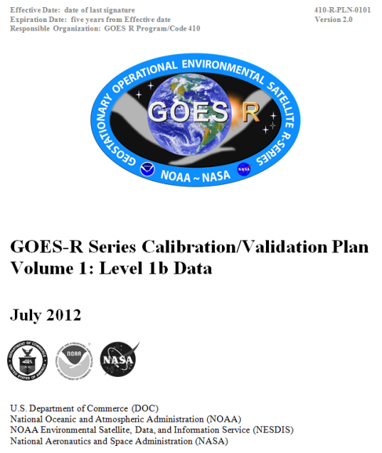
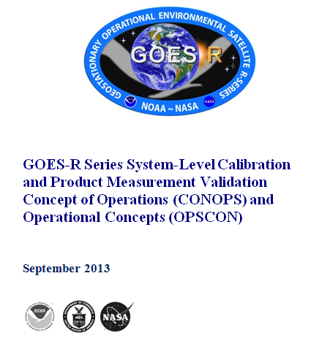
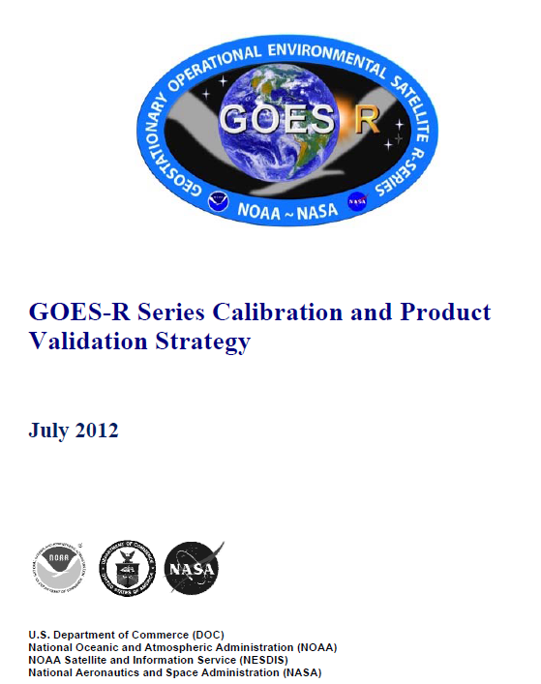
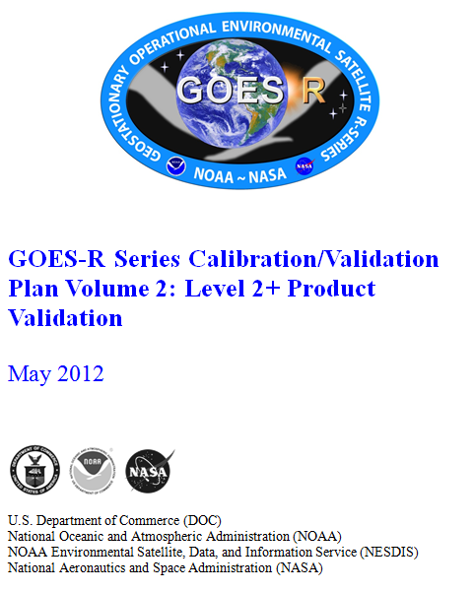
GOES-R Program Cal/Val Documents
Calibration and Product Validation Strategy
Cal/Val Plan Vol. 1 (L1b Data) & Vol. 2 (L2+ Product Val)
Cal/Val CONOPS & OPSCON
Cal/Val Methods and Processes
Capabilities, Functions, Resources and Operational Processes and Procedures
Scope, Organizations & Working Groups, Roles & Responsibilities, and Schedules
All documents at CDR-level, except for the Cal/Val CONOPS and OPSCON document (under development).

Slide 10
GOES-R Cal/Val Resources
Resource | Pre-Launch | Post-Launch Testing | Mission Operations
Data and Tools
GOES-R Pre-Launch Instrument Cal Test Data | ✓ | ✓ | ✓
Synthetic GOES-R Instr. Cal, L0, and L1b/L2+ Product Data | ✓
GOES-R Instr. Cal, L0, and L1b/L2+ Product Data |  | ✓ | ✓
GOES-R Algorithm Input Data |  | ✓ | ✓
Field Campaign and Validation Data Sets | ✓ | ✓ | ✓
Models (e.g., AIPS, Graffir, Val Site BRDF, ROLO) /Analysis Tools | ✓ | ✓ | ✓
GOES-R Portal and Web Sites | ✓ | ✓ | ✓
Facilities and Equipment
Vendor Offices, Manufacturing Centers, Test Labs/Equipment | ✓ | ✓
NIST Test Labs/Equipment | ✓
NASA Agency Offices & Test Labs/Equipment | ✓ | ✓
NOAA Agency Offices & Operational Facilities | ✓ | ✓ | ✓
Independent Test Facilities (e.g., Mass General Hospital) | ✓
Field Campaign Assets (e.g. SURFRAD, ARM) | ✓ | ✓ | ✓

Slide 11
GOES-R POSST Scope: Pre-Launch
  Manage GOES-R CIPS val schedules, milestones, and risks
  Identify gaps in, and compile and track requests for, CIPS validation resources
  Develop
    CIPS Concept of Operations (CONOPS) and Operational Concepts (OPSCON)
    Product validation maturity definitions and their association with post-launch program milestones
    Cal-related Post-Launch Tests (PLTs)
    Product-related Post-Launch Product Tests (PLPTs)
    External Data Operations Validation Objectives (EDOVOs)
    CIPS validation briefings for GOES-R pre-launch system reviews – e.g. System Integration Review (SIR), Mission Operations Review (MOR), and Flight Operations Review (FOR)
  Coordinate
    Pre-launch instrument calibration testing assessment/acceptance process
    Development of post-launch CIPS validation capabilities
    Stakeholder and user (e.g., NWS and NCEP), and data provider (e.g., field campaign and validation asset sponsoring organizations), involvement with GOES-R CIPS validation
    Training of CIPS partners that may need to utilize Ground Segment (GS) data storage, monitoring and analysis resources, and NOAA data storage and archive facilities.
    Testing of GOES-R data/product accessibility, CIPS monitoring and validation tools, system-level compatibility between the space and ground segments, and functionality of product processing

Slide 12
GOES-R POSST Scope: Launch-to-Handover
  Manage GOES-R CIPS val schedules, milestones, and risks
  Identify gaps in, and compile and track requests for, CIPS validation resources
  Develop CIPS validation briefing for post-launch readiness and handover reviews
  Coordinate
    CIPS validation
      Test data acquisition with support of the MOST and DOST
      Collaborative data analysis and reporting amongst POSST collaborators
      Anomaly reporting, triage and analysis amongst POSST collaborators
      Reports for post-launch readiness and handover reviews
    Stakeholder and user (e.g., NWS and NCEP), and data provider (e.g., field campaign and validation asset sponsoring organizations), involvement with GOES-R CIPS val
  Assess CIPS validation maturity

Slide 13
GOES-R POSST Operations Manager (POM)
The POSSM is a member of GOES-R PSE
POSSM direction regarding POSST activities comes from the GOES-R PSE Lead Engineer and Deputy, and the GOES-R Program Scientist
POSSM duties in regards to CIPS validation:
  Establish POSST working concepts and processes
  Foster communication between POSST entities, and with GOES-R program/project managers, stakeholders and user-community representatives
  Maintain validation schedules and track associated progress towards milestones
  Track and update PSE validation-related watch and risk items
  Track validation-related anomalies, and chair the Cal/Val Anomaly Review Board (CARB)
  Monitor validation resources and communicate resource needs to PSE Lead and Deputy Engineers and Program Scientist
  Prepare briefing materials for program and project reviews
  Pre-Launch
    Coordinate PLT planning and other readiness activities
    Note gaps in planned validation efforts and lead effort to resolve them
  Post-Launch
    Coordinate PLT efforts
    Compile submitted PLT reports and release them to the appropriate responsible person

Slide 14
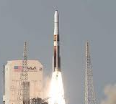
GOES-R POSST Timeline
GOES-R Series Pre-launch POSST Activities
POSST Task in Coordination with
Post-Launch Test (PLT) Planning/ Preparation & System-Level Test Planning/Implementation
Cal&INR PLT Short Form Definition & Development
Cal&INR PLT Long Form Definition & Development
ETE I-V Testing
DOT I-II
Data Operations Tests (DOT) Planning & Ground Segment Training
MOST Activity
Pre-Launch Instrument Cal Testing Assessment (Ends After All Instruments Delivered)
DOST Activity
Cal/INR/Product Science (CIPS) Val Tool Development
CIPS Val Tool Testing
MOST, DOST & Main User Activities
CIPS Val Definitions & CIPS CONOPS/OPSCON Development
*Post-Launch Product Test (PLPT) Definition and Development &
CIPS OPSCON Rehearsals
CIPS OPSCON Rehearsals
120 Days
90 Days
60 Days
12 months
6 Months
DOST & Main User Activities
Sep13
Apr14
Apr15
Oct15
POSST Kick-Off
Mission Operations Review (MOR) and System Integration Review (SIR)
Flight Operations Review (FOR)
Launch
Internal
POSST Activity Only
GOES-R Series Post-launch POSST Activities
Launch & Orbit Raising
[<=5yrs Storage & >=8.4 Yrs Ops]
Post-launch Testing (PLT) [6 Months]
Operations
Activation & Characterization Test
System Performance Operational Test (SPOT)
Post-PLT Product Val
Post-GSAR Product Val
Pre-Launch Instrument Cal Testing Assessment (Ends After All Instruments Delivered)
Initial Checkout
Cal/INR Val & Analyisis
*PLPT
PLPT Val Analysis
14 Days
40 Days
14 Days
Dec15
84 Days
42 Days
6 Months
Oct16
18 Months
Oct15
Mar15
Apr16
Contingency Operations Readiness Review (CORR)
Beginning of PLPT
Operational Acceptance Review (OAR) – Handover S/C to OSPO
Ground Segment Acceptance Review (GSAR) – Handover GS Operations to OSPO
* NOAA Science Tests

Slide 15
Foundations of GOES-R Validated Products
The primary function of GOES-R product validation is to provide data and information to GOES-R Stakeholders regarding product performance relative to validation standards – e.g., in-situ data, other satellite measurements, etc.
GOES-R validation does not judge product fitness-for-purpose, whether it be for operations or research. Such judgment is reserved to the Stakeholders.
GOES-R product validation efforts do not drive the algorithm change process, although it could provide important information needed for that process. So graduation through validation stages is not necessarily precluded by algorithm changes.
For each GOES-R Product and for each product validation stage:
  Document the scope of testing (type of measurement, geographical extent, temporal extent, etc.), analyses, and reporting to be completed.
  Document product anomalies found during the validation process, and any resolution recommendations.
  Clearly state the overall maturity level of validation, and its usefulness to a Stakeholder in judging product fitness-for-purpose.
Ultimately need to associate validation stages with GOES-R transition and handover events.

Slide 16
GOES-R Product Validation Maturity Stages
GOES-R Product (L1b and L2+) Validation Maturity Stages (Nominal Mission)
Beta Activities Early release of product. (e.g., At-launch version of the product algorithm and its input parameter is initially used to generate the product) Initial calibration applied. (L1b) Rapid changes in product input tables can be expected. Some changes to product algorithms may be needed. Product quick looks and initial comparisons with ground truth data are performed. Anomalies may be found in the product, but thorough analysis may not be performed. Products are made available to users to gain familiarity with data formats and parameters. End state Product is minimally validated, and may still contain significant identified and unidentified errors. Information/data from validation efforts can be used to make qualitative, but not quantitative, assessments regarding product fitness-for-purpose. Clear documentation of product performance exists that includes known product anomalies.
Provisional Activities Validation and quality assurance (QA) activities are ongoing by the Government, and the general research community is now encouraged to participate. High severity algorithm anomalies are identified and analyzed, and lesser severity anomalies have been identified. Users are engaged and user feedback is assessed. End state Product performance (L1b or L2+) is demonstrated through analysis of a small number of independent measurements obtained from selected locations, periods, and associated ground-truth/field program efforts. Product analysis are sufficient for qualitative, and limited quantitative, determination of product fitness-for-purpose. Clear documentation of product performance exists that includes known product anomalies and recommended remediation strategies for high severity anomalies and weaknesses. Testing has been fully documented.
Comprehensive Activities Validation, QA, and anomaly resolution activities are ongoing by the Government and the general research community. Algorithm anomalies of all severities are identified and analyzed. Users are engaged and user feedback is assessed. End state Product performance for all products is defined and documented over a wide range of representative conditions via numerous and ongoing ground-truth and validation efforts. Clear documentation of product performance exists that includes all known product anomalies and their recommended remediation strategies, regardless of severity level. Product analyses are sufficient for full qualitative and quantitative determination of product fitness-for-purpose. Testing has been fully documented.

Slide 17
GOES-R Post-Launch Product Validation Stages (Nominal Timeline)
Launch & Orbit Raising
Post-launch Testing (PLT) - 180 Days
Operations
<=5yrs Storage + >=8.4 Yrs Ops
Activation & Characterization Test (ACT)
Initial Checkout
System Performance Operational Test (SPOT)
Post-Handover Product Validation
Cal/INR Checkout
*Post-Launch Product Testing (PLPT)
14 Days
40 Days
14 Days
84 Days
42 Days
1 Year
1 Year
Contingency Operations Readiness Review (CORR)
Operational Acceptance Review (OAR) – Handover to OSPO
ABI (L1b)
ABI (KPP)
ABI (Other L2+)@
GLM (L2+)
SpWx (L1b)@
Unvalidated Product
Beta
Provisional
Comprehensive
@ Maturity level may vary for each product, as product availability is driven by maturity of
algorithm implementation, as well as the existence of science phenomena and associated ground-truth data.
* NOAA Science Test
Beginning of each color represents when product enters a given validation stage.
Notes:
Last updated: 9/9/2013

Slide 18
Outline
GOES-R Program Cal/Val:
  Scope
  Partners
  Product Operations Science Support Team (POSST) synopsis
  Timeline
  Product validation maturity stages
POSST Planning for GOES-R Cal/Val:
  Post-Launch Support Readiness Preparations
    System Integration Review (SIR) and Mission Operations Review (MOR) support
    GOES-R System-level Cal and Product Measurement Val CONOPS/ OPSCON finalization
    Cal/INR/Product Science (CIPS) Monitoring and Analysis Software Tool (MAST) planning, development, implementation, and testing
    Defining CIPS-related external data operations validation objectives (EDOVOs)
    Creating a CIPS post-launch test (PLT) suite
    Ground Segment training coordination
    PLT validation field campaign planning and coordination

Slide 19
POSST Preparation for MOR and SIR
BACKGROUND
GOES-R Program continuity depends on successful completion of milestone reviews, such as the MOR and SIR
Information from these reviews becomes a health status report about the GOES-R Program to NESDIS and NOAA Administrators, Congress, and the American Public.
REVIEW PANEL
CURRENT GOALS and ACTIVITIES
Create a coherent story about POSST cal/val roles and responsibilities, resources, and management and technical plans
Bi-weekly POSST meetings between now and SIR are planned to make sure the reality of the POSST is reflected in the review briefings
Completion Date - MOR (Apr ’14), SIR (May ‘14)
STATUS
MOR agenda is nearing completion
MOR success criteria have been flowed to POSST roles and responsibilities and activities

Slide 20
GOES-R System-level Cal and Product Measurement Val CONOPS/OPSCON
BACKGROUND
Cal/Val Concept of Operations (CONOPS) describes the data; organizational infrastructure and interfaces; software tools; and other resources available to POSST members to perform GOES-R system-level cal and product measurement val
Cal/Val Operational Concept (OPSCON) outlines the manner in which POSST members do business in relation to the CONOPS in the process of carrying out their cal/val duties
DRAFT
CURRENT GOALS and ACTIVITIES
Complete revision of document
Submit document to GOES-R Program configuration management (CM) process
Revise document per CM feedback
POSST CONOPS/OPSCON “rehearsals”
Completion Date - MOR
STATUS
The document is nearly ready for submission to GOES-R Program configuration management

Slide 21
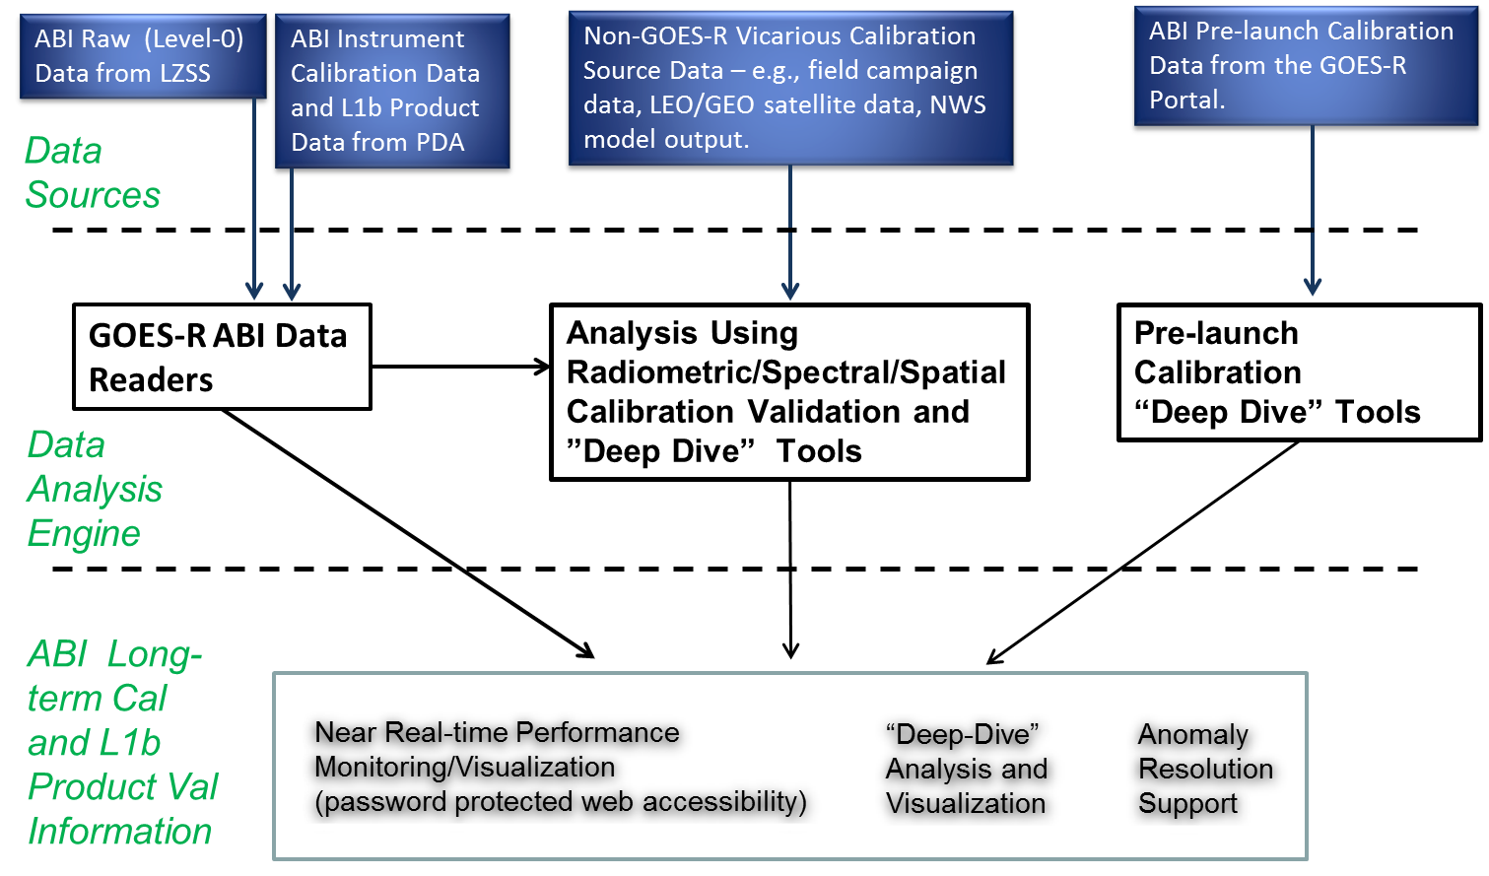
CIPS MAST planning, development, implementation, and testing
BACKGROUND
GOES-R Cal/INR/Product Science (CIPS) Monitoring and Analysis Software Tool (MAST) capabilities include:
  General tools to input, merge and visualize GOES-R data
  Tools to monitor on-orbit calibration and product performance
  Cal/Val deep-dive analysis tools
Functional CIPS MAST modules are key to successful post-launch cal/val efforts
CIPS MAST L1b Example
STATUS
About nine-months behind previously projected maturity
A MAST Manager (Dave Pogorzala) has been brought aboard to the POSST
CURRENT GOALS and ACTIVITIES
The CIPS MAST planning effort will require a great deal of coordination and cooperation from all POSST entities to design, plan, implement, and test the software tools.
Completion Date – GOES-R PLT SPOT

Slide 22
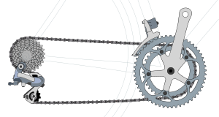
Defining CIPS-related EDOVOs
BACKGROUND
External Data Operations Validation Objectives (EDOVOs) need to be created by the POSST to make sure that Data Operations Support Team (DOST) Ground Segment Data Operations Tests (DOTs) enable testing of
  The infrastructure of POSST organizations that will accommodate GOES-R data needed to support cal/val
  Analysis tools that need to be ready to work with that data when it starts to flow
  Cal/val-related program communications and processes that need to be in place during PLT
EDOVOs created by POSST members working at agencies outside of GS
External DOTs performed by POSST members working at agencies outside of GS
Ground Segment DOTs performed by the DOST
STATUS
Most EDOVOs have been written for the Calibration Working Group (CWG)
CURRENT GOALS and ACTIVITIES
Algorithm Working Group (AWG) needs to complete their EDOVOs
Completion Date – 1 Feb ‘14

Slide 23
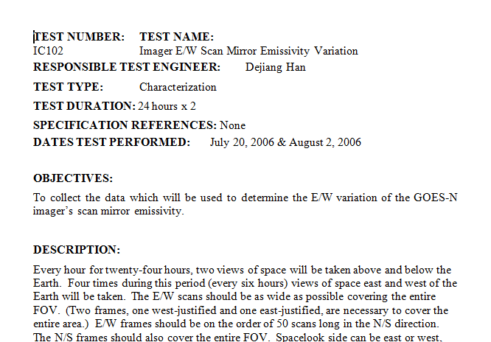
Creating a CIPS Post-Launch Test Suite
BACKGROUND
PLT preparation for the POSST means having first-light-ready test scripts and protocols
STATUS
Cal and INR related Post-Launch Tests have been drafted and are being considered by the Mission Operations Support Team (MOST)
CURRENT GOALS and ACTIVITIES
Ensure Cal and INR PLT are captured by MOST and short forms are written properly. (Note - Product validation Post-Launch Performance Tests have not been identified. Although, similar in structure to Heritage GOES “NOAA Science Tests”, GOES-R with its expanded instrument capabilities and product sets will require much more planning as we move towards launch.)
Completion Date – MOR

Slide 24
GS Training for Cal/Val Personnel
BACKGROUND
Training courses will be given by Harris for those that may be working with the Ground Segment, or interacting with Ground Segment assets such as the Development Environment.
POSST member attendance to these courses will be coordinated by the POM with the GOES-R Training Lead.
STATUS
The first round of feedback has been given to the GOES-R training lead regarding what types of courses that may be needed by POSST members.
CURRENT GOALS and ACTIVITIES
Flight project will add further feedback.
Completion Date – 17 Jan ‘14

Slide 25
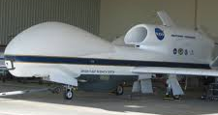
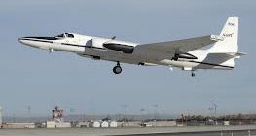
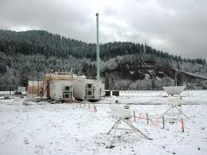
Planning PLT Validation Field Campaign Efforts
BACKGROUND
Field campaigns are essential to GOES-R product validation efforts
Field campaigns are also very expensive, so utilizing them for multi-purpose validation objectives is important
STATUS
Some pre-launch GOES-R cal/val field campaign activity has been occurring. (See Steve Goodmans talk)
CURRENT GOALS and ACTIVITIES
Validation maturity stages for each product need to be matrixed to field campaign efforts
Links between GOES-R and JPSS field campaign efforts need to be clearly identified

Slide 26
Summary
The GOES-R POSST has been created to coordinate and manage all GOES-R system-level cal/val efforts.
The GOES-R POSST has a comprehensive cal/val program to ensure product integrity
  Cal/Val Strategy
  Cal/Val Plans
  Cal/Val CONOPS&OPSCON
The GOES-R POSST is leveraging diverse complementary technical capabilities and resources
The GOES-R POSST provides life cycle cal/val support for a successful GOES-R program

Slide 27
Back-up Slides

Slide 28
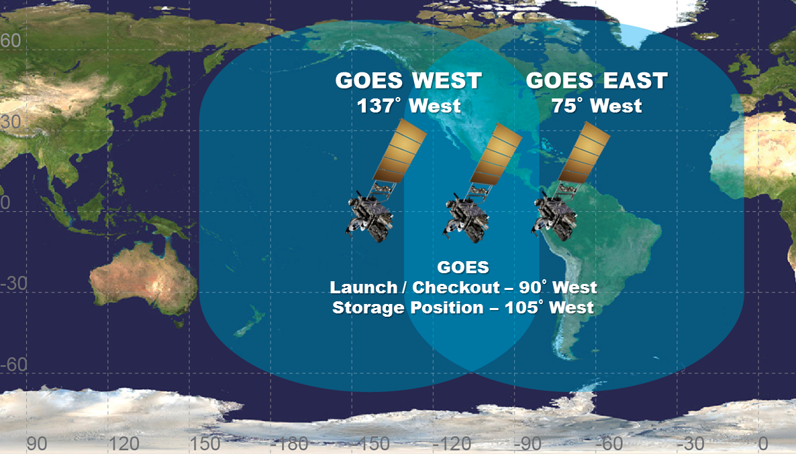
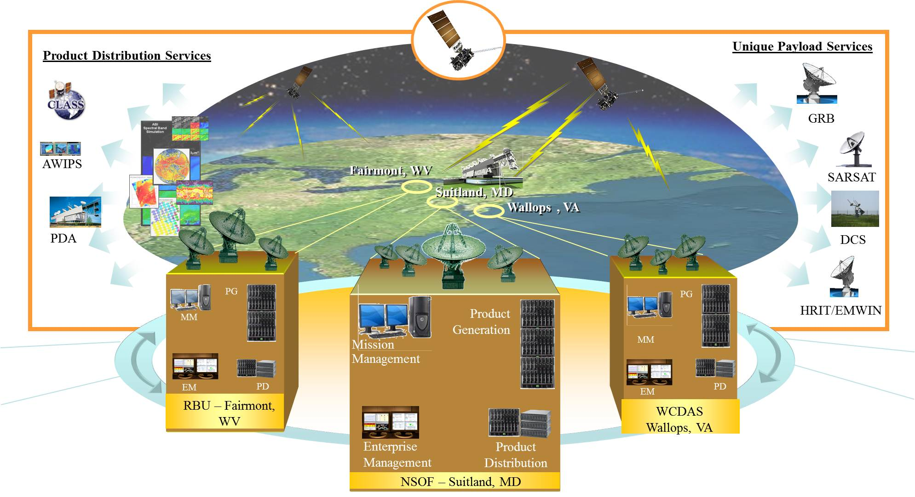
GOES Fleet and GOES-R Architecture

Slide 29

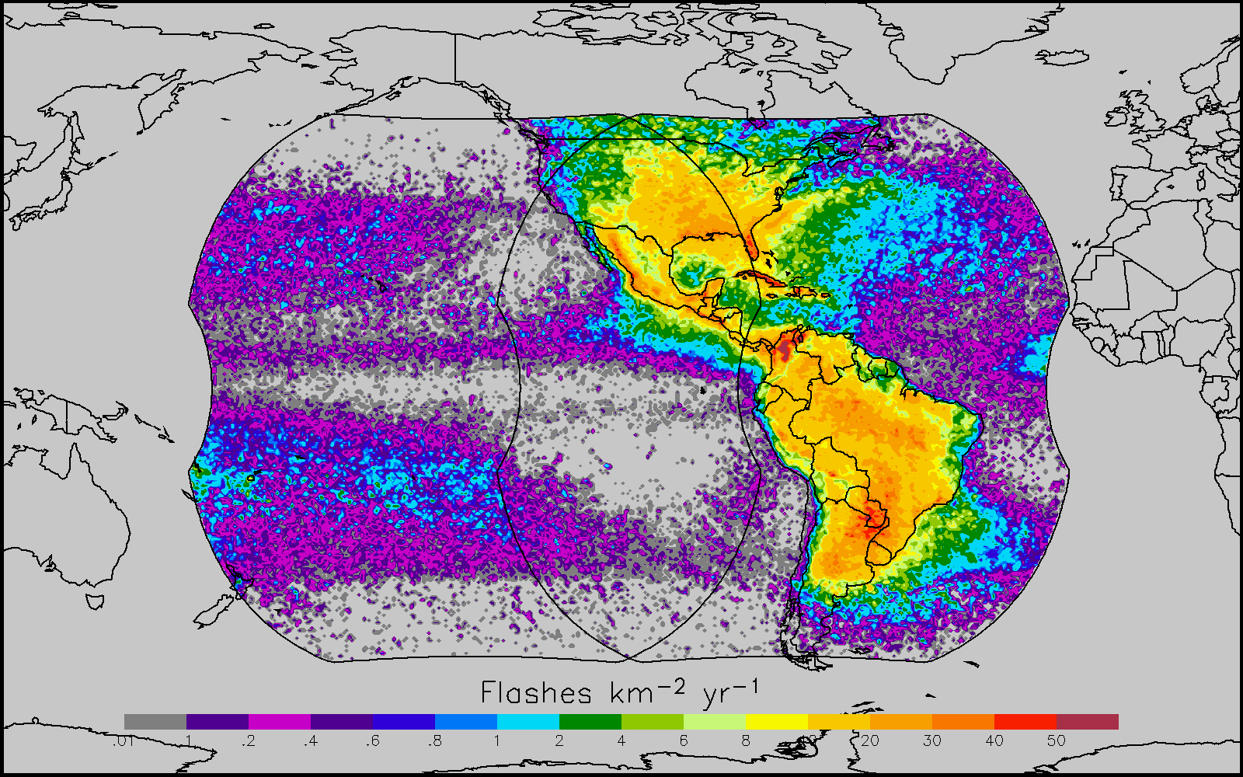
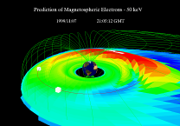

Instrument Overview
GOES-R supports NOAA mission to provide forecasts and warnings for the United States, its territories, and adjacent waters for the protection of life and property and the enhancement of the national economy.
GOES-R is the next generation of GOES satellites that will provide a major improvement in quality, quantity, and timeliness of data collected.
Earth Pointing
In-Situ
Sun Pointing
Spare
Visual & IR Imagery
Lightning Mapping
Space Weather Monitoring
Solar Imaging
Advanced Baseline Imager (ABI)
Geostationary Lightning Mapper (GLM)
Space Environment in-Situ Sensor Suite (SEISS)
Magnetometer
Solar Ultra-Violet Imager (SUVI)
Extreme UV/X-Ray Irradiance Sensors (EXIS)
New and improved capabilities for:
  increased lead times for severe weather warnings
  better storm tracking capabilities
  solar, space weather, and climate analyses
  advanced products for aviation, transportation, commerce

Slide 30
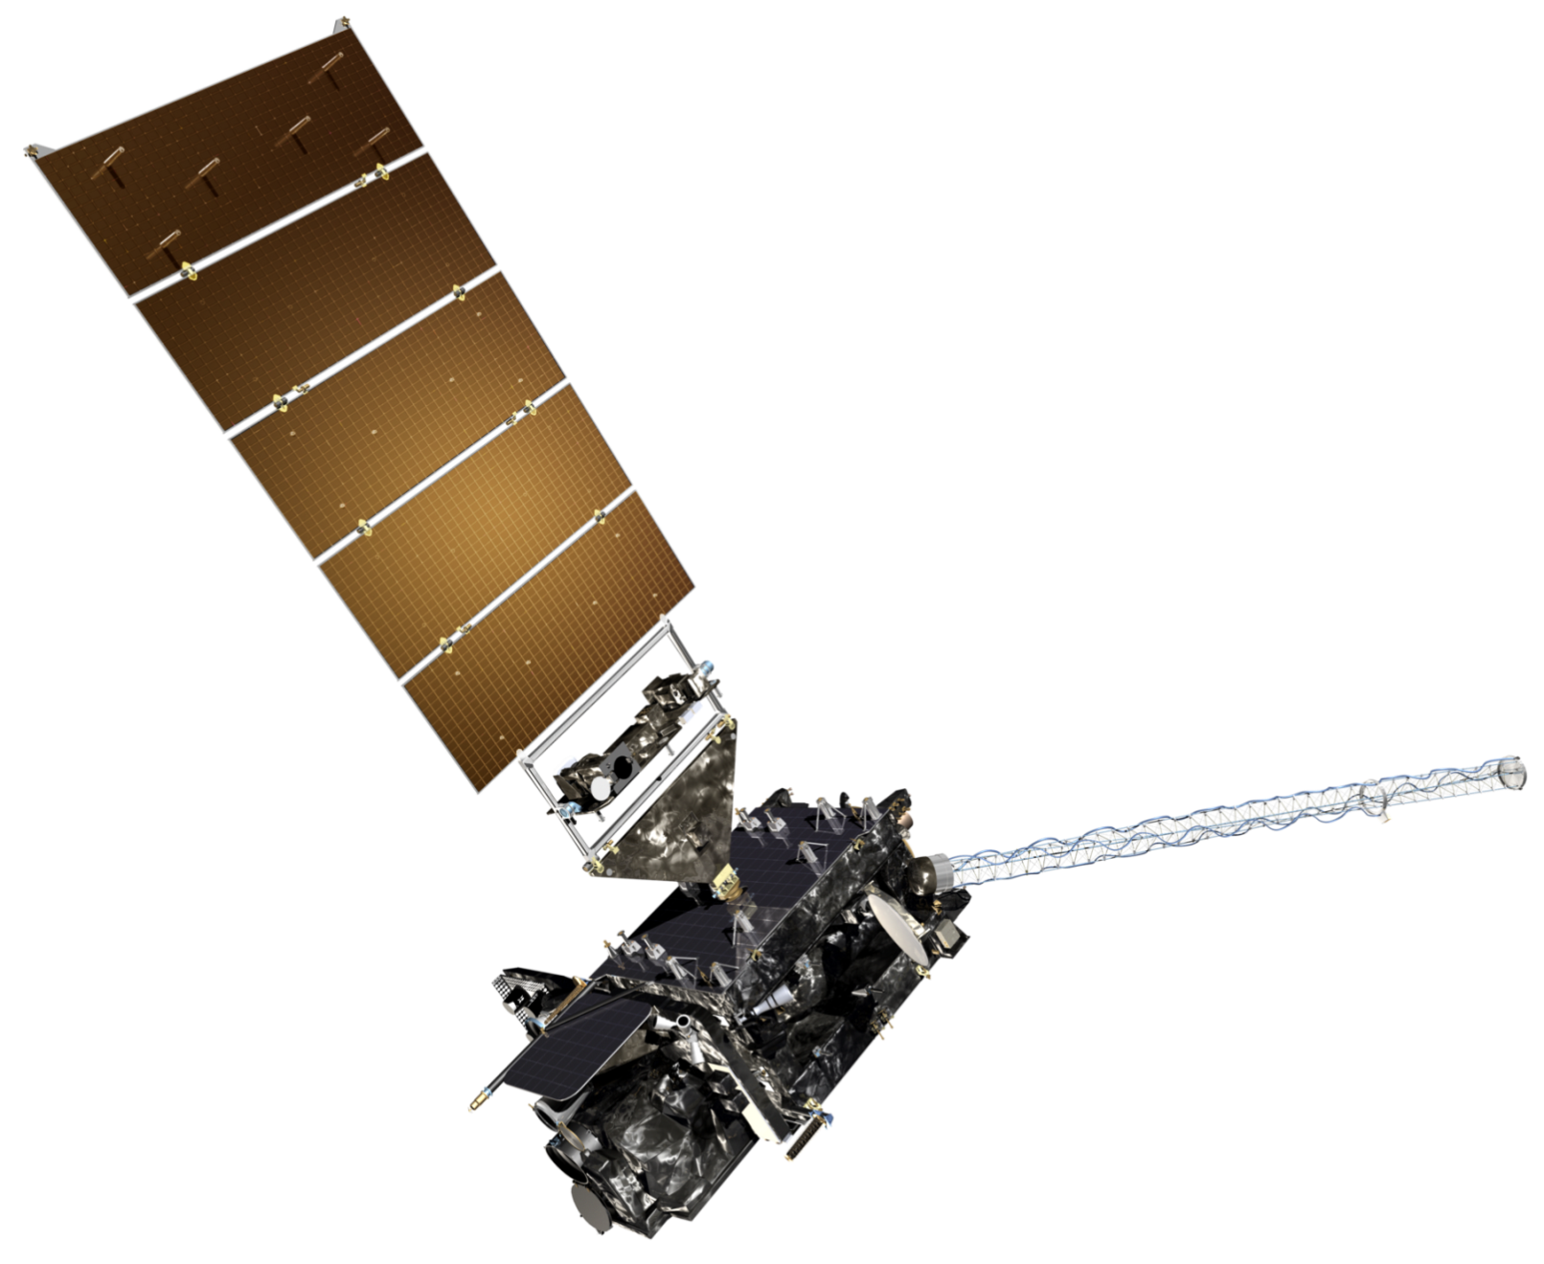
GOES-R Satellite
Solar Array
Solar Ultraviolet Imager (SUVI)
Magnetometer
Extreme Ultraviolet and X-Ray Irradiance Sensor (EXIS)
Space Environment In-Situ Suite (SEISS)
Geostationary Lightning Mapper (GLM)
Advanced Baseline Imager (ABI)

Slide 31
GOES-R Data and Product Overview
GOES-R Products
GOES-R Raw Data Throughput
Radiances* | Cloud and Moisture Imagery (KPP)
Solar Imagery: X-ray* | Rainfall Rate / QPE
Energetic Heavy Ions* | Legacy Vertical Moisture Profile
Magnetospheric Electrons and Protons: Low Energy* | Legacy Vertical Temperature Profile
Magnetospheric Electrons and Protons: Medium and High Energy* | Derived Stability Indices
Solar and Galactic Protons* | Total Precipitable Water
Geomagnetic Field* | Clear Sky Masks
Solar Flux: EUV* | Downward Shortwave Rad.: Surface
Solar Flux: X-Ray* | Fire / Hot Spot Characterization
Lightning Det: Events, Groups, Flashes* | Land Surface (Skin) Temperature
Aerosol Detection (including Smoke & Dust) | Sea Surface Temperature (skin)
Aerosol Optical Depth | Reflected Shortwave Rad.: TOA
Volcanic Ash: Detection & Height | Snow Cover
Cloud Optical Depth | Derived Motion Winds
Cloud Particle Size Distribution | Hurricane Intensity
Cloud Top Phase | Cloud Top Pressure
Cloud Top Height | Cloud Top Temperature
ABI | GLM
SEISS | EXIS
SUVI | Magnetometer
 | * Included in GRB
Fill Packets
L1b
Space Wx
Mbps
GLM
ABI
ABI provides 3x spectral, 4x coverage, and 5x temporal resolution of current imager
GOES-R product requirements drive instrument performance requirements, which often are the same as, or more strict than, heritage GOES.
L2+ Products are remainder outside of oval

Slide 32
Importance of Calibration & Validation
Calibration: The process to determine factors for converting and correcting raw detector measurements into science data units (e.g., radiance) with the specified level of accuracy.
[GOES-R calibration requirements are in MRD Section 3.4.8]
  Calibration is applied to GOES-R raw instrument data to transform them into L1b measurements … the fundamental building blocks for all L2+ products.
Validation: The process of determining that the deliverable item satisfies its intended use in its intended environment.
[GOES-R validation requirements are in MRD Section 3.2.2]
  Validation provides user confidence that GOES-R data can be used for their intended purpose, e.g., weather forecasting or numerical weather prediction.

Slide 33
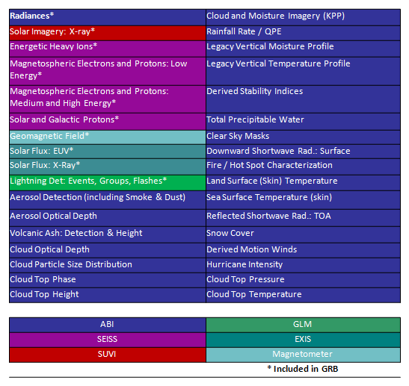
Product Validation Stage @ CORR
L1b Products inside oval
3
3
4
10
10
4
10
4
4
Product Validation State*
10
10
4
10
4
UNVALIDATED
BETA
PROVISIONAL
COMPREHENSIVE
10
4
10
4
3
4
Lightning Det: Events, Groups, Flashes*
L2+ Products are remainder outside of oval
4
4
4
4
N/A
10
4
4
4
N/A
4
4
4
4
GLM
*Numbers in chart indicate the projected number of months to end of that validation state.
33

Slide 34
Product Validation Stage @ PLPT Start
L1b Products inside oval
1
1
1
7
7
1
7
1
1
Product Validation State*
7
7
1
7
1
UNVALIDATED
BETA
PROVISIONAL
COMPREHENSIVE
7
1
7
1
7
1
Lightning Det: Events, Groups, Flashes*
L2+ Products are remainder outside of oval
1
1
1
1
N/A
7
1
1
1
N/A
1
1
1
1
GLM
*Numbers in chart indicate the projected number of months to end of that validation state.
34

Slide 35
Product Validation Stage @ OAR
L1b Products inside oval
TBD
TBD
12
6
12
12
6
12
12
Product Validation State*
6
6
12
6
12
UNVALIDATED
BETA
PROVISIONAL
COMPREHENSIVE
6
12
6
12
6
12
Lightning Det: Events, Groups, Flashes*
L2+ Products are remainder outside of oval
12
12
12
12
N/A
6
12
12
12
N/A
12
12
12
12
GLM
*Numbers in chart indicate the projected number of months to end of that validation state.
35

Slide 36
Product Validation Stage @ GSAR
L1b Products inside oval
TBD
TBD
6
12
6
6
12
6
6
Product Validation State*
12
12
6
12
6
UNVALIDATED
BETA
PROVISIONAL
COMPREHENSIVE
12
6
12
6
12
6
Lightning Det: Events, Groups, Flashes*
L2+ Products are remainder outside of oval
6
6
6
6
N/A
12
6
6
6
N/A
6
6
6
6
GLM
*Numbers in chart indicate the projected number of months to end of that validation state.
36

