Slide 1


JPSS Calibration/Validation Activities
Mitch Goldberg National Oceanic & Atmospheric Administration | NOAA
JPSS Program Scientist
Lihang Zhou (JPSS AWG-lead), Fuzhong Weng (SDR-lead), Ivan Csiszar (EDR –lead) +
STAR Algorithm Leads

Slide 2
My Assignment
Discuss JPSS Program calibration/validation activities and identify synergies
What we need to do as an organization

Slide 3
JPSS Science POCs and Leads
Program
Mitch Goldberg – NOAA Program Scientist
Jim Gleason – NASA Project Scientist
Flight Project
Jim Butler – Project Scientist
Ground Segment - SDR
Fuzhong Weng – STAR SDR Lead
Bruce Guenther – DPA SDR Lead
Ground Segment - EDR
Ivan Csiszar – STAR EDR Lead
TBD – DPA EDR Lead
ATMS
Ed Kim – Instrument Scientist
ATMS SDR
Fuzhong Weng – ATMS SDR Lead
EDR Algorithms
Jeff Key – Cryosphere EDRs
Larry Flynn – Ozone EDRs
Ivan Csiszar – Land EDRs
Alexander Ignatov – SST EDRs
Don Hilger – Imagery EDRs
Tony Reale (acting) – Sounding EDRs
Andy Heidinger – Cloud EDRs
Istvan Laszlo – Radiation Budget EDRs
Menghua Wang – Ocean Color EDR
Shobha Kondragunta – Aerosol EDRs
CrIS
Dave Johnson – Instrument Scientist
CrIS SDR
Yong Han – CrIS SDR Lead
OMPS
Glen Jaross – Instrument Scientist
OMPS SDR
Xianqian (Fred) Wu – OMPS SDR Lead
VIIRS
Kurt Thome – Instrument Scientist
VIIRS SDR
Changyong Cao – VIIRS SDR Lead

Slide 4
Program Science
Program Science provides science integrity for the JPSS Program
NOAA JPSS Program Scientist provides the link between the JPSS operational user community and the JPSS Program through
Chairing the Low Earth Orbiting Requirements Working Group for gathering and defining requirements,
Managing the JPSS Proving Ground and Risk Reduction program to foster improved user applications and science feedback.
Provides overarching science oversight for the Program
NASA JPSS Project Scientist ensures instruments meet specification through oversight of prelaunch and post launch commissioning of instrument performance.
NOAA/NESDIS Center for SaTellite Applications and Research (STAR) provide cal/val algorithm support to Ground Segment Product Generation and algorithm maintenance/sustainment
IDPS Products – coordinated by Data Product and Algorithms (DPA)
ESPC Products – coordinated by Office Systems Development (OSD)
STAR also supports 2) and 3)

Slide 5
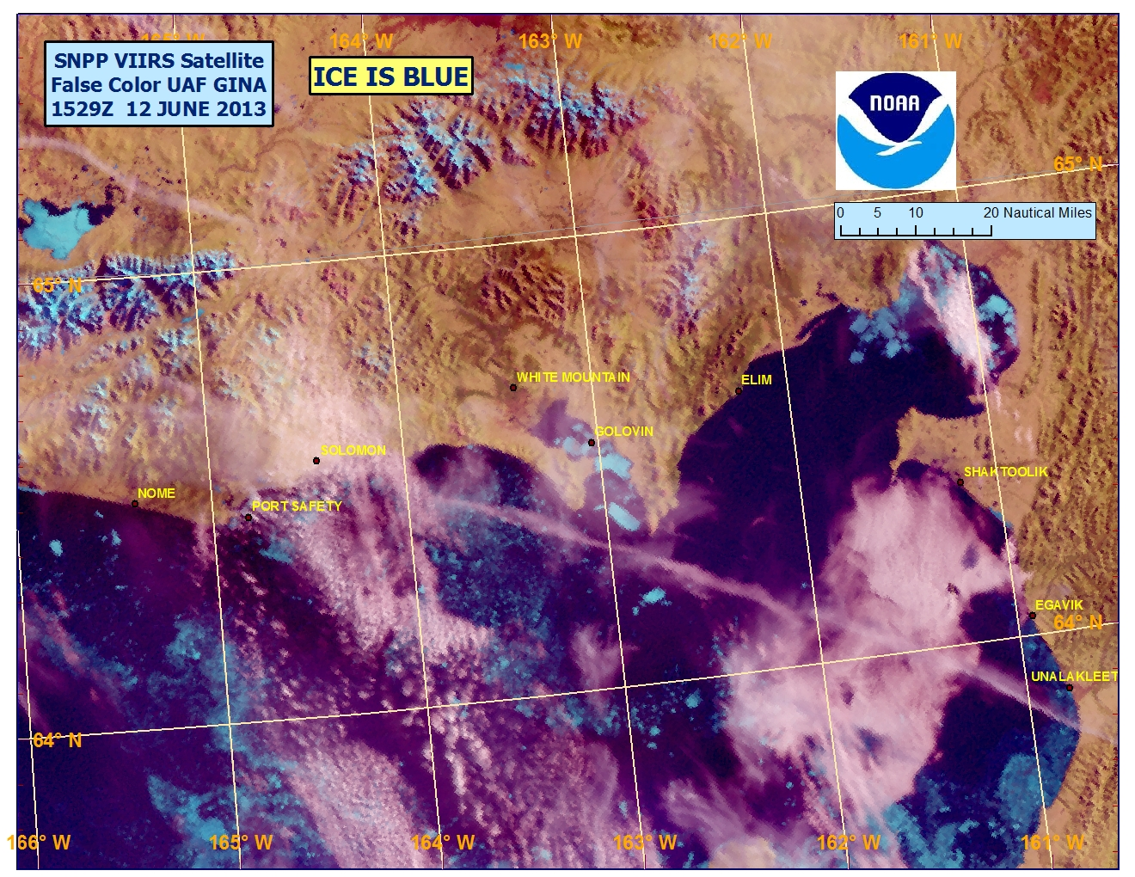
Operational use of SNPP data
May 1, 2012, VIIRS imagery used to support local warning and forecast operations throughout the NWS Alaska Region.
May 22, 2012, the Advanced Technology Microwave Sounder (ATMS) radiances were operationally assimilated in the National Centers for Environmental Prediction’s (NCEP)/ NWS Global Forecast System (GFS).
September 25, 2012, ATMS data was assimilated operationally into the European Centre for Medium-Range Weather Forecasts (ECMWF) weather forecast models.
April 2013, the United Kingdom Meteorology Office began assimilating operational data from the Cross-track Imaging Radiometer Suite (CrIS) and ATMS into its weather forecast models.
August 20, 2013, NCEP began incorporating S-NPP CrIS satellite data operationally into the GFS.
October 31, 2013, NCEP/CPC started to use OMPS Ozone operationally
November, 2013, NRL started to use ATMS operationally in their global forecast model.

Slide 6
Calibration/Validation
Four Phases of Cal/Val:
Pre-Launch; all time prior to launch – Algorithm verification, sensor testing, and validation preparation
Early Orbit Check-out (first 30-90 days) – System Calibration & Characterization
Intensive Cal/Val (ICV); extending to approximately 24 months post-launch – xDR Validation
Long-Term Monitoring (LTM); through life of sensors
For each phase:
Exit Criteria established
Activities summarized
Products mature through phases independently
We Are Here
Joint Polar Satellite System

Slide 7
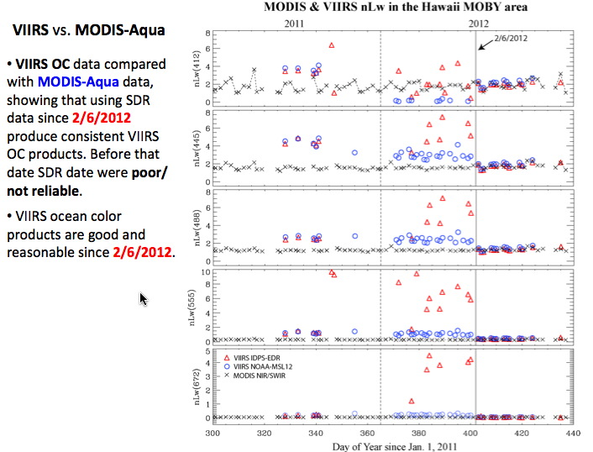
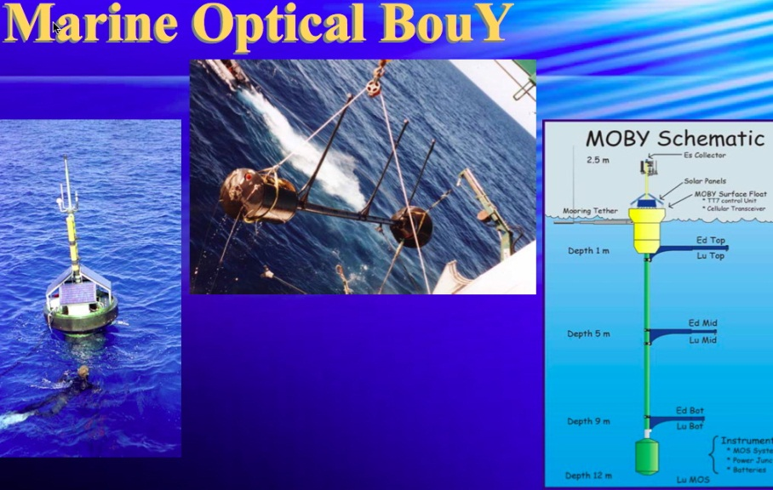
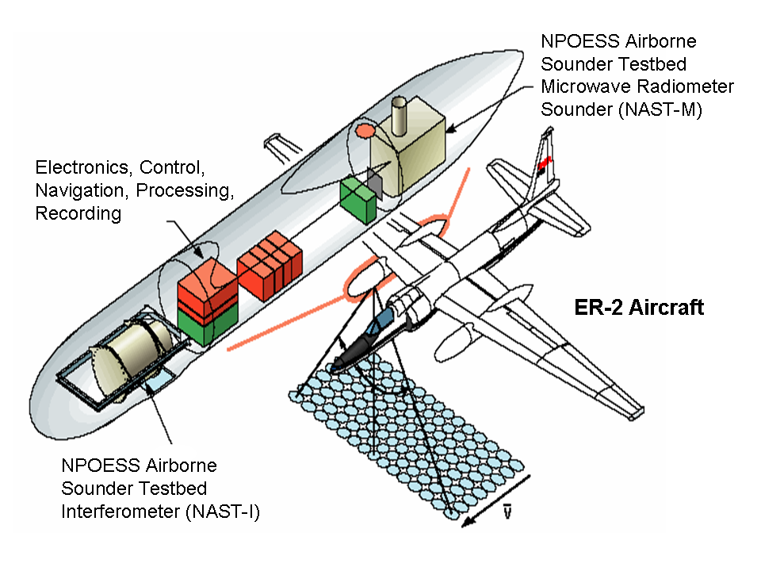
Supporting Cal/Val Sites/Campaigns
Airborne instruments

Slide 8
Criteria for SDR Beta Maturity
Beta
Early Release Product
Initial Calibration is Applied and Minimal Validation
Large errors may exist
Version control may not identify errors
Available to allow users to gain familiarity with data formats and parameters
Data not ready to be used in scientific publications or applications

Slide 9
Criteria for SDR Provisional Maturity
http://ozoneaq.gsfc.nasa.gov/omps
http://ozoneaq.gsfc.nasa.gov/omps
Provisional
Product quality may not be optimal
Incremental product improvements are still occurring as calibration parameters are adjusted
Version control is in affect
General research community is encouraged to participate in the QA
Users are urged to consult the SDR product status documents prior to use of the data in publications
Ready for operational evaluation

Slide 10
Criteria for SDR Validated Maturity
http://ozoneaq.gsfc.nasa.gov/omps
http://ozoneaq.gsfc.nasa.gov/omps
Validated
On-orbit sensor performance characterized and calibration parameters adjusted accordingly
Ready for operational use and scientific studies
There may be later improved versions
There will be strong version control with documentation

Slide 11
SNPP EDR Maturity Definitions (1)
For SNPP, product quality used the following scale
Beta: Early release product that is minimally validated and may contain significant errors. Establishes baseline for product, available to allow users to gain familiarity, but Product is not appropriate as the basis for quantitative scientific publications studies and applications
Provisional: Product quality may not be optimal and Product accuracy is determined for a broader (but still limited) set of conditions. No requirement to demonstrate compliance with specifications. Incremental product improvements are still occurring, but version control is in effect. General research community is encouraged to participate in the QA and validation of the product, but need to be aware that product validation and QA are ongoing. Users are urged to consult the EDR product status document prior to use of the data in publications. Product is ready for operational evaluation.

Slide 12
SNPP EDR Maturity Definitions (2)
Validated Stage 1: Using a limited set of samples, the algorithm output is shown to meet the threshold performance attributes identified in the JPSS Level 1 Requirements Supplement with the exception of the S-NPP Performance Exclusions
Validated Stage 2: Using a moderate set of samples, the algorithm output is shown to meet the threshold performance attributes identified in the JPSS Level 1 Requirements Supplement with the exception of the S-NPP Performance Exclusions
Validated Stage 3: Using a large set of samples representing global conditions over four seasons, the algorithm output is shown to meet the threshold performance attributes identified in the JPSS Level 1 Requirements Supplement with the exception of the S-NPP Performance Exclusions

Slide 13
Overarching Message
The SDR review panel was generally very impressed with the details of the presentations and the dedication of the scientists supporting the SDR validation. The SDR teams are well managed. There is no question that ATMS, CrIS, and VIIRS have met the validation level by clearing demonstrating that specification have been met. OMPS has made significant improvements since the provisional declaration. OMPS still needS more work to get to the complete validated stage. The ICVS has been established as a vital cornerstone of the SDR program.

Slide 14
Review Panel Members
Mitch Goldberg, Chair, JPSS Program Scientist, LORWG Chair
James Gleason, SNPP and JPSS Project Scientist
James Yoe, NWS/NCEP & JCSDA Chief Administrative Officer , LORWG
Mike Johnson, NWS/OST, LORWG
Rick Stumpf, NOS, Center for Coastal Monitoring and Assessment, LORWG
Gary Wick, OAR, LORWG
Jeff Privette, NCDC, LORWG Advisor
David Benner, NESDIS/OSPO Chief of Satellite Services Division, LORWG
Tom Schott, NESDIS/ OSD/ NDE Product Dev. Mgr./LORWG Co-Chair
Eric Gottshall, NESDIS/NJO/ DPA (IDPS) Product Manager
Lihang Zhou, NESDIS/STAR/ JPSS Algorithm Science Manager

Slide 15
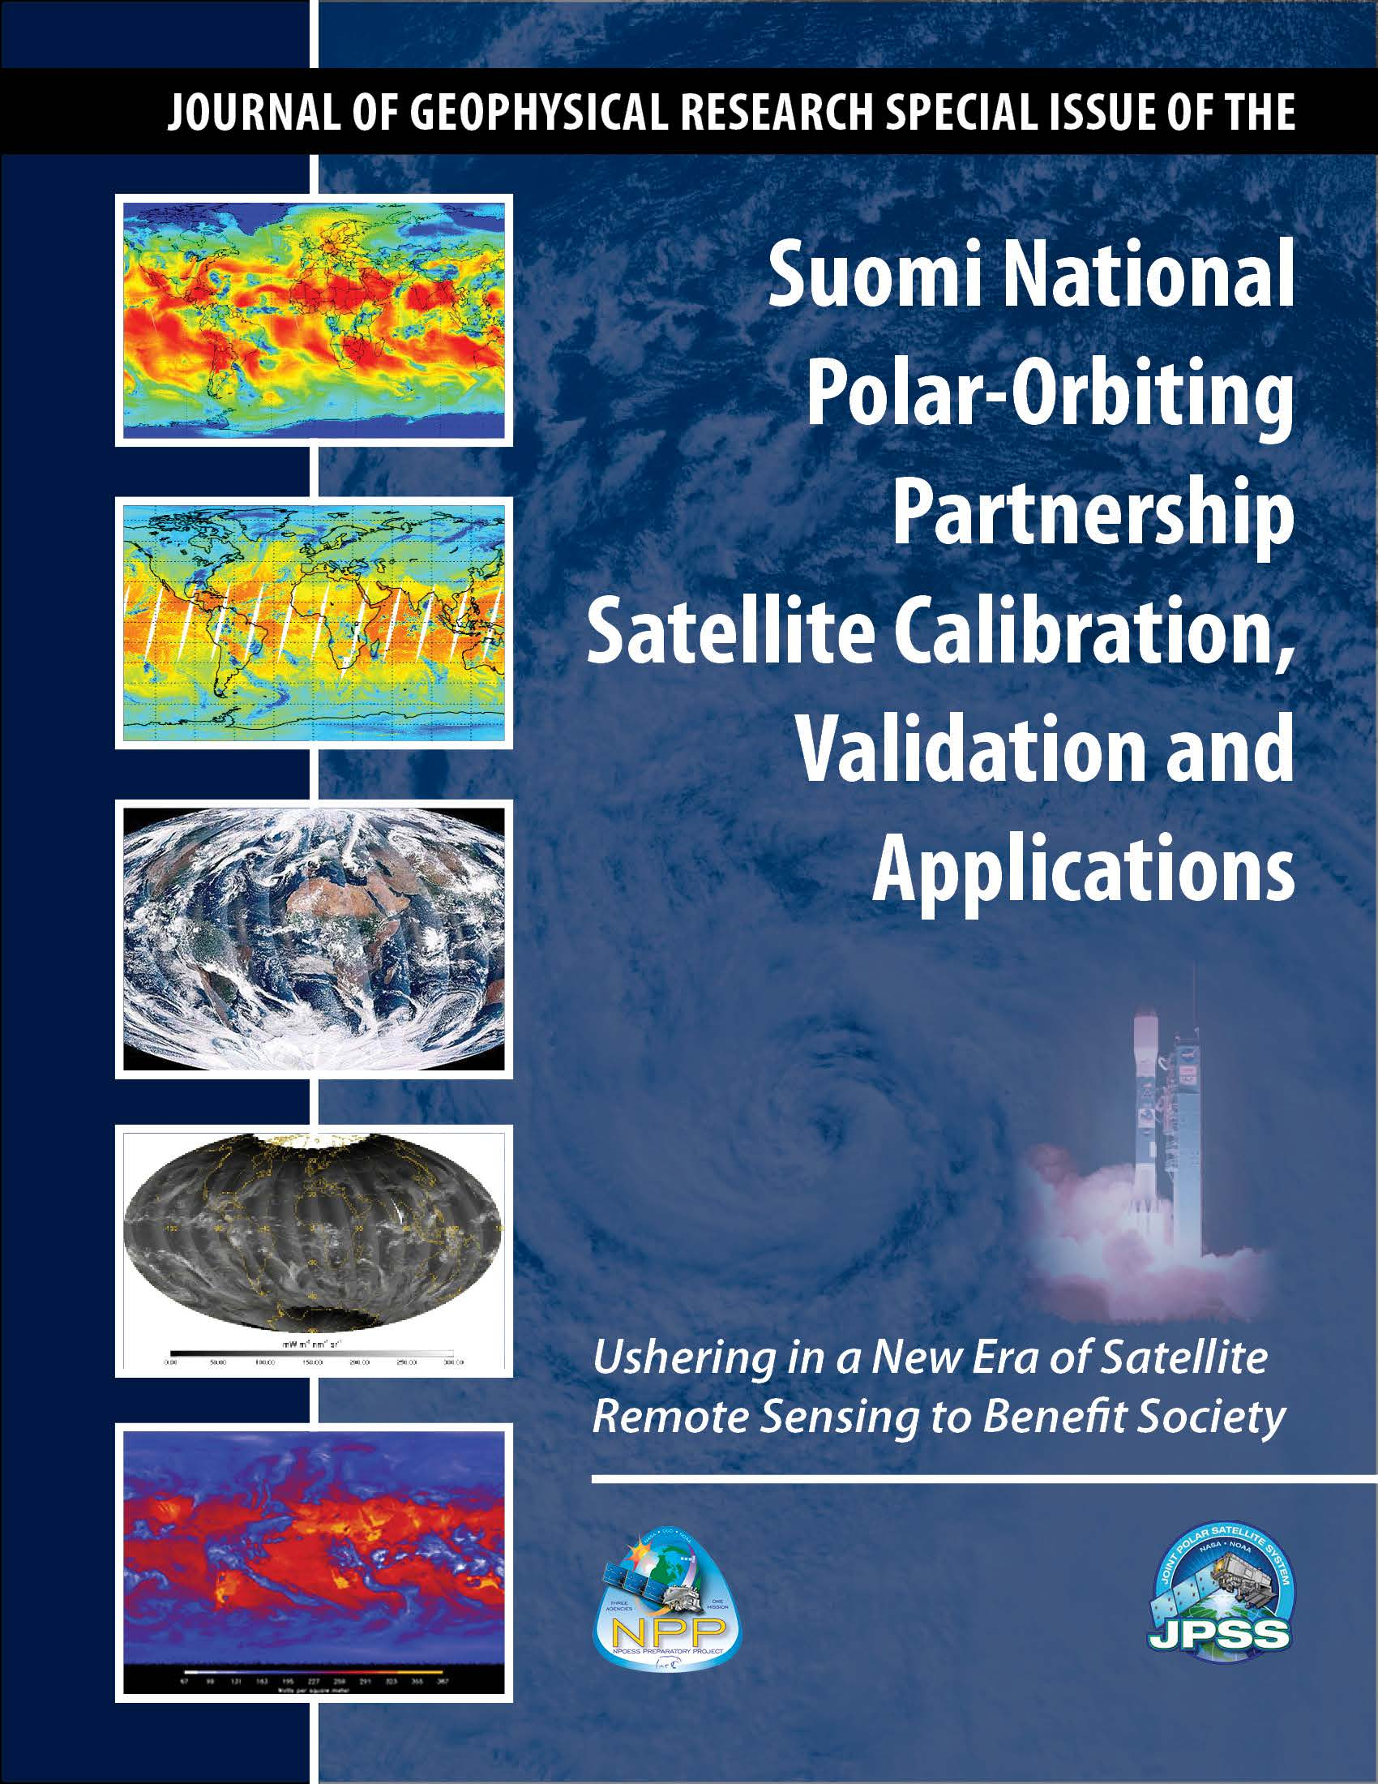
American Geophysical Union (AGU) JGR Special Issue on Suomi NPP CalVal
25 papers have been accepted in AGU Journal Geophysical Research Special Issue on Suomi NPP satellite calibration, validation and applications. 10 papers are still in peer-review process with major or minor revision
Guest Editor: Fuzhong Weng

Slide 16
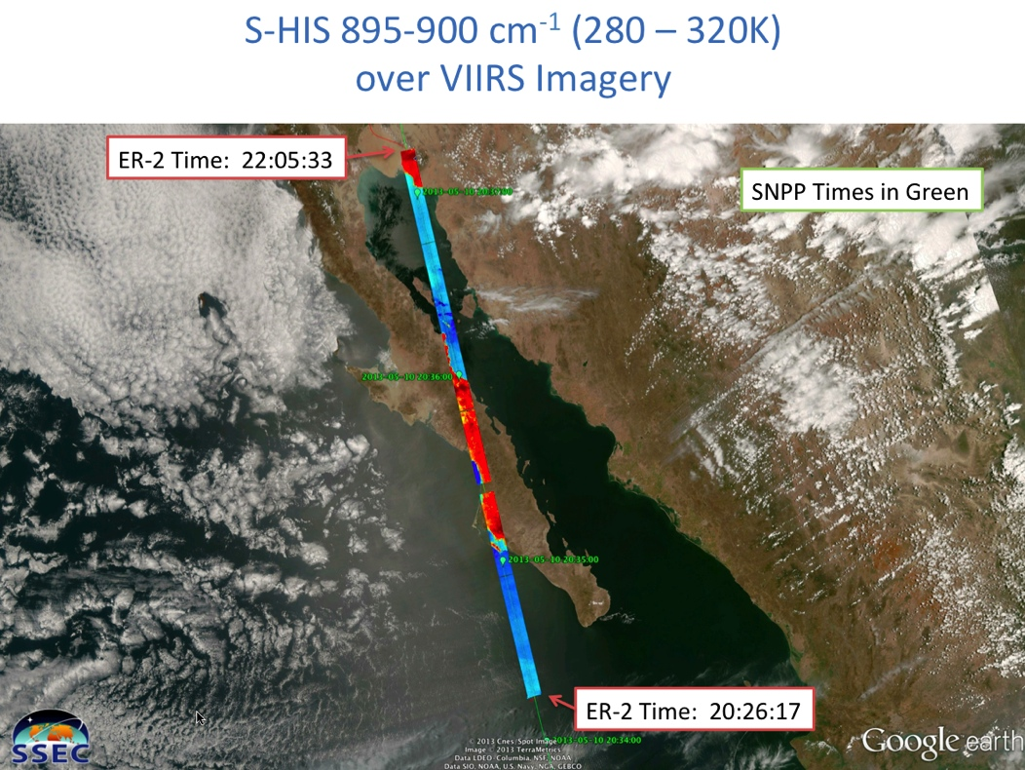
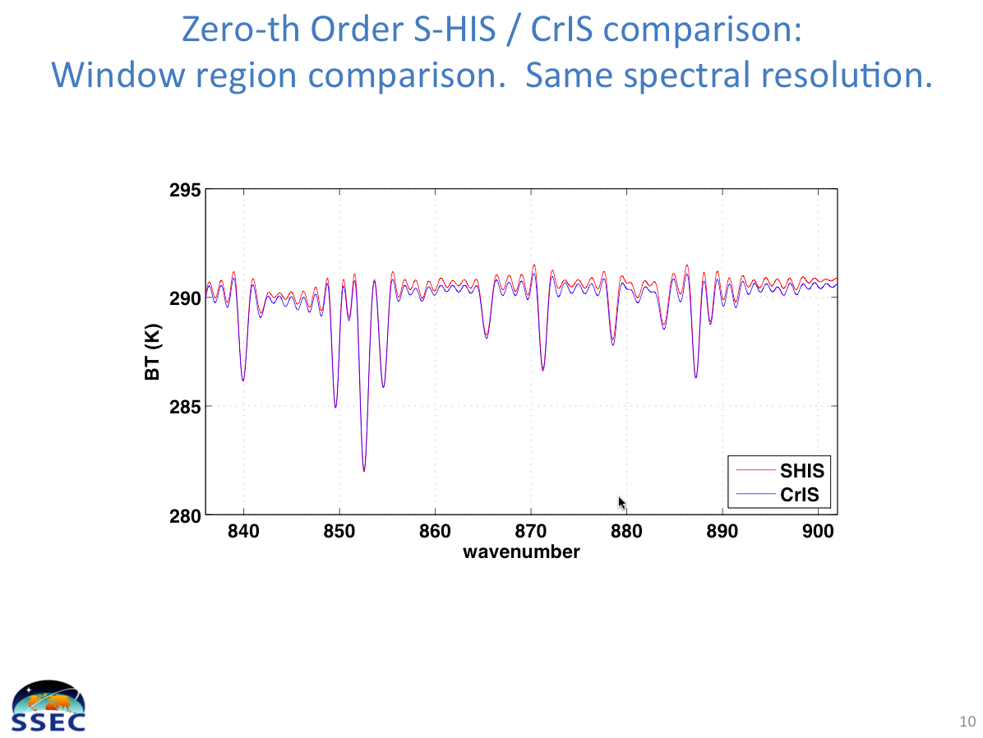
JPSS PGRR Deep-Dive Validation First S-NPP ER-2 Aircraft Campaign to provide validation for CrIS, ATMS and VIIRS NIST traceable absolute calibration for CrIS
May 10, 2013 – first look
ER-2 with aircraft validation sensors under flies Suomi NPP sensors. In the case of CrIS,
the validation sensor in this example is from the Scanning High-resolution Interferometer
Sounder (S-HIS) which has been tied to a NIST traceable calibration source. Quick look
comparisons show excellent agreement. Significance – NIST traceable validation is critical
for uncertainty analysis needed to fully assess data quality of S-NPP and JPSS sensors.

Slide 17
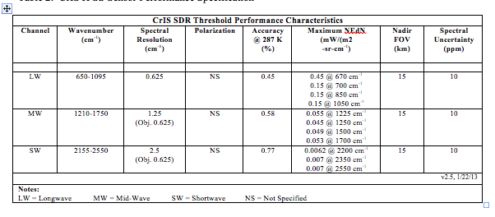
CriS Specifications

Slide 18
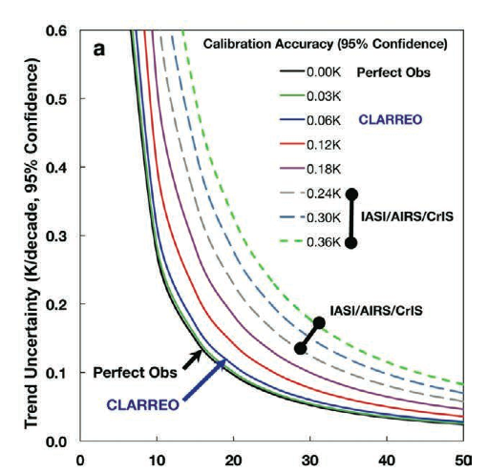
Why do we care about 0.1 C absolute accuracy?

Slide 19
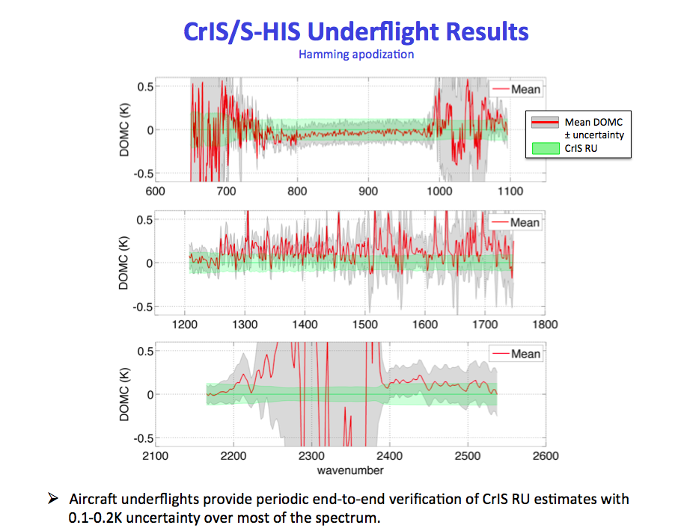

Slide 20
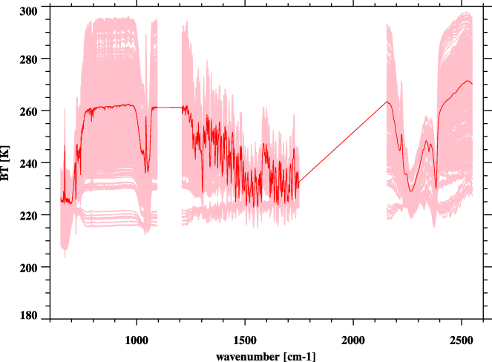
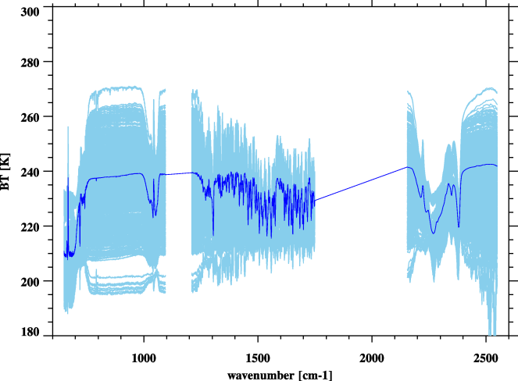
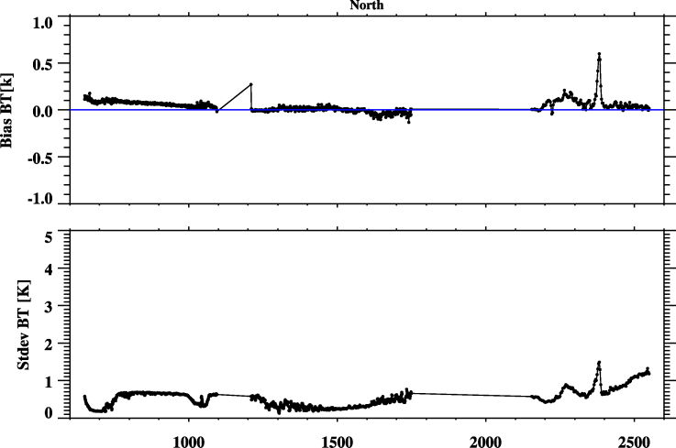
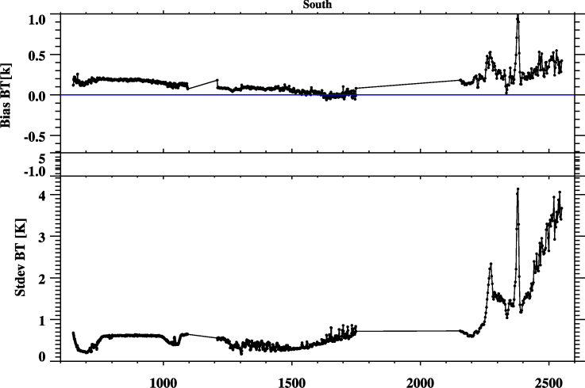
SNO Results between CrIS and IASI/Metop-B from 10 months’ reprocessed CrIS SDR (2013/02-12)
North Pole (774)
South Pole (783)
Bias: CrIS-IASI
Bias: CrIS-IASI
STDEV: CrIS-IASI
STDEV: CrIS-IASI

Slide 21
VIIRS SDR Requirements and Performance (all performance values are stable since provisional)
Band | Driving EDR(s) | Center Wavelength (μm) | Equiv. Width (μm) | Horizontal Sample Interval (km) (track × scan) |  | Band Gain | Ltyp or Ttyp (Spec) | Lmin or Tmin | Lmax or Tmax | Spec SNR or NEdT (K) | On Orbit SNR or NEdT (K) | MODIS equiv. band
 |  |  |  | Nadir | End of Scan
VisNIR
M1 | Ocean Color Aerosol | 0.411 | 0.0198 | 0.75×0.75 | 1.60x1.58 | H | 44.9 | 30 | 135 | 352 | 588 | B8
 |  |  |  |  |  | L | 155 |  | 615 | 316 | 1045
M2 | Ocean Color Aerosol | 0.444 | 0.0143 | 0.75×0.75 | 1.60x1.58 | H | 40 | 26 | 127 | 380 | 572 | B9
 |  |  |  |  |  | L | 146 |  | 687 | 409 | 1010
M3 | Ocean Color Aerosol | 0.486 | 0.0190 | 0.75×0.75 | 1.60x1.58 | H | 32 | 22 | 107 | 416 | 628 | B10
 |  |  |  |  |  | L | 123 |  | 702 | 414 | 988
M4 | Ocean Color Ae­rosol | 0.551 | 0.0209 | 0.75×0.75 | 1.60x1.58 | H | 21 | 12 | 78 | 362 | 534 | B4/B12
 |  |  |  |  |  | L | 90 |  | 667 | 315 | 856
I1 | Imagery EDR | 0.639 | 0.0775 | 0.375x0.375 | 0.80x0.79 | S | 22 | 5 | 718 | 119 | 214 | B1
M5 | Ocean Color Aerosol | 0.672 | 0.02 | 0.75×0.75 | 1.60x1.58 | H | 10 | 9 | 59 | 242 | 336 | B13/B1
 |  |  |  |  |  | L | 68 |  | 651 | 360 | 631
M6 | Atmosph. Correct. | 0.745 | 0.0146 | 0.75×0.75 | 1.60x1.58 | S | 9.6 | 5.3 | 41 | 199 | 368 | B15
I2 | NDVI | 0.862 | 0.0394 | 0.375x0.375 | 0.80x0.79 | S | 25 | 10.3 | 349 | 150 | 264 | B2
M7 | Ocean Color Aerosol | 0.862 | 0.0387 | 0.75×0.75 | 1.60x1.58 | H | 6.4 | 3.4 | 29 | 215 | 457 | B16/B2
 |  |  |  |  |  | L | 33.4 |  | 349 | 340 | 631
DNB | NCC Imagery | 0.700 | 0.200 | 0.75×0.75 | 0.75×0.75 | LG/MG/HG | 3E-9 | 3E-9 | 0.02 | 6 | >9 | -
S/MWIR
M8 | Cloud Particle Size | 1.238 | 0.0271 | 0.75×0.75 | 1.60x1.58 | S | 5.4 | 3.5 | 165 | 74 | 221 | B5
M9 | Cirrus/Cloud Cover | 1.375 | 0.0150 | 0.75×0.75 | 1.60x1.58 | S | 6 | 0.6 | 77.1 | 83 | 227 | B26
I3 | Binary Snow Map | 1.602 | 0.0572 | 0.375x0.375 | 0.80x0.79 | S | 7.3 | 1.2 | 72.5 | 6 | 149 | B6
M10 | Snow Fraction | 1.602 | 0.0587 | 0.75×0.75 | 1.60x1.58 | S | 7.3 | 1.2 | 71.2 | 342 | 586 | B6
M11 | Clouds | 2.257 | 0.0467 | 0.75×0.75 | 1.60x1.58 | S | 0.12 | 0.12 | 31.8 | 10 | 22 | B7
I4 | Imagery Clouds | 3.753 | 0.360 | 0.375x0.375 | 0.80x0.79 | S | 270 | 210 | 353 | 2.5 | 0.4 | B20
M12 | SST | 3.697 | 0.192 | 0.75×0.75 | 1.60x1.58 | S | 270 | 230 | 353 | 0.396 | 0.12 | B20
M13 | SST/Fires | 4.067 | 0.165 | 0.75×0.75 | 1.60x1.58 | H | 300 | 230 | 343 | 0.107 | 0.04 | B23
 |  |  |  |  |  | L | 380 |  | 634 | 0.423
LWIR
M14 | Cloud Top Properties | 8.578 | 0.324 | 0.75×0.75 | 1.60x1.58 | S | 270 | 190 | 336 | 0.091 | 0.06 | B29
M15 | SST | 10.729 | 0.990 | 0.75×0.75 | 1.60x1.58 | S | 300 | 190 | 343 | 0.07 | 0.03 | B31
I5 | Cloud Imagery | 11.469 | 1.75 | 0.375x0.375 | 0.80x0.79 | S | 210 | 190 | 340 | 1.5 | 0.4 | B31
M16 | SST | 11.845 | 0.866 | 0.75×0.75 | 1.60x1.58 | S | 300 | 190 | 340 | 0.072 | 0.03 | B32

Slide 22
VIIRS-SHIS Absolute Uncertainty Sources and Estimates
Spatial Matchup (geolocation) Error
< 0.01 K (ensemble)
Temporal Offset
.07, .05, .06, .05 K for M14, 15, 16, I5, resp.
Actual is expected < 50% of above numbers because above numbers reflect 30-50 minute difference between repeat SHIS coverage. Actual difference of SHIS and VIIRS is 4-16 minutes.
SHIS Radiometric Uncertainty
~0.1 K @ 290 K for all bands
Altitude Temperature Correction
50% of correction:
I4 0.02 K I5 0.03 M12 0.01 M13 0.01 M14 0.18 M15 0.06 M16 0.02
RSS Total Uncertainty Estimate
~0.12 K (I4, I5, M12, M13, M15, M16)
0.21 K (M14)

Slide 23
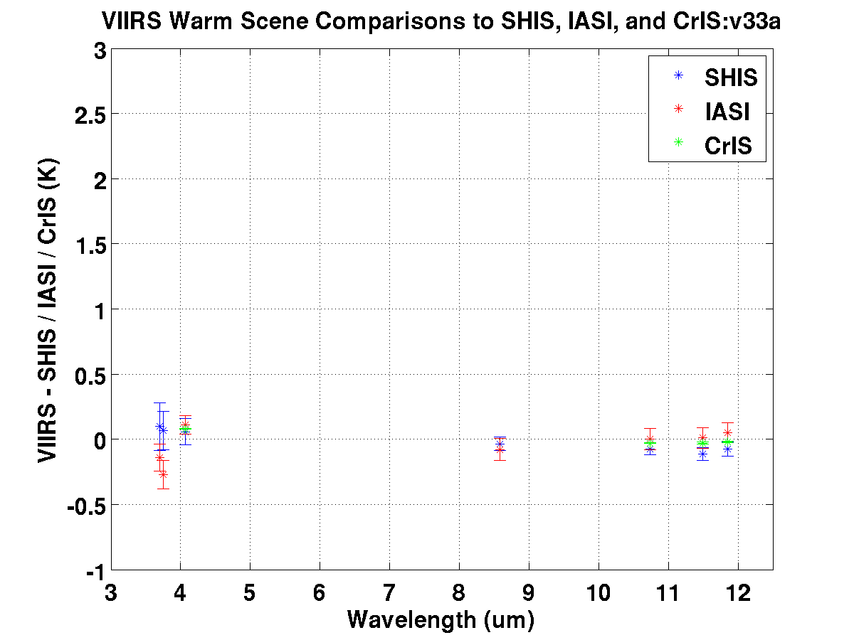
Average over all matchups in each band (w/Stan. Err)
SHIS Nighttime 5/30/2013 Case
IASI 3/2012 – 12/2013 SNOs (275 K)
CrIS 7/1/2013 Mx8.1 Global Day (285 K)
VIIRS SDR absolute uncertainty spec. interpolated to 290 K
Close agreement in VIIRS comparisons to CrIS, IASI, and SHIS
M12
I4
M13
M15
I5
M16
M14

Slide 24
VIIRS Geolocation Conclusions
VIIRS geometric performance is as expected
Geolocation mean errors for I-/M-bands are near 0 and uncertainties are ~ 70 m at nadir, meeting specifications at nadir and edge-of-scan
Caveat: DNB terrain corrected geolocation product is expected in Mx8.3 in March 2014
Encoder and scan time/period are nominal
Orbit and attitude are nominal
Quality flags are well-understood
Limited verification of on-orbit spatial responses and BBR agrees with prelaunch measurements
VIIRS SDR/Geometric performance maturity should be rated as Validated (except for DNB TC geolocation)

Slide 25
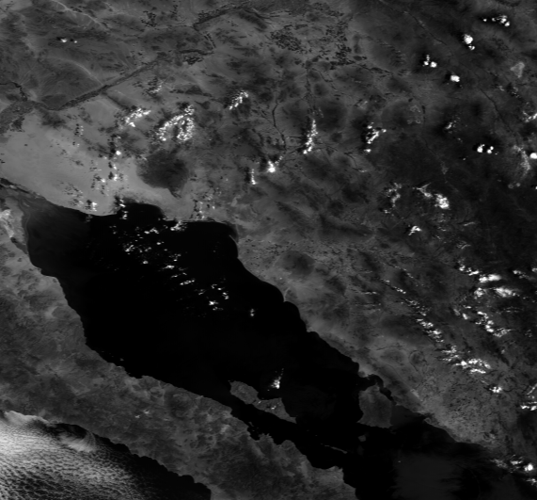
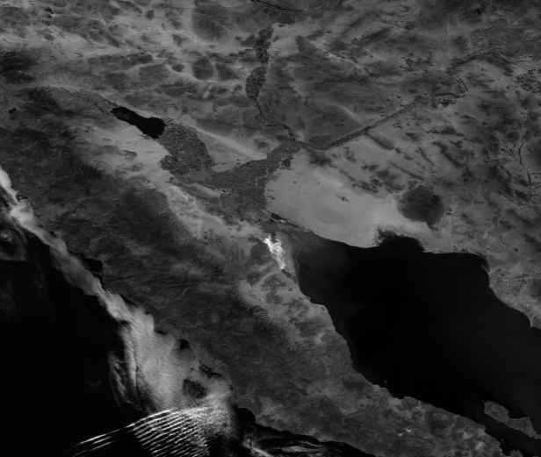
VIIRS as Geolocation Reference Standard Assessing MetOP-B/AVHRR
VIIRS vs. MetOp-A
VIIRS vs. MetOp-B
Metop-A on Sep 26 at 17:25 Metop-B on Oct 3 at 17:31 VIIRS on Oct 3 at 20:42

Slide 26
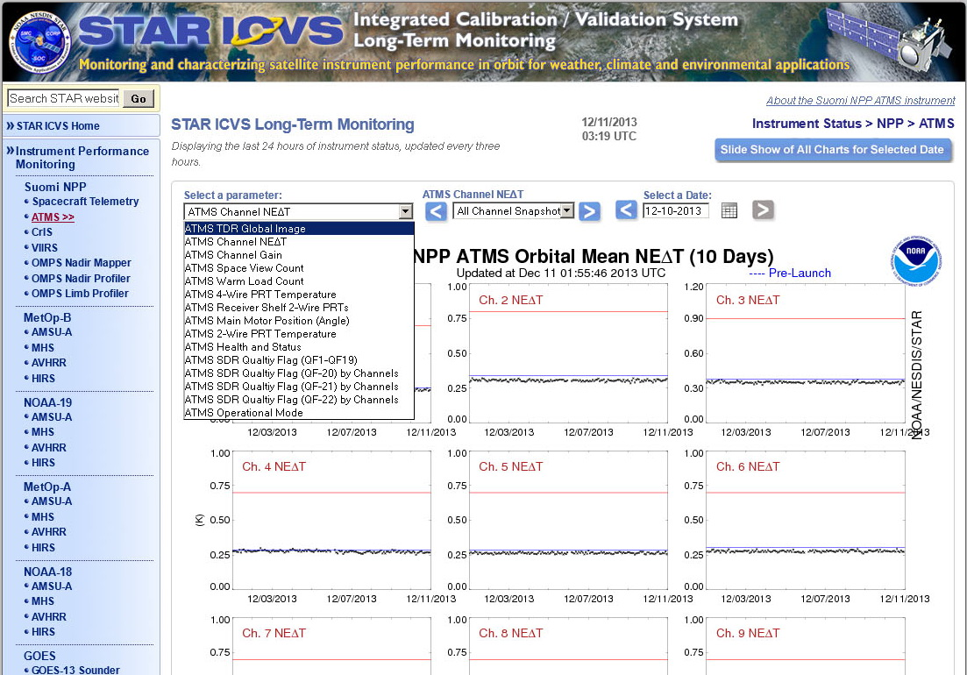
Introduction to ICVS-LTM for ATMS
http://www.star.nesdis.noaa.gov/icvs/status_NPP_ATMS.php

Slide 27
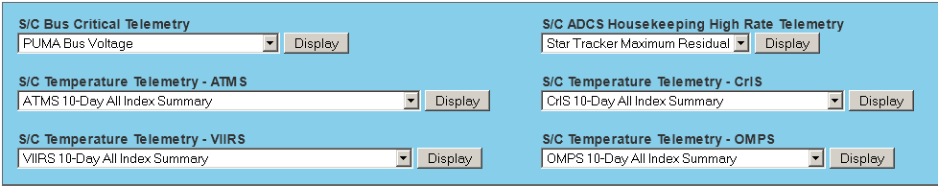
S/C Telemetry/Diary Parameters
ATMS G-Band RX Shelf Temperature
ATMS Scan Drive Mechanism Temperature
ATMS Baseplate Temperature
ATMS Calibration Target Bench Temperature
ATMS V-Band RX Shelf Temperature
ATMS Coldplate Operational Temperature (via DSEP ECC 1)
ATMS Coldplate Operational Temperature (via DSEP ECC 2)
ATMS Coldplate Operational Heater Deadband (via DSEP ECC 1)
ATMS Coldplate Operational Heater Deadband (via DSEP ECC 2)
ATMS Coldplate Operational Heater Operational Setpoint (via DSEP ECC 1)
ATMS Coldplate Operational Heater Operational Setpoint (via DSEP ECC 2)
VIIRS Sensor I/F 1 Temperature
VIIRS Sensor I/F 2 Temperature
VIIRS Telescope Moter Survival Heater Temperature
VIIRS Aft Optics Housing Temperature
VIIRS EM Coldplate Temperature
VIIRS EM Nadir Panel Temperature
VIIRS Coldplate Temperature (via DSEP ECC 1)
VIIRS Coldplate Temperature (via DSEP ECC 2)
VIIRS Electronics Coldplate Heater Deadband (via DSEP ECC 1)
VIIRS Electronics Coldplate Heater Deadband (via DSEP ECC 2)
VIIRS Electronics Coldplate Heater Operational Setpoint (via DSEP ECC 1)
VIIRS Electronics Coldplate Heater Operational Setpoint (via DSEP ECC 2)
CrIS Sensor I/F 1 Temperature
CrIS Sensor I/F 2 Temperature
CrIS Structure Near Survival Heater Temperature
CrIS PCE Temperature
CrIS Interferometer Electronics Temperature
CrIS SSM Temperature
OMPS Sensor I/F 1 Temperature
OMPS Sensor I/F 2 Temperature
OMPS Total Column Thermistor Temperature
OMPS Nadir Profiler Thermistor Temperature
OMPS Limb Thermistor Temperature

Slide 28
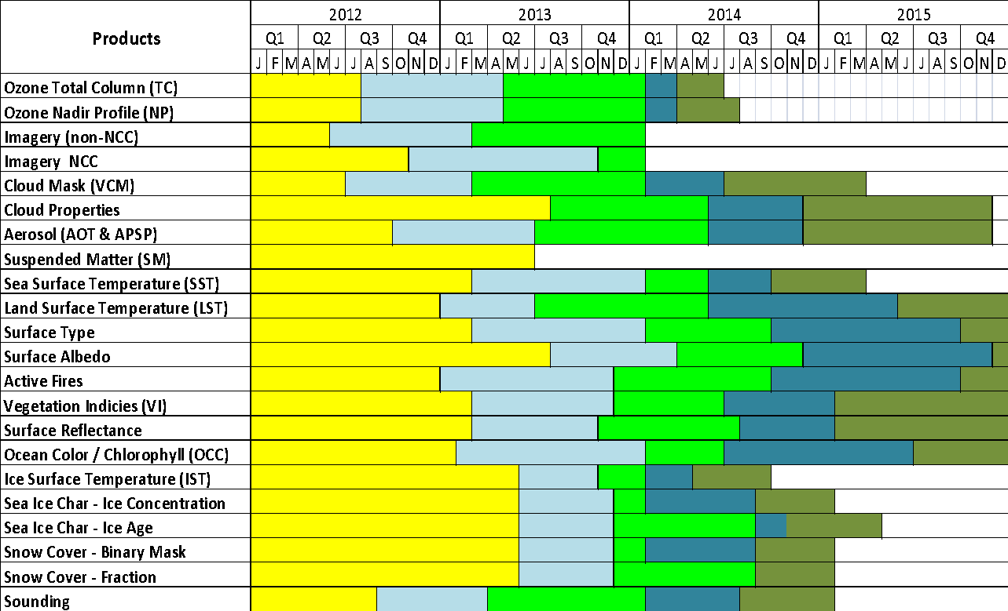
SNPP EDR Validation Schedule
http://www.star.nesdis.noaa.gov/jpss/Data.php
Beta
Provisional
Stage 1
Stage 2
Stage 3

Slide 29
Overarching Message
The review panel was generally very impressed with the details of the presentations and the dedication of the scientists supporting the EDR validation. The EDR teams are well managed. The EDRs have met their goals of either provisional or validated stage 1 with exception of night COP for water clouds .
Algorithm choice is important. Algorithms are available to resolve most problems.
Need user guides, use SPSRB template and consider current documents Internal (maintenance) vs external user guides
Quality flags are critical for user to tell them where not to use the data
We care about persistent errors. So for outliers even though spec has been achieved, we want to know if these are systematic or random. And if they are systematic how would that impact an end user.
Notes:
Good quality flaf; DPA-STAR:
RFA on bad areas Define persistant errors vs random

Slide 30
Algorithm Assessment Outcome Categories
NPOESS algorithm has evolved into the NOAA-endorsed JPSS algorithm.
NPOESS algorithm will not meet requirements or efforts to do so are too large, replace with NOAA-endorsed JPSS algorithm
NOAA-endorsed algorithm should be used even if NPOESS algorithm meets performance because of legacy, enterprise, blended products, and other considerations.

Slide 31
Cloud Provisional Recommendations
All cloud products except Night COP for Water Clouds are provisional.
The Cloud Team feels that remaining issues with Day COP are significant enough to prevent Validation Stage 1.
The Review Board recommends assessment of CLAVR-X algorithms as the replacement algorithms. Freeze further NPOESS cloud property algorithm improvements.
Action to Andy Heidinger to present to review panel within 30 days results based on CLAVR-X with similar rigor shown in this review.
CLAVR-X = clouds from AVHRR and beyond.
Beyond = VIIRS, ABI = Enterprise Algorithm
CLAVR-X is in CSPP with user engagement .

Slide 32
SST
SST is provisional
However algorithm and user choice is ACSPO
SST falls into category 3:
NOAA-endorsed algorithm should be used even if NPOESS algorithm meets performance because of legacy, enterprise, blended products, and other considerations.
Other consideration -- NDE is providing this SST operationally to users. There is no IDPS users.
Same rationale as NUCAPS decision
Stop IDPS algorithm work and focus cal/val on ACSPO.

Slide 33
VIIRS CLOUD MASK (VCM) Overall Results (Daytime)
Requirement | Level 1 | Match-Up | Golden Granule
PCT: Daytime, ocean | 94% | 95.3% | 96.5%
PCT: Daytime, land | 90% | 93.9% | 94.4%
PCT: Daytime, desert | 90% | 96.0% | 95.7%
Leakage: Daytime, ocean | 1% | 0.6% | 0.1%
Leakage: Daytime, land | 3% | 2.2% | 0.7%
Leakage: Daytime, desert | 3% | 2.8% | 1.2%
False Alarms: Daytime, ocean | 5% | 3.5% | 2.6%
False Alarms: Daytime, land | 7% | 3.6% | 4.2%
False Alarms: Daytime, desert | 7% | 1.2% | 2.9%

Slide 34
VCM Overall Results (Nighttime)
Requirement | Level 1 | Match-Up | Golden Granule
PCT: Nighttime, ocean | 85% | 95.2% | N/A
PCT: Nighttime, land | 88% | 94.5% | N/A
PCT: Nighttime, desert | 88% | 94.0% | N/A
Leakage: Nighttime, ocean | 5% | 1.3% | N/A
Leakage: Nighttime, land | 5% | 3.7% | N/A
Leakage: Nighttime, desert | 5% | 4.9% | N/A
False Alarms: Nighttime, ocean | 8% | 2.8% | N/A
False Alarms: Nighttime, land | 8% | 1.5% | N/A
False Alarms: Nighttime, desert | 8% | 0.9% | N/A
VCM cannot be expected to be perfect for all downstream algorithms. Downstream algorithms should
build upon VCM and apply additional tests if needed. Such as screening for aerosols with respect to SST.

Slide 35
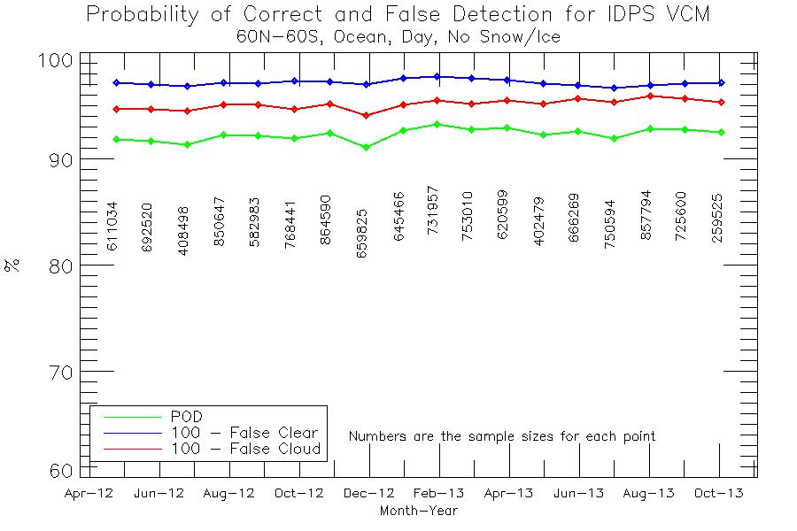
VIIRS-CALIOP Matchups Stats
Build 7.0/7.1
Build 6.3
Build 7.2
- New Build
- Provisional
- Thresholds Change

Slide 36
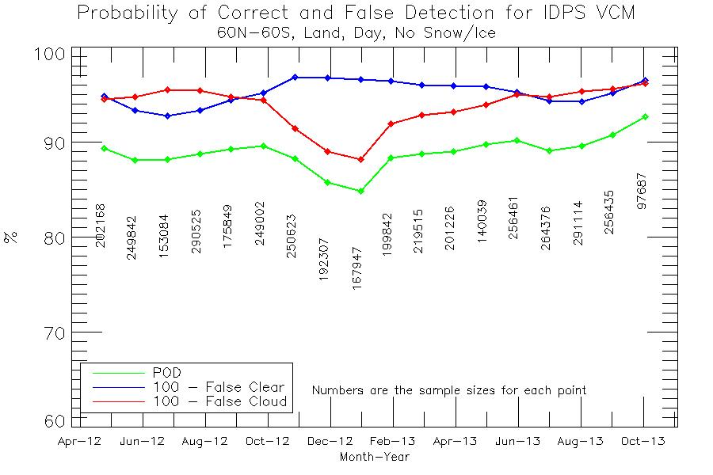
VIIRS-CALIOP Matchups Stats
Build 7.0/7.1
Build 6.3
Build 7.2
- New Build
- Provisional
- Thresholds Change

Slide 37
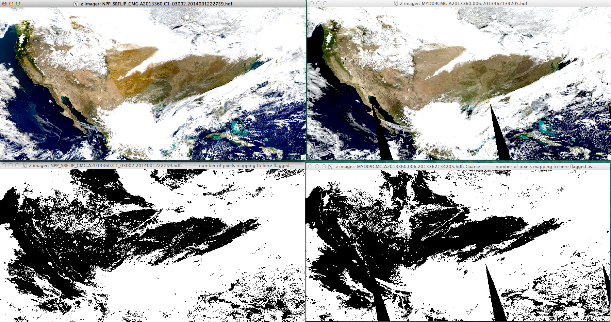
Cloud mask compare well with some small difference in snow/cloud (not a concern to us)
From Eric Vermote

Slide 38
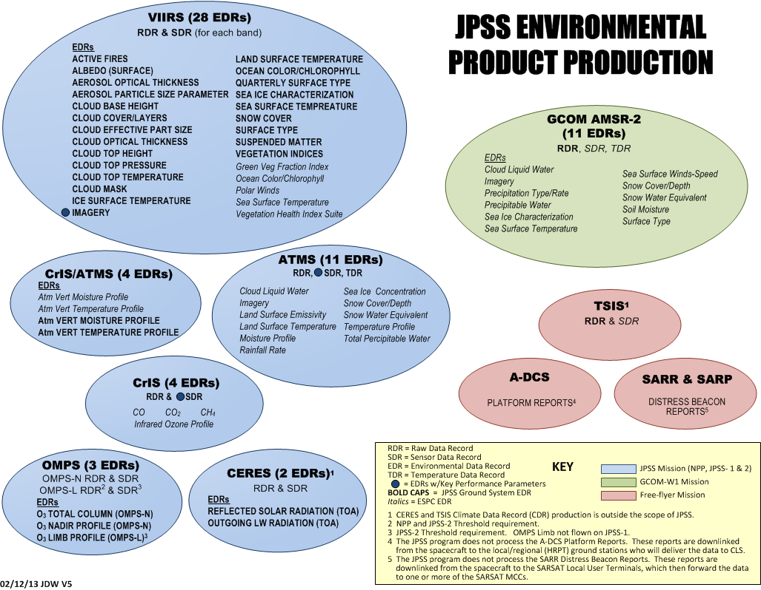
Expand EDR reviews to the other JPSS products

Slide 39
Recommendations
Teams should include independent assessments
NRL provides feedback on SST
NASA provides feedback on clouds
Identify someone that’s already doing this type of work to reduce cost. NASA MODIS cloud expert can be asked to validate the VIIRS or ABI cloud mask and products. Or work with international working groups – Winds, Soundings, Clouds.
Great synergy is possible because STAR is leading both JPSS and GOES-R efforts

Slide 40
Expand the Algorithm Assessment Outcome Categories
NPOESS algorithm has evolved into the NOAA-endorsed JPSS algorithm.
NPOESS algorithm will not meet requirements or efforts to do so are too large, replace with NOAA-endorsed JPSS algorithm
NOAA-endorsed algorithm should be used even if NPOESS algorithm meets performance because of legacy, enterprise, blended products, and other considerations.
GOES-R and JPSS algorithm should be different for practical reasons.
GOES-R and JPSS algorithms should merge into one multisensor algorithm (e.g. CLAVR-X) to support blended products, to be consistent with NOAA goals of enterprise solutions and to reduce overall cost

Slide 41
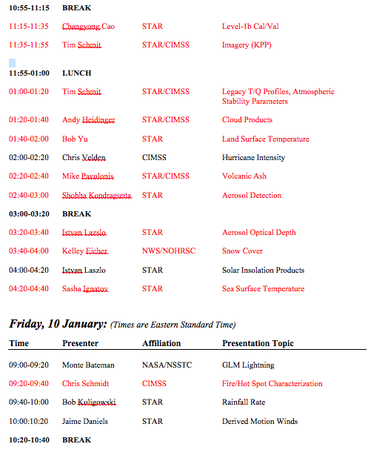
LOOK!!

Slide 42
SOAR Program Office
Director
Algorithm Integration
JPSS
International
NASA
Quality Assurance
NDE
GOES-R
Cal/Val
Research & Development
User Readiness
Blended Products
responsible for operational algorithm
development and readiness
establishes and ensures data quality
requirements, including the adherence to
CMMI leve 3 development processes
integration of algorithms
into product generation systems
new R&D for initial algorithm development,
new applications, and algorithms for
day-2 products, including blended products
ensures integration of Cal/Val acrossing
observing systems
Project
Elements
ensure users are ready for
new satellite data streams
Algorithm Development and User Readiness Testbed

