Slide 1
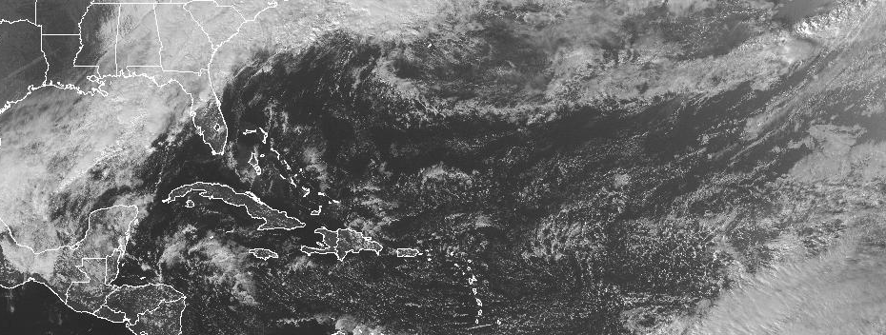
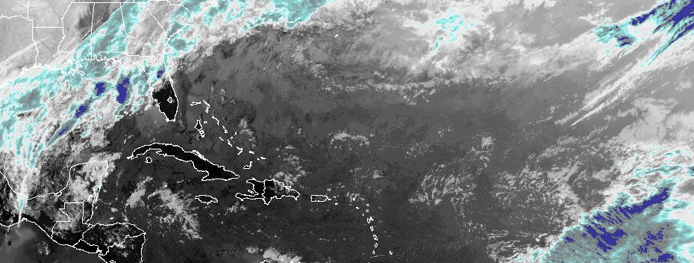
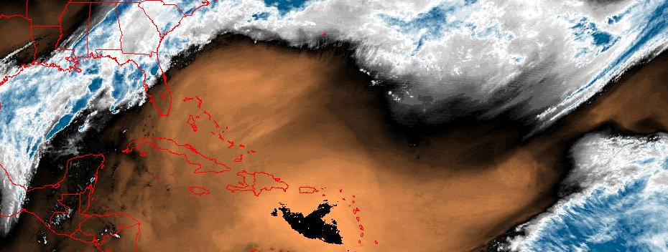
Calibration Working Group
L1b Cal/Val Update
Presented by Changyong Cao
NOAA/NESDIS/STAR
GOES-R Calibration Working Group
January 9, 2014

Slide 2
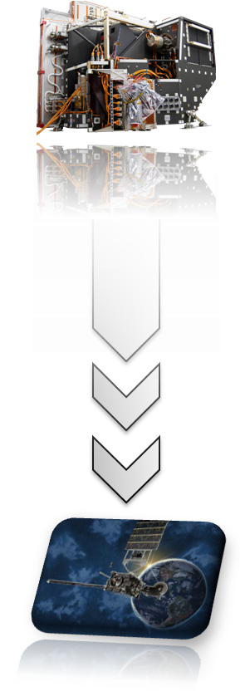
Pre-Launch Update:
GOES-R & GOES-S
GOES-R Advanced Baseline Imager (ABI) passes Pre Shipment Review
    GOES-R ABI PSR was held on September 24-26 at the vendor facility in Fort Wayne, IN
    CWG provided support to the ABI prelaunch calibration data analysis to verify the pre-launch instrument performance on behalf of NOAA, with several important findings
    After a thorough review by the vendor, government, and the independent review team it was concluded:
      ABI has been qualified with overall excellent radiometric performance
      ABI FM1 instrument can proceed towards shipment
CWG is well positioned to provide post-launch support and ensure ABI's performance throughout the lifetime of the instrument.
CWG is continuing pre-launch support for GOES-S (ABI FM2) currently about to enter TVAC

Slide 3
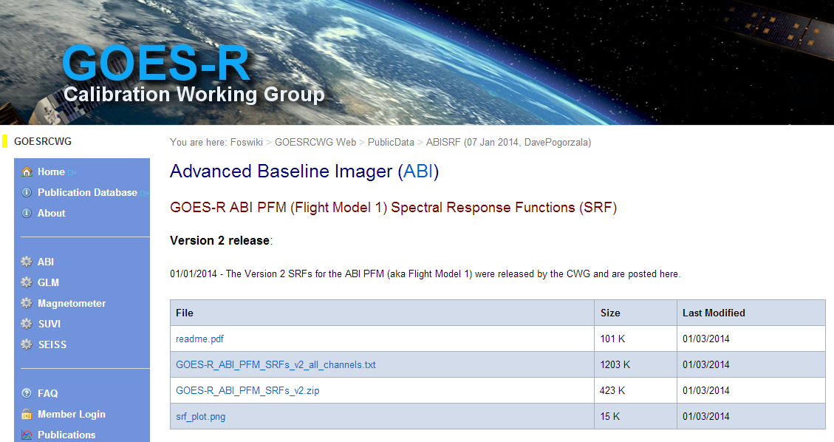
New Release of ABI PFM SRFs:
Version 2
Version 2 is a result of prelaunch testing and analysis by Vendor, Flight, and CWG:
  This release is the most accurate representation of the ABI SRFs:
    Significant differences exist from previous update
    Differences are due to the following:
      Spectral transmittance filters were replaced in 11 of 16 channels
      Additional corrections were based on NIST bandpass filter measurements and analysis (channels 1.38 μm and 2.25 μm )
Version 2 of ABI PFM SRFs is now available:
http://ncc.nesdis.noaa.gov Click GOES-R/ABI
  New format:
Ch# npts
WL WN normalized SR

Slide 4
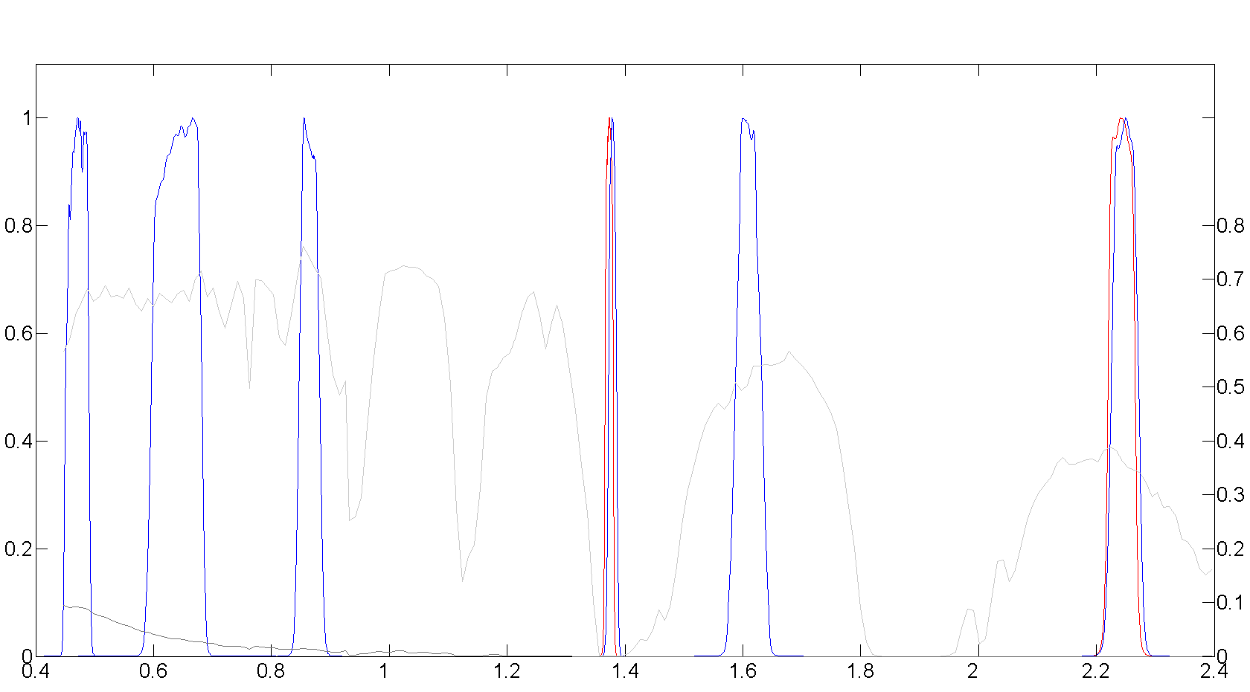
Reflective Solar Bands:
SRFs for 2 bands have changed
1.0
ABI SRFs:
V1
V2
Hyperion Obs.:
Ocean Clear
Ocean Cloudy
Summary:
2.25 µm band SRF changed: bandpass filter was replaced during the testing program
1.38 µm and 2.25 µm band SRFs changed based on NIST bandpass filter measurement results
TOA Reflectance [%]
0
Wavelength [μm]

Slide 5
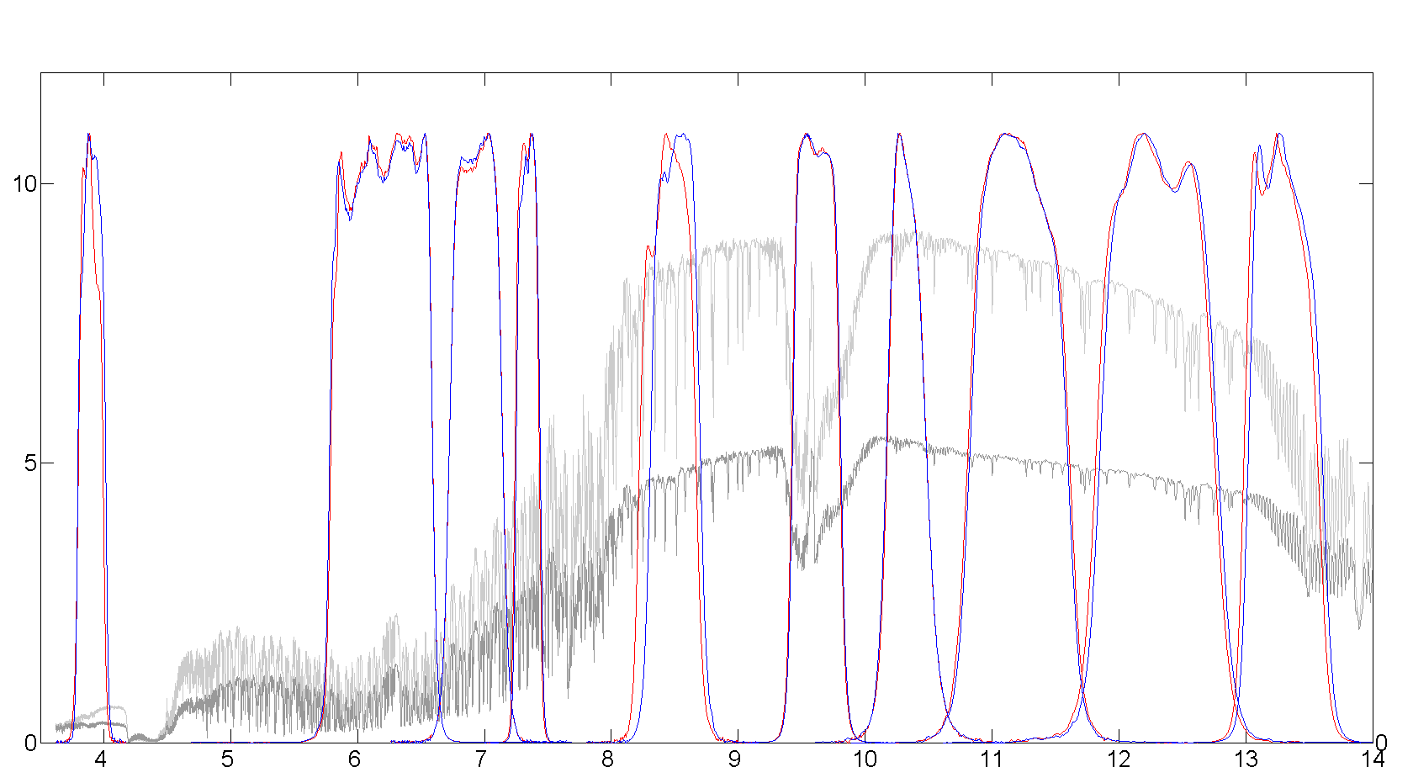
Thermal Emissive Bands:
SRFs for all bands have changed
Summary: Bandpass filters were replaced during pre-launch testing
12
ABI SRFs:
V1
V2
IASI Obs.:
Ocean Clear
Ocean Cloudy
Radiance [W/m² sr µm]
Wavelength [μm]

Slide 6
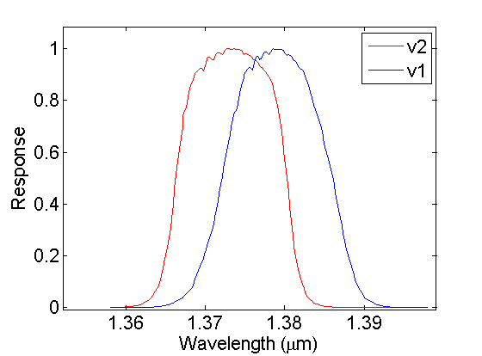
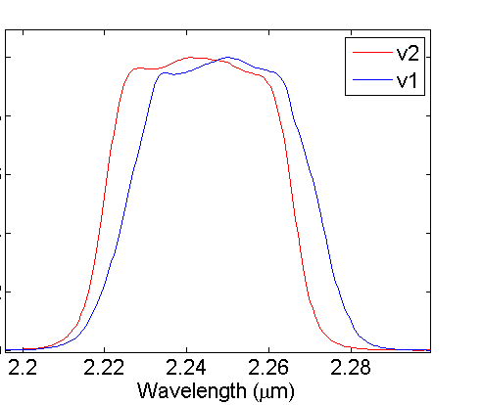
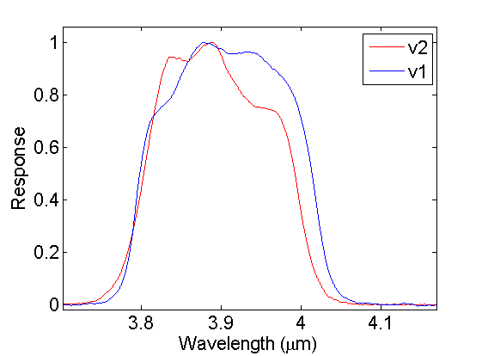
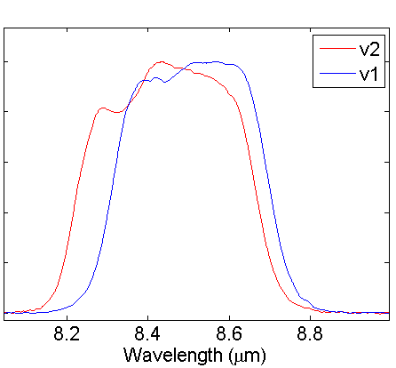
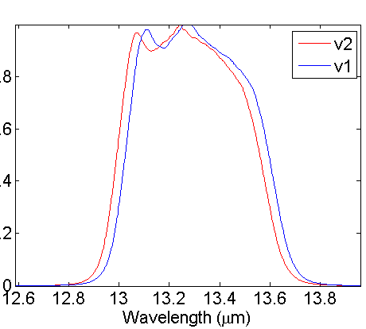
Quantitative Comparison:
Center Wavelength and Radiometric Differences
Center Wavelength Differences
Channels [μm] | Center Wavelength Difference [nm]
0.47 | 0.0
0.64 | 0.0
0.86 | 0.0
1.38 | -5.7
1.61 | 0.0
2.25 | -5.5
3.90 | -13.6
6.18 | 6.2
6.95 | 0.8
7.34 | -8.2
8.50 | -56.8
9.61 | -6.7
10.35 | 3.8
11.20 | -1.6
12.30 | -28.4
13.30 | -33.3
1.38 µm
2.25 µm
3.9 µm
8.5 µm
13.3 µm
Radiometric comparisons using Hyperion and IASI observations demonstrated differences that approached 2% (radiance) for RSB and exceeded 1 K for TEB

Slide 7
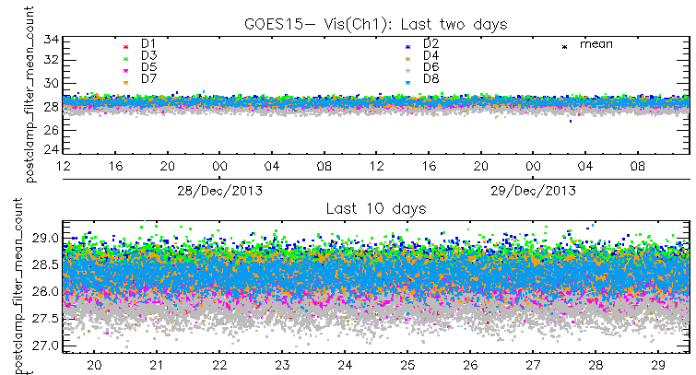
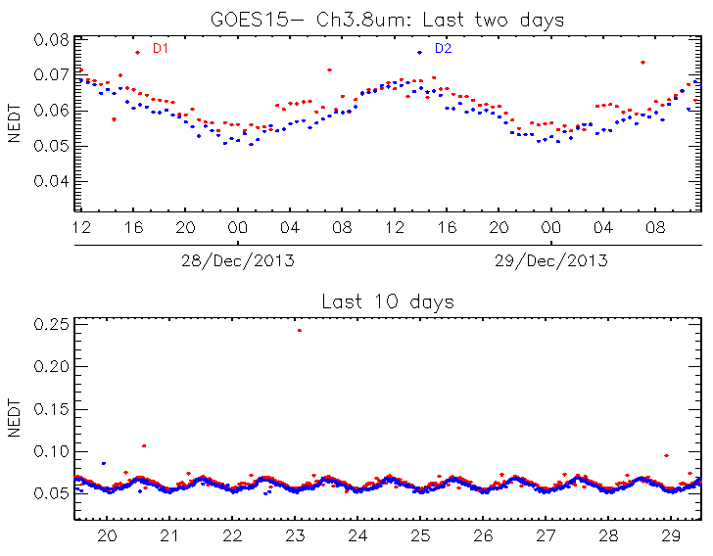
Post Launch Preparations: PLT & Science Tests
Current GOES ICVS Performance Monitoring Capabilities
  Developing capabilities and tools for post launch instrument performance characterization and monitoring:
    PLT – instrument functionality
    Science Tests – instrument performance
    ICVS – Monitoring of instrument parameters
  Leveraging the VIIRS Post Launch 57 tasks & current GOES PLT
  Collaboration with AWG and POSST
GOES-15 Space Look
GOES-15 NEΔT

Slide 8
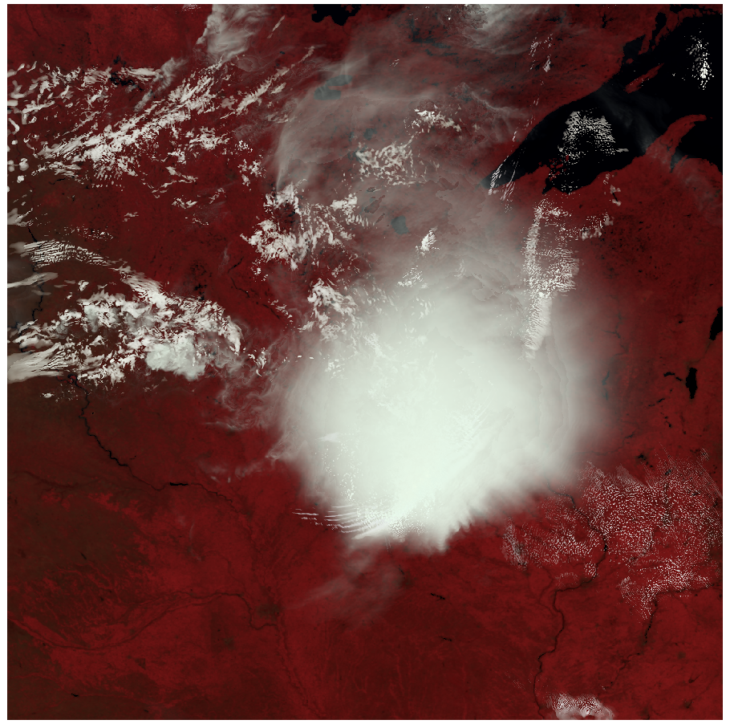
Post Launch Cal/Val Support
  Developing deep dive analysis capabilities.
  For each PLT (currently ~15) and science test, specific tools are being developed.
  Additional tools being developed in 2014:
    Vicarious Calibration (DCC, Deserts, Ocean, Lunar, and Stellar)
    INR tools and capability
    Inter-calibration tools
    New Image Quality Metrics
    Implementation of the vendor Resampler Algorithm applied to proxy ABI data generated by UW
Image courtesy of UW
0.86, 0.64, 0.47um
WRF output from UW as proxy L0 data
ABI Resampled Data
Improved Assessment of L1b Impacts → flow down to L2+

Slide 9
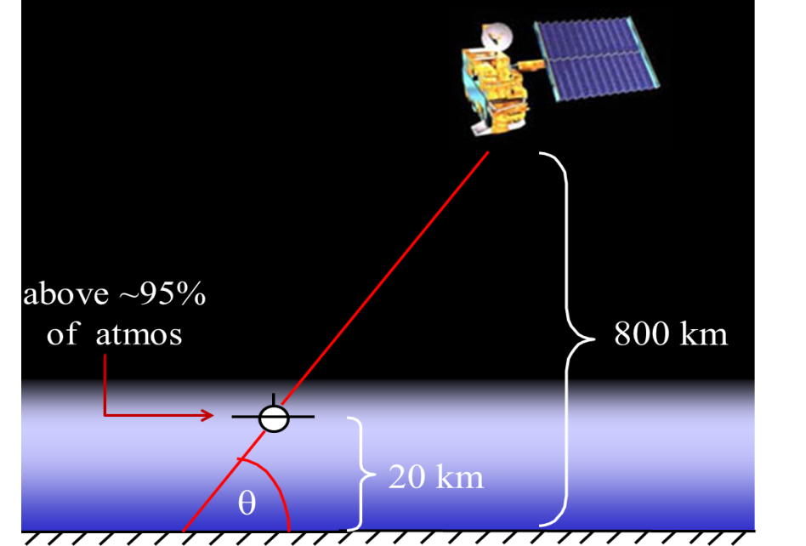
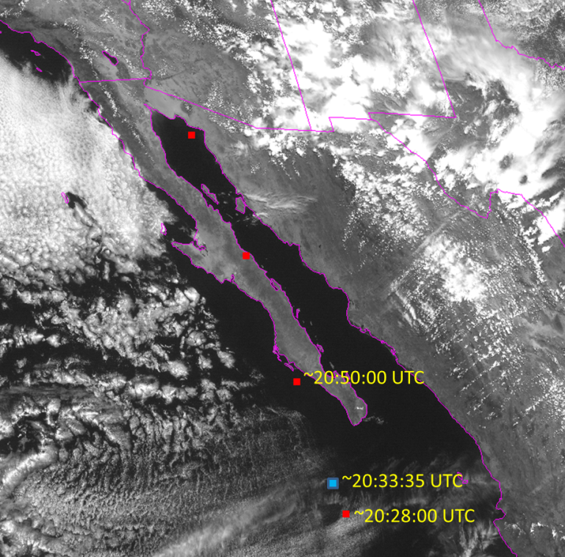
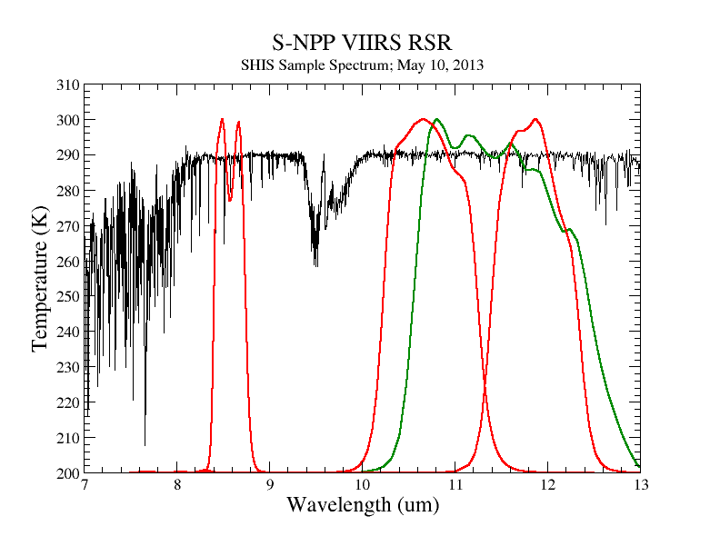
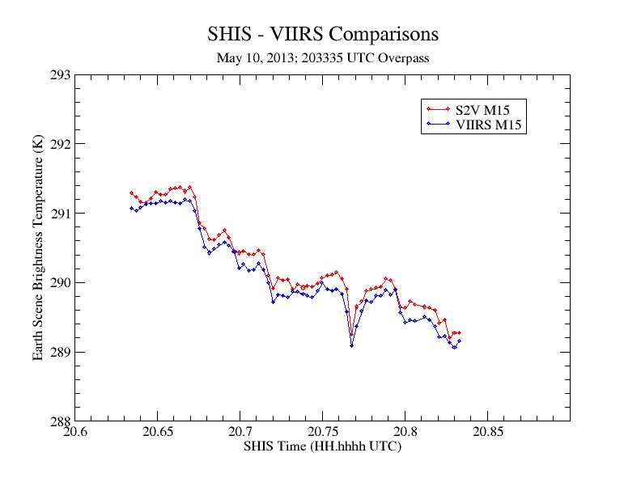
S-NPP Field Validation Campaigns:
NASA ER-2 Underflights
VIIRS SDR accuracy evaluation
SHIS (NIST-traceable blackbody source, 0.1 K)
MASTER (50 m spatial resolution mapping)
3 underflights for S-NPP
RSS Total Uncertainty Estimate
  ~0.12 K (I4, I5, M12, M13, M15, M16)
  0.21 K (M14)
SHIS – VIIRS Comparison
Complete Spectral Coverage

Slide 10
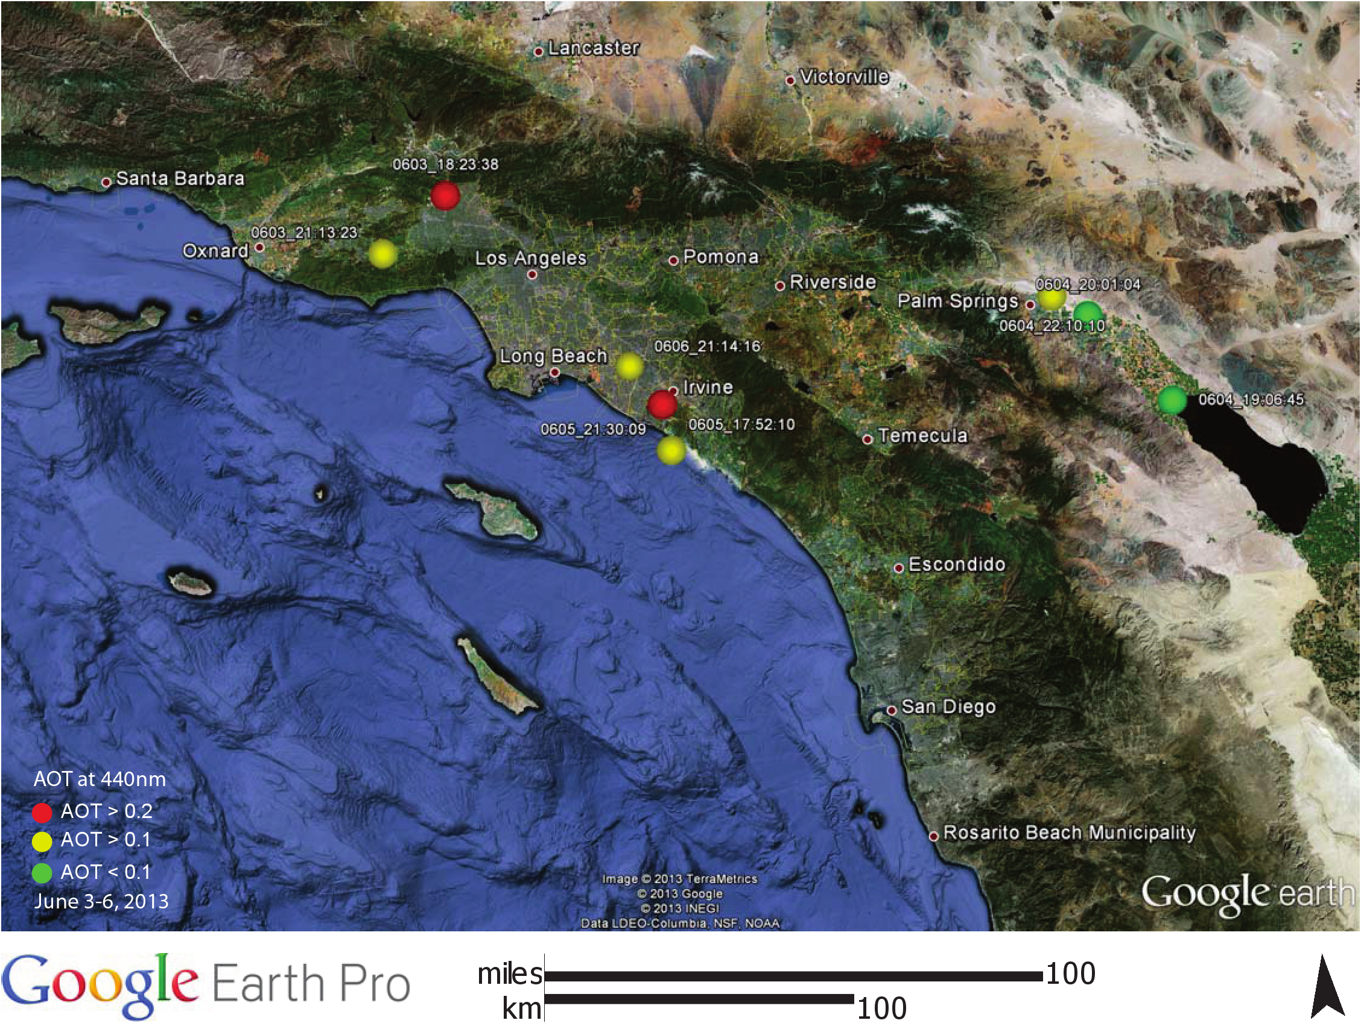
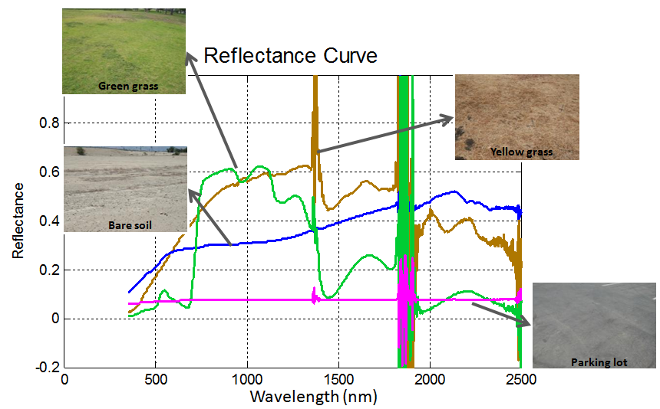
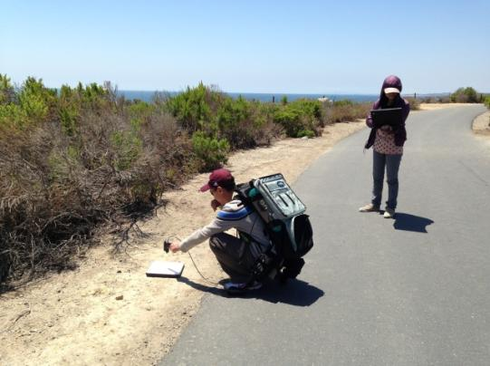
Demonstrated GOES-R Under-flight Campaign Readiness
Sun Photometer Measurements
ASD Field Measurements
STAR scientists demonstrated GOES-R field campaign readiness support in collaboration with NASA HYSPIRI mission collecting ground spectral reflectance and aerosol data with the GOES-R ASD field spectrometer and sun photometer

Slide 11
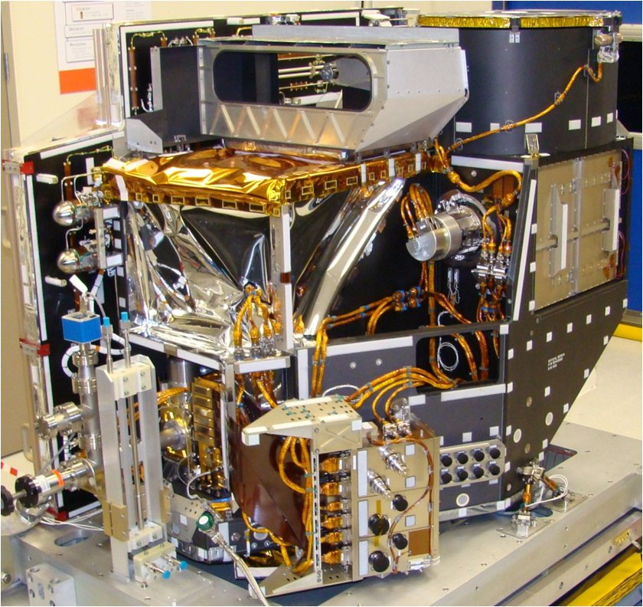
JMA AHI Cal/Val Collaboration
Collaborating with Japan Meteorological Agency (JMA)
  MOU is in place with multiple successful exchanges
  AHI is a sister instrument to the future GOES-R ABI
  Plans to launch in late 2014, which is ahead of the GOES-R
  Analysis of AHI data may provide potential risk mitigation opportunities that can be leveraged for ABI support
JMA shares with NOAA early on-orbit calibration and instrument performance data, such as solar diffuser, blackbody, and potentially lunar data for cal/val purposes (NOAA and JMA MOU)
NOAA scientists collaborate with JMA on instrument calibration/validation using AHI data (proposal funded by the program office for JMA visitors)
Use S-NPP VIIRS as a transfer radiometer to perform inter-comparisons between AHI and ABI
JMA: Himawari
16 Band Imager
Spectral Region | Spatial Resolution
6 VNIR/SWIR | 0.5,1 & 2 km
10 Infrared | 2 km

Slide 12
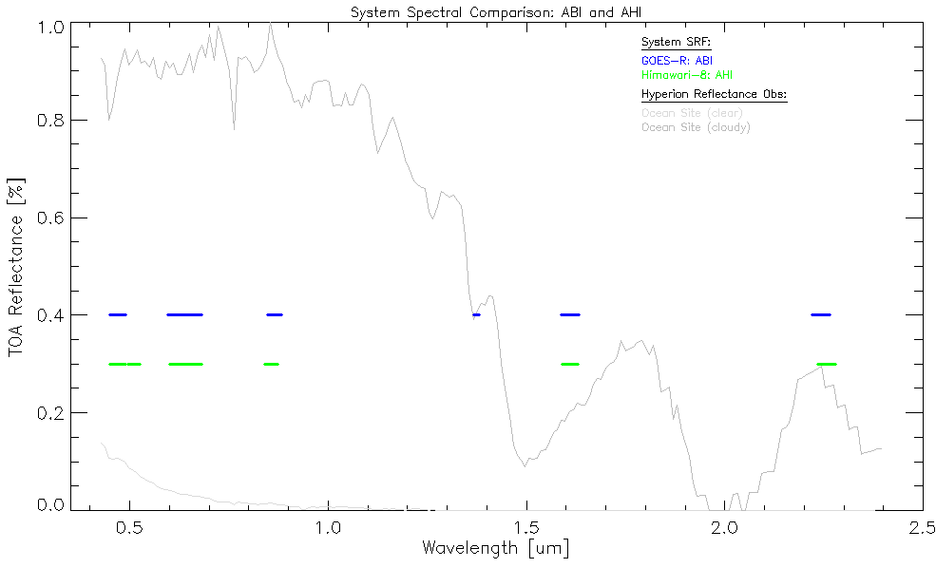
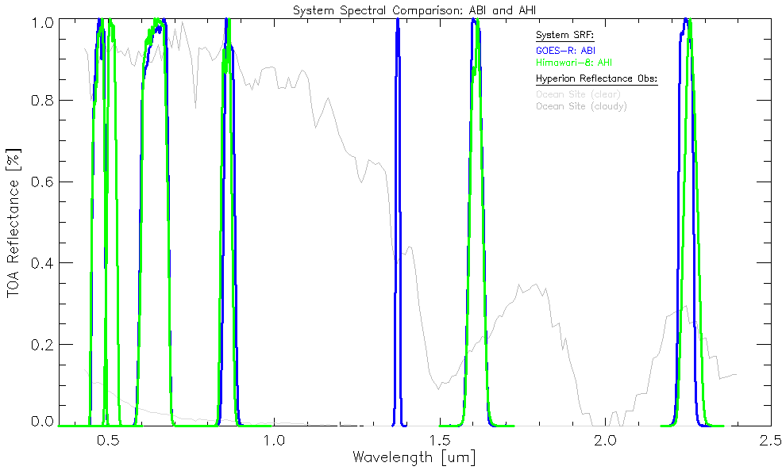
ABI and AHI:
Reflective Solar Band Comparison
ABI: Daytime Cirrus Band
AHI: Green Band
12

Slide 13
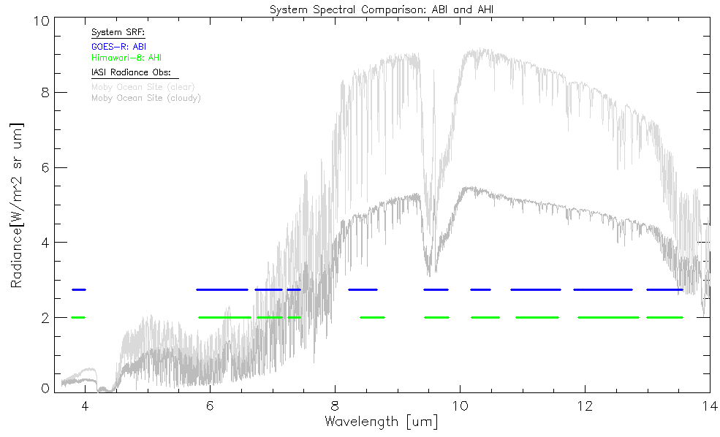
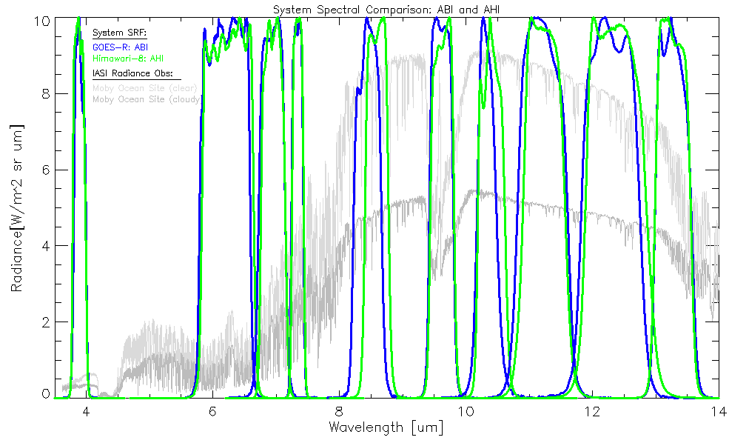
ABI and AHI:
Emissive Band Comparison

Slide 14
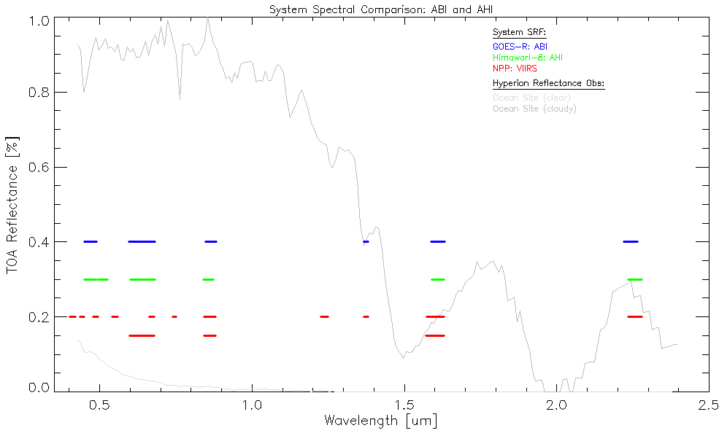
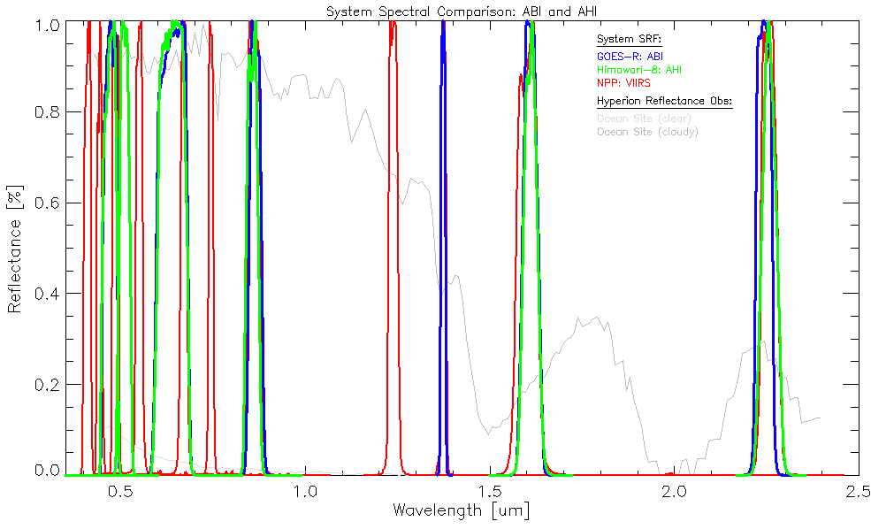
ABI, AHI & VIIRS:
Reflective Solar Band Comparison

Slide 15
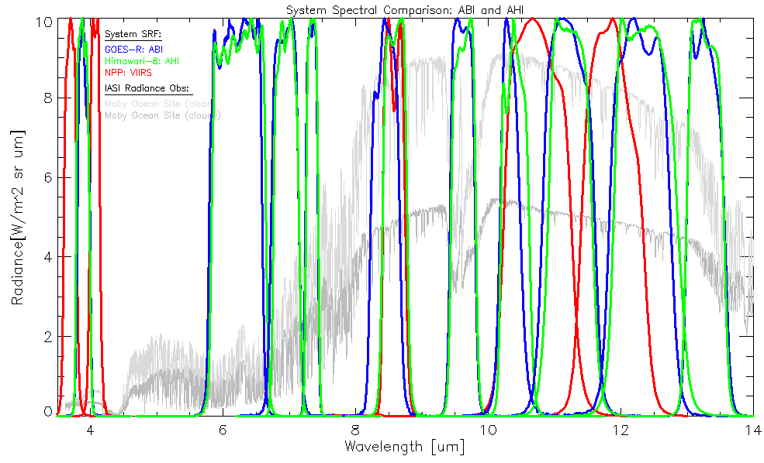
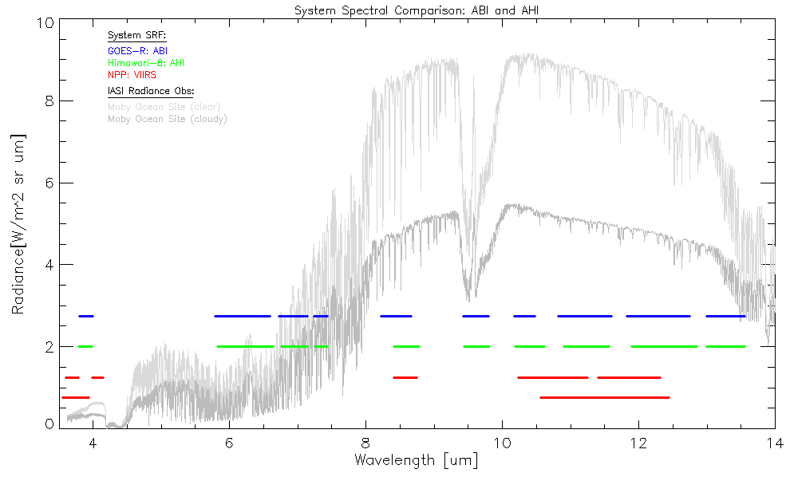
ABI, AHI & VIIRS:
Emissive Band Comparison

Slide 16
Path Forward
Leverage JPSS VIIRS and JMA AHI for GOES-R ABI post-launch activities:
  AHI and VIIRS are assets to be utilized during PLT and Science Testing
  In preparation for inter-comparisions:
      Predicted radiometric biases between ABI and VIIRS RSB channels for GOES-R post-launch support
        A. Pearlman, D. Pogorzala, and C. Cao, Applied Optics, 52 7660 (2013)
      Using S-NPP VIIRS as a Transfer Radiometer to Inter-compare GOES-R ABI and Himawari-8 AHI
        AMS 2014 Annual Meeting
Focused capability and tool development efforts in support of GOES-R ABI PLT and Science Testing
Leverage lessons learned from current GOES and other similar missions
Foster collaboration with AWG, Flight, and POSST

Slide 17
Summary
Instrument Status:
  CWG pre-launch assessment of GOES-R ABI PFM complete:
    Successful GOES-R ABI PSR held September 24-26 in Fort Wayne, IN
  CWG is continuing support for GOES-S ABI (entering TVAC)
Version 2 of ABI PFM SRFs released:
  Significant differences exist from version 1
  Update reflects results from pre-launch testing and analysis
Ramping up support for GOES-R post-launch efforts:
  PLT, Science Tests, and Long-Term Monitoring
Collaborating with JMA to enhance GOES-R Readiness

