Slide 1


Cloud Team Report
Andrew Heidinger, Michael Pavolonis
NOAA/NESDIS
Steve Wanzong, Andi Walther, Pat Heck, William Straka, Marek Rogal
UW/CIMSS
Patrick Minnis
NASA/LaRC

Slide 2
Outline
Enhancements
Current Activities
Validation Progress
Road to GOES-R Post-Launch Test (PLT) and Post-Launch Product Validation

Slide 3
Cloud Team Algorithm Highlights
Cloud Team developed 5 algorithms for 10 products.
Clear-sky Mask and Nighttime Cloud Optical Properties are no longer actively funded.
Mask remains integral to many other products but feedback has dwindled.
Height, Phase and Daytime Optical Properties are still supported since they are the most used.
Validation tools and proxy data usage has expanded significantly.
These algorithms are running on almost all sensors and finding use in many applications.

Slide 4
Identifying and Planning for Algorithm Enhancements Beyond Baseline

Slide 5
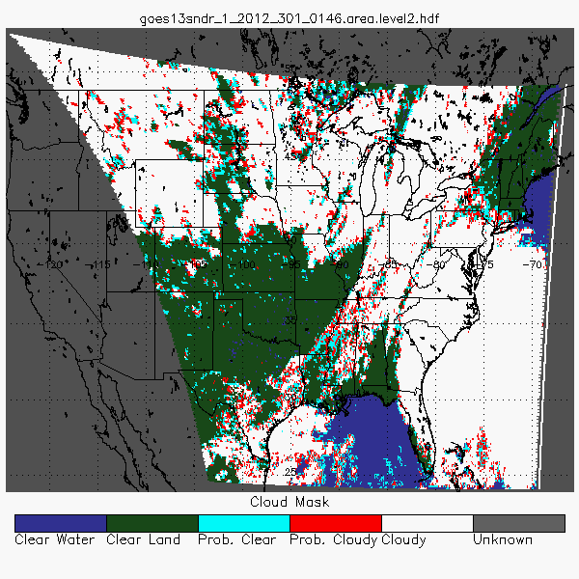
Algorithm Enhancements: Application to Current Sensors
CLAVR-x and GEOCAT continue to run AWG cloud algorithms on a growing list of sensors. (Enterprise?)
Majority of GOES-R AWG Cloud Algorithms have also made it into NESDIS Ops via CLAVR-x/GSIP.
At CIMSS, these are run in real-time
This data is available via ftp, CIMSS-LDM, and ADDE. Images are served through Google Maps & Earth and AWIPS (selected products).
Current geo sensors: GOES-I/L,GOES-M/P, GOES-Sounder, MSG, COMS and MTSAT
Current leo sensors: AVHRR/3, MODIS and VIIRS
Cloud Mask applied to GOES-13 Sounder. Goes Sounder provides most ABI IR bands over USA in Geo.

Slide 6
Algorithm Enhancements
Mask: Probabilistic logic implemented, users can pick final threshold for clear/cloudy.
Phase: Expansion to all IR channel combinations.
ACHA: Full off-diagonal covariance matrices, generate optical depth and particle size, and true physical boundaries (top and base). Supports 6.7,8.5 11,12,13.3 μm channels.
DCOMP: Extended to 1.6 and 3.9 micron channels. New logic to improve over-snow performance. Use of ACHA optical depth as constraint for thin cirrus clouds.

Slide 7
Current Activities

Slide 8
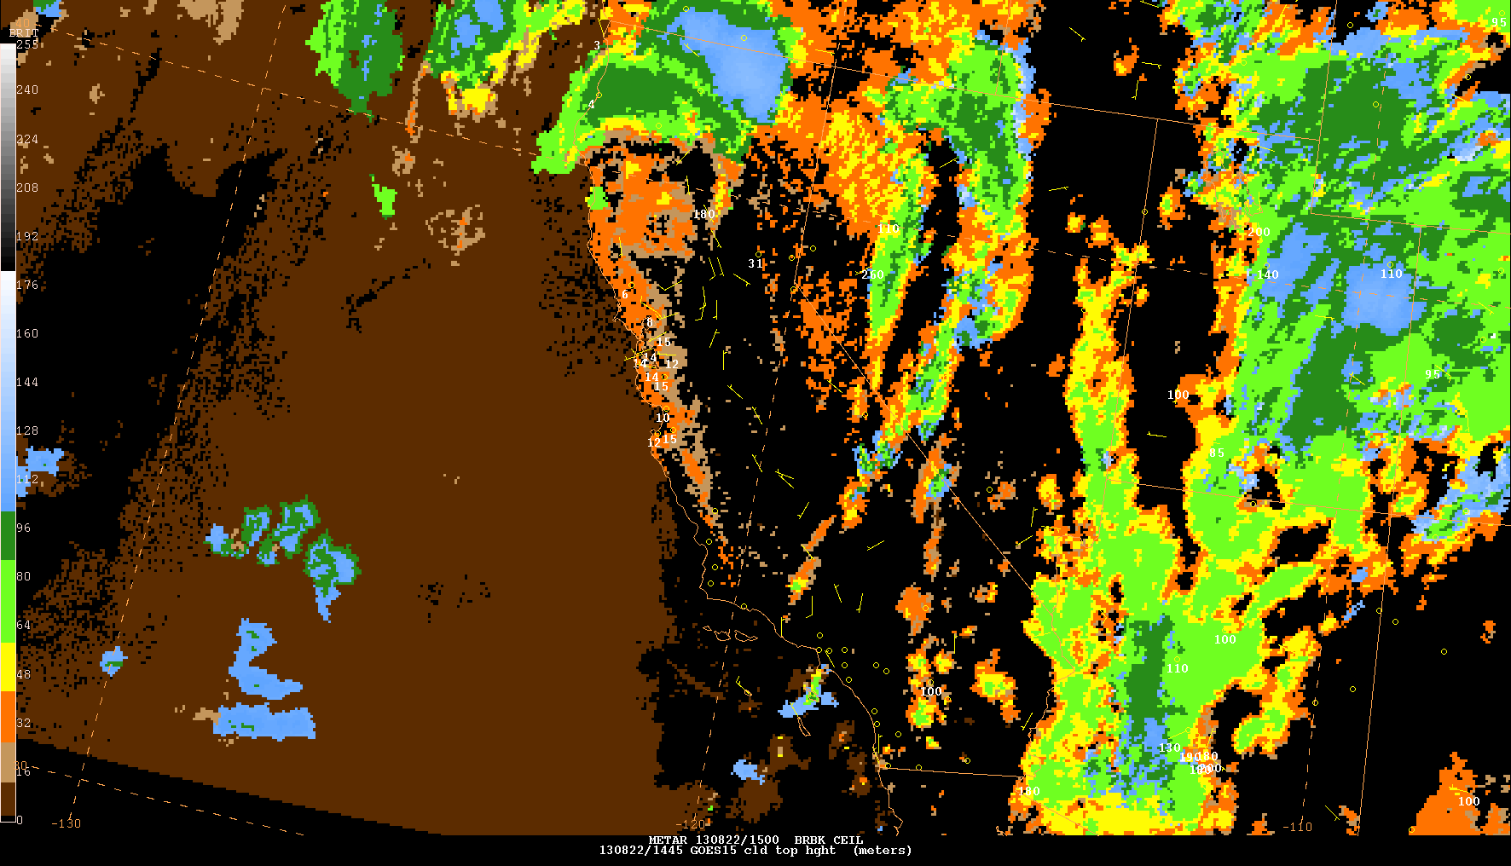
Proving Ground Activities.
Mask, phase and height are served directly to the OCONUS and AWC PG Experiments.
Cloud Optical Depth and Particle Size were served during the AWC Winter Experiment to support the Icing Product.
Cloud products also support other applications.
Example ACHA display in AWIPS used at AWC
(Amanda Terborg)

Slide 9
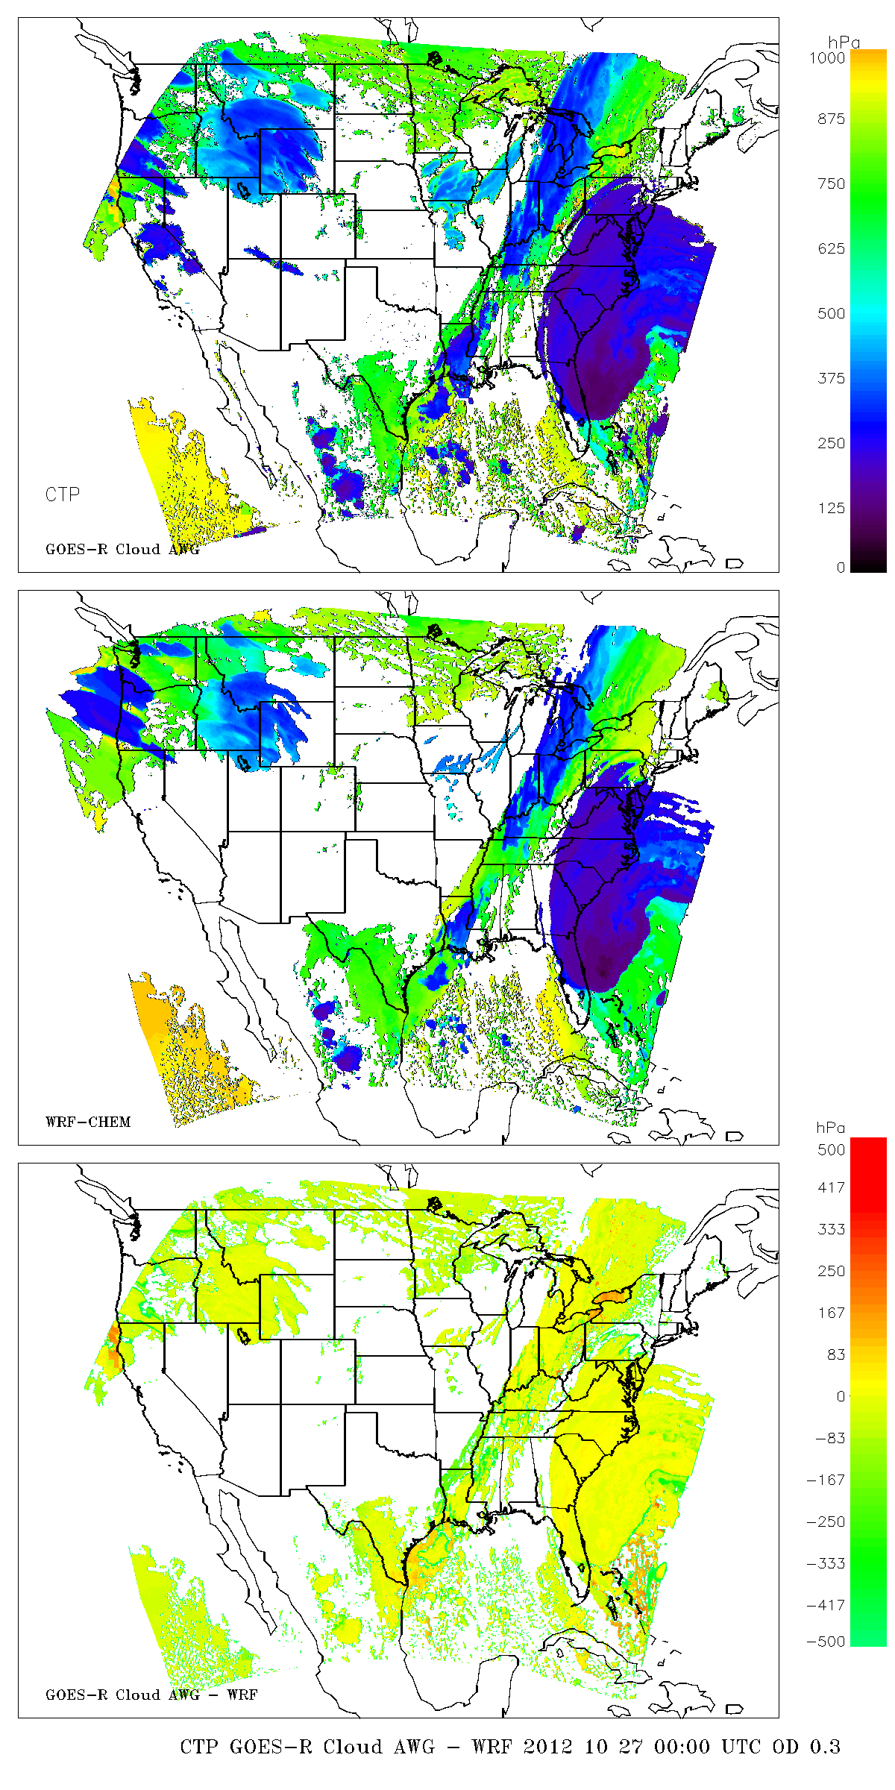
Generation of AWG Cloud Products on Simulated ABI
CIMSS Proxy Data Team Generates Simulated ABI Data using WRF-Chem.
Scene on right is Hurricane Sandy.
GEOCAT modified to ingest Simulated ABI Data and allows for AWG Product Generation.
Model cloud profiles and selected products mapped to same resolution which enables direct comparison.
Retrieved
Truth

Slide 10
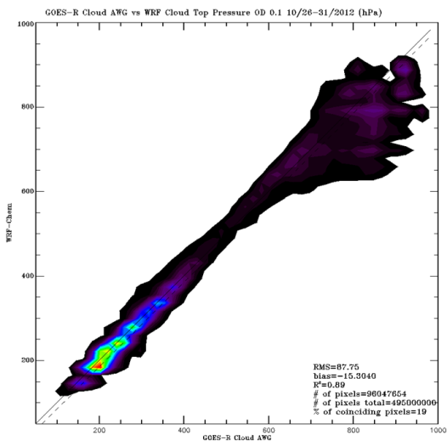
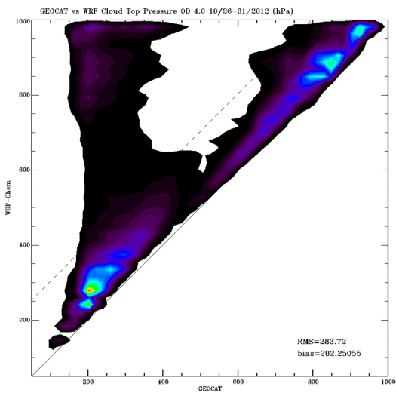
Generation of AWG Cloud Products on Simulated ABI
Model provides profile of cloud hydrometers.
We can verify our algorithms assumptions on vertical structure and the impact on CTP performance.
Image on left shows comparison of ABI CTP to model CTP where we compute CTP at level where optical depth into cloud = 0.1 (near true top).
Image on right shows same comparison but model CTP computed where optical depth into cloud = 4 (deep into cloud or top of lower cloud layer).

Slide 11
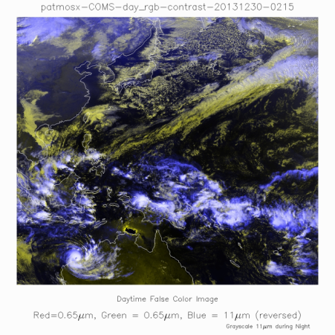
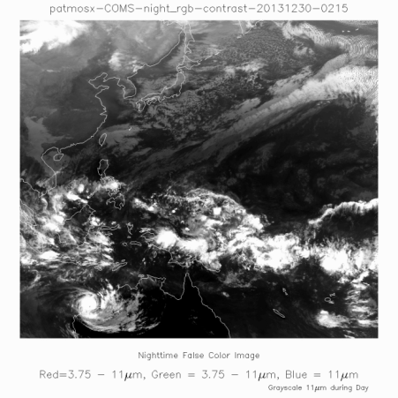
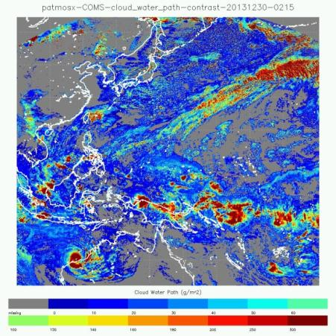
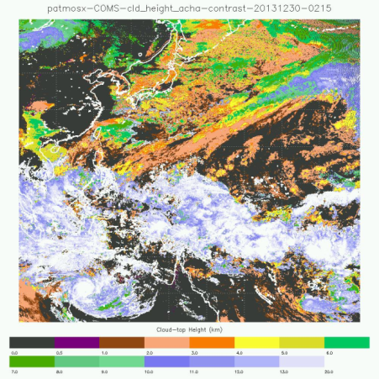




Field Campaign Support
AWG Cloud Products Appear in the UCAR Field Catalogs for:
CONTRAST 2014
DC3 2012
TORERRO 2011/2012
AWG Cloud Products also provided to
HS3 – 2013
SAAWSO – 2012/2013
CalNex - 2011
Data Served to CONTRAST from COMS

Slide 12
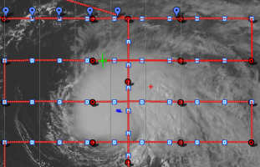
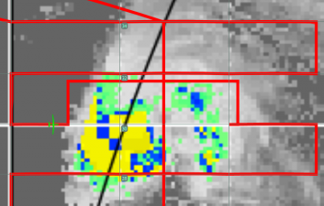

HS3 Example: Flight diversion Due to AWG Cloud Height
Cloud Height
ACHA Cloud top heights were in excess of 50,000 ft. so the decision was made to divert the Global Hawk.
Diversion cost opportunity to investigate inner core of the tropical cyclone.
Questions were quickly raised as to whether the Global Hawk needed to divert during this flight.

Slide 13
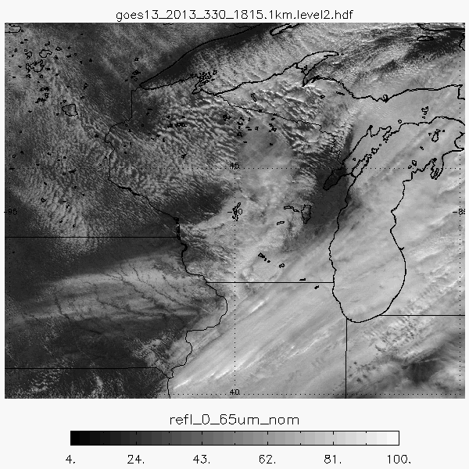
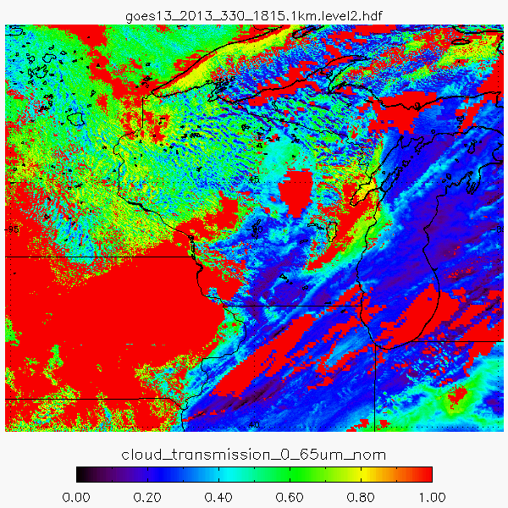
Industrial Applications: Solar Energy Forecasting Support
AWG Cloud Products will be served to the DOE SunShot Program in 2014.
SunShot’s Goal: improve solar power forecasting
NOAA partnering with DOE. Two teams funded: NCAR, IBM
Cloud AWG supporting teams with GOES real-time 1km cloud products.
1 km / 1 minute data from GOES-14 SRSOR being used for experiments.

Slide 14
Validation Progress

Slide 15
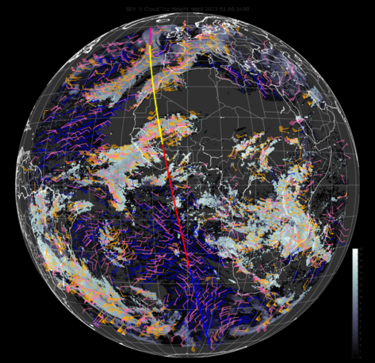
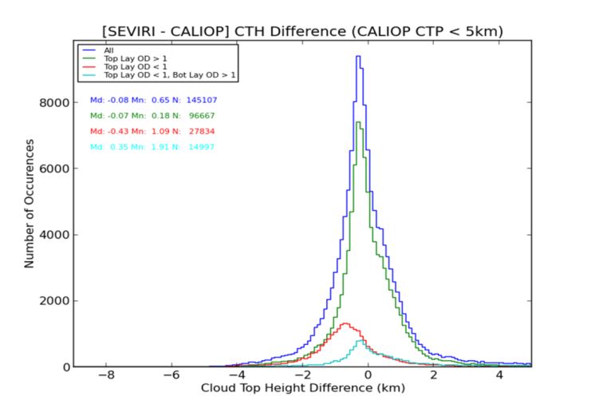
Validation Progress: SSEC SEVIRI Monitoring Page
Cloud Team collaborates with SSEC Co-location Team (Holz/Quinn)
SSEC runs a Real-Time SEVIRI Validation Page using MODIS and CALIPSO..
Calipso Track
All clouds
Thin cirrus
One Month of SEVIRI vs CALIOP

Slide 16
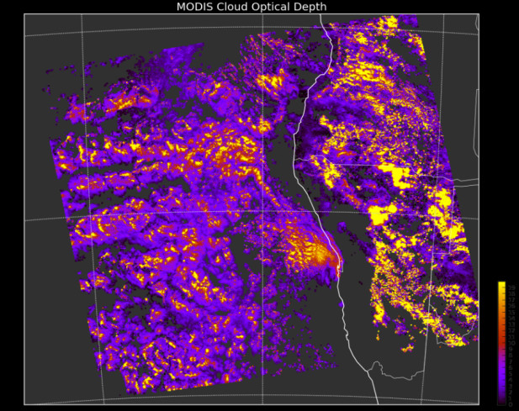
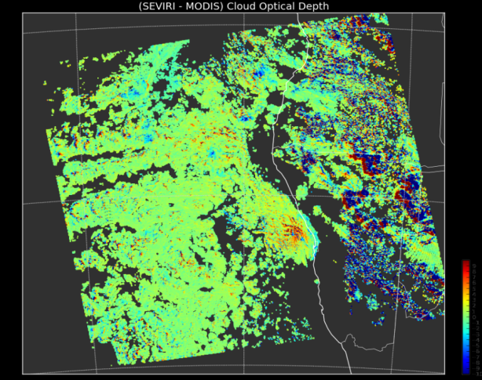
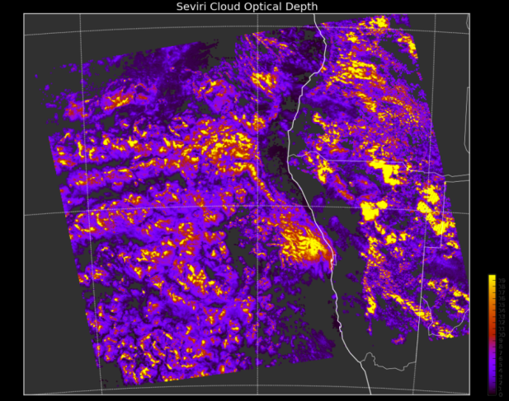
Validation Progress: SSEC SEVIRI Monitoring Page
SSEC page also compares NASA MODIS to AWG Cloud Products from SEVIRI.
Images show Cloud Optical Depth.
NASA MODIS Cloud Optical Depth
AWG/SEVIRI – NASA/MODIS
AWG SEVIRI Cloud Optical Depth

Slide 17
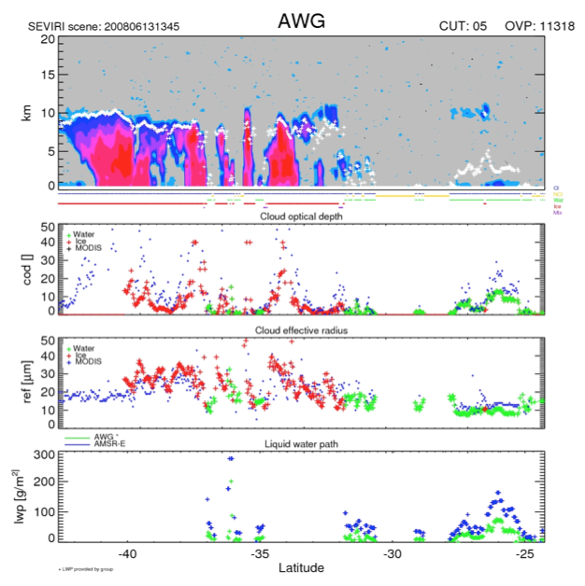
Cloud Retrieval Evaluation Workshop (CREW)
AWG Cloud Team continues to participate in the EUMETSAT sponsored CREW Workshops.
4th CREW is in March, 2014
CREW enables direct comparison of cloud products from multiple agencies.
Allows us to track our relative performance and learn or share new ideas with the community.
Image on left is a standard CREW analysis applied to AWG.

Slide 18
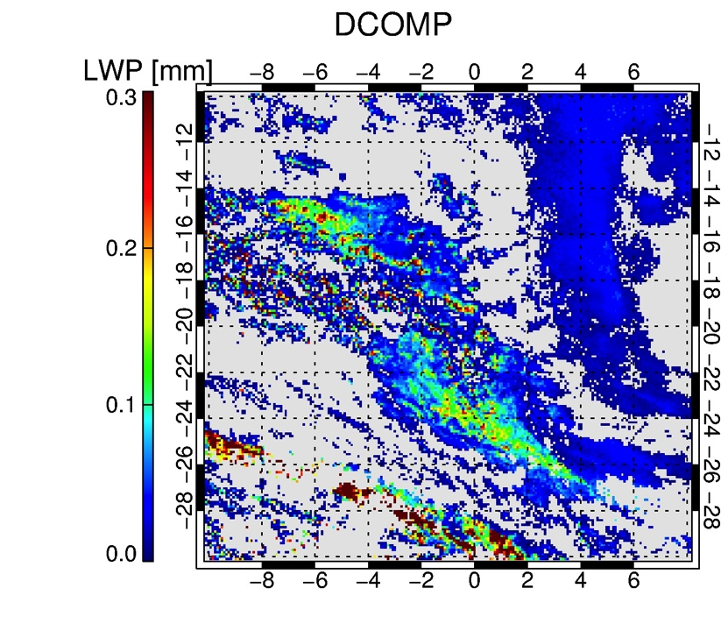
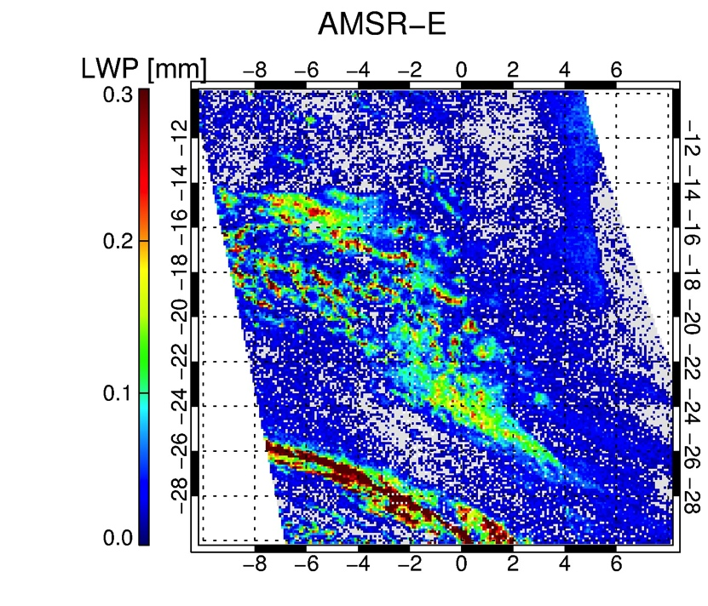
Validation of Daytime Cloud Optical Properties:
One independent validation source for daytime cloud products is microwave-based Liquid Water Path (LWP) product from AMSR-E.
LWP is the link of optical properties to a quantitative water mass.
Validation shows that we meet the specs although different spatial resolution, required filtering for cloud masking rain, ice clouds in MW data and temporal mismatch complicate the effort.
AWG/SEVIRI – Liquid Water Path
AMSR-E Liquid Water Path

Slide 19
Plans

Slide 20
Post Launch Validation Plans
We intend to continue to use space-borne Lidar from the Earth-Care mission which scheduled for 2016.
We hope to continue work with the field campaigns since it provides insight from other non-satellite experts.
We hope there is a CREW-like Workshop for GOES-R.
Application specific validation/tailoring is most important for product success.

Slide 21
User Engagement Plans
If funded continues to go down, the time is now to fund training for AWG products. Hard to do this years after the algorithm developer is gone.
Availability to serve Real-Time data from STAR and its CI’s is excellent and needs to be supported (PG?).
Climate researchers remain a big user of cloud products.
NCDC CDR program would only support transition of mature climate data records into the archive. Gap in support for developing climate records.

Slide 22
Concerns about Post Launch
JPSS Cal/Val teams were formed to provide independent assessments. Is this planned or do we continue to validate our own algorithms?
Many groups run our algorithms outside of our team. Algorithm support becomes challenging and falls outside of PSDI. (CSPP is a potential example of this issue.)
What is our role in algorithm updates? The IDPS/ADL model is not optimal. Will NESDIS pursue independent processing similar to the NOAA Unique Products on NPP/JPSS?

Slide 23
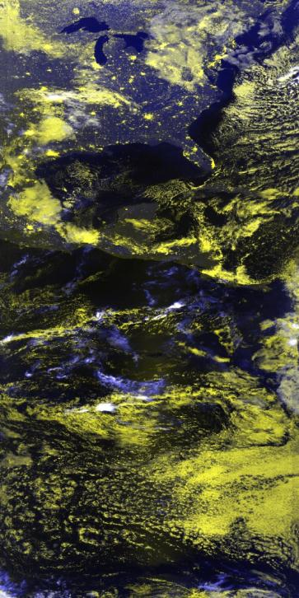
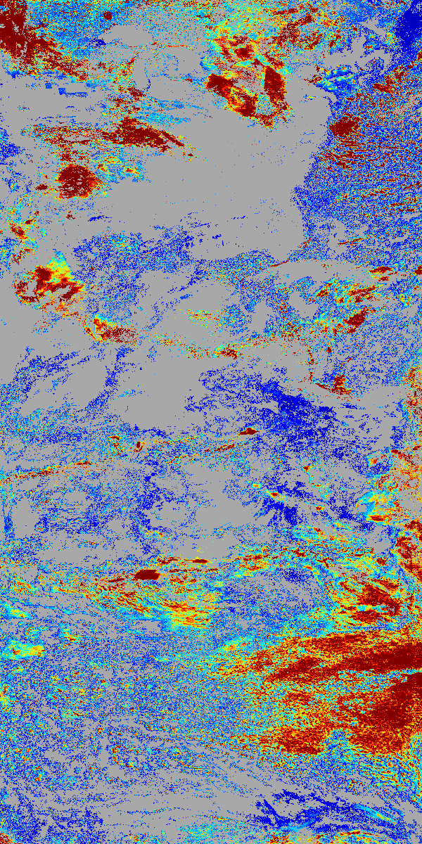
Synergy with JPSS
The AWG Cloud Algorithms are the basis for the JPSS-RR Algorithm Continuity Cloud Algorithms being implemented into the NOAA-AIT FRAMEWORK.
Some AWG Cloud algorithms also modified to work with lunar reflectances from VIIRS. This has lead to new insight into our nighttime performance.
VIIRS+CrIS allows for good ABI spectral consistency. We are using SSEC PEATE data and running AWG ACHA on VIIRS + CrIS.
Lunar Reflectance
VIIRS Cloud Op. Depth

Slide 24
Conclusions
AWG Cloud Algorithms have been ported to the current suite of sensors, are running in real-time and finding application in many areas. AWG is big success story for the NESDIS cloud products.
Much of the current User Engagement (PG and real-time distribution) is subsidized by AWG. Is that consistent with AWG’s mandate?
We have had no Harris contact so we are wondering what the future responsibility is for us. Our funding levels can’t sustain the whole team.

Slide 25
Thank You!
Extra Material Follows

Slide 26
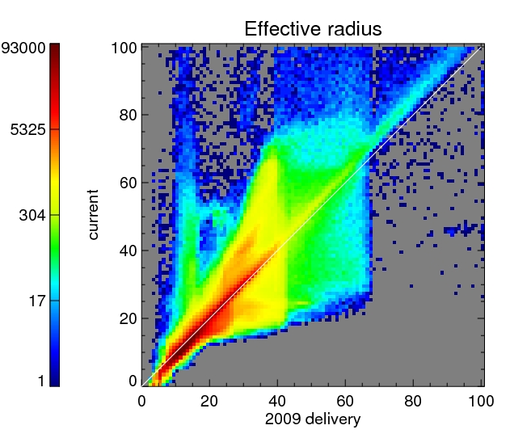
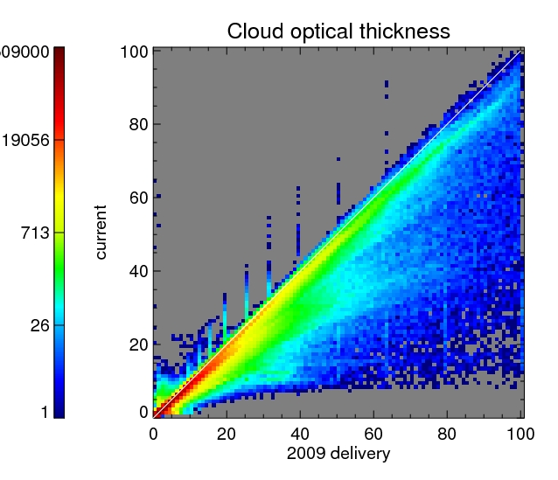
DCOMP Improvements since 2009 release
Overall performance remains similar
Improved inversion technique removes distinct ‘a-priori’ peaks in distribution
Improved atmospheric correction lead to slight differences particular at higher values

Slide 27
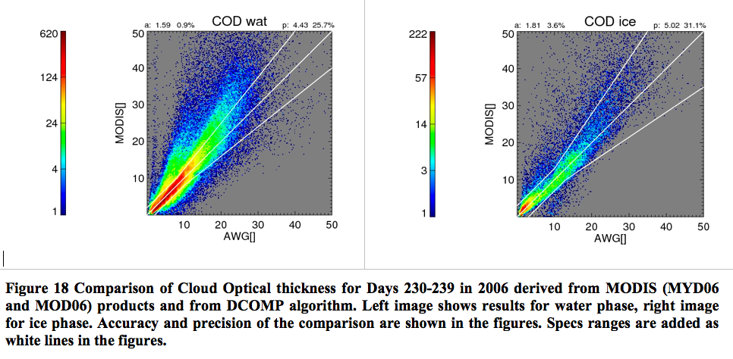
DCOMP Comparison to MODIS

Slide 28
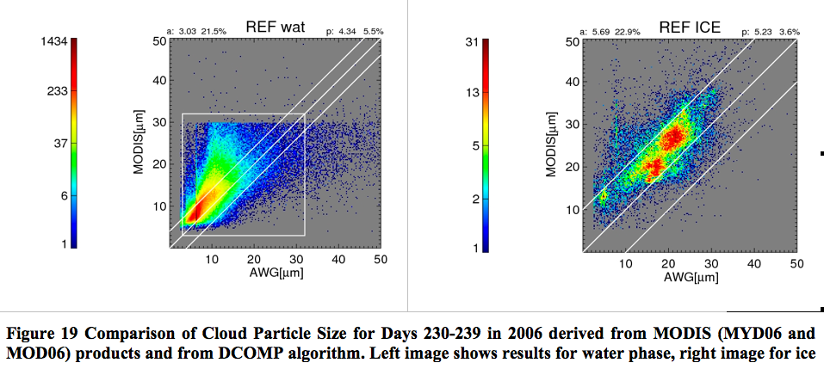
DCOMP Comparison to MODIS

Slide 29
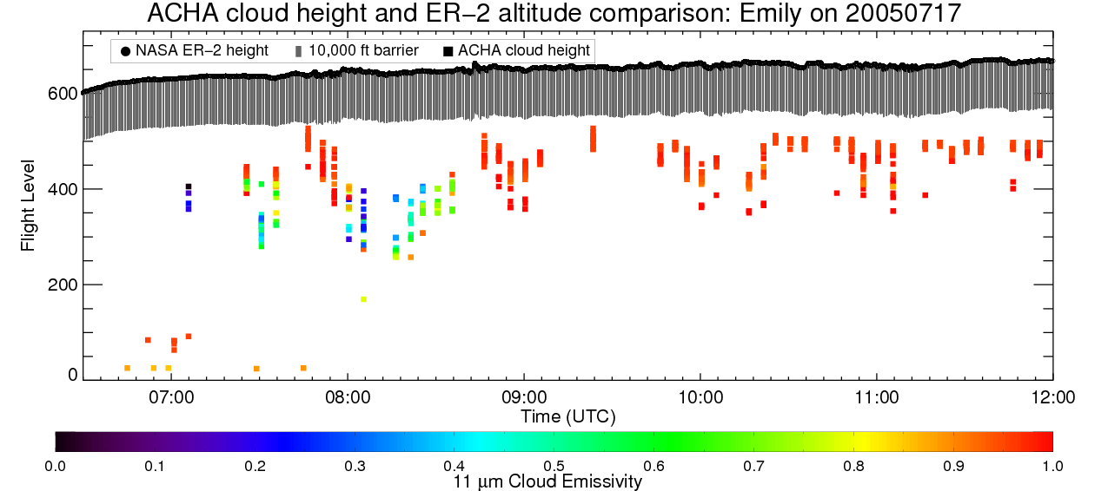
HS3 Example: Flight diversion Due to AWG Cloud Height
ACHA cloud heights for the ER-2 over-flight of Emily. ACHA cloud heights are the plotted squares, with the NASA ER-2 flight level (black line) and 10,000 ft. margin (grey shading) are also plotted.
Notes:
New Rules:
Regions with indicators of persistent convection, notably lightning with flash rates > 1-2 flashes/min or TOTs, should be avoiding unless they can be over-flown by at least 10,000 ft.
Regions of cold cloud tops that have not exhibiting indicators of intense convection as in (1) above should be considered acceptable for over-flights within 5000 ft. of cloud tops.

