Slide 1
2nd GOES-R AWG Validation Workshop
Winds Application Team
Topic: Hurricane Intensity Estimation (HIE) Algorithm
Chris Velden (CIMSS)
Tim Olander (CIMSS)
Jaime Daniels (STAR)

Slide 2
Outline
Product Generation and Assessment
Proxy products being used and recent validation methods/results
User engagement and interactions within GOES-R Proving Ground demonstrations
Algorithm Enhancements Beyond Baseline
Description of upgrades to current baseline algorithm
Test results and benefits of enhancements
Road to GOES-R Post-Launch Testing/Product Validation
Validation and user engagement plans

Slide 3
Product Generation and Assessment
HIE is currently an algorithm/product being assessed in the GOES-R Hurricane Proving Ground
Based on the current operational ADT algorithm developed at CIMSS
Provides intensity estimates during North Atlantic hurricane season utilizing 15-minute MSG SEVERI and GOES CONUS imagery
MSG east of 60° W
GOES CONUS west of 60° W and north of 15° N
Estimates available online in real-time since 2010 at :
http://tropic.ssec.wisc.edu/real-time/adt/goesrPG/adt-PG.html
CIMSS actively engages GOES-R PG HIE users for assessment of algorithm performance and recommendations for improvements
NHC analysts have noted cases when the higher-res imagery lead to better HIE response time to intensity changes vs. the ADT
CIMSS HIE team has addressed several issues highlighted during independent analysis of HIE during the PG process

Slide 4
Product Generation and Assessment
Analysis by Jack Beven (NOAA/NHC) for GOES-R PG review
2011/2012 HIE Validation Comparison
Vs. NHC Best Track | Max Wind Error (kt) | Max Wind Bias (kt) | MSLP Error (mb) | MSLP Bias (mb) | CI# Error | CI# Bias
2011 | 9.2 | -2.0 | 5.3 | -0.1 | 0.46 | -0.12
(# data points) | 1890 | 1890 | 1725 | 1725 | 1890 | 1890
2012 | 11.4 | -2.6 | 8.4 | 0.9 | 0.57 | -0.17
(# data points) | 1482 | 1482 | 1479 | 1479 | 1482 | 1482
The 2012 stats are slightly worse than for 2011. The most likely reason is a large number of sheared and hybrid storms (Sandy) in the 2012 data set.
Required AWG HIE Accuracy (5 m/s) and Precision (8 m/s)

Slide 5
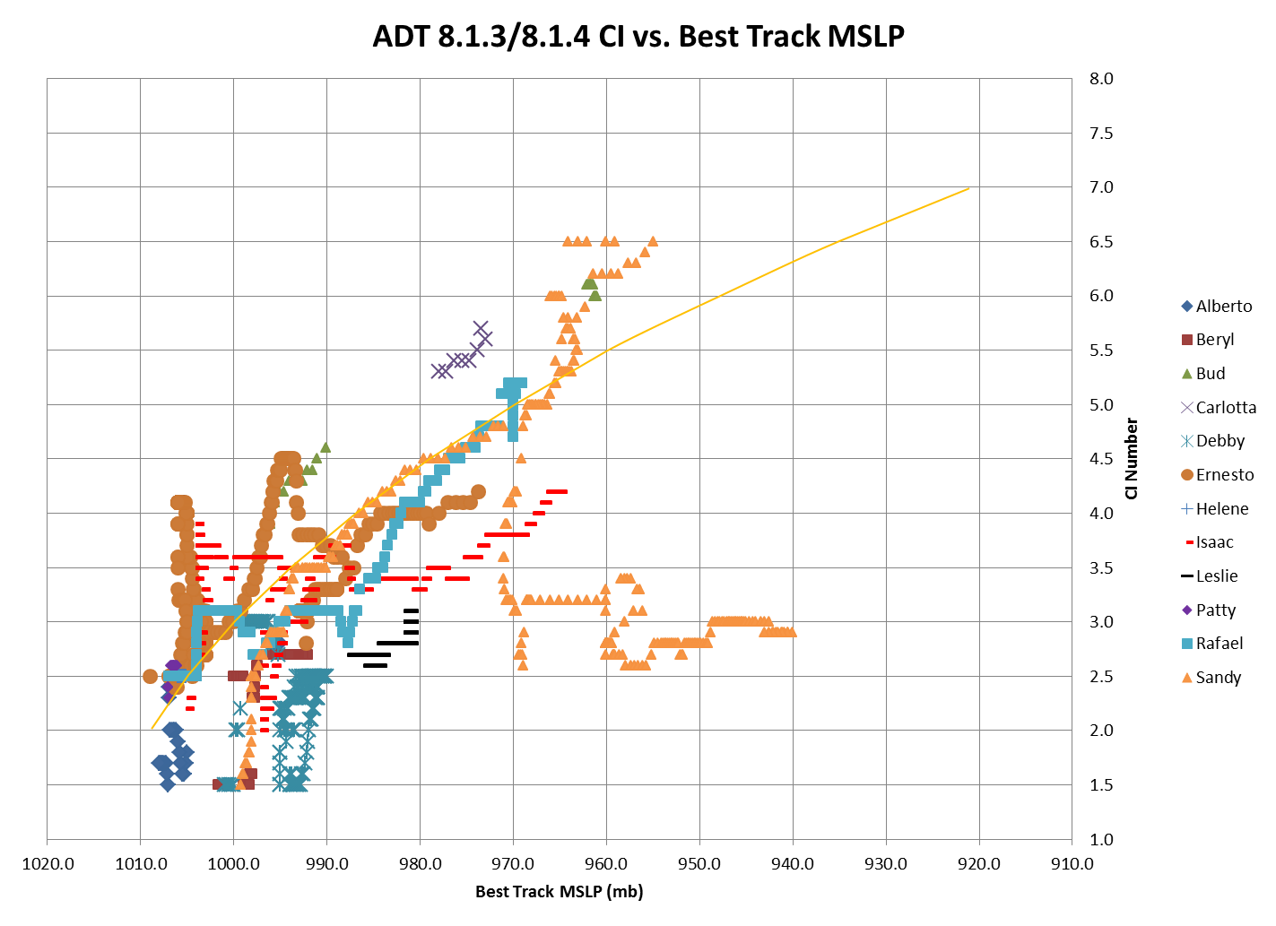
Product Generation and Assessment

Slide 6
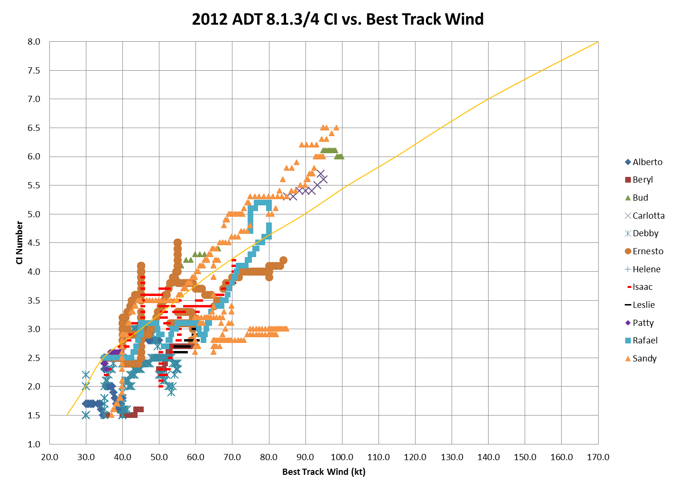
Product Generation and Assessment

Slide 7
Product Generation and Assessment
HURRICANE MICHAEL DISCUSSION NUMBER 13 NWS NATIONAL HURRICANE CENTER MIAMI FL AL132012 500 AM AST THU SEP 06 2012 MICHAEL HAS CONTINUED TO INTENSIFY OVER THE PAST SEVERAL HOURS WITH THE EYE BECOMING WARMER AND THE EYEWALL CONVECTION STAYING STRONG. WHILE SUBJECTIVE ESTIMATES WERE NEAR 90 KT AT 0600 UTC...OBJECTIVE ESTIMATES FROM ADT AND THE GOES-R HIE PRODUCT HAVE RECENTLY BEEN BETWEEN 107 AND 110 KT. A BLEND OF THESE DATA GIVE AN INITIAL WIND SPEED OF 100 KT...MAKING MICHAEL THE FIRST MAJOR HURRICANE... CATEGORY THREE OR HIGHER...OF THE SEASON.
GOES-R Proving Ground Feedback comment (6 Sept 2012)
desk = HSU Atlantic
product = Hurricane Intensity Estimate
time = 08Z 9/6/2012
feature = Hurricane Michael
use = TC Analysis
comment = The HIE was quite responsive to the rapid intensification of Michael overnight.
Forecasters used the HIE as part of the justification to increase the intensity on the 09Z
advisory to 100 kt:
HURRICANE MICHAEL DISCUSSION NUMBER 13
NWS NATIONAL HURRICANE CENTER MIAMI FL AL132012
500 AM AST THU SEP 06 2012
MICHAEL HAS CONTINUED TO INTENSIFY OVER THE PAST SEVERAL HOURS WITH
THE EYE BECOMING WARMER AND THE EYEWALL CONVECTION STAYING STRONG.
WHILE SUBJECTIVE ESTIMATES WERE NEAR 90 KT AT 0600 UTC...OBJECTIVE
ESTIMATES FROM ADT AND THE GOES-R HIE PRODUCT HAVE RECENTLY BEEN
BETWEEN 107 AND 110 KT. A BLEND OF THESE DATA GIVE AN INITIAL WIND
SPEED OF 100 KT...MAKING MICHAEL THE FIRST MAJOR HURRICANE...
CATEGORY THREE OR HIGHER...OF THE SEASON.

Slide 8
Algorithm Enhancements Beyond Baseline
Code differences (HIE vs. ADT)
Current ADT version at CIMSS is v8.1.5
v8.1.4 delivered and operational at NESDIS/SAB (v8.1.5 delivery: Spring 2014)
HIE is ADT version 8.1.2
Major upgrade: ADT module (v8.1.4) now directly accesses and interrogates polar satellite microwave (PMW) data and internally derives “eye score” values (instead of using externally-derived values as needed by the HIE)
ADT code was rewritten to modify logic
ADT code also has many more PMW rules, such as;
“HOLD” intensity if PMW data is >8 hrs old
Resetting PMW implementation if T# falls below 4.0 (allows for new PMW impact in storms that go through major intensity cycles)
Land interaction rule (over land for 6 hours turns off PMW rules)

Slide 9
Algorithm Enhancements: Beyond Baseline
Code differences (HIE vs. ADT)
Scene Type regression equations have been empirically modified to adjust for biases noted in validation studies
HIE currently does not have new equations for converting CI# to MSLP
Inferior MSLP intensity estimates (not an AWG requirement, but users do want these values)
HIE currently does not output satellite viewing angle or satellite type ID into history file listing/bulletin (ADT does, based on user requests)

Slide 10
Algorithm Enhancements Beyond Baseline
Code differences (HIE vs. ADT)
ADT code relies upon internal McIDAS-X based navigation and calibration routines when reading in GOES satellite imagery, while HIE will use AIT framework imagery via GEOCAT
HIE and ADT input data may be slightly different (HIE uses different method to obtain brightness temperatures than ADT). ADT uses McIDAS-X AREA files and calibration code to obtain brightness temperatures, while HIE framework "runs” AREA files through GEOCAT to get radiance and then converts to Brightness temperature using Planck Function. This can cause differences of 0.01 to 0.05 degrees K.
AER/Harris HIE code is being written completely in C++ while the ADT code is written mostly in C
As a result, meshing recent ADT updates with AER/Harris code could be difficult
May require extensive effort to correctly implement the new PMW differences

Slide 11
Algorithm Enhancements Beyond Baseline
Implementation differences (HIE vs. ADT)
HIE (to our knowledge) has not been tested on non-GOES satellites within the AWG framework. The current ADT operates on Meteosat, MSG and MTSAT geo satellites to fulfill SAB tropical cyclone monitoring requirements. It is our understanding that the current GOES-R requirement for HIE is for operation on GOES-R family of satellites only.
HIE will not allow any user interaction (such as manual scene type or location overrides). Current ADT v8.1.4/5 does (user request).
HIE "official output requirement" is a single wind speed value ONLY!
ADT outputs a current intensity analysis bulletin and history file listing of parameters requested by users. These are currently not required in HIE.
HIE output will be into a netCDF file instead of the current ADT ASCII-format history file. Will “Tailored Outputs” be available for users?
Current Intensity Estimate “Bulletin” with multiple parameters listed
History file “listings” with all user-requested present/past information
Graphical “time-series” display of intensity estimates
Current ADT output analysis products are regularly utilized by operational forecasters, and are a necessary and essential part of the ADT intensity estimation process

Slide 12
Post Launch
ADT/HIE developers at CIMSS will continue to work with our NOAA partners in the HIE algorithm implementation and P/L validation stages
Mimic current efforts involved with validating the operational ADT
Conduct annual statistical analysis with NESDIS/SAB to evaluate accuracy of ADT versus their subjective Dvorak estimates and NHC Best Track values (done since 2010) using routine metrics derived by NESDIS/SAB (example--next slide)
Code used to derive these statistical comparisons are the basis for GOES-R HIE validation software delivered to AIT in December 2010
Extend the validation efforts to include comparisons between the operational ADT and the HIE
Ensure compatibility of results.
Real-time monitoring: Troubleshoot any issues and/or notable differences.
Continue user participation through the GOES-R PG.

Slide 13
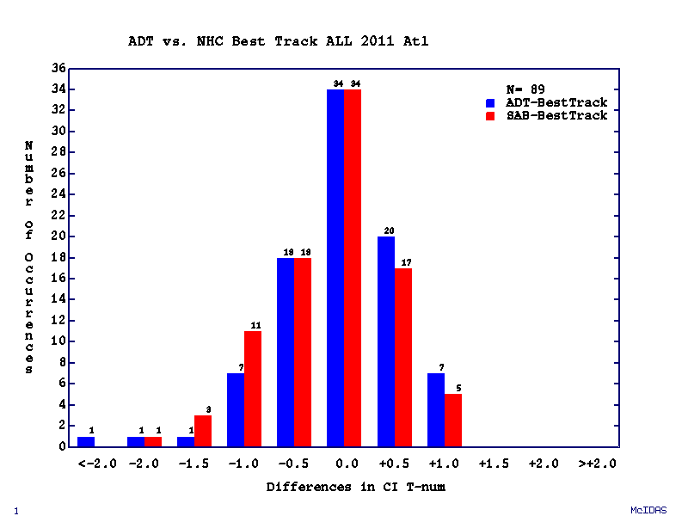
Post Launch
Example of Proposed P/L HIE Validation (patterned after current ADT validation methods)
NORTH ATLANTIC – 2011 TC Season
Independent comparisons between real-time ADT and subjective DT operational intensity estimates from NESDIS/SAB
Homogeneous sample: ADT and SAB estimates within +/- 30 minutes
Validated against NHC Best Track intensity (when aircraft reconnaissance in situ measurement within +/- 2 hours)
89 total matches (homogeneous)
bias aae stdv
SAB:CI# -0.14 0.45 0.57
SAB:Win -2.93 6.89 8.96
SAB:MSL 3.26 6.56 9.26
ADT:CI# -0.02 0.48 0.65
ADT:Win -0.74 9.80 11.82
ADT:MSL -0.77 6.39 8.52 Note: wind speed units in knots

Slide 14
Summary
The Advanced Dvorak Technique (ADT) is the “parent” algorithm for the GOES-R HIE (Hurricane Intensity Estimation) and continues to advance beyond the version delivered to GOES-R AWG/Harris/AER
Improvements based upon statistical analysis and empirical observations by CIMSS developers and aided by outside/independent users
Major additions to code:
Direct ingest and analysis of PMW data within ADT/HIE code; no longer relies upon externally-derived inputs/scores
PMW code is multi-language (C, C++, F90); will likely require extensive work to integrate with Harris/AER HIE code
HIE algorithm (in the form of modified ADT) is already being evaluated as part of the GOES-R Hurricane PG
NOAA/NHC provides in-season feedback, and annual evaluations
NESDIS/SAB continues to work directly with CIMSS ADT developers in implementing latest ADT versions into operations (via GOES PSDI) and conducting yearly evaluations. We deem this as a good model for PL validation of the HIE.

Slide 15
2nd GOES-R AWG Validation Workshop
Winds Application Team
Topic: Hurricane Intensity Estimation (HIE) Algorithm
Back-up Slides

Slide 16
Algorithm Enhancements Beyond Baseline
Test results: Proof of positive PMW “eye score” impact on ADT
In developing TC stages, ADT intensities often plateau during CDO events until an eye feature appears in IR imagery.
PMW imagery can better identify organizing eyewall structures below the cirrus shield.
Based on the amount of eyewall organization (wrap) and strength, a PMW “score” is calculated. This score is determined from objectively analyzed structure using 85GHz, and related to TC intensity based on empirically-derived thresholds.
Can result in the over-ride of the IR-based T# (depending on score, two different T# intensity estimates can be assigned (either T# = 4.3 or 5.0)).
Additional logic in ADT algorithm “merges” new PMW-derived T# values into existing history file to eliminate unnatural intensity jumps (linear extrapolation back 12 hours from PMW estimate point). New logic also linearly increments the PMW value forward in proportion to DvT model Tnum expected growth.

Slide 17
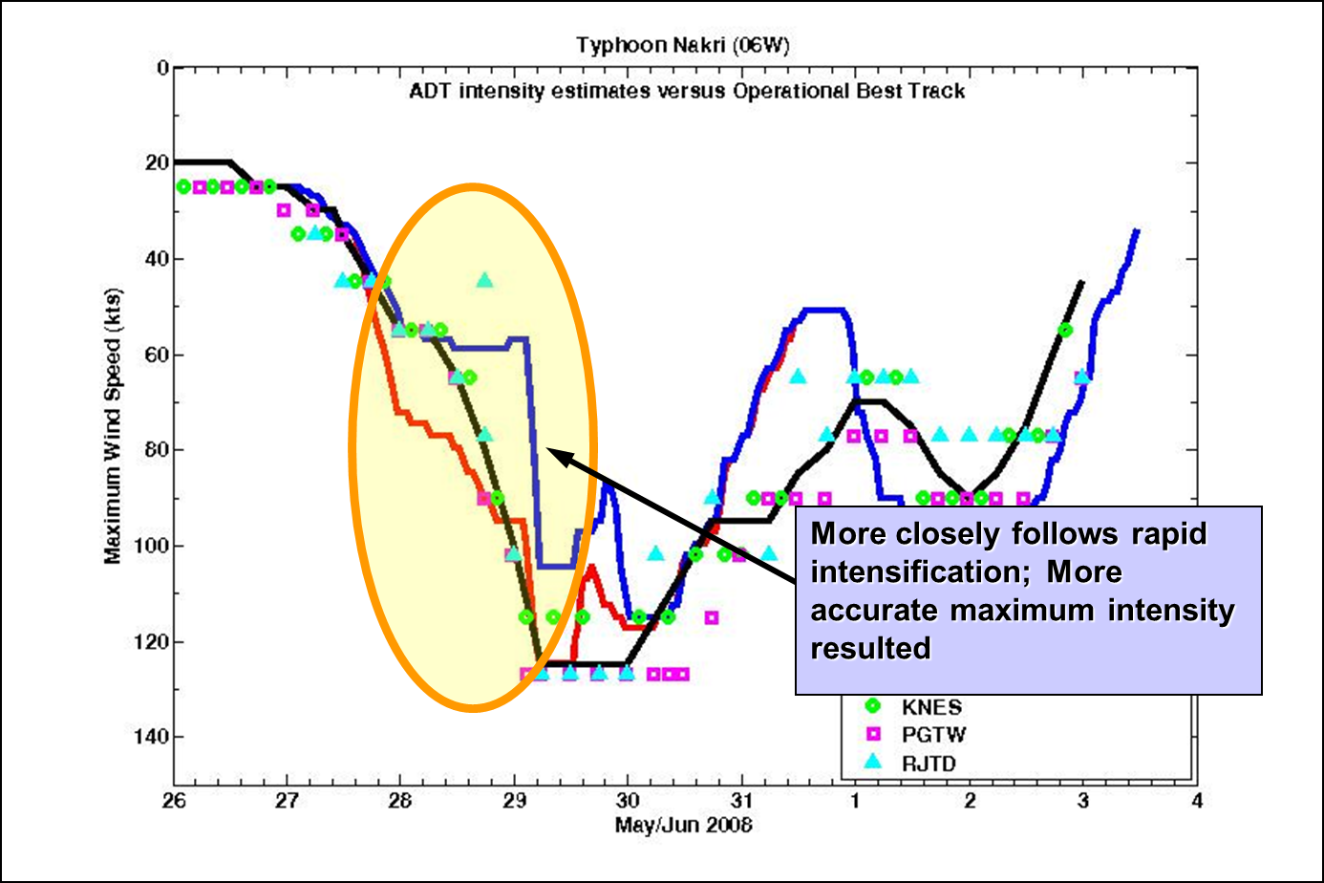
Algorithm Enhancements: Beyond Baseline

Slide 18
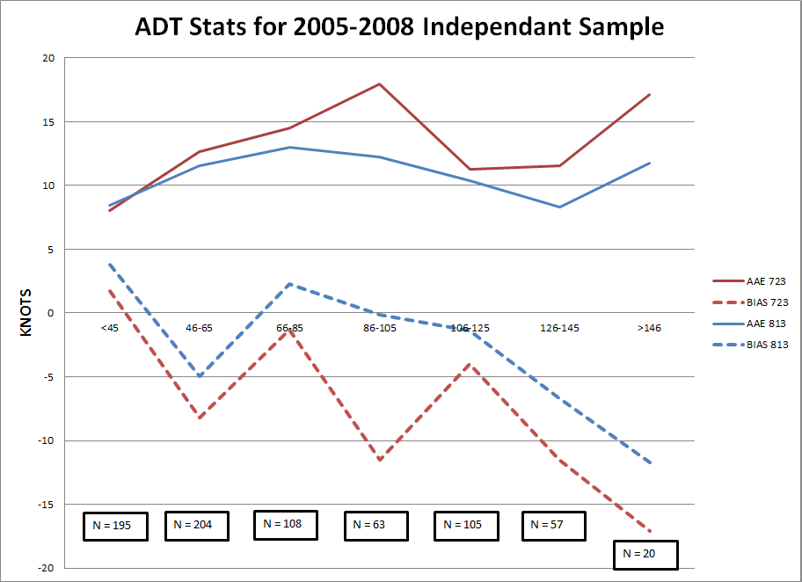
Algorithm Enhancements: Beyond Baseline
Comparison of latest ADT version (v8.1.3, with PMW) and previous version (v7.2.3, w/o PMW)
7.2.3 Mean Error
7.2.3 Bias
8.1.3 Mean Error
8.1.3 Bias
Intensity range affected most by
PMW “eye score” addition

