Slide 1


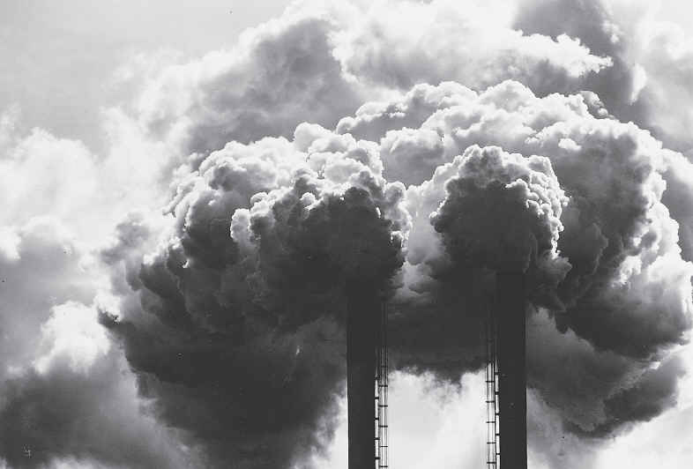
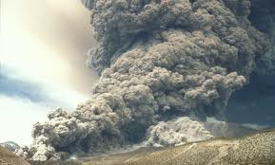
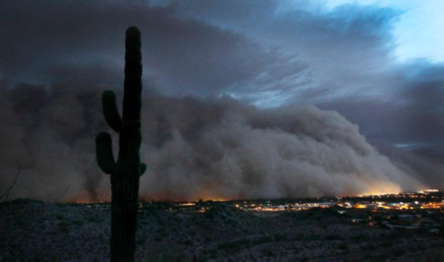
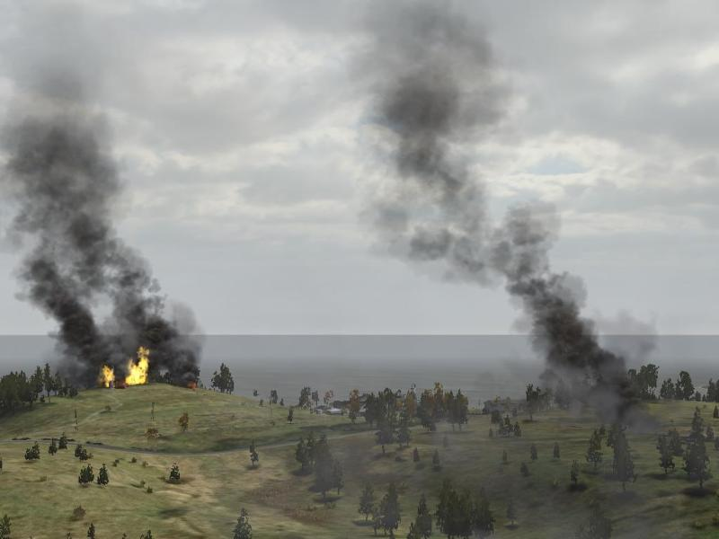
GOES-R ABI Aerosol Detection Product (ADP) Validation
Shobha Kondragunta¹ and Pubu Ciren²
¹NOAA/NESDIS/STAR ²IMSG@NOAA
Second AWG Validation Workshop
January 9-10, 2014

Slide 2
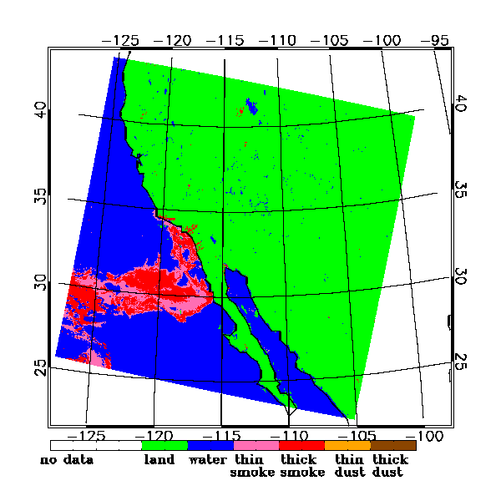
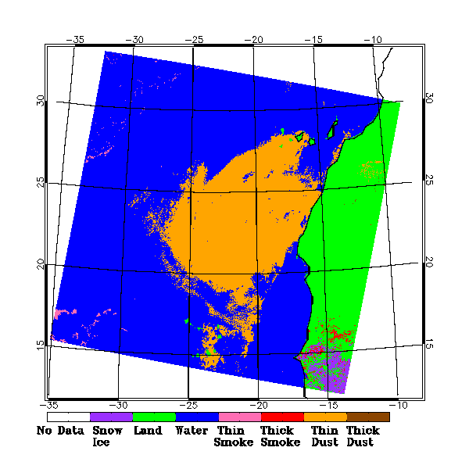
Product Generation and Assessment (1)
Aerosol Detection Product
Smoke and dust at 2 km resolution
Testing of the product and validation using proxy data is, however, done at pixel resolution
1 km for MODIS
750 m for VIIRS
Smoke from fires in California on October 28, 2003
Saharan dust storm off of Africa on September 4, 2005
Notes:
Provide a list of products and their specifications (spatial and temporal resolution, coverage). Include an example display(s) of your products.

Slide 3
Product Generation and Assessment (2)
Ongoing generation of ADP Level-2 proxy product with MODIS L1B as proxy.
Ongoing testing of ADP algorithm using VIIRS L1B as proxy.
Ongoing assessment of ADP dust mask with CALIPSO VFM and AERONET, and smoke detection with CALIPSO VFM and AIRS Carbon Monoxide (CO).
Notes:
Provide a list of products and their specifications (spatial and temporal resolution, coverage). Include an example display(s) of your products.

Slide 4
Product Generation and Assessment (3)
Future GOES Imager (ABI) Band | Nominal Wavelength Range (μm) | Nominal Central Wavelength (μm) | Nominal Central Wavenumber (cm-1) | Nominal sub-satelliteIGFOV (km) | Sample Use
1 | 0.45-0.49 | 0.47 | 21277 | 1 | Dust/Smoke
2 | 0.59-0.69 | 0.64 | 15625 | 0.5 | Dust/Smoke
3 | 0.846-0.885 | 0.865 | 11561 | 1 | Dust/Smoke
4 | 1.371-1.386 | 1.378 | 7257 | 2 | Dust/Smoke
5 | 1.58-1.64 | 1.61 | 6211 | 1 | Smoke
6 | 2.225 - 2.275 | 2.25 | 4444 | 2 | Smoke
7 | 3.80-4.00 | 3.90 | 2564 | 2 | Dust/Smoke
8 | 5.77-6.6 | 6.19 | 1616 | 2
9 | 6.75-7.15 | 6.95 | 1439 | 2
10 | 7.24-7.44 | 7.34 | 1362 | 2
11 | 8.3-8.7 | 8.5 | 1176 | 2
12 | 9.42-9.8 | 9.61 | 1041 | 2
13 | 10.1-10.6 | 10.35 | 966 | 2
14 | 10.8-11.6 | 11.2 | 893 | 2 | Dust/Smoke
15 | 11.8-12.8 | 12.3 | 813 | 2 | Dust/Smoke
16 | 13.0-13.6 | 13.3 | 752 | 2
M3
M7
M9
M10
M11
M12
M15
M16
VIIRS bands mapped to ABI

Slide 5
Product Generation and Assessment (4)
Source of Proxy input | Time period coverage | No. of events (Granules) |  | Geo- coverage
 |  | Dust | Smoke
MODIS L1B radiance | March 2000 - present | 526 | 263 | Global
VIIRS L1B radiance | June 2012 – present | 43 | 23 | Global
Simulated Radiance with WRF-CHEM (from CIMSS) | 2010.08.24-2010.08.25 | 0 | 1 | CONUS
Notes:
Provide a list of products and their specifications (spatial and temporal resolution, coverage). Include an example display(s) of your products.

Slide 6
Product Generation and Assessment (5)
Matchup criteria
Temporally: ±15 minutes from MODIS overpass time
Spatially: a circle with a 25 km radius centered around AERONET station
Dust and non-dust categories
AERONET
Dust: AOD > 0.3 and Angstrom Exponent < 0.6
Non-dust: Angstrom Exponent > 0.6
ADP
Dust: Ratio of dust/non-dust pixels in the matchup region > 66%
Non-dust: ratio of dust/non-dust pixels in the matchup region < 33%

Slide 7
Product Generation and Assessment (6)
AIRS Total column carbon monoxide (CO) is introduced as a validation dataset for smoke mask from ABI ADP
Advantages:
On the same platform as Aqua MODIS
High values of CO are present in smoke plumes from fires
Disadvantages:
Low spatial resolution ( ~14 km )
Retrieval sensitivity higher for elevated (mid troposphere) CO

Slide 8
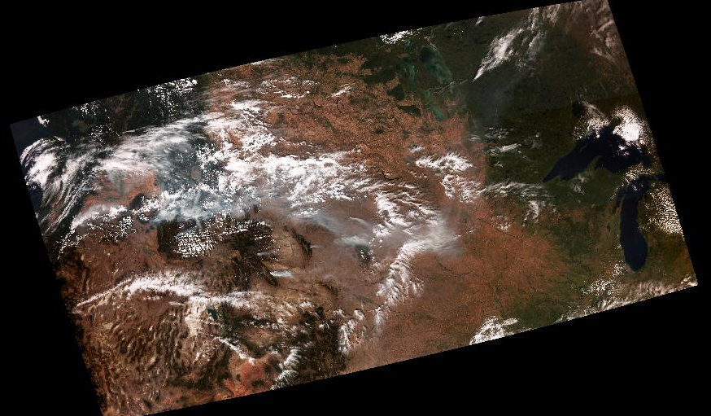
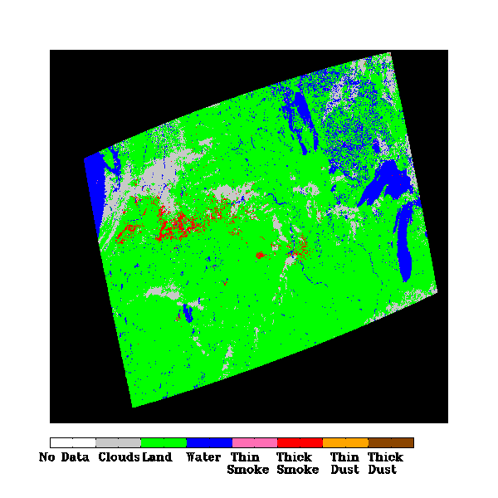
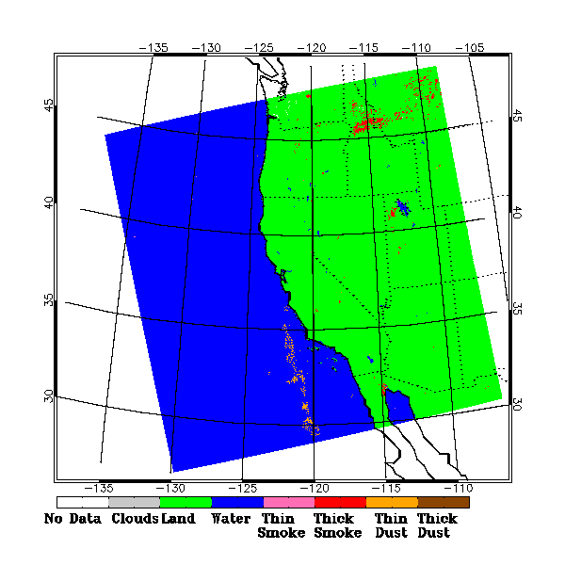
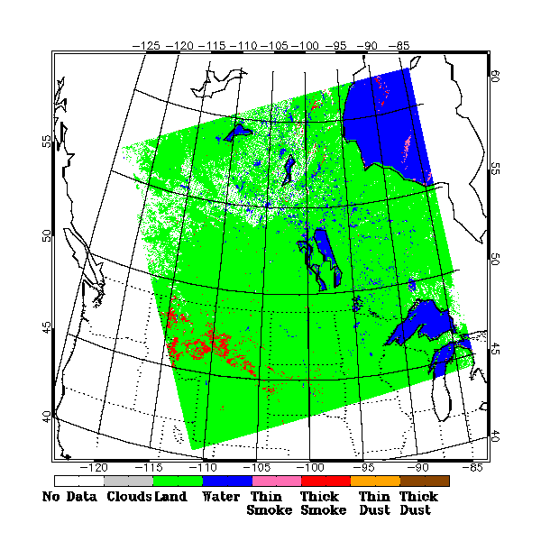
Product Generation and Assessment (7)
RGB image
Smoke from multiple fires in the western US
on 09/15/2012 captured by both Aqua MODIS and SNPP VIIRS.
ADP
ADP
UTC:2110
UTC:1935
SNPP VIIRS granules
Aqua MODIS granules

Slide 9
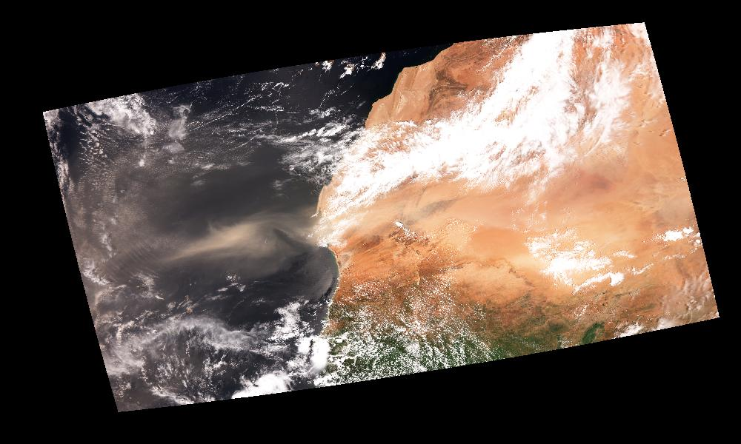
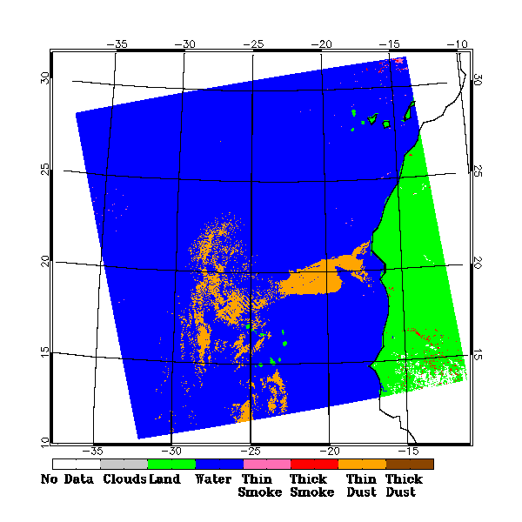
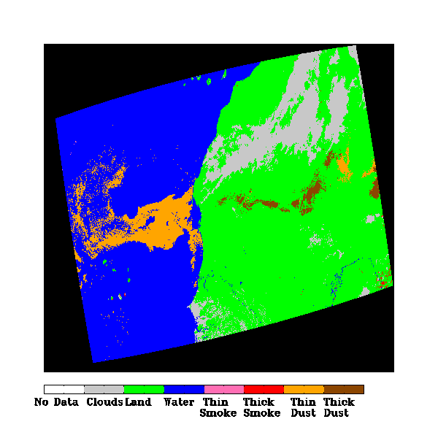
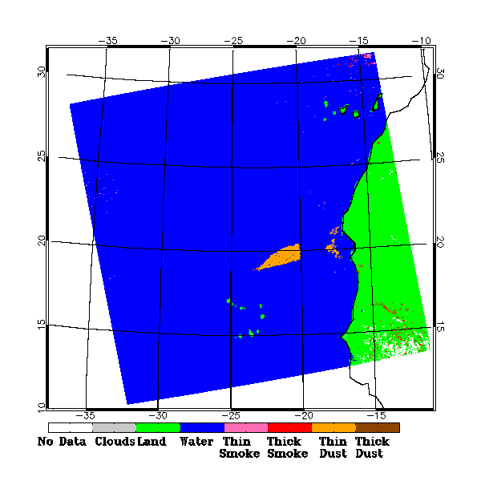
Product Generation and Assessment (8)
RGB image
Dust off of Africa on September 14, 2013 nicely captured when ABI algorithm was applied to VIIRS but not MODIS. Sunglint an issue for MODIS.
UTC:1455
SNPP VIIRS granules
Aqua MODIS granule

Slide 10
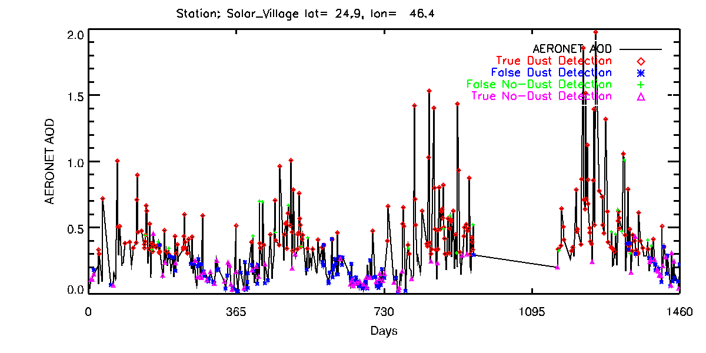
Product Generation and Assessment (9)
Time Series of Dust Detection Matchups with AERONET
POD=88%
FAR=38%
2006

Slide 11
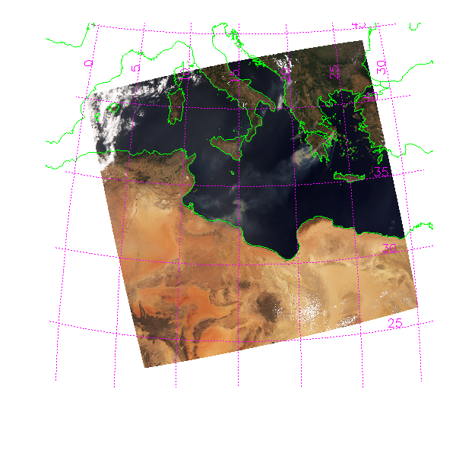
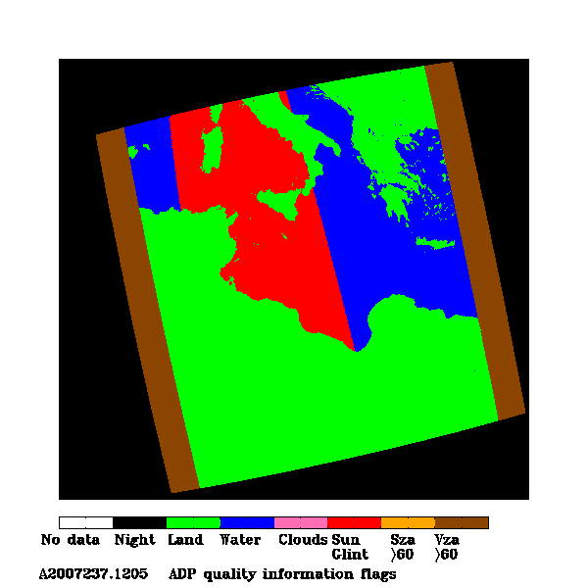
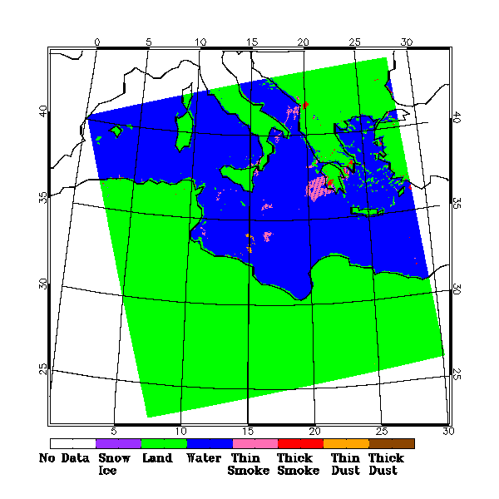
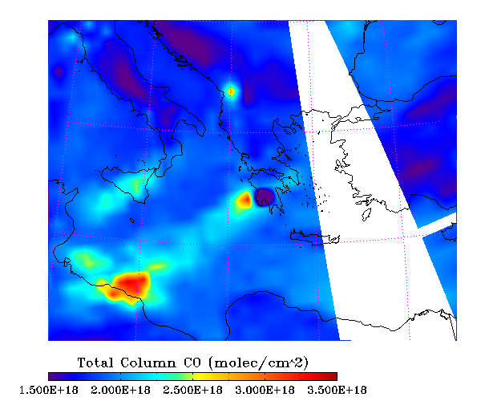
Product Generation and Assessment (10)
Aqua MODIS RGB
AIRS total column CO is being used to evaluate smoke detection from ABI ADP. ABI algorithm was tested on smoke from fires in Greece on August 25, 2007 observed by Aqua MODIS. Parts of the smoke plume well detected by ABI algorithm but a big blob of smoke plume was not detected.
AIRS Total column CO
ABI ADP
No smoke in ABI ADP corresponding to this CO plume. This is also the sun glint region.

Slide 12
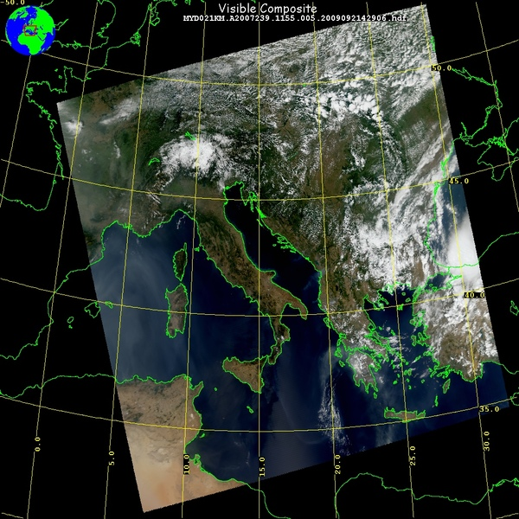
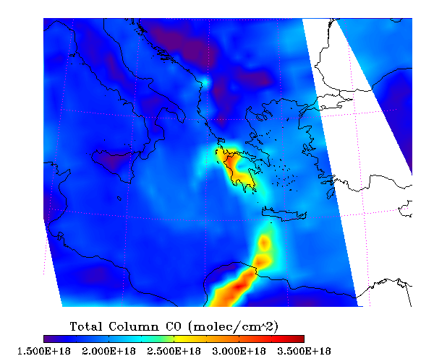
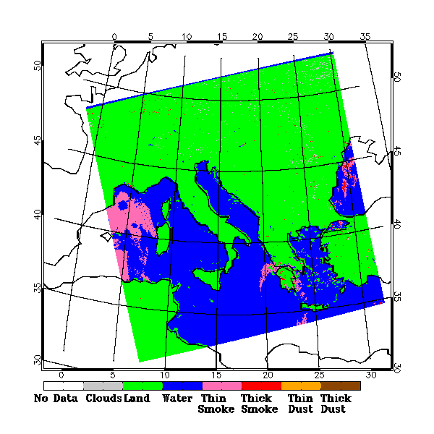
Product Generation and Assessment (11)
MODIS RGB
A few days later…on August 28, 2007
AIRS doesn’t have coverage (due to orbital gap) for the region that MODIS shows a very large area of smoke.
AIRS Total column CO
ABI ADP

Slide 13
Product Generation and Assessment (12)
User engagement (more focus on SM/AOD than aerosol detection)
NWS
Need: Operational air quality forecast verification
Engagement: through GOES-R air quality proving ground activities the last 4 years.
Annual workshops with hands on exercises and demos
PG telecons
Others (EPA, state/local agencies, …)
Need: air quality monitoring and exceptional events rule
Engagement: through GOES-R air quality proving ground activities the last 4 years
Annual workshops with hands on exercises and demos
Presentations at meetings such as AMS, AGU, etc.
Youtube videos (http://youtu.be/vuoDpVafZAA and http://youtu.be/k17IYMCcHvY) released (beta version) and played at NOAA booth during AGU and AMS.

Slide 14
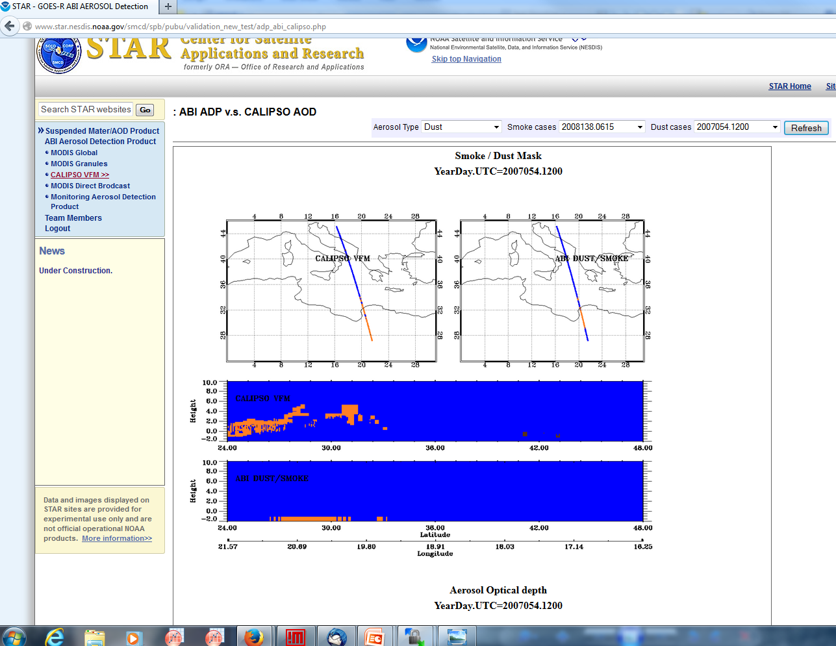
Routine Validation Tools against CALIPSO VFM
Routine processing of ABI ADP algorithm on MODIS L1B data and near real time evaluation using CALIPSO data
http://www.star.nesdis.noaa.gov/smcd/spb/pubu/validation_new_test/adp_abi_calipso.php
Match-ups and Statistics metrics are automatically generated and produced for each smoke/dust event.

Slide 15
Results from Routine Validation Tools against CALIPSO VFM: Dust
Performance metrics for Aqua MODIS dust mask from Dust Aerosol Index algorithm and ABI aerosol detection algorithm against CALIPSO Vertical Feature mask (VFM) product. Time period: from 2006 to 2012 with total 18358 matchups (15477 and 2881, respectively for over land and water).
Surface Type |  | Accuracy (%) | POCD (%) | POFD (%)
Land | VIIRS DAI algorithm on MODIS | 70.0 | 80.6 | 49.7
 | ABI ADP algorithm on MODIS | 63.6 | 44.1 | 74.2
Water | VIIRS DAI algorithm on MODIS | 82.3 | 76.1 | 18.9
 | ABI ADP algorithm on MODIS | 66.1 | 59.5 | 25.4
Specification for ABI dust detection is 80% over land and water
POCD: Probability of Correct Detection
POFD: Probability of False Detection

Slide 16
Results from Routine Validation Tools against CALIPSO VFM: Smoke
Performance metrics for Aqua and Terra MODIS smoke detection using ABI ADP algorithm.
Surface Type | Accuracy (%) | POCD (%) | POFD (%)
Land | 69.1 | 66.7 | 28.6
Water | 73.6 | 63.4 | 31.6
Specification for ABI smoke detection is 80% over land and 70% over water
POCD: Probability of Correct Detection
POFD: Probability of False Detection

Slide 17
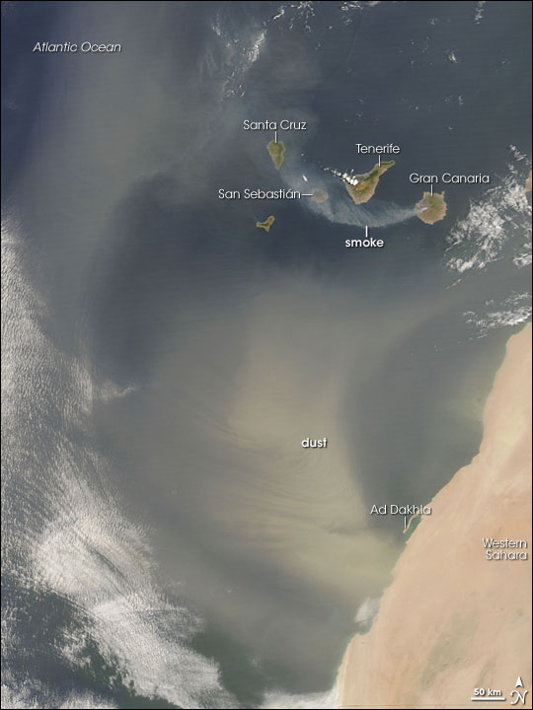
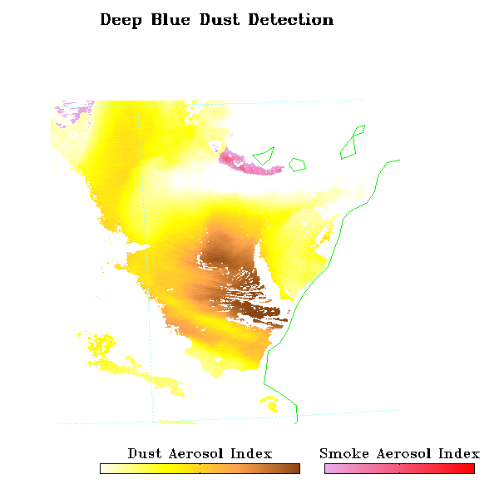
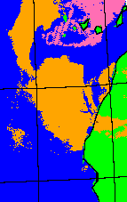

A case study of mixed dust and smoke on July 28, 2007
ABI ADP on MODIS

Slide 18
Algorithm Enhancements
Internal cloud tests to improve cloud/dust discrimination.
Bright pixel index to reduce false dust detections.
NDVI and view angle dependent thresholds
Aggregate the pixel level retrieval to a 2-km product

Slide 19
Post-Launch Test (PLT) and Post-Launch Product Validation
Work with calibration team to determine that all ABI bands are fully functional.
Tune thresholds with collocated CALIPSO VFM.
Generate global monthly mean smoke/dust fraction and compare to both CALIPSO and MISR to evaluate ABI ADP spatial and temporal patterns.
Compare ABI ADP to SNPP VIIRS dust and smoke.
Focus on Alaska in the evaluation because of availability of multiple views from VIIRS.

Slide 20
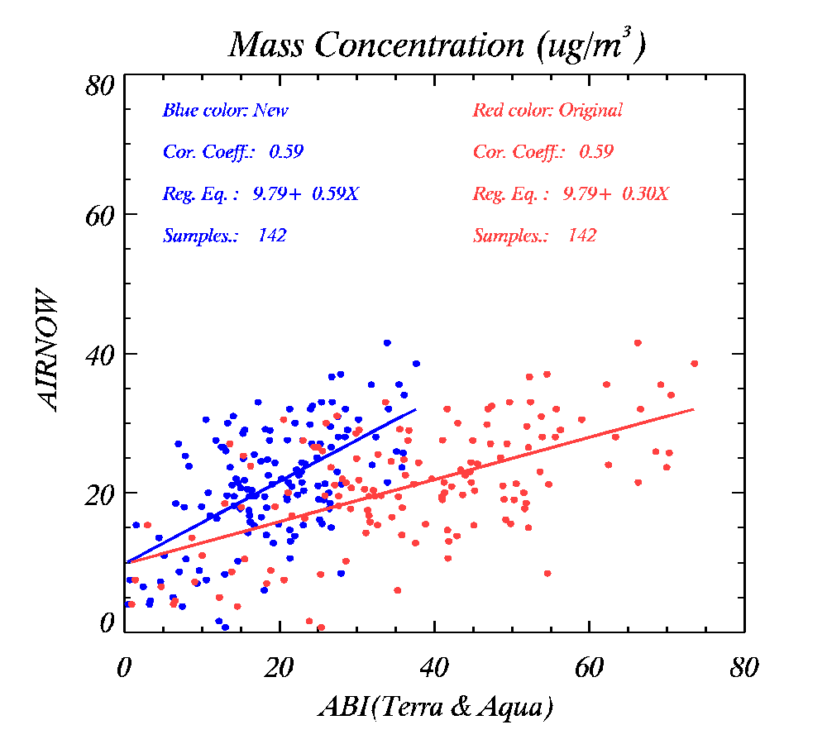
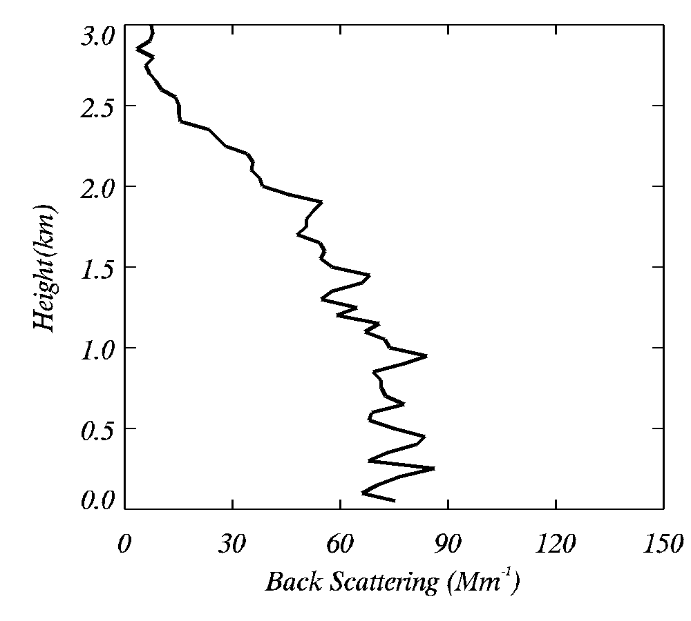
ABI Retrieval | Bias | RMS
Aerosol height (h) from 6S | 13.53 | 14.50
Aerosol height (h) from aircraft | -4.30 | 6.20
h
ABI vs. AIRNOW July 2011 mass concentration (PM2.5) comparisons during DISCOVER-AQ
GOES-R ABI estimates of surface PM2.5 correlate well with AIRNOW (ground) but there is a bias of 13.53 µg/m3 (data in red)
In scaling ABI AOD to PM2.5, a 3 km aerosol height was assumed as in 6S radiative transfer model. Aircraft data show aerosol height of 1.1 km.. Therefore, ABI estimates of surface PM2.5 were adjusted accordingly.
Analysis indicates that knowing aerosol height is very important when AOD is scaled to surface PM2.5 concentrations.
Chuanyu Xu of IMSG contributed to the aircraft data analysis

Slide 21
Summary
Processing ABI ADP algorithm over a long time period revealed some algorithm issues:
False dust detections over bright surfaces which will be avoided with the introduction of “bright pixel index based on NDVI” to screen out the bright pixels;
Most matchups of CALIPSO were also for thin dust plumes for which ABI is not expected to perform well (only plumes with AOD > 0.2 are expected to be detected);
Performance metrics for smoke are closer to specifications but metrics depend on matchup data. Sample size is not large enough due to narrow CALIPSO scan;
Additional validation datasets (AIRS CO and VIIRS ASDA product) will be considered in the future for evaluation of ABI smoke detection.
Comparison of ABI ADP with VIIRS dust detection has shown that the lack of 412 nm on ABI is going to be a short coming.
Evaluation of ABI suspended matter (PM2.5 concentration)
Field campaign data from DISCOVER-AQ (B-W area, Califorina San Joaquin valley, Houston) will be acquired to generate validation statistics stratified by geographic region and aerosol type.

