Slide 1
Updates on GOES-R Aerosol Optical Depth Validation
Mi Zhou (IMSG)
Istvan Laszlo (STAR)
Hongqing Liu (IMSG)
Pubu Ciren (IMSG)
Shobha Kondragunta (STAR)

Slide 2
OUTLINE
Generated Proxy Data
Algorithm Enhancements
Validation Activities
Post-launch Plan
Summary

Slide 3
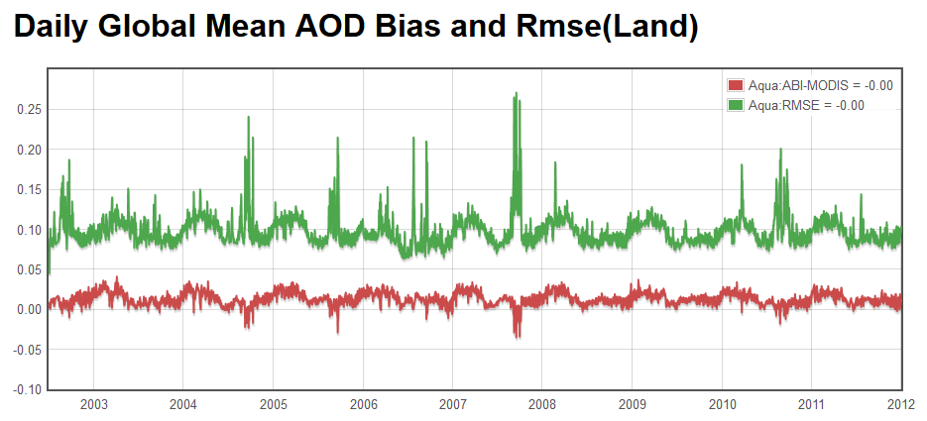
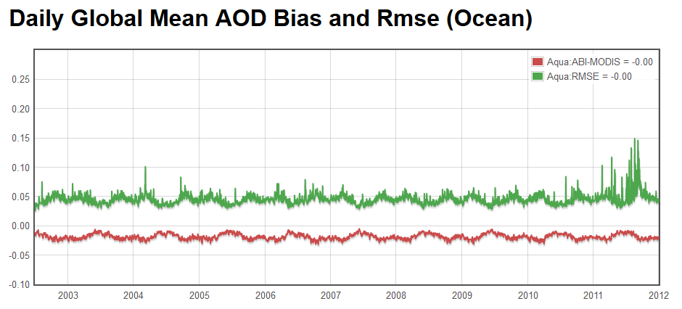
Proxy MODIS Reflectance
MODIS reflectances are used as proxy for ABI to retrieve AOD
Many MODIS and ABI channels are similar
Provide a wide range of realistic atmospheric and surface conditions.
Currently routine and deep-dive validation use clear-sky reflectance from MOD04 aerosol product
Obtained from MODIS collection 5 aerosol product at 10km resolution;
Avoid ABI vs. MODIS cloud screening differences;
Since 1st Workshop evaluation has been extended from years 2000 – 2009 to years 2000 – 2012.
Newly generated L1b reflectance at ABI channel resolution
MODIS L1b reflectance are processed to ABI channel resolution (2 km);
Provide the opportunity to test cloud screening for ABI aerosol algorithm.
ABI vs. MODIS/Aqua AOD

Slide 4
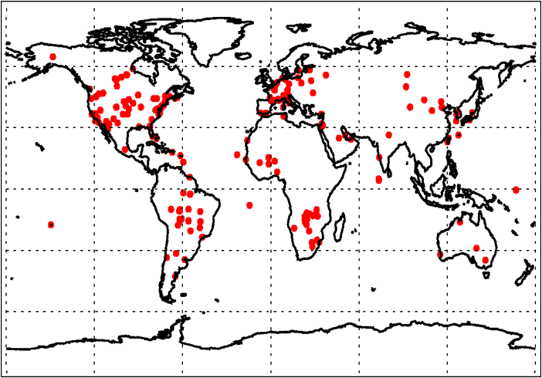
AERONET Ground Truth
The ground-based AERONET remote sensing network provides a comprehensive dataset of aerosol properties for evaluating satellite retrievals.
Level 1.5 data: automatically cloud-cleared; time lag of one or two days; potential for near-real time routine validation.
Level 2.0 data: quality assured and widely used; but the time lag can be several months or longer; included for deep-dive validation.
AERONET Stations
09/2007

Slide 5
Available Proxy Dataset
AERONET-ABI(MODIS )match-up data:
AERONET data are temporally averaged within 1-hour window around MODIS overpass
ABI data AOD retrievals are spatially averaged in a 50x50 km box centered at AERONET station.
Collected and co-located
AERONET level 2.0 and MOD04 clear-sky reflectance at 10-km resolution for years 2000-2012;
AERONET level 1.5 and MOD04 clear-sky reflectance at 10-km resolution for years 2010- Nov 2013;
AERONET level 2.0 and MODIS L1b reflectance at ABI channel resolution (2 km) for year 2009.
ABI aerosol algorithm is run using proxy MODIS reflectances and ABI AODs are validated with AERONET.
Notes:
5
5

Slide 6
Field Campaign Data
AOD at 550nm, July 30, 2012
Field measurements at Cape Cod, MA (for deep dive)
Location: 42.03°N, 70.05°W, near the ocean
Part of the Two-Column Aerosol Project (TCAP) (ARM field campaign)
Surface albedo and AOD measurements (partially supported by GOES-R Proving Ground to Joseph Michalsky and Kathy Lantz, NOAA/ESRL)
Instruments: MFRSR and MFR (sampled every 20 seconds simultaneously)
Deployment period: 28 June to 6 September, 2012
Wavelengths: 413, 496, 671, 869, 937, 1623 nm
Estimated uncertainty: is 0.01 in AOD, 2% in albedo
Albedo at 496nm, July 30, 2012

Slide 7
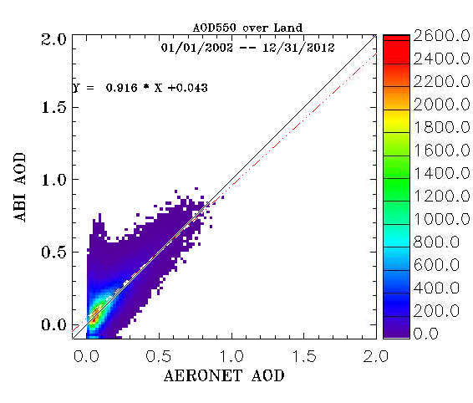
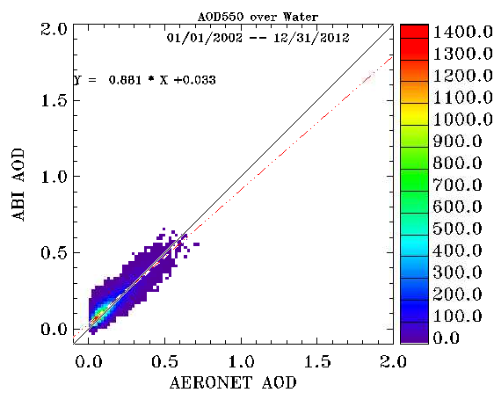
Validation with Extended Dataset
Using AERONET-MODIS dataset for years 2002-2012
Over Land
Over Water
AOD range | Accuracy | Precision | # of points
<0.04 | 0.06 (0.06) | 0.13 (0.13) | 24,421
0.04 - 0.8 | 0.03 (0.04) | 0.13 (0.25) | 157,067
> 0.8 | -0.06 (0.12) | 0.32 (0.35) | 4218
Range | AOD | Accuracy | Precision | # of points
Low | <0.4 | 0.02 (0.02) | 0.06 (0.15) | 38,436
High | >0.4 | -0.05 (0.10) | 0.18 (0.23) | 3,221
ABI AODs meet requirements.
Notes:
7
7

Slide 8
Algorithm Enhancement –
Internal Cloud Check (1)
One Month Framework Run Validation for Aug. 2006
Range | Land |  |  |  | Water
 | AOD | Accuracy | Precision | # of points | AOD | Accuracy | Precision | # of points
Low | <0.04 | 0.14 (0.06) | 0.21 (0.13) | 100 | <0.4 | 0.08 (0.02) | 0.10(0.15) | 49
Medium | 0.04 - 0.8 | 0.08 (0.04) | 0.16 (0.25) | 748
High | > 0.8 | 0.12 (0.12) | 0.20(0.35) | 6 | >0.4 | 0.06 (0.10) | 0.04 (0.23) | 3
MODIS Aqua L1b reflectances at 1km resolution are used as proxy;
ABI cloud mask, “clear” pixel from the 4-level cloud mask, is used for cloud screening;
Numbers in red are F&PS requirements;
Framework run overestimates AOD and does not meet accuracy requirements for low and medium ranges over land, and for low range over ocean.
CAVEAT: Sample size is limited from one-month data! Statistics are not robust.
Notes:
8
8

Slide 9
Algorithm Enhancement –
Internal Cloud Check (2)
Case Study
While framework run with MODIS L1b reflectance does not meet all accuracy requirements, off-line run using MOD04 clear-sky reflectance for the same time period can meet the requirement.
Aqua granule MYD20062181840 was selected with co-location with AERONET at station CCNY.
ABI-framework uses ABI cloud mask.
ABI offline run uses the internal cloud checks.
Co-located AERONET Site
Site | Longitude | Latitude
CCNY | -73.949 | 40.821
 | AERONET | ABI-framework | ABI-offline
AOD | 0.266 | 0.641 | 0.325
Case study suggested that the ABI cloud mask may not be sufficient for ABI aerosol retrieval.

Slide 10
Algorithm Enhancement –
Internal Cloud Check (3)
Internal Cloud Check
LAND
Channel 0.47 um reflectance test (> 0.4)
Channel 1.38 um reflectance test (> 0.025)
Channel 0.47 um reflectance spatial variability test for standard deviation of 3x3 array (> 0.0025)
Channel 1.38 um reflectance spatial variability test for standard deviation of 3x3 array (> 0.003)
OCEAN
Channel 0.64 um reflectance spatial variability test for standard deviation of 3x3 array (> 0.003)
Dust call back 0.47/0.66 ratio (< 0.75)
Channel 0.47 um reflectance test (> 0.4)
IR cirrus tests – if any of 3 specific ABI Cloud Mask tests indicates ‘cloudy’, then ’cloudy’: PFMFT, CIRH2O, RFMFT
Channel 1.38 um reflectance test (> 0.025)
Apply reflectance threshold and spatial variability tests;
Use available ABI channel and ABI cloud mask.
Results for August 2006
Updated One Month Framework Run for Aqua, Aug. 2006
Range | Land |  |  |  | Water
 | AOD | Accuracy | Precision | # of points | AOD | Accuracy | Precision | # of points
Low | <0.04 | 0.04 (0.06) | 0.13 (0.13) | 93 | <0.4 | 0.01 (0.02) | 0.04 (0.15) | 45
Medium | 0.04 - 0.8 | -0.002 (0.04) | 0.13 (0.25) | 696
High | > 0.8 | -0.06 (0.12) | 0.15 (0.35) | 6 | >0.4 | 0.07 (0.10) | 0.06 (0.23) | 3
ABI AOD meets requirements when internal cloud test is used.

Slide 11
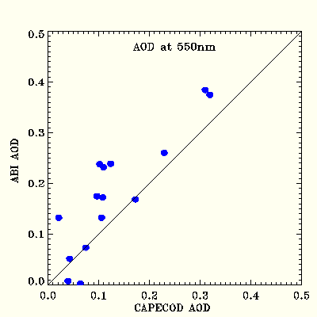
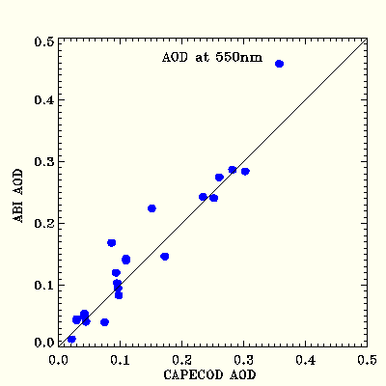
Validating AOD with Ground Measurements at Cape Cod
Over Land
Over Water
Bias: 0.04
Std: 0.06
Bias: 0.01
Std: 0.03
15 match-ups were found over land and 22 over water after spatially (50 x 50 -km box) and temporally (1-hour window) co-locating with MODIS.
MODIS L1b proxy reflectance was generated at ABI channel resolution, and ABI AOD algorithm was run to produce 2km product.
A better agreement is observed over water than over land.

Slide 12
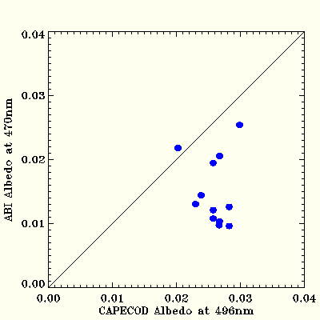
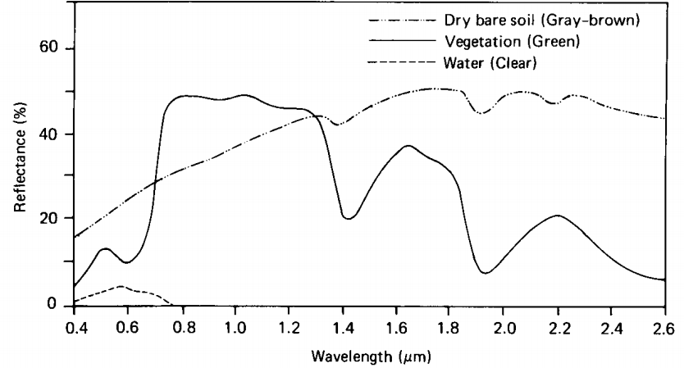
Validating Land Surface Albedo with Ground Measurements at Cape Cod
Bias: -0.010
Std: 0.006
The land surface relationship assumption between SWIR and VIS reflectance remains challenging for aerosol retrieval over land, and the current ABI aerosol algorithm uses a linear relationship.
ABI albedo at channel 470nm is chosen to compare with Cape Cod measurement at 496nm as there is no exact channel match.
The albedo at 496nm is expected to be larger than that at 470nm, which could partially explain the underestimation of albedo by ABI .
The land surface relationship between SWIR and VIS reflectance could be improved as a function of NDVI potential algorithm enhancement.
Vegetation
(Lillesand and Kiefer, 1994)

Slide 13
Is AERONET level 1.5 good enough for AOD validation?
Validating ABI AOD for year 2010
level 2.0
Over land, statistics are comparable for low and medium AOD ranges, which account for 98% land retrievals.
Over ocean, the statistics are generally comparable.
This suggests the feasibility to set up a near-real time routine validation of ABI aerosols using AERONET L1.5 data.
At high AOD range over land, the difference is noticeabe, which will need to be further validated when AERONET L2.0 data become available in deep-dive validation.
Range | Land |  |  |  | Ocean
 | AOD | Accuracy | Precision | # of points | AOD | Accuracy | Precision | # of points
Low | <0.04 | 0.06 | 0.14 | 4,552 | <0.4 | 0.02 | 0.06 | 5,842
Medium | 0.04 - 0.8 | 0.03 | 0.14 | 22,372
High | > 0.8 | -0.05 | 0.32 | 658 | >0.4 | -0.04 | 0.16 | 399
level 1.5
Range | Land |  |  |  | Ocean
 | AOD | Accuracy | Precision | # of points | AOD | Accuracy | Precision | # of points
Low | <0.04 | 0.05 | 0.14 | 4,942 | <0.4 | 0.01 | 0.07 | 6,616
Medium | 0.04 - 0.8 | 0.02 | 0.14 | 25,827
High | > 0.8 | -0.23 | 0.70 | 819 | >0.4 | -0.06 | 0.19 | 453

Slide 14
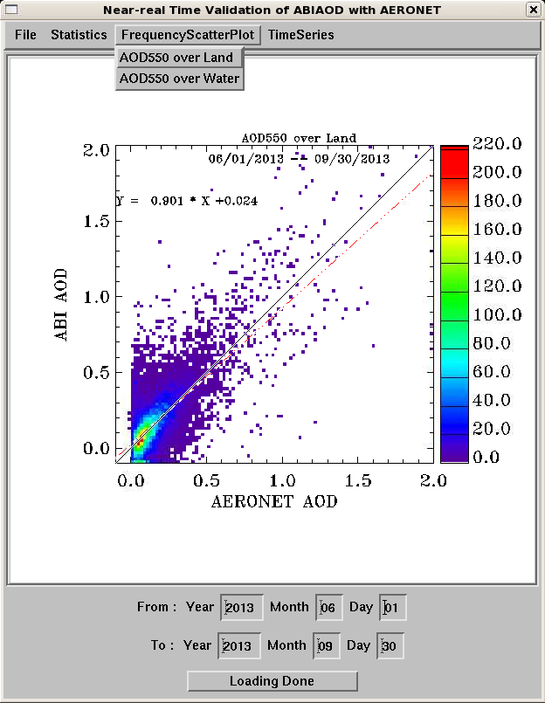
Routine Validation Tool
Example of frequency scatter-plot
AERONET level 1.5 instead of level 2.0 is used for near-real time validation.
Example frequency scatter-plot for September, 2013 over land is shown.
Users can specify validation period.
Users can choose from functions: statistics, frequency scatter-plot and time series.
The “Statistics” pull-down menu generates the scatter-plot and the metrics to characterize the AOD product accuracy and precision.
regression line

Slide 15
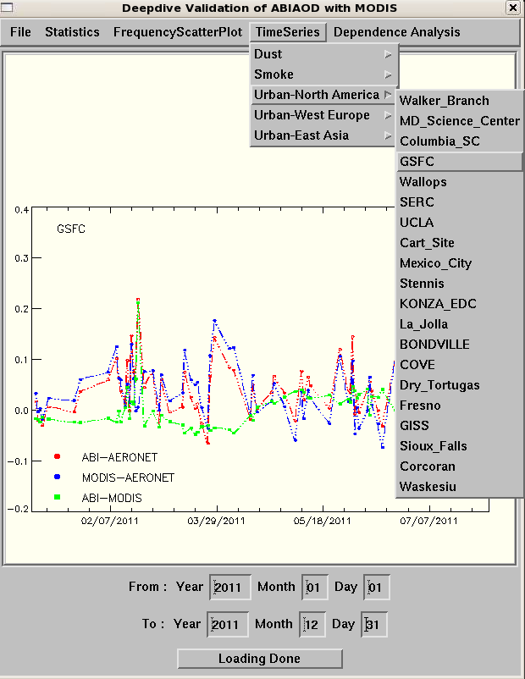
Deep – Dive Validation Tool
Same functions as in routine validation: statistics generation, scatter-plot/frequency scatter-plot and time series;
Add function for dependence analysis on parameter of interest: input, diagnostic, and intermediate.
Example: Cross validation between ABI, MODIS and AERONET level 2.0;
typical aerosol type
AERONET station
Notes:
15
15

Slide 16
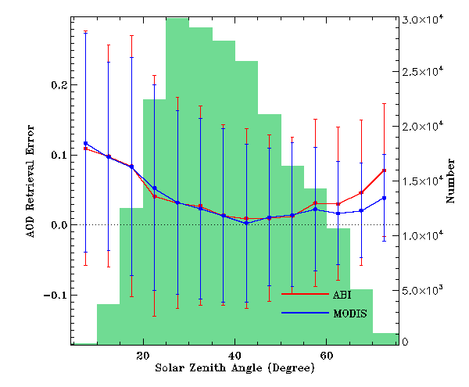
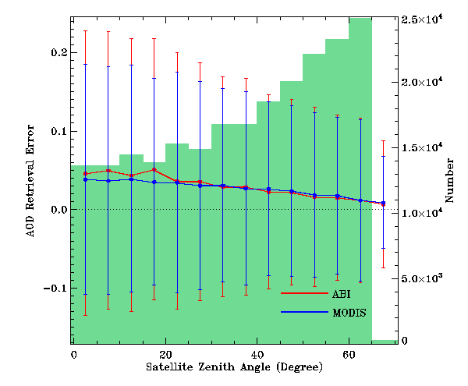
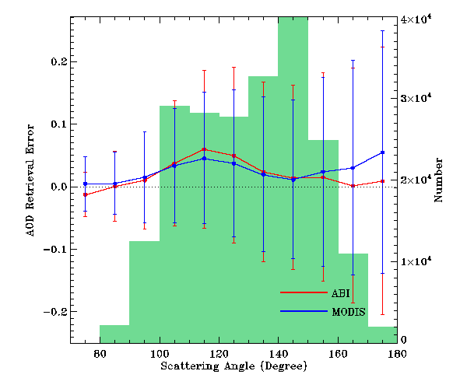
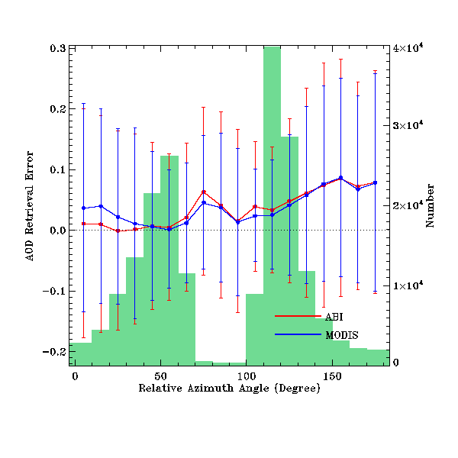
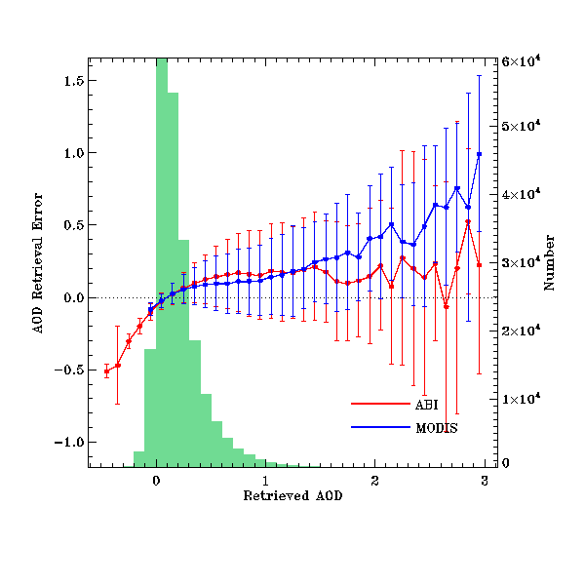
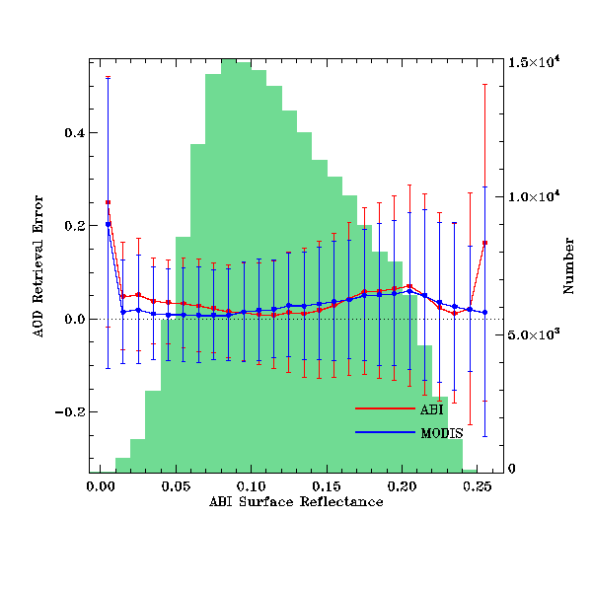
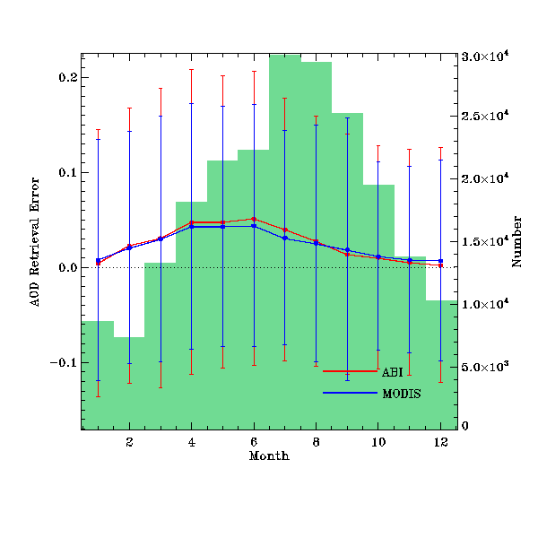
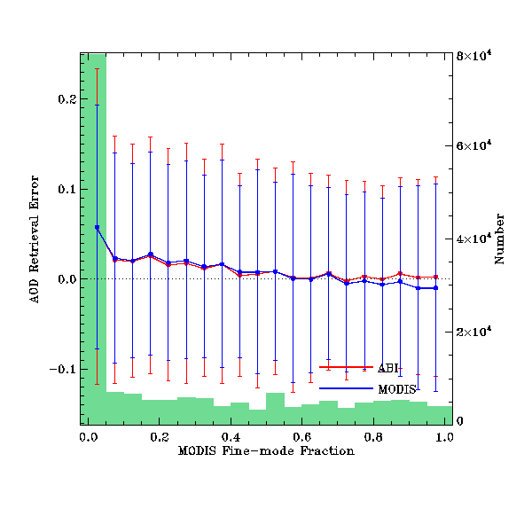
Dependence Analysis over Land
AOD retrieval error
Solar zenith angle
Satellite zenith angle
Scattering angle
Relative Azimuth Angle
AOD retrieval error
Month
Fine-mode fraction
Retrieved AOD
Retrieved surface albedo
ABI AOD retrievals run with co-located AERONET-MODIS dataset for years 2000-2012.
ABI and MODIS ADOs generally have similar pattern.
AOD error vs. retrieved AOD shows similar pattern for AOD range of 0 – 1.5; and ABI shows a smaller error for AOD > 1.5. Note that MODIS does not report AOD < -0.05.

Slide 17
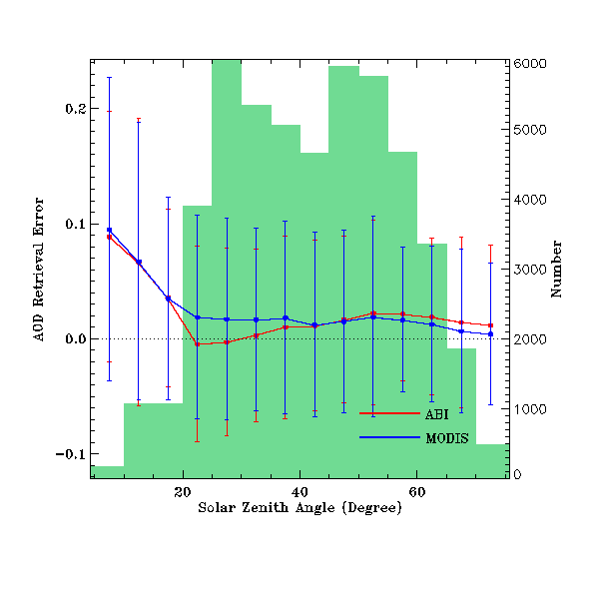
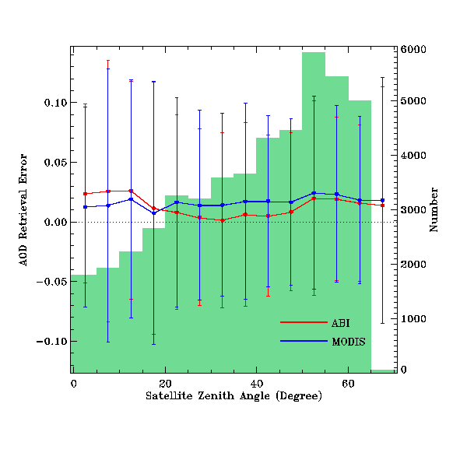
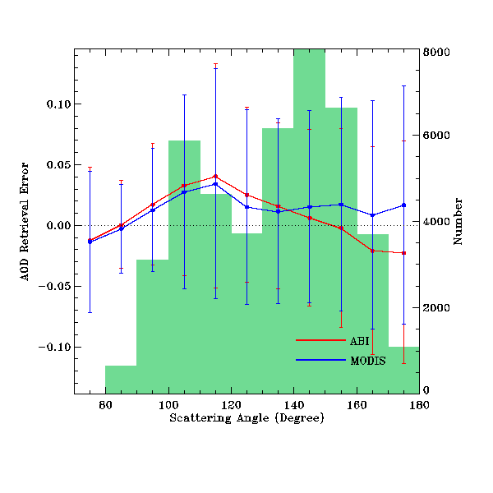
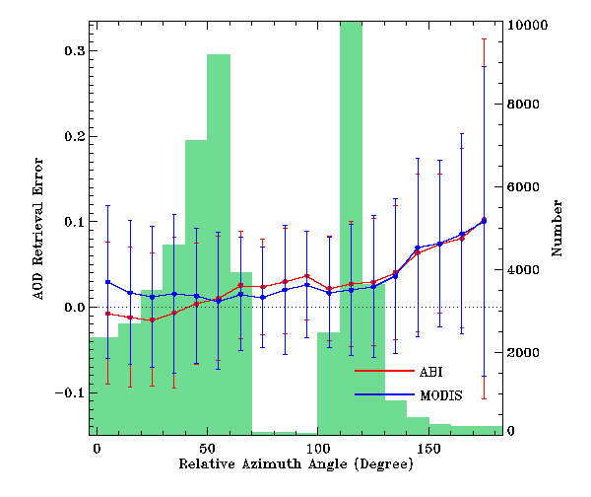
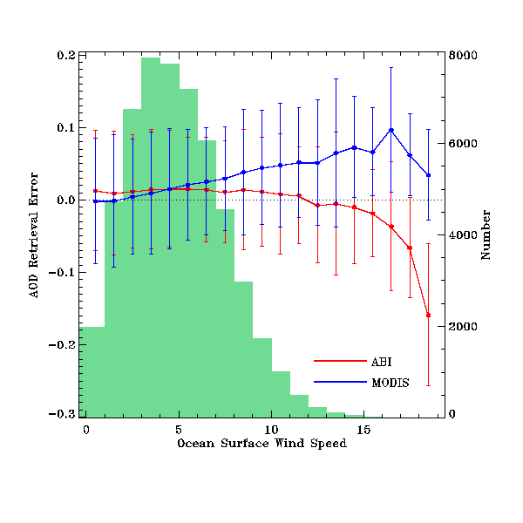
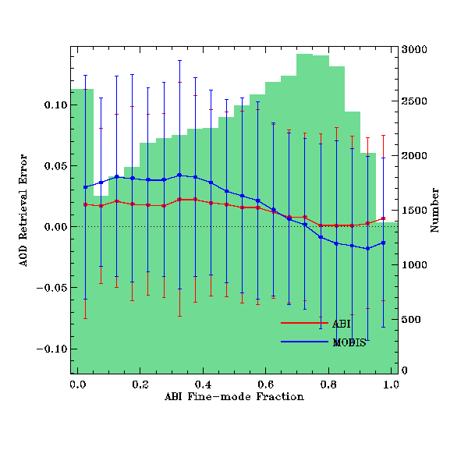
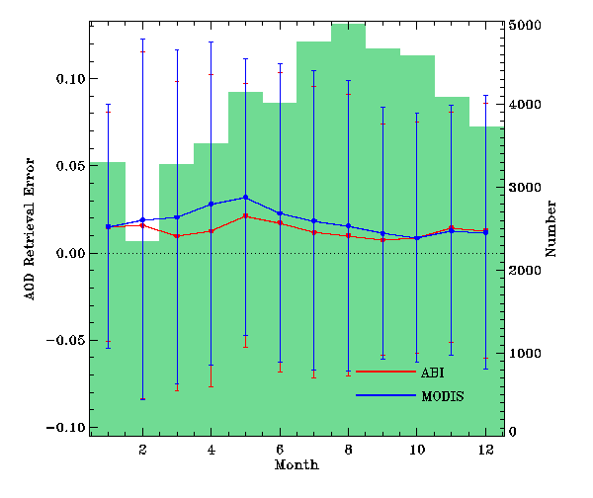
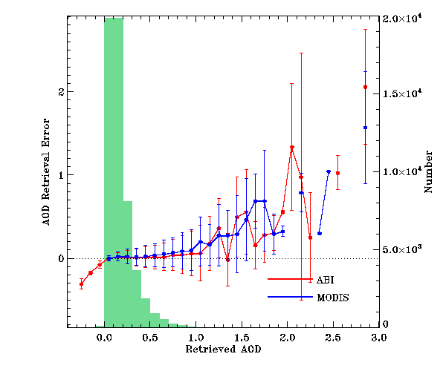
Dependence Analysis over Ocean
AOD retrieval error
Solar zenith angle
Satellite zenith angle
Scattering angle
Relative Azimuth Angle
AOD retrieval error
Month
Retrieved AOD
Ocean surface wind speed
Fine-mode fraction
ABI AOD retrievals run with co-located AERONET-MODIS dataset for years 2000-2012.
ABI and MODIS AODs generally have similar pattern.
Accuracy decreases when wind speed goes out of the LUT range.

Slide 18
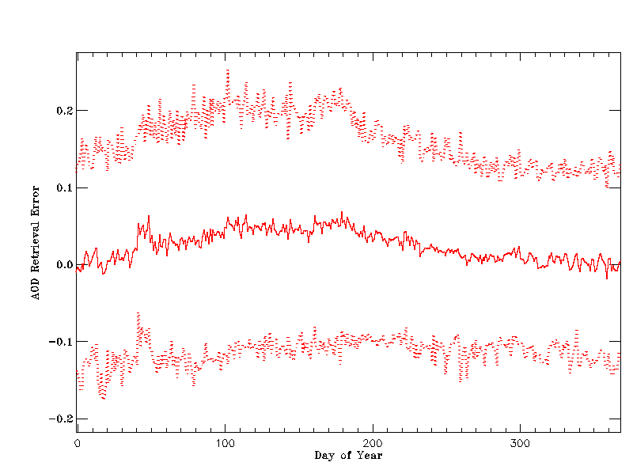
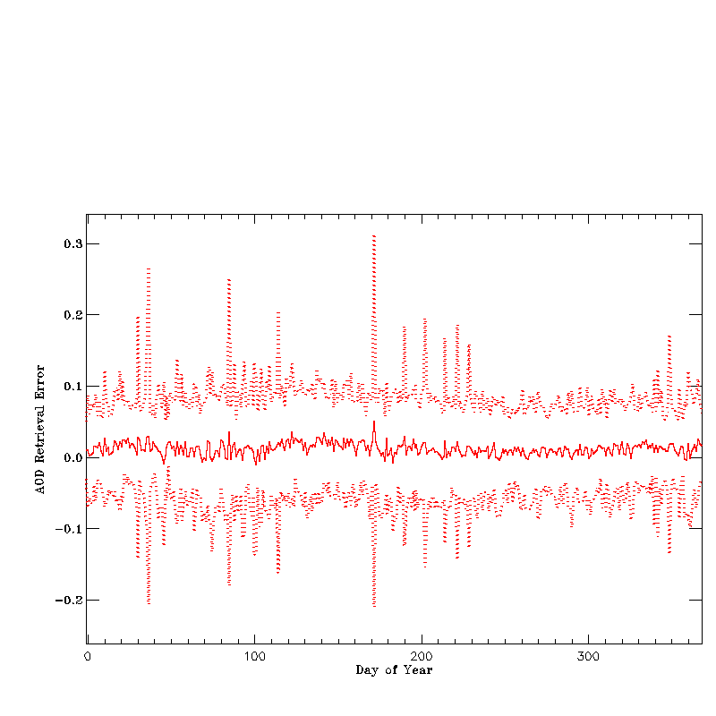
Derive Threshold for Routine Daily Monitoring
Over Land
Over Ocean
Mean + σ
Mean + σ
Mean
Mean
Mean - σ
Mean - σ
Routine daily monitoring/validation requires threshold values of statistics, so that out-of-bound retrievals trigger deep-dive validation.
Using co-located AERONET-MODIS dataset for years 2000-2012, ABI retrievals were collected for each day of year from day 1 – day 366 to calculate the mean value and σ.
Mean ± σ is suggested as daily monitoring threshold.

Slide 19
Validation with ABI Channel Resolution Proxy Reflectance
Proxy MODIS L1b reflectance at ABI channel resolution is generated, at the co-locations with AERONET level 2.0, for year 2009.
ABI aerosol algorithm is run to produce 2km AOD product.
Aerosol internal cloud tests are applied, where individual cloud test was implemented at pixel level; 2 km × 2 km is masked as “cloudy” if any of the pixels is identified as cloudy by individual tests.
Data filtering strategy is the same as in MODIS aerosol algorithm.
Range | Land |  |  |  | Water
 | AOD | Accuracy | Precision | # of points | AOD | Accuracy | Precision | # of points
Low | <0.04 | -0.02 (0.06) | 0.08 (0.13) | 116 | <0.4 | 0.01 (0.02) | 0.15(0.15) | 468
Medium | 0.04 - 0.8 | -0.004(0.04) | 0.16 (0.25) | 1074
High | > 0.8 | -0.28 (0.12) | 0.34(0.35) | 60 | >0.4 | -0.30 (0.10) | 0.33 (0.23) | 8
ABI AODs meet the requirement everywhere except high AOD range with limited data points.

Slide 20
Connections to other Programs
Provided ABI MODIS Proxy AOD for field campaigns:
NOAA SENEX 2013 campaign (Southeast Nexus)
Studying the Interactions Between Natural and Anthropogenic Emissions at the Nexus of Climate Change and Air Quality
Provided aerosol data retrieved for June-early July 2013 from MODIS reflectances using the ABI algorithm
SEAC4RS
Studies of Emissions and Atmospheric Composition, Clouds and Climate Coupling by Regional Surveys
Provided aerosol data retrieved for mid July-August 2013 from MODIS reflectances using the ABI algorithm
Data were provided to Bradley Pierce (STAR)

Slide 21
Potential Algorithm Enhancements (1)
Implement internal cloud tests
has been tested for one month (Aug 2006);
candidate for transition to ops, but need more evaluation
Develop NDVI-dependent spectral surface reflectance relationships
software tool to derive these relationships has been developed for NPP/JPSS
tool should be applied to an extensive set (12 months) of actual (good quality) ABI reflectances

Slide 22
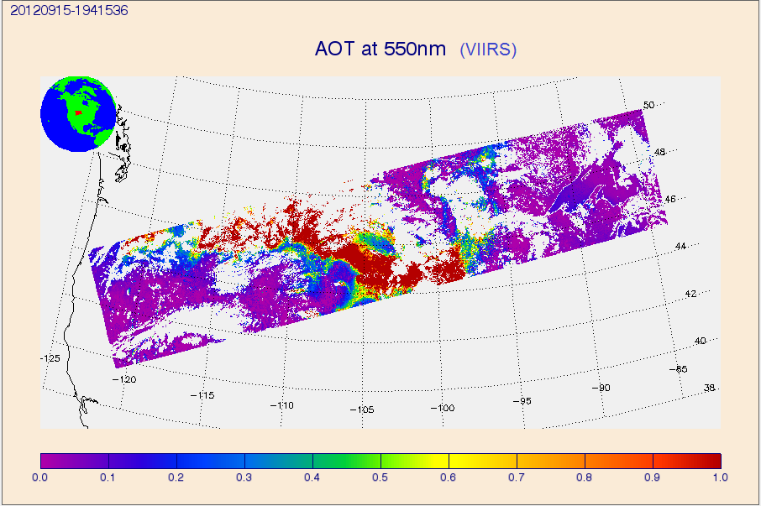
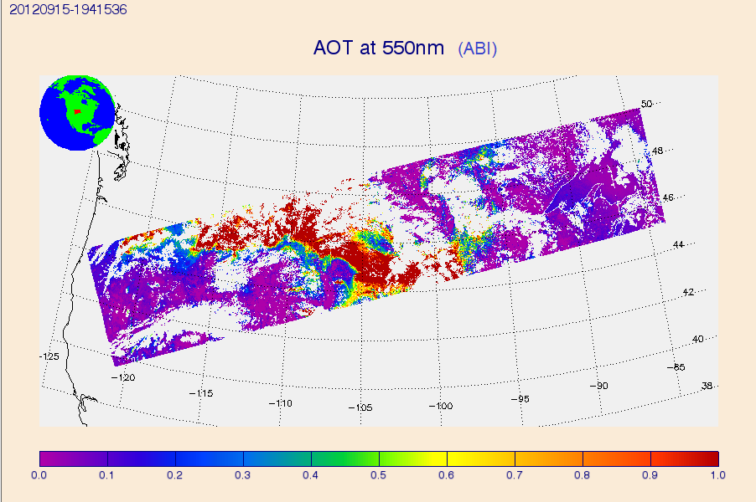
Potential Algorithm Enhancements (2)
Replace current ABI AOD algorithm for over-land retrieval with one developed under JPSS Risk Reduction Project (JPSS PGRR)
unified code with a single core to handle either ABI or VIIRS inputs
combines current IDPS and ABI over-land algorithms
tries IDPS retrieval first, switches to ABI when IDPS “fails”
not yet tested; would need to run ABI, and ABI+IDPS on VIIRS data for an extended period of time, and compare it to IDPS

Slide 23
Post-launch Validation (1)
Post-launch Test (checkout) period (L+6 months)
Validation tool is applied to one month of data from the end of the period
ABI aerosol products are compared with like VIIRS and AERONET products
Expected to reveal any major issues, but not a “full” evaluation
Post-launch product validation (PLT+12 months)
Algorithm update tasks:
Re-generate LUT and ancillary coefficients using actual sensor response functions
Re-derive SWIR –VIS land surface reflectance relationship
Comparison with existing ground networks (AERONET)
Inter-comparison with other satellite-based aerosol data (VIIRS)
Global, regional, seasonal statistics
Update “reference” statistics used in routine monitoring/evaluation
Notes:
23
23

Slide 24
Post-launch Validation (2)
Post-launch product validation (PLT+12 months) (contd.)
Use field campaign data when available
No specific campaigns have been indentified at this time, but field data including aerosol, surface albedo and gas amount are preferred
Challenges:
No continuous, permanent reference data are available over open ocean; evaluation must rely on island/coastal sites
For evaluation, spatial averaging of ABI AOD and temporal averaging of AERONET AOD are needed, thus strict validation of instantaneous 2-km ABI AOD product is not possible.

Slide 25
Summary
Available proxy data
10-km data now covers years 2000 – 2012
New proxy data using L1b MODIS reflectance processed at ABI product resolution
Validation activities
Routine validation uses co-located AERONET level 1.5 and MODIS data for near-real time validation
Deep-dive validation uses the extended co-located AERONET level 2.0 and MODIS data
Presented validation results with new proxy data at ABI channel resolution
Algorithm enhancements
internal cloud masking has been developed and is a candidate for transition to ops
NDVI-dependent SWIR-VIS land-surface reflectance relationship needs development
JPSS PGRR algorithm already has the above two enhancements in some form, but needs more extensive testing; surface reflectance relationship must be re-derived using ABI data
Post-launch validation will apply tools developed in the pre-launch phase

