Slide 1
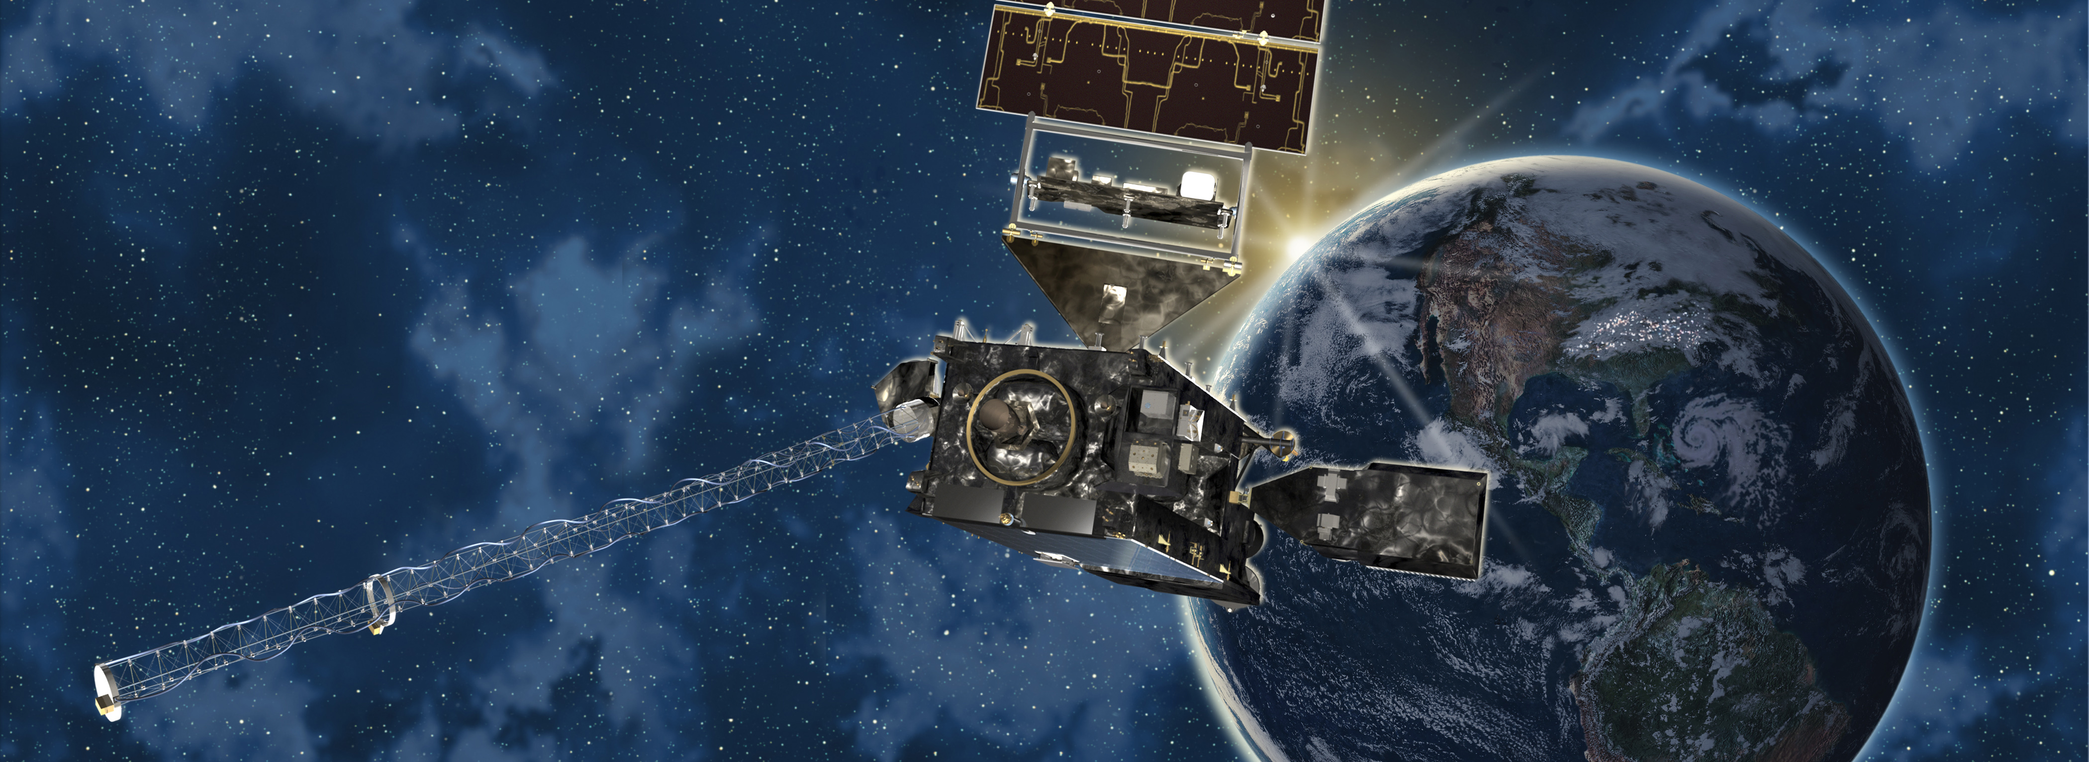
Fractional Snow Cover – 2013 AWG Validation Workshop
Thomas Painter, Kelley Eicher, Ben Oatley (UCAR)
Andy Rost (NOAA)

Slide 2
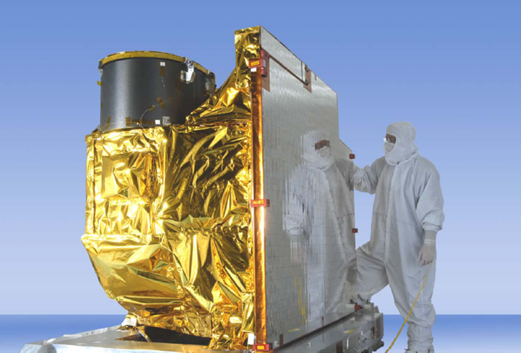
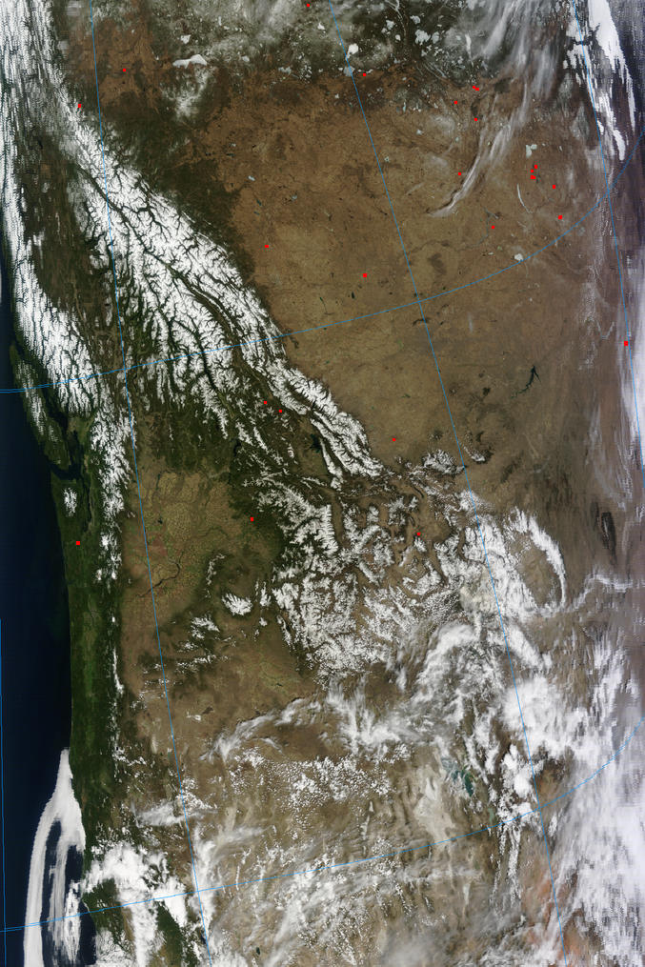
Outline
2012/2013 Validation
Validation Tool Status
2012/2013 Product Examples
Algorithm Enhancements
Post-Launch Activities
Summary

Slide 3
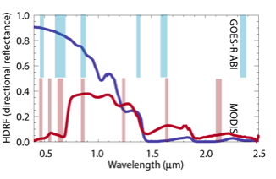
2012/2013 Validation
Processing/Validation period – 11/1/12 through 5/31/13
1071 total granules
Proxy ABI – MODIS (GOES-R pre-launch validation) *
* data and plots on next slide
Proxy ABI consists of 5 MODIS bands that approximately coincide with GOES-R ABI bands.
Snow reflectance – dark blue line Veg. reflectance – dark red line

Slide 4
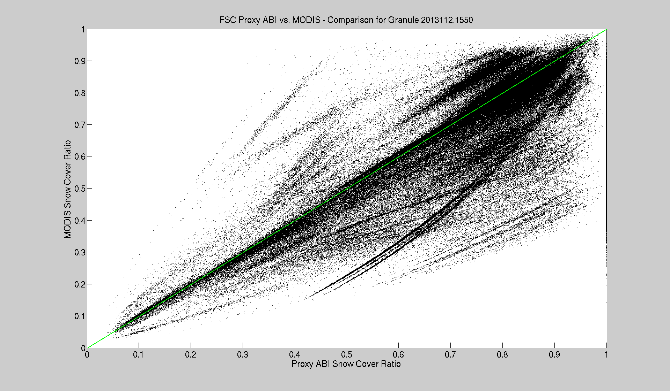
2012/2013 Validation (cont.)
Granule 2013112.1550 : 42.5% pixels have snow, 56.5% cloud
Accuracy: 6.67% Precision: 14.49% Omission: 0.1% Co: 0.04%

Slide 5
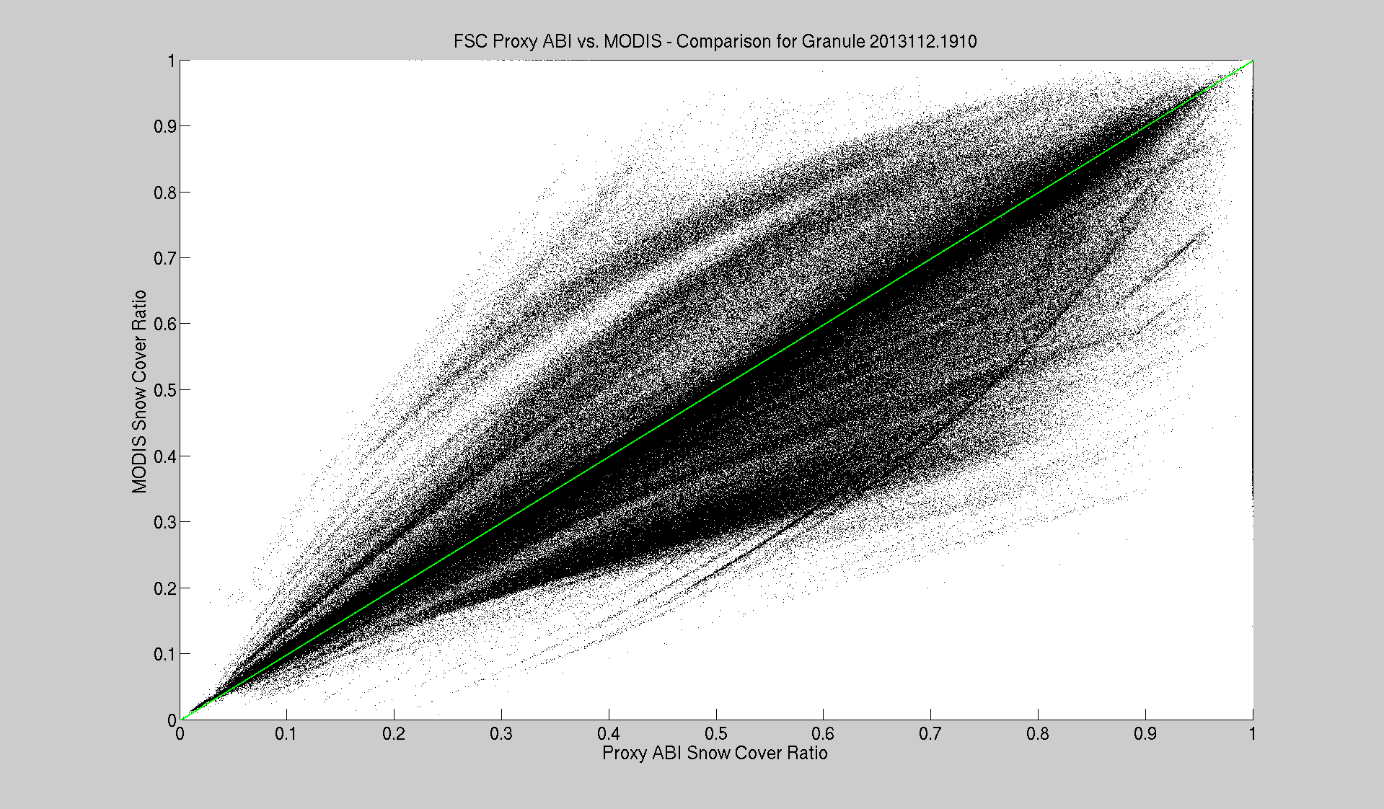
2012/2013 Validation (cont.)
Granule 2013112.1910 : 36.9% pixels have snow, 33.1% cloud
Accuracy: 2.98% Precision: 11.21% Omission: 2.1% Co: 0.2%

Slide 6
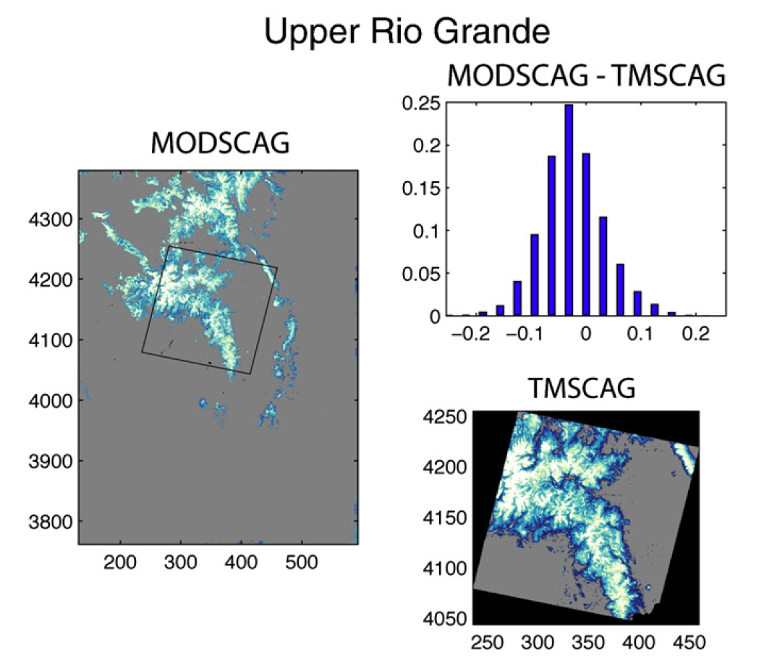
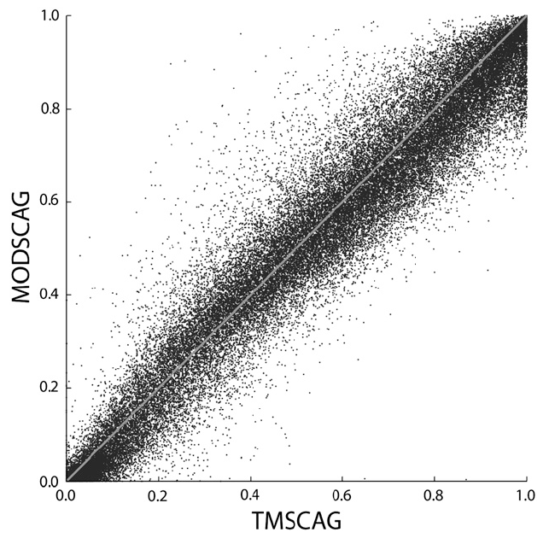
2012/2013 Validation
MODIS - TM (GOES-R pre-launch validation)
FSC High-resolution validation for small areas of select MODIS granules

Slide 7
2012/2013 Validation (cont.)
2012/2013 Validation Summary:
FSC Validation | Accuracy %f | Precision %f
TM - Obs. | 3.0 | 6.0
MODIS – TM * | -5.7 | 8.9
Proxy ABI - MODIS | 0.9 | 6.9
Overall | -1.8 (spec. <15%) | 12.7 (spec. <30%)
* K. Rittger, et al. 2012

Slide 8
Validation Tool Status
Routine Validation Tools
basic product comparison stat. generators and associated data plots (ex. on prev. slides)
image generators (ex. on Prod Ex. slides)
fully developed
Deep Validation Tools
High-RMSE Cluster Finder (ex. on next slide)
Raw/Verbose Diagnostic mode*
Single-Pixel Diagnostic mode*
fully developed
* integrated into algorithm code (more info. later)

Slide 9
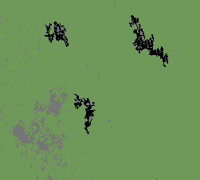
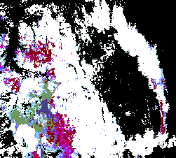
Validation Tool Status (cont.)
High-RMSE Cluster Finder
identifies clusters based on input thresholds
identifies center pixel of highest average RMSE within cluster (green)
identifies pixel with highest RMSE in cluster (red)

Slide 10
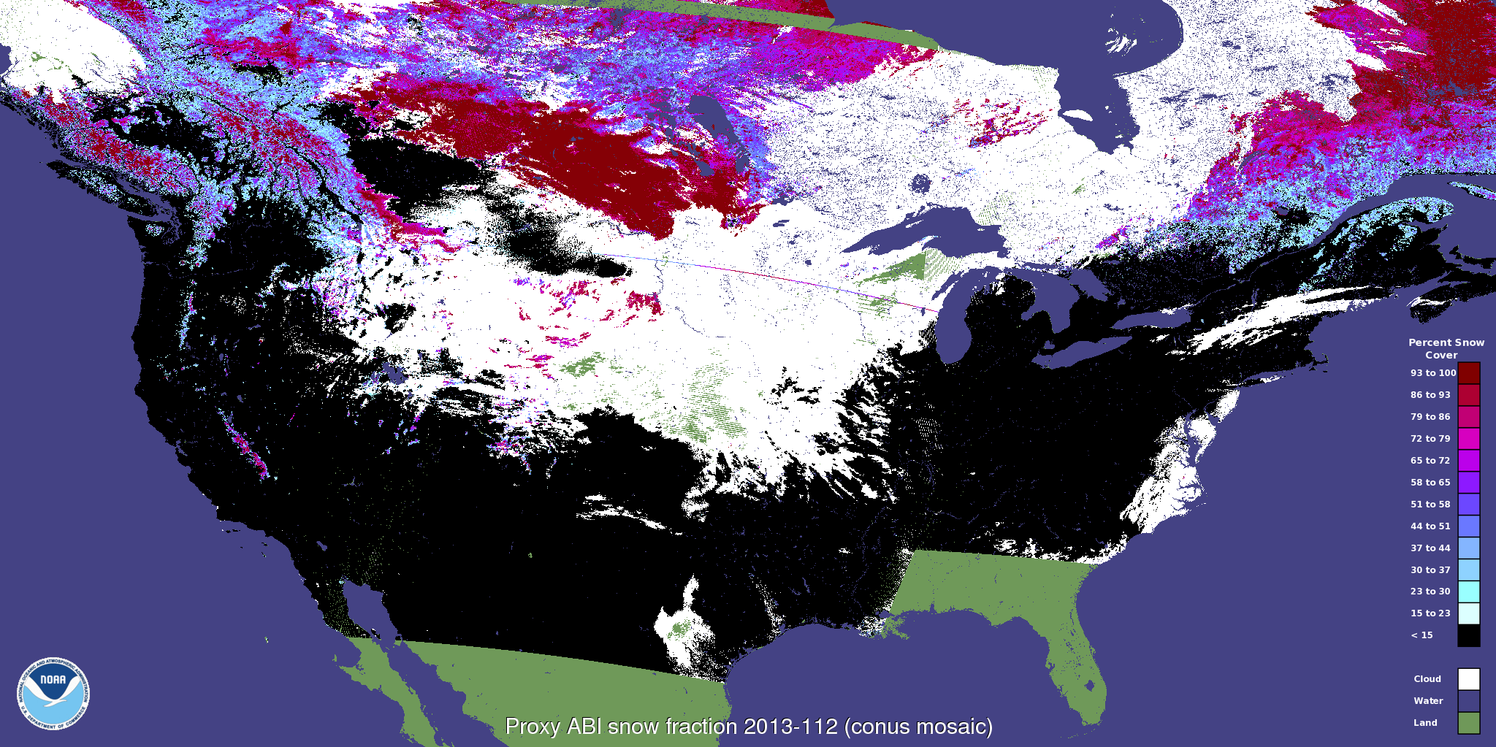
2012/2013 Product Examples
Proxy ABI FSC mosaic image for April 22, 2013

Slide 11
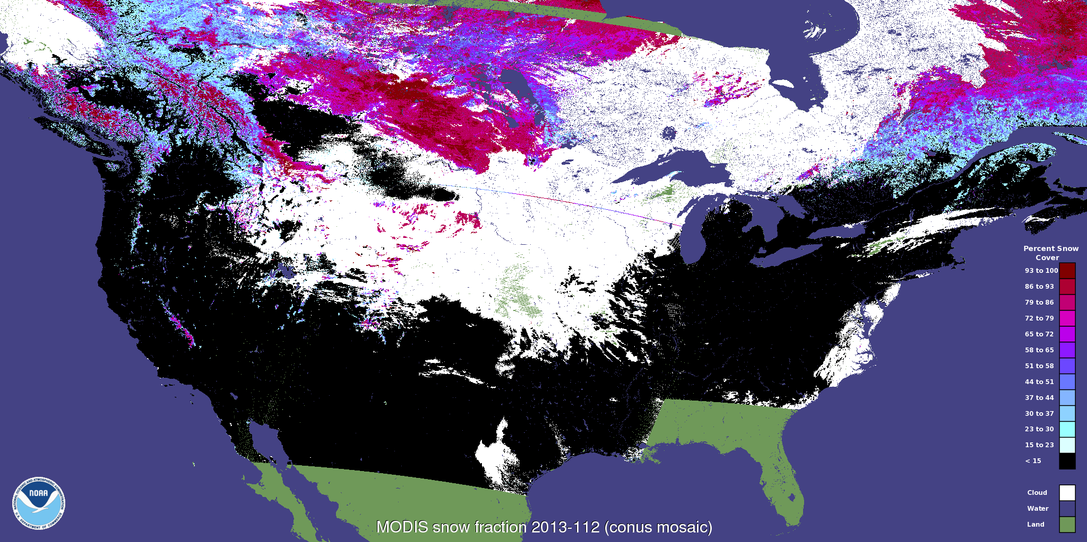
2012/2013 Product Ex. (cont.)
MODIS FSC mosaic image for April 22, 2013

Slide 12
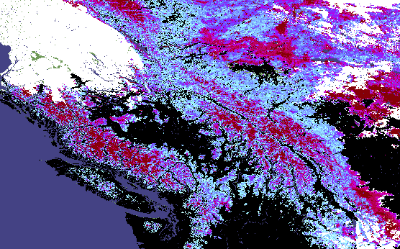
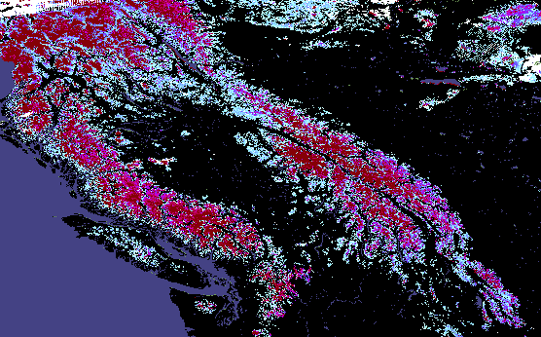
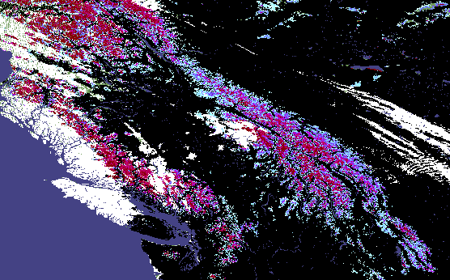
2012/2013 Product Ex. (cont.)
Proxy ABI FSC, Canada/NW US, Apr-May
Day 112, Apr 22
Day 125, May 5
Day 130, May 10
* color key same as mosaics on previous slides
* true color visual, day 125

Slide 13
Algorithm Enhancements
Algorithm “normal” run-mode
Bug – modeled fractions <0 not being output
fixed
revealed extreme fractional values (<<0 and >>1)
low-light conditions (often cloud shadow)
MODIS band 5 detector issues
Shade Filter
pixels modeled with shade EM fract > input threshold, set to NDV and set quality flag (plot on next slide)
eliminates extreme values
Physical fractions
normal output must fall between 0% and 100%
over reflectance cases… fraction >1, set to 1

Slide 14
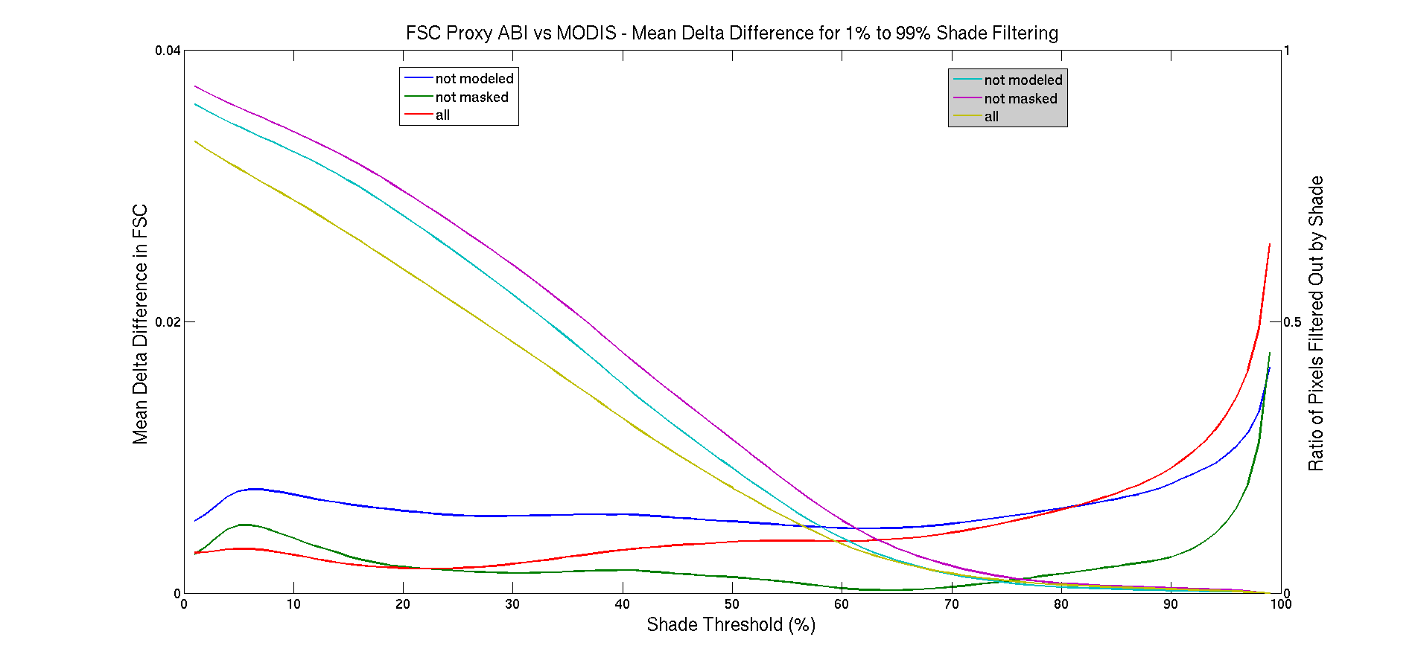
Algorithm Enhancements (cont.)
Shade Filter threshold determination
21 random granules analyzed (>20% pixels w/ snow)
Chose 75%, conservative… <3% of pixels affected

Slide 15
Algorithm Enhancements (cont.)
Diagnostic run-mode
raw fractional output – no shade filtering, no physical fraction requirement
verbose information output for intermediate state data for best model. CSV format
fully developed
Single-pixel Diagnostic run-mode
select specific pixel to model
verbose information output for intermediate state data for ALL models considered. CSV format
fully developed
Parallax Correction (supplemental software, not implemented in algorithm)
adjusts position of data by parallax effect
high-res DEM data needed for best correction
in testing phase

Slide 16

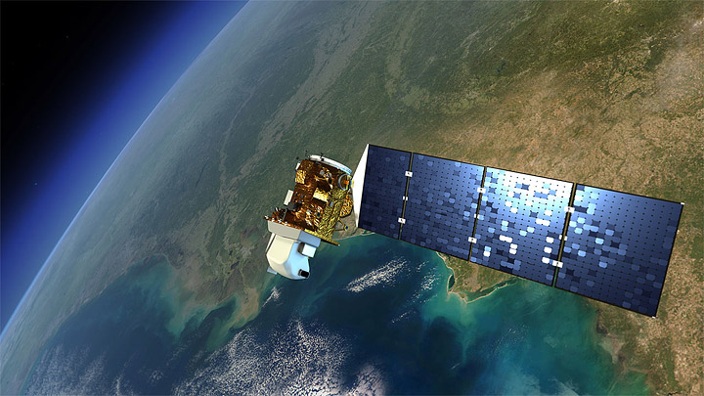

Post-Launch Activities
Surface Reflectance product required
not currently planned
Continue validation with MODIS data
Work towards using newer satellites for validation
JPSS
NPP VIIRS
Landsat 8
Validate using NRCS SNOTEL sites

Slide 17
Summary
Continued validation efforts show FSC algorithm performing well
Will push algorithm enhancements when AWG is ready
Harris currently evaluating AER implementation
Post-Launch operation will require a Surface Reflectance product

