Slide 1
Shortwave Radiation Budget (SRB) Algorithm and Products
GOES-R AWG 2nd Validation Workshop
Hye-Yun Kim (IMSG), Istvan Laszlo (NOAA) and Hongqing Liu (IMSG)

Slide 2
Outline
Algorithm, products and proxy data overview
Evaluation procedure
Recent validation results
Algorithm enhancements
Post-launch test/product validation and challenges
Summary

Slide 3
SRB algorithm and products
SRB algorithm is a RT-based, hybrid algorithm
Direct path: used when all inputs required are available.
Indirect path: used when not all inputs are available.
Products
Downward Shortwave Radiation at surface (DSR)
5 km (mesoscale), 25 km (CONUS), 50 km (Full Disk).
Reflected Shortwave Radiation at Top-Of-Atmosphere (RSR)
25 km (CONUS and Full Disk).
Generated every hour
Only daytime
Regardless of sky condition (clear, cloudy)

Slide 4
Proxy data
Proxy data used
MODIS Terra/Aqua (added 3+ years of data since 1st Validation Workshop); Period covered: 2000/2002-2013
TOA reflectance (from MOD/MYD02),
Geometry (from MOD/MYD03),
Surface elevation (from MOD/MYD03),
Aerosol optical depth (from MOD/MYD04),
Cloud optical depth/size/height/phase (from MOD/MYD06),
Ozone (from MOD/MYD07),
Total precipitable water (from MOD/MYD07, NCEP Reanalysis),
Snow mask (from MOD/MYD10),
Surface albedo (from MCD43C3)
CERES TOA flux
Proxy data generated
“ABI-like” DSR and RSR
DSR and RSR for 8 sites for period 2000/2002-2013
RSR over extended area on specific dates
DSR in GOES Surface and Insolation Product (GSIP) (early version of ABI indirect path)

Slide 5
Validation (Reference) Data
SURFRAD+COVE for DSR, CERES for RSR
Field measurements at Cape Cod, MA (for deep dive)
Location: 42.03°N, 70.05°W, near the ocean
Part of the Two-Column Aerosol Project (TCAP) (ARM field campaign)
Surface albedo and AOD measurements (partially supported by GOES-R Proving Ground to Joseph Michalsky and Kathy Lantz (NOAA/ESRL))
Instruments: MFRSR and MFR (sampled every 20 seconds simultaneously)
Deployment period: 28 June to 6 September, 2012
Wavelengths: 413, 496, 671, 869, 937, 1623 nm
Estimated uncertainty: is 0.01 in AOD, 2% in albedo
Surface radiation measurement
Instruments: Sky Radiation (SKYRAD) collection of radiometers (1-minute sampling) for downwelling shortwave fluxes

Slide 6
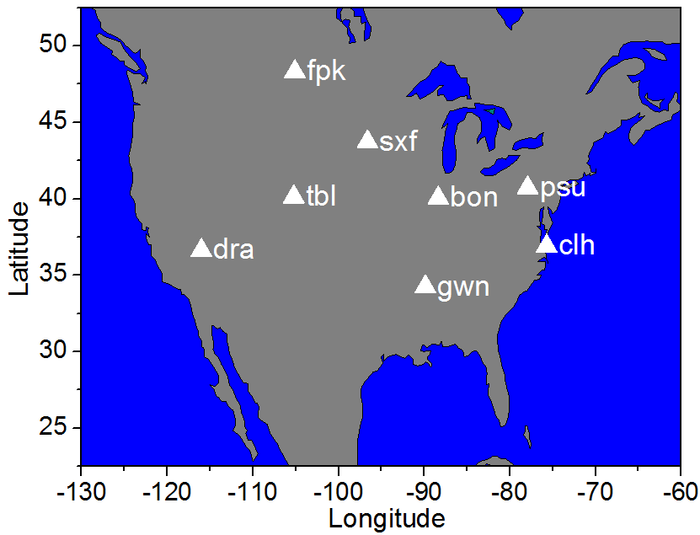
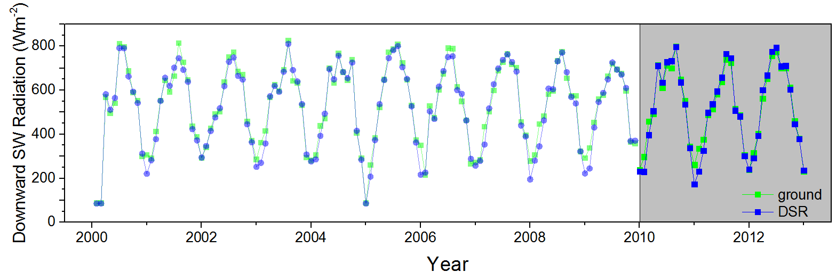
Validation (1) : Collocation
Collocation process for product evaluation
DSR: over ground station (SURFRAD+COVE)
Collocation of retrieval and ground measurement is performed at instantaneous time scale.
Retrievals are averaged spatially, ground measurements are averaged temporally.
RSR
Collocation of retrievals and independent satellite data.
new
“Monthly” instantaneous, all stations

Slide 7
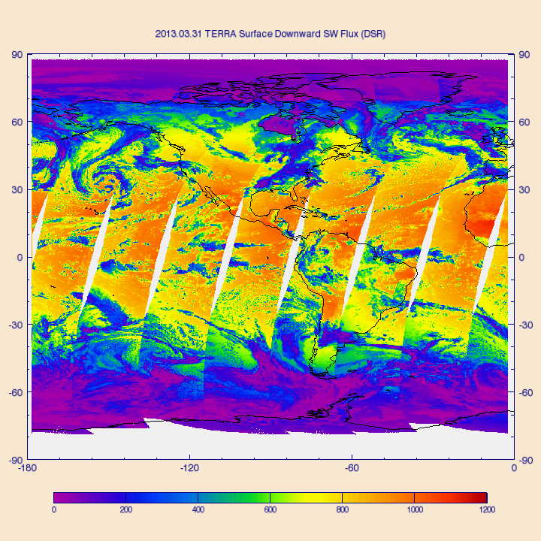
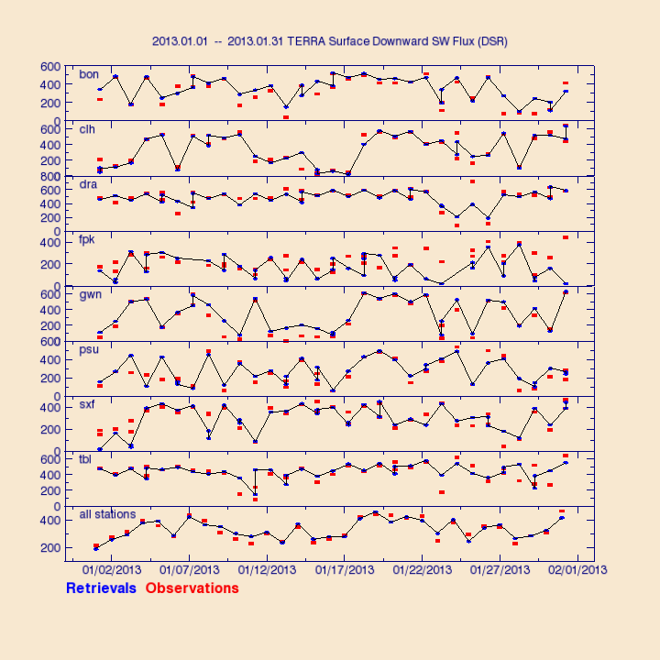
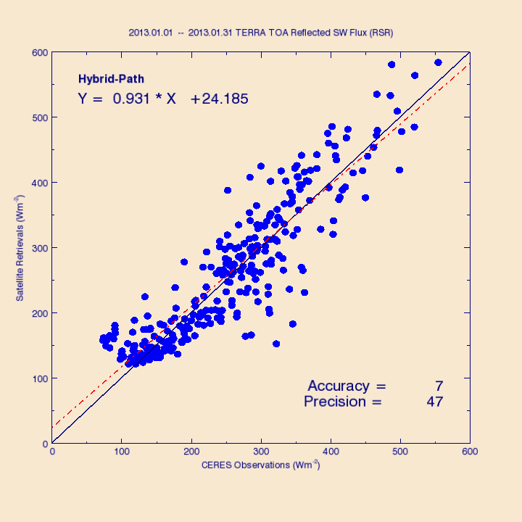
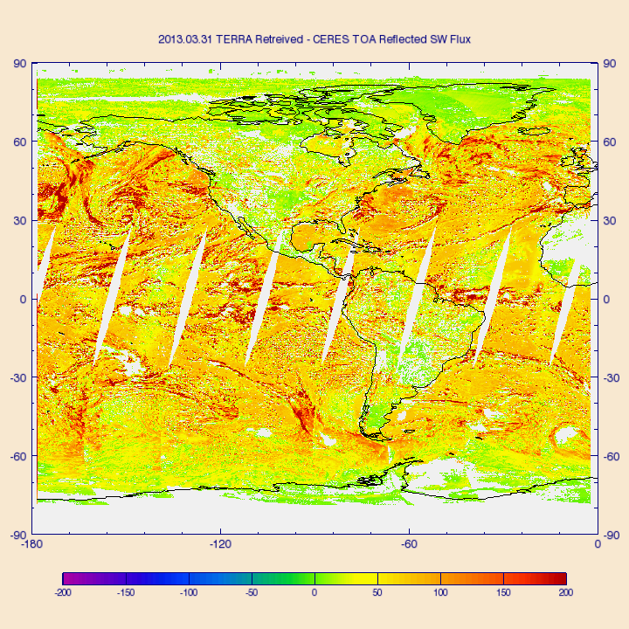
Validation (2) : Routine validation
Routine and automated monitoring of products.
Presents instantaneous retrieval results (DSR and RSR), quality flags, and metadata on specific date.
Validates retrievals for a period of time and generates scatter plots and time series plots.
Validates RSR over extended area using CERES on specific date.
Figures: DSR, DSR time series, RSR scatter, RSR and CERES difference.

Slide 8
Validation (3) : Routine validation
Product monitoring
Establish “reference” (expected) statistics from good (quality controlled) satellite-retrievals and ground/TOA reference data
Compare time series of recent retrieval statistics with reference stats
Reference statistics
Reference data: 13 years (2000/2002 – 2012) of ABI proxy retrievals (from MODIS Terra/Aqua), SURFRAD+ ground DSR, CERES-based RSR
Accuracy and precision are calculated from the reference data for daily and monthly temporal scales (and at each station in the future)
Recent retrieval statistics
Recent retrievals: MODIS Terra/Aqua (Jan. to Apr. 2013)
Accuracy and precision are calculated from recent retrievals on matching temporal and spatial scales

Slide 9
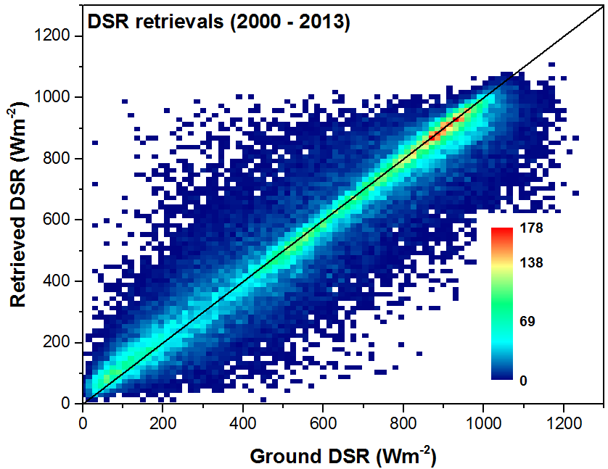
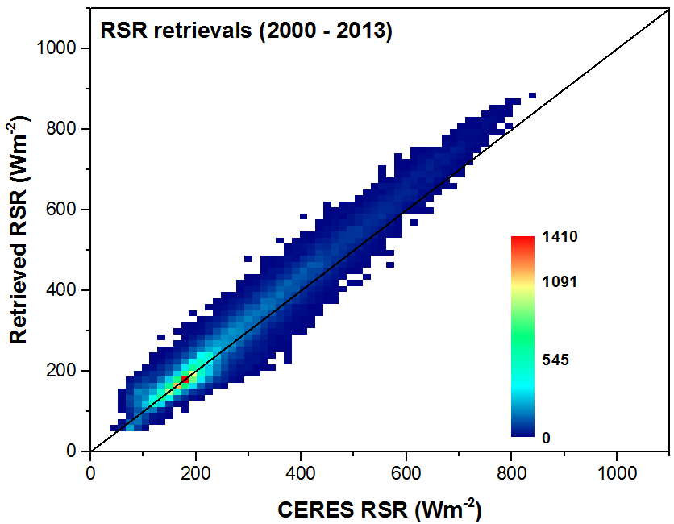
Validation (4) : Routine validation
DSR Range | Accuracy | Precision
<200 | 41 (110) | 80 (100)
≥200,≤500 | 15 (65) | 126 (130)
>500 | -33 (85) | 95 (100)
RSR Range | Accuracy | Precision
<200 | 12 (110) | 28 (100)
≥200,≤500 | 16 (65) | 46 (130)
>500 | 43 (85) | 50 (100)
(Requirements are in parenthesis)
Notes:
Retrieval: hybrid (direct and indirect path)

Slide 10
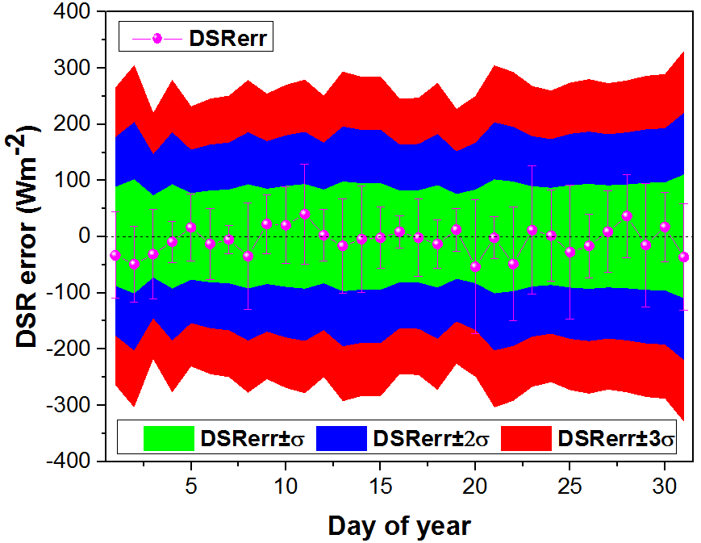
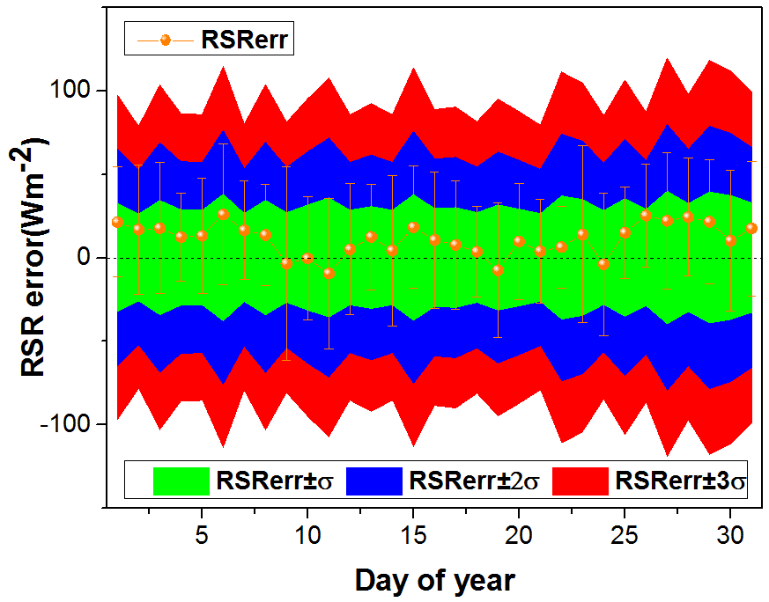
Validation (5) : Routine validation
Comparison of reference and recent daily statistics.
Red, blue, green envelopes are reference stats.
mean ± 1*std, mean ± 2*std, mean ± 3*std
Recent retrievals in Jan. 2013
Downward SW radiation at surface (DSR, top)
Reflected SW radiation at TOA (RSR, bottom)
Recent retrieval statistics mostly fall within ± 2*std range of reference statistics.

Slide 11
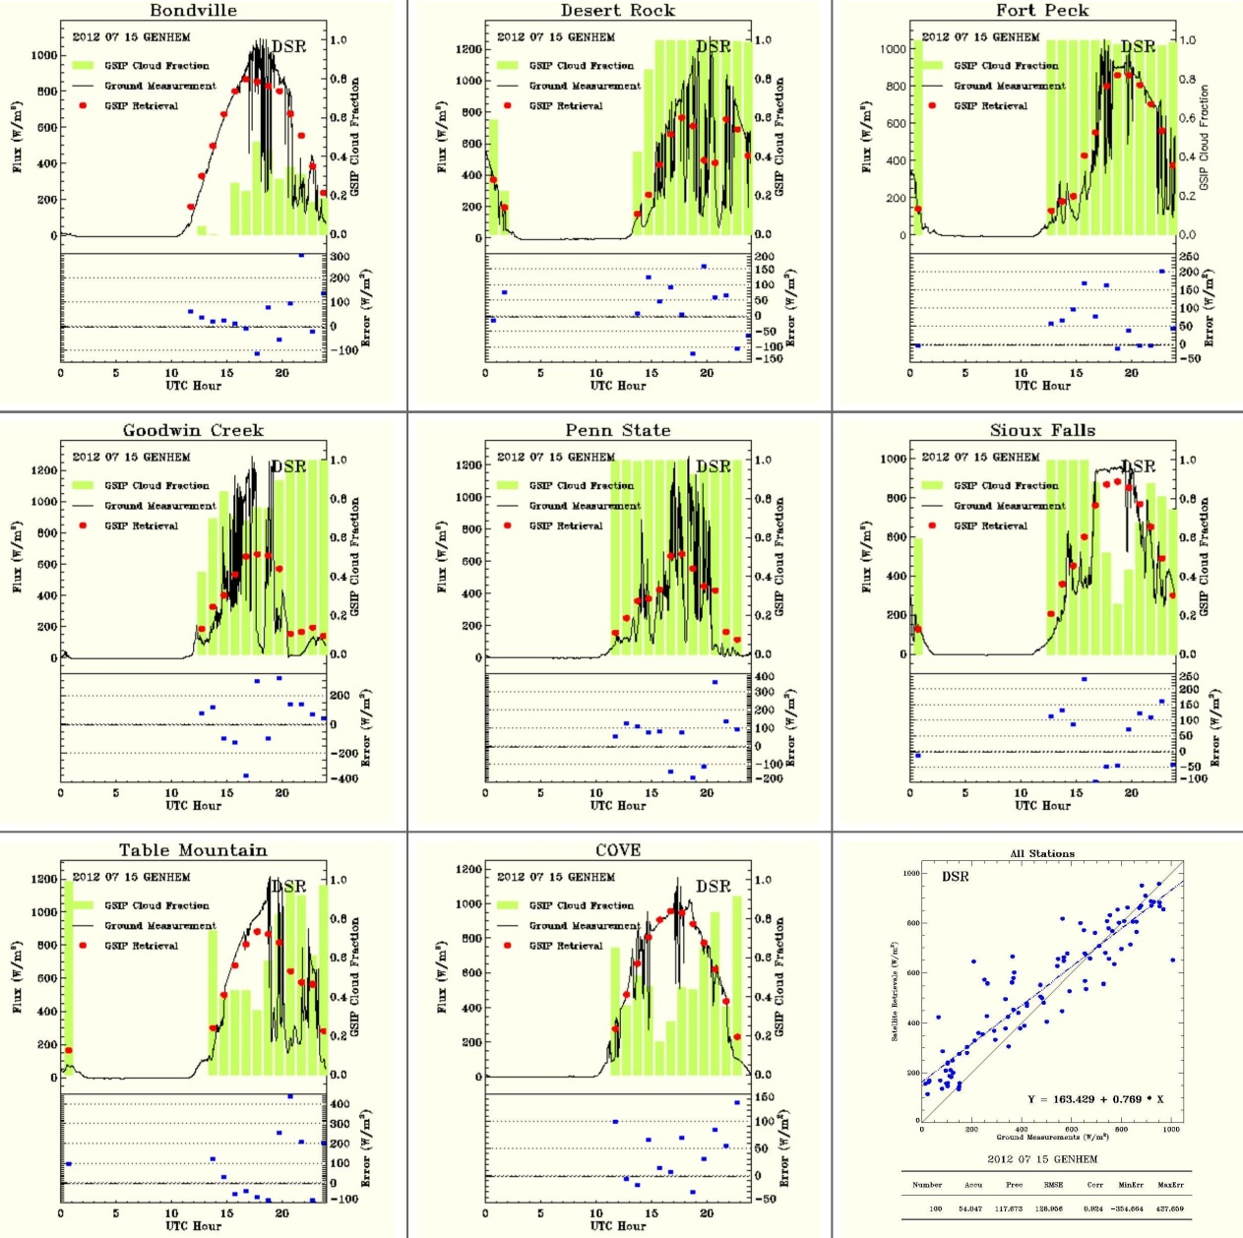
Validation (6) : Routine validation
Example of DSR daily validation
GOES-R validation tool is applied to operational GOES Surface and Insolation Product (GSIP)
Ground DSR (black) : one minute average, highly variable during a day
Satellite retrieval (red): instantaneous, 50-km spatial average
Cloud fraction from satellite (green)
DSR error (blue): difference between instantaneous retrieval and ground where ground measurements were averaged over 30 minutes

Slide 12
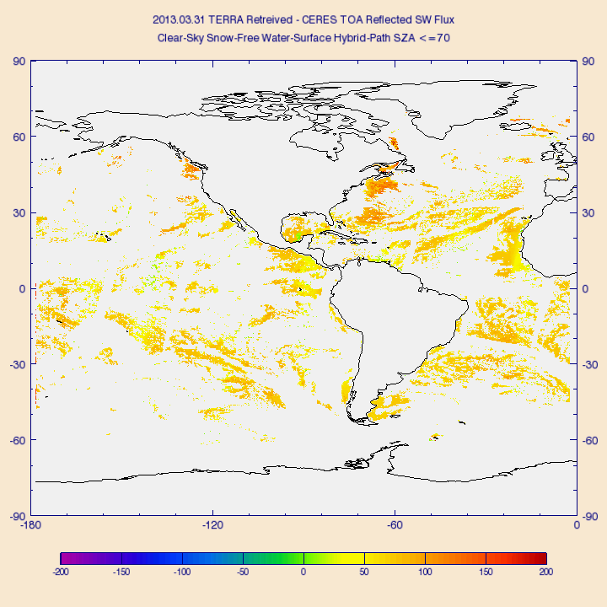
Validation (7) : Deep-dive validation
Deep-dive allows analysis based on scene type, retrieval path, surface type, etc.
Example:
Clear sky RSR over ocean only
Difference image on March 31, 2013
Systematic overestimation is observed
Figure: RSR retrieval – CERES observation, clear sky ocean, solar zenith angle ≤ 70° on 3/31/2013

Slide 13
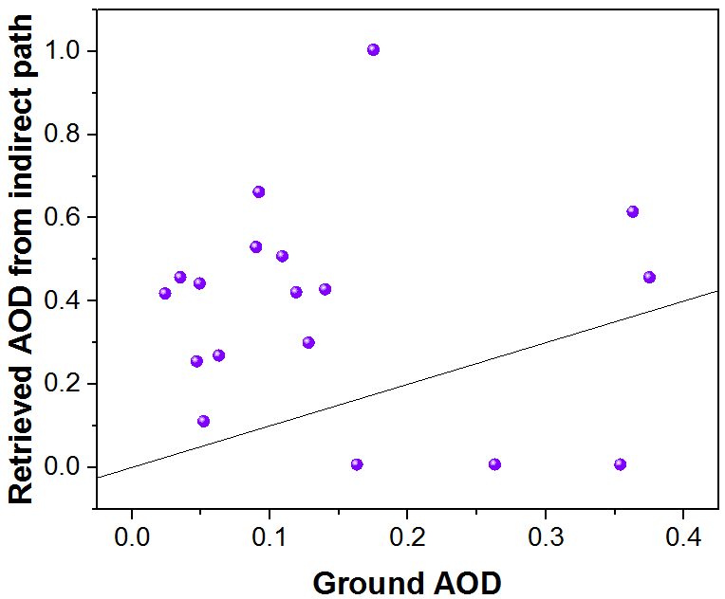
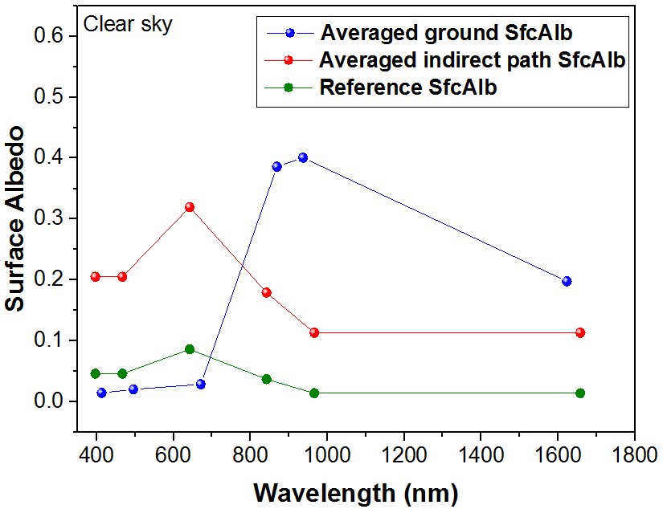
Validation (8) : Field campaign data - DSR
Comparison of clear-sky ABI (indirect path) DSR with observed DSR at Cape Cod, MA
Large DSR errors – conducted deep dive val
Indirect path | accuracy | precision
DSR (Wm⁻²) | -46 | 34
Comparison of retrieved AOD (intermediate, diagnostic product), and observed AOD shows large differences.
Reason (partial): based on ABI grid coordinates and IGBP the retrieval assigns water as surface instead of vegetation

Slide 14
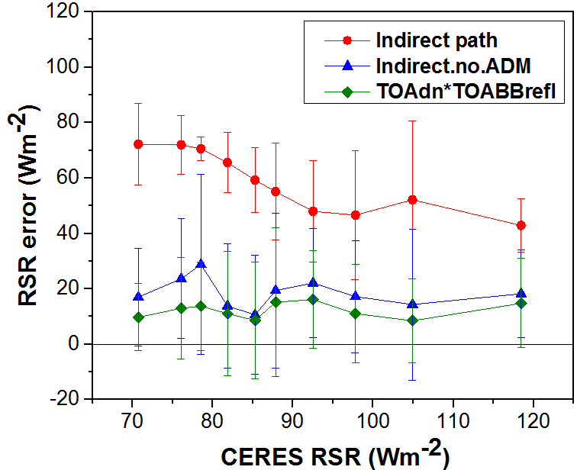
Validation (9): Clear sky RSR validation at Cape Cod
3-way RSR retrievals
(a): NTB + ADM + LUT overwrite (red) [current indirect path]
(b): NTB, no ADM, + LUT overwrite (blue)
(c): NTB, no ADM, no LUT overwrite (green)
RSR (Wm⁻²) | accuracy | precision
(a) | 58 | 19
(b) | 19 | 22
(c) | 12 | 18
Method (c) has the smallest bias and std
More testing is needed!

Slide 15
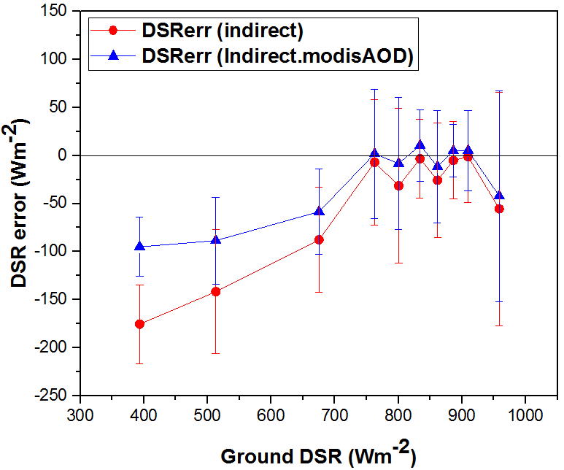
Potential Algorithm Enhancements (1)
Use ABI AOD product (when available) in indirect path retrieval
Currently using AOD retrieved internally from broadband albedo
Limited testing suggests reduction in bias and std
Candidate for transition to ops
Provide C and FD products (at least) at 5 km resolution
Continuity of current capability - GOES Surface Insolation Product (GSIP) will be at 4 km resolution in updated version
Tested
Candidate for transition to ops
Add PAR to output
Coral-health modeling needs PAR
Already calculated internally
Candidate for transition to ops
Figure: indirect path DSR retrieval error (red) and indirect path DSR retrieval error when MODIS AOD is used (blue).
Bias is decreased by 25 Wm⁻².

Slide 16
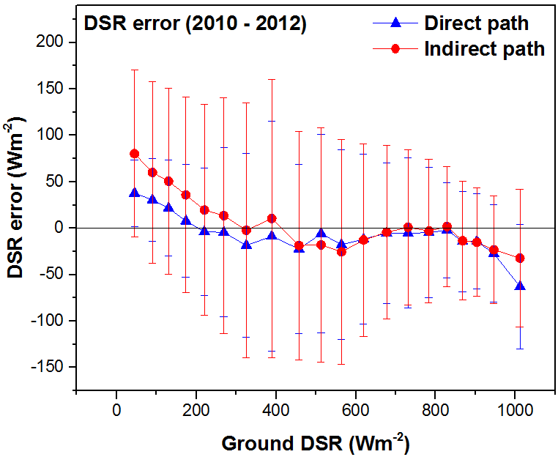
Potential Algorithm Enhancements (2)
Get RSR directly from NTB and ADM conversion
Do not overwrite with RSR calculated from LUT
Results from limited testing is on previous slide
More testing is needed!
Consider internal retrieval of narrowband surface albedo so direct path can be applied for DSR
Tests showed DSR is better from direct path (std is smaller)
Research & development are needed
Consider mountain slope/shadowing effect
Further research and algorithm development are required
DSR Requirement |  |  | Direct |  | Indirect
range | bias | std | bias | std | bias | std
<200 | 110 | 100 | 24 | 48 | 57 | 98
[200,500] | 65 | 130 | -12 | 95 | 5 | 130
>500 | 85 | 100 | -16 | 73 | -13 | 84

Slide 17
Post-Launch Test/ Product Validation
Post-launch Test (checkout) period (L+~6months)
Using data from last month of period:
DSR is tested with ground-based measurements
RSR testing is likely to be done only indirectly, via DSR; real-time CERES RSR is not expected to be available
DSR is compared with GSIP data (assumed to overlap with GOES-R for a few months after launch) – checking consistency
Post-launch product validation (L+13 months)
One month is needed to generate clear-composite for indirect path - Twelve months of comprehensive validation activities are needed to achieve statistically representative validation results
Algorithm coefficient configuration
Update/regenerate ABI-specific coefficients (NTB) with ABI data
RSR: evaluation with CERES data
DSR: evaluation with existing ground network (SURFRAD)
Re-derive “reference” statistics for routine monitoring/evaluation

Slide 18
Post-Launch Test/ Product Validation
Post-launch product validation (contd.)
Tools developed during the pre-launch phase are used
Generate DSR and RSR matchup data
Collect/save input needed (ABI and ancillary) to re-process retrievals for deep-dive evaluation, and
Collect/save intermediate data (retrieved optical depth and spectral surface albedo, direct and diffuse fluxes)
needed to identify source of error. It also allows for continual improvement of the algorithm.
Data storage need may present a challenge!
Evaluation is stratified based on scene type, surface type, solar zenith angle, diurnal cycles and properties of cloud and aerosol.
No specific field campaigns have been identified, but plan on using atmosphere and surface data from field campaigns that provide data publicly (e.g., ARM).

Slide 19
Post-Launch Test/ Product Validation
Challenges
Spatial and temporal averaging are needed, thus strict validation of instantaneous product is not possible.
Lack of extensive, permanent good-quality surface observations over ocean. DSR validation will have to rely on limited costal and island stations.
For DSR validation, continued funding support to the SURFRAD network is required to continue the current level of data availability and consultation.
CERES data for validating RSR is available only with a substantial lag (days-months). All relevant satellite retrievals must be saved until the validation can be performed.
Saving intermediate data for deep-dive validation increases storage requirement.

Slide 20
Summary
Extended dataset for validation (~13 years)
Proxy data are from MODIS and GOES
Truth data are from ground measurement and CERES observation
Routine and deep-dive validation
Established “Reference statistics“ for product monitoring
Demonstrated deep-dive validation using data from field measurements (Cape Cod)
Post-launch validation will apply tools developed in the pre-launch phase
Three potential algorithm enhancements are straightforward to implement (candidates for transitions to ops), three enhancements require more testing or substantial development

