Slide 1
GOES-R AWG Product Validation Tool Development
Aerosol Optical Depth/Suspended Matter and Aerosol Particle Size Mi Zhou (IMSG)
Pubu Ciren (DELL)
Hongqing Liu (DELL)
Istvan Laszlo (STAR)
Shobha Kondragunta (STAR)
Notes:
This presentation should reflect your current plans (and schedule) for the development of product validation tools (routine & deep-dive) for each of your products

Slide 2
OUTLINE
Products
Validation Strategies
Routine Validation Tools
“Deep-Dive” Validation Tools
Ideas for the Further Enhancement and Utility of Validation Tools
Summary
Notes:
Plan on a 15-20 min presentation. Slide counts per topic area are provided as guidance. Slide counts will vary depending upon number of products and tools.

Slide 3
Products
Aerosol Optical Depth (AOD) / Suspended Matter (SM)
Aerosol Particle Size (APS)
Angstrom Exponent is reported
at 2 km every 15 minutes for CONUS and FD

Slide 4
Monitoring & Validation Background
Functions of tools:
routine monitoring (may not need reference data)
routine validation (reference data, matchup procedure)
deep-dive validation (reference data, other correlative data, matchup)
Basic elements:
data acquisition (ABI, ground, other sat products)
spatial and temporal matching
analysis (computing statistics)
present results (display maps, scatter plots)
Reference data:
ground: Level 2.0 aerosol products from AERONET
independent satellite data: standard aerosol products from MODIS
Notes:
Highlight/summarize validation strategy for each product.
Identify reference/”ground truth” datasets that are needed and where/how these are obtained
Identify validation tools (routine & deep-dive) that are needed and being developed

Slide 5
“Routine” Validation Strategy
Spatial and temporal match-up with ground “truth” AERONET
ground data are temporally averaged within a 1-hour window around the MODIS overpass time and the MODIS data are spatially averaged in a 50x50-km box centered on the ground station
Quality control comparison data set
AERONET uses level 2 quality assured product (no additional QC)
Interpolating AERONET AOD to 550nm on logarithm scale
Good ABI retrievals indicated by the overall quality flag
Temporary measures until ABI clear mask is not available:
Highest 50% and lowest 20% of ABI retrieved AODs in 50x50-km boxes are filtered out
Spatial variability test on ABI AOD for screening out possible cloud contamination
Appropriate statistics (bias, std) are calculated and compared to F&PS
Notes:
First validato

Slide 6
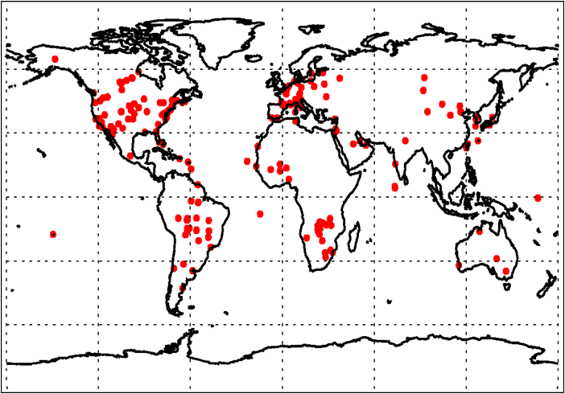
Primary Reference Data
AERONET aerosol product
The ground-based AERONET remote sensing network provides a comprehensive dataset of aerosol properties and has been widely used for evaluating satellite retrievals and model simulations in the aerosol community.
All-Points AERONET Level 2.0 AOD data can be downloaded at the website http://aeronet.gsfc.nasa.gov/cgi-bin/combined_data_access_new. The ground measurements are at 15 minutes temporal resolution.
AERONET Stations
09/2007
Notes:
First validato

Slide 7
More Reference Data
MODIS aerosol product
AOD, Ångström Exponent, fine-mode weight over ocean, surface reflectance over land, aerosol type over land from MODIS collection 5 aerosol products that can be downloaded from ftp://ladsweb.nascom.nasa.gov/allData/5/.
Current state of the art, extensively validated product.
Large variety of atmospheric and surface conditions.
CALIPSO
AOD and aerosol type from CALIPSO Lidar Level 2 5 km aerosol layer data at http://eosweb.larc.nasa.gov/cgi-bin/searchTool.cgi?Dataset=CAL_LID_L2_05kmALay-Prov-V3-01
Provide aerosol model profile
MAPSS
A Multi-sensor Aerosol Products Sampling System in development at http://disc.sci.gsfc.nasa.gov/aerosols/services/mapss/mapssdoc.html#caliop
Provides co-located MODIS-AERONET, CALIPSO-AERONET, and MISR-AERONET data
09/2007
Notes:
First validato

Slide 8
“Routine” Tools
Monitor operational Level-2 aerosol products
Displays images of product and quality flags
Plots histograms for specified granules
Collocate aerosol products with the reference (“truth”) observations
Compare with ground truth
Time series for collocated AERONET stations
Frequency scatter-plot and linear regression
Statistics for comparison with F&PS requirements
IDL is used for visualization and calculation of statistics

Slide 9
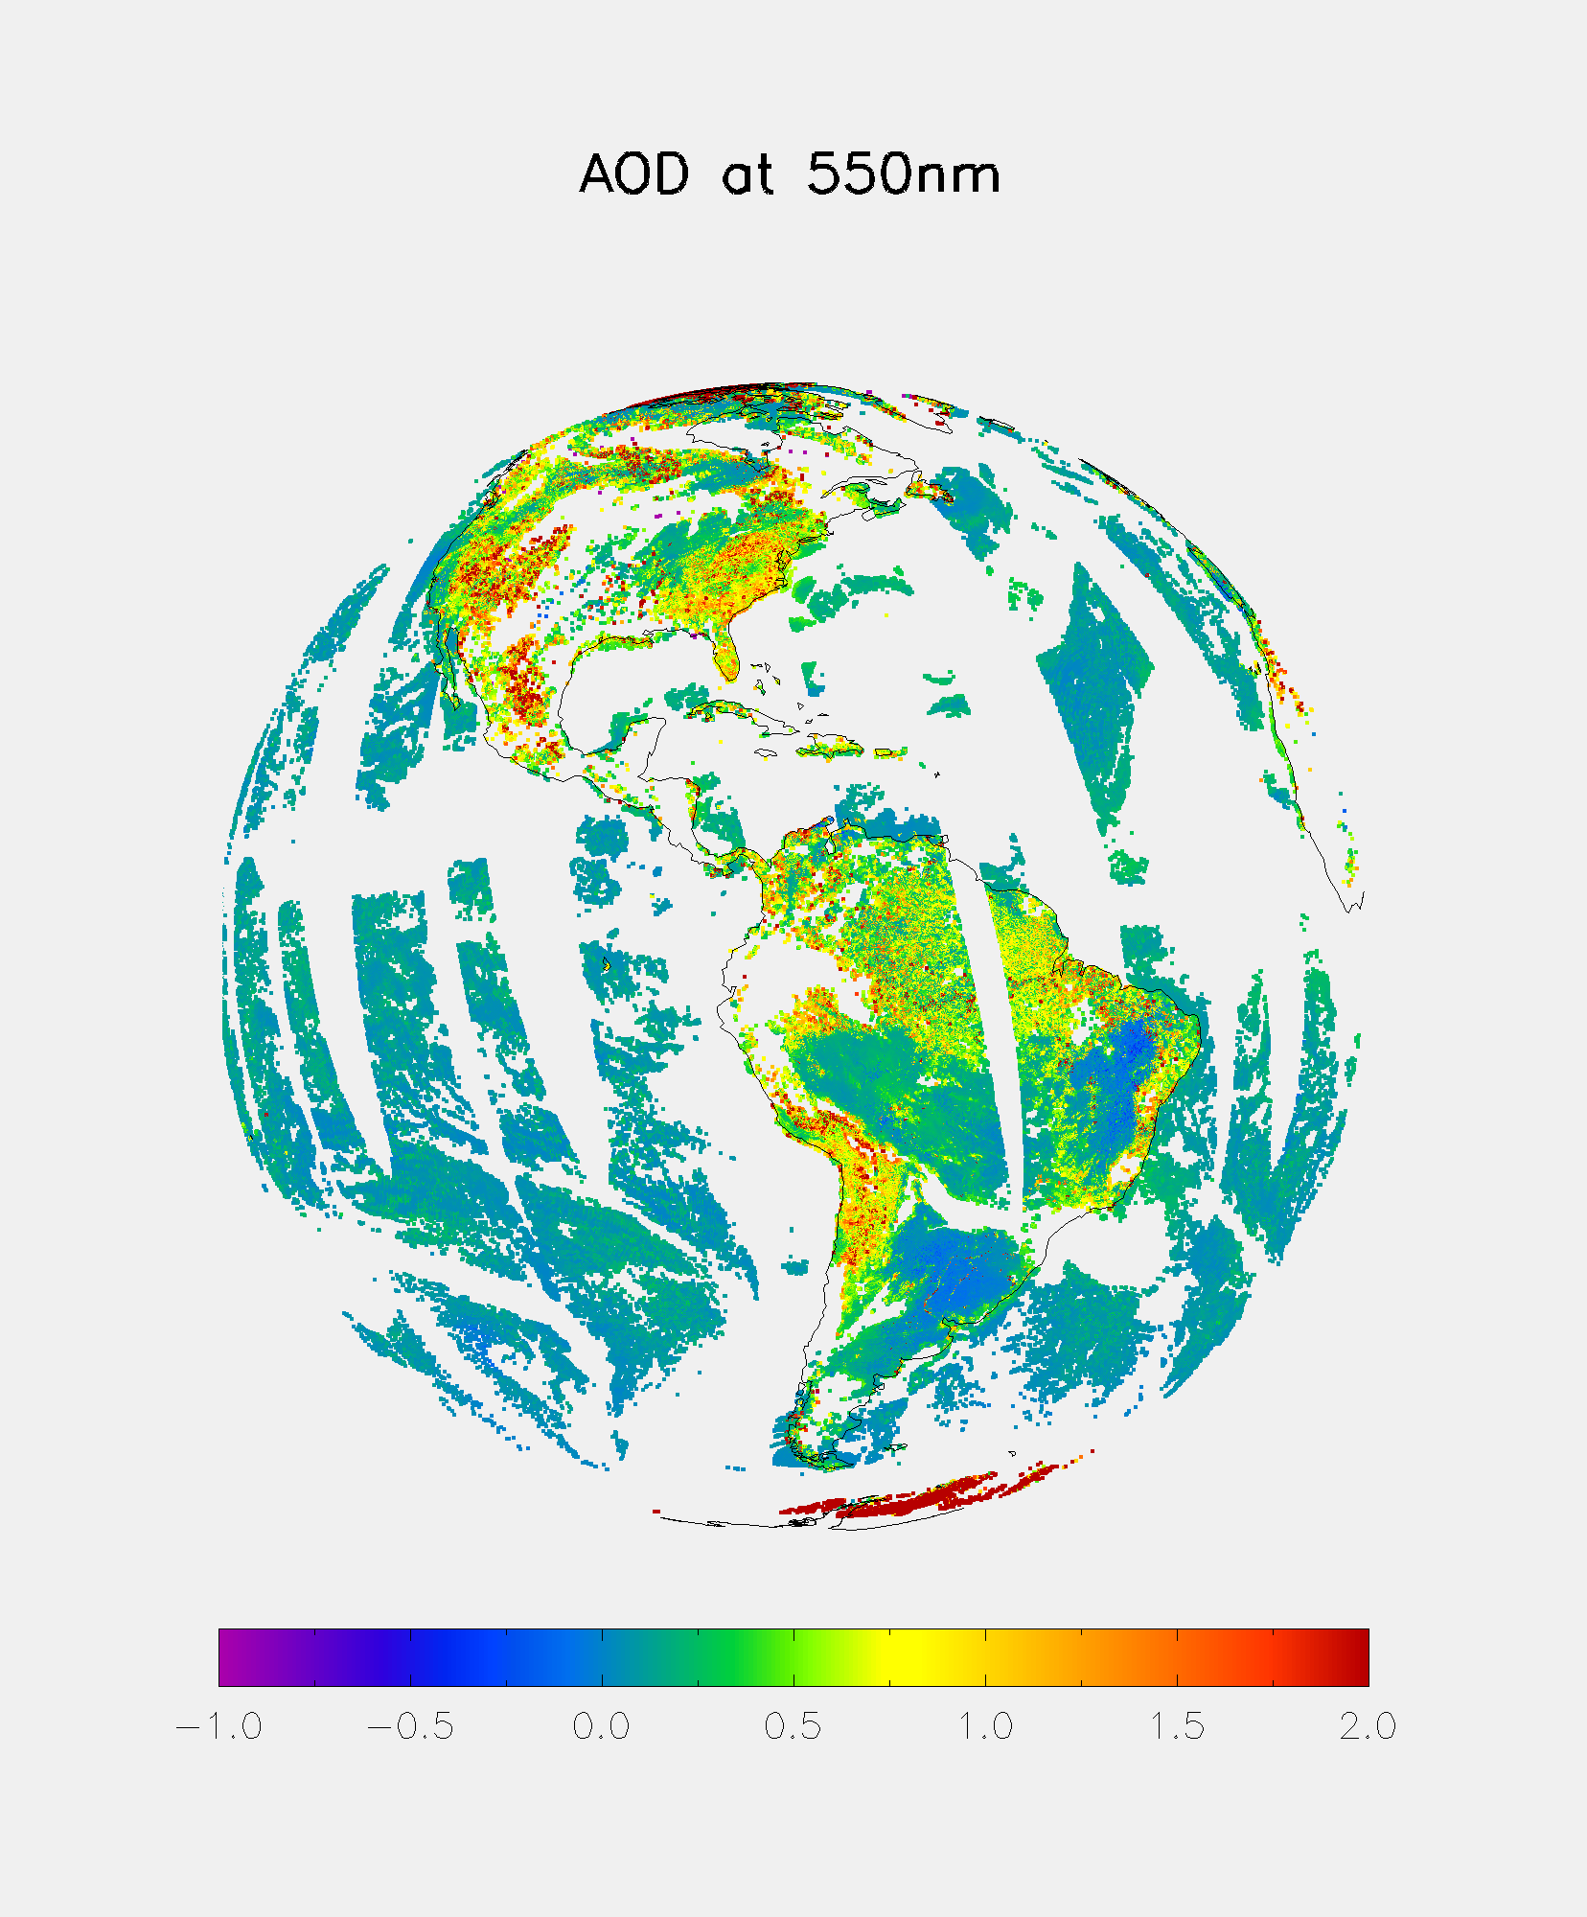
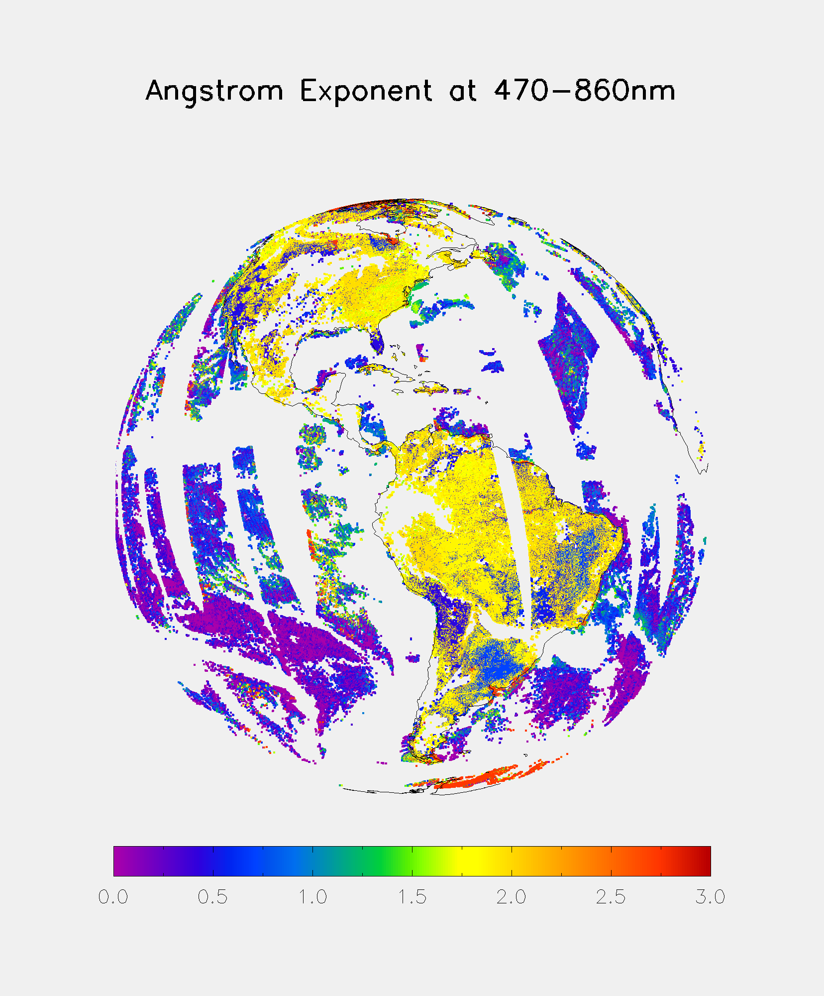
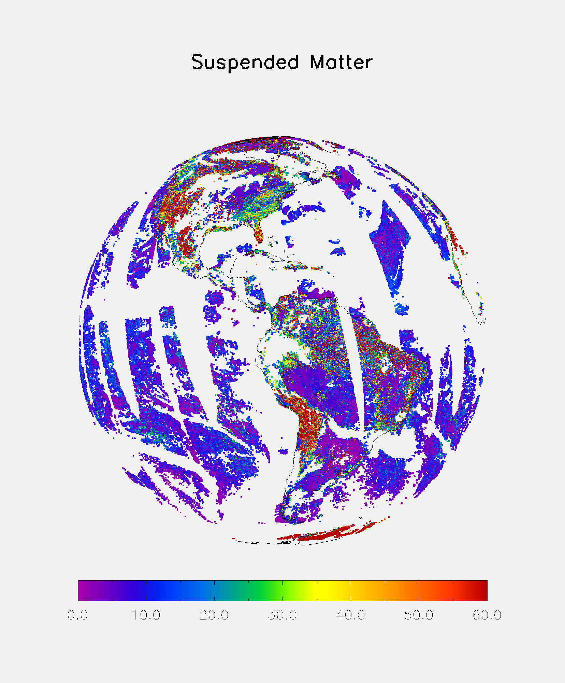
“Routine” Tools (1)
Example of Product Displays of GOES-east region for Aqua Day 2006213 from framework output
(µg/cm²)

Slide 10
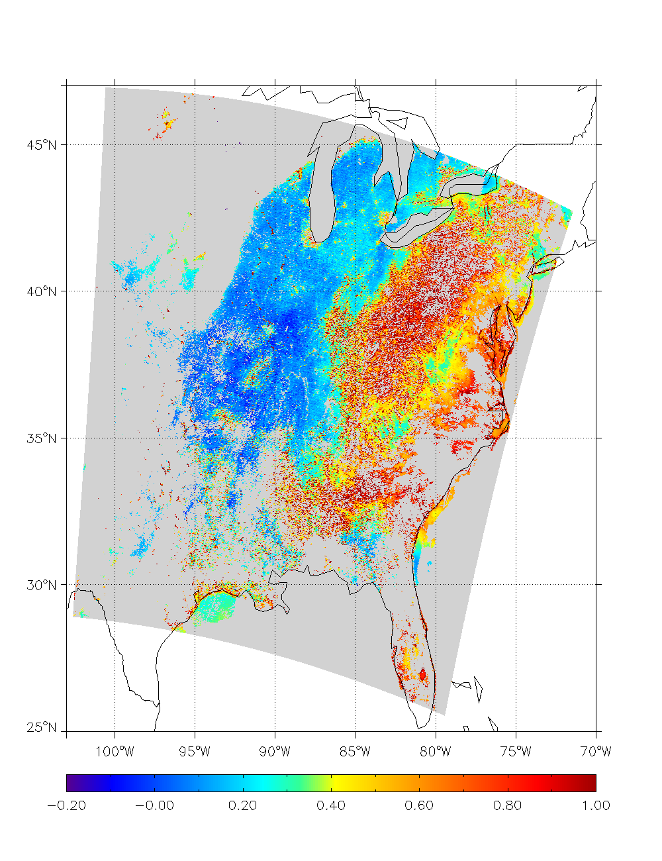
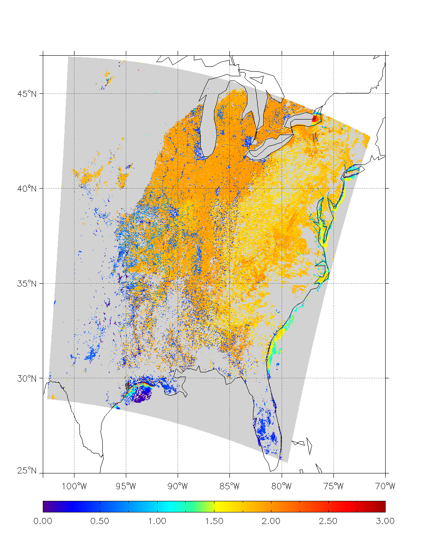
“Routine” Tools (2)
Granule Display
AOD at 550nm
Mean 0.371
Std 0.368
Max 4.982
Min -0.394
Terra granule 2006213_1645 from framework output
Angstrom Exponent at 470-860nm
Mean 1.636
Std 0.542
Max 2.732
Min -0.194

Slide 11
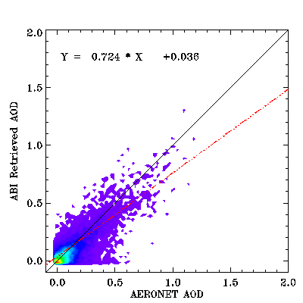
“Routine” Tools (3)
Example of frequency scatter-plot and the calculated statistics in comparison with requirements (in red) using co-located AERONET-MODIS data set for year 2006
Accuracy/Precision/# of matchups
Land
<0.04 [0.04,0.8] >0.8
-0.06 / 0.05 /3633 0.04 / 0.12 /15800 0 .17 / 0.34 /567
0.06 / 0.13 0.04 / 0.25 0.12/ 0.35

Slide 12
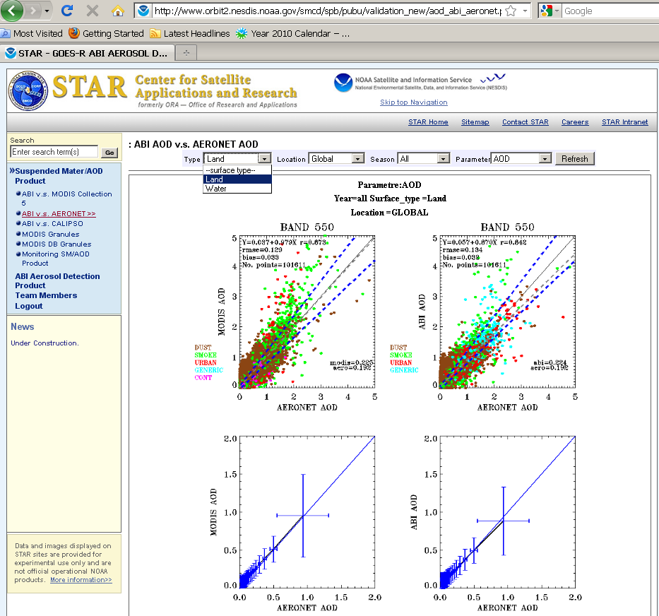



“Routine” Tools (4) – GUI

Slide 13
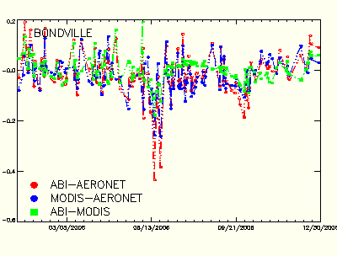
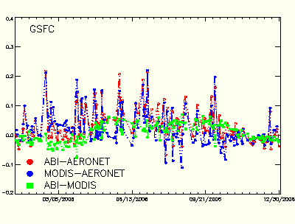
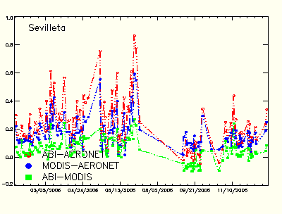
“Routine” Tools (5)
Time series of retrieval error
East US
West US
Notes:
-

Slide 14
Deep-Dive Tool

Slide 15
“Deep-dive” Validation Strategy
ABI retrievals are co-located with reference data in space and time
Expanded comparison data set to include input / diagnostic / intermediate parameters in addition to aerosol product, such as
Surface reflectance and aerosol type over land from MODIS
Quality flag of aerosol product from MODIS
Aerosol model profile from CALIPSO
Detailed analysis, for example, dependence of aerosol products on input, correlation with diagnostic / intermediate parameters
Analysis of deep-dive validation results in re-processing
To check proposed solution fixes the problem
Notes:
First validato

Slide 16
“Deep-Dive” Tools
Assumes access to all ancillary and intermediate data used to generate the product; and performs detailed analysis of the retrieval error dependence on various parameters:
Geometry: solar zenith angle, satellite zenith angle, scattering angle and relative azimuth;
Ancillary input: water vapor, ozone, ocean surface wind speed / direction
Intermediate data: surface reflectance, aerosol type
Quality flags such as cloud masks, land surface type, snow/ice mask
Season
AOD
Display input, intermediate and/or diagnostic data (not shown)
IDL is used for visualization and calculation of statistics

Slide 17
What Triggers “Deep-Dive”?
When consistent over- or under- estimation over a prescribed threshold is observed at a station “deep-dive” assessment is triggered
Analysis of the retrieval error dependence on various parameters (geometry, ancillary input, intermediate data, quality flags, season, and AOD) is conducted to identify problems
When problem is identified, say due to incorrect input of satellite zenith angle, the offline-algorithm is re-run and the time series is re-plotted.

Slide 18
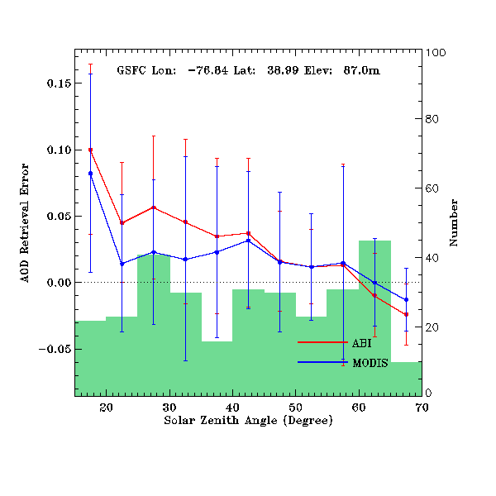
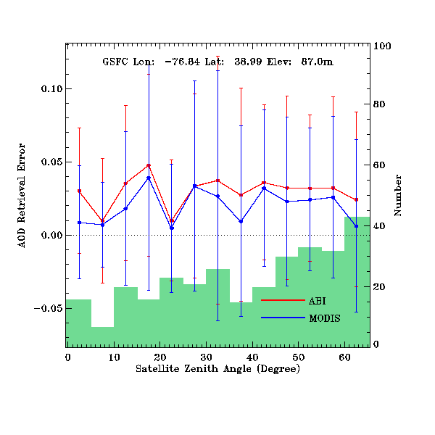
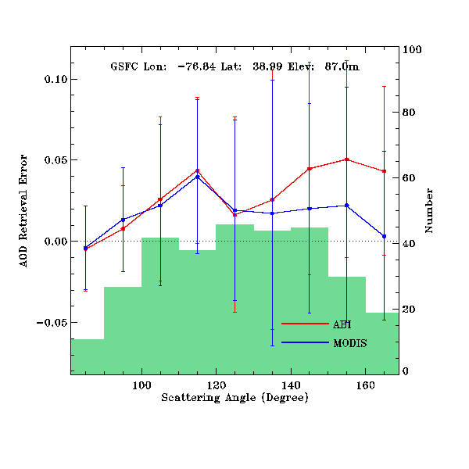
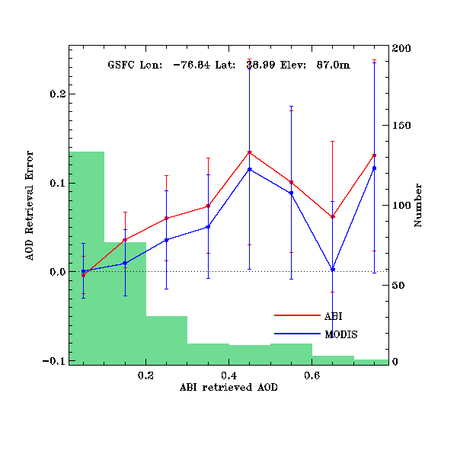
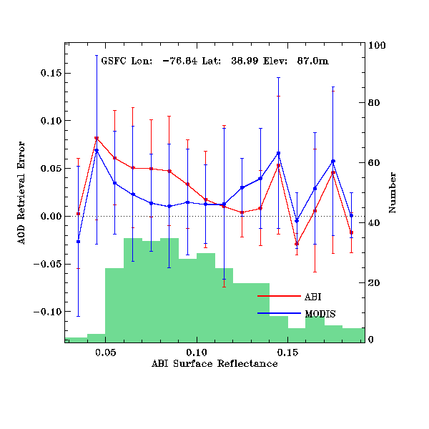
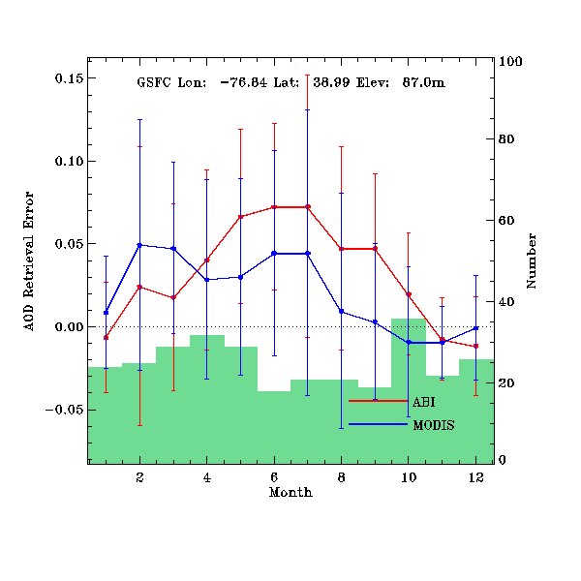
“Deep-Dive” Tools - Dependence on Angle, etc.
Notes:
First validato

Slide 19
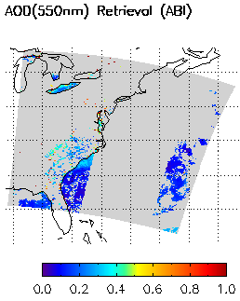
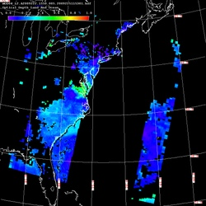
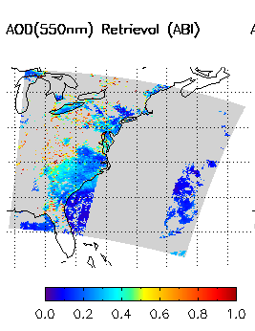
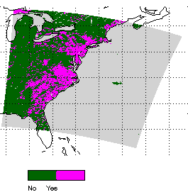
Example use of “Deep-Dive” Tools
ABI retrieval
MODIS retrieval
ABI image vs. MODIS image has much less valid retrievals;
Plotting of inputs suggests it is due to bad snow mask
Correct snow mask and reprocess this granule
ABI snow mask
Correct ABI snow mask
Reprocessed ABI retrieval
Notes:
First validato

Slide 20
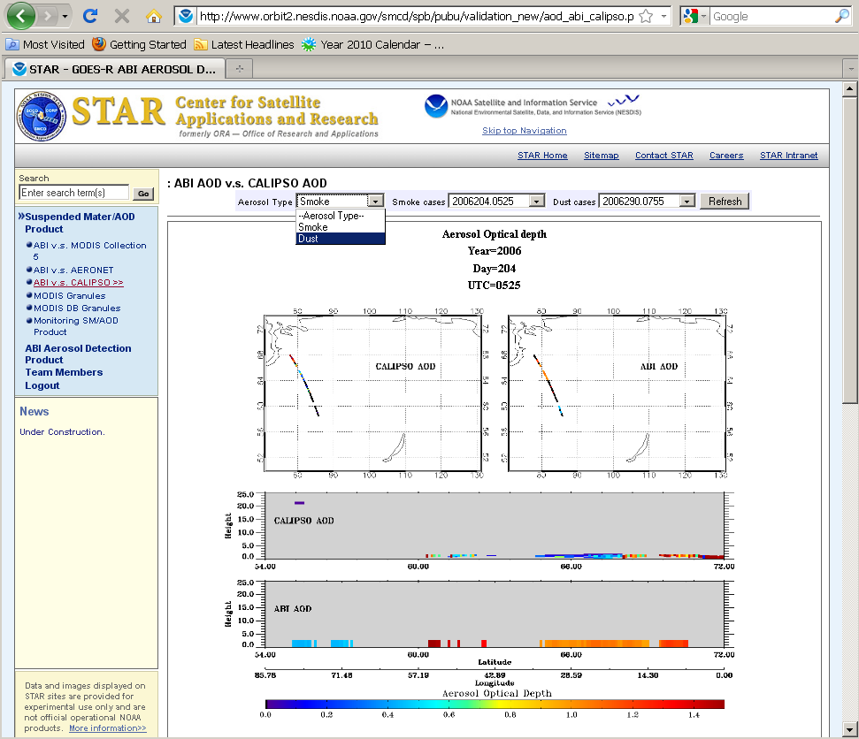
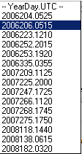
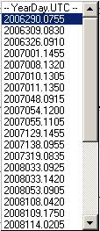
“Deep-dive” Tools - GUI

Slide 21
Ideas for the Further Enhancement and Utility of Validation Tools
Calculate and display
additional statistics
temporal averages on different scales (daily, weekly, monthly)
Identify signatures by which even non-experts can identify potential problems – needed for routine operational monitoring
Implement automatic detection of possible systematic drift or continuous abnormal retrieval in routine validation.
establish “reference” (expected) statistics from good data
compare time series of actual statistics with reference stats
trigger action (e.g., sending warning email) when actual stats exceed reference stats + x std.
Uniform (common) web interface for all ABI products.
Notes:
Please provide your thoughts and ideas for enhancing the capabilities and utililty of the validation tools beyond what you already planned to do. For example:
1) Could your matchup databases support product reprocessing? Will do
2) What new visualization technologies could be used to further enhance the capability/utility of a routine or “deep-dive” validation tool?
3) What web interfaces to your validation tool outcomes could/should be developed (if not already developed)? TBD
4) Other ideas? Aerosol temporal resolution is 5min but cloud 15 mins, it is said internally 5 mins cloud products are available.

Slide 22
Summary
Current tools perform three functions:
routine monitoring of product
routine validation with reference data
deep-dive validation with reference and intermediate data
Validation truth data have been identified and processed
Planned enhancements include:
more stats
automatic detection of problems

