Slide 1
NPP ATMS SDR Product Review Meeting NOAA Science Center, Camp Springs, MD Jan 13, 2012
Raytheon IDPS
Wael Ibrahim

Slide 2
Outline
Maintenance Build (Mx) Key Dates
EDR-PR Requirement Status
Operational Algorithm Updates Post Launch Build (Mx5)
Cal/Val Activity Contributions
Path Forward
Notes:
Remove sub bullets

Slide 3
Outline
Maintenance Build (Mx) Key Dates
EDR-PR Requirement Status
Operational Algorithm Updates Post Launch Build (Mx5)
Cal/Val Activity Contributions
Path Forward
Notes:
Remove sub bullets

Slide 4
Maintenance Build Key Dates (1 of 2)
Mx I1.5.05.01 (AKA Mx5.1 Urgent Release)
MOT Transition To OPS (TTO) (AIDP “AFWA” and NIDP “NESDIS”) Complete - 12/9/11 (L+42d)
Mx I1.5.05.02 (AKA Mx5.2 Urgent Release)
Test Readiness Review (TRR) – 1/10/12
Factory Regression Test – 1/16/12-1/20/12
Post-Test Review (PTR) Complete – 1/20/12
Maintenance Readiness Review (MRR) – 1/19/12
Site Delivery – 1/23/12
AFWA Installation, Test & Checkout (ITCO) – 1/23/12-1/27/12
NESDIS ITCO – 1/23/12-1/27/12
MOT ITCO – 1/23/12-1/27/12
Site Checkout Complete – 1/27/12
MOT TTO – 1/27/12 (Tentative; MOT’s decision)

Slide 5
Maintenance Build Key Dates (2 of 2)
Mx I1.5.06.00 (AKA Mx6)
Following dates are controlled by Raytheon CGS, hence, confirmed:
TRR – 01/11/12
Factory Regression Test – 01/11/12-01/25/12
PTR Complete – 01/25/12
MRR – 01/26/12
Following dates are dependent on magnitude of “Launch Freeze” slip, hence, tentative:
Site Delivery – 01/27/12
Site HW Setup – 01/30/12-02/27/12
AFWA ITCO – 02/06/12-02/27/12
AFWA MOT ITCO – 02/13/12-03/6/12
NESDIS ITCO – 02/20/12-03/13/12
NESDIS MOT ITCO – 02/27/12-03/20/12
Site Checkout Complete – 03/20/12
AFWA TTO Complete – 4/3/12
NESDIS TTO Complete – 4/10/12
Due to Launch Freeze Slip, Mx6 is expected to be ready for OPS ~ End of May’12

Slide 6
Outline
Maintenance Build (Mx) Key Dates
EDR-PR Requirement Status
Operational Algorithm Updates Post Launch Build (Mx5)
Cal/Val Activity Contributions
Path Forward
Notes:
Remove sub bullets

Slide 7
EDR-PR Requirement Status
100% passed on IPAC, Additional Nominal and Non-Nominal Testing for ATMS TDR/SDR/Remap/GEO
ATMS SDR - 8 Requirements
IPAC Supplemental Verification Report (SVR) - ECR-IDP-R1291
Additional Nominal & Non-Nominal SVR - ECR-IDP-003827
ATMS Remap SDR - 4 Requirements
IPAC Supplemental Verification Report (SVR) - ECR-IDP-R1291
Additional Nominal & Non-Nominal SVR - ECR-IDP-003827
ATMS SDR GEO, ATMS Remap GEO - 4 Requirements
IPAC, Additional Nominal & Non-Nominal SVR - ECR-IDP-004170

Slide 8
Outline
Maintenance Build (Mx) Key Dates
EDR-PR Requirement Status
Operational Algorithm Updates Post Launch Build (Mx5)
Cal/Val Activity Contributions
Path Forward
Notes:
Remove sub bullets

Slide 9
Operational Algorithm Updates Post Mx5 (1 of 4)
Science Drops/Tech Memos/CCRs Implemented in Mx6
ATMS SDR 474-CCR-11-0073 (in Mx5.1)
ATMS SDR/TDR Ephemeral Processing Coefficient Table (PCT; ATMS-SDR-CC) Updates
Launch updates:
Modification of the warm load and cold load smoothing function to a triangular weighting function
Updating data limits for the pre launch calibration range
Providing warm and old load corrections
Updating non-linearity Parameters
Relaxing limits on counts so that no scans will be excluded in early orbit
Number of scans in averages are set to odd
Cold and Warm positions error limits are increased
Providing versions for Side A and Side B
Updates to address issues in the following DRs:
DR4461: Ops code tailored to scan profile #1
DR4460: Limits too high on space view counts for channels 7-8

Slide 10
Operational Algorithm Updates Post Mx5 (2 of 4)
Science Drops/Tech Memos/CCRs Implemented in Mx6 (Cont.)
ATMS SDR GEO 474-CCR-11-0175 (DR4337) (in Mx5.1)
ATMS Rotation Matrix Update (Sensor Mounting Offsets in ATMS-SDR-CC) per post environmental alignment measurements
TM NP-EMD.2011.220.0005: NPP Post-Environment Alignment Geo Mounting Coefficients Update
DQM PCR
ALG0020_ATMS_Remap_A355_ISTN_ATMS_NGST_3.1.1 (DR4336) (474-CCR-11-0199) (in Mx5.1)
Updates to ATMS Remap SDR Backus-Gilbert (B-G) coefficients in ATMS-FPMATCH-LUT for use with CrIS and ATMS sensors that are synchronized at the start of scan, also ATMS/CrIS sensor mounting offset updates per post vibration testing are taken into consideration
All drops successfully performed stand-alone and integrated chain testing

Slide 11
Operational Algorithm Updates Post Mx5 (3 of 4)
DRs/ATDRs Implemented in Mx6
4308, ATMS SDR: Incorrect Fill Types in SDR output
1 PRO PCR
4243, ATMS SDR: Error in time deviation constant - ATMS SDR ALLOW_TIME_DEV (in atms_constants.f) is not used, should be deleted
1 PRO PCR
1 DQM PCR to update allowableDev value in ATMS SDR CC XML file
Additional PCRs Implemented in Mx6
Correct applicable values for Operational_Mode metadata in CDFCB (in Mx5.1)
ATMS Remap OAD Update
Update ATMS Verified RDR XML file

Slide 12
Operational Algorithm Updates Post Mx5 (4 of 4)
Post Mx6
DR 4514 (ATMS GEO): ATMS TDR geolocation packaging anomaly (no PCR yet)
DR 4512 (ATMS SDR): NEdT in SDR output noisy (no PCR yet)
DR 4510 (ATMS Remap): ATMS remap routine run twice with CrIS off
1 PRO PCR
DR 4479 (ATMS): Instrument data limits exceeded in Mx5.1 (no PCR yet)
DR 4472 (ATMS): Delta G/G Stability (no PCR yet)
DR 4446 (ATMS GEO/Remap GEO): Gelocation QC flag does not reflect dummy scans (short granules)
ATMS SDR GEO PCR, ATMS Remap GEO PCR
DR 4413 (ATMS Remap): B-G LUT functional test (474-CCR-12-0296)
PRO PCR to correct ATMS Metadata items related to G-Ring_Latitude/Longitude, N/S/W/E_Bounding_Coordinate and N_Nadir_Latitude/Longitude_Max/Min

Slide 13
Outline
Maintenance Build (Mx) Key Dates
EDR-PR Requirement Status
Operational Algorithm Updates Post Launch Build (Mx5)
Cal/Val Activity Contributions
Path Forward
Notes:
Remove sub bullets

Slide 14
Cal/Val Activity Contributions (1 of 35)
ATMS Geolocation Verification
Verifying ATMS Exit Vectors are output for each channel (22 channels) and each beam position (96 EV beam positions) and they are output in Sensor Coordinates, i.e., not affected by sensor mounting offsets.
The following illustration shows an outline of IDPS Common GEO functionality

Slide 15
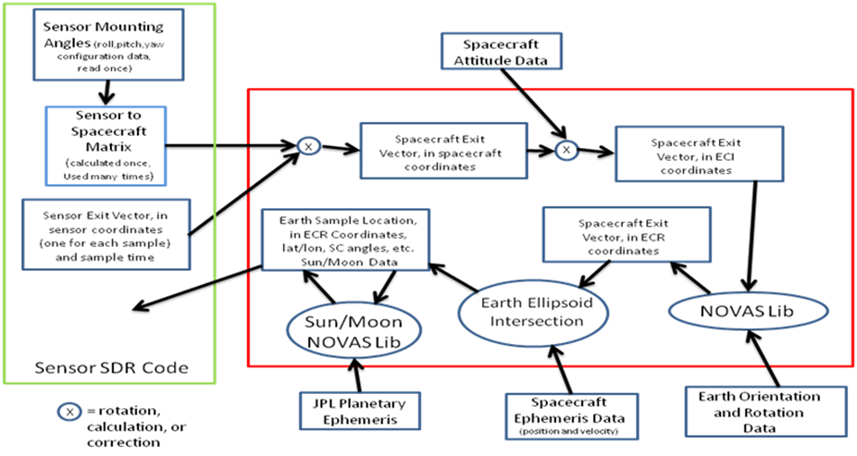
Cal/Val Activity Contributions (2 of 35)
Sensor exit vector is in sensor coordinates and is NOT corrected for sensor mounting angles or spacecraft attitude

Slide 16
Cal/Val Activity Contributions (3 of 35)
ATMS Geolocation Verification (Cont.)
ATMS Exit Vectors are compared b/n Mx5 (No Sensor Mounting Offsets) and Mx5.1 (Sensor Mounting Offsets are applied)

Slide 17
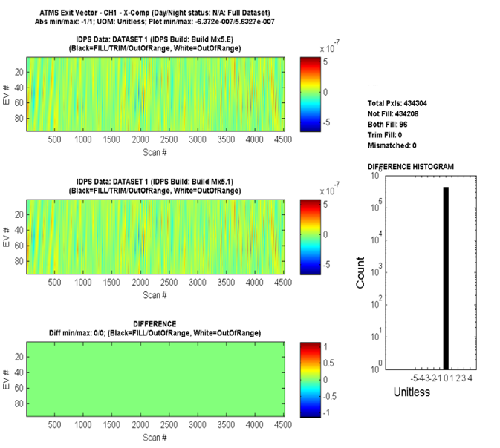
Cal/Val Activity Contributions (4 of 35)
Comparison of the X-Component of the ATMS Exit Vector for the ATMS granules in Proxy Dataset 1 for Channel 1 (23.8 GHz – V-Pol, 5.2 deg beam width)

Slide 18
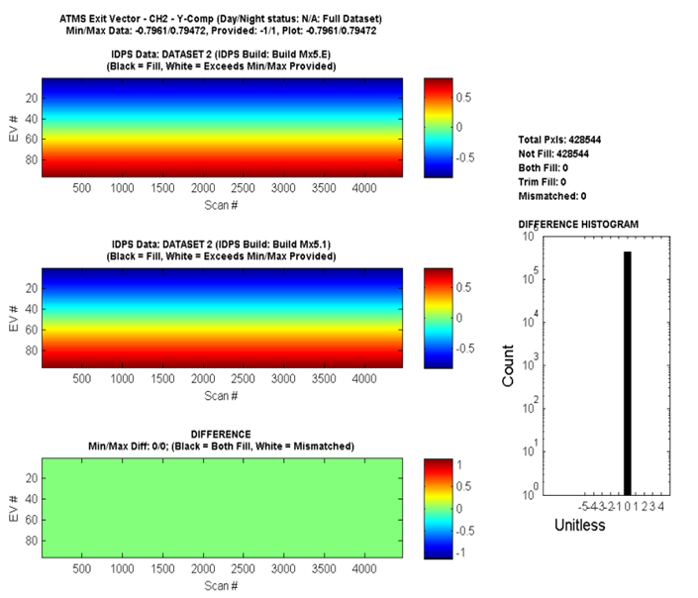
Cal/Val Activity Contributions (5 of 35)
Comparison of the Y-Component of the ATMS Exit Vector for the ATMS granules in Proxy Dataset 2 for Channel 2 (31.4 GHz – V-Pol, 5.2 deg beam width)

Slide 19
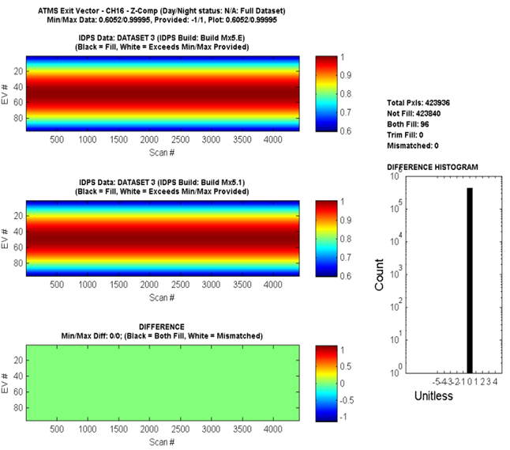
Cal/Val Activity Contributions (6 of 35)
Comparison of the Z-Component of the ATMS Exit Vector for the ATMS granules in Proxy Dataset 3 for Channel 16 (88.2 GHz – V-Pol, 2.2 deg beam width)

Slide 20
Cal/Val Activity Contributions (7 of 35)
ATMS Geolocation Verification
Verifying ATMS geolocation fields by mapping/comparing the overlapping ATMS swaths onto the VIIRS swaths. For each ATMS beam position (96 per scan), find the closest VIIRS pixel positions. Recall ATMS geolocation is ellipsoid-based (i.e., none terrain corrected), thus VIIRS ellipsoid Imagery-resolution geolocation (1536 pixels “In-Track” x 6400 pixels “In-Scan”) is used to provide more pixels for search and mapping (vs. using Moderate-resolution geolocation for example).
The following plots show selected VIIRS granules and their counterpart overlapping ATMS granules

Slide 21
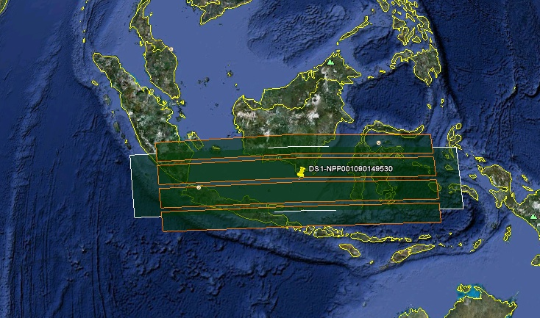
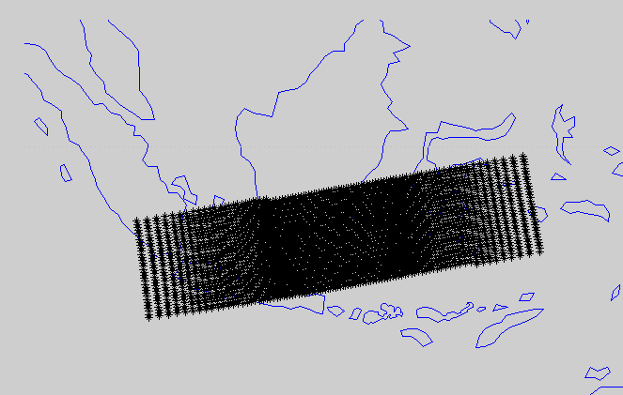
Cal/Val Activity Contributions (8 of 35)
VIIRS Granule:
VIIRS Granule and Overlapping ATMS Granules (over Indonesia)

Slide 22
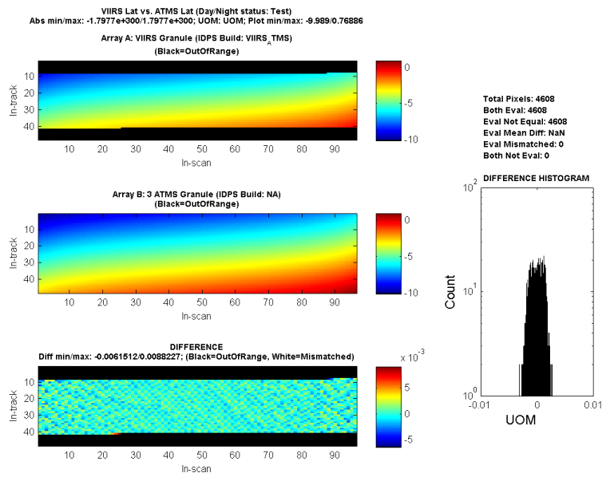
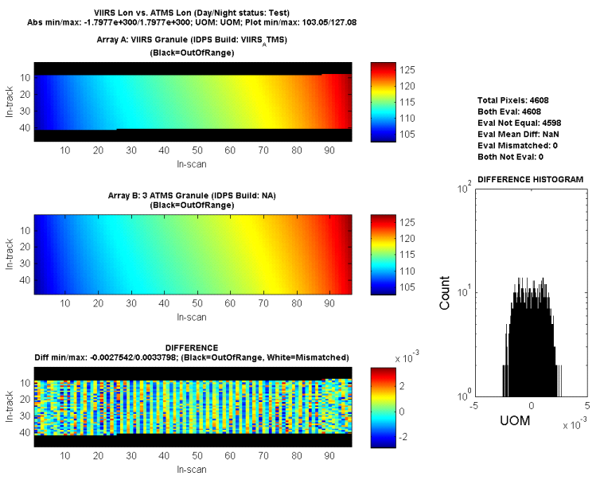
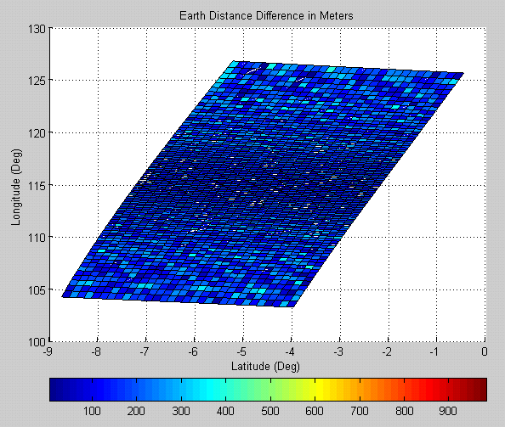
Cal/Val Activity Contributions (9 of 35)
VIIRS Granule:
VIIRS Granule and Overlapping ATMS Granules (over Indonesia)

Slide 23
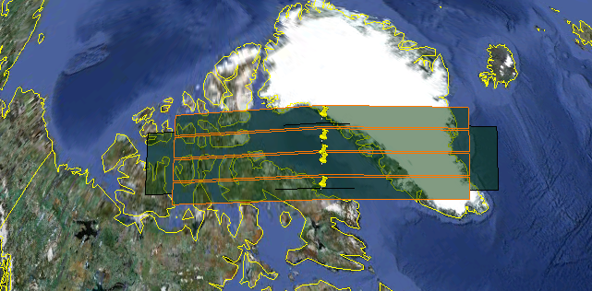
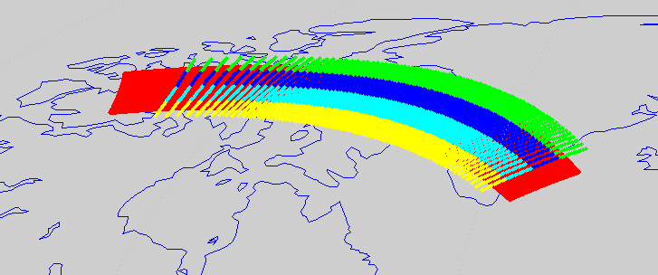
Cal/Val Activity Contributions (10 of 35)
VIIRS Granule:
VIIRS Granule and Overlapping ATMS Granules (Baffin Bay)

Slide 24
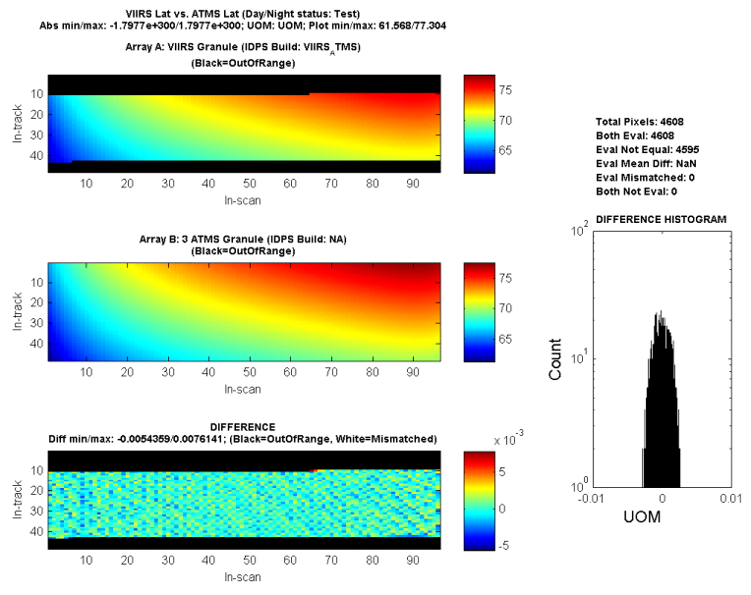
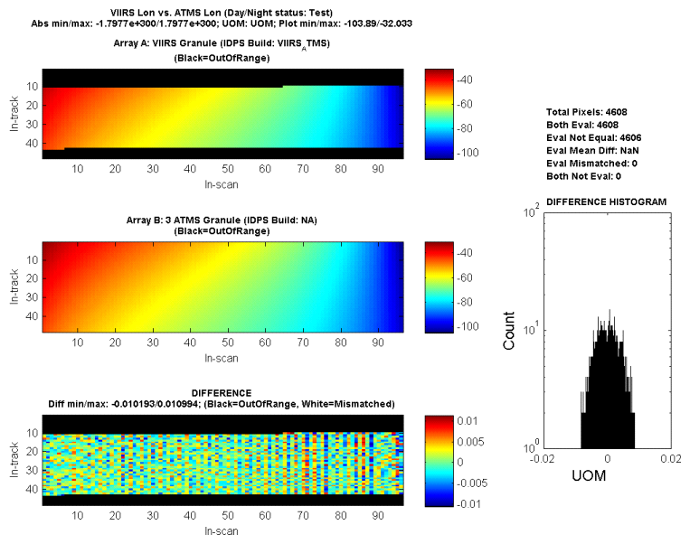
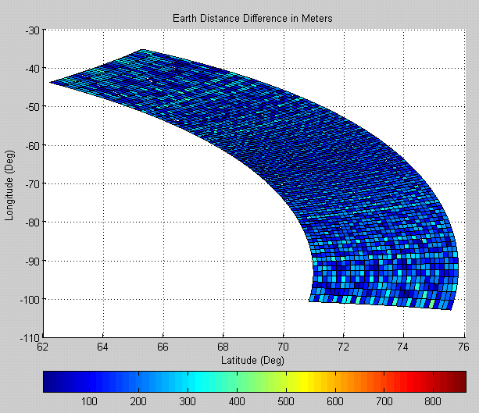
Cal/Val Activity Contributions (11 of 35)
VIIRS Granule:
VIIRS Granule and Overlapping ATMS Granules (Baffin Bay)

Slide 25
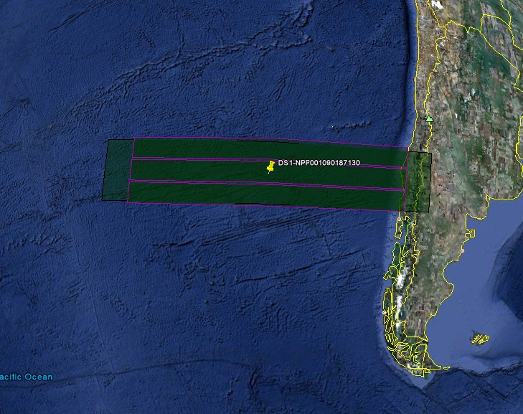
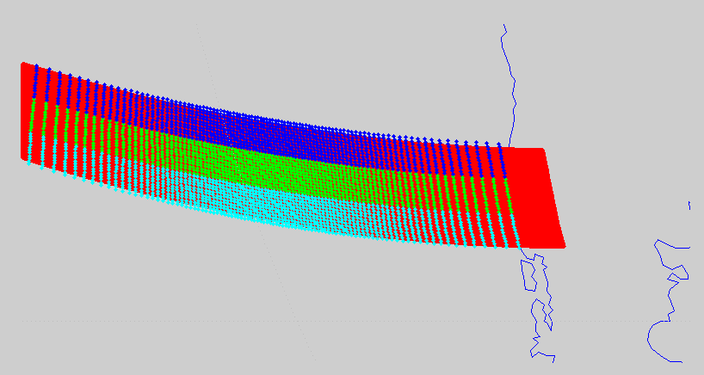
Cal/Val Activity Contributions (12 of 35)
VIIRS Granule:
VIIRS Granule and Overlapping ATMS Granules (South East Pacific)

Slide 26
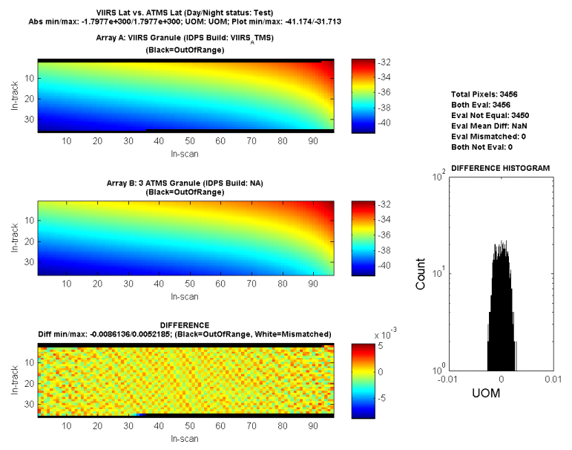
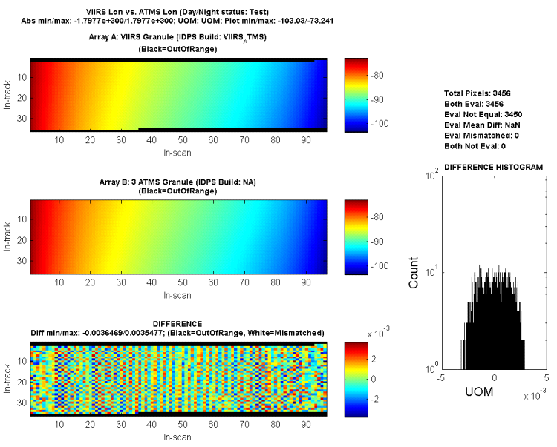
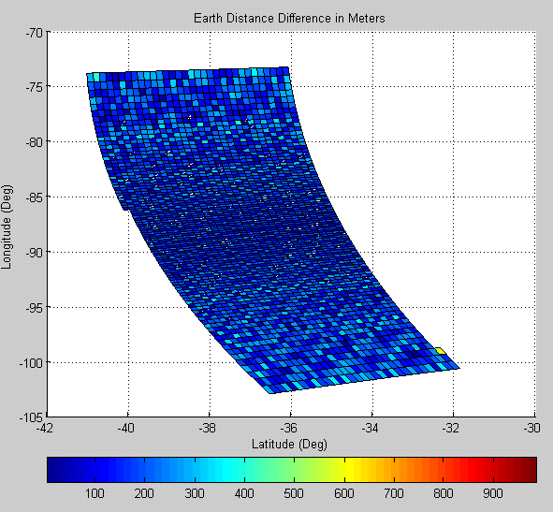
Cal/Val Activity Contributions (13 of 35)
VIIRS Granule:
VIIRS Granule and Overlapping ATMS Granules (South East Pacific)

Slide 27
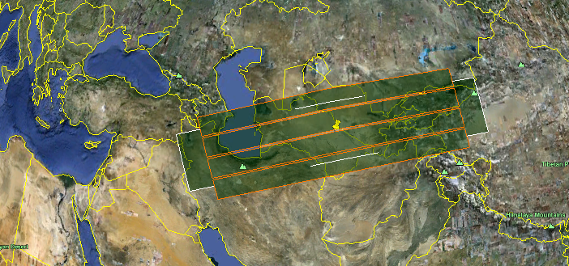
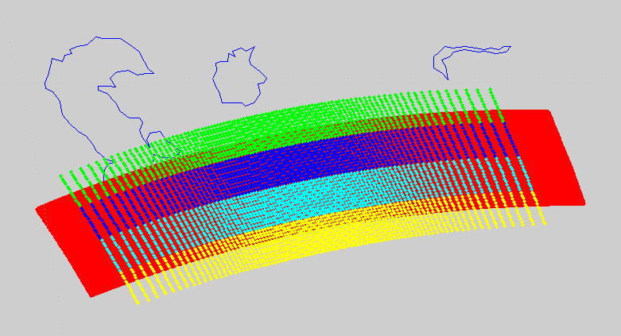
Cal/Val Activity Contributions (14 of 35)
VIIRS Granule:
VIIRS Granule and Overlapping ATMS Granules (Himalayas)

Slide 28
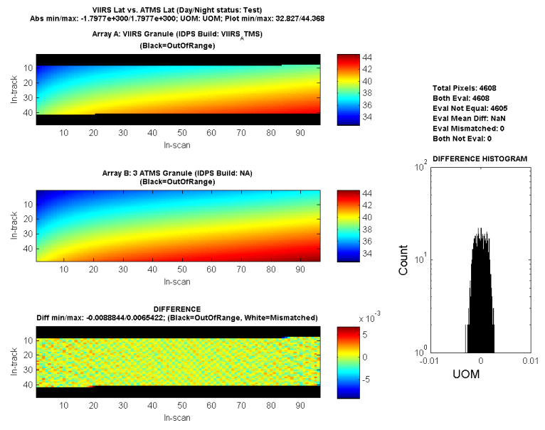
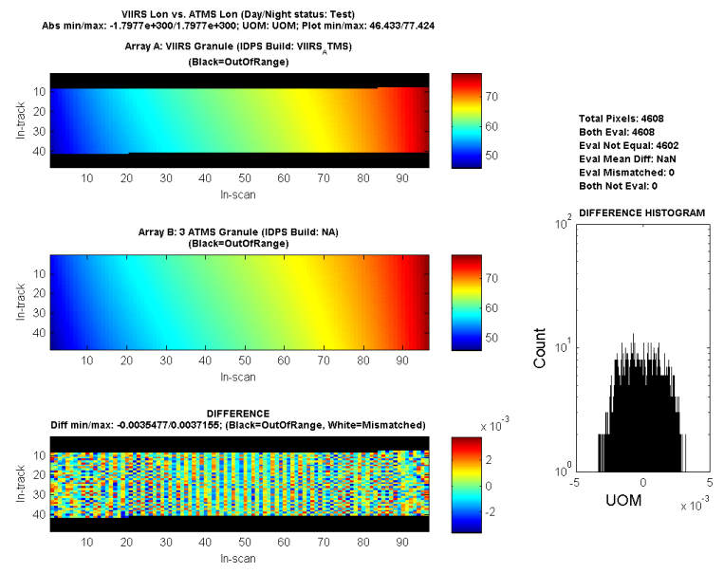
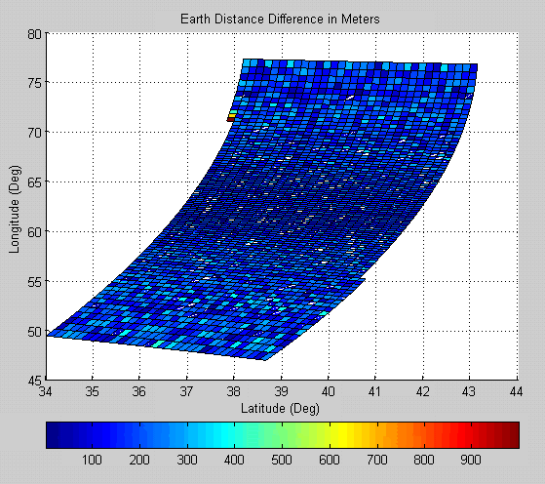
Cal/Val Activity Contributions (15 of 35)
VIIRS Granule:
VIIRS Granule and Overlapping ATMS Granules (Himalayas)

Slide 29
Cal/Val Activity Contributions (16 of 35)
Sensor Mounting Update Verification
Comparing geolocation fields (beam latitude (CHs 1, 2, 3, 16 & 17), beam longitude (CHs 1, 2, 3, 16 & 17), height, satellite azimuth angle, satellite range, satellite zenith angle, solar azimuth angle and solar zenith angle) b/n Mx5 (No Sensor Mounting Offsets) and Mx5.1 (Sensor Mounting Offsets are applied)
The following 2 plots show the comparison for the beam latitude and longitude, respectively, for the ATMS granules in Proxy Dataset 1 for Channel 1 (23.8 GHz – V-Pol, 5.2 deg beam width). The plots show the differences due to the updated sensor mounting offsets in Mx5.1.

Slide 30
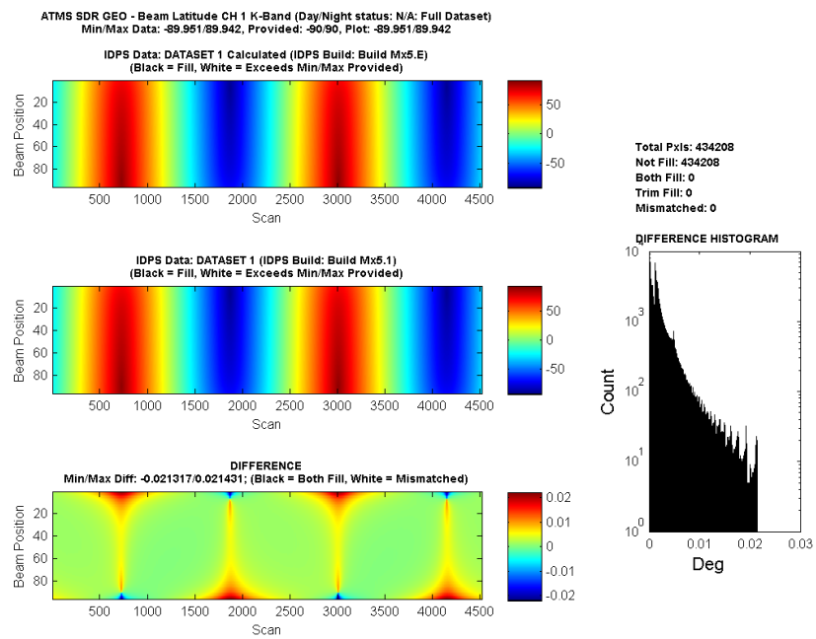
Cal/Val Activity Contributions (17 of 35)
Comparison of the beam latitude for the ATMS granules in Proxy Dataset 1 for Channel 1 (23.8 GHz – V-Pol, 5.2 deg beam width). The plots show the differences due to the updated sensor mounting offsets in Mx5.1.

Slide 31
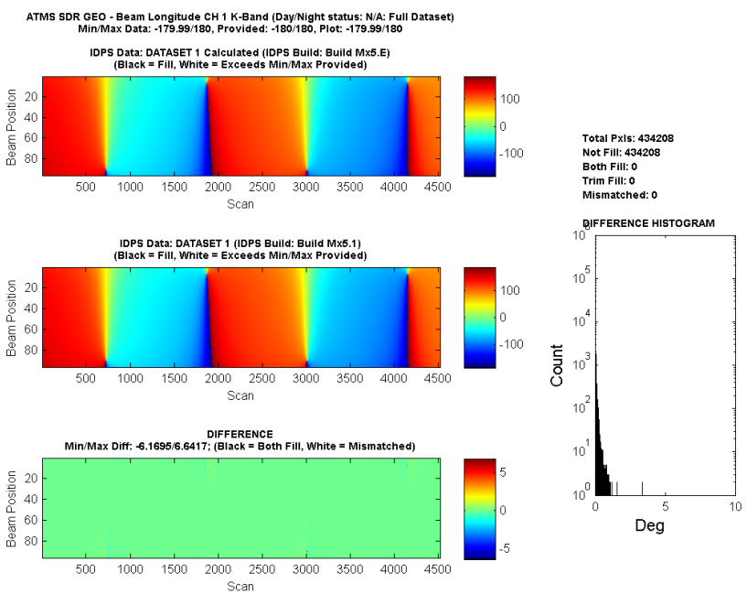
Cal/Val Activity Contributions (18 of 35)
Comparison of the beam Longitude for the ATMS granules in Proxy Dataset 1 for Channel 1 (23.8 GHz – V-Pol, 5.2 deg beam width). The plots show the differences due to the updated sensor mounting offsets in Mx5.1.

Slide 32
Cal/Val Activity Contributions (19 of 35)
Missing Attitude and Ephemeris QF (ATMS SDR GEO and ATMS Remap GEO) Verification
ATMS SDR GEO:
QF1_ATMSSDRGEO (bits 1-2; Attitude & Ephemeris Availability Status) – 1 QF per scan (i.e., 12 QFs per a 32-sec ATMS SDR granule):
0: Nominal (A&E) data available
1: Missing Data <= Small Gap
2: Small Gap < Missing Data < Granule Boundary
3: Missing Data >= Granule Boundary

Slide 33
Cal/Val Activity Contributions (20 of 35)
Missing Attitude and Ephemeris QF (ATMS SDR GEO and ATMS Remap GEO) Verification (Cont.)
ATMS Remap GEO:
QF1_ATMSSDRGEO (bits 1-2; Attitude & Ephemeris Availability Status) – 1 QF per scan (i.e., 4 QFs per a 32-sec ATMS Remap granule):
0: Nominal (A&E) data available
1: Missing Data <= Small Gap
2: Small Gap < Missing Data < Granule Boundary
3: Missing Data >= Granule Boundary

Slide 34
Cal/Val Activity Contributions (21 of 35)
Missing Attitude and Ephemeris QF (ATMS SDR GEO and ATMS Remap GEO) Verification (Cont.)
To test these conditions, the following scenarios (utilizing Proxy Dataset 4) to remove S/C Diary RDRs (each S/C Diary RDR granule is 20-sec duration) are executed and analyzed:
1 S/C diary RDR (S/C diary RDR granule NPP001212012200 2nd RDR in RATMS-RNSCA_npp_d20030125_t0700133_e0700453; Beginning_Time/Ending_Time: 07:00:21 / 07:00:41) in middle of ATMS granule: t0700151_e0700465, NPP001212012123.
1 S/C diary RDR (S/C diary RDR granule NPP001212014600 3rd RDR in RATMS-RNSCA_npp_d20030125_t0703573_e0704292; Beginning_Time/Ending_Time: 07:04:21 / 07:04:41) overlapping beginning of ATMS granule: t0704311_e0705025, NPP001212014682.

Slide 35
Cal/Val Activity Contributions (22 of 35)
Missing Attitude and Ephemeris QF (ATMS SDR GEO and ATMS Remap GEO) Verification (Cont.)
2 S/C diary RDRs overlapping ATMS granule t0707431_e0708145, NPP001212016602:
S/C diary RDR granule NPP001212016600 3rd RDR in RATMS-RNSCA_npp_d20030125_t0707092_e0707412; Beginning_Time/Ending_Time: 07:07:41 / 07:08:01.
S/C diary RDR granule NPP001212016800 3rd RDR in RATMS-RNSCA_npp_d20030125_t0707412_e0708132; Beginning_Time/Ending_Time: 07:08:01 / 07:08:21.

Slide 36
Cal/Val Activity Contributions (23 of 35)
Missing Attitude and Ephemeris QF (ATMS SDR GEO and ATMS Remap GEO) Verification (Cont.)
4 S/C diary RDRs overlapping ATMS granule t0930045_e0930359, NPP001212102034.
S/C diary RDR granule NPP001212101800 2nd RDR in RATMS-RNSCA_npp_d20030125_t0929324_e0930044; Beginning_Time/Ending_Time: 09:29:41 / 09:30:01.
S/C diary RDR granule NPP001212102000 1st RDR in RATMS-RNSCA_npp_d20030125_t0930044_e0930364; Beginning_Time/Ending_Time: 09:30:01 / 09:30:21.
S/C diary RDR granule NPP001212102200 2nd RDR in RATMS-RNSCA_npp_d20030125_t0930044_e0930364; Beginning_Time/Ending_Time: 09:30:21 / 09:30:41.
S/C diary RDR granule NPP001212102400 2nd RDR in RATMS-RNSCA_npp_d20030125_t0930364_e0931084; Beginning_Time/Ending_Time: 09:30:41 / 09:31:01.

Slide 37
Cal/Val Activity Contributions (24 of 35)
Missing Attitude and Ephemeris QF (ATMS SDR GEO and ATMS Remap GEO) Verification (Cont.)
The following plot shows the comparison of the ATMS SDR GEO (A&E Availability Status) QF triggering (MX6.C Nominal vs. MX6.D Non-Nominal) which aligns with the scans where the S/C Diary RDR granules were removed. The horizontal axis is the number of scans (26 ATMS SDR granules are used in this comparison) and the vertical axis is the QF value (0 to 3). In the top left-hand-side section of the plot, the blue represents the QF value from the MX6.C Nominal run (QF is not triggered, hence value of 0 for all scans in all 26 ATMS granules), the red represents the QF value from the MX6.D Non-Nominal run (where QF is triggered correctly in response to the removed S/C Diary RDRs). The bottom left-hand-side of the plot shows the “Difference”, i.e., comparison plot.

Slide 38
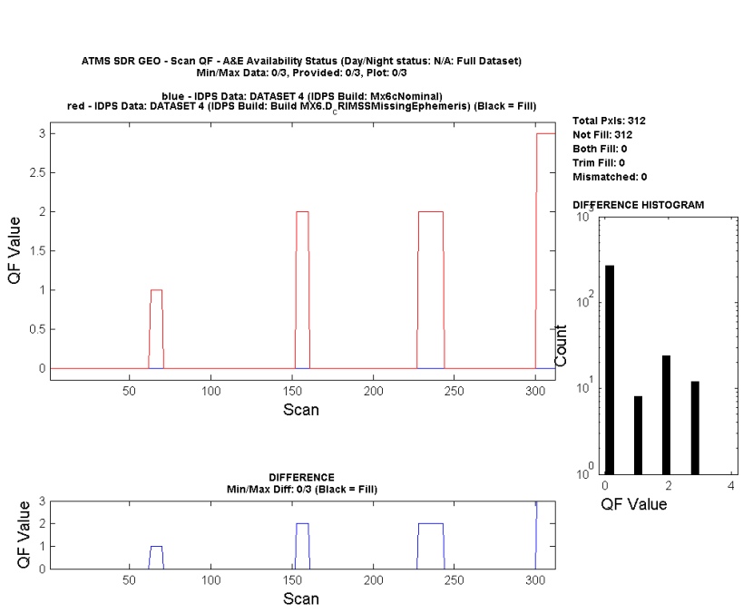
Cal/Val Activity Contributions (25 of 35)

Slide 39
Cal/Val Activity Contributions (26 of 35)
Missing Attitude and Ephemeris QF (ATMS SDR GEO and ATMS Remap GEO) Verification (Cont.)
The following plot shows the comparison of the ATMS Remap SDR GEO (A&E Availability Status) QF triggering (MX6.C Nominal vs. MX6.D Non-Nominal) which aligns with the scans where the S/C Diary RDR granules were removed. The horizontal axis is the number of scans (23 ATMS Remap SDR granules are used in this comparison) and the vertical axis is the QF value (0 to 3). In the top left-hand-side section of the plot, the blue represents the QF value from the MX6.C Nominal run (QF is not triggered, hence value of 0 for all scans in all 23 ATMS Remap granules), the red represents the QF value from the MX6.D Non-Nominal run (where QF is triggered correctly in response to the removed S/C Diary RDRs). The bottom left-hand-side of the plot shows the “Difference”, i.e., comparison plot.

Slide 40
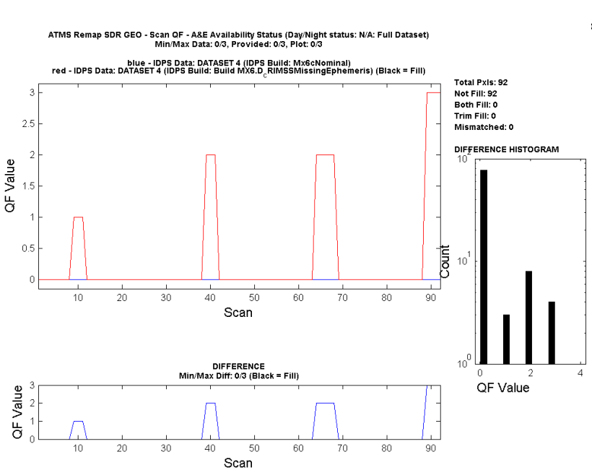
Cal/Val Activity Contributions (27 of 35)

Slide 41
Cal/Val Activity Contributions (28 of 35)
ATMS SDR PCT Update Verification
Comparing ATMS SDR/TDR fields (e.g,., ATs, BTs) and QFs b/n Mx5 (Original PCT) and Mx5.1 (Updated PCT per CCRs 474-CCR-11-0073 & 474-CCR-11-0175)
Compared ~5 orbits of ATMS SDR from 2011/11/08 (1,000 RDRs):
1st RDR: RATMS-RNSCA_npp_d20111108_t2055513_e2056233_b00163_c20111109013617692108_noaa_ops.h5
1,000th RDR: RATMS-RNSCA_npp_d20111109_t0543163_e0543483_b00168_c20111109073906432986_noaa_ops.h5

Slide 42
Cal/Val Activity Contributions (29 of 35)
ATMS SDR PCT Update Verification (Cont.)
The following 7 plots show the comparison for the ATMS SDR BTs for Channels 1, 2, 3, 16 & 17, Cold NEdT and Warm NEdT, respectively.

Slide 43
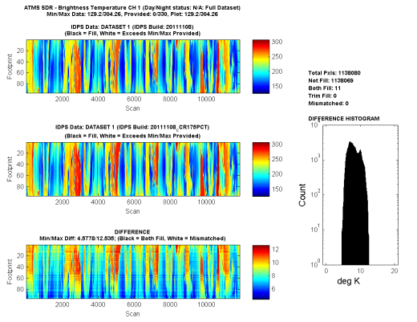
Cal/Val Activity Contributions (30 of 35)

Slide 44
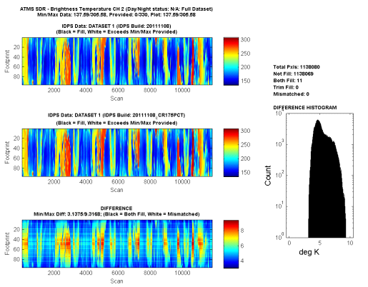
Cal/Val Activity Contributions (31 of 35)

Slide 45
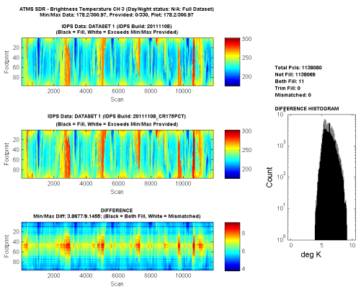
Cal/Val Activity Contributions (32 of 35)

Slide 46
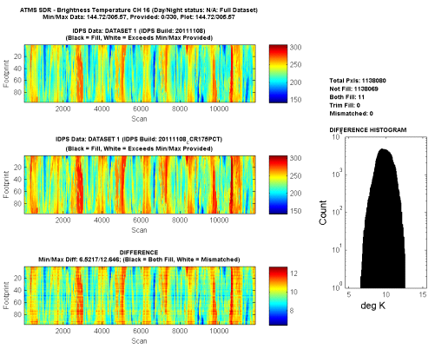
Cal/Val Activity Contributions (33 of 35)

Slide 47
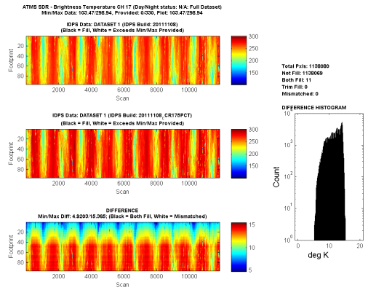
Cal/Val Activity Contributions (34 of 35)

Slide 48
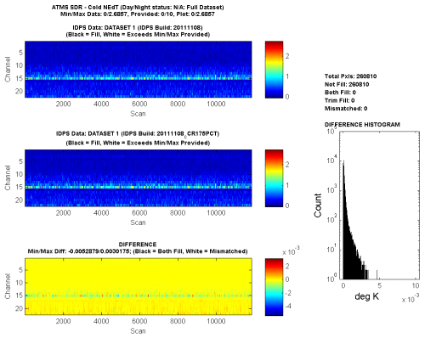
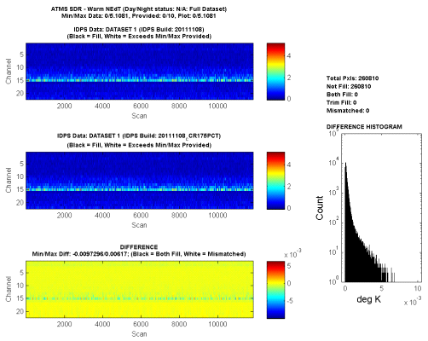
Cal/Val Activity Contributions (35 of 35)

Slide 49
Outline
Maintenance Build (Mx) Key Dates
EDR-PR Requirement Status
Operational Algorithm Updates Post Launch Build (Mx5)
Cal/Val Activity Contributions
Path Forward
Notes:
Remove sub bullets

Slide 50
Path Forward
Continue to provide prompt responses to raised operational algorithm issues through DRs/CCRs/etc.
Continue to improve Matlab-based QCV tool suite and share updated scripts w/ ATMS SDR Cal/Val team members.
Continue to analyze ATMS SDR/Remap obtained data through CLASS/NSIPS/GRAVITE
We stand ready to continue serving as a valued partner in the Intensive Cal/Val enterprise, for resolution of both science and engineering related issues.

