Slide 1
NGAS ATMS Cal/Val Activities and Findings
Degui Gu, Alex Foo and Chunming Wang
Jan 13, 2012

Slide 2
NGAS Responsibilities for NPP ATMS Cal/Val
NGAS ATMS team supports NPP ATMS Cal/Val by applying our in-depth knowledge of ATMS sensor hardware, ATMS SDR algorithm science and algorithm operational implementation at IDPS
Main responsibilities include
Support the Cal/Val team to verify IDPS xDR data products including data format, content and quality
Support to DR investigation and anomaly resolution
Support to fine tuning of algorithm code and LUTs/processing coefficients
Provide LUT and PCT updates and perform verification testing using operational code on GRAVITE ADA

Slide 3
ATMS RDR Verification Activity and Results
Verified ATMS RDR data product by inspection and monitoring of selected ATMS RDR products, including science RDRs, Calibration RDRs, and Engineering RDRs
Converted PRT readings (counts) into physical temperatures to evaluate stability and uniformity of the warmload calibration target temperatures
Analyzed calibration data consistency to assess calibration accuracy
Findings:
Warmload temperatures were stable, showing small and repeatable orbital patterns of temperature variability ~0.2K for KAV bands and ~0.4K for WG bands, respectively. Also noticed some diurnal variability with a daily temperature variation of ~0.5K for KAV bands and ~0.7K for the WG bands, respectively
Warmload temperatures were uniform, with typical temperature contrasts around 40-50mK and maximum contrasts around 100mK among different PRTs within each band
Examination of calibration data (WC, DC, PRT temperatures and Gains) revealed some degree of inconsistency between calibration data, likely affecting SDR calibration accuracy. Some channels are more affected (e.g., channel 16 and channel 1) than others
Empirical bias correction or possible algorithm enhancement may need to be developed to minimize the scan and scene dependent SDR radiance errors for the channels affected most

Slide 4
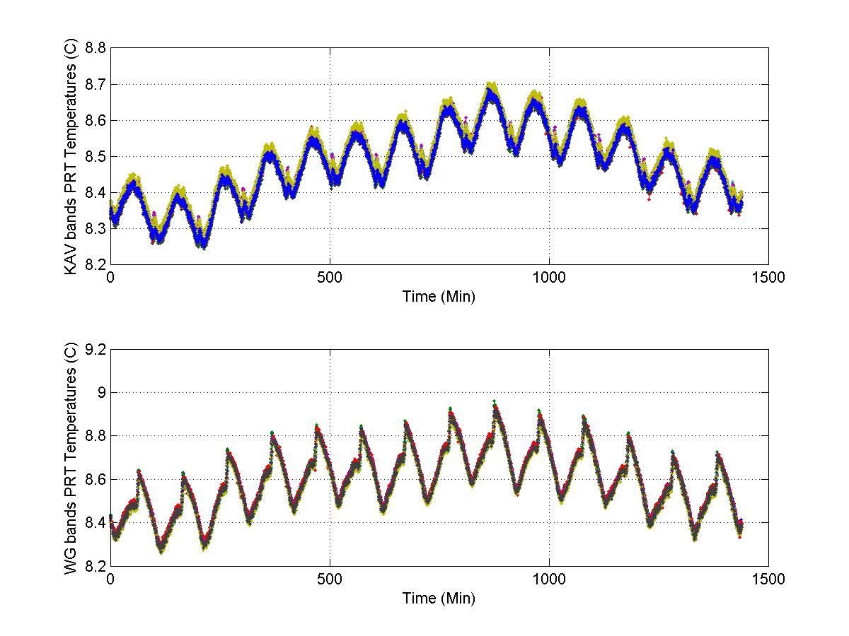
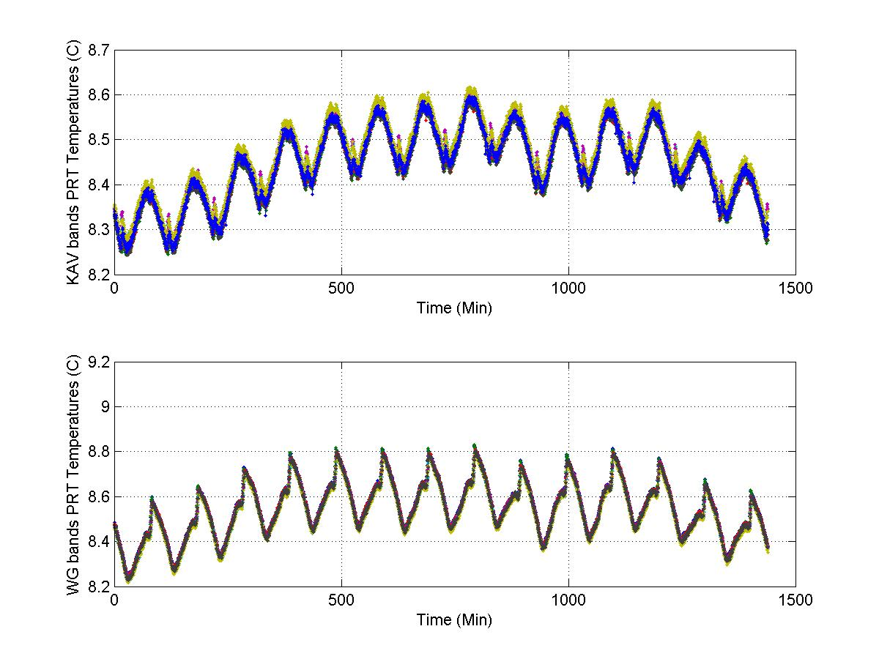
ATMS Warmload Temperature Stability Assessment
KAV Bands
WG Bands
11/10/2011
11/19/2011
12/19/2011
01/03/2012
Warmload temperatures vary in narrow range (0.5K for KAV bands and 0.7K for WG bands), showing repeatable patterns related to orbital phase. Alex Foo and Degui Gu, NGAS

Slide 5
ATMS Warmload Temperature Uniformity Assessment
KAV Bands
WG Bands
11/10/2011
11/19/2011
12/19/2011
01/03/2012
Warmload temperatures are uniform (typical temperature contrast of 40-50mk). Larger contrast up to around 100mK at certain orbital positions. Alex Foo and Degui Gu, NGAS

Slide 6
Warmload Temperature Contrast Patterns
Warmload temperature contrast spiked around the north pole for the WG bands. Similar spikes occurred at ~45 degree south for the KAV bands. Alex Foo and Degui Gu, NGAS

Slide 7
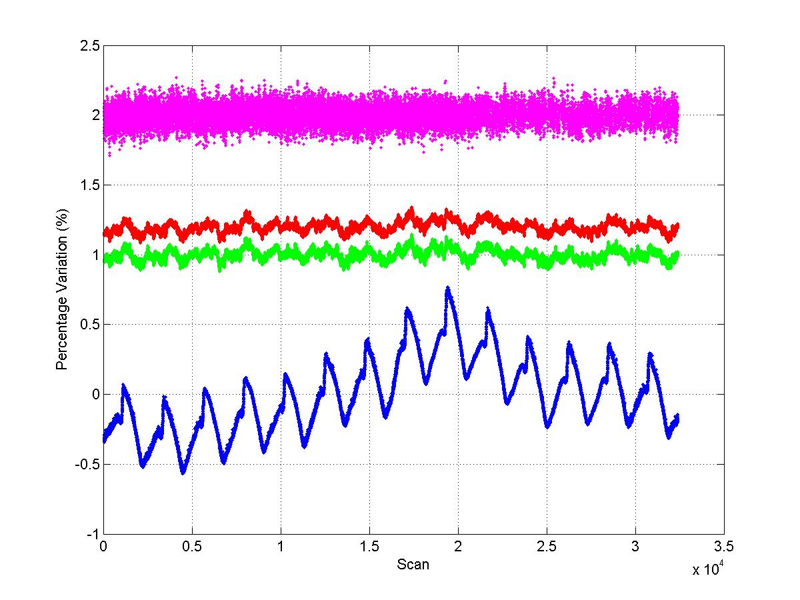
ATMS Calibration Data Consistency Assessment (1)
CHANNEL 20
GAIN Variability (%). Shifted 2%
Warm (R) and Cold (G) Counts Variability (%). Shifted 1-1.2%
PRT Temperature Variability (%)
ATMS calibration data consistency check. Channel 20. Nov 18, 2011. Data downloaded from GTP. Cold counts and warm counts vary in phase, and gains are relatively flat. Alex Foo and Degui Gu, NGAS

Slide 8
ATMS Calibration Data Consistency Assessment (2)
CHANNEL 16
GAIN Variability (%). Shifted 2%
Warm (R) and Cold (G) Counts Variability (%). Shifted 1-1.2%
PRT Temperature Variability (%)
ATMS calibration data consistency check. Channel 16. Nov 18, 2011. Data downloaded from GTP. Cold counts have more variability than warm counts, and gains also show significant variability. Need further investigation and assessment of impact on SDR quality. Alex Foo and Degui Gu, NGAS

Slide 9
ATMS SDR Verification Activity and Results
Verified ATMS SDR data product by inspection and monitoring of selected ATMS SDR contents, including Brightness Temperatures, Geolocations, and Quality Flags
Generated global images for qualitative assessment of brightness temperature and geolocation quality
Generated remap SDRs using NG offline Cal/Val tool and compared to Ops product to verify remap SDR quality
Computed daily averages of brightness temperature as a function of footprint position to evaluate geometry effects and possible scan-dependent biases
Examined ATMS-Only EDR product to assist evaluation of ATMS SDR quality
Supported anomaly resolution and DR investigation to improve SDR data product quality

Slide 10
ATMS Brightness Temperature Images: Channel 1
ATMS channel 1 brightness temperature image (without antenna and bias correction). Ascending orbits. 2011-11-10. Data downloaded from GRAVITE. Alex Foo, Chunming Wang and Degui Gu, NGAS

Slide 11
ATMS Brightness Temperature Images: Channel 17
ATMS channel 17 brightness temperature image (without antenna and bias correction). Descending orbits. 2011-11-10. Data downloaded from GRAVITE. Alex Foo, Chunming Wang and Degui Gu, NGAS

Slide 12
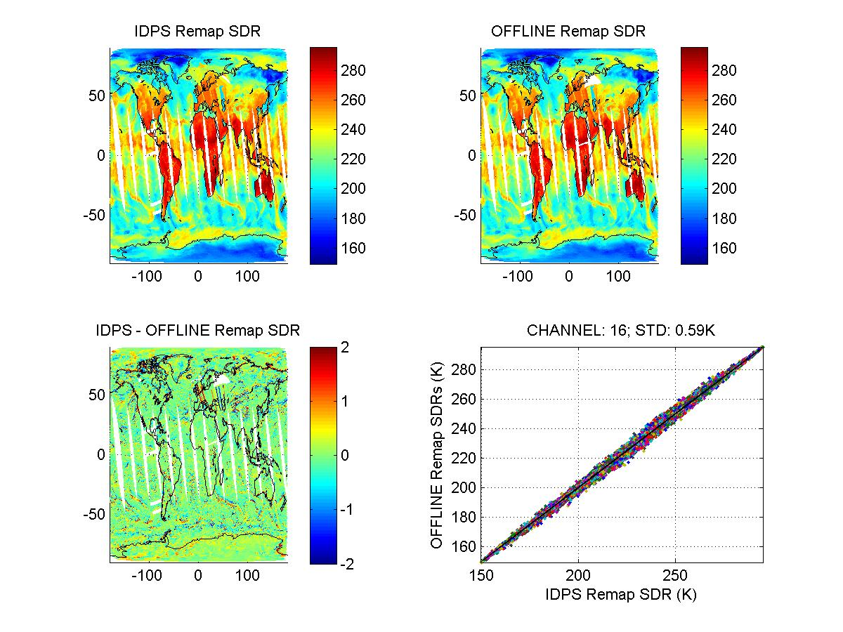
ATMS Remap SDR Quality Assessment (1)
ATMS Remap SDR image. 2011-11-10. Ascending orbits. Channel 16. IDPS products were using B-G LUT based on perfect ATMS/CrIS co-alignment, perfect antenna pattern, and near nadir synchronization between the two sensors. OFFLINE Remap SDRs were generated using NGAS Cal/Val tool that uses the latest B-G LUT. The differences in resulted Remapped SDRs are significant and consistent with previous NGAS estimates. Alex Foo, Chunming Wang and Degui Gu, NGAS

Slide 13
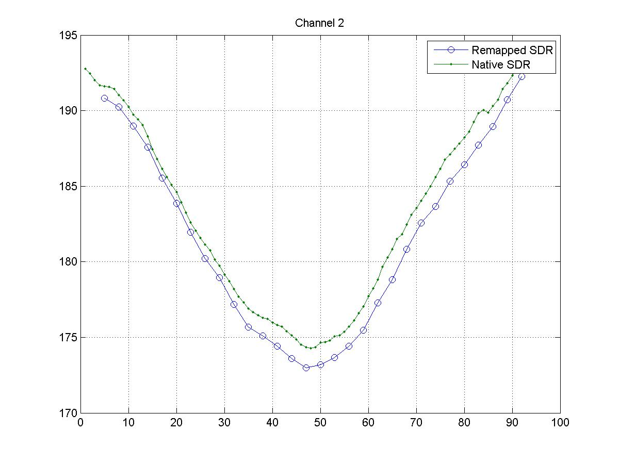
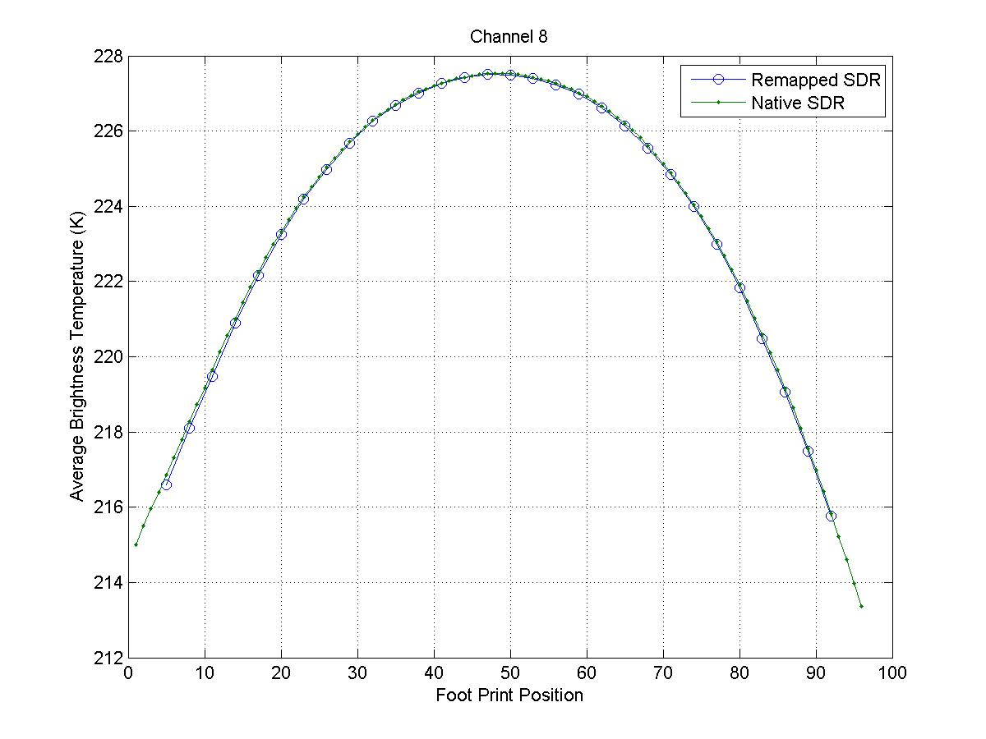
ATMS Remap SDR Quality Assessment (2)
Results preliminary
Averaged brightness temperatures for each scan position
Data analyzed: Jan 3, 2012

Slide 14
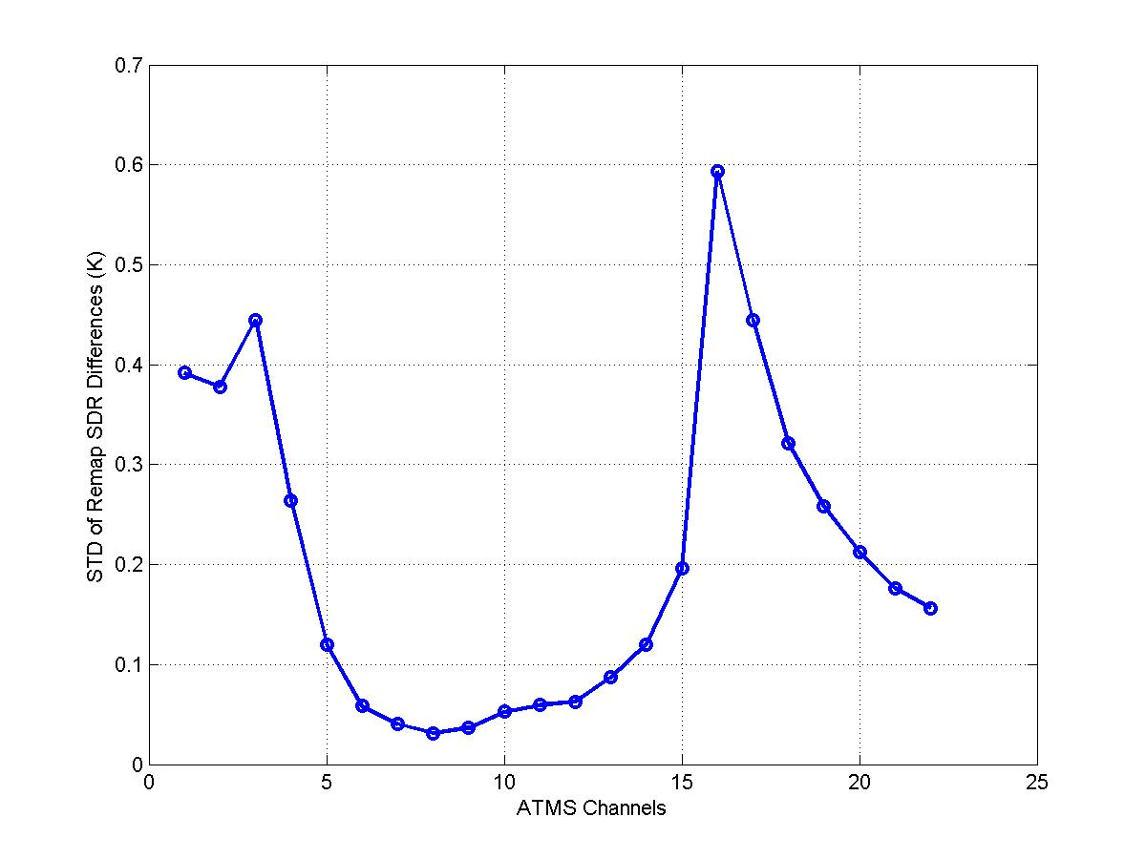
Expected ATMS Remap SDR Quality Improvement using the updated B-G remapping coefficient LUT
Significant improvement to ATMS Remap SDR quality is expected with Build MX5.1 which uses the updated B-G LUT, derived from the measured ATMS/CrIS co-alignment, the actual ATMS/CrIS synchronization, and the measured ATMS antenna pattern. Results based on analysis of 2011-11-10 ATMS SDRs. Similar results for other days. Alex Foo, Chunming Wang and Degui Gu, NGAS

Slide 15
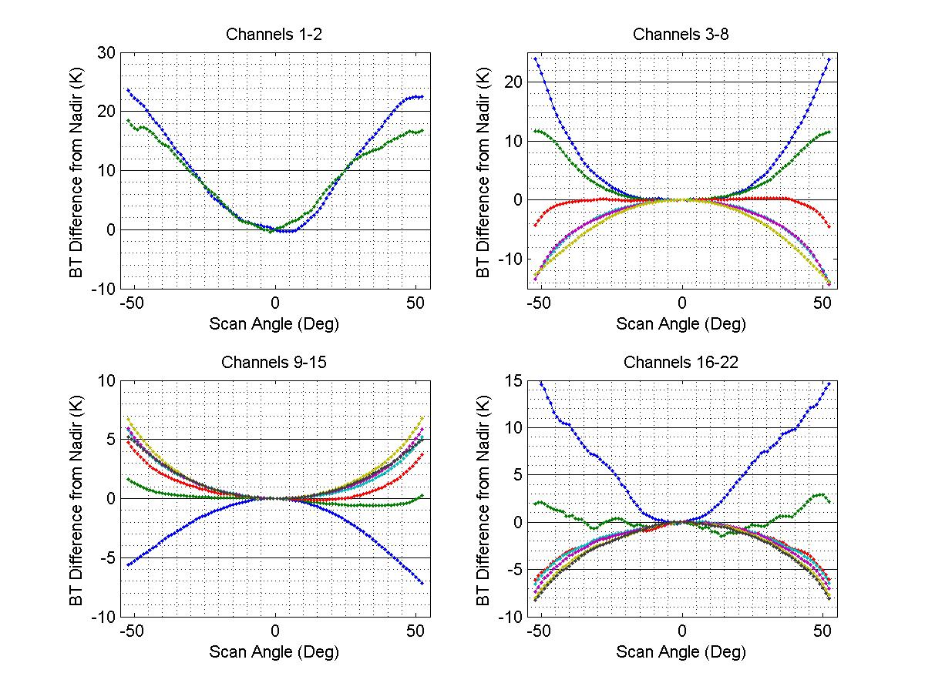
Geometry Effects on ATMS Brightness Temperature
Daily average brightness temperatures showing effects of sensor viewing geometry. Shown are brightness temperature difference from nadir views. Data collected on January 8, 2012. Most of the cross scan temperature variation are likely due to surface emissivity and limb effects, but may also contain some calibration errors due to uncorrected sidelobe effects. Alex Foo and Degui Gu, NGAS

Slide 16
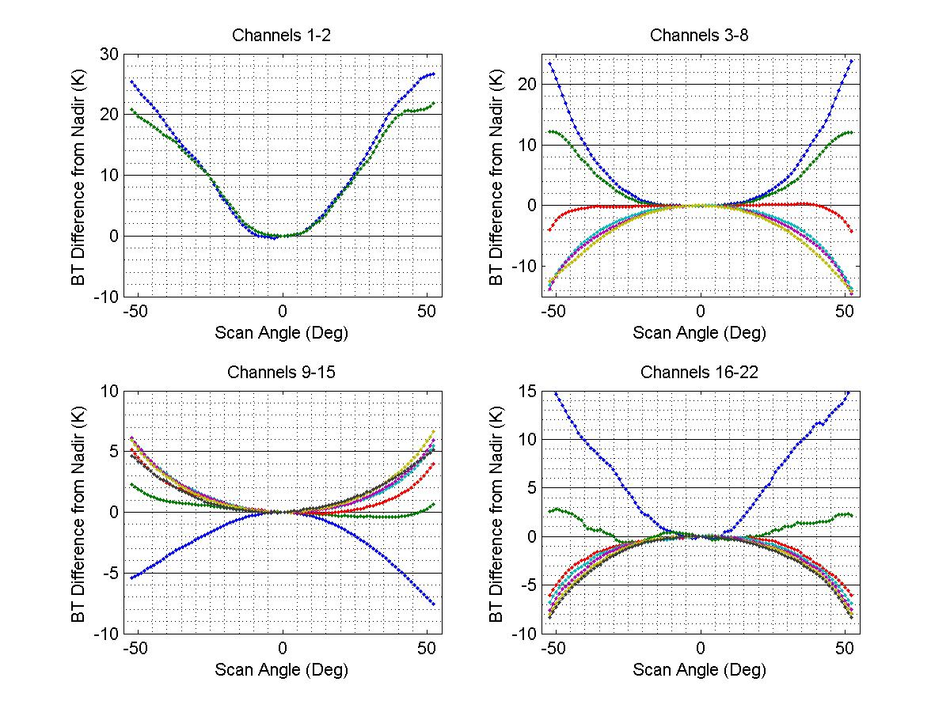
Geometry Effects on ATMS Brightness Temperature
Same as previous slide, but for a different day (January 5, 2012). Similar geometry effects. Exact values are somewhat different, and may be resulted from changes in scene conditions. Alex Foo and Degui Gu, NGAS

Slide 17
ATMS Retrieved Atmosphere Temperature (500mb)
Atmospheric Temperature (K) at ~500 mb produced from ATMS SDRs, which are not corrected for antenna beam efficiency and scan-dependent biases. Ascending orbits. 2011-11-10. Data downloaded from GRAVITE. Xialin Ma and Degui Gu, NGAS

Slide 18
ATMS Retrieved Atmosphere Moisture (500mb)
Atmospheric water vapor mixing ratio (g/kg) at ~500 mb produced from ATMS SDRs, which are not corrected for antenna beam efficiency and scan-dependent biases. Ascending orbits. 2011-11-10. Data downloaded from GRAVITE. Xialin Ma and Degui Gu, NGAS

Slide 19
ATMS SDR Data Product Improvement with PCT Updates
Supported anomaly resolution and DR investigation to improve SDR data product quality
DR4462: space view and blackbody antenna position error flags triggered
Findings: The flags were triggered correctly because RDR values are out of bound (set to tight). No error in ATMS SDR algorithm code, and sensor is working properly, consistent with prelaunch TVAC test behavior
Resolution: updated the PCT to relax the threshold values
DR4463: cold count quality flag not triggered when cold counts were below thresholds
Findings: The CC_LIMIT flag didn’t get triggered when cold count was below the limit because a parameter named “chkConsistWcCc” in the PCT file was incorrectly set to “false”. When this parameter is set to false, a number of calibration related quality flags including CC_Limit will never get triggered. NGAS conducted the investigation on ADA, and later received confirmation from Raytheon that the operational code has the same setting
Resolution: updated the PCT to set “chkConsistWcCc = True”
DR 4413: Incorrect CrIS/ATMS synchronization parameters in Remap algorithm PCT
Findings: Worked with MIT-LL and DPA to re-calculate the expected time difference between ATMS FOV47 and CrIS FOR15 based on NPP operation scenario that they are synchronized at the start of scan
Resolution: updated the affected PCT parameters and performed functional testing on G-ADA. CCR is being processed by DPA/DPE for operational implementation

Slide 20
Blackbody Antenna Position Error Caused by Position #1 Resolver Counts Deviation
Table constructed from ATMS Calibration data book
ATMS Blackbody Antenna Position Error Quality Flag was triggered because Blackbody Pos #1 Resolver counts deviate from the expected value (35286) more than the preset threshold (7). Positions 2-4 are within the bound and do not trigger the flag. This is consistent with TVAC data that showed position #1 has larger deviation from the expected counts. Alex Foo and Degui Gu, NGAS

Slide 21
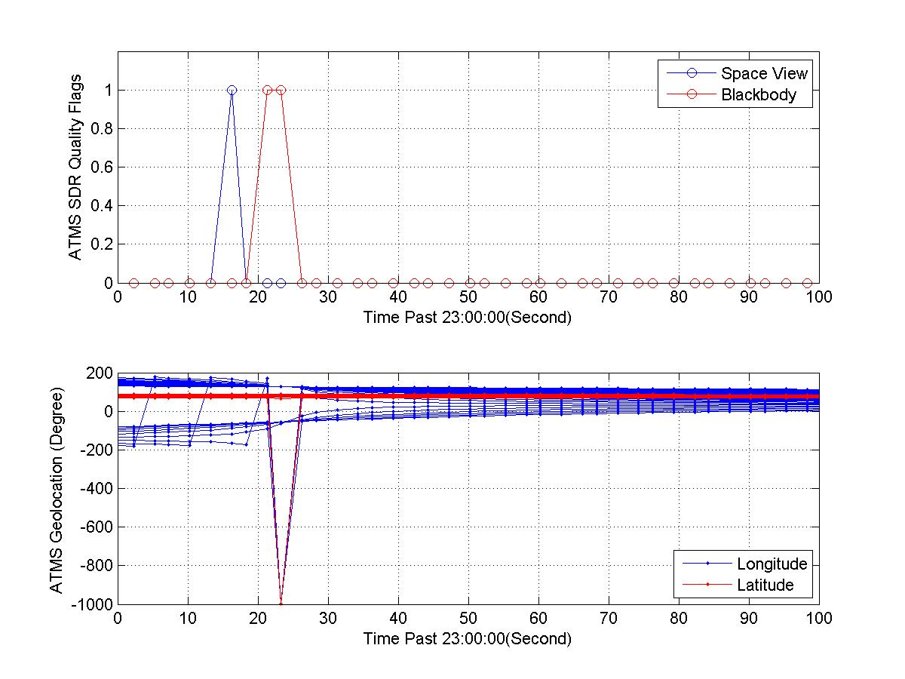
GPS Anomaly Impact on ATMS SDR Product
ATMS SDR Quality Flag Inspection
ATMS SDR Geolocation Quality Inspection
GPS anomaly occurred on Jan 4, 2012, and was shut off for troubleshooting. Impact on ATMS data products were evaluated. Inspection of ATMS SDR data showed antenna error flags being triggered and geolocation data containing fill values around 23:00:22. Independent inspection of RDRs by MIT-LL revealed RDR anomaly in the same time period. Alex Foo and Degui Gu, NGAS

Slide 22
Next Steps
Continue to support the Cal/Val team to verify and validate xDR data products
Continue to support DR investigation and anomaly resolution
Perform functional testing of algorithm code and LUT updates on G-ADA
Assess ATMS SDR accuracy and quantify scan-dependent biases
Develop effective approach to correct scene and scan-dependent biases and to assess impact on CrIMSS EDR performance

Slide 23
Summary and Conclusion
ATMS xDR products have been verified
ATMS sensor is stable
IDPS product generation algorithms perform consistently
Expect improved SDR product quality from Build MX5.1
Additional algorithm LUT updates are being processed by DPA/DPE
Need more data and analyses to characterize sensor sidelobe effects and to evaluate impact on SDR calibration accuracy
Need to update PCT and/or develop algorithm code enhancement correct scene and scan dependent calibration errors

