Slide 1
NPP ATMS TDR and SDR Product Review
NRL Preliminary Assessment Results
Contributors:
Steve Swadley, Gene Poe, Nancy Baker, Ben Ruston, Kim Richardson (NRL)
Al Uliana, Pedro Tsai, Glen Carl (SAIC)
NPP ATMS SDR Product Review, NOAA Science Center, Camp Springs, MD 13 January 2012

Slide 2
Outline
TDR vs. SDR Scan Biases
NE∆T and Gain Analysis
Allan Variance Analysis
Geolocation Analysis
NWP Departure Analysis
Possible RDR Anomalies
Near Term Plans for ATMS at NRL

Slide 3
TDR vs. SDR Scan Biases
Averages computed by scan position
Ratios computed with respect to two central beam positions
SDR has a large Bias compared to TDR
SDR Beam Efficiency and Scan position offsets were computed
via regression vs. TDR
Bias and noise signature is verified with NWP OB-BK Analysis
SDR shows a non-physical scan position noise

Slide 4
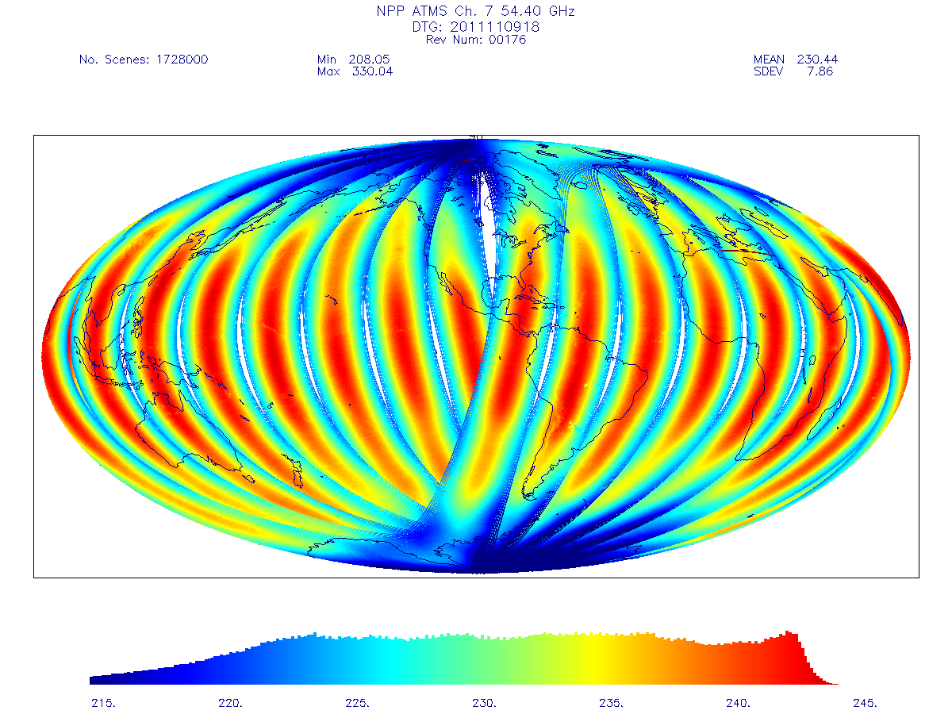
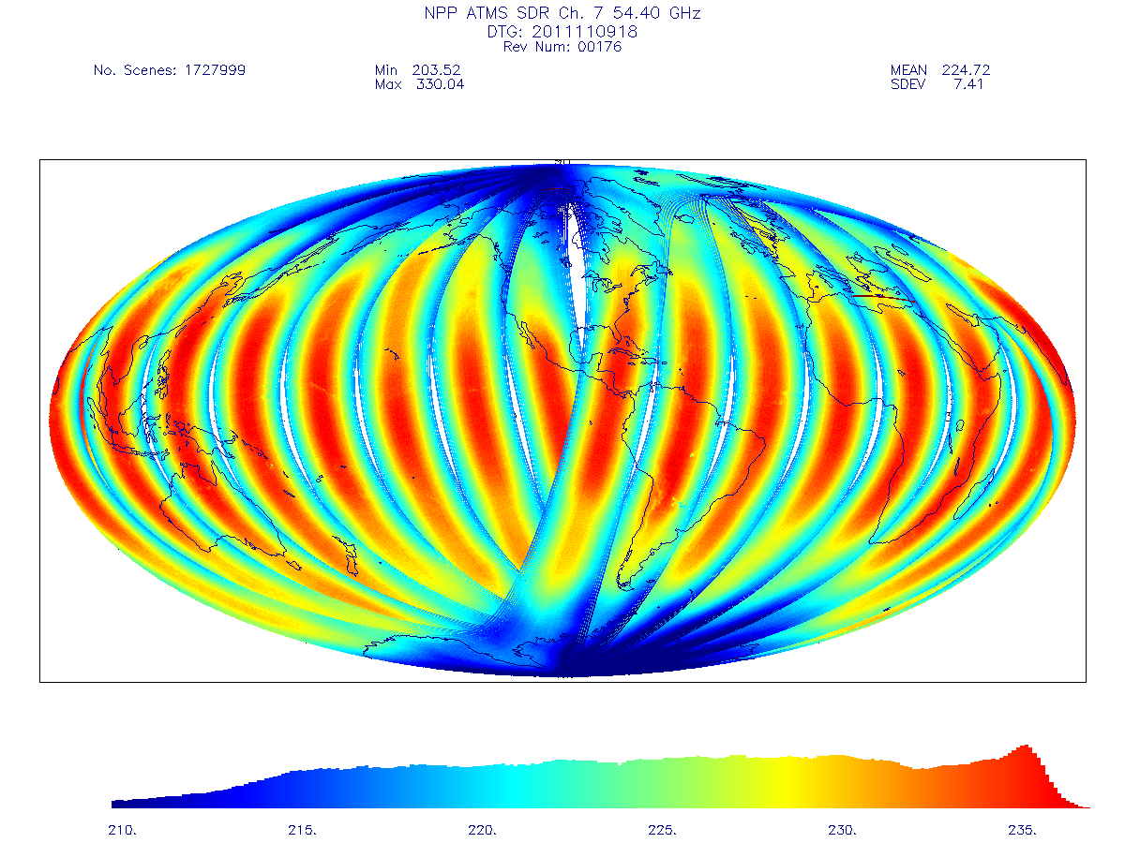
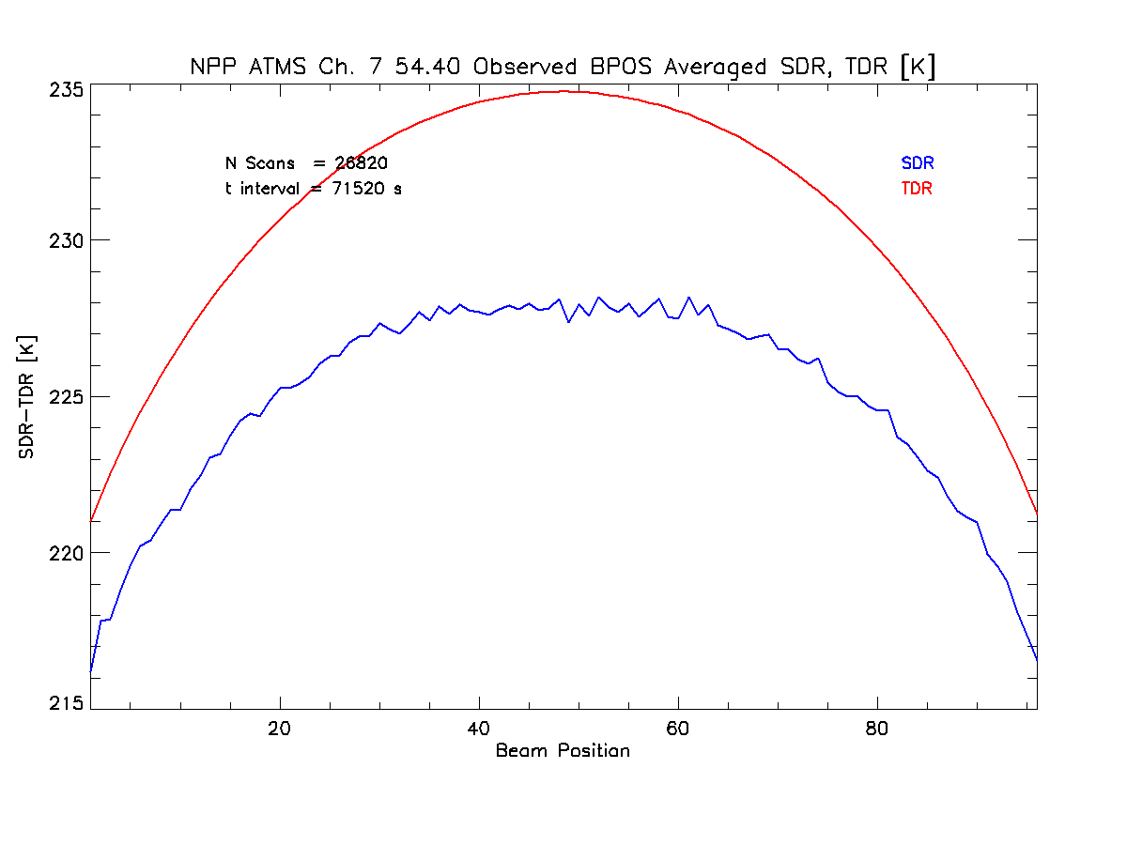
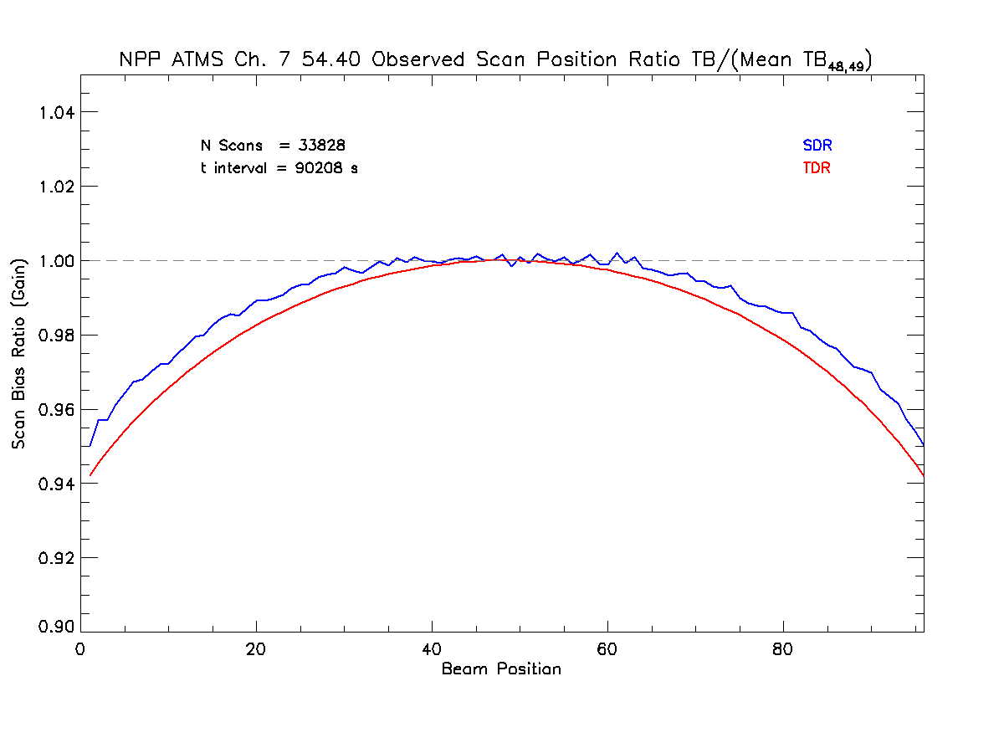
TDR
SDR

Slide 5
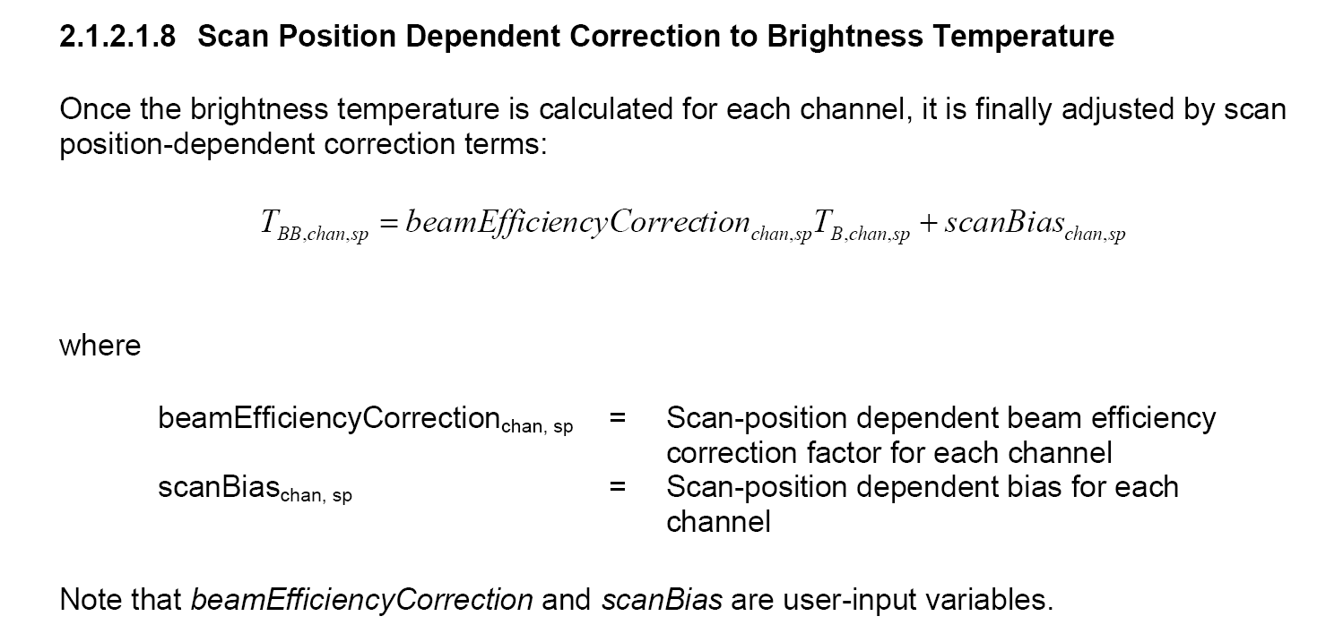
Extracted from:
OPERATIONAL ALGORITHM DESCRIPTION DOCUMENT
FOR ATMS SDR (D39309 Rev B)

Slide 6
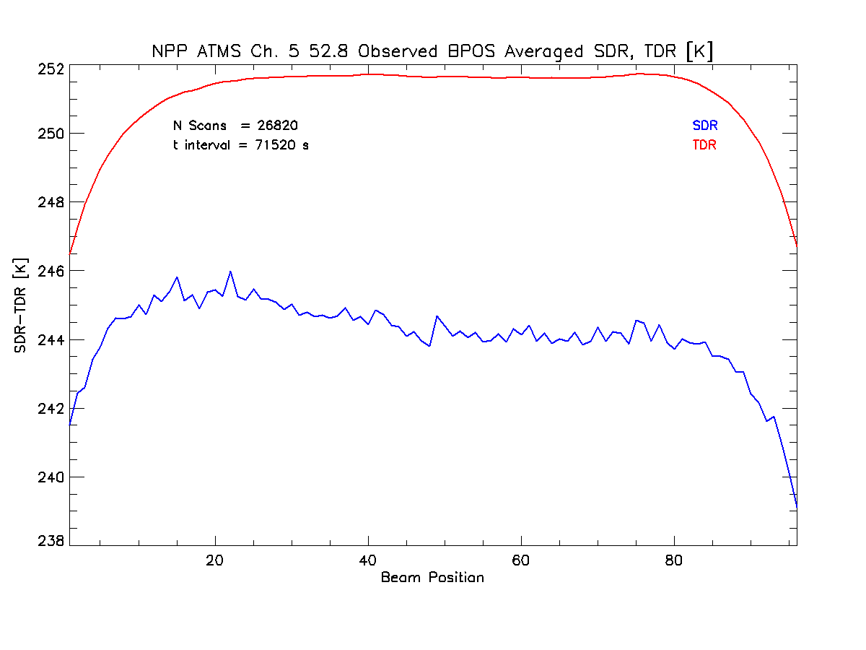

Slide 7
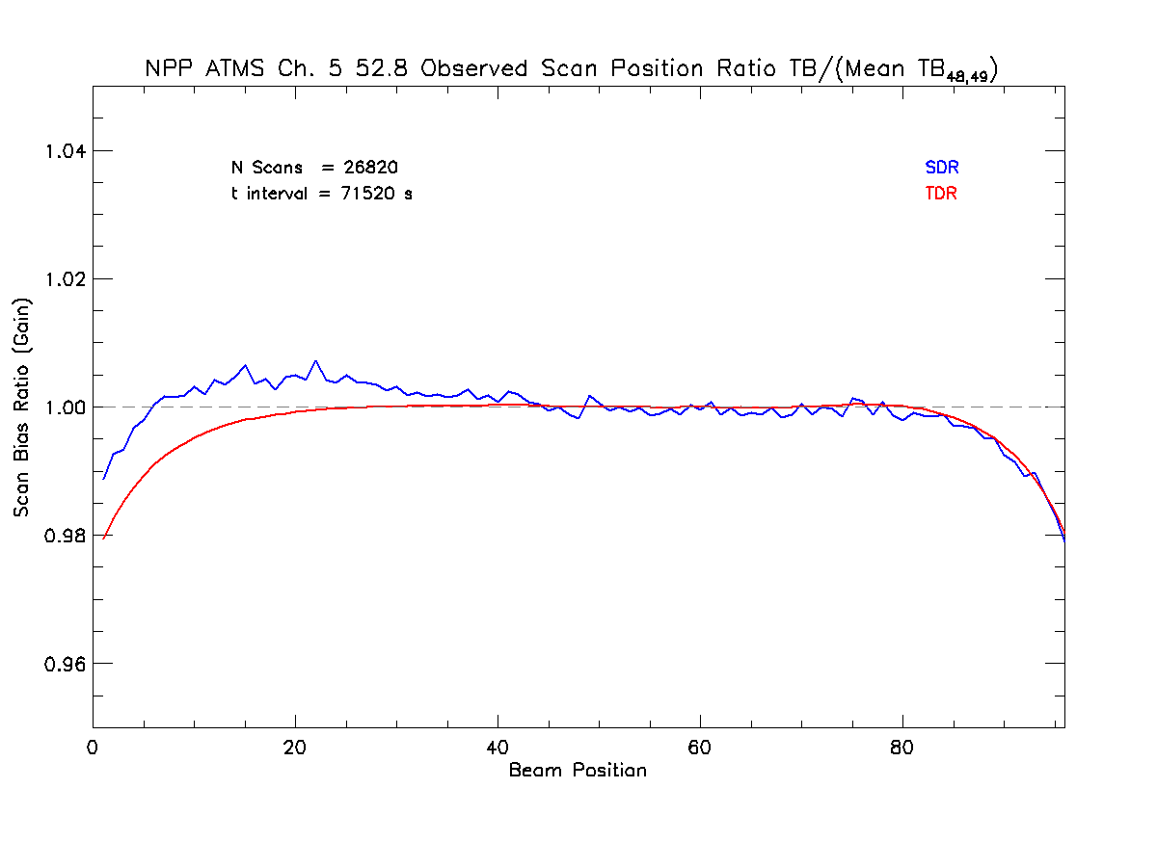

Slide 8
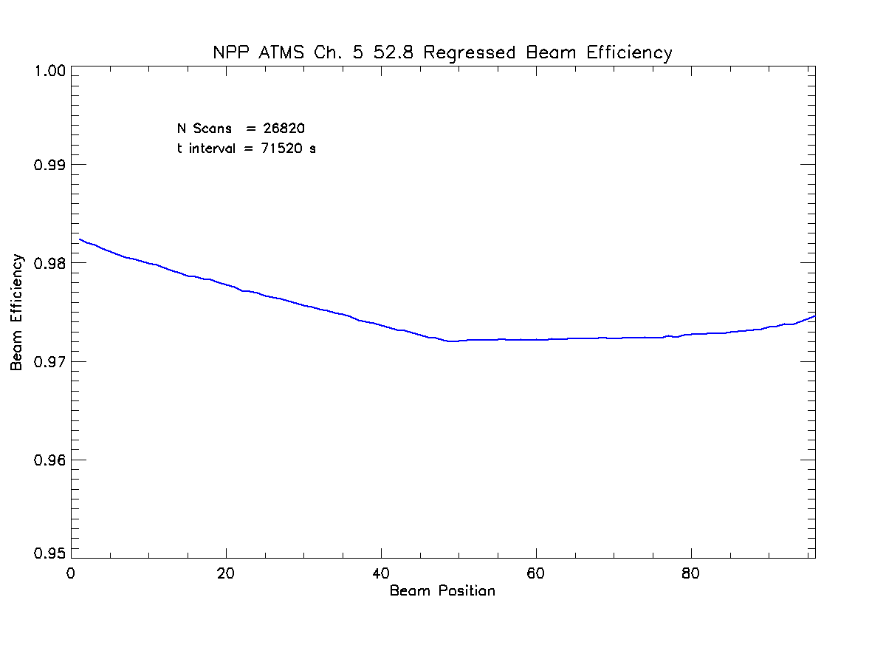

Slide 9
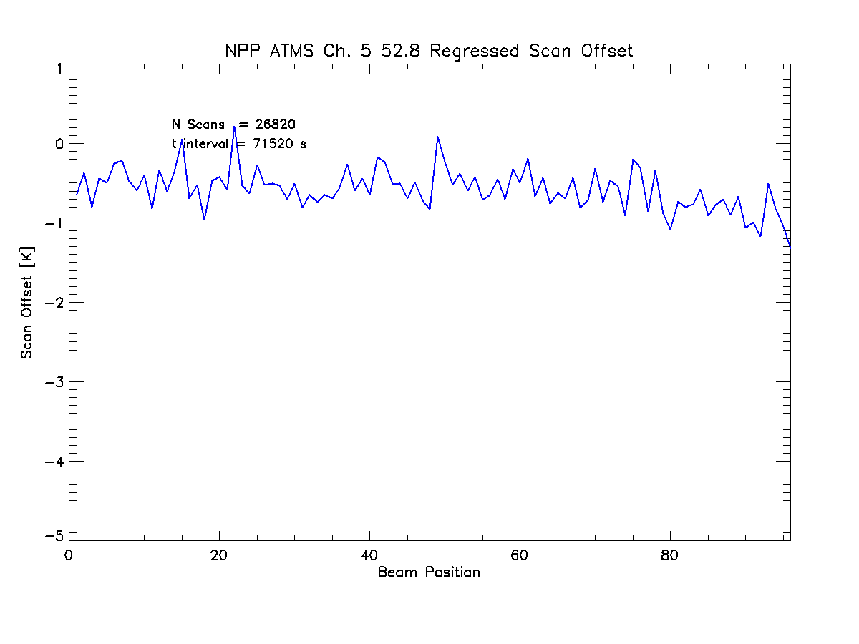

Slide 10
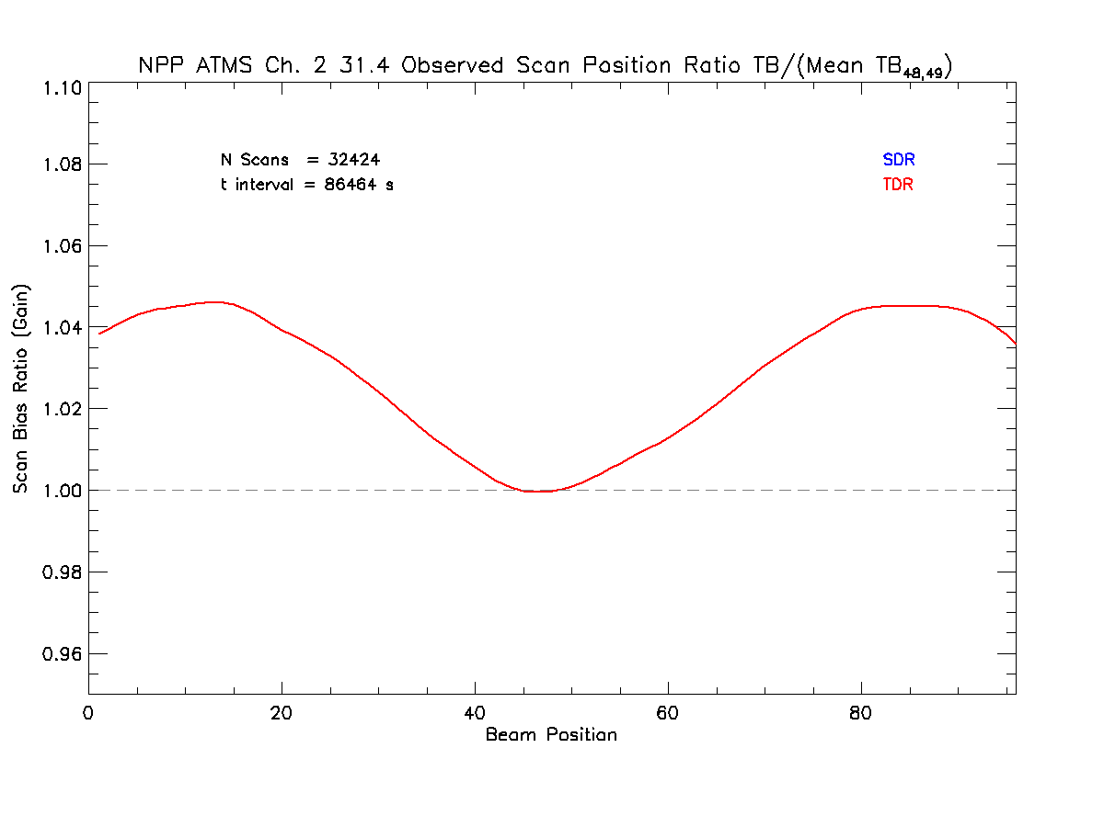
TDR vs. SDR Scan Biases, Post 12 December 2011
Beam Efficiency Correction set to unity and scan Bias set to zero
TDR and SDR are identical

Slide 11
NRL RDR NE∆T and Gain Analysis
Comparisons with SDR provided NE∆Ts and Gains
i = scan index
j = sample index
n_{sc} = number of scans,
N_{s} = number of samples
per scan (4)
C_{ij} = Hot Target counts for given scan and sample within scan
T_{Wl} = Physical temperature of the warm load derived from the PRT data
T_{Cos} = Physical temperature of the cold calibration
= Average of the Warm Load radiometric counts (4 samples per scan, for 8 scans)
N_{i} = Average of the Cold Cal radiometric counts (4 samples per scan, for 8 scans)

Slide 12
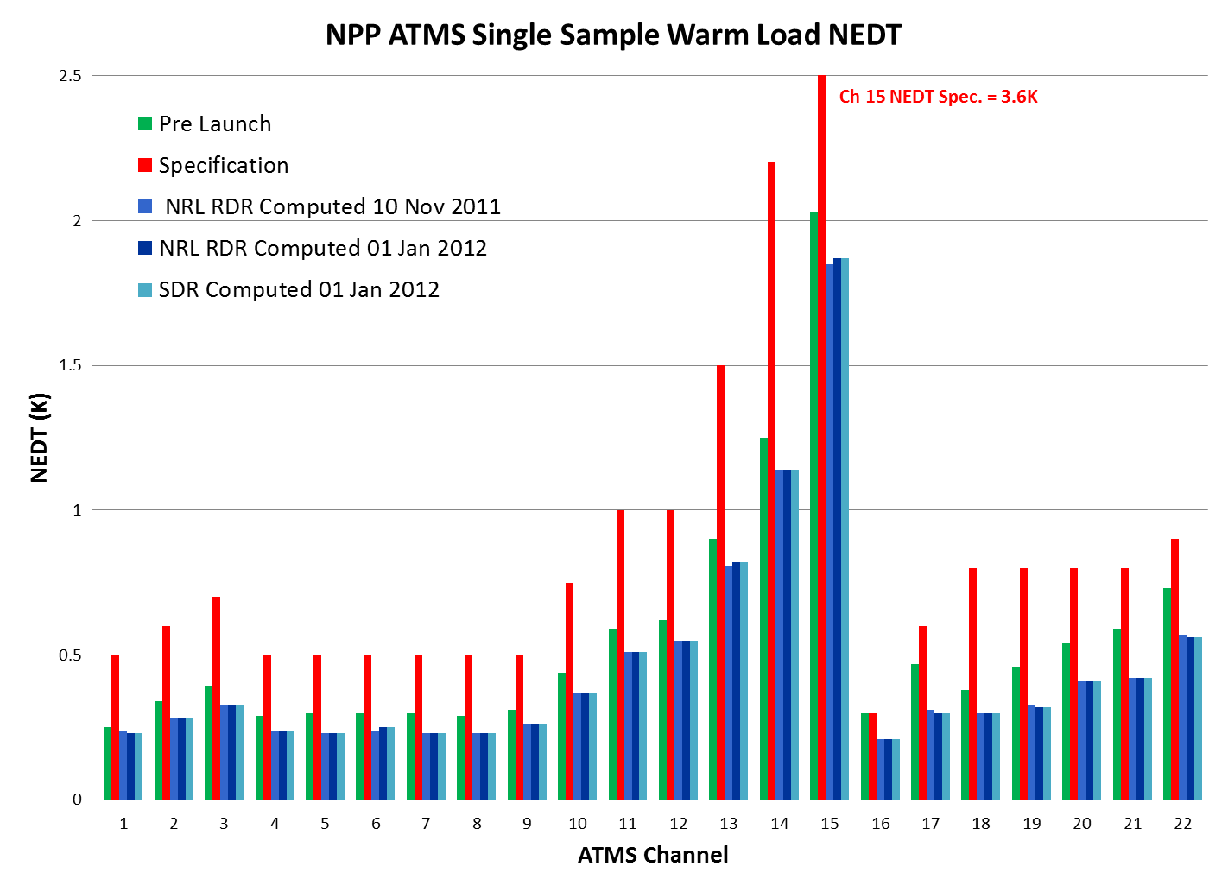

Slide 13
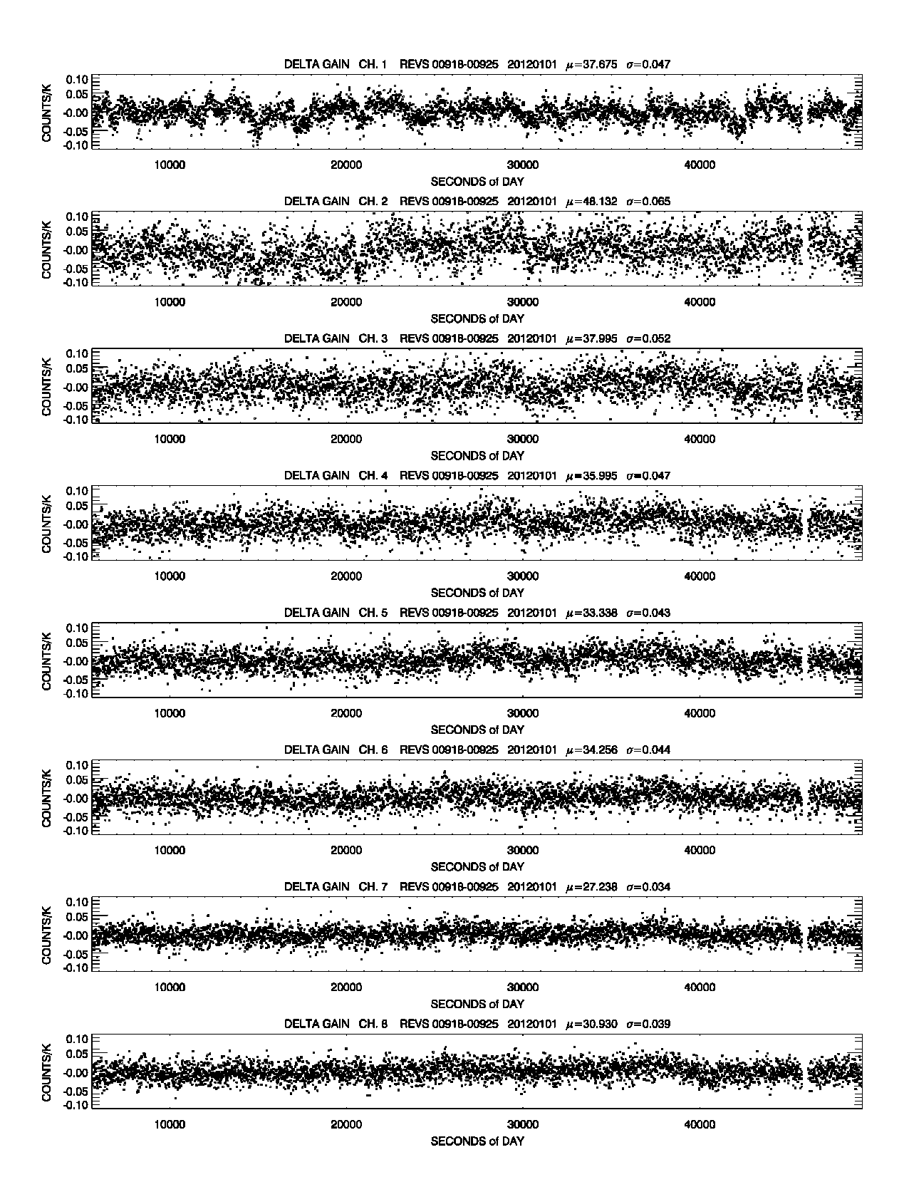
NRL RDR Computed Gains
Match those of the SDR file
Scan to Scan Gain Variation
would benefit from a more
Optimal number of scans of
calibration data being averaged

Slide 14
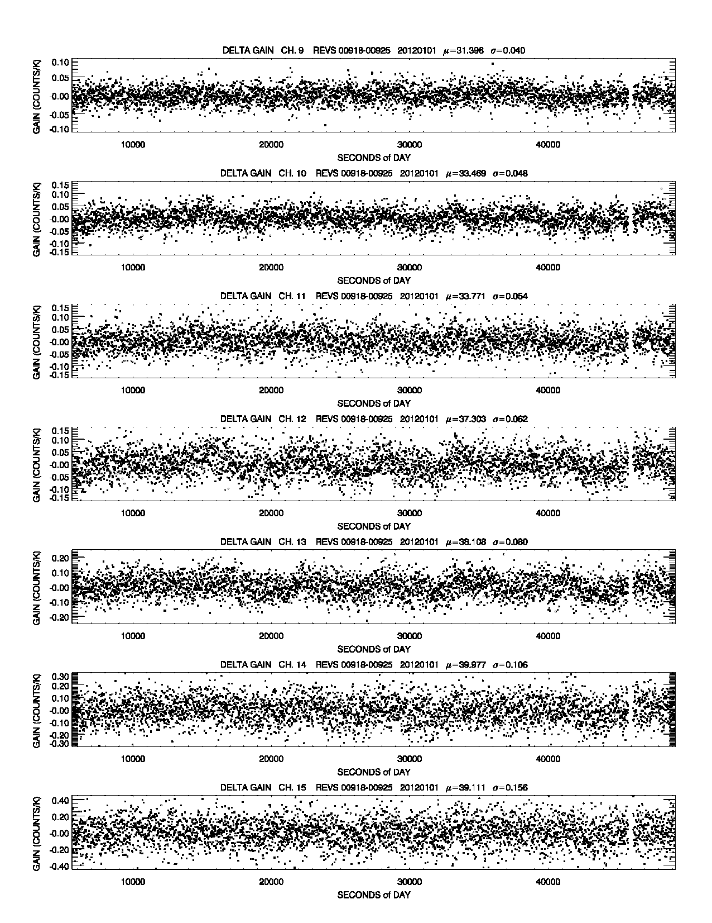

Slide 15
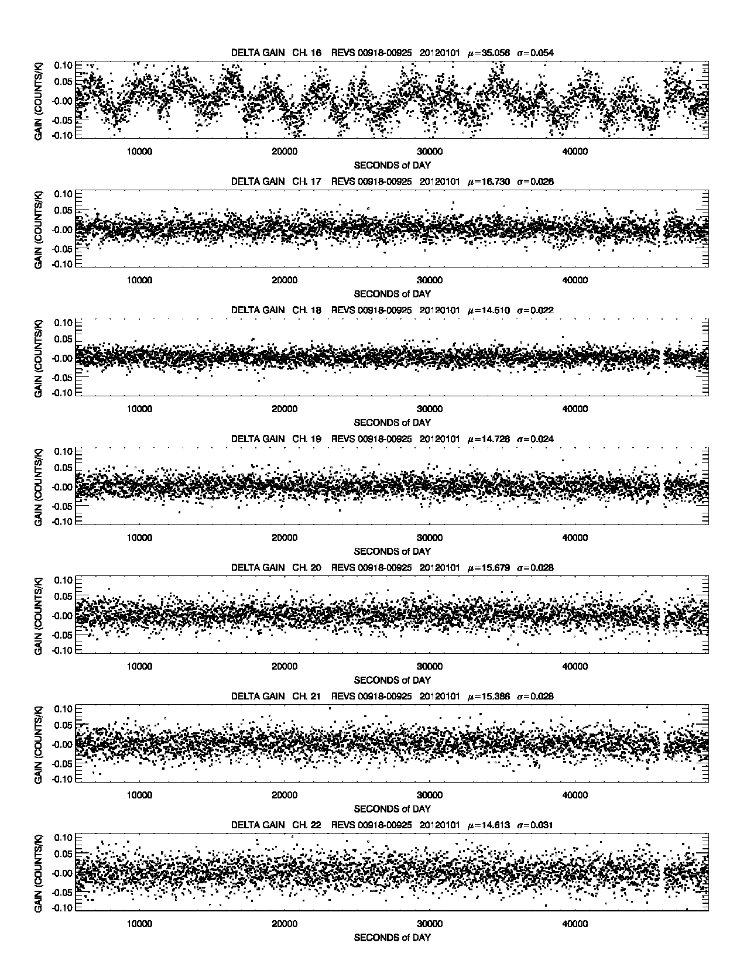

Slide 16
NRL Allan Variance Analysis
Allan Variance of the Warm and Cold Calibration Counts
Assesses the contribution of calibration noise to scene NE∆T
Determine optimal number of scans to average to
minimize calibration noise
Does ATMS calibration noise behave as 1/f¹ or 1/f²

Slide 17
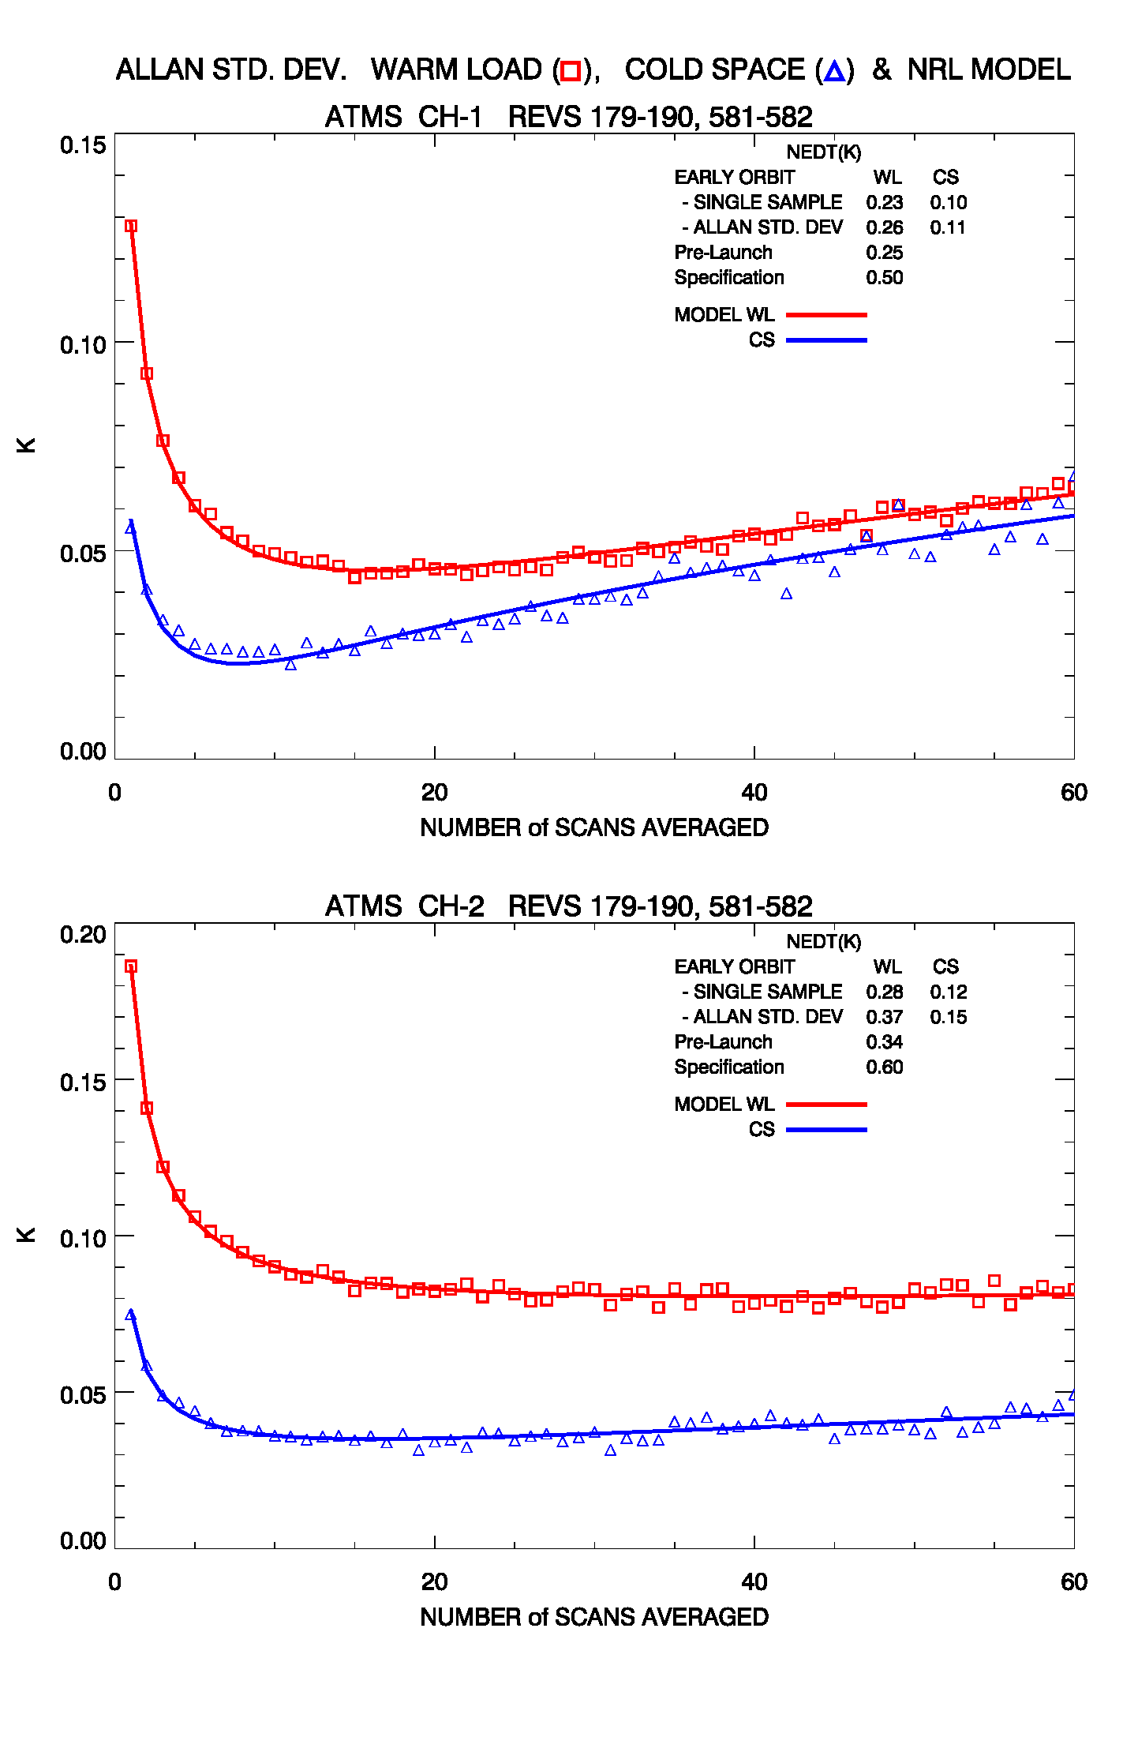
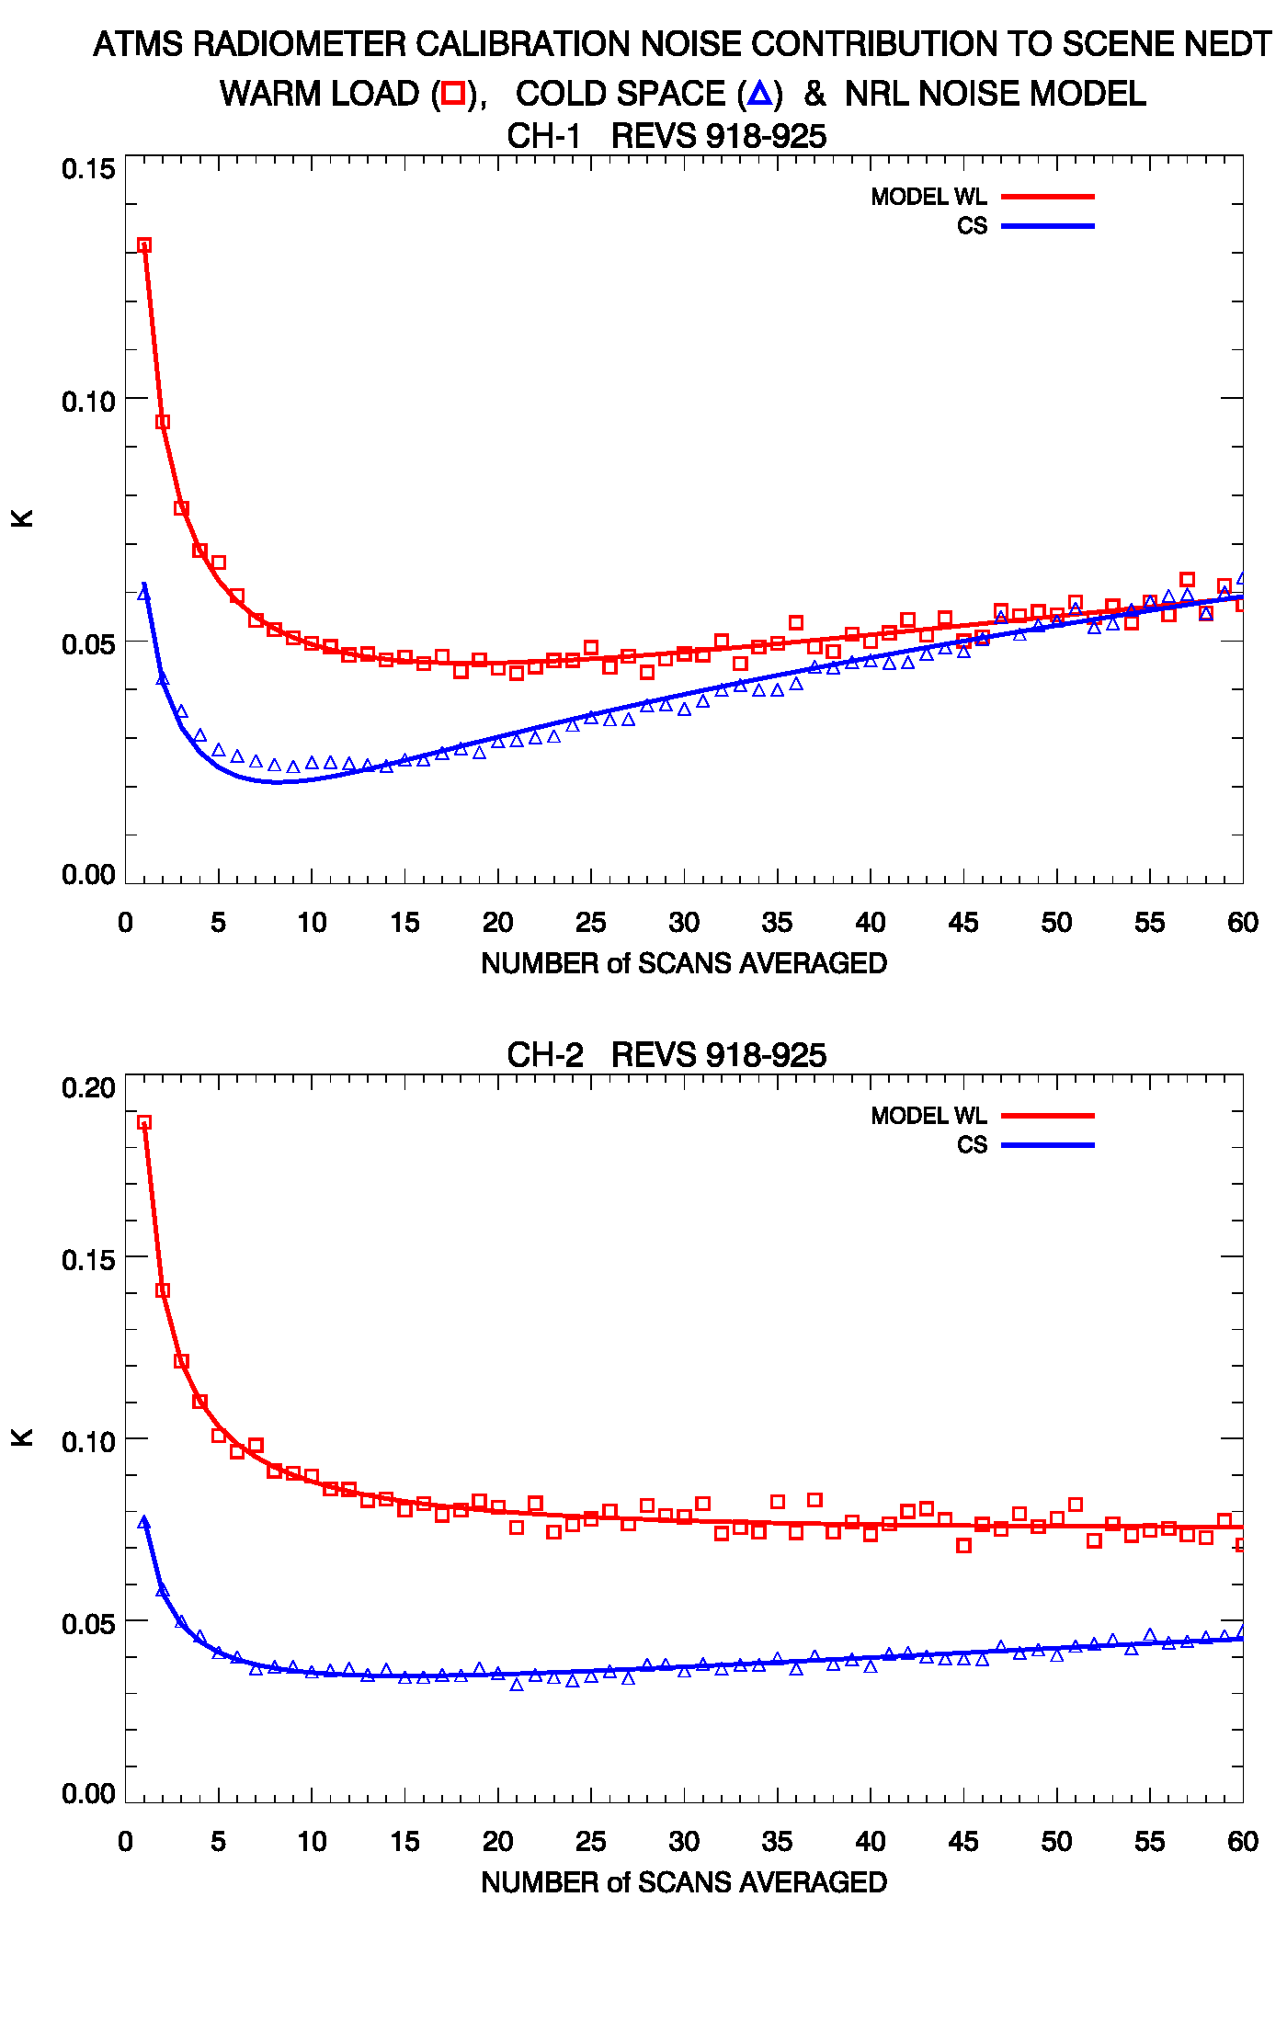

Slide 18
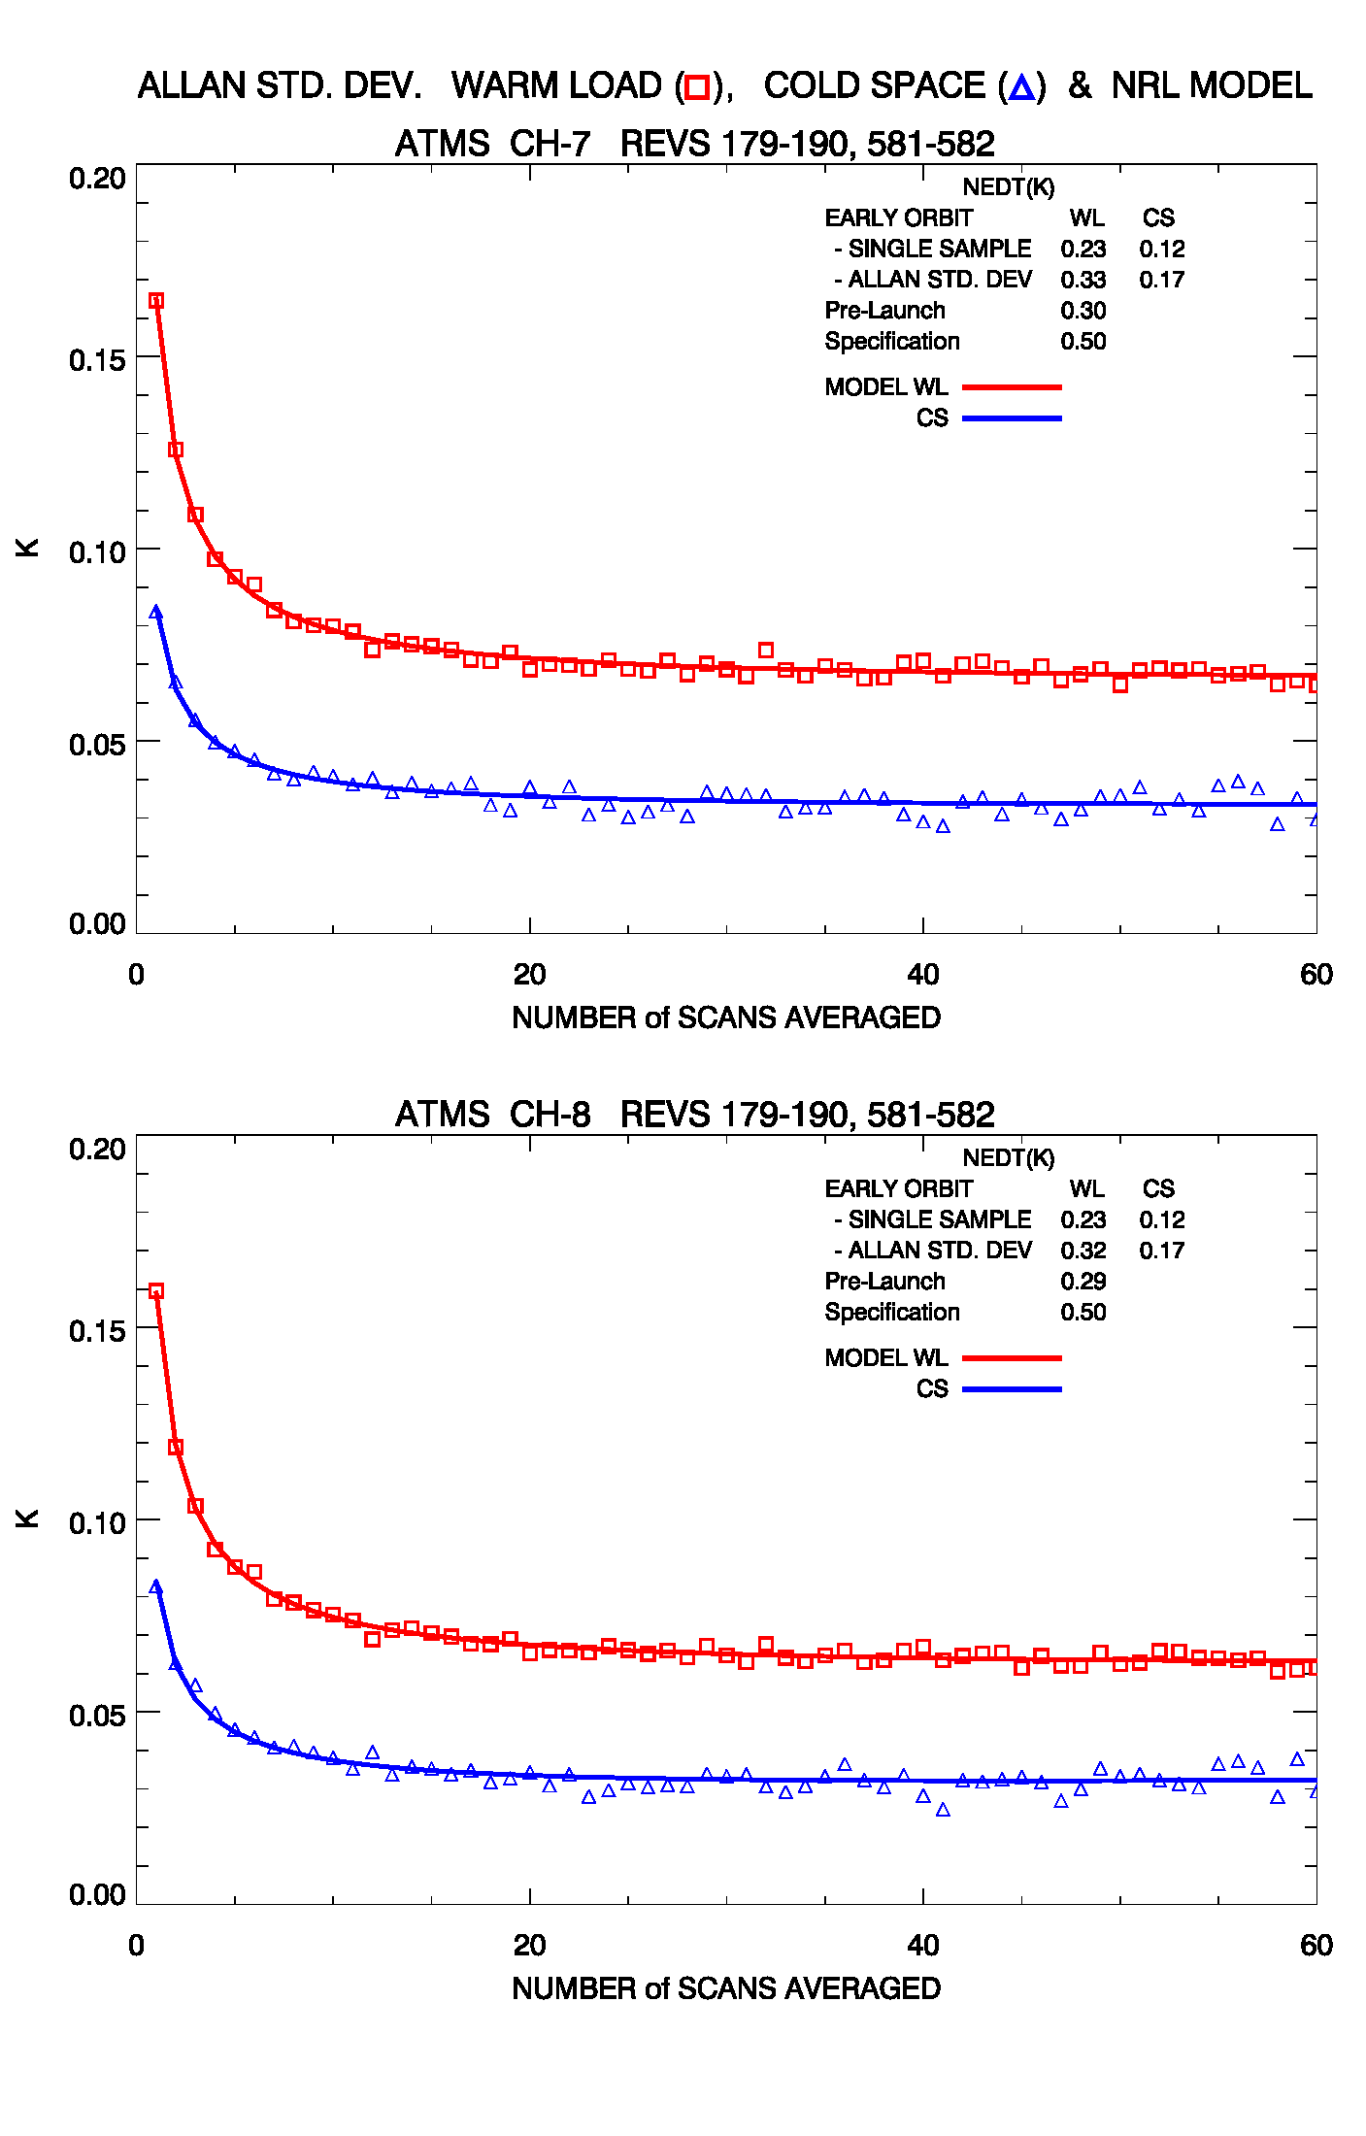
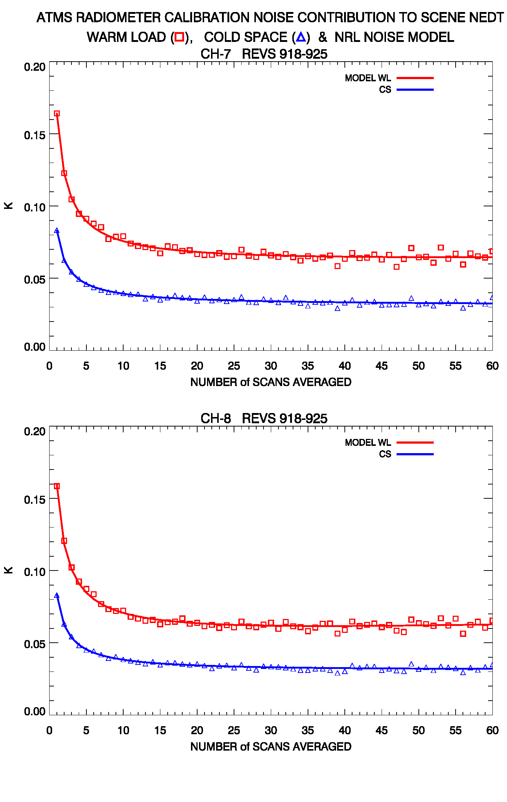

Slide 19
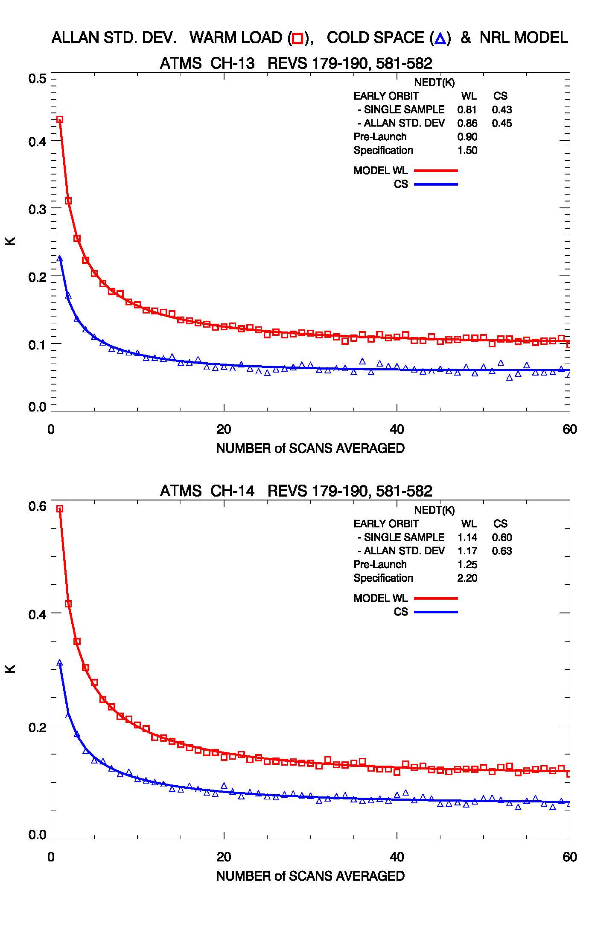
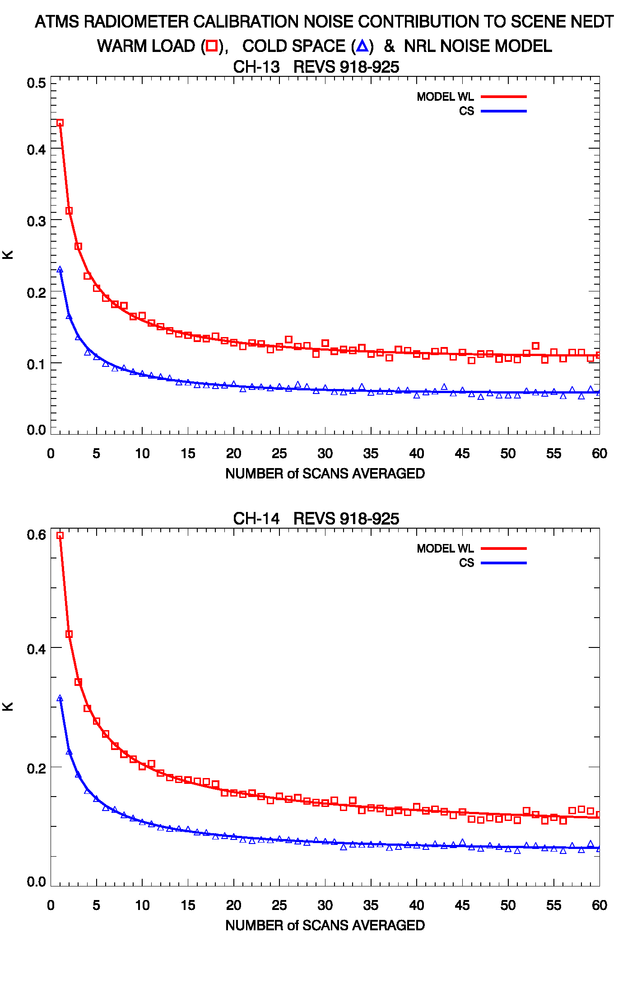

Slide 20
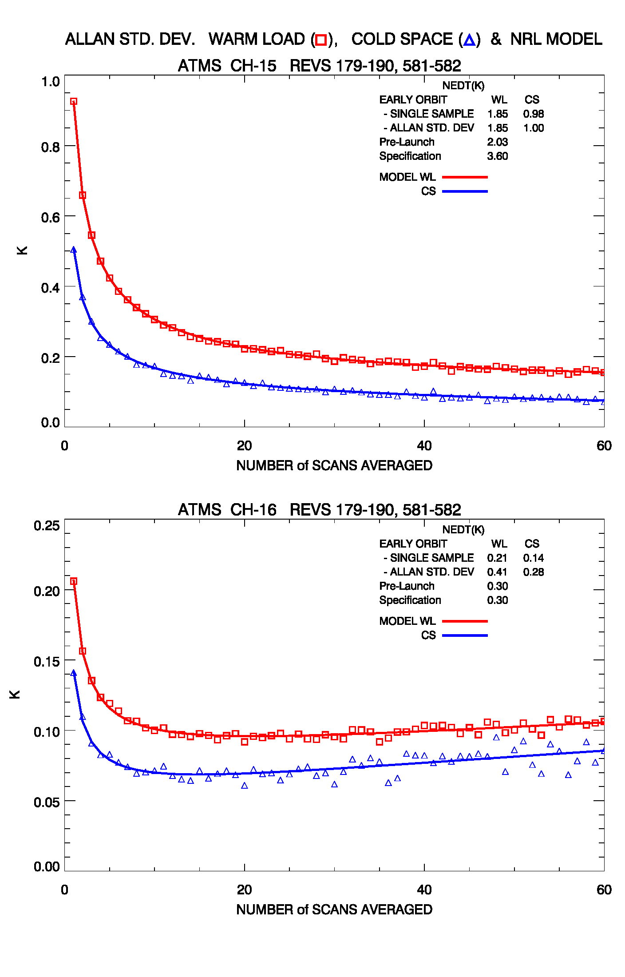
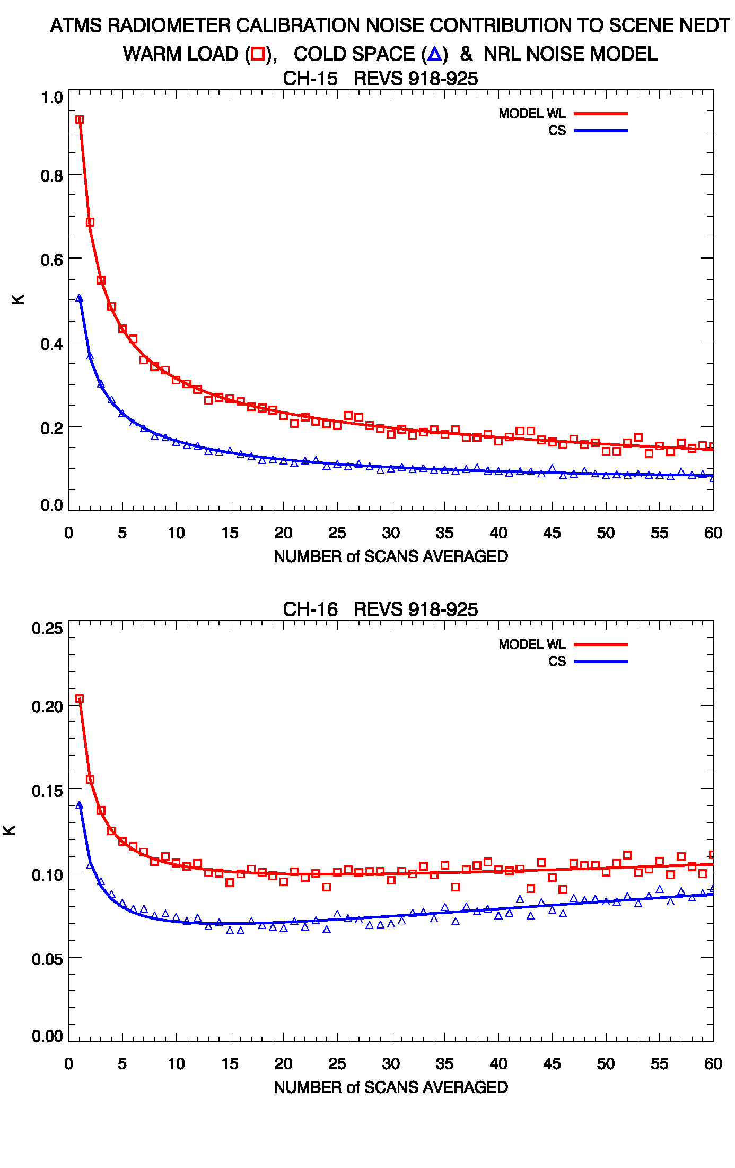

Slide 21
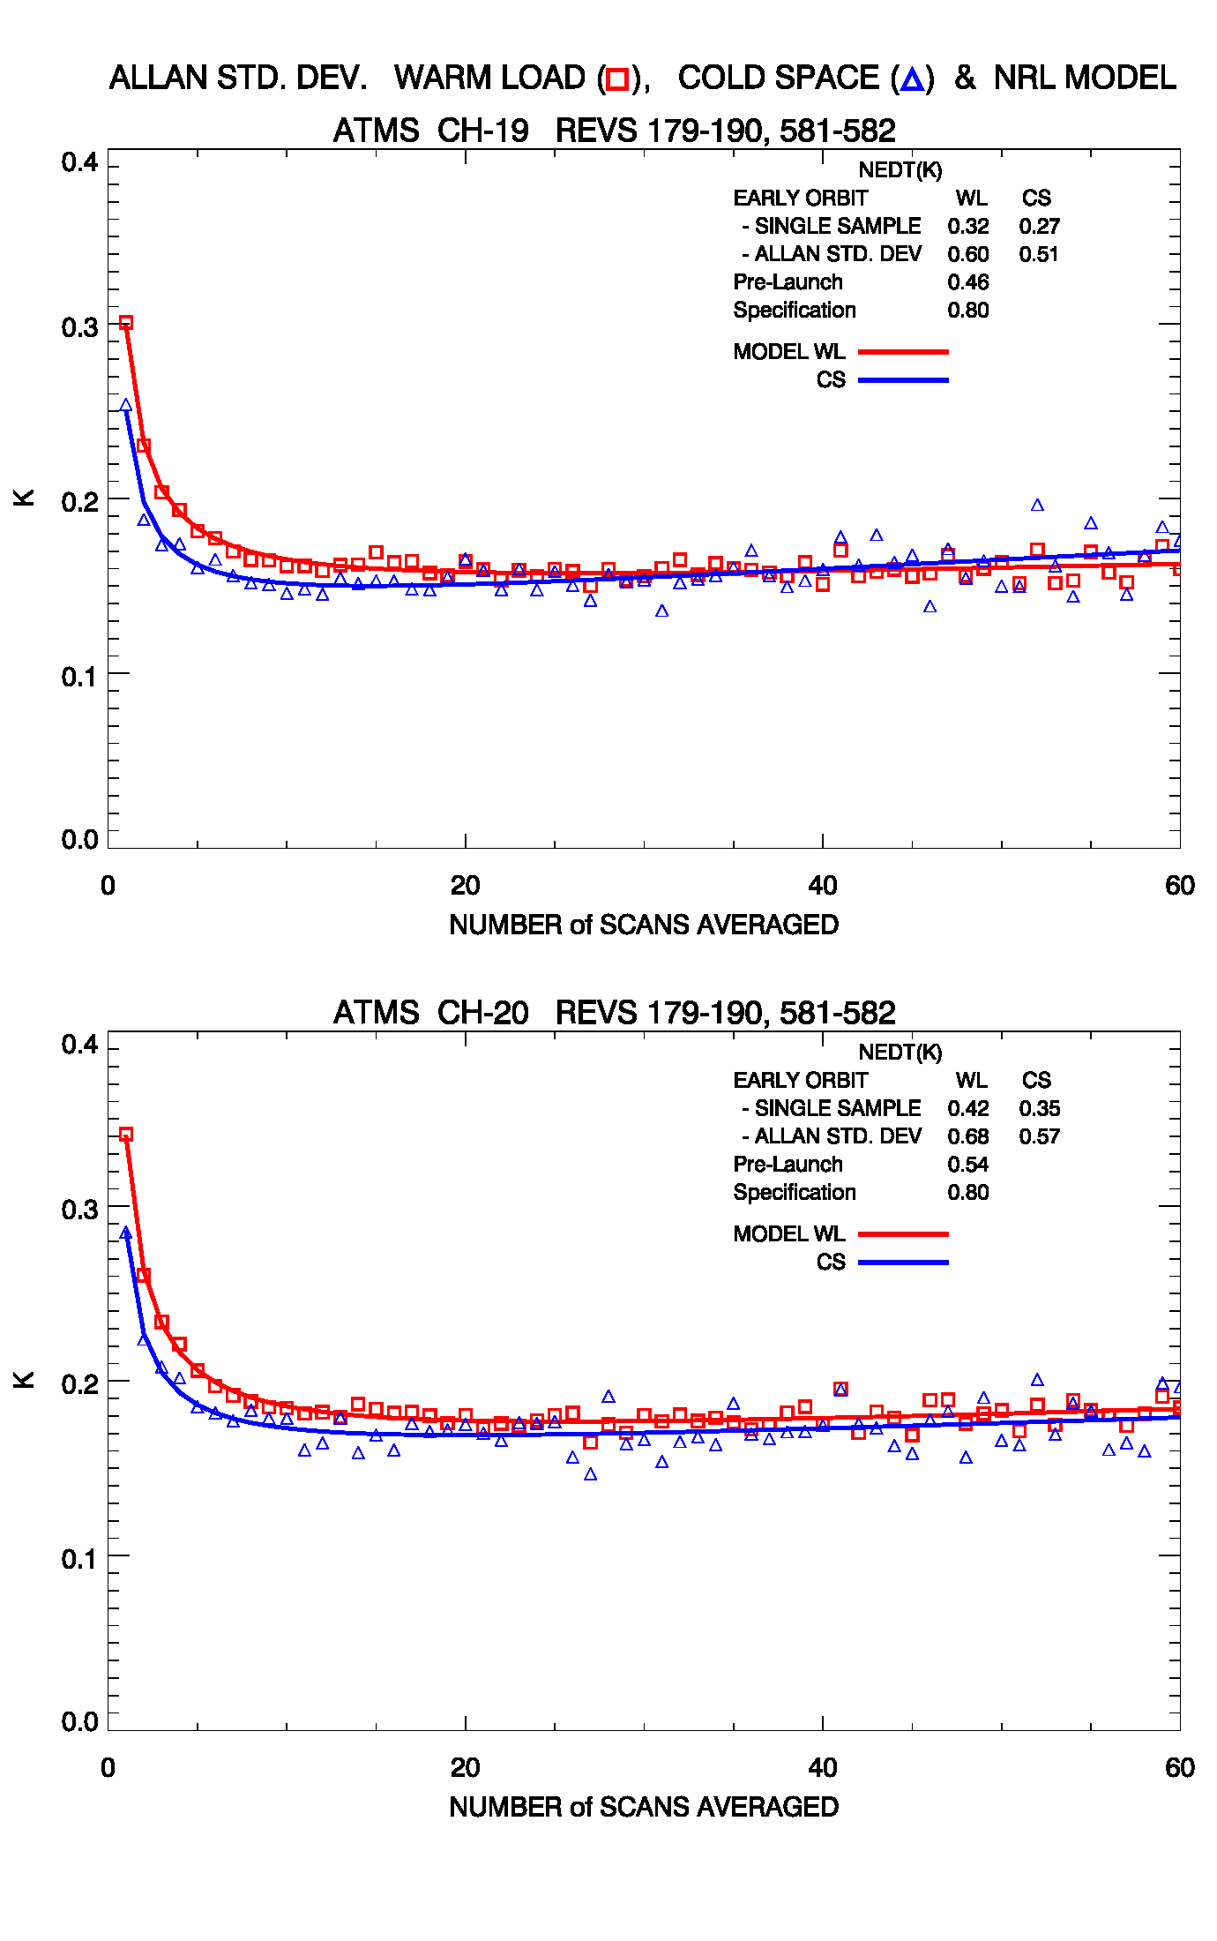
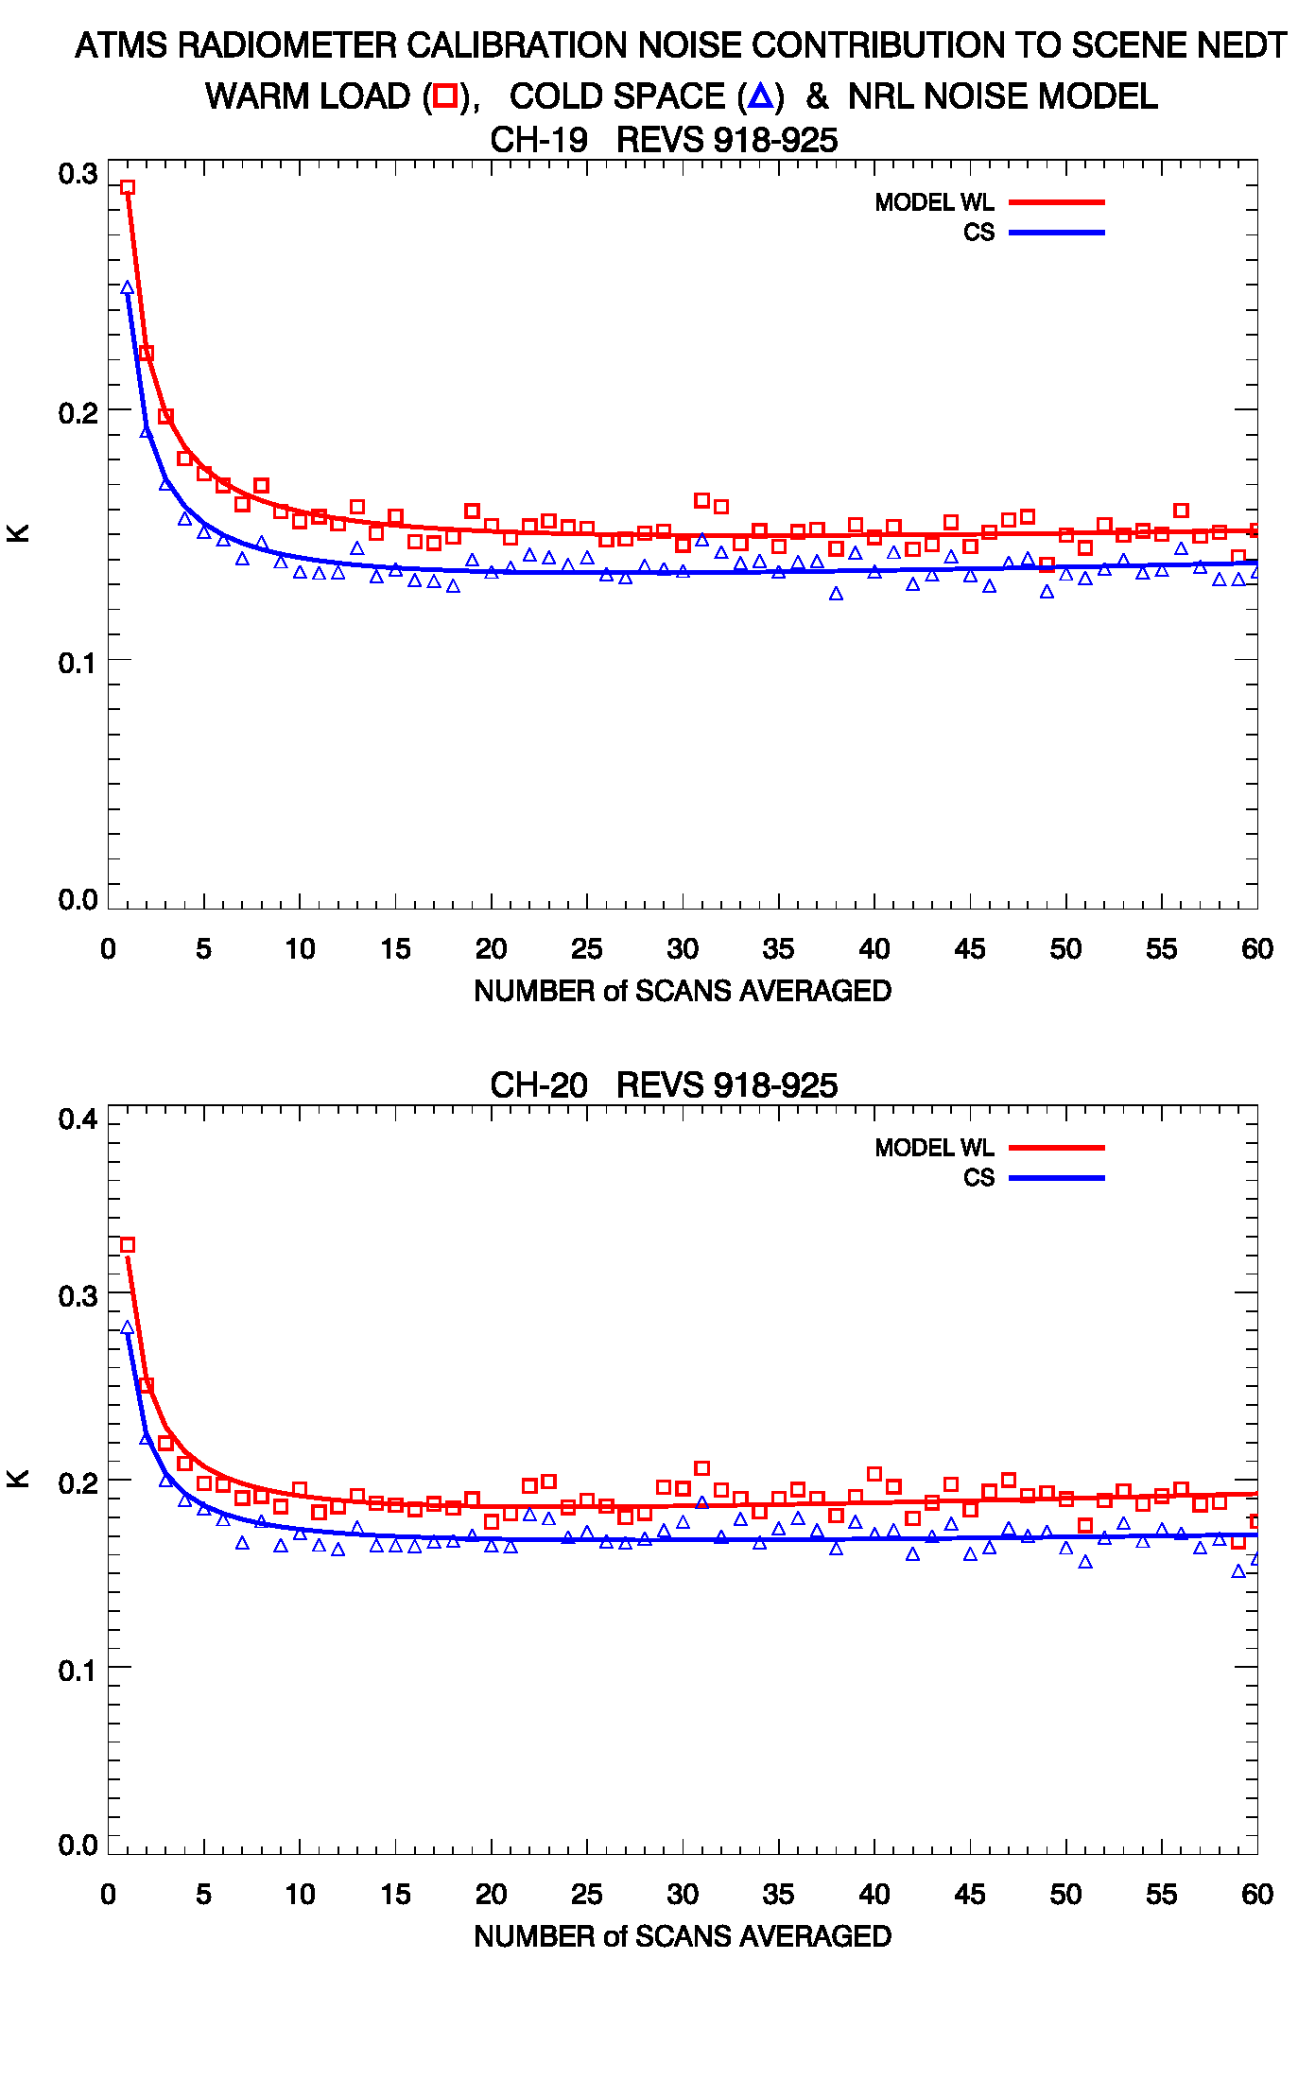

Slide 22
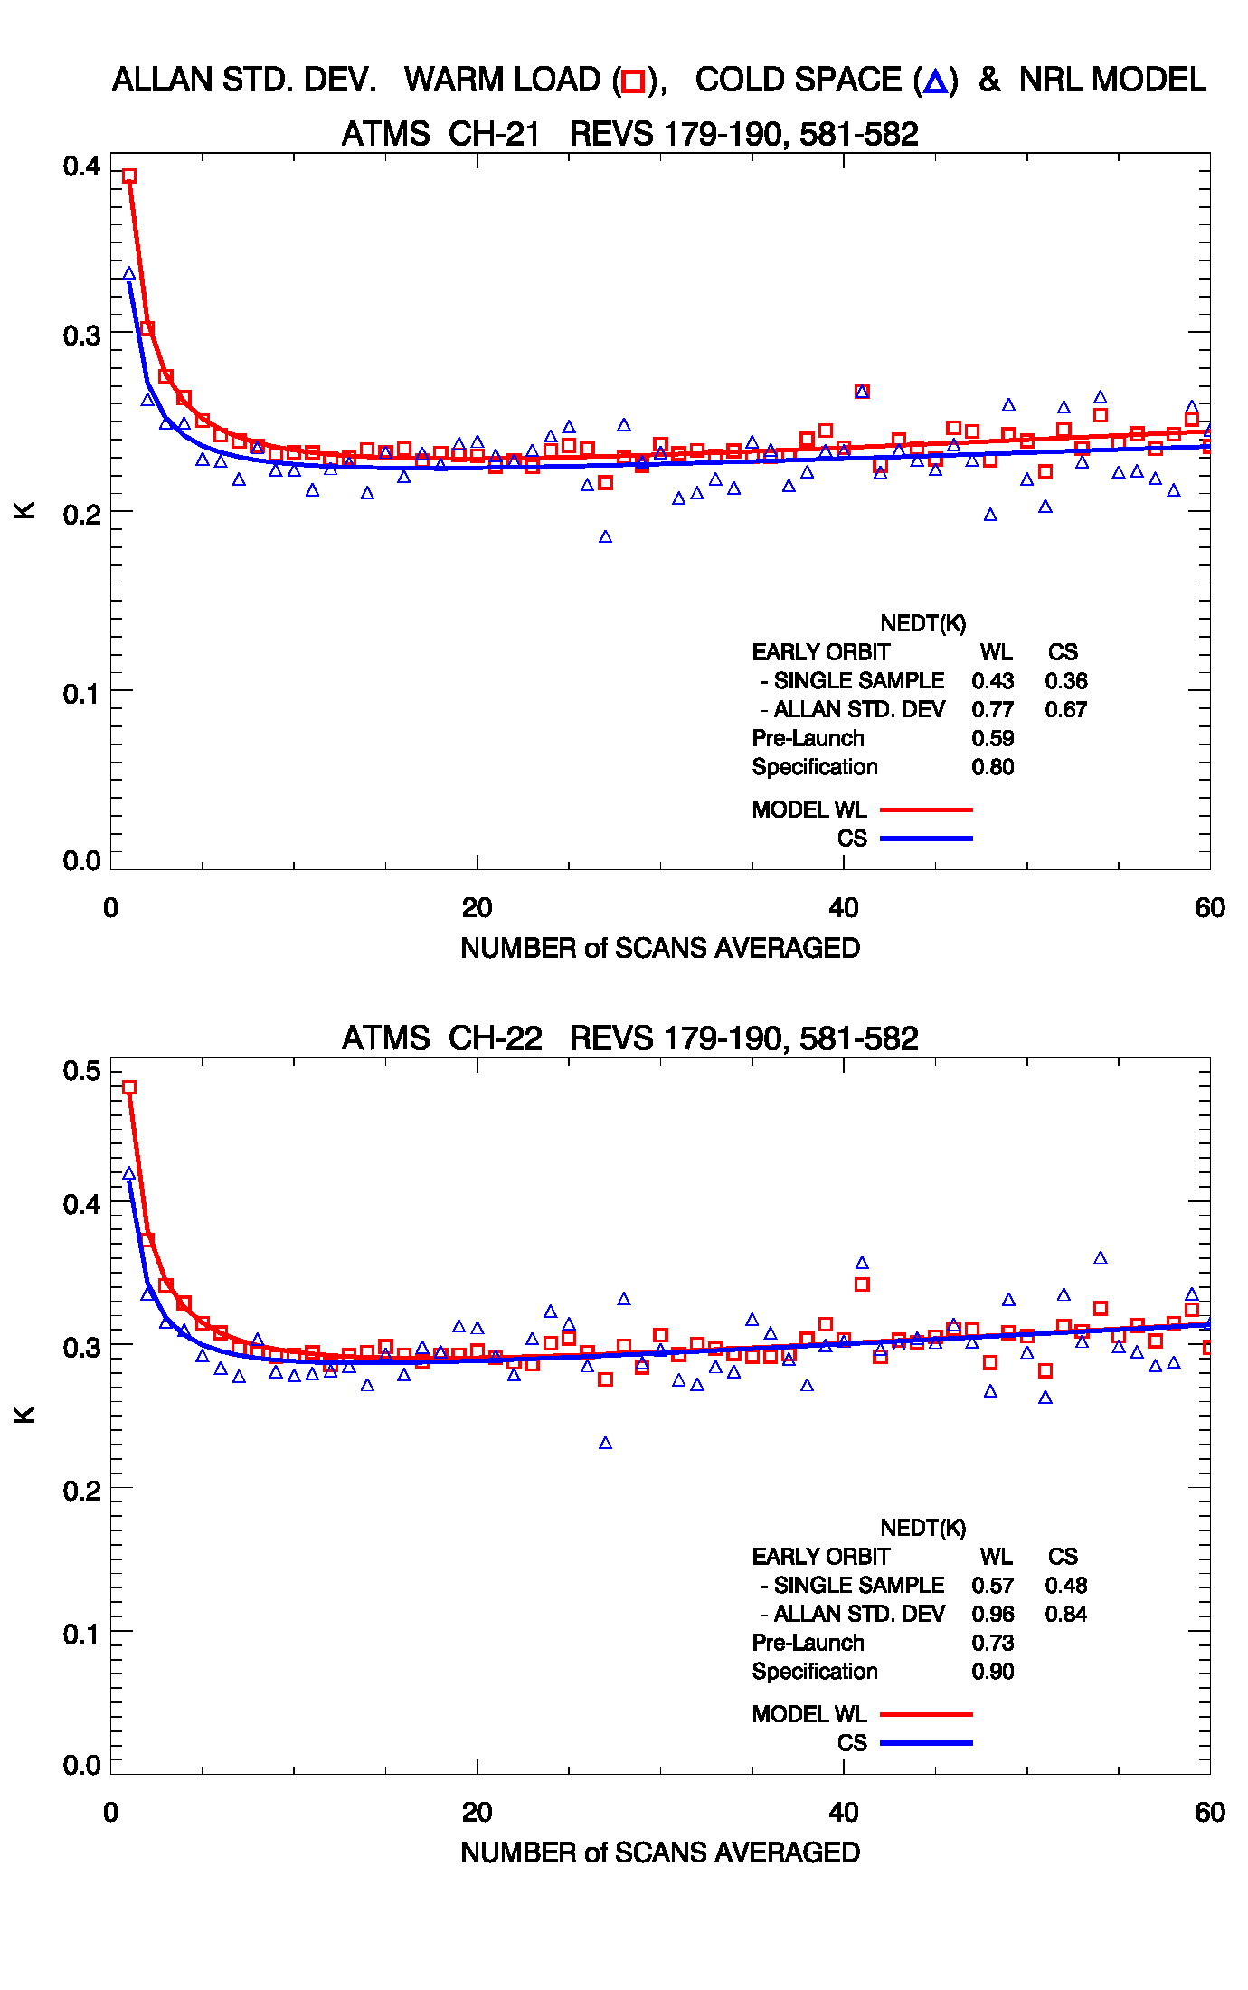
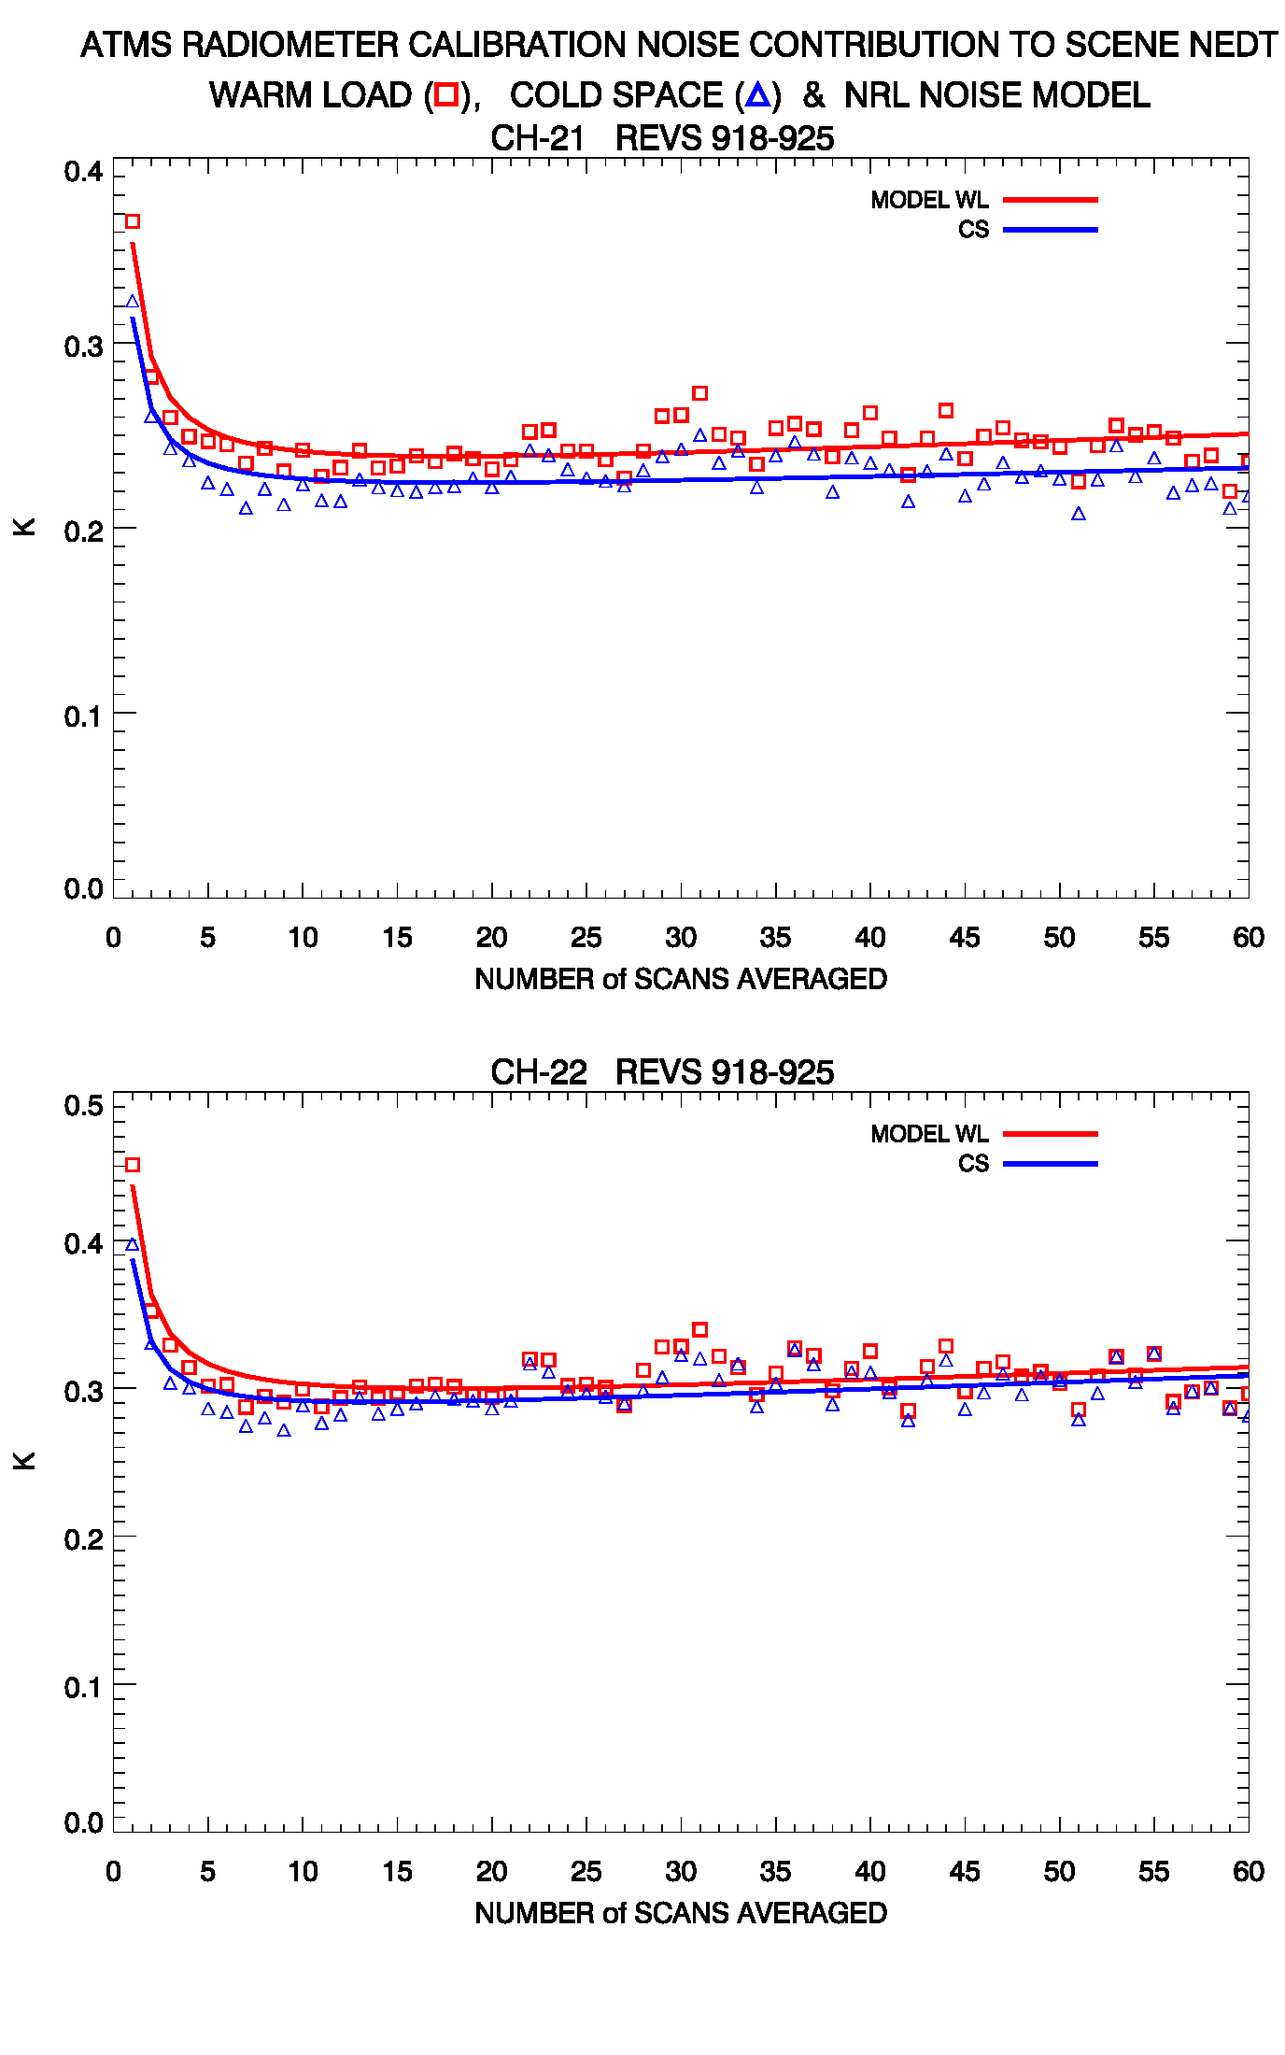

Slide 23
NRL Geolocation Analysis
ATMS "window" channels (23.8, 31.4, 50.3, 88.2 and 165.5 GHz) for an
ascending pass, 10 by 20 degree lat/lon box, Orbit 882 (29 Dec 2011)
over Southern Europe and Northern Africa
The geo-location analysis technique employed relies on the large contrast
between land and ocean brightness temperatures and is a modification of
the methods used for SSM/I, SSMIS and WindSat, wherein shorelines are
derived from the imagery and overlaid with an accurate global island, lake
and shoreline data base. [See: "Geo-location Error Analysis of the Special
Sensor Microwave Imager/Sounder", TGARS Vol. 46, No. 4, Apr. 2008]
Note that both along-scan and along-track directions were used in the derived
shoreline estimates shown as red points below the imagery.
Preliminary Geolocation Analysis shows all channels are within Spec.

Slide 24
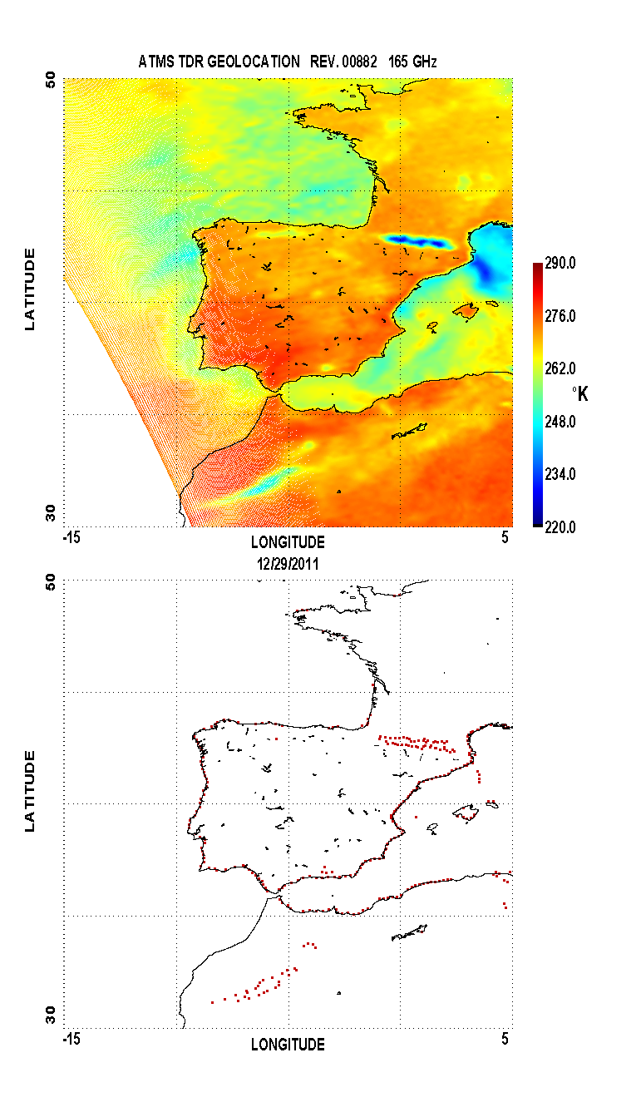
ATMS Ch 17
Black High Resolution Coastline
Superimposed with red tick marks from
the edge detection algorithm

Slide 25
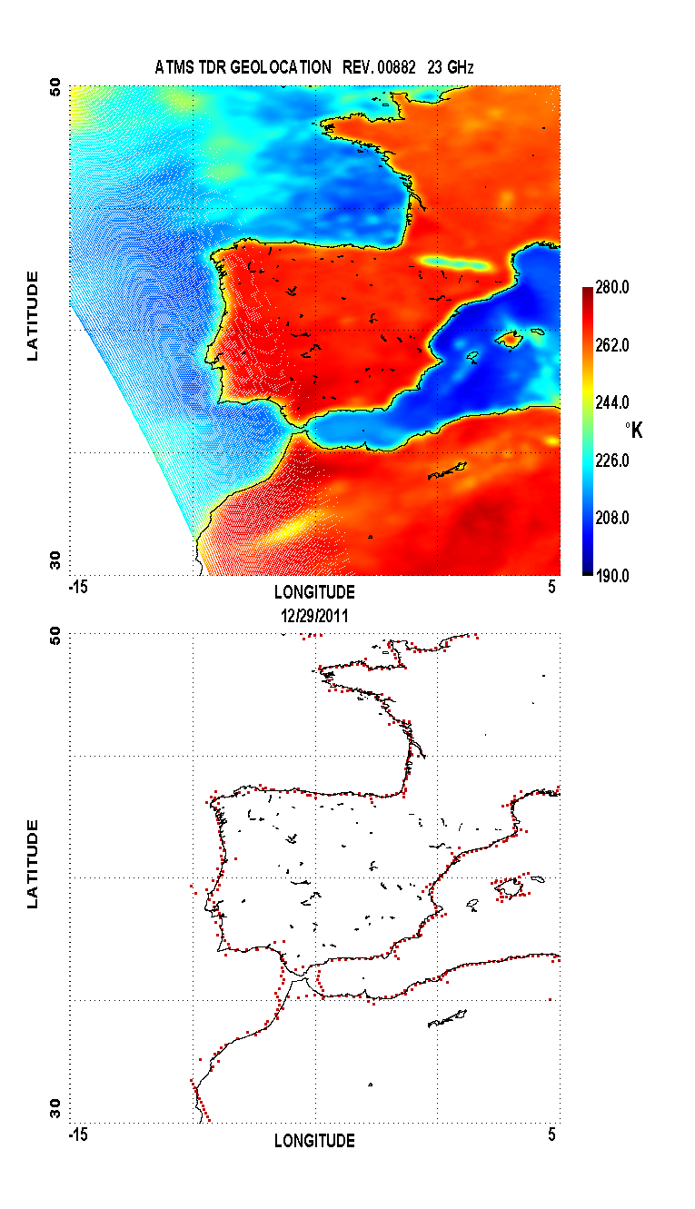
ATMS Ch 1
ATMS Ch 2

Slide 26
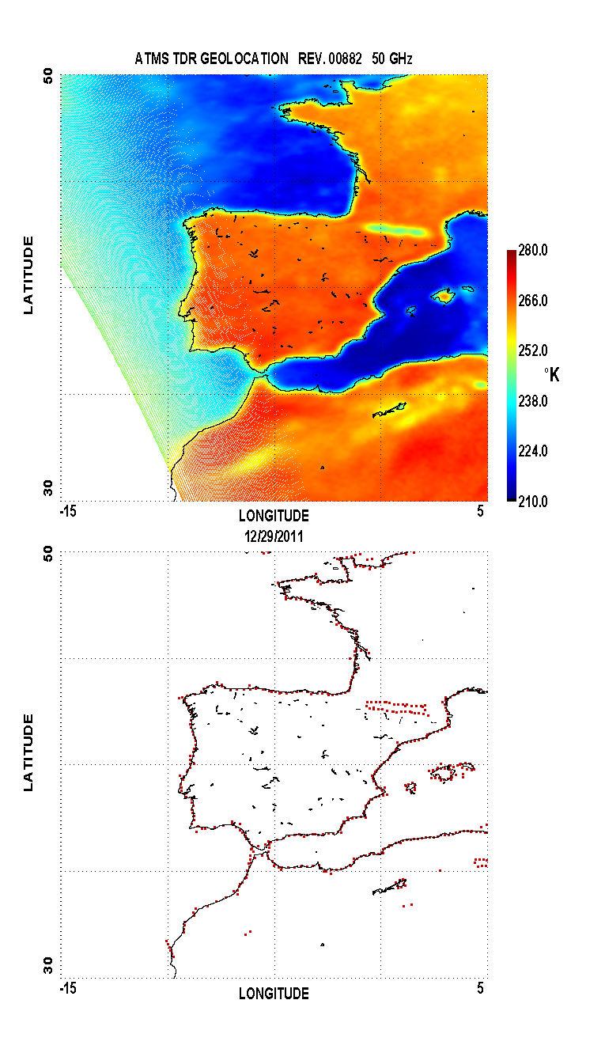
ATMS Ch 3
ATMS Ch 16

Slide 27
NRL NAVDAS-AR Preliminary OB-BK Analysis Results
Raw SDR Departures are shown
No Bias Corrections Applied
No Quality Control Applied (Clouds, Precipitation)
All Surface types accepted (Land, Sea Ice, etc.)
No Spatial Averaging Applied
CRTM V2.01
Pre 12 December SDR scan position “noise” apparent
Pre and Post 12 December bias and noise patterns
match values observed when comparing the
old and new SDR and TDR scan averaged TBs
Post 12 December OB-BK patterns show both calibration
and scene noise

Slide 28
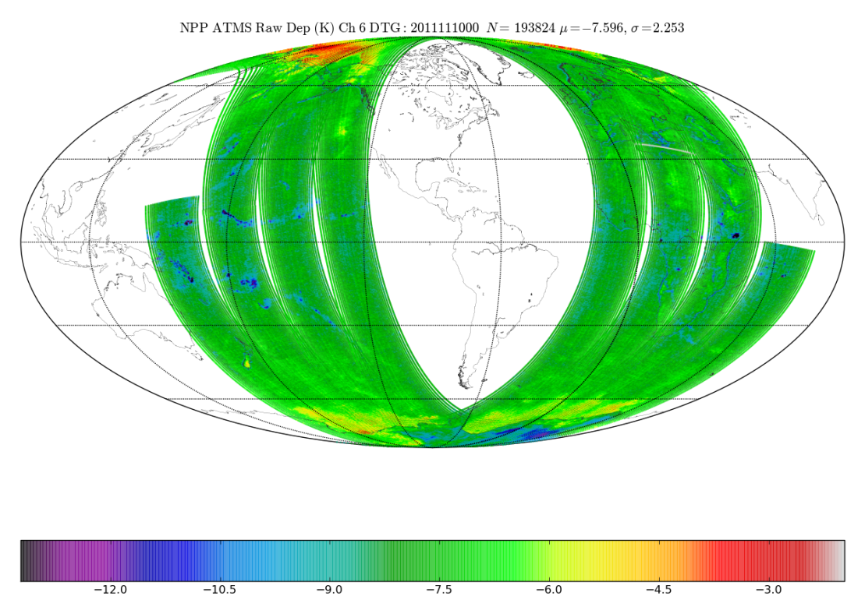
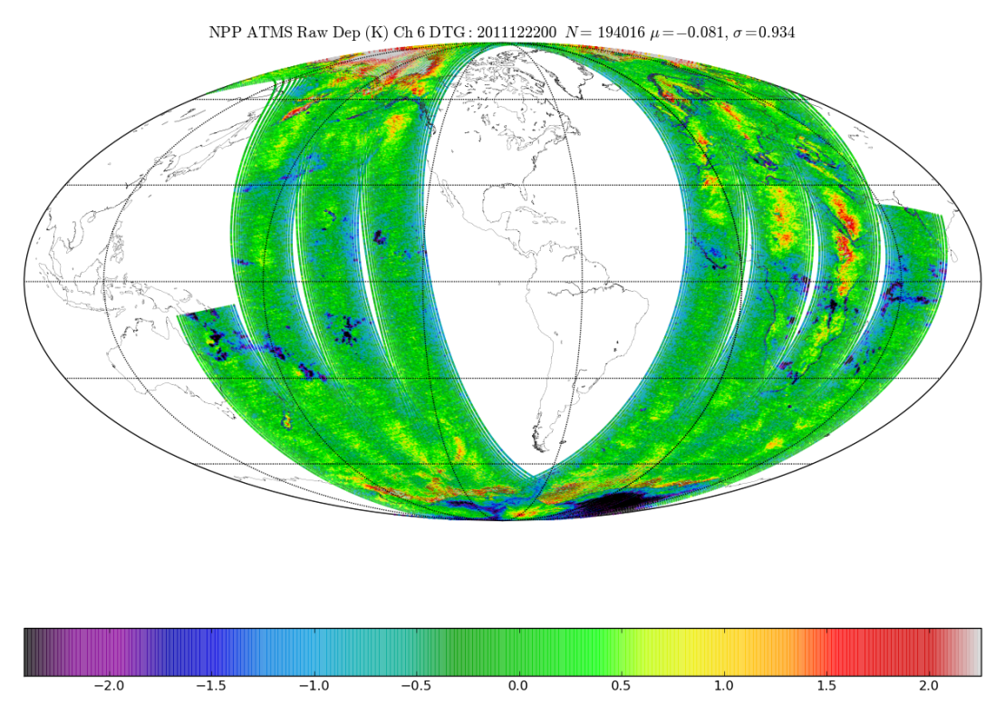
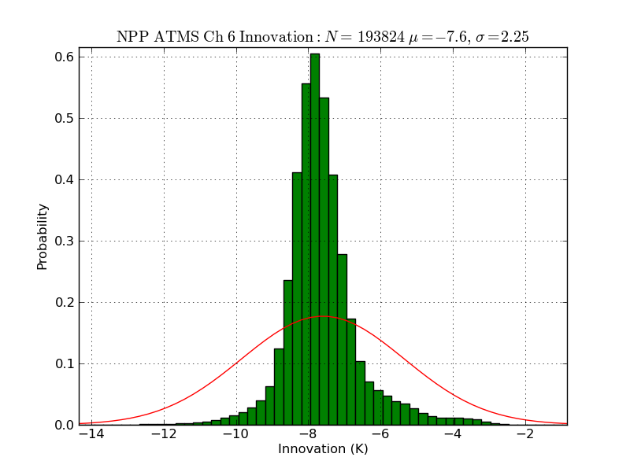
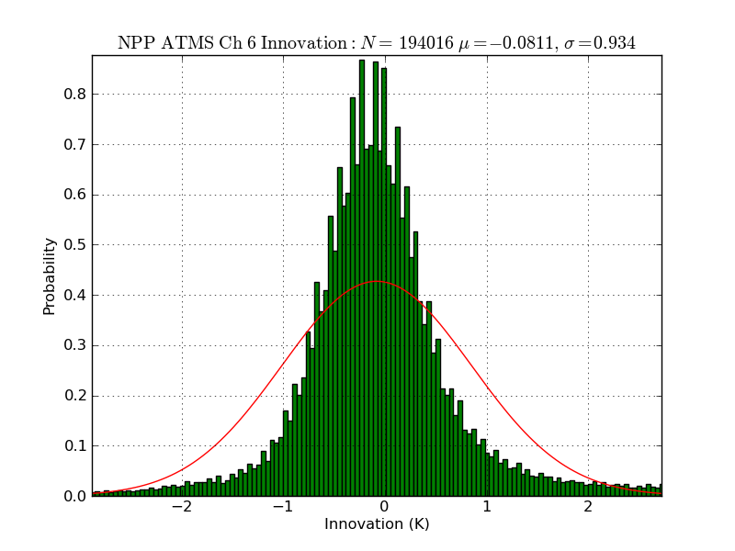
ATMS Ch 6 O-B 2011111000
ATMS Ch 6 O-B 2011122200

Slide 29
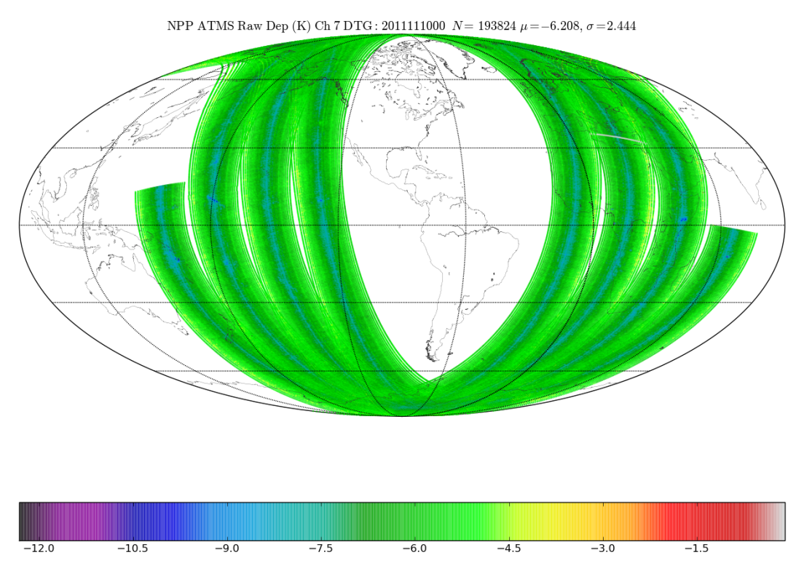
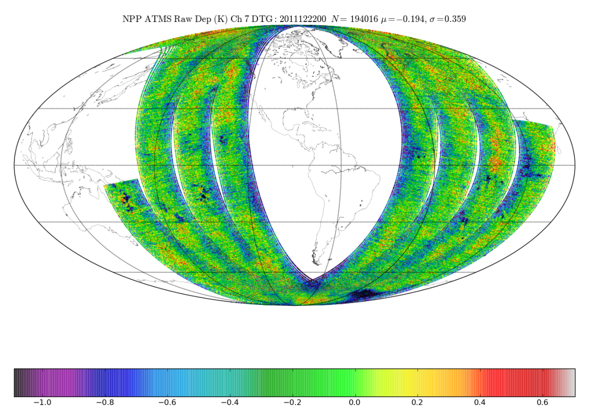
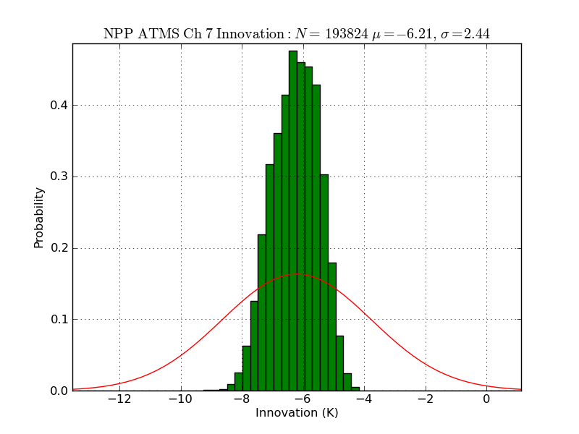
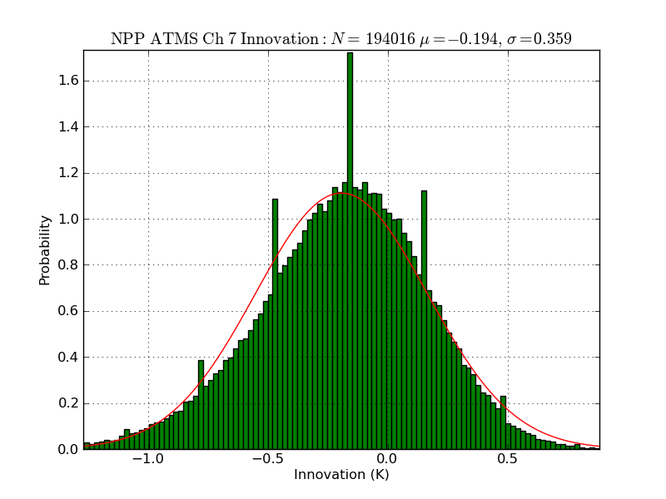
ATMS Ch 7 O-B 2011111000
ATMS Ch 7 O-B 2011122200

Slide 30
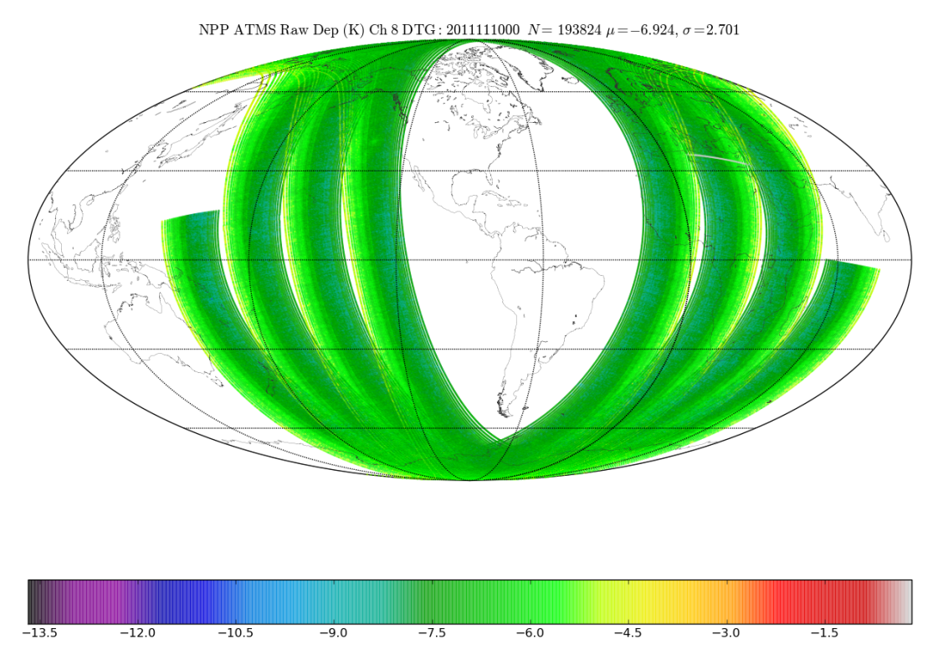
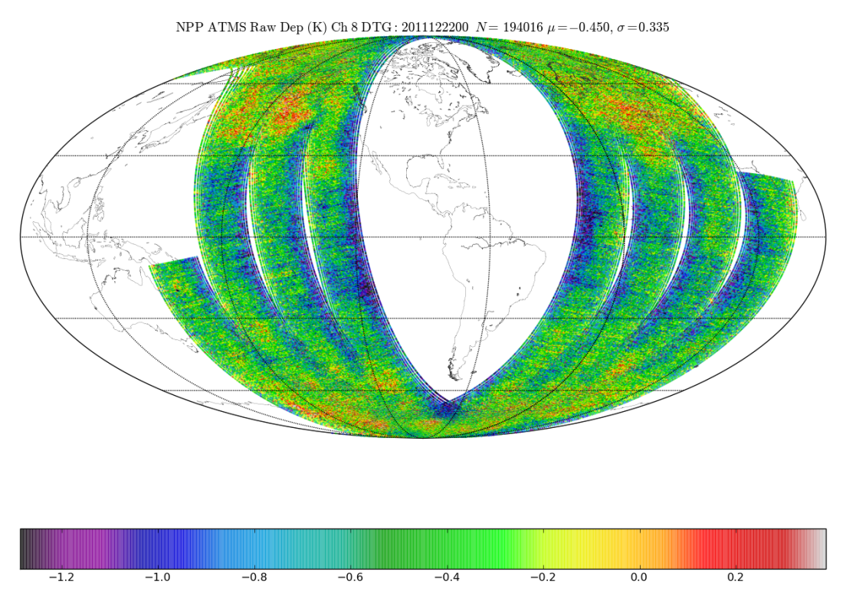
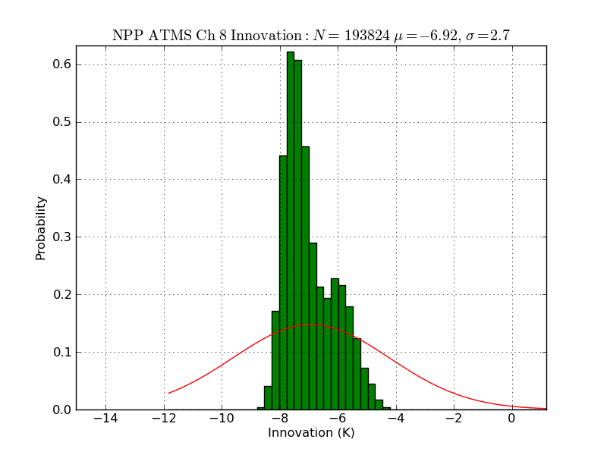
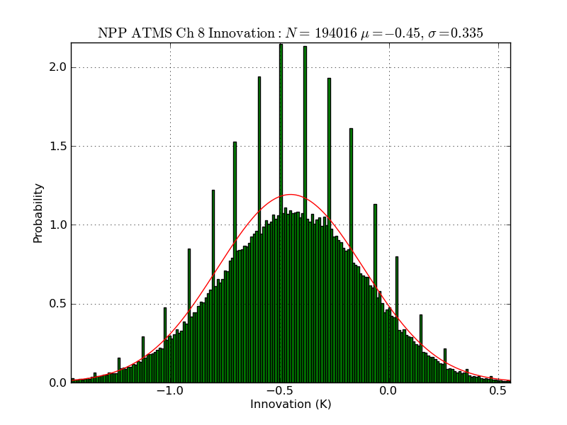
ATMS Ch 8 O-B 2011111000
ATMS Ch 8 O-B 2011122200

Slide 31
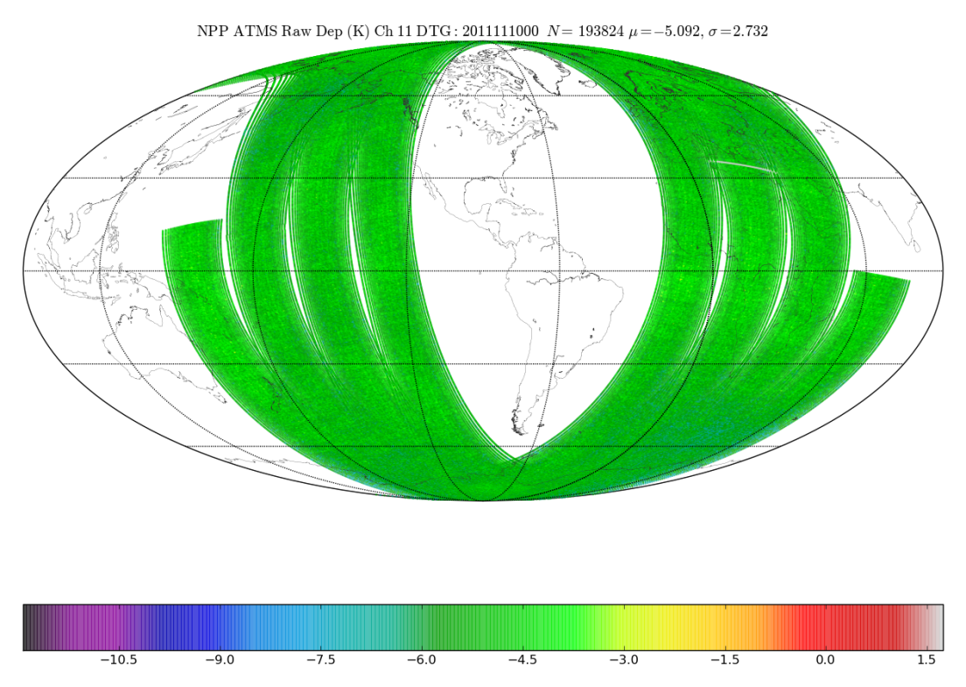
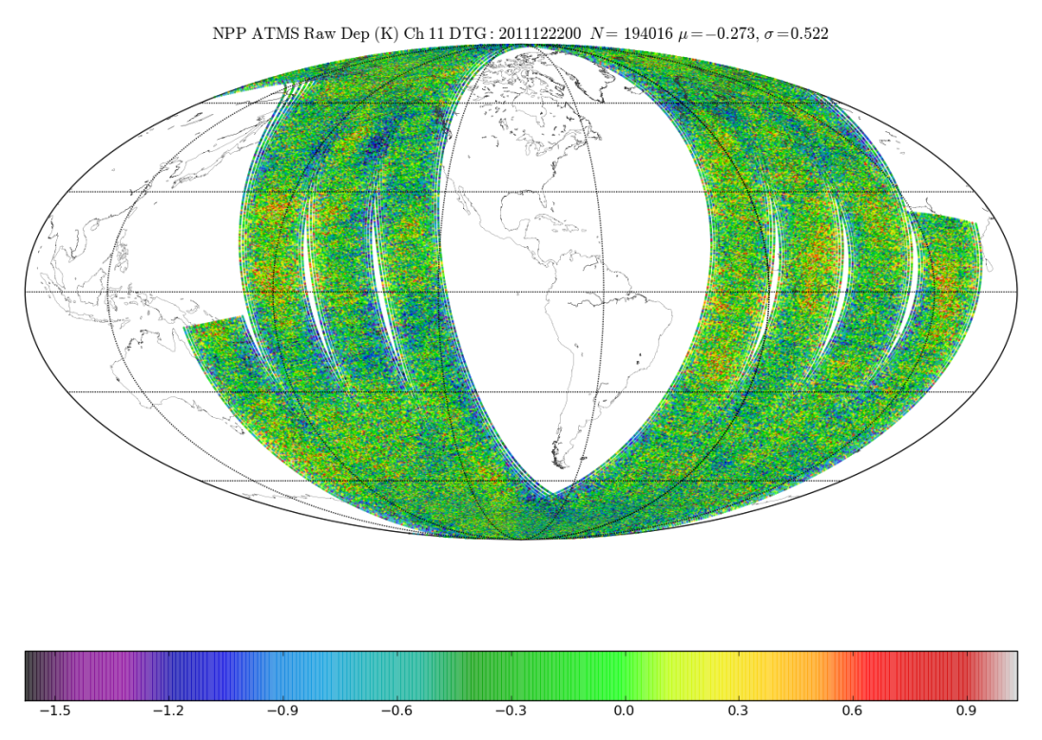
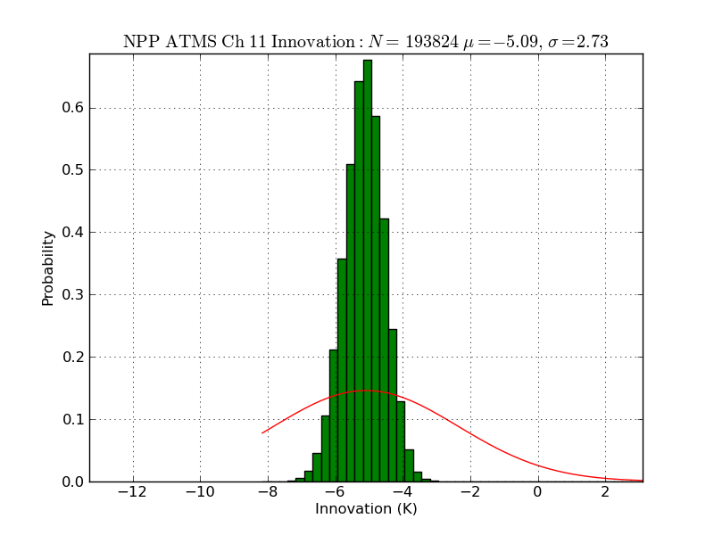
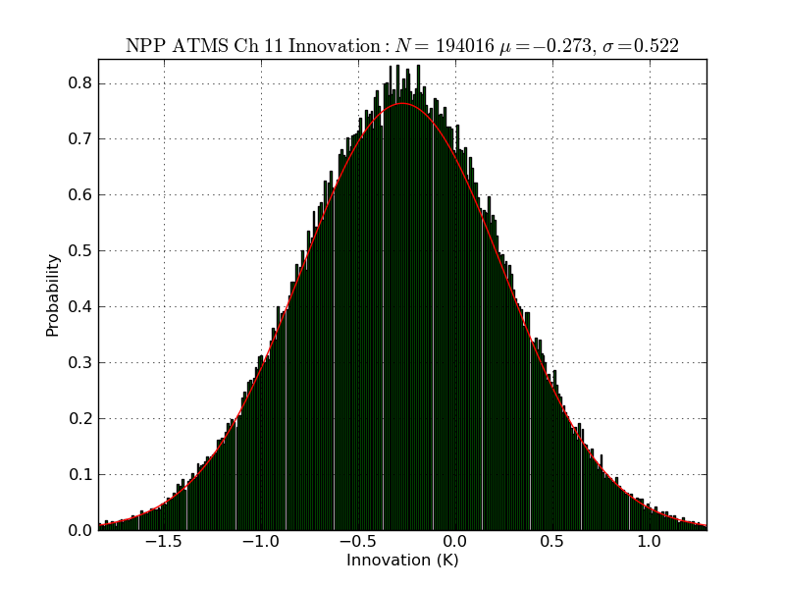
ATMS Ch 11 O-B 2011111000
ATMS Ch 11 O-B 2011122200

Slide 32
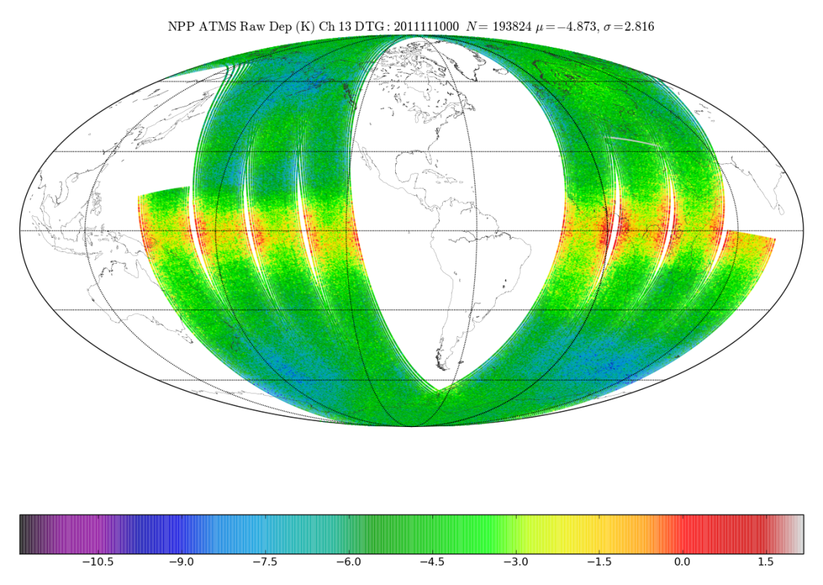
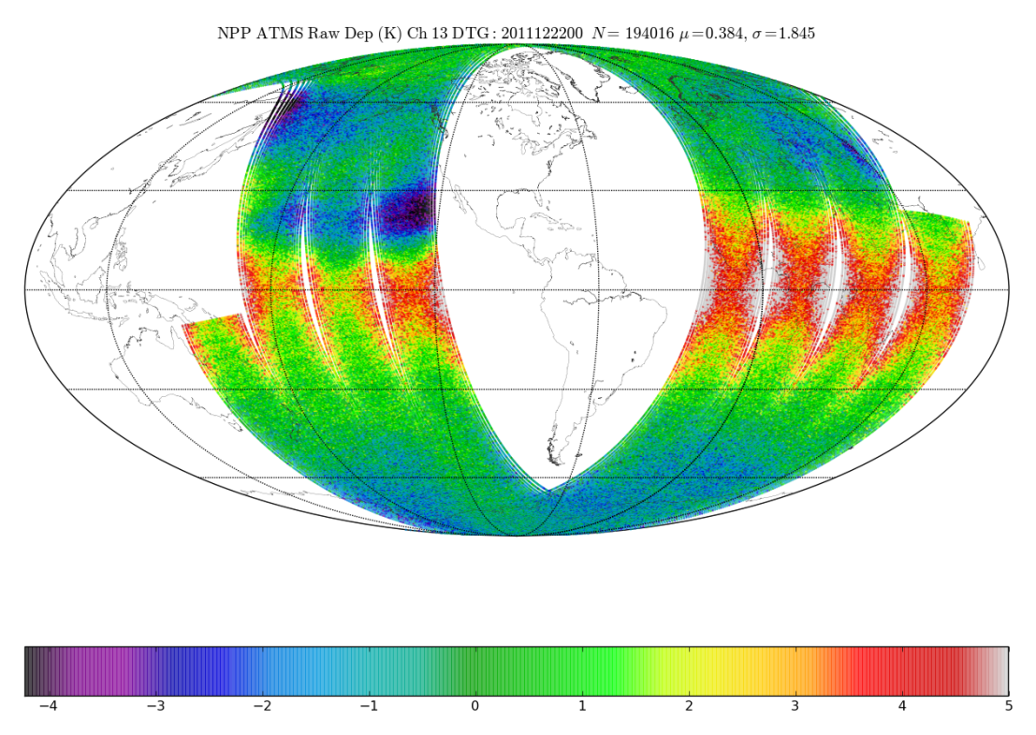
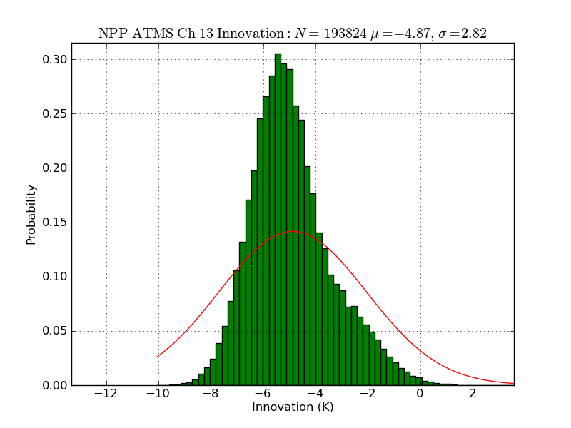
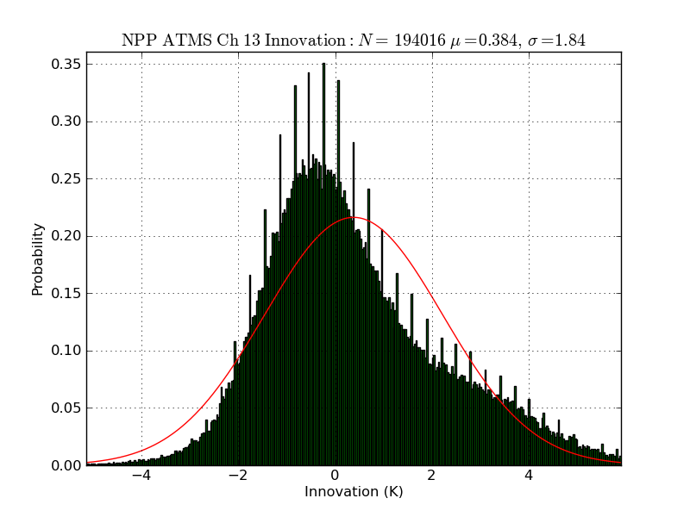
ATMS Ch 13 O-B 2011111000
ATMS Ch 13 O-B 2011122200

Slide 33
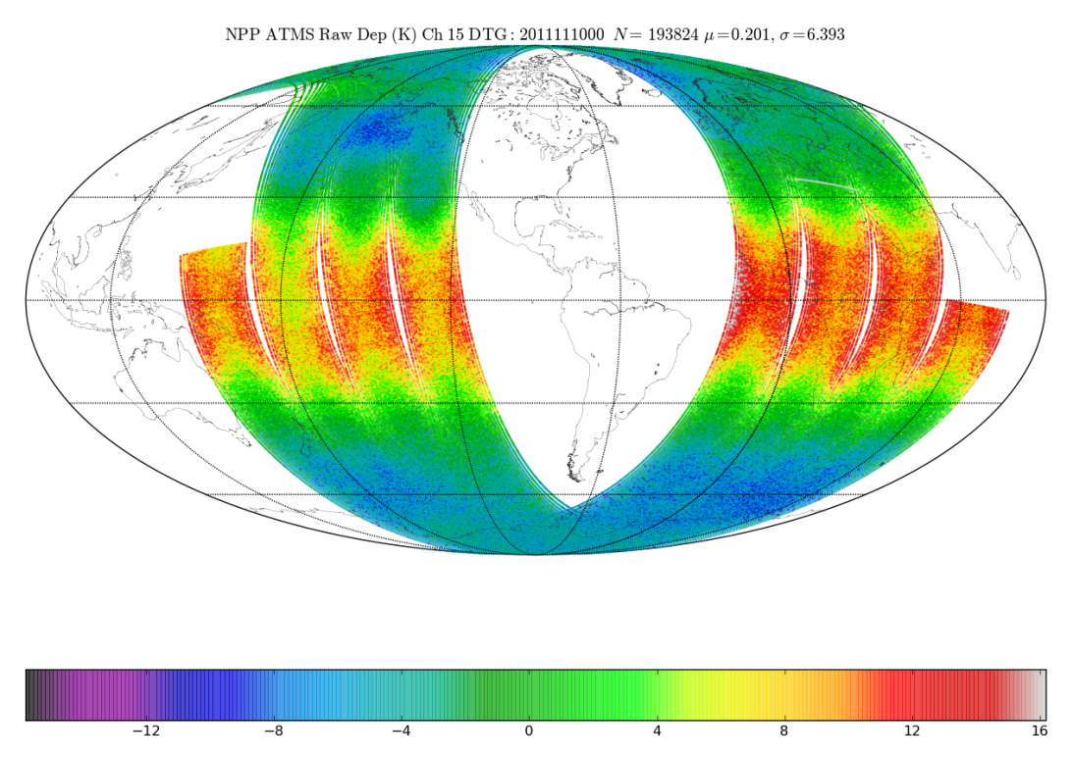
ATMS Ch 15 O-B 2011111000
ATMS Ch 15 O-B 2011122200

Slide 34
ATMS Ch 22 O-B 2011111000
ATMS Ch 22 O-B 2011122200

Slide 35
NRL Observed RDR Anomalies
RDR Processor is necessary for a thorough ATMS Calibration Analysis
NRL has developed an IDL ATMS RDR processor
MIT LL Matlab RDR processor also in house (Leslie)
Small discontinuities in the KV and WG Warm Load PRT Time Series
Sub-orbital oscillations in the G-band (165, 183 GHz) Shelf Temps
Sub-orbital oscillations in the K, KA Receiver Front End (RFE) Temps

Slide 38
Near Term Plans for ATMS at NRL
Continue NAVGEM ATMS Assimilation Trials
Assess Spatial Averaging Strategies
Continue Allan Variance Analysis to determine Optimum
calibration averaging scheme
Continue Real-time Calibration and Telemetry Monitoring
Prepare an NRL NPP ATMS Cal/Val status report
Gaussian Weights for σ = 25 km or FWHM = 59 km
w_{i}(p) = exp(-r_{i}² / 2σ²)

Slide 39
Backup Slides

Slide 44
NRL Allan Variance Analysis
Allan Variance of the Warm and Cold Calibration Counts
allows us to express variance in a meaningful way when
more complex noise source are present

