Slide 1
Suomi NPP SDR Provisional Product Review ICVS-LTM
Ninghai Sun, Fuzhong Weng, Li Bi, Michael Grotenhuis, Xin Jin,
Lin Lin, Scott Hu, Lilly Qi
Suomi NPP SDR Product Review
NOAA Center for Weather and Climate Prediction (NCWCP)
5830 University Research Park, College Park, Maryland
October 23 - 24, 2012

Slide 2
Outlines
STAR Team Membership
Accomplishments
Lessons Learned and path forward
Summary

Slide 3
STAR Team Membership
Science Lead
Fuzhong Weng
System Lead
Ninghai Sun
ATMS
Li Bi/Lin Lin
CrIS
Xin Jin/Li Bi/Lilly Qi
VIIRS
Scott Hu
OMPS
Mike Grotenhuis

Slide 4
Accomplishments
LTM system enhancements and New Capability:
Added NPP spacecraft data in ICVS-LTM according NASA flight segment users’ requests
Routinely Monitored NPP Instrument Bias
Improved OMPS Monitoring
Corrected some bugs in NEDT and Instrument temperature calculations
Add VIIRS SD/SDSM degradation monitoring and VIIRS global image
NPP Instrument Performance Monitoring Website (Trending, Bias, and Products)
NPP ATMS/CrIS Software Tools (readers, imaging processing, documents, etc.)

Slide 5
S/C Telemetry/Diary Parameters
ATMS G-Band RX Shelf Temperature
ATMS Scan Drive Mechanism Temperature
ATMS Baseplate Temperature
ATMS Calibration Target Bench Temperature
ATMS V-Band RX Shelf Temperature
ATMS Coldplate Operational Temperature (via DSEP ECC 1)
ATMS Coldplate Operational Temperature (via DSEP ECC 2)
ATMS Coldplate Operational Heater Deadband (via DSEP ECC 1)
ATMS Coldplate Operational Heater Deadband (via DSEP ECC 2)
ATMS Coldplate Operational Heater Operational Setpoint (via DSEP ECC 1)
ATMS Coldplate Operational Heater Operational Setpoint (via DSEP ECC 2)
VIIRS Sensor I/F 1 Temperature
VIIRS Sensor I/F 2 Temperature
VIIRS Telescope Moter Survival Heater Temperature
VIIRS Aft Optics Housing Temperature
VIIRS EM Coldplate Temperature
VIIRS EM Nadir Panel Temperature
VIIRS Coldplate Temperature (via DSEP ECC 1)
VIIRS Coldplate Temperature (via DSEP ECC 2)
VIIRS Electronics Coldplate Heater Deadband (via DSEP ECC 1)
VIIRS Electronics Coldplate Heater Deadband (via DSEP ECC 2)
VIIRS Electronics Coldplate Heater Operational Setpoint (via DSEP ECC 1)
VIIRS Electronics Coldplate Heater Operational Setpoint (via DSEP ECC 2)
CrIS Sensor I/F 1 Temperature
CrIS Sensor I/F 2 Temperature
CrIS Structure Near Survival Heater Temperature
CrIS PCE Temperature
CrIS Interferometer Electronics Temperature
CrIS SSM Temperature
OMPS Sensor I/F 1 Temperature
OMPS Sensor I/F 2 Temperature
OMPS Total Column Thermistor Temperature
OMPS Nadir Profiler Thermistor Temperature
OMPS Limb Thermistor Temperature

Slide 6
S/C Telemetry/Diary Parameters
PUMA Bus Voltage
PUMA Total Bus Current
PUMA Battery 1 Voltage
PUMA Battery 2 Voltage
PUMA Battery 1 Pressure
PUMA Battery 2 Pressure
Wheel 1 Speed/Direction
Wheel 2 Speed/Direction
Wheel 3 Speed/Direction
Wheel 4 Speed/Direction
Gyro(TARA) 1 Motor Current
Gyro(TARA) 2 Motor Current
Gyro(TARA) 3 Motor Current
Reaction Wheel 1 Motor Current
Reaction Wheel 2 Motor Current
Reaction Wheel 3 Motor Current
Reaction Wheel 4 Motor Current
System Pressure
Propulsion Deck -Z Temperature
Propulsion Tank Temperature (Gas Side)
Star Tracker Maximum Residual
Total System Momentum 1
Total System Momentum 2
Total System Momentum 3

Slide 7
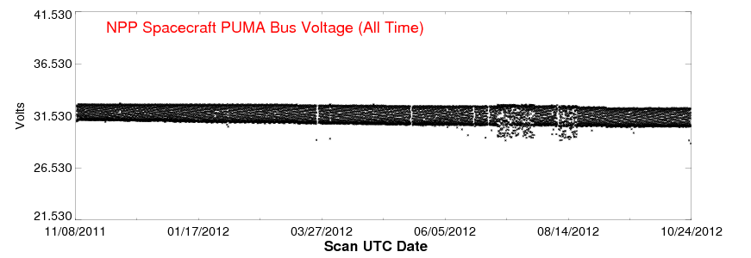
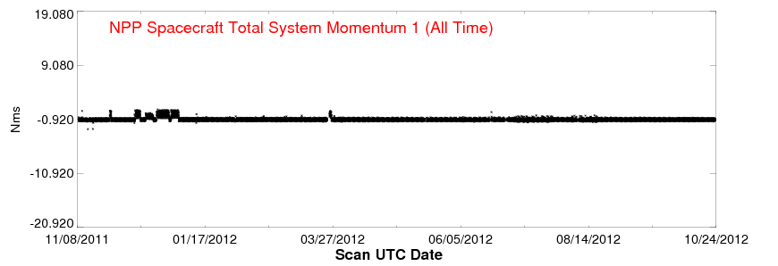
S/C Telemetry/Diary Parameters

Slide 8
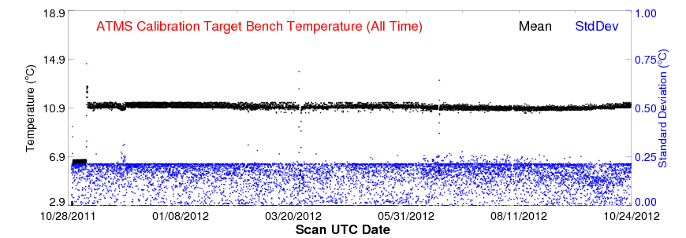
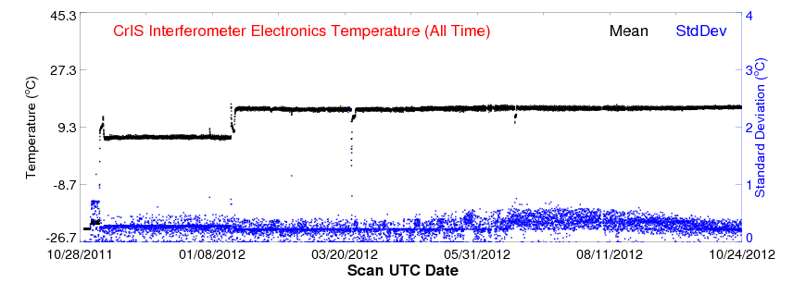
S/C Telemetry/Diary Parameters

Slide 9
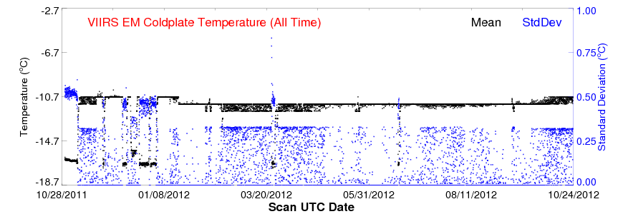
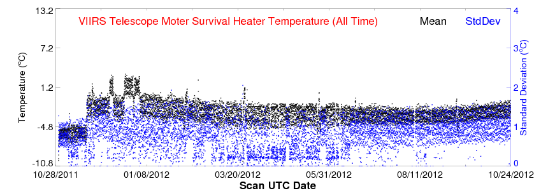
S/C Telemetry/Diary Parameters

Slide 10
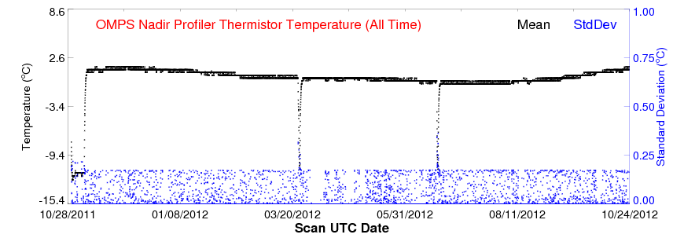
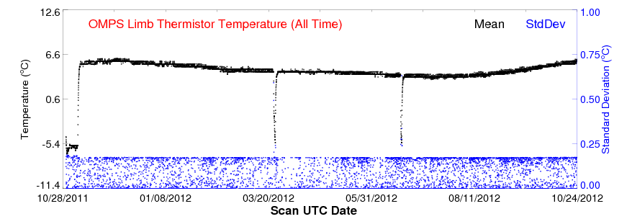
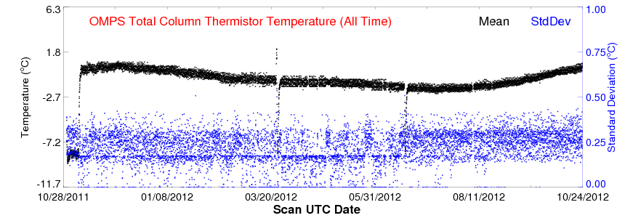
S/C Telemetry/Diary Parameters

Slide 11
ATMS RDR Parameters
Parameters | Descriptions | Dimensions | Usage
Channel NE∆T | Noise equivalent differential temperature | 22 channels | sensitivity trending
Warm Count | Blackbody warm target count | 4 readings/channel * 22 channels | Onboard calibration target trending
Space view Count | Space view cold target count | 4 readings/channel * 22 channels | Onboard calibration target trending
Channel Gain | Calibration gains for each channel | 22 channels | Calibration trending
4-Wire PRT Temperature | Blackbody platinum resistance thermometer (PRT) temperature | 2 bands | Stability trending
2-Wire telemetry temperatures | Receiver shelf temperature, Scan drive mechanism temperature, IF module temperature, etc. | 31 temps | Instrument health status
Instrument telemetry | Scan drive power supply voltage, Receiver voltage, etc. | 35 parameters | Instrument health status

Slide 12
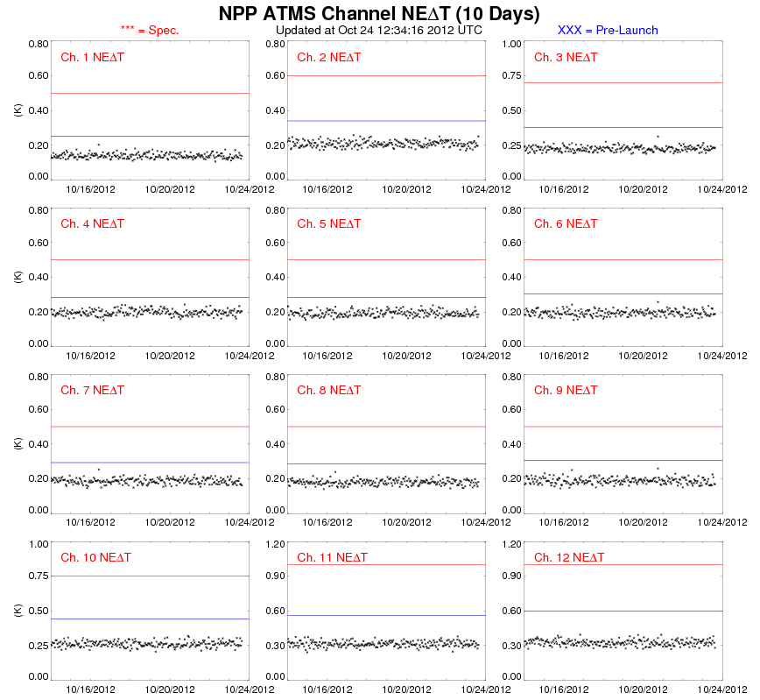
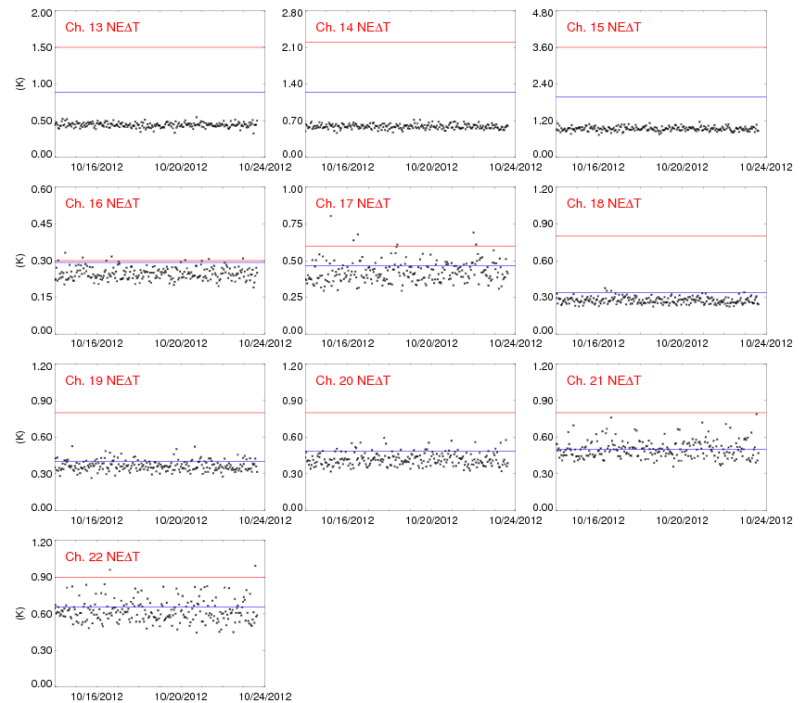
ATMS RDR Parameters

Slide 13
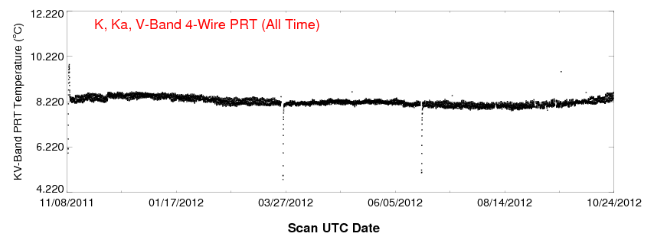
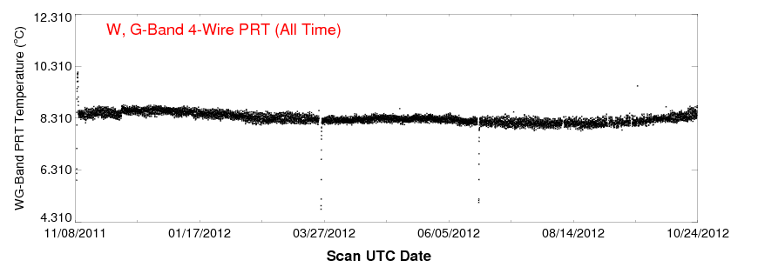
ATMS RDR Parameters

Slide 14
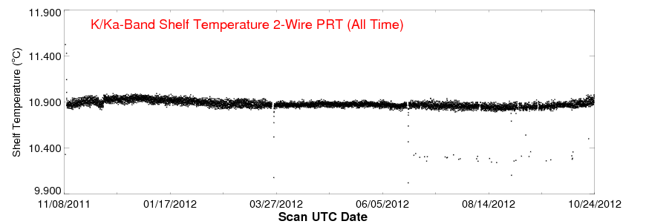
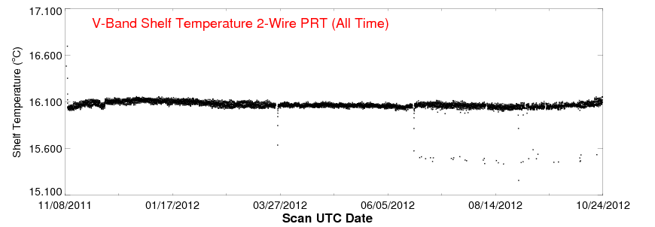
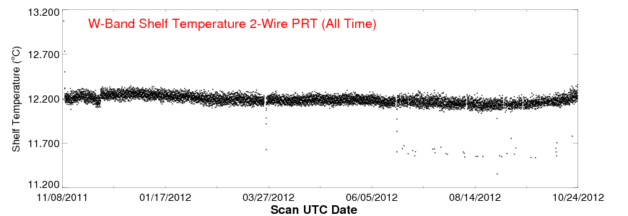
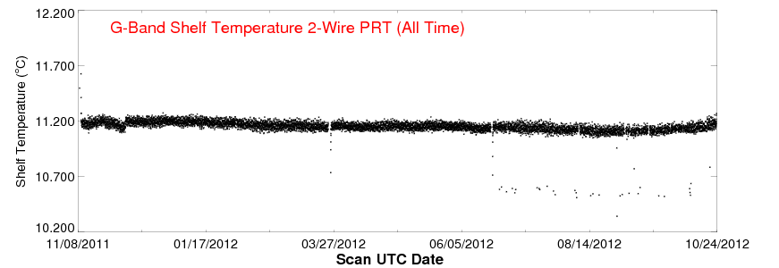
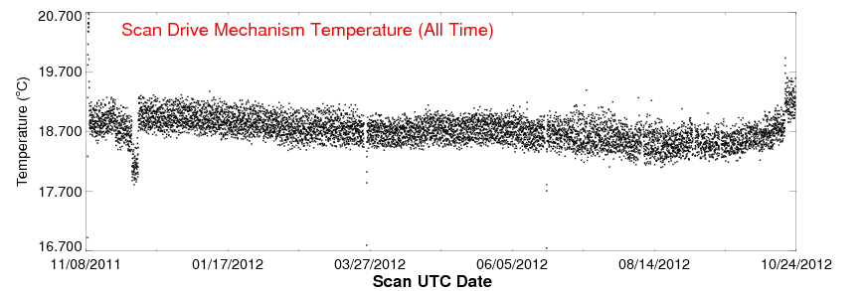
ATMS RDR Parameters

Slide 15
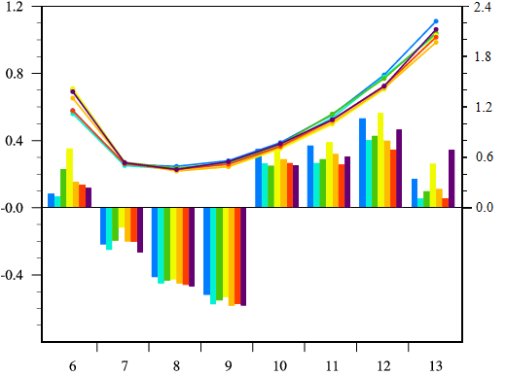
ATMS TDR Parameters
Std. Dev. (K)
Bias (K)
S/C Telemetry/Diary Parameters
ATMS Channel

Slide 16
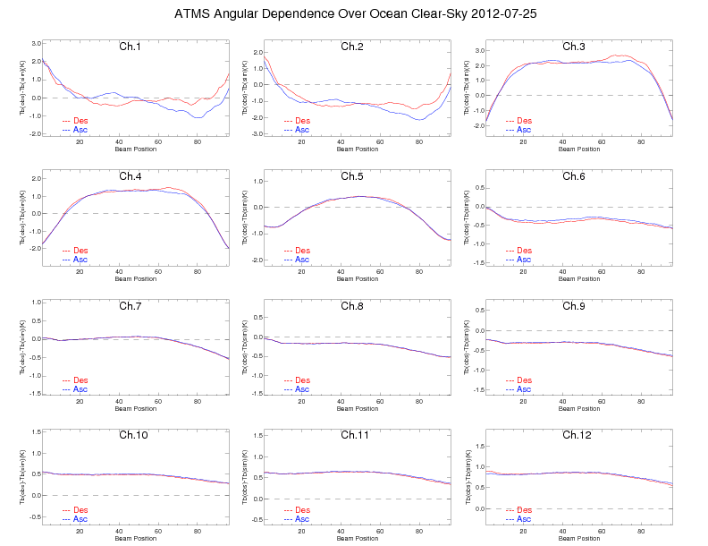
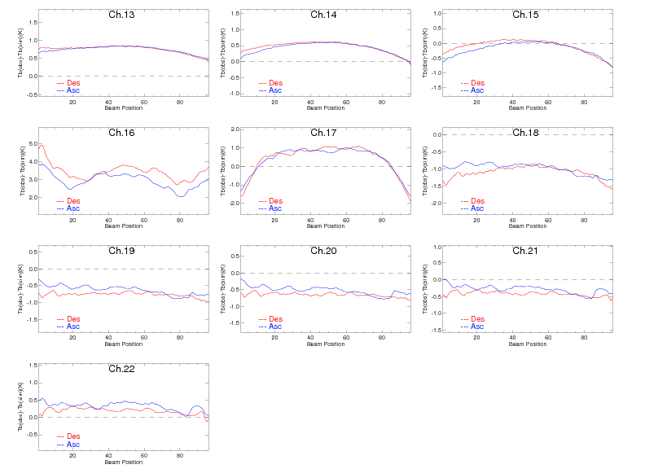
ATMS TDR/SDR Bias Parameters

Slide 17
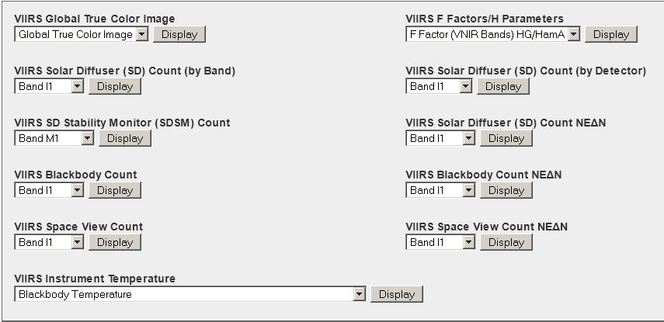
VIIRS OBC/Telemetry Parameters

Slide 18
VIIRS OBC/Telemetry Parameters
Parameters | Descriptions | Dimensions | Usage
Telemetry temperatures | BB, RTA, cavity, HAM, FPA, cooler, Mainframe, Circuit Card Assembly | 21 temps | Instrument Healthy status
SD_Counts | VIIRS observation DN of Solar diffuser for band I1~I3, M1~M11, DNB over band average | 14 bands | Degradation trending
SD NE∆N | Noise NE∆N for SD signal of solar bands | 14 bands | SNR trending
SD_Counts by detectors | VIIRS observation DN of Solar diffuser I1~I3, M1~M11, DNB over detector average | 14bands *32d | degradation for Detector uniform
SDSM signal | SDSM signal of SD and Sun in every orbit | 8 bands | SD trending
SV_Counts | VIIRS observation Space view DN for 22 bands | 22bands | Background signal trending
SV NE∆N | Dark Noise NE∆N for Space view signal | 22bands | Dark noise signal
BB_Counts | VIIRS observation Blackbody DN for 22 bands | 22 bands | IR gain derivation
BB NE∆N | Noise NE∆N for black body signal | 22bands | IR NEDT derivation
F factors and H factors | Degradation of Solar bands based on SD signal and SDSM | 14 bands | Solar bands degradation
IR NE∆T | Noise equivalent temperature for IR bands M4, M5, M12-M16 | 7 IR bands | IR bands noise
IR Calibration Gain | Calibration gains for IR bands M4, M5, M12-M16 | 7 IR bands | IR bands calibration trending

Slide 19
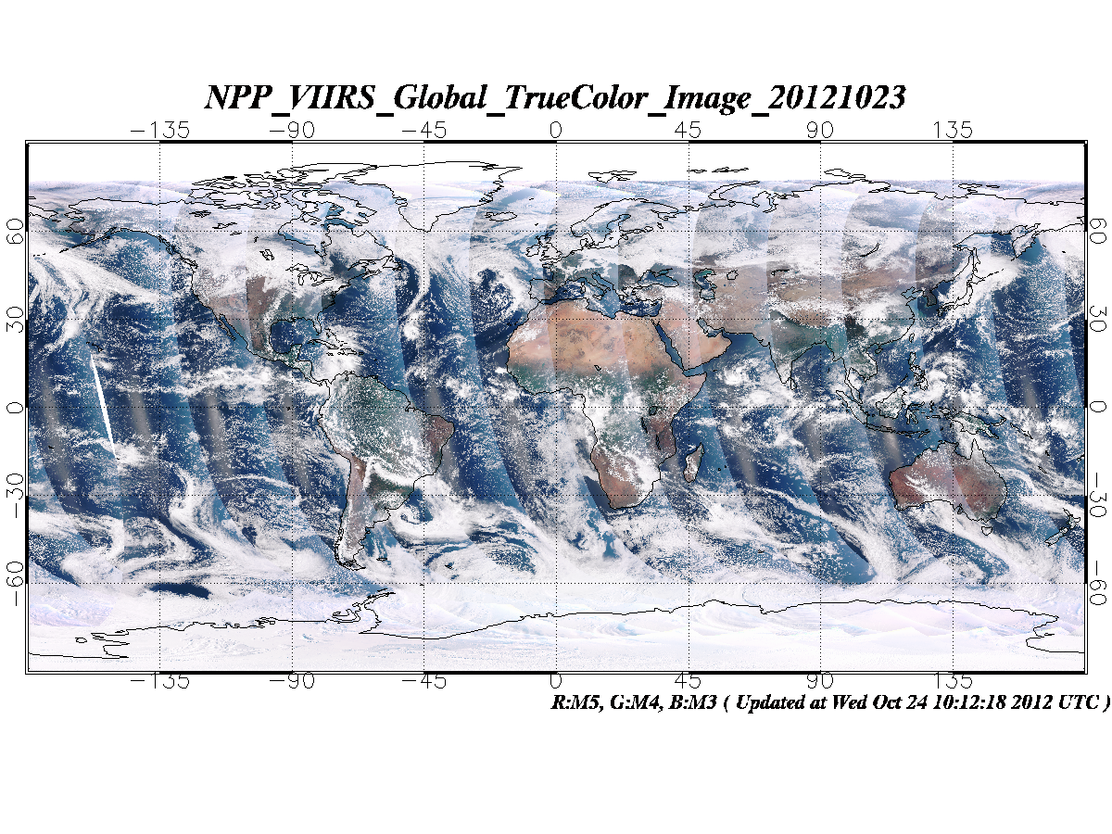
VIIRS Global True Color Image

Slide 20
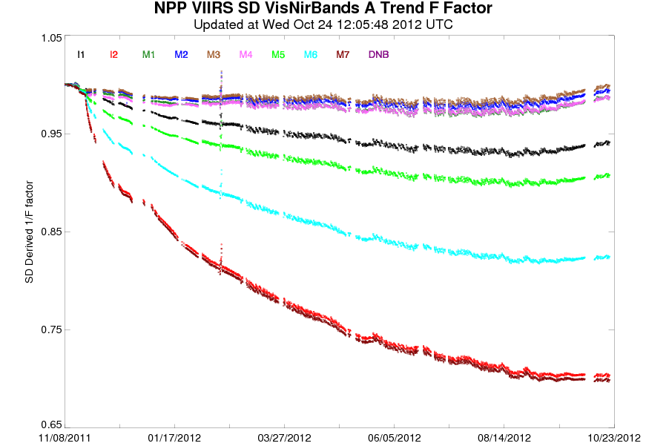
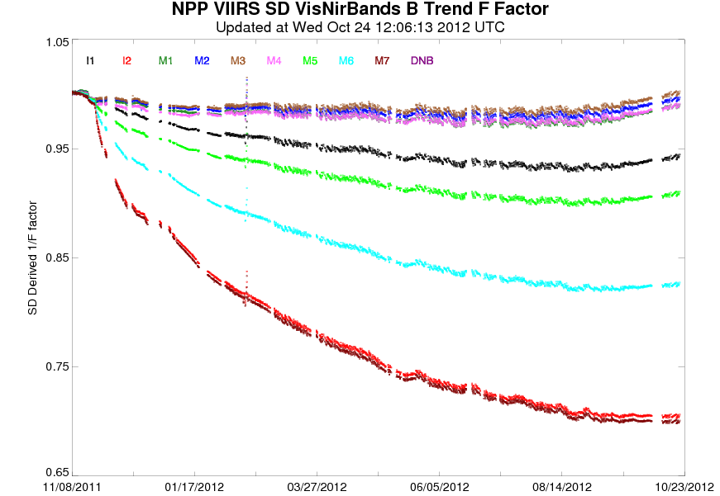
VIIRS OBC/Telemetry Parameters
VIS/NIR Band F Factor

Slide 21
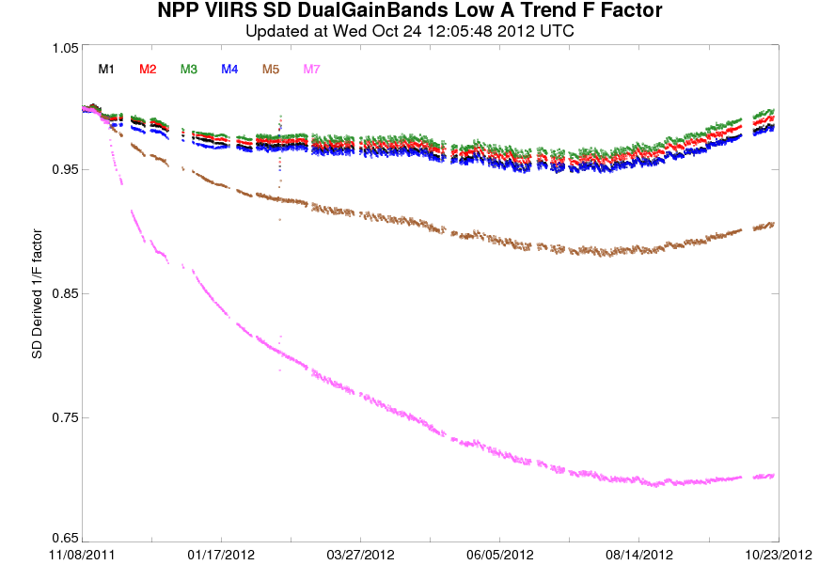
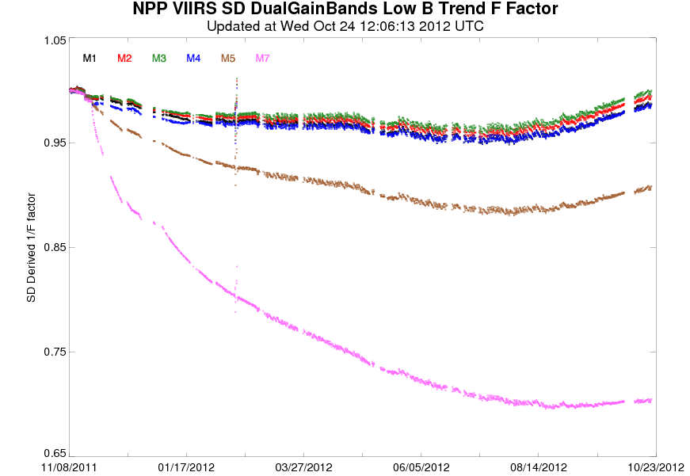
VIIRS OBC/Telemetry Parameters
Dual Gain Band F Factor

Slide 22
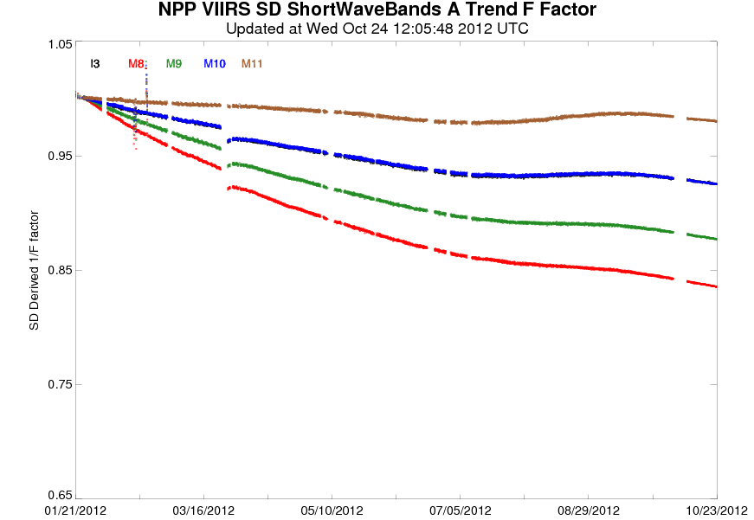
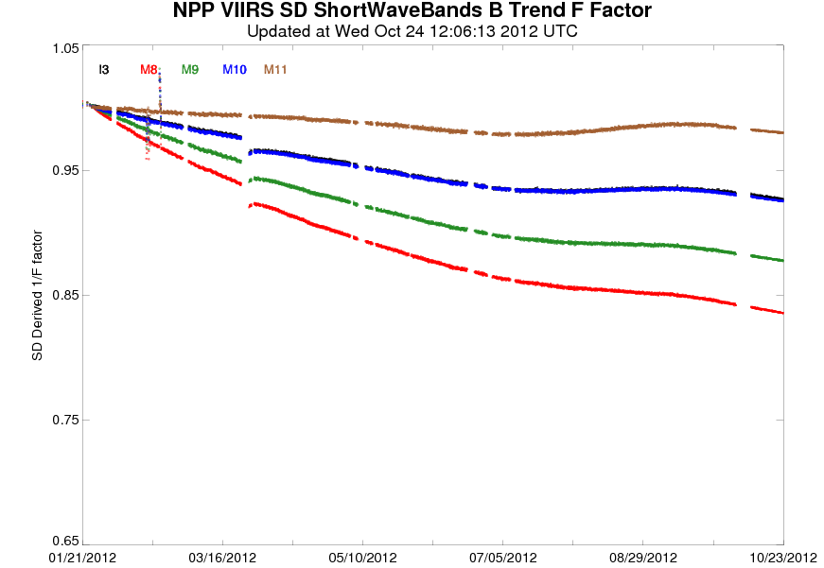
VIIRS OBC/Telemetry Parameters
Shortwave Band F Factor

Slide 23
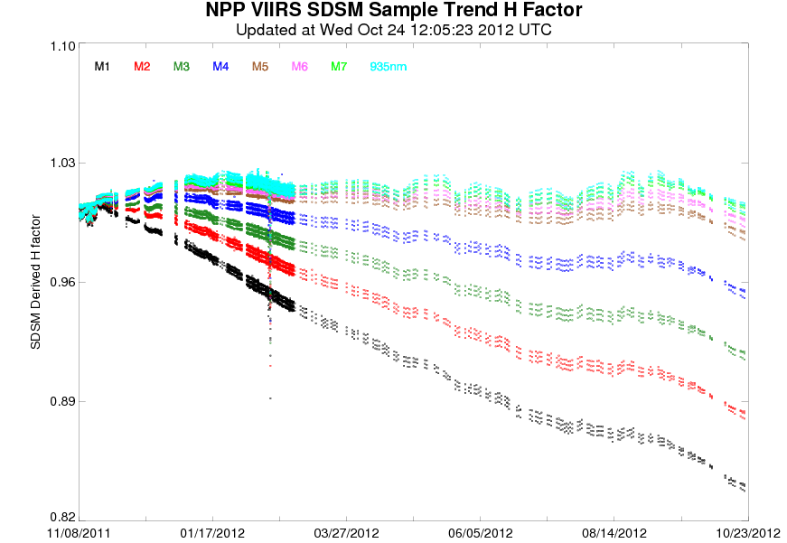
VIIRS OBC/Telemetry Parameters

Slide 24
CrIS RDR/SDR Parameters
Telemetry Parameters
Housekeeping Parameters
Name | Description
RDR_TLM_ICT_PRTTemp | ICT PRT temperature
RDR_TLM_OMA_Temp | OMA structure temperature
RDR_TLM_StageCooler_Temp | Stage 1/2/3/4 cooler temperature
RDR_TLM_Other_Temp | BS/SB/Telescope Temperature
RDR_Laser_Diode | Laser diode current & temperature
RDR_Servo_Error | SSM Cross/In-track servo error over 30 FORs
Name | Description
SSMelectronicsboardTemp | SSM electronics board Temperature
ServoMotorwindingTemp | Cr- & In-Track Motorwinding Temperature
PorchswingVelocity | Porchswing Velocity
MotorCurrent | Porchswing/DA-X/DA-Y Motor Current
DA_XY_Tilt_Err | DA-X & DA-Y Tilt Error
Name | Description
SSMelectronicsboardTemp | SSM electronics board Temperature
ServoMotorwindingTemp | Cr- & In-Track Motorwinding Temperature
PorchswingVelocity | Porchswing Velocity
MotorCurrent | Porchswing/DA-X/DA-Y Motor Current
DA_XY_Tilt_Err | DA-X & DA-Y Tilt Error
Instrumental Responses

Slide 25
CrIS RDR/SDR Parameters
Name | Description
npp_cris_window_map | 11 μm (900 cm⁻¹) BT map
npp_cris_H2O_map | 6.7 μm (1500 cm⁻¹) BT map
npp_cris_window2_map | 4.0 μm (2500 cm⁻¹) BT map
npp_cris_O3_map | 9.7 μm (1030 cm⁻¹) BT map
npp_cris_SDR_Quality_map | SDR overall QF map
npp_cris_SDR_Quality | SDR overall QF time series over 9 field of views (FOV)
npp_cris_SDR_MAX_SD_imgy | Max std. dev. of imaginary NEDN per scan
npp_cris_SDR_AVG_NEDN | Average spectral NEdN of the day
npp_cris_SDR_MAX_NEDN | Maximal spectral NEdN of the day
npp_cris_SDR_AVG_imgy | Average spectral imaginary part of the day
npp_cris_SDR_MAX_imgy | Maximal spectral maginary part of the day
npp_cris_sdr_Invalid_Radiometric_Calibration | Radiometric Cal. Invalidity flag over 9 FOVs
npp_cris_sdr_Invalid_Spectral_Calibration | Spectral Cal. Invalidity flag over 9 FOVs
npp_cris_sdr_FCE_Correction_Failed | FCE Correction Failed flag over 9 FOVs
npp_cris_sdr_FCE_Detection | FCE Detection flag over 9 FOVs
npp_cris_sdr_Invalid_Geolocation | Geolocation Invalidity flag over 9 FOVs
npp_cris_sdr_Invalid_RDR | RDR Invalidity flag over 9 FOVs
npp_cris_sdr_Bit_Trim_Failed | Bit Trim Failed flag over 9 FOVs
SDR_Laser_Wavelength | 3 laser wavelength parameters
SDR_NumberOfValidPRTTemps | # of valid PRT temp count
Scan_Level_QF1 | 6 Scan-level QFs
SDR_DS_Symmetry | Asymmetry in DS IGMs
SDR_ICT_Temp_Stab_Cons | ICT temp stability & consistency
SDR_DS_WindowSize | DS WindowSize
SDR_ICT_WindowSize | ICT WindowSize
SDR_DS_SpectralStability | DS Spectral Stability
SDR_ICT_SpectralStability | ICT Spectral Stability
SDR_ImpulseNoise_Count | Impulse Noise over 9 FOVs
SDR_SDRFringe_Count | SDR Fringe over 9 FOVs
SDR_ES_ZPDFringe_Count | ES ZPD Fringe over 9 FOVs
SDR_ES_ZPDMagnitude_Count | ES ZPD Magnitude over 9 FOVs
npp_cris_sdr_Day_Night | Day/Night flag over 9 FOVs
SDR_Lunar_Intrusion_QF2 | Lunar Intrusion flag
npp_cris_SDR_Spectrum_NP | Spectral Rad/BT at North Pole
npp_cris_SDR_Spectrum_EQ | Spectral Rad/BT at Equator
npp_cris_SDR_Spectrum_SP | Spectral Rad/BT at South Pole
npp_cris_imgy900_map | 11 μm (900 cm⁻¹) imgy. rad. map
npp_cris_imgy2500_map | 4 μm (2500 cm⁻¹) imgy. rad. map

Slide 26
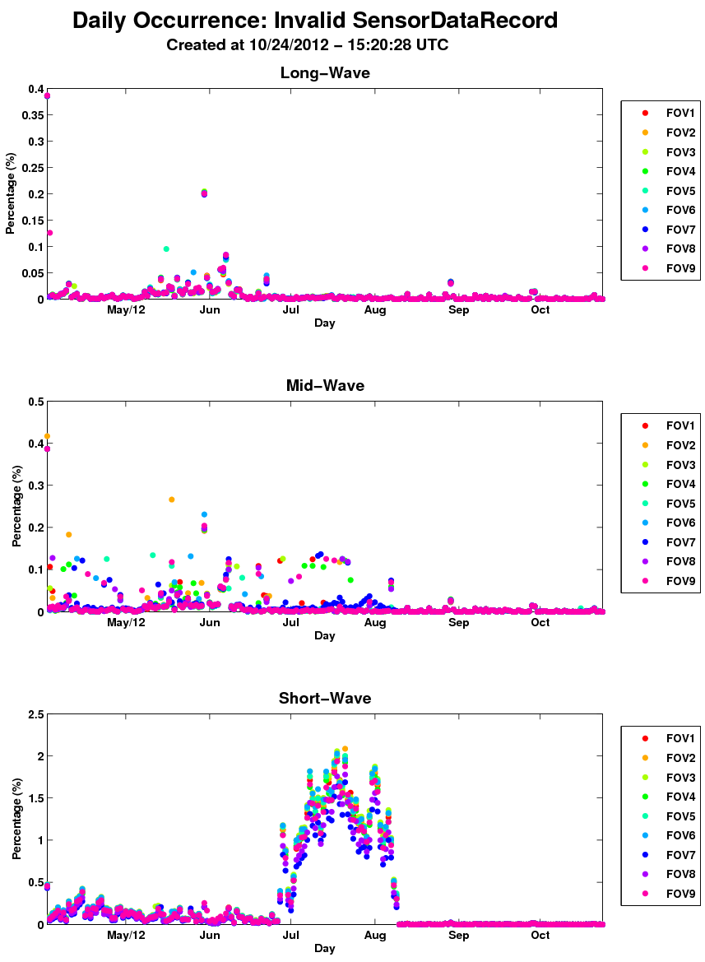
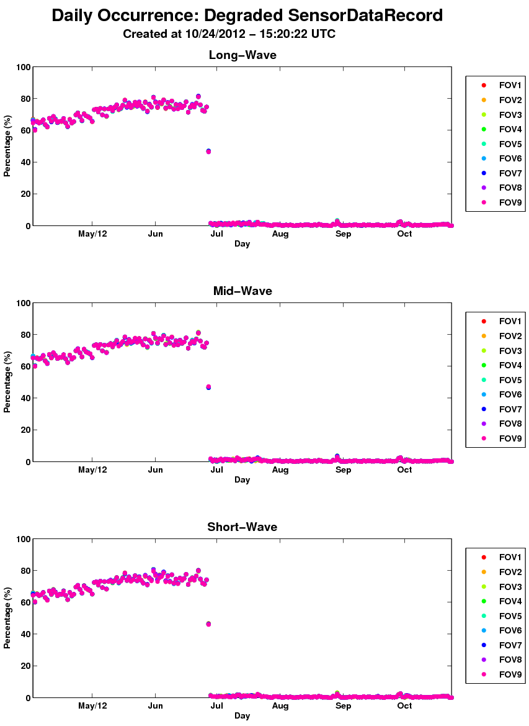
CrIS RDR/SDR Parameters

Slide 27
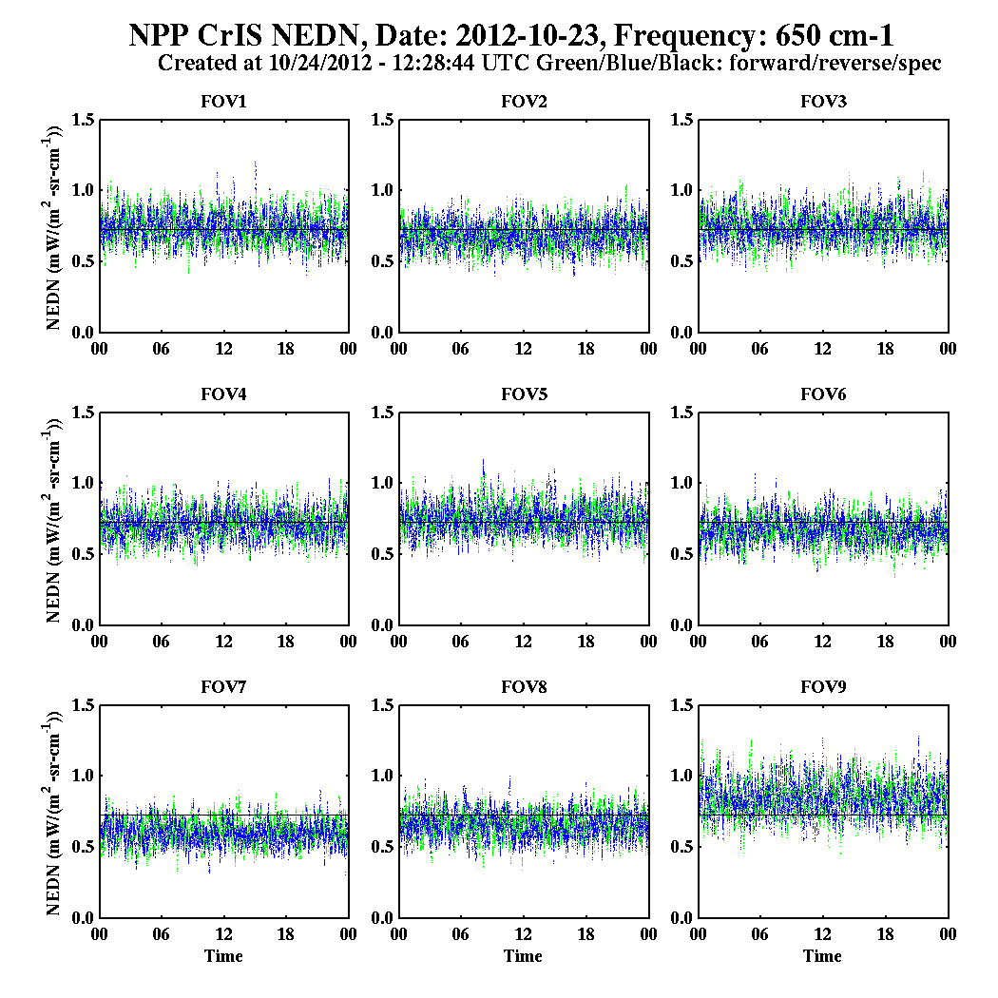
CrIS RDR/SDR Parameters

Slide 28
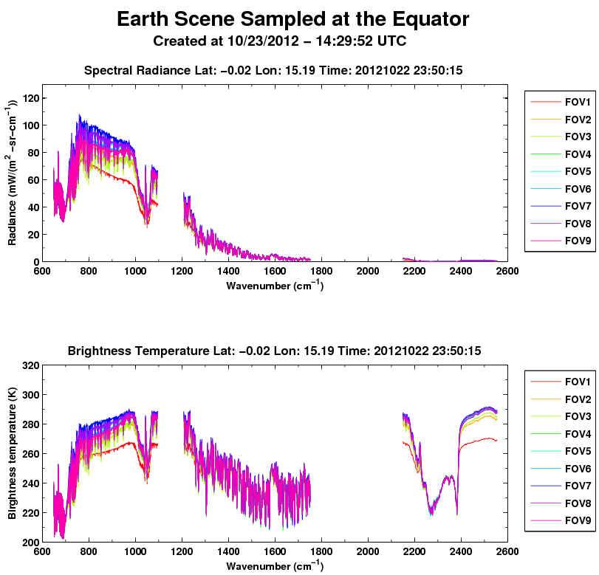
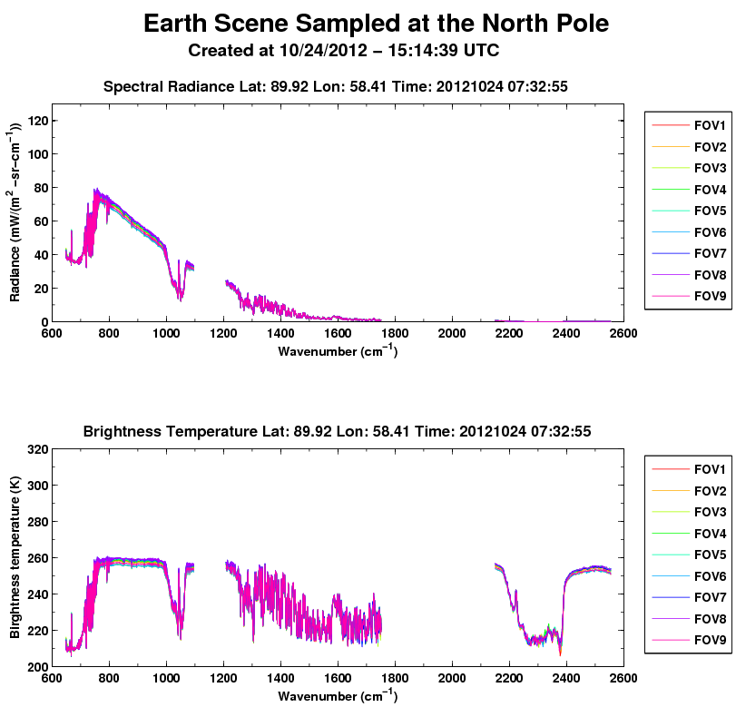
CrIS RDR/SDR Parameters

Slide 29
OMPS Parameters
Parameters | Purpose
Instrument Status Four temperatures for TC Eight temperatures for NP Examples: CCD, Window, Conduction Bar, Housing, Telescope, … | Monitor variation of instrument status Watch for health and safety issues Assist anomaly investigation
Instrument Performance Specified requirements Examples: Linearity, Dark Count, Hot Pixels, Solar Cal | Monitor variations in instrument performance Verify compliance with specifications Assist anomaly investigation
Operation Status 12 for TC 15 for NP Examples: LUT versions, ID, … | Monitor operation and processing status Assist anomaly investigation
Product Quality Self-consistency Inter-comparison | Evaluate product quality in relation to other monitoring

Slide 30
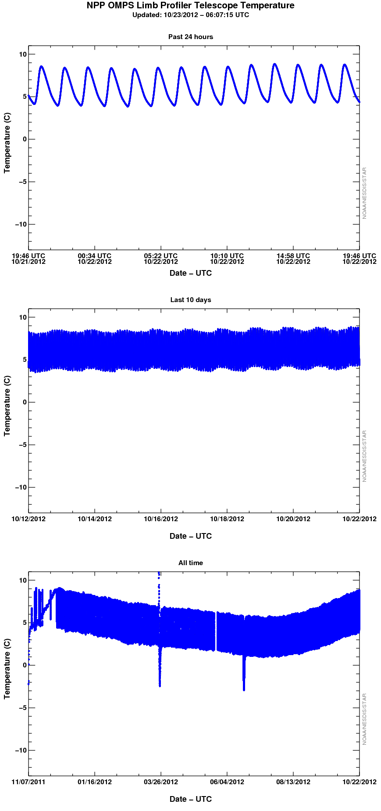
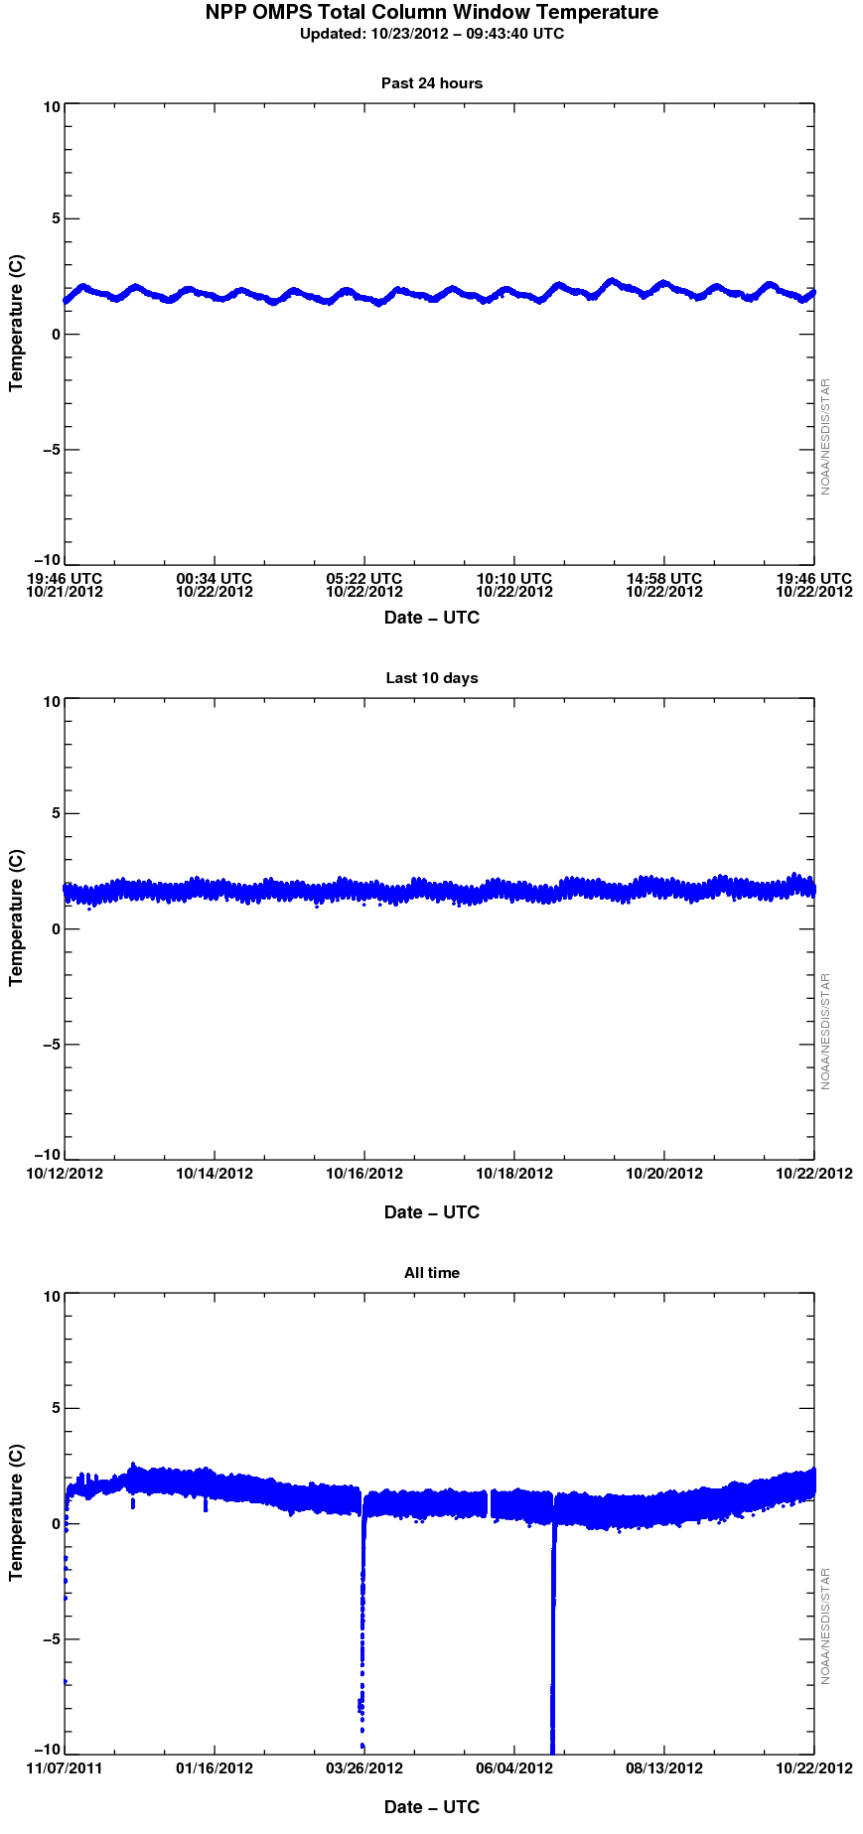
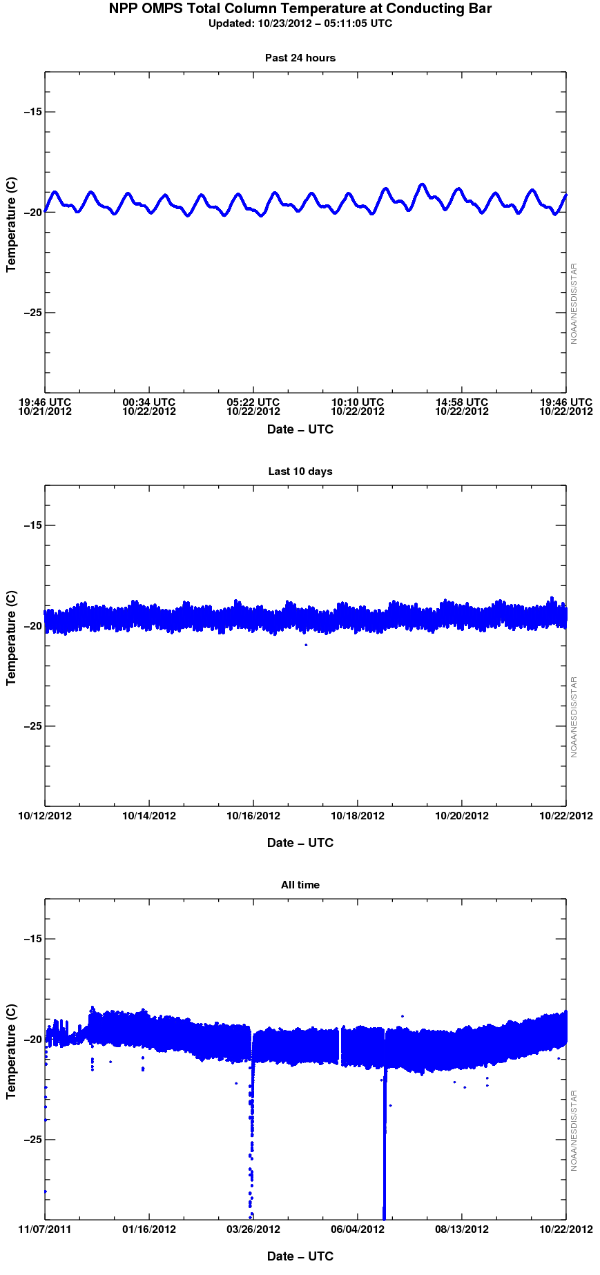
OMPS Parameters
LP Telescope Temperature
TC Window Temperature
TC Conducting Bar Temperature

Slide 31
Path Forward
Add more spacecraft status monitoring to support flight segment
Add more instrument status and performance monitoring for Cal/Val teams
Add instrument status /quality anomaly notification function
Improve user experience of current website for easy access and understanding
Integrate latest instrument trending analysis of each SDR group into ICVS
Improve the bias monitoring capability including more detailed analysis (e.g. biases wrt angular, scene, type)
Prepare ICVS/LTM for J1 and J2 missions
Provide periodical instrument performance analysis report to JPSS program and CGMS

Slide 32
Summary
STAR LTM system is developed for NPP/JPSS Integrated Calibration/Validation to support Cal/Val EOC/ICV/LTM
Advanced SDR sciences and algorithms are transitioned into operations
The notification related to instrument anomalies are self-generated
Users from broader community (e.g. NWP, forecasters) are now will being benefited from STAR LTM system

