Slide 1
VIIRS Cloud Mask (VCM) Validation Stage 2
Dr. Thomas Kopp – VCM Validation Lead
Dr. Andrew Heidinger – Cloud Product Lead
Dr. William Thomas – VCM JPSS Algorithm Manager

Slide 2
VCM Basics
Fundamentally the VCM is a moderate band pixel-by-pixel determination of cloud cover
As originally defined in the NPOESS system specification, it is “used in the processing of many EDRs, which classifies pixels as Confidently Clear, Confidently Cloudy, Probably Clear, and Probably Cloudy”, this logic remains in place for JPSS
The original requirements broke down the VCM performance into various backgrounds (e.g. day/night, ocean/land/desert) and characteristics (e.g. probability of correct typing, leakage, false alarms)
The design of the VCM also breaks down the cloud identification process by condition and background
This logic has continued into the S-NPP and JPSS programs
The applicable JPSS Level 1 Requirements sections, including the supplemental, are the requirements we are considering today
This is our “target”

Slide 3
VCM Cal/Val Team
NESDIS/STAR - A. Heidinger (Product Lead)
The Aerospace Corporation - T. Kopp (Validation Lead)
UW/CIMSS - R. Frey, D. Botambekov
Northrop Grumman - K. Hutchison, B. Iisager
NASA/DPE - B. Thomas (JAM)
Raytheon – K. Brueske (OAA)
AFWA - J. Cetola
NRL, Monterey - K. Richardson
NESDIS/STAR - L. Remer (Aerosol Liaison)
UMBC - E. Vermote (Land Liaison)
NRL, Stennis - D. May (Ocean Liaison with J-F. Cayula)

Slide 4
VCM Team Responsibilities
The Cal/Val approach is basically a 3-legged pedestal with assistance from liaisons and program personnel
NOAA/STAR leads product development and performs large scale analyses such as match-up comparisons
Aerospace leads the validation effort and determines when and how threshold updates occur
Northrop Grumman leads the development of Golden Granules and provides fundamental software support and development
This 3-legged pedestal has been in place since 2005
Other key contributors are our JPSS Algorithm Manager, Raytheon (OAA) representative, and our liaisons

Slide 5
Validation Stage 2
A product at validation stage 2 will, using a moderate set of samples, be shown to have met all threshold requirements
Evaluation factors include impacts from ancillary data, SDRs, all quality flags, and inputs from other users
The latter is covered by briefings from the VIIRS EDR teams
Documentation, to include appropriate versions of all Processing Coefficient Tables (PCTs), must be up-to-date
This is true for the VCM, details to follow
All DRs should be accounted for
These will be briefed
The VCM has met all of these conditions, as we will show

Slide 6
Definitions
Probability of Correct Typing (PCT): The percentage of confidently clear or confidently cloudy pixels that are properly identified as such in each background type
Leakage: The percentage of pixels identified as confidently clear that in reality contain cloud
False Alarms: The percentage of pixels identified as confidently cloudy that are in reality contain no clouds (they may contain aerosols)
PCPC: The percentage of pixels identified as Probably Cloudy or Probably Clear (hence PCPC)
PCPC is no longer a documented requirement, though we still track it in our Golden Granules (GGs)

Slide 7
VCM Requirements – Part 1
The VCM requirements are detailed in the JPSS Level 1 requirements supplemental, section 5.3.5
Although it does not use the word “global”, its description states “Cloud Mask describes the area of the earth’s horizontal surface that is masked by the vertical projection of detectable clouds”, making it a global product
The VCM must also do the following (note none of the below have a quantitative value attached to them):
Determine cloud phase
Determine if a cloud is, in reality, an aerosol
Locate cloud shadows
Identify pixels that contain a fire (read in from the Fire Product)
An older requirement for volcanic ash has been removed
Cell size is that of the Moderate bands

Slide 8
VCM Requirements – Part 2
Quantitative requirements are as follows:
PCT:
Ocean, day, Cloud Optical Thickness (COT) > 1.0: 94%
Land, day, COT > 1.0: 90%
Ocean, night, COT > 1.0: 85%
Land, night, COT > 1.0: 88%
Leakage:
Ocean, day, COT > 1.0, no sun glint: 1%
Land, day, COT > 1.0: 3%
All night conditions, COT > 1.0: 5%
False Alarms
Ocean, day, COT > 1.0: 5%
Land/Desert day, no NDVI between 0.2 and 0.4, COT > 1.0: 7%
All night conditions, COT > 1.0: 8%

Slide 9
VCM Requirements – Part 3
Quantitative requirements present some dilemmas that must be resolved up front
Ocean requirements specifically mention “no sun glint” only for leakage, not for PCT or false alarms
VCM team interpretation is no sun glint is applicable to all ocean, day requirements
Desert is only cited in false alarms
VCM team interprets “land” as including desert when desert is not specified
NDVI exception is only cited for land, day, false alarms
We are ignoring this exception (more later), VCM meets the requirement under all NDVI conditions
There are no quantitative requirements for VCM performance over snow and ice
VCM team will still show results over these backgrounds
All VCM requirements go towards VCM performance, no requirements were levied on the VCM explicitly for downstream EDR support
It is therefore likely that achieving VCM requirements in and of itself is not sufficient to show the VCM is acceptable to all downstream users

Slide 10
Pre-launch Work on the VCM
The core team of NG, SSEC, and Aerospace began collaboration on the VCM in 2005
Collective agreement was made for all software changes under the leadership of NG until the government took over the role circa 2009/2010
Critical updates were made to numerous cloud detection tests, cloud phase, and cloud shadows
Improvements were suggested and ultimately implemented from all three organizations
The approach remained the same after the government took the lead for Cal/Val and, later, the algorithms themselves

Slide 11
Status at Beta
Beta was declared after the 30-day spin-up set of threshold adjustments were implemented on the IDPS (April 2012)
74 thresholds were adjusted during the 30 day spin up
This implementation also opened up the VCM to analysis and critique by the other VIIRS EDR teams
1012 granules of VCM/MODIS/CALIPSO match-ups were produced for beta

Slide 12
Status at Provisional
Product quality was evaluated using two days of match-ups data between CALIPSO and the VCM over the month of November 2012, and compared to results from May 2012
Results were executed twice, one for all clouds observed by CALIPSO and one with thin clouds removed
Thin was defined as high cloud with an optical depth less than 0.3
Analysis tool assumed a binary cloud mask
Probably clear is counted as confidently clear, same for cloudy
This penalizes the VCM, recall actual definitions of leakage/false alarms is based on confident results only
VCM had improved from beta approximately 5-10%, results were at that time within 10% of all “NPOESS” requirements (JPSS requirements were not set yet)
Some leakage percentages were cut in half
VCM was declared provisional as of November 2012

Slide 13
Improvements Since Provisional (1)
VCM PCTs were updated (tuned) on February 8, May 10/28, and September 24 2013
The February update improved cirrus detection over all backgrounds and removed an incorrect latitude limit for certain low cloud detection tests
The May update improved cloud detection over deserts, activation of the 17-day NDVI update, and major changes to cloud phase discrimination between mixed and opaque ice phase clouds
An error occurred with the initial implementation on May 10, and was corrected on May 28
The September update continued the effort to address climatological NDVI impacts, additional scattering angle considerations for desert and sun glint, and adjustments for precipitable water (PW) limits for thin cirrus detection
Most important tuning effort over the past year was adjusting thresholds for negative impacts from monthly climatological values of NDVI

Slide 14
Improvements Since Provisional (2)
Software updates were made to the VCM in association with Build 7.1 (July 10) and Build 7.2 (August 20)
Build 7.1 included:
Adding a PW variable in the algorithm for detecting (thin) cirrus
Improved logic for dust identification over open water
Build 7.2 included:
Significant improvement to snow/ice/cloud differentiation in daytime granules
Added thresholds for the gross nighttime Infrared (IR) and Mid-Wave IR difference cloud detection test
Corrected logic for cloud shadows
Most important software update was the snow/ice/cloud differentiation logic, this was a major hurdle in reducing leakage over many areas within daytime granules

Slide 15
VCM Inputs
The VCM relies upon 13 of the 16 M-bands and 4 of the 5 I-bands for all of its computations
The VCM is tuned for known biases and noise
It also depends upon ancillary data critical for accurate cloud identification
Background surface temperatures at night (GFS)
Water vapor content (GFS)
Snow and ice
Currently an updated monthly snow/ice coverage
NDVI
Currently a monthly climatology based on MODIS and updated once every 17 days

Slide 16
VIIRS Bands Used in the VCM
VIIRS Band | Central Wavelength (μm) | Bandwidth (μm) | Wavelength Range (μm) | Band Explanation | Spatial Resolution (m) @ nadir
M1 | 0.412 | 0.02 | 0.402 -0.422 | Visible | 750 m
M2 | 0.445 | 0.018 | 0.436 - 0.454
M3 (blue) | 0.488 | 0.02 | 0.478 - 0.488
M4 (green) | 0.555 | 0.02 | 0.545 -0.565
M5 (red) | 0.672 | 0.02 | 0.662 -0.682
M6 | 0.746 | 0.015 | 0.739 - 0.754 | Near IR
M7 | 0.865 | 0.039 | 0.846 -0.885
M8 | 1.240 | 0.02 | 1.23 –1.25 | Shortwave IR
M9 | 1.378 | 0.015 | 1.371 -1.386
M10 | 1.61 | 0.06 | 1.58 –1.64
M11 | 2.25 | 0.05 | 2.23-2.28
M12 | 3.7 | 0.0155 | 3.61 –3.79 | Medium-wave IR
M13 | 4.05 | 0.02 | 3.97 –4.13
M14 | 8.55 | 0.3 | 8.4 -8.7 | Longwave IR
M15 | 10.763 | 1.0 | 10.26 -11.26
M16 | 12.013 | 0.95 | 11.54 -12.49
DNB | 0.7 | 0.4 | 0.5 - 0.9 | Visible | 750 m across full scan
I1 | 0.64 | 0.08 | 0.6 -0.68 | Visible | 375 m
I2 | 0.865 | 0.039 | 0.85 –0.88 | Near IR
I3 | 1.61 | 0.06 | 1.58 - 1.64 | Shortwave IR
I4 | 3.74 | 0.38 | 3.55-3.93 | Medium-wave IR
I5 | 11.45 | 1.9 | 10.5 –12.4 | Longwave IR
Bands highlighted in pale yellow are used within the VCM

Slide 17
Results
The following slides break the summary of results into 3 sections
Golden Granules
Quantitative results are currently daytime only
Match up results, to include time series analysis
Quality Flags
A small subset of the many potential examples will be shown, but any GG, single match up set, or QF result is available
First, let’s summarize where the VCM is at as of November 2013

Slide 18
VCM Overall Results (Daytime)
Requirement | Level 1 | Match-Up | Golden Granule
PCT: Daytime, ocean | 94% | 95.3% | 96.5%
PCT: Daytime, land | 90% | 93.9% | 94.4%
PCT: Daytime, desert | 90% | 96.0% | 95.7%
Leakage: Daytime, ocean | 1% | 0.6% | 0.1%
Leakage: Daytime, land | 3% | 2.2% | 0.7%
Leakage: Daytime, desert | 3% | 2.8% | 1.2%
False Alarms: Daytime, ocean | 5% | 3.5% | 2.6%
False Alarms: Daytime, land | 7% | 3.6% | 4.2%
False Alarms: Daytime, desert | 7% | 1.2% | 2.9%

Slide 19
VCM Overall Results (Nighttime)
Requirement | Level 1 | Match-Up | Golden Granule
PCT: Nighttime, ocean | 85% | 95.2% | N/A
PCT: Nighttime, land | 88% | 94.5% | N/A
PCT: Nighttime, desert | 88% | 94.0% | N/A
Leakage: Nighttime, ocean | 5% | 1.3% | N/A
Leakage: Nighttime, land | 5% | 3.7% | N/A
Leakage: Nighttime, desert | 5% | 4.9% | N/A
False Alarms: Nighttime, ocean | 8% | 2.8% | N/A
False Alarms: Nighttime, land | 8% | 1.5% | N/A
False Alarms: Nighttime, desert | 8% | 0.9% | N/A

Slide 20
Golden Granule Listing - Day (1)
Number | Location | Identifier | Main Purpose
1 | Gulf of Alaska | D20120217_t2219 | Glaciated low clouds
2 | Sahel | D20120220_t1425 | Sun glint and NDVI
3 | North Atlantic | D20120220_t1615 | I-band spatial test
4 | Greenland | D20120307_t1443 | Sea ice
5 | China | D20120313_t0552 | Heavy aerosols
6 | Beaufort Sea | D20120531_t1956 | Cirrus over ice
7 | Central Asia | D20120505_t0740 | False alarms over elevated terrain
8 | Sahel | D20120514_t1455 | Heavy aerosols
9 | SW USA | D20120523_t2034 | Smoke
10 | Interior Africa | D20120819_t1252 | Desert

Slide 21
Golden Granule Listing - Day (2)
Number | Location | Identifier | Main Purpose
11 | Sahara | D20120810_t1226 | Desert
12 | Antarctica | D20121201_t1823 | MWIR over snow
13 | Guatemala | D20130117_t1905 | False snow
14 | Argentina | D20130117_t1713 | False snow
15 | Canada | D20130123_t1904 | Cloud versus ice
16 | Baja California | D20120609_t2014 | False alarms/sun glint
17 | Australia | D20130401_t0535 | NDVI impacts
18 | Iran | D20130331_t0936 | Same as #17
19 | Chile | D20130329_t1819 | Same as #17
20 | Horn of Africa | D20130407_t1037 | Same as #17
21 | Open Ocean | D20130822_t2252 | Cloud EDRs

Slide 22
Golden Granule Listing - Night (1)
Number | Location | Identifier | Main Purpose
22 | Ocean off Sahel | D20121027_t0021 | Low clouds impacting SST
23 | S. Pacific | D20121027_t1214 | Glaciated low clouds
24 | Arctic Ocean | D20121217_t0028 | Leakage over ice
25 | Open Ocean | D20130329_0740 | Cloud EDRs
26 | Antarctica | D20130909_t0316 | Same as #23
27 | Open Ocean | D08222013_t2219 | Same as #23
28 | N. Canada | D20130909_t0920 | Leakage over land
29 | Siberia | D20130909_t1931 | Leakage over snow/ice
30 | White Sea | D20130909_t2250 | Leakage over snow/ice
31 | Himalayas | D20130909_t1941 | False alarms at higher elevations
32 | Amazon | D20130909_t0434 | False alarms in humid

Slide 23
Overview – GG Approach
Baseline Definition of VCM used in Performance Assessment
G-ADA version 7.2
Includes DR7107 (snow/ice preprocessor), DR7275 (PCT)
Test Data Sets
18 Golden Granules, each consisting of 3-VIIRS granules of 3200x768 pixels
Note only the first 18 GGs are used for quantitative assessment
Manually generated cloud masks serve as correlative data sets
Requirements
JPSS Level 1 Requirements, version 2.9, dated 27 June 2013 (addressing non-degraded conditions)
Stratification of Results
Conditions assume SZA < 85-degrees (all results shown are daytime)
Non-degraded conditions for Ocean and All Land Backgrounds
Non-degraded conditions for Individual Land Backgrounds
Degraded conditions for Ocean (sun glint) and Land (TOC NDVI)
NDVI is based on external values as the ones used within the VCM are climatology based
An example of the GG process follows

Slide 24
GG#4 - Middle Granule (Greenland)
Red = M5, Green = M10, Blue = M9
(Keith Hutchison, Barbara Iisager, Robert Mahoney, NGAS)

Slide 25
GG#4 Manual Cloud Mask
(Keith Hutchison, Barbara Iisager, Robert Mahoney, NGAS)

Slide 26
VCM M7 Reflectance Test (Before)
This is the “baseline” VCM performance prior to the update
(Keith Hutchison, Barbara Iisager, Robert Mahoney, NGAS)

Slide 27
VCM M7 Reflectance Test (After)
Improvement is realized after correcting the minimum of the SSEC thresholds to become closer to the values after 30-day spin up
(Keith Hutchison, Barbara Iisager, Robert Mahoney, NGAS)

Slide 28
VCM Performance From GGs – All
Ocean Day, COT Assumed > 1.0 | Number of Pixels | PCT | False Alarms | Leakage (Outside Glint)
System Spec |  | 94.0% | 5.0% | 1.0%
VCM Performance | 38,618,862 | 96.5% | 2.6% | 0.1%
Land Background#, COT Assumed > 1.0 | Number of Pixels | PCT | False Alarms * | Leakage
System Spec |  | 90.0% | 7.0% | 3.0%
VCM Performance | 28,385,616 | 94.4% | 4.2% | 0.7%
# Includes Backgrounds of Desert, Coast, and Land
- Results for individual backgrounds appears on next slide
* Valid for TOC NDVI values < 0.2 or > 0.4

Slide 29
VCM Performance - Land
Land Background, COT Assumed > 1.0 | Number of Pixels | PCT | False Alarms | Leakage
System Spec |  | 90.0% | 7.0% | 3.0%
Land#, [0.2> TOC NDVI > 0.4] | 18,535,780 | 93.9% | 4.8% | 0.4%
Desert | 9,007,858 | 95.7% | 2.9% | 1.2%
Coast | 841,978 | 92.7% | 4.1% | 2.3%
# TOC NDVI values based upon ancillary data input to VCM

Slide 30
VCM Performance vs. Other
Background Type | Number of Pixels | PCT | False Alarms | Leakage
System Spec |  | n/a | n/a | n/a
Inland Water | 797,558 | 91.4% | 7.2% | 0.0%
Snow/Ice | 12,097,523 | 89.3% | 2.4% | 6.4%

Slide 31
VCM Performance for Degraded Conditions
Ocean Day - Sun Glint | Number of Pixels | PCT | False Alarms | Leakage
System Spec #
VCM Performance | 7,173,487 | 96.8% | 1.9% | 0.2%
Land - 0.2 < TOC NDVI < 0.4 | Number of Pixels | PCT | False Alarms * | Leakage
System Spec#
VCM Performance | 7,201,121 | 93.3% | 4.7% | 1.0%
# Specs contained in Level 2 documents not available at this time

Slide 32
VIIRS-CALIOP Matchups Description
CALIPSO and S-NPP/VIIRS get in sync every 3-4 days
UW-Madison PEATE is creating matchup files on a regular basis, when the time difference between the satellites is less than 20 minutes
CALIOP Cloud Fraction is converted to cloud mask:
From 0.00 to 0.05 – Confidently Clear
From 0.06 to 0.49 – Probably Clear
From 0.50 to 0.94 – Probably Cloudy
From 0.95 to 1.00 – Confidently Cloudy
Only Confidently Clear/Cloudy pixels were taken for analysis
Cloud pixels with COD < 1.0 were filtered out
Type of background, and its conditions, are taken from the VCM QFs

Slide 33
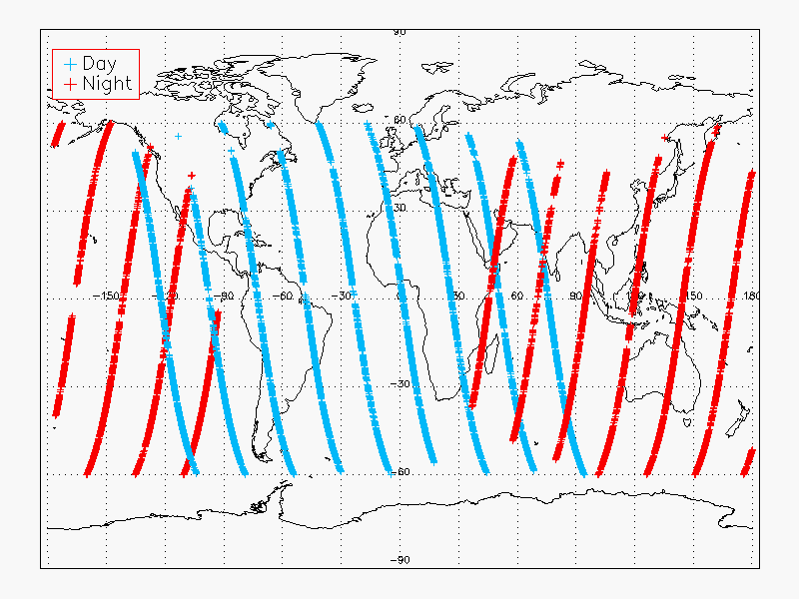
VIIRS-CALIOP Matchup Example
2012-11-10 VIIRS-CALIOP collocation
pixels restricted to 60N-60S

Slide 34
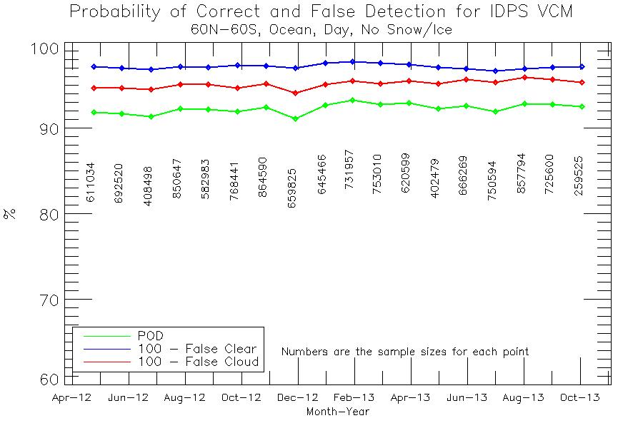
VIIRS-CALIOP Matchups Stats
Build 7.0/7.1
Build 6.3
Build 7.2
- New Build
- Provisional
- Thresholds Change

Slide 35
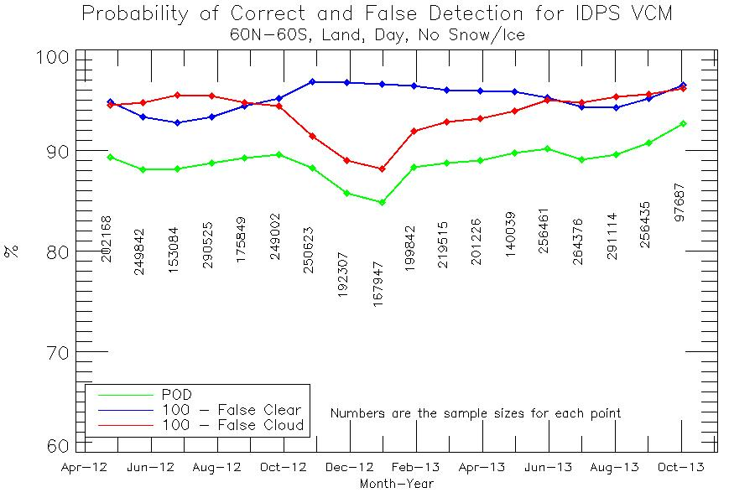
VIIRS-CALIOP Matchups Stats
Build 7.0/7.1
Build 6.3
Build 7.2
- New Build
- Provisional
- Thresholds Change

Slide 36
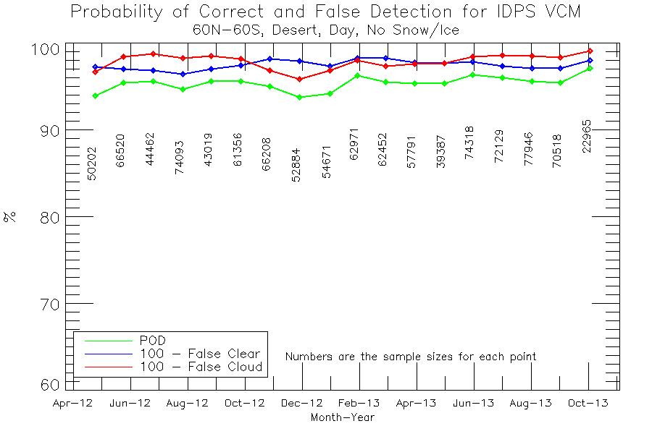
VIIRS-CALIOP Matchups Stats
Build 7.0/7.1
Build 6.3
Build 7.2
- New Build
- Provisional
- Thresholds Change

Slide 37
Summary of Match Up - Day
The performance over ocean surface is very consistent
30 day spin up addressed the major VCM issues over ocean
Sun glint is not included in these results
Land day steady improvement over the past year is from continued focus on NDVI
Drop in the winter of 2012 from snow/cloud challenges
These were addressed in Build 7.2, hence do not appear in 2013
Desert day also shows steady improvement
Latest update of the PCT in September appears to have pushed desert results to excellent values
Note barren regions in cold polar regions are treated as desert in the algorithm, but as land in the statistics

Slide 38
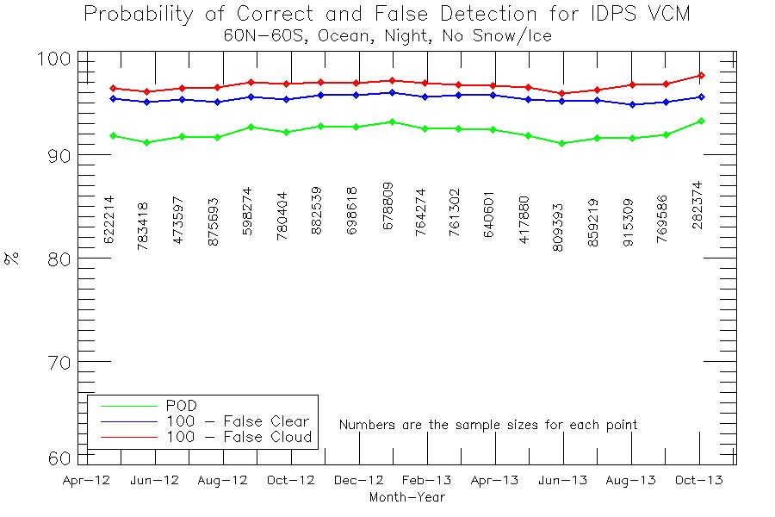
VIIRS-CALIOP Matchups Stats
Build 7.0/7.1
Build 6.3
Build 7.2
- New Build
- Provisional
- Thresholds Change

Slide 39
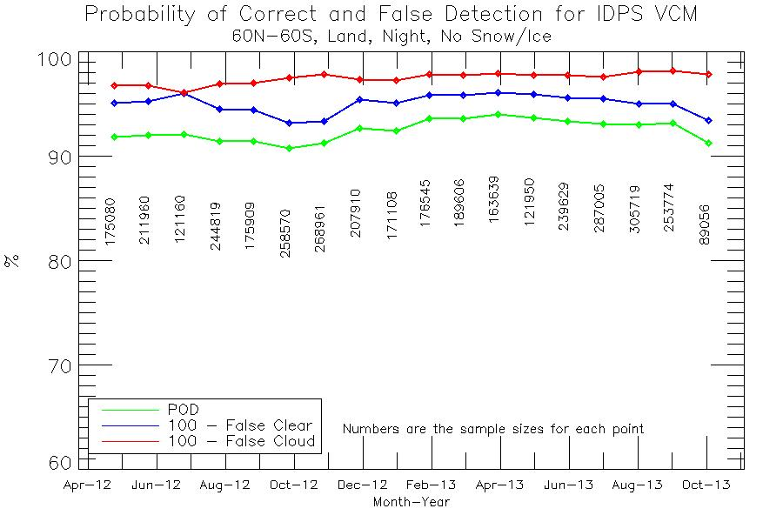
VIIRS-CALIOP Matchups Stats
Build 7.0/7.1
Build 6.3
Build 7.2
- New Build
- Provisional
- Thresholds Change

Slide 40
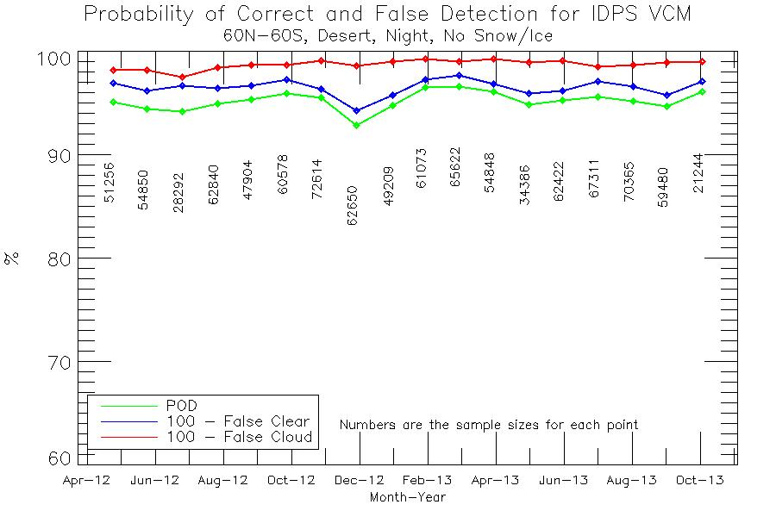
VIIRS-CALIOP Matchups Stats
Build 7.0/7.1
Build 6.3
Build 7.2
- New Build
- Provisional
- Thresholds Change

Slide 41
Summary of Match Up - Night
The performance over ocean surface is again very consistent
General feedback on night results over water have consistently been that the VCM is acceptable
Land night appears to indicate a seasonal tendency
Since NH has the majority of land locations, the results imply greater challenges in the autumn
This will be a focus for tuning in the coming weeks
Desert night performance has been strong since the 30 day spin up

Slide 42
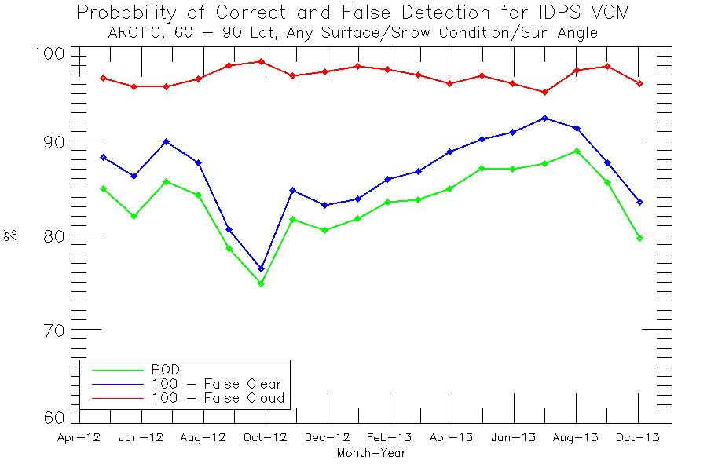
VIIRS-CALIOP Matchups Stats

Slide 43
Summary of Match-Up Results
Explaining all of the changes in the VCM performance is complicated in part due to a high dependence on ancillary data (NDVI, Snow, etc.)
In polar regions the performance is following the seasonal change, i.e. decreases during the winter season (a target for future improvement)
See DR list
Trending results over snow difficult due to the inability to unquestionably determine if the background has snow/ice or not
This situation has improved with the monthly update, and results will be generated in following validation stages
The significant effort to mitigate NDVI are evident

Slide 44
Quality Flags (1)
The VCM output is all contained in the form of Quality Flags (QFs)
As such, there are 31 (!) QFs that need to be verified in some fashion
All of the quantitative requirements go toward only one of the thirty-one QFs (Cloud Confidence)
Therefore the VCM team must have sufficient evidence that each of the other 30 QFs are acting as expected

Slide 45
Quality Flags (2)
The 30 remaining QFs may be broken down as follows:
Fixed background conditions (land/ocean, day/night)
Variable background conditions (snow, fire, glint)
Results of each of the individual cloud detection tests
This comprises 12 QFs
Cloud Phase
Degraded conditions (NDVI, polar night)
Miscellaneous required output (aerosol, cloud shadow)

Slide 46
Quality Flags (3)
After discussions with JPSS, especially DPA, it was agreed for the sake of this briefing to tie each QF to specific granule(s) that revealed the correctness of each QF
Examples are not needed for all 30
However examples will be shown for particular QFs
All but 6 of the QFs may be viewed through the use of a tuning tool developed by Aerospace
Every QF may be evaluated by Raytheon as part of their integration testing
Each QF output may be displayed during this process
Many statistics generated from Golden Granules apply VCM embedded QFs
Cited granules are in the form (d)yyyymmdd_(t)hhmm

Slide 47
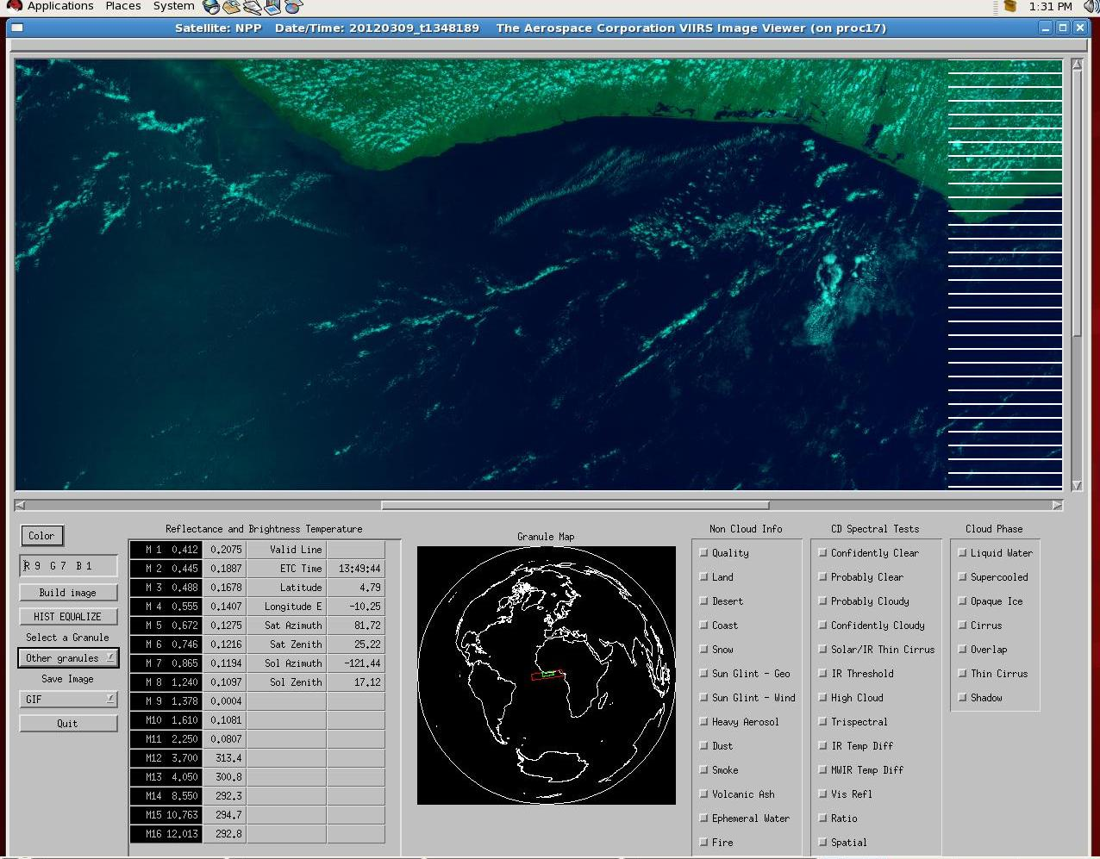
Aerospace Visualization Tool

Slide 48
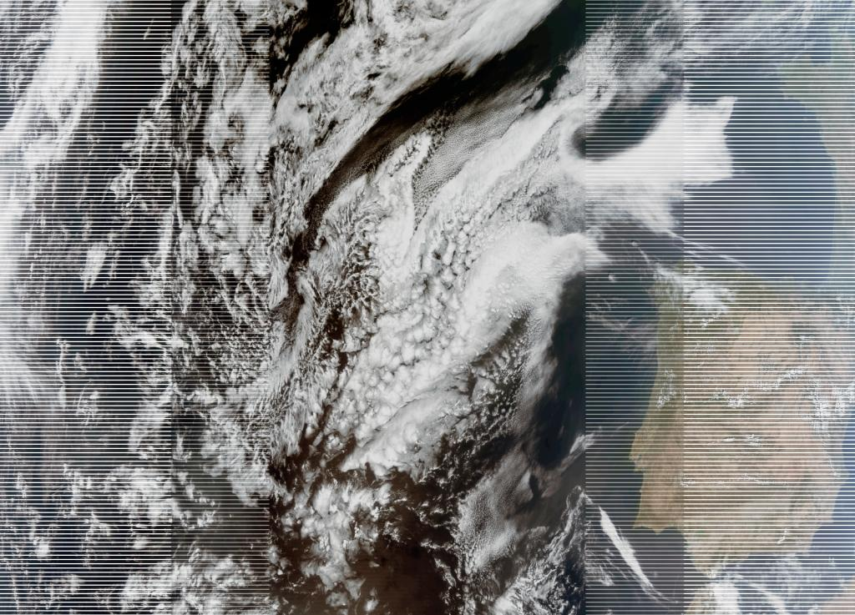
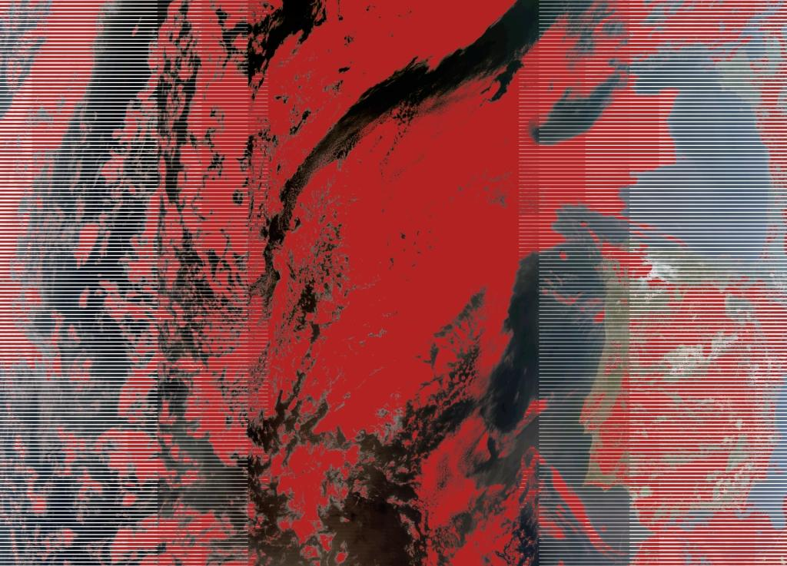
Aerospace Visualization Example
Example is East Atlantic/Spain, red is visual brightness test (QF)

Slide 49
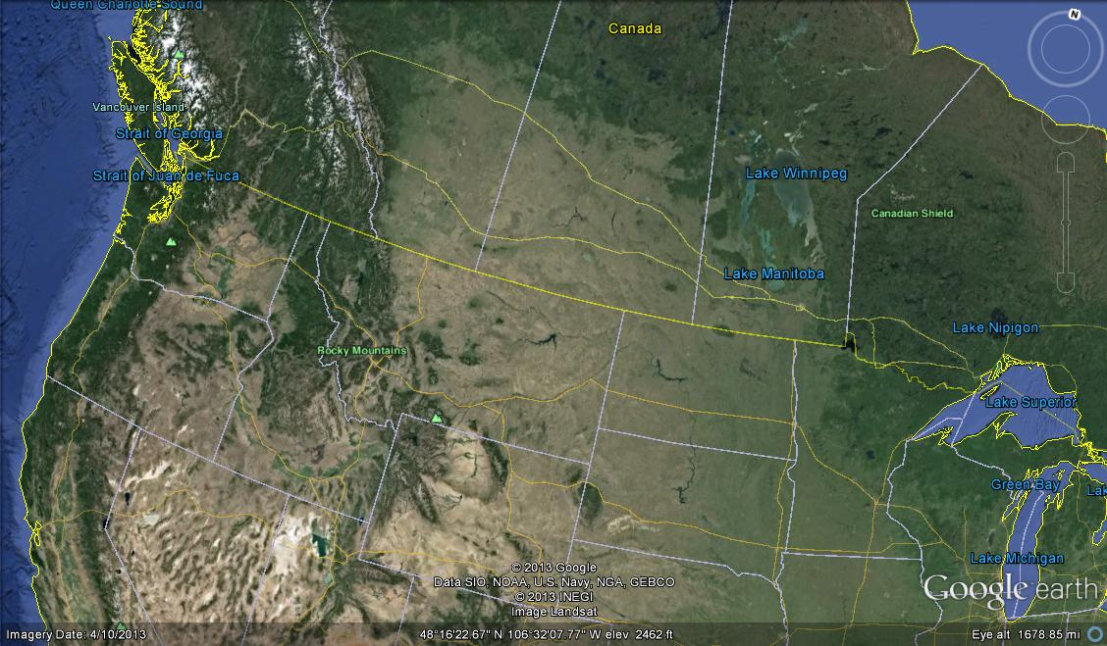
Raytheon Example (1)
Google Earth display of northwestern US, dark backgrounds across Idaho and west coast are boreal forest
Source: Raytheon Data Quality Library (DQL) Analysis and Visualization Toolkit

Slide 50
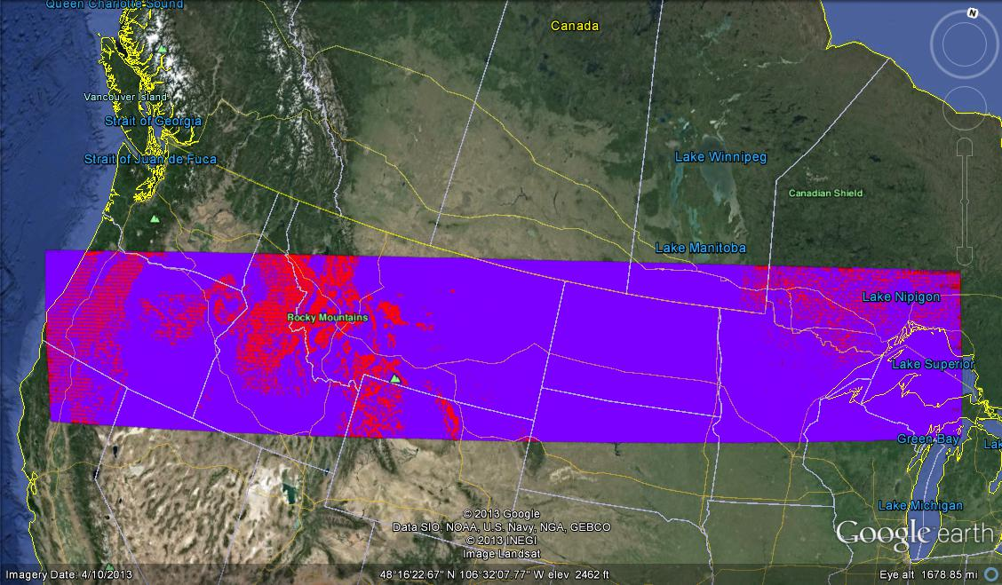
Raytheon Example (2)
Conifer Boreal Forest QF in the VCM, red is true for this QF
Source: Raytheon Data Quality Library (DQL) Analysis and Visualization Toolkit

Slide 51
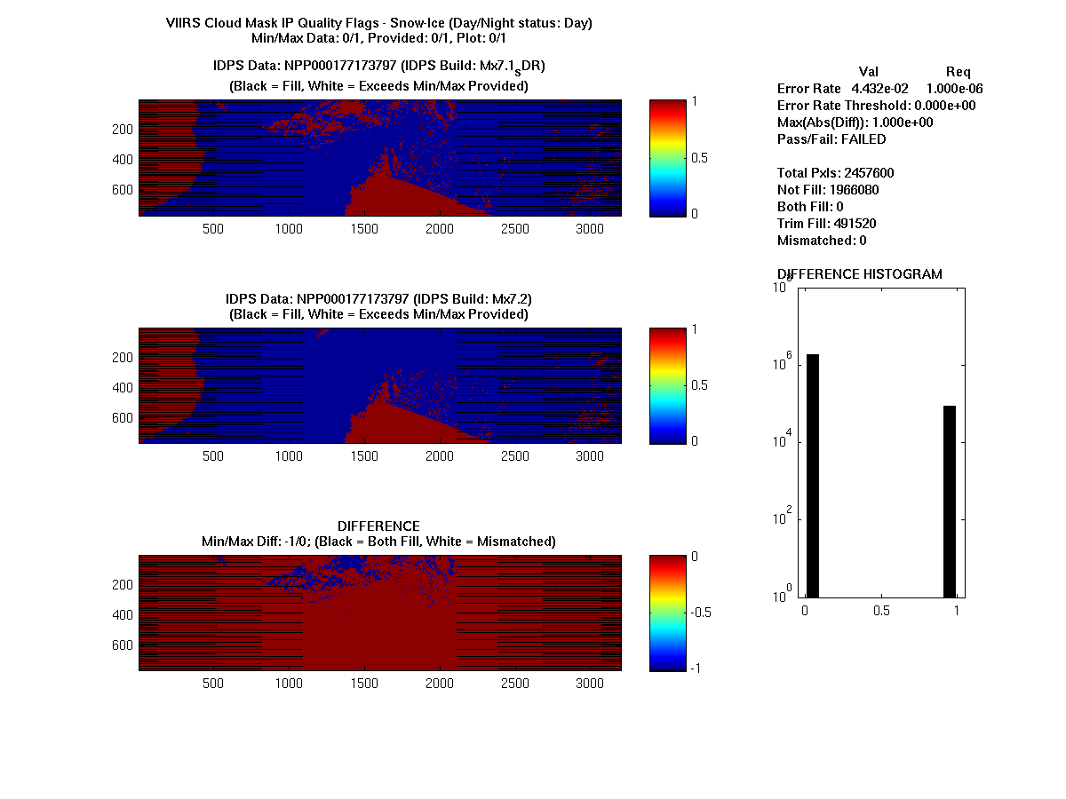
Raytheon Example (3)
Mx7.1
Mx7.2
Mx7.2 – Mx7.1
Source: Raytheon Data Quality Library (DQL) Analysis and Visualization Toolkit

Slide 52
QF Set 1 (Fixed Backgrounds)
Quality Flag | Output | General Location | Granules
Day/Night | Day (1) Night (0) | Any terminator | d20120515_t0129 (Norway)
Land/Water | Desert (0) Land (1) Inland Water (2) Sea Water (3) Coastal (5) | Any, but best with granules covering all types (India/Pakistan, American W. Coast) | d20130108_t0510 (China) d20130110_t1942 (Mexico) All GGs
Conifer Boreal Forest | True (1) False (0) | NW US, Canada, Russia | d20130123_t1905 (Canada) d20120515_t1949 (West US) GG #15

Slide 53
QF Set 2 (Variable Backgrounds)
Quality Flag | Output | General Location | Granules
Snow/Ice | Present (1) Not Present (0) | Greenland, Arctic Ocean/Alaska | d20120314_t1413 (Greenland) d20120515_t0129 (Norway) d20121024_t2051 (NW US) GG #1, 4, 6, 7, 12, 13, 14, 15
Sun Glint | None (0) Geometer Based (1) Wind Speed (2) Both (3) | Ocean where the latitude is close to where the sun is overhead | d20120313_t0219 (EQ. Pacific) d20130902_t0922 (Indian O.) GG #2, 9, 17
Fire | Yes (1) No (0) | Where there are fires (input is from the Fire product) | d20130616_t1204 (C. Africa) GG #9
Ephemeral Water | True (1) False (0) | Recent flooding | d20130718_t1838 GG #6

Slide 54
Snow Example
Granule is from May 2013 over the Midwest, this is how we identified incorrect snow logic that was corrected in Build 7.2

Slide 55
QF Set 3 (Individual Cloud Tests) - I
Quality Flag | Output | General Location | Granules
Cirrus (Solar M9) | Cloud (1) No Cloud (0) | Jet stream, convective outflow, Daytime only | d20130710_t1755 (Andes) d20130711_t0742 (Himalayas) d20120906_t2229 (C. Pacific) GG #5, 7, 10, 13, 14, 17
Cirrus IR (BTM15 – BTM16) | Cloud (1) No Cloud (0) | Jet stream, convective outflow | d20120319_t0752 (G. Lakes) d20120318_t1016 (C. Pacific) GG #18
IR Threshold (BTM15) | Cloud (1) No Cloud (0) | Any nighttime | d20120319_t0755 (SE USA) d20120318_t1001 (E. Pacific) GG – All nighttime
High Cloud (BTM12 – BTM16) | Cloud (1) No Cloud (0) | Nighttime over land | d20120319_t0752 (G. Lakes) GG #24, 28, 30, 31
IR Temperature Difference (BTM14 – BTM15) & (BTM15 – BTM16) | Cloud (1) No Cloud (0) | Oceans, especially tropical waters | GG #2, 5, 9, 16, 17, 22

Slide 56
QF Set 3 (Individual Cloud Tests) - II
Quality Flag | Output | General Location | Granules
Temperature Difference (BTM15 – BTM12) | Cloud (1) No Cloud (0) | Any except desert | d20130402_t2049 (Cal. Coast) d20130401_t0735 (Himalayas) d20120319_t0751 (S. Canada) GG #1, 3, 6, 7, 8, 9, 10, 15, 16
Temperature Difference (BTM12 – BTM13) | Cloud (1) No Cloud (0) | Any daytime outside of desert and glint | d20130402_t2047 (SW USA) d20130409_t1206 (Arctic) GG #2, 5, 7, 8, 9, 12, 13, 14, 16
Visible Reflectance (RM5) | Cloud (1) No Cloud (0) | Any daytime land, but not desert | d20130717_t0532 (Australia) d20130717_t1229 (Sahel) d20130401_t0732 (India) GG #5, 7, 13, 14, 16, 17
Visible Reflectance (RM1) | Cloud (1) No Cloud (0) | Any daytime desert | d20130717_t1232 (Sahara) d20130218_t1222 (Sahara) GG #2, 5, 7, 8, 11, 16
Visible Reflectance (RM1) | Cloud (1) No Cloud (0) | Any daytime ocean | d20120906_t1401 (E. Atlantic) d20120906_t2220 (C. Pacific) GG #1, 3, 4, 6, 9, 17
Visible Ratio (RM7/RM5) | Cloud (1) No Cloud (0) | Any daytime, no snow or desert | d20120906_t1402 (Spain) d20120906_t2229 (C. Pacific) GG #3, 6, 9, 10, 13, 14, 15, 16

Slide 57
QF Set 3 (Individual Cloud Tests) - III
Quality Flag | Output | General Location | Granules
Spatial Uniformity | True (1) False (0) | Any ocean | d20120906_t2222 (EQ. Pacific) d20120906_t0844 (Indian O.) GG #1, 3, 6, 16
Thin Cirrus Present | True (1) False (0) | Same as cirrus tests | d20130717_t1227 (EQ Africa) d20130218_t1222 (Sahel) d20120906_t2220 (C. Pacific) GG #2, 7, 10, 12, 15, 17

Slide 58
Example – Cirrus (1)
Granule is along the Chilean coast, 2 July 2013
Image is Red = M9, Green = M7, Blue = M1
Cirrus is indicated by a red shade, but the bright red to the right is the Andes

Slide 59
Example – Cirrus (2)
Same granule before and after tuning the cirrus test, results in green

Slide 60
QF Set 4 (Cloud Phase)
Quality Flag | Output | General Location | Granules
Cloud Phase | Not Executed (0) Clear (1) Probably Cloudy or Probably Clear (2) Water Phase (3) Mixed Phase (4) Opaque Ice (5) Cirrus (6) Overlap (7) | Any | See next slide

Slide 61
Cloud Phase Results (1)
 | > 0.0 | >0.1 | >0.2 | >0.3 | >0.4 | >0.5 | >2.0
All data | 0.687 | 0.785 | 0.815 | 0.826 | 0.831 | 0.836 | 0.823
daytime | 0.692 | 0.775 | 0.805 | 0.819 | 0.825 | 0.832 | 0.815
nighttime | 0.681 | 0.794 | 0.823 | 0.831 | 0.836 | 0.838 | 0.826
Over land | 0.639 | 0.709 | 0.732 | 0.744 | 0.754 | 0.760 | 0.740
Over water | 0.701 | 0.808 | 0.839 | 0.850 | 0.853 | 0.857 | 0.842
Lat > 60 deg | 0.648 | 0.693 | 0.717 | 0.728 | 0.734 | 0.739 | 0.744
Lat <60 deg | 0.695 | 0.807 | 0.839 | 0.849 | 0.855 | 0.860 | 0.843
This chart shows the fraction of VIIRS cloudy pixels (filtered by the CALIOP optical depth) with a cloud phase that agrees with the cloud phase of the highest cloud layer as determined from CALIOP. Data is from May 10, 2012. VCM is from Build 6.7

Slide 62
Cloud Phase Results (2)
 | > 0.0 | >0.1 | >0.2 | >0.3 | >0.4 | >0.5 | >2.0
All data | 0.771 | 0.830 | 0.848 | 0.855 | 0.857 | 0.858 | 0.822
daytime | 0.763 | 0.817 | 0.835 | 0.841 | 0.844 | 0.844 | 0.807
nighttime | 0.779 | 0.842 | 0.862 | 0.869 | 0.871 | 0.871 | 0.834
Over land | 0.785 | 0.826 | 0.846 | 0.855 | 0.856 | 0.856 | 0.797
Over water | 0.766 | 0.830 | 0.848 | 0.854 | 0.856 | 0.857 | 0.826
Lat > 60 deg | 0.805 | 0.834 | 0.838 | 0.839 | 0.837 | 0.835 | 0.784
Lat <60 deg | 0.763 | 0.828 | 0.850 | 0.851 | 0.862 | 0.863 | 0.831
This chart shows the fraction of VIIRS cloudy pixels (filtered by the CALIOP optical depth) with a cloud phase that agrees with the cloud phase of the highest cloud layer as determined from CALIOP. Data is from November 10, 2012.
VCM is the code that includes the latest scientific logic and thresholds as of ADL4.2 build Mx7.2.

Slide 63
QF Set 5 (Degraded Conditions)
Quality Flag | Output | General Location | Granules
Degraded: TOC NDVI (0.2 < NDVI < 0.4) | False (0) True (1) | Sahel, SW USA, Mexico, Australia | d20120515_t1946 (Australia) d20131015_t1243 (Sahel) GG #2, 8, 9, 16
Degraded: Sun Glint in Pixel | False (0) True (1) | Same as glint flag | d20120901_t1858 (G. Mexico) GG #2, 9, 17
Degraded: Polar Night | False (0) True (1) | Nighttime poleward of 60 degrees latitude | d20120515_t0716 (Antarctica) GG #24, 26, 28, 29, 30

Slide 64
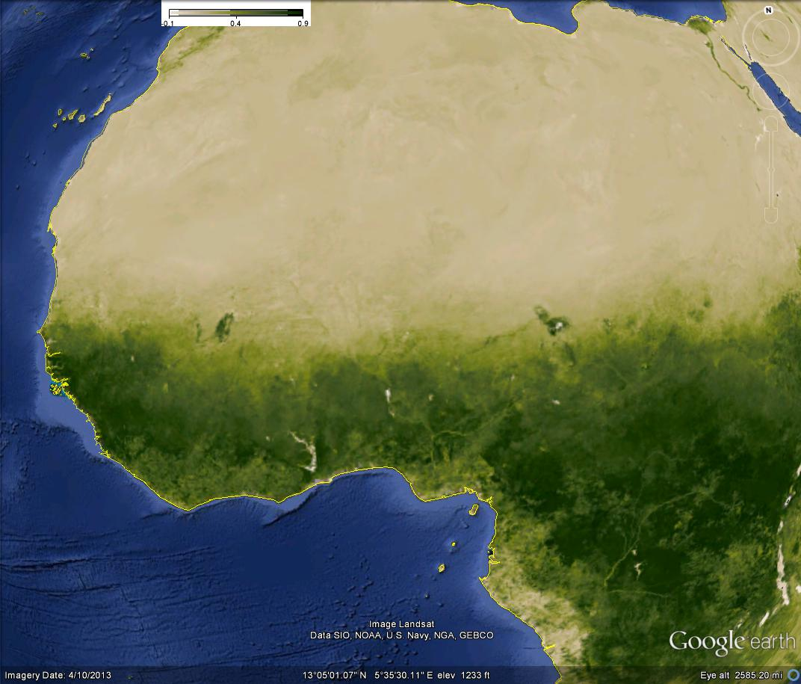
NDVI Degraded Example (1)
Source: Raytheon Data Quality Library (DQL) Analysis and Visualization Toolkit

Slide 65
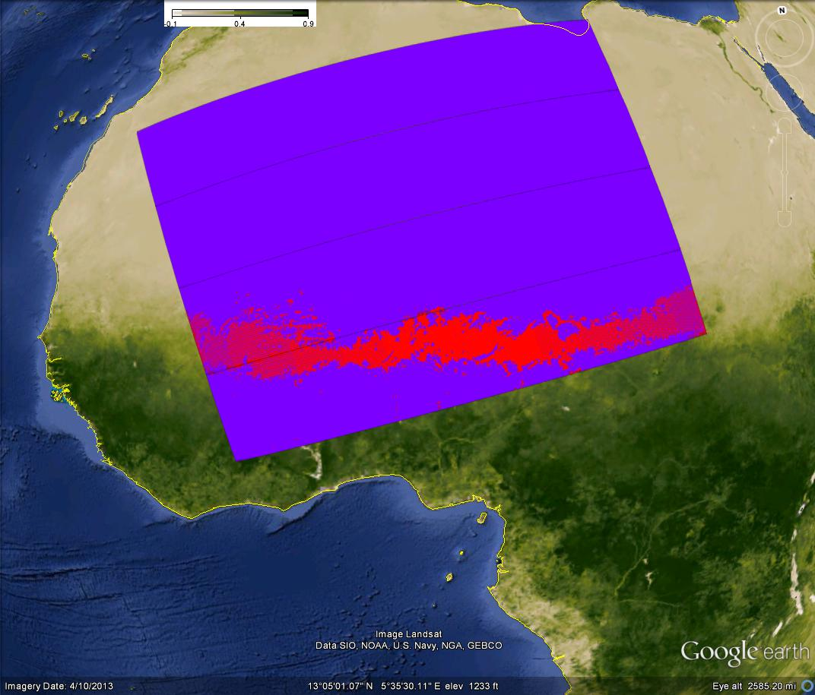
NDVI Degraded Example (2)
Red = True
Source: Raytheon Data Quality Library (DQL) Analysis and Visualization Toolkit

Slide 66
QF Set 6 (Required Conditions) - I
Quality Flag | Output | General Location | Granules
Cloud Mask Quality | Poor (0) Low (1) Medium (2) High (3) | Any with degraded conditions or known SDR errors | d20120309_t1214 (N. Africa)
Shadow Detected | No (0) Yes (1) | High clouds with sharp edges | GG – All daytime
Non Cloud Obstruction (Heavy Aerosol) | No (0) Yes (1) | Off the coast of NW Africa | d20120514_t1455 (E. Atlantic) GG #5, 8, 9
Adjacent Pixel Cloud Confidence | Confident Clear (0) Probably Clear (1) Probably Cloudy (2) Confident Cloudy (3) | Any | d20130804_t0658 (C. Asia)

Slide 67
QF Set 6 (Required Conditions) - II
Quality Flag | Output | General Location | Granules
Dust Candidate | False (0) True (1) |  | d20120514_t1455 (E. Atlantic) GG #5, 8, 9
Smoke Candidate | False (0) True (1) | Volcanoes, Fires | d20120514_t1455 (E. Atlantic) GG #5, 8, 9
Dust or Volcanic Ash | False (0) True (1) | See note below
Volcanic ash is not a requirement for the VCM under JPSS.
It was a requirement under NPOESS.

Slide 68
QF results
VCM team has reviewed all 31 Quality Flags
Tuning alone has shown the benefit of many of the QFs
Raytheon verifies QF output during integration testing
The Golden Granules have also generated results where individual QFs are applied
The overwhelming evidence supports the conclusion each QF is acting as it should

Slide 69
Input Comments (1)
The VIIRS SDRs have performed well from a VCM point-of-view
No striping or artifacts are regularly seen in the VCM due to SDR inputs
Note the VCM is able to adjust for known biases and increasing levels of noise when they occur
We have not had to do this since the 30-day spin up
The GFS input is acceptable but there are consequences from its resolution
The GFS 2-meter temperatures is adequate at night for the IR threshold or “cold” test
The 2-meter temperature is not adequate during the day for the same cloud detection test due to large temperature gradients along coastlines, which the GFS cannot capture
This was known before launch, so the test is not part of the current daytime approach of the VCM
DR 7407 addresses how the VCM team believes this should be accounted for
The humidity fields are adequate
Rare but sharp artificial cloud boundaries can occur when there is a sharp moisture gradient where one side of the gradient has very low values (e.g. Andes, Himalayas)

Slide 70
Input Comments (2)
The snow/ice input has been improved with the monthly updates and the improvements within the VCM implemented in Build 7.2
Since monthly updates are based on actual fields, not climatology, the snow/ice backgrounds are generally good but lag reality as much as 40 days
Build 7.2 vastly improved snow/ice/cloud discrimination in daytime granules such that the VCM now correctly identifies missing snow/ice from the ancillary data set
The VCM is not capable to correct snow/ice errors at night, so aging snow/ice fields will impact the VCM when real time has diverged from the most recent update
Sharp and unnatural cloud boundaries will be seen when this occurs

Slide 71
Input Comments (3)
The VCM depends upon the Normalized Difference Vegetation Index (NDVI) to define the thresholds for its visual brightness test
Beginning in February 2013, this devolved to a monthly climatology that updates on a 17-day rotation
Note the mismatch between the update cycle (17 days) and the climatology being applied
The consequence is the VCM will apply improper thresholds in locations where the actual NDVI deviates significantly from the climatological value
The VCM team has spent more of its tuning resources on minimizing these consequences than on any other aspect of the VCM over the past year
Note that any changes made to repair the areas with incorrect values can adversely effect where they are correct, so the ability to mitigate this issue is limited
Nevertheless, it has been sufficiently mitigated to meet requirements

Slide 72
NDVI impacts (1)
Granule is over central Australia. Circled area in the far right will be our focus

Slide 73
NDVI impacts (2)
Red is confidently cloudy. Missing cloud in the center bottom is obvious and tied to snow/cloud differentiation, but not as obvious is the excessive false alarms in the upper right

Slide 74
NDVI impacts (3)
Red is confidently cloudy. Build 7.2 fixes the missed cloud, but only tuning can address the issue in the upper right. Results in the circle are from the PCT update in September 2013. Situation is improved but not fully resolved. Any further adjustments negatively impact other areas where the NDVI values match the true surface

Slide 75
Requirement Based DRs - Closed
DRs closed since declaration of provisional:
DR 5039 – Water vapor consideration for M9
Build 7.1
DR 5038 – Cloud/Dust discrimination
Build 7.1
DR 4998 – Leakage feedback from Cal/Val teams
PCT updates
DR 7107 – Cloud/snow discrimination in the VCM
Build 7.2
DR 5040 – Isolated cloud artifacts in sun glint
PCT updates
DR 7143 – Threshold changes for cloud detection over desert (M1) and cloud phase
PCT updates
DR 7275 – Threshold adjustments for cloud detection over land and cirrus detection in dry atmospheres
PCT update

Slide 76
Requirement Based DRs – Open (1)
DR 7402: Missing cirrus in polar night
Major issue for ice EDRs
Being actively worked, delivery expected next month
DR 7403: Increasing coverage of M12 – M16
Impacts all nighttime EDRs
Test is being excluded in locations where it should not be
Being worked with DR 7402
DR 7404: Add moisture consideration for M12/M15 difference test
Impacts low cloud detection over cold surfaces at night
Being worked with DR 7402
DR 7405: Leakage over land at night (tuning #1)
The IR threshold test thresholds are too high
Will be included in next tuning update (Feb/Mar 2014)
DR 7406: Missed low cloud at night (tuning #2)
Thresholds for M12/M15 difference also need adjustments
Will be included in next tuning update (Feb/Mar 2014)

Slide 77
Requirement Based DRs – Open (2)
DR 7407: Add SST first-guess as input to the VCM
Addresses most critical issue for SST EDR (cloud edges)
Awaiting new field being added to the IDPS
DR 7408: Scattering angle adjustment to cloud phase
Impacts cloud EDRs
At extreme angles some striping in the cloud phase output has been seen
Being worked by AIT
DR 7409: Inconsistency in cloud confidence
Code is computationally correct but actual routine is different across subroutines doing the same calculation
To be addressed in late 2014
DR 7410: Aerosol improvements
Challenges have been identified in differentiating clouds from aerosols over land
Study underway by some aerosol members, solution TBD

Slide 78
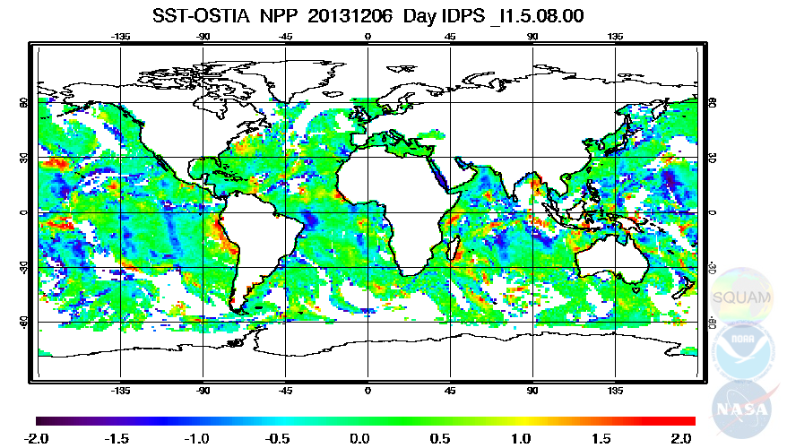
DR 7407 (SST)
2
3
1
Blue represents cold bias – potential cloud contamination
As the VCM team understand this, there are three sources of error
1) SST algorithm at edge-of-scan 2) aerosols 3) leakage

Slide 79
Requirement Based DRs – Open (3)
DR 7437: Issues with ephemeral water flag
Impacts cryosphere and aerosol EDRs
Ephemeral water being misidentified in cloud shadow
VCM is also changing its internal geography flag when ephemeral water is flagged
To be worked in the spring 2014
DR 7438: Leakage over cold desert
Low clouds are being missed during the day over polar, snow free, locations at extreme scattering angles
Issue has been tied to barren ground being treated as desert instead of land
To be worked spring 2014
DR 7240: Cloud over fires
The VCM is placing clouds over most fires due to large differences in the MWIR and LWIR temperatures
Root cause is known, but the fix requires a restructuring of the sequence of processes in the VCM
To be worked spring 2014 or later, depending on the final complexity and the priorities of other DRs

Slide 80
Requirement Based DRs – Open (4)
DR 7276 – Add viewing angle to Mid-Wave IR difference test
In Build 8.3
DR 7277 - Nighttime cloud confidence adjustments
In Build 8.3
DR 4903 – Snow discontinuity at 85 degrees solar angle
Root cause is complex, fix in discussion
DR 4326 – M12 minus M16 test adjustment
Replaced by DR 7403, but not yet formally closed
DR 7278 – Cloud detection in sun glint
Solution is the same as DR 7407

Slide 81
Version Control - Documents
All key documents are up-to-date
ATBD and OAD both match the operational Imagery product
The VCM ATBD is version C and in coordination
The VCM OAD is version B and up-to-date in the repository
The format of the VCM Intermediate Product or IP (CDFCB-X) has not changed since before launch
The format of the output is stable and not expected to change for Block 2.0
A User’s Guide has not been created for the VCM
To be produced as part of validation stage 2
A JGR article on the VCM is in its second review.
See the ATBD for a bibliography of articles covering many aspects of the VCM logic

Slide 82
Version Control - Code
The VCM IP software was last updated in Build 7.2 (20 August 2013)
The most recent Processing Coefficient Table (PCT) or tuning update was implemented on 24 September 2013 as CCR 1170
The timing of the VCM becoming validation stage 1 is timed with this PCT update
Snow is updated approximately once a month, and NDVI every 17 days
Snow updates go through the AERB, but NDVI updates are automated and do not
The VCM team keeps track of each of these events and sends monthly updates of the timing of each to the program
In this manner all non-daily updates to the VCM (e.g. GFS) are tracked for future reference
Therefore all software, PCT, and ancillary data is tracked and under configuration control

Slide 83
Users and Product Status
Six caveats may be found in the VCM “Read Me” file at the time provisional was declared
Dependency on two external fields (snow and NDVI) that were fixed values from 2002
Snow updated monthly as of January 2013
NDVI no longer a fixed field, updates occurring but only climatology actually applied
Difficulties differentiating low clouds from snow/ice
Resolved in the daytime with Build 7.2
Leakage, which remains a concern although the VCM is meeting requirements
Main concern is cloud edges, identified by three different Cal/Val teams
Results near edge-of-scan
Mitigated with implementation of scattering angle curves and adjustments to the related coefficients
Aerosol differentiation from clouds
Concern remains especially over land, as noted in the DR list
VCM performance at night over land/snow/ice
Also addressed in DRs, performance over snow/ice the primary focus of the next VCM software update (early February 2014)

Slide 84
Path Forward
Primary function of the validation team in the next few months is twofold
Complete tuning for nighttime scenes
Address specific concerns from VIIRS Cal/Val teams
Cloud edges over water
Excessive leakage over snow/ice, including polar night
Pursue quantitative validation of cloud phase and aerosol quality flags (validation stage 3)
Continue to interact and be responsive to other VIIRS EDR team needs
The VCM must continue to address items where the downstream EDRs believe improvement is needed for their products to reach validation stage 1

Slide 85
Conclusion
VCM has now achieved validation stage 2
All quantitative requirements have been met or exceeded
All documentation is up-to-date
User’s Guide has not been developed yet, but is not required for validation stage 2
All DRs related to JPSS requirements are closed
Work on the VCM is not complete
Leakage numbers are within requirements but certain downstream products need additional improvements
Polar regions need work
Many DRs still in place that should be resolved

