Slide 1


Supplemental Material for
Request for
VIIRS Cloud Properties
Beta Maturity
DR # 7154
CCR # 1075
DRAT discussion: 4/17/2013
AERB presentation: June 12, 2013
Cloud Properties Products Team
Andrew Heidinger, NOAA/NESDIS/STAR, Team Lead
Eric Wong, NGAS Cloud Algorithm Lead
Robert Holz, SSEC/PEATE Validation co-Lead
Janna Feeley, Cloud Products JAM

Slide 2
VIIRS Cloud Properties Product Cal/Val Core Team
NESDIS/STAR - A. Heidinger (Cloud Product Lead)
UW/CIMSS – R. Holz, A. Walther, M. Oo, D. Botambekov
Northrop Grumman – E. Wong
NASA/DPE – J. Feeley (JAM)
Raytheon – K. Brueske
ARM (Uni. Of Utah) – J. Mace, Q. Zhang
University Colorado St./CIRA – S. Miller, Dan Lindsey, Curtis Seeman, Y. Noh

Slide 3
Cloud Product Users
  U.S. Users
    AFWA – Air Force Weather Agency
    NOAA NWP (Stan Benjamin, Brad Ferrier)
    FNMOC
    NWS through JPSS PG
  User Community
    Navigation, Transportation
    Operational Weather Prediction
    Climate Research through NOAA CLASS.
    DOD

Slide 4
Beta EDR Maturity Definition
Early release product.
Minimally validated.
May still contain significant errors.
Versioning not established until a baseline is determined.
Available to allow users to gain familiarity with data formats and parameters.
Product is not appropriate as the basis for quantitative scientific publication studies and applications.
Goto: outline, p.2

Slide 5
Summary of Cloud Properties Product Requirements Based on JPSS L1RD Thresholds
Cloud Base Height
  Measurement Uncertainty = 2 km
Cloud Cover/Layers
  Total Cloud Cover Uncertainty (not applicable to layers) 0.1 + 0.3*sin(sensor zenith Angle) of HCS Area
Cloud Effective Particle Size
  Precision & Accuracy: 22% for Water; 28% for Ice ( or 1 μm whichever larger)
Cloud Optical Thickness (τ)
  Precision = 33%; Accuracy = 24% ( or =1 τ , whichever larger for both Prec. & Acc.)
Cloud Top Height
  Precision = 1 km; Accuracy = 1 km ( both increased to 2 km for thin clouds, i.e. τ < 1 )
Cloud Top Pressure
  Precision & Accuracy: 100 mb (0-3km); 75 mb (3-7 km); 50 mb (> 7km)
Cloud Top Temperature
  Precision & Accuracy = 3 K ( both increased to 6 K for thin clouds, i.e. τ < 1 )

Slide 6
Summary of the VIIRS Cloud EDR
VIIRS Cloud Products generated from 6 algorithms.
  Daytime Cloud Optical Properties
  Daytime and Night Cloud Top Properties
  Perform Parallax Correction
  Cloud Cover Layers
  Cloud Base Height
Products are
  optical depth
  effective particle size,
  top-temperature,
  top-pressure
  top-height
  cover by layer (up to 5 values)
  base height
Channels used (7 M-bands, M5,M8,M10,M12,M14,M15,M16)
Important sensitivities
  Surface albedo and emissivity
  Clear-sky radiative transfer
  Cloud mask and phase errors are hard to recover from
Goto: outline, p.2

Slide 7
VIIRS Daytime Cloud IP Flow
VIIRS SDR
COP LUT
NWP Moisture Profiles
Upstream Input
Algorithm
Ancillary Data
Output
VIIRS Cloud Mask
Day Cloud Optical and Properties Algorithm
Optical Depth IP,
Particle Size IP
VIIRS Cloud Phase
Cloud Top Temperature IP
Cloud Top Height and Pressure IP
Day Cloud Top Properties Algorithm (includes day water module)
Temperature to Height/Pressure Conversion Logic
Parallax Correction Algorithm
NWP Profiles
OSS Clear-sky & Cloud RTM (day water only)
Cloud Cover Layers Algorithm
Cloud Cover Layers IP
Cloud Base Algorithm
Cloud Base IP
Notes:
Ancillary
GFS forecast surface pressure, lapse rate, and air temperature (for topography corrected surface pressure)
Look-up tables
DEM for surface altitude
Infrared and Microwave OSS coefficients
Local Angle Correction
IR emissivity and reflectivity covariance
MW emissivity covariance
AVTP and AVMP and Ozone covariance

Slide 8
VIIRS Nighttime Cloud IP Flow
VIIRS SDR
IR Parameterizations
IR Clear-sky PFAAST RTM
Upstream Input
Algorithm
Ancillary Data
Output
VIIRS Cloud Mask
Night Cloud Optical & Top Temperature Algorithm
Cloud Optical Depth, Particle Size, Cloud Top Temperature IP
VIIRS Cloud Phase
Cloud Top Temperature, Top Height and Top Pressure IP
Night Cloud Top Properties Algorithm
GFS Profiles
Temperature to Height Conversion Logic
Parallax Correction Algorithm
Cloud Cover Layers Algorithm
Cloud Cover Layers IP
Cloud Base Algorithm
Cloud Base IP
Notes:
Ancillary
GFS forecast surface pressure, lapse rate, and air temperature (for topography corrected surface pressure)
Look-up tables
DEM for surface altitude
Infrared and Microwave OSS coefficients
Local Angle Correction
IR emissivity and reflectivity covariance
MW emissivity covariance
AVTP and AVMP and Ozone covariance

Slide 9
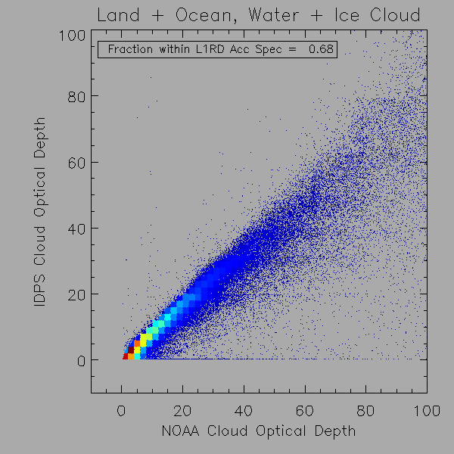
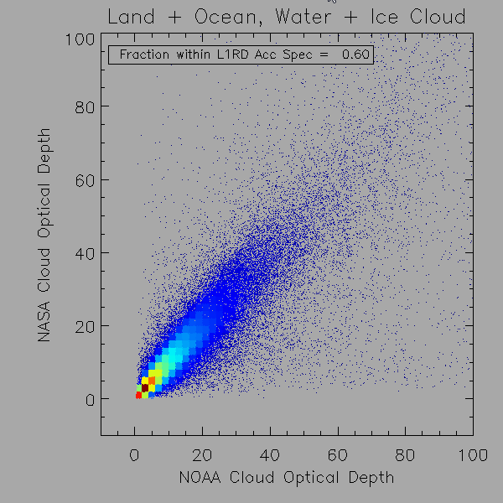


Methods to Compare IDPS to NOAA and NASA Products
(Impact of Phase Filter)
We conducted three types of analysis
  Colocated IDPS/VIIRS and NASA/MODIS over many days (left)
  IDPS/VIIRS and NOAA/VIIRS for one day where we excluded pixels with different phases (right image). Note we also include NOAA vs. NASA on MODIS for reference.
  CALIPSO/CALIOP comparison to IDPS CTP. (shown later)
We feel #2 is a better judge of the algorithm in isolation and is the basis for our beta decision. #1 represents the impact of all components and will be looked at more in future validation decisions.
Filtered by Phase Agreement
No Filter by Phase Agreement

Slide 10
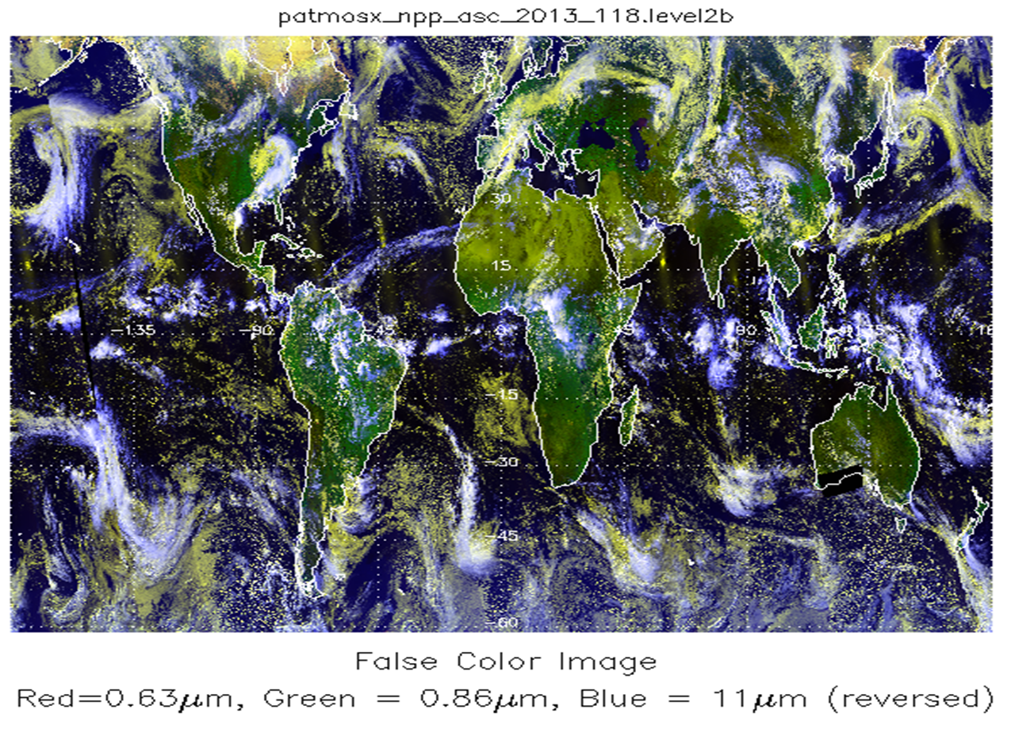
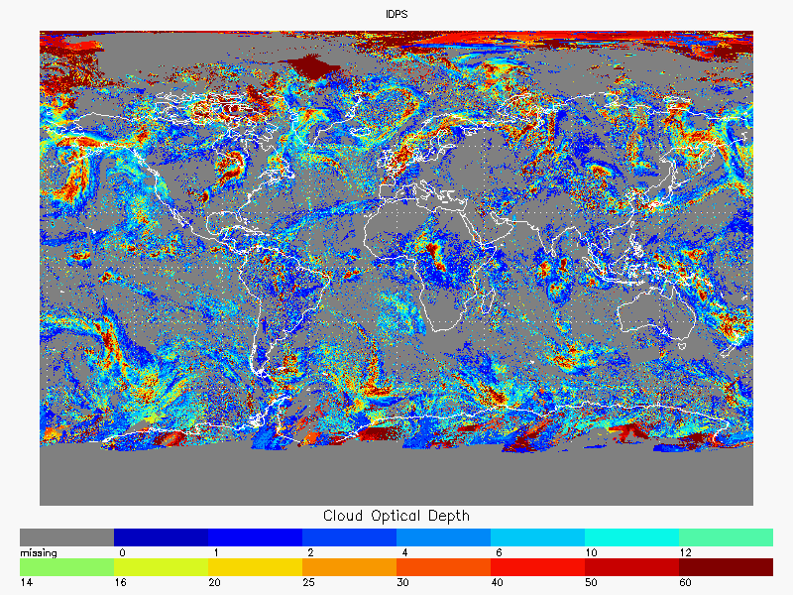
Comparison to NOAA VIIRS Products
Data analyzed was from April 28, 2013 – two days after COP LUT update.
NOAA products generated from IDPS VCM data (mask and phase errors are excluded).
NOAA VIIRS data based on modifications of GOES-R AWG code.
QF flags ignored.
No penalty for failed retrievals.
Granules mapped to globe at 0.1º resolution. Most nadir view taken in regions of orbital overlap.
Snow and ice covered areas ignored.
Same analysis applied to MODIS and NOAA algorithms applied to TERRA/MODIS data. Useful reference in gauging NOAA vs IDPS results.
MODIS is C5 ATML2 (C6 is coming)
L1RD accuracy specification made relative to NOAA, not an independent validation source.

Slide 11
Cloud Optical Thickness (COT) is defined as the optical thickness of the atmosphere due to cloud droplets, per unit cross section, integrated over each and every distinguishable cloud layer, in a vertical column above a horizontal cell on the Earth’s surface

Slide 12
Optical Depth Comparison
Plots show a scatterplot. Color represent density. Red is high, dark blue is low density.
Good correlation of IDPS with NOAA. 68% of IDPS within L1RD spec relative to NOAA.
Tighter but less symmetric scatter seen between IDPS and NOAA, than NOAA and NASA

Slide 13
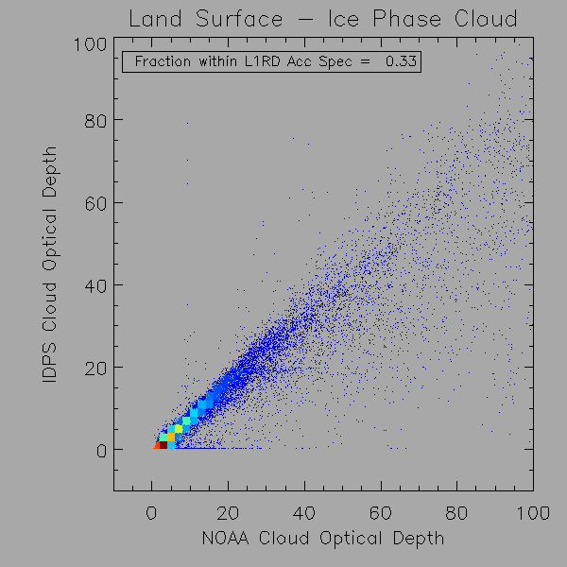
Comparison of VIIRS Day Ice COT with NOAA COT under Land background (by UW/CMISS)
Good comparison with NOAA COT
33 % pixels of VIIRS day ice COT within L1RD accuracy requirement
Scatter due to large variation of land surface albedos

Slide 14
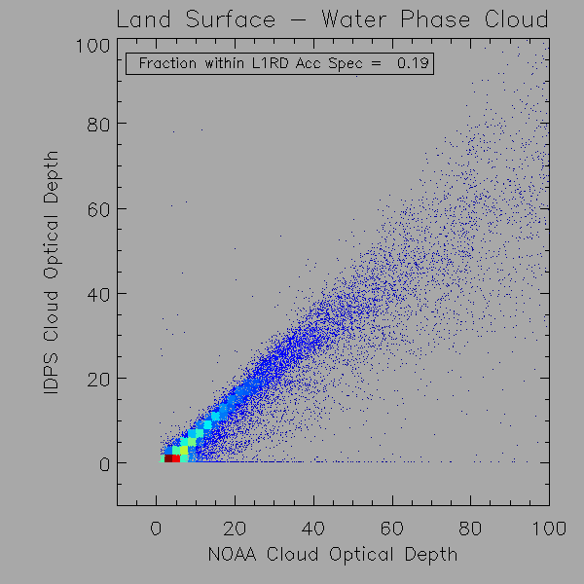
Comparison of VIIRS Day Water COT with NOAA COT under land background (by UW/CMISS)
Reasonable good comparison with NOAA COT
19 % pixels of VIIRS Day Water COT within L1RD accuracy requirement
Scatter due to large variation of land surface albedos

Slide 15
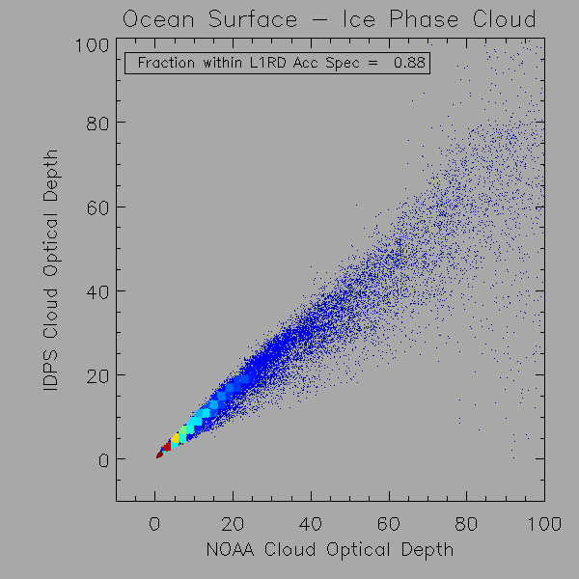
Comparison of VIIRS Day Ice COT with NOAA COT under ocean background (by UW/CMISS)
Good comparison with NOAA COT
88 % pixels of VIIRS day ice COT within L1RD accuracy requirement
Small scatter due to near constant ocean surface albedos

Slide 16
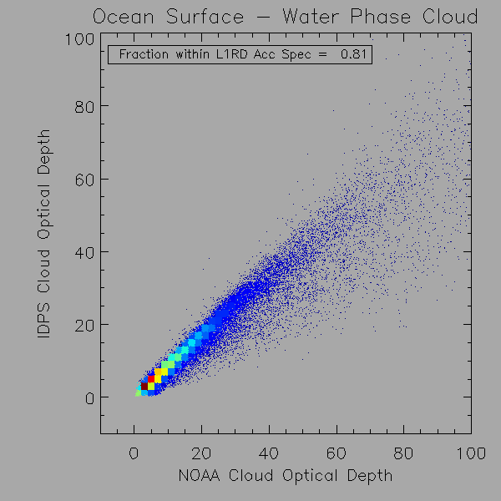
Comparison of VIIRS Day Water COT with NOAA COT under ocean background (by UW/CMISS)
Good comparison with NOAA COT
81 % pixels of VIIRS day water COT within L1RD accuracy requirement
Small scatter due to near constant ocean surface albedos

Slide 17
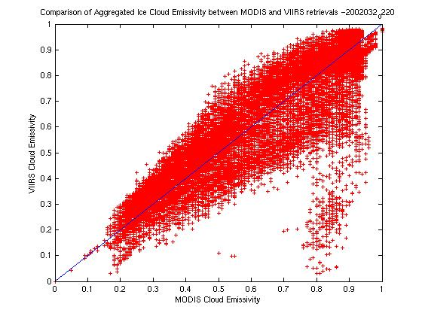
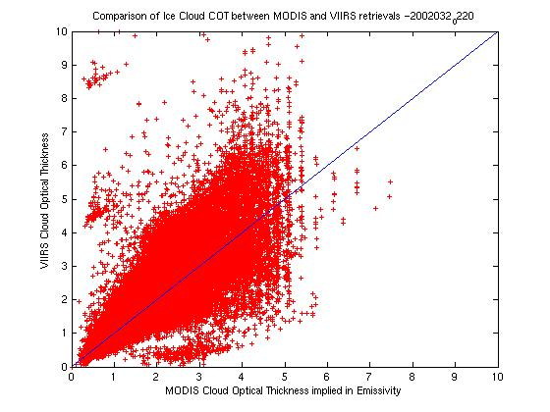
Comparison of Night Ice COT with MODIS Night COT Implied from Cloud Emmissivity Product (By NG)
VIIRS Night Ice cloud COT performance estimate:
  Average Accuracy ~ 20%
  Average Precision ~ 40%
Night water cloud COT performs poorly due the 2 errors found in code: (1) sensor zenith angle not accounted for; (2) a factor used during algorithm testing not removed

Slide 18
Cloud Effective Particle Size (CEPS) is a representation of the cloud particle size distribution. The effective particle size or effective particle radius is defined as the 3rd moment of the drop size distribution to the 2nd moment, averaged over a layer of air within a cloud. For ensembles of irregular shaped particles such as ice crystals, the exact mathematical relationship between size distribution and effective radius is somewhat obscure, since a radius is not well defined.

Slide 19
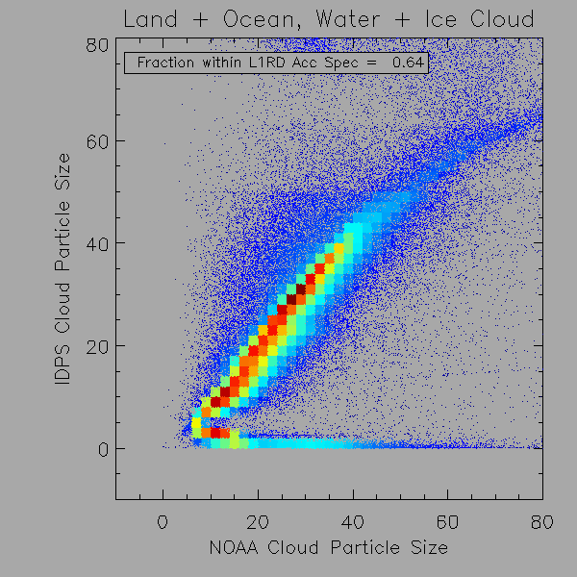
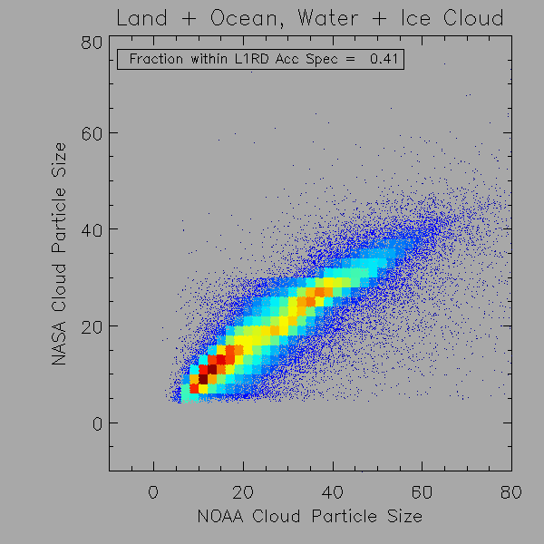
Cloud Effective Particle Size Comparison
Good correlation of IDPS with NOAA. 64% of IDPS within L1RD spec relative to NOAA.
Cluster of points with very small CEPS from IDPS is still a problem and is being investigated. These are failed IDPS retrievals over land (QF would catch this)
Higher correlation of NOAA with NASA than IDPS and NOAA. C5 CEPS < C6 CEPS

Slide 20
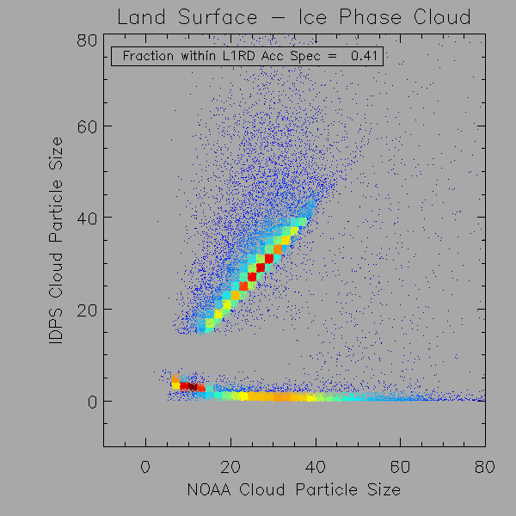
Comparison of VIIRS Day Ice CEPS with NOAA CEPS under Land background (by UW/CMISS)
Reasonably good comparison with NOAA CEPS
41 % pixels of VIIRS day ice CEPS within L1RD accuracy requirement
Scatter due to large variation of land surface albedos

Slide 21
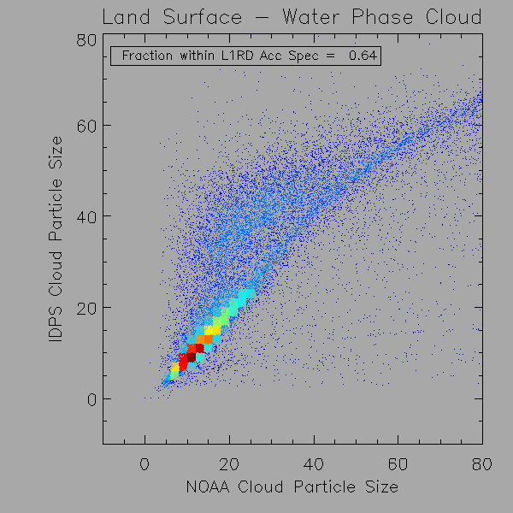
Comparison of VIIRS Day Water CEPS with NOAA CEPS under land background (by UW/CMISS)
Reasonably good comparison with NOAA CEPS
64 % pixels of VIIRS day water CEPS within L1RD accuracy requirement
Scatter due to large variation of land surface albedos

Slide 22
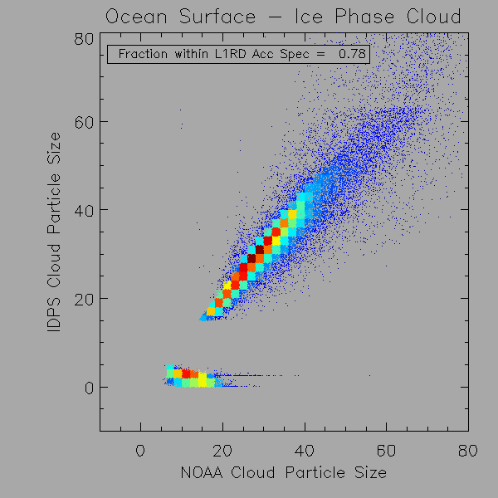
Comparison of VIIRS Day Ice CEPS with NOAA CEPS under ocean background (by UW/CMISS)
Good comparison with NOAA CEPS
78 % pixels of VIIRS day ice CEPS within L1RD accuracy requirement
Smaller scatter due to near constant ocean surface albedos

Slide 23
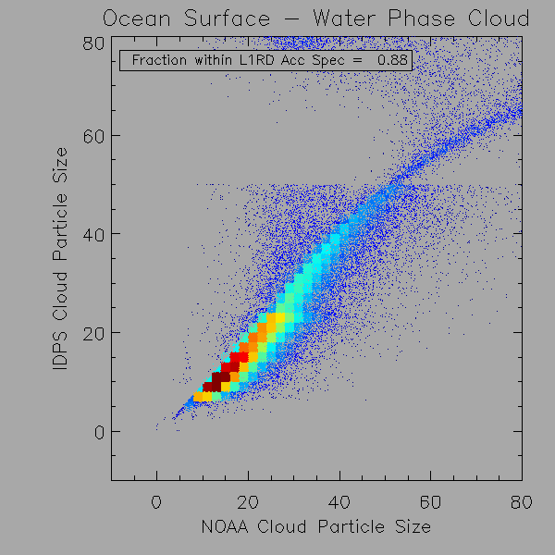
Comparison of VIIRS Day Water CEPS with NOAA CEPS under ocean background (by UW/CMISS)
Good comparison with NOAA CEPS
88 % pixels of VIIRS day water CEPS within L1RD accuracy requirement
Smaller scatter due to near constant ocean surface albedo

Slide 24
Direct Comparison to NASA MODIS Products
The UW NPP Atmospheric PEATE has developed tools to co-locate VIIRS and MODIS.
These comparisons as shown do not stratify by phase and therefore show a “true” comparison.
These comparisons include errors in phase assignment.
As a consequence, the agreement is much less than that seen in the previous NOAA vs IDPS analysis but same features are evident.
Full presentation includes stratification by Cloud Top Temp.

Slide 25
VIIRS-MODIS Collocation
The Co-located VIIRS-MODIS matchups Cloud Optical Thickness and Effective Particle Size over Land and Ocean
MODIS (C005.1 1km) and VIIRS (IP) IVCOP are matchup in 5 minutes temporal resolution
3 Cloud Top Temperature threshold (<233.16, >253.16 and >273.16) are used to define cloud phase
Julian days: 120,122,123,125,128,130,131 and 133 of 2013

Slide 26
VIIRS-MODIS COT comparison
Number of sample= 234 mills
Both Ice and water cloud
Color bar shows number density in log scale ( example: 3 =1,000)

Slide 27
VIIRS-MODIS COT comparison
Number of sample= 56 mills
Phase = Ice
CTT< 233.16
Mean bias=1.94
STD=45.78
CORRCOEF=0.422
Uncertainty=45.85
Mean bias= mean of (VIIRS COT – MODIS COT)
Uncertainty = root mean square error (or mean bias)

Slide 28
VIIRS-MODIS COT comparison
Number of sample= 113 mills
Phase = Ice/water
CTT> 253.16
Mean bias=20.34
STD=89.89
CORRCOEF=0.312
Uncertainty=93.08

Slide 29
VIIRS-MODIS COT comparison
Number of sample= 44 mills
Phase = water
CTT> 273.16
Mean bias=3.20
STD=28.66
CORRCOEF=0.48
Uncertainty=28.87

Slide 30
VIIRS-MODIS EPS comparison
Number of sample= 213 mills
Both Ice and water cloud
Color bar shows number density in log scale ( example: 3 =1,000)

Slide 31
VIIRS-MODIS EPS comparison
Number of sample= 52 mills
Phase = Ice
CTT< 233.16
Mean bias=4.99
STD=20.91
CORRCOEF=0.389
Uncertainty=21.42

Slide 32
VIIRS-MODIS EPS comparison
Number of sample= 101 mills
Phase = Ice/water
CTT> 253.16
Mean bias=8.16
STD=27.73
CORRCOEF=0.295
Uncertainty=29.12

Slide 33
VIIRS-MODIS EPS comparison
Number of sample= 37 mills
Phase = Water
CTT> 273.16
Mean bias=8.94
STD=32.51
CORRCOEF=0.197
Uncertainty=33.83

Slide 34
VIIRS-MODIS COT comparison
Number of sample= 234 million
Both Ice and water cloud
Color bar shows number density in log scale ( example: 3 =1,000)

Slide 35
VIIRS-MODIS EPS comparison
Direct Comparison to NASA MODIS Products
Number of sample= 213 million
Both Ice and water cloud
Color bar shows number density in log scale ( example: 3 =1,000)

Slide 36
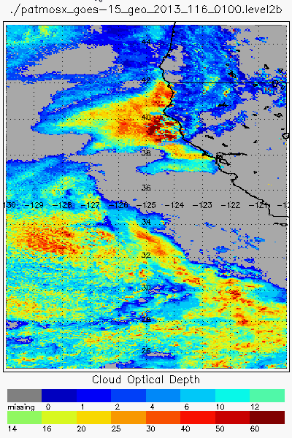
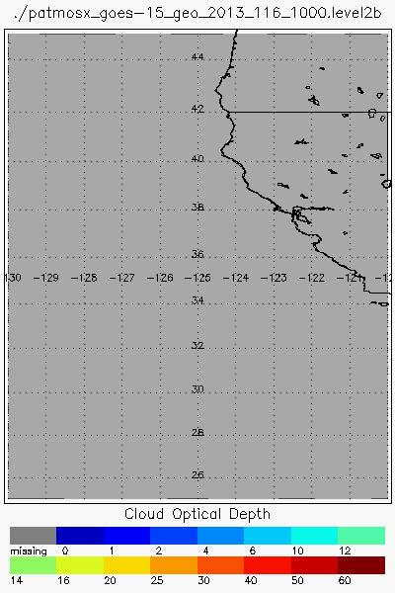
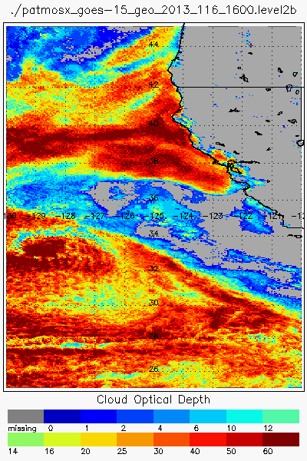
Qualitative Assessment of VIIRS Nighttime COP based on comparisons with GOES results over Marine Stratus (known dirunal cycle)
The images below show the GOES-R AWG Daytime Cloud Optical Properties (DCOMP) applied to GOES-15. The data is cloud optical depth which is related to the mass of the cloud.
Image on the left is at 6:00 PM local (Evening), image on the right is at 9AM local (Morning) on April 26, 2013.
Image in the middle is at 2 AM local (Night), where there is no sunlight and no DCOMP results from GOES (this is the gap).
Stratus clouds tend to grow through the night in both coverage and mass.
GOES-15 Evening
GOES-15 Night
GOES-15 Morning
Nighttime

Slide 37
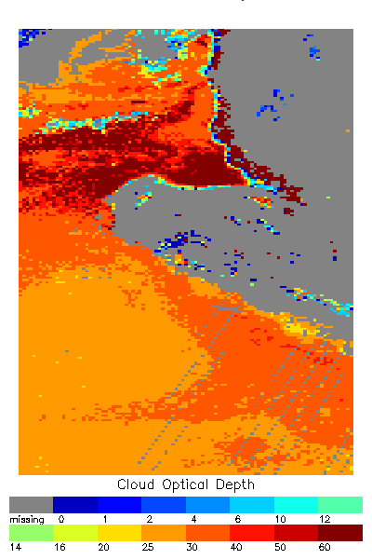
The left and right are the same GOES data shown previously
VIIRS IR channels do provide information to allow for a retrieval and the center image shows the cloud optical depth from the official IDPS product from VIIRS at 2:00 am local.
IR retrievals struggle to retrieve optical depths above 4 with skill and the lack of thermal contrast with low clouds also poses problems for IR retrievals.
The IR VIIRS cloud optical depths do not seem to be consistent with the GOES results and the expected diurnal behavior of the stratus clouds.
GOES-15 Evening
IDPS VIIRS IR Night
GOES-15 Morning
Bowtie Gaps

Slide 38
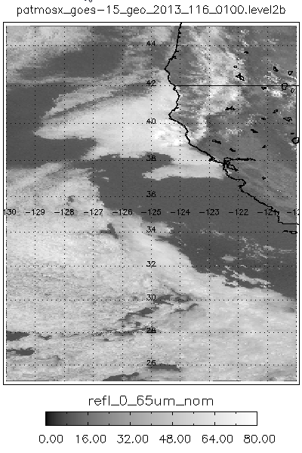
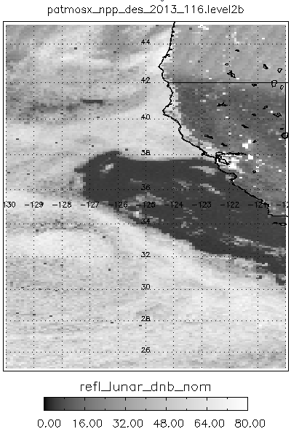
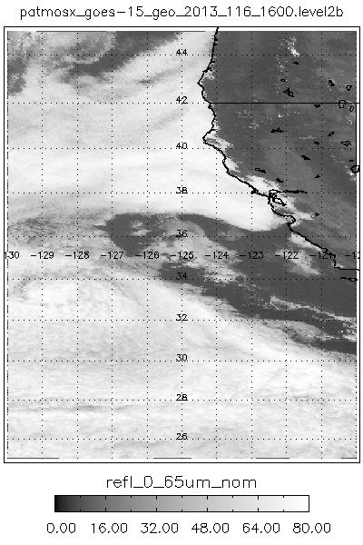
Comparison to Experimental NOAA VIIRS DNB Retrievals
The VIIRS DNB offers daytime like capabilities when sufficient moon-light is present.
The images below show the GOES 6 pm (left), GOES 9 am (right) and VIIRS-DNB (center) visible reflectance images. Note the presence of city lights in the VIIRS DNB.
Cloud detection and phasing is also being modified to exploit the DNB.
GOES-15 Evening
VIIRS DNB Night
GOES-15 Morning
city lights

Slide 39
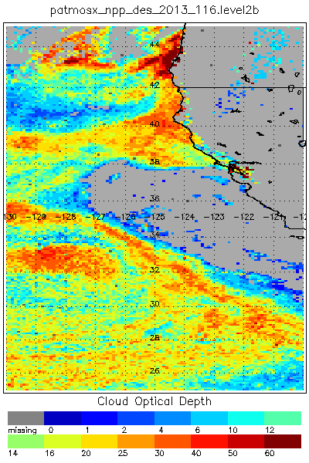
Comparison to Experimental NOAA VIIRS DNB Retrievals
We have developed the Nighttime Lunar Cloud Optical Properties (NLCOMP) to derive cloud properties at night and these properties include cloud optical depth (center image).
Note, the consistency from the NLCOMP results with the GOES results is much greater than with the IR-only IDPS results. Nighttime COP bug fixes will help improve these comparisons (TBD).
Our sensitivity studies shows similar day-time performance for optical depth and similar day-time performance for particle size for many cloud types. There is a null-point where scattering and transmission effects reduce the sensitivity to particle size for certain clouds.
GOES-15 Evening
VIIRS DNB Night
GOES-15 Morning

Slide 40
Plans and Issues with Cloud Optical Properties – including Cloud Optical thickness and Cloud Effective Particles Size
Need to reduce errors for Night COP – improve on the parameterization equations used in the IR method.
Need to correct 2 algorithmic errors found in the Night Water COP algorithm – inconsistent to ATBD, they must be fixed
Need to reduce CTH bias by reducing errors in CTT retrieval performed in COP – improve on the parameterization equation characterizing the extinction coefficient ratio of 2 IR bands

Slide 41
Conclusions: Cloud Optical Properties
The VIIRS Cloud Optical Properties EDRs (including COT and CEPS EDR) have met the Beta Maturity stage based on the definitions and the evidence shown
  It meets or exceeds the definition of Beta in most cases
  The product performance for day conditions is close to meeting requirements at this time.
  The product performance for night conditions is not meeting requirements at this time pending issues to be resolved
Issues have been uncovered during validation of the VIIRS Cloud Optical properties Product and solutions will be evaluated.
  Identified problems are related to the night COP algorithms
  Revised k-ratio parameterization equation is needed to remove bias in CTH, a product derived from CTT calculated in COP algorithm

Slide 42
Cloud Top Pressure (CTP) is defined for each cloud-covered Earth location as the set of atmospheric pressures at the tops of the cloud layers overlying the location

Slide 43
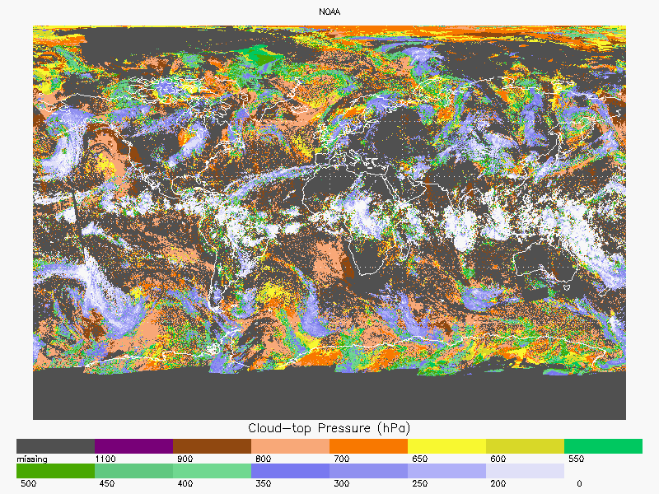
Global Cloud Top Pressure From NOAA GOES-R Cloud Product

Slide 44
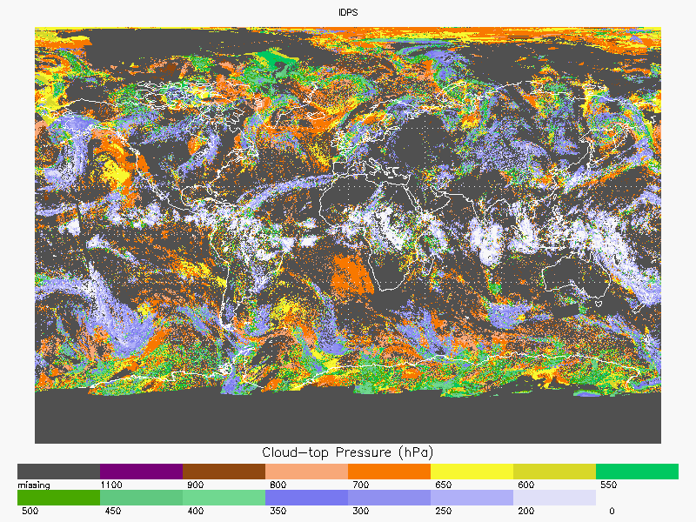
Global Cloud Top Pressure From NPP VIIRS Cloud Product

Slide 45
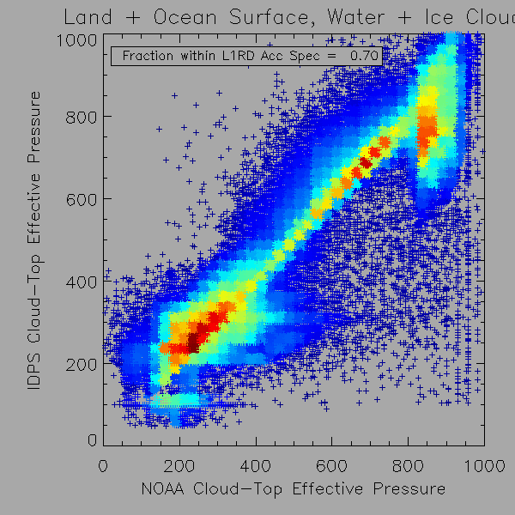
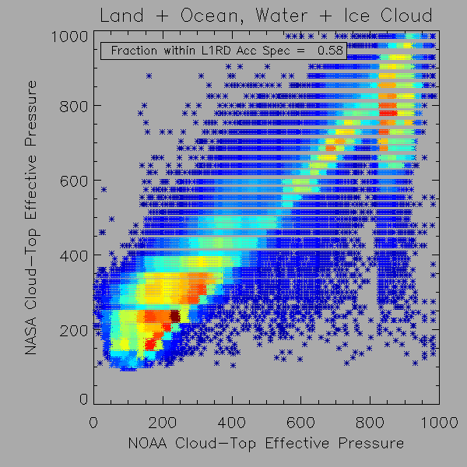
Cloud Top Pressure Comparison
Good correlation of IDPS with NOAA. 64% of IDPS within L1RD spec relative to NOAA.
IDPS shows a cluster of Tropopause solutions that is being investigated.
Both IDPS and NASA show lower pressures for marine clouds than NOAA. NOAA implemented marine stratus fix, NASA and IDPS will do this.
NASA is likely much better than NOAA which uses VIIRS channels from MODIS (no CO₂)

Slide 46
Cloud Top Height (CTH) is defined for each cloud-covered Earth location as the set of heights above sea level of the tops of the cloud layers overlying the location

Slide 47
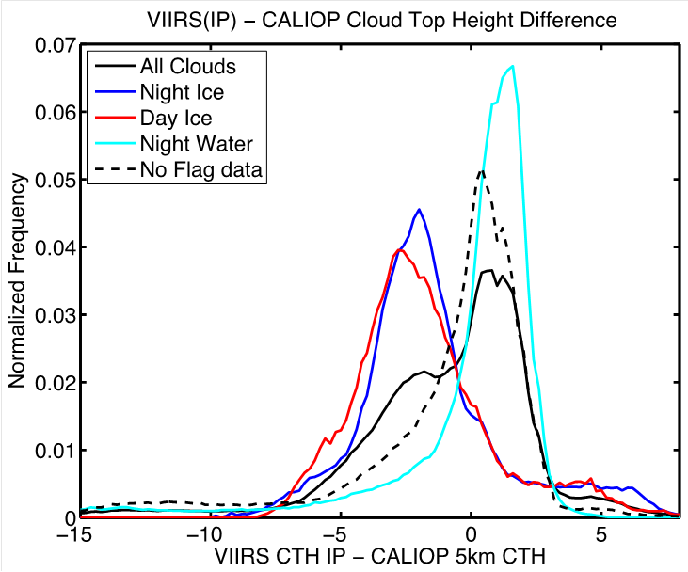
Global Cloud Top Height Evaluation of VIIRS with CALIOP CTH product
The global distribution of CTH differences between CALIOP and VIIRS IP retrievals is presented.
The results from VIIRS retrievals indicate a significant negative CTH bias for ice clouds.
The mean and standard deviation of biases relative to CALIOP separated by retrieval type. Negative values occur when VIIRS underestimates CALIOP.
3 months of VIIRS/CALIOP matchups
 | COT < 1.0 | COT >1.0
Accuracy (mean km) % in spec | 12 % | 63 %
Precision (STD) (km) % in spec | 43 % | 49 %

Slide 48
VIIRS Cloud Top Height Performance Estimate based on CALIPSO Lidar Measurements
The mean and standard deviation of biases relative to CALIOP separated by retrieval type. Negative values occur when VIIRS underestimates CALIOP.
 | All Retrievals | Night Ice | Day Ice | Night Water | Day water
Mean (km) | -0.9 | -1.5 | -1.8 | -1.8 | -1.1
STD (km) | 3.4 | 2.9 | 2.7 | 3.3 | 3.7
 | COT < 1.0 | COT >1.0
Accuracy (mean km) % in spec | 12 % | 63 %
Precision (STD) (km) % in spec | 43 % | 49 %

Slide 49
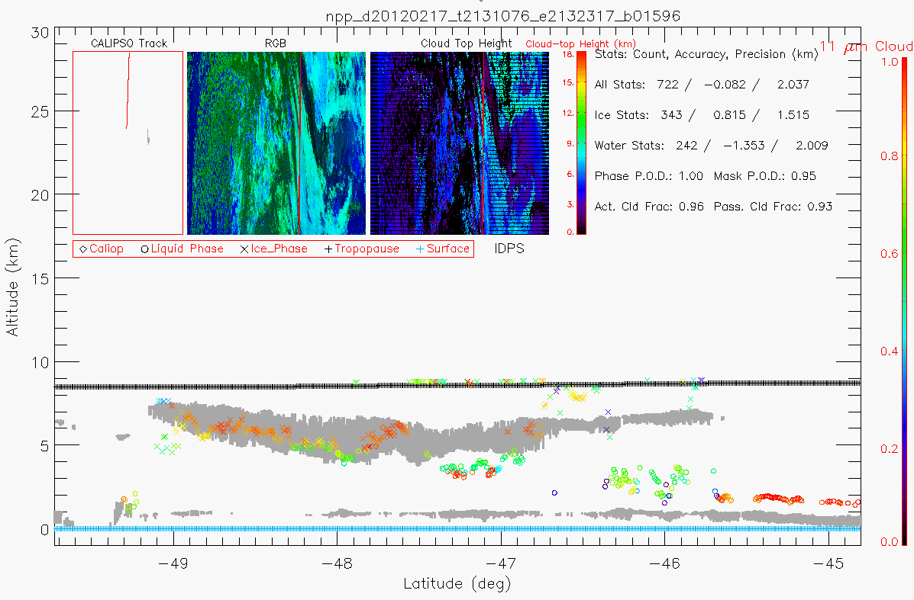
Comparison of VIIRS CTH with CALIOP CTH for One Granule
Detailed comparisons on a granule basis indicate some performance issues that likely account for these differences.
IDPS gives clouds placed at the Tropopause. (A) – DR to be submitted
IDPS overestimates heights in low-level marine clouds. (B) – fixed per DR 4740
IDPS also does not account for multilayer scenarios. (C).
These issues are common issues to these type of algorithms.
CALIPSO/CALIOP Matchup with IDPS VIIRS CTP IP
A
C
B

Slide 50
Cloud Top Temperature (CTT) is defined for each cloud-covered Earth location as the set of atmospheric temperatures at the tops of the cloud layers overlying the location

Slide 51
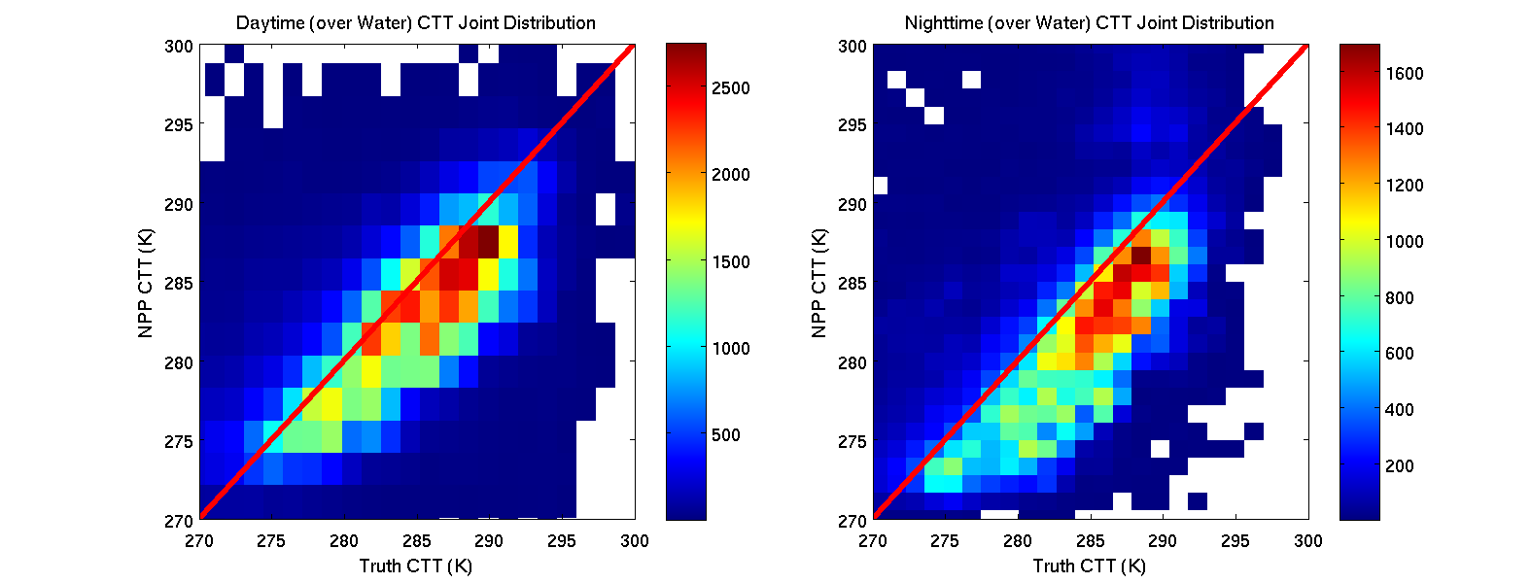

Global Cloud Top Temperature Evaluation of VIIRS with CALIOP CTT product
NPP CTT shows a negative bias indicating CTH being overpredicted
DR 4740 (Marine Layer cloud Update) to be Operationalized for MX 7.0 will reduce or eliminate this CTT cold bias

Slide 52
Conclusions: Cloud Top Parameters
The VIIRS Cloud Top Parameters (which contain CTH, CTP and CTT EDR) have met the beta maturity stage based on the definitions and the evidence shown
  They meet or exceed the definition of beta in most cases
  There is a negative bias in the ice cloud CTH however, it should meet requirement when problems are fixed (see below)
Issues have been uncovered during validation of the VIIRS Cloud Optical properties Product and solutions will be evaluated.
  Identified problems are related to the COP algorithms where CTT is calculated
  Revised k-ratio parameterization equation is needed to remove negative bias in CTH which also affecting CTT and CTP performance

Slide 53
Cloud Cover (CCL) is defined as the fraction of a given area of the Earth’s horizontal surface that is masked by the vertical projection of clouds

Slide 54
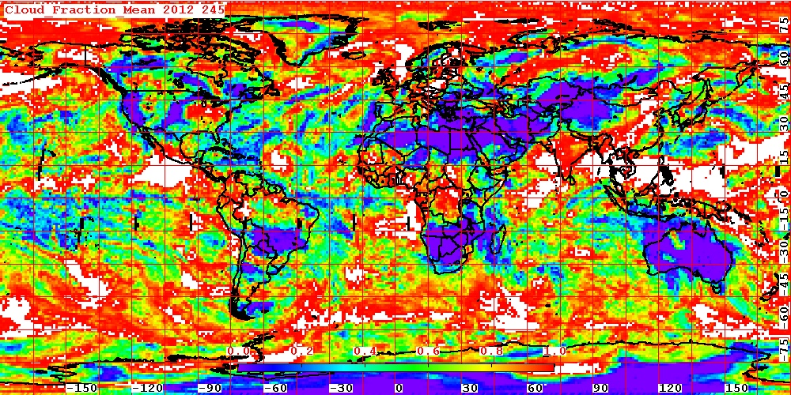
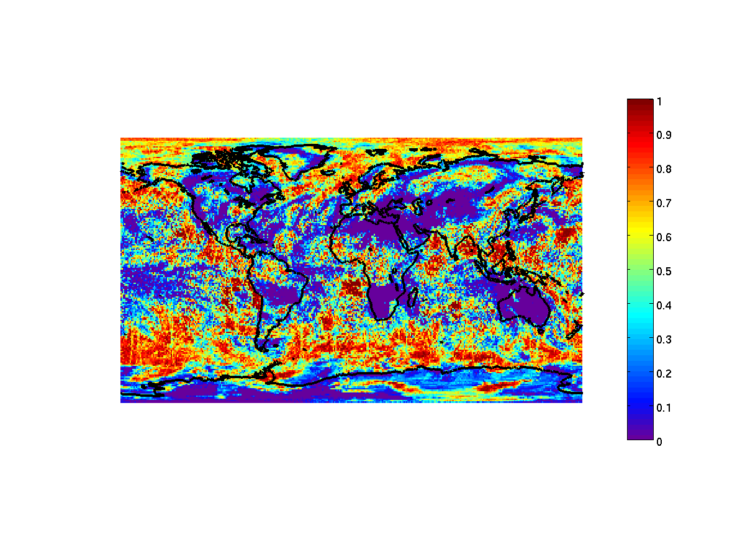
Comparison of NPP Global Cloud Cover with MODIS Product
MODIS Cloud Cover
NPP Cloud Cover
NPP Cloud Cover is qualitatively similar to MODIS

Slide 55
Performance of VIIRS Cloud Cover EDR derived from VIIRS Cloud Mask Probability of Cloud Detection
Cloud Cover is defined as the faction of a given area, i.e. the Horizontal Cell Area, covered by the vertical projection of clouds
VIIRS CCL algorithm calculates Cloud Cover based directly on VCM “confidently cloudy” pixels.
Therefore the error or uncertainty of Cloud Cover must be equal to error (s) in detecting clouds (or 1- Probability of Cloud Detection)
There are 2 sources of cloud detection errors: False Alarm; (2) Leakage
Uncertainty of Cloud Cover = False alarm + Leakage

Slide 56
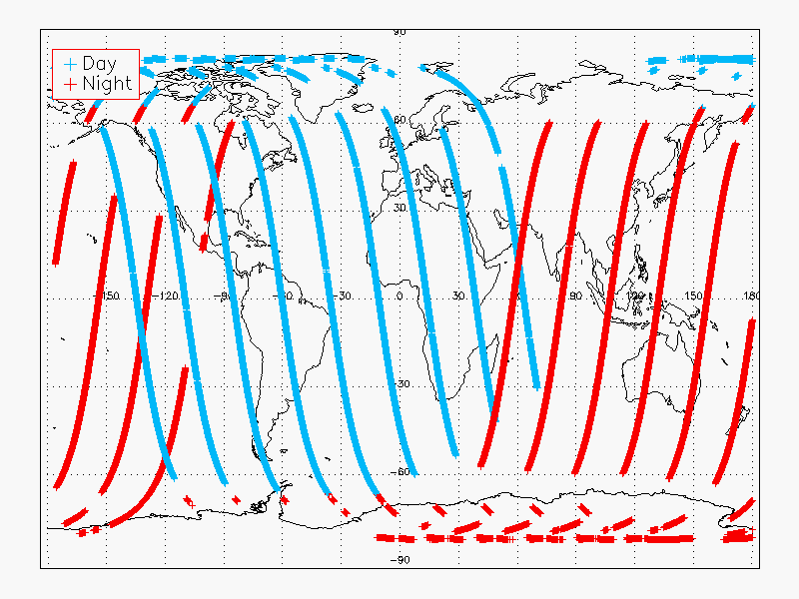
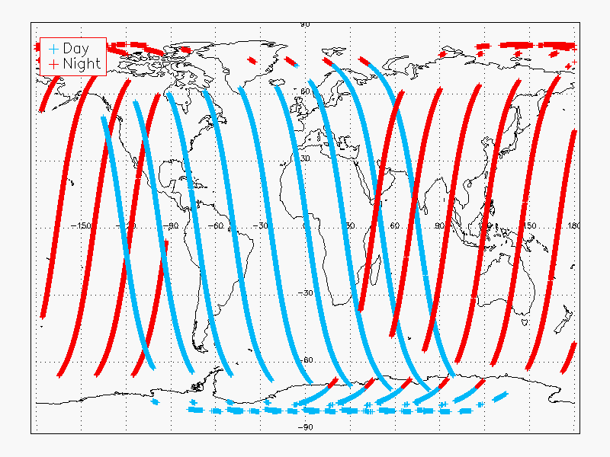
Product Quality – Global/All Clouds (From VIIRS Cloud Mask Provisional Status TIM, February 2013, VCM Cal/Val Team)
90N – 90S, Ocean/Land, Day/Night, No Snow/Snow/Ice
CALIOP - VIIRS Matchup Pixels, 05/10/2012
CALIOP - VIIRS Matchup Pixels, 11/10/2012
VIIRS Cloud Mask | Sample Size | Cloud fraction |  |  |  | Probability of
 |  | Active | Passive | Pr. Clear | Pr. Cloudy | Detection | False D. | Leakage
5/10/2012 | 257266 | 0.661 | 0.567 | 0.080 | 0.032 | 0.857 | 0.024 | 0.119
11/10/2012 | 304681 | 0.732 | 0.654 | 0.068 | 0.029 | 0.881 | 0.021 | 0.099
Cloud Cover Uncertainty is given by the 2 sources of error in cloud detection
Based on VCM Provisional stated performance, Cloud Cover Uncertainty = 0.143

Slide 57
Cloud Base Height (CBH) is defined as the height above sea level where cloud bases occur

Slide 58
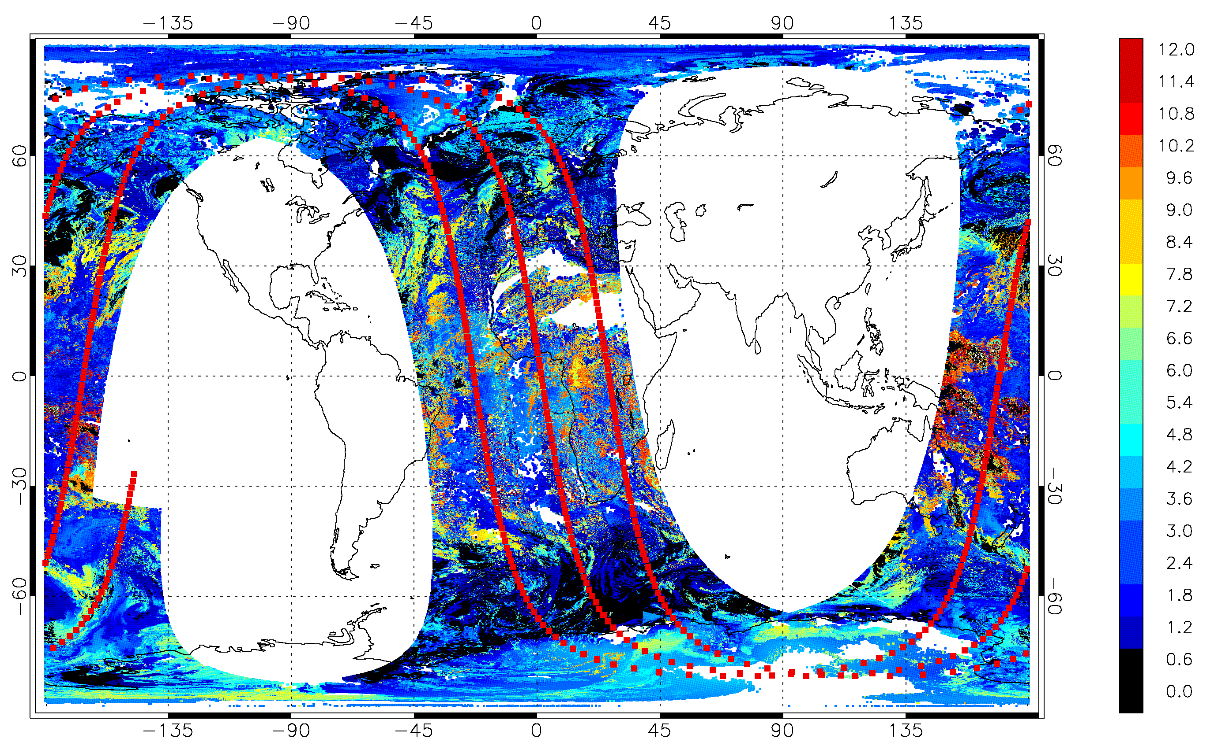
Cloud Base Height Evaluation with CloudSat (By Univ. Colorado State, CIRA)
Cloud Base Comparisons with CloudSat (CIRA)
Example VIIRS/CloudSat matchup period from 17 February 2012 between 11:19 and 15:47 UTC. The CloudSat track is plotted as the dotted red line, and the VIIRS Cloud Base Height IDPS data (in km AGL) are plotted underneath.

Slide 59
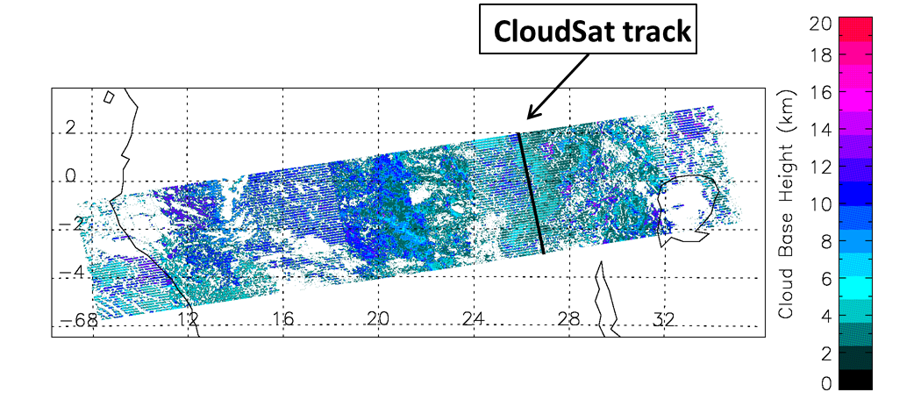
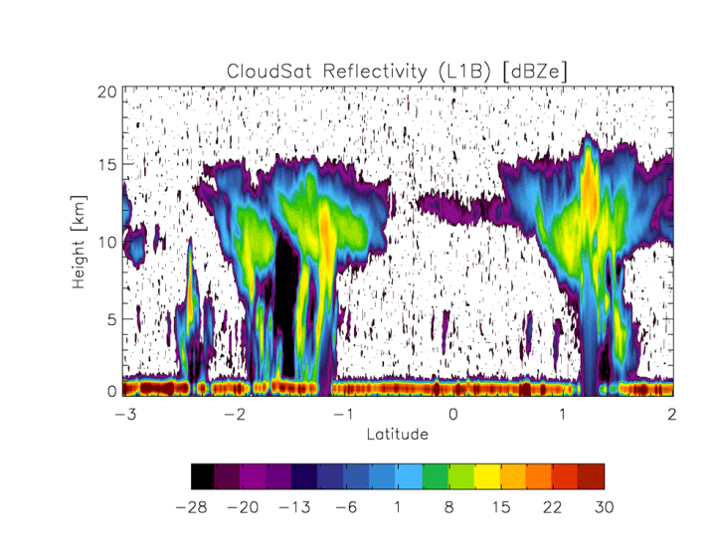
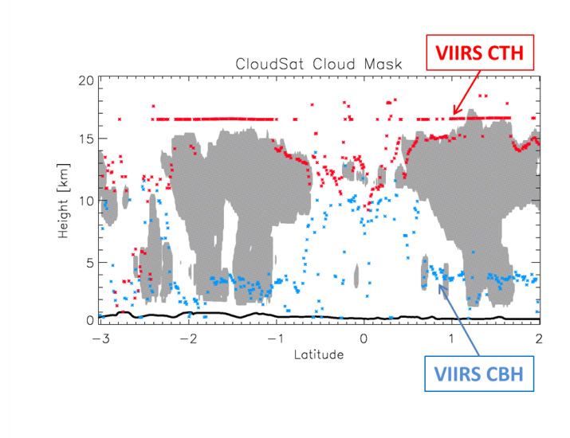
Comparison of VIIRS Cloud Base Height with CloudSat Cloud Base height Product (By Univ. Colorado State, CIRA) - continued
Sample comparison of VIIRS cloud top and base heights with CloudSat cloud mask from 11:59:16 UTC to 12:00:40 UTC on 17 February 2012
CloudSat reflectivity with VIIRS CBH IP (blue asterisks) overlaid
In general, VIIRS CBH tend to over-predict the base height for low clouds, however, under-predicts the base for high clouds

Slide 60
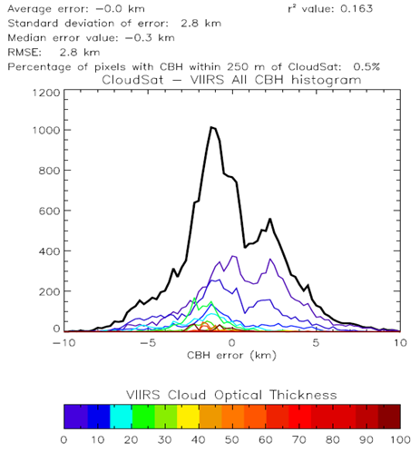
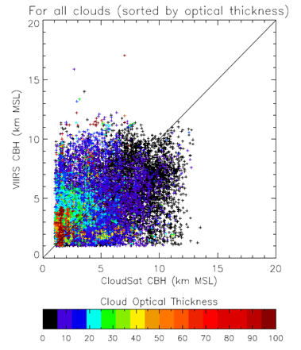
Comparison of VIIRS Cloud Base Height with CloudSat Cloud Base height Product
The left figure presents scatter Plots of CBH for all valid CloudSat and VIIRS retrievals from September 2012. Points are color-coded according to the cloud optical thickness (see color scale). Note the large spread away from the diagonal line.
The colored histograms represent errors for clouds in various optical thickness bins (see color scale). The thick black curve represents the histogram for all clouds.
VIIRS CBH overall Performance Estimate: Uncertainty = 2.8 km

Slide 61
Comparison of VIIRS Cloud Base Height with CALIPSO Cloud Base Height Product (by NG)
VIIRS CBH compared against CALIPSO lidar for all clouds (left) and single-layer clouds (right).
Notable features include VIIRS CBH overestimate of low cloud bases, underestimation of high cloud bases,
Significant number of missed detections which may be related to VIIRS Cloud Mask performance.

Slide 62
Plans and Issues with Cloud Base Height Products
Issues identified: In general CBH algorithm over-predicts the base height of low clouds, however, under-predicts the base height of high clouds

Slide 63
Conclusions: Cloud Base Height Product
The VIIRS cloud base height Products have met the beta maturity stage based on the definitions and the evidence shown
  They meet the definition of Beta in cases studied
Issues related to the products are the over-prediction of low cloud base and under-prediction of high cloud base – the problem is most likely caused by the error in the constant Cloud Liquid Water Contents of the 4 water cloud types. The level of error will be assessed and an error reduction approach will be developed

Slide 64
Validation of Perform Parallax Correction Algorithm

Slide 65
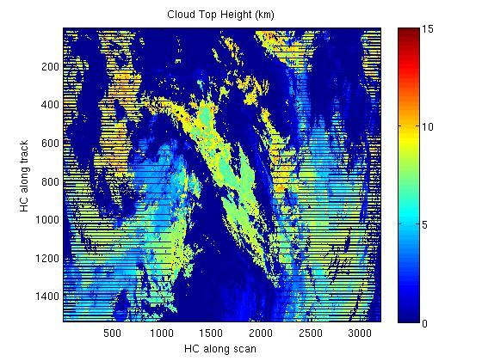
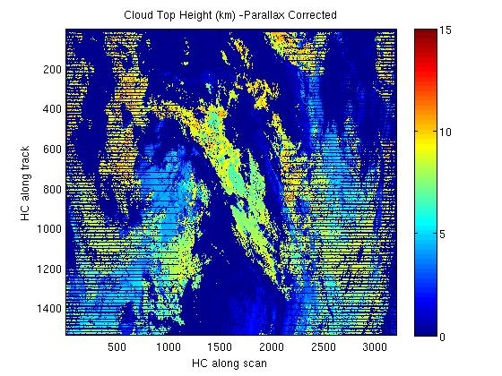
Comparison of CTH and Parallax corrected CTH IP – 2 granules from 09/01/2012, ~ 16:00
Cloud Shifted due to parallax correction

Slide 66
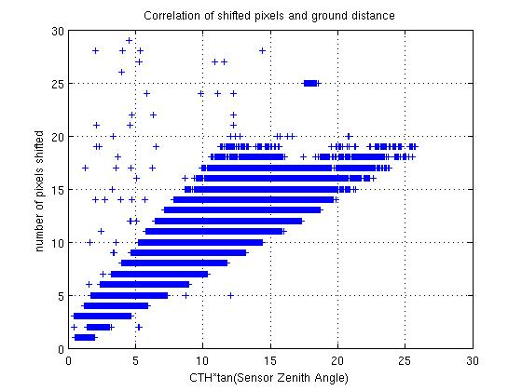
Comparison of PPC cloud IP products
The expected linear relationship appears to hold
Off diagonal points are from Edge-of-scan region where curvature effect is expected to be large

Slide 67
Future Plans and Issues
We have gotten these changes into IDPS
  A day COP LUT derived from the NOAA GOES-R AWG COP LUT (implemented April 26, 2013).
  A code fix to implement NOAA marine stratus temperature to height/pressure conversion. (not implemented yet).
We plan to implement these fixes
  Nighttime COP bugs identified by NGAS.
  MODIS (latitude dependent) marine stratus T to Z,P conversion
  Nighttime COP ice cloud scattering (k-ratio) parameterization based on latest theory.
  CBH modification of LWC/IWC values used for the various cloud types
  Modification of quality flags.
Future Work
  Several issues remain without identified causes.
  Nighttime COP and cloud base continued work

Slide 68
Conclusions
VIIRS Cloud EDRs have made significant improvement over the past year.
  Adoption of new COP NOAA-based LUTS has mitigated many artifacts.
VIIRS Cloud EDRs have met the beta stage based on the definitions and the evidence shown
  We are confident all products except Nighttime COP and cloud base meet or exceed beta.
  Nighttime COP bugs have been identified and we expect full beta compliance once implemented.
  Nighttime COP is not a common product (not available from MODIS) and we think the community has less expectations for nighttime COP than daytime COP.
  Cloud base performance is also expected to improve. The specifications are low therefore we urge beta approval for this product.
  For these reasons, we support beta for all cloud products.

Slide 69
Extra Material

