Slide 1
Comparison of sweep direction errors with old and new FIR filter
D. L. Mooney
SDR Group meeting
4/25/2012

Slide 2
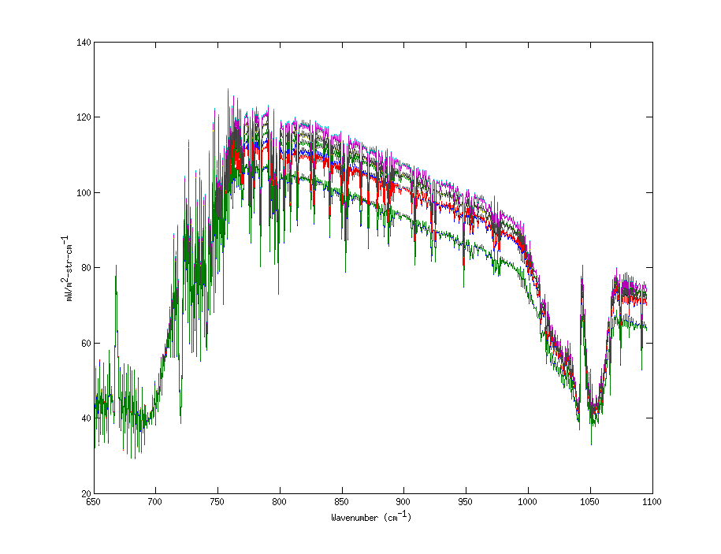
LW spectra averaged from 672.5-676.125 cm-1

Slide 3
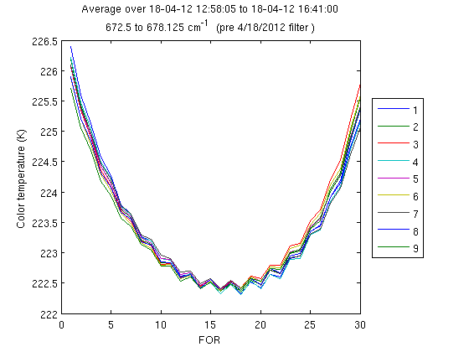
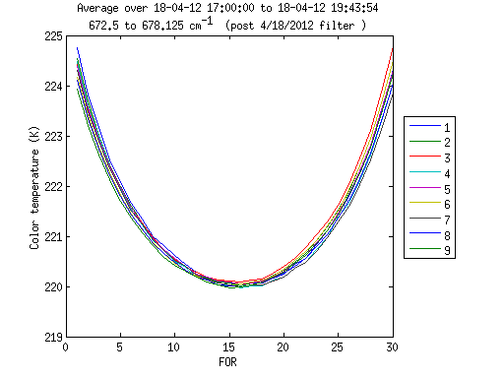
Four hour average of LW spectra
Old filter
New filter

Slide 4
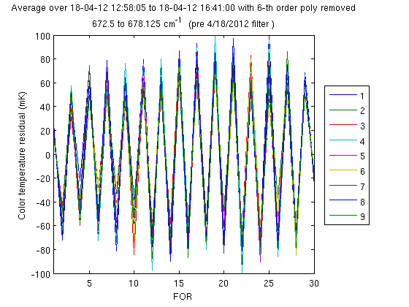
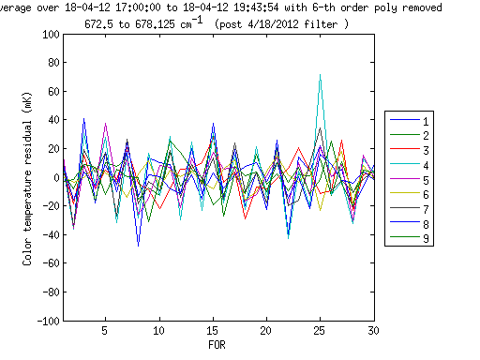
Old vs. new filter sweep error (> 3 hr averages)
Old filter
New filter
Smaller sweep direction error with new FIR filter

Slide 5
Summary
Results for the new filter are significantly better
There is still a small residual
Processing the data with explicit residual removal
Expect all residual error will be removed

