Slide 1
CrIS SDR Provisional Readiness Review
Lawrence Suwinski
Joe Predina
Laura Jairam
10-23-2012
This document is not subject to the controls of the International Traffic in Arms Regulations (ITAR) or the Export Administration Regulations (EAR)

Slide 2
Exelis Primary Roles During CrIS Post Launch Support
1) Early Orbit Instrument Checkout (10/28/11 – 2/8/12)
Instrument activation and functional checkout
On-site (at NSOF) and remote support from Fort Wayne
Engineering Packet #32 coordination & upload (2/8/12)
All EOC activities discussed at SDR Beta Review
2) Engineering Packet Calibration Table Uploads
Engineering Packet #33 coordination & upload (4/11/12)
Engineering Packet #34 coordination & upload (6/27/12)
Engineering Packet #35 (10/22/12) upload support
3) Additional support via NOAA SOW
Develop new FCE Algorithm that works for all scenes
Improve SDR Algorithm ICT environmental model
Train NOAA personnel on Engineering Packet upload process
Review instrument anomalies per SDR team lead request

Slide 3
Engineering Packet Updates

Slide 4
Exelis Support to Engineering Packet Updates
Engineering Packet #33, 4/11/12 (Discussed at Beta Review)
ILS parameters best fit to atmospheric spectra
Nonlinearity parameters adjusted to provide best match of all 9 FOVs over a range of brightness temperatures
ICT emissivities smoothed to reduce retrieval noise
Engineering Packet #34, 6/27/12
Update temperature drift limits to reduce number of degraded spectra
Developed new thermal drift algorithm that was implemented in MX6.3 version of operational code
Details are in following slides
Engineering Packet #35, 10/22/12
Cooler stage 2 limit changed to 4K since readout circuit found to contain oscillation
Zeroed out interferometer boresight to SSMF angles
Provides more accurate geolocation
Exelis provided in-house training to NOAA/STAR personnel on packet creation and upload process

Slide 5
SDR Algorithm Monitors Several Temperatures for Excessive Drift
CrIS Engineering Packet contains temperature drift rate limits used by SDR Algorithm for “Degraded SDR” quality flag
SDR flagged “degraded” if one or more thermal drifts exceeds limit within 4 minute moving window
Four thermal drift limits are regularly exceeded on-orbit
ICT Temp #1
ICT Temp #2
Stage 3 cooler
Stage 4 cooler
Two Minute Temperature Drift Limit (Engineering Packet #33)
ICT temp #1 0.06 K
ICT temp #2 0.06 K
Beamsplitter temp #1 0.2 K
Scan mirror temp 1.3 K
Scan baffle temp 1.7 K
OMA structure #1 0.2 K
OMA structure #2 0.2 K
Telescope 0.2 K
Stage 1 cooler 0.3 K
Stage 2 cooler 1.0 K
Stage 3 cooler 0.025 K
Stage 4 cooler 0.025 K

Slide 6
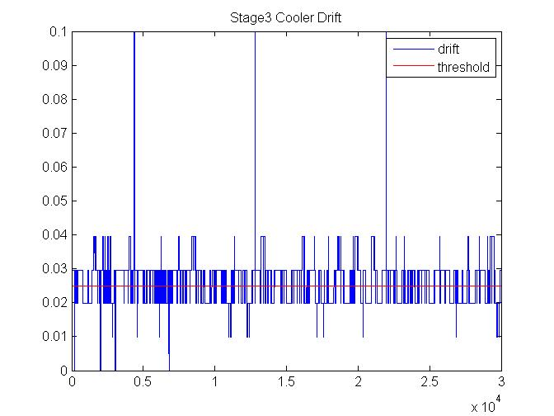
Example: Stage 3 Cooler Temperature Drift Consistently Exceeded Limits
Drift Calculated During 30 Sample Moving Window [Max – Min]
Same large scale outages as ICT
Plot provided by NGAS
Drift (Kelvin)
Many low level noise triggered outages
Sample Number
This document is not subject to the controls of the International Traffic in Arms Regulations (ITAR) or the Export Administration Regulations (EAR)
6

Slide 7
SDR “Degraded” QC Flag Found to Undergo High False Alarm Rate Due to Four Problems
Engineering Packet #33 temperature drift limits not correct
Results in QC flag triggered at lower level than intended
SDR algorithm uses 4 minute window to calculate drift instead of 2 minutes
Results in a calculated drift 2 times too large
SDR algorithm method not robust against temperature telemetry noise
Algorithm is sensitive to noise peaks
Linear thermal drift calculated by SDR Algorithm not consistent with instrument performance
Drift rate algorithm needs to distinguish between linear and nonlinear drift
Fixed by Updating Engineering Packet
(#34)
Fixed by Replacing [Max – Min] Algorithm with Better Noise Robust Algorithm
This document is not subject to the controls of the International Traffic in Arms Regulations (ITAR) or the Export Administration Regulations (EAR)
7

Slide 8
Temperature Drift Limits Were Updated in Engineering Packet #34 to Reduce Spectra Flagged as Degraded
Engineering Packet #33 Two Minute Temperature Drift Limit
Engineering Packet #34 Two Minute Temperature Drift Limit
ICT temp #1 0.06 K
ICT temp #2 0.06 K
Beamsplitter temp #1 0.2 K
Scan mirror temp 1.3 K
Scan baffle temp 1.7 K
OMA structure #1 0.2 K
OMA structure #2 0.2 K
Telescope 0.2 K
Stage 1 cooler 0.3 K
Stage 2 cooler 1.0 K
Stage 3 cooler 0.025 K
Stage 4 cooler 0.025 K
ICT temp #1 0.12 K
ICT temp #2 0.12 K
Beamsplitter temp #1 0.5 K
Scan mirror temp 1.3 K
Scan baffle temp 1.7 K
OMA structure #1 0.5 K
OMA structure #2 0.5 K
Telescope 0.5 K
Stage 1 cooler 0.25 K
Stage 2 cooler 1.0 K
Stage 3 cooler 0.05 K
Stage 4 cooler 0.05 K
Updated to this
Corresponds to Current NPP CrIS Sensor Specification

Slide 9
Better Algorithm Was Needed for Identifying Temperature Drifts Having Most Negative Impact on Performance
Data Set Available
30 temperature samples spanning 4 minute window
15 prior & 15 after earth scene of interest
~10 mK rms random noise per sample
Objective…Flag thermal drift conditions that produce a calibration bias
Average window temperature different than center of window temperature
Robust to telemetry random and spike noise
Magnitude of calibration error (% uncertainty) exceeds basis of analysis for CrIS thermal Drift specification
Examples of Thermal Drift
Average
Average
Average
Type 1 Most Common
Calibration Impact….. Negligible
Type 2 Occasional
Calibration Impact…….half of Type 3
Type 3 Rare
Calibration Impact…….Worst Case Used for CrIS Sensor Specification

Slide 10
New Thermal Drift Algorithm Eliminates Unnecessary Degraded Spectra
Trigger Degraded QC flag when
Where:
= temperature telemetry drift limit for 2 minutes (from engineering packet)
= temperature of i^{th} sample in moving window (from science telemetry packet) Note: for ICT PRT1 & ICT PRT2 this value is an average of 40 temperature samples reported in science telemetry packet
Triggers flag when twice engineering packet drift rate limit exceeded
Triggers flag when engineering packet drift rate limit exceeded
Never triggers flag
Type 1
Type 2
Type 3
Algorithm Implemented in MX6.3 Operational Code

Slide 11
Additional NOAA Funded Cal/Val Tasks

Slide 12
Exelis Funded to Perform Additional Cal/Val Tasks
SOW provided from 5/14/12 through 1/31/13
Description of work includes:
Developing better Fringe Count Error (FCE) detection and correction algorithm
Develop improved ICT environmental model for SDR Algorithm
Improve scan baffle temperature model for SDR Algorithm
Collaborate with other team members regarding additional SDR Algorithm improvements
Reorder application of radiometric calibration and spectral corrections
Support Engineering Packet #34 and #35 release and upload (covered in previous slides)
Provide training to NOAA personnel on Engineering Packet creation and upload process
Perform anomaly investigation and resolution per SDR team lead discretion
Participate in weekly telecons and Product Review meetings
Details Discussed in Following Slides

Slide 13
FCE Algorithm Development

Slide 14
FCE Algorithm Background
Current FCE detection scheme does not work for earth scenes that are at or below the instrument background level
Current ICT/DS detection and correction methodology works since phase in reference scenes is relatively constant
ES phases vary and large percentage of scenes are declared ‘degraded’ due to inability to identify presence of FCEs
FCE detection/correction currently turned off in operational code
Goal of new algorithm is twofold:
Have the ability to detect and correct FCEs in all earth scenes, regardless of scene
Retain functional algorithm for ICT/DS scenes
New FCE algorithm developed, implemented and tested in Matlab
Simple bin-counting threshold provides 100% detection with no false alarms
Diagnostic data test bed developed to simulate FCE injection
Algorithm is able to detect and correct for loss of -18 to +18 fringes with less than 1 mK of residual error in all cases

Slide 15
FCE Detection/Correction Flow Implemented in Matlab
On-Orbit Diagnostic Data
Diagnostic Data Used As Input to Simulate FCEs, Test Algorithm and Establish/Verify Thresholds
FCE Simulation Code

Slide 16
Detection Methodology Influenced by Several Factors
Detection algorithm uses LWIR FOV5 as initial indication of possible FCE presence
Exelis SDR Algorithm rewritten to process all 9 FOVs in parallel
Provides large speed enhancement
Means only 1 band is needed for FCE detection
Low signal interferograms pose challenging detection cases
Implementing a bin counting scheme allows for 100% detection with no false alarms
Schemes using a mean value found not to be 100% reliable
FOV-to-FOV variations seen in LWIR imaginary components for FCE=0 cases
Detection performed on well behaved FOV5
FCE magnitude determination performed for all FOVs
Data marked invalid if all FOVs do not agree on FCE magnitude
FCE=0 case included in magnitude determination to further eliminate false alarms

Slide 17
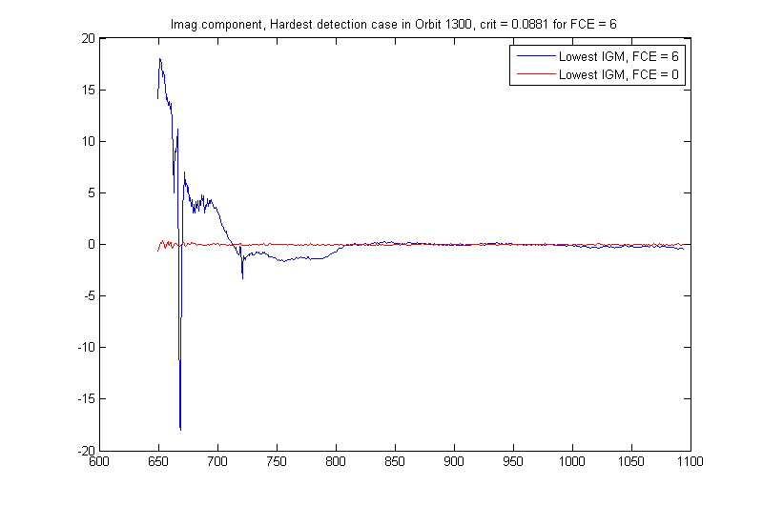
Certain FCE Numbers Create Difficult Detection Cases
Longwave Imaginary component,
Hardest detection case in Orbit 1300, FCE = 6
Using only this range,
the two are nearly identical
Wavenumber range used in detection: 650-1075cm⁻¹
50 bins with |Im (650-1075)| > 1 radiance = FCE detected

Slide 18
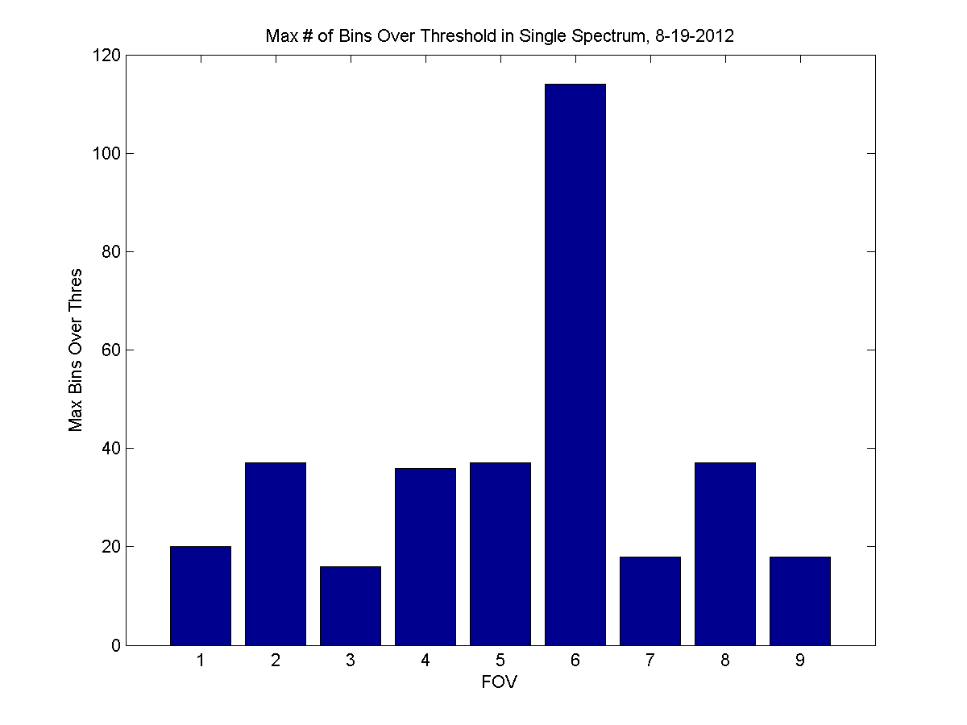
Testing Across FOVs Reveal FOV False Alarm Dependency
Maximum # of Bins Over 1 radiance in Single Spectrum, 8-19-2012
50 bin threshold
Applied the new FCE detection scheme to a day of LWIR operational SDRs
No false alarms on 8 of 9 FOVs
FOV6 had 9 false alarms

Slide 19
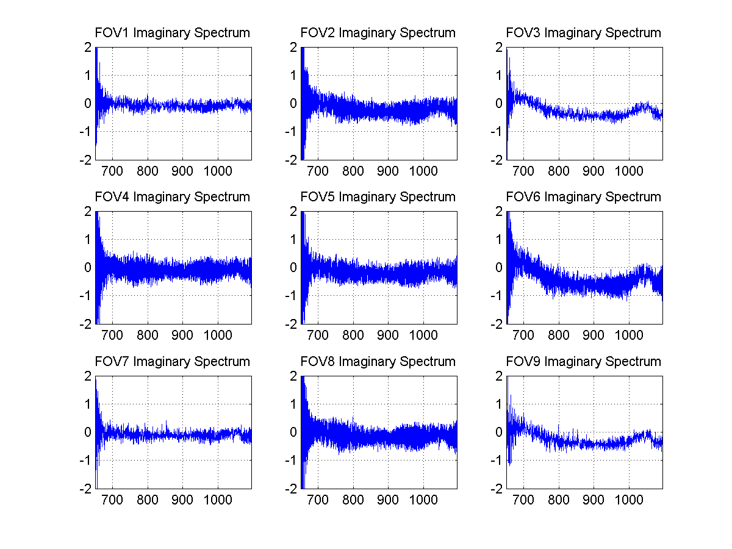
Dependency Traced to Differing Imaginary Signatures
FOV6 profile has significant non-zero features
Will use FOV5 for FCE detection, with a back up FOV
FOV5 confirmed to work for NPP

Slide 20
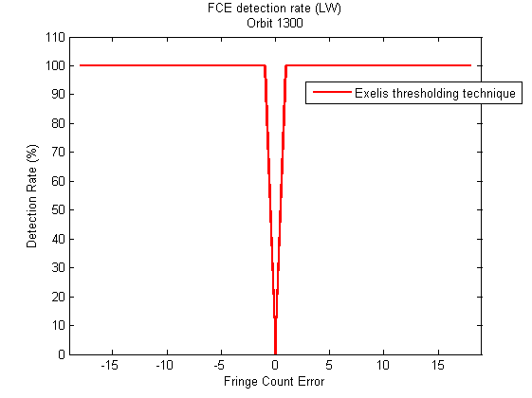
FCE Detection Rate Results for FOV5 Show 100% Detection
Injected FCE using Matlab testbed
Perfect detection and no false alarms on test orbit
- Only FOV 5 tested, FOR 1 & 15 both had same results

Slide 21
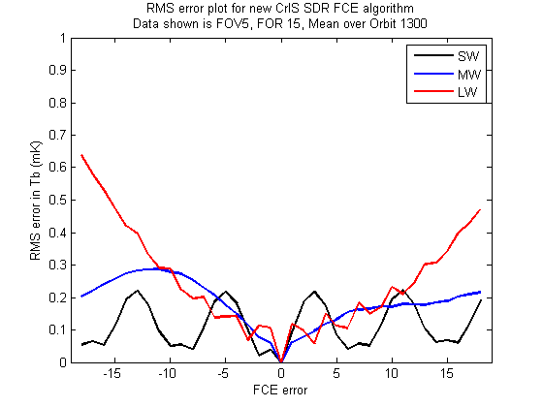
Mean RMS Errors for Full Orbit Demonstrate Correction to <1 mK
Minimal FOR dependency observed in RMS errors

Slide 22
FCE Algorithm Summary
Exelis has developed an algorithm to reliably detect and correct FCEs of magnitudes from -18 to +18
Reference scene FCE algorithm remains same as operational
ES algorithm now detects and corrects FCEs for all scenes
If LWIR FOV5 contains >50 bins above 1 r.u., FCE is detected
All LWIR FOVs phase corrected from -18 to +18 FCE to find imaginary component minima
If FOVs agree on magnitude, reference scene windows are aligned to the ES
If FOVs do not agree, spectra are marked invalid
Diagnostic data used to simulate FCEs and validate the detection/correction algorithms
Detection is 100% with no false alarms
Resulting corrections match expected to <1 mK
Algorithm currently being implemented into Exelis SDR code

Slide 23
Improved ICT and Scan Baffle Models

Slide 24
ICT Model Temperature Inputs Trended and Reviewed
ICT, scan baffle, OMA and beamsplitter temperatures reviewed over a 50 orbit data set and trended monthly
Idea is to use trended data to correlate Exelis thermal model and provide better scan baffle profile
10 orbit profiles from 1st day of each month trended from February through September
Scan baffle profiles shown here; remainder of data in Appendix
Inherent variations seen in temperature profiles that limit effectiveness of ICT model or scan baffle improvements
Profiles are not very repeatable orbit-to-orbit or seasonally
Revised environmental model not needed for J1
3-bounce trap ICT eliminates need for most of model
Current model will have view factor for ‘cold’ beamsplitter set to 1, all others set to 0
Will ensure proper calculation of the ICT radiance based on specular reflection of cold beamsplitter view

Slide 25
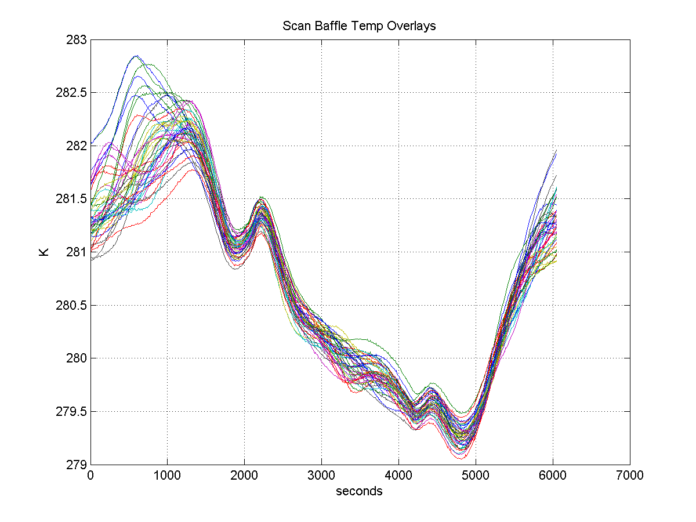
Scan Baffle Temperature Shows Larger Variation Near Equator
Regions Following Equator Overpasses Contain Higher Variation

Slide 26
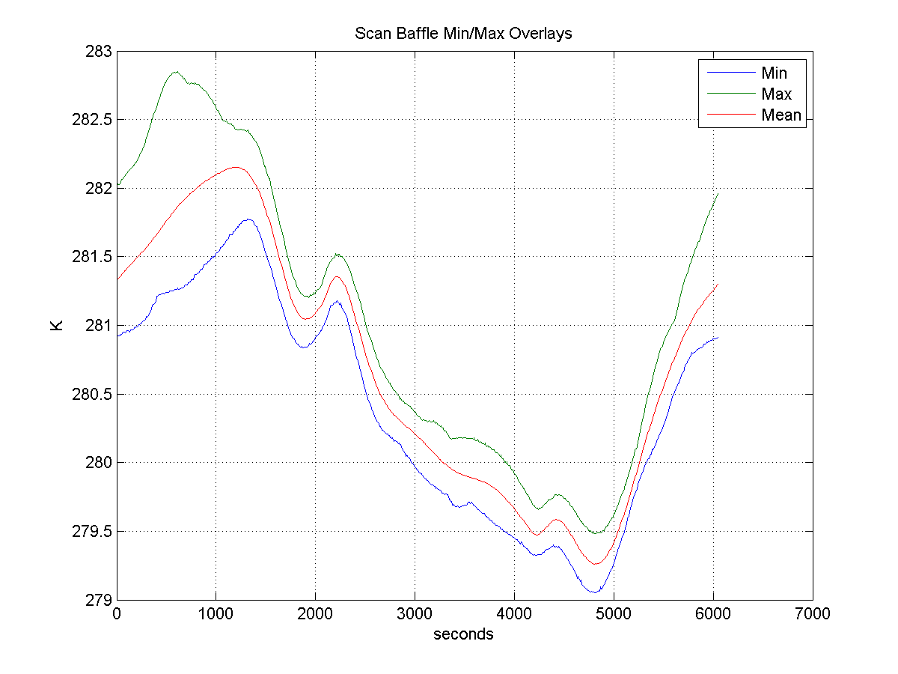
Averaged Profiles Reveal Up to 1.5K Variation by Orbit

Slide 27
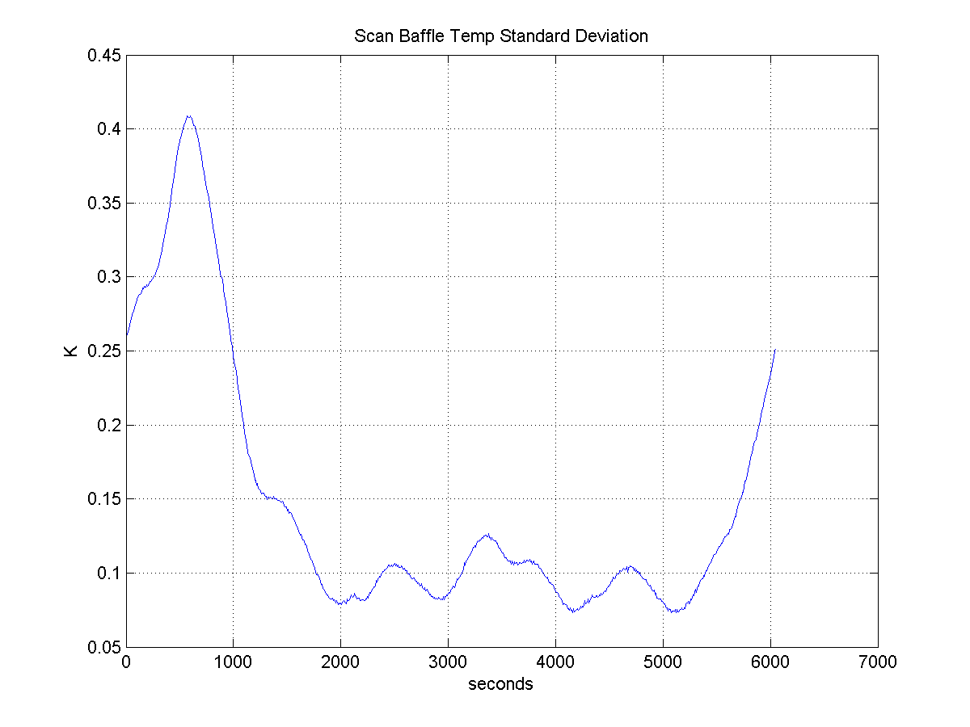
Standard Deviation Also Larger Following Equator Crossing
Data Following Ascending Equator Crossing is Most Noisy

Slide 28
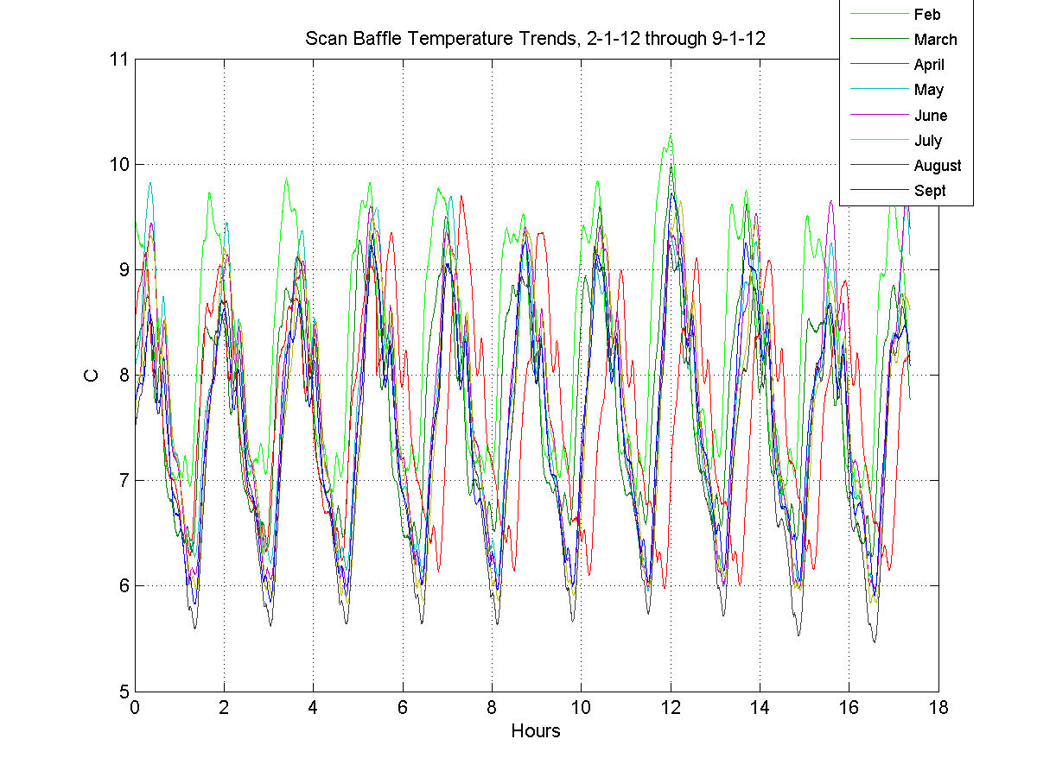
Scan Baffle 10 Orbit Overlays Not Very Repeatable
Scan Baffle Correction Profile to Be Further Reviewed for Future Adjustments
Overlays of Other Temperatures Can Be Reviewed in Appendix

Slide 29
Reordering of Radiometric Calibration and Spectral Corrections

Slide 30
Differences Between Ordering of Radiometric Calibration and Spectral Corrections Evaluated
Reversal of ordering is desired since it will improve SDR Algorithm execution speed
No F_{INT} matrix multiplication required for ILS correction
Need for post-calibration filter also removed
Removes matrix multiplication from CMO calculation
Orders implemented and compared using:
TVAC4 Scan Scenario data
On-orbit data from 7-21-2012
Differences between orders evaluated and plotted
Percent differences ratioed to 287K BB
Straight differences
Differences seen to be larger for scenes with spectral content
Results are similar to MIT-LL analysis

Slide 31
Impact of Reordering Spectral/Radiometric Calibrations in SDR Algorithm Evaluated by Exelis
Current Order, v2.20 of SDR Algorithm:
Sort Data and FCE
Radiometric Cal (with F_{INT})
Bandpass
Filter
Resampling to User Grid
RDRs
DFT
ILS Corrections and User Apodization
Geolocation
SDRs
Proposed Order, Including New ES FCE Method:
Sort Data and ICT/DS FCE
Resampling to User Grid
ILS Corrections and User Apodization
RDRs
DFT
Radiometric Cal (no F_{INT})
Boxes in Blue Are Changed From Current Order
ES FCE
Geolocation
SDRs

Slide 32
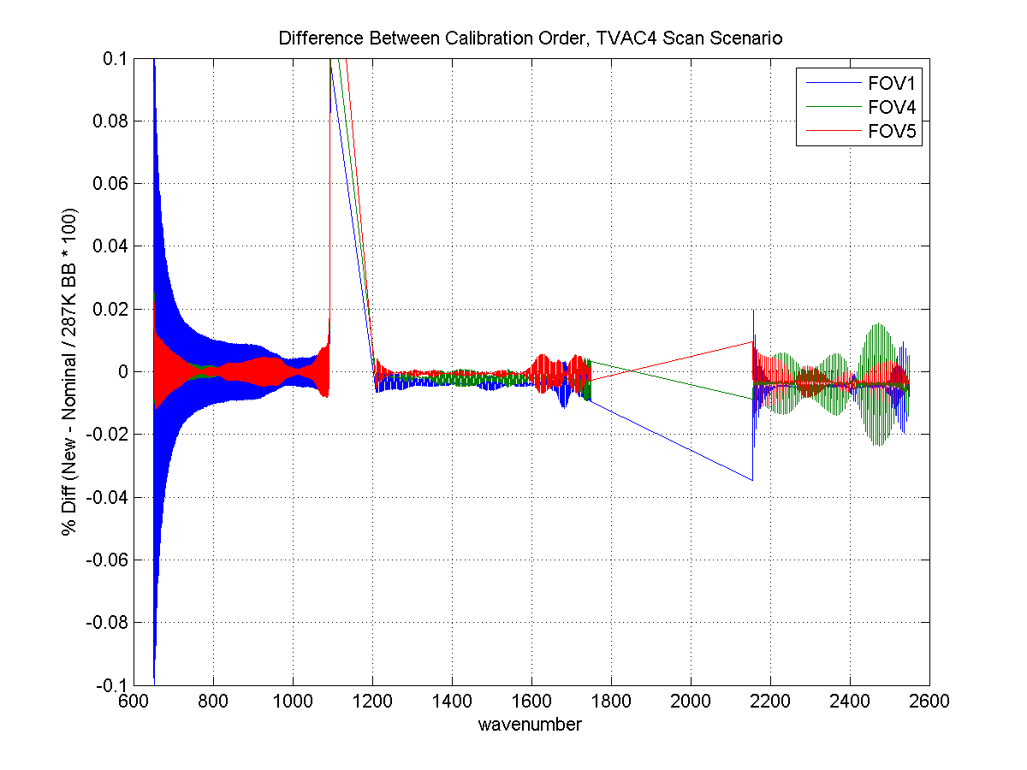
Comparison of Order Using TVAC Blackbody Data Shows < 0.03% Impact
Matches Very Closely, Except Near Extreme LWIR Band Edge

Slide 33
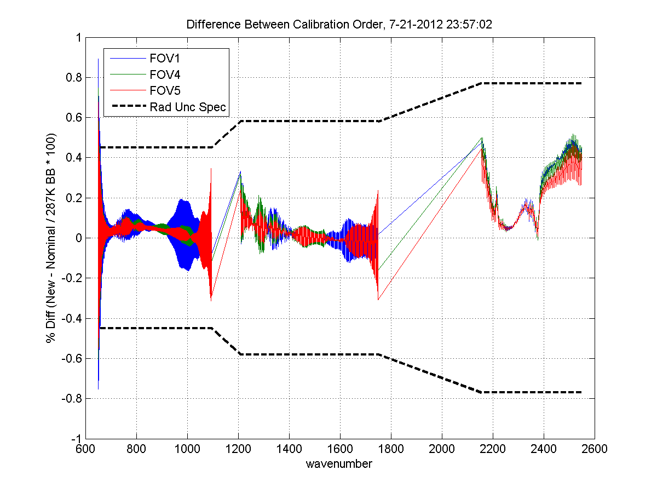
Up to 0.5% Difference Seen When Analyzing On-Orbit Structured Scenes
Larger Differences Seen in Structured Scene

Slide 34
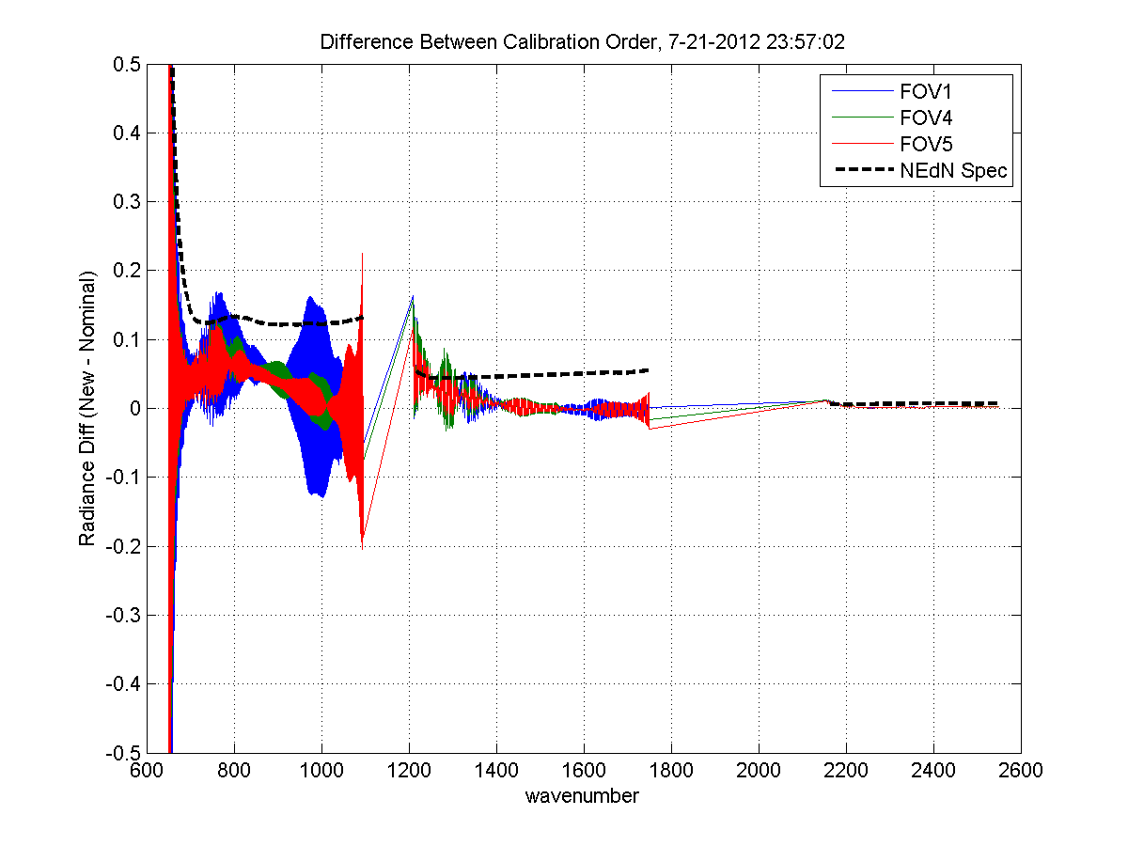
Radiance Differences Show Actual Change in Values is Small
Difference Less Than NEdN In Most Cases

Slide 35
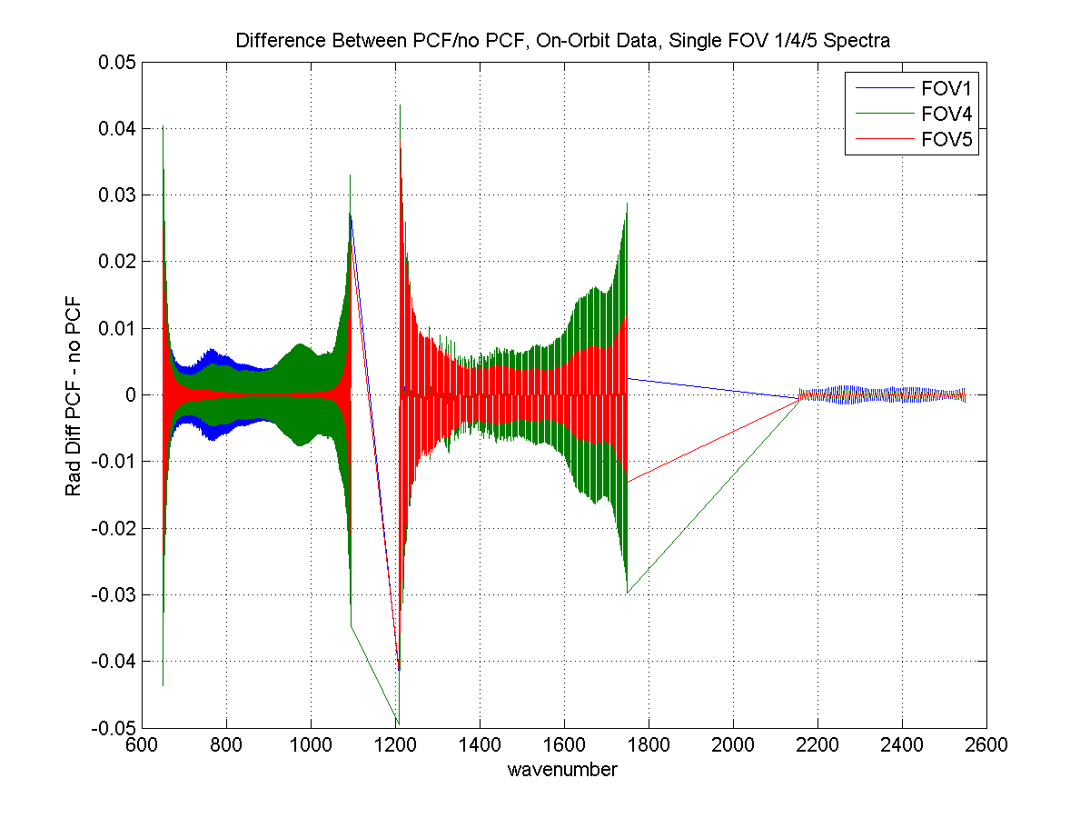
PCF/No PCF Comparison Demonstrates Filter Is Not Needed With New Calibration Order

Slide 36
Summary
Differences between current and proposed order evaluated
On-orbit data shows difference on the order of the detector NEdN specs
Needs for post-cal filter and F_{INT} matrix eliminated with change
Change in order and elimination of filter implemented in Exelis SDR code
Plan is to continue to collaborate with team regarding other SDR Algorithm improvements
Self-apodization correction
Spectral resampling
Improved calibration performance at band edges

Slide 37
On-Orbit Anomalies

Slide 38
Exelis Involvement in Anomaly Investigation
Exelis has been involved in several anomaly investigations
One will be discussed in this review
Root cause determination of on-orbit responsivity variation first reported by UW
Other anomalies/investigations will be briefed by various team members

Slide 39
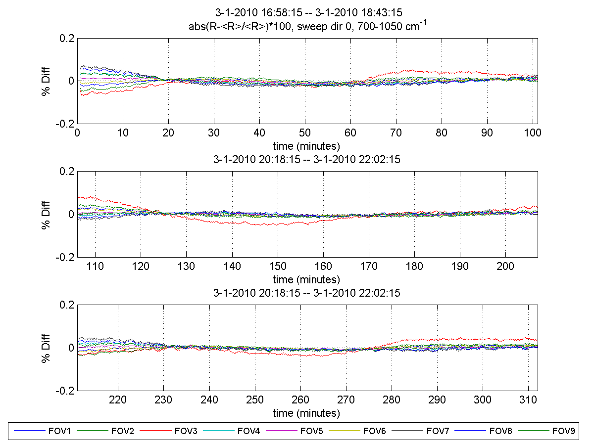
Responsivity Variation Reported by UW Confirmed to Be Present in TVAC Data
UW Will Discuss On-Orbit Findings

Slide 40
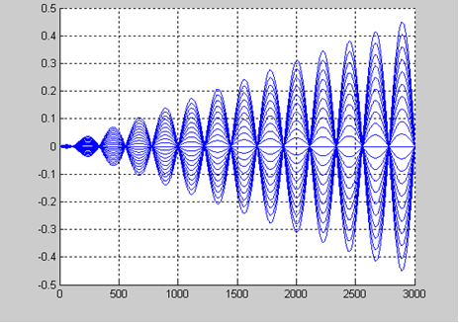
Simulation of Optical Coating Introducing an 11 µm Delay Matches On-Orbit Observations
Percent Variations and Null Wavenumbers Match On-Orbit Variations Very Well;
Channeling is Root Cause
Transmission
Wavenumber
Channeling Effect Calibrates Out and Does Not Affect SDR Performance

Slide 41
Summary

Slide 42
Exelis SDR Provisional Summary
Exelis has and continues to work on agreed tasking:
SDR Algorithm improvements
Engineering packet support
Anomaly investigations
Will continue to work with SDR team regarding future SDR improvements
Exelis considers CrIS SDRs ready for Provisional Status

Slide 43
Appendix

Slide 44
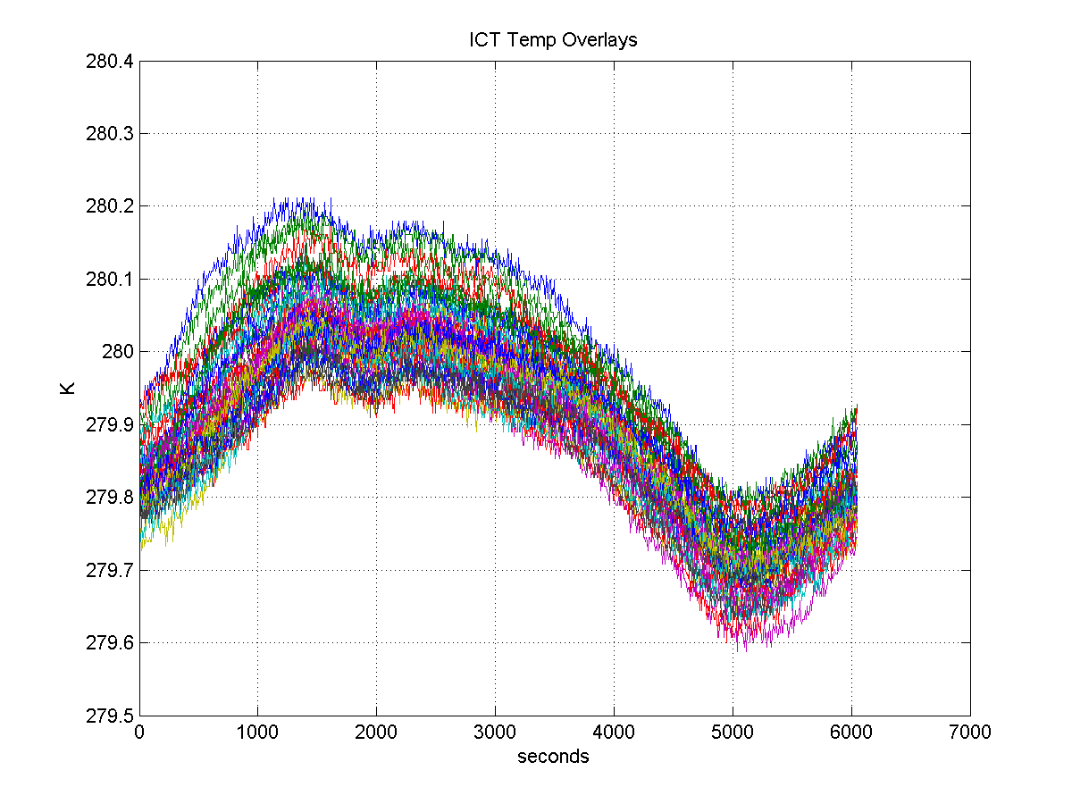
ICT Temperature Overlays, 43 Orbits
ICT Profiles Are Relatively Stable

Slide 45
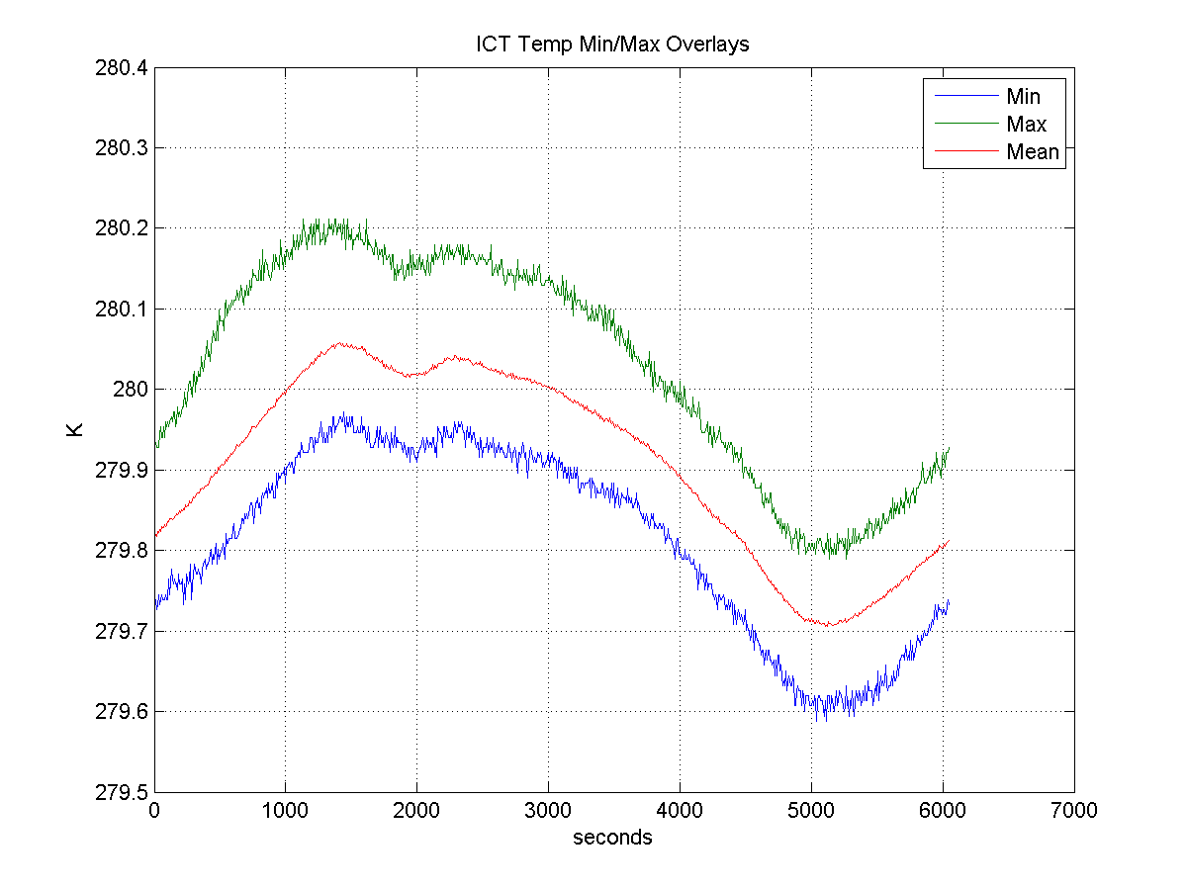
ICT Min/Max/Average Profile

Slide 46
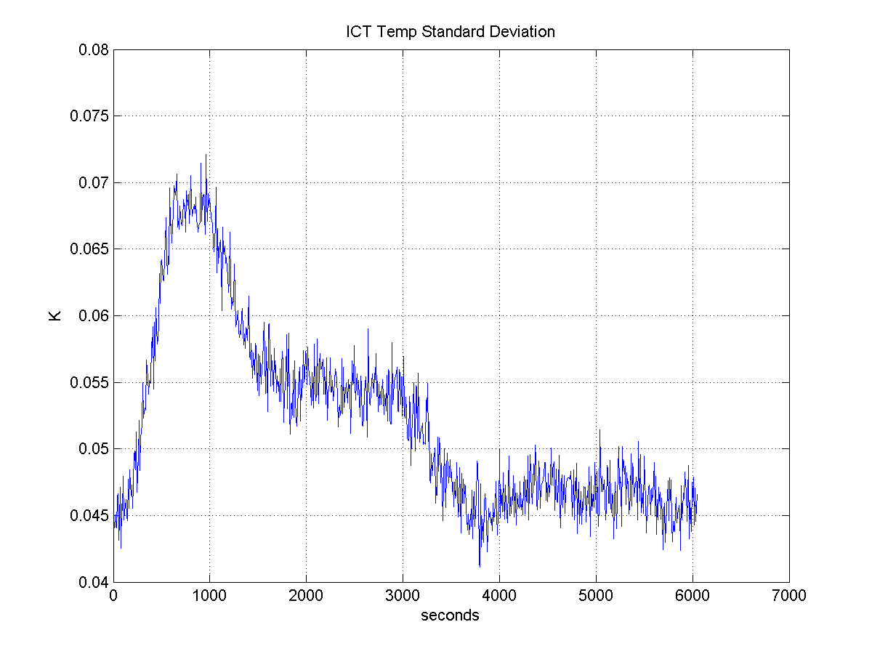
ICT Standard Deviation
Peak Seen In Similar Location to Scan Baffle Peak

Slide 47
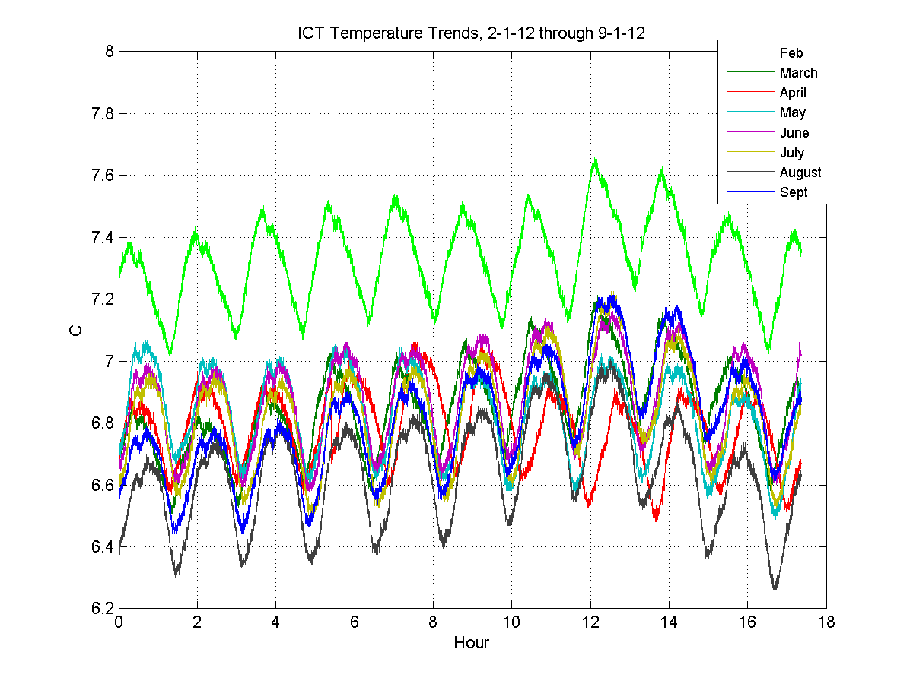
ICT 10 Orbit Overlays
February Results High For Most Telemetry; Instrument Activation Activities Performed During This Time

Slide 48
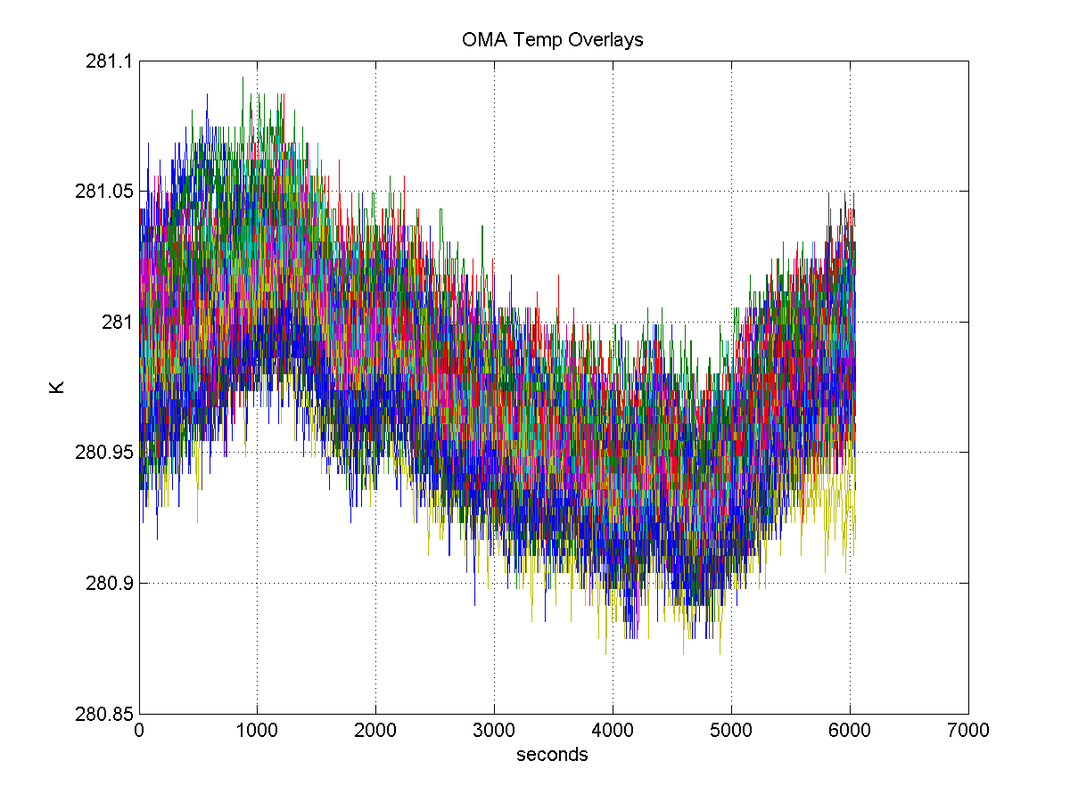
OMA Temperature Overlays, 43 Orbits
Profiles Are Stable

Slide 49
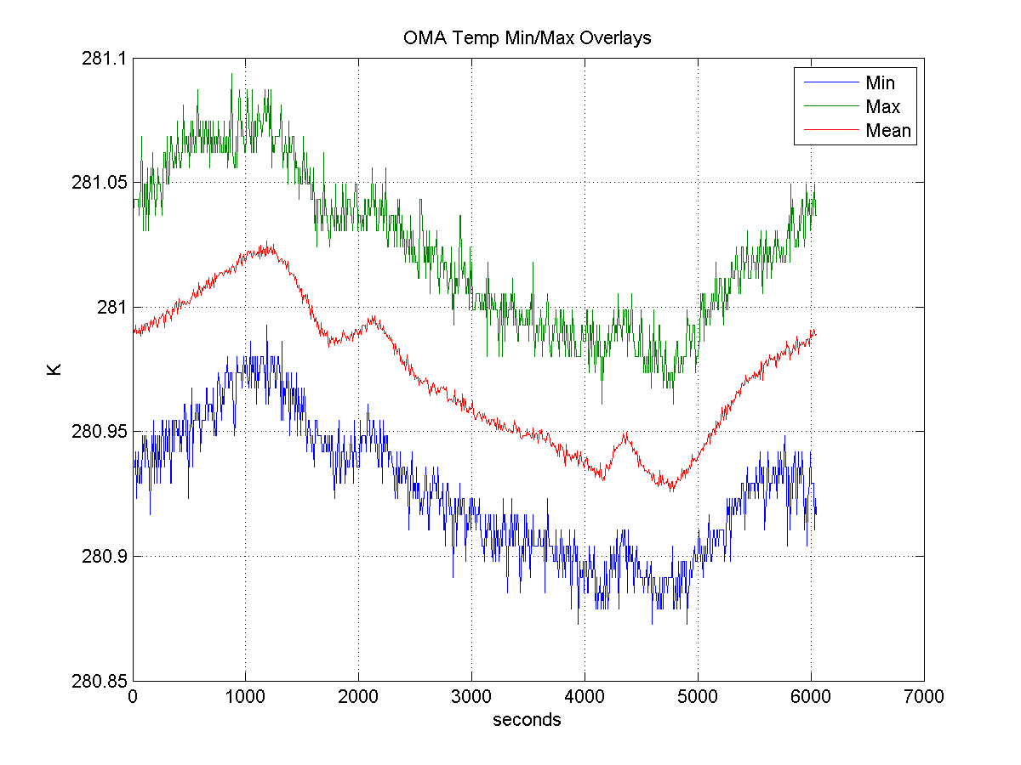
OMA Min/Max/Average Profile

Slide 50
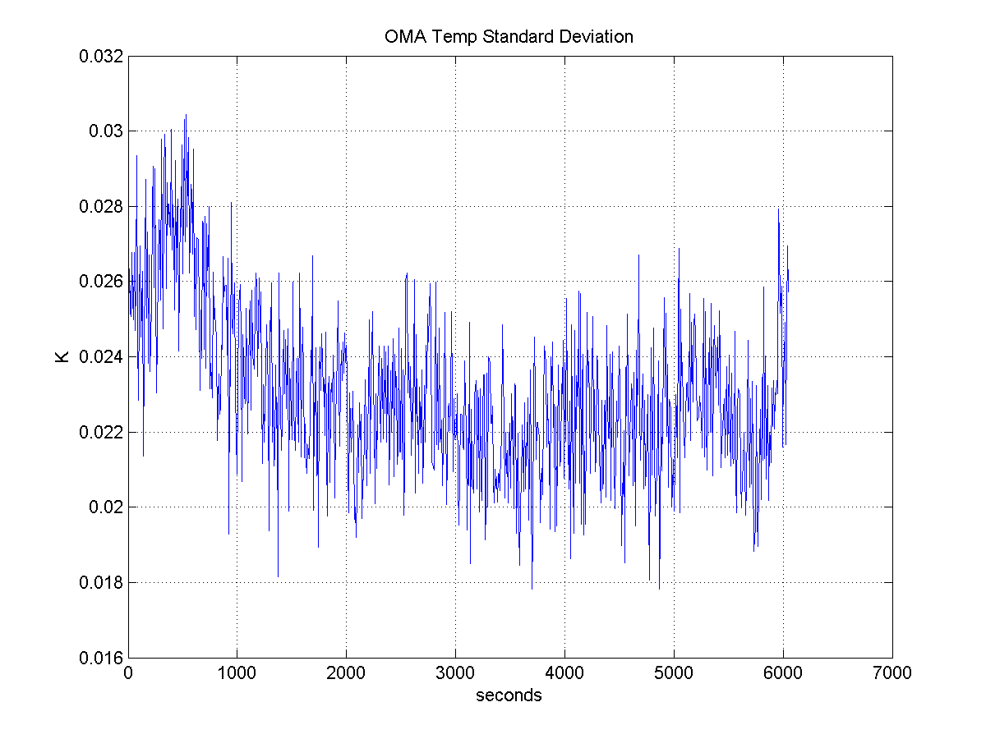
OMA Standard Deviation
Small Peak Seen

Slide 51
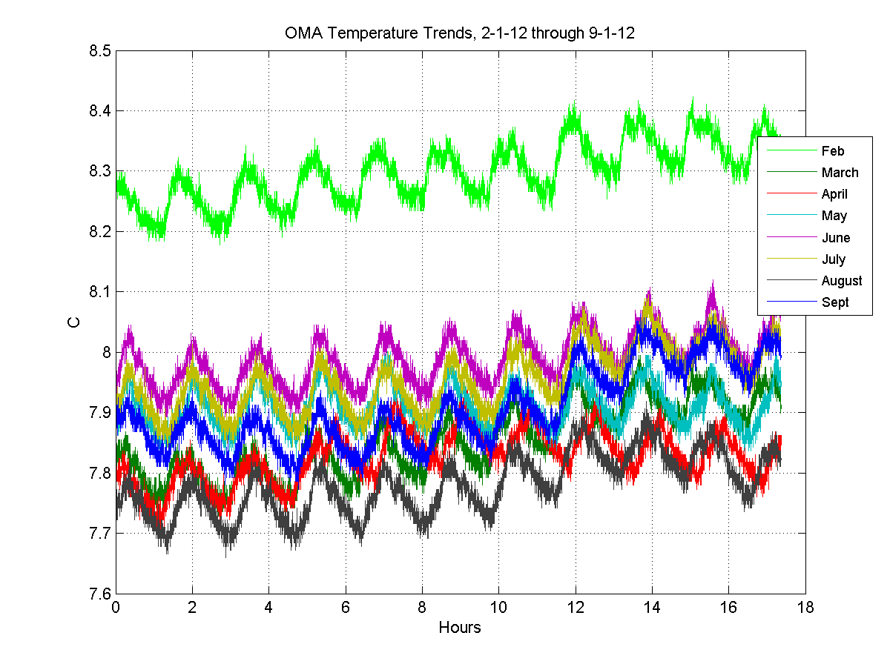
OMA 10 Orbit Overlays

Slide 52
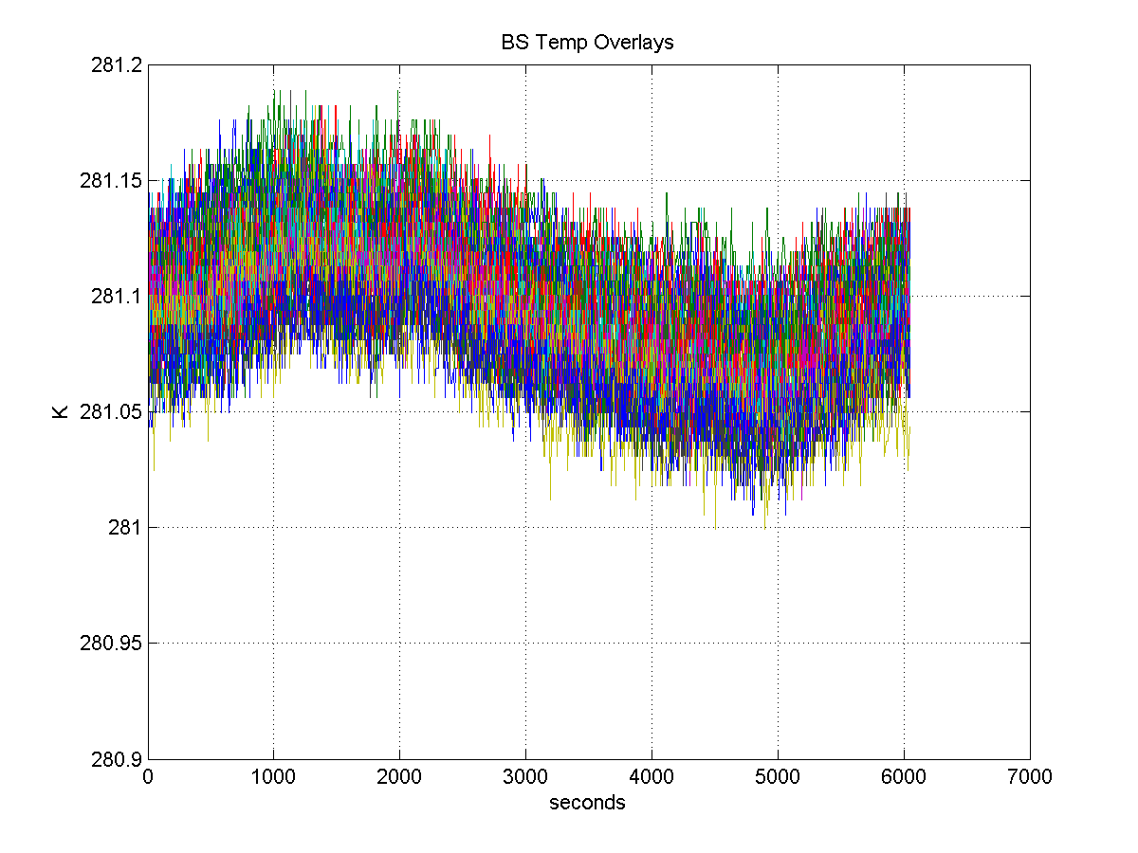
BS Temperature Overlays, 43 Orbits
Profiles Are Stable

Slide 53
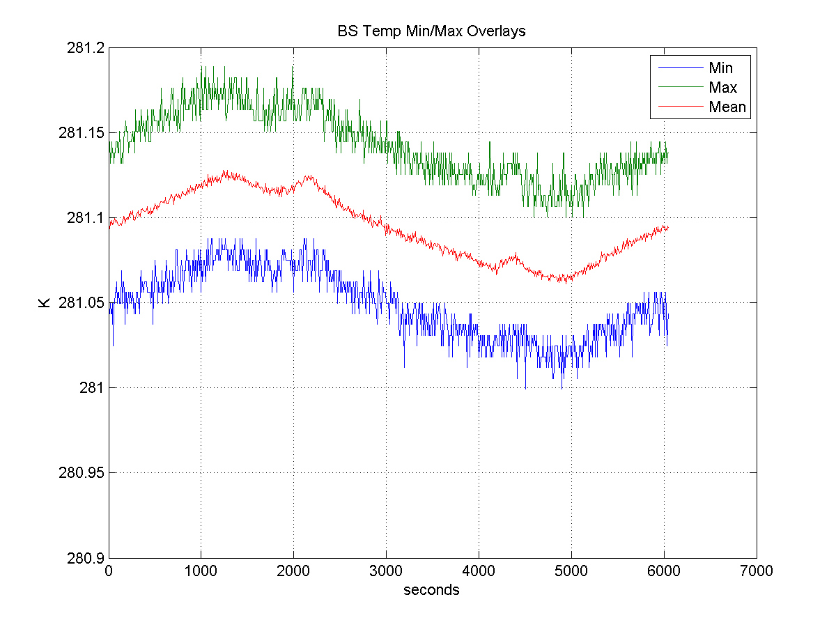
BS Min/Max/Average Profile

Slide 54
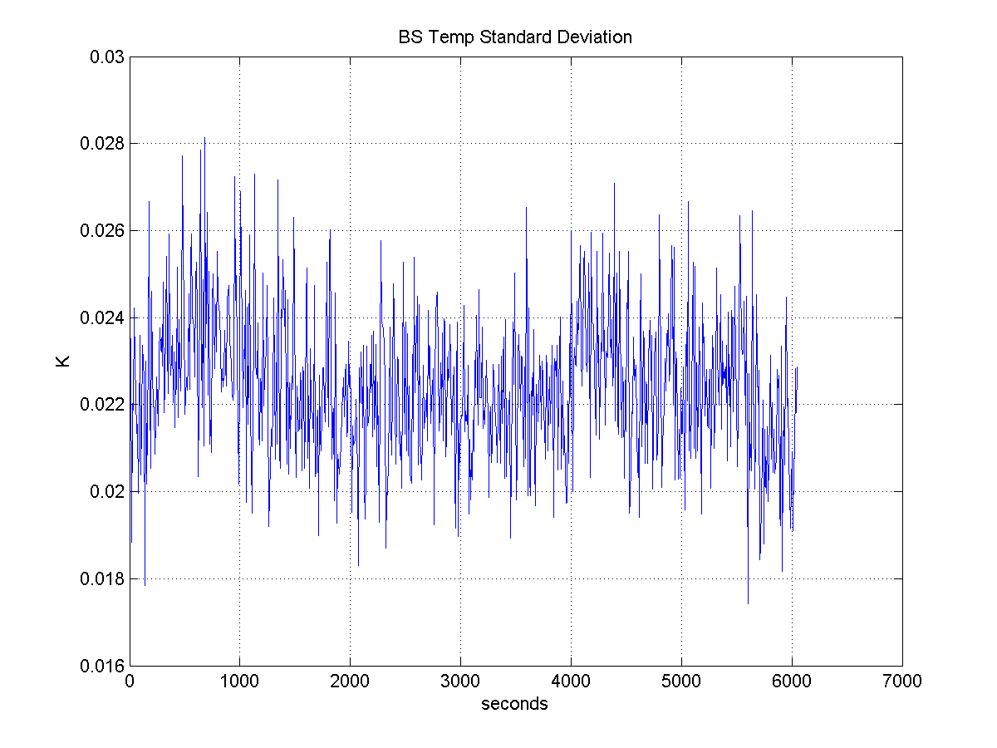
BS Standard Deviation

Slide 55
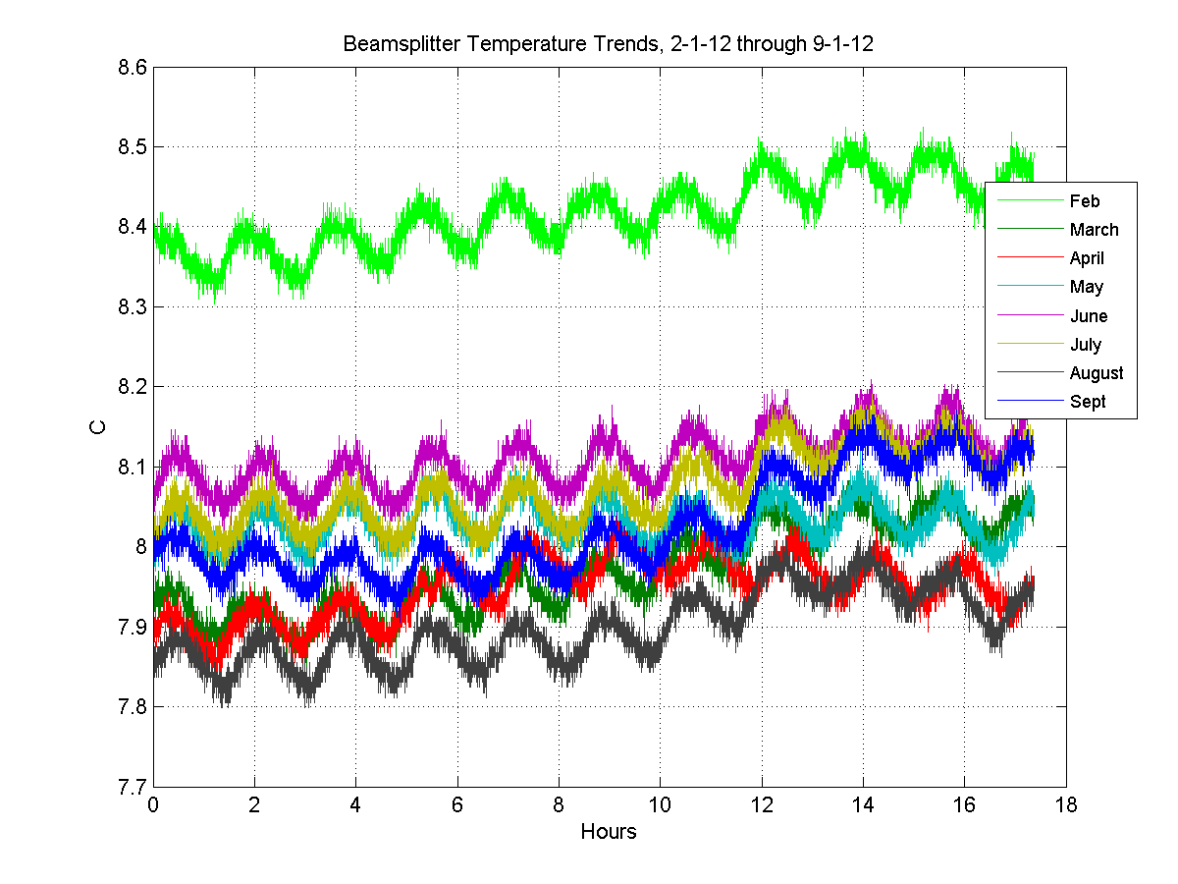
Beamsplitter 10 Orbit Overlays

Slide 56
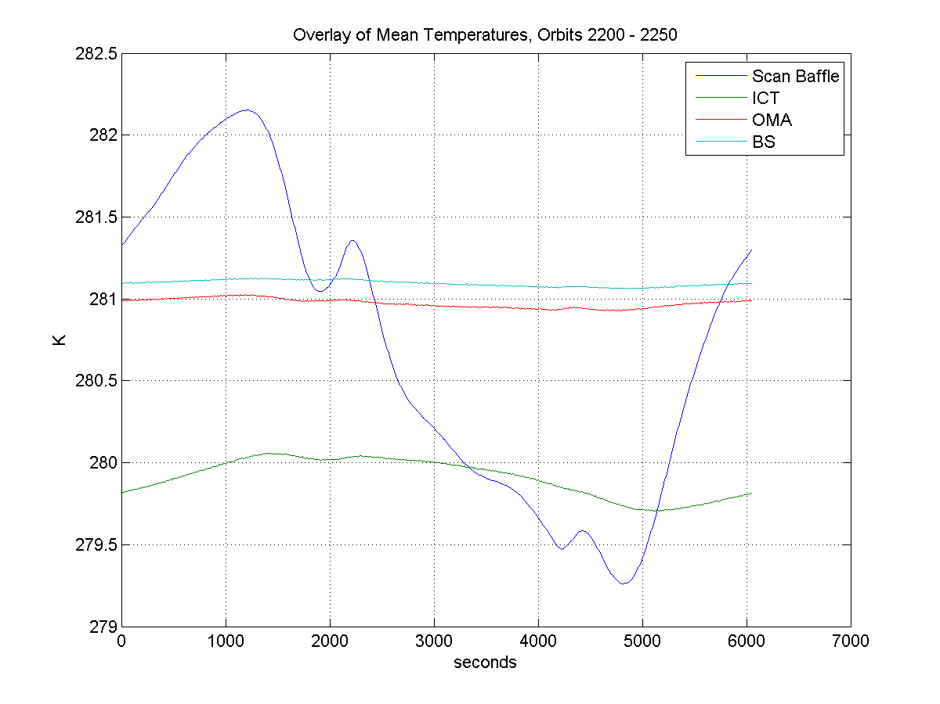
Overlay Of Mean Temperature Profiles Demonstrates Scan Baffle Varies Most

