Slide 1





UW CrIS SDR Status Report
David Tobin, Hank Revercomb, Joe Taylor,
Bob Knuteson, Dan DeSlover, Lori Borg
Suomi NPP SDR Product Review
NCWCP, College Park, MD
23-24 October 2012

Slide 2
UW CrIS SDR
Cal/Val Tasks
CrIS In-orbit RU Estimation
Radiometric Non-linearity Refinement & Evaluation
Internal consistency checks on spectral calibration, spectral self-apodization correction and resampling
ICT Environmental Model Evaluation and Refinement
Internal
consistency checks
on Radiometric Calibration
SNO comparisons with IASI and AIRS
CrIS/VIIRS Radiance Comparisons
Variable
artifact assessment using PCA
Clear sky
Obs minus Calc Analysis
Radiometric Noise assessment
Analysis of non-uniform scene effects on the ILS
Early broadband comparisons with GOES and other GEOs

Slide 3
Summary
QC and file latency
  The frequency of repair granules and missing data has decreased substantially over time.
  Users should avoid the associated corrupt spectra by using the QC flags.
Spectral calibration is very good.
  Small changes to the ILS parameters could be considered to further improve the Inter-FOV agreement, most notably for SW FOVs 1 and 6.
CrIS/AIRS comparisons show mean differences of less than 0.1K and stable with time.
  Signal level dependence is very good; some differences at coldest scene temperatures in the SW.
CrIS/VIIRS comparisons show mean differences of less than 0.1K and stable with time.
  Mean agreement improves when the VIIRS OBC is cooled during linearity characterization tests.
  Shows clear dependence on scene BT for M15 @ 10.8um
FOV-2-FOV differences are less than ~30 mK
  Larger differences previously reported for SW regions are an artifact of the analysis technique.
  CrIS/VIIRS comparisons for SW window (and Responsivity variation analysis, not shown) implies good performance of the ICT environmental model.
Nonlinearity looks very good
  a₂ changes at the ~5 percent (~30mK) level are being investigated, considered.

Slide 4
Data QC and File Latency
Corrupt spectra are due to data transmission issues (repair granules, partially full packets). Corrupt spectra include artifacts ranging from a few tenths K to ~100K.
SCRIS file QC Flags based on packet fill percent and Imaginary Radiance components now properly flag/handle the corrupt spectra.
The frequency of repair granules has decreased substantially over time.
However, repair granules are not typically issued within 3 hours, and repair granules do not always appear to incorporated in IDPS/CLASS generated SCRIS files, and so users need to make use of the QC Flags.
Direct Broadcast data and/or data processed using ADL/CSPP after all repair granules have been received do not have these issues.
These comments/results are relative to how UW gets the CrIS data (via IDPS, CLASS, and SD3E). Characteristics of data distributed to DA centers in ~real-time should also be understood.

Slide 5
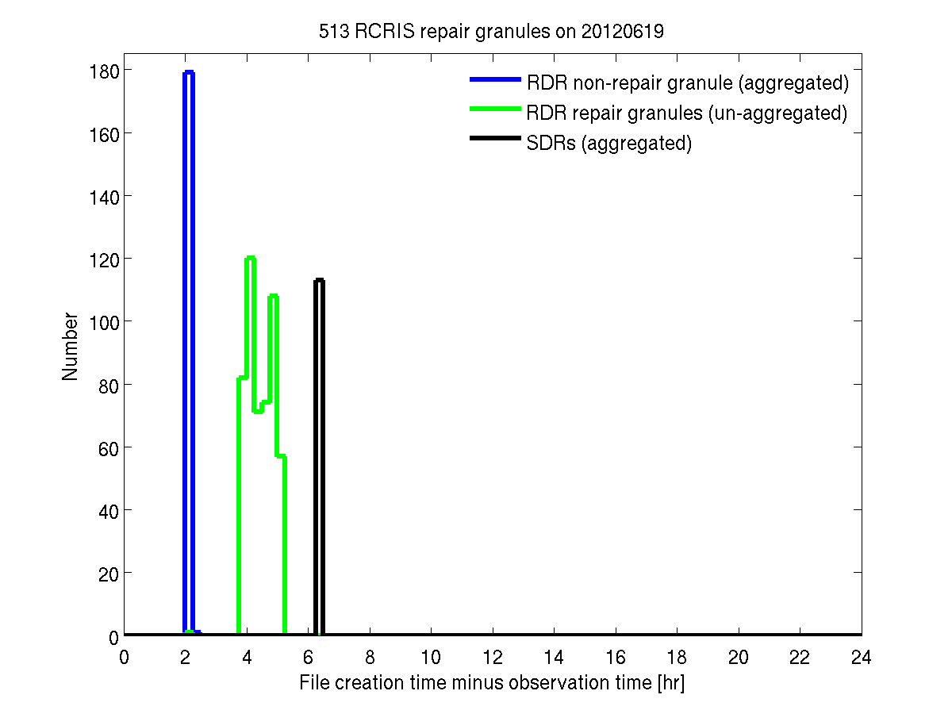
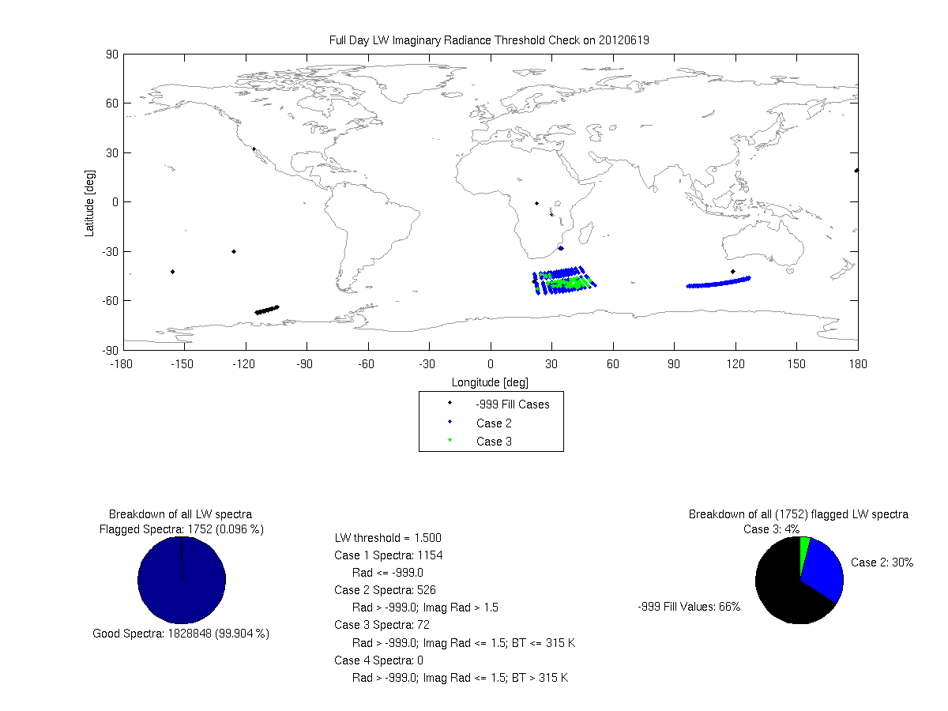
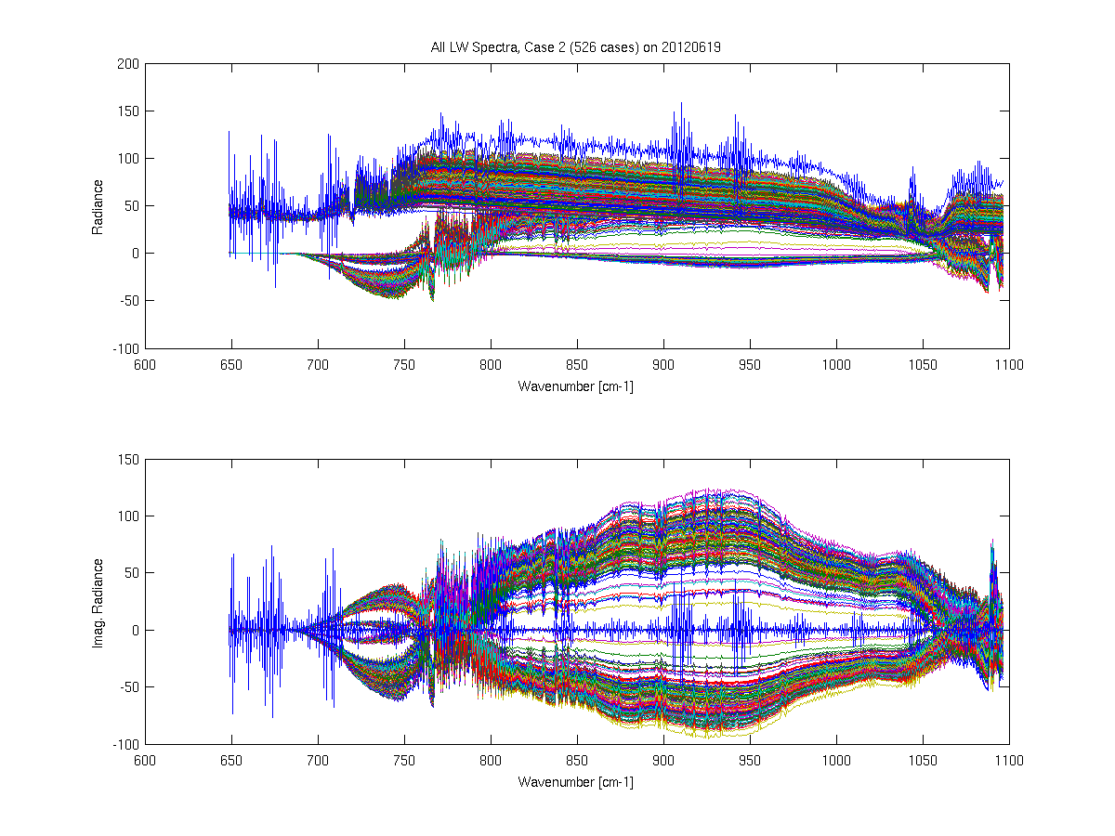
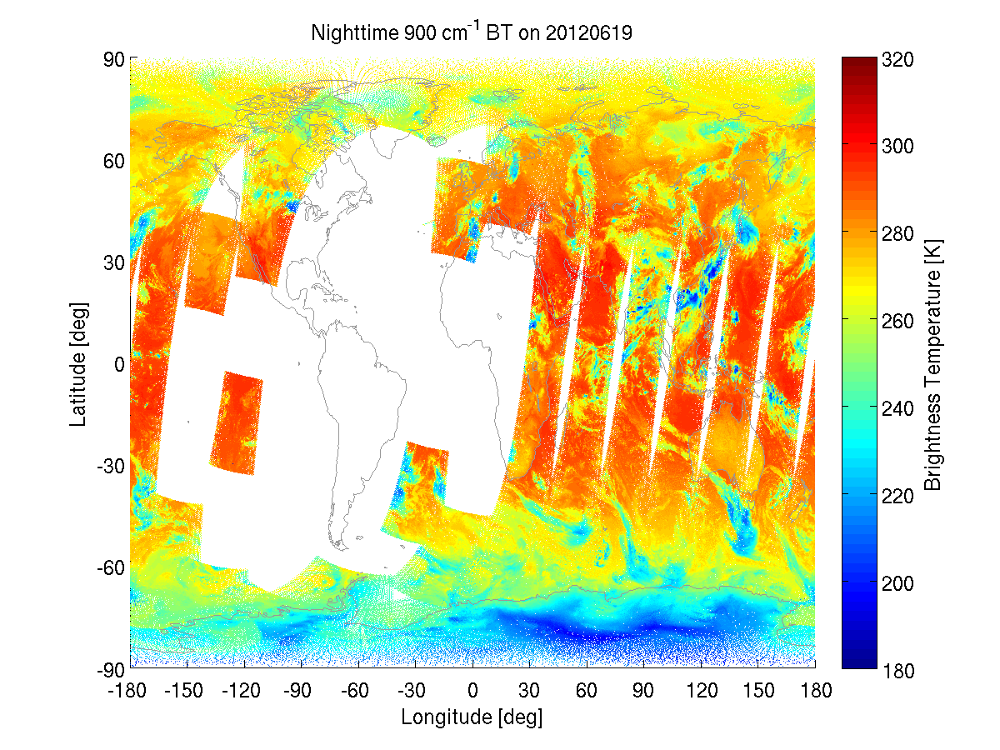
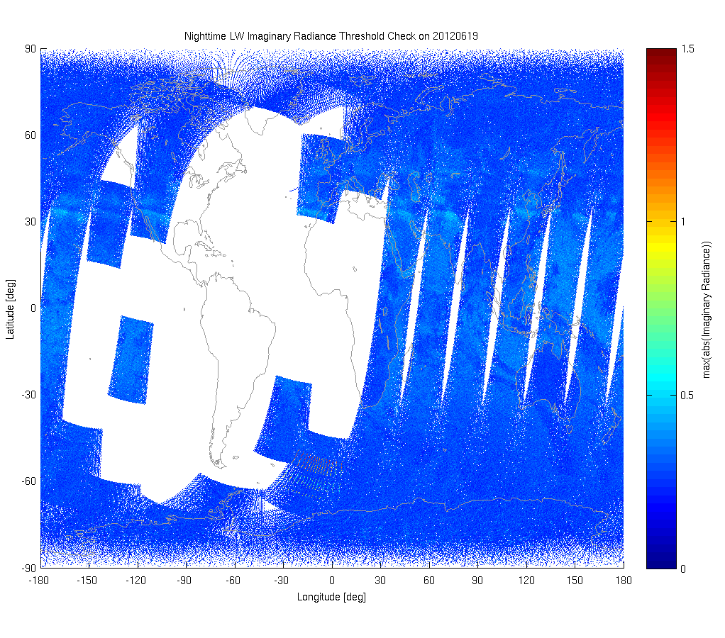
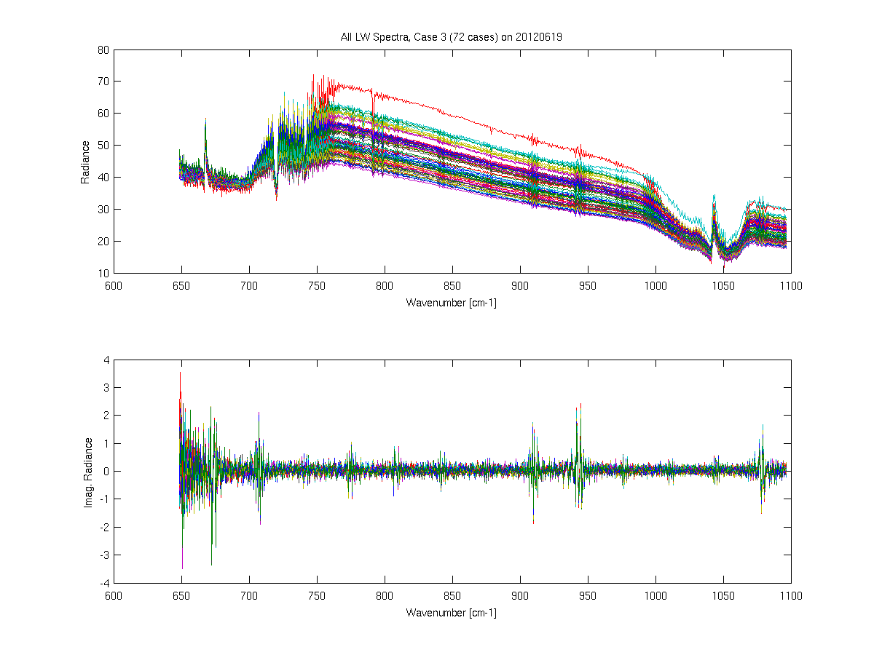
Example QC plots for 2012.06.19, IDPS/CLASS products:
Latency plot
1. Aggregated RCRIS created at +2 hrs
2. RCRIS repair granules created at +4-5 hrs
3. Aggregated SCRIS files created at +6 hrs
Flagged spectra
Flagged, Case 2
Real Part
Imaginary Part
Flagged, Case 3

Slide 6
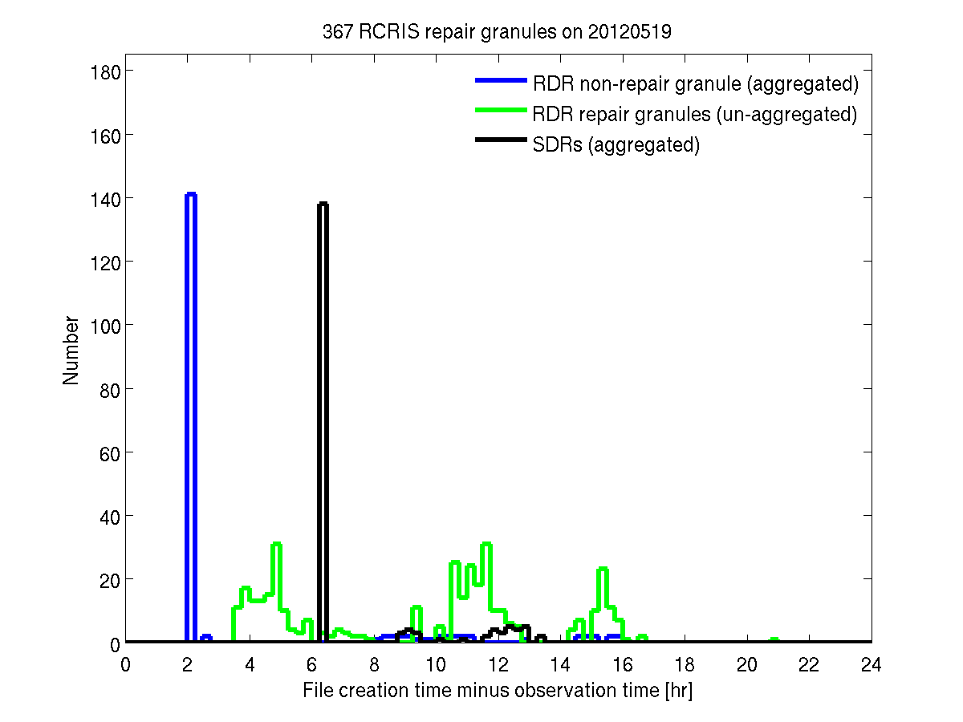
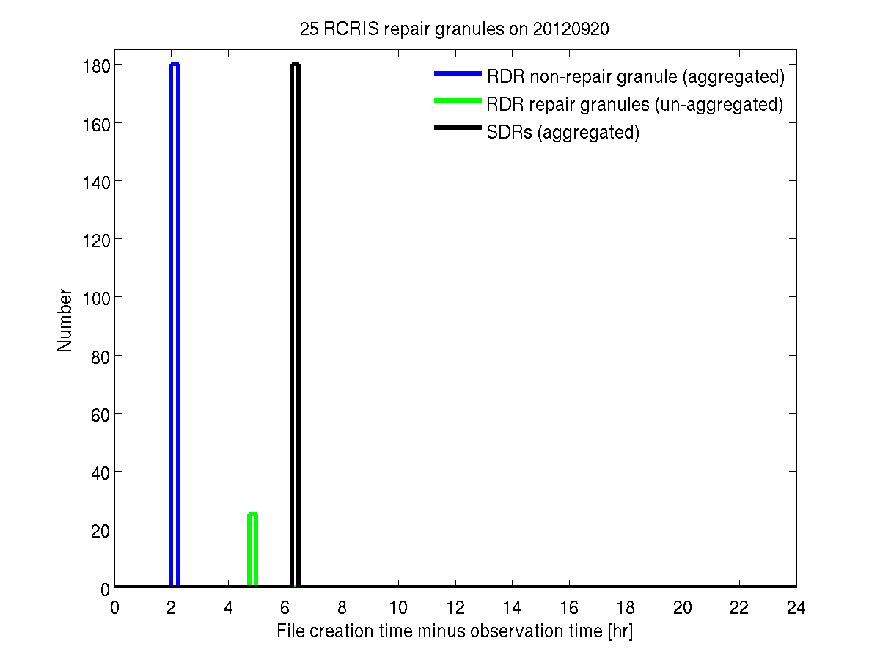
QC time series
SDRs, data percentage per day
SDRs, good data percentage per day
RDR repair granules per day

Slide 7
Inter-FOV spectral calibration
The spectral calibration is very good.
Neon lamp views indicate metrology laser variations are less than 1ppm over the last 8 months.
The Inter-FOV calibration is better than 0.2 ppm for LW, 0.3 ppm for LW, 0.7 ppm for SW
Small changes to the ILS parameters could be made to further improve the Inter-FOV agreement, most notably for SW FOVs 1 and 6. (Full spectral resolution data should also be used to assess potential changes).

Slide 8
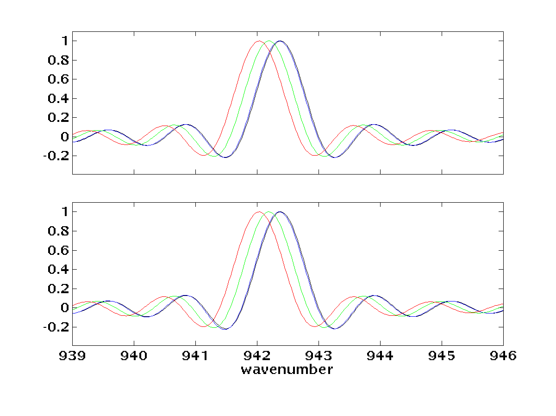
Example Center, Side, and Corner FOV ILSs, before Self-Apodization Corrections
 |  | Center FOV | Edge FOV | Corner FOV
centroid (cm⁻¹) | Obs | 942.367 | 942.195 | 942.034
 | Calc | 942.366 | 942.195 | 942.034
FWHM (cm⁻¹) | Obs | 0.747 | 0.757 | 0.767
 | Calc | 0.751 | 0.759 | 0.767
Lfoot | Obs | 0.358 | 0.329 | 0.313
 | Calc | 0.347 | 0.328 | 0.313
Rfoot | Obs | 0.347 | 0.326 | 0.311
 | Calc | 0.345 | 0.329 | 0.313
Calculated
Pure sinc
Center FOV5
Edge FOV4
Corner FOV1
Observed
Notes:
The laser wavelength used here and discussed throughout is ½ of the physical wavelength. It is used to represent the distance between samples that is ½ of the laser wavelength because all zeros are used for sampling.

Slide 9
Metrology laser wavelength deviations, derived from Neon lamp views:
Mean value = 773.13031008 nm
Longwave band, 730-740 cm⁻¹
Inter-FOV spectral shifts w/r/t FOV5,
derived from spectral correlation analysis:
Midwave band, 1350-1380 cm⁻¹
Shortwave band, 2200-2250 cm⁻¹

Slide 10
Metrology laser wavelength deviations, derived from Neon lamp views:
Mean value = 773.13031008 nm
Inter-FOV Spectral Cal w/r/t FOV5;
Mean values over last 6 months:
Longwave band, 730-740 cm⁻¹
Inter-FOV spectral shifts w/r/t FOV5,
derived from spectral correlation analysis:
Midwave band, 1350-1380 cm⁻¹
Shortwave band, 2200-2250 cm⁻¹

Slide 11
CrIS/AIRS Radiometric Comparisons
Mean differences are less than 0.1K
Time dependence is very small
Signal level dependence is very good; some differences at cold scene temperatures in the SW.

Slide 12
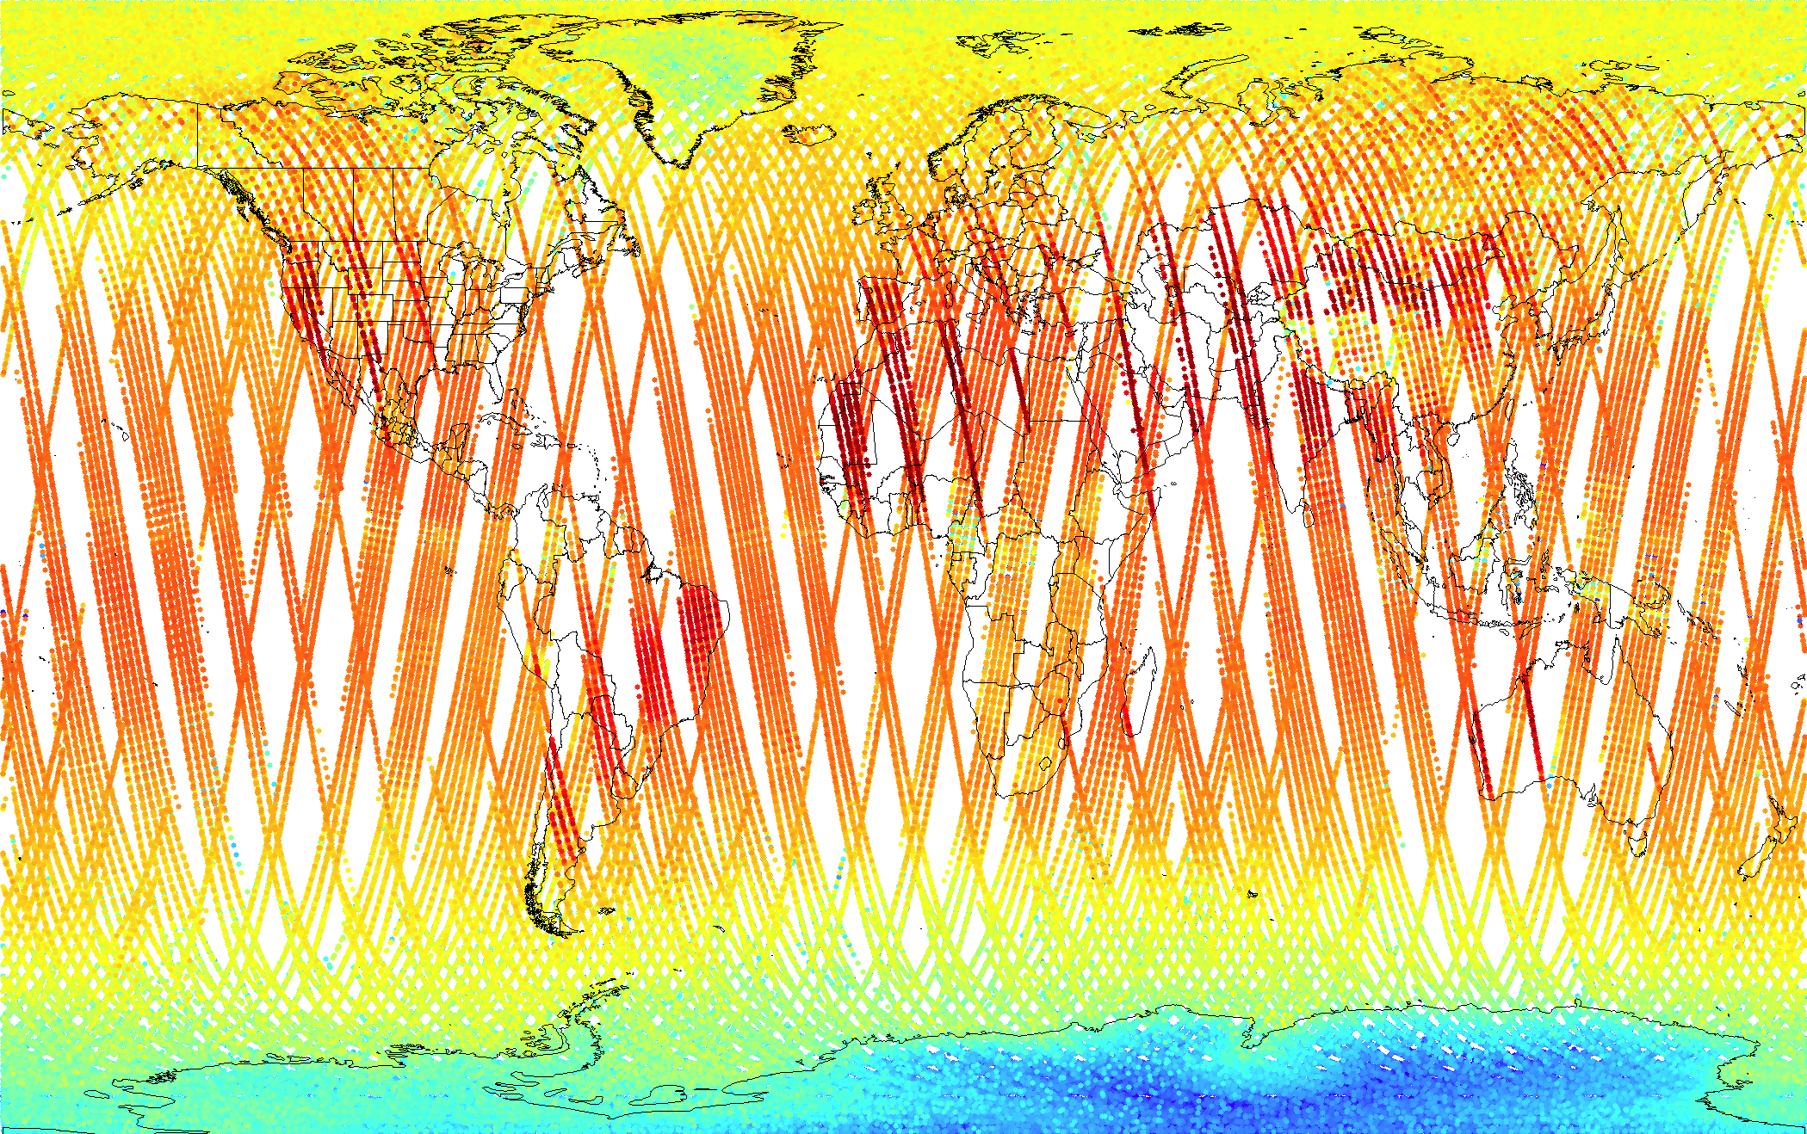

CrIS/AIRS dataset, 25 Feb to 7 Oct
320K
835 cm⁻¹ BT (K)
180K
455,874 “big circle” samples, 25 Feb to 7 Oct
Scan angles ≤ 30°; Scan angle difference ≤ 3°; Time Diff <= 20 min
AIRS data is L1B v5; CrIS data is ADL (CSPP v1.1) with native Eng. Packets

Slide 13
Selected wavenumber regions
To largely avoid the AIRS L1B SRF issues, comparisons shown here are performed for representative ~10 cm⁻¹ regions, selected for sensitivity to CrIS nonlinearity and the CrIS ICT environmental model:
672-682
830-840
1382-1408
1585-1600
2360-2370
2500-2520
CrIS
AIRS

Slide 14
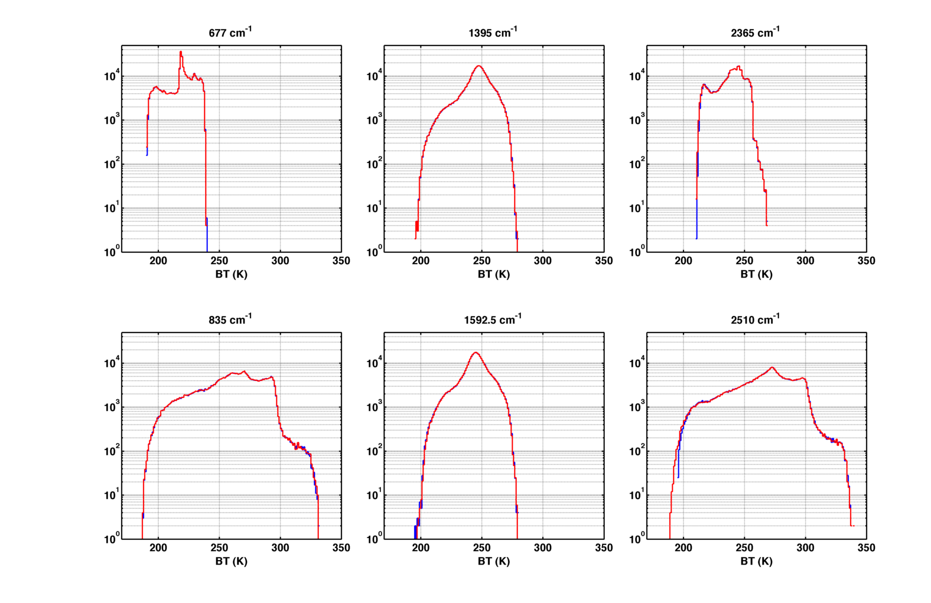
BT Distributions
CrIS
AIRS

Slide 15
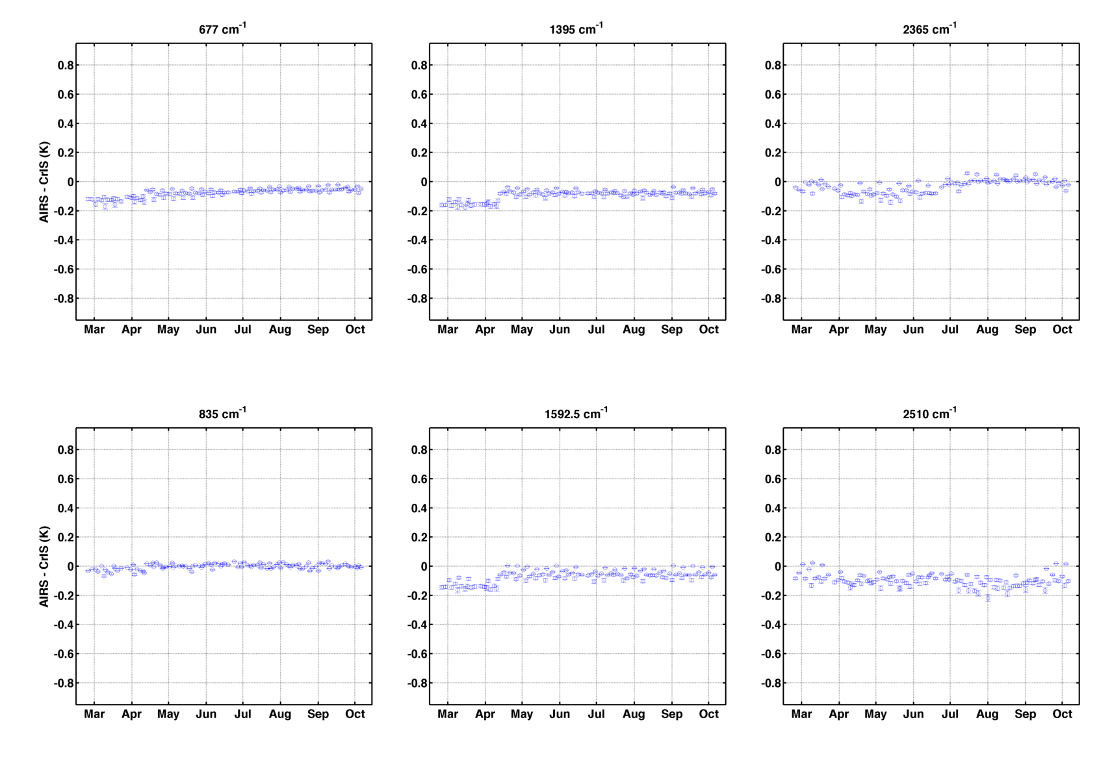
Daily Mean Differences
v33 upload
V33 Engineering packet upload on April 11 (changes to NL a2 coefficients for LW and MW)
Changes over time are very small.
Largest are for LW 677 cm⁻¹ region, ~30mK, under investigation.
Interesting change in SW 2365 cm⁻¹ behavior in late June.

Slide 16
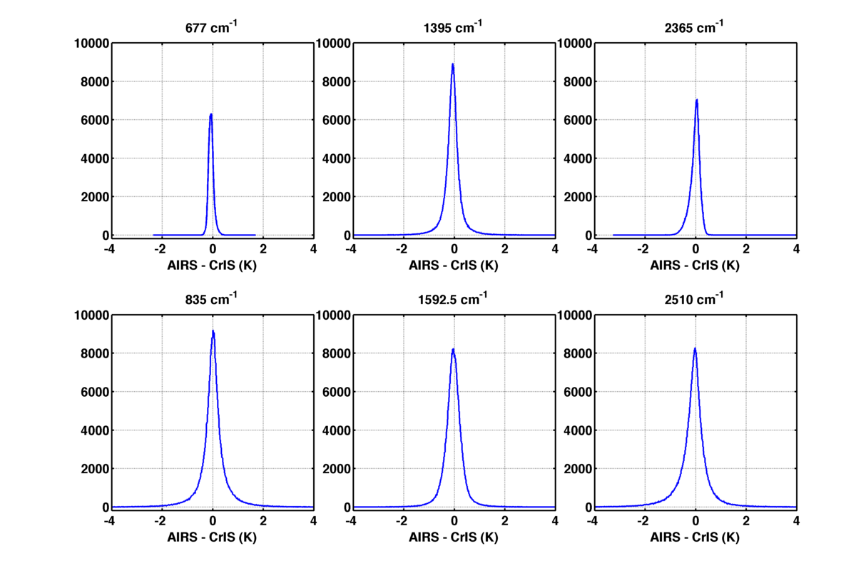
BT Difference Distributions, 13 Apr – 7 Oct
-0.061 ± 0.001 K
-0.077 ± 0.002 K
0.038 ± 0.006 K
0.020 ± 0.004 K
0.067 ± 0.002 K
-0.058 ± 0.003 K

Slide 17
CrIS/VIIRS Radiometric Evaluations
(in collaboration with Chris Moeller)
The comparisons are beneficial for both VIIRS and CrIS
Mean differences are <0.1K
Comparisons shows clear dependence on scene BT for M15, with VIIRS cooler than CrIS by 0.4K at 205K.
Mean agreement improves when the VIIRS OBC is cooled during quarterly linearity characterization tests.
Small changes in mean differences (~12mK) over last 6 months.

Slide 18
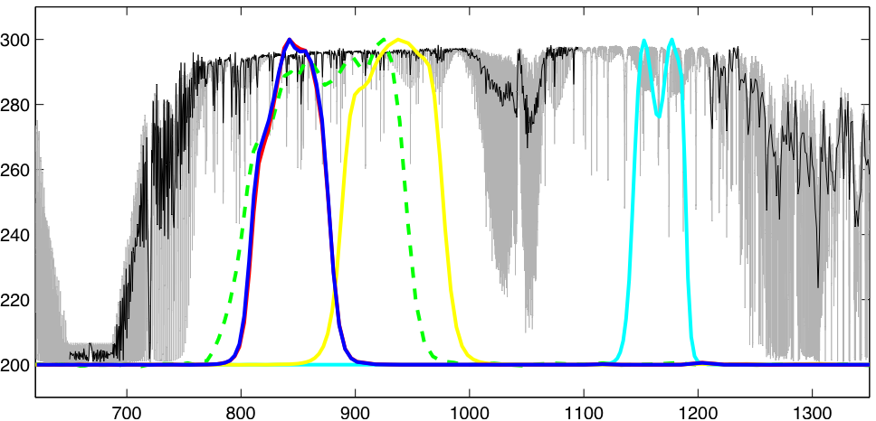
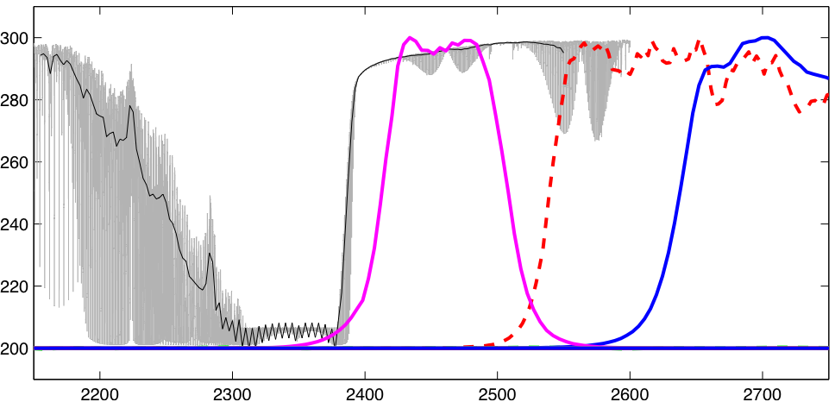
Monochromatic spectrum, CrIS spectrum, and VIIRS SRFs
BT (K)
M15
10.8um
M16A
12um
wavenumber, 1/cm
BT (K)
M13
4um
wavenumber, 1/cm

Slide 19
CrIS processing is CSPP with v33 Eng. Packet; VIIRS is IDPS product
Each day includes ~500,000 colocations which pass a spatial uniformity test
Daily mean differences are < 0.1K since VIIRS OBC LUT change in early March
Major discontinuities are due to known events (e.g. VIIRS OBS LUT change in early March, shutdown/restart on March 24/25, VIIRS OBC temperature ramp in late May and mid Sept)
Slow trends in all three bands, ~12 mK, since May

Slide 20
mean scene BTs
M13 differences show little dependence on scene BT, except for coldest scenes
M15 and M16 show clear scene BT dependence of differing magnitude

Slide 21
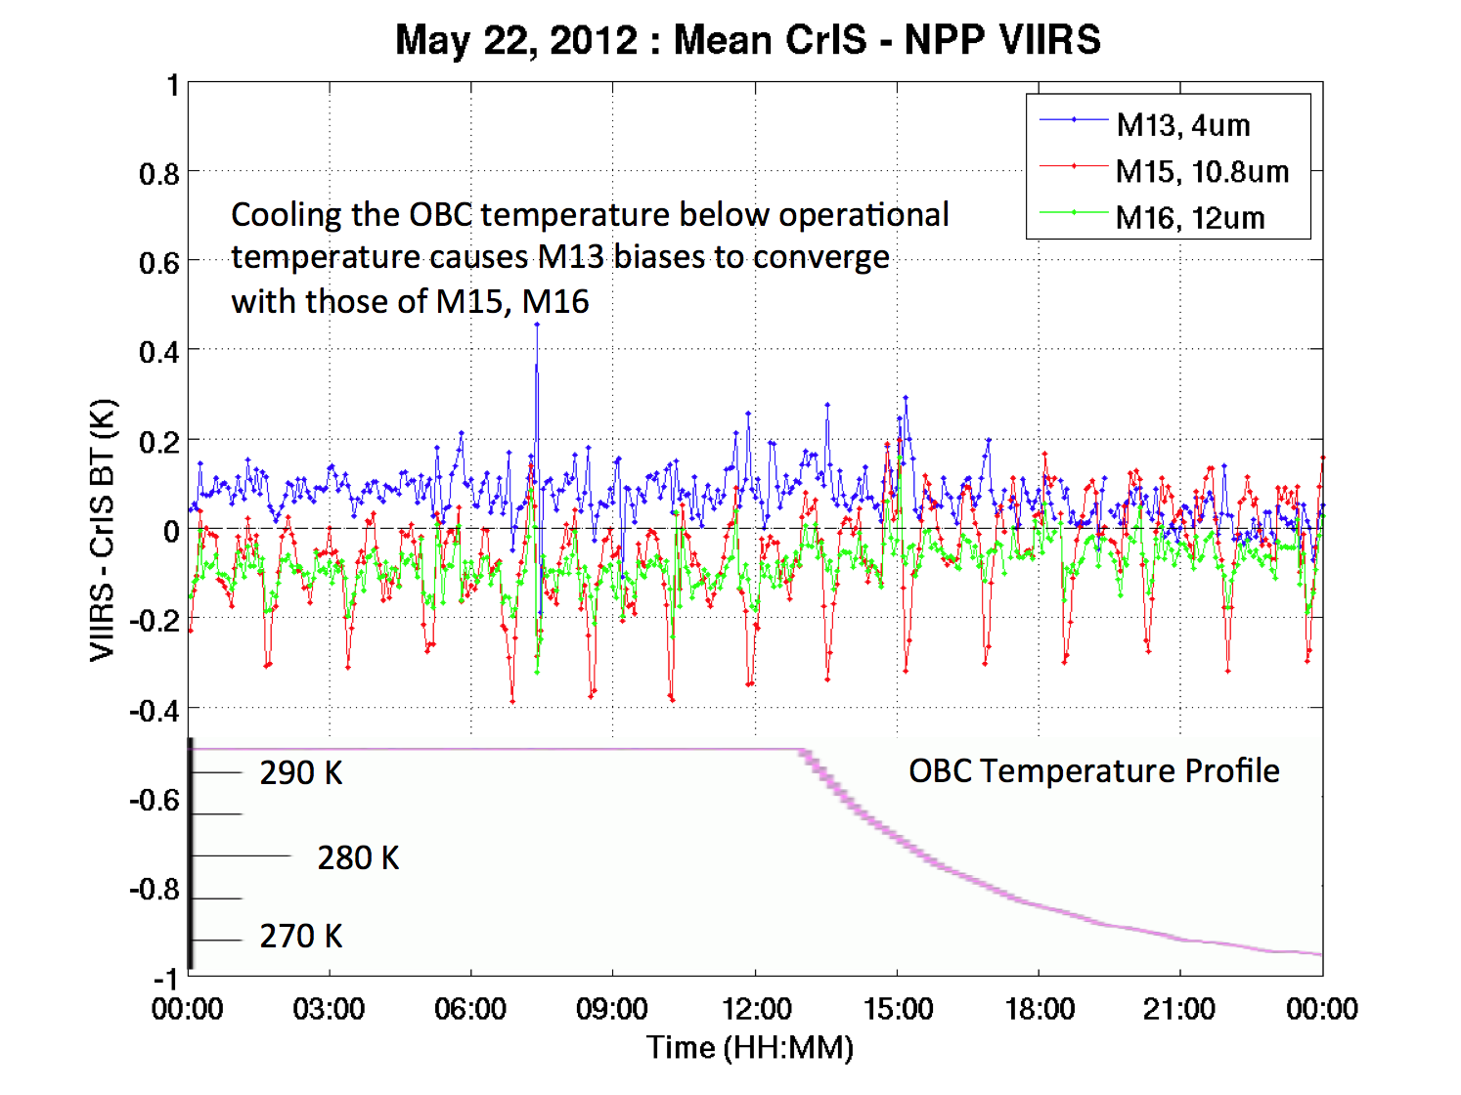
Figure c/o
C. Moeller
As the VIIRS OBC temperature approaches the instrument temperature, the VIIRS calibration becomes less sensitive to knowledge of the OBC emissivity and to knowledge of the instrument temperatures, and also changes the nonlinearity “set point”; Changes to the CrIS/VIIRS comparisons during this test implies that small improvements to the VIIRS calibration parameters are possible.
For warm scenes, cooling the OBC temperature causes (1) M13 biases to converge with those of M15 and M16, as well as (2) better overall agreement with CrIS.

Slide 22
FOV-2-FOV Radiometric Differences
FOV-2-FOV differences are less than ~30 mK
Larger differences previously reported for SW band are an artifact of the analysis technique.
CrIS/VIIRS comparisons for SW window implies good performance of the ICT environmental model.

Slide 23
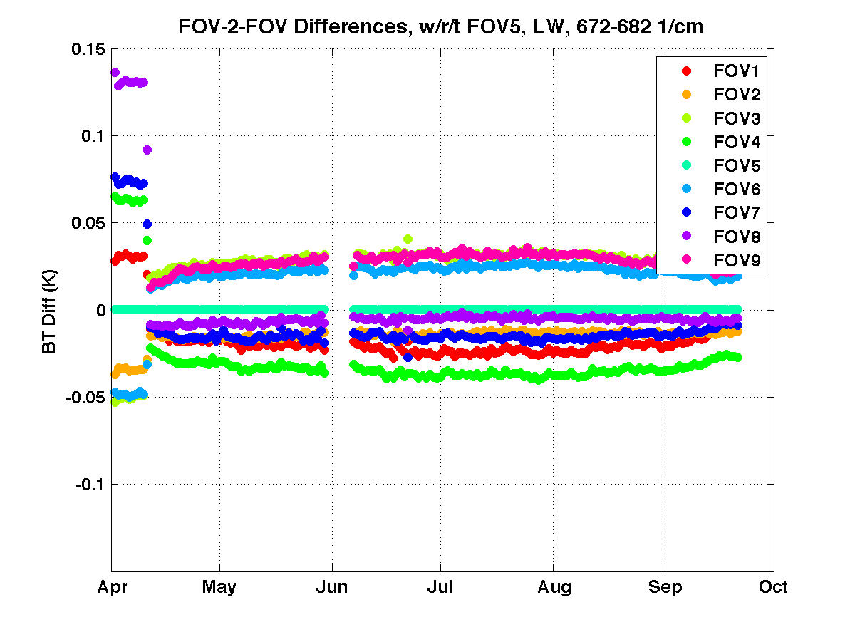
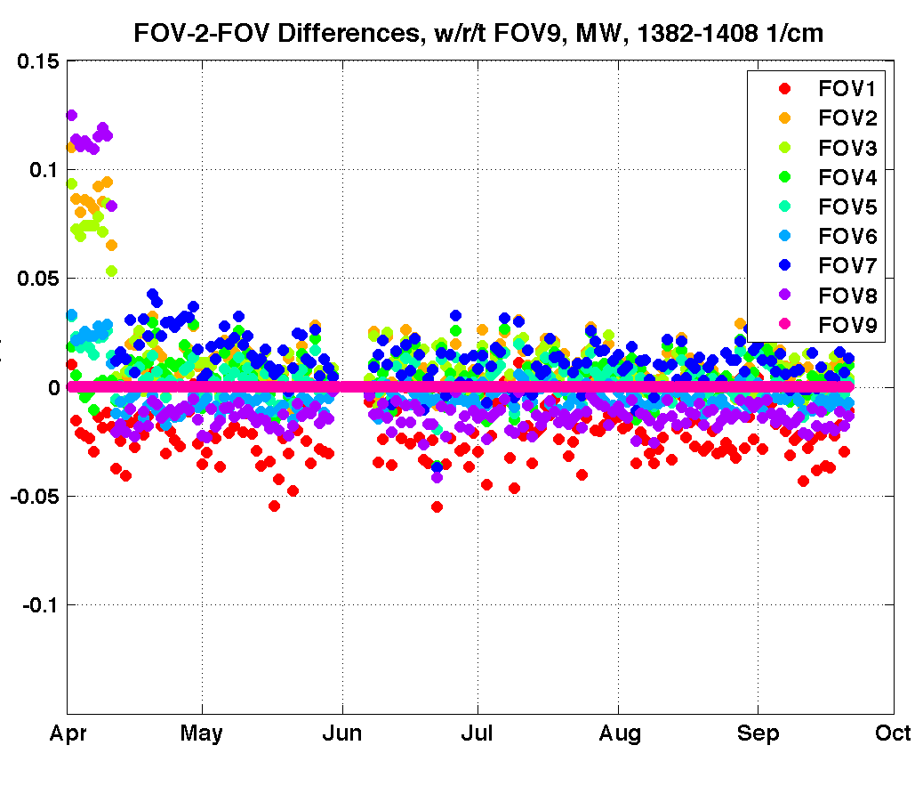
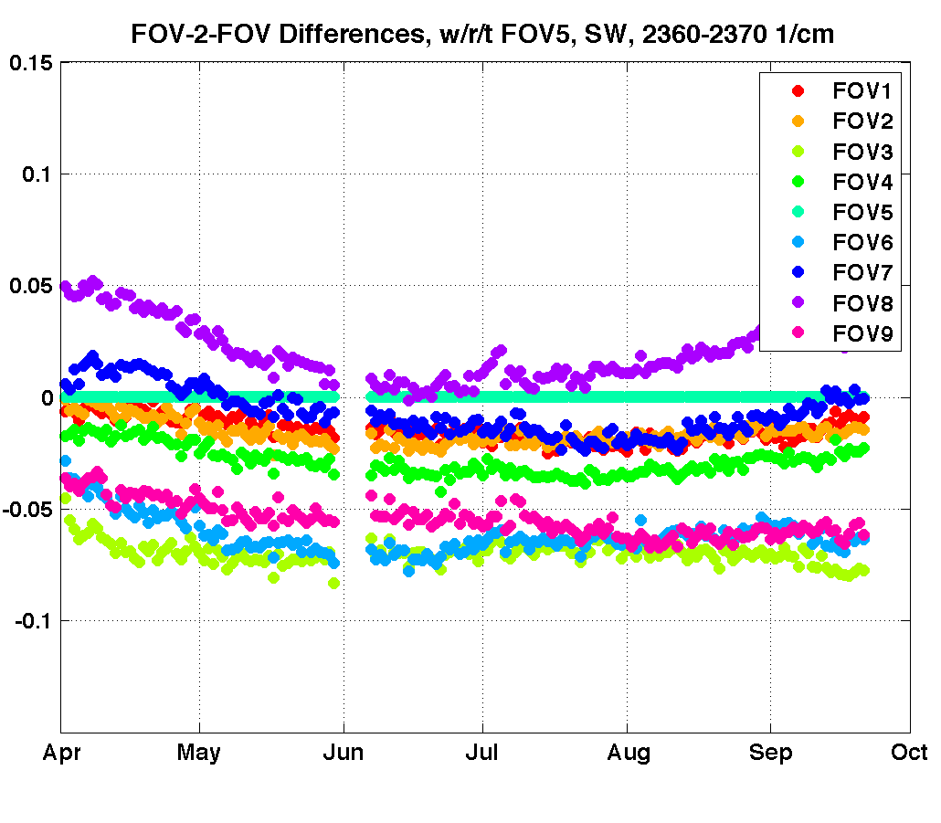
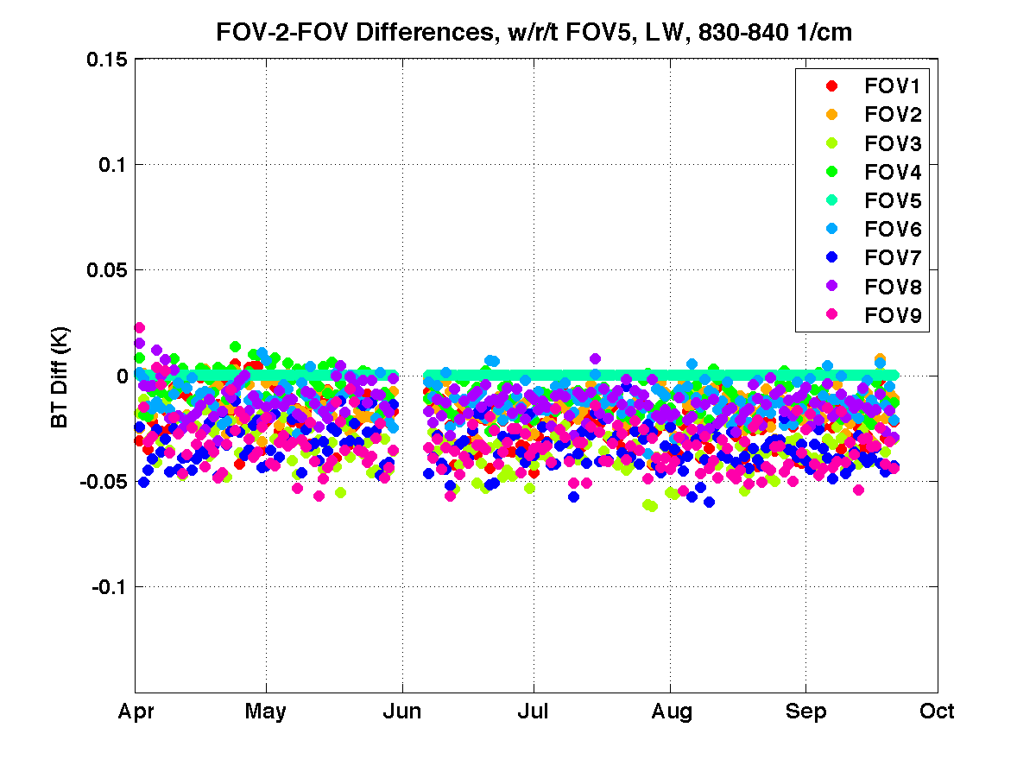
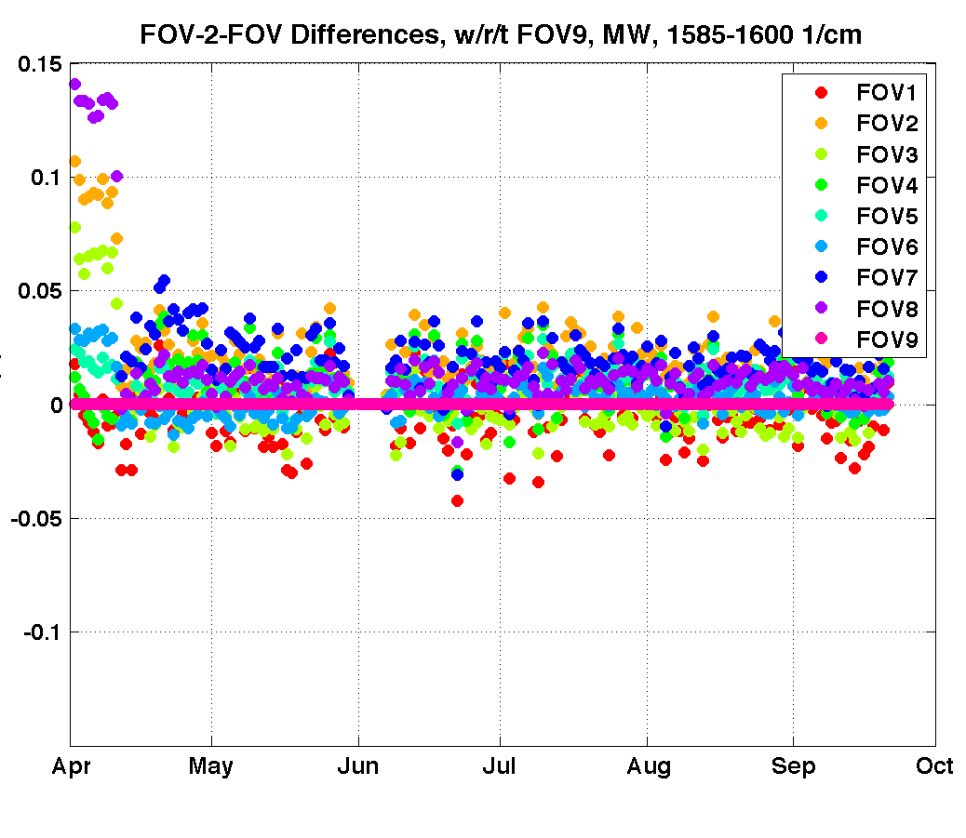
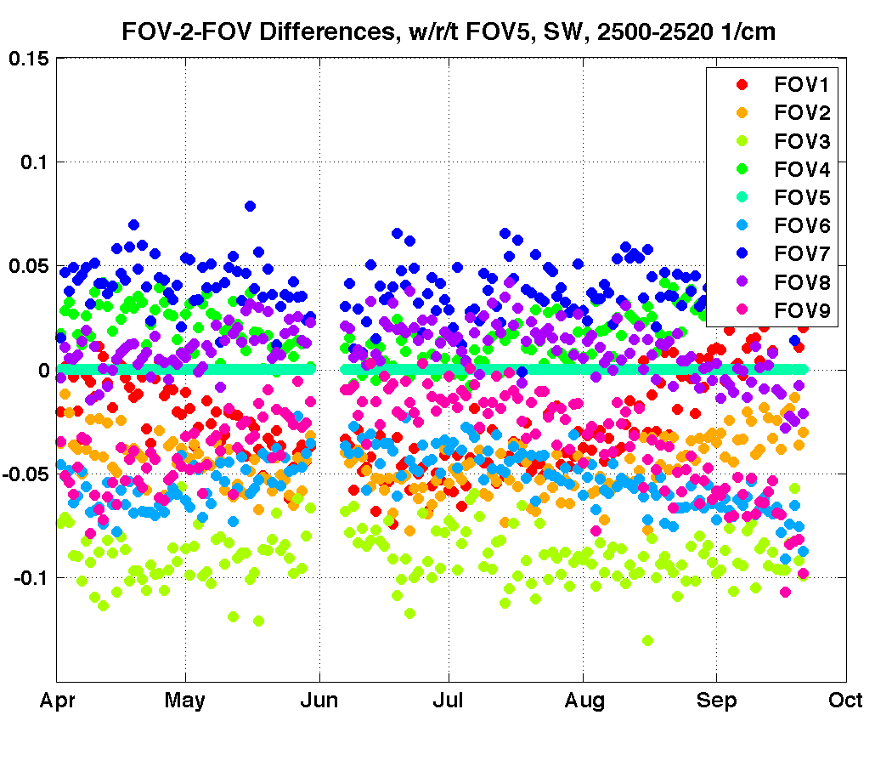
“CrIS-only” FOV-2-FOV differences;
Daily mean differences
LW, 672-682 cm⁻¹, wrt FOV5
MW, 1382-1408 cm⁻¹, wrt FOV9
SW, 2360-2390 cm⁻¹, wrt FOV5
LW, 830-840 cm⁻¹, wrt FOV5
MW, 1585-1600 cm⁻¹, wrt FOV9
SW, 2500-2520 cm⁻¹, wrt FOV5
IDPS SCRIS files

Slide 24
“CrIS-only” FOV-2-FOV differences;
Mean Differences over last 6 months
LW and MW values are less than ~30mK.
SW values are larger, particularly for FOVs 3,6, and 9, for both opaque and window regions.

Slide 25
CrIS/VIIRS M13 (4um) comparisons
CrIS/VIIRS comparisons, broken out by CRIS FOV, offer an independent way to assess CrIS FOV-2-FOV differences; Less impact of view angle differences present in CrIS-only approach.
SW window region is most sensitive to the CrIS ICT environmental model, which includes the modeled term for the SSM Baffle which varies with orbit phase.
Variations shown here are well behaved as a function of orbit phase. Some low level behavior (~0.1K) seen for FOVs 7 and 8.

Slide 26
“CrIS-only” and CrIS/VIIRS derived FOV-2-FOV differences
The CrIS/VIIRS comparisons for SW M13, opposed to the CrIS-only results, do not show the larger differences for FOVs 3,6,9.
The CrIS/VIIRS comparisons for LW M16 show very good agreement with the CrIS-only results.
FOV-2-FOV differences for all bands/regions are less than ~30mK
Currently investigating impacts of CrIS-only approach limitations on other wavelength regions.

Slide 27
Radiometric Nonlinearity
NL corrections look very good, based on FOV-2-FOV and other analyses.
a2 changes below the ~10 percent level are being investigated. (Pre-launch characterization had 10% (LW) and 15% (MW) 1-sigma uncertainty).

Slide 28
Example Impact of Nonlinearity Correction on calibrated Earth view radiances
NLC: C’ = C / (1 - a₂ V_{DC} )
Notes:
Warm scene. ~clear sky
Positive and negative signatures in LW.

Slide 29
v32 (TVAC, yellow) and v33 (In-orbit, orange) a2 values
Notes:
NL Summary:
Overall, the FOV-2-FOV analysis is working well.
MW7 value changed by ~100% (not unexpected)
MW6 and 9 remained linear
Overall, FOV-2-FOV values are larger (~10%) than v32 values.
But does not necessarily suggest actual changes in all FOVs due to differences in TVAC vs. In-orbit analysis uncertainties
SW biases are not zero, and are FOV dependent.
The next iteration of Nonlinearity analysis will likely require modifications to the analysis technique, addressing the SW biases and other possible sources of radiometric bias.

Slide 30
Nonlinearity Monitoring
Create daily estimates of fractional change in detector a₂ values.
Example below for FOV-2-FOV differences shown previously.
No conclusive evidence for a₂ change exceeding the 10% level.

Slide 31
October 6 Suomi-NPP underflight
A “piggy-back” flight, funded by JPSS Program Science, as part of the recent NASA HS3 campaign.
A dedicated Suomi-NPP campaign will be held in May 2013 in support of the "Validated" SDR review.

Slide 32
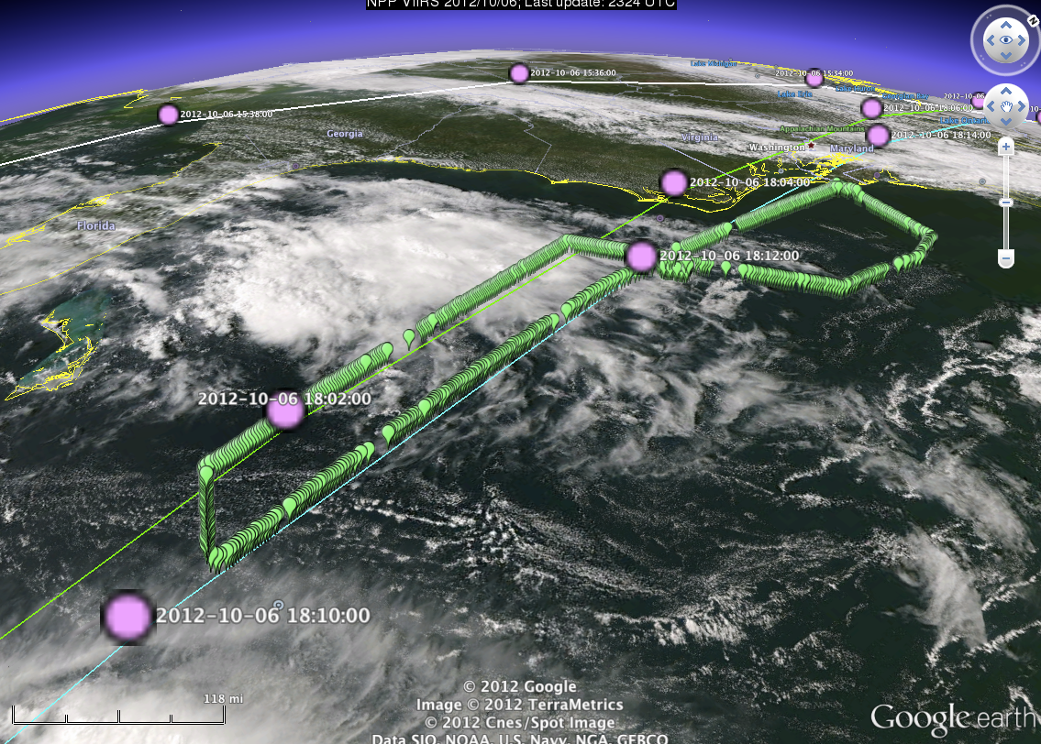
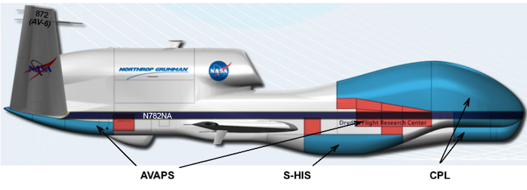
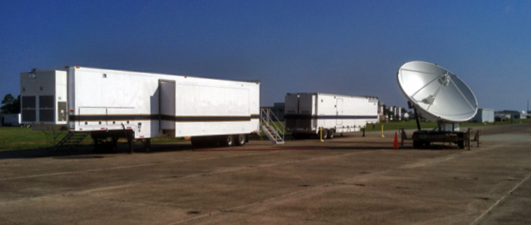

Slide 33
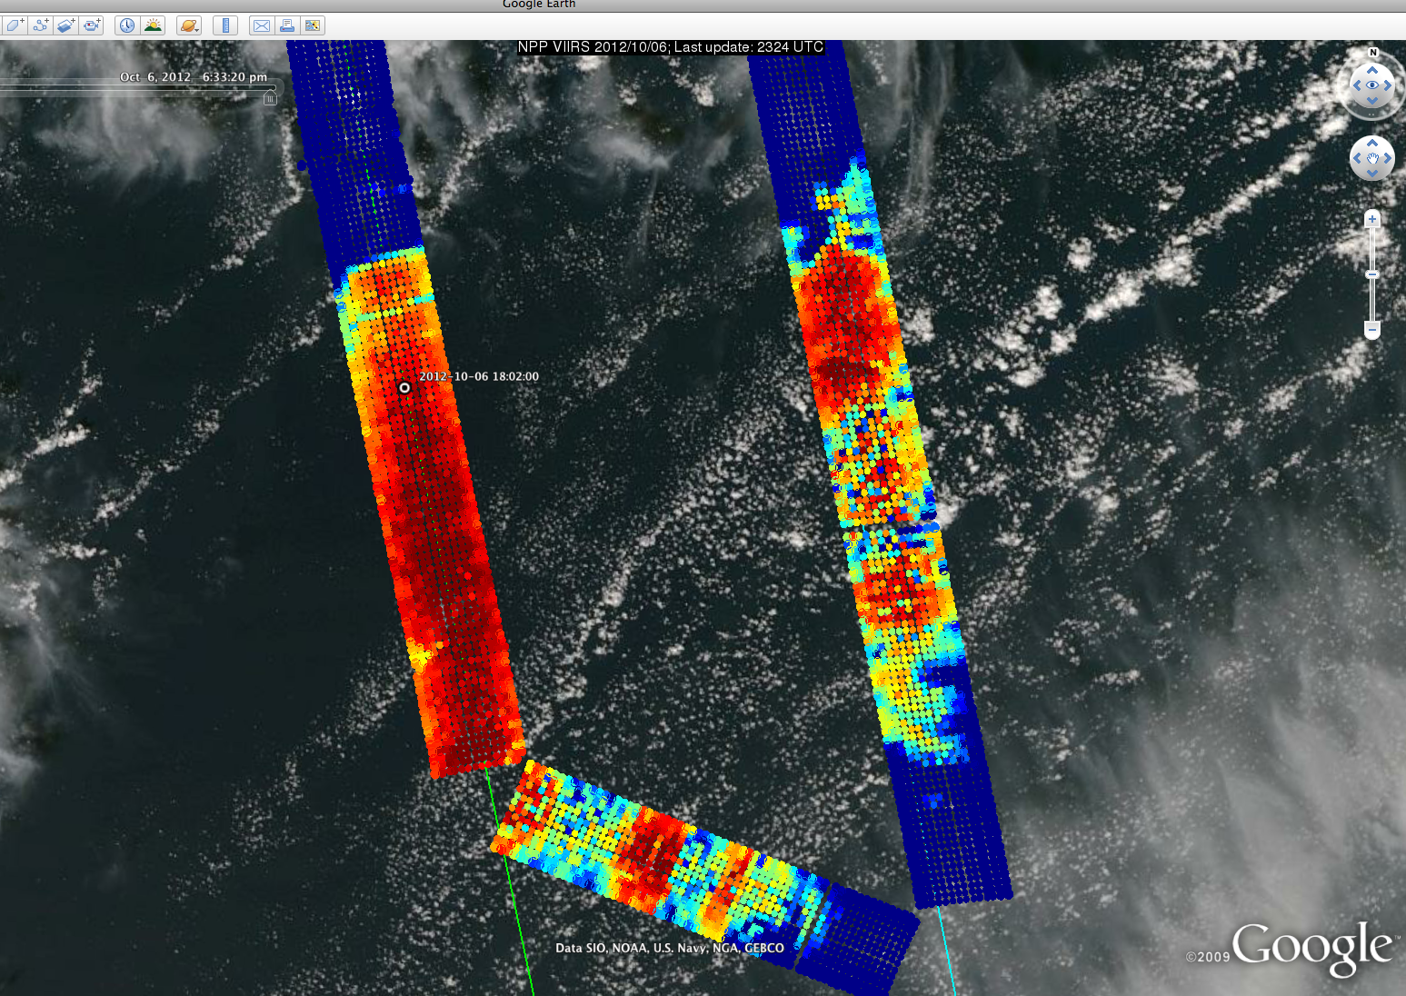
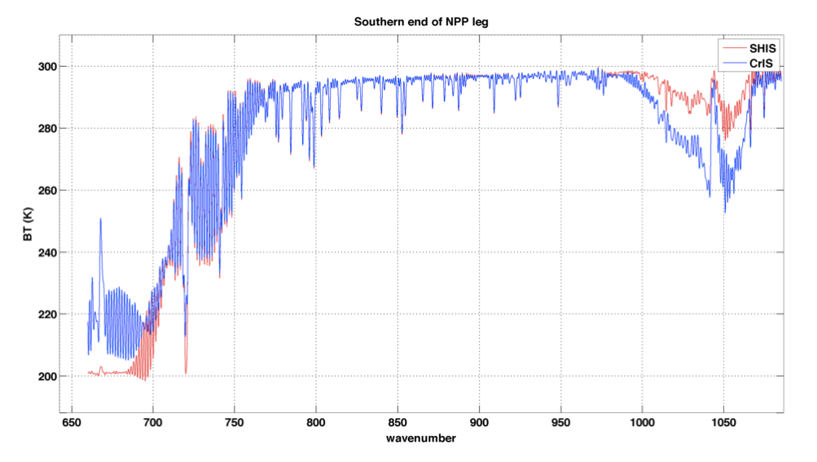
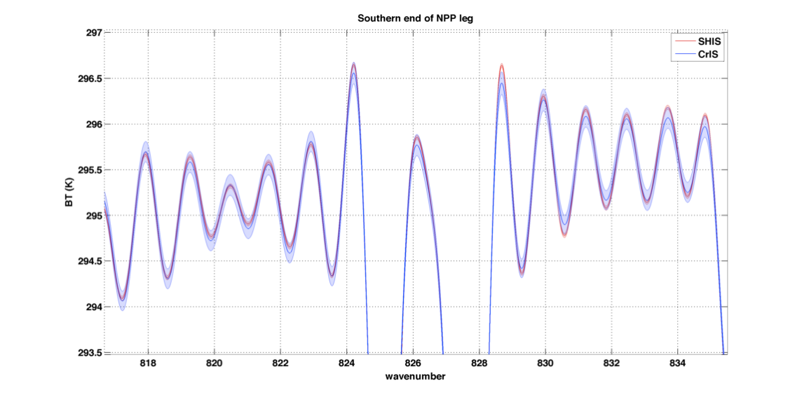
Preliminary
S-HIS/CrIS Radiance comparison:

Slide 34
Summary
QC and file latency
  The frequency of repair granules and missing data has decreased substantially over time.
  Users should avoid the associated corrupt spectra by using the QC flags.
Spectral calibration is very good.
  Small changes to the ILS parameters could be considered to further improve the Inter-FOV agreement, most notably for SW FOVs 1 and 6.
CrIS/AIRS comparisons show mean differences of less than 0.1K and stable with time.
  Signal level dependence is very good; some differences at coldest scene temperatures in the SW.
CrIS/VIIRS comparisons show mean differences of less than 0.1K and stable with time.
  Mean agreement improves when the VIIRS OBC is cooled during linearity characterization tests.
  Shows clear dependence on scene BT for M15 @ 10.8um
FOV-2-FOV differences are less than ~30 mK
  Larger differences previously reported for SW regions are an artifact of the analysis technique.
  CrIS/VIIRS comparisons for SW window (and Responsivity variation analysis, not shown) implies good performance of the ICT environmental model.
Nonlinearity looks very good
  a₂ changes at the ~5 percent (~30mK) level are being investigated, considered.

Slide 35
Future Efforts
  “Spectral ringing”
    Currently investigating with PCA, Earth view DM data, and the possible role of the NF
  Inter-FOV spectral calibration
    Considering small changes to the ILS parameters
  Nonlinearity
    Evaluating small changes to a₂ at the ~5% level
    Incorporate other evaluations (e.g. obs-calc, CrIS/AIRS/IASI intercal, revisit DM analysis, etc.)
  Full Spectral resolution
    Re-visit ILS and Nonlinearity assessment when in full resolution mode
  Non-uniform scene effects on the ILS
  Aircraft Campaign participation with the Scanning-HIS
  Overall RU estimation
    Include refined estimates of contribution uncertainties, and new terms as needed, to produce an updated model of CrIS Radiometric Uncertainty

