Slide 1
NGAS CrIS SDR Cal/Val Activity and Highlights
Oct 23, 2012
Lihong Wang, Chunming Wang, Denise Hagan and Degui Gu

Slide 2
NGAS Responsibilities for NPP CrIS Cal/Val
NGAS CrIS team supported NPP CrIS Cal/Val by applying our in-depth knowledge of the CrIS sensor hardware, CrIS SDR algorithm science and algorithm operational implementation at IDPS
NGAS team responsibilities
  Develop and test CrIS SDR algorithm code and LUT/PCT updates
  Support verification of IDPS operational algorithm software implementation on G-ADA
  Support DR investigation and anomaly resolution
  Support assessment of CrIS sensor and SDR performance

Slide 3
Overview
CrIS SDR algorithm code and LUT/PCT update deliveries
  Key SDR algorithm issues resolved
  Verification test of operational SDR algorithm code/LU updates on G-ADA
  Assessment of IDPS implementation of code/LUT updates
Support to CrIS sensor and SDR performance validation
  Radiometric calibration: NEdN, non-linearity, sweep direction biases, radiometric accuracy
  Spectral calibration: FOV to FOV spectral offset and stability
  Geolocation: comparison with VIIRS GEO
  CrIMSS EDR product

Slide 4
Key DRs Investigated to Update CrIS SDR Operational Algorithm Software
DR 4478: Added a flag to catch SDRs with larger than expected imaginary radiances
  To catch bad radiances potentially resulted from Fringe Count Error (FCE detection and correction module is turned off due to known deficiencies)
DR 4557: Fixed SDR overall quality flag error: packets with partially filled values
  Affected RDRs not properly labeled
DR 4661: Fixed SDR overall quality flag error: having a value of 3
  Degraded condition and invalid condition not cross checked before setting the flag
DR 4680: Fixed SDR overall quality flag extensively set to degraded
  Calibration window size set too conservative at 30 (relaxed to 15)
  Code for computing thermal drifts not optimized and inconsistent with threshold values in the engineering packet
  Incorrect thermal drift threshold values in Engineering packet (addressed in V34 update by Exelis)
DR 4821: Fixed geolocation error due to a bug in computing LOS vector
  Error uncovered by STAR and confirmed by NG. Fix developed by STAR and verified by NGAS

Slide 5
CrIS SDR Algorithm Code Update Deliveries for Operational Implementation
First package delivered to DPE/DPA on May 24, 2012 to address DR 4661 and DR 4680 Part I
Second package delivered to DPE/DPA on July 12, 2012 to address DR 4478 and DR 4680 Part II
All code changes were implemented and verified on G-ADA before submission to DPE/DPA
Delivery packages contain details of code updates and performance verification test results and additional data requested by DPE (unit test data, unit test results and DPE code/LUT change request forms)
Updates were approved by AERB and implemented in IDPS MX6.3

Slide 6
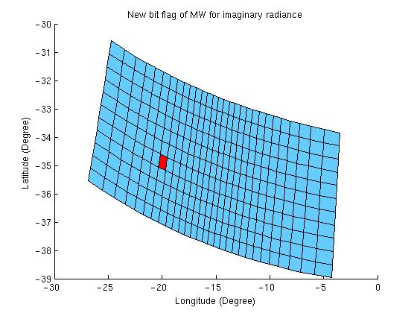
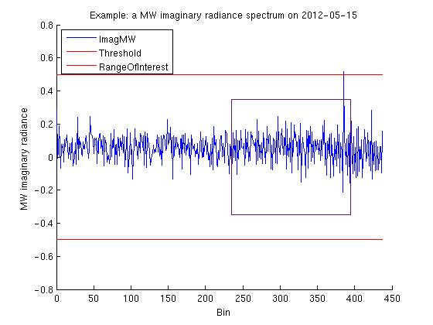
Verification of Addition of Bit Flag to Identify Erroneous Data (DR 4478)
The bit flag is triggered when midwave imaginary radiance threshold is exceeded
Data demonstrated that the new quality flag works for detecting bad data by applying threshold limit on imaginary component of spectra; “good spectra” have imaginary radiance near zero (Lihong Wang, NGAS)

Slide 7
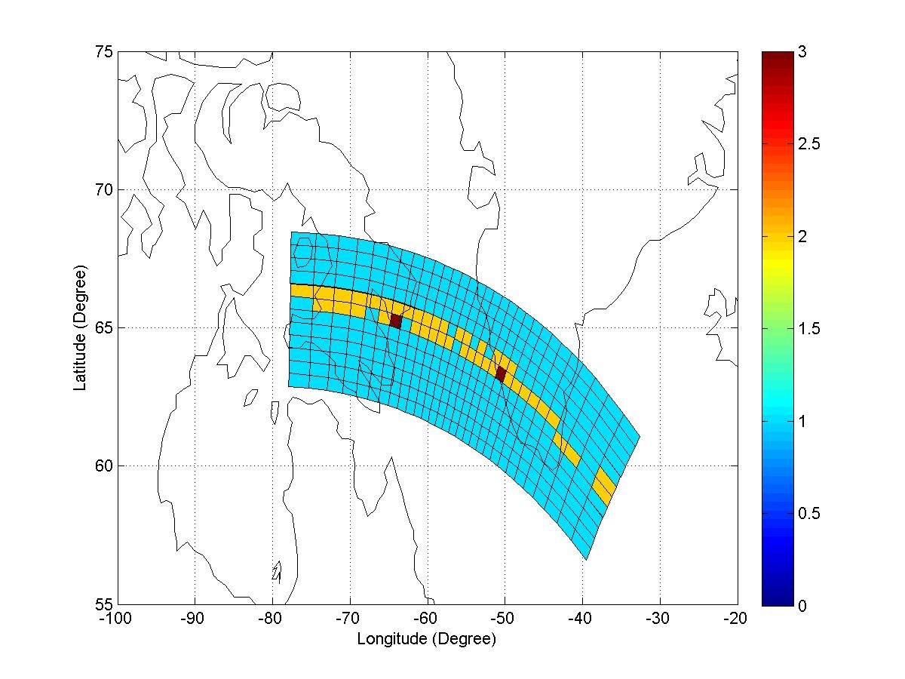
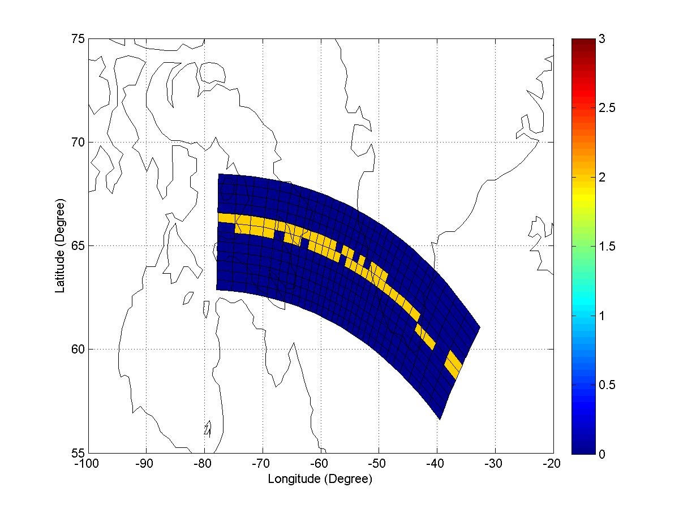
Verification of Overall Quality Flag Value (DR 4661)
Before MX6.3 update
After MX6.3 update
Lihong Wang, NGAS
Quality flag 0=good
1=degraded
2=invalid
3=undefined
Overall quality flag after code correction has no degraded values and no values equal to 3 (Lihong Wang, NGAS)

Slide 8
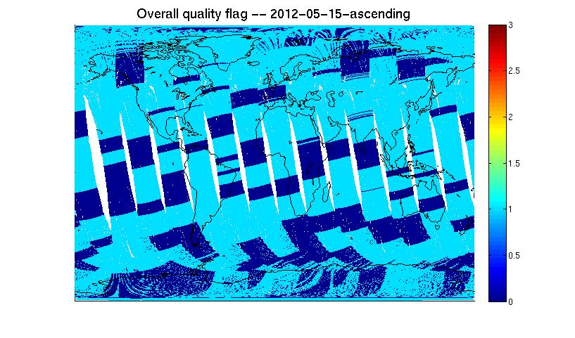
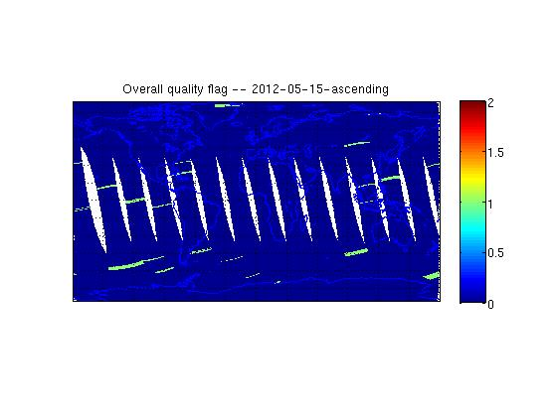
Issues with CrIS SDR Quality Flag Mostly Fixed with MX6.3 Update
Before MX6.3 update
After MX6.3 update
Quality flag
2 – invalid
1 – degraded
0 -- valid
Distribution of overall quality flag for CrIS Golden Day May 15, 2012. Before the update, CrIS SDR data were extensively labeled as degraded (left). After the MX6.3 update and engineering packet V34 upload, most of the data are now correctly labeled as valid. (Lihong Wang, NGAS)

Slide 9
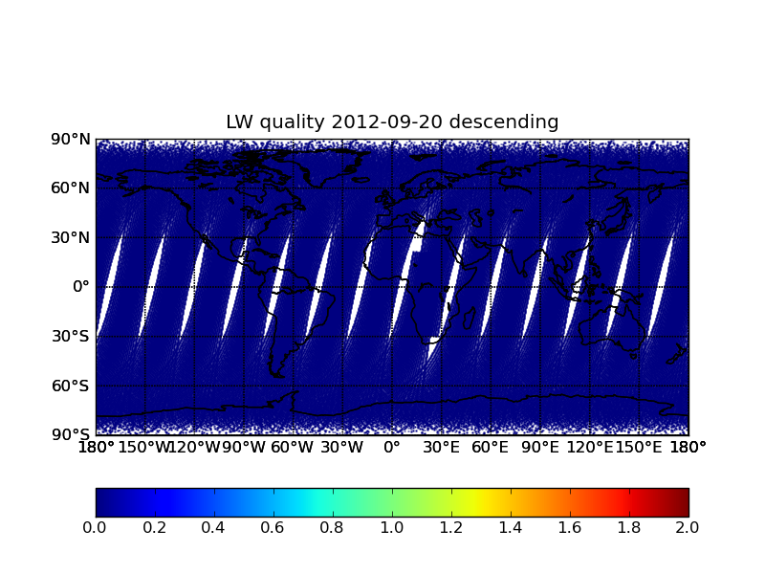
Additional Code and Engineering Packet Update to Completely Resolve Quality Flag Issue
Set RDR quality to invalid for missing packets (DR 4875)
Relax stage2 cooler temperature drift limit to 4K
Overall quality
2 – invalid
1 – degraded
0 – valid
Distribution of overall quality flag for CrIS Golden Day Sep 20, 2012. Data generated on G-ADA using MX6.3 plus additional changes. All issues were fixed. (Lihong Wang, NGAS)

Slide 10
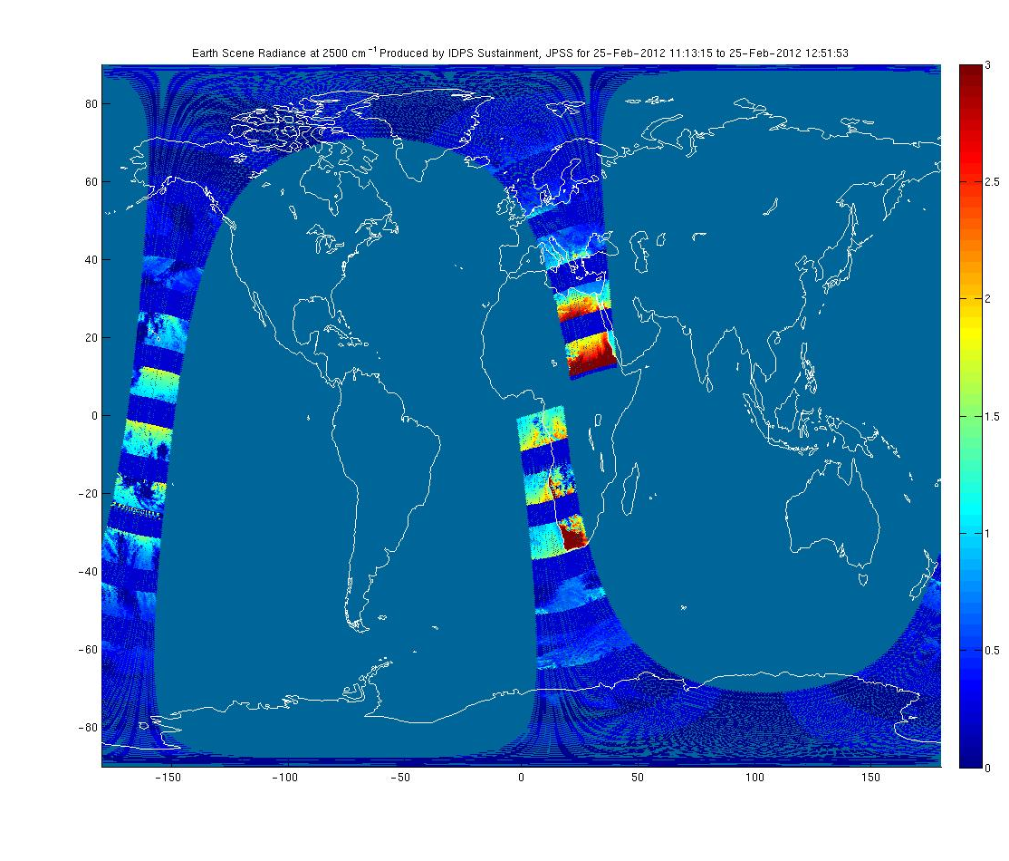
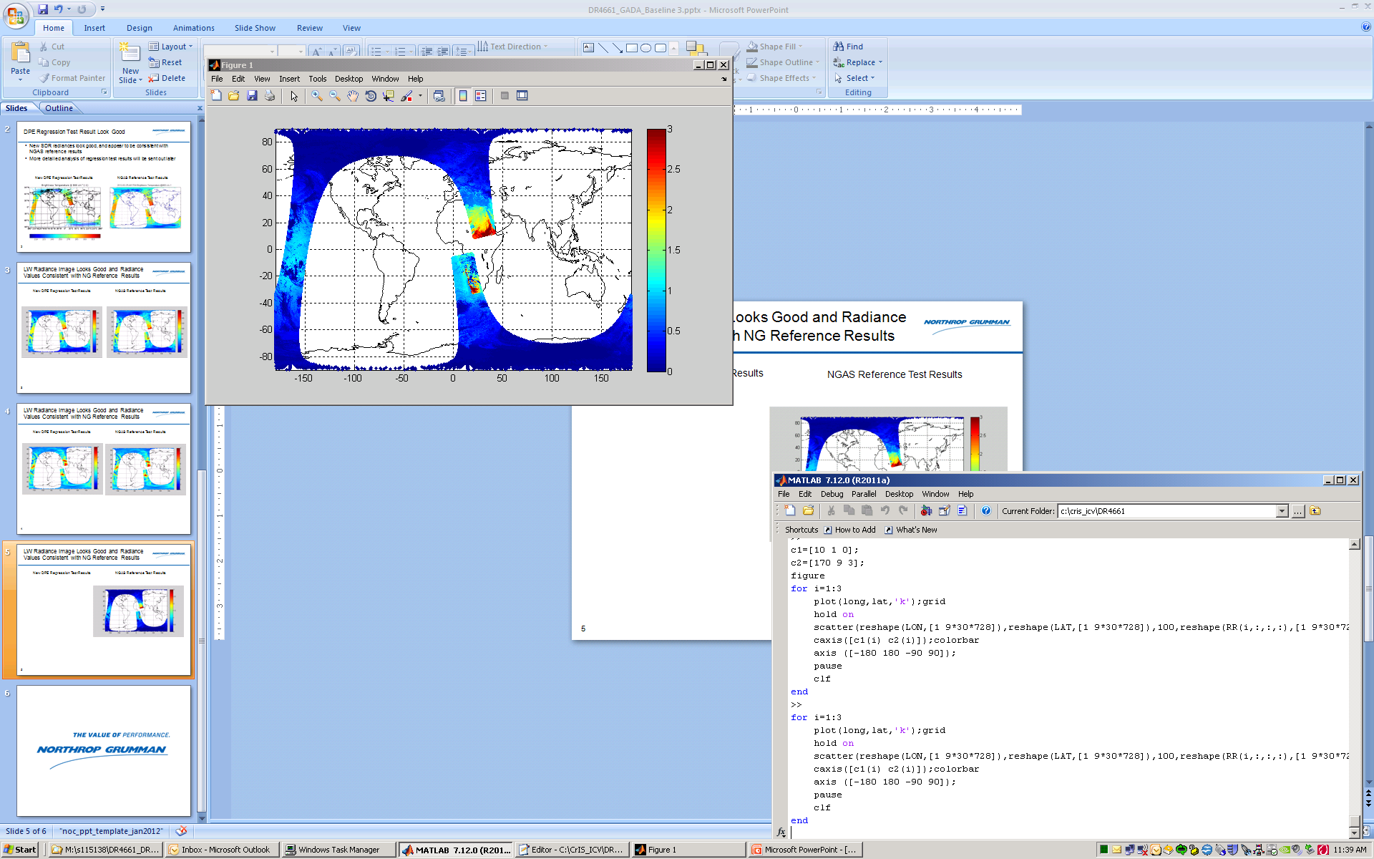
Support to DPE Regression Test and Verification
Failed regression test results
New regression test results
  Shortwave radiances (at 2500cm-1) generated in DPE regression test using Golden Day 2/15/2012 dataset. Initial results (left) were corrupted due to incorrect set-up configuration file. New results generated using NGAS provided configuration file were good and matched NGAS reference results. (Lihong Wang, NGAS)

Slide 11
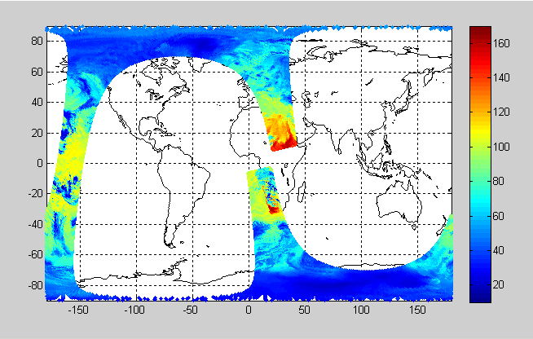
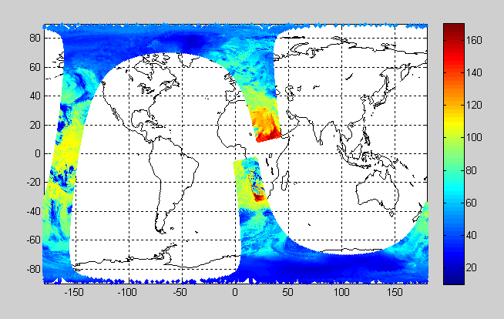
Support to DPE Regression Test and Verification
New DPE Regression Test Results
NGAS Reference Test Results
LW Radiance at 900 cm⁻¹
LW Radiance at 900 cm⁻¹
Start
End
Descending
Orbit
  LWIR radiances (at 900cm-1) generated in DPE regression test using Golden Day 2/15/2012 dataset. Initial results were corrupted due to incorrect set-up configuration file, but new results (left) generated using NGAS provided configuration file were good and matched NGAS reference results (right). (Lihong Wang, NGAS)

Slide 12
Verification Test of Engineering Packet V34 Update on G-ADA
Performed verification test of engineering packet V34 update on G-ADA to ensure
  The update will achieve the expected improvements on SDR data products
  IDPS SDR processing is not adversely impacted
Verification test approach
  Test performed using one orbit of data (b0175, on 2/26/12) using MX5.3 on G-ADA
  Engineering packets in the last portion of the RDR data were replaced with the new engineering packet to assess impact on SDR product and processing
Verification test results
  SDRs overall quality flag issue fixed as expected
  New threshold values in the updated engineering packet are used by the algorithm as expected
  The engineering packet update did NOT cause SDR processing interruption, nor re-computation of LUTs (i.e., CMO), as expected

Slide 13
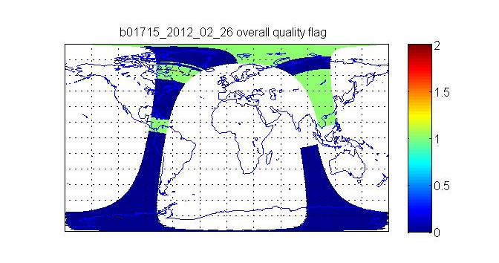
CrIS SDR Quality Flag Improved with the Updated Engineering Packet V34
SDR overall quality flag has correct values after V34 update
Start Orbit
End Orbit
V34 inserted
from here
Updated engineering packet improved overall SDR quality flag. No SDRs are labeled as degraded after the new engineering packet is inserted into the RDR data (Lihong Wang, NGAS)

Slide 14
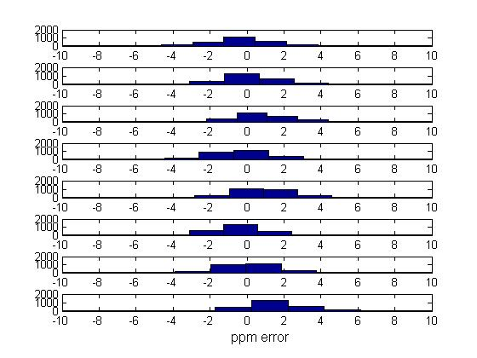
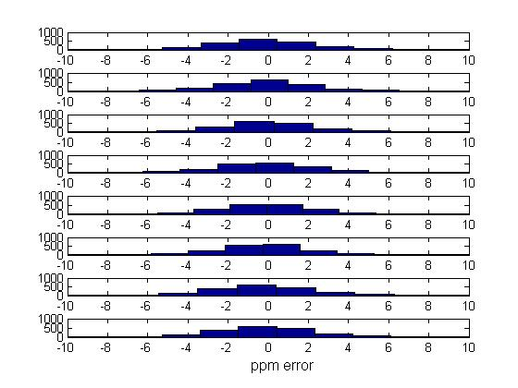
Validation of IDPS CrIS SDR Data Products: Spectral Calibration
FOV-to-FOV Relative Spectral Calibration Accuracy
Before EP V33 Update
After EP V33 Update
FOV1
FOV2
FOV3
FOV4
FOV6
FOV7
FOV8
FOV9
(Denise Hagan, NGAS)

Slide 15
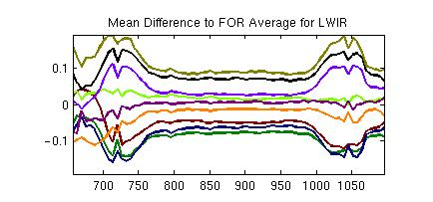
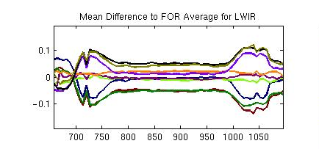
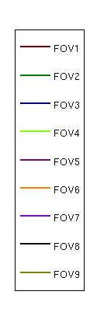
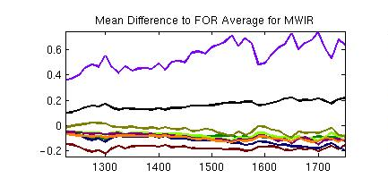
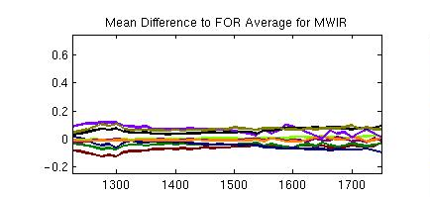
Verification of IDPS CrIS SDR Data Products: Radiometric Calibration
FOV-to-FOV Brightness Temperature Variability (K)
Before EP V33 Update
After EP V33 Update
(Chunming Wang, NGAS)

Slide 16
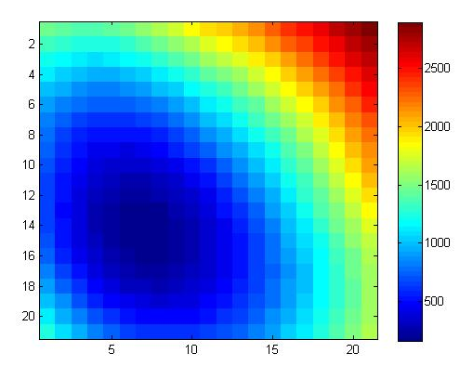
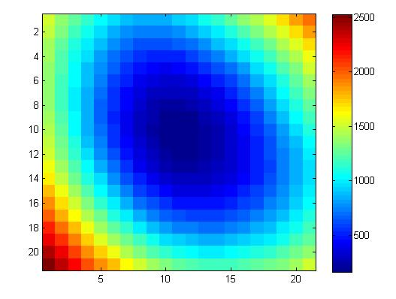
Verification of IDPS CrIS SDR Products: Geolocation
Correlation between CrIS and VIIRs radiances
Before MX6.3 Update
After MX6.3 Update
(0,0)
(0,0)
Operational data before MX6.3 code update required VIIRS pixels to be shifted (-4,3) to achieve best correction between the two. After the update, the correlation is nearly at the maximum without any shifts (0-1). (Denise Hagan, NGAS)
.

Slide 17
Excellent NEdN Performance Consistent with TVAC Test Results
NSIPS DQF PGEs track NEdN and other Key Parameters
TVAC4
TVAC4
On-orbit
On-orbit
On-orbit NEdN performance similar to pre-launch, with MWIR FOV7 NEdN slightly out of family. (Denise Hagan, NGAS)

Slide 18
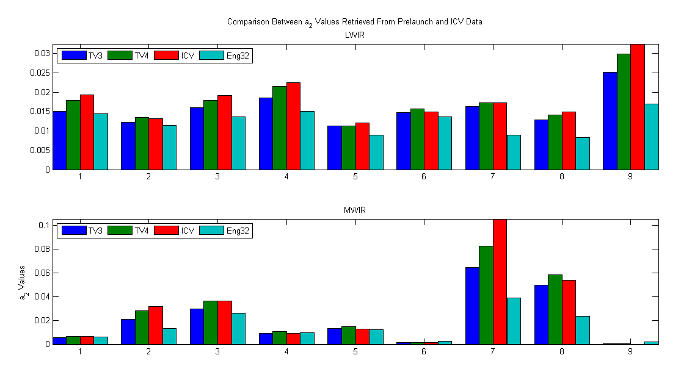
CrIS Sensor Detector Nonlinearity Assessment
Assessment of on-orbit CrIS detector non-linearity and comparison to TVAC test results. LWIR FOV9 and MWIR FOV7 show largest changes from the at-launch values (Eng V32). (Chunming Wang, NGAS)

Slide 19
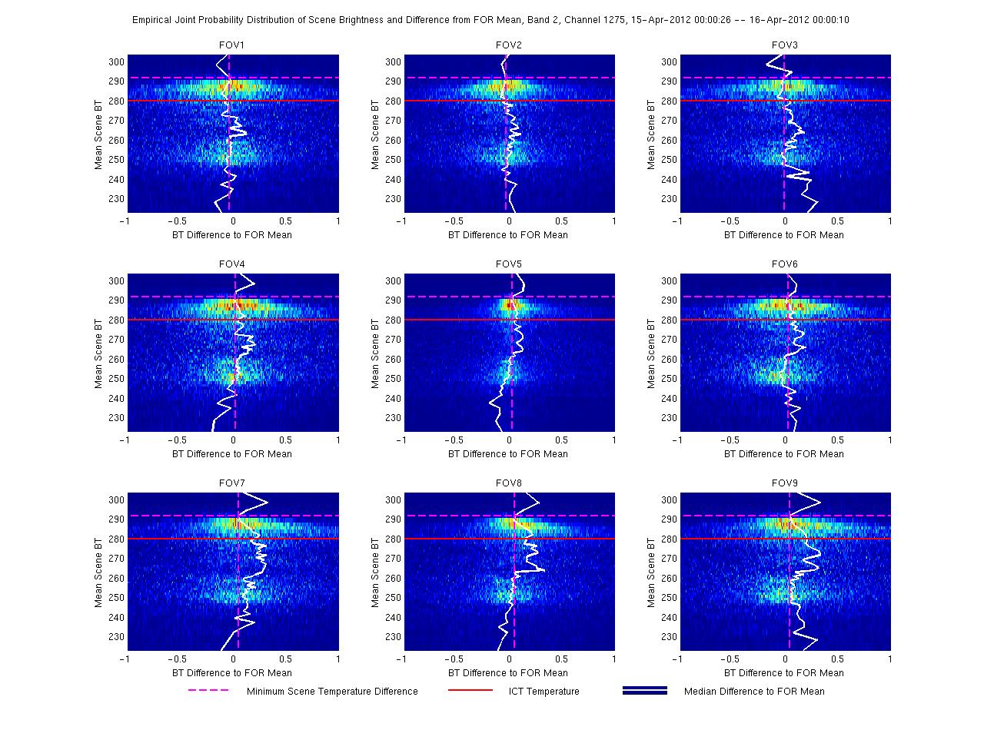
Statistical Analyses of FOV-to-FOV Radiance Differences
Statistical FOV-to-FOV differences is analyzed as a function of the Earth scene temperature to evaluate CrIS sensor/SDR radiometric performance. (Chunming Wang and Degui Gu, NGAS)

Slide 20
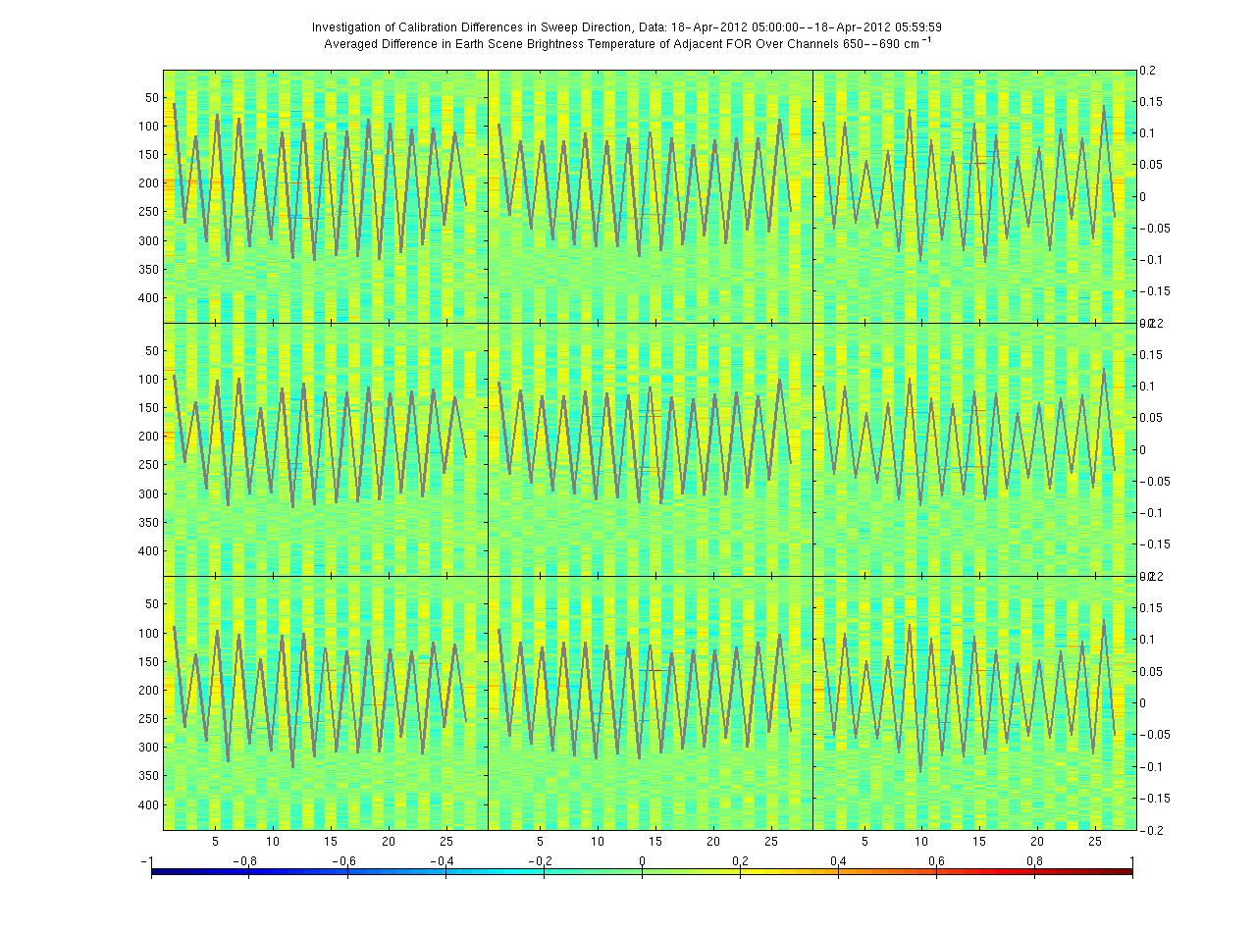
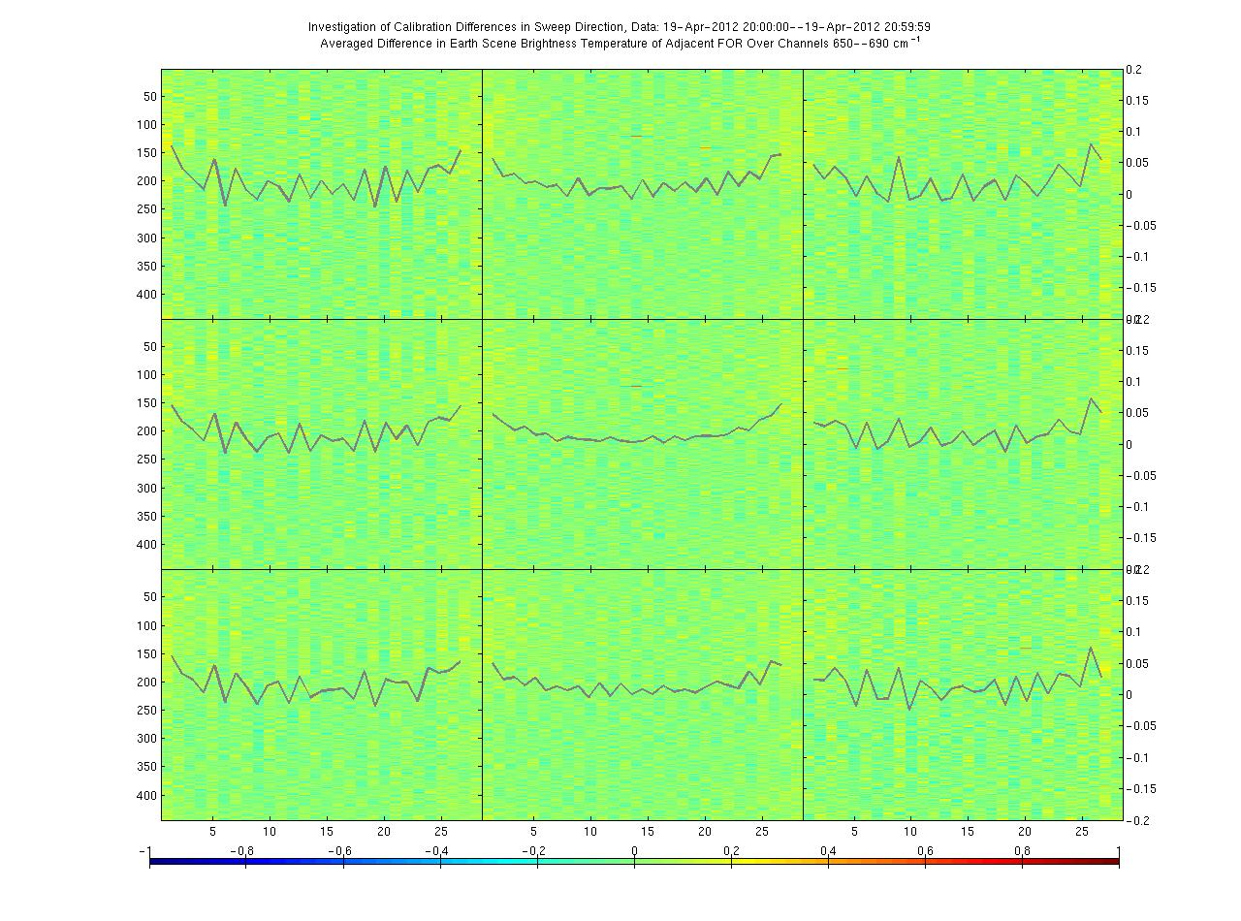
Assessment of CrIS Sweep Direction Biases
Examination of averaged radiances showed significant reduction of sweep direction dependent biases after new digital filter upload on April 18, 2012
April 18, 2012 5:00-6:00 GMT
April 19, 2012 20:00-21:00 GMT
(Chunming Wang, NGAS)

Slide 21
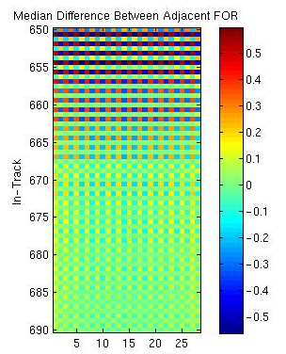
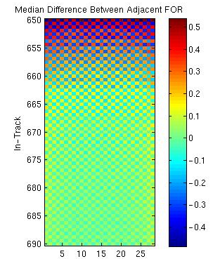
Discovered Remaining CrIS Sweep Direction Biases for FOV5
Inspection of individual channels revealed that FOV5 still has significant amount of biases following digital filter upload
April 18, 2012 5:00-6:00 GMT
April 19, 2012 20:00-21:00 GMT
Wavenumber cm⁻¹
Wavenumber cm⁻¹
FOR Position
FOR Position
(Chunming Wang, NGAS)

Slide 22
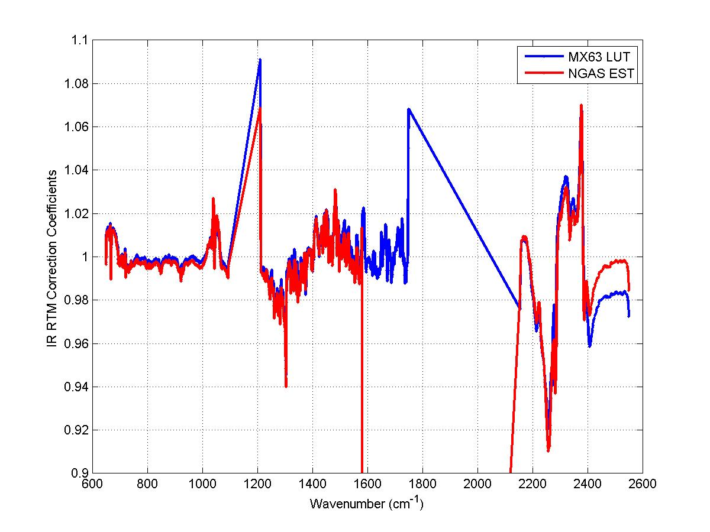
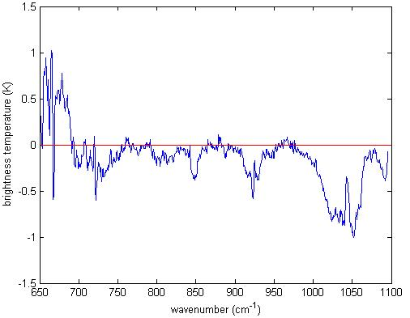
CrIS Absolute Radiometric Calibration Accuracy Assessment Using OSS Forward Model
Clear Sky Radiance Difference
CrIMSS IR Bias Correction Coefficients
Brightness temperature difference (K)
Excellent agreement over the window channels between the observed CrIS clear sky radiances and the simulated radiances using the Optimal Spectral Sampling (OSS) forward model and ECMWF match-up data. Larger differences in the spectral regions are largely due to the forward model error. (Xia-lin Ma, Denise Hagan, and Degui Gu, NGAS)

Slide 23
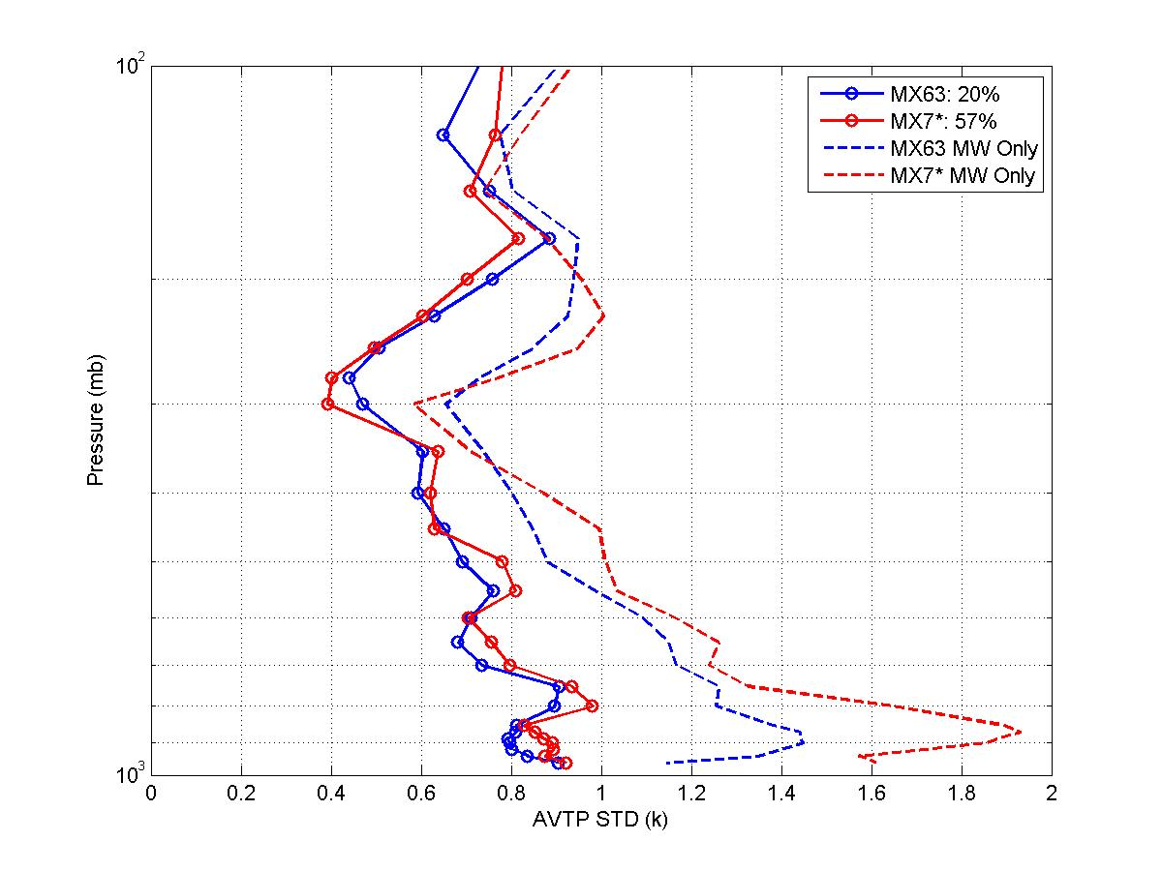
CrIS Provided Superior Sounding Capability
Temperature Profile EDR quality over cloud free ocean
Statistical differences of the atmospheric temperature profile EDRs retrieved from CrIS/ATMS compared to ECMWF match-up truth. Golden Day May 15, 2012. Cloud free ocean scenes. (Xia-Lin Ma and Degui Gu, NGAS)

Slide 24
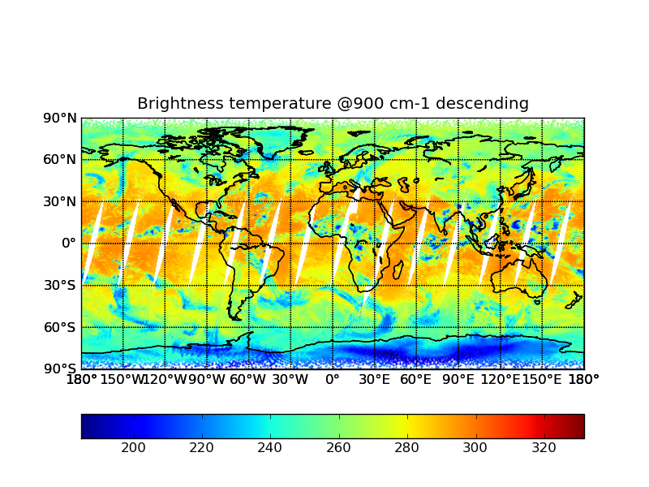
Summary
CrIS SDR operational algorithm code has been significantly improved to fix a number of errors and anomalies. The planned additional code update (minor) and engineering packet V35 update will remedy remaining known quality flag issues
Radiometric, spectral and geolocation accuracy of the CrIS SDR data products have been verified to meet expectations based sensor requirements and pre-launch TVAC testing
Golden Day 2012-09-20: NG LW Data Generation on G-ADA

