Slide 1
Request for
VIIRS Ice Surface Temperature EDR
Beta Maturity
DR # 7132
CCR # 474-CCR-13-0945
DRAT discussion: April 19, 2013
AERB presentation: April 24, 2013
Cryosphere Products Validation Team
Jeff Key, NOAA/NESDIS/STAR, Team Lead
Paul Meade, Cryosphere Products JAM

Slide 2
Outline
VIIRS IST EDR Users
Beta EDR Maturity Definition
Summary of IST EDR
VIIRS IST EDR requirements
History of Algorithm Changes/Updates
Beta Maturity Evaluation
Beta Justification Summary
Caveats of Operational VIIRS IST EDR
Additional Supporting Documentation
Future Plans Toward Provisional Status
Conclusions

Slide 3
VIIRS IST EDR Product Users
  U.S. Users
    NSIDC, National Snow Ice Data Center
    NIC, National/Naval Ice Center
    OSPO, Office of Satellite and Product Operations
    STAR, Center for Satellite Applications and Research
    GSFC, NASA/Goddard Space Flight Center Hydrological Sciences Branch
    NWS, National Weather Service, including the Alaska Ice Desk
    CLASS, Comprehensive Large Array-data Stewardship System
  User Community
    Navigation
    Emergency Management
    Operational Weather Prediction
    Climate Research
    DOD

Slide 4
Beta EDR Maturity Definition
Early release product.
Minimally validated.
May still contain significant errors.
Versioning not established until a baseline is determined.
Available to allow users to gain familiarity with data formats and parameters.
Product is not appropriate as the basis for quantitative scientific publication studies and applications.

Slide 5
Summary of the VIIRS IST EDR
The VIIRS Ice Surface Temperature (IST) EDR provides surface temperatures retrieved at VIIRS moderate resolution, for snow/ice covered oceans for both day and night.
The baseline split window algorithm statistical regression method uses two VIIRS Infrared bands, 10.76 μm (M15) and 12.01 μm (M16) for both day and night and is based on the Advanced Very High Resolution Radiometer (AVHRR) heritage IST algorithm (Yu et al., 1995).
IST EDR performance is dependent upon on the quality of the input SDR brightness temperatures, VIIRS Cloud Mask IP cloud confidence, Ice Concentration IP, Aerosol Optical Thickness IP and regression coefficients derived from matchups between the VIIRS M15 and M16 top of atmosphere (TOA) brightness temperatures and truth surface temperature sources for snow/ice covered ocean surfaces

Slide 6
Summary of the VIIRS IST EDR
Algorithm Inputs
NPPxDRs & IPs
VIIRS_ST_04
VIIRS 750m SDR
VIIRS 750m TC GEO
VIIRS Cloud Mask IP
VIIRS Ice Concentration IP
VIIRS Aerosol Optical Thickness IP
Ice Surface Temperature
Auxiliary Data
VIIRS IST Tunable parameters
VIIRS IST Regression Coefficient LUT
Output EDRs & IPs
VIIRS Ice Surface Temp. EDR
Notes:
Ancillary
GFS forecast surface pressure, lapse rate, and air temperature (for topography corrected surface pressure)
Look-up tables
DEM for surface altitude
Infrared and Microwave OSS coefficients
Local Angle Correction
IR emissivity and reflectivity covariance
MW emissivity covariance
AVTP and AVMP and Ozone covariance

Slide 7
Summary of VIIRS IST EDR
Processing Flow
For each pixel
Determine Pixel Quality
and set flags
next
pixel
T
No retrieval quality check
set IST EDR to FILL
IST split window retrieval
determine day or night mode
IST split window regression
T
IST split window if BT15 valid range
F
IST single band retrieval
determine day or night mode
IST single band regression
Check for invalid IST value range
T
set IST EDR to FILL
F
next
pixel

Slide 8
VIIRS IST EDR L1RD Requirements
Ice Surface Temperature (IST)
“IST is the radiating, or "skin", temperature at the ice surface. It includes the aggregate temperature of objects comprising the ice surface, including snow and melt water on the ice. Inland water bodies and coastal ice temperatures will be obtained from the LST EDR.
As an objective, the Ice Surface Temperature EDR shall measure the atmospheric temperature 2 m above the surface of the ice.
8

Slide 9
VIIRS IST EDR L1RD Requirements (Continued)
Ice Surface Temperature (IST) Requirements from L1RD Supplement. v2.4
EDR Attribute | Threshold | Objective
IST Applicable Conditions 1. Clear, only
a. Sensing Depth | Ice Surface | Ice Surface
b. Horizontal Cell Size Nadir Worst Case | 1 km 1.6 km | 0.1 km 0.1 km
c. Mapping Uncertainty, 3 sigma Nadir Worst Case | 1 km 1.6 km | 0.1 km 0.1 km
d. Measure Range | 213-275 K | 213-293 K (2 m above ice)
e. Measurement Uncertainty | 1 K
f. Refresh | At least 90% coverage of the global every 24 hours (monthly average) | 12 hrs
g. Geographic Coverage | Ice-covered oceans | All ice-covered waters
RGB Image shows dense smoke (high absorption) in northwest, north central and central coastal portions of image.
9

Slide 10
History of Algorithm changes/updates
Date | Update/DR# | Reason | Status
04-17-2013 | 7138 | IST EDR OAD Corrections | open
04-17-2013 | 7137 | IST EDR ATBD Section 2.3 Wording Error Correction | open
11-18-2011 | 4457 | EDR PR to define mid quality criteria | open
11-18-2011 | 4456 | EDR PR update to Define the exclusion criteria for quality summations | open
11-18-2011 | 4455 | Update EDR PR to define high quality retrievals | open
12-22-2010 | 4136 | ECR A-337 Dec 10 Look Up Table drop | request closure
07-17-2009 | 2936 | Ice Surface Temp and IST use different emissivities for ice | Deferred for future re-evaluation

Slide 11
Beta Maturity Evaluation
Beta Maturity Evaluation Approaches
  Visualizations and quantitative comparisons of daily global gridded VIIRS IST, comparison with MODIS IST and NCEP surface air temperature, Ice Bridge flight IST
  Time series analysis and bias analysis
    NH analysis dates: 1/29/2012, 2/1/2012, 3/14/2012
    SH analysis dates: 4/10/2012
    Beaufort Sea analysis dates: 3/14/2012 (IceBridge), 2/12/2012, 2/25/2012, 2/26/2012, 3/30/2012
    Terra Nova Bay analysis dates: 2/12/2012, 2/25/2012, 2/26/2012, 3/30/2012

Slide 12
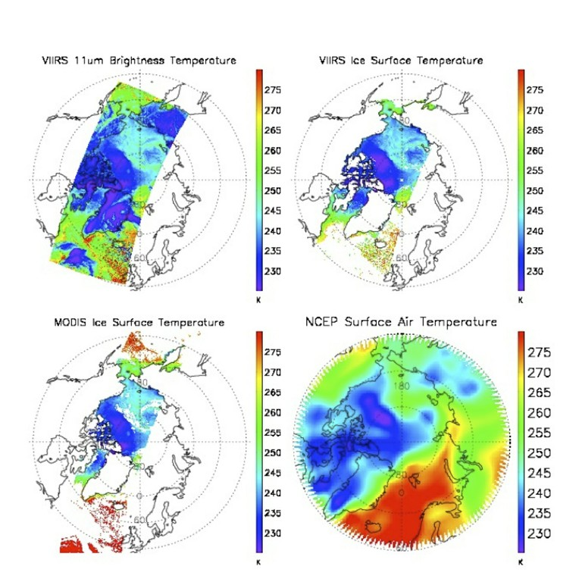
Beta Maturity Evaluation – Comparison VIIRS IST with MODIS and NCEP
Ice Surface Temperature (IST) EDR validation activities have shown that VIIRS IST has a 1-2 K cold bias relative to the MODIS Ice Surface Temperature product. The bias for VIIRS Land Surface Temperature over the ice sheet (not shown) is less than for IST.
Comparisons to NCEP and International Arctic Buoy Program (IABP) air temperatures show a similar spatial pattern but yield a VIIRS cold bias of approximately 4 K, which is the opposite of the MODIS comparison. The comparison confirms the validity of the MODIS IST. Note that this bias appears to be less with recently re-processed data.

Slide 13
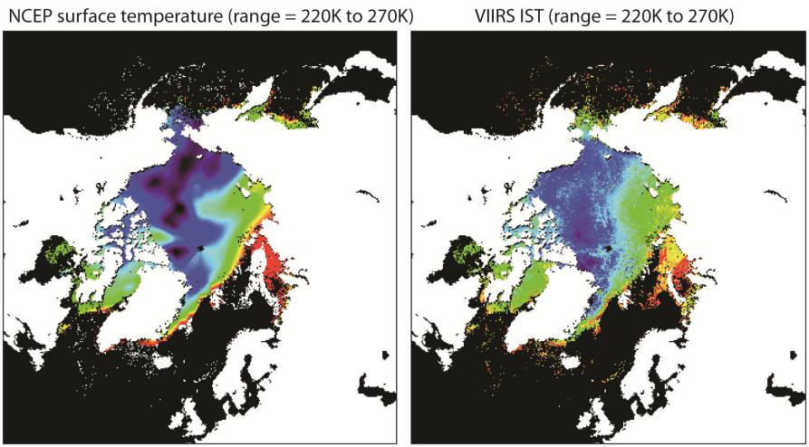
Beta Maturity Evaluation – NH comparison
NCEP vs. VIIRS IST, Feb 27, 2012. Spatial patterns appear consistent.

Slide 14
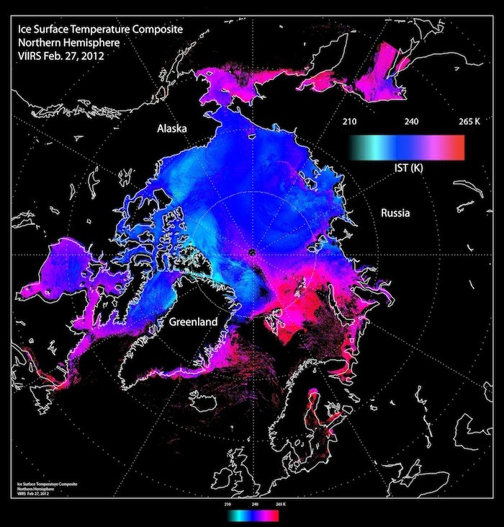
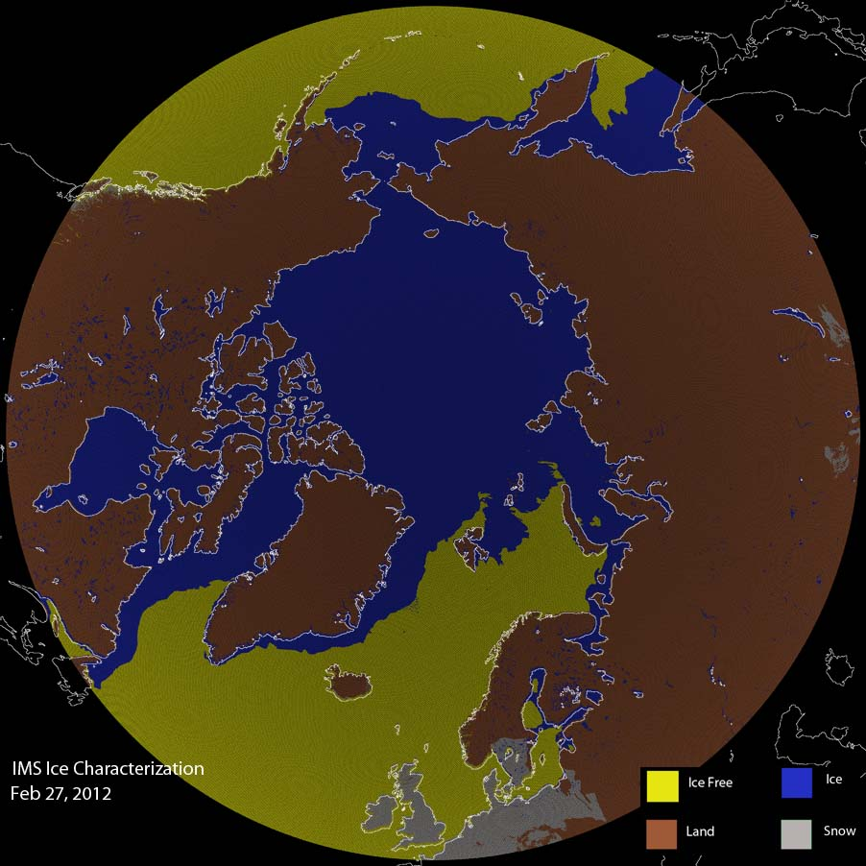
Beta Maturity Evaluation – NH comparison
Left: IST EDR for Feb 27, 2012. Right: Corresponding IMS ice data, showing reasonable correspondence of sea ice location.

Slide 15
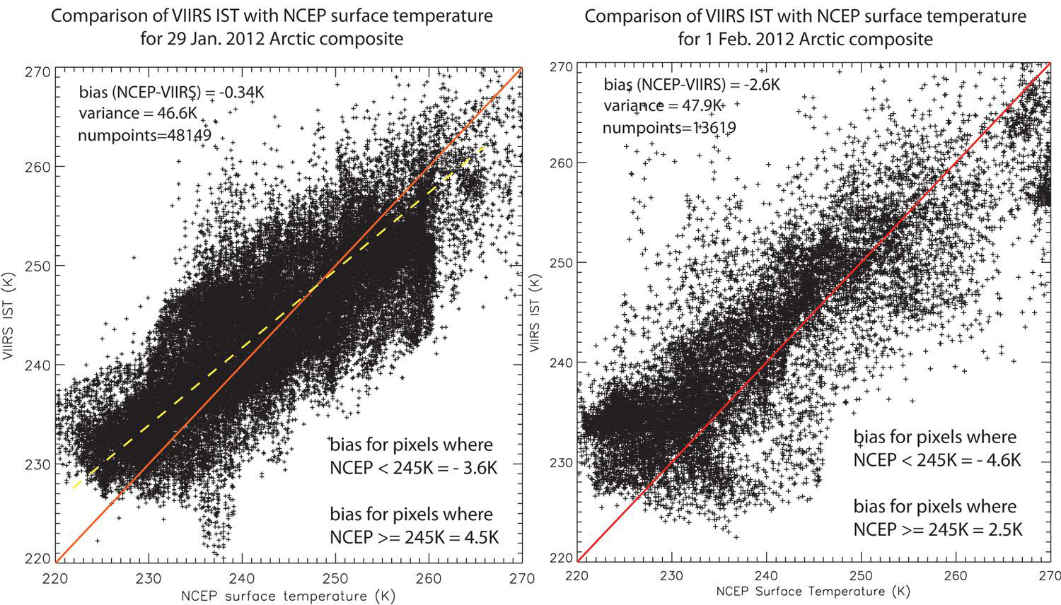
Beta Maturity Evaluation – global comparison
VIIRS is biased high (too warm) compared to NCEP reanalysis (opposite of the MODIS & IceBridge results). Bias increases with decreasing temperature.

Slide 16
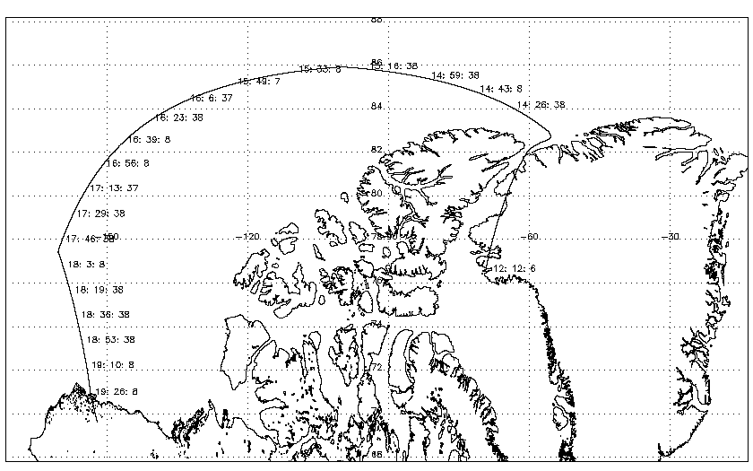
Beta Maturity Evaluation – Comparison VIIRS IST EDR with IceBridge Flight IST
Track of the NASA P-3 aircraft for the March 14, 2012 IceBridge flight. UTC times are shown along the track. The P-3 flew at an altitude of 1000 ft over the sea ice. Among several instruments, it carried a KT-19: a downward-pointing, IR pyrometer that measures the surface temperature (in this case, the IST). The KT-19 measurements are considered Beta as of this writing.

Slide 17
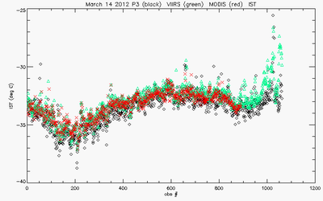
Beta Maturity Evaluation – Comparison VIIRS IST EDR with IceBridge Flight IST
NASA's Land PEATE re-processed portions of the VIIRS IST EDR that are co-incident with IceBridge flights over sea ice during March and April 2012. The resulting VIIRS IST EDR shows much better agreement with the ice surface temperature observed by the IceBridge P-3 aircraft ‘s KT-19 instrument than the previous IST EDR data produced in March 2012.
A comparison of IST measured by the NASA P-3 aircraft's KT-19 instrument (J. Yungel, PI) and the VIIRS IST EDR
mean VIIRS = -33.2358 ˚C
mean KT-19 = -33.7450 ˚C
mean MODIS = -33.3882 ˚C
VIIRS - KT-19 = +0.5092 ˚C
MODIS- KT-19 = +0.3568 ˚C
VIIRS – MODIS = +0.1524 ˚C
Comparison between the IST (in deg C) measured by the KT-19 (in black, smoothed over 100 points), the nearest VIIRS IST measurement (in green) and MODIS observation (red). The comparison is for the leg from 16:03:37 -19:10:08 (west of -120 lon). The VIIRS overpass occurred from 16:01 - 16:06 UTC . VIIRS, MODIS, and the KT-19 IST's show consistent good agreement along the flight track, with VIIRS close to meeting the 0.5 ˚C (or K) spec.

Slide 18
Beta Justification Summary
Criteria: Early release product
  IST EDR performance is dependent on VIIRS SDR, VIIRS Cloud Mask IP, Ice Concentration IP, Aerosol Optical Thickness IP and IST Regression Coefficients
    VIIRS SDR Cal and Geo products reached provisional maturity in March, 2013.
    VIIRS Cloud Mask IP reached provisional maturity in February, 2013
    VIIRS Aerosol Optical Thickness reached beta maturity in September 2013
    VIIRS Ice Concentration IP beta maturity pending approval
Criteria: Minimally validated
  Evaluation is based on a limited number of focus days (global comparisons for retrieval products)
  Some detailed analysis has been done on other days with a limited set of granules focused on a region

Slide 19
Beta Justification Summary
Criteria: Available to allow users to gain familiarity with data formats and parameters
  Cryosphere IST EDR team has evaluated IDPS EDR products available from CLASS
    Users can access and read the products and the product compares reasonably with the heritage satellite snow map products
  Beta release will allow other users within the community to gain experience with the data formats and parameters.
    This is important to allow users to complement the validation activity.

Slide 20
Beta Justification Summary
Criteria: Product is not appropriate as the basis for quantitative scientific publication studies and applications
  The product has known flaws (see caveats slides later in this presentation), but these products are of sufficient quality to justify use by a broader community
  Most of the issues
    IST EDR contains retrievals over false ice retrieved by the VIIRS Sea Ice Concentration IP. Some of the false ice retrieved by the VIIRS Sea Ice Concentration IP has been linked to cloud leakage from a VIIRS Cloud Mask (VCM) which is still maturing and out of date Grid-VIIRS-Snow-Ice-Cover-Rolling Tiles (not update daily) that affects the VCM performance
    IST EDR surface temperature performance bias exists but is expected to improve with updated regression coefficients but the bias has been observed to be reduced by examining re-processed data with more recent IDPS code, primarily due to improvements in the VIIRS Cloud Mask.

Slide 21
Caveats for Operational VIIRS IST EDR
(additional issues)
List known problems and proposed technical solutions if there are any
  Examination of the VIIRS IST EDR shows temperature over false ice retrieved by the Sea Ice Concentration IP. Such errors will be reduced with MX 8.0 VIIRS Cloud Mask update and implementation additional quality checks in the Sea Ice Concentration IP for future builds beyond MX 8.0
  - Current IST bias should be reduced with updated IST regression coefficients based on matchup of VIIRS M15, M16 TOA brightness temperatures with surface temperature truth. Evidence of lower bias has been shown with IceBridge IST comparisons.

Slide 22
Additional Supporting Documentation
TIM Meetings and Presentations
  Cal/Val Team Meeting, April 2012
Monthly/weekly reports https://groups.ssec.wisc.edu/groups/jpss/cryosphere/reports

Slide 23
Future Plans and Issues
No code changes currently planned
Detailed performance characterization requires:
  Update of IST regression coefficients based on matchup with VIIRS and truth IST sources
Major actions for the provisional maturity justification and schedule
  Ability to check for reduced quality VIIRS Ice Concentration IP input based on quality flags to with additional quality checks to be added to the Ice Concentration IP

Slide 24
Conclusion
VIIRS IST EDR has met the beta maturity stage based on the definitions and the evidence shown
  It exceeds the definition of beta in most cases
  Off-line EDR product performance overall is close to meeting requirements at this time and meets requirements in some cases. It continue to improve.
Some issues have been uncovered during validation and solutions are being evaluated.
  Improvements in IST EDR performance may be realized as the VIIRS Cloud Mask IP matures and additional quality flags become available in the VIIRS Ice Concentration IP to avoid IST retrievals near clouds

